Slide 1
Light Precipitation Retrievals for Global Precipitation Measurement
Sarah Ringerud¹
Mircea Grecu^{2,1}
¹NASA Goddard Space Flight Center
²Goddard Earth Science Technology and Research II, University of Maryland Baltimore County

Slide 2
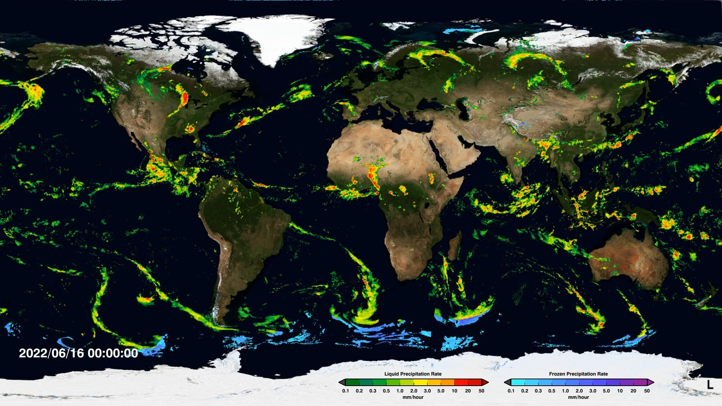
  IMERG: Integrated Multi-SatellitE Retrievals for GPM
Notes:
As users of this data, important to know where it comes from and what some of it’s limitations are

Slide 3
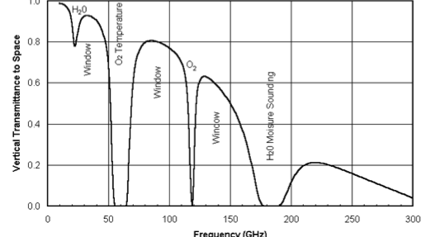
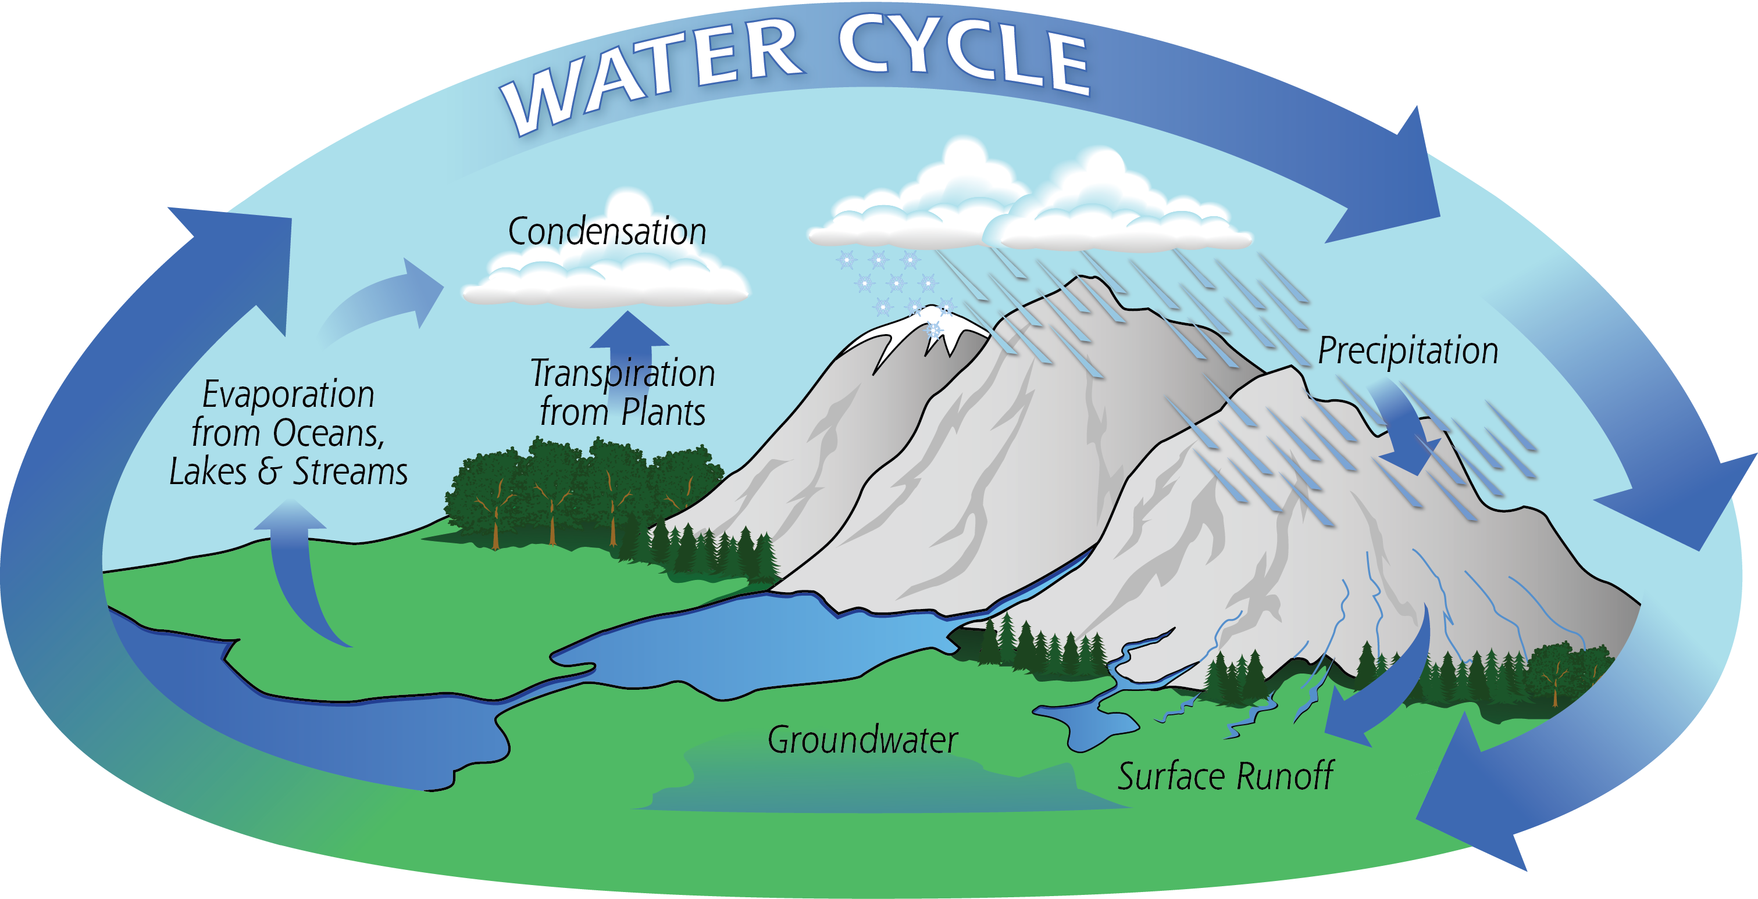
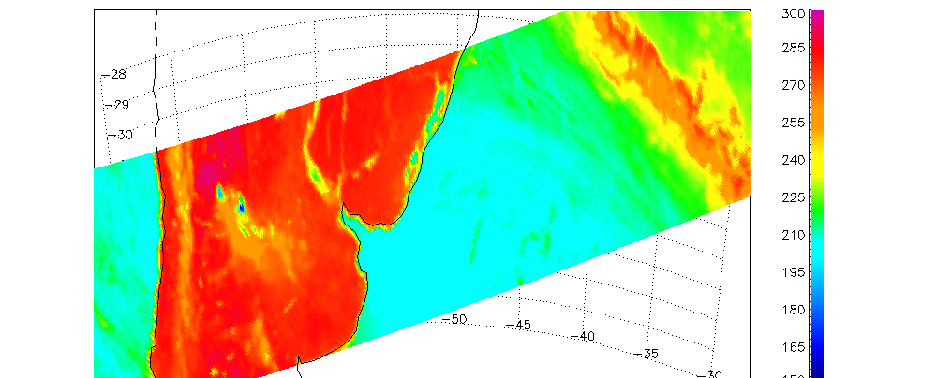
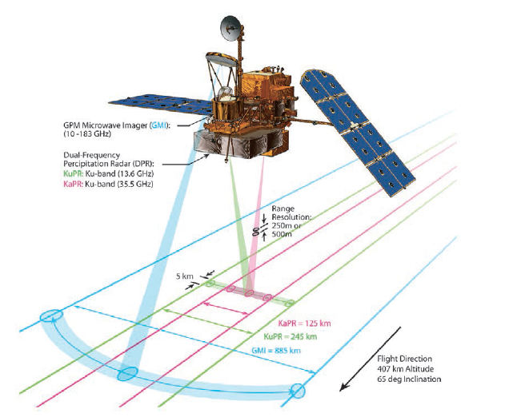
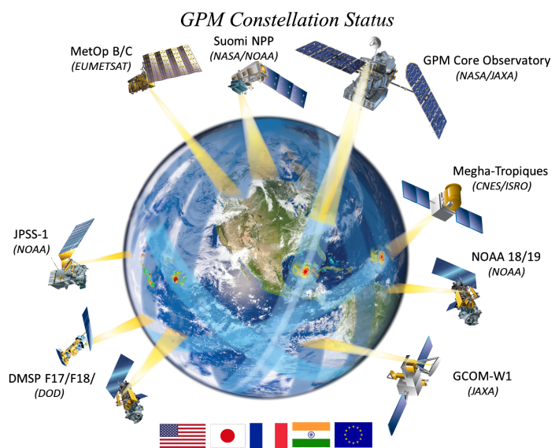
  GPM: Global Precipitation Measurement Mission
37V

Slide 4
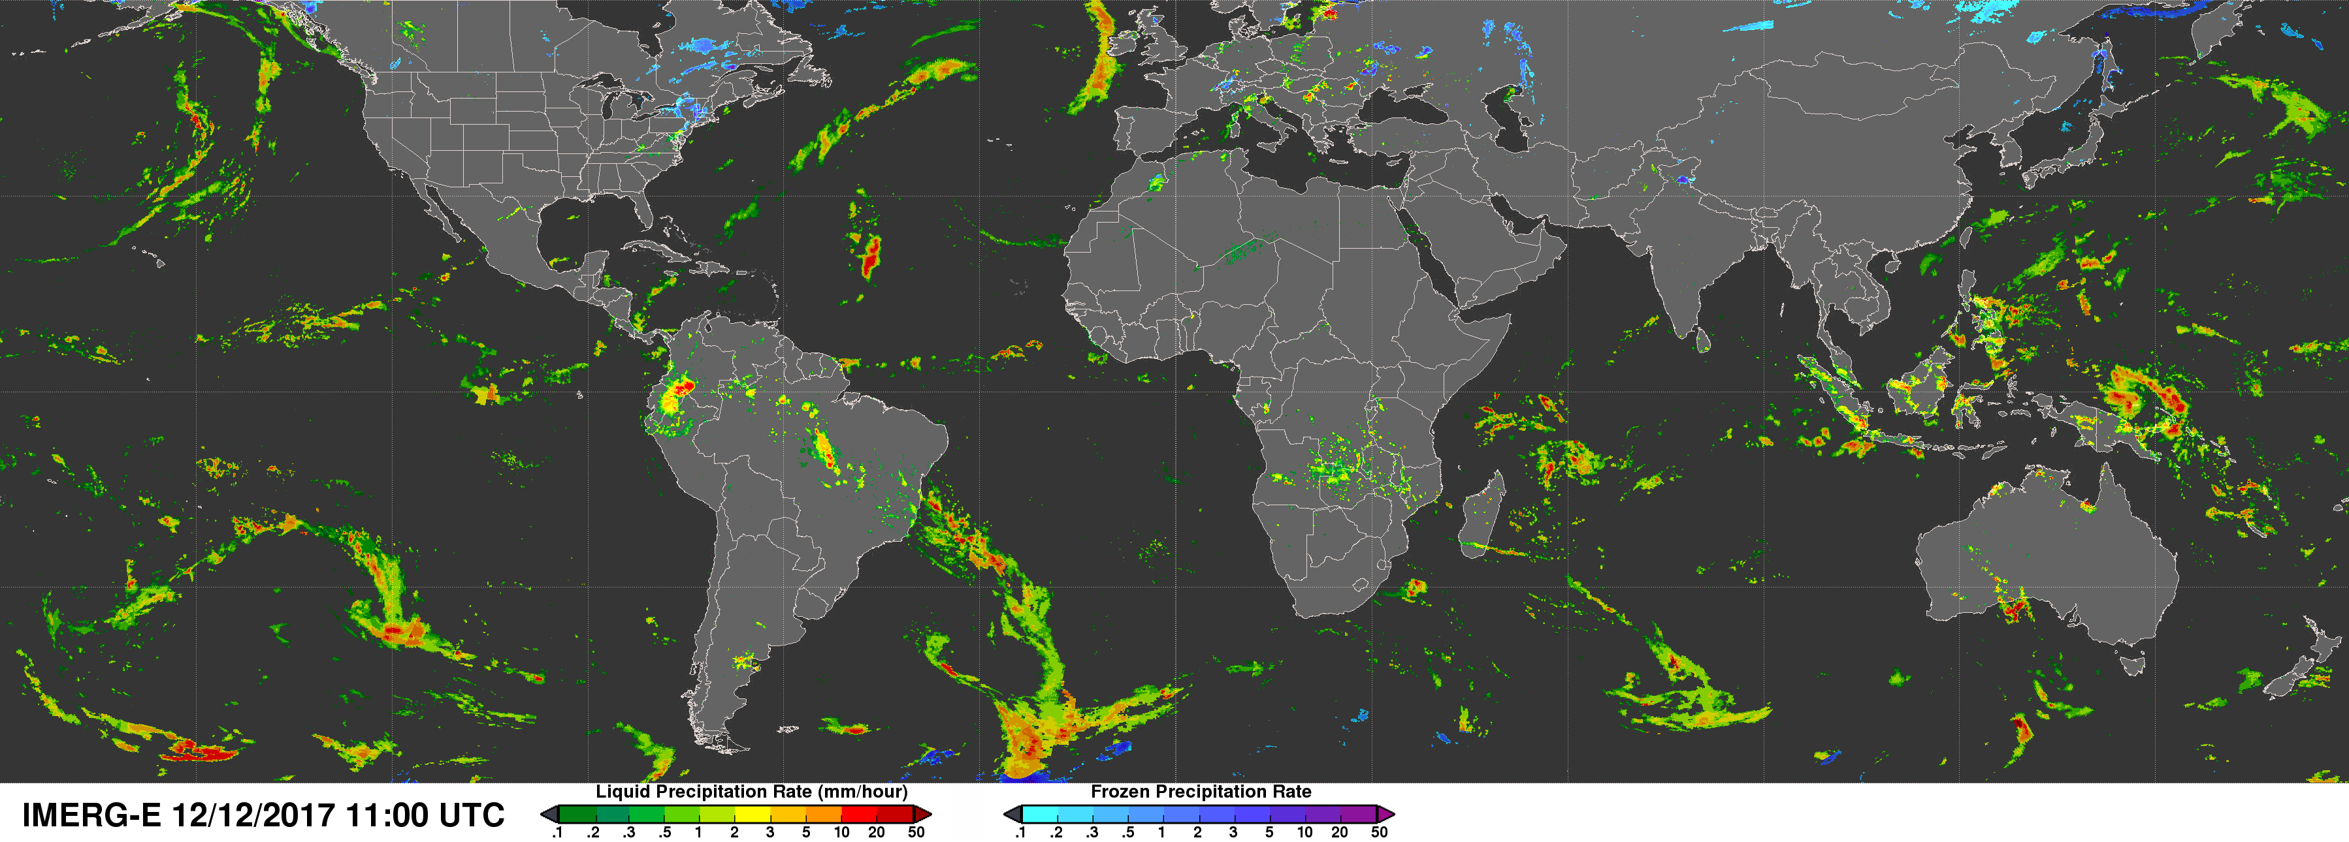
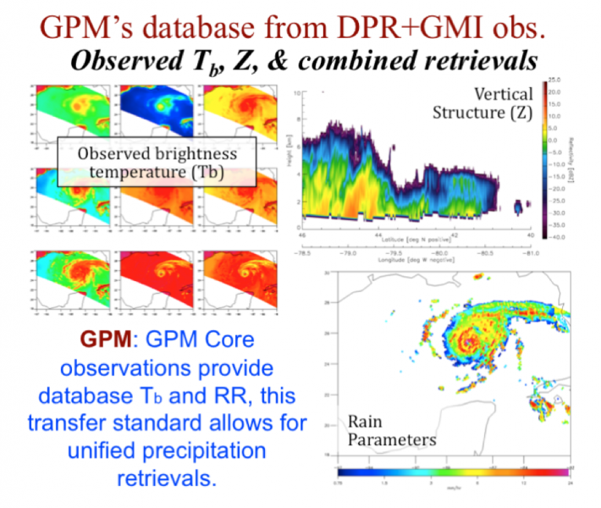
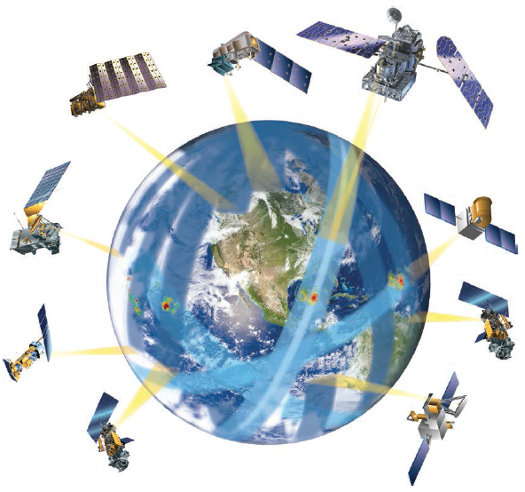

Introduction
GPM constellation concept: increase coverage in time and space
Use core satellite active-passive combined retrievals to create database that is applied for all constellation members
Core satellite acts as transfer standard for consistent constellation retrievals
*Retrieves only if detectable
radar signal*
pmm.nasa.gov/multimedia/images/GPM
Notes:
GPM has as a goal broad coverage in space and time. Can’t do this with one satellite, so we use a constellation of passive microwave radiometers. Each of these has different frequencies, footprints, viewing angles, etc. so use the core satellite as a transfer standard for consistent retrievals. Will talk more about how that works in the next couple of slides.

Slide 5
Goal: Use Radiometer information where available to add light precipitation below radar sensitivity
Figure 1: CloudSat-GPM coincident overpass on 24 January 2015 near 2200 UTC. The top three panels show the (uncorrected for attenuation) equivalent radar reflectivity profile (dBZ) from CloudSat, DPR Ku- and Ka-band respectively. The bottom panel shows the line-trace of the 13 GMI channels.

Slide 6
Light Precipitation
CloudSat for increased sensitivity
Southern Ocean testbed
More precipitation in general, lots observed below DPR sensitivity
Adapted from Tang et al. 2017 Figure 6: Precipitation frequency distributions based on global coincident events between GPM DPR and CloudSat CPR.
Behrangi et al. 2016 Figure 12: Maps of 2007-2010 averaged precipitation rates (mm/day) from various products over land and ocean south of latitude 55.

Slide 7
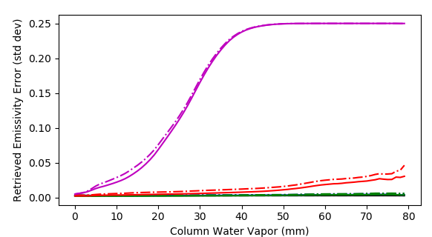

Munchak et al. 2020 1DVAR All-Sky Retrieval
Optimal Estimation Retrieval for GPM GMI
  Anticipated to be part of GPM Combined retrieval product in Version 8
  MERRA-2 first guess, error covariance constructed from radiosonde
  Retrieve emissivity vector, water vapor
  Output includes measure of convergence (Normalized Error)
Utilize non-convergence information: similar to NOAA MiRS methodology
Information Content
Mean posterior emissivity error (square root of diagonal elements of Sx) Munchak et al. 2020
Notes:
NOTE MIRS retrieval is similar scheme but includes hydrometeors

Slide 8
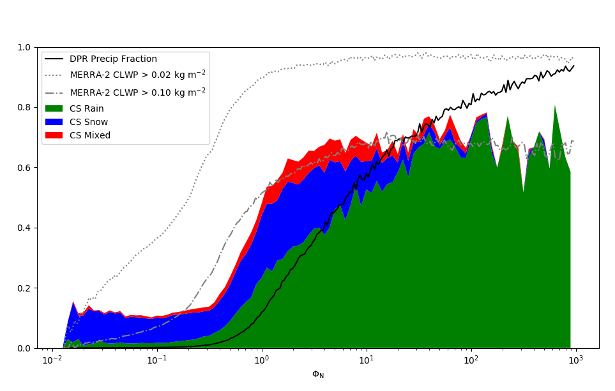
Precipitation Fraction and Normalized Error
Light Precipitation detectable by GMI but not DPR
Munchak et al. 2020
Notes:
Data were compiled from all CloudSat-GPM matchups between March
2014 and December 2018 over land surfaces.
Will be operational part of GPM CMB product starting in version 7

Slide 9
Two years of ITE 790

Slide 10
Retrieval Cut-offs
Munchak et al. analysis suggests 0.5 cutoff
  Inflection point in matched CloudSat over 2 year dataset
Information content in the error parameter is obvious but NOT definitive
  May be many reasons that retrieval does not converge

Slide 11
Bayesian Retrieval
Error parameter as a place to start
GPROF: Operational GPM Constellation retrieval
  Where error parameter > 0.5 and DPR RR = 0
Use multispectral Tb information and environmental parameters in Bayesian scheme to retrieve “most likely” state
  Weight by: Tb, Chi-sq, TPW, SkinT

Slide 12
Conclusions and path forward
Information content from multispectral Tbs has great potential to add light precipitation information across the GPM constellation
  Implement in 2BCMB
  Transfers to constellation and IMERG via database
Validation is critical but complicated
  CloudSat sample size is small for statistical conclusions
  Radiative transfer - radiometric consistency with observed Tbs
  Will look for validation datasets of opportunity
CloudSat sensitivity
Training database is small using CloudSat-GPM matchups
Bayesian or AI/ML – need a large input dataset in each case

