Slide 1
Space Station Operations Capabilities in a Shoebox
Marshall Space Flight Center’s Telescience Resource Kit
NASA/MSFC/Jeff Lippincott

Slide 2
What is TReK?
The Telescience Resource Kit (TReK) is a suite of software applications and libraries that provide generic data system services.
It was developed for use by payload teams to communicate with their experiments onboard International Space Station (ISS).
The TReK software is verified for use onboard ISS and is provided free of charge.
It includes software to communicate with the Huntsville Operations Support Center (HOSC) Payload Operations Integration Center (POIC).
Supported Platforms:
  Windows 10.
  Red Hat Enterprise Linux 8.x.
  Cross-Compiled versions available upon request.

Slide 3
Operations History at Marshall Space Flight
Center (MSFC)
The Huntsville Operations Support Center (HOSC) is a 24x7 multi-mission ground systems operations facility at MSFC in Huntsville, Alabama which has provided support for many NASA programs including Apollo, Skylab, Space Shuttle, Spacelab, and ISS.
Prior to ISS MSFC supported Spacelab Missions which typically lasted from 10 days to 3 weeks. Payload teams would travel to Marshall Space Flight Center (MSFC ) to operate experiments for the duration of the mission.
The POIC has supported around the clock operations for ISS since 2001 and integrates research requirements and monitors payload activity to ensure the experiments are safely executed.

Slide 4
The Need for a Common Ground System
ISS payload operations teams are located at other NASA centers, commercial facilities, universities, and international partner sites.
There are approximately 230 science investigations planned for ISS for the next six months.
Payloads on ISS have durations of days to years which makes remote operations for payloads necessary in order to lower overall costs.
Since ISS has multiple crew members year around, there are many security and other unique interface requirements that are necessary to ensure crew safety. A common ground system prevents all payload teams from writing the same code to meeting these unique requirements. This is especially important for short duration experiments.
TReK was created to fill this need and has been operational since July 2000.

Slide 5
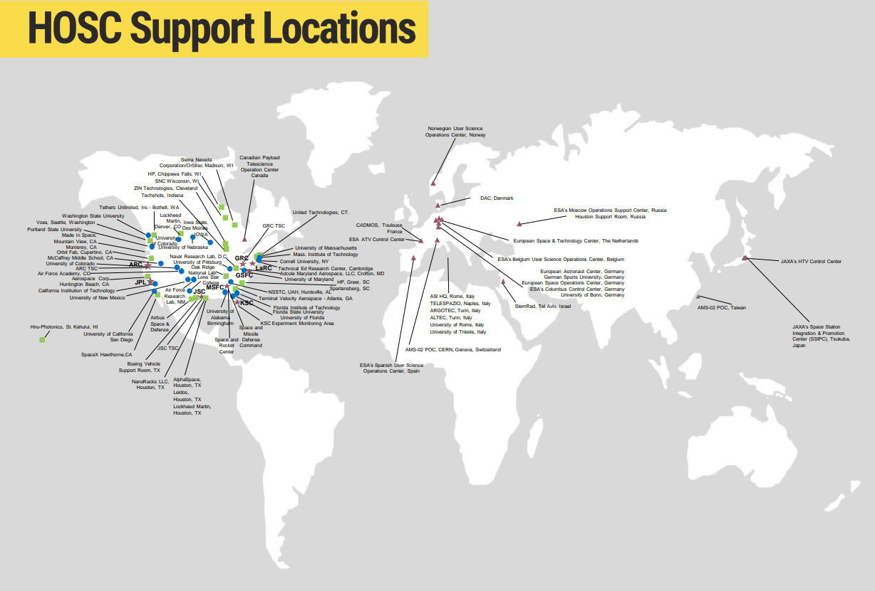
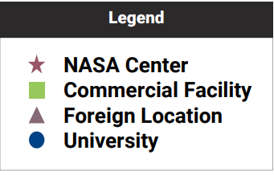

Slide 6
Capabilities
Communication – Consultative Committee for Space Data Systems (CCSDS), Standard Internet Protocols (Unicast, Multicast, TCP Listener, TCP Server, and TCP Client).
Packet Support – Create, populate, build, and decompose packets. Includes support for pre-defined and custom headers and packets.
Data - Receive, process, record, playback, forward, and display telemetry data.
Command – Create, modify, send, track, and record commands.
Metadata - Metadata (packet definitions, limit information, etc.) can be stored in one or more databases or files.
  Packets can be defined using an ASCII file format, various XML file formats, or a database. There is also an application that provides the capability to use drag and drop to define a custom header or packet and generate the associated metadata file for use with other applications.

Slide 7
Capabilities
Application Programming Interface (API) – Core libraries are C++ with wrappers for ANSI-C, Python, and .NET support (.NET Core support coming soon). The API provides a bridge for users to develop software to access and extend services. This includes writing custom software for use onboard a spacecraft or on the ground utilizing just the capabilities needed for a particular operations concept.
File Transfer – Send and receive files using CCSDS File Delivery Protocol (CFDP).
Delay Tolerant Networking (DTN) - Configure and manage (start, stop, monitor) an Interplanetary Overlay Network (ION) DTN node.
Cryptography – FIPS 140-2 Compliance to encrypt and decrypt both files and packets.
ISS Onboard Interfaces – API to ease integration of payloads into ISS.

Slide 8
Usage
Small Footprint - Software is designed using libraries so each individual capability can be installed with a minimum amount of software. [e.g., install only CFDP capability on flight computer]. This provides the capability to configure and install a single individual data system capability with a small footprint. [Linux installs]
Environments – TReK is used in many different environments during the payload lifecycle:
  Standalone – standalone with built in simulators to support training, payload development, and payload testing in a lab environment.
  Standalone Test Environments -- TReK has interfaces with multiple ISS Test Systems to support payload development, testing, and ISS software verification testing:
  HOSC On Demand Test Environment (ODTE) which provides a flight-like end-to-end test environment.
  Integrated Test Environments – TReK is used during integrated testing with ISS ground and flight systems as well as certification of flight readiness (COFR) activities.
  Flight Operations with the HOSC.
TReK is currently used for ISS operations by almost all ISS payload teams. It has also been used successfully for Fast, Affordable, Science and Technology Satellite (FASTSAT) and return to flight operations after the Columbia accident on a WB-57 aircraft. TReK is also planned for use by the Gateway program and some small satellites.

Slide 9
Contact Information
Website: https://trek.msfc.nasa.gov
Email: trek.help@nasa.gov

