Slide 1

Windform® XT 2.0 Use as 3U CubeSat Primary Structure
August 6, 2023
Amanda Stark
Andrew Paddock
Thuan Nguyen
Kurt Woodham
http://engineering.larc.nasa.gov/
Notes:
Amanda
Welcome to the NASA Langley Research Center presentation on the use of Windform XT 2.0 for the primary structure of the GPX2 cubesat

Slide 2
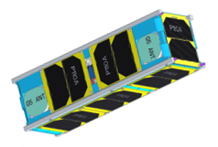
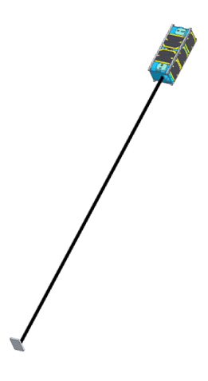
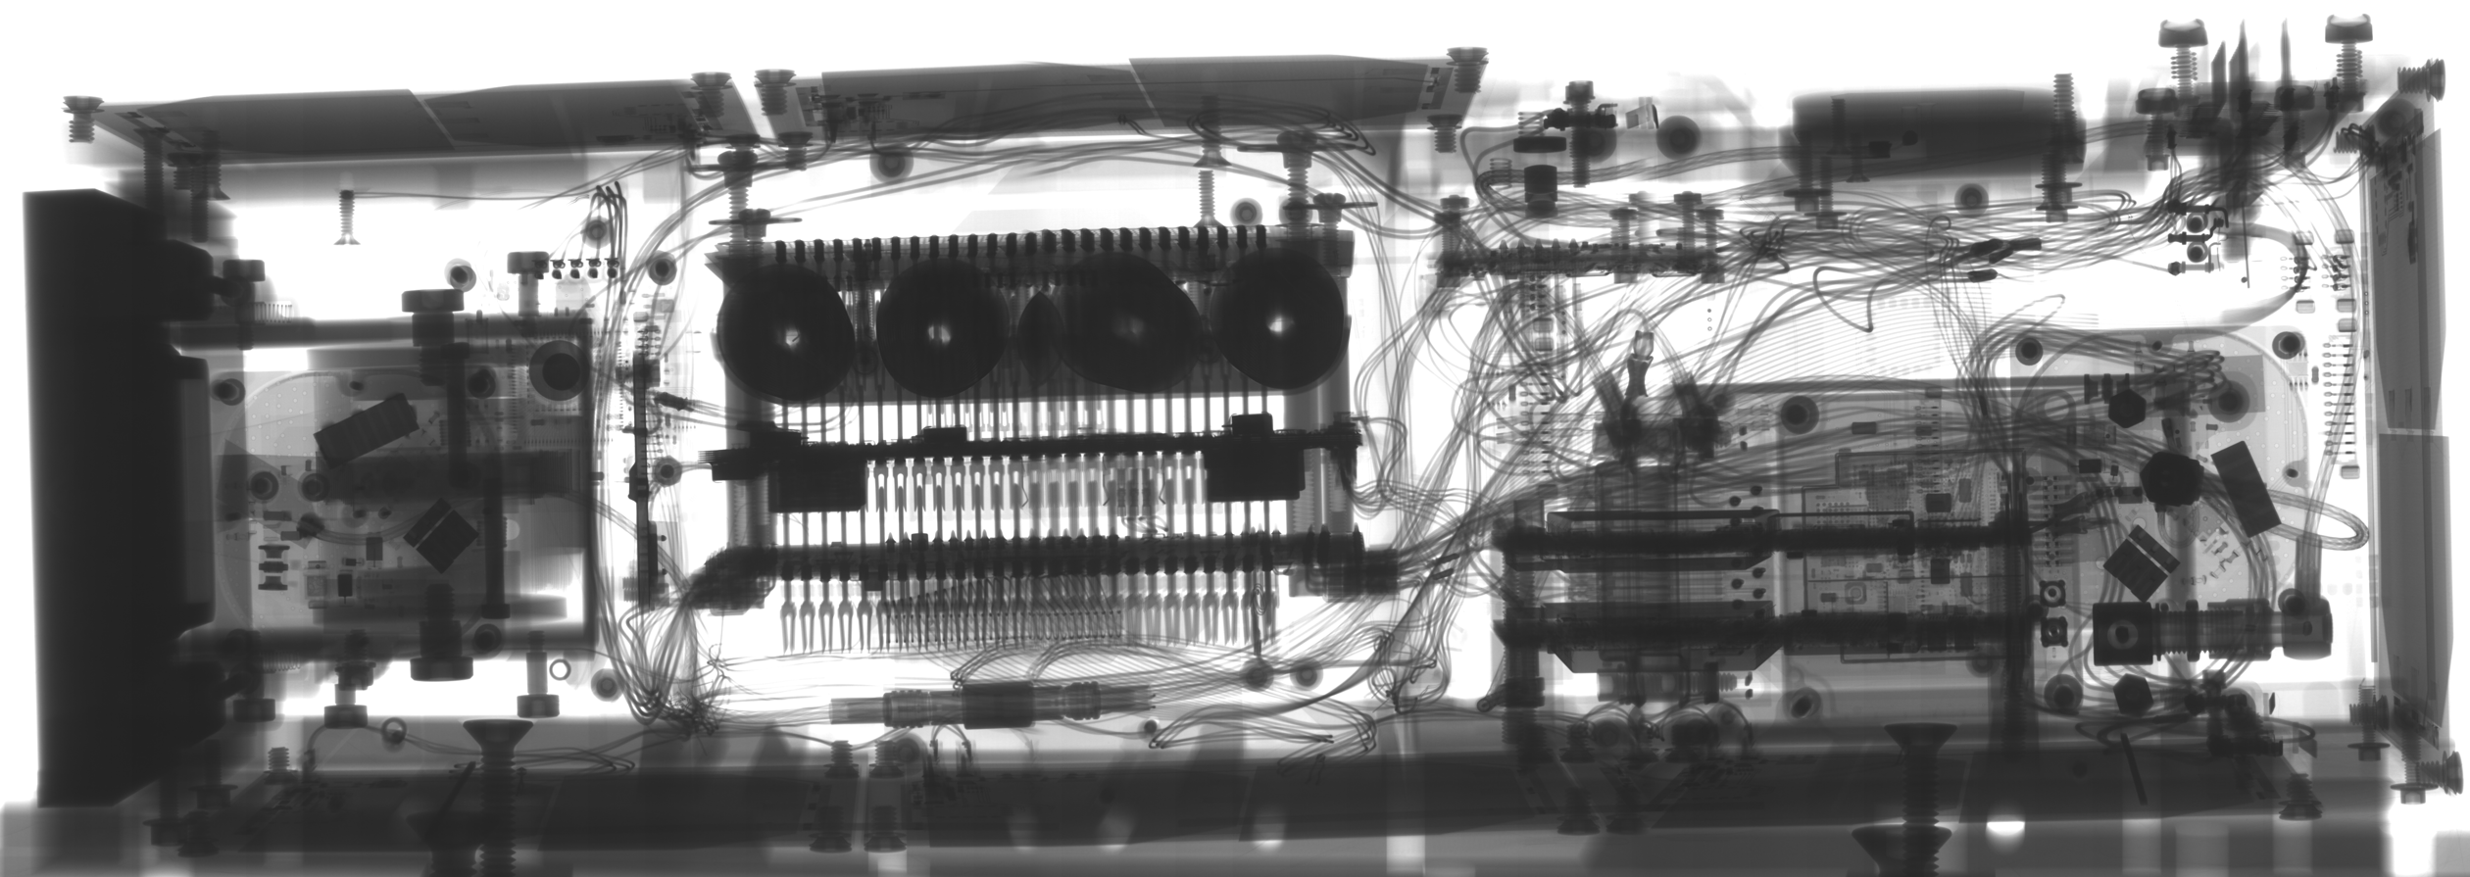
Content
GPX2 Background
Windform® Information
Design & Analysis
Testing
Lessons Learned
Notes:
Amanda
We will briefly summarize these topics as discussed in our recently released paper by the same title.

Slide 3
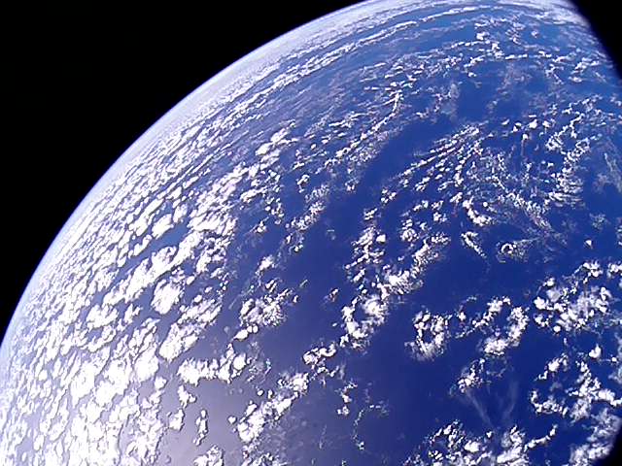
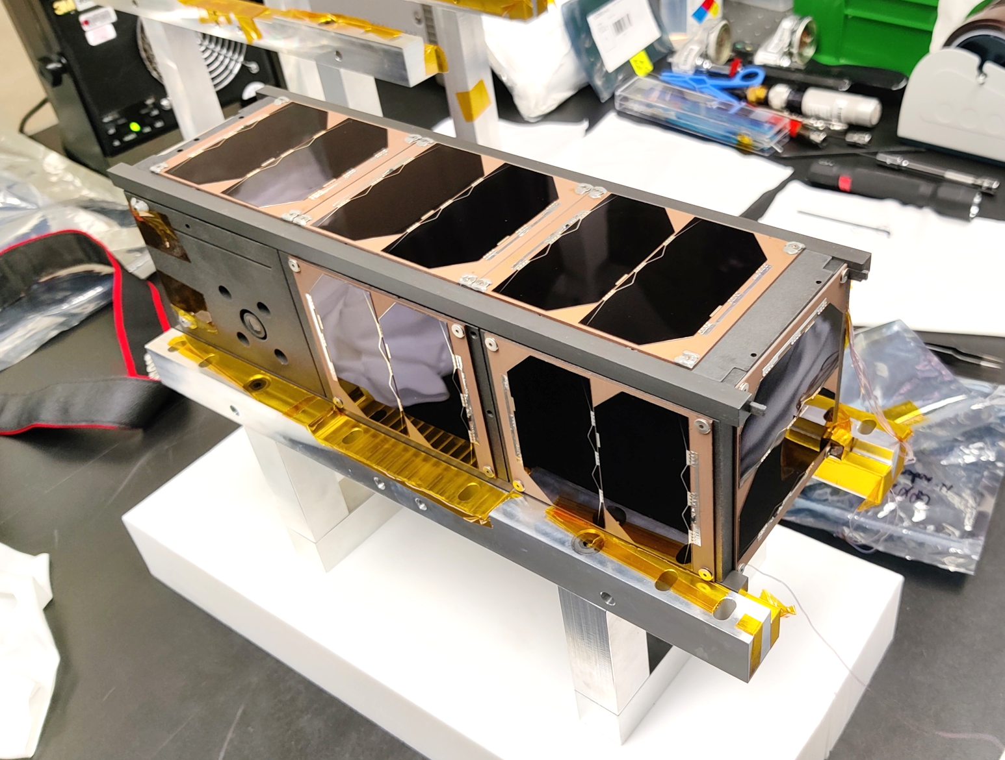
GPX2 Launched in 2022!
NASA Langley funded 3U CubeSat
  Explore the viability of using a Commercial Off-The-Shelf differential Global Position System in low earth orbit
  Small team of engineers working part-time to design, build, test, and launch
  Survived the pandemic!
  Launched July 2022
  Started to received data packages within a week after launch
2022-08-02 uCAM III Photo
Notes:
Amanda

Slide 4
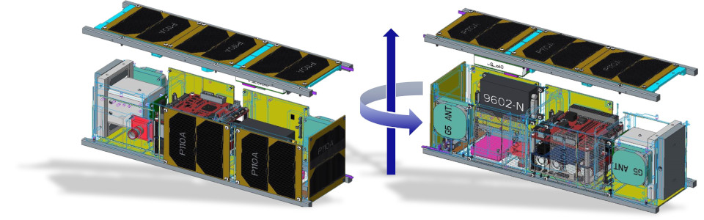
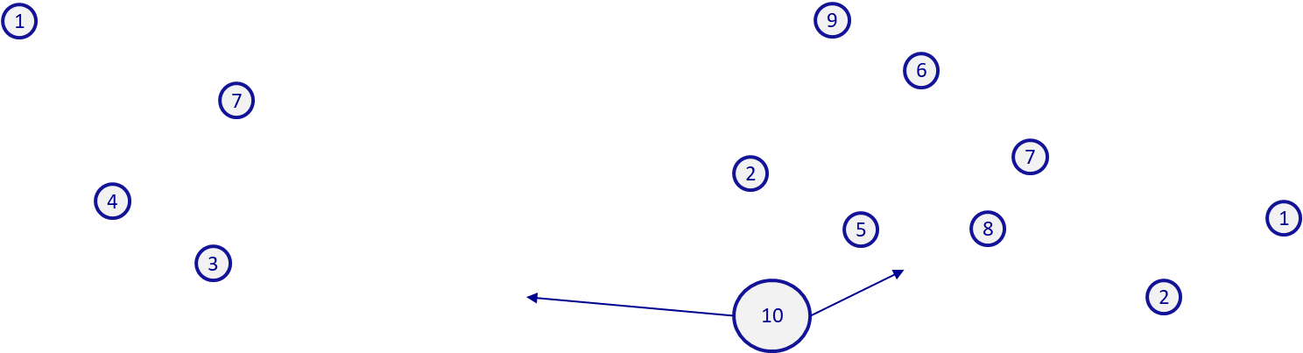
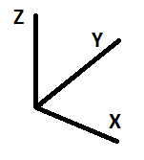
GPX2 Architecture
1 | 2m Gravity Gradient Boom (Redwire) | 2 | GPS Antenna (x2) (Antcom)
3 | Solar array (x10) (GOMSpace) | 4 | JPEG Camera (4D Systems uCAM-III)
5 | Iridium Antenna (NAL Research) | 6 | Iridium Modem (NAL Research)
7 | Flight Computer Processing Unit (FCPU) (LaRC D203) | 8 | Power Subsystem (GOMSpace)
9 | GPS receiver (x2) (NovAtel) | 10 | Windform® XT 2.0 Chassis (3U 30x10x10cm)
*Technology demonstration: Iridium for space-to-space communications extends knowledge base developed by ARC TEchEdSat project working with Iridium Chief Systems Engineer, and greatly reduces ground operations complexity; Windform® XT 2.0 (composite polyamide reinforced with carbon fibers) is 40% weight of AL with reduced lead time.
Notes:
Andy
To reduce manufacturing costs and lead times as well as increase design flexibility, the project chose additively manufactured Windform® XT 2.0 as the primary bus material for GPX2. The bus is a two-part, 3D-printed structure consisting of a single-piece, five-walled chassis and single-walled cover. The bus was designed to allow accommodation of the payload electronics stack as well as antennas, receivers, modems and a deployable stabilization boom.

Slide 5
Windform® XT 2.0
What is Windform®?
Disadvantages
A composite polyamide reinforced with short carbon fibers
Owned and trademarked by CRP Technology S.r.l.
Selective Laser Sintered (SLS) material is anisotropic, structurally & thermally
Need to accommodate print tolerancing for critical dimensions
Potential voids generated during printing
Consideration
CTE mismatch with Aluminum
3D Printing Advantage
Precise Hole Locations
Mass reduction when compared to aluminum structure
Small fixture Features
Monolithic Design
Unique Support Structure for Components
Notes:
Andy
There have been reports that Windform XT 2.0 has been used by SmallSat groups in the past for relatively non-structural components, but GPX2 is the first 3U CubeSat flown (that we’re aware of) to utilize this material to manufacture the primary payload Bus structure. Windform is a selective laser-sintered carbon fiber-filled polyamide that is trademarked by CRP Technology S.r.l. Similar to most composites and additively manufactured structures, Windform is anisotropic and has a density roughly 40% of that of aluminum.

Slide 6
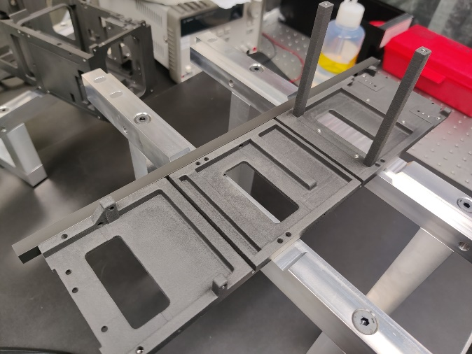
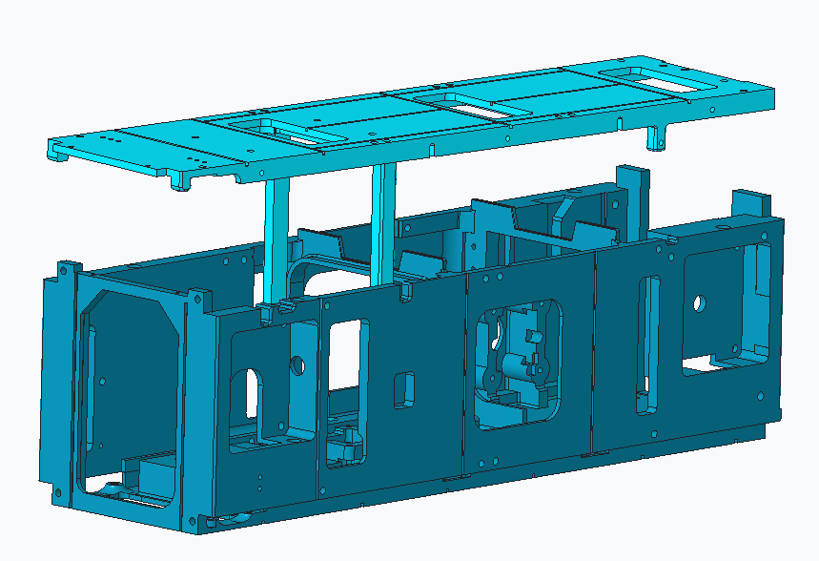
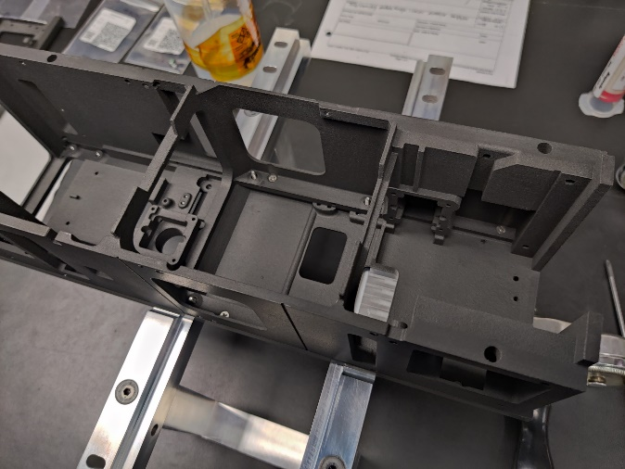
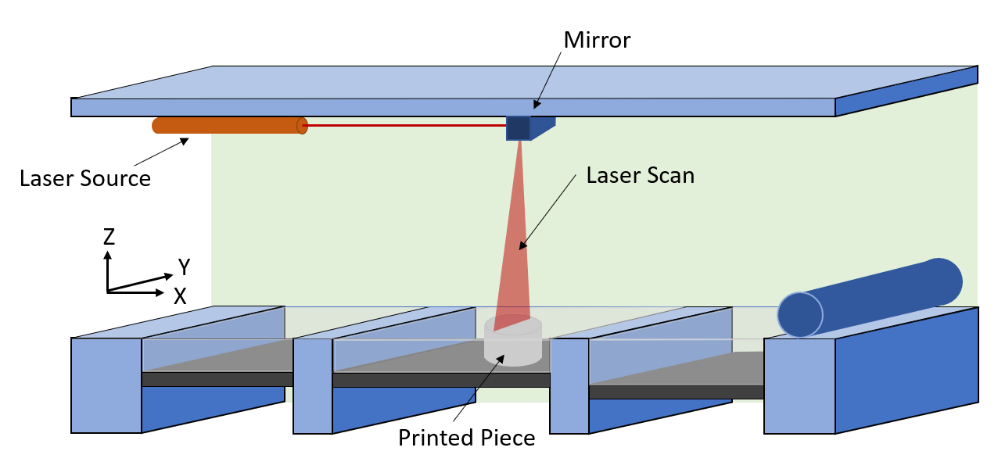
Structural Design
Creo CAD
Final Components
SLS with Windform® XT 2.0
Notes:
Andy
The 30cm x 10 x 10 Windform® Bus consists of the Chassis and Cover which contain numerous features that are not possible to create with subtractive manufacturing for monolithic structures. This allowed the GPX2 team to minimize joints and fastening hardware as well as decrease assembly costs. Features that cannot be post-worked to achieve the desired tolerances must take the relatively large AM ranges into account during the design phases. This certainly is important for holes – considering their end roles of course. Holes that are required to have a high accuracy (ie, to be tapped, fastener through-holes) should be designed slightly undersized with final sizing achieved after printing. The GPX2 Bus contains 60 holes that were designed to be tapped for Helicoils. These small hole sizes ranged from #1 up to M3. Inherently, AM can produce voids within the structure, so some type of Non destructive evaluation should be considered along with mismatches in the coefficient of thermal expansion for joints of different materials.
Launch loads and on-orbit environments drive most of the mechanical and structural requirements of a spacecraft and the launch loads can vary between different launch vehicles. The GPX2 spacecraft flew up to its 500km orbit at just over half of the launch provider’s weight limit and adhered to outgassing and space debris requirements.

Slide 7
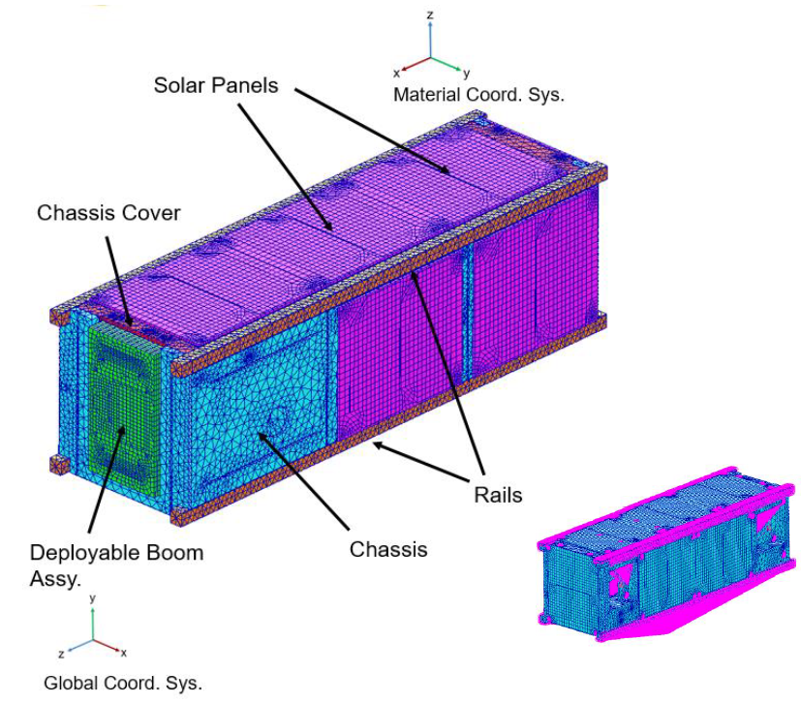
Structural Analysis
Finite Element Model and
Analysis Overview
Analysis tools
  MSC Patran version 2017.0.2 to model/mesh
  MSC NASTRAN 2017.1 for analysis
All electronic components modelled as lump masses for system level.
Worst case directional strength used to determine Margin of Safety
98 fasteners from #1 up to M3 sizes
  Negative margins at E-stack motivated joint redesign, fastener pull-out & Engineering Development Unit (EDU) qualification vibe testing
Random Vibration Analysis was run following GSFC-NASA-7000A General Environmental Verification Standard (GEVS)
Notes:
Andy
A finite element model was created to analyze modal response, stresses for quasi-static, random vibe, acoustic environmental, shock and fastener pull-out. Patran and NASTRAN were used to model, mesh and analyze. The values for the lowest strength direction were used to conservatively calculate margins in all axes. There were slight negative margins in fasteners for the initial design of the electronic stack interface with the Chassis. This led to a redesign of that joint and motivated the team to conduct helical insert pull-out tests in WindForm coupons. An EDU qual. vibe test was also conducted using dummy masses for the mass-significant components. The results of these tests vastly increased confidence of the electronic stack joint design.
Modal analysis results were considered from 20 to 2150 Hz. The first mode was much higher than the GEVS standard requirement for a minimum of 70 Hz.

Slide 8
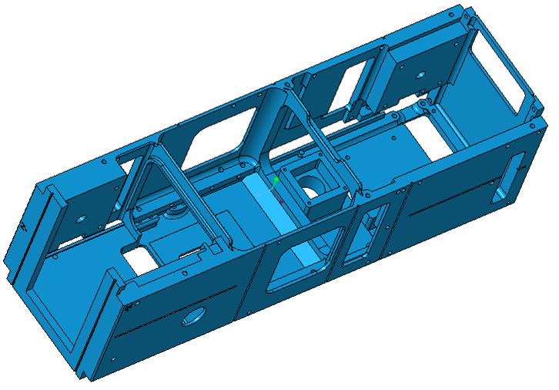
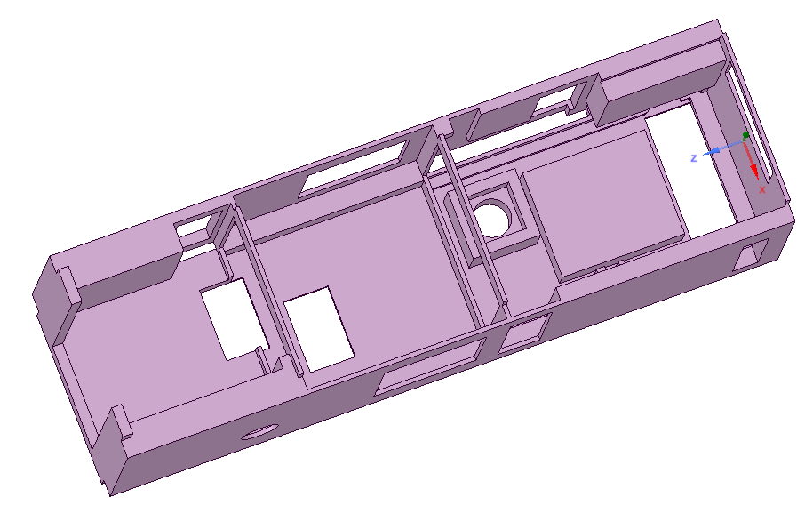
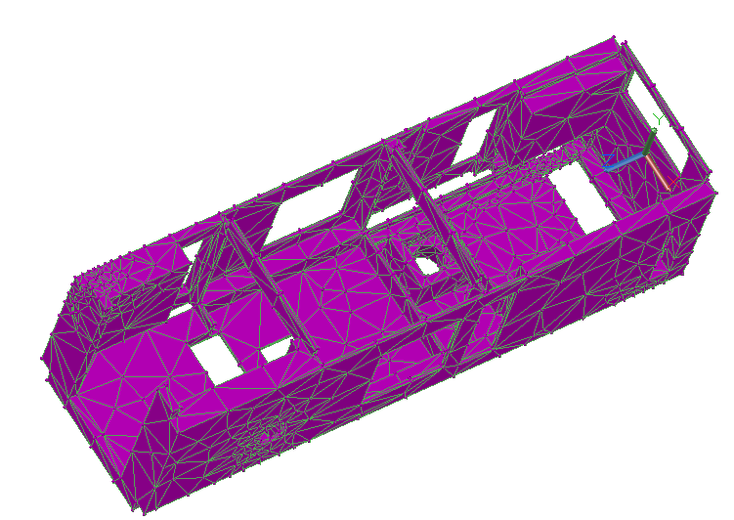
Thermal Analysis
Practice at NASA Langley is to simplify the system in Thermal Desktop using built in geometric shapes
  Electronic components were modeled as lump masses with heat loads added to represent self heating
CREO CAD
SpaceClaim
Thermal Desktop
Notes:
Amanda
CRTech’s Thermal Desktop was used to create and analyze our thermal model, which involved breaking the CAD model down into simplified geometric shapes in SpaceClaim with mathematical expressions, or node sets, used as the physical connection points. This was exceptionally difficult to do since the bus components were designed to accommodate the non-structural elements and had different wall thicknesses. Then the full structure was imported into Thermal Desktop. This allowed for additional simplification as well as the inclusion of material properties.

Slide 9
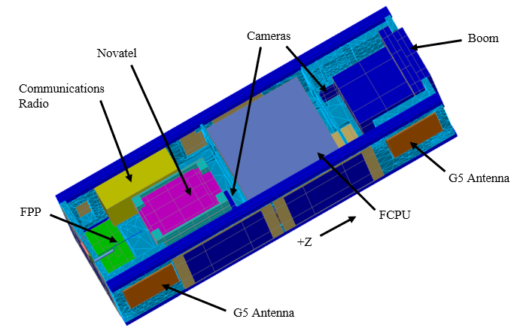
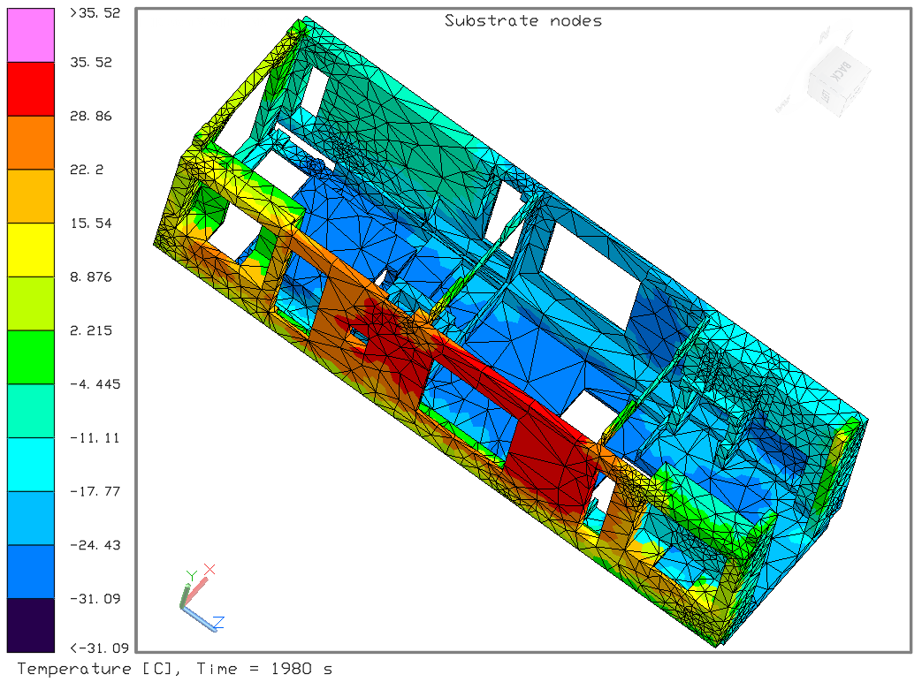
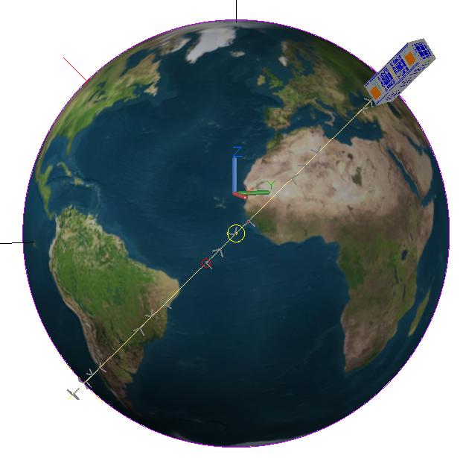
Thermal Analysis
Model uses
Worse case hot/cold orbit predictions
  Collect predictions from each electronic component
Three different operating modes
Planning thermal vacuum testing
Identify placement for flight thermistors
GPS Experiment Case
Details included in the model
Orbital environment
Material optical and thermophysical properties
Different power cases to match mission phases
Cold Case Analysis Orbit
Notes:
Amanda
Thermal Desktop also provides orbit parameters to be established so that the space environment can be included in the thermal analysis work. The cold case orbit is included here and viewed from the sun. Several different power cases were included and allowed the mission to be broken into shorter analysis cases. Once completed the temperature predictions were evaluated and thermal gradients in the bus components could be observed. This thermal model was used to identify max and min predicted temperatures for the full system, identify potential operational temperatures for electronic components, identify locations for flight thermistors on the bus components, and design a thermal vacuum test.

Slide 10
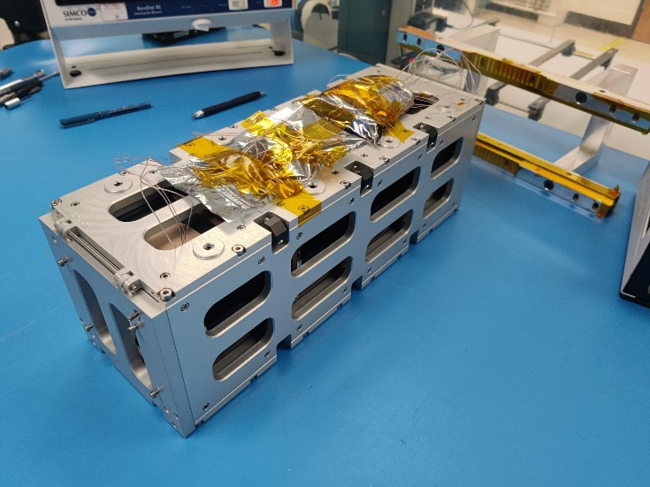
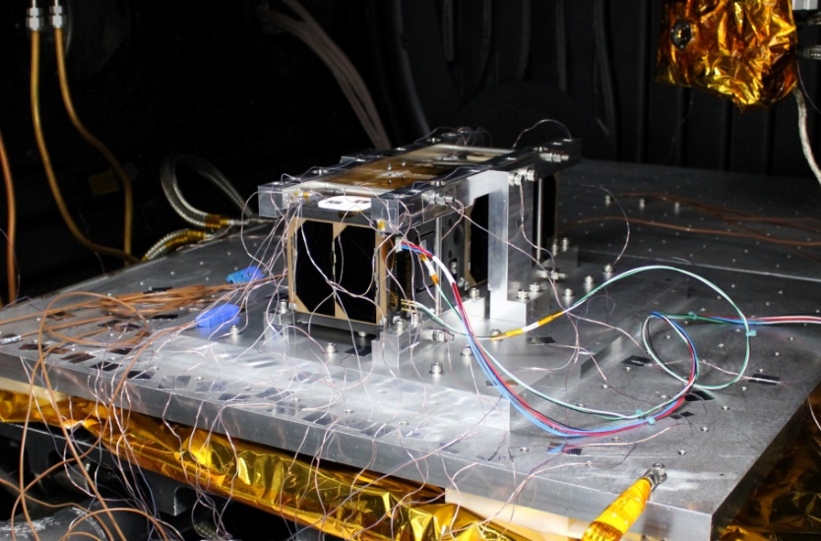
Spacecraft Testing
Vibration (EDU and Full System)
Thermal Vacuum
Goal: To validate the structural design using the EDU and test the full system at protoflight levels
Accelerometers were placed within the EDU but could not be placed within the spacecraft
  Placed on the exterior in the same location as EDU
Outcome:
Visual inspection found no issues with the structural integrity of the Windform bus for both the EDU and full system test
Goal: To stress the full system over the predicted on-orbit temperature range over two thermal cycles with 4 hour dwells at extremes
Thermal vacuum chamber was set to 4˚C/min rate for most transition, but transitions took longer than predicted
Solar panels did not allow for test TCs to be applied to the chassis/bus
Outcome:
Visual inspection found no issues with the integrity of the Windform bus
Performance of the full system was validated
Notes:
Amanda
The full spacecraft went through both thermal Vacuum and vibe testing. One aspect of the vibe campaign, unrealized, was that while the EDU unit accommodated accelerometers within the bus, the flight unit would only allow for external placements.
The thermal vacuum test was to validate the workmanship and thermally stress the full system. With the external surface of the spacecraft covered with solar panels there was no space for test TC application during setup. Test TCs were placed on all electronic components and on the test fixture. It was observed that the spacecraft rate of change was much slower than the chamber settings and were slower than the predictions even with the test fixture being designed to help with thermal paths. For each test the bus was visually inspected and there was no visual issues found. For the TVAC test the performance for the full system was validated.

Slide 11
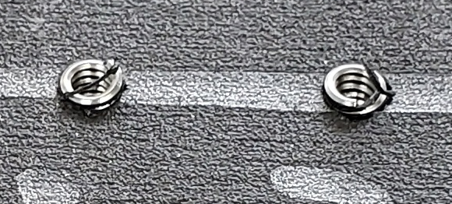
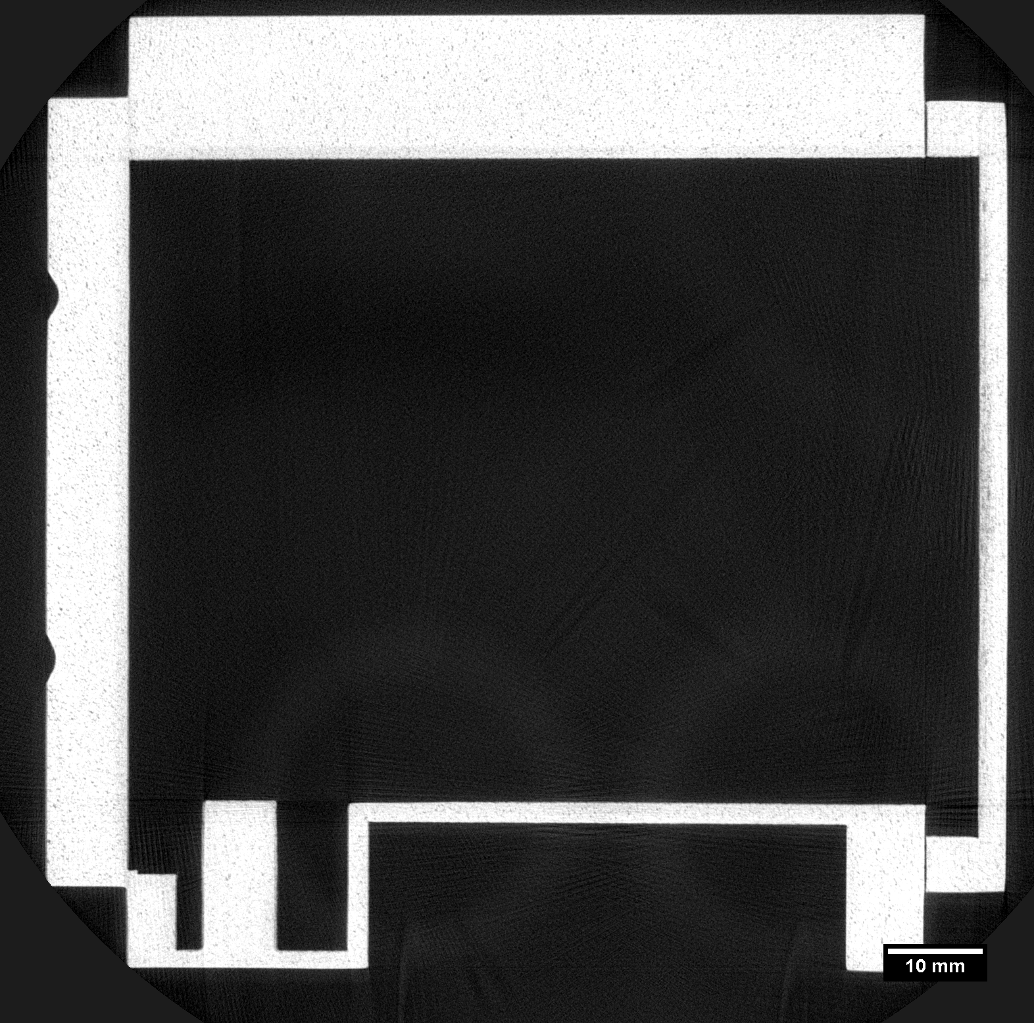
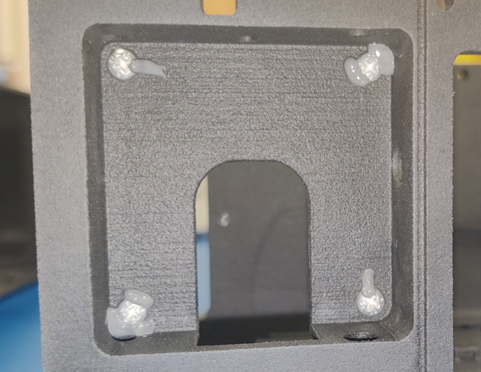
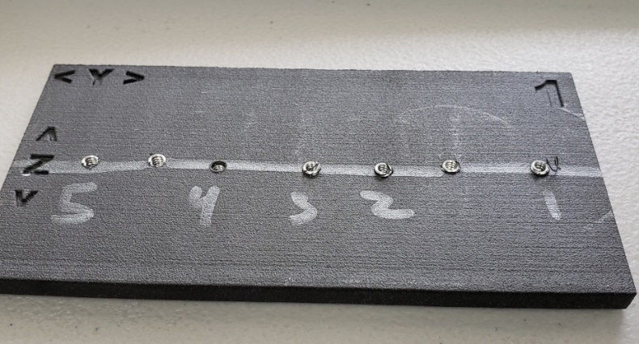
Analysis and Verification For Windform®
CT Scan Analysis
Adhesive Study
Fastener Pull-out
Identified printing anomalies that would not have been discovered through visual inspection
Tested 2 fastener-head staking epoxies and geometries for application
Performed helical insert pull-out strength testing
Notes:
There were three tests that were done specifically for Windform.
One was a CT scan of the bus components, the second was an adhesive study, and the third was a fastener pull-out.
Our CT scan was looking to see if there were anomalies in the print process that may cause issues during the mission.
The adhesive study was conducted to verify that we were using adequate epoxy to stake our fasteners since there was some concern about how strong the adhesive bonds would be.
Our fastener pull out test focused on the helical inserts and verified that they would not pull-out during launch and transit.

Slide 12
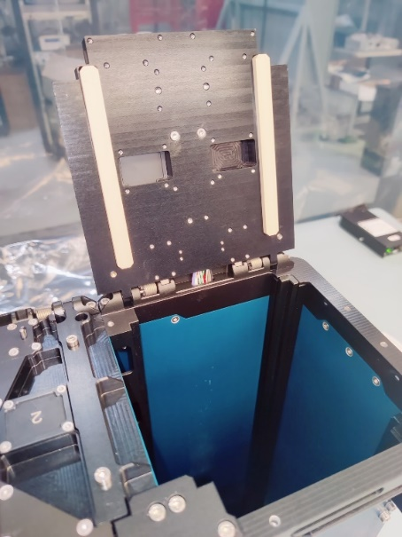
Lessons Learned Highlights
Polymer Loaded Joints
Joints for CTE Mismatch
Fit Check
Preloaded fasteners with plastic components experienced a loss of torque
Aluminum rails fastened to Windform®
Space craft fit test deployer but not flight deployer
Lesson:
Consider single fixed fastener with sliding attachment. Would need sub-assembly thermal testing
Lesson:
Work with materials to identify a torque/retorque schedule
Running Torque Measurement
Running torque generally not measured for tapped holes, but did uncover some anomalies
Lesson:
Fit-check/measure all critical components/dimensions as soon as possible
Lesson:
Measure running torque for small, tapped holes
Notes:
Amanda
GPX2 was a project with a very small team of engineers and part of its goal was to see how adequate such a team would be to design, build, test, and launch a 3U cube sat.
Lessons learned were captured and documented in Langley’s Knowledge Management system and we wanted to share a few of them related to using a 3D printed material.
The CTE mismatch between the aluminum rails and Windform did seem to cause a loss of preload in the fasteners and if we are to do it again, we would consider sliding attachments where CTE mismatch could be a design issue.
Regarding torque measurements, establish a torque/retorque schedule where polymetric components are involved, with a coupon test series.
Additionally, running torque should be measured for small tapped holes in metals.
Finally, a fit check was performed where GPX2 did not fit in the flight deployer as it had in the test deployer. Rail to rail geometric requirements were defined and not explicitly measured.
Perform flight unit measurements as soon as possible.

Slide 13
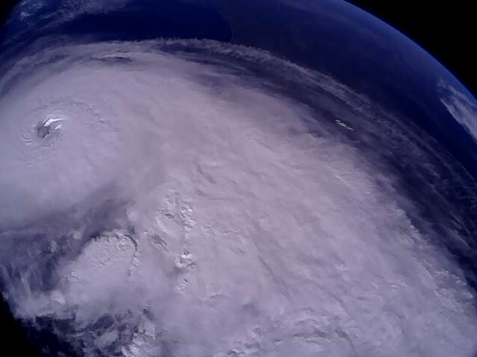
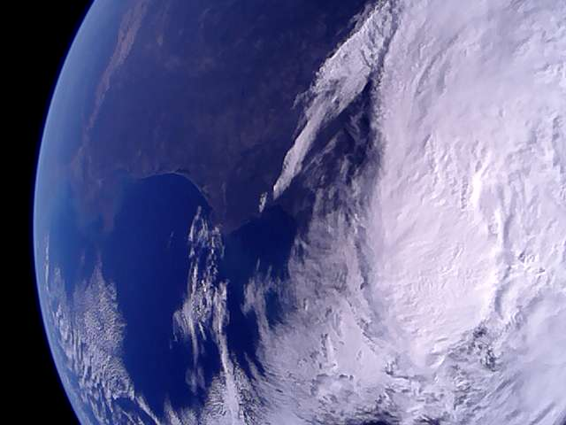
Conclusion
GPX2 was the first to validate and launch a 3D printed material for the primary 3U structure.
  Allowed for freedom to design features that could not be realized through subtractive manufacturing
  Potential reduction in mass
  Lessons learned to streamline applications to future missions
  Collected temperatures on-orbit were within expected range
2022-09-28 14:24:54 UTC Gulf of Mexico, uCAM III Photo
2022-09-29 13:57:59 UTC Landfall over FL, uCAM III Photo
Notes:
Amanda
GPX2 validated application of Windform for the primary structure of a 3U cubesat, which provided design flexibility, potential mass reduction – at least compared to an impossibly identical aluminum bus, and certainly reduced production time. Thorough lessons learned were documented and presented for the benefit of future missions.
Questions and comments are welcome now or while the two of us are here for the remainder of the conference.

Slide 15
Windform® XT 2.0
GPX2 Mechanical Requirements for Bus
Requirement | Definition | GPX2 Status
Mass | Shall not exceed 6 kg | 3.16 kg
Outgassing | TML < 1.0% CVCM < 0.1% | TML 0.53% CVCM 0.0%
Space Debris Compliance | NASA-STD-8719.14 | Passed analysis
Windform® XT 2.0 Material Details
Dark charcoal color
Direction | Modulus (Mpa) | Tensile Strength (Mpa)
X | 7736 | 81.8
Y | 3514 | 58.6
Z | 2324 | 38.9
Average Measured Emittance and Absorbance
Density: 1.1 g/cm³ (alum ≈ 2.7 g/cm³)
Thermal Conductivity - Radial: 0.76 W/m-K
Thermal Optical Characteristic | Average Value
Emittance | 0.903
Absorbance | 0.898
Notes:
Andy
There have been reports that Windform XT 2.0 has been used by SmallSat groups in the past for relatively non-structural components, but GPX2 is the first CubeSat flown by NASA Langley to utilize this material to manufacture the primary payload Bus structure. Windform is a selective laser-sintered carbon fiber-filled polyamide that is trademarked by CRP Technology S.r.l. Similar to most composites and additively manufactured structures, Windform is anisotropic. It has a density roughly 40% of that of aluminum. Launch loads and on-orbit environments drive most of the mechanical and structural requirements of a spacecraft and the launch loads can vary between different launch vehicles. The GPX2 spacecraft flew up to its 500km orbit at just over half of the launch provider’s weight limit and adhered to outgassing and space debris requirements. Values for thermal conductivity, optical emittance and absorption are presented here as well.

