Slide 1
Ultra-Stable Observatory Roadmap Team (USORT) Status
Lee Feinberg, Laura Coyle, Dave Redding, Breann Sitarski, Jon Tesch
Mike Menzel, Sang Park, Marcel Bluth, Julie Van Campen, Breann Sitarski, Jon Tesch

Slide 2
Overall Status
Team has been up and running since March
Developed a WBS spanning each of the 5 subgroups traced from top level goals through Level 4 technology needs including gaps
  Taking a holistic approach when feasible (including Concept Maturity Level and Manufacturing Readiness Level, verification and facilities)
  Metrics identified, working on capabilities and gaps
  Will present status at the High Contrast workshop in August
Planning a dedicated Ultrastable Observatory ITAR workshop in mid Fall to review roadmap product/gaps
Goal is to inform future RFP’s, START and TAG

Slide 3
Team Members (as of 7/18/23)

Slide 4
Ultra-stable Observatory Roadmap Process
Fill in the Metrics/
Capabilities
Define WBS Item Metrics/Capabilities
Feedback from High Contrast Workshop
8/10-8/12
Evaluate SOA for each technology
Example:
Areal Density <25Kg/M2
Example: Areal Density, PMSA thermal stability
Define WBS for Each Group:
Based on Investment Areas
USORT Workshop
TBD
Define Top Level Launch and Mass Assumptions
Identify Gaps
Choose Driving Cases
Choose Segmentation Assumptions
Review Error Budget(s)
Input to START, TAG teams
Update/Iterate
Blue=Process steps
Yellow=External Interface
Interface with Coronagraph Technology Error Budgets/Assumptions
Future Technology Investments

Slide 5
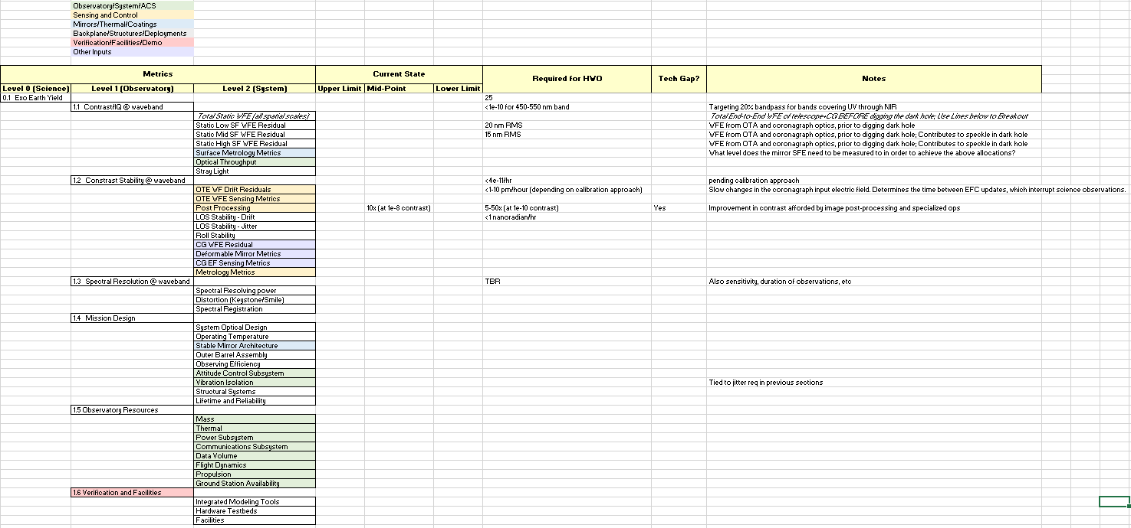
METRICS: Defining key performance regimes and current capabilities to identify gaps and create roadmaps to address them
Metrics are mapped to the 5 subgroups at various levels
Try to keep metrics architecture agnostic, especially at the higher levels.
At lower levels, include options for approaches/components for comprehensive evaluation, with attention paid to bounding cases.
Gap analysis will inform roadmap creation and will be flowed to START and TAG team.

Slide 6
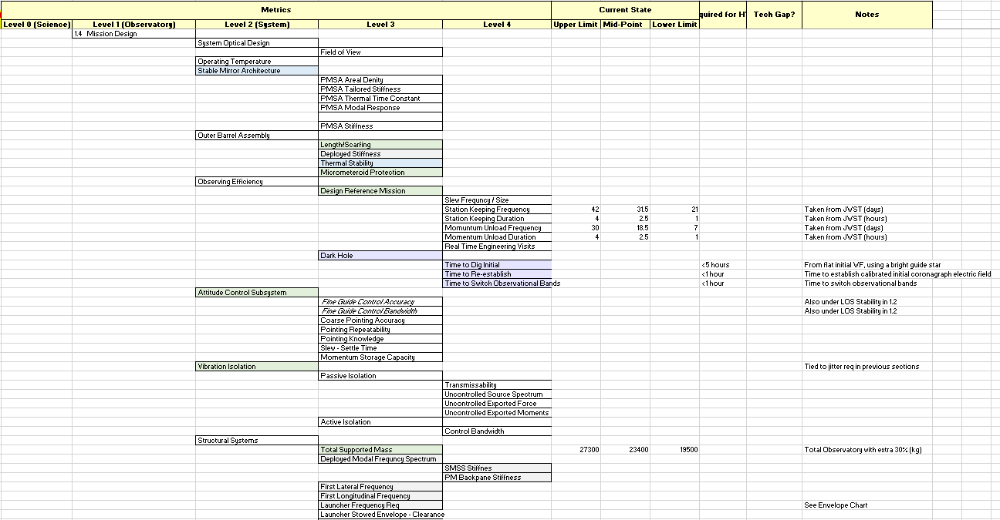
Detail, Section 1.4: Mission Design
Guide specifications for a mirror development effort

Slide 7
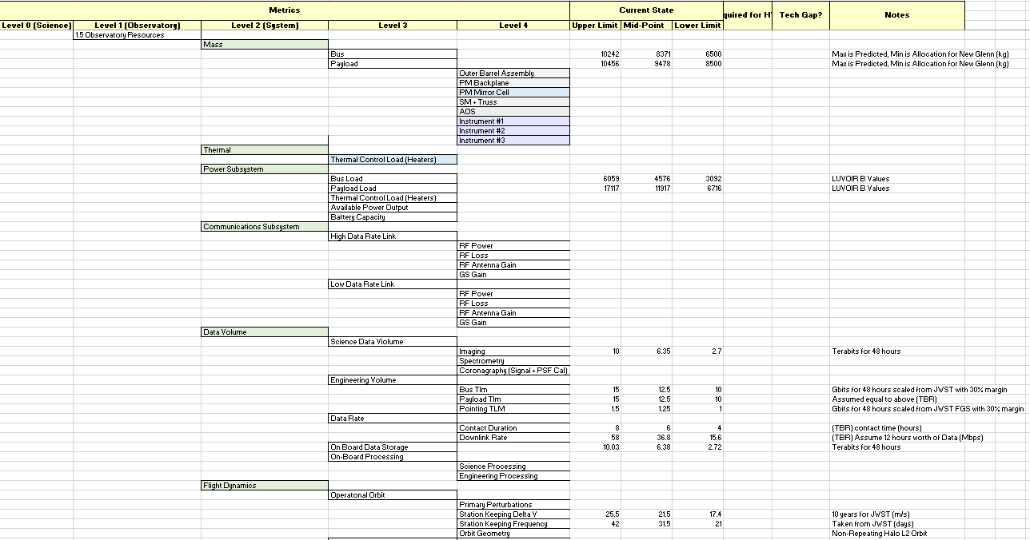
Detail, Section 1.5: Observatory Resources
Launch Vehicle Capability

Slide 8
USORT Sensing and Control Subgroup
Status
July 27, 2023

Slide 9
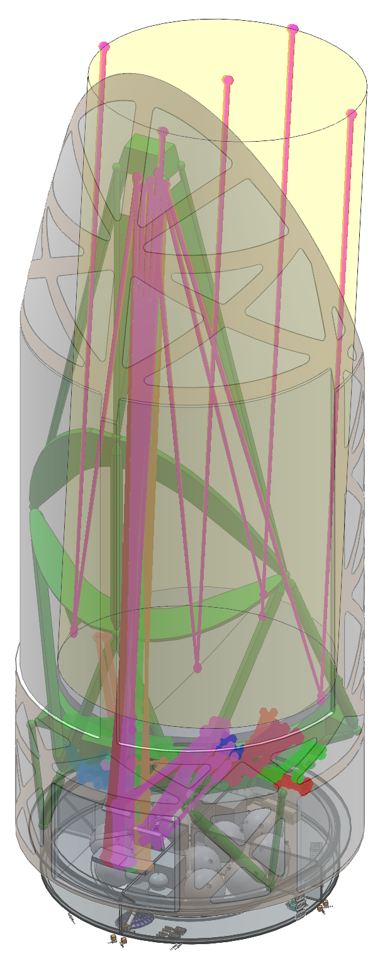
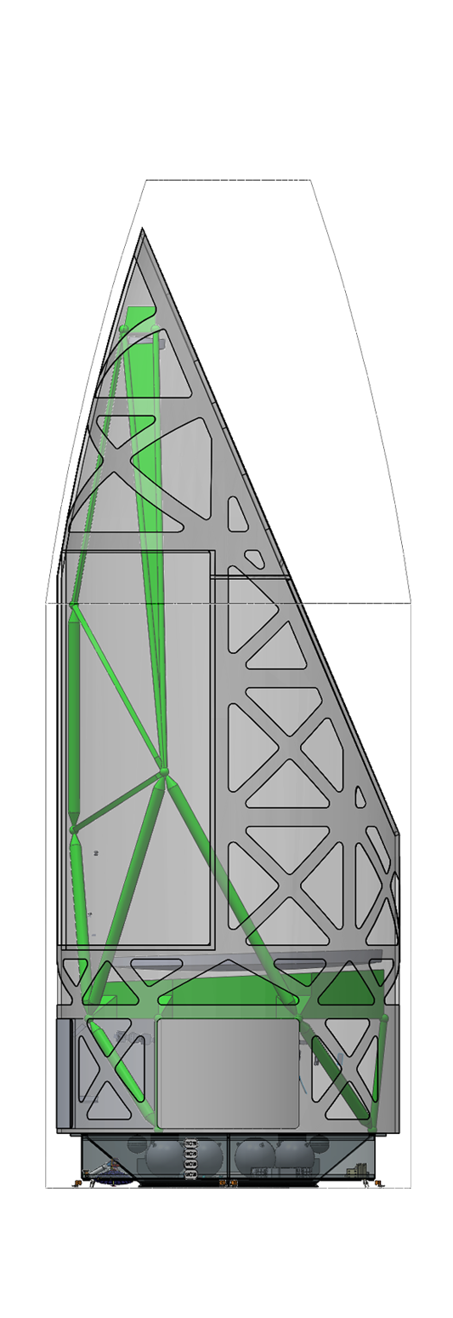
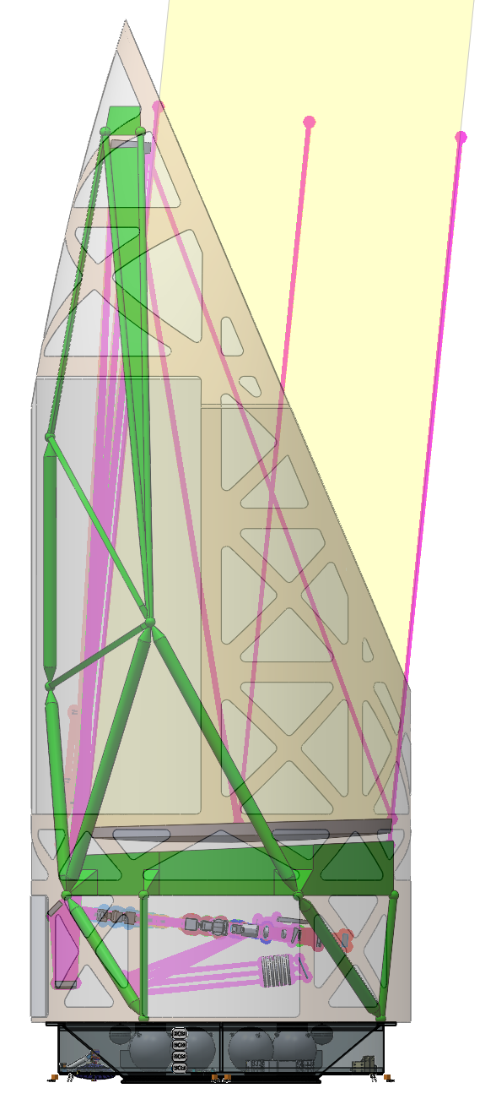
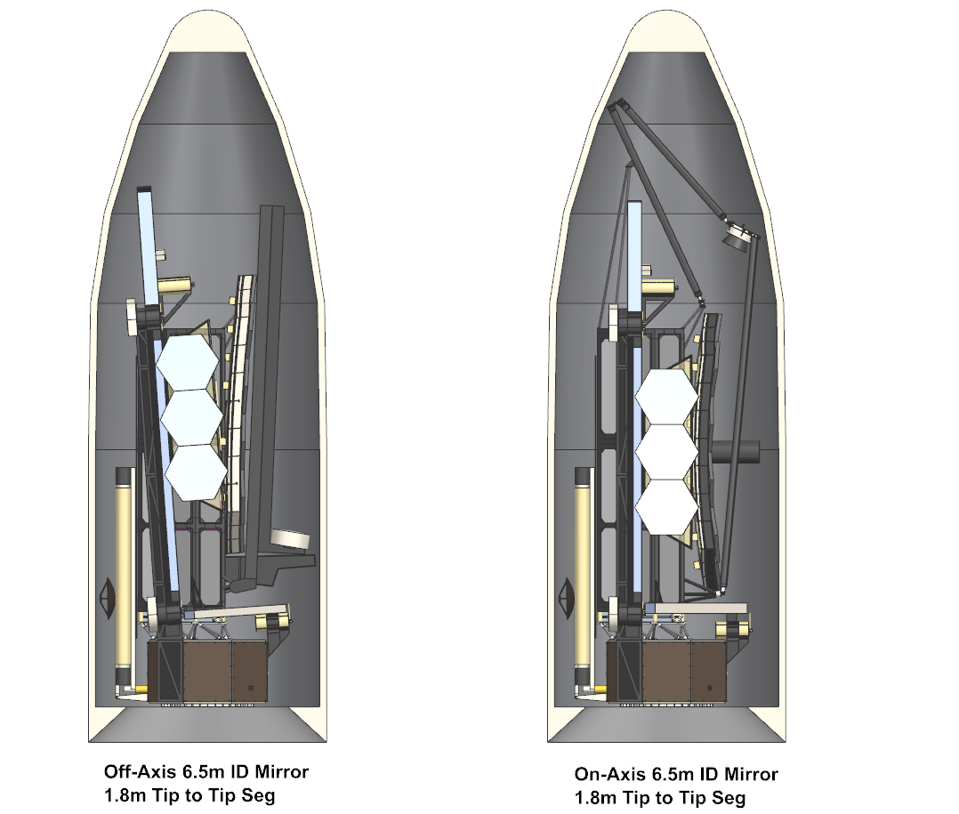
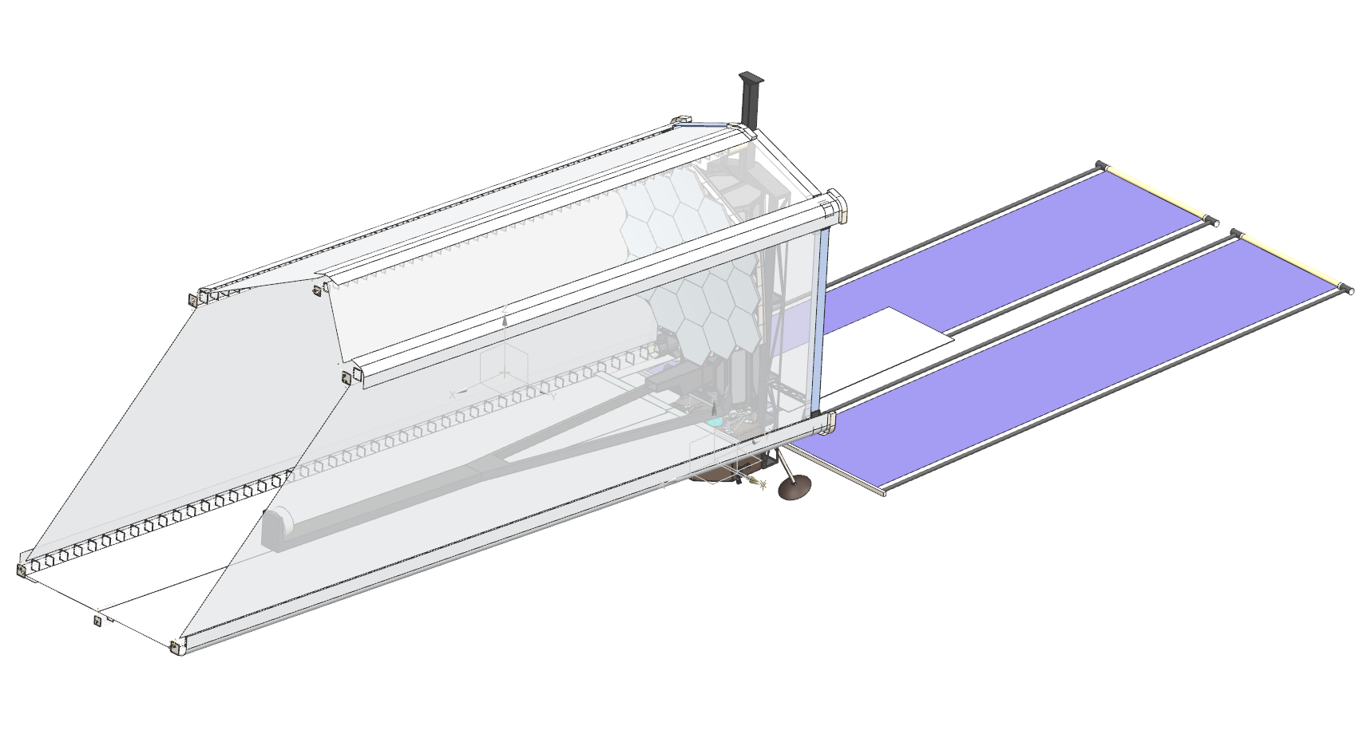
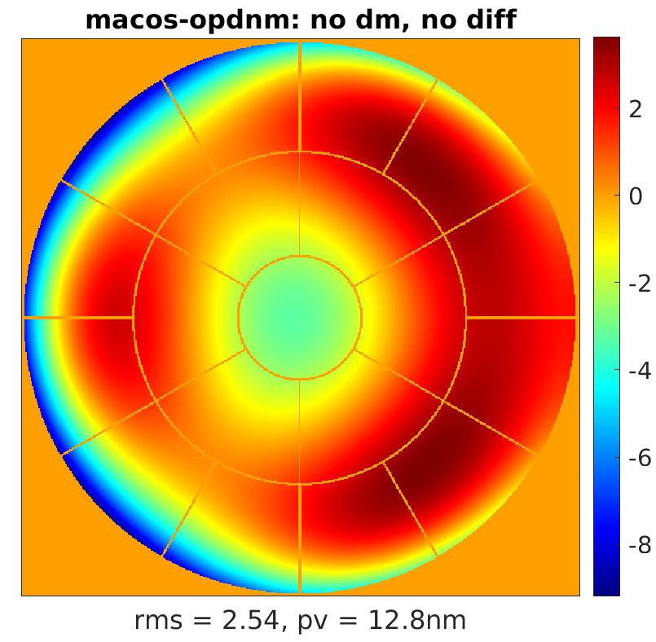
Sensing and Control, For Hex and Keystone Segmentation
Starship Standard
New Glenn Shown (Starship is wider so fits easier)
Starship Long shroud
7.5m (295”) dia
21m
13.3m
6.5m (256”)
Hex segmentation for a fully-deployed architecture alternative
  Fits in SLS, Starship, New Glenn
Keystone for a non-deployed
architecture alternative
  Requires SLS or Starship long shrouds

Slide 10
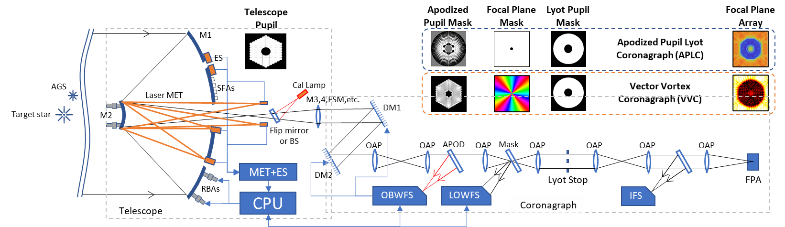
Sensing and Control Elements
  OTA:
    Rigid Body Actuators (RBAs) for segments and SM
    Surface Figure Actuators (SFAs) for segments
    Edge sensors (ES)
    Laser metrology (MET)
    Fine Steering Mirror
    Calibration lamps / artificial guide stars (AGS)
    Electronics and computers
Coronagraph:
  DM1 and DM2
  Fast Steering Mirror
  Out-of-band wavefront sensor (OBWFS)
  Low-order wavefront sensor (LOWFS)
  Electronics and computers

Slide 11
What We’ve Been Up To
S&C group has heard about telescope and coronagraph S&C SOA from a sequence of excellent talks. Thanks to Laurent Pueyo, Bob Reasenberg, Feng Zhao, Mark Colavita and Chris Shelton, Becky Jensen-Clem and Kent Wallace, Olivier Guyon, Garreth Ruane, and Ilya Poberezhskiy
Telescope pose sensing and control discussions included:
  Weakly resonant PDH laser metrology, for use in optical edge sensing
    Approach has potential for <1 pm performance for the basic measurement
    Flight compatible implementation not yet developed ➔ Tech Gap
  Classic heterodyne laser metrology laser truss to measure the full OTA poses
    SIM project demoed pm sensitivity using large devices
    Small devices developed for telescope applications demonstrated at ~ 1 nm, with pathways open to better performance ➔ Tech Gap
  Capacitive edge sensors designed for TMT
    Measures gap as well as piston
    Avoids interleaved structures
    nm level performance now; perf can be improved; not being studied for HWO application
  ULTRA team has been developing Capacitive Edge Sensors for HWO…. ➔ Tech Gap
    Getting close to requirements on single edge sensor
Metrology system configuration design using telescope models → next slide

Slide 12
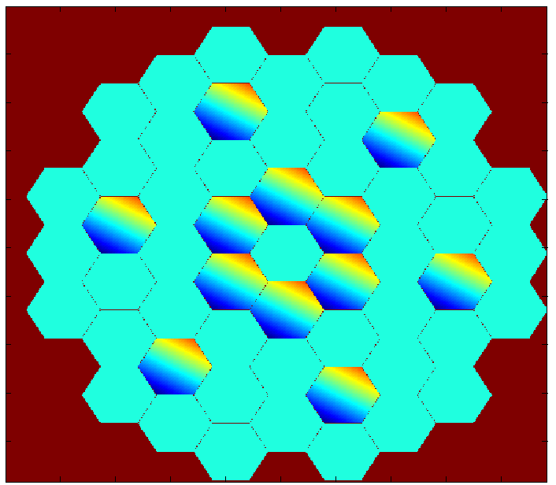
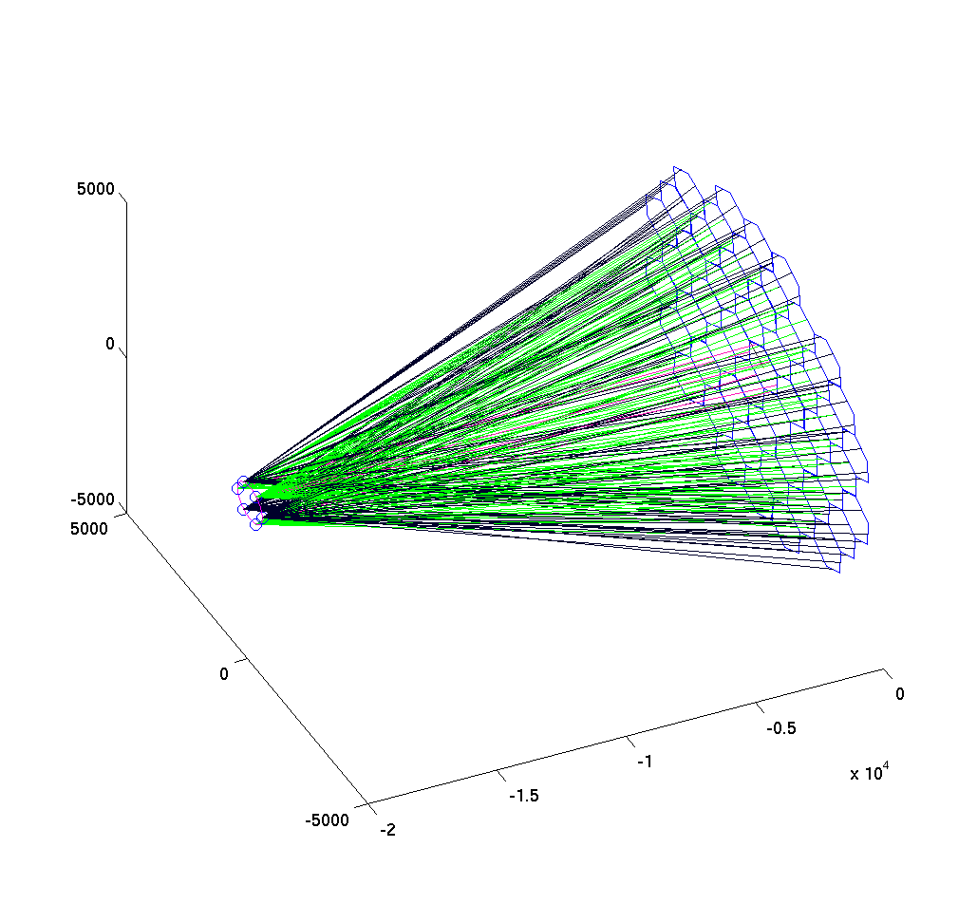
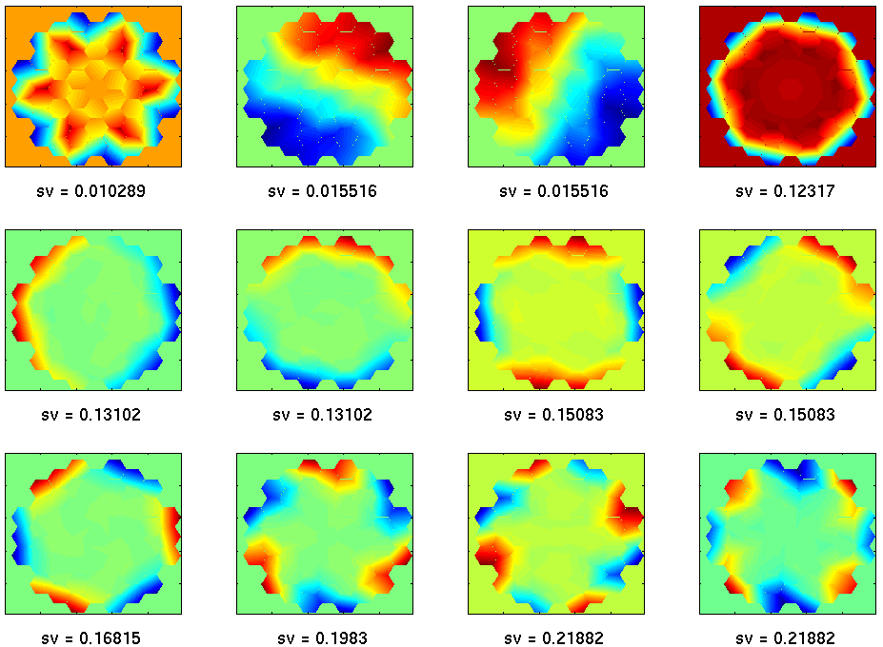
Telescope MET Example: Hex Segmentation
Hybrid configuration, with ES on all 55 segments, and Laser Met on 12 segments
LUVOIR B Primary Truss Metrology Model
55 PM segments, 6 BL per segment, 6 CC locations near m2. Shown: metrology beams on all segments
Edge Sensors were added between each pair of adjacent segments, 2 per edge. Each sensor measures 3 DOF:
Segment-to-segment edge piston
Segment gap
Segment shear
Sensor accuracy does not need to be 1-10 pm in each DOF, though it does in the piston DOF
Configurations are compared using a “wavefront error multiplier” (WEM) metric: the sensor error-to-wavefront error sensitivity
MET-only WEM is 4.9
  → σ_{MET} < 2 pm for 10 pm WFE
Hybrid MET-Edge Sensor WEM is 2.19
  → σ_{MET} < 5 pm for 10 pm WFE
Edge Sensor-only configuration does not observe the SM and PM together
Average Wavefront Error Multiplier (WEM) = 2.19
Analysis by John Lou
Weak eigen-modes of the hybrid sensor configuration

Slide 13
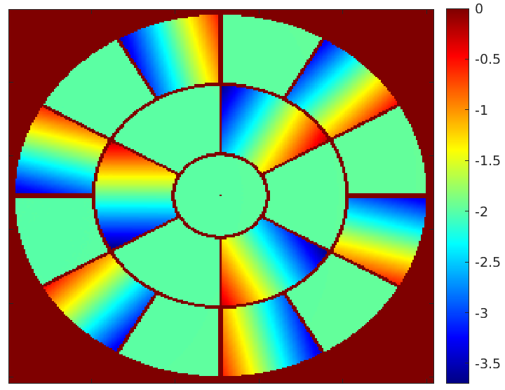
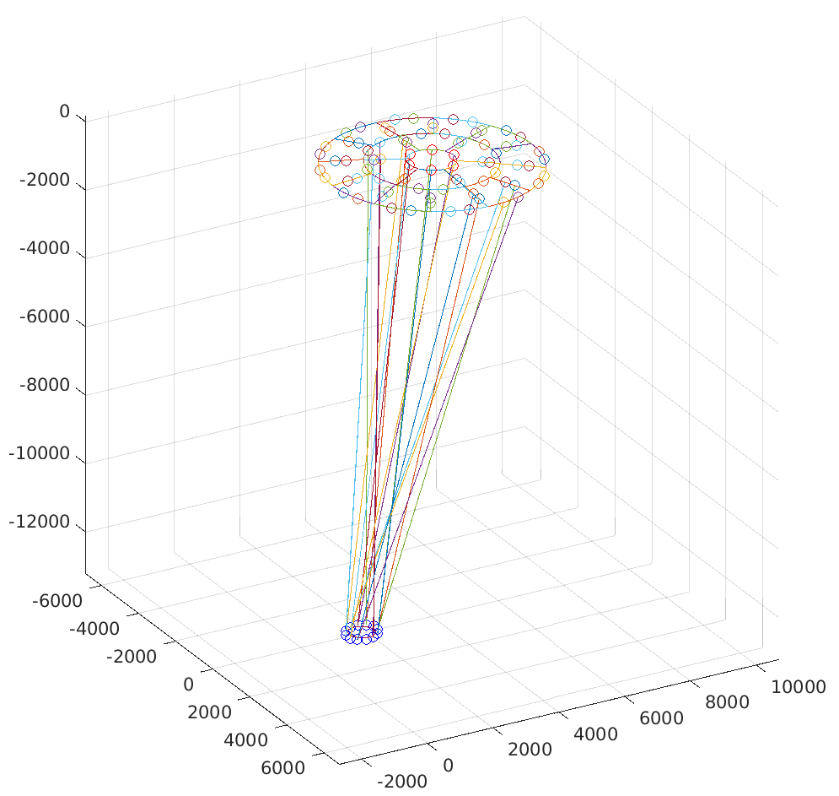
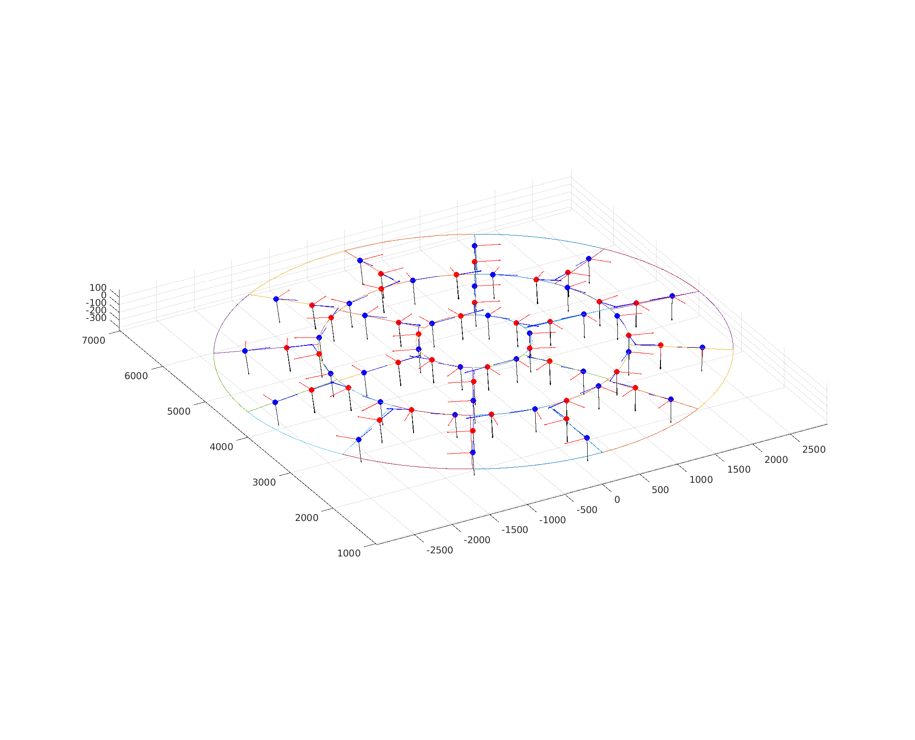
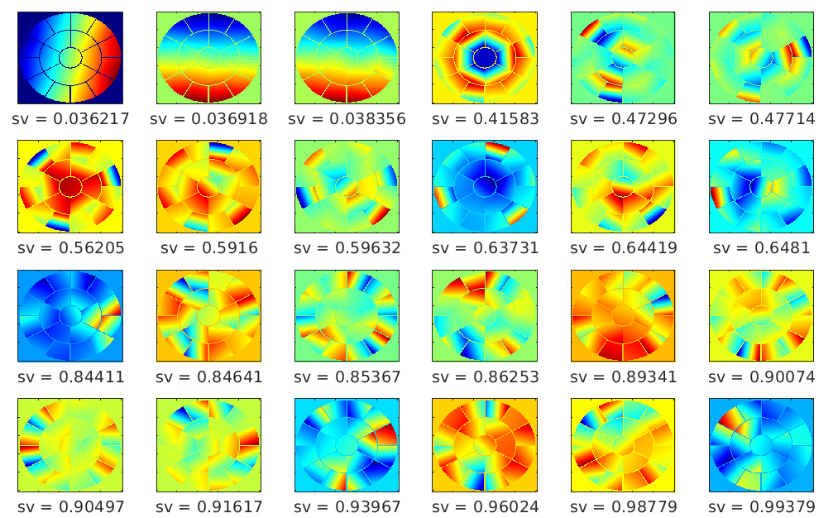
Telescope MET Example: Keystone
Hybrid configuration, with ES on all 19 segments, and Laser Met on 9 segments
6MST Primary Truss Metrology Model
19 PM segments, 6 BL on each segment, 12 CC locations near m2. Shown: metrology beams on central segment; one segment on inner ring; one segment on outer ring
Edge Sensor local coordinate frames
generated at each sensing spot. Each sensor measures segment-to-segment edge piston, gap and shear
Average Wavefront Error Multiplier (WEM) = 2.0
In this example, the sensor error-to-wavefront error (WFE) multiplier (WEM) is 2, for PM-to-SM control
This implies ~5 pm sensor error per sensor measurement will lead to ~<10 pm WFE contribution
mm
mm
Analysis by John Lou
Weak eigen-modes of the hybrid sensor configuration

Slide 14
On the coronagraph side…
Keck on-sky Zernike WF sensing is providing a new mode for segment phasing
  With work, could be useful for demonstrating functionality for HWO
Results using ZWFS on DST are encouraging
  Demonstrated pm sensitivity – but very long integrations are required
Model and error budget validation on CGI has developed important new practices
  Analytic and computational models used and validated
  Excellent references – Krist, Nemati, Kern on CGI, and Coyle for HWO
  Most useful approach uses e2e computational models, with MUFs to match measured performance
Lessons from OBWFS modeling
  Controlling the full electric field (WF and amplitude) using 2 DMs provides better performance than controlling WF only
  An internal light source can be used for high spatial frequency, high BW stabilization of the back end, using both DMs
  Together with the telescope control, this offers a path for end-to-end active stabilization
PSF estimation and subtraction using WF sensing could be very powerful
Out-of-Field WFS, using a separate camera – Alden’s talk today!

Slide 15
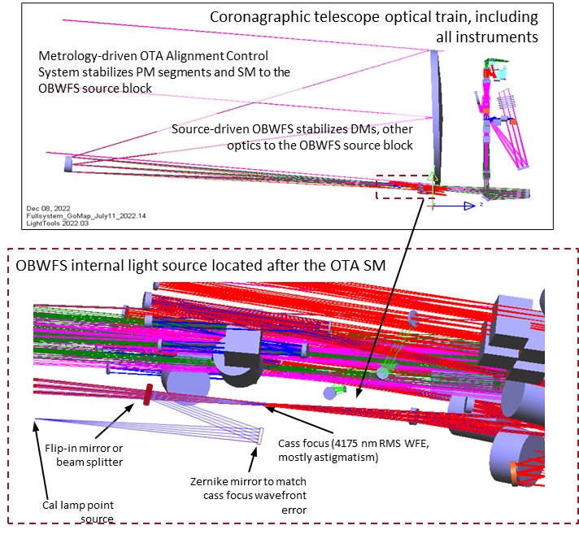
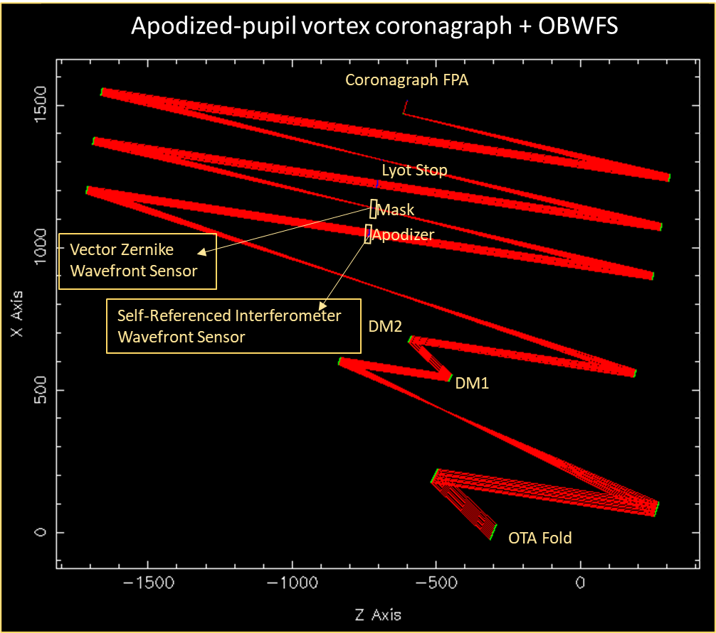
Example: Coronagraph + Out-of-Band WF Sensor (OBWFS)
Out-of-Band WF sensors can measure the full complex field at the Coronagraph entrance pupil, and drive both DM1 and DM2, for best contrast control

Slide 16
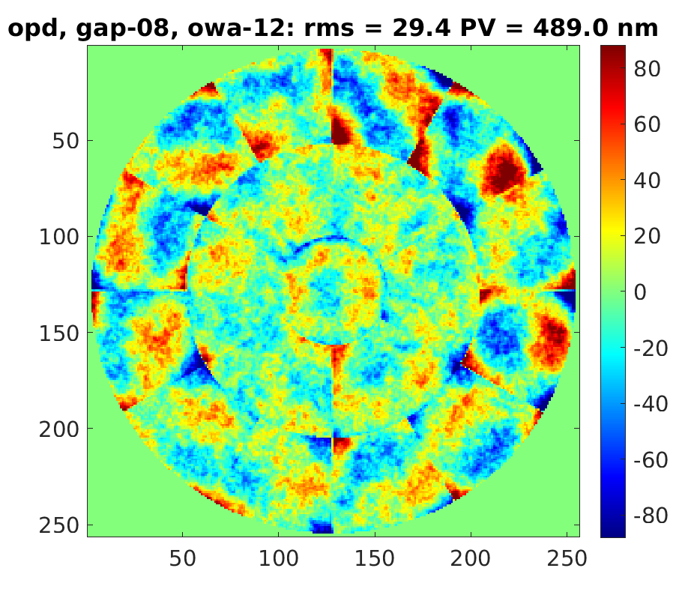
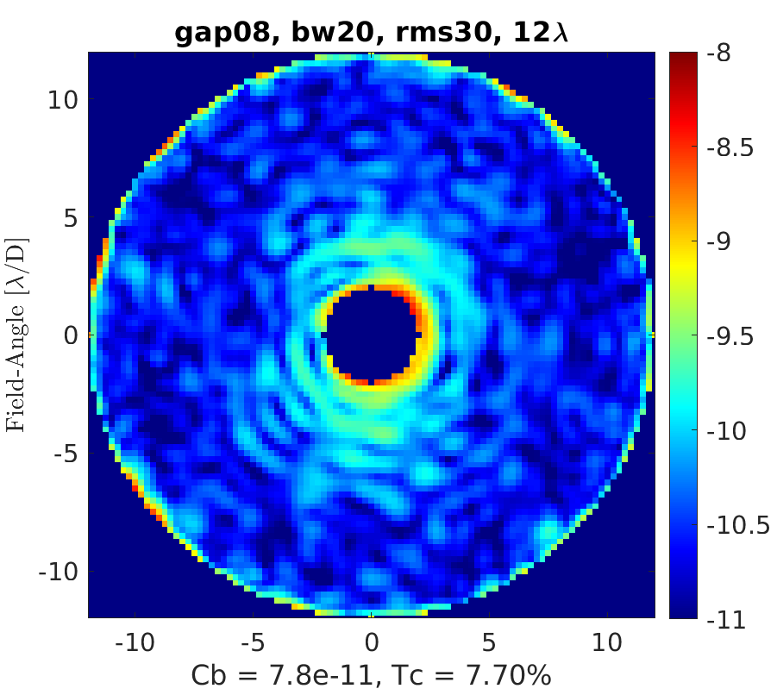
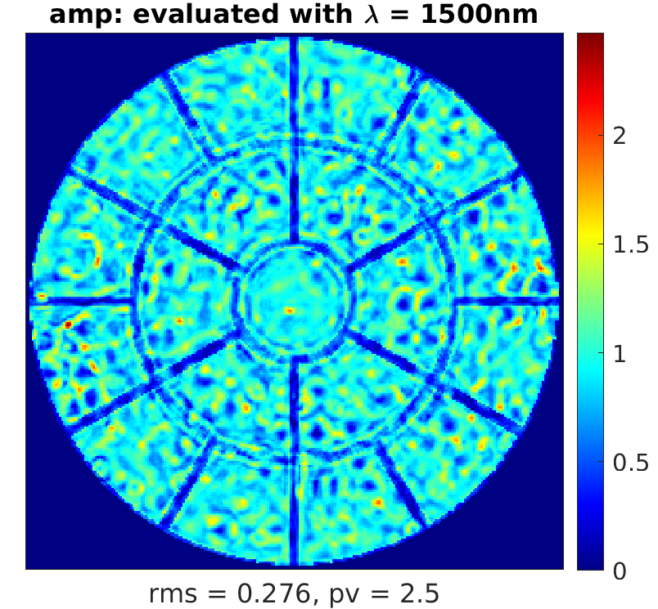
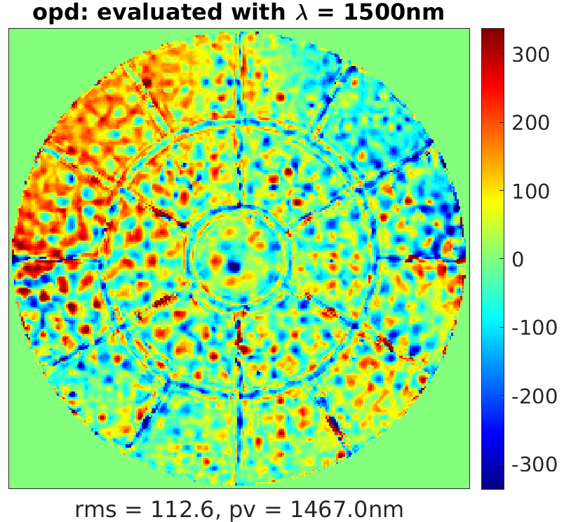
Example: Stabilizing Coronagraph Contrast, Using
Out-of-Band WF Control
Starting with 30 nm WFE, the coronagraph digs a dark hole, with 20% bandwidth at 500 nm wavelength
The resulting amplitude and phase are measured at 1500 nm wavelength – and become the control targets for OBWFSC

Slide 17
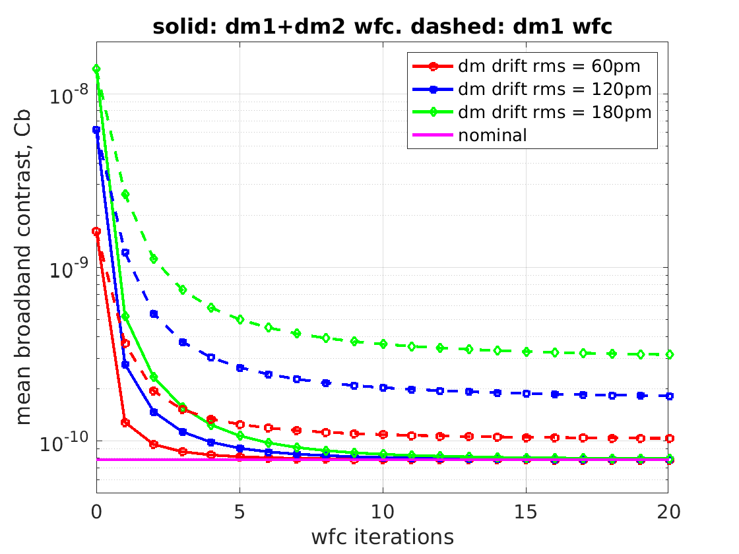
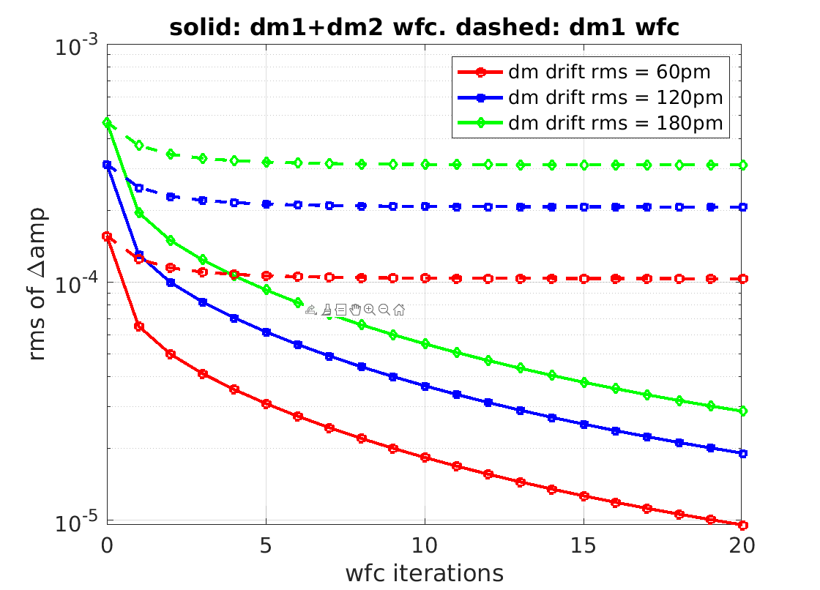
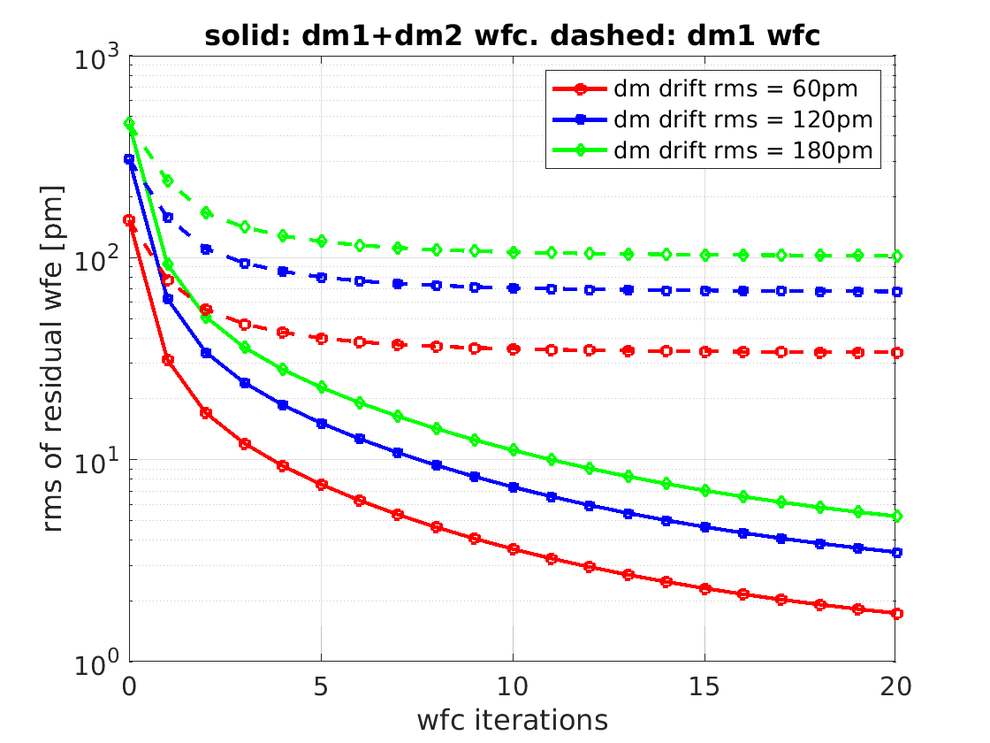
Two Control Methods
  Control using DM 1 (only) does not recover full performance
  Control using DMs 1 and 2 does recover full performance
→ Measure the full field
DM errors are injected: DM drift, or a stale go-to target, etc.
Then OBWFSC attempts to restore the coronagraph field, 2 cases:
  Control using DM 1 (only) to maintain the coronagraph wavefront
  Control using DMs 1 and 2, to maintain the coronagraph electric field
DM 1 control
DM 1 & 2 control

Slide 18
Sensing and Control Key Tech Gaps
Metrology, including laser truss and edge sensors
  Measurement accuracy
  Measurement stability
OTA Control: various architectures
  Rigid body control
  Segment mirror figure control
Coronagraph OBWFSC
  Spatial and temporal BW, with natural GS and internal source
  Full electric field control

Slide 19
Science target
Sensor
Science path
LGS
Out-of-field WFS source
Actuator
LOWFS path
Estimator/
Controller alg.
Commands/data
OTA PM/SM
Instrument Optics
FSM
DM1/DM2
Science FPA
ZWFS
RBA controller
Rigid body actuators
Laser metrology
WFS FPA
Edge sensors
OBWFS source
FSM Controller
High spatial, high frequency (100 Hz)
Tip/tilt, high temporal (1 kHz)
OTA Controller
FGS, accels, RWA telem, etc.
Electric Field Controller
Instrument E. Field
(1–10 Hz)
ZWFS/
OBWFS
Low spatial, low temporal (1-10 Hz)
Low spatial, high temporal (100 Hz)
OOF WFS
High spatial, low temporal (0.01 Hz)
HOWFS
Low spatial residual feed-forward (100 Hz)
E. Field Setpoint
MET temps, PRTs, etc.
PM/SM offload
(1 Hz)
Large capture range OTA WFSC
OTA pose setpoint (1 Hz)
Optimal OTA pose (as needed)
Telescope
Instrument
Wavefront telemetry downlinked for post-processing

Slide 20
Degree of freedom control matrix
Purpose: identify instabilities across observatory and identify which technologies/approaches can be used to minimize those instabilities
Identify technology gaps, especially for critical components
Determine gaps for critical instabilities

Slide 21
Temporal frequency at which the instability could occur
Spatial frequency of error that the instability could impart
Sensing & control systems/technologies for HWO
Likely contributors to instability in the system
Critical
Filled boxes = how technologies address instabilities
Green = no technology gap
Blue = technology gap to be filled

Slide 22
Previous example was just a small part of full matrix
Subsystems: Primary Mirror Backplane, Primary Mirror Segment Assembly, Secondary Mirror Assembly, Secondary Mirror Support Structure, Aft optics, instruments, thermal management system, ACS, barrel, high gain antenna, wavefront sensors, etc.
Technologies = Primary and secondary mirror actuators, edge sensors, laser metrology, various wavefront sensors, deformable mirror, PSF calibration, coronagraph, fast steering mirror, thrusters, vibration isolators, active thermal mirror, etc.

Slide 23
Primary Mirror Segment Assembly

Slide 24
Obs-ACS-SE Working Group Status (1 of 2)
The group has filled in its metrics matrix using information from:
  LUVOIR-B
  RST
  JWST
  Disturbance Free Payload (DFP) Demonstrations
  HST
Mass metrics / allocations were established from JWST and LUVOIR-B and allocations were based on compatibility with anticipated capabilities of Starship and New Glenn Launchers.
  Allocations based on a New Glenn capability of 15,000 kg
  Stowed volume was also determined from these launchers.
Observatory Line of Sight and WFE stability strawman allocations were taken from the ULTRA Team Stability Budget Summary presentation by Laura Coyle, Scott Knight and Paul Lightsey dated March 31, 2023.
  LOS stability of 0.3 mas
  WFE stability (misalignment) ~ 10 pm
  Wavefront Stability 38 pm
Observatory stability metrics assumed the use of the DFP vibration isolation system and have margin relative to the LOS and WFE needs. However, this system is at the demonstrator level, rather than flight.
  The group reviewed a presentation on the DFP and its pointing and WFE stability performance, “Derived HWO-Scale Observatory Point Design, Design Guidance and Roll-Up of LOS and WFE Error Contributions under Steady State Observation”
  This system has constraints on the ”stiffnesses” of harness and other hardware that cross the Spacecraft to Telescope interface

Slide 25
Obs-ACS-SE Working Group Status (2 of 2)
The resource budgets (mass and power) include the option for Control Moment Gyros (CMGs) versus Reaction Wheel Assemblies (RWAs). There are advantages to either of these options that should be carefully traded.
  RWA based system will probably not achieve slew times desired from LUVOIR-B requirements, but could achieve JWST-like slew times (90 deg in 60 min)
The power subsystem will leverage LUVIOR-B which in turn leveraged International Space Station (ISS) heritage.
  Maximum of power load 23,000 watts
  The power allocations for thermal control were taken from the LUVIOR-B design which envelope power needs for a “Barrel Design” rather than a planar sunshield.
Science data through-put and storage needs were driven by estimates for coronagraphic PSF calibration. Estimate assumed continuous calibration data collection from 512 x 512 pixels, 8 bits each at 10 Hz for 48 hours.
  Data downlink rates were estimated assuming ground contacts every 12 hours and fell within the capabilities of the RST communication subsystem.
    RST Ka-Band communication system capability 500 Mbps at L2 Halo Orbit using a 70 Watt TWTA and 1.8 m HGA
Molecular contamination loss allocations (3% per optical surface, 1216A) were taken from the HST STIS instrument.
  This area will require further investigation and trade studies.
The group has discussed integrated modeling processes and will be investigating the best way to structure performance budgets to be compatible with allocations and performance assessments using these models.

Slide 26
Mirrors/Thermal/Coatings (MTC): Status
Technologies needed to produce stable mirrors for HWO are not far from reality. However, the challenge is to develop an integrated mirror assembly and demonstrate at a (sub)system-level the stability required for the mission.
  Stable Mirror metrics/capabilities are heavily depended on the systems-level flow-down ‘requirements’, such as mass-allocations (ie: launch-vehicle), telescope architecture, and error budget:
    As an example: Mirror assembly architecture with/without surface figure actuators will drive the required stiffness based on the mirror spatial distortion
        Then that drives the mirror areal-density. But must be within the mass and power (mirror heaters) allocation based on the launch vehicle selection.
          The areal density will drive the optical performance stability with thermal control capabilities.
  Coatings
    Most of the coating requirements (reflectance over wavelength) are ‘demonstrated’ but will need to demonstrate scalability (SOTA: 50mm x 50mm coupons with 10Ang micro-roughness but need to demonstrate on a full scale with ROC)
  Component interfaces
    Positional stability of Mirror bonds, active control metrology devices, thermal sensors, etc. over temporal frequency will carefully need to be analyzed and then verified.
  Develop Testbed Demonstrators
    Develop competitive ‘design’ down-selection process
      Start with model-based trade-studies. Integrated models will need to predict the performances with high accuracy and confidence. Higher resolution material properties will be needed for this.
        Then develop competitive small-scale hardware demonstrations.
          Then develop full-scale Testbed for TRL 5/6 Stable Mirror Demonstrations.

Slide 27
Status
Summary
Team Members
Developed metric categories for PM BP, SMSS, and Baffle
  Most of the meat is at level 4
Documenting findings in Combined Metrics spreadsheet
  ~80% complete
Significant contribution from team members
  Thanks!
Useful and Informative interactions with rest of the teams
  Hopefully represented in the content
Name | Organization
Alphonso Stewart | NASA/GSFC
Austin Van Otten | NGC
Brandon Chalifoux | UofA
Brian Childs | JPL
Case Bradford | JPL
Charlie Atkinson | NGC
Joe Pitman | Helio Space
Marc Roth | NGC
Marcel Bluth | KBR
Mike Eisenhower | SAO
Paul Reynolds | NGC

Slide 28
Notable Outcomes
Technology Gap Triggers
Category | Trigger
CTE Control – Tolerance and Uncertainty | <1x10⁻⁸ strain/K at flight piece part acceptance testing
CME and Creep Control – Strain rate after Dryout time | <1x10⁻¹⁰ strain/hr within 60 days after launch
Wing and SMSS deployment repeatability | Engineering unless mass and envelope limit latch count on each hinge line
PMBA and SMSS Thermal Control | < 1 mK variation limit
Baffle deployment | Deployment of sections are synchronized Deployed sections physically interact/interface
Analysis Models | < 5 nm deformation prediction uncertainty
Recommended Studies
Category | Activity
PMBA/SMSS Temp Control and CTE Control Interaction | Balance project elements. Understand interaction.
PMBA/SMSS Temp Control Architecture | Sensor count, placement, and sampling rate High sampling rate (> 1 Hz) could drive architecture
PMBA Structural Architecture | Tube/frame versus Panel – revisit JWST study
Baffle IML Thermal Control | Determine if required and if so, define the metrics.
PMBA Wings and SMSS Deployed Stiffness | Track regularly to keep CTE, mass, and f_{n} in solution space
Micrometeoroid Shield | Analysis to confirm # of layers

Slide 29
In progress work
Refine technology gap identification
  Add TRL level for each technology
Identify which technology gaps are in active development and note industry partner
Complete similar matrix for verifications + facilities to determine cross-section of testbed facilities needed over the next few decades

Slide 30
Key findings from team to date
Detailed mission technology roadmaps are architecture-dependent, which is not yet defined for HWO. Roadmapping activities at this early stage consider bounding performance needs and potential approaches/technologies based on current best understanding.
Important to be holistic in our approach. It’s not just about TRL, but also about Concept Maturity Level (CML) and Manufacturing Readiness Level (MRL).
Important to think in terms of system engineering starting with Level 0/1 requirements like rocket options we want to support and science drivers
The biggest priority to refine technology roadmaps is architecture evaluations derived from modeling and simulation to develop error budgets and specs that we believe in. This needs to be a real priority next year.
  Calibration method needs to be folded into the error budget and could significantly relax requirements
Baffle complexity is turning out to be an important consideration in the overall architecture
  Total length could be 22 meters for an off-axis telescope!
Decision on rocket compatibility can drive mass allocations, deployment needs
Testbeds are key to validate models and to help characterize control loop interactions for overall performance and for a tiered sensing and control system operating at various spatial and temporal bandwidths.
  Need subscale (eg, 3 segments) testbeds, both ultrastable/vacuum and ambient

