Slide 1
Systems Considerations for HWO
Lee Feinberg, GSFC

Slide 2
First steps
Before we “dive in” to defining GOMAP science and technologies and architectures, it’s helpful to take a step back and think about how do this right
Most important, we should try and follow good system engineering processes so we do things in the correct order
A good starting point is to review NASA’s official documentation on how to do system engineering, the System Engineering Handbook…

Slide 3
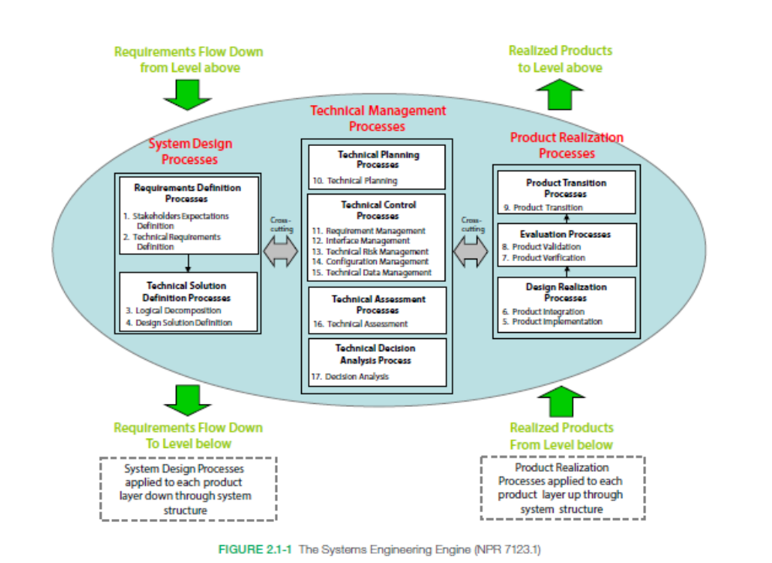
NASA System Engineering Handbook Process

Slide 4
First steps
The first steps are:
  Stakeholder expectations
  Technical requirements
Stakeholders:
  NASA headquarters defines key top level contstraints
  To some level, this has started with HWO Big Picture
  Needs to include input on cost, schedule, rocket assumptions, international assumptions
Technical Requirements
  Collaboratively established between scientists and engineering teams

Slide 5


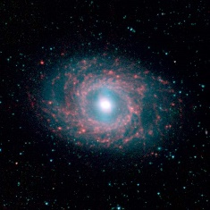
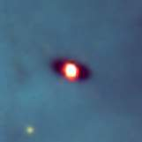
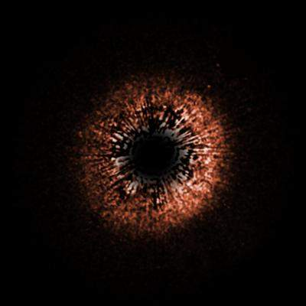





Example Product for Technical Requirements: JWST Science Themes Linked to L.1 Requirements
First light and
reionization
The assembly of galaxies
Birth of stars and
proto-planetary systems
Planetary systems and the origins of life
First Light and Re-Ionization
Assembly of Galaxies
➠
L1-1: 5.1.1.1 Density of Galaxies Measure the space density of galaxies to a 2 μm flux density limit of 1.0 x 10⁻³⁴ Wm-2Hz-1 via imagery within the 0.6 to 27 μm spectral band to enable the determination of how this density varies as a function of their age and evolutionary state.
➠
L1-2: 5.1.1.2 Spectra of Galaxies Measure the spectra of at least 2500 galaxies with spectral resolutions of approximately 100 (over 0.6 to 5 μm) and 1000 (over 1 to 5 μm) and to a 2 μm emission line flux limit of 5.2x10⁻²² Wm⁻² to enable determination of their redshift, metallicity, star formation rate, and ionization state of the intergalactic medium.
First Light and Re-Ionization
Assembly of Galaxies
Birth of Stars and Protoplanetary Systems
Planetary Systems/Origins
➠
L1-3: 5.1.1.3 Physical & Chemical Properties of Young Stellar Objects Measure the physical and chemical properties of young stellar objects, circumstellar debris disks, extra-solar giant planets, and Solar System objects via spectroscopy, and imagery within the 0.6 to 27 μm spectral band to enable determination of how planetary systems form and evolve.
First Light and Re-Ionization
Assembly of Galaxies
Birth of Stars and Protoplanetary Systems
Planetary Systems/Origins
➠
L1-4 : 5.1.1.4 Observing Time Enable, within a 5-year mission, a total observing time of at least 1.1x10⁸ seconds on targets located at any position on the celestial sphere.

Slide 6
What might a system process look like?
START:
Science Definition and Traceability
DRM, Science Questions and Themes, Traceability Matrix, etc
Level 0 Guidance:
Rockets Assumptions
Cost and Schedule
Heritage Assumptions
Etc.
Science Analyses (eg, Yield): Parametrics and Point Design Studies
NASA HQ/GOMAP
Science Requirements
(L.1, L.2)
Point Design 1:
Integrated Models, Error Budgets
Tech Roadmaps
Level 0 Guidance:
Rockets Assumptions
Cost and Schedule
Heritage Assumptions
Etc.
TAG:
Engineering and Science Analysis
GOMAP
Products
Point Design 2:
Integrated Models, Error Budgets
Tech Roadmaps

