Slide 1
San Joaquin Valley Health & Air Quality
Evaluating the Overlap of Social Vulnerabilities and Air Quality in the San Joaquin Valley Air Pollution Control District
Jonathan Szeto • Jasper Beardslee • Piper Christian • Bethany MacCarter • Alma Quintero
Virtual Environmental Justice – VEJ| Summer 2023
Notes:
Speaker notes:
Hello everyone, we are the San Joaquin Valley Health and Air Quality group based out of the Virtual Environmental Justice node. Our teams are [goes around naming teammates] and the title of our presentation is Evaluating the Overlap of Social Vulnerabilities and Air Quality in the San Joaquin Valley Air Pollution Control District
! I hope you enjoy the presentation.
------------------------------Image Information Below ------------------------------

Slide 2
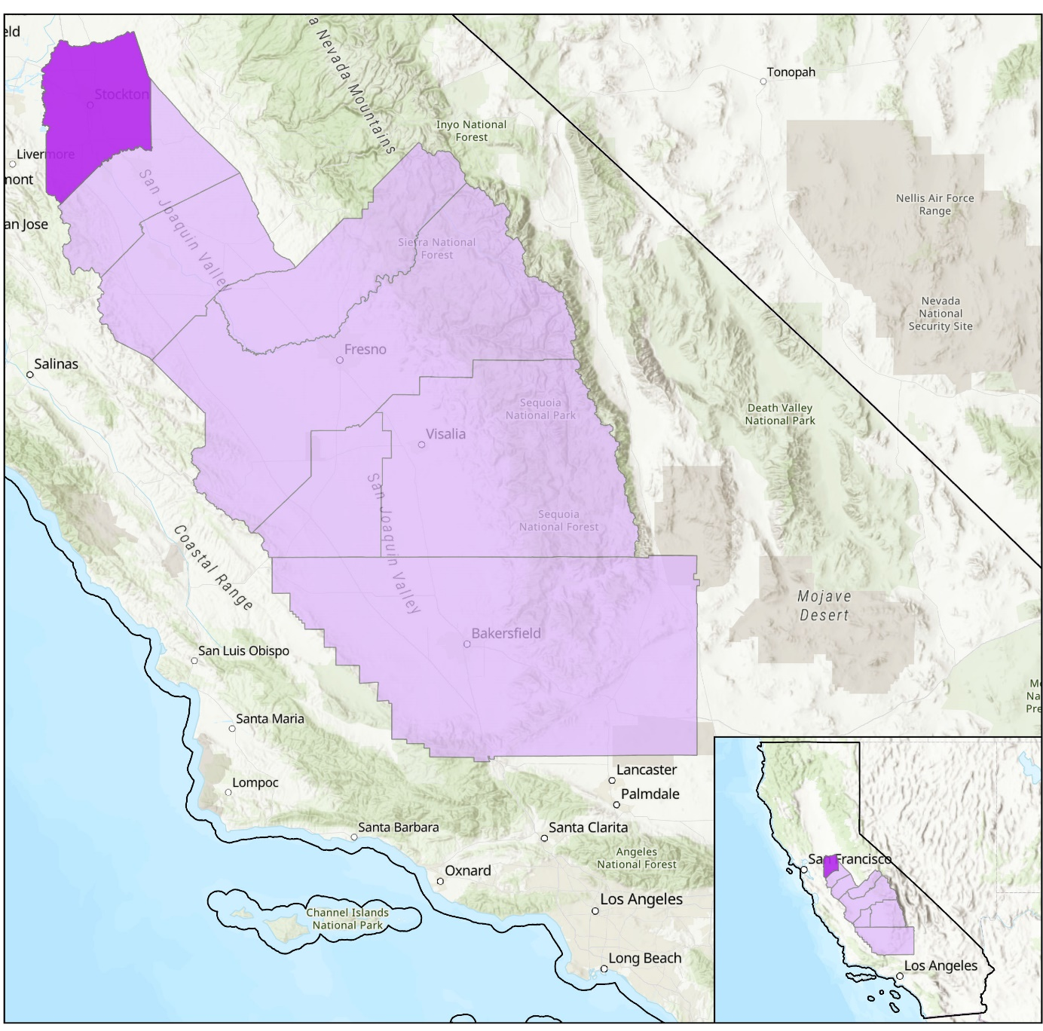


Study Area + Period
San Joaquin County
N
San Joaquin Valley
California
Stockton
Study Time Period
2012 – 2023
Case study of an isolated burning event
Basemap Source: Esri, FAO, NOAA, USGS
0
25
100
200
50
150
Notes:
Speaker notes:
Our study area was the San Joaquin Valley in central California, with a specific focus on San Joaquin County in the northwest portion since this is where our partners were based. Within the valley, there are a total of 8 counties. Our time period is 2012-2023 with some case studies on isolated burning events to compare air pollution on high pollution days and normal days.
------------------------------Image Information Below ------------------------------
Basemap Source: Esri, FAO, NOAA, USGS

Slide 3
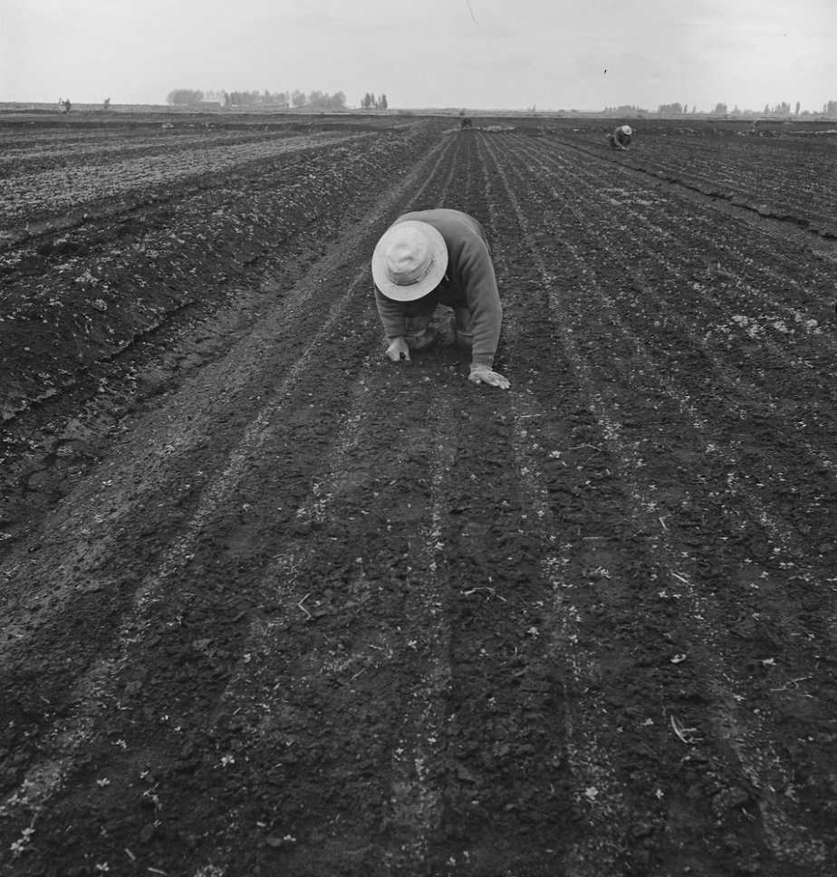
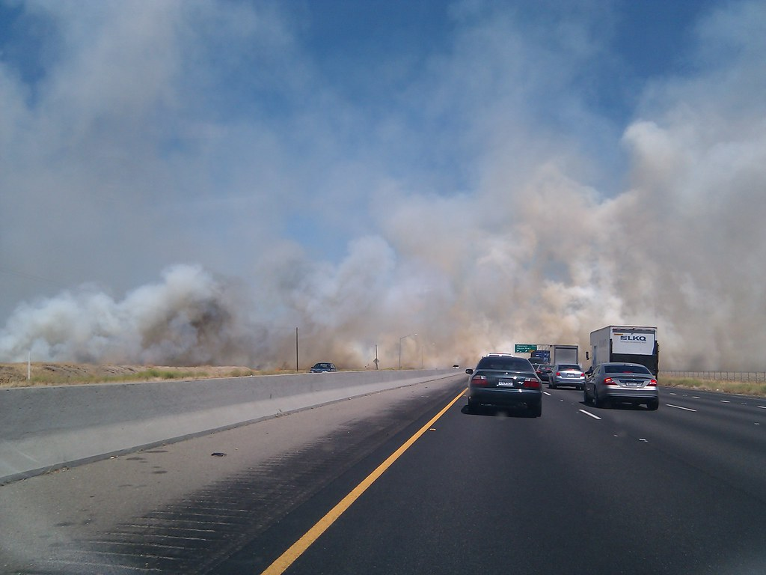
Partner: Little Manila Rising
Nonprofit focused on advocating for equitable solutions to harmful policies
Strong emphasis on environmental justice and health equity
Founded in 2000
Based in Stockton in San Joaquin County
Image Credit: Mark Doliner, anchoreditions
Notes:
Speaker notes:
Our community partner for this project was Little Manila Rising (LMR). LMR was founded in 2000 and is based out of Stockton in San Joaquin County California. While at first founded to bring more attention to the discrimination facing the local Filipino community, the nonprofit now focuses on advocating for equitable solutions to harmful policies that affect all discriminated groups in the county. The group currently has a strong emphasis on environmental justice and health equity given the large amounts of pollution in the Valley.
------------------------------Image Information Below ------------------------------
Image Credit: Mark Doliner
Image Source: https://openverse.org/image/3aa68de0-5308-4fe1-90ea-ab7711539366?q=air%20pollution%20california%20road (CC-BY-SA 2.0)
Image Credit: anchoreditions
Image Source: https://openverse.org/image/3042868d-25bc-4023-8b60-15af054cd30b?q=stockton%20California (Public Domain)

Slide 4



Community Concerns
Community Impacts
Values of
Environmental Justice
Fair and equal treatment regardless of positionality
Holistic and non-reductive
Public Health
Air Quality
Understanding impact on the lives of real people
Community Organizing / Outreach
Everyone is affected differently by environmental issues
Notes:
Speaker notes:
In terms of community concerns, there are three main in which our project helps alleviate community impacts. On the health side, our project helps better understand the public health and air quality issues that are currently affecting the San Joaquin Valley and its residents. With this information, it will allow our partners to improve organizing to advocate for more robust policies to improve health equity. Pursuing projects like this are partner given the value of environmental justice. EJ is important because everyone should be treated equality regardless of positionality and its imperative that we understand how our environment impacts the lives of real people, especially since everyone is affected differently by these issues.

Slide 5




Objectives
Model Air Pollution Distribution Across the San Joaquin Valley
Visualize Disparities in Impact Based on Social Vulnerability
Identify Overlap Between Poor Air Quality and Regional Burning
Validate Remotely-sensed and Ground-based Air Quality Data
Notes:
Speaker notes:
Our project had four main objectives:
Model air pollution distribution across the San Joaquin Valley through time series and exposure maps.
Use both air pollution and social vulnerability data to visual the disparities of impact in the study area.
Identify overlap between poor air quality and regional burning
Validate remotely-sensed and ground-based air quality data.

Slide 6

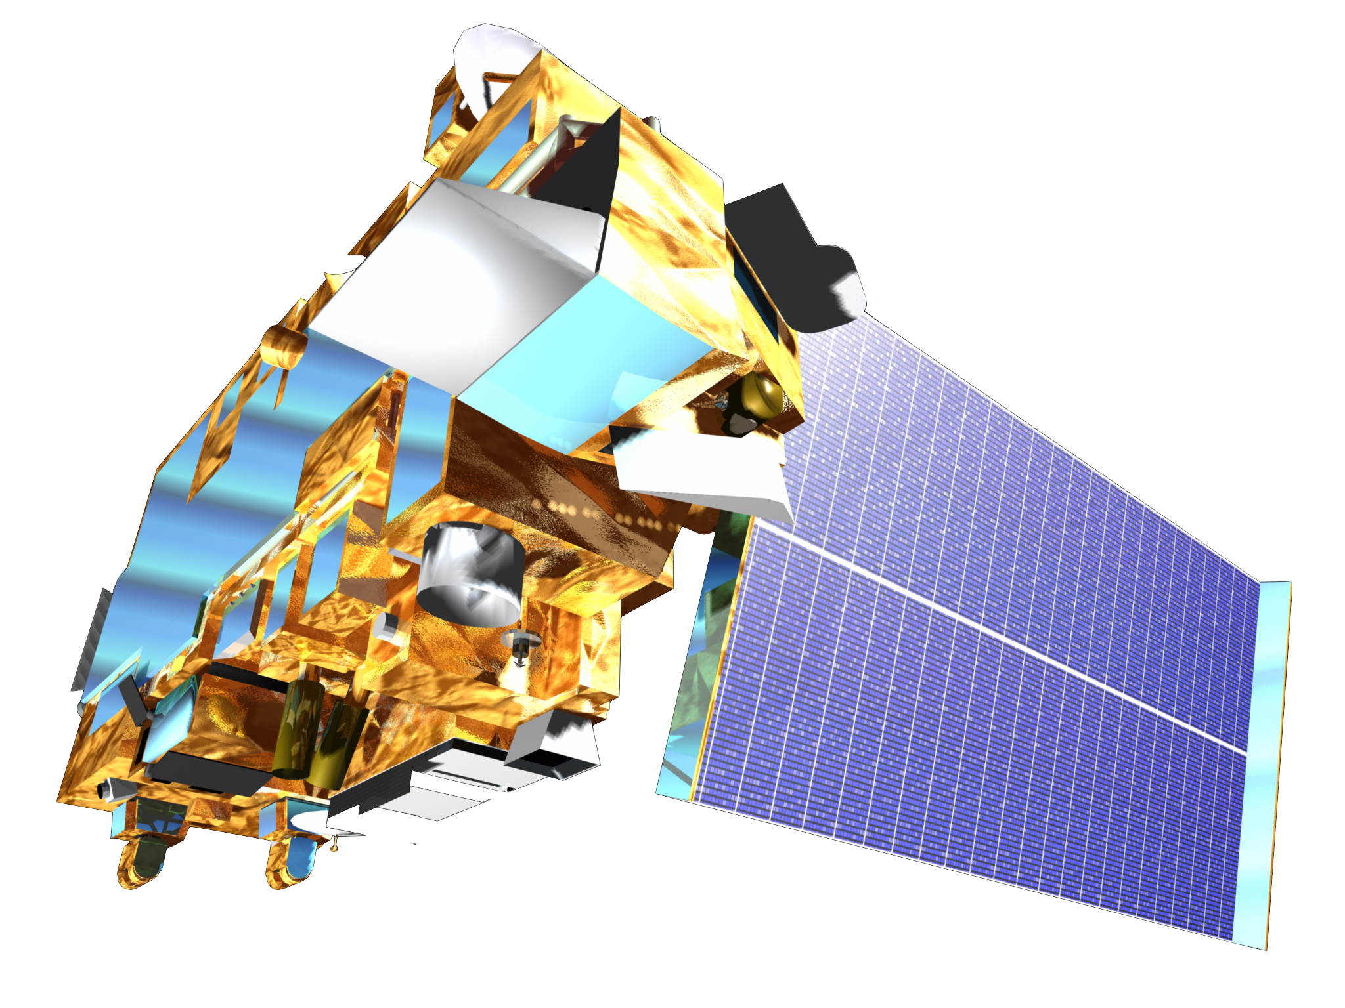

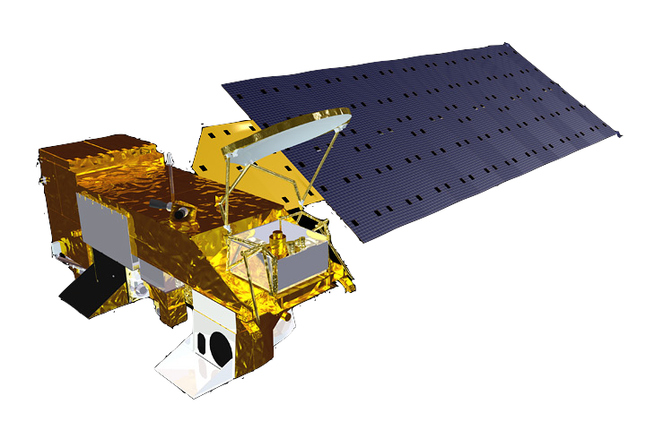
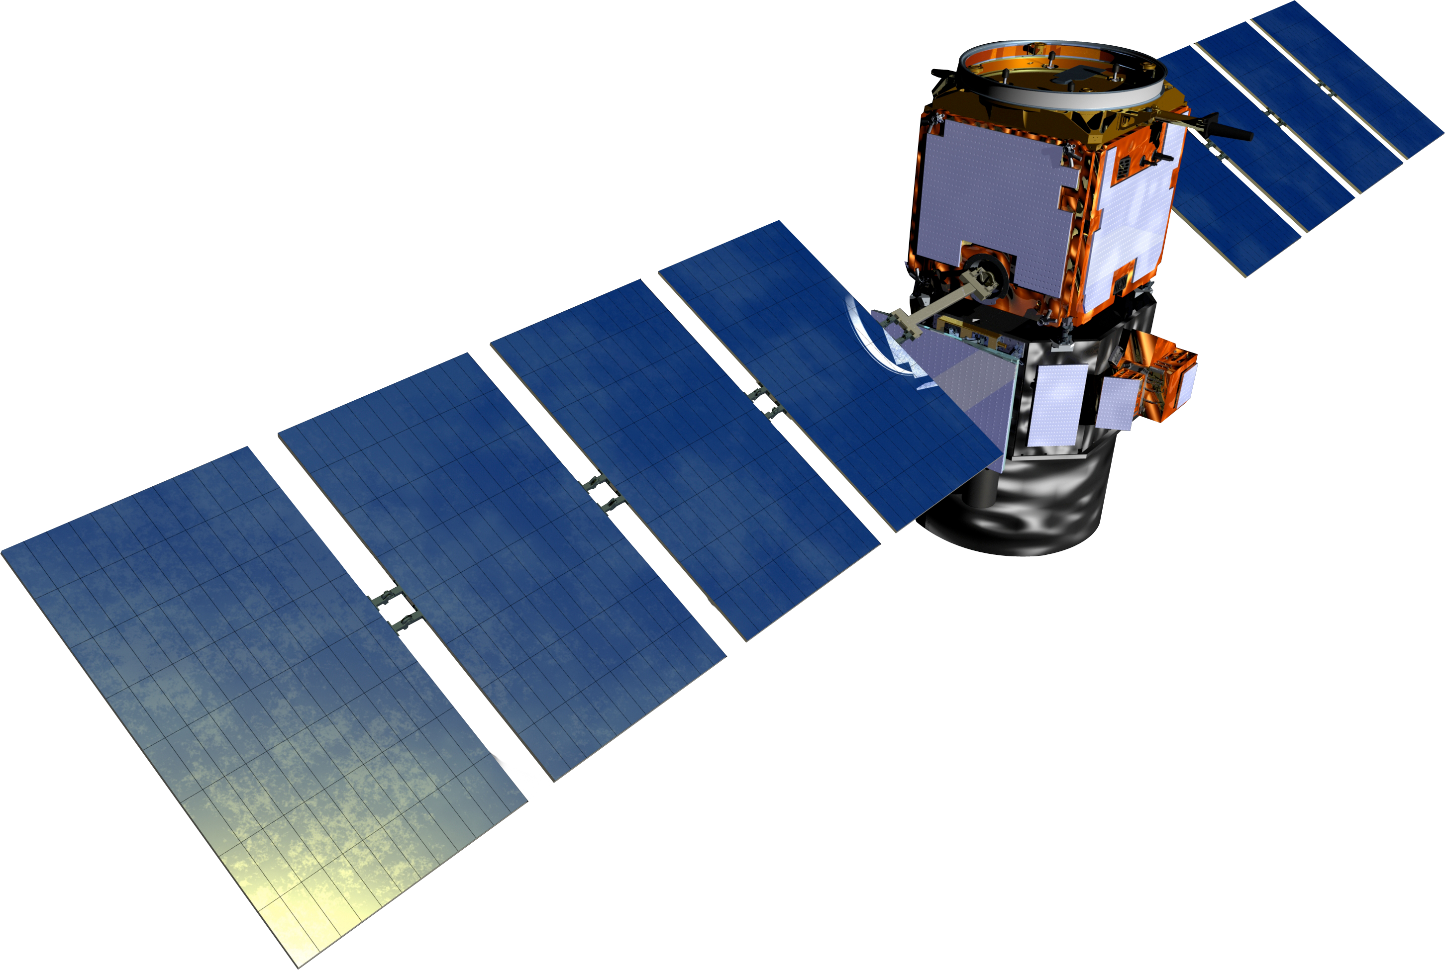
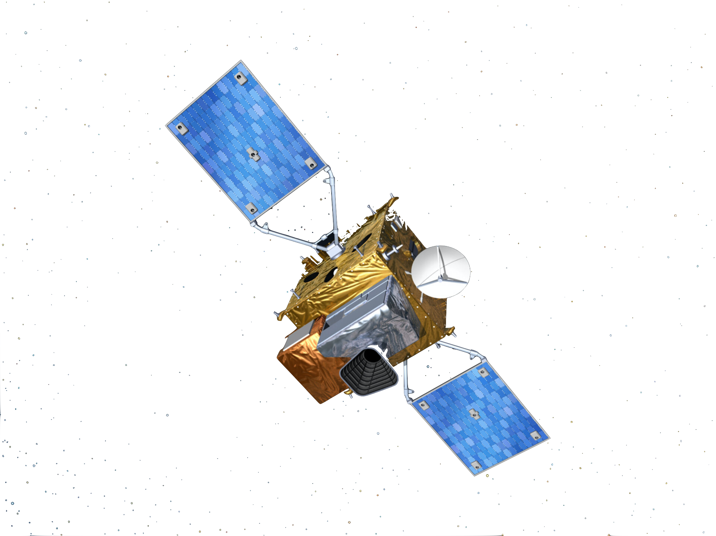
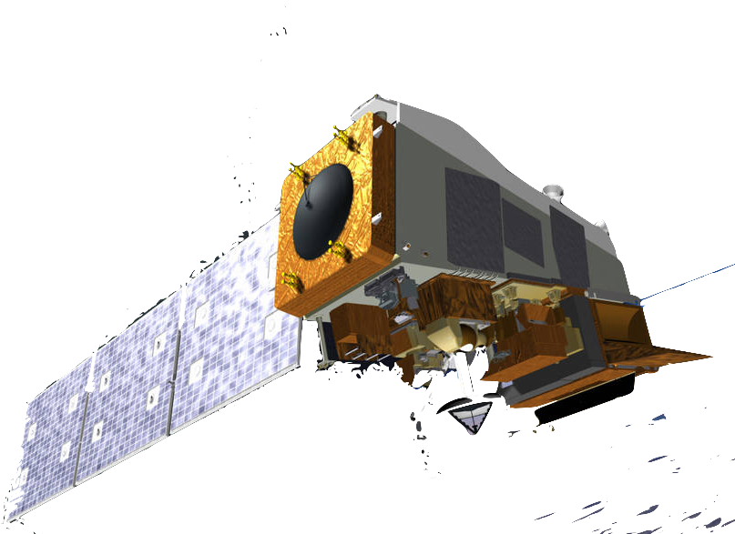
Earth Observations
Terra MODIS
Temporal Resolution: Daily
Spatial Resolution: 1 km
Aerosol Optical Depth (AOD), MAIAC Product
Aqua MODIS
Temporal Resolution: Daily
Spatial Resolution: 1 km
Aerosol Optical Depth (AOD), MAIAC Product
Temporal Resolution: 16-day
Spatial Resolution: 30 m
CALIPSO CALIOP
Vertical Feature Mask (VFM)
Sentinel-5 TROPOMI
Temporal Resolution: Daily
Spatial Resolution: 7 x 3.5 km²
Nitrogen Dioxide (NO₂)
Suomi NPP VIIRS
Temporal Resolution: Twice Daily
Spatial Resolution: 375 m
Active Fire Detection
Image Credit: NASA, ESA
Notes:
Speaker notes:
For our project, we used five satellites and sensors to analyze varying variables of interest. MODIS on both Terra and Aqua were used to calculate Aerosol Optical Depth, CALIOP on CALIPSO was used to create a Vertical Features Mask during our case study date. TROPOMI on Sentinel-5 was used to determine Nitrogen dioxide over our study area, and finally VIIRS on Suomi NPP was used to count the number of active fires in our study area.
------------------------------Image Information Below ------------------------------
Image Credit: NASA
Satellite Images Source: https://science.nasa.gov/get-involved/toolkits/spacecraft-icons and https://www.devpedia.developexchange.com/dp/index.php?title=List_of_Satellite_Pictures ,
Image Credit: European Space Agency (ESA)
Image Source: https://www.esa.int/Applications/Observing_the_Earth/Copernicus/Sentinel-4_and_-5
Earth Image Source: PowerPoint Stock Images (Public Domain)

Slide 7


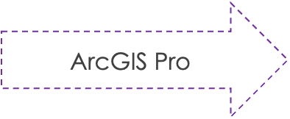
Methodology – Air Quality Exposure
Data
Processing and Analysis
End Products
MODIS MAIAC
(AOD)
AOD Timeseries & Concentration Maps
Satellite Observations
Sentinel-5P
TROPOMI (NO₂)
NO₂ Timeseries &
Concentration Maps
CALIPSO CALIOP
(VFM)
Aerosol Profile Analysis
In Situ Observations:
EPA: PM_{2.5}, NO₂
Notes:
Speaker notes:
Air Quality Exposure in our study area used data from MODIS, TROPOMI and CALIOP to characterize air pollution in our study area, which was then validated by EPA in situ observations from ground sensors. We then processed it using GEE and ArcGIS pro to produce time series graphs and concentration maps for AOD and NO2 and also an aerosol profile vertical features mask from CALIPSO

Slide 8

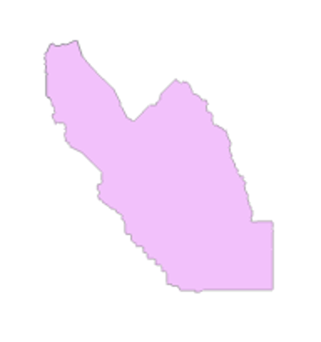
Methodology – Social Vulnerability Index
Data
Processing and Analysis
EPA EJ Screen
Principal Component Analysis (PCA)
San Joaquin County (SJC):
Total Population
Population Poverty status
Minority Status
Percent Low Income
Unemployment Rates
Less than High School Education
Age < 5 years
Age > 65 years
Life Expectancy
AOD & NO₂
Exposure Maps
ArcGIS Pro
R Studio
CDC Social Vulnerability Index
San Joaquin Valley (SJV):
End Products
Pulmonary Diseases
Coronary Heart Diseases
Asthma Rates
Health Insurance
CDC PLACES
Bivariate Choropleth Maps (AOD/PM2.5, NO₂)
Air Quality Vulnerability Index by Census Tract
Notes:
Speaker notes:
Social Vulnerability indicators were derived from EPA EJ Screen and CDC Places initiative and can be found on this slide. These indicators were then aggregated into one social vulnerability index through a method outlined by the CDC and validated by a Principal Component Analysis conducted in R. A map of this social vulnerability index by census tract was then overlayed with our air pollution exposure maps to create a bivariate choropleth map showcasing the overlap of social vulnerability and pollution exposure.

Slide 9
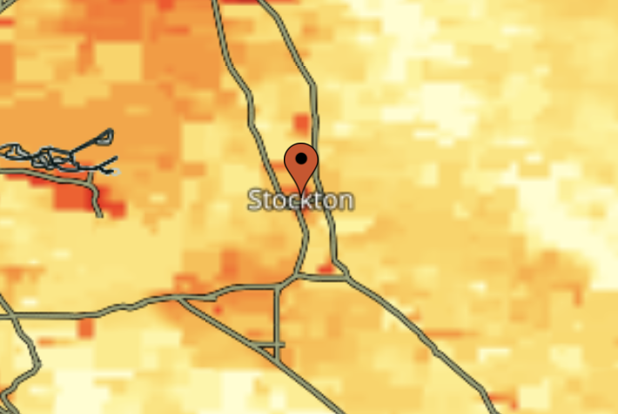
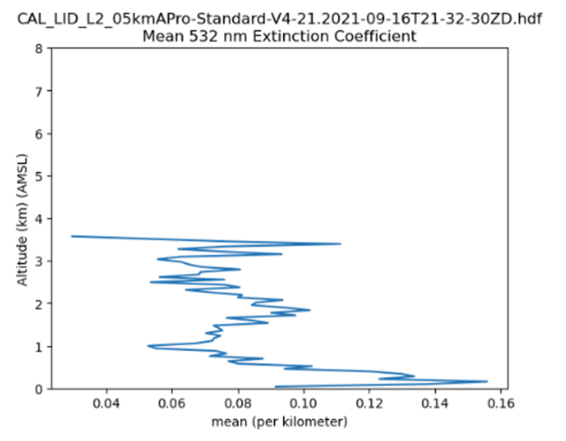
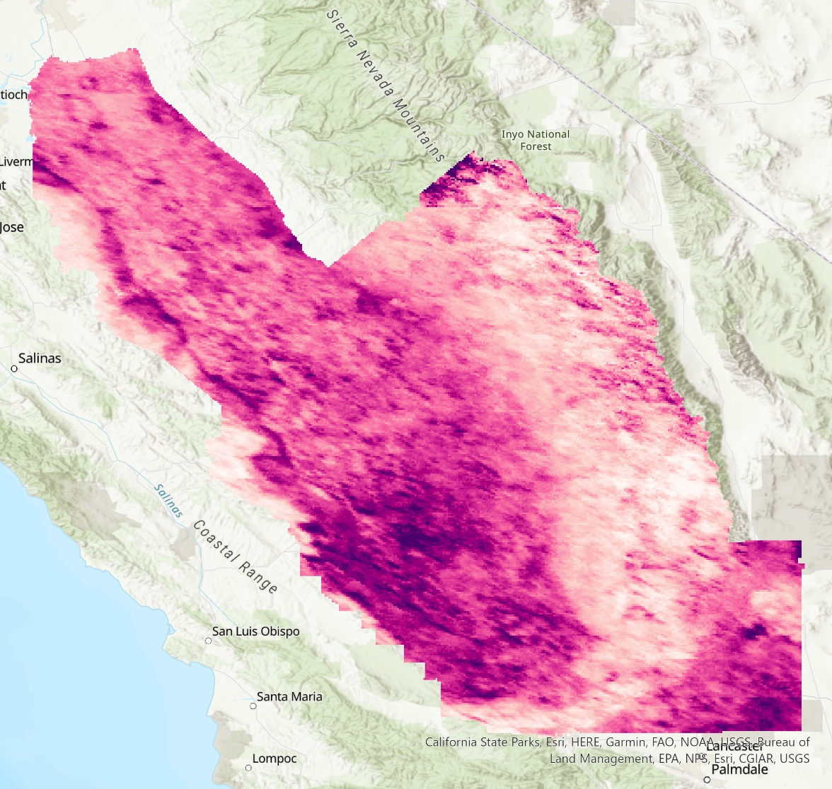
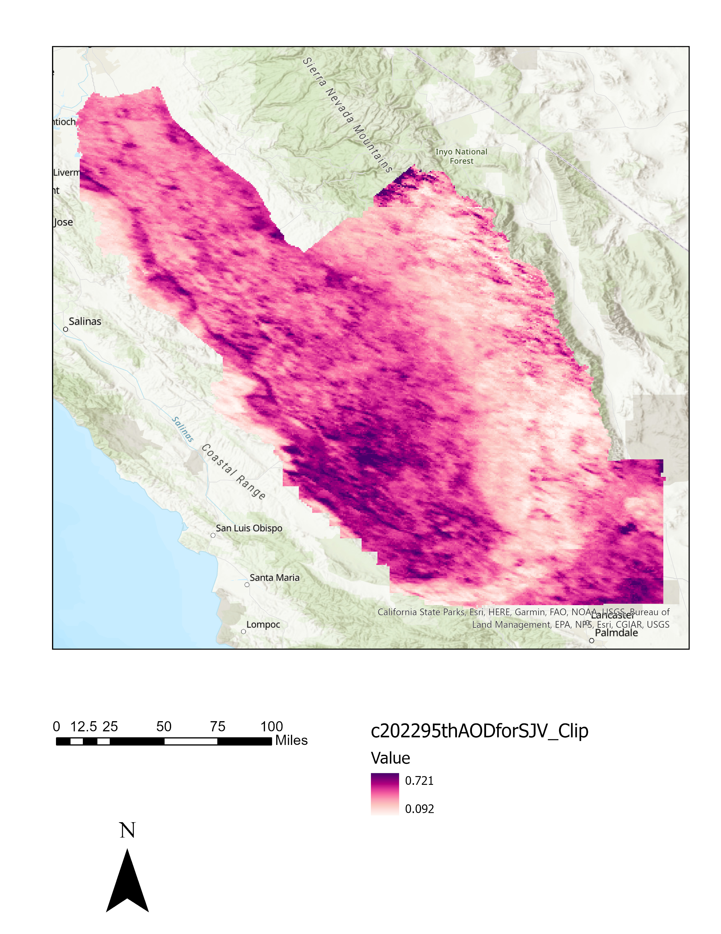
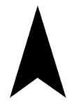
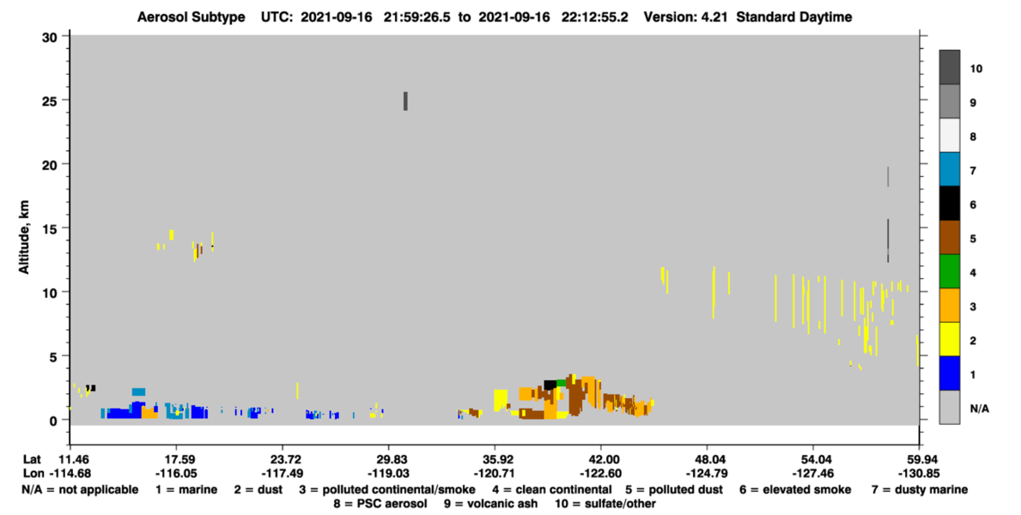
Results – AOD
2022 95th Percentile AOD
Aerosol Optical Depth
N
0.721
Stockton
0.092
Modesto
Fresno
Visalia
Bakersfield
0
25
50
75
100
12.5
Miles
Notes:
Speaker note:
Here is a map of the distribution of aerosol optical depth across the valley. Areas along major roads and the urban areas tended to have higher levels of aerosol optical depth as compared to more remote and less populated areas.

Slide 10
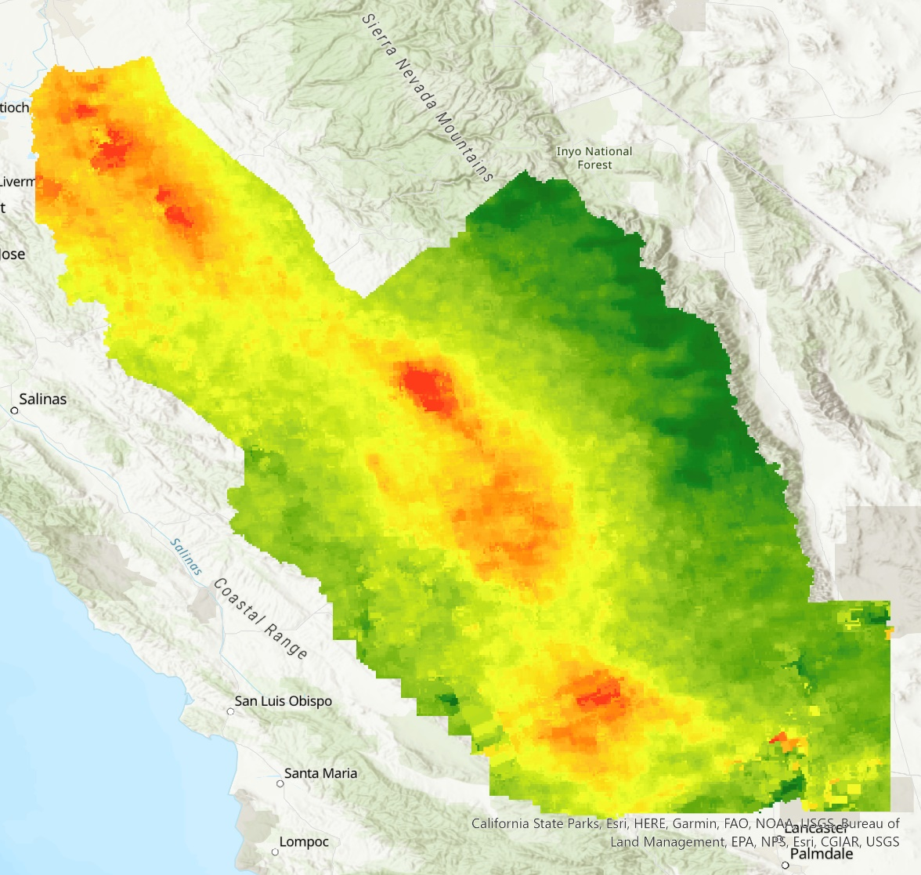

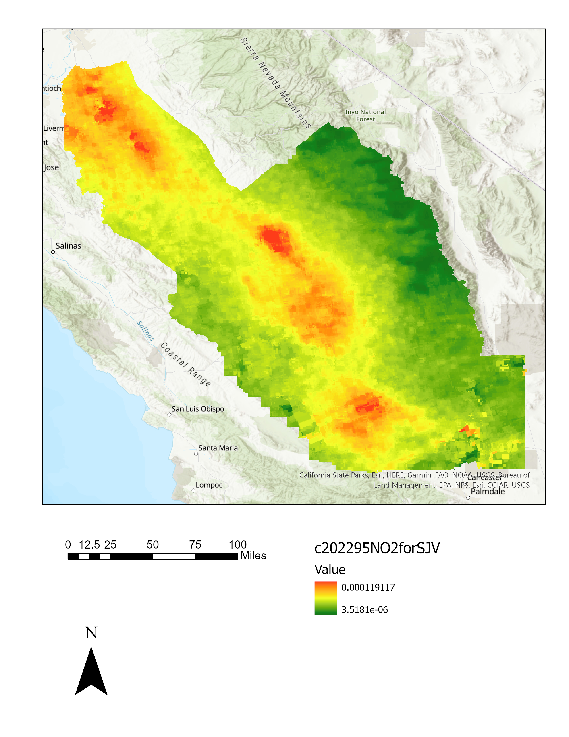
Results – NO₂
2022 95th Percentile NO₂
2022 95th Percentile NO₂ + Major Roads
Nitrogen Dioxide
Nitrogen Dioxide
N
N
High
High
Stockton
Stockton
Low
Low
Modesto
Modesto
Fresno
Fresno
Visalia
Visalia
Bakersfield
Bakersfield
0
25
50
75
100
12.5
0
25
50
75
100
Miles
12.5
Miles
Notes:
Here is a map of the distribution of 95th percentile NO2 across the valley. Areas along major roads and the urban areas tended to have higher levels of NO2 as compared to more remote and less populated areas.

Slide 11
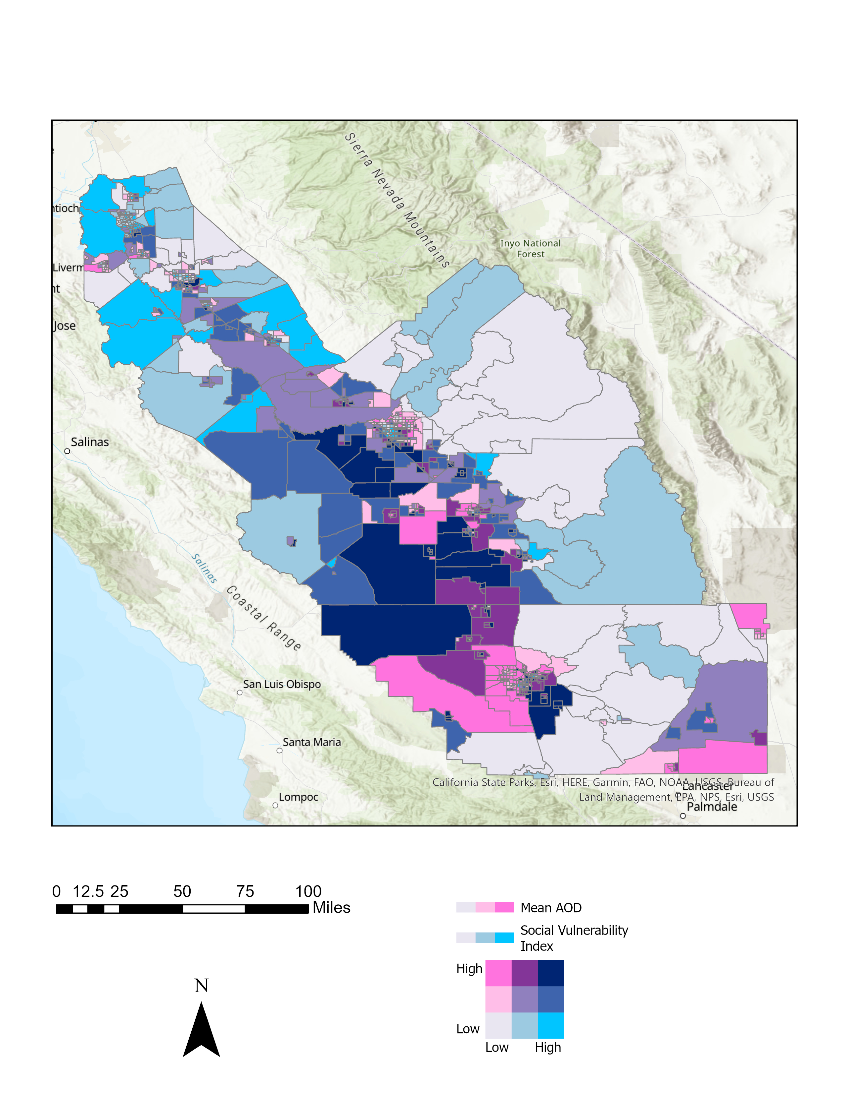
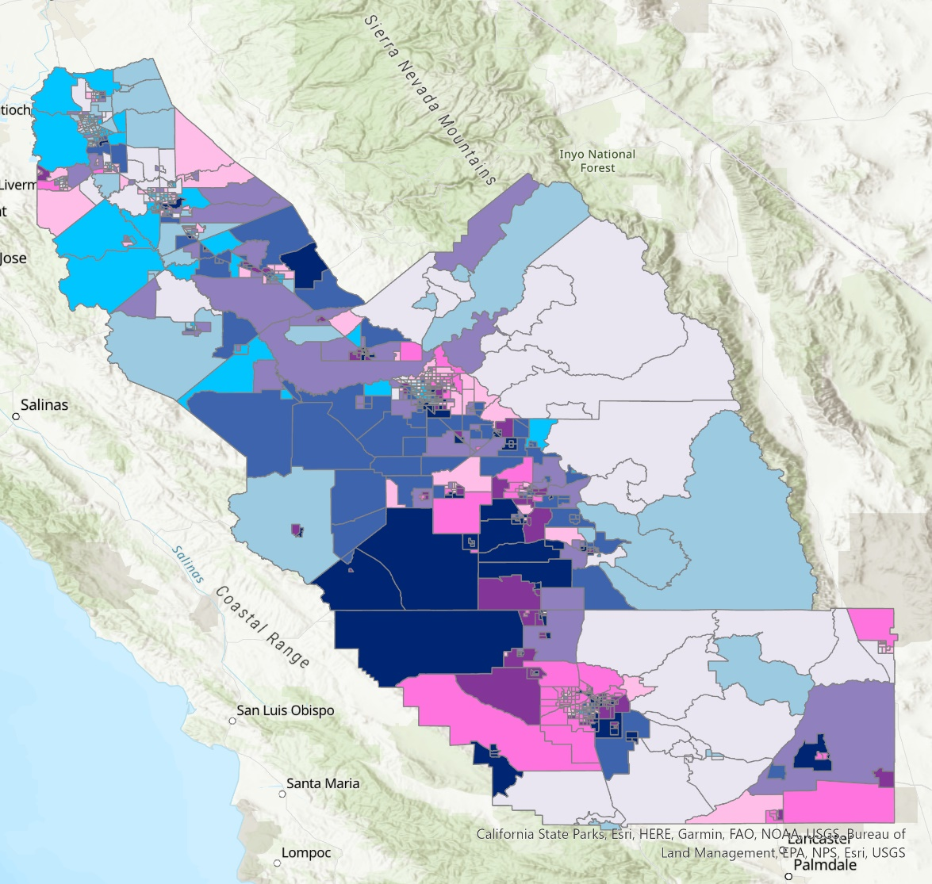
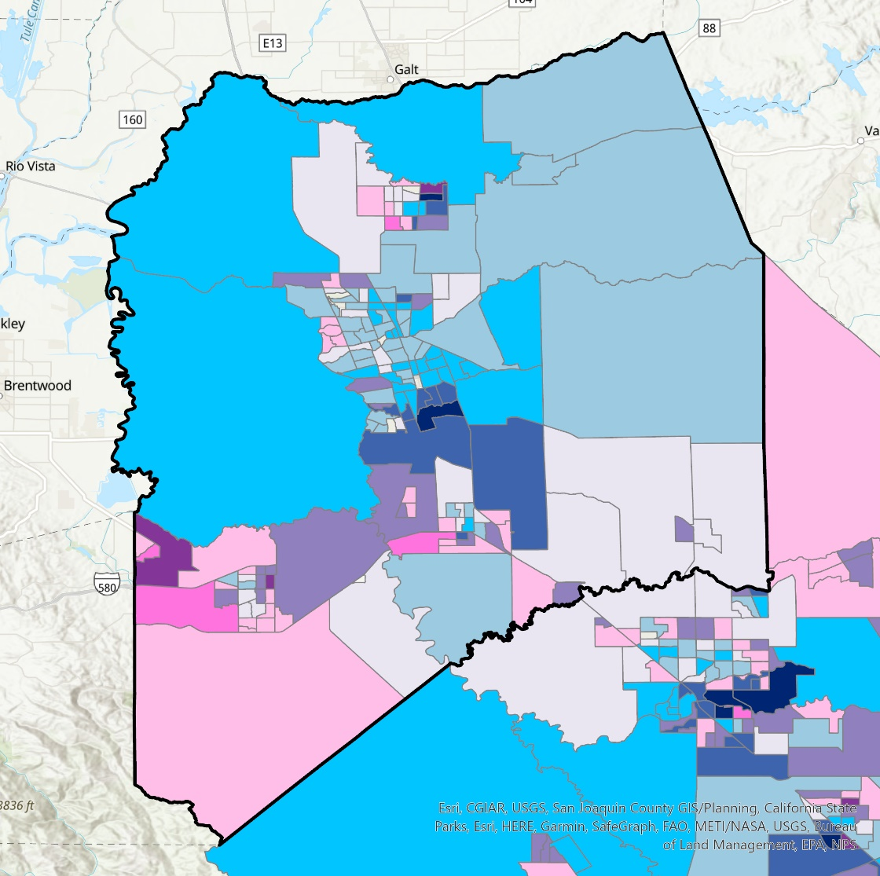

Results – Bivariate AOD
2022 95th Percentile AOD Bivariate – SJV
2022 95th Percentile AOD Bivariate – SJC
Mean AOD
Mean AOD
Social Vulnerability Index
Social Vulnerability Index
High
N
High
N
Stockton
Modesto
Low
Low
Low
High
Low
High
Fresno
Stockton
Visalia
Bakersfield
Modesto
0
25
50
75
100
12.5
2.5
10
15
20
Miles
0
5
Miles
Notes:
These are two bivariate maps showing the overlap of 95th percentile AOD and social vulnerability across the whole valley and just San Joaquin County. Darker purple areas are census tracts that have higher AOD and social vulnerability, and allows us to better visualize the disparate impact of air pollution in our study area. Many urban census tracts and rural agricultural tracts face the worst pollution vulnerability.

Slide 12
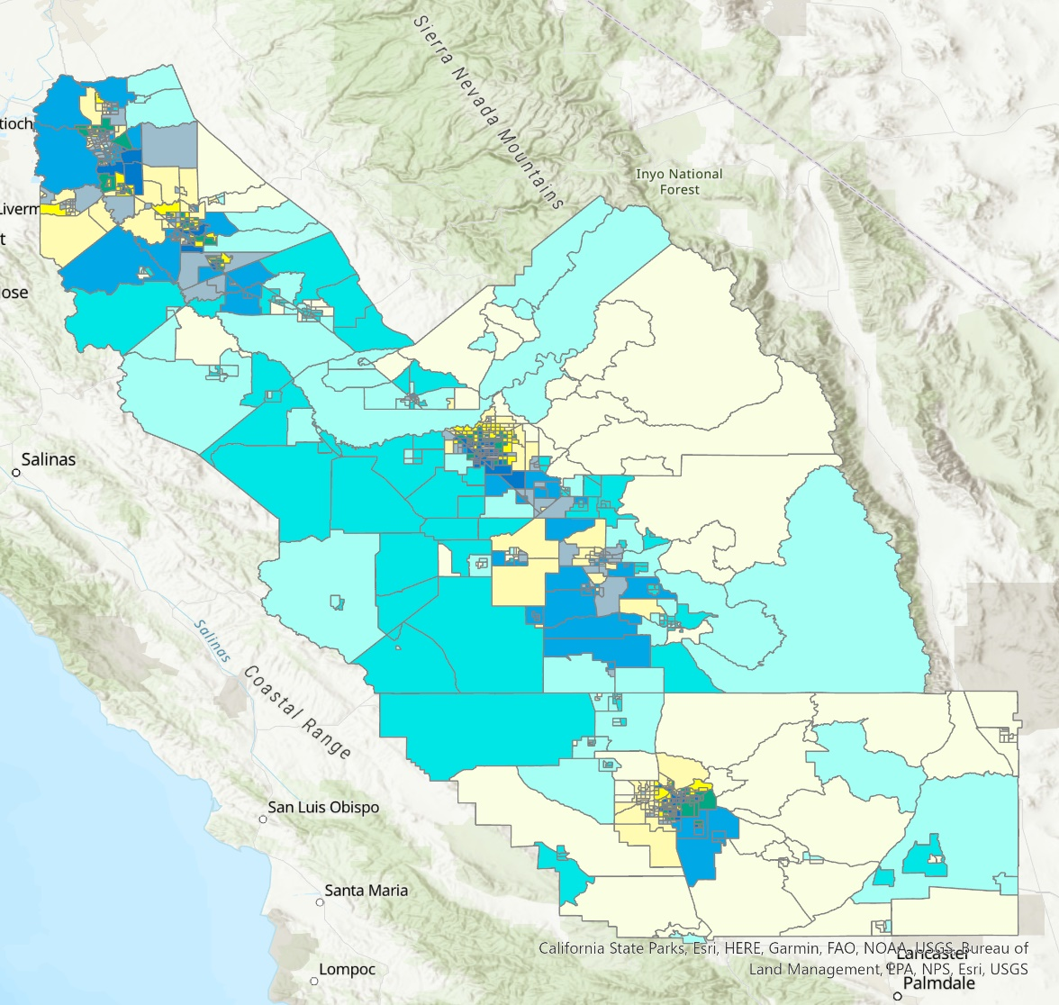
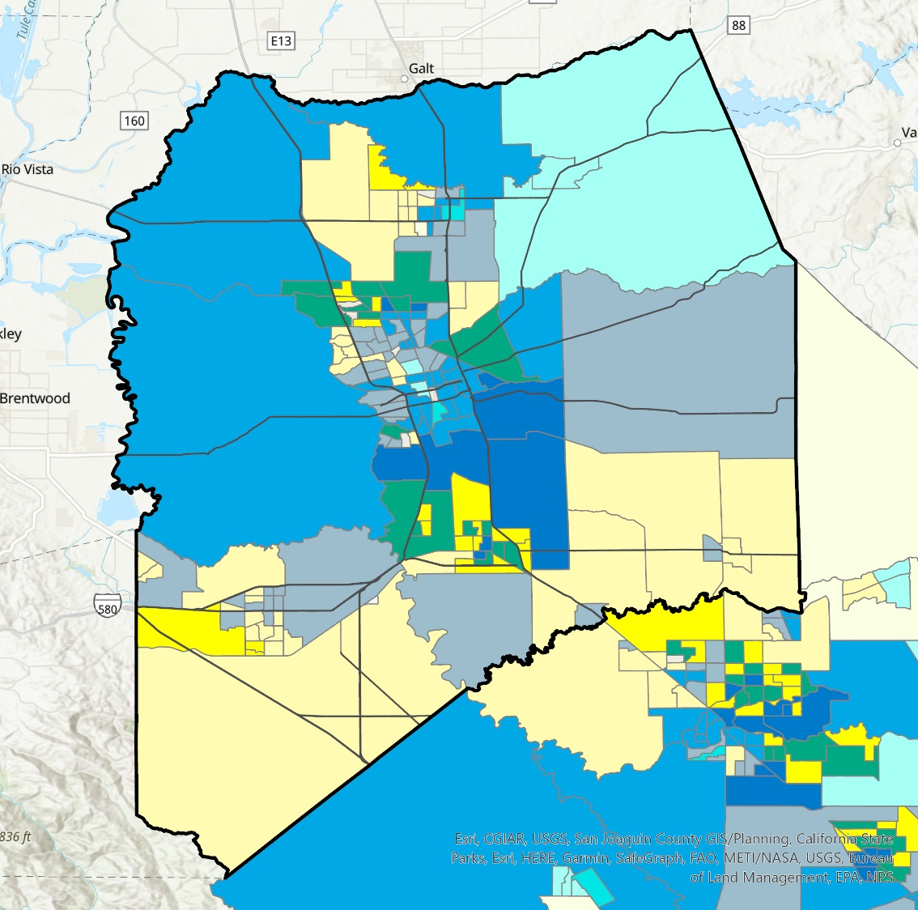
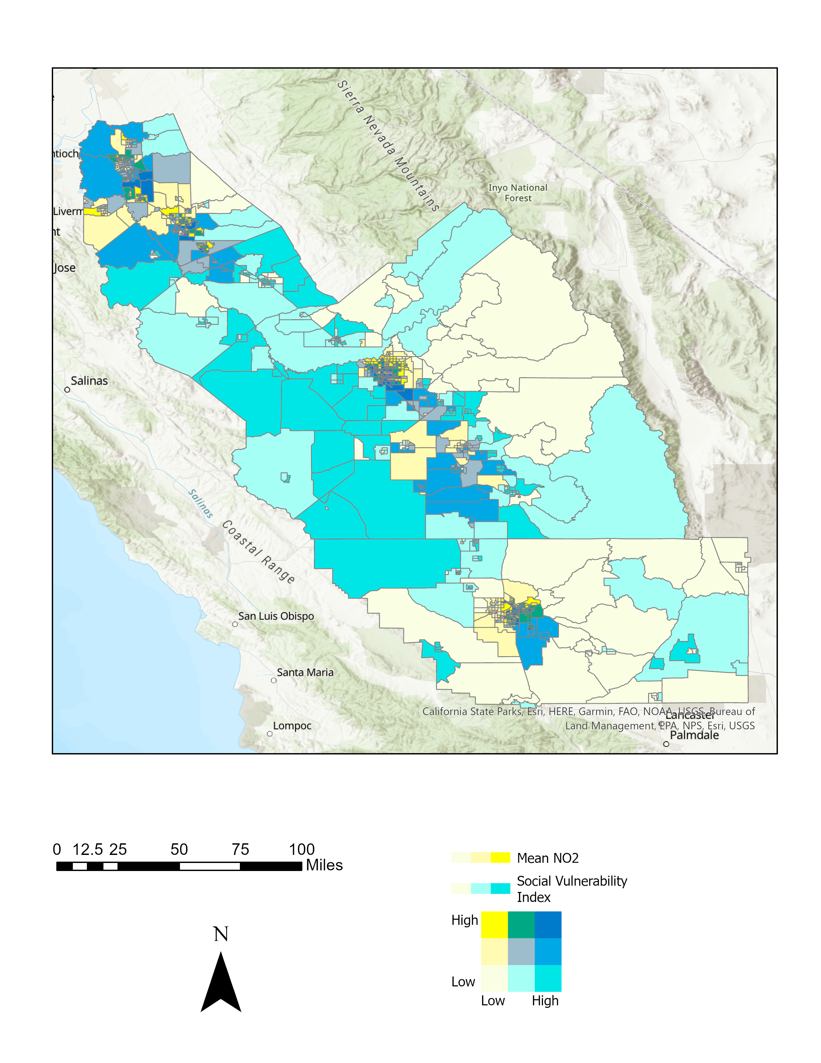
Results – Bivariate NO₂
2022 95th Percentile NO₂ Bivariate (SJV)
2022 95th Percentile NO₂ Bivariate + Major Roads (SJC)
Mean NO₂
Mean NO2
Social Vulnerability Index
Social Vulnerability Index
Stockton
High
N
High
N
Modesto
Low
Low
Low
High
Low
High
Stockton
San Joaquin County
Major Roads
Fresno
Visalia
Bakersfield
Modesto
0
25
50
75
100
12.5
Miles
2.5
10
15
20
0
5
Miles
Notes:
These are two bivariate maps showing the overlap of 95th percentile NO2 and social vulnerability across the whole valley and just San Joaquin County. Bluer areas are census tracts that have higher NO2 and social vulnerability, and allows us to better visualize the disparate impact of NO2 pollution in our study area. Many urban census tracts along the highway and corridors and in urban areas face the worst NO2 pollution vulnerability in our study area. Census tracts from more rural and less populated areas have less NO2 exposure.

Slide 13
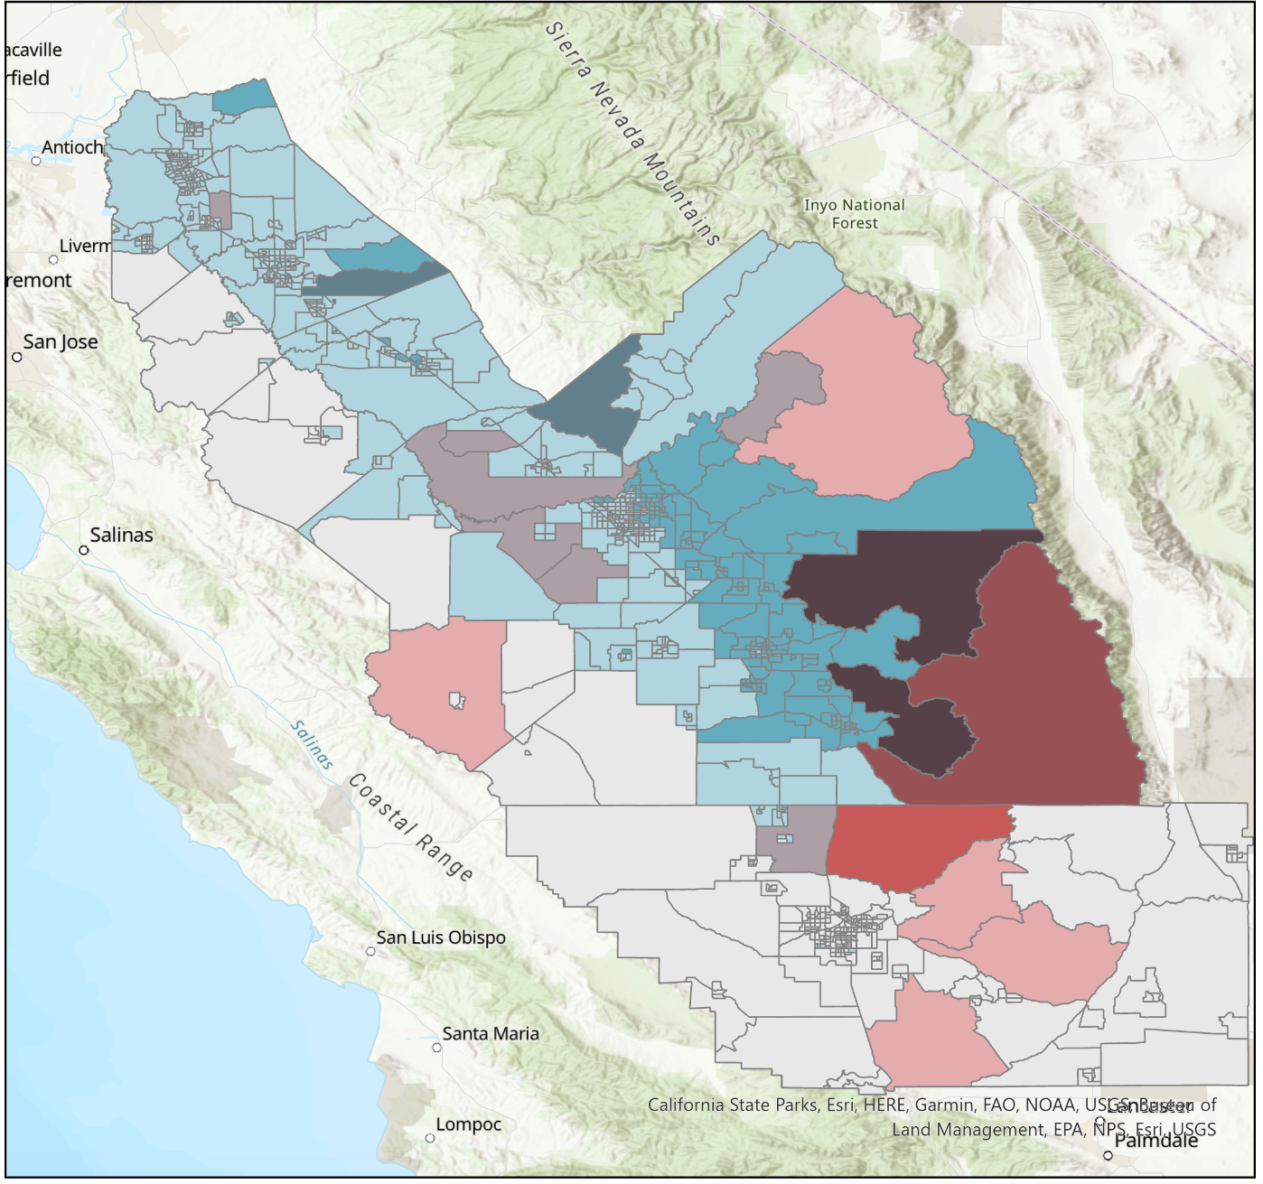

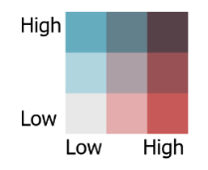
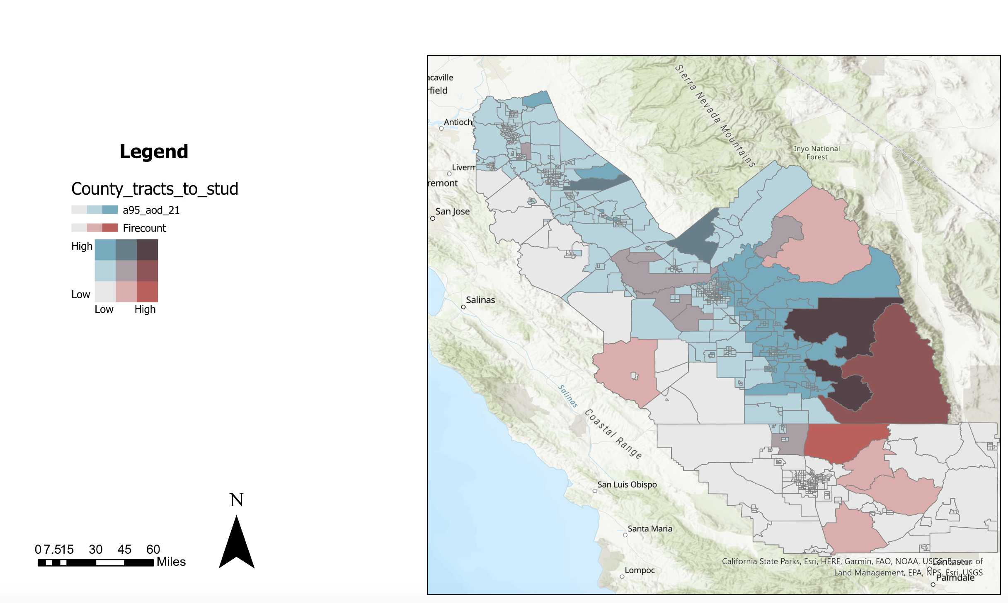
Results – Active Fire vs. Aerosol Optical Depth
AOD v. Active Fire 2021
95% tile AOD
N
Active Fires
High
Low
Low
High
0
8.75
35
70
17.5
52.5
Miles
Notes:
Speaker notes:
If we overlap the same data with the highest AOD values in 2021, we can see that many areas with high counts of fire by VIIRS also had higher max values of AOD. However, there is no significant correlation between fire counts and AOD values or burn permits and AOD values.

Slide 14
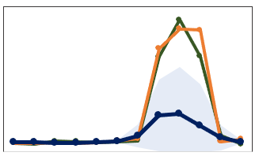
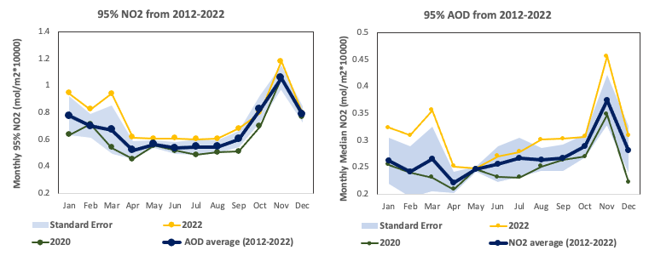
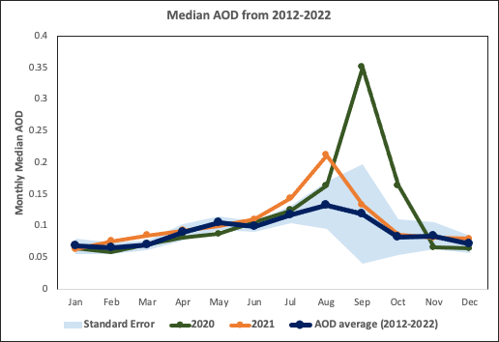
Results – NO₂ & AOD Time Series
95% NO₂ from 2018 – 2022 (SJV)
95% AOD from 2012 – 2022 (SJV)
4
1.4
3.5
1.2
3
Monthly 95% AOD
1
2.5
Monthly 95% NO₂ (mol/m2*10,000
0.8
2
1.5
0.6
1
0.4
0.5
0
0.2
Sep
Oct
Nov
Dec
Jan
Feb
Mar
Apr
May
Jun
Jul
Aug
Sep
Oct
Nov
Jan
Dec
Feb
Mar
Apr
May
Jun
Jul
Aug
Standard Error
2022
Standard Error
2020
2020
2021
AOD Average (2012–2022)
NO₂ Average (2018-2022)
Notes:
Speaker notes:
Here is a median and 95%tile NO2 yearly time series that model NO2 values across SJV on a monthly basis. In this one, the average was modelled per month and the outlier of 2022 was modelled independently as well.

Slide 15
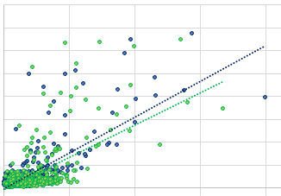
Results – AOD/PM_{2.5} Validation
4
Filtered Data | Fresno R² | Madera R²
All Data (2019–2022) | 0.4219 | 0.5589
2019 Only | 0.0214 | 0.0567
2020–2022 | 0.4423 | 0.5689
Fall | 0.2717 | 0.3851
Winter | 0.2804 | 0.3955
Spring | 0.4700 | 0.5820
Summer | 0.5946 | 0.6867
Fire Season | 0.5711 | 0.6373
Not Fire Season | 0.1050 | 0.0948
PM 2.5 < 15µg/m³ | 0.0265 | 0.0095
PM 2.5 >= 15µg/m³ | 0.4033 | 0.5650
PM 2.5 < 35µg/m³ | 0.0919 | 0.0964
PM 2.5 >= 35µg/m³ | 0.3475 | 0.4359
3.5
R^2 = 0.56
3
2.5
Daily AOD
R^2 = 0.42
2
1.5
1
0.5
0
0
50
100
150
200
Daily PM 2.5 (ug/m3)
Fresno
Fresno Linear Regression Line
Madera
Madera Linear Regression Line
Notes:
Speaker notes:
This our validation of AOD to PM2.5 for the full data set, which saw moderate correlation of about 0.42 or 0.56 dependent on the sensor. Based on findings from the previous slide, additional analyses were looked at in which we found higher correlation between AOD and PM2.5 in spring/summer/ fire season and when PM 2.5 was over 15mg/m3 (the WHO guidelines for maximum 24-hour exposure PM2.5). While AOD does not perfectly correlate with PM 2.5, it is a positive to see it correlates best when PM2.5 is high, which is when it matters most for human health.

Slide 16
Errors, Uncertainties, and Limitations
Environmental
Data Processing
Satellites
Suomi-NPP VIIRS does not collect all active fires in the study area.
Cloud Mask technical limitations.
CALIPSO data did not overlap with a non-wildfire high pollution date for case study.
Sentinel NO₂ data has large gaps for daily data.
Atmospheric inversions limit the accuracy of validation, especially in winter months.
AOD represents pollutants in entire air column but only the lower altitude concentrations are relevant to communities.
Conducting zonal statistics on air quality raster led to loss of pollution data in some census tracts
Some social indicator data had to be estimated.
Social vulnerability index does not show adaptative characteristics well, such as HVAC installation rate.
Notes:
Speaker notes:
Now, there were some errors and limitations that we had to face throughout the project and they can be broken into three categories: environmental, data processing, and satellites. The major environmental limitation we had was with validation where as atmospheric inversions in the winter months led to a limitation on our validation during this time period. Similarly, since AOD represents pollutants in their air column, this naturally leads to less accuracy in terms of relevant pollutants since only near-surface pollutants are relevant for public health.
In terms of data processing, we had a lot of errors that led to less accurate zonal statistics or the omission of some census tracts. When doing zonal stats in ArcGIS pro from the air quality rasters, some of the census tracts couldn’t be calculated, leading to the loss of about 20 census tracts. Similarly, some social indicators from CDC and EPA EJScreen was not available for some census tracts, meaning it had to be estimated and thus is less accurate. Lastly, our index shows static characteristics but does not include adaptive characteristics that illustrate the populations attempt or possibility to adapt and better adjust to their environment.
Lastly, in terms of satellite you have the natural limitation in overpass time and clouds with the cloud mask, with notably CALIPSO only overlapping every 16 days so we could not get an extremely high pollution date not caused by wildfires for the case study.

Slide 17
Conclusions
Air pollution is not equitably distributed across San Joaquin Valley
Aerosol optical depth concentrations were greater in agriculture areas while NO₂ concentrations were greater in non-agriculture and urban areas.
Air pollution in the SJV was greater in months with more active fires, however census tracts with more active fires did not see any difference in air quality than those with less.
Census tracts with greater social vulnerability are exposed to
statistically higher concentrations of NO₂.
Satellite remote sensing can be used to estimate air quality in the SJV
with moderate accuracy.
Notes:
Speaker notes:
Some major conclusions we got from this presentation were:
1)
2) Different tracts saw higher or less concentrations of certain pollutants
3) Air pollution and active fires had a temporal relationship, but not a spatial one.
4) Socially vulnerability census tracts saw statistically higher concentrations of NO2 but not AOD.
5) Satellite remote sensing can be used to estimate air quality in the SJV with moderate accuracy, especially during certain times of the year like summer.

Slide 18
Future Work
Explore other Environmental Hazards
Further Utilize Satellite Capabilities
Develop comprehensive Social Vulnerability Index
Incorporate more adaptive indicators into the social vulnerability index
Do further aerosol-altitude analysis with CALIPSO or explore other air pollutants, such as CO or HCHO with TROPOMI
Urban heat, wildfires, and water quality are all environmental hazards affecting SJV
Notes:
Speaker notes:
In the future, projects could focus on other environmental hazards, like wildfires or urban heat. Similarly, CALIPSO could be utilized more in future projects to more in-depth analyze aerosol subtypes at different altitudes. As mentioned in the last slide, adaptive indicators are not included in the social vulnerability index, which could also be added in future studies.

Slide 19
The San Joaquin Valley Health & Air Quality team would like to thank:
J
This material contains modified Copernicus Sentinel data (2017), processed by ESA.
Partner
  Jermaine Reece, Little Manila Rising
Science Advisors
  Dr. Liz Wiggins, NASA Langley Research Center
  Dr. Travis Toth, NASA Langley Research Center
  Dr. Kenton Ross, NASA Langley Research Center
  Lauren Childs-Gleason, NASA Langley Research Center
  Lance Watkins, Arizona State University
Fellow
  Julianne Liu, NASA DEVELOP Virtual Environmental Justice
Notes:
Speaker notes:
The team would like to thank and acknowledge all our advisors who guided us on this project. Also thank you to Julianne for being an awesome fellow and our partner Little Manila Rising for giving us great context for the importance of this issue and motivated us to be as ambitious as we were with our approach.

Slide 20
Supplementary Results

Slide 21



Objectives
Model Air Pollution Distribution Across the San Joaquin Valley
Visualize Disparities in Impact Based on Social Vulnerability
Identify Overlap Between Poor Air Quality and Regional Burning
Validate Remotely-sensed and Ground-based Air Quality Data
Notes:
Speaker notes:
The first objective we will discuss is modeling air pollution distribution across the SJV.

Slide 22
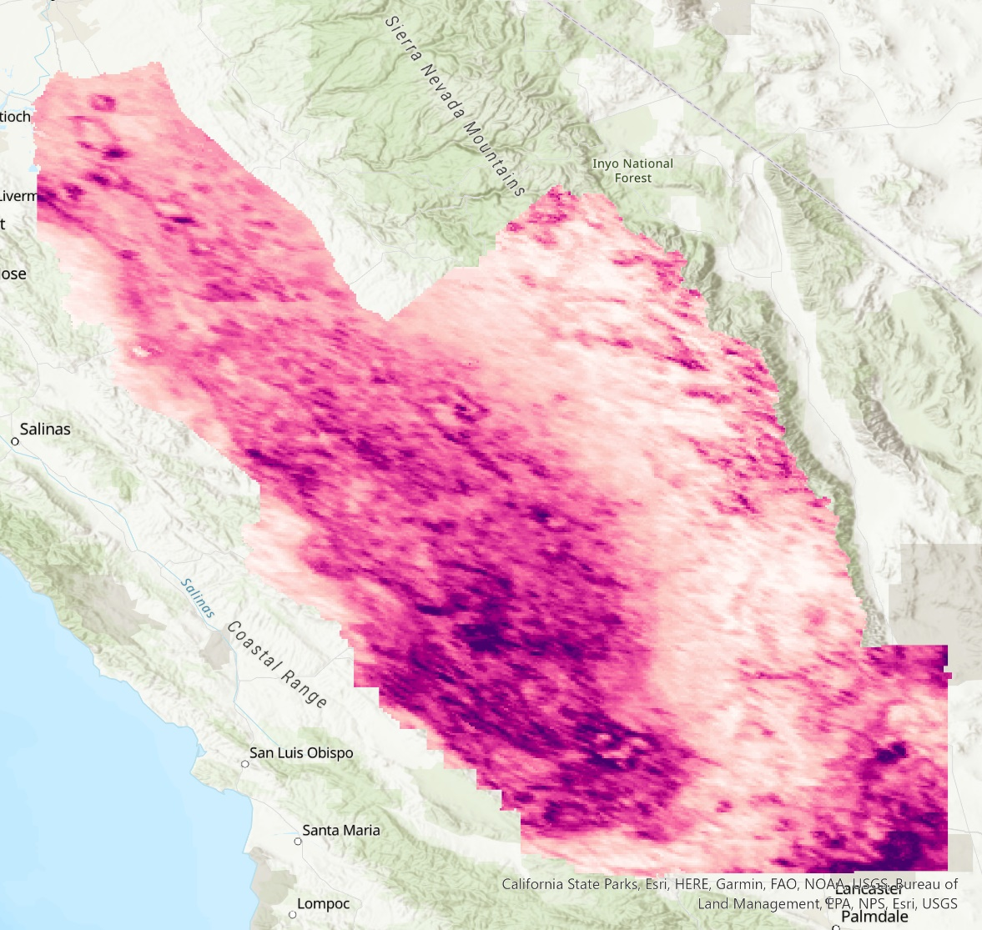
Results – AOD (San Joaquin Valley)
2022 Median AOD
2022 95th Percentile AOD
Aerosol Optical Depth
Aerosol Optical Depth
N
N
N
0.721
0.178
Stockton
0.041
Stockton
0.092
Modesto
Modesto
Fresno
Fresno
Visalia
Visalia
Bakersfield
Bakersfield
0
25
50
75
100
0
25
50
75
100
12.5
12.5
Miles
Miles
Notes:
Speaker note:
Here is a map of the distribution of aerosol optical depth across the valley. Areas along major roads and the urban areas tended to have higher levels of aerosol optical depth as compared to more remote and less populated areas.

Slide 23
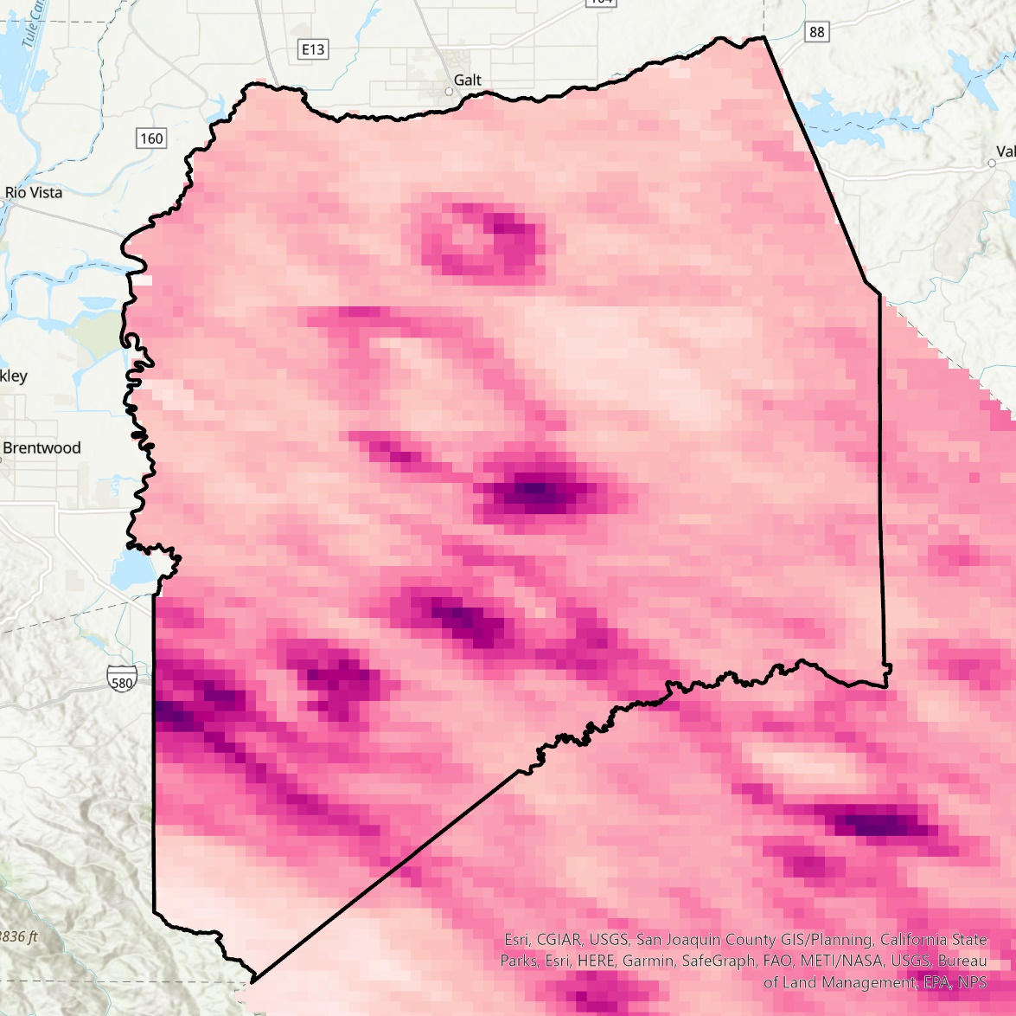

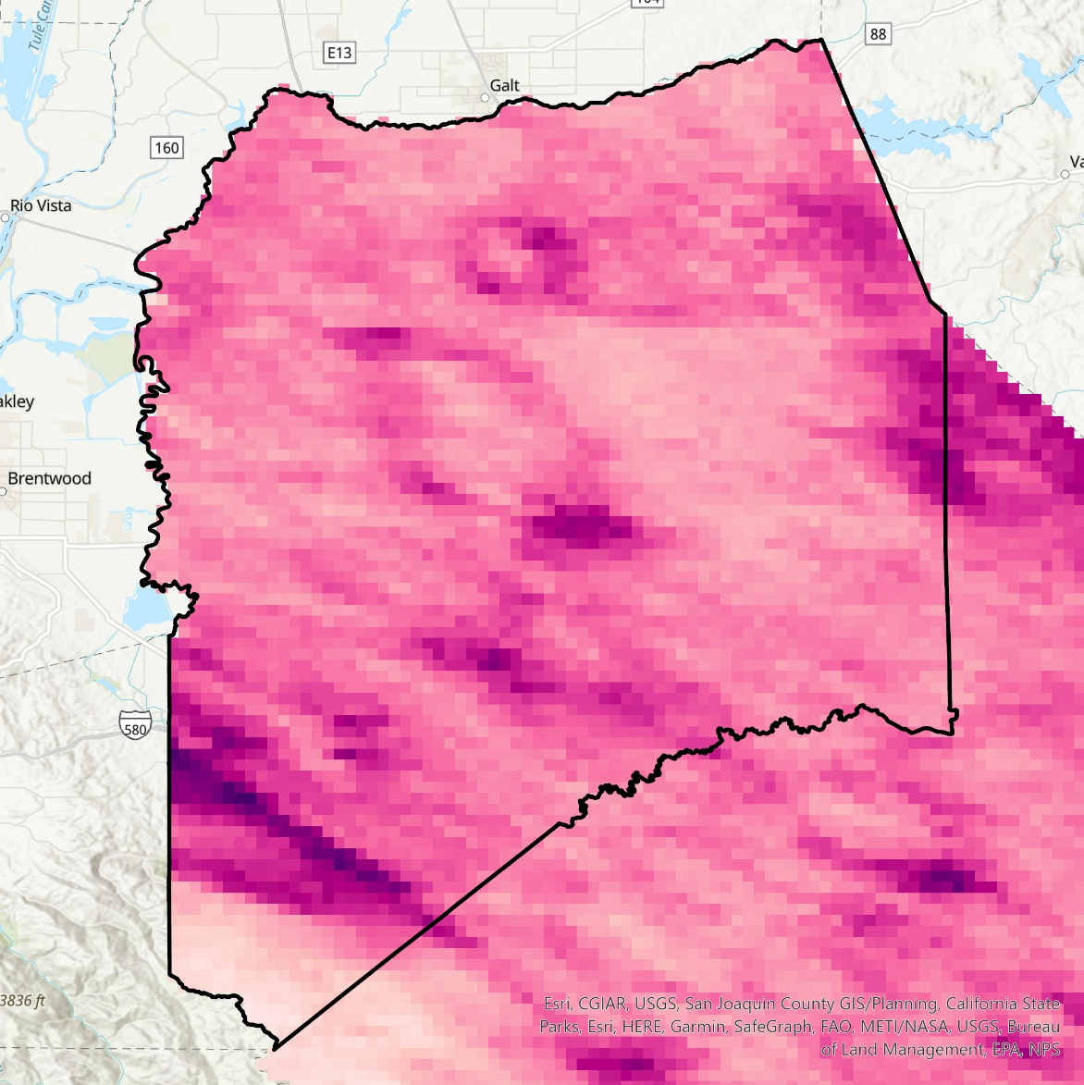
Results – AOD (San Joaquin Valley)
2022 Median AOD
2022 95th Percentile AOD
Aerosol Optical Depth
Aerosol Optical Depth
N
0.178
N
0.721
0.041
0.092
San Joaquin County
San Joaquin County
Stockton
Stockton
Modesto
Modesto
0
2.5
10
15
20
0
2.5
10
15
20
5
Miles
5
Miles
Notes:
Speaker note:
This is the AOD distribution across San Joaquin County. Both the median and 95%Tile distribution is shown.

Slide 24
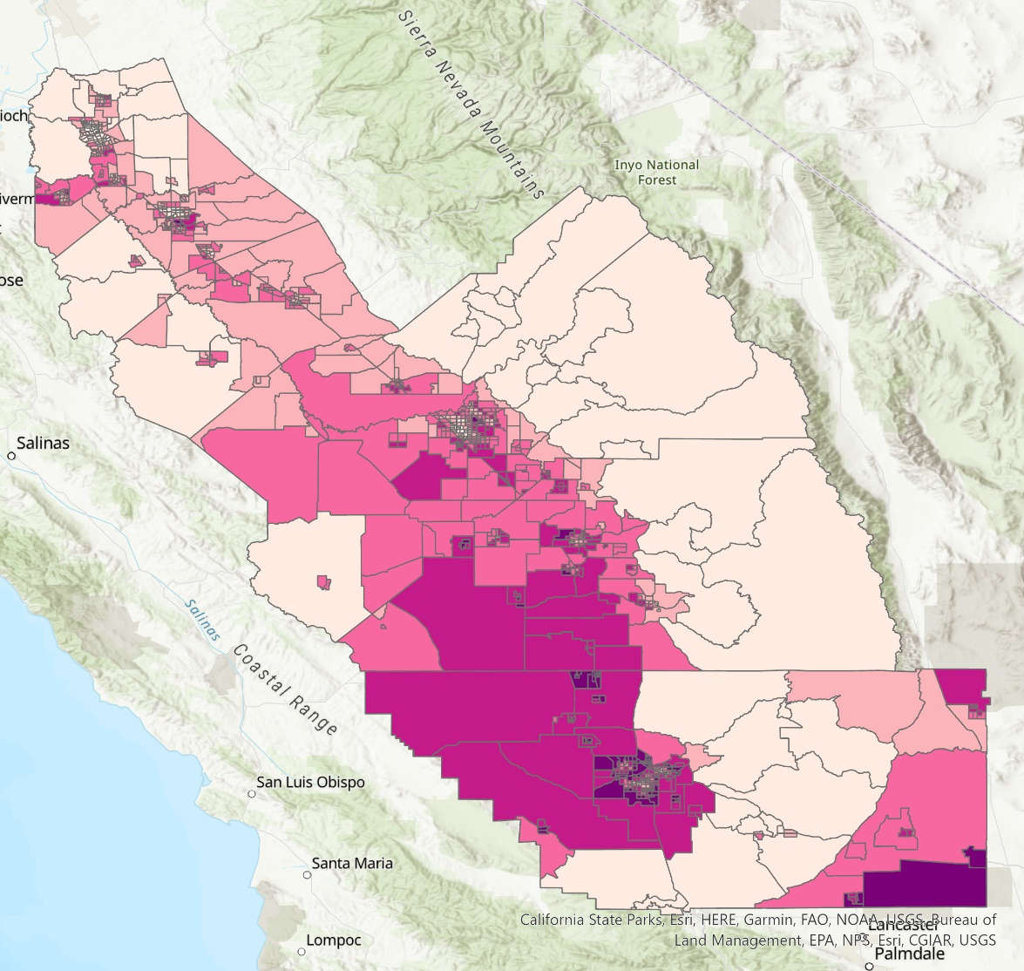
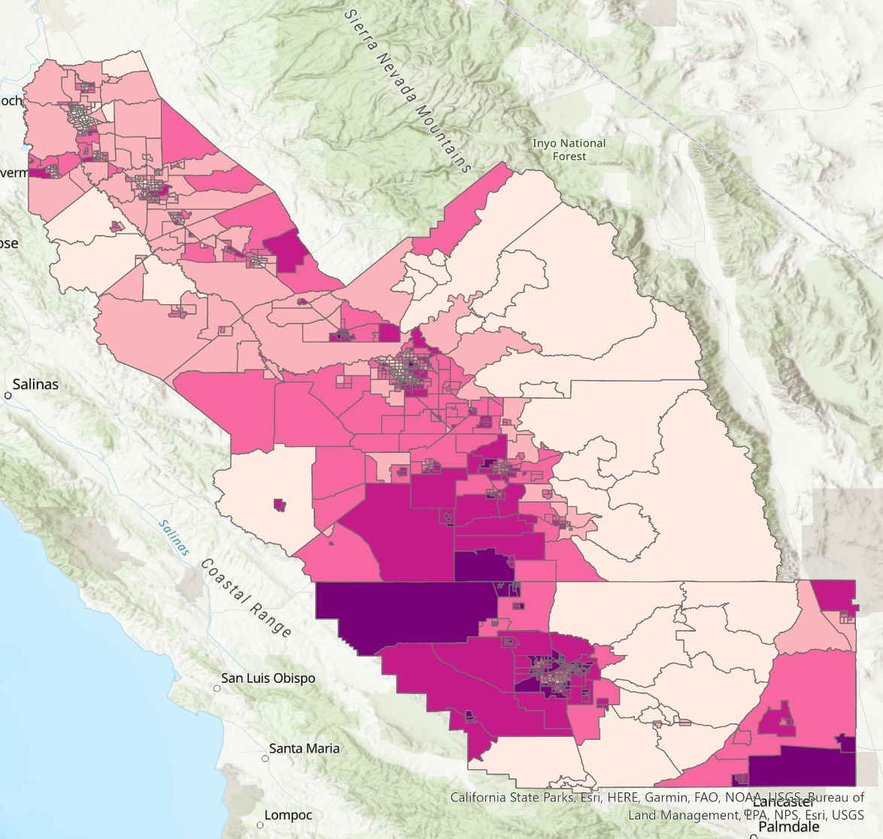

Results – AOD (San Joaquin Valley)
2022 Median AOD – Zonal Statistics (Mean)
2022 95th Percentile AOD – Zonal Statistics (Mean)
Aerosol Optical Depth
Aerosol Optical Depth
N
N
High
High
Stockton
Stockton
Medium
Medium
Modesto
Modesto
Low
Low
Fresno
Fresno
Visalia
Visalia
Bakersfield
Bakersfield
0
25
50
75
100
25
50
75
100
12.5
0
Miles
12.5
Miles
Notes:
Speaker note:
Here is a map of the distribution of aerosol optical depth across the valley. Areas along major roads and the urban areas tended to have higher levels of aerosol optical depth as compared to more remote and less populated areas.

Slide 25
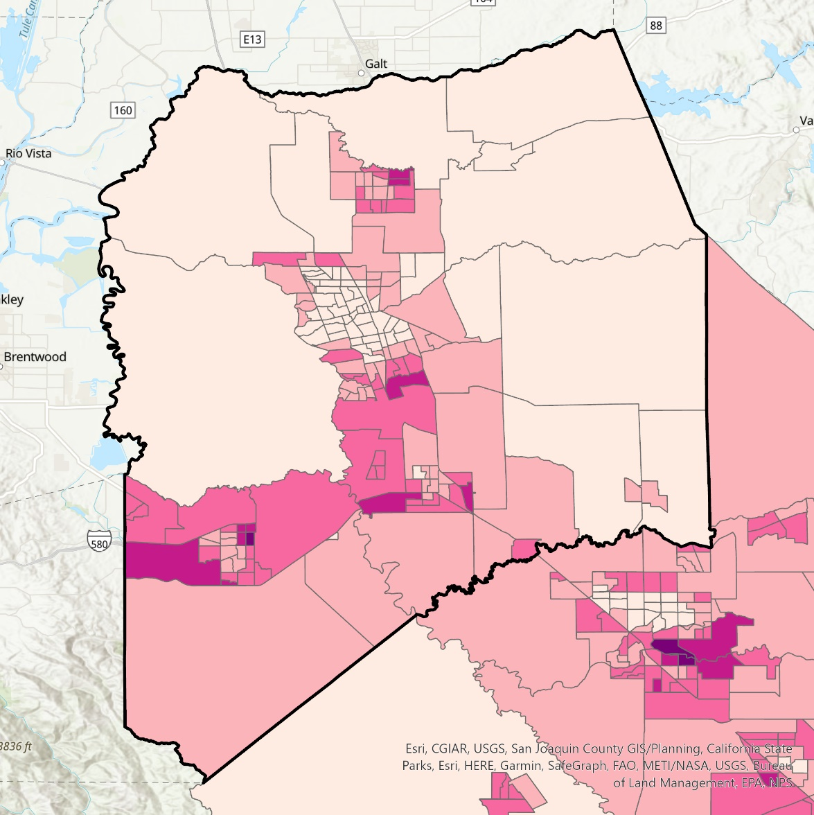
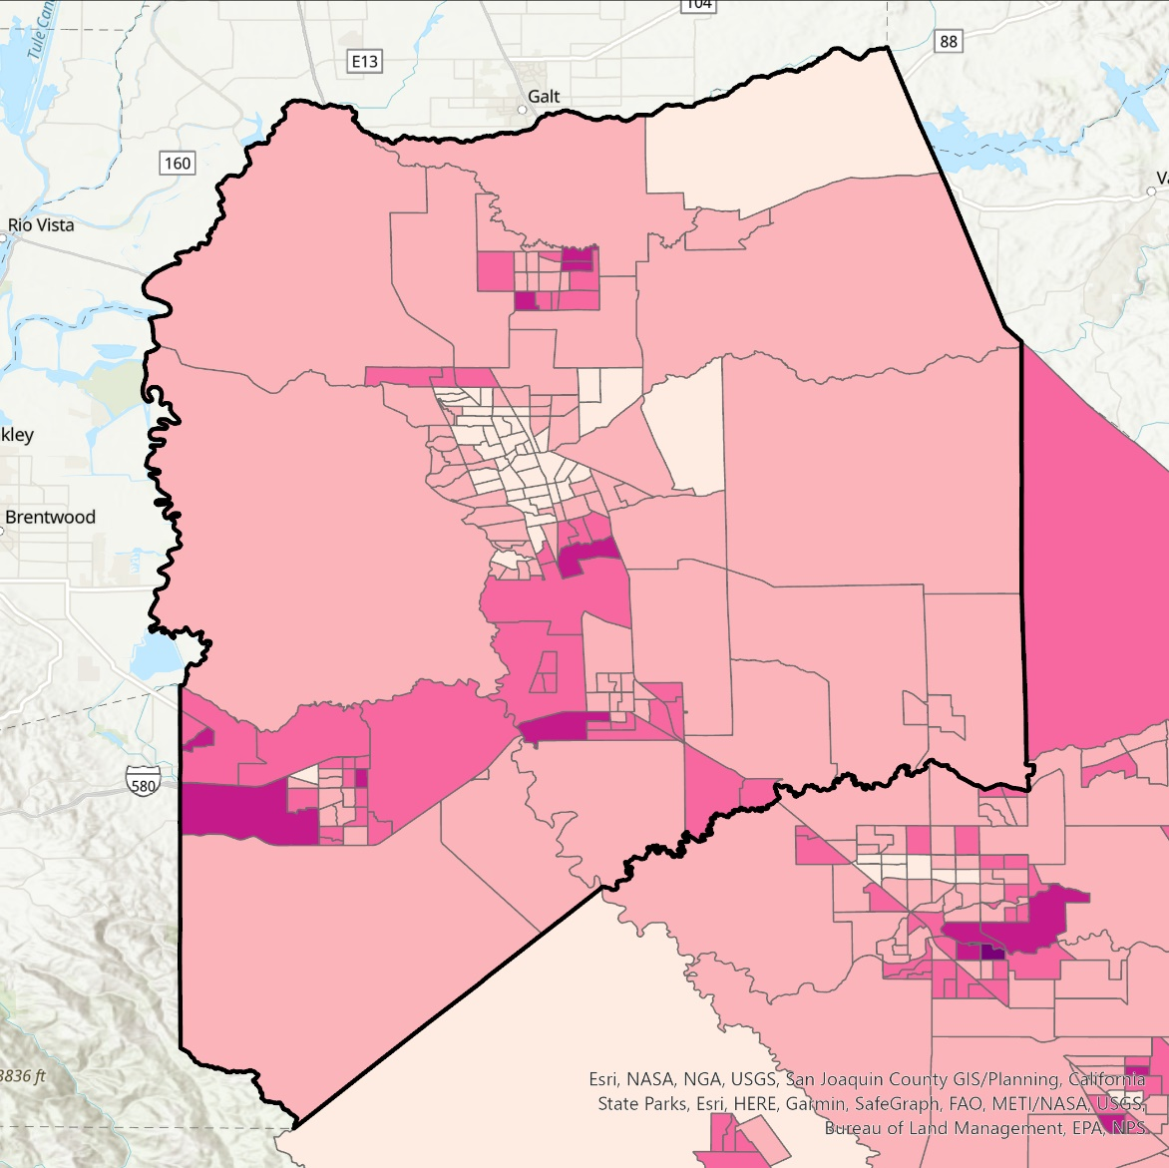


Results – AOD Zonal Statistics (San Joaquin County)
2022 Median AOD – Zonal Statistics (Mean)
2022 95th Percentile AOD – Zonal Statistics (Mean)
Aerosol Optical Depth
N
Aerosol Optical Depth
High
N
High
Medium
Medium
Low
Low
Stockton
Stockton
Modesto
Modesto
2.5
10
15
20
0
2.5
10
15
20
0
5
Miles
5
Miles
Notes:
Speaker notes:
This is the AOD distribution broken up by census track in San Joaquin County

Slide 26
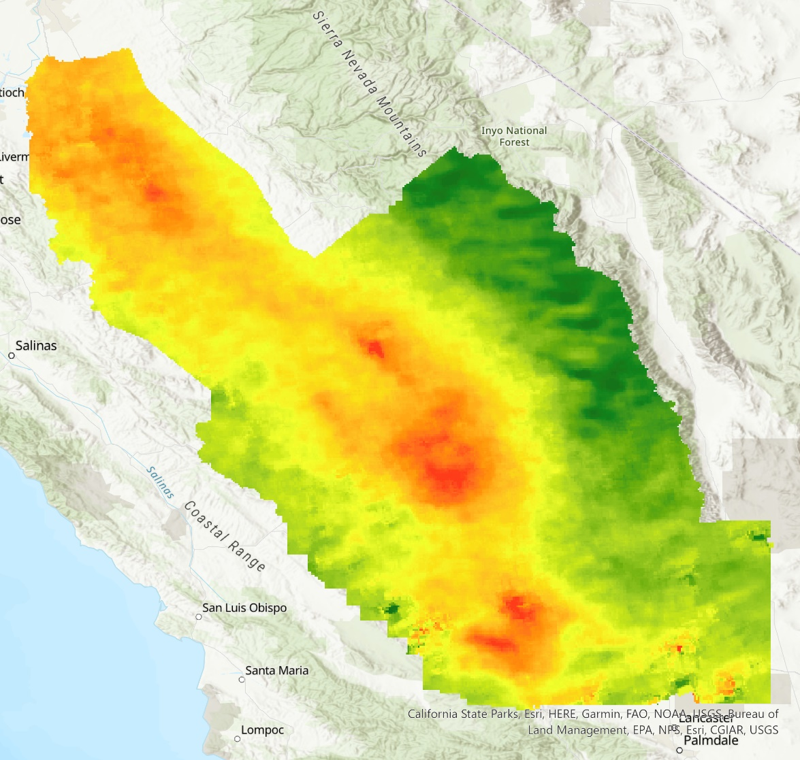

Results – NO₂ (San Joaquin Valley)
2022 Median NO₂
2022 Median NO₂ + Major Roads
Nitrogen Dioxide
N
Nitrogen Dioxide
High
N
Stockton
High
Low
Stockton
Low
Modesto
Modesto
Fresno
Fresno
Visalia
Visalia
Bakersfield
Bakersfield
0
25
50
75
100
12.5
0
25
50
75
100
Miles
12.5
Miles
Notes:
Here is a map of the distribution of median NO2 across the valley. Areas along major roads and the urban areas tended to have higher levels of aerosol optical depth as compared to more remote and less populated areas.

Slide 27
Results – NO₂ (San Joaquin Valley)
2022 95th Percentile NO₂
2022 95th Percentile NO₂ + Major Roads
Nitrogen Dioxide
Nitrogen Dioxide
N
N
High
High
Stockton
Stockton
Low
Low
Modesto
Modesto
Fresno
Fresno
Visalia
Visalia
Bakersfield
Bakersfield
0
25
50
75
100
12.5
0
25
50
75
100
Miles
12.5
Miles
Notes:
Here is a map of the distribution of 95%tile NO2 across the valley. Areas along major roads and the urban areas tended to have higher levels of aerosol optical depth as compared to more remote and less populated areas.

Slide 28
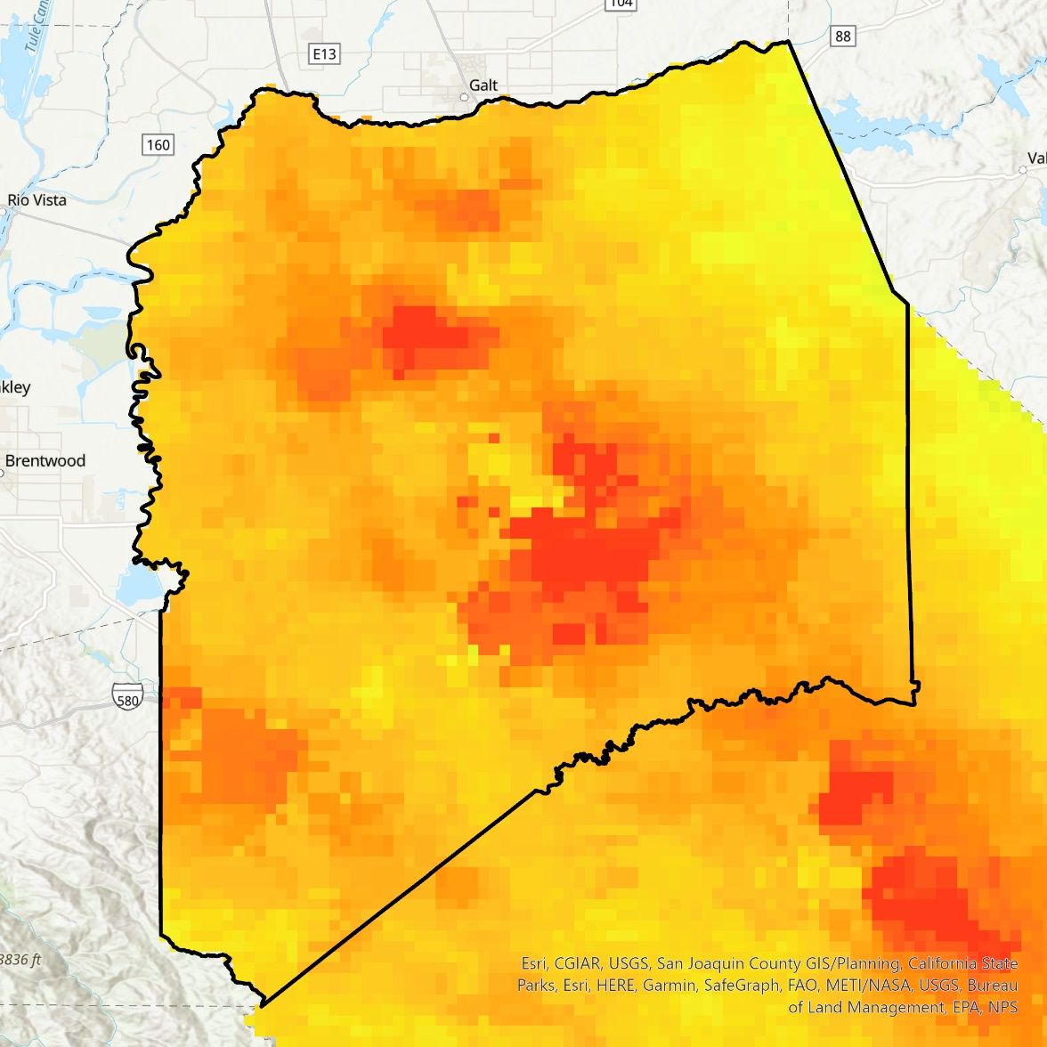
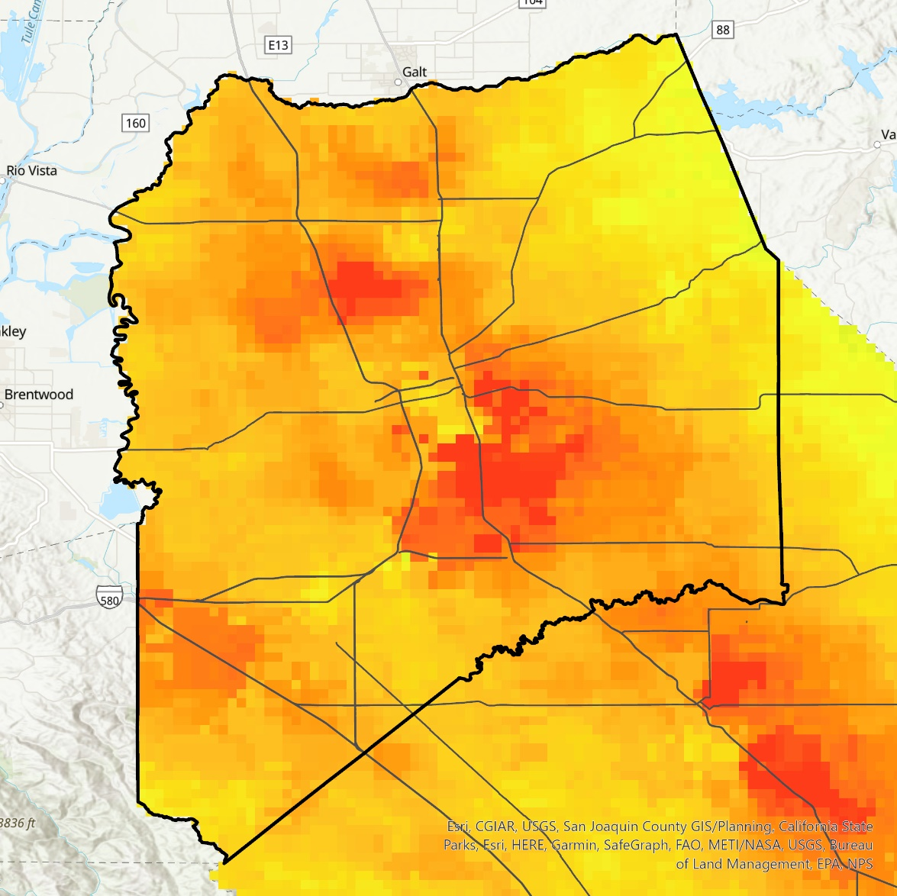

Results – NO₂ (San Joaquin County)
2022 95th Percentile NO₂
2022 95th Percentile NO₂ + Roads
Nitrogen Dioxide
High
N
Stockton
Low
Stockton
San Joaquin County
Major Roads
Modesto
Modesto
2.5
10
15
20
2.5
10
15
20
0
5
0
0
5
10
15
20
2.5
Miles
5
Miles
Miles
Notes:
Speak notes:
Here is the distribution of 95%tile NO2 across San Joaquin County and then an overlap with major roads. You can see the hotspots of NO2 overlap with highways in the county.

Slide 29
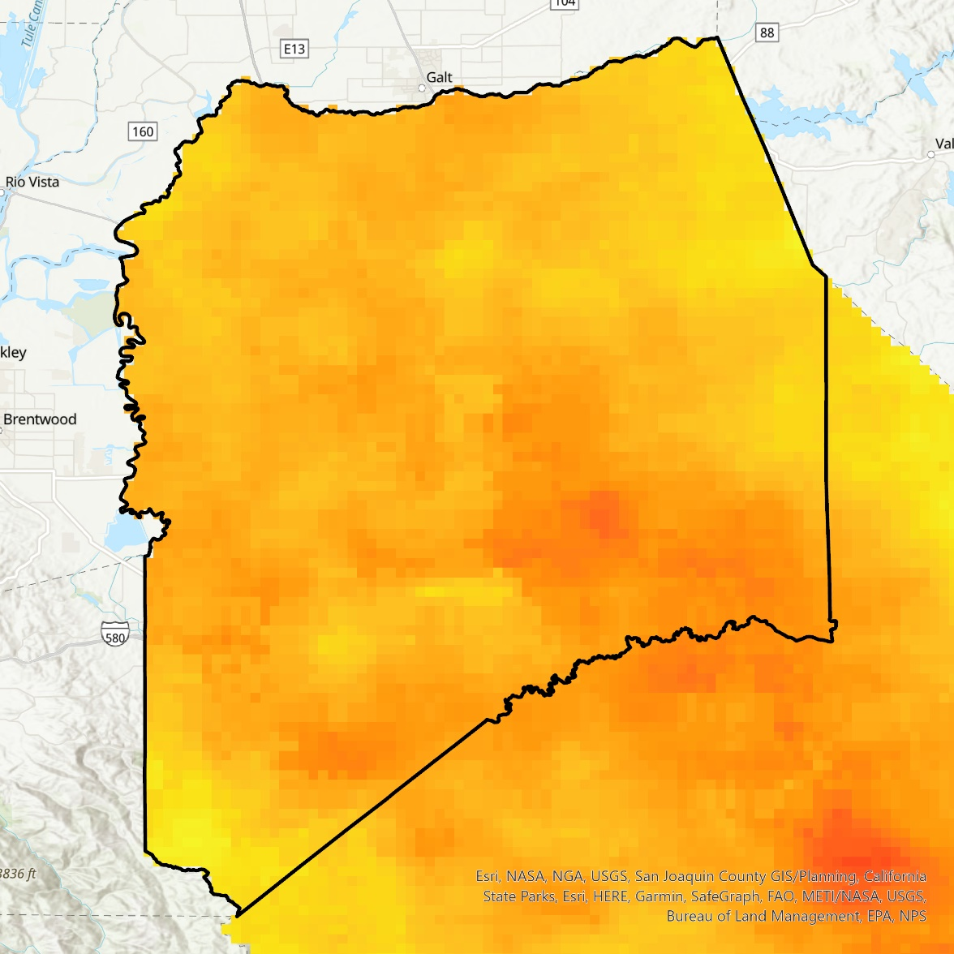
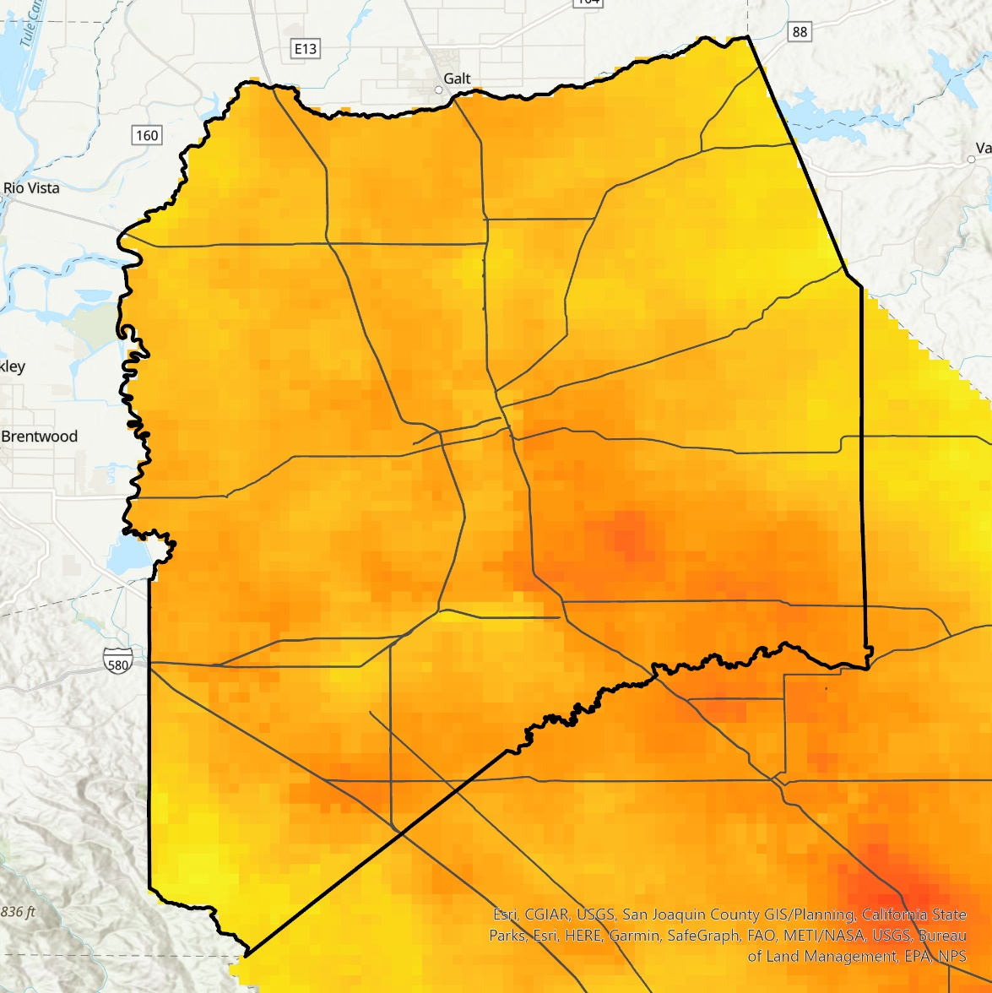
Results – NO₂ (San Joaquin County)
2022 Median NO₂
2022 Median NO₂ + Roads
Nitrogen Dioxide
High
N
Stockton
Stockton
Low
San Joaquin County
Major Roads
Modesto
Modesto
0
2.5
0
5
10
15
20
2.5
10
15
20
Miles
5
Miles
Notes:
Speak notes:
Here is the distribution of median NO2 across San Joaquin County and then an overlap with major roads. You can see the hotspots of median NO2 still overlap with highways in the county.

Slide 30
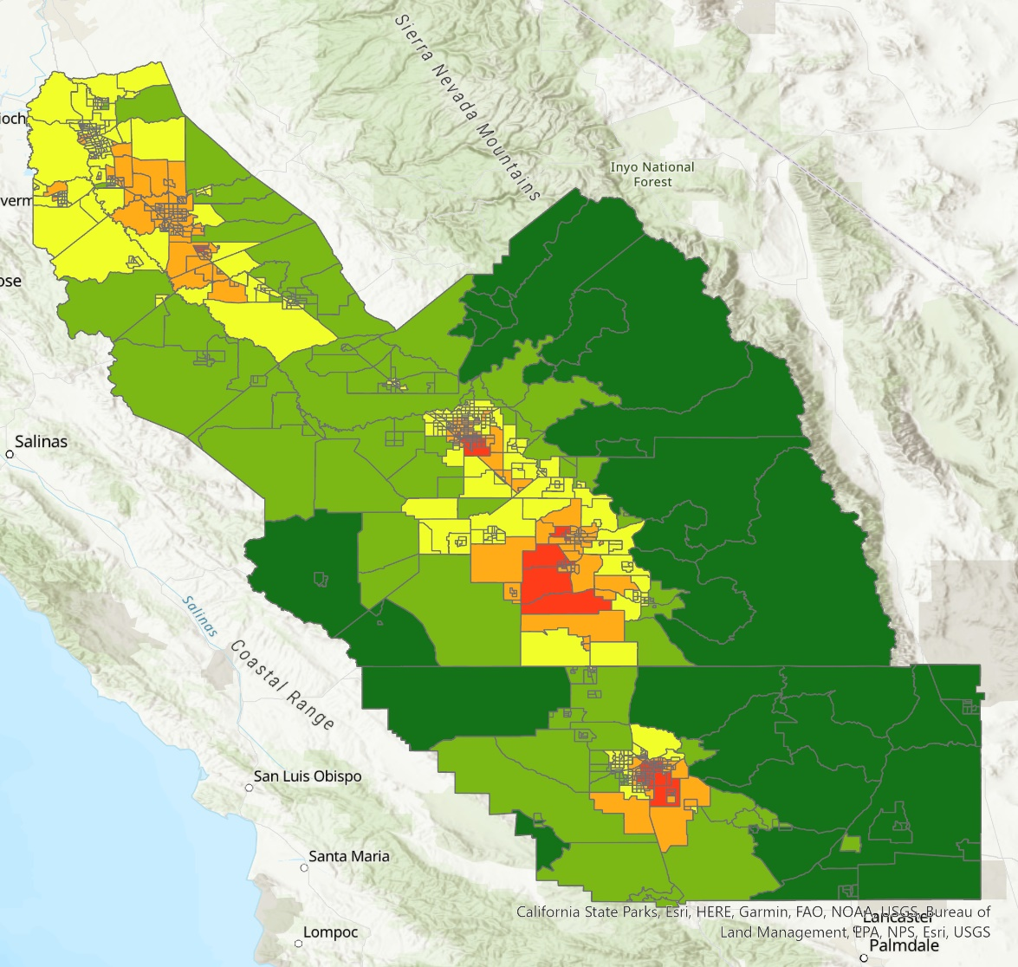
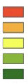

Results – NO₂ Zonal Statistics (San Joaquin Valley)
2022 Median NO₂ - Zonal Statistics (Mean)
Nitrogen Dioxide
High
Stockton
N
Medium
Modesto
Low
Fresno
Visalia
Bakersfield
0
25
50
75
100
12.5
Miles
Notes:
Speaker note:
Here is a map of the distribution median NO2 across the valley by zonal statistics.

Slide 31
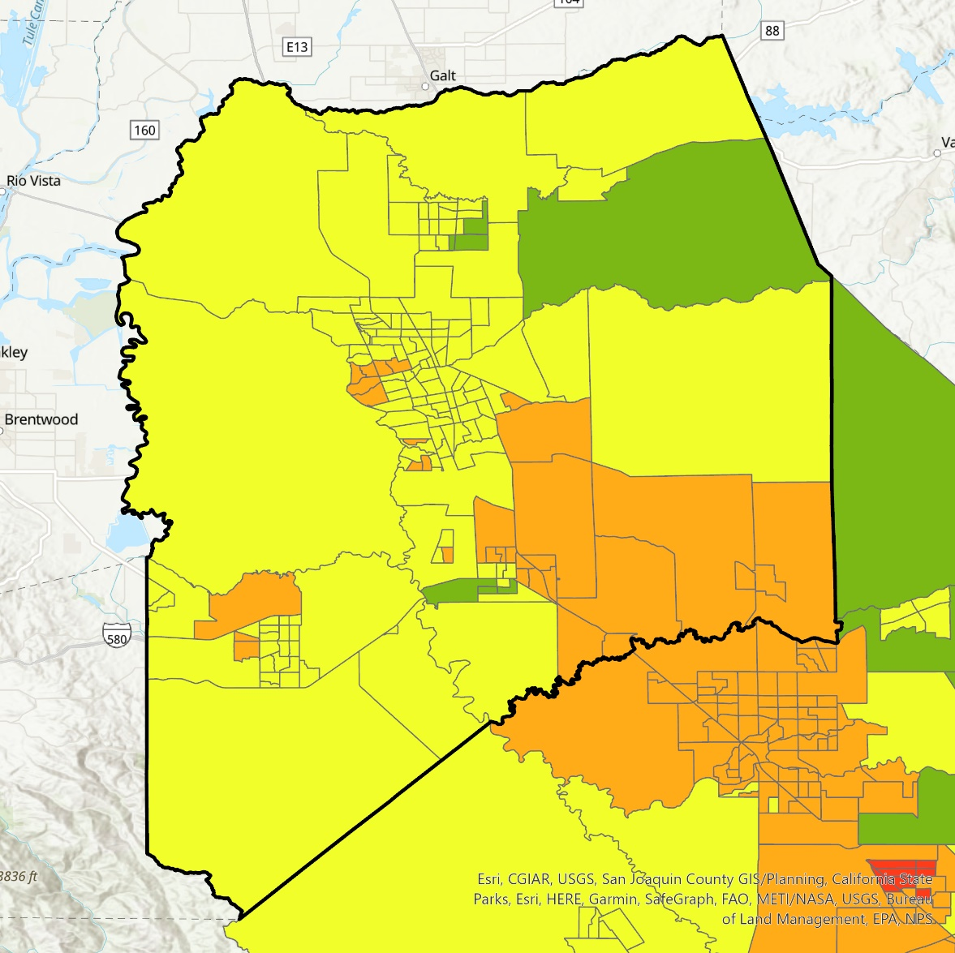
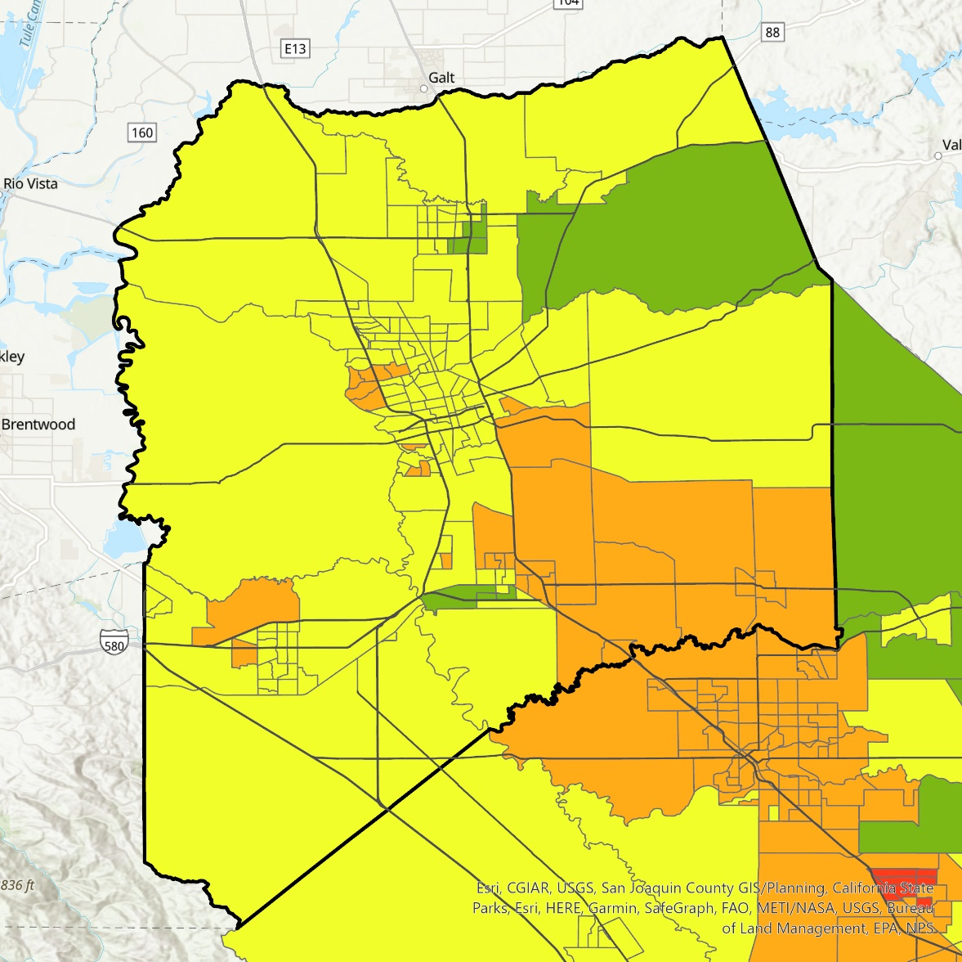
Results – NO₂ Zonal Statistics (San Joaquin County)
2022 Median NO₂ + Major Roads –
Zonal Statistics (Mean)
2022 Median NO₂ – Zonal Statistics (Mean)
Nitrogen Dioxide
High
N
Medium
Stockton
Low
Stockton
San Joaquin County
Major Roads
Modesto
Modesto
2.5
10
15
20
2.5
10
15
20
0
5
Miles
0
5
Miles
Notes:
San Joaquin County zonal stats for median NO2 in 2022.

Slide 32
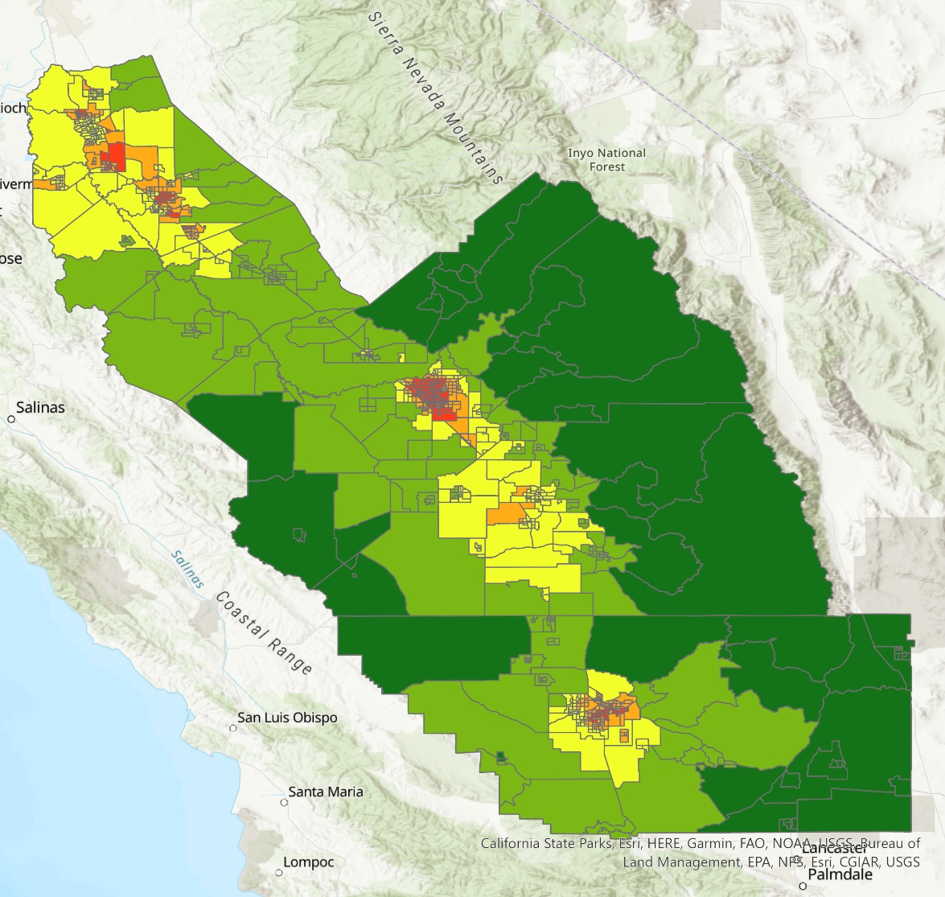

Results – NO₂ Zonal Statistics (San Joaquin Valley)
2022 95th Percentile NO₂ – Zonal Statistics (Mean)
Nitrogen Dioxide
High
N
Stockton
Medium
Modesto
Low
Fresno
Visalia
Bakersfield
0
25
50
75
100
12.5
Miles
Notes:
Speaker note:
Here is a map of the distribution 95%tile NO2 across the valley by zonal statistics.

Slide 33
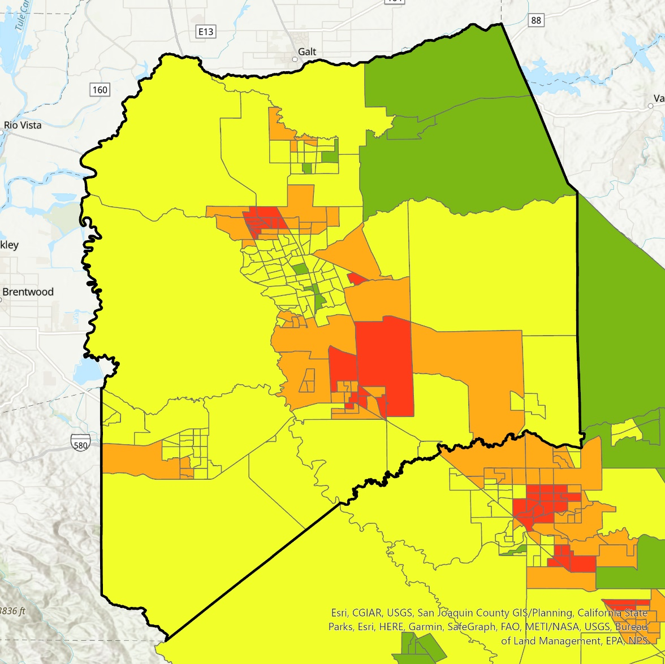
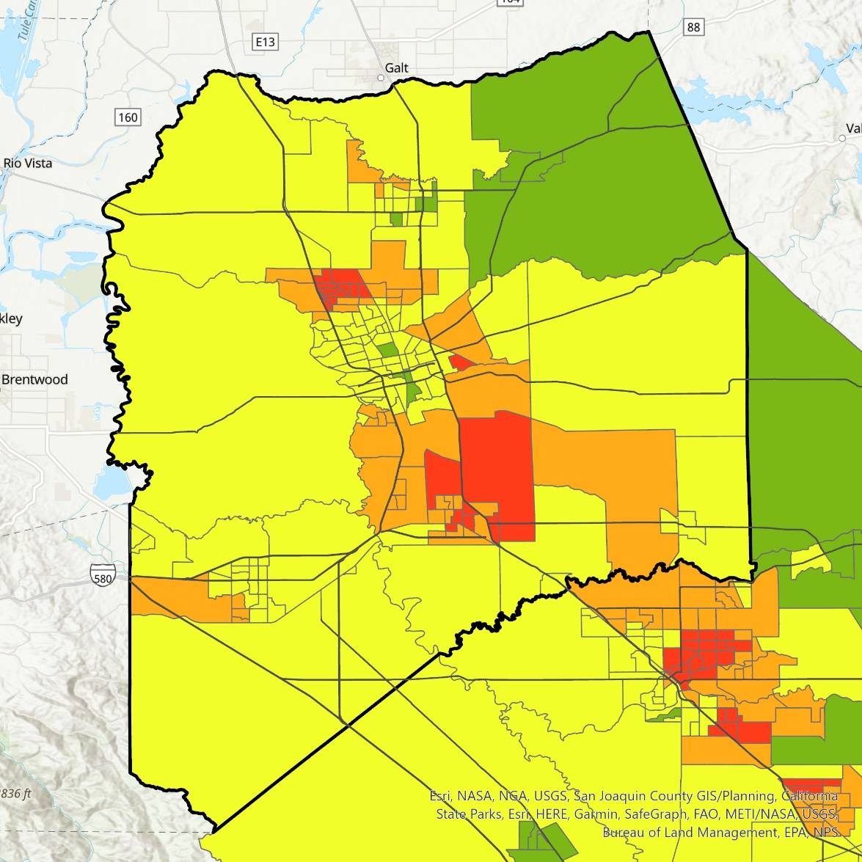
Results – NO₂ Zonal Statistics (San Joaquin County)
2022 95th Percentile NO₂ –
Zonal Statistics (Mean)
2022 95 NO₂ + Major Roads –
Zonal Statistics (Mean)
Nitrogen Dioxide
High
N
Stockton
Medium
Stockton
Low
San Joaquin County
Major Roads
Modesto
Modesto
2.5
10
15
20
2.5
10
15
20
0
5
Miles
0
5
Miles
Notes:
Speaker note:
Here is a map of the distribution 95%tile NO2 across the San Joaquin County by zonal statistics.

Slide 34
Results – Median AOD Time Series
Median AOD from 2012–2022
0.4
0.35
0.3
0.25
Monthly Median AOD
0.2
0.15
0.1
0.05
0
Jan
Feb
Mar
Apr
May
Jun
Jul
Aug
Sep
Oct
Nov
Dec
Standard Error
2020
2021
AOD Average (2012-2022)
Notes:
Speaker notes:
Here is a median AOD yearly time series that model AOD values across SJV on a monthly basis. The purple line represents the average of the 11 year time period, while the red and green are the two outlier years that deviated heavily from the average, mostly due to wildfires.

Slide 35

Results – AOD Time Series
95% AOD from 2012–2022
Median AOD from 2012–2022
0.4
0.4
0.35
0.35
0.3
0.3
Monthly 95% AOD
0.25
Monthly Median AOD
0.25
0.2
0.2
0.15
0.15
.1
.1
0.05
0.05
0
0
Sep
Oct
Nov
Dec
Sep
Oct
Nov
Jan
Dec
Feb
Mar
Apr
May
Jun
Jul
Aug
Jan
Feb
Mar
Apr
May
Jun
Jul
Aug
Standard Error
2020
Standard Error
2020
2021
AOD Average (2012-2022)
2021
AOD Average (2012-2022)
Notes:
Speaker notes:
Here is both the median and 95%tile AOD time series for SJV

Slide 36


Results – AOD Time Series
Median AOD from 2012–2022
95% AOD from 2012–2022
0.4
0.35
0.35
0.3
0.3
0.25
0.25
0.2
0.2
0.15
0.15
.1
.1
0.05
0.05
0
0
Sep
Oct
Nov
Jan
Dec
Feb
Mar
Apr
May
Jun
Jul
Sep
Aug
Oct
Nov
Jan
Dec
Feb
Mar
Apr
May
Jun
Jul
Aug
Standard Error
2020
Standard Error
2020
2021
AOD Average (2012-2022)
2021
AOD Average (2012-2022)
Notes:
Speaker notes:
Here is both the median and 95%tile AOD time series for San Joaquin County.

Slide 37

Results – NO₂ Time Series
Median NO₂ from 2018–2022
0.5
0.45
0.4
Monthly Median NO2 (mol/m2) *10,000
0.35
0.3
0.25
0.2
0.15
Nov
Jan
Dec
Feb
Mar
Apr
May
Jun
Jul
Aug
Sep
Oct
2018
2021
2020
2019
2022
Notes:
Speaker notes:
Here is a median NO2 yearly time series that model NO2 values across SJV on a monthly basis. This shows all the years

Slide 38

Results – NO₂ Time Series
95% NO₂ from 2018–2022
1.35
1.15
Monthly 95% NO2 (mol/m2) *10,000
0.95
0.75
0.55
0.35
0.15
Feb
Jan
Mar
Apr
May
Jun
Jul
Sep
Oct
Dec
Aug
Nov
2018
2021
2020
2019
2022
Notes:
Speaker notes:
Here is a 95%tile NO2 yearly time series that model NO2 values across SJV on a monthly basis. This shows all the years

Slide 39
Results – NO₂ Time Series
95% NO₂ from 2018–2022
Median NO₂ from 2018–2022
1.4
0.5
1.2
0.45
1
0.4
Monthly 95% NO2 (mol/m2*10,000
0.8
0.35
Monthly Median NO2 (mol/m2*10,000
0.6
0.3
0.4
0.25
0.2
0.2
Sep
Oct
Nov
Dec
Sep
Oct
Nov
Jan
Dec
Feb
Mar
Apr
May
Jun
Jul
Aug
Jan
Feb
Mar
Apr
May
Jun
Jul
Aug
Standard Error
2022
Standard Error
2022
2020
NO₂ Average (2018-2022)
2020
NO₂ Average (2018-2022)
Notes:
Speaker notes:
Here is a median and 95%tile NO2 yearly time series that model NO2 values across SJV on a monthly basis. IN this one, the average was modelled per month and the outlier of 2022 was modelled independently as well.

Slide 40


Results – NO₂ Time Series: San Joaquin County
95% NO₂ from 2018–2022
Median NO₂ from 2018–2022
1.6
0.6
1.4
0.55
1.2
0.5
0.45
1
Monthly Median NO2 (mol/m2) *10,000
0.4
Monthly 95% NO2 (mol/m2) *10,000
0.8
0.35
0.6
0.3
0.4
0.25
0.2
0.2
Sep
Oct
Nov
Jan
Dec
Feb
Mar
Apr
May
Jun
Jul
Sep
Aug
Oct
Nov
Jan
Dec
Feb
Mar
Apr
May
Jun
Jul
Aug
Standard Error
2022
2020
Standard Error
2022
NO₂ Average (2018-2022)
2020
NO₂ Average (2018-2022)
Notes:
Speaker notes:
Here is a median and 95%tile NO2 yearly time series that model NO2 values across San Joaquin County on a monthly basis.

Slide 41

Objectives
Model Air Pollution Distribution Across the San Joaquin Valley
Visualize Disparities in Impact Based on Social Vulnerability
Identify Overlap Between Poor Air Quality and Regional Burning
Validate Remotely-sensed and Ground-based Air Quality Data
Notes:
Speaker notes:
The second objective we will discuss is visualizing disparities in impacts based on social vulnerability.

Slide 42

Results – Bivariate AOD
2022 Median AOD Bivariate
2022 95th Percentile AOD Bivariate
Mean AOD
Mean AOD
Social Vulnerability Index
Social Vulnerability Index
Stockton
High
N
Stockton
High
N
Modesto
Low
Modesto
Low
Low
High
Low
High
Fresno
Fresno
Visalia
Visalia
Bakersfield
Bakersfield
0
25
50
75
100
25
50
75
100
12.5
0
Miles
12.5
Miles
Notes:
Speaker notes:
Here are bivariate maps that show mean AOD and social vulnerability by census tract in the entire SJV. Darker values are areas with higher AOD and higher social vulnerability.

Slide 43


Results – Bivariate AOD (San Joaquin County)
2022 95th Percentile AOD Bivariate
2022 Median AOD Bivariate
Mean AOD
Social Vulnerability Index
Stockton
High
N
Stockton
Low
Low
High
San Joaquin County
Modesto
Modesto
2.5
10
15
20
2.5
10
15
20
0
5
0
5
Miles
Miles
Notes:
Speaker notes:
Here are bivariate maps that show mean AOD and social vulnerability by census tract in just San Joaquin County. Darker values are areas with higher AOD and higher social vulnerability.

Slide 44

Results – Bivariate NO₂
2022 Median NO₂ Bivariate
2022 95th Percentile NO₂ Bivariate
Mean NO₂
Mean NO₂
Stockton
Social Vulnerability Index
Social Vulnerability Index
High
N
Stockton
High
N
Modesto
Modesto
Low
Low
Low
High
Low
High
Fresno
Fresno
Visalia
Visalia
Bakersfield
Bakersfield
0
25
50
75
100
25
50
75
100
12.5
0
Miles
12.5
Miles
Notes:
Speaker notes:
Here are bivariate maps that show mean NO2 and social vulnerability by census tract in the entire SJV. Darker more blue values are areas with higher NO2 and higher social vulnerability.

Slide 45


Results – Bivariate NO₂ (San Joaquin County)
2022 Median NO₂ Bivariate
2022 Median NO₂ Bivariate + Major Roads
Mean NO2
Stockton
Social Vulnerability Index
High
N
Stockton
Low
Low
High
San Joaquin County
Major Roads
Modesto
Modesto
2.5
10
15
20
2.5
10
15
20
5
0
5
Miles
0
Miles
Notes:
Speaker notes:
Here are bivariate maps that show median NO2 and social vulnerability by census tract in just San Joaquin County. Darker more blues values are areas with higher NO2 and higher social vulnerability.

Slide 46


Results – Bivariate NO₂ (San Joaquin County)
2022 95th Percentile NO₂ Bivariate + Major Roads
2022 95th Percentile NO₂ Bivariate
Mean NO2
Stockton
Social Vulnerability Index
Stockton
High
N
Low
Low
High
San Joaquin County
Major Roads
Modesto
Modesto
2.5
10
15
20
2.5
10
15
20
5
0
5
Miles
0
Miles
Notes:
Speaker notes:
Here are bivariate maps that show 95%tile NO2 and social vulnerability by census tract in just San Joaquin County. Darker more blues values are areas with higher NO2 and higher social vulnerability

Slide 47




Stockton Aerosol Profile: High Pollution Day
Altitude (km)
AOD
0
5
8
Mean 532 nm Extinction Coefficient
7
6
5
4
3
2
1
0
0.4
0.0
0.1
0.2
0.3
0.5
0.6
0.7
Mean (Per Kilometer))
Notes:
Speaker notes:
This is a case study of a high pollution day where there was also a wildfire. Vertical feature is high and aerosol types include smoke. Extinction coefficient plot shows high values at high altitudes.

Slide 48


Stockton Aerosol Profile: Moderate Pollution Day
Altitude (km)
AOD
0
5
8
Mean 532 nm Extinction Coefficient
7
6
5
4
3
2
1
0
0/04
0.12
0.06
0.08
0.10
0.14
0.16
Mean (Per Kilometer))
Notes:
Speaker notes:
This is a case study of a moderate pollution day where there was no wildfire. Vertical feature is high and aerosol types include most polluted dust. Extinction coefficient plot shows moderately high values at moderate altitudes

Slide 49




Stockton Aerosol Profile: Low Pollution Day
Altitude (km)
AOD
0
5
8
Mean 532 nm Extinction Coefficient
7
6
5
4
3
2
1
0
0.06
0.10
0.02
0.09
0.03
0.04
0.05
0.07
0.08
Mean (Per Kilometer))
Notes:
Speaker notes:
This is a case study of a low pollution day where there was no wildfire. Vertical feature is low and aerosol types include mostly just dust. Extinction coefficient plot shows moderately low values at low altitudes.

Slide 50
Objectives
Model Air Pollution Distribution Across the San Joaquin Valley
Visualize Disparities in Impact Based on Social Vulnerability
Identify Overlap Between Poor Air Quality and Regional Burning
Validate Remotely-sensed and Ground-based Air Quality Data
Notes:
Speaker notes:
Next we will discuss the overlap between poor air quality and regional burning.

Slide 51


Results – Active Fires Distribution
Active Fire Count (2021)
0 - 15
N
16 - 100
101 - 200
201 - 1499
1500+
0
17.5
35
8.75
52.5
70
Miles
Notes:
Speaker notes:
Using the Suomi-NPP satellite VIIRS data, we were able to look at active fires throughout the study area. The areas that saw the largest counts of active fires that coincided with satellite overpass is in darker red and mostly in the Sequoia National Park in Tulare County. Other areas of the forest and agricultural land saw some fires, but most urban and suburban areas saw little to no fires.

Slide 52
Results – Active Fire vs. Aerosol Optical Depth
AOD v. Active Fire 2021
95%tile AOD
N
Active Fires
High
Low
Low
High
0
8.75
35
70
17.5
52.5
Miles
Notes:
Speaker notes:
If we overlap the same data with the highest AOD values in 2021, we can see that many areas with high counts of fire by VIIRS also had higher max values of AOD. However, there is no significant correlation between fire counts and AOD values or burn permits and AOD values.

Slide 53

Results – Burn Permits + Active Fire Time series
Notes:
Speaker notes:
Here is a time series of the number of burn permit administered and the number of active fires detected by month from 2012 to 2021. The highlighted blue columns indicate California wildfire season which stretches from June to October. Burn permits spike during non wildfire season which makes sense since the state would not want to contribute to more fires or air quality issues during the already horrid wildfire season. As you can see in the time series of wildfires in red, we see that active fire detections do peak during wildfire season, potentially indicating that the majority of observed fires in the study area are wildfires and that they are much more of an issue than agricultural burning.

Slide 54



Results – AOD + Active Fire Time series
Notes:
Speaker notes:
Here is a regression model to find the correlation between active fires and AOD across the SJV.

Slide 55


Results – AOD + Active Fire Time series: San Joaquin County
Notes:
Speaker notes:
Here is a regression model to find the correlation between active fires and AOD across the San Joaquin County.

Slide 56
Results – Burn Permits vs. Active Fires
Number of Burn Permits Administered
Test | Mean 1ª | Mean 2^{b} | Variance 1 | Variance 2 | N 1 | N 2 | T-Stat | Critical Point | P-value^{d}
Ag vs. Non-Ag tracts: # Burn Permits | 68.65 | 3.75 | 14,327.74 | 514.81 | 218 | 772 | 7.99 | 1.97 | 3.71 x 10⁻¹⁴
Ag vs. Non-Ag tracts : # Active Fires | 10.93 | 34.73 | 493.94 | 258,312.09 | 218 | 772 | 1.30 | 1.96 | 0.20
Ag vs. Non-Ag tracts: # Active Fires (No wildfire dates)^{c} | 10.93 | 2.50 | 493.94 | 454.31 | 218 | 768 | 4.99 | 1.97 | 9.66 x 10⁻⁷
a. 1 refers to t-test components for agriculture census tract data c. Data from dates of significant wildlife as recorded by Calfire in 2021 were removed from affected census tracts
b. 2 refers to t-test components for non-agriculture census tract data d. Highlighted indicates statistically significance difference.
Notes:
Speaker notes:
Now if we begin to look at burn permits vs. active fires, we see that if we look at every census tract in our study area, there is no correlation between burn permits and the number of fires detected in a census tract, at least in 2021. This makes sense since wildfires are more of an issue and they are spontaneous and don’t wait for a burn permit to happen. However, if we just look at agricultural census tracts, there is actually a large correlation between burn permits and active fires detected, indicating that 1) wildfires do not occur as frequently in these tracts and 2) illegal burning is relatively tame given that not only are the values correlated, but the number of active fires detected are less than the number of burn permits administered. Furthermore, there were statistically significant more burn permits given in agriculture than non-agriculture census tracts, but there was not a statistically significant differences in the number of active fires unless significant wildfire data points are removed. in 2021, removing the 4 census tracts in the Sequoia National Park where the massive wildfire occurred in September and October leads to agriculture census tracts having significantly more fires, further underscoring that wildfires dominate the fire count in this study area.

Slide 57





Results – Agriculture vs. Non-Agriculture Tracts
N
N
Agriculture Tract
Agriculture Tract
Non-agriculture Tract
Non-agriculture Tract
0
17.5
35
70
0
17.5
35
70
8.75
52.5
8.75
52.5
Miles
Miles
 | Median AODª | 95%tile AOD | Median NO₂^{c} | 95%tile NO₂ | Median CO | 95%tile CO
Agriculture tract | 0.107 | 0.354 | 0.0000367 | 0.0000661 | 0.0335 | 0.0452
Non-agriculture tract | 0.104 | 0.327 | 0.0000396 | 0.0000836 | 0.0333 | 0.0447
P-value^{b} | 0.00619 | 4.18 x 10⁻⁶ | 4.66 x 10⁻¹¹ | 8.32 x 10⁻⁴⁰ | 0.0111 | 0.00158
a. Values for all air quality indicators were calculated from data collected from 2019-2022. c. AOD is unitless. NO₂ and CO is measured in molecules/m²
b. Highlighted indicates statistically significance difference
Notes:
Speaker notes:
From USDA cropland data layer, the team was able to classify each pixel in the study area as an agricultural content or non agricultural content. From there, each census tract could be labeled an agriculture census tract or non-agriculture census tract depending on what the majority of classified pixels in its area was. From there, we could then do some analysis to see the difference between air pollution over agriculture land vs non-agriculture land. Notably, AOD and CO is higher over agriculture tracts, while NO2 is higher over non-agriculture tracts.

Slide 58



Results – Agriculture vs. Non-Agriculture Tracts
Agriculture
Non-agriculture
Median and 95% AOD and CO was significantly higher in Agricultural Census Tracts, while Median and 95% NO2 was significantly higher in Non-Agricultural Census Tracts.
a. Values for all air quality indicators were calculated from data collected from 2019-2022. c. AOD is unitless. NO₂ and CO is measured in molecules/m²
b. Highlighted indicates statistically significance difference
Notes:
Speaker notes:
From USDA cropland data layer, the team was able to classify each pixel in the study area as an agricultural content or non agricultural content. From there, each census tract could be labeled an agriculture census tract or non-agriculture census tract depending on what the majority of classified pixels in its area was. From there, we could then do some analysis to see the difference between air pollution over agriculture land vs non-agriculture land. Notably, AOD and CO is higher over agriculture tracts, while NO2 is higher over non-agriculture tracts.

Slide 59
Objectives
Model Air Pollution Distribution Across the San Joaquin Valley
Visualize Disparities in Impact Based on Social Vulnerability
Identify Overlap Between Poor Air Quality and Regional Burning
Validate Remotely-sensed and Ground-based Air Quality Data
Notes:
Speaker notes:
Lastly, we will discuss validation and how we went about determining the accuracy of our remotely sensed measured based on how they matched with in-situ sensors.

Slide 60

Results – AOD AERONET Validation
MODIS and AERONET AOD Validation
5
4
Linear regression of MODIS AOD with AERONET Sensor had an R^2 of .88 and standard error of 0.1377
AERONET AOD
3
2
1
1
2
3
4
5
MODIS AOD
Notes:
Speaker notes:
This graph shows our AOD to AOD validation where we validated AOD values from MODIS (which measures from space down) against AOD values from Fresno (which measures from ground up). There is a high correlation with an R-squared values of 0.89

Slide 61

Results – NO₂ Validation
80
1.8
70
1.6
60
1.4
1.2
50
Sensor NO2 Concentration (ppb)
1
Sensor NO2
40
Satellite NO2 Concentration (mol/m2*10000)
0.8
Satellite NO2
30
0.6
20
0.4
10
0.2
0
0
May 2019
June 2020
Jan 2021
July 2021
Feb 2022
Aug 2022
Aug 2018
Dec 2019
March 2023
Notes:
Speaker notes:
This graph shows daily NO2 satellite data and highlights that there are large gaps in the data we used for validation, particularly from January through May.

Slide 62

Results – NO₂ Validation
1.8
1.6
Filtered Data | Fresno R² | Kern R²
All Data | 0.3892 | 0.3958
2019 Only | 0.3853 | 0.6666
2020-2022 | 0.3961 | 0.271
Fall | 0.3446 | 0.3098
Winter | 0.4308 | 0.2829
Spring | 0.4423 | 0.3039
Summer | 0.1089 | 0.1365
1.4
R^2 = 0.40
1.2
R^2 = 0.39
1
Satellite NO₂ (mol/m2*10,000)
0.8
0.6
0.4
0.2
0
0
10
20
30
40
50
60
70
Sensor NO₂ (ppb)
Fresno
Fresno Linear Regression Line
Kern
Kern Linear Regression Line
Notes:
Speaker notes:
This graph shows as validating No2 from Tropomi to in-situ ground-based EPA standard for two different sensors—data was relatively similar for both. There is moderate correlation with R^2 being ~0.39, but the satellite tended to overestimate the NO2 values a little.

Slide 63

Results – AOD/PM_{2.5} Validation (Fresno)
180
3.5
160
3
140
2.5
120
AOD
100
2
PM 2.5 (mg/m3)
80
1.5
60
AOD
1
40
PM 2.5
20
0.5
0
0
Oct 2019
Jan 2021
April 2022
July 2022
Oct 2022
April 2021
July 2021
April 2020
Oct 2021
Jan 2022
July 2020
July 2019
Jan 2020
Oct 2020
April 2019
Jan 2019
Dates
Notes:
Speaker notes:
Breaking down the AOD/PM2.5 validation by time for one of the sensors, we can see certain periods or certain concentrations of PM2.5 were better matched between ground based and satellite sensors. Notably, 2019 was a bad year and it is more accurate in summers than winters and at higher concentrations.

Slide 64
Results – AOD/PM_{2.5} Validation
4
Data Filter | Fresno R² | Madera R²
All Data (2019-2022) | 0.4219 | 0.5589
2019 Only | 0.0214 | 0.0567
2020-2022 | 0.4423 | 0.5689
Fall | 0.2717 | 0.3851
Winter | 0.2804 | 0.3955
Spring | 0.4700 | 0.5820
Summer | 0.5946 | 0.6867
Fire Season | 0.5711 | 0.6373
Not Fire Season | 0.1050 | 0.0948
PM 2.5 < 15µg/m³ | 0.0265 | 0.0095
PM 2.5 >= 15µg/m³ | 0.4033 | 0.5650
PM 2.5 < 35µg/m³ | 0.0919 | 0.0964
PM 2.5 >= 35µg/m³ | 0.3475 | 0.4359
3.5
R^2 = 0.56
3
2.5
Daily AOD
R^2 = 0.42
2
1.5
1
0.5
0
0
50
100
150
200
Daily PM 2.5 (ug/m3)
Fresno
Fresno Linear Regression Line
Madera
Madera Linear Regression Line
Notes:
Speaker notes:
This our validation of AOD to PM2.5 for the full data set, which saw moderate correlation of about 0.42 or 0.56 dependent on the sensor. Based on findings from the previous slide, additional analyses were looked at in which we found higher correlation between AOD and PM2.5 in spring/summer/ fire season and when PM 2.5 was over 15mg/m3 (the WHO guidelines for maximum 24-hour exposure PM2.5). While AOD does not perfectly correlate with PM 2.5, it is a positive to see it correlates best when PM2.5 is high, which is when it matters most for human health.

Slide 65
Errors, Uncertainties, and Limitations
Environmental
Data Processing
Satellites
Suomi-NPP VIIRS does not collect all active fires in the study area.
Cloud Mask technical limitations.
CALIPSO data did not overlap with a non-wildfire high pollution date for case study.
Sentinel NO2 data has large gaps for daily data.
Atmospheric inversions limit the accuracy of validation, especially in winter months.
AOD represents pollutants in entire air column but only the lower altitude concentrations are relevant to communities.
Conducting zonal statistics on air quality raster led to loss of pollution data in some census tracts
Some social indicator data had to be estimated.
Social vulnerability index does not show adaptative characteristics well, such as HVAC installation rate.
Notes:
Speaker notes:
Now, there were some errors and limitations that we had to face throughout the project and they can be broken into three categories: environmental, data processing, and satellites. The major environmental limitation we had was with validation where as atmospheric inversions in the winter months led to a limitation on our validation during this time period. Similarly, since AOD represents pollutants in their air column, this naturally leads to less accuracy in terms of relevant pollutants since only near-surface pollutants are relevant for public health.
In terms of data processing, we had a lot of errors that led to less accurate zonal statistics or the omission of some census tracts. When doing zonal stats in ArcGIS pro from the air quality rasters, some of the census tracts couldn’t be calculated, leading to the loss of about 20 census tracts. Similarly, some social indicators from CDC and EPA EJScreen was not available for some census tracts, meaning it had to be estimated and thus is less accurate. Lastly, our index shows static characteristics but does not include adaptive characteristics that illustrate the populations attempt or possibility to adapt and better adjust to their environment.
Lastly, in terms of satellite you have the natural limitation in overpass time and clouds with the cloud mask, with notably CALIPSO only overlapping every 16 days so we could not get an extremely high pollution date not caused by wildfires for the case study.

Slide 66
Conclusions
Air pollution is not equitably distributed across San Joaquin Valley
Aerosol optical depth concentrations were greater in agriculture areas while NO₂ concentrations were greater in non-agriculture and urban areas.
Air pollution in the SJV was greater in months with more active fires, however census tracts with more active fires did not see any difference in air quality than those with less.
Census tracts with greater social vulnerability are exposed to
statistically higher concentrations of NO₂.
Satellite remote sensing can be used to estimate air quality in the SJV
with moderate accuracy.
Notes:
Speaker notes:
Some major conclusions we got from this presentation were:
1)
2) Different tracts saw higher or less concentrations of certain pollutants
3) Air pollution and active fires had a temporal relationship, but not a spatial one.
4) Socially vulnerability census tracts saw statistically higher concentrations of NO2 but not AOD.
5) Satellite remote sensing can be used to estimate air quality in the SJV with moderate accuracy, especially during certain times of the year like summer.

Slide 67
2022 95th Percentile NO2 + Major Roads
Stockton
Modesto
Fresno
Visalia
Bakersfield
Nitrogen Dioxide
High
0
25
50
75
100
Low
12.5
Miles
Notes:
Here is a map of the distribution of 95%tile NO2 across the valley. Areas along major roads and the urban areas tended to have higher levels of aerosol optical depth as compared to more remote and less populated areas.

