Slide 1


Thermal Management Challenges and Technology Options for Lunar Regenerative Fuel Cells
Ryan Gilligan, Phillip J. Smith, Robert Green
NASA Glenn Research Center
TFAWS Interdisciplinary Paper Session
Presented By
Ryan Gilligan
Thermal & Fluids Analysis Workshop
TFAWS 2023
August 21-25, 2023
NASA Goddard Space Flight Center
Greenbelt, MD

Slide 2
Outline
Lunar Surface Energy Storage Need
Why RFCs?
What Are RFCs?
RFC Thermal Management System Example
High Flux Thermal Switch Requirements
High Flux Candidate Technology Review
Summary

Slide 3
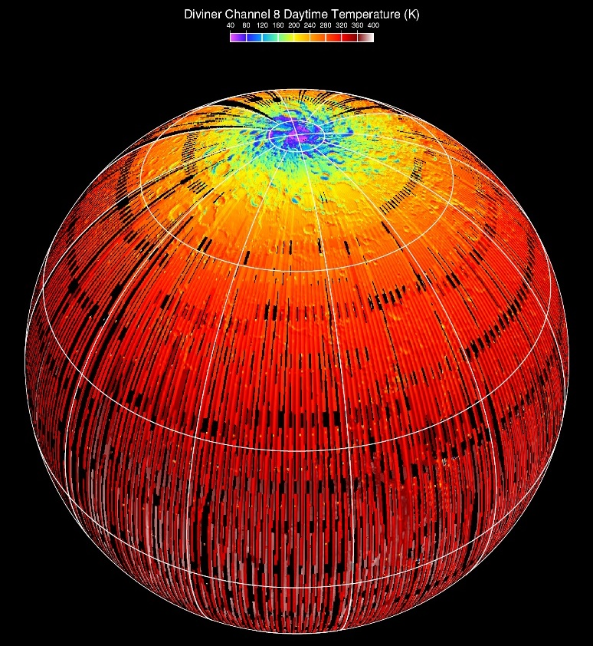
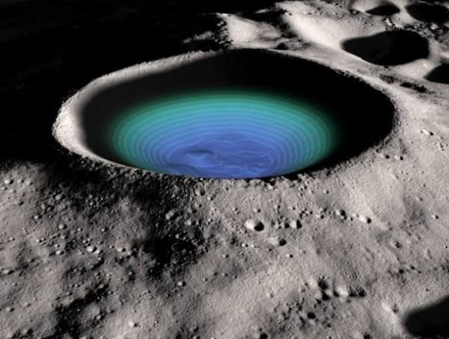
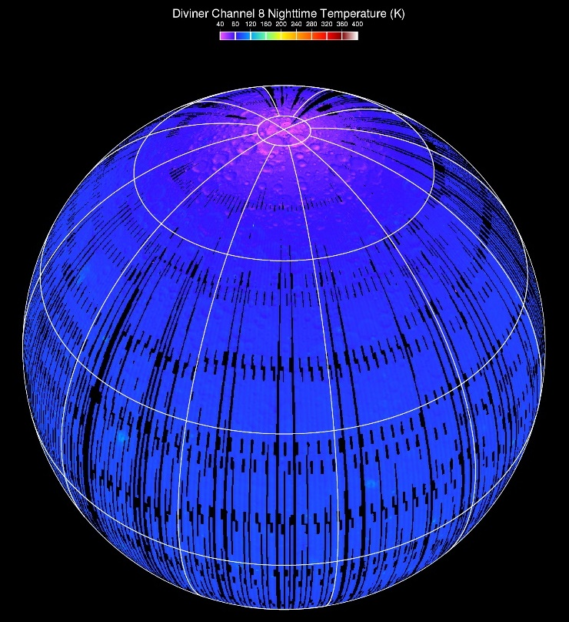
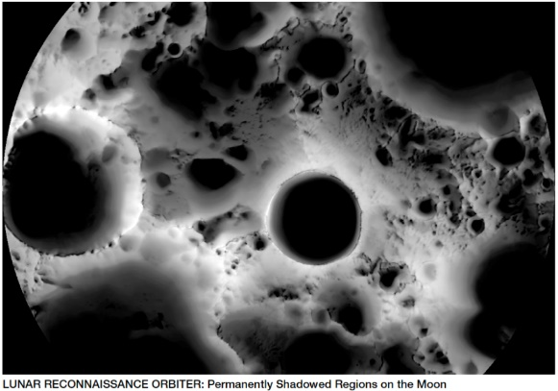
The Lunar Environment
Temperature maps of
Lunar surface during day (left) and night (right). Impact craters (middle).
The average temperature on the Moon (at the equator and mid latitudes) varies from 90 Kelvin (-298 ºF or -183 ºC), at night, to 379 Kelvin (224 ºF or 106 ºC) during the day.
Extremely cold temperatures near 35 Kelvin (-397 ºF or -238 ºC) within the permanently shadowed large polar impact craters
Lunar day/night cycle lasts between 27.32 and 29.53 Earth days (655.7 to 708.7 hours)
Regulating hardware temperatures in this varying environment requires both power and energy
Notes:
Without an atmosphere, the moon is a surface of extremes; when it is hot, it is very hot. When it is cold it is very cold. When it changes from one to the other, the transitions can be comparatively quick. Surviving in this environment takes many technologies and significant resources. Because of the very, very different environment on the moon, very few terrestrial components/systems are viable for use on the moon. They require significant customization and development. NASA has identified the Artemis Program as the mechanism to complete this customization and development effort.

Slide 4
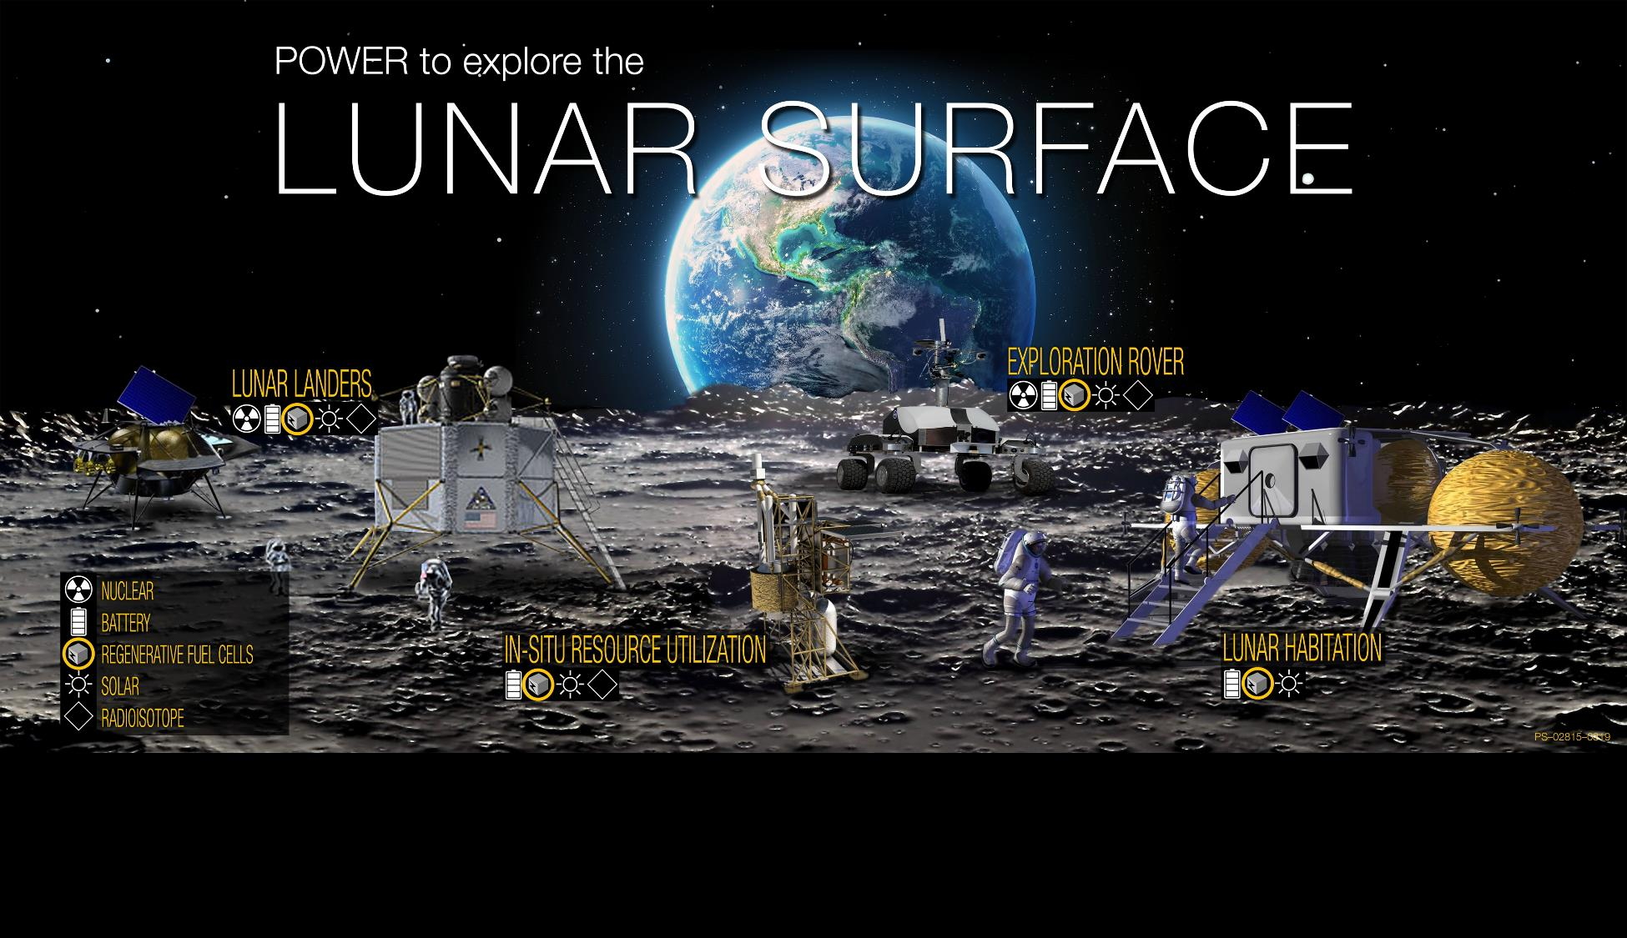
Regenerative Fuel Cells are an integral part of a Lunar Surface Power Architecture
  Regenerative Fuel Cells (RFCs) for Lunar Exploration
  RFCs can provide energy storage to provide power in locations near humans where nuclear power may not be an option
  RFCs can provide continuous power for longer-term operations (such as the lunar night)
  RFCs enable mission operations in harsh environments such as permanently shadowed craters
Notes:
All lunar applications required ENERGY and POWER. RFCs complement nuclear and battery technologies.

Slide 5
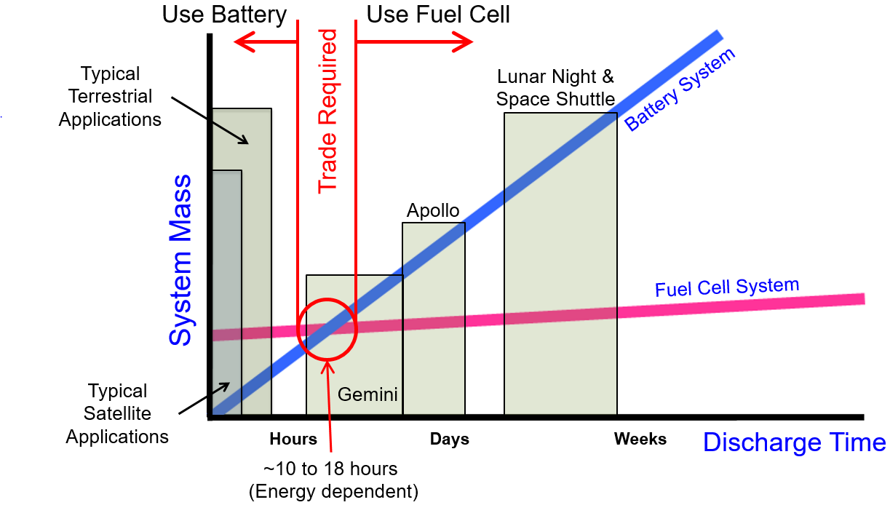
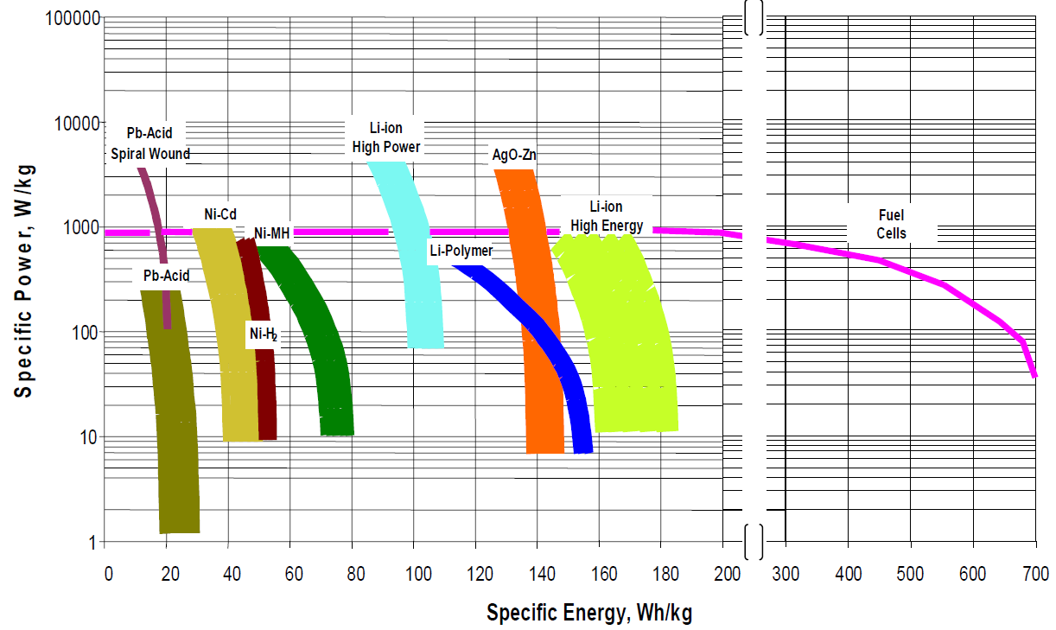
Why RFCs
Technologies are Complementary not Competitive
  No power or energy storage technology meets
  all requirements for all applications
  Each technology has a place within the overall exploration space
  Energy Storage Metric = Specific Energy (W·hr/kg)
    Packaged Li-ion Battery Systems ~ 160 W·hr/kg
    Regenerative Fuel Cell Systems <100 to >600 W·hr/kg based on location and energy requirements
Energy Options for Space Applications | Battery = TRL 9 Primary Fuel Cell = TRL 5 Regenerative Fuel Cell = TRL 3

Slide 6
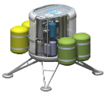
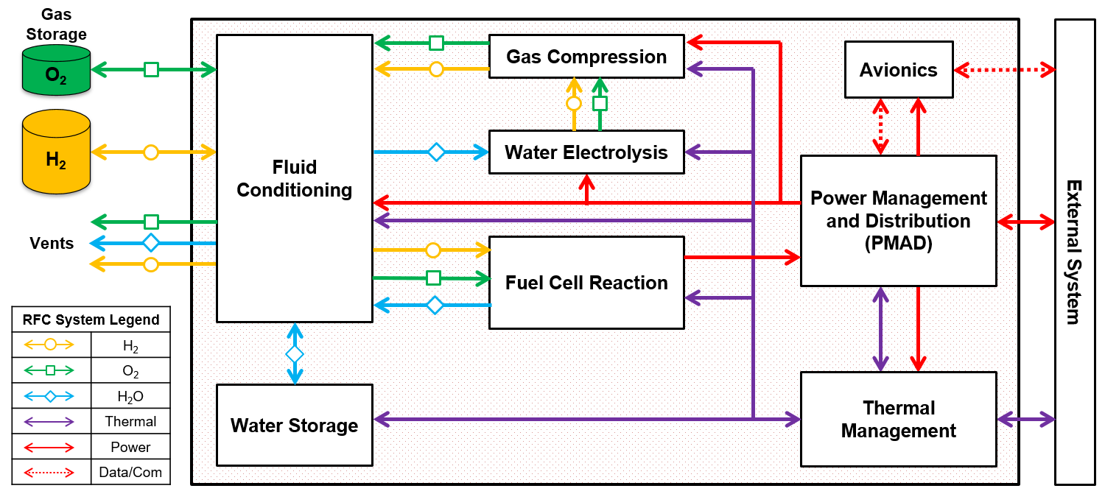
What is a Regenerative Fuel Cell?
What:
A system that utilizes fluids (i.e. H₂ and O₂ gases) to store energy
Why:
Higher specific energy (W·hr/kg) for high energy applications than a fully packaged battery system
RFC System Enclosure

Slide 7
RFC Project: Technology Challenges by Element
O₂ Gas Storage
Water-accelerated corrosion
Cleanliness Pressure Cycles Thermal Cycles
Fluid Processing and Control Module
DI Water Lift Pumps Electrolysis-compatible Biocides*** Sensor Calibration Stability Water Polishers / De-ionizers Water Quality
Catalytic Recombiner Phase Separators Regenerative Gas Dryers
Cleanliness Corrosion Material Compatibility Operations / Procedures Pressure Cycles Thermal Cycles
Water Electrolysis & Gas Compression
Efficient / Reliable Reactant Compression Electrolyte Mechanical Properties*** Safety Sensor (H₂–in–O₂, High Pressure) Stack Integration (Life, Performance, Reliability)***
Bipolar Plate / Interconnect Performance*** Catalyst Performance*** Electrode Performance*** Electrolyte Ionic Conductivity*** Safety Sensor (O₂–in–H₂, High Pressure) Water Quality***
Cleanliness Corrosion Material Compatibility Pressure Cycles
Avionics
Radiation-tolerant Avionics
Software
External System
H₂ Gas Storage
Water-accelerated embrittlement
Cleanliness Pressure Cycles Thermal Cycles
Power Management and Distribution
Radiation-tolerant Power Electronics
Power Standards (Quality, Interfaces)
Fuel Cell Reaction
Electrolyte Mechanical Properties*** Electrolyte Performance Stability*** Stack Integration (Life, Performance, Reliability)***
Bipolar Plate / Interconnect Performance*** Catalyst Performance*** Degassing Product Water*** Electrode Performance*** Electrolyte Ionic Conductivity*** Gas Diffusion Layer Performance*** Internal Water Management
Cleanliness Corrosion Material Compatibility
Legend
Tech Dev Required
Tech Dev Recommended
Engineering Required
*** = Required development depends on electrolyte: PEM vs Alkaline vs Solid Oxide
Water Storage
Water Quality
Contaminant Mitigation Dormancy / Shelf Life
Cleanliness Corrosion Fluid Volume Management Material Compatibility Pressure Cycles
Thermal Management
High Flux Thermal Switch (kW-scale)
Radiator / Heat Sink
Multi-range thermal systems Long-life coolant pumps

Slide 8
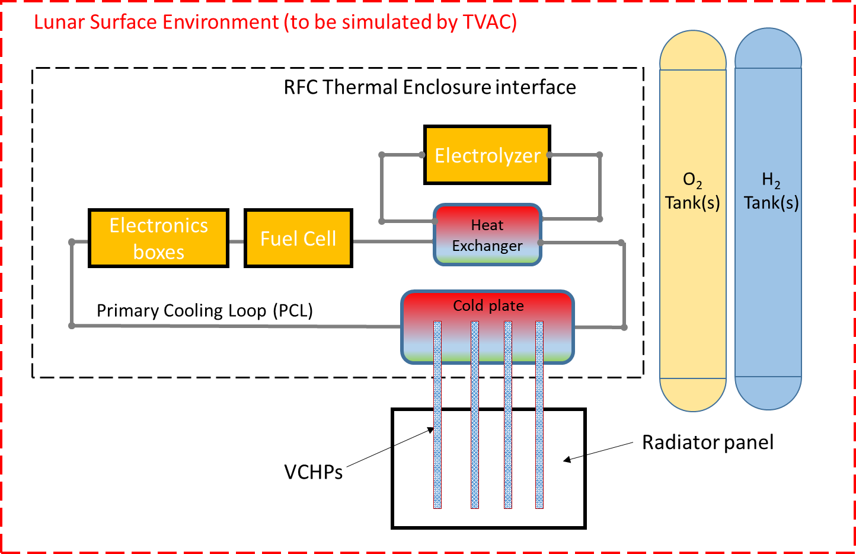
RFC Thermal Management System Example
Heat load sources
  Fuel Cell (FC), Electrolyzer (EZ) Stacks
  Balance of Plant Components (PMAD/Avionics, valves, pumps, etc)
  External loads (heat transfer to/from surface environment) via radiation and conduction
Passive Components
  Radiator panel
  MLI
  Thermal Coupling
Active Components
  Pumped cooling loop (x2)
  Heaters
  Heat Exchangers
High Flux
Thermal Switch
The Primary Cooling Loop (PCL) rejects heat from electronics and FC stacks directly, heat from EZ stack indirectly via a heat exchanger with a secondary recirculation loop. This heat is rejected via a high flux thermal switch to a radiator panel.

Slide 9
High Flux Thermal Switch
Challenge
  High internal and external heat load occurs during lunar day
    Need to reject max heat load when surface environment is also hottest
  Moderate heat loads during lunar night
    Need to conserve heat generated internally to keep temperatures within operating ranges while surface temperatures are extremely low
The radiator and the associated coupling technology must be able to adjust to these contrasting heat rejection needs, and ideally, be able to effectively disconnect during the lunar night to minimize heat loss
Lunar Day |  |  | Lunar Night
Steady State Heat Generation Nominal (W) | Steady State Heat Generation Maximum (W) | Transient Heat Generation Maximum (W) | Steady State Heat Generation Nominal (W) | Steady State Heat Generation Maximum (W) | Transient Heat Generation Maximum (W)
287 | 420 | 508 | 286 | 605 | 685
Representative thermal loads
for 100W net-power output scale RFC. Does not include heater power to maintain reactant storage tanks during night.

Slide 10
Thermal Switch Requirements
The method used to thermally connect the PCL to the radiator is a critical consideration and must:
  Maintain the PCL within a narrow temperature range
  Accommodate thermal rejection power from a variable PCL temperature and to a variable environmental sink temperature
  Maintain a minimum fluid temperature during the long lunar night
  Minimize parasitic losses from the fluid system to the environment during the lunar night
  Avoid interference with the geometry, orientation, and placement of the radiator
  Function in a vacuum environment of <1 mPa (10–5 torr)
  Be freeze-tolerant or nonfreezing to a minimum of 120 freeze and thaw cycles
  Desirable to use non-toxic fluids

Slide 11
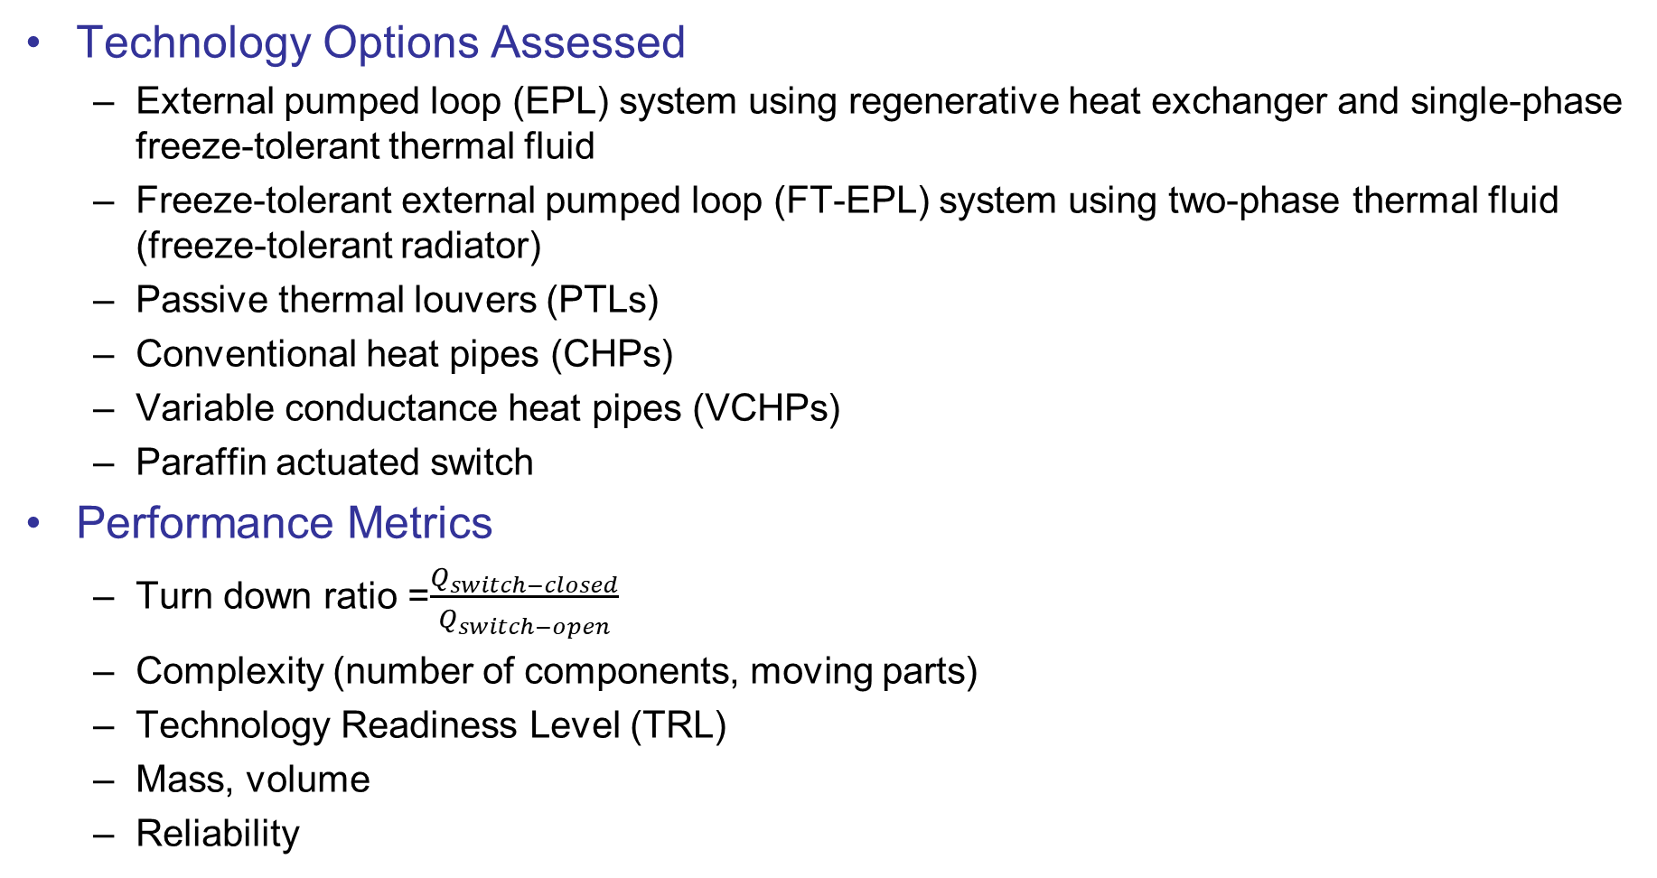
Trade Study
Technology Options Assessed
  External pumped loop (EPL) system using regenerative heat exchanger and single-phase freeze-tolerant thermal fluid
  Freeze-tolerant external pumped loop (FT-EPL) system using two-phase thermal fluid (freeze-tolerant radiator)
  Passive thermal louvers (PTLs)
  Conventional heat pipes (CHPs)
  Variable conductance heat pipes (VCHPs)
  Paraffin actuated switch
Performance Metrics
  Turn down ratio =$\frac{Q_{switch−closed}}{Q_{switch−open}}$
  Complexity (number of components, moving parts)
  Technology Readiness Level (TRL)
  Mass, volume
  Reliability

Slide 12
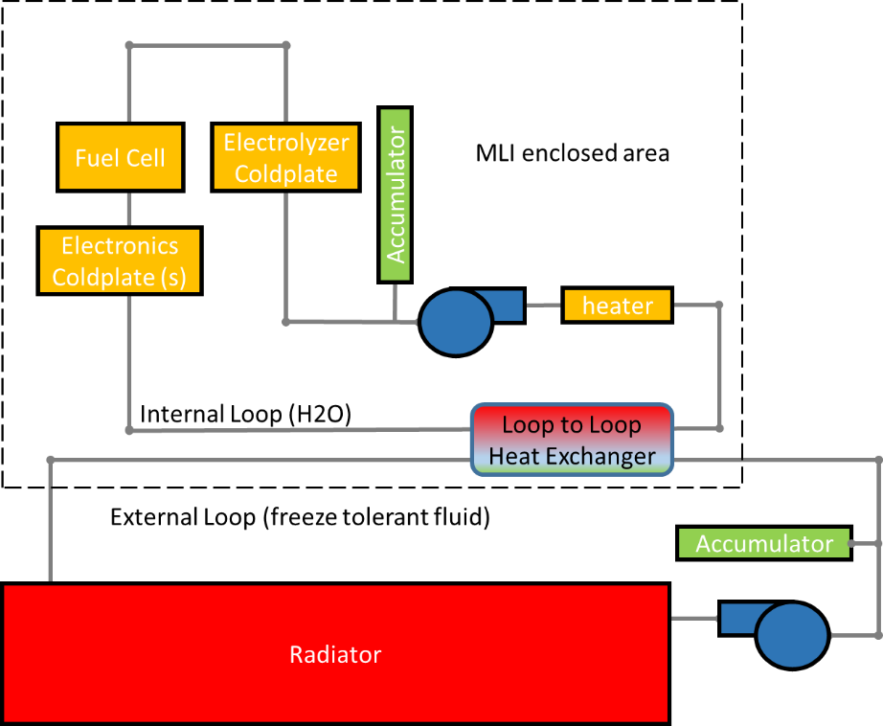
EPL System with Regen Heat Exchanger and Single-Phase Freeze-Tolerant Fluid
Choice of thermal fluid highly dependent on the mission thermal environment
A radiator bypass line in the loop plus a thermostatic valve (not shown) controls the thermal fluid return temperature to the RFC internal loop heat exchanger
Pros:
  Mature and flight demonstrated technology
Cons:
  Parasitic loads of pump impact RFC round trip efficiency
  Freezing concern when bypassing radiator during lunar night
  Complexity (number of components, moving parts)
High level process flow diagram showing EPL coupled with RFC thermal management system.

Slide 13
Freeze-Tolerant External Pumped Loop
Utilizes 2 phase working fluid (WF) that allows gas to flow through radiator under low heat load conditions
2 NASA funded SBIRs evaluated this technology
Design Concept 1
  Parallel tube configuration with both phases operating under high heat loads
  Liquid freezes and gas circulates through radiator under low heat loads
Design Concept 2
  Freeze-tolerant condensers in parallel tubes fed vapor from a membrane evaporator (coupled to the primary cooling loop)
  Condensers self-regulate the thermal conductivity by condensing the WF (e.g., H2O)
    Potential to achieve turndown ratios >10

Slide 14
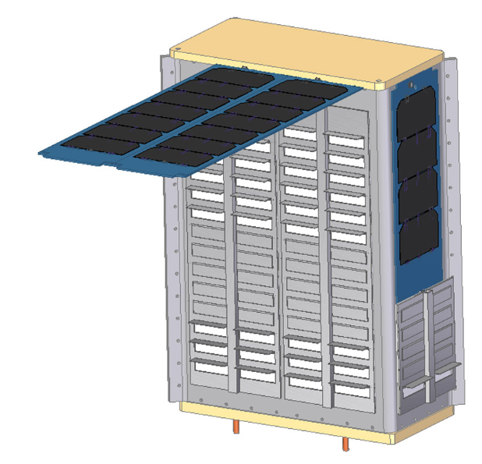
Passive Thermal Louvers
Increases or decreases view factor from radiator panel to surroundings by mechanical louver
Bimetallic springs that are thermally connected to the radiator actuate pivoting blades or vane louver at predetermined set points
Commercial Off-The Shelf (COTS) options for louvers are primarily for a lower heat rejection power than what is required for RFC (hundreds of Watts to kW depending on RFC scale)
Turn down ratios of approximately 6 (effective emissivity of 0.14 to 0.74 for ε* = 0.85 radiator in IR spectrum)
NASA-Developed Passive
Thermal Louver for CUBESATs [ref 1]

Slide 15
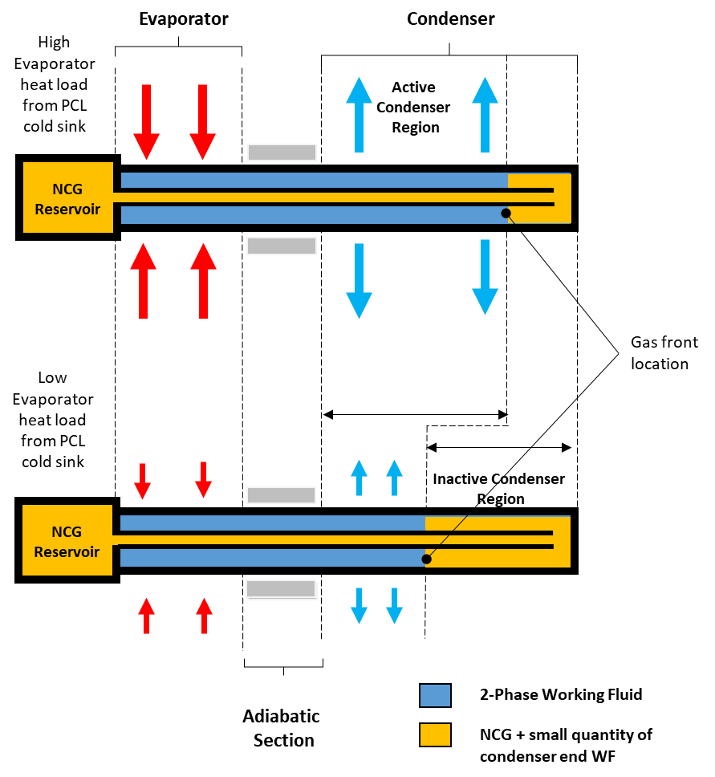
Variable Conductance Heat Pipes (VCHPs)
Uses evaporator, an adiabatic section, and a wick to return the condensate back to the evaporator
VCHP adds a non- condensable gas (NCG) to the two-phase WF and a NCG reservoir
  Usually located at condenser end with parasitic heater
  Applications where this parasitic heater is not available or desirable (RFC), NCG reservoir can be located next to evaporator section
  NCG quantity in the reservoir is proportional to the evaporator WF vapor pressure
At full design thermal power most NCG is driven into the gas reservoir allowing the entire condenser region to be active
At lower thermal power, the evaporator WF vapor pressure drops allowing the WF and NCG boundary to move into the condenser region
  Reduces the active heat transfer area until a new equilibrium is achieved
Illustration of working principle of VCHP.

Slide 16
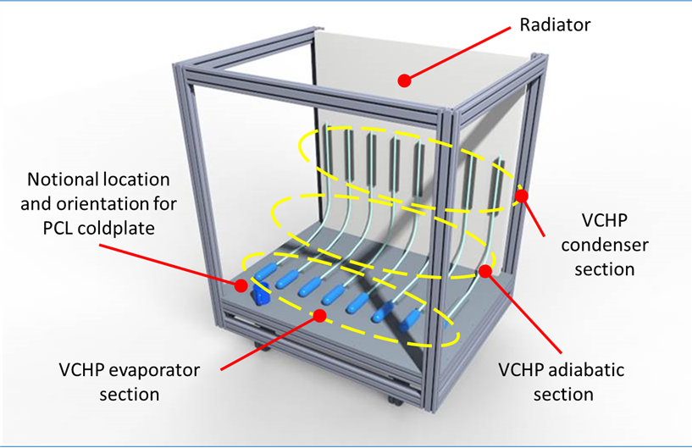
VCHP Operation Continued
The WF and VCHP charge pressure combination is chosen to minimize evaporator WF saturation temperature change versus pressure
  This maintains a small evaporator temperature band
If the power level is low enough, there will be no convective heat transfer in the VCHP as the NCG will occupy the entire condenser section
  Small amount of heat transfer via gas and thin-walled tubing conduction
  Orders of magnitude less than the WF two-phase heat transfer
  Allows the VCHP to function as a “thermal switch”
VCHP Design Concept for RFC

Slide 17
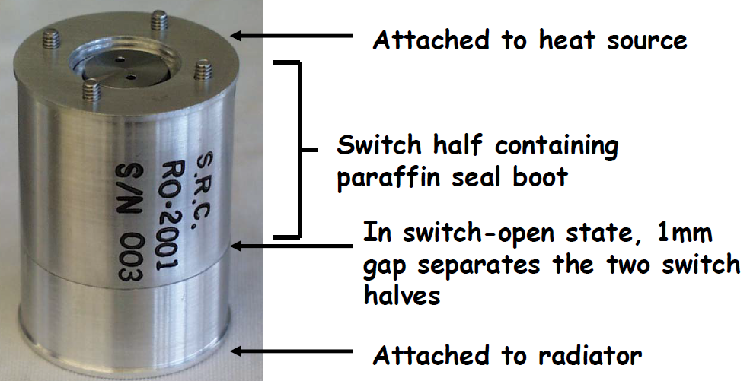
Paraffin Based Thermal Switch
Incorporated at the interface between internal and external thermal loops
Paraffin-based actuator contracts and expands with temperature such that thermal contact varies between a heat source and heat sink at a set temperature
COTS cylinders 2.5-cm diameter by 3.8 cm-long reject ~6W each (1.2 W/cm²)
COTS thin plate thermal switches integrate 2.5 x 2.5 -cm squares each capable of rejecting 12W (1.9 W/cm²)
Wide temperature regime from –130 to 100 °C and offer set points from –10 to 50 °C
High turndown ratios of thermal conductivity around 78:1
NASA – JPL Developed Heat Switch
[Ref 1]

Slide 18
Conclusion
RFCs offer potential for high specific energy power solutions for future lunar missions
Thermal management of RFC in lunar environment is critical challenge due to need to reject thermal energy during lunar day and conserve thermal energy during lunar night
Different technology options exist to serve as a high heat flux thermal switch between the RFC primary cooling loop and heat rejection interface (radiator)
  Each technology has advantages and disadvantages as pertains to TRL, complexity, mass, parasitic power required, and cost
  Different options could be used in combination to obtain the required turndown ratio
  Advances in these technologies can help enable future lunar missions by addressing one of the primary challenges of sustained operations – the long, cold lunar night

Slide 19
References
“CubeSat Form Factor Thermal Control Louvers”. NASA Technology Transfer Program. < https://technology.nasa.gov/patent/GSC-TOPS-40 >
Sunada, E. et al. “Paraffin Actuated Heat Switch for Mars Surface Applications”. Space Technology Applications International Forum 2002.

Slide 20
BACKUP

Slide 21
Advantages | Disadvantages | Relative maturity
External pumped loop (EPL)
Simple; flight demonstrated | External loop may contain hazardous fluids. It requires an extra heat exchanger and second loop with associated controls, pumps, and support hardware that increases complexity, parasitic electrical power, and possibility of mechanical failure. | High technology readiness level (TRL)
Freeze-tolerant external pumped loop (FT-EPL)
Simpler and lighter than external loop pumped system; high thermal turndown ratio; lower parasitic power requirements than external loop pumped system; can use H₂O working fluid (WF) | Adds complexity in terms of additional components to system. | Low TRL
Passive thermal louver (PTL)
Simple design; high solar irradiance capability; spaceflight heritage; fully passive thermal control; fairly wide range of operational temperature band and set points | Limited turndown ratio (~5.3) Does not allow for both maximum heat transfer and prevention of loop freezing without adding parasitic heating. Limitations of mounting locations. COTs sizes are small, requiring multiple louver systems or a custom designed system. Limited to single source vendor. | High TRL
Conventional heat pipe (CHP)
Lightweight; passive, no parasitic pumping load loss; flight demonstrated | Limited ability to regulate the PCL temperature within a narrow range. Limited ability to limit heat transfer below a desired temperature. | High TRL
Variable conductance heat pipe (VCHP)
Lightweight; passive, no parasitic pumping load loss; maintains near constant PCL temperature; can effectively shut off at a desired temperature; parasitic heating requirements are very small | There are specialized design considerations. Careful coordination with VCHP supplier is required to insure adequate performance. | Moderate TRL
Thermal Switches
Lightweight; passive; modular, easy to package | Small scale relative to RFC thermal loads. Cost is a factor. | Moderate TRL

Slide 22
Primary Fuel Cells vs. Primary Battery
Electrical Power to enable and augment exploration activities
Primary Metric = Specific Power ( W / kg )
Batteries store energy intimately with the energy conversion mechanism
Primary fuel cells store energy remotely from the energy conversion mechanism
Different Hazards and Mitigations
  Batteries sensitive to Thermal Runaway
  Fuel Cells sensitive to Material Compatibility and Process Fluid management issues
Different Voltage to State-of-Charge (SoC) relationships
  Battery voltage dependent on quantity of stored energy
  Fuel Cell voltage independent of quantity of stored energy
Different Scalability
  Battery system specific energy determined by chemistry and packaging
  Fuel Cell system specific energy determined by quantity of reactants and packaging
Primary Fuel Cell
Primary Battery
Energy Storage
Oxidizer
Fuel
Battery
Q_{TH}
Q_{TH}
Byproducts
Discharging
Energy Conversion
Mechanism
Discharging
Notes:
Need to mention that within the PEM technologies:
LT-PEM: Perfluorosulfonic acid-based (Nafion) solid state membrane
HT-PEM: Phosphoric Acid electrolyte using a polybenzimidazole (PBI) support matrix
Different chemical reactions: H2/O2 and Hydrogen Peroxide

Slide 23
Regenerative Fuel Cell vs. Rechargeable Battery
Energy Storage enabling and augmenting exploration activities
Regenerative Fuel Cell
Rechargeable Battery
Primary Metric = Specific Energy ( W·hr / kg )
Rechargeable batteries store energy intimately with the energy conversion mechanism
Regenerative fuel cells (RFCs) store energy remotely from the energy conversion mechanisms
Different Hazards and Mitigations
  Batteries sensitive to Thermal Runaway
  RFC have very complicated supporting systems
Different Voltage to State-of-Charge (SoC) relationships
  Rechargeable battery voltage dependent on quantity of stored energy
  RFC discharge voltage independent of quantity of stored energy
Different Recharge/Discharge capabilities
  Battery rates determined by chemistry and SoC
  Fuel Cell and electrolyzer independently “tunable” for mission location
Energy
Storage
Fuel
Oxidizer
Energy Conversion
Mechanism (Charge)
Q_{TH}
Q_{TH}
Byproducts
Battery
Discharging
Charging
Charging or
Discharging
Energy Conversion Mechanism
(Discharge)
Notes:
Need to mention that within the PEM technologies:
LT-PEM: Perfluorosulfonic acid-based (Nafion) solid state membrane
HT-PEM: Phosphoric Acid electrolyte using a polybenzimidazole (PBI) support matrix
Different chemical reactions: H2/O2 and Hydrogen Peroxide

Slide 24
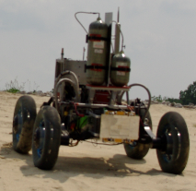
Electrochemical System Definitions: Primary Fuel Cell
Example Aerospace System
2H₂ + O₂ → 2H₂O + 4e⁻ + Heat
H₂ or CH₄
Reactant storage determines Specific Energy and Total Energy Capacity
O₂
Discharging Only
ΔP
Q_{TH}
Proton Exchange Membrane (PEM) Fuel Cell
Converts gaseous hydrogen and oxygen reactants into electrical power, heat, and water
Operational duration limited by supplied reactants
RFC Fuel Cell Operating Conditions:
  Operation temperature range: 60 – 80 °C
  Operational pressure range: 38 – 45 psia
H₂O
Stack design and operation determines Specific Power
Q_{ELE}
Q_{ELE}
Discharging

Slide 25
Electrochemical System Definitions: Electrolyzer
Chemical Conversion
Example Aerospace System
2H₂O + 4e⁻ → 2H₂ + O₂ + Heat
2 H₂O
2 H₂+ O₂
H₂
O₂
Water From
Lunar Ice (ISRU)
Fuel Cell Product Water
Biological Functions
PEM Electrolyzer
Converts liquid water into hydrogen and oxygen gas when supplied electrical power
RFC Electrolyzer Operating Conditions:
  Temperature range: 60 – 80°C
  Pressure range: 15 – 2500 psia
ΔP
Q_{TH}
H₂O
Q_{ELE}
Input Power

