Slide 1
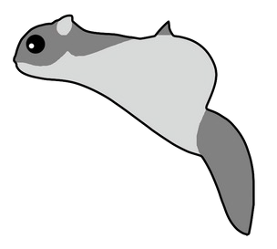
arcjetCV
Automating arcjet data analysis
TFAWS, August 2023
Magnus A. Haw
NASA Ames Research Center
Alexandre M. Quintart
NASA Ames Research Center

Slide 2
Introduction
ML models
Outline
Software development
Discoveries

Slide 3
Introduction
Arcjet testing
Material properties
Entry modeling
Mission requirements & constraints
NASA heatshields require extensive ground testing and modeling
Ground tests are expensive ~$100k/sample and complex but necessary to evaluate material performance
Consequently, every arcjet test should extract as much material data as possible

Slide 4
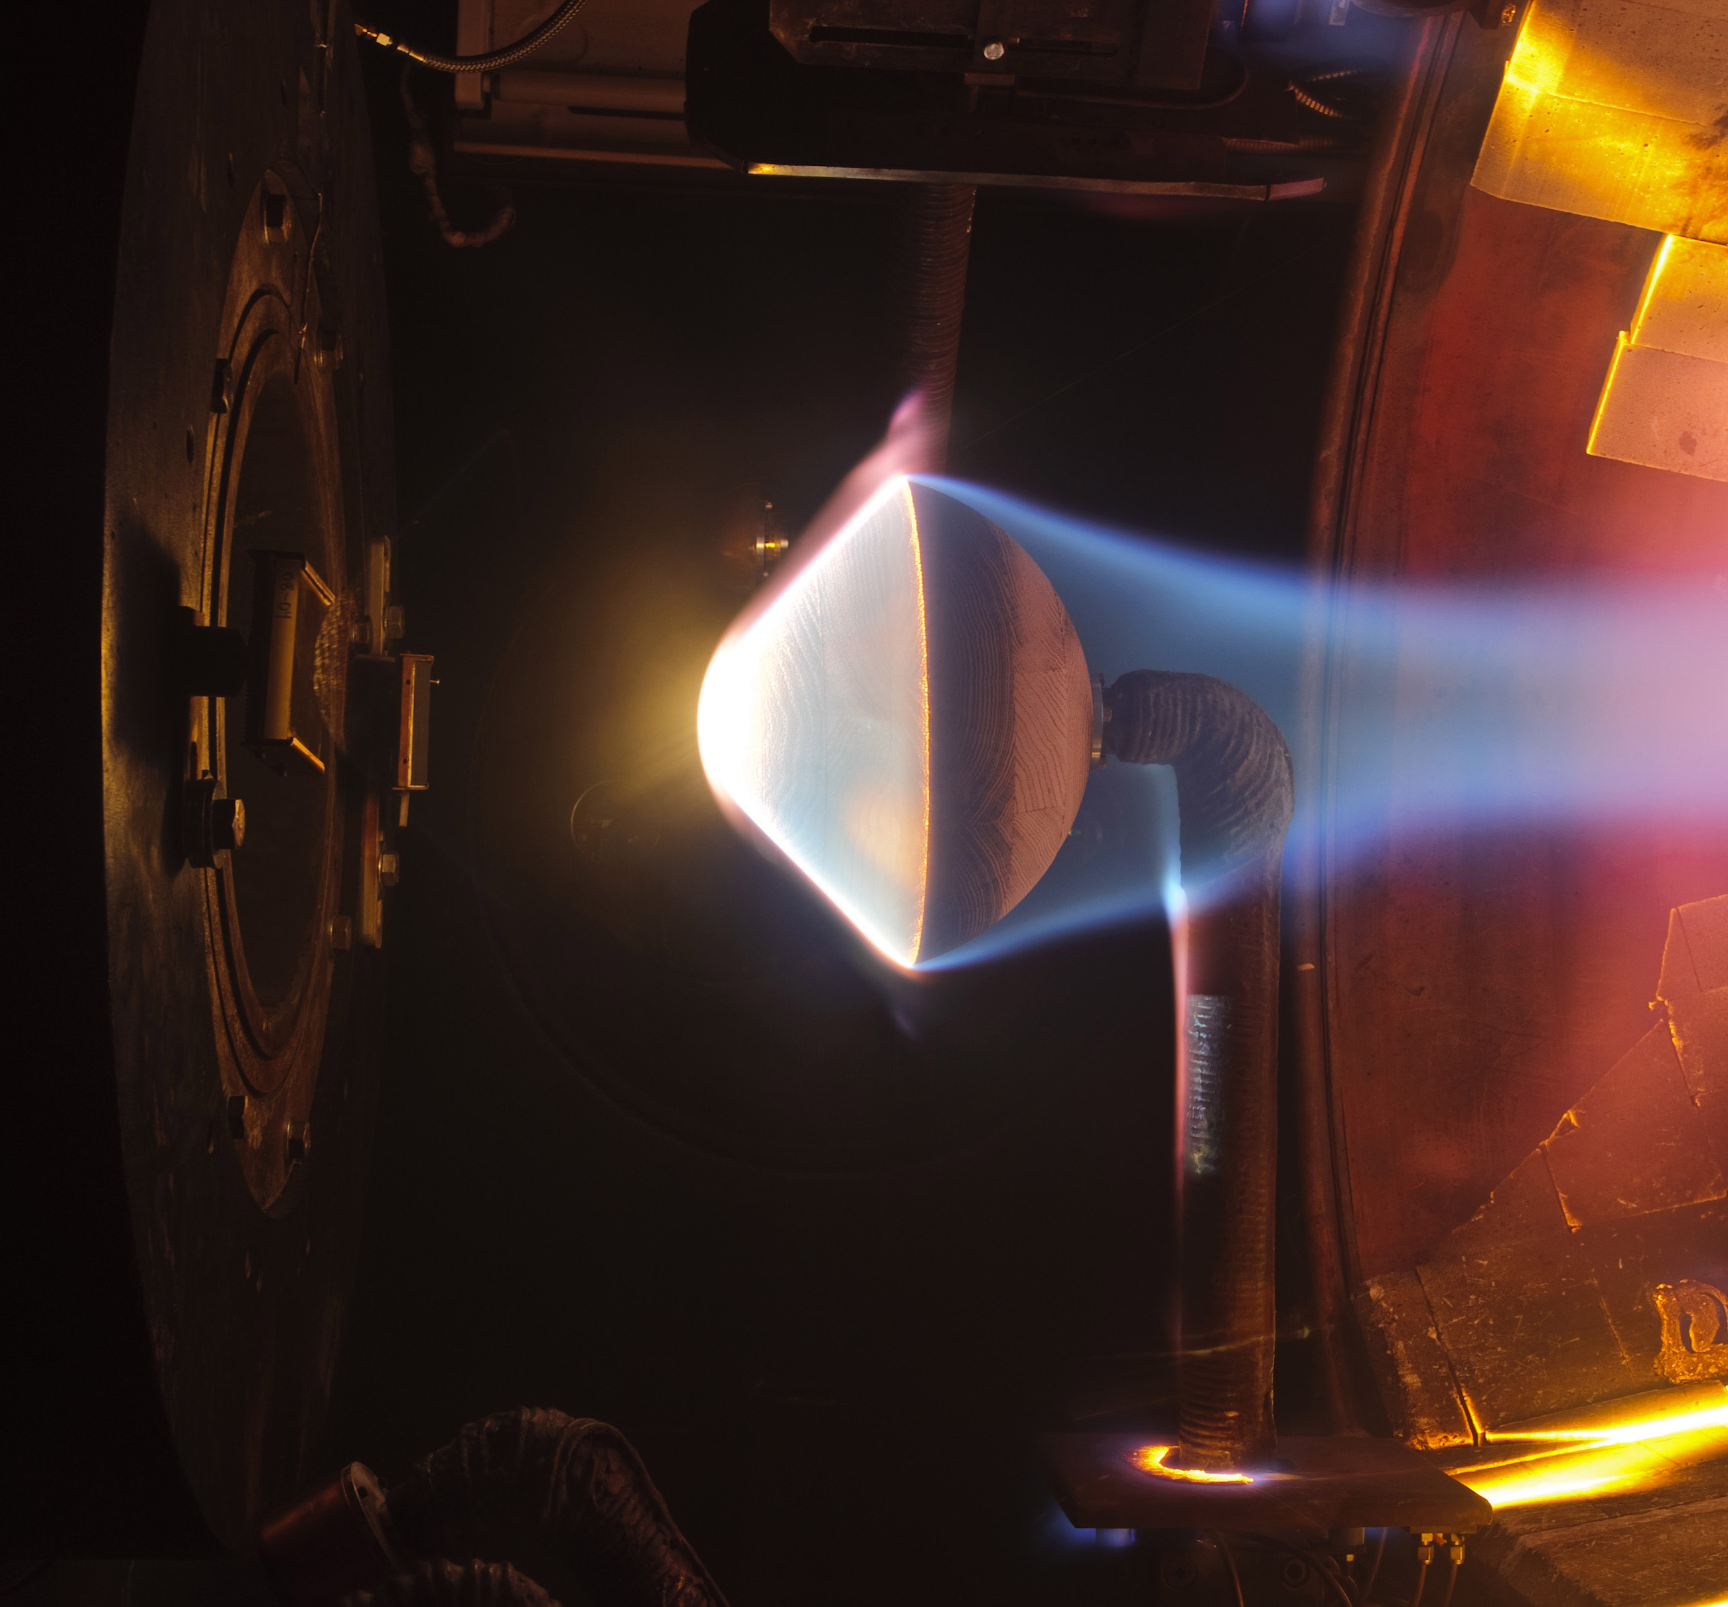
Arcjet testing
Def. arcjet: plasma wind tunnel
Material samples (2-6” ⍉) are fabricated and instrumented with internal thermocouples
Samples are placed in test chamber and exposed to high enthalpy flow from arcjet
Material properties are inferred from combination of calorimetry, CFD, thermocouple data, pyrometers, and surface recession
arcjet test chamber showing sample under test

Slide 5
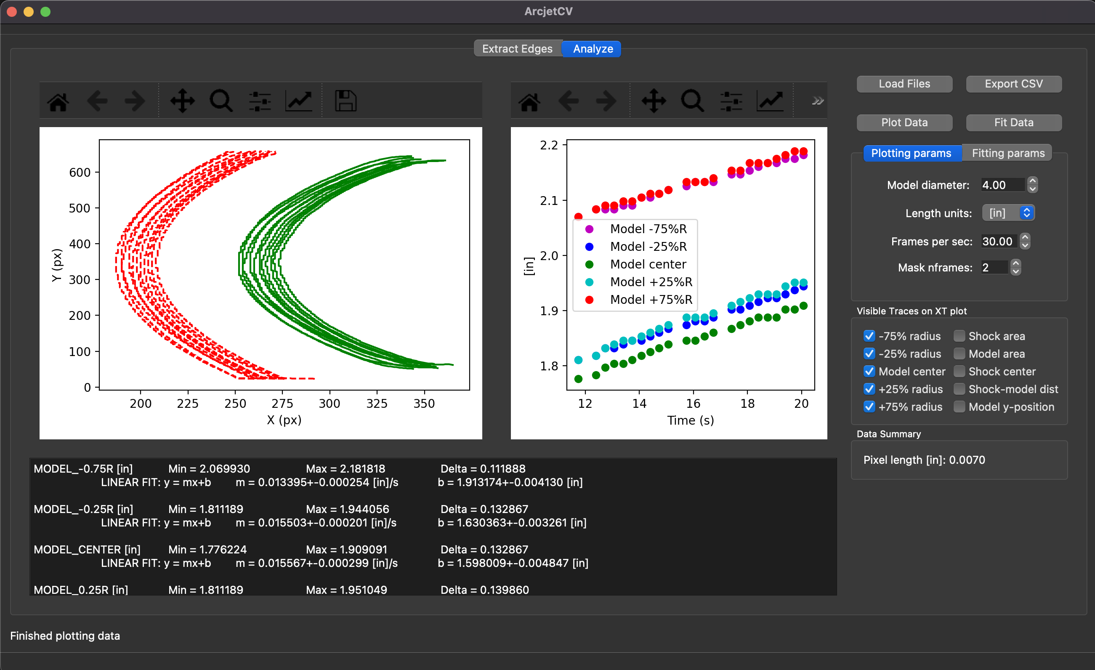
Problem
Material samples are only 3D scanned before and after a test, no in-situ sensing
Tracking recession from video was sufficiently difficult that it did not occur for most samples
Non-linear recession and complex behaviors (e.g., melt, swelling, shrinkage) cannot be quantified without time-resolved recession
Solution: arcjetCV
Computer vision & machine learning automate data pipeline
Graphical user interface enables anyone to process video
Result: new time-resolved recession tracking for all samples

Slide 6
Software overview
Desktop Interface
Web Browser Interface

Slide 7
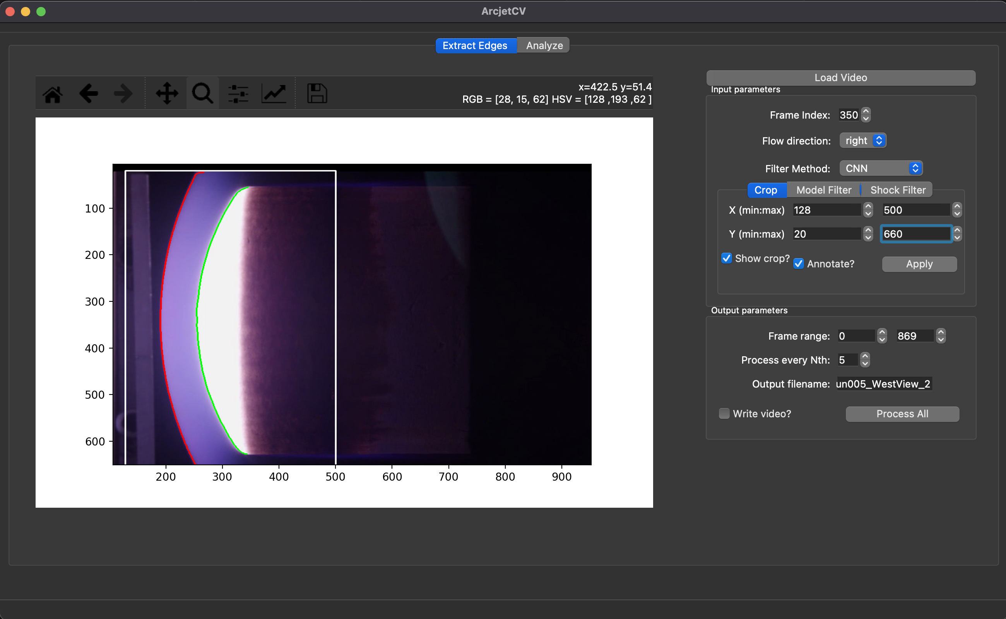
Desktop Interface
1. Load a video
Select flow direction
- Select a filter :
⚬ CNN
⚬ AutoHSV
⚬ Gray
⚬ HSV
⚬ Decision Tree
Crop & Filter parameters
- Output settings
2. Process segmentation

Slide 8
Desktop Interface
X-Y traces of shock and the sample edge
Time dependence plot
3. Export
Parameters
Plot selection
Fitting parameters

Slide 9
Web Interface Development
Problem:
Difficult to provide support for all operating systems
Time consuming to update software on many machines individually
Solution:
Setup arcjetCV on a secure local server
-Use SSO (NASA Launchpad for authentication)
-Access controlled via NAMS requests
-Limited upload file size (<1 GB)
-Limited concurrent users
-Significantly harder to release as a software

Slide 10
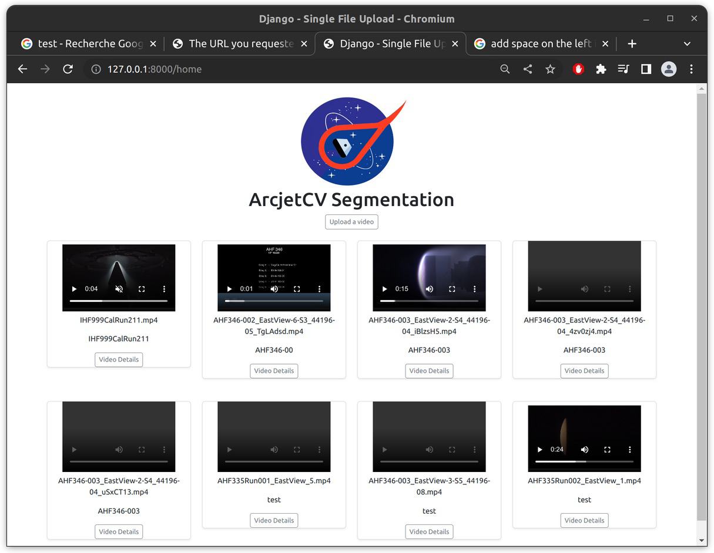
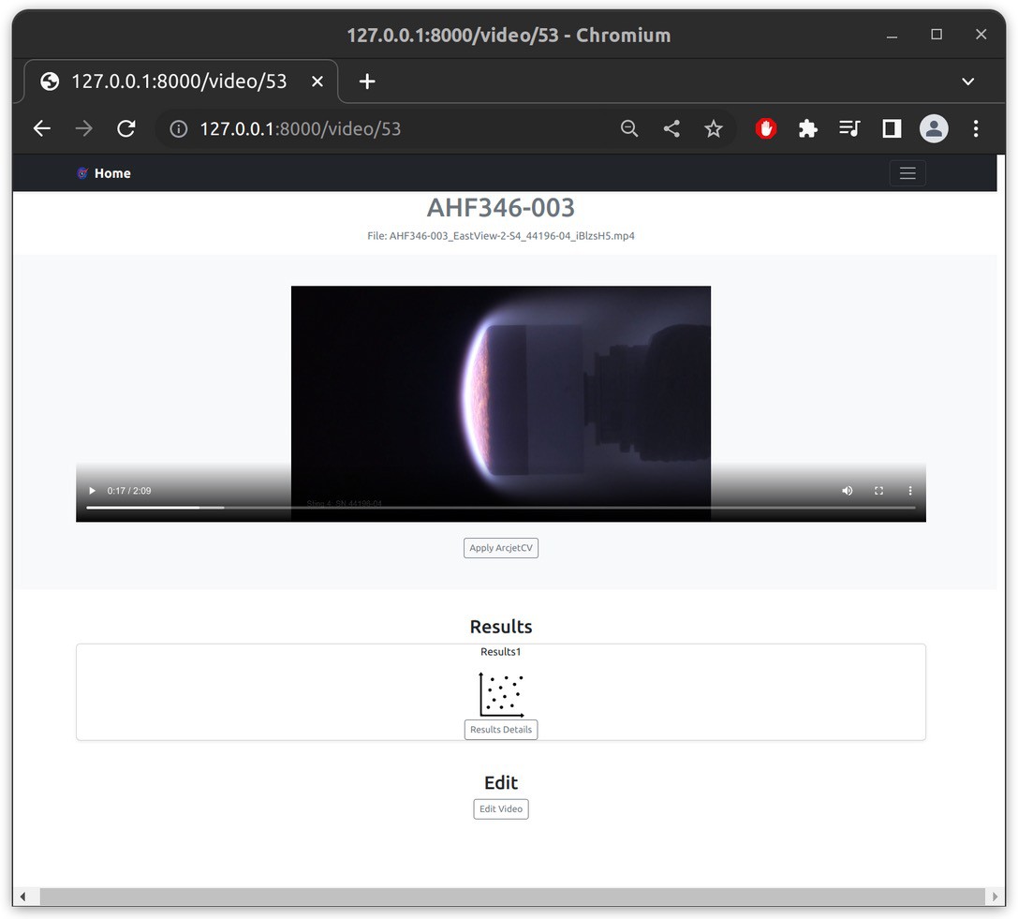
Web Browser Interface
Setup arcjetCV on a secure local server

Slide 11
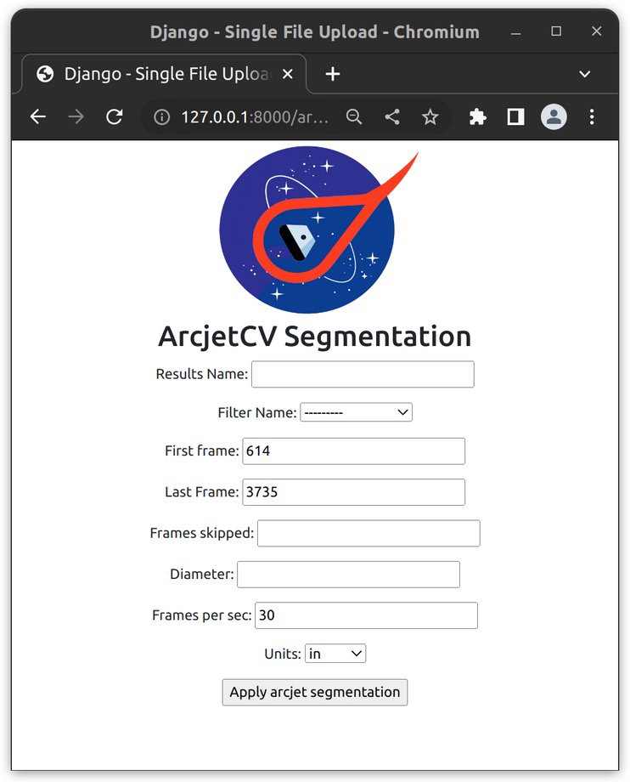
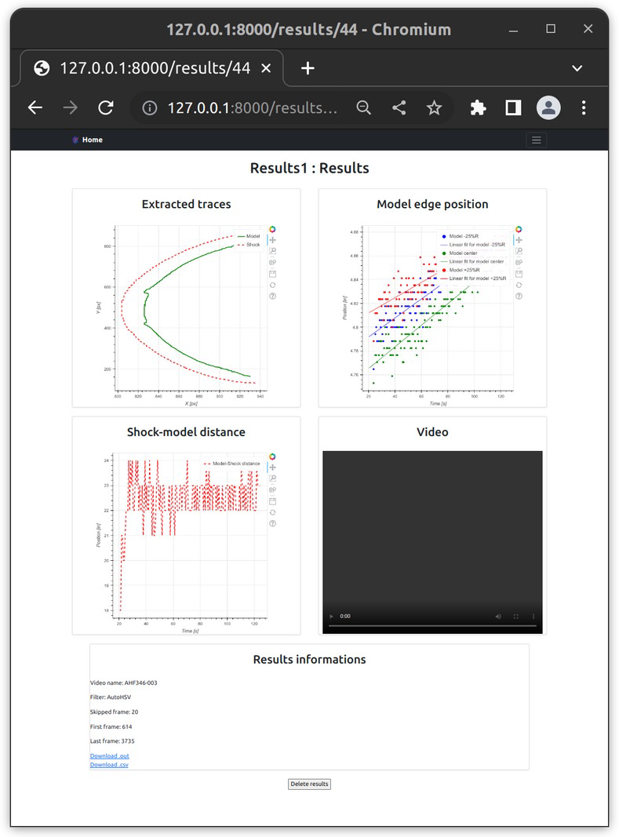
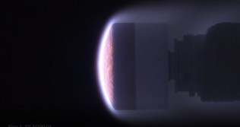
Web Browser Interface
Setup arcjetCV on a secure local server

Slide 12
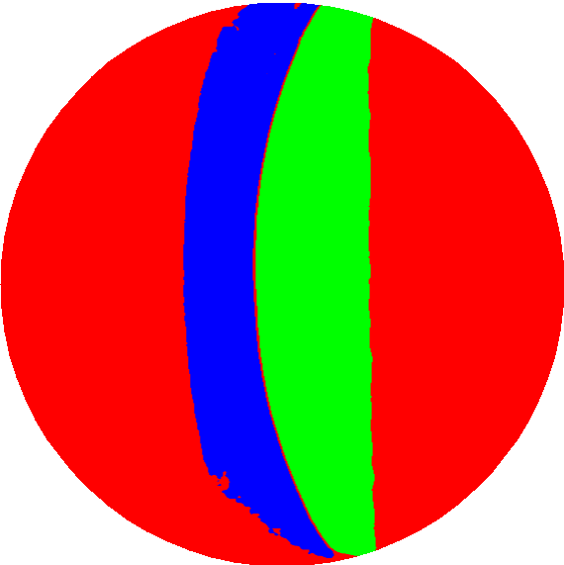
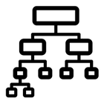
ML Models
VGG16-UNet (CNN model for high accuracy)
Decision tree model (for fast segmentation)
Time segmentation (1D CNN for detection of start/stop frames)
How arcjetCV automates the annoying/time consuming stuff

Slide 13
Convolutional neural net (CNN)
CNNs are neural nets designed to recognize patterns in images
typically trained on manually labeled images
robust performance compared to other methods
arcjetCV uses a CNN with a VGG16-UNet architecture to classify a given image frame into 3 classes:
- material sample
- shock
- background
This segmentation is then passed through simple image processing methods to extract the leading edge of the sample.

Slide 14
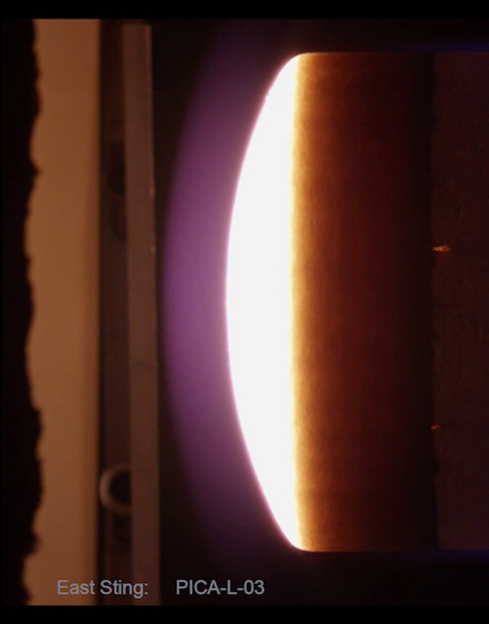
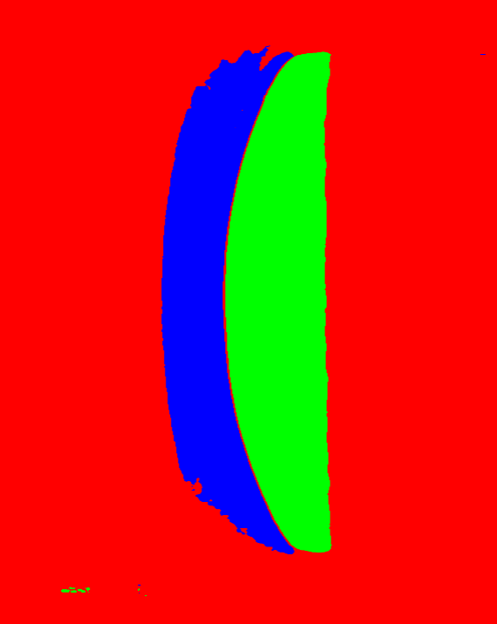
CNN - Results
Shock Sample Background
Convolutional Neural Network

Slide 15
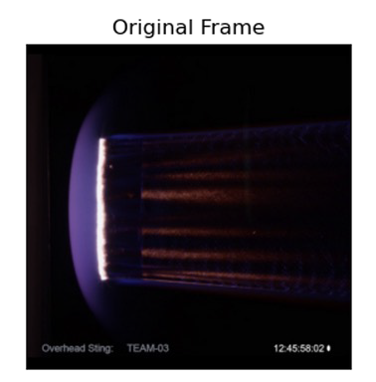
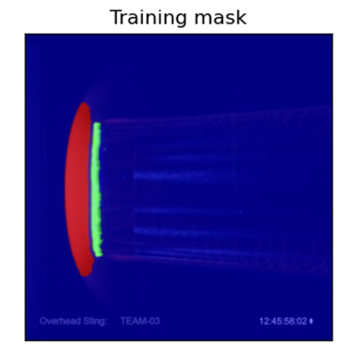
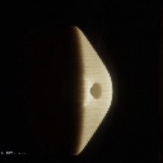
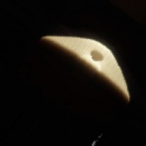
CNN - Training
Data labeling:
Laborious manual process to segment ~800 representative frames by hand
The GrabCut algorithm was used to speed up this manual labeling
Training Data Augmentation
Increased training dataset by changing the orientation and the position of the samples

Slide 16
CNN - Accuracy
The VGG16-UNet architecture was chosen because it had the best performance out of the 10 architectures tested
These parameters represent the segmentation accuracy of the model predictions relative to validation frames not included in the training set
VGG16-UNet
F1 score:
tp = true positif fp = false positif
fn = false negative
Sample: 0.9494
Shock: 0.9789
Accuracy: 0.9943

Slide 17
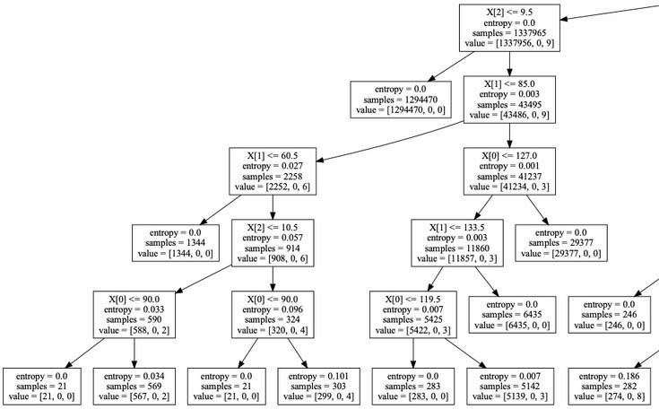
Decision Tree
Decision tree = algorithm that only contains conditional control statements.
This model was developed to provide a faster segmentation model suitable for real-time feedback applications. It uses the HSV (hue, saturation, value) parameter space instead of RGB since the separation between target classes (sample, shock, background) is larger.
Decision Tree parameters:
Minimum number of samples required to split an internal node = 500
Depth of the tree = 10
Input params: HSV of single pixel
Output: Sample, Shock, Background classification
Accuracy: 0.93573

Slide 18
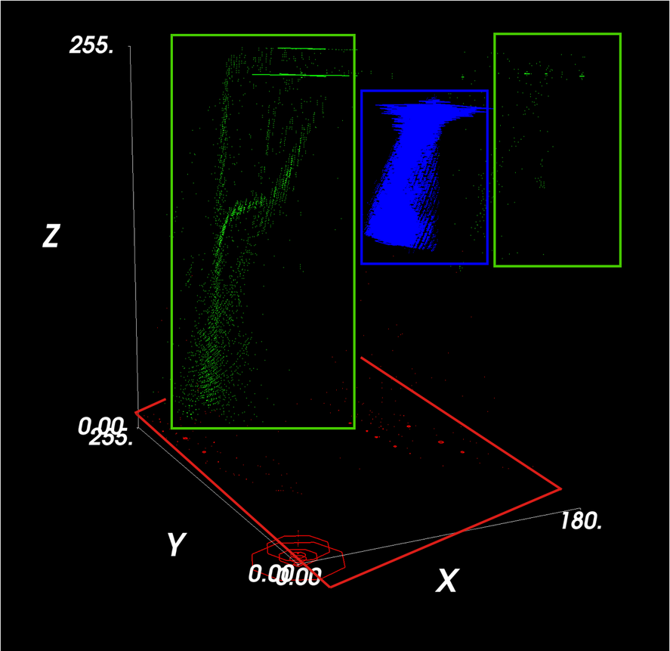
Decision Tree- Accuracy
Why a decision tree ?
Model | CNN | Decision Tree
Performance | 1Hz | 20Hz
Accuracy | 0.9943 | 0.93573
Conclusion | Slow but highest accuracy | Fast with reasonably good accuracy
V
The decision tree works well because the different classes are well separated in HSV space
H
S
Sample
Shock
Background

Slide 19
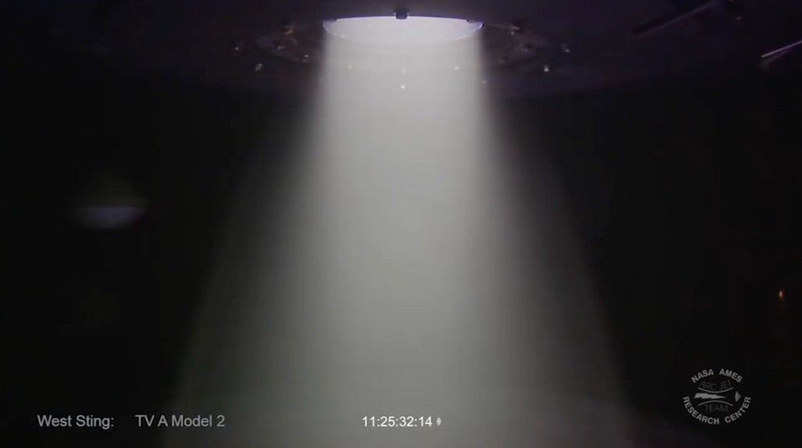
Time Segmentation
Example Problem: Manually detecting and extracting each sample insertion in raw video files is a time bottle neck.
25 MINUTES 240 FPS
50 GB
MANUALLY CROPPING EACH SAMPLE INSERTION IS HARD WORK

Slide 20
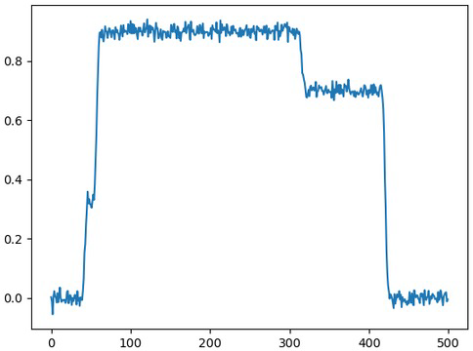
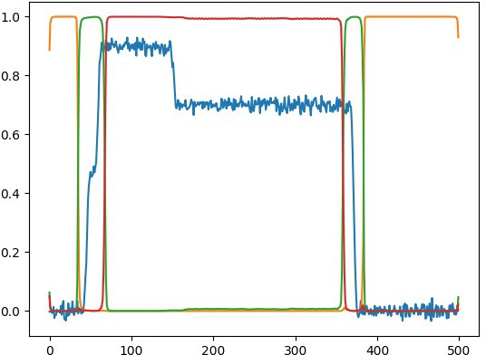
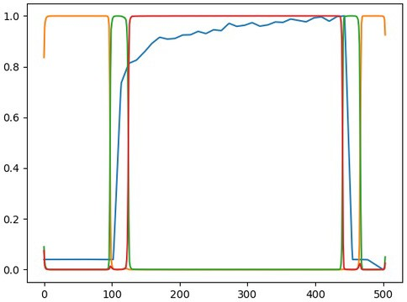
Time Segmentation
Goal: Train a CNN to find start/stop times of arbitrary length time series
Problem: Not enough data for training
→ Solution:
Create artificial 1D data over a wide range of S/N
Sample in the frame
No sample
Transitional area
Artificial signal
Training data segmentation
Signal prediction

Slide 21
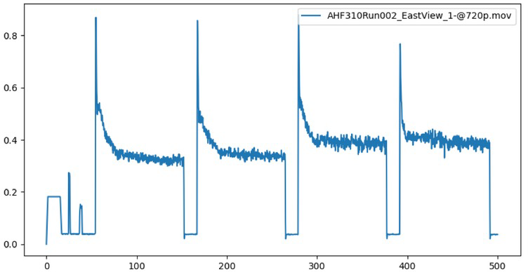
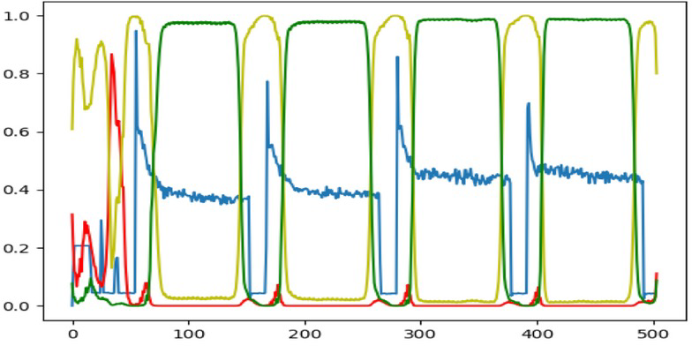
Application: Multiple Insertions
Applying the time segmentation model allows multiple insertions to be parsed even with the typical assortment of varying thresholds, noise, and spikes.
Sample in the frame
Transitional area
No Sample

Slide 22
DISCOVERIES
Non-linear recession
Shock standoff
Shape changes

Slide 23
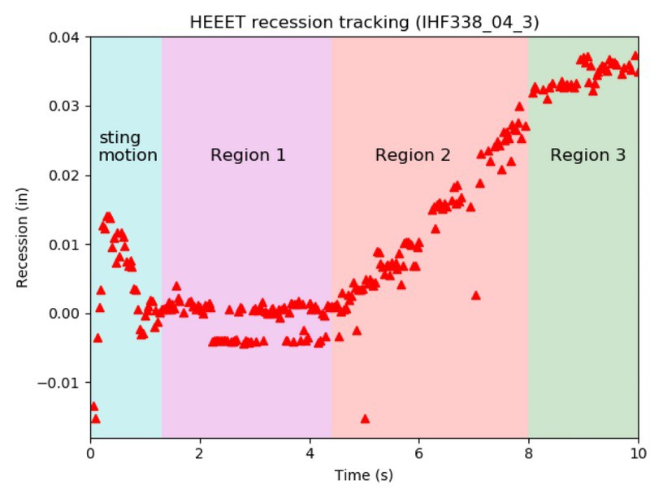
Non-linear Recession
Before: Recession considered linear
With arcjetCV: 3 Regions:
Region 1: Nearly no recession
Region 2: Constant recession rate
Region 3: reduced recession rate

Slide 24
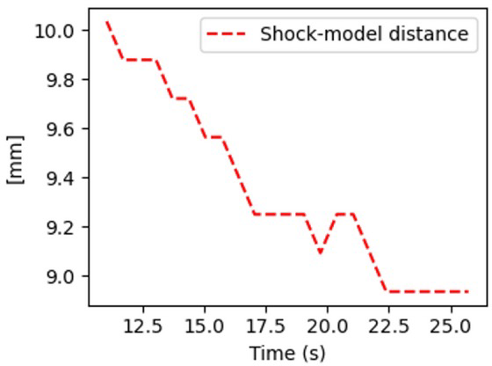
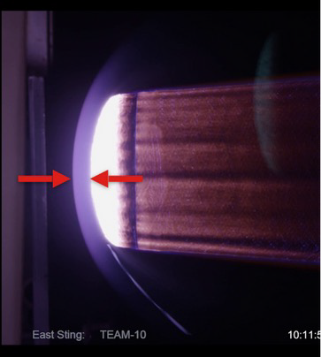
Changing Shock Standoff
Validation metric for coupled aerothermal + radiation simulations
Shock-sample distance decrease implies that the pressure at the sample surface is changing with time
→ Aerothermal conditions are changing
→ The sample is becoming more porous

Slide 25
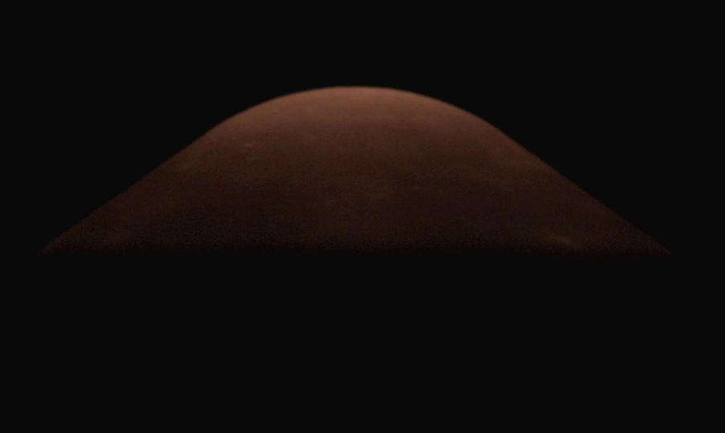
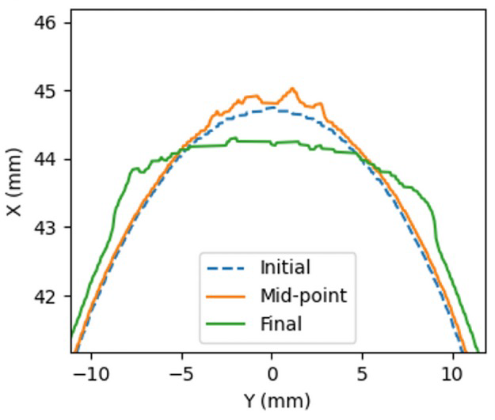
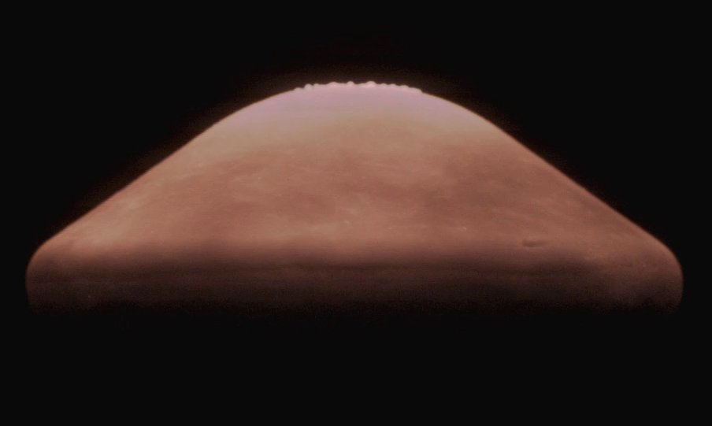
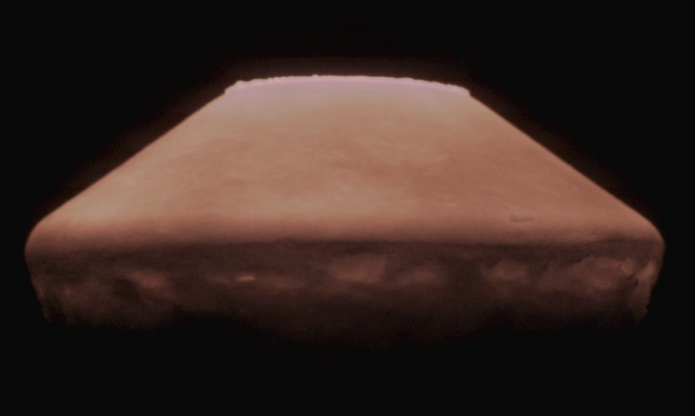
Shape change
Sample shape deforms/flattens at the nose and develops millimetre scale ripples/bubbles
The entire sample is expanding (e.g. negative recession at the edges).
→ Provide the first validation for new 3D material simulations, tracking melt flow

Slide 26
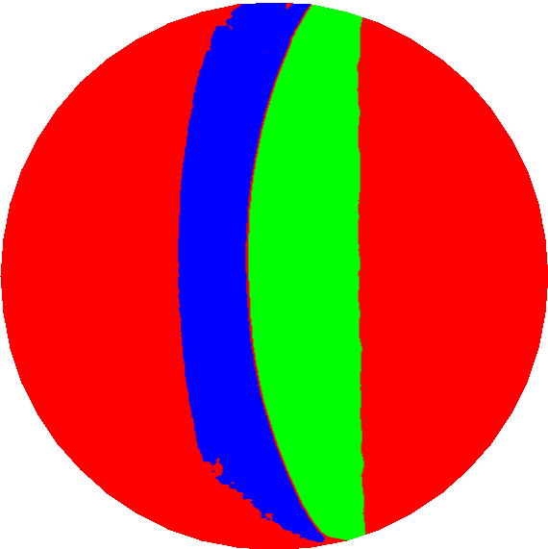
Summary
arcjetCV
3 ML models
2 interfaces
3 operating systems
macOS
Windows
Linux
Desktop interface
Web Browser interface
Enabling
Decision Tree
vgg16-UNet
TimeSeg
⚬ Time-resolved recession data products
⚬ 2D model validation
⚬ Shock standoff measurements
→ Better mission planning and risk management

Slide 27
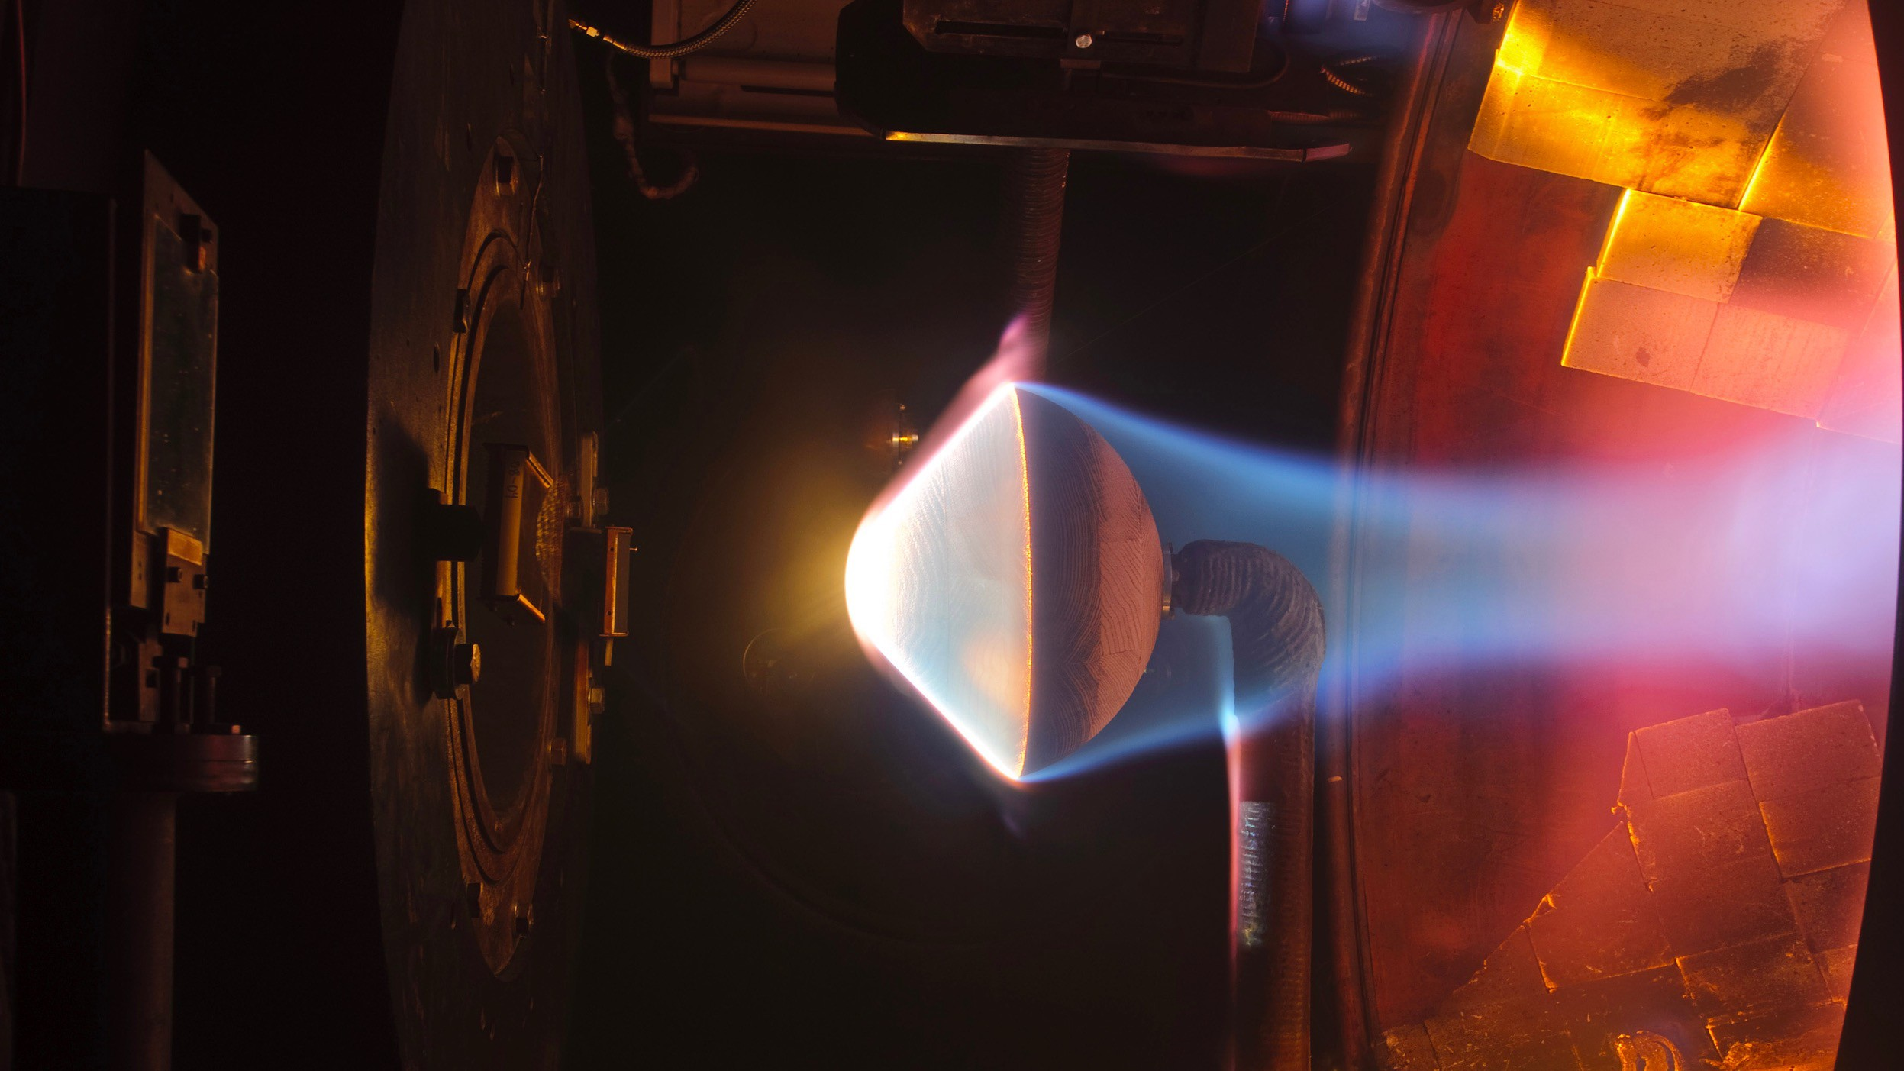
Thank you for your attention !
Let's keep in touch
magnus.haw@nasa.gov
alex@flying-squirrel.space
27

Slide 28
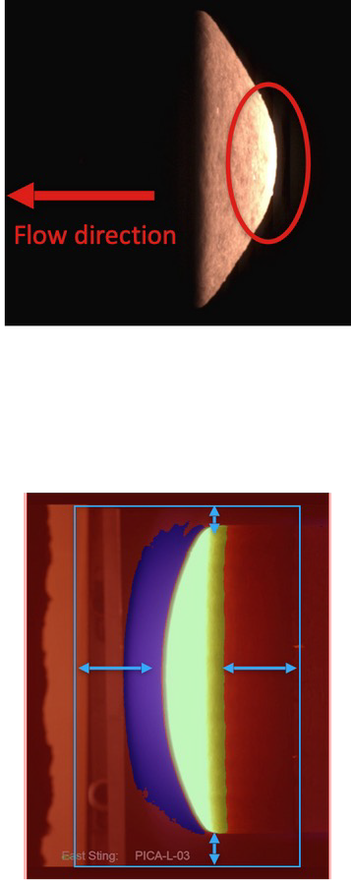
Other features: AutoCrop & AutoDirection
AutoDirection
Calculates the weighted average location of pixels intensity
Depending on the location relative to image center, the flow direction is determined
2) AutoCrop
Segment a frame in the middle of the video
Get the extrema pixel location and bounding box
Set the crop window by adding a percentage to the minimum bounding box width and height

