Slide 1
July 14, 2023
RST Optical Telescope Integration and Test Preparation
SPIE Conference – Optics + Photonics
L3Harris Technologies | NASA Goddard Space Flight Center
Tony Whitman | Joshua Abel
Peter Miller | Bente Eegholm
Brian Martens | Matthew Bolcar
Pete McCarthy | J. Scott Smith
Erin Schiele | Joel Proebstle

Slide 2
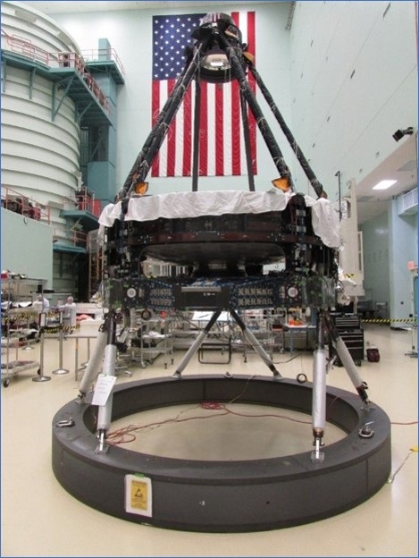
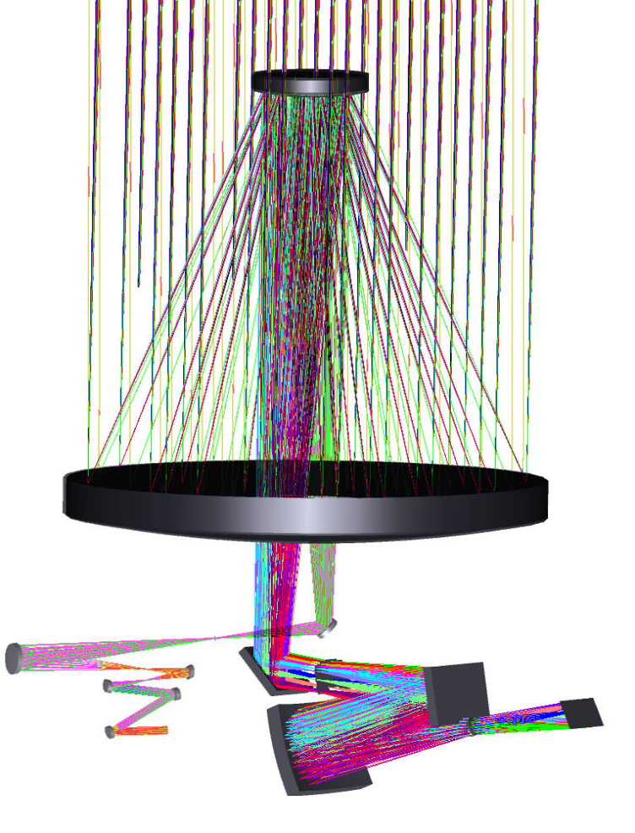
Optical telescope taking shape
All assembly-level testing complete
Integration more than half complete
  SM stacked on PM
  Redundant actuators installed for fine focus of the SM
  Actuator installed under each support tube
  Light scrapers on each tube for stray light control
  Complete coverage of heaters and sensors with associated wiring
  strategically placed accelerometers for later testing at inaccessible locations
  Cables installed on tubes for SM assembly
  Blankets along tubes installed
SM
PM
TOMA
TCA
POMA
AOM
CGI
WFI

Slide 3
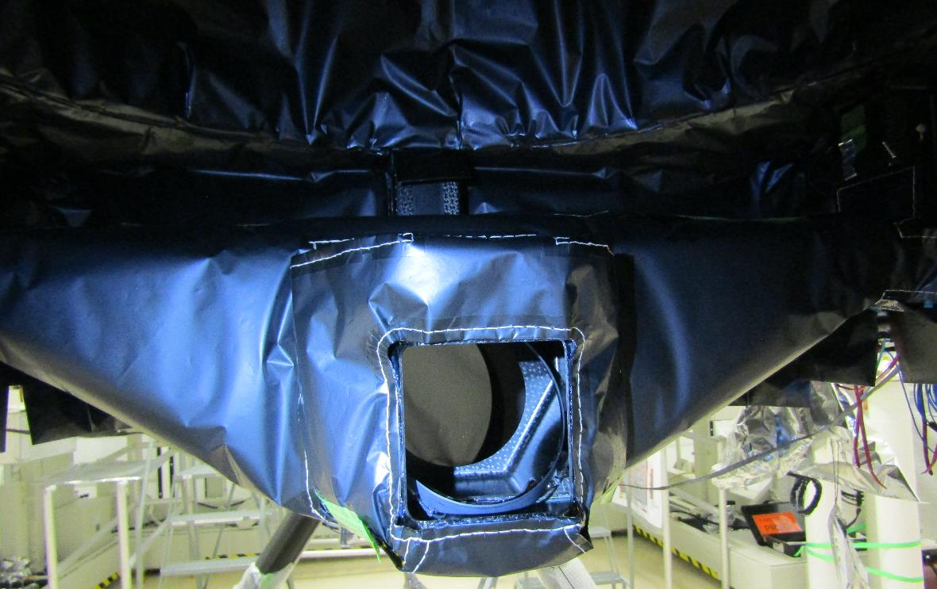
POMA installed, wired, and blanketed
SM
From SM
PM
To TOMA
TOMA
POMA
TCA
AOM
WFI
CGI

Slide 4
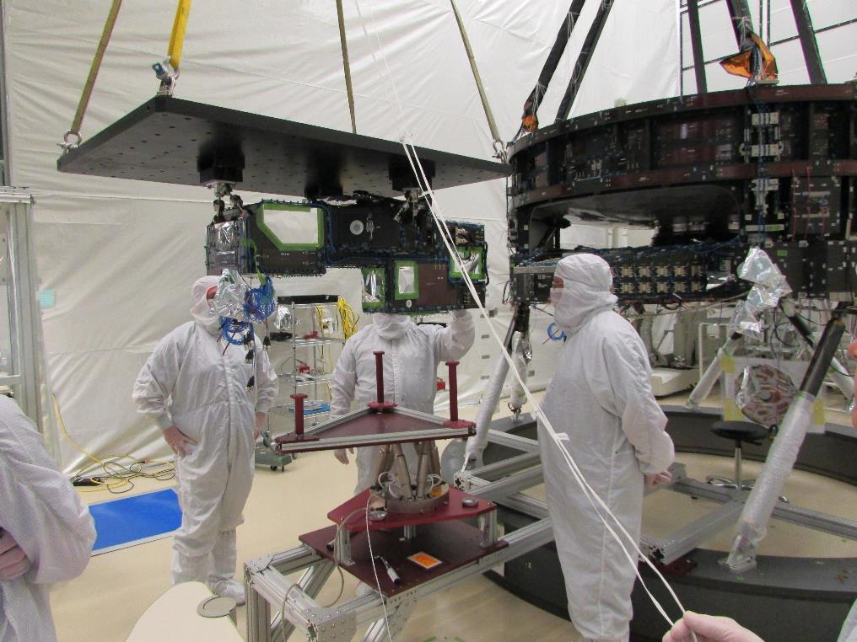
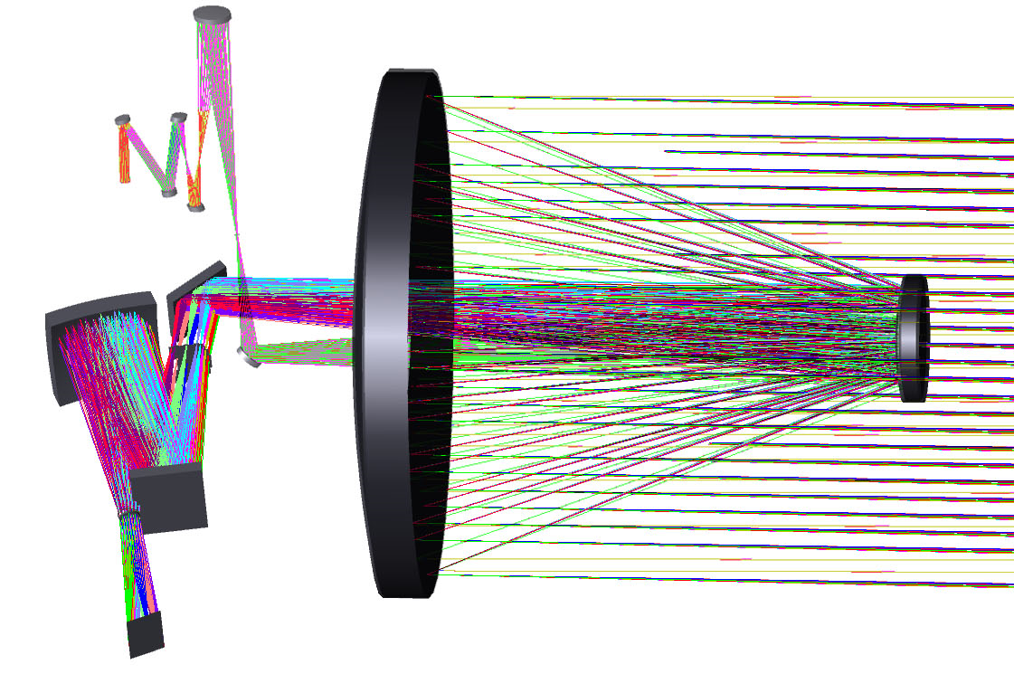
TOMA complete, tested, and ready for integration
TOMA

Slide 5
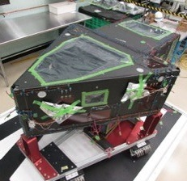
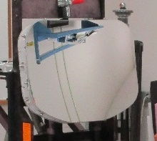
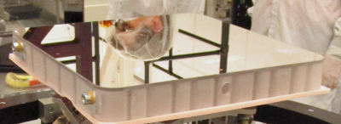
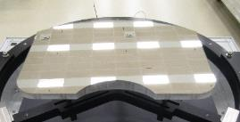
Aft Optics Structure and 3 mirror assemblies ready
Fold Mirror 1 assembled with 3 actuators
Fold Mirror 1 installed into the Aft Optics Structure
Then FM1 + AOS installed under the Aft Metering Structure with 6 struts
With an interferometer at the Coronagraph exit beam and another interferometer at the Wide Field image, the SM, TOMA, FM2, and TM are aligned to target WFE at the set image planes
Tertiary Mirror
Fold Mirror 1
Fold Mirror 2

Slide 6
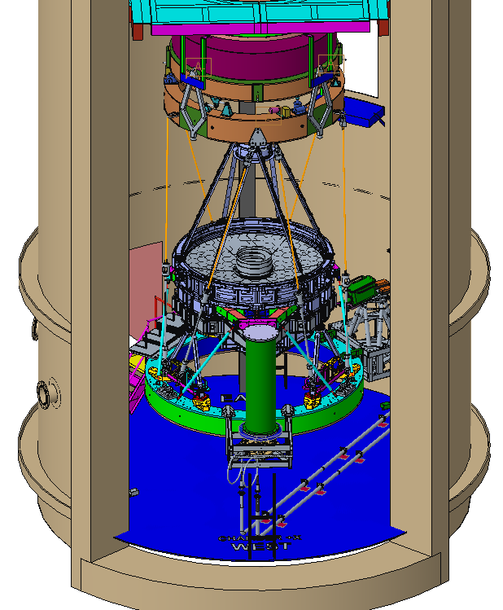
Chamber in preparation for optical alignment
Chamber used to pump down to low pressure for interferometric testing
Decades-old auto-collimating flat mirror hangs with telescope from vibration isolators
Interferometer sets pupil and focus position using optical mechanical references
Shack Hartmann sensor for coronagraph channel calibrated to interferometer and wavefront sensor calibrated to interferometer while light-weighted primary mirror gravity sag off loaded

Slide 7
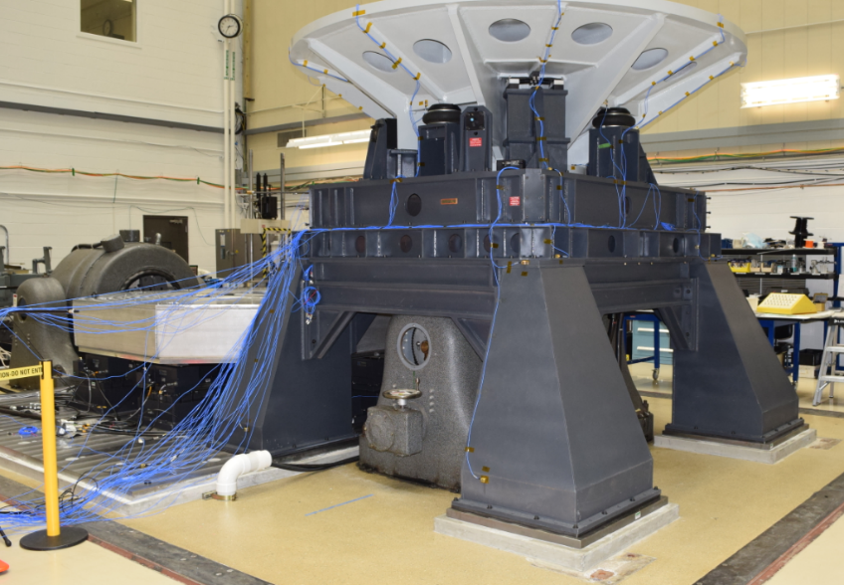
Vibration facility has started characterization testing
Weldment sized to Roman telescope on bearings attached to lateral shaker
Head expander for Roman telescope on vertical shaker

Slide 8
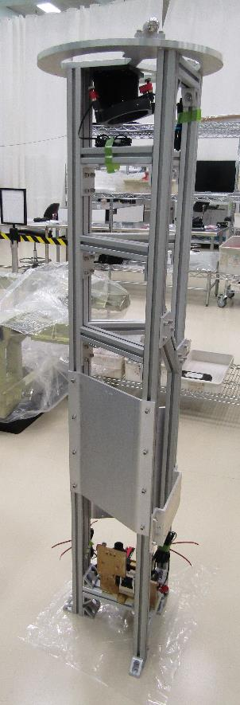
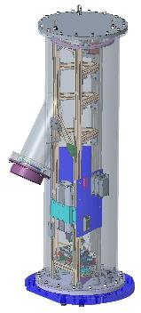
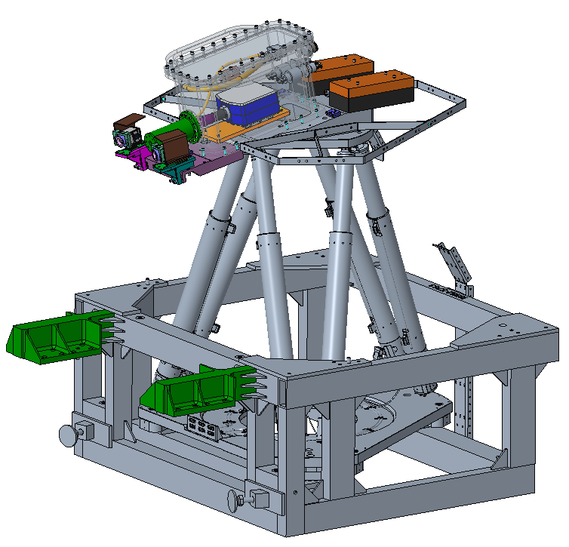
Optical test equipment for image planes in assembly
Wavefront Sensors
WF beam
Interferometers
CG beam
Shack Hartmann sensor

Slide 9
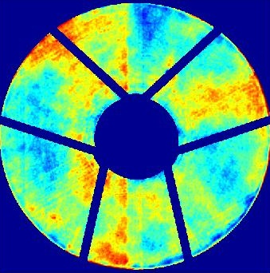
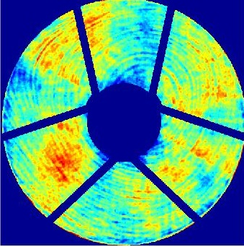
Predicted wavefront error maps ~ 70 nm RMS
Wide field map
Coronagraph field map

Slide 10
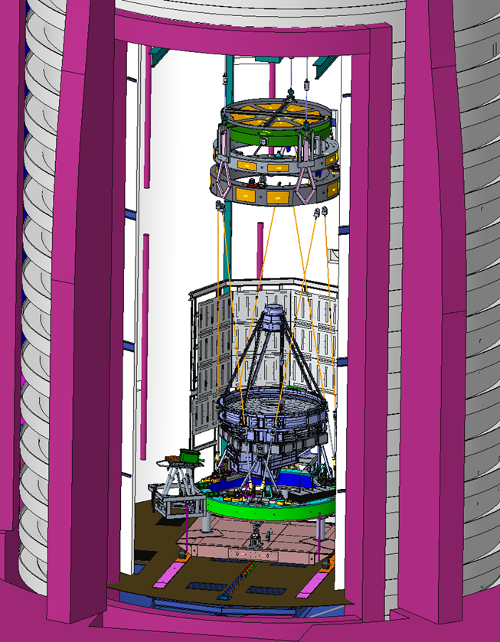
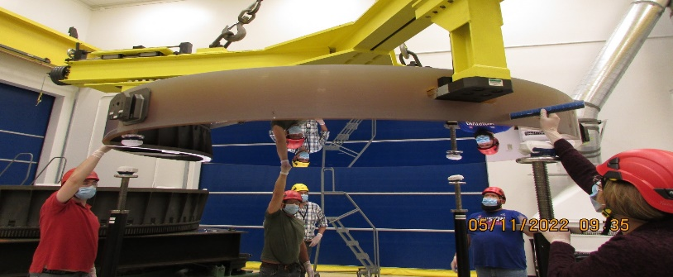
Thermal vacuum chamber in preparation for test
The optical telescope will be tested at operating temperature, at survival temperature and in vacuum using a heater shroud inside an LN₂ shroud inside a vacuum chamber
A new auto-collimating flat mirror is complete and ready for integration in the chamber
Renovation of the chamber for vibration isolated optical testing is in process
  Structure removal complete
  Structure modification in process
Thermal shroud assembly is in process

Slide 11
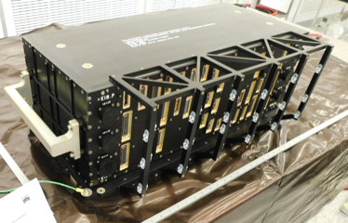
Telescope Control Electronics in environmental testing
The electronics include 96 channels of proportional – integral heater control and motor control of 13 mirror position actuators
The initial electrical performance test with electrical loads and similar actuators completed in room temperature
The box is currently undergoing electromagnetic interference and compatibility testing
Next tests
  Thermal cycling
  Vibration test while powered in the launch configuration
  Thermal vacuum performance test

Slide 12
Summary
The optical telescope for the Roman Space Telescope is more than halfway assembled
The control electronics box is assembled and stepping through environmental testing
The system optical alignment configuration has started assembly
The vibration test configuration has started characterization testing
The thermal vacuum test configuration is under construction

