Slide 1
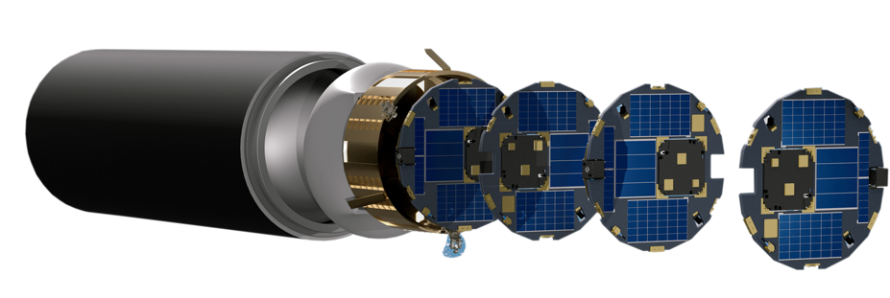

National Aeronautics and
Space Administration
NASA Small Spacecraft
Technology Program
Roger C. Hunter
Program Manager
Small Spacecraft Technology Program
NASA Town Hall ✦ August 7, 2023
Small Satellite Conference

Slide 2
2023-2024 Launch Schedule
Technology Demonstrations | Launch Timeframe
Starling: Demonstration of Autonomous Swarm Technologies | Launched July 17, 2023
R5 (S2 and S4): Rapid Technology Maturation | NET 16 Oct 2023
R5 (S3 and S5): Rapid Technology Maturation | NET 1 Nov 2023
PY4: Four CubeSat Swarm of PYCubed-Based Spacecraft | NET 1 Jan 2024
DUPLEX: Dual Propulsion Experiment | 1 Feb 2024
ACS3: Advanced Composite Solar Sail System | Q1 / CY2024
PTD-4: Pathfinder Technology Demonstrator-4: Payload: LISA-T High-Power Deployable Solar Array Antenna | NET Jun 2024
PTD-R: Monolithic UV/SWIR/VIS Camera | NET Jun 2024
Courier: Solar Electric Propulsion Module | Oct 2024
DiskSat: Two-Dimensional, High-Power, High-Aperture Maneuverable Spacecraft | Q4 / CY2024
CLICK B/C: CubeSat Laser Infrared CrossLinK | NET Dec 2024

Slide 3
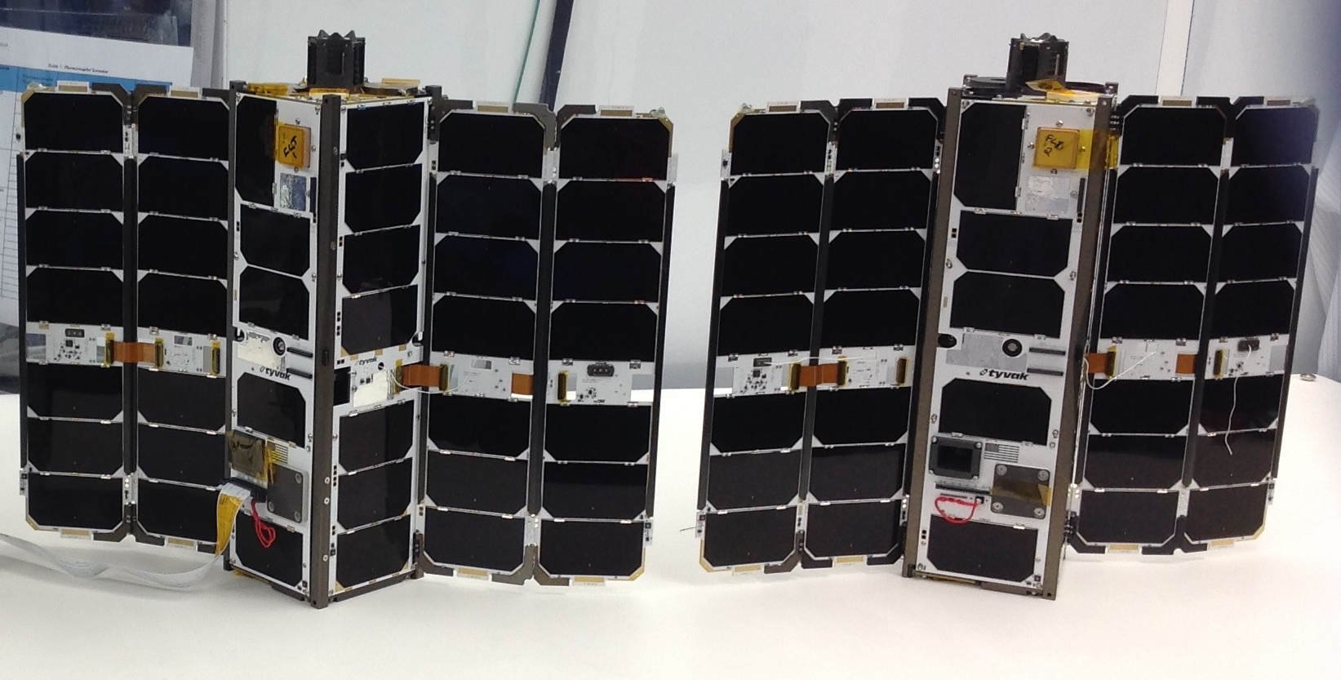
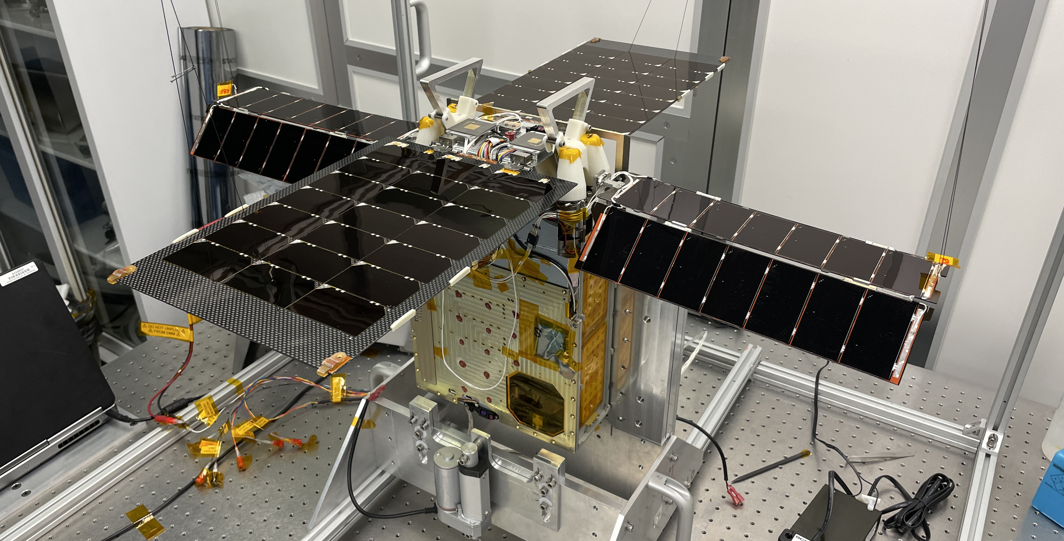
Spacecraft at End of Mission in 2023
CubeSat Proximity Operations
Demonstration (CPOD)
Launched: May 25, 2022
End of Mission: June 30, 2023
The mission was unable to demonstrate rendezvous, proximity operations and docking (RPOD) maneuvers as planned due to challenges with propulsion and GNC subsystems.
Lunar Flashlight
Launched : December 11, 2022
End of Mission: May 11, 2023
Spacecraft unable to generate enough thrust to complete maneuvers to stay in the Earth-Moon system to search for surface ice in the permanently shadowed craters of the South Pole.
Image Credits: Terran Orbital Corporation
Image Credits: NASA/JPL-Caltech
3

Slide 4
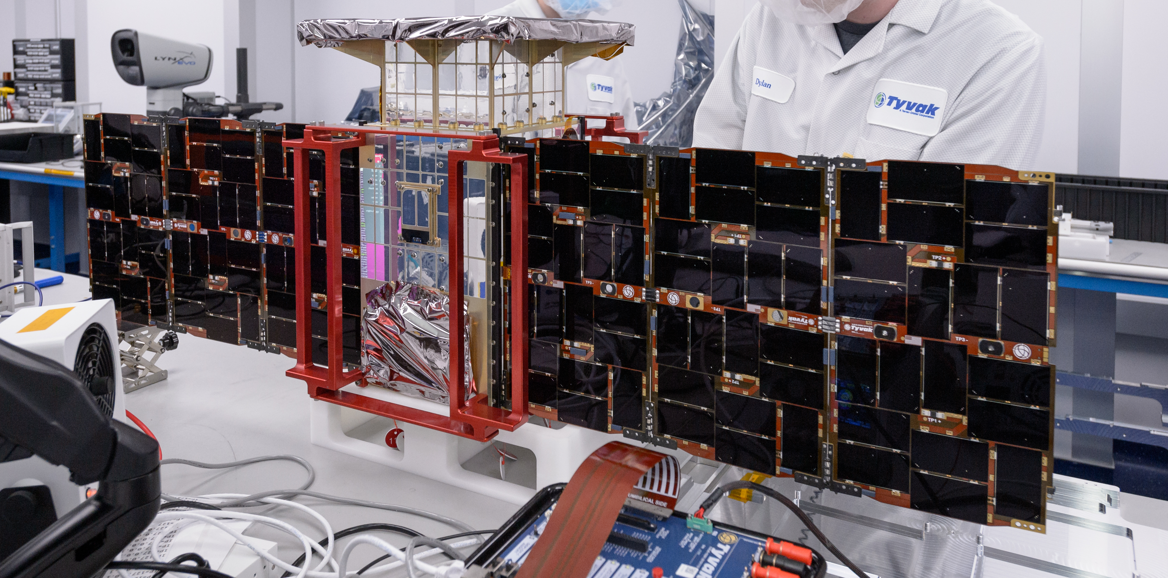
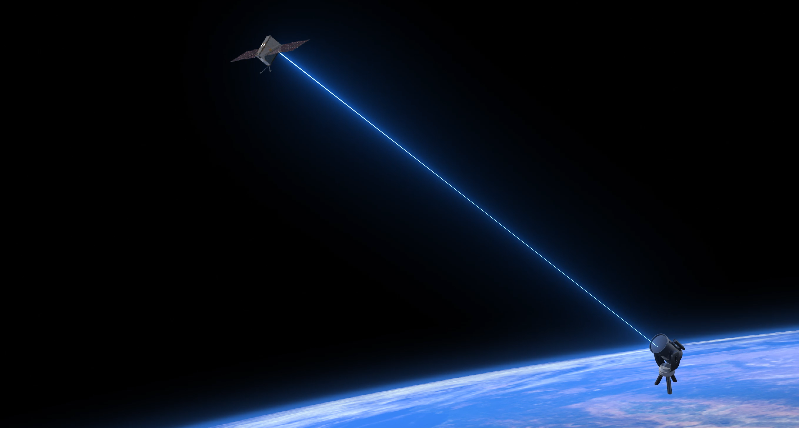
On-Orbit U-Class Technology Demonstration Missions
CAPSTONE
Launched: June 28, 2022
Status: Ongoing
Demonstrate ability to enter and maintain a near rectilinear halo orbit around the Moon. Demonstrate one & two way ranging and autonomous spacecraft navigation
Pathfinder Technology Demonstrator (PTD-3)
Launched: May 25, 2022
Status: Ongoing
Demonstrate TeraByte InfraRed Delivery (TBIRD) technology for high-bandwidth laser communications. Demonstrated 200 gigabit per second data downlink rate on April 28.
Spacecraft Image Credits: NASA;
Animation Credits: NASA
4

Slide 5
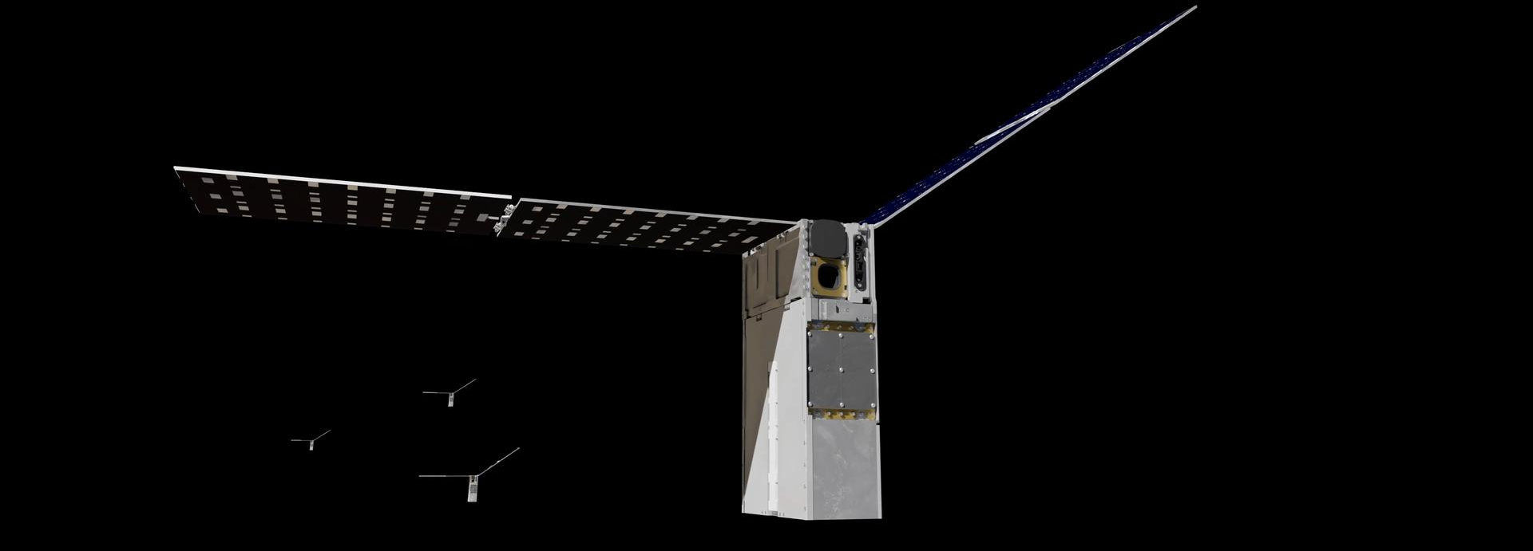
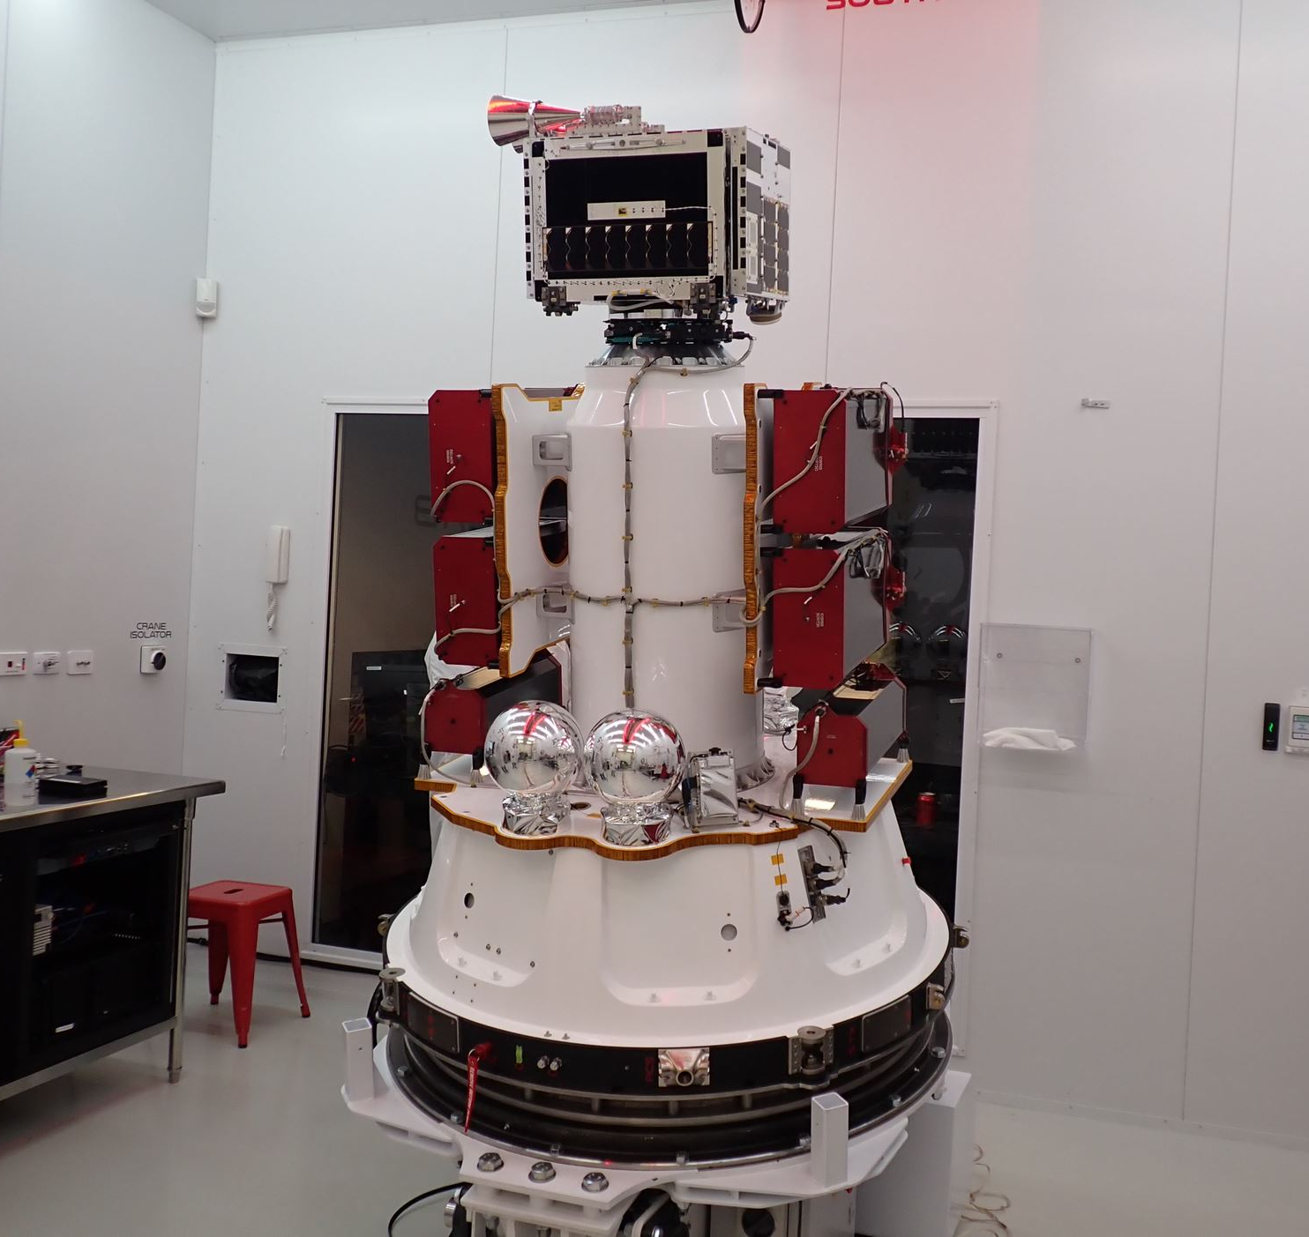
Starling
Starling’s four 6U CubeSats launched on July 17, 2023 from Rocket Lab Launch Complex 1 in Mahia, New Zealand. Starling will test swarm maneuver planning and execution, communications networking, relative navigation, and autonomous coordination between spacecraft. Animated Image Credits: NASA. Image Credits: Rocket Lab

Slide 6
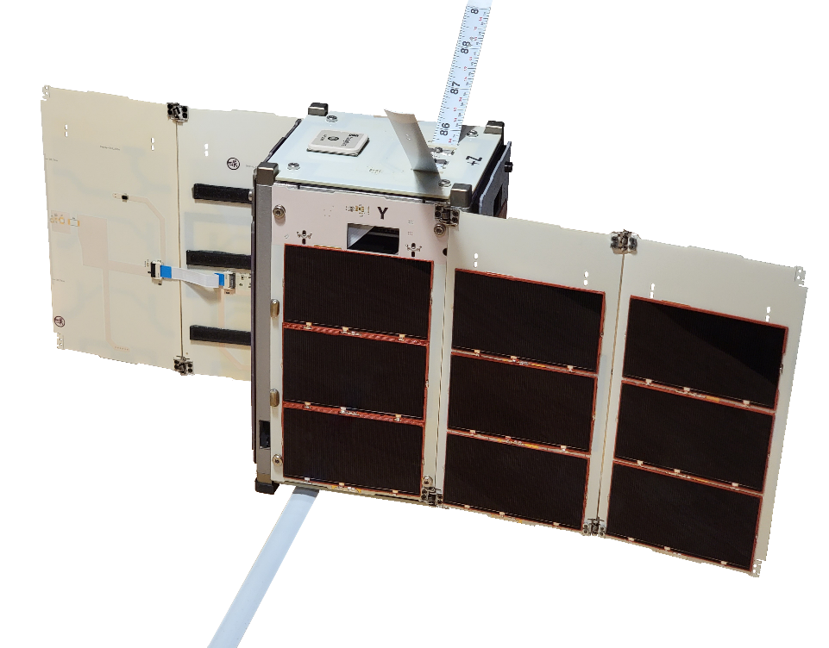
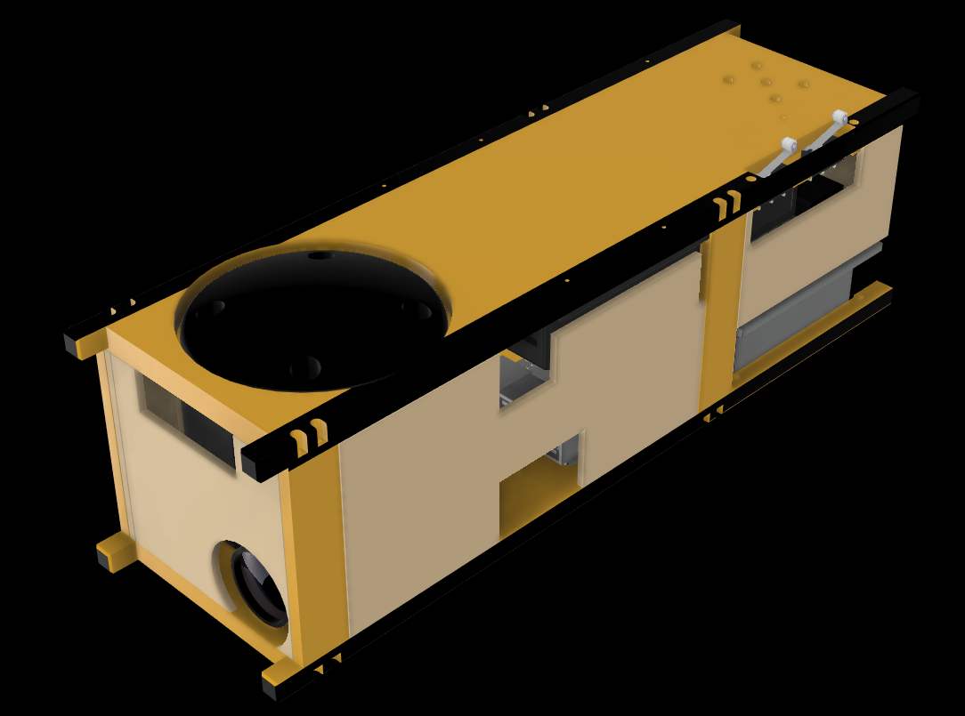
Upcoming U-Class Technology Demonstration Missions – 2023-2024
R5
Launch Timeframe:
NET October 16, 2023.
PY4
Launch Timeframe:
NET January 1, 2024.
Build and operate rapid, low-cost, highly-capable spacecraft platforms to demonstrate payloads of interest and technology relevant to human spaceflight .
Demonstrate low size, weight, power, and cost (SWaP-C) spacecraft-to-spacecraft ranging,
on-orbit relative navigation, and coordinated simultaneous multi-point radiation measurements.
Image Credits: NASA
Image Credits: Max Holliday, NASA Ames
6

Slide 7
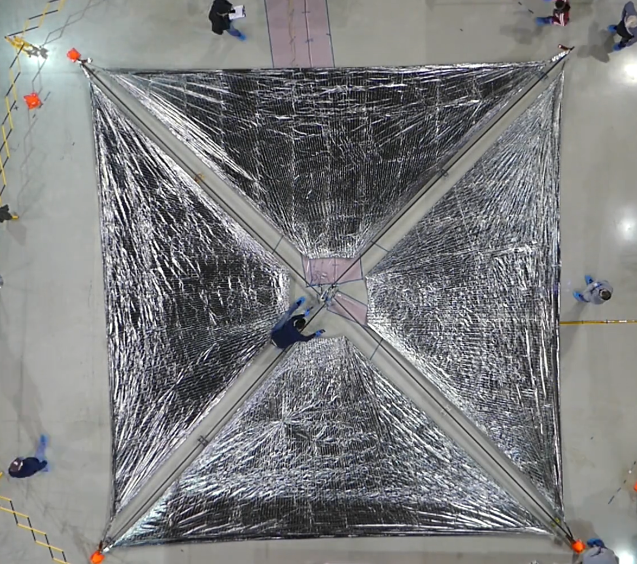
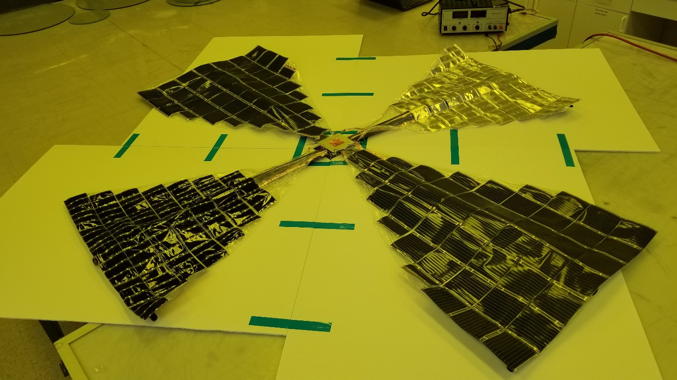
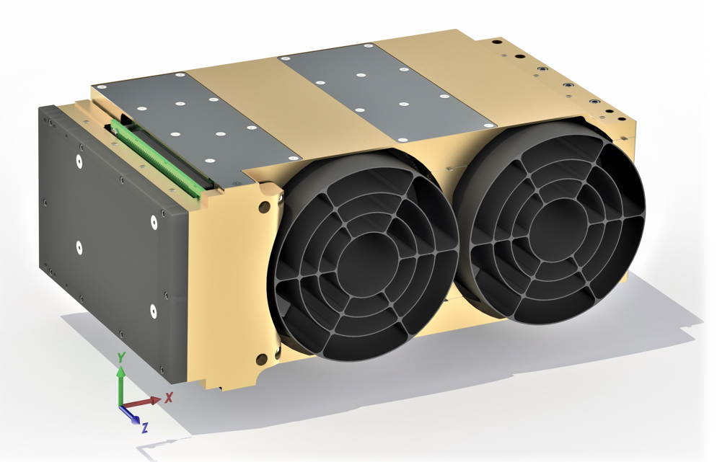
Upcoming U-Class Technology Demonstration Missions – 2024
Advanced Composite Solar Sail System (ACS3)
Launch Timeframe:
Q1 CY2024
Demonstrate deployment
of the composite boom
solar sail in low-Earth orbit. The unfurled solar sail will measure approximately 84 m²
Pathfinder Technology Demonstrator (PTD-4)
Launch Timeframe:
NET June 2024
Demonstrate Lightweight Integrated Solar Array and anTenna (LISA-T) – A high-power deployable solar array antenna
Pathfinder Technology Demonstrator (PTD-R)
Launch Timeframe:
NET June 2024
Demonstrate a new type of UV and SWIR Telescope that may be used in a wide range of applications.
Image Credits: NASA
Image Credits: Lawrence Livermore National Laboratory
7
Image Credits: NASA

Slide 8
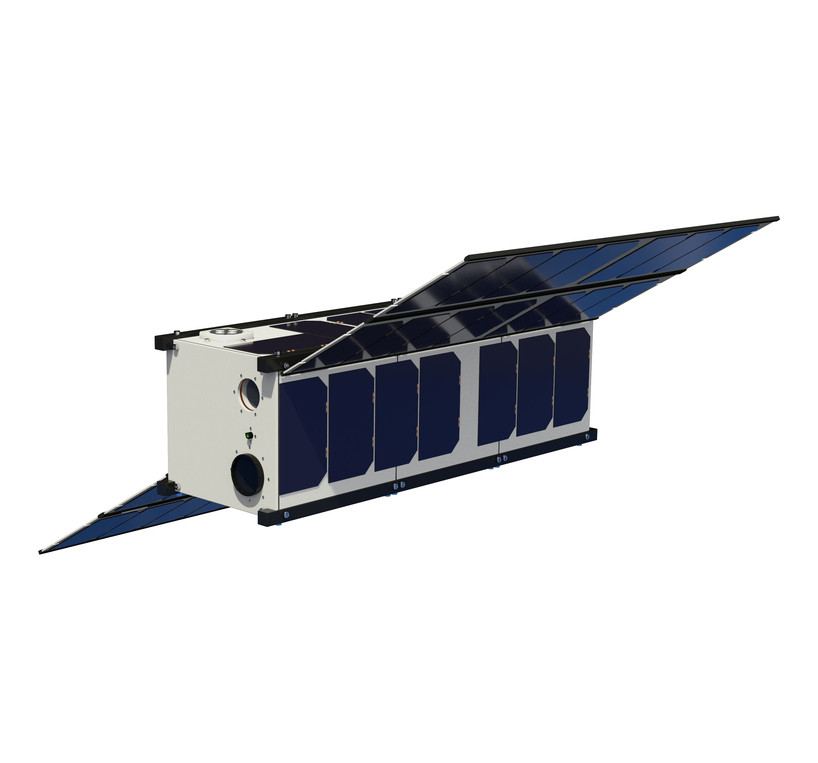
Upcoming U-Class Technology Demonstration Missions - 2024
CubeSat Laser Infrared CrosslinK
(CLICK B/C)
Launch Timeframe: December 2024
Demonstrate optical crosslink and precision ranging between two 3U CubeSats at a data rate of 20 Mbps and range up to 580 km
Image Credits: NASA

Slide 9
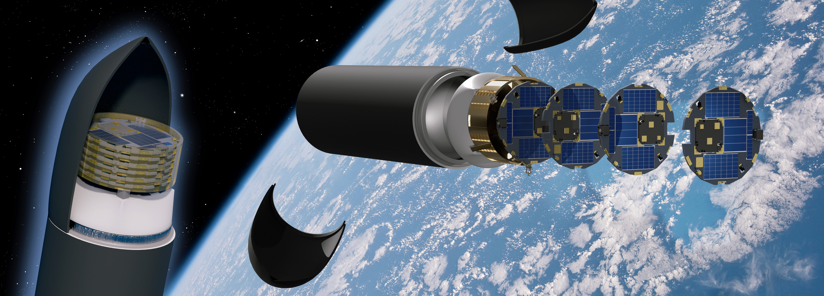
DiskSat
DiskSats are high-power and high-aperture alternatives to CubeSats. They are launched in tight stacks but are deployed individually to ensure no recontact between satellites. This first DiskSat demonstration is anticipated to launch no earlier than the last quarter of CY2024. Image Credit: The Aerospace Corporation

Slide 10
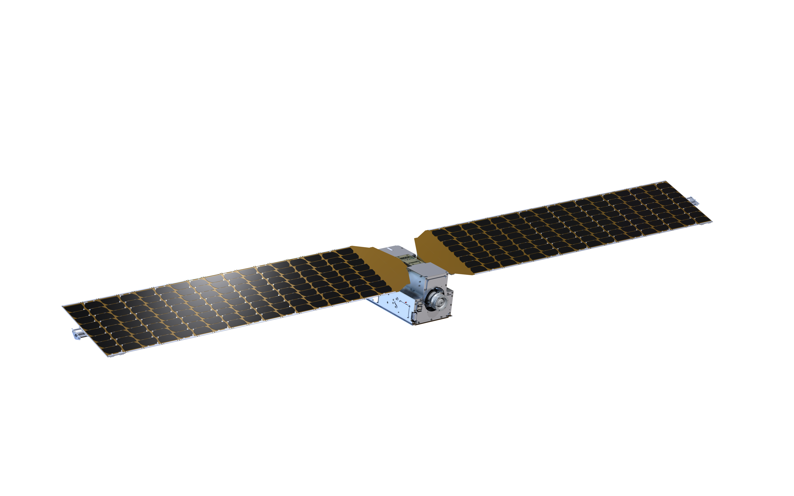
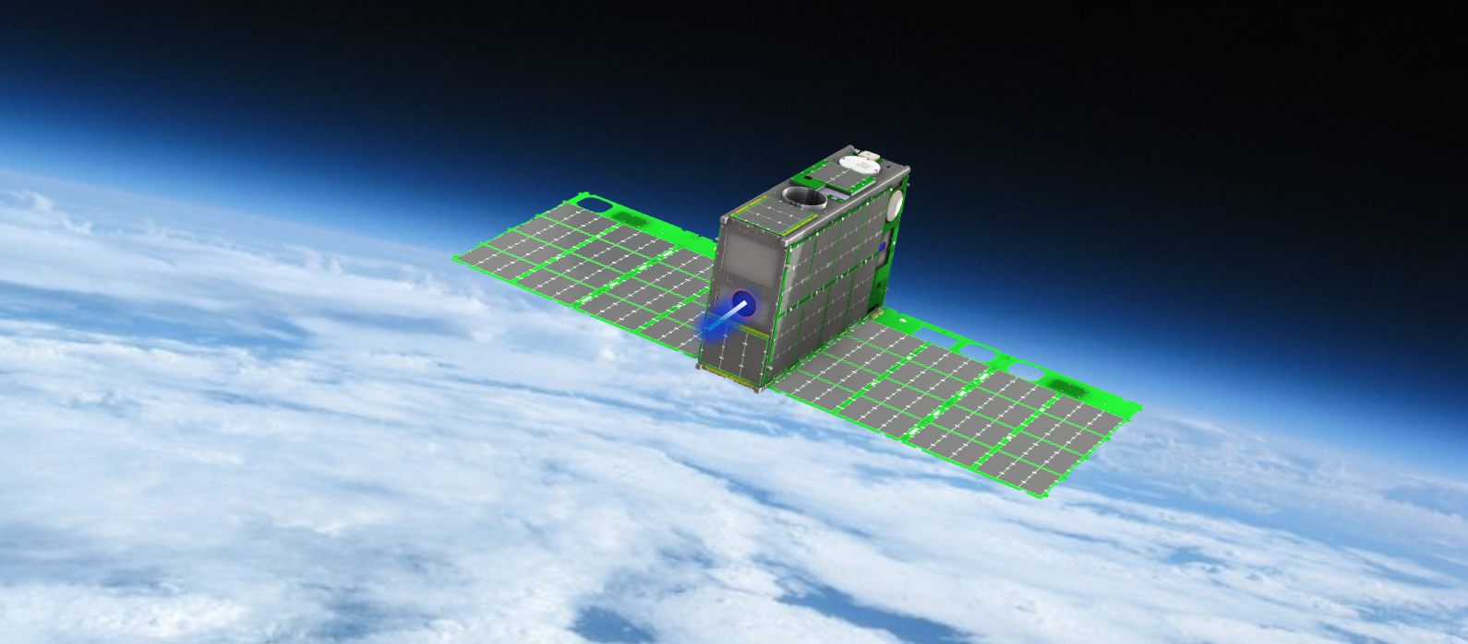
Tipping Point Projects – 2019
The 12U Courier CubeSat contains a compact, high impulse solar electric propulsion module. The mission will demonstrate a Halo Hall Effect Thruster which operates between 85-175 W.
Launch Timeframe: Oct. 2024
Image Credits: ExoTerra Resource, LLC.
A 6U Dual Propulsion Experiment CubeSat. Both propulsion systems, the Fiber-fed Pulsed Plasma Thruster and Monofilament Vaporization Propulsion, were developed with NASA SBIR funding.
Launch Timeframe: Feb. 1, 2024
Image Credits: CU Aerospace, LLC.

Slide 12
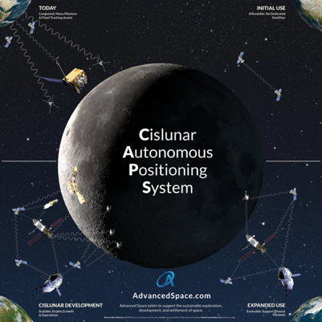
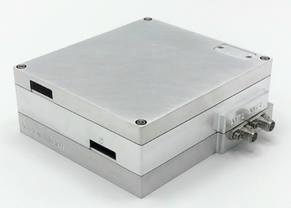
Announcement of Collaboration Opportunity Projects – 2018
Diagram of the concept of operations for the Cislunar Autonomous Position System (CAPS). CAPS is an innovative spacecraft-to-spacecraft navigation solution to be demonstrated on the CAPSTONE mission currently in orbit around the Moon. CAPS is anticipated to allow future spacecraft the ability to determine their location relative to the Moon without relying exclusively on tracking from Earth.
Image Credits: Advanced Space, LLC
A public-private partnership with NASA’s Goddard Space Flight Center
The Vulcan Wireless CubeSat radio, NSR-SDR-S/S. This CubeSat radio is a fully integrated, full-duplex, software-defined radio transponder. The radio transponder is being tested for compatibility with NASA’s Space Network.
Image Credits: Vulcan Wireless, Inc.
A public-private partnership with NASA’s Goddard Space Flight Center

Slide 13
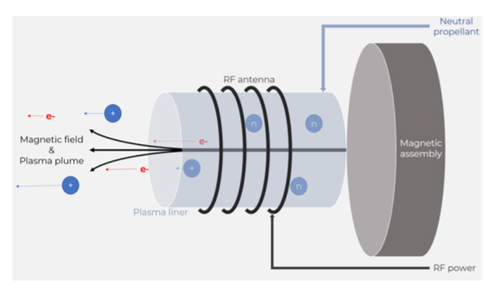
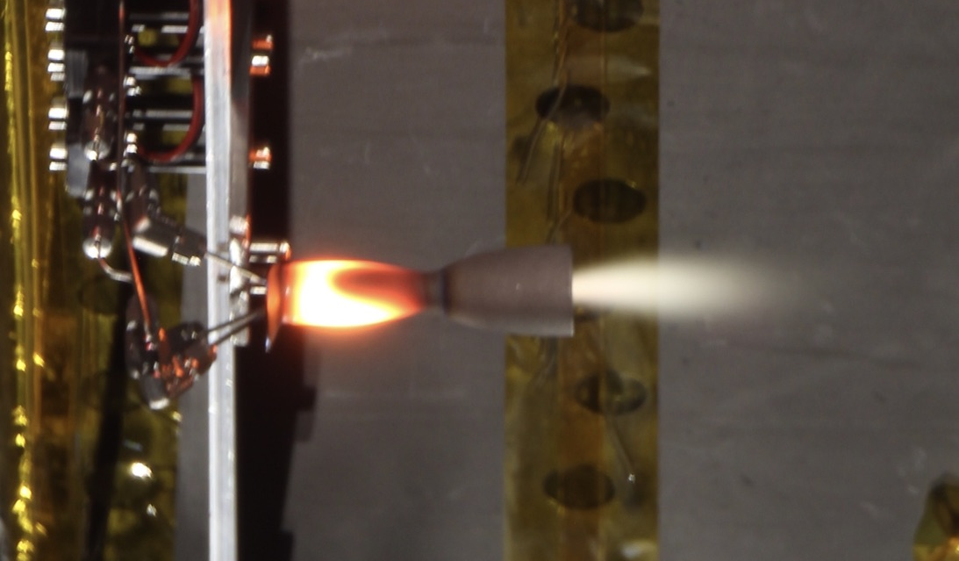
Announcement of Collaboration Opportunity Projects - 2020
The Phase Four RF plasma thruster operates by using RF to heat propellant into ionized plasma that is then ejected away from a spacecraft by a permanent magnet, creating thrust.
Image Credits: Phase Four
A public-private partnership with NASA’s Glenn Research Center
A prototype bipropellant thruster is shown in ambient pressure testing. The key technology being tested is the propellant pump - an enabling technology for launch safety approval (no stored gas) and system performance (lightweight tanks). Testing includes a propulsion system composed of monopropellant and bipropellant systems.
Image Credits: Stellar Exploration, Inc.
A public-private partnership with NASA’s Ames Research Center

Slide 14
THE OPEN NEWS
Uncontrolled Invasion: NASA’s Starling Mission Sending Multitude of Satellites into Space
Patil, Pooja. “Uncontrolled Invasion: NASA’s Starling Mission Sending Multitude of Satellites into Space.” The Open News, 18 July 2023, www.openthenews.com/uncontrolled-invasion-nasas-starling-mission-sending-multitude-of-satellites-into-space.

