Slide 1
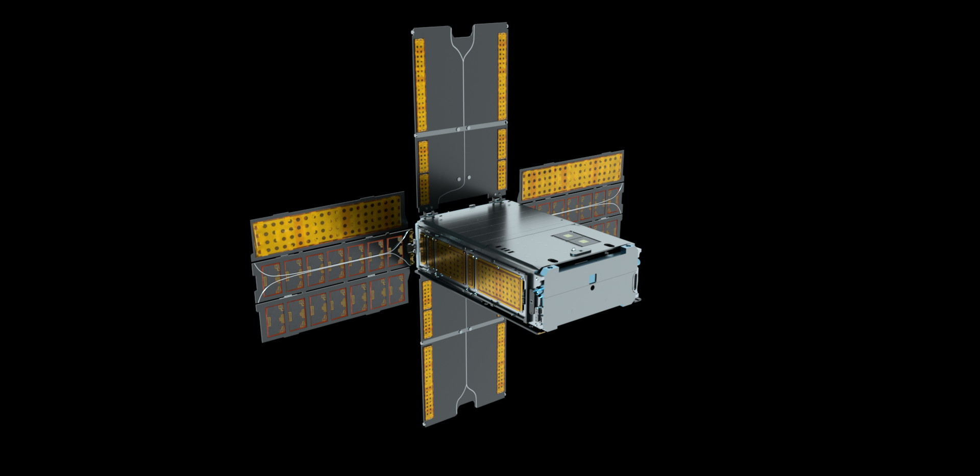

BioSentinel: the first deep space biology CubeSat mission
Mission summary and lessons learned
Matthew Napoli, PM
NASA Ames Research Center
NASA/Daniel Rutter

Slide 2
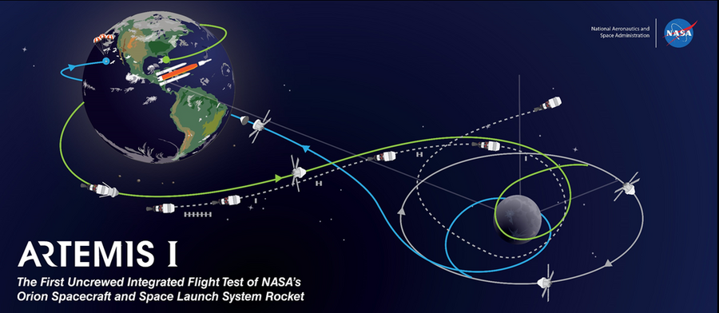

BioSentinel Mission
HQ Directorate: Exploration Systems Development Mission Directorate Mars Campaign Office (ESDMD-MCO)
Objective: develop a deep space tool with autonomous life support technologies to study the biological effects of the space radiation environment
NASA’s first biological study in interplanetary deep space:
  combine bio studies with autonomous
  capability & dosimetry beyond LEO
  beyond the protection of Earth’s
  magnetosphere
  Compare radiation environments
  (free space, ISS, lunar surface)
Lunar transit
(3-7 days)
Heliocentric Orbit
(6 months)
Secondary payload
deployment (L+4-5 hrs)

Slide 3






BioSentinel: sending biology further than ever before
The limits of life in space – as we know it – is 12.5 days on a lunar round trip or 1.2 years in LEO. As we send people further into space, we need to understand the biological risks and how they can be addressed
36 million mi
Mars
Millions mi
NEA
• L2
240,000 mi
Unknown
Distance from Earth
Known
180-300 mi
Extended ISS
62 mi
6 months
12 months
18 months
3 years

Slide 4

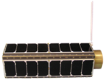



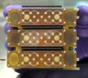
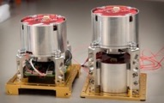
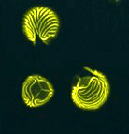

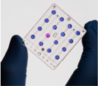
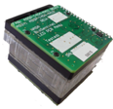
NASA Ames pioneering biological space missions
GeneSat-1 (2006 / 3U): gene expression
PharmaSat (2009 / 3U): drug dose response
O/OREOS* (2010 / 3U): survival, metabolism
SporeSat-1 (2014 / 3U): ion channel sensors, microcentrifuges
EcAMSat (2017 / 6U): antibiotic resistance
BioSentinel (2022 / 6U): DNA damage response from deep space radiation

Slide 5
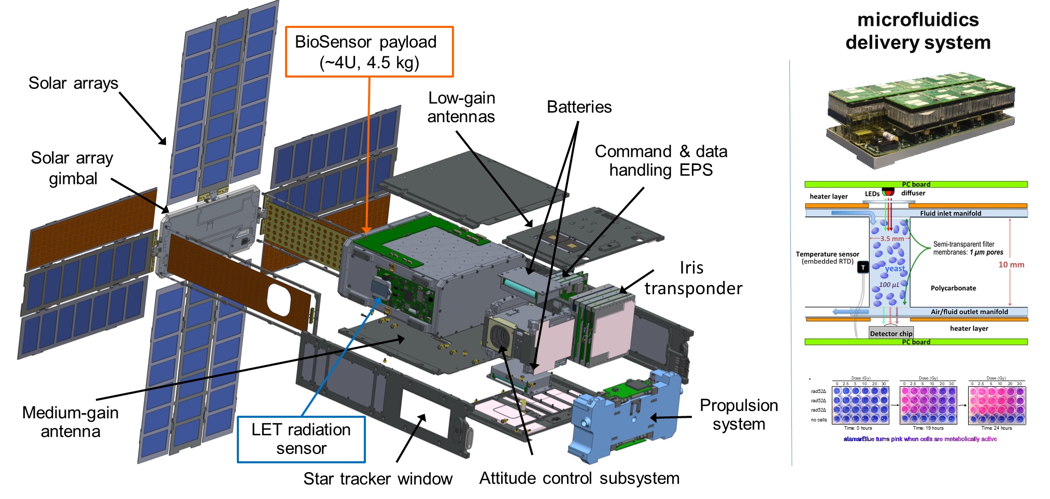
BioSentinel: 4U experiment in a 6U CubeSat

Slide 6
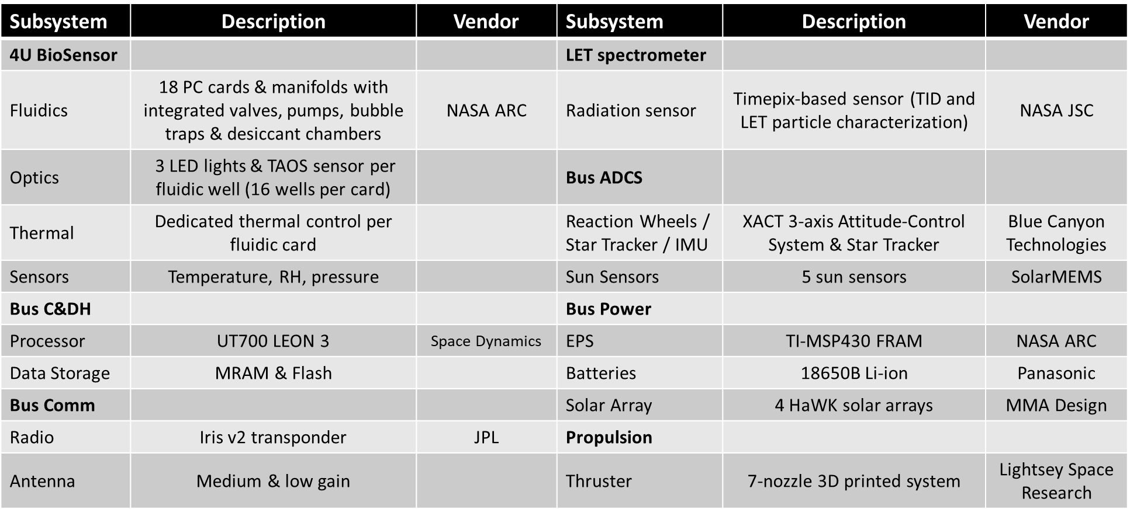
BioSentinel Subsystems

Slide 7
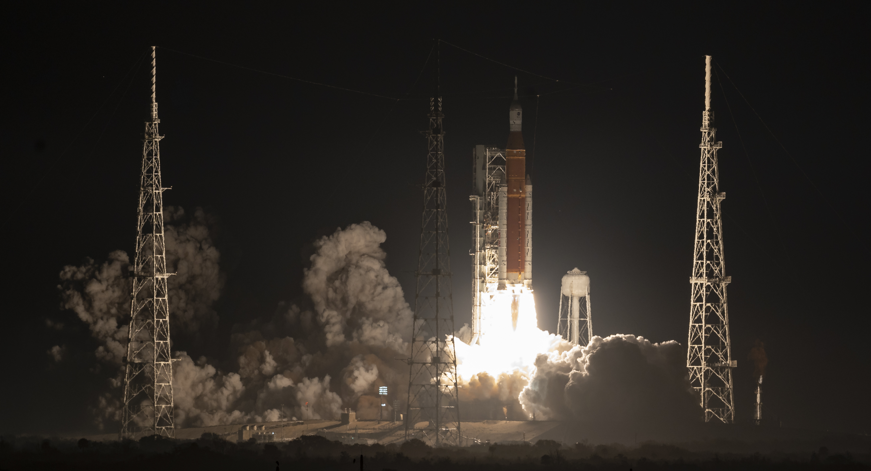
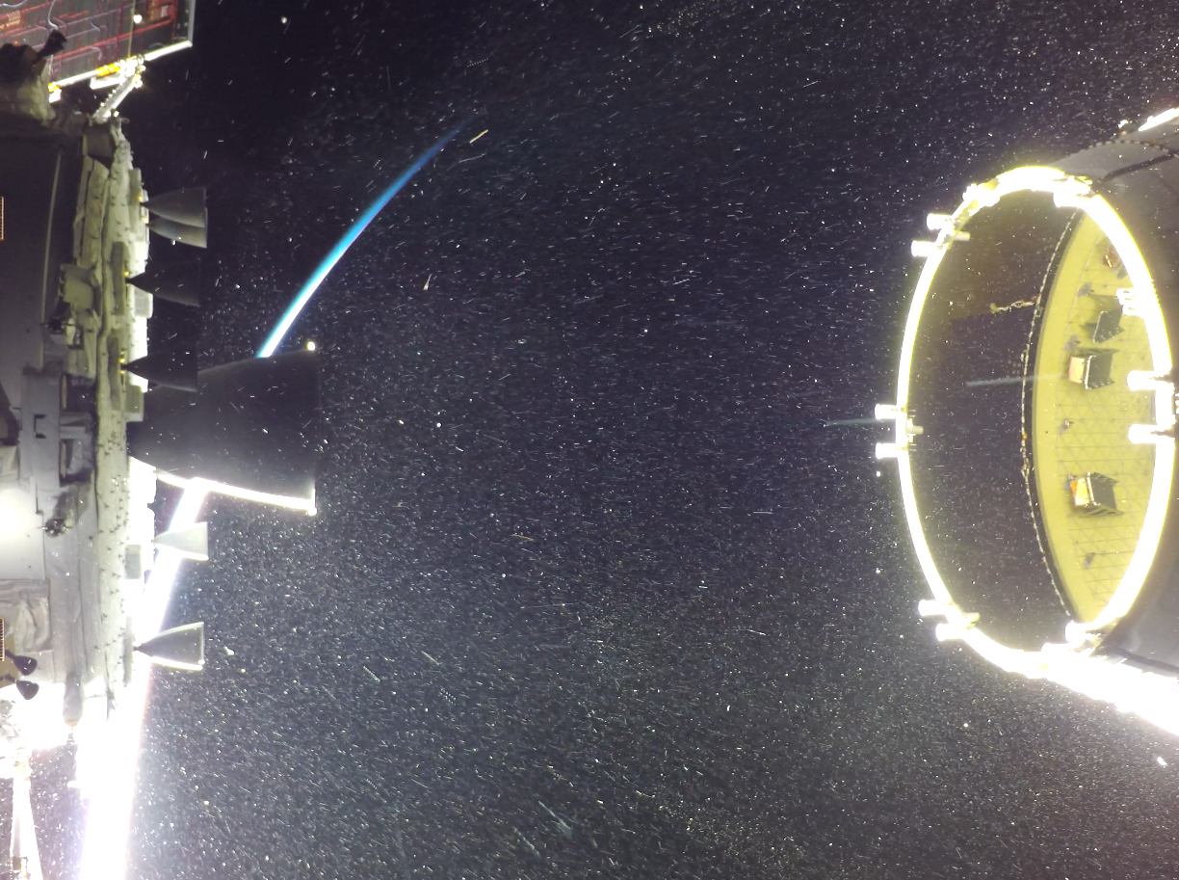
Launch and Deployment: November 16, 2022
NASA/Bill Ingalls

Slide 8
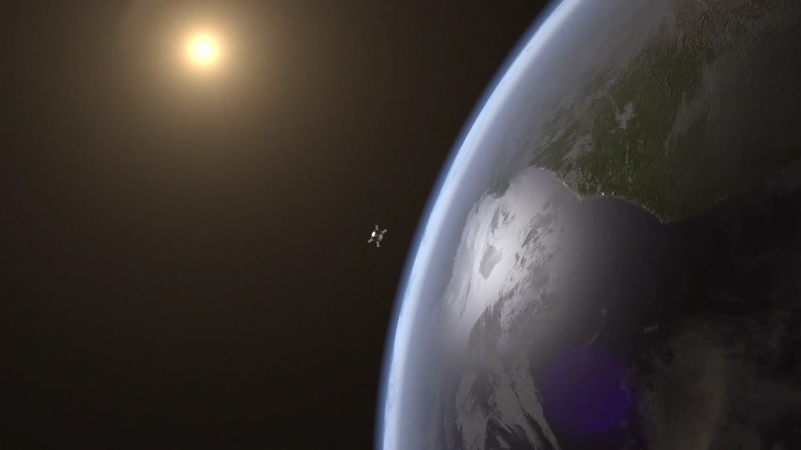
Launch and Deployment

Slide 9
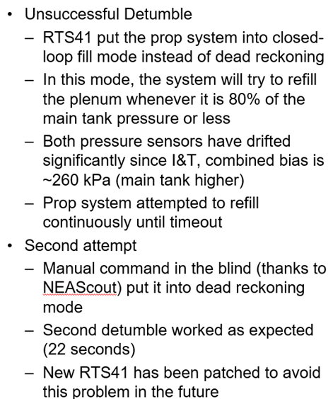
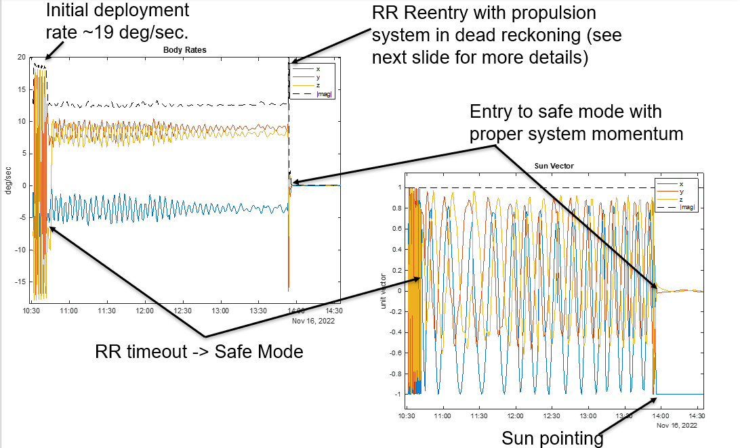
Initial Deployment – Tumbling Anomaly
Tumbling on Deployment

Slide 10
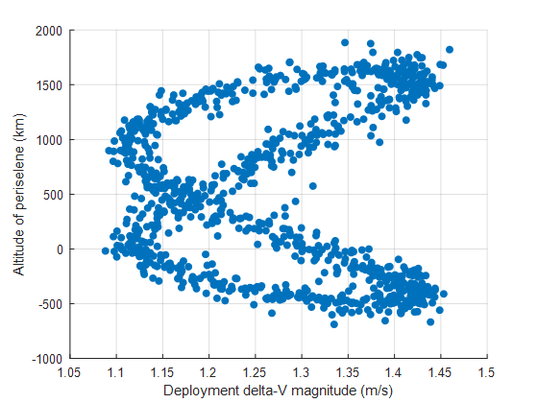
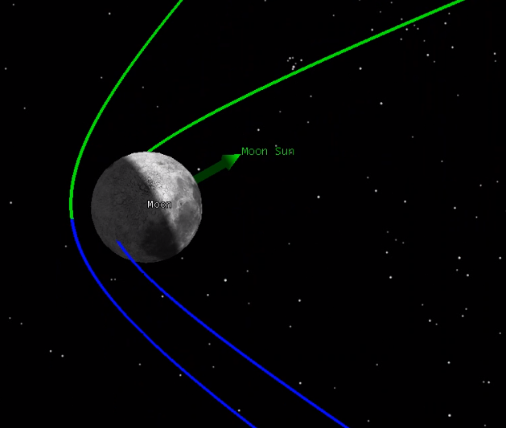
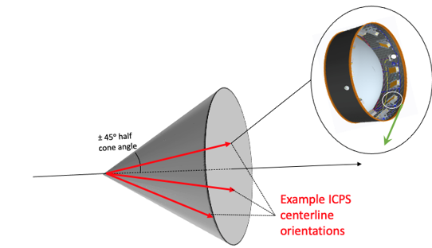
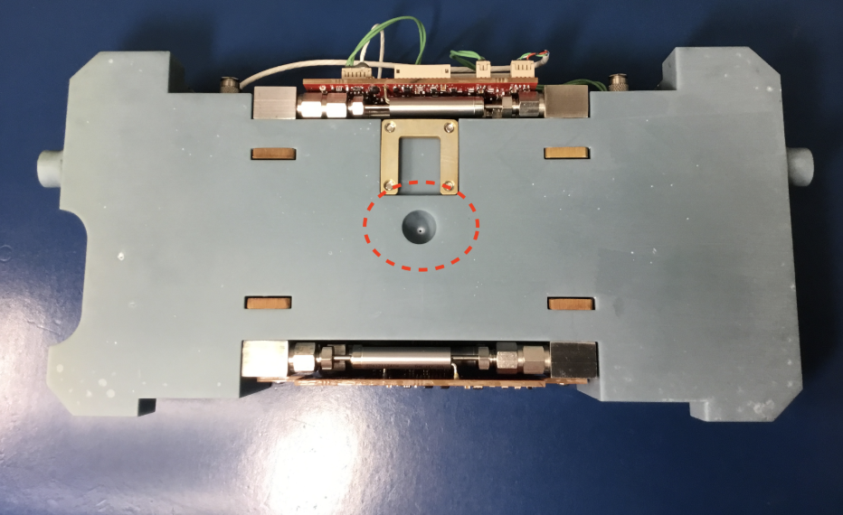
Lunar Impact Risk – Example Analysis
Trajectory Uncertainty
Baseline CONOPS did not have a dV maneuver planned. Initial lunar impact risks of <10% was deemed an acceptable risk.
However, VERY high probability of lunar impact for new launch dates:
  Aug 29th - 30%, Sept 2nd - 54%, Sept 5th - 56%, Nov 16th - 14%
Avoiding this impact requires a dV maneuver shortly after deployment
Prop Subsystem:
  The capability for dV ~ 4.2 m/s is possible because the propulsion system fortuitously included extra fuel and an extra rear nozzle that had not been planned for the nominal mission.
Lunar Impact
August 29th Launch Deployment Variability
  Propulsion Rear nozzle
Image:Terry Stevenson

Slide 11
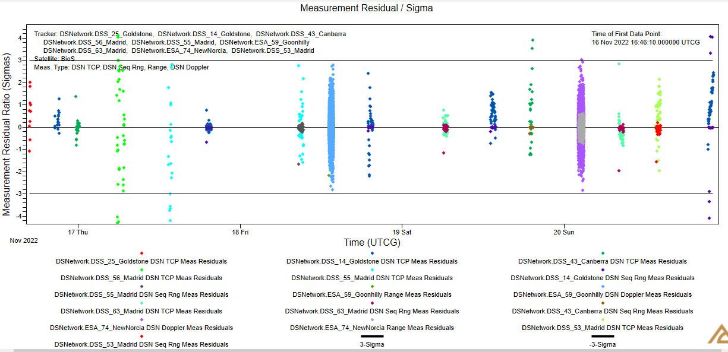
Navigation
Trajectory Determination
  Final pre-flyby OD (includes TCP, Sequential Ranging, DSN & ESA tracking data) indicated:
    Flyby Altitude: 406 km
    Eclipse Duration: 36.5 minutes

Slide 12
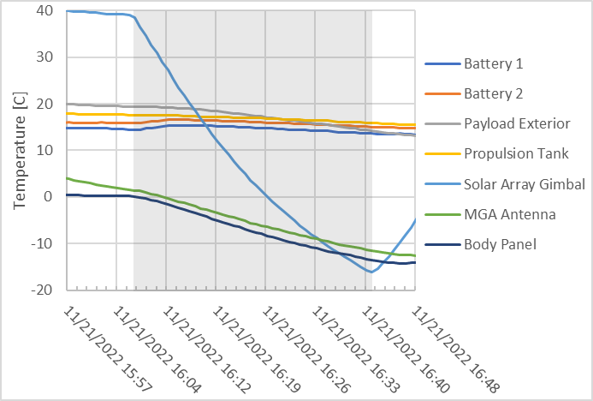
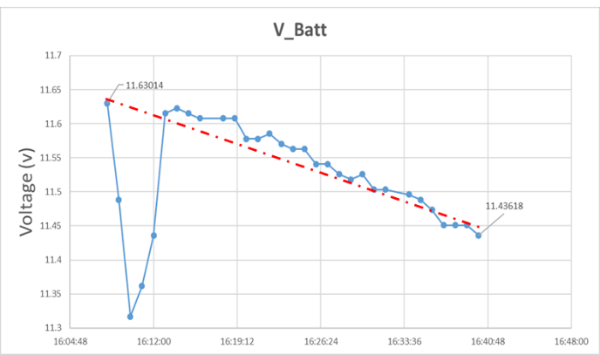
Lunar Eclipse Performance
  During the 36.5-minute eclipse payload could not drop below freezing or risk bursting fluidics
*The initial voltage dip was due to transmitter enabling.
Notes:
36.5 minutes

Slide 13
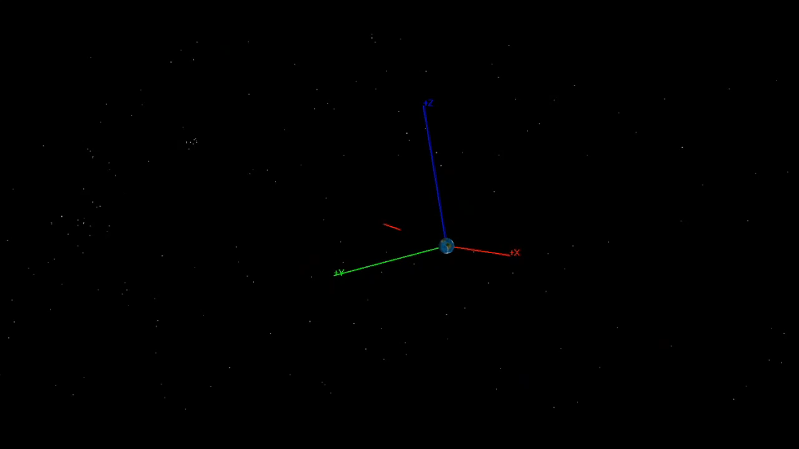
Lunar Flyby
NASA/Jose Alvarellos

Slide 14
Flight Tracker
Mission Events
Pass | Date/Time (UTC) | Station | Notes
1 | 16 Nov 2022320/11:41 | DSS-25 | Initial Acquisition. Rate reduction not complete, spacecraft tumbling.
1-extra | 16 Nov 2022320/13:52 | DSS-14 | Blind command to re-enabled rate reduction.
2 | 16-Nov-22 320/16:25 | DSS-25 | Confirmed rate reduction complete.
3 | 16-Nov-22 320/20:20 | DSS-14 | Deployed Solar Arrays
4 | 16 Nov 2022 320/23:20 | DSS-43 | Orbital Determination from first 4 passes. Lunar avoidance maneuver called-off.
5 | 17 Nov 2022 321/06:05 | DSS-56 | (would have been the pass for the maneuver) Transitioned to nominal pointing
…
 | 21 Nov 2022 325/15:41 |  | Lunar Flyby @ 406km periselene altitude
21 | 21 Nov 2022 17:15 | DSS-14 | Post Eclipse H&S nominal
…
54 | 05 Dec 2022 16:00 | DSS-65 | Science Phase - Experiment #1 Start
… | Over 200 successful DSN comm passes to date. |  | Over 100 successful comm passes and 3 experiments run to date.

Slide 15
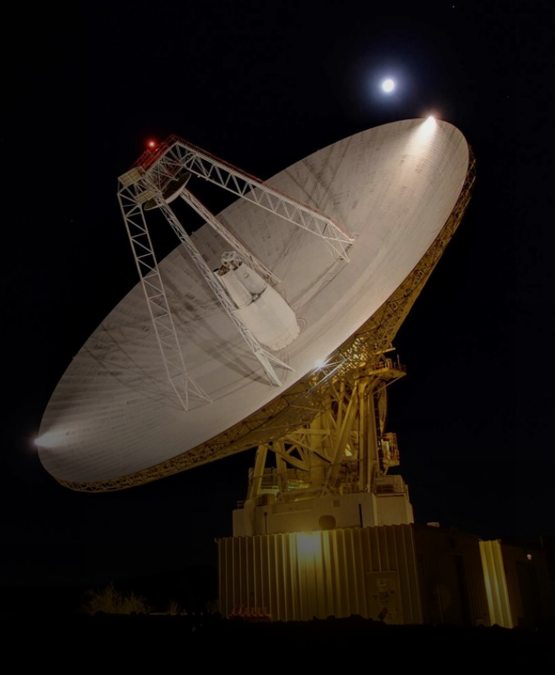
DSN Communication Performance
Requirement | Performance
DL: 8000 bps / 48 ksps | Baseline data rate. Good success. See occasional drops in BSNR with few frame drops.
DL: 1000 bps / 6 ksps | Good. For some passes, downlink signal level is significantly lower than predicts, for others nominal.
DL: 500 bps / 1 ksps | Successful locks.
DL: 62.5 bps / 125 bps | Initially unsuccessful at locking on telemetry. Configurations adjusted then checkout was nominal.
UL: 2000 bps | No issues on checkout. Intermittent dropout requires radio reboot.
UL: 1000 bps | No issues
UL: 500 bps | No issues
UL: 62.5 bps | No issues
Ranging | No issues.
Monitor Data | No issues.
DSN Command success rate >99%
NASA/JPL

Slide 16
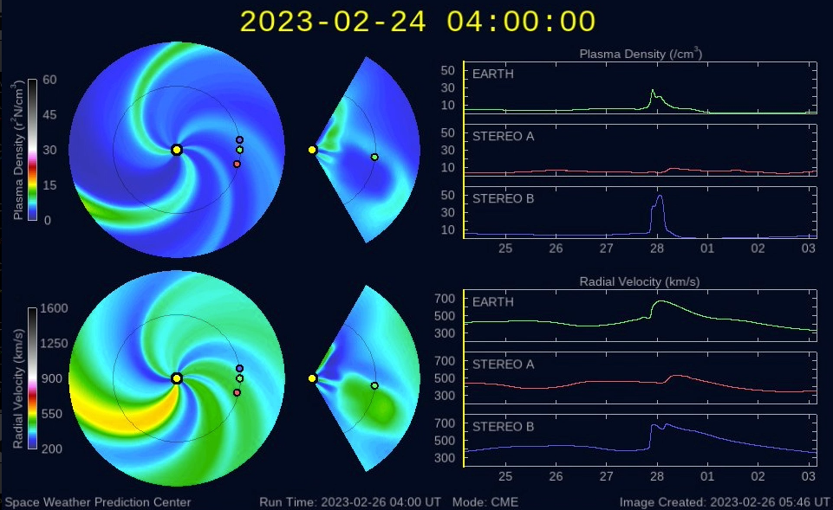
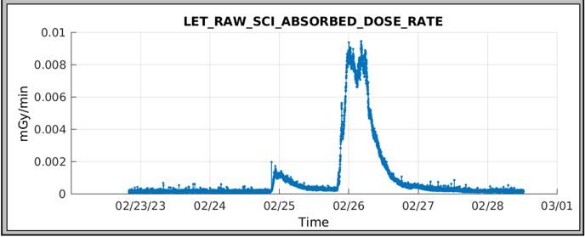
Deep Space Science Operations
  BioSensor Payload
  Performed 4 sets of biology experiments on the spacecraft. No growth observed in cell samples and similar results were observed on the ground control unit. The cell viability was affected by long exposure to increased humidity inside the BioSensor.
  The BioSensor payload technology was demonstrated in deep space and learnings will be utilized in future mission including CLPS project, LEIA.
  Linear Energy Transfer (LET) Spectrometer Payload
  Continues to gather radiation dosimetry
  Has captured solar events including coronal mass ejections
  Flux measurements from the GOES satellite (top) and BioSentinel LET spectrometer (bottom) recorded for a pair of Coronal Mass Ejection events on Feb. 24 and 25, 2023

Slide 17
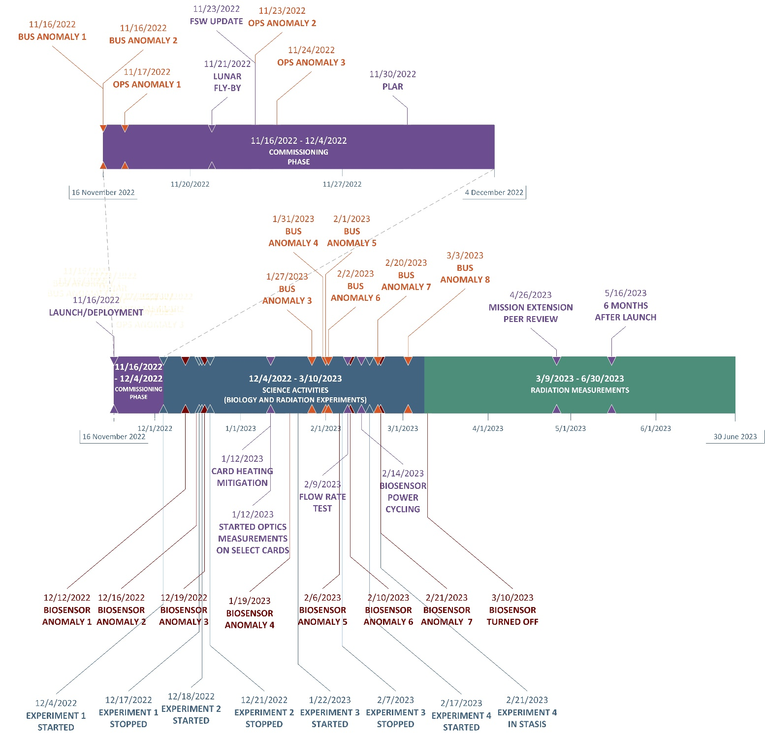
Other Mission Operation Anomalies
  Cold Gas Propulsion System
    Stuck valve 5
    Liquid in Plenum resulting in extra thrust until depleted
  Flash memory corruption on a partition

Slide 18
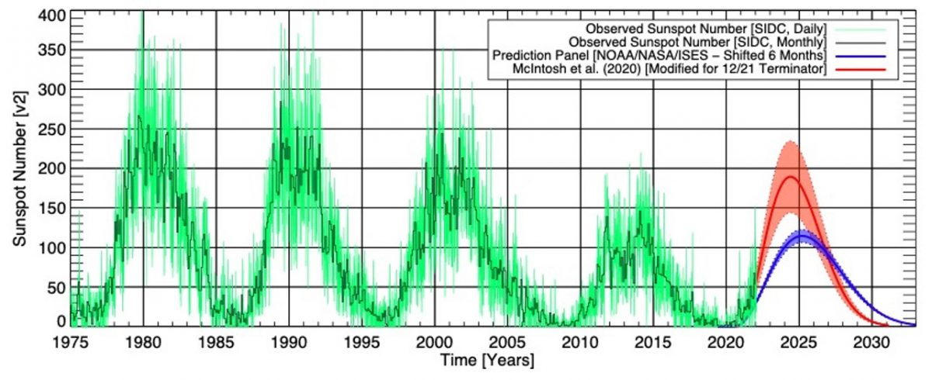
Extended Mission
ESDMD-MCO Program Office has extended the BioSentinel Mission
Science Objectives in partnership with the JSC RadWorks team:
Characterize solar energetic particle (SEP) events, especially as we head deeper towards solar maximum. Such measurements will provide valuable information to the heliophysics community for the development of SEP models.
Provide space radiation characterization in multiple environments using the same radiation detector, including heliocentric orbit, low Earth orbit, cis-lunar space, and on the lunar surface.
Monitor galactic cosmic radiation (GCR) flux rates in a unique location while transitioning into the solar cycle maximum period.
Hardware Heritage for long durations (up to 2 years) in deep space
LET Timepix detectors ahead of future operations on Lunar Gateway and Artemis
NASA Engineering and Safety Center (NESC) EEE Cots Parts Validation for cubesat components
  Solar Cycles

Slide 19
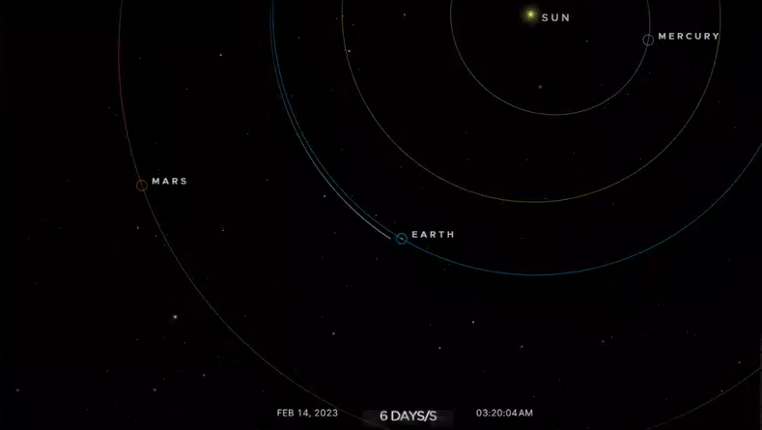

NASA/JPL

Slide 20
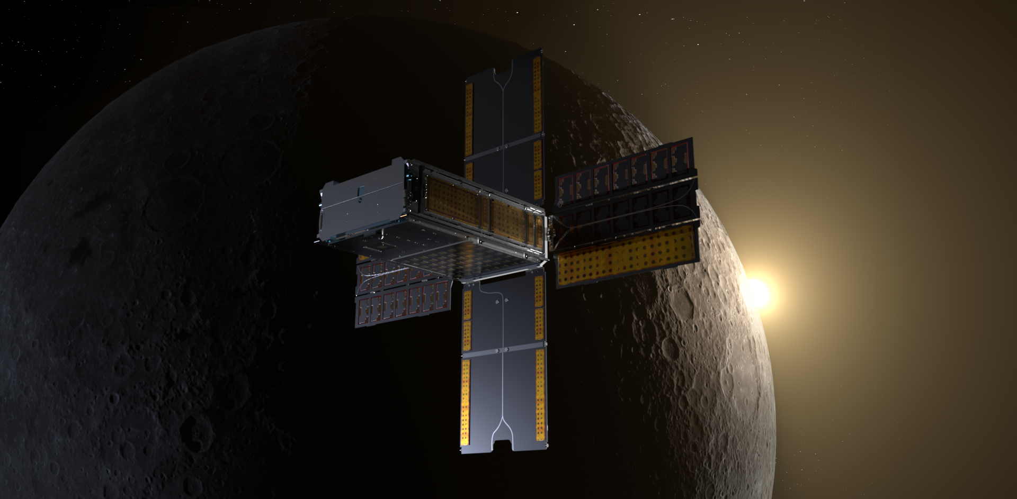
Acknowledgements to:
  ESDMD-MCO Program Office
  BioSentinel Team
  Co-Authors
    Cheryle Kong, Jeffrey Homan, Jesse Fusco, Robert Nakamura, Mike Padgen, Shang Wu, Philip Shih, Mohammad Hejase, Sergio R. Santa Maria, Josh Benton, Dennis Heher, Terry Stevenson, Andres Dono Perez, Jose Alvarellos
NASA/Daniel Rutter

