Slide 1
Space Nuclear Propulsion Systems – Thermal Gap Overview
Angela Krenn
Principal Technologist for Thermal Management Systems
NASA Space Technology Mission Directorate
August 2023
angela.g.krenn@nasa.gov

Slide 2
Outline
Context for In-space transportation options
NEP/Chem Overview
NEP/Chem Thermal Gaps & Active Work
NTP Overview
NTP Thermal Gaps & Active Work
Conclusions
References

Slide 3
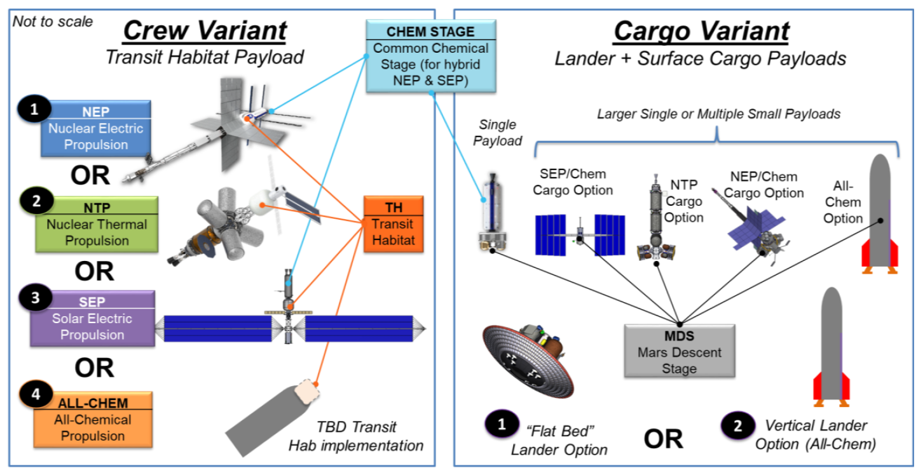
Mars Transit Options
Reference ESDMD-001 Moon to Mars Architecture Definition Document

Slide 4









NEP/Chem Overview
Power management,
storage, and distribution
Electric propulsion
engines
5
Heat to
electrical power
conversion
6
Radiation
shield
Propellant
storage
1
Nuclear production
of heat
2
7
High thrust combustion
3
4
Cryogenic storage
Waste heat
rejection

Slide 5


Gap 1: Nuclear reactor heat acquisition
Parameter | Goal
Heat Load | 4 – 10 MW_{th}
Temperature | 1,200 – 1,400 K
Transport Distance | ~ 5 – 10 m
Heat flux | ~0.3 – 1 MW/m2
Allowable temperature drop | ~50 – 150 K
Other considerations | Operable in micro-g and high-thrust environments High-reliability life of > 20,000 hours
Heat to electrical
power conversion
1
Nuclear production
of heat
Heat must be acquired from the nuclear system and delivered to the power conversion system with minimal loss. This may be accomplished via heat pipes, direct gas heat transfer, pumped liquid metal, or other novel approaches.
State of the art is liquid metal heat pipes
~1 – 35 kw @ ~1,200 – 1,400 K ~ 1 m
ONGOING WORK
2023 SBIR Z2.01 Spacecraft Thermal Management, Scope for High-temperature heat acquisition and transport
The Peregrine Falcon Corporation: Consolidation of heat pipes within a U-8Mo Core for High efficiency and long-term reliability
Advanced Cooling Technologies: Hot end thermal management system for nuclear electric propulsion

Slide 6

Gap 2: Nuclear waste heat transport/spreading
Gap 3: Lightweight, high temp radiators
Heat to electrical
power conversion
Parameter | Goal
Heat Load | 4 – 10 MW
Transport Distance | ~ 10 - 100 m
Heat rejection temp | ~ 300 – 600 K
Areal Density (radiator) | ~ 2 - 6 kg/m2
Other considerations | Operable in micro-g and high-thrust environments High-reliability life of > 20,000 hours MMOD tolerant
ONGOING WORK
Space Technology Research Grants
Cornell University: AdVECT: Additive Vehicle-Embedded Cooling Technologies
University of Cincinnati: High-Temperature Lightweight Radiator Panels with 3D-Printed Titanium Loop Heat Pipes
Penn State: High Temperature Additively Manufactured Monolithic Heat Pipe Radiators
University of New Mexico: Advanced Lightweight Heat Rejection Radiators for Space Nuclear Power Systems
2
3
4
Waste heat
rejection
$R=σeAT^{4}$
State of the art is ~1 – 35 kW @ 300 K
and an areal density ~19 kg/m2
Very large area radiators are required to reject sufficient waste heat to space. The resulting mass of the radiators dominates the mass of the system, thus adversely impacting the system mass-to-power ratio (alpha). Increasing the heat rejection temperature is the only way to reduce the radiator area but must be balanced with optimizing conversion efficiency to achieve the optimal alpha. Reducing areal density allows for an improved alpha at any given temperature.

Slide 7
Gap 4: High Temp Thermal Control Coatings
Heat to electrical
power conversion
Parameter | Goal
Adherence temp (titanium or composite substrates) | ~ 300 – 600 K
IR Emissivity | > 0.88 (EOL)
Solar Absorptivity | > 0.25 (EOL)
Other considerations | Radiation tolerant MMOD tolerant > 5-year design life
State of the art is IR emissivity ~ 0.87, solar absorptivity ~ 0.35 (after 5 years in LEO)
Adherence demonstrated at relevant temps only on aluminum substrates, delamination experienced during testing on other surfaces
Higher solar absorptivity values may be tolerated depending on vehicle design and trajectory
2
3
4
Waste heat
rejection
ONGOING WORK
2023 SBIR Z10.03 Space Nuclear Propulsion, Scope for Primary Heat Rejection Subsystem
Polaronyx, Inc.: Robotic High-Emissivity Surface Treatments
Ultramet: High-Emissivity CVD Dendritic Rhenium Coatings for NEP Radiator Panels
Once waste heat is delivered to, and spread along, the radiator surface, high IR emissivity coatings are required to radiate that heat to space. Sun-facing surfaces require low solar absorptivity.

Slide 8


Gap 5: Thermal Management of Electrical Harnesses Supporting EP Systems
Parameter | Goal
Voltage | ~600 – 800 VDC, extensible to 2 kVDC
Direct current | > 10 A, extensible to 200 A
Operating Temp | > 575 K
Survival Temp | < 215 K
Other considerations | Low outgassing materials Derating consistent with NASA standards for connectors and wiring Cable lengths, flexibility, and abrasion resistance
Power management,
storage, and distribution
Electric propulsion
engines
5
Power, commands, and telemetry are relayed between the power processing unit (PPU) and the thruster via dedicated electrical harness assemblies.
ONGOING WORK
2023 SBIR Z10.04 Materials, Processes, and Technologies for Advancing In-Space Electric Propulsion, Scope for High-Temperature, High-Voltage Electric Propulsion Harness Connectors and Cables
Ad Astra Rocket Company: Improved Design of the VASMIR Radio Frequency Transmission Line
State of the art is stranded, plated copper wiring with multilayer, crosslinked fluoropolymer insulation: 600 -1,000 VDC @ < 13 K

Slide 9
Gap 6: NEP Thruster Materials Knowledge Gap
Electric propulsion
engines
6
NEP Thrusters will need to operate at a higher power density than heritage thrusters, pushing the threshold of traditional materials. Testing is required to determine material impacts when operating in these conditions. Uncharacterized materials gaps may exist.
Parameter | Goal
Power | 100 kWe
Thrust | 4700 mN
Specific Mass | 3 kg/kWe

Slide 10
Gap 7: Cryogenic Fluid Management
7A
Parameter | Goal
Propellant boiling points | LO2 90 K LCH4 111 K
Aggregation/transfer duration | ~ 1 year
Other considerations | Operational mitigations to minimize losses due to chilldown and leaks Power and mass
Cryogenic transfer
Multiple cryogenic propellent launches must aggregate and transfer cryogenic propellant into the transportation stage in-orbit. In transit, liquid will need to be fed to the engines. Children gaps include unsettled mass gauging, automated cryo-couplers, minimal loss chilldown, no-vent fill, autogenous pressurization, advanced cryo distribution components, two phase/micro-g flowmeters, and micro-g liquid acquisition. Thermal modeling is also important to handle thermal stratification, mixing, venting, etc.
ONGOING WORK
Technology Demonstration Missions: Cryogenic Fluid Management Portfolio Project
4 CFM Technology demonstration Tipping Point awards
Multiple modeling, mass gauging, valve maturation, refrigeration, and other efforts
Many other developments through multiple funding sources

Slide 11
Gap 7: Cryogenic Fluid Management
Parameter | Goal
Propellant boiling points | LO2 90 K LCH4 111 K
Storage duration | ~2 – 3 years
Other considerations | System design to minimize heat loads on cryo tanks (thermal soak back) Operational mitigations to minimize losses due to chilldown and leaks Power and mass
7B
Cryogenic storage
Cryogenic liquid propellant must be stored on-board with minimal losses from heat leak induced boiloff for the entire duration of the mission (on the order of 2-3 years). Children gaps include advanced insulation/thermal control coatings/sunshades, cross-cutting propellant utilization, conductive heat leak minimization, broad area cooling, lightweight high efficiency cryo coolers, advanced cryo distribution components, thermodynamic vents, and two phase/micro-g flowmeters.
ONGOING WORK
Technology Demonstration Missions: Cryogenic Fluid Management Portfolio Project
4 CFM Technology demonstration Tipping Point awards
Multiple modeling, mass gauging, valve maturation, refrigeration, and other efforts
Many other developments through multiple funding sources

Slide 12


NTP Overview
Power generation (solar arrays),
management, storage, and distribution
Radiation shield
Hot, expanding gas
for thrust
3
2
5
4
Nuclear production
of heat
1
Cryogenic storage
Reaction control
system

Slide 13
Gap 1: Cryogenic Fluid Management
Parameter | Goal
Propellant boiling points | LH2 20 K
Aggregation/transfer duration | > 1 year
Other considerations | Operational mitigations to minimize losses due to chilldown and leaks Power and mass
1A
Cryogenic transfer
Multiple cryogenic propellent launches must aggregate and transfer cryogenic propellant into the transportation stage in-orbit. In transit, liquid will need to be fed to the engines. Children gaps include unsettled mass gauging, automated cryo-couplers, minimal loss chilldown, no-vent fill, autogenous pressurization, advanced cryo distribution components, two phase/micro-g flowmeters, and micro-g liquid acquisition. Thermal modeling is also important to handle thermal stratification, mixing, venting, etc.
ONGOING WORK
Technology Demonstration Missions: Cryogenic Fluid Management Portfolio Project
4 CFM Technology demonstration Tipping Point awards
Multiple modeling, mass gauging, valve maturation, refrigeration, and other efforts
Many other developments through multiple funding sources

Slide 14
Gap 1: Cryogenic Fluid Management
Parameter | Goal
Propellant boiling points | LH2 20 K
Storage duration | ~2 – 3 years
Other considerations | System design to minimize heat loads on cryo tanks (thermal soak back) Operational mitigations to minimize losses due to chilldown and leaks Power and mass
1B
Cryogenic storage
Cryogenic liquid propellant must be stored on-board with minimal losses from heat leak induced boiloff for the entire duration of the mission (on the order of 2-3 years). Children gaps include advanced insulation/thermal control coatings/sunshades, cross-cutting propellant utilization, conductive heat leak minimization, broad area cooling, lightweight high efficiency cryo coolers, advanced cryo distribution components, thermodynamic vents, and two phase/micro-g flowmeters.
ONGOING WORK
Technology Demonstration Missions: Cryogenic Fluid Management Portfolio Project
4 CFM Technology demonstration Tipping Point awards
Multiple modeling, mass gauging, valve maturation, refrigeration, and other efforts
Many other developments through multiple funding sources

Slide 15
Gap 2A: Cold Gas to Nuclear Interface
Gaps 2B: High deltaT Materials
3
2
4
Parameter | Goal
Cold Temp | ~ 20 K
Hot Temp | ~ 2700 - 3000 K
Material operational life requirement | ~2 – 3 years
Nuclear production
of heat
Cryogenically cold liquid hydrogen must interface with the nuclear reactor in such a way that the hydrogen gas picks up as much heat as possible. Hydrogen gas must be heated to ~2700 K.
Materials in the nuclear reactor must tolerate the abrupt transition from 20 K to 2700 K for the duration of the mission.

Slide 16
Gaps 3, 4, 5: High Temperature Materials
Parameter | Goal
Cold Temp | ~ 20 K
Hot Temp | ~ 2700 - 3000 K
Material operational life requirement | ~2 – 3 years
Hot, expanded gas
for thrust
3
2
5
4
Nuclear production
of heat
Temperatures in the reactor and downstream components will exceed current materials testing capabilities. Extrapolated material properties suggest the required temperatures are near the edge of failure.
High temperatures drive reactor design decisions and present unique challenges.
Thermal soak back considerations will also impact system design.
ONGOING WORK
Space Nuclear Propulsion (SNP) project
Materials and core components testing for fuel & moderator development
(2) Phase-1 extensions for reactor designs and development
NASA/DARPA partnership for a flight demonstration mission
Demonstration Rocket for Agile Cislunar Operations (DRACO)

Slide 17
Questions?

