Slide 1
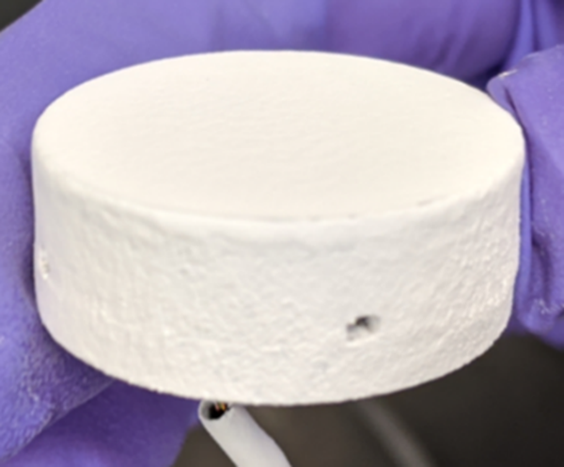
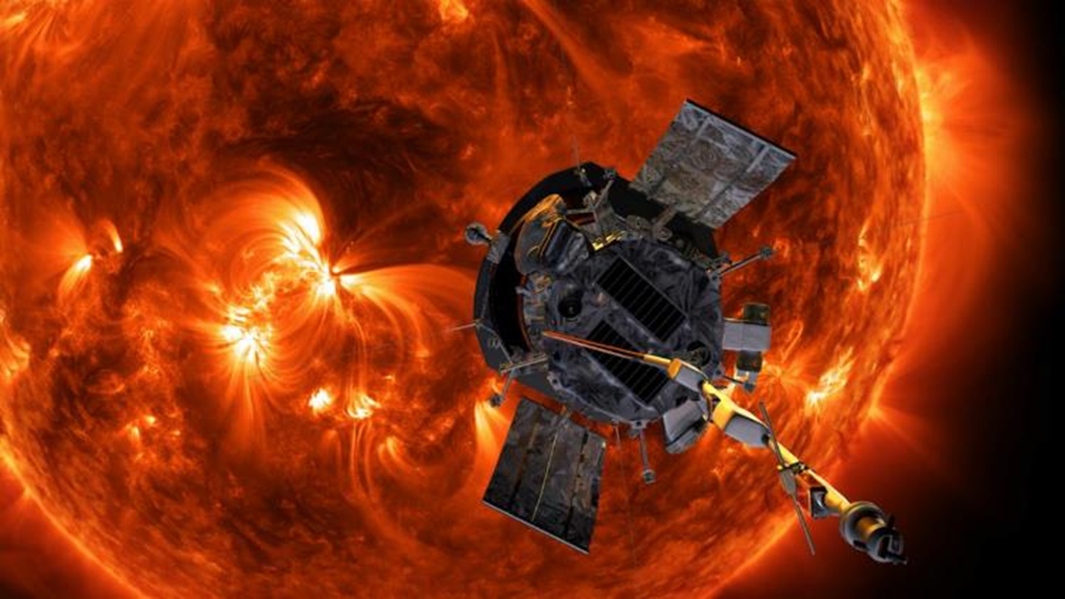
Solar White
Angela Krenn
TFAWS, August 2023
Thermal Control Coating development with goals for solar absorptivity (α) of 0.01 and IR emissivity (ε) of 0.9
  These values would allow passive cooling to 90 K (on a sphere at 1 AU with no other heat loads)
  Applicability to in-space cryogenic storage, and cooling detectors for science
  May enable high temperature superconductors with applicability to active radiation shielding, and enhanced EP systems
Solar White Paint
Sprayed over aluminum
 | SoA Paint (AZ-93) | Solar White Paint | SoA Tile | Solar White Tile
solar absorptivity (α) | ~0.15 | ~0.04 | ~0.06 | 0.01 – 0.04
IR emissivity (ε) | ~0.91 | ~0.99 | ~0.83 | ~0.99
The Parker Solar Probe’s approach to the Sun is limited by its heat shield. A Solar White tile coating may allow substantially closer approach distances to the Sun, allowing scientific study and potentially allowing a spacecraft to slingshot around the Sun to reach interstellar velocities.

