Slide 1

Improved Damage Characterization of Carbon-Carbon with Micro-X-Ray Computed Tomography
Bryan A. Kubitschek and David E. Glass
NASA Langley Research Center, Hampton, VA USA
11th International Conference on High Temperature Ceramic Matrix Composites
Jeju, Korea 27- 31, August 2023

Slide 2
Outline
Background
Interlaminar tensile (ILT) tests
Hypervelocity impact
Concluding remarks

Slide 3
Objective
Objective
Use micro-x-ray computed tomography (CT) to improve quantifying the damage and progressive failure of carbon/carbon (C/C)
Purpose
Manufacturers will be able to improve their fabrication processes by understanding how damage occurs
A tool to bridge the gap between experimental and simulation data by capturing three-dimensional (3-D) displacement fields from mechanical tests on specimens and boundary conditions during the test
Material databases can be made more useful by improving the extraction of mechanical properties from mechanical tests
Background
Damage-based criterion can be directly related to the physical attributes of a material, such as matrix crack density, and can give insight into the micromechanics of the material despite its macroscopic nature
Most in-situ techniques needs to be conducted with in-situ synchrotron due to the small size of constituents to get a distinctive volumetric speckle pattern. It is desired to inspect the damage characterization at the mesoscale

Slide 4
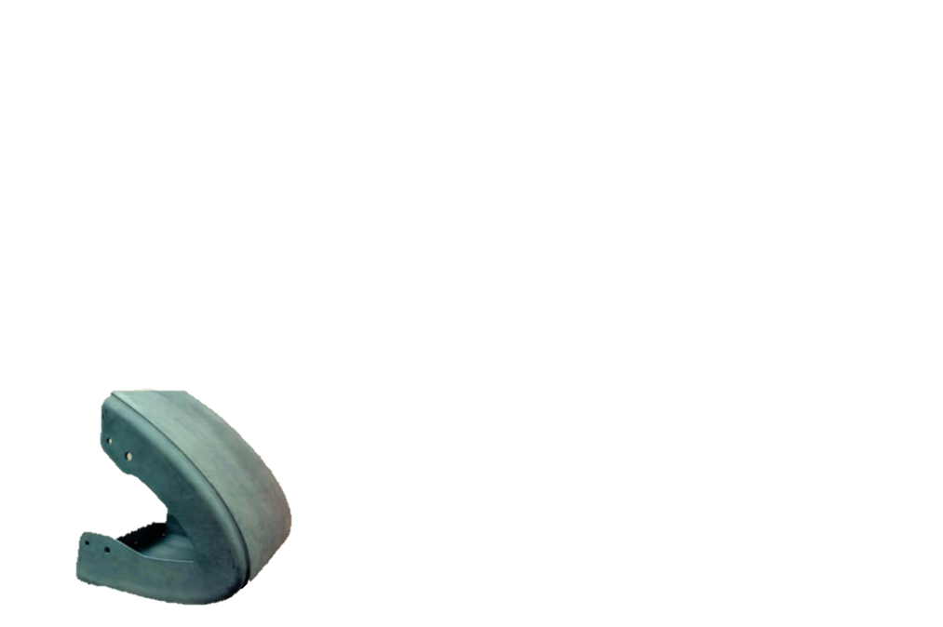
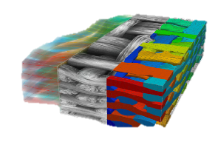
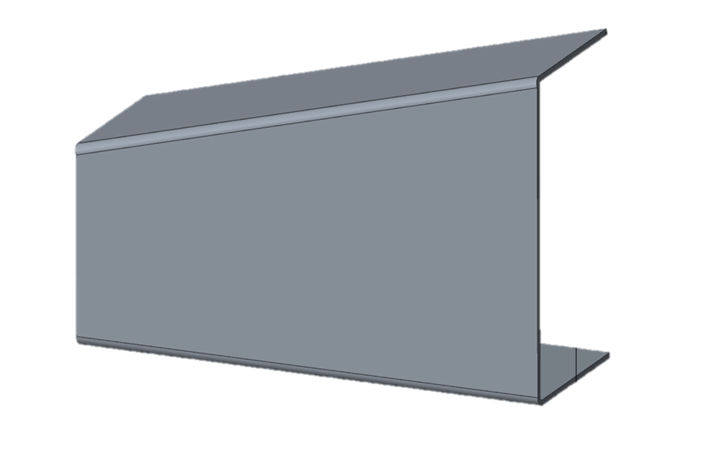
In-Situ Testing Scale
Current physical capability of in-situ x-ray testing
Scanning Electron Microscope (SEM) – analysis of individual constituents
Synchrotron x-ray CT – investigation of fiber-tow interface
Micro-x-ray CT scale – track damage at the scale of the unit cell and larger
Synchrotron light source
Accelerates electrons to extremely high energies for x-ray inspection
Approximately 16 in the U.S. and 60 in the world
Expensive and time consuming
High focus and quality imaging
In-situ synchrotron
Constituents
Microscale
Mesoscale
Coupon
In-situ SEM
In-situ Micro-x-ray CT
Element
Subcomponent
Component
Flow chart describing the scale for in-situ testing

Slide 5
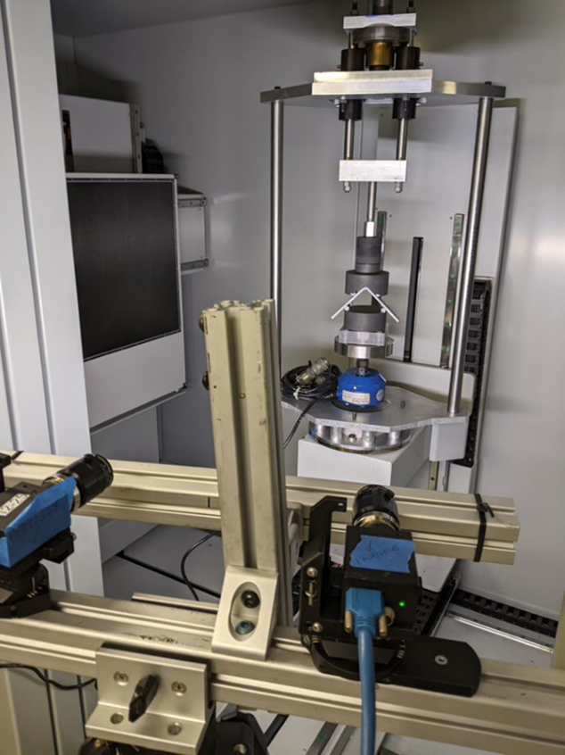
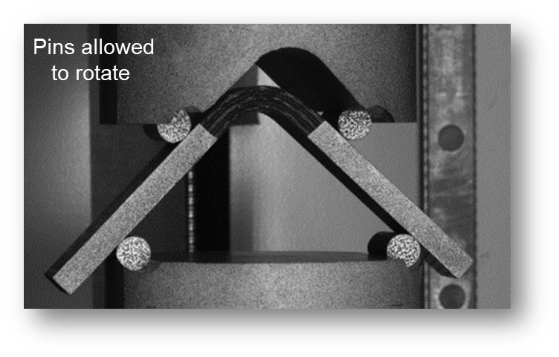
In-Situ Testing
Micro-x-ray CT tests are conducted at NASA Langley Research Center (LaRC)
Followed ASTM D3846 for test-stand design
Loads were applied by hand
Used digital image correlation (DIC) to compare in-situ measured data
Tests were loaded incrementally by hand
  Interface 1201-BJ 10,000 lb load cell
  Interface model 9840 data acquisition system
CT Scan Parameters
60 Kv, 140 µA
80° scan range

Slide 6
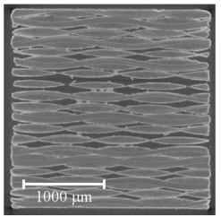
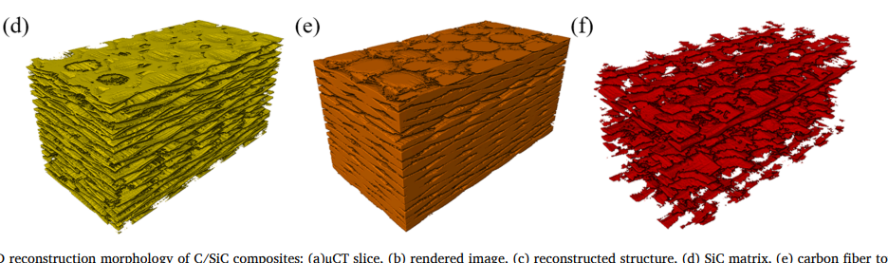
Material
The ability to visually separate constituents in refractory composites is attractive for in-situ damage characterization
Carbon/Carbon (C/C)
Carbon/Silicon-Carbide (C/SiC)
Silicon-Carbide/Silicon-Carbide (SiC/SiC)
Oxide/Oxide
Pore
Fiber
Matrix
C/SiC CT Image [1]
Silicon-Carbide Matrix
Carbon Fiber
Pores
1) Niu. G., et al. “Internal Damage Evolution Investigation of C/SiC Composites Using in-situ Tensile X-Ray Computed Tomography Testing and Digital Volume Correlation,” Composites Part A 163, Dec. (2022)

Slide 7
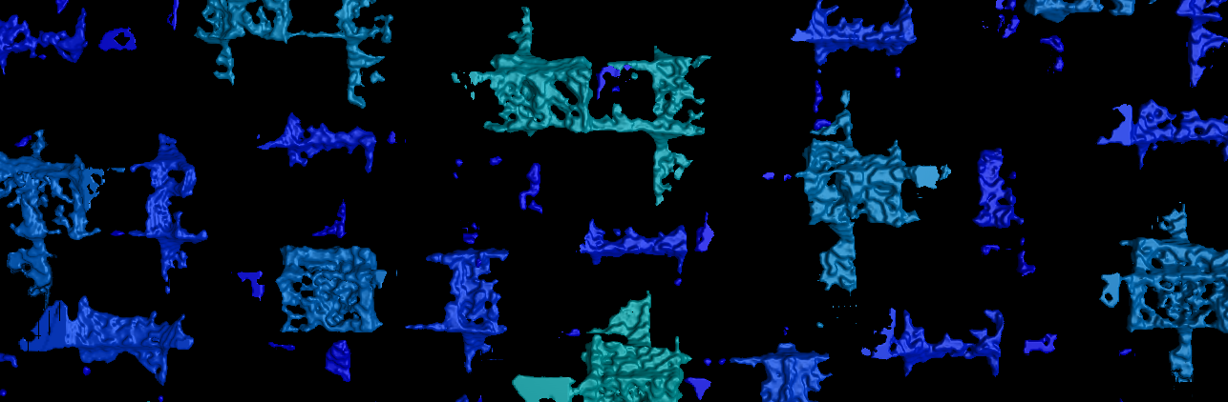
Damage Metrics
Types of Damage
Matrix cracking - onset of damage commonly begins from matrix cracks and pores
Fiber fracture
Fiber/matrix debonding
Using in-situ testing for damage characterization
Identify the presence of defects or impurities within the matrix, fiber, and fiber/matrix interface
Quantify the distribution of pores and the correlation to the location of the onset of damage, failure plane, ultimate strength and re-distribution of internal stresses
Quantify inherent matrix cracks and pores are formed from pyrolysis during manufacture
Measure the amount of interfacial debonding as it relates to over elasticity and shear material properties
Accuracy of fiber orientation and how it correlates to material performance
Pores from C/C, notice the repetition of different size and shapes
Notes:
The onset of fiber constituent damage in ceramic matrix composites is a critical factor to consider when assessing the mechanical performance and reliability of these materials. Ceramic matrix composites (CMCs) are a class of advanced materials that offer a combination of high strength, stiffness, and thermal stability, making them suitable for various high-temperature applications.
Fiber constituents, such as carbon or ceramic fibers, play a crucial role in enhancing the mechanical properties of CMCs. They provide the materials with high tensile strength and toughness, enabling them to withstand extreme mechanical loading conditions. However, these fibers are susceptible to damage, which can adversely affect the overall performance of the composite.
The onset of fiber constituent damage typically occurs due to various mechanisms, including matrix cracking, fiber/matrix debonding, and fiber fracture. These mechanisms can be influenced by factors such as applied stress, temperature, and environmental conditions. Understanding the onset and progression of fiber constituent damage is essential for designing CMCs with improved durability and reliability.
Matrix cracking is one of the primary forms of damage observed in CMCs. It occurs when the matrix material surrounding the fibers develops microcracks under mechanical loading. These cracks can propagate through the matrix, leading to a loss of load-bearing capacity and compromising the integrity of the composite. Matrix cracking can be influenced by factors such as fiber volume fraction, fiber orientation, and matrix properties.
Fiber/matrix debonding is another critical mode of damage in CMCs. It refers to the separation or detachment of the fibers from the surrounding matrix material. Debonding can occur due to various reasons, including thermal expansion mismatch between the fibers and matrix, inadequate interfacial bonding, and mechanical loading. Fiber/matrix debonding can significantly reduce the load transfer between the fibers and matrix, leading to a loss of mechanical strength and stiffness.
Fiber fracture is the complete failure of individual fibers within the composite. It can occur due to high tensile or compressive stresses exceeding the fiber's strength limit. Fiber fracture can be influenced by factors such as fiber properties, fiber volume fraction, and the presence of defects or impurities within the fibers. The occurrence of fiber fracture can lead to a significant loss of load-carrying capacity and structural integrity.
To mitigate the onset of fiber constituent damage in CMCs, various approaches can be employed. These include optimizing fiber/matrix interfaces, improving matrix properties, and tailoring the composite microstructure. Additionally, advanced characterization techniques, such as microscopy and non-destructive evaluation methods, can be utilized to investigate and monitor the damage initiation and progression in CMCs.

Slide 8
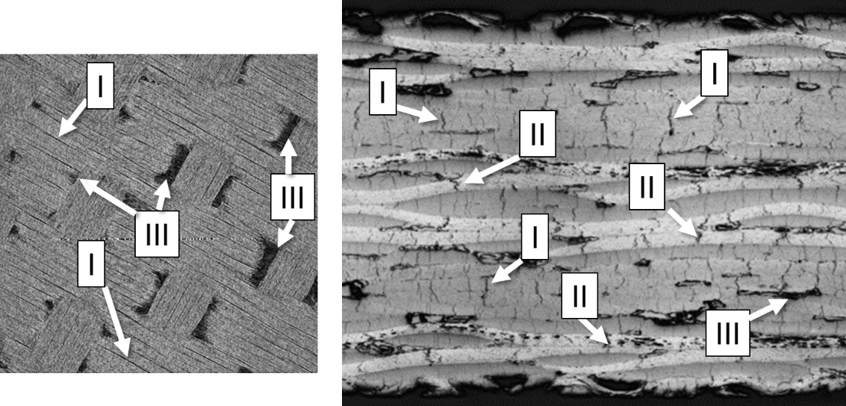
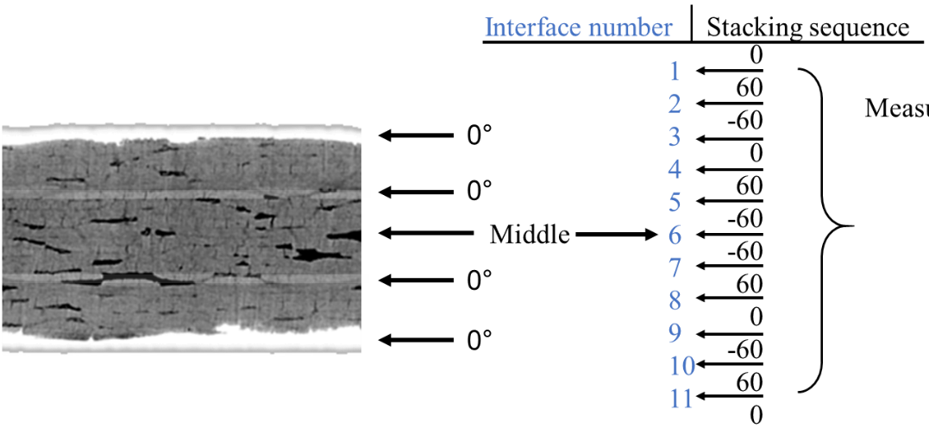
Characterization Damage with Pores
Most C/C manufacturing techniques leave pores throughout the material, creates spots susceptible to the onset of damage.
Interface Delamination
The interface number is the space between two adjacent plies
Pores
Type I – tow crack
Type II – matrix crack
Type III – denuded matrix void

Slide 9
Outline
Background
Interlaminar tensile tests
Hypervelocity impact
Concluding remarks

Slide 10
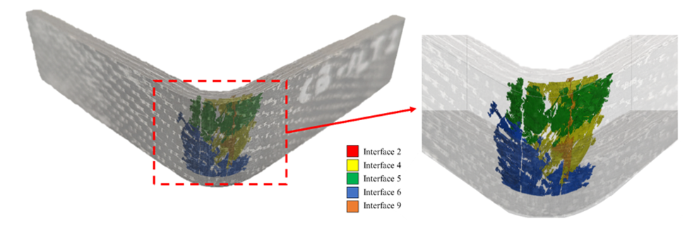
Interlaminar Tensile – CB – ILT
Test
Four-point bend curve-beam interlaminar (CB-ILT) tensile specimen
Purpose
Extract out a curve-beam interlaminar strength
Data captured
Measured the delaminated area between each ply, denoted with the interface numbers
Delaminated areas did not reach across the width of the specimen
Future work
Create a ply-by-ply simulation with cohesive elements at the interface to predict the measured delamination

Slide 11
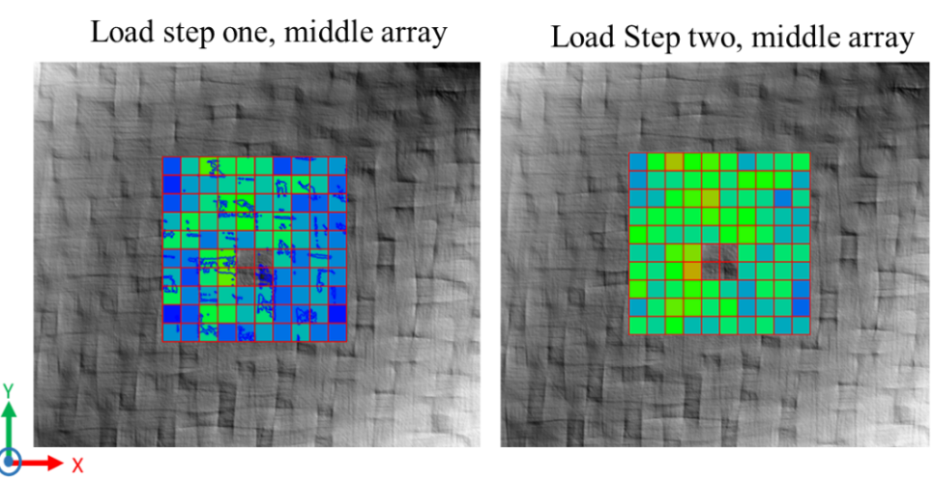
Interlaminar Tensile – Flatwise – ILT
Test
Flatwise ILT
Purpose
Measure the interlaminar strength and the effect of porosity on the ultimate strength
Data captured
The standard deviation in the change of porosity correlates well with the final ILT strength
The higher the standard deviation in the change of porosity, the higher the recorded ILT strength
Future work
Conduct additional tests and investigate if the distribution of porosity correlates to the location of the failure plane
Load step one,
Middle array
Load step two,
Middle array

Slide 12
Outline
Background
Interlaminar tensile tests
Hypervelocity impact
Concluding remarks

Slide 13
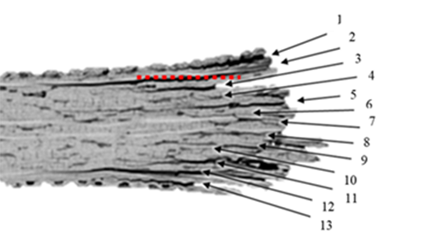
HVI Diagnostic Technique
Test
Evaluate effect of hypervelocity impact (HVI) on C/C
Purpose
Measure the per-ply delamination
Data captured
Measured the per-ply delaminated area for HVI at 30° and 60° impacts
Future work
Create a ply-by-ply simulation with cohesive elements at the interface to predict the measured delamination
In-situ load the specimen to further damage specimens that only exhibited rear-side spallation

Slide 14
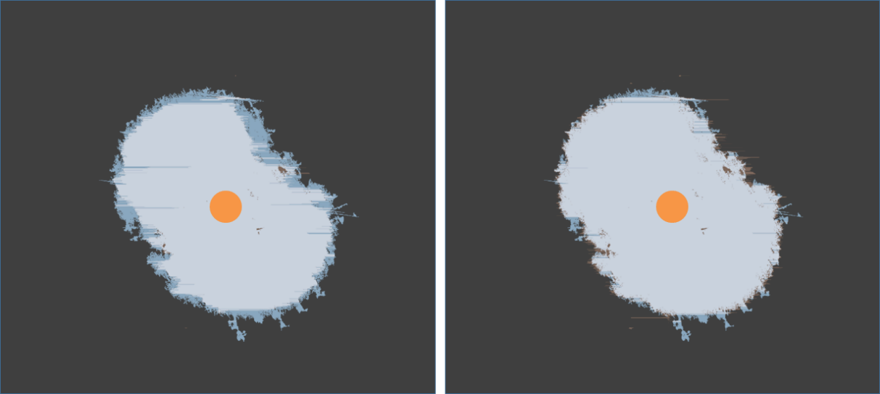
HVI Diagnostic Technique
Primary damage mode is delamination between plies
Interface numbers are used to identify delaminated areas (Interface 2 located between Ply 2 and Ply 3)
10-15 CT image slices required to capture a delaminated interface
“Egg plot” depicts combined delaminated area from the 12 image slices
12 image slices compose the delaminated area measured in interface 2
1
2
3
4
5
6
7
8
9
10
11
12

Slide 15
HVI Diagnostic Technique
In-house code for determination of delamination volume
Input the 2-dimensional (2-D) delamination area measured from each CT image and outputs a 3-D delaminated volume
The volume is then projected onto a 2-D plane
Validation of delamination volume using other in-house codes
Edgewise code (EC) – depicted by the light-blue area
Through-thickness code (TTC) – depicted by brown area
White area is where both methodologies depicted a delaminated area
Identical grayscale values
Converged grayscale values
EC
TTC
Center of impact

Slide 16
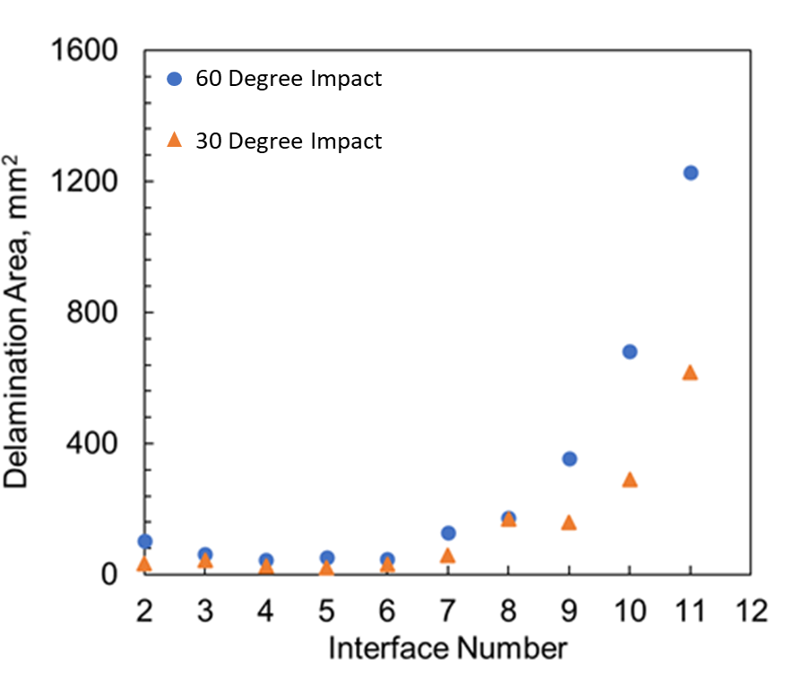

HVI Data
Multi-physics numerical code using arbitrary-Lagrangian-Eulerian techniques to run the model
A micro-structural scale model with explicitly define material properties were define for warp and fill tows
Simulation of interlaminar fracture & fiber-two yielding in 2-D C/C were compared to the per-ply delaminated area
Simulation is still being developed to compare to HVI delaminated area measurements
Simulation of a 30 - degree HVI
A cross-section CT image of a 30 - degree HVI

Slide 17
Outline
Background
ILT
HVI
Concluding remarks

Slide 18
Concluding Remarks
Evaluation capabilities for in-situ micro-x-ray CT for damage characterization of C/C
Current data captured from in-situ testing of C/C
Measured the delaminated area between each ply, denoted with the interface numbers
Delaminated areas did not reach across the width of the specimen
The standard deviation in the change of porosity correlates well with the final ILT strength
The higher the standard deviation in the change of porosity, the higher the recorded ILT strength
Improved HVI damage diagnostics by measuring per-ply damage
Measured the per-ply delaminated area of HVI C/C at 30° and 60° impact angles

Slide 19
Acknowledgements
Appreciation
Structural Mechanics and Concepts Branch
Langley Research Center Hot Structures Team

