Slide 1
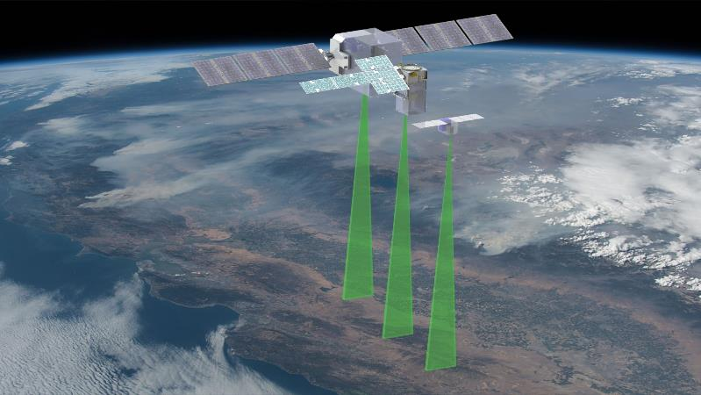
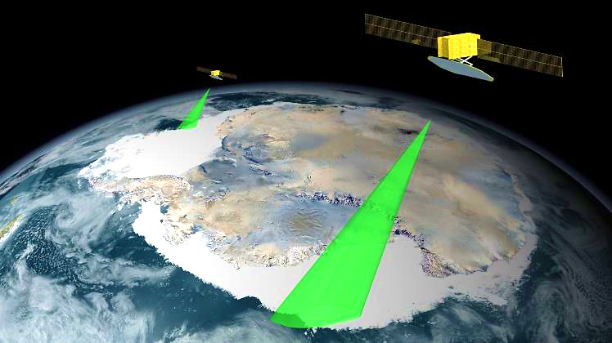
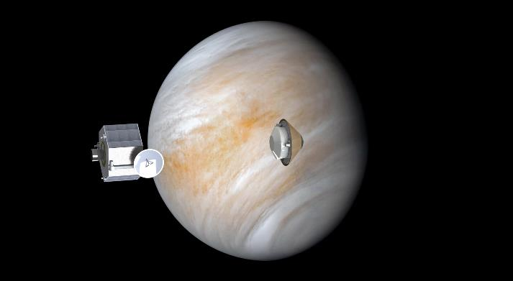
FELLOWSHIP OF THE DESIGN LABS
NASA ARC MISSION DESIGN CENTER OVERVIEW
ALAN CASSELL

Slide 2

Outline
Mission Design Center Overview
Staffing
Services Description
Stakeholder Engagement & Communication
Study Products
Case Study- Tailored Study- Technology Demonstration Mission

Slide 3
Staffing
MDC Lead
MDC Leadership
Lead SE
[Launch, Flight System
& Propulsion]
Core Staff
Mission Design
[Trajectory Analysis &
Flight Dynamics]
Scenario Planning,
Mission Design
Matrixed Support
Study
Coordination
Study Lead & Liaisons
[SE, PM or Science/Technologist]
Systems Analysis
[Space Sciences & Mechanical Design]
Systems Engineering, & Operations
ARC Staff or
Customer team.
SMEs
As needed based
on study scope
Mechanical Systems
[ME & Payload Accommodation]
Mechanical Systems & Design
Power
Comm
Thermal
Propulsion
EDL
ADCS
C&DH
Ops
Costing
Graphics

Slide 4
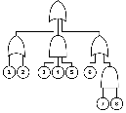


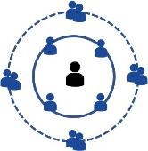
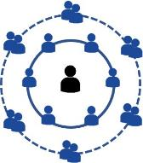



General MDC Study Process Overview
CML 1
CML 2
CML 3
CML 4
STM
Concurrent Engineering
Specify
Eval Criteria
Examine Trade Space
IDEA
Consider Key Design Drivers
Trade Analysis
Produce Key Questions
Generate & Assess
Partials
Prioritize Promising Approaches
Core Team
SMEs as Needed
GR&As
MISSION DESIGN CENTER
Concept/Idea
Feasibility
Assessment
Trade Space Understood
Point
Design
LEGEND:
IDEA
CONCEPTS & TRADES
POINT DESIGNS
BASELINE DESIGN

Slide 5
Services & Process Overview
ACTIVITY | CONSULTATIONS & PRE-PLANNING | FORMULATION SUPPORT | MINI STUDIES | TAILORED STUDIES | FULL STUDIES
LEVEL of EFFORT | 20-30 h | ~50 h | 200 h | 200-500 h | >500 h
DURATION | Varies | Varies | 3-4 Weeks | 1-3 Months (Generally) Large Activities can be run as multiple tailored studies | 1-3 Months (Generally) Longer duration for certain activities
MDC LEAD | X | X | X | X | X
LEAD SE | X | X | X | X | X
STUDY LEAD |  |  | X | X | X
CORE TEAM |  |  | X | X | X
SELECT SMEs | X | X | X | X | X
FULL SME |  |  |  |  | X
COSTING |  |  | X | X | X
GRAPHICS |  | LIMITED | LIMITED | X | X

Slide 6
Consultations & Pre-Planning
Pre-arranged appointments to get feedback on developing mission concepts, technology demonstrations, instrumentation concepts & similar early-stage activities.
Follow-on sessions as needed to aid in idea ‘pitch’ support.
Session Team comprised of MDC Core Team & SMEs as Needed
  MDC Lead
  MDC Lead SE
  MDC Mission Designer
  SMEs as needed (SE, Technology, Flight Dynamics, Power/C&DH, Comm, ADCS, Thermal, EDL, etc.)
CML 1
CML 2
CML 3
CML 4
STM
Concurrent Engineering
Core Team
SMEs as Needed
Specify
Eval Criteria
Examine Trade Space
IDEA
Consider Key Design Drivers
Trade Analysis
Produce Key Questions
Generate & Assess
Partials
Prioritize Promising Approaches
GR&As
MISSION DESIGN CENTER
Concept/Idea
Feasibility
Assessment
Trade Space Understood
Point
Design
LEGEND:
IDEA
CONCEPTS & TRADES
POINT DESIGNS
BASELINE DESIGN

Slide 7
Formulation & New Activity Support
Limited engagement with well defined expectations
Engagement with stakeholders as needed to provide background information and quick turn products. Key objectives & top-level draft requirements generally needed as inputs. STM & TDTM generation on request.
Formulation Team comprised of MDC Core Team & SMEs as Needed
  MDC Lead
  MDC Lead SE
  MDC Mission Designer
  SMEs as needed (SE, Technology, Flight Dynamics, Power/C&DH, Comm, ADCS, Thermal, EDL, etc.)
CML 1
CML 2
CML 3
CML 4
STM
Concurrent Engineering
Core Team
SMEs as Needed
Specify
Eval Criteria
Examine Trade Space
IDEA
Consider Key Design Drivers
Trade Analysis
Produce Key Questions
Generate & Assess
Partials
Prioritize Promising Approaches
GR&As
MISSION DESIGN CENTER
Concept/Idea
Feasibility
Assessment
Trade Space Understood
Point
Design
LEGEND:
IDEA
CONCEPTS & TRADES
POINT DESIGNS
BASELINE DESIGN

Slide 8
Mini-Studies
Span the spectrum of activities including competed, non-competed and early stage feasibility assessments.
Prefer active and engaged customer team. Key inputs are draft STM or TDTM. Refinements to STM/TDTM on request.
Mini-Study Teams comprised of MDC Core Team & SMEs as Needed
  MDC Lead
  Study Lead
  MDC Lead SE
  MDC Core Team
  Costing (analogous costing with limited parametric costing)
  SMEs as needed, per agreement with customer
CML 1
CML 2
CML 3
CML 4
STM
Concurrent Engineering
Specify
Eval Criteria
Examine Trade Space
IDEA
Consider Key Design Drivers
Trade Analysis
Produce Key Questions
Generate & Assess
Partials
Prioritize Promising Approaches
Core Team
SMEs as Needed
GR&As
MISSION DESIGN CENTER
Concept/Idea
Feasibility
Assessment
Trade Space Understood
Point
Design
LEGEND:
IDEA
CONCEPTS & TRADES
POINT DESIGNS
BASELINE DESIGN

Slide 9
Tailored Studies
Span the spectrum of activities including competed, non-competed and early- stage feasibility assessments.
Prefer active and engaged customer team. Key inputs are draft STM or TDTM.
Study Products can be tailored to the opportunity and/or customer need.
Tailored Study Teams comprised of MDC Core Team & SMEs as Needed
  MDC Lead
  Study Lead
  MDC Lead SE
  MDC Core Team
  Cost (Primarily analogous & parametric costing, can be tailored)
  Graphics
  SMEs as needed, per agreement with customer
CML 1
CML 2
CML 3
CML 4
STM
Concurrent Engineering
Specify
Eval Criteria
Examine Trade Space
IDEA
Consider Key Design Drivers
Trade Analysis
Produce Key Questions
Generate & Assess
Partials
Prioritize Promising Approaches
Core Team
SMEs as Needed
GR&As
MISSION DESIGN CENTER
Concept/Idea
Feasibility
Assessment
Trade Space Understood
Point
Design
LEGEND:
IDEA
CONCEPTS & TRADES
POINT DESIGNS
BASELINE DESIGN

Slide 10
Full Studies
Generally higher cost missions (>$100 M), can span the CML 2-4 range in one extended session, or broken into smaller sessions (tailored).
Prefer active and engaged customer team. Key inputs are draft STM or TDTM.
Duration, LOE, and study products agreed to with stakeholders.
Full Study Teams comprised of MDC Core Team & SMEs
  MDC Lead
  Study Lead
  MDC Lead SE
  MDC Core Team
  Cost (Primarily parametric and bottoms-up costing, can be tailored)
  Graphics
  External SMEs as needed, per agreement with customer. Sometimes specific instrumentation expertise required.
CML 1
CML 2
CML 3
CML 4
STM
Concurrent Engineering
Specify
Eval Criteria
Examine Trade Space
IDEA
Consider Key Design Drivers
Trade Analysis
Produce Key Questions
Generate & Assess
Partials
Prioritize Promising Approaches
Core Team
SMEs as Needed
GR&As
MISSION DESIGN CENTER
Concept/Idea
Feasibility
Assessment
Trade Space Understood
Point
Design
LEGEND:
IDEA
CONCEPTS & TRADES
POINT DESIGNS
BASELINE DESIGN

Slide 11
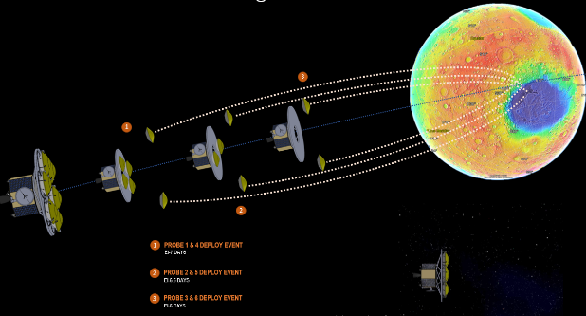
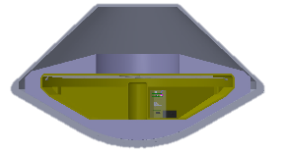
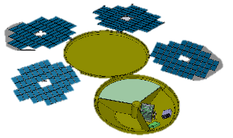
STAKEHOLDER COMMUNICATION CHART
GRAPHICAL SUMMARY
DASHBOARD
ENTRY
PROBE
ACTIVITY | STATUS | DATES | POC | MDC POC
PLANNING MEETINGS |  | 1/2023-3/2023 | M. MURBACH | A. CASSELL
CML 2 MINI STUDY |  | 4/14/2023 | M. MURBACH | C. PAYNE
CML 3
NBC/PAR
CML 4
COMPLETED
LANDER
IN PROGRESS
NOT STARTED
PI- Marc Murbach (ARC-RS) PM- Seth Schisler (ARC-P) SE- TBD
OPPORTUNITY TYPE: Low-Cost Mars, Mars Exploration Program, Anticipated Cost Range: $100-200 M
GOALS & OBJECTIVES:
Measure total regional pressure gradient associated with the Hellas feature.
Associate the concentration of water vapor with the regional climate and dynamics with the subliming southern residual polar water cap
Constrain the total water flux off of the subliming southern cap
Correlate the change in radiative forcing associated with suspended dust and specific saltation and lifting events
Characterize the surface radiation environment
MISSION DESCRIPTION:
Regional network of landed weather stations using Mars Orbiter Comm Relay for Telemetry.
MISSION OVERVIEW
NOTES:
CML 2 Mini-Study Key Findings:
Mature instrument concept such that detailed probe/lander requirements can be drafted
Perform more extensive trades in Launch/Cruise/Probe Targeting segments
More mass efficient probe design needed to enable soft landings at higher altitude landing sites. Recommend team consider low Ballistic coefficient aeroshell designs.
SUMMARY

Slide 12
Study Products
ACTIVITIES
 | CONSULTATIONS & PRE-PLANNING | FORMULATION SUPPORT | MINI STUDIES | TAILORED STUDIES | FULL STUDIES
MISSION TRACEABILITY MATRIX | X | X | X | X | X
REQUIREMENTS DEVELOPMENT | X | X | X | X | X
GROUND RULES & ASSUMPTIONS | X | X | X | X | X
GRAPHICS/ANIMATION |  | LIMITED | LIMITED | X | X
ARCHITECTURE TRADES | X | X | X | X | X
FLIGHT SYSTEM TRADES | X | X | X | X | X
LAUNCH SYSTEM TRADES | LIMITED | LIMITED | X | X | X
TRAJECTORY/ORBIT ANALYSIS |  | X | X | X | X
SCENARIO PLANNING |  | LIMITED | LIMITED | X | X
POWER BUDGET |  |  | LIMITED | X | X
DATA BUDGET |  |  | LIMITED | X | X
POINTING BUDGET |  |  | LIMITED | X | X
DELTA V BUDGET |  |  | X | X | X
LINK ANALYSIS |  |  | X | X | X
MASS BUDGET/MEL |  |  | LIMITED | X | X
CAD DESIGN (CONCEPT) |  |  | X | X | X
THERMAL ANALYSIS |  |  | LIMITED | X | X
OPERATIONS PLANNING |  |  | LIMITED | X | X
EDL ANALYSIS |  |  | LIMITED | LIMITED | X
TOP RISKS |  |  | LIMITED | LIMITED | X
CML ASSESSMENT |  |  | X | X | X
INSTRUMENT(S) ASSESSMENT |  | LIMITED | LIMITED | LIMITED | X
COST ESTIMATION |  |  | ANALOGOUS | X | X
RECOMMENDATIONS |  |  | LIMITED | LIMITED | X
PRODUCTS

Slide 13
Case Study:
Tailored Study- Technology Demonstration Mission

Slide 14
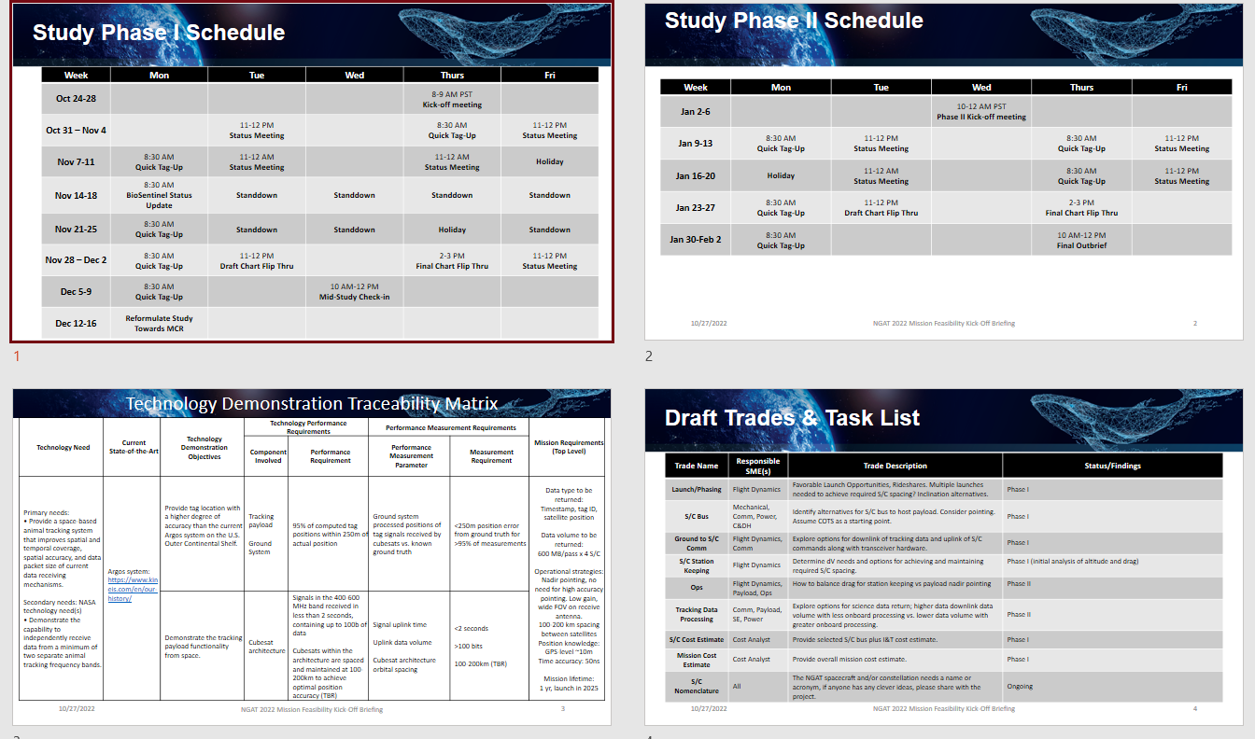
Tailored Study- Technology Demonstration Mission
2-Phase Study to Assist Tech Demo Team in achieving MCR Entrance Criteria
Study Format:
2-Phase Study w/ customer check point (Mid-Study Review).
Check point used to refine scope of Phase 2 deliverables.
Final Outbrief 1.5 h long presentation package with supporting analysis products.
Study Inputs: Developed in Customer Engagement & Pre-Planning meetings.
Draft TDTM
Study Trades & Task List

Slide 15
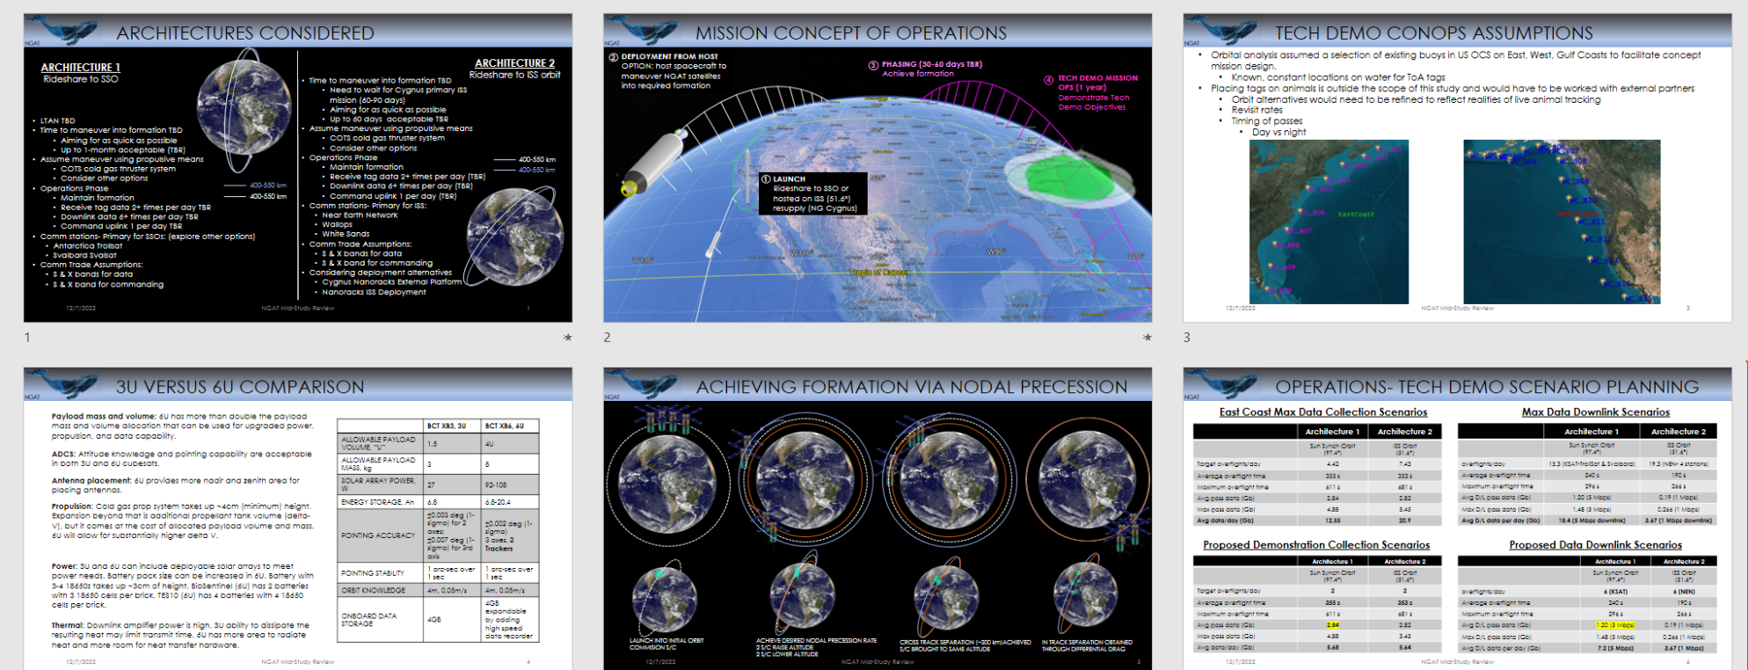
Tailored Study- Technology Demonstration Mission
Phase 1- Architecture & Flight System & Operations Trades
Phase 1 Key Trades:
Established Architectures to be considered
Developed ConOps & Operations Planning Scenarios.
Compared Flight System options.

Slide 16
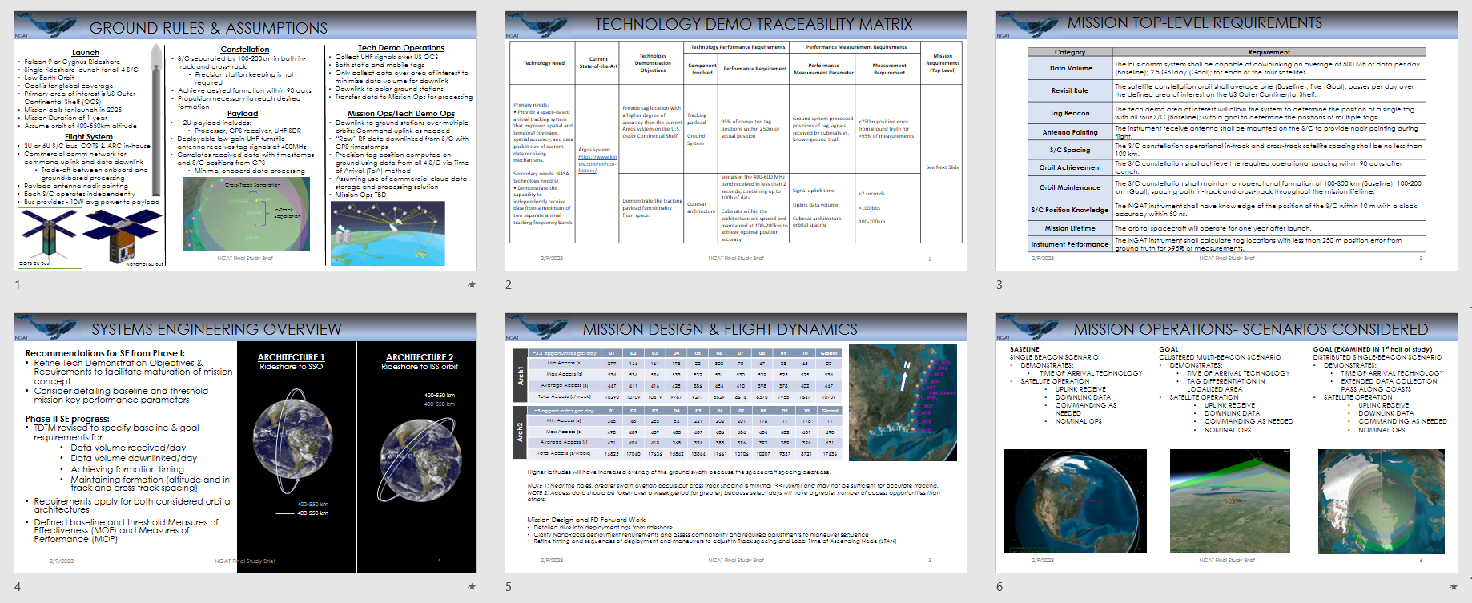
Tailored Study- Technology Demonstration Mission
Phase 2- Systems Engineering & Mission Design Trades
Systems Engineering and Mission Design:
Defined Ground Rules & Assumptions
Refined Technology Demonstration Traceability Matrix
Recommended changes to Top-Level Requirements.
Provided Tech Demo Operational Scenarios.

Slide 17
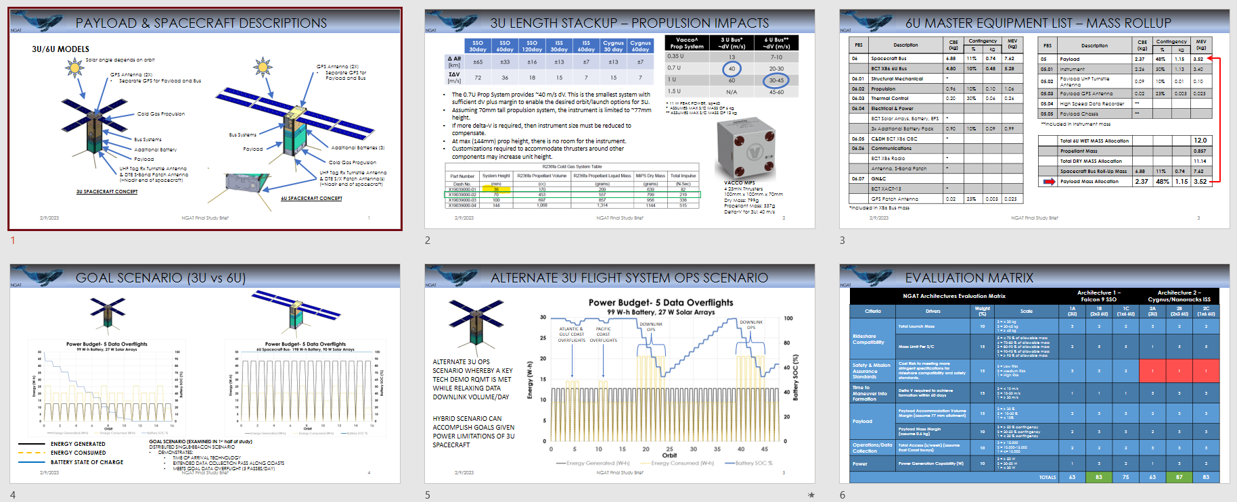
Tailored Study- Technology Demonstration Mission Study
Phase 2- Payload Accommodation, Ops Planning, Architecture Evaluation
Detailed Analysis:
Payload volume and mass constraints
Propulsion system trades.
Developed Master Equipment List.
Proposed Architecture Operational Scenarios.
Architecture Evaluation Matrix for various point designs.

Slide 18
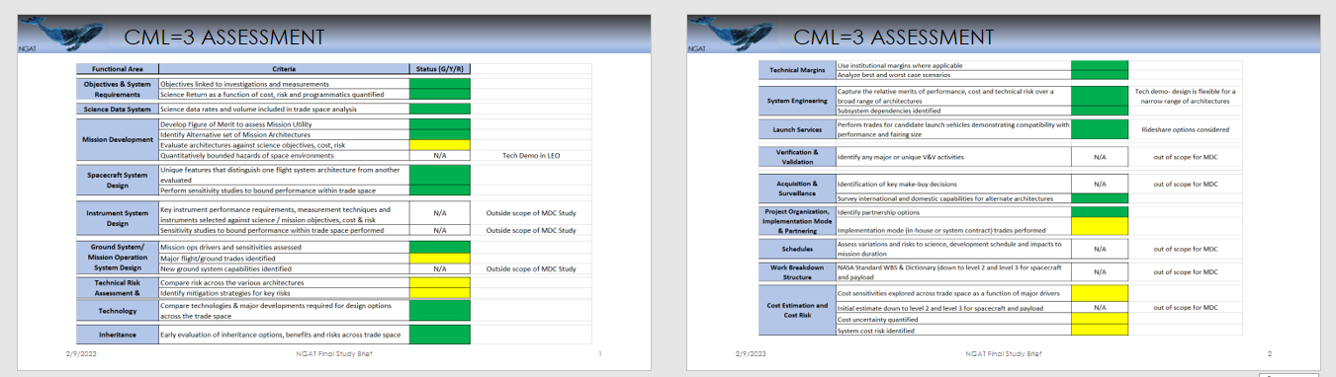
Tailored Study- Technology Demonstration Mission Study
CML=3 Assessment
CML assessment categories tailored for Technology Demonstration Objectives and Stakeholder Feedback. 8 categories from primary list agreed to be out of scope for study.
Limited cost estimation work performed per direction from project manager and key stakeholder.

Slide 19
Questions/Comments

