Slide 1




Suzanne (Suzy) Maddock
IDC² Working Group Lead

Slide 2
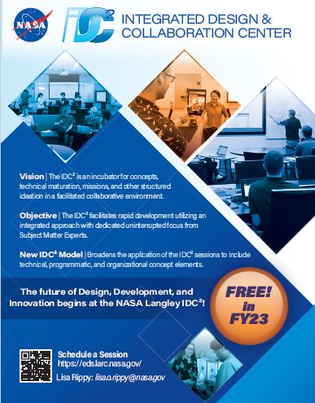
What is the IDC² ?
The IDC² is an incubator for concepts, technical maturation, missions, and structured ideation in a facilitated collaborative environment.
Provides Facilitation, Coordination, and access to Subject Matter Experts matrixed from disciplines across LaRC
Design space configured for optimal collaboration across different medias
Efficient use of time and resources maximizing uninterrupted team focus
Customer determines design goals, participates throughout the process, and helps define the products
Inclusive of all organizations within NASA and our partners

Slide 3
Engineering Design Studio (2016-2022) Evolution
Prior to FY21: IDC² was known as the Engineering Design Studio (EDS)
  In FY16, the EDS had 2 dedicated civil servants and 1.5 dedicated contractors; funding was on the order of $300K plus additional for CS labor and equipment funding
  By FY19 with decreasing budgets, there were no CS dedicated staff and <1.0 dedicated contractor staff. Relied on ‘white space’ for civil servants and conducted 20+ sessions
FY19-21: Center ran two assessments with cross-organizational teams with the following outcomes:
  Validation that EDS, with expanded use cases and processes, is a vital Center capability
  New Governance model – Mission Integration Forum and Working Group
  Established ED as the capability ‘host’
  Established cost sharing arrangement between the Center and Mission-Facing Organizations.
  Developed draft success metrics
  Identified need to ‘rebrand’ the EDS

Slide 4
IDC² (2022-present)
FY22/23: Rebranded EDS to IDC²; funding provided for CS Facilitation, Working Group Lead, and SME support along with Contractor funding and facility IT upgrades for failing equipment (~$1.2M)
  The IDC² reopened for in-person sessions in September of 2023.
  Since September of FY22-August FY23, there have been 36 sessions in the IDC².
FY24: Procurement funding only will be provided (Request $600K) with 2.0 dedicated contractors planned
FY25: Center management has recommended a pay-as-you-go funding model

Slide 5
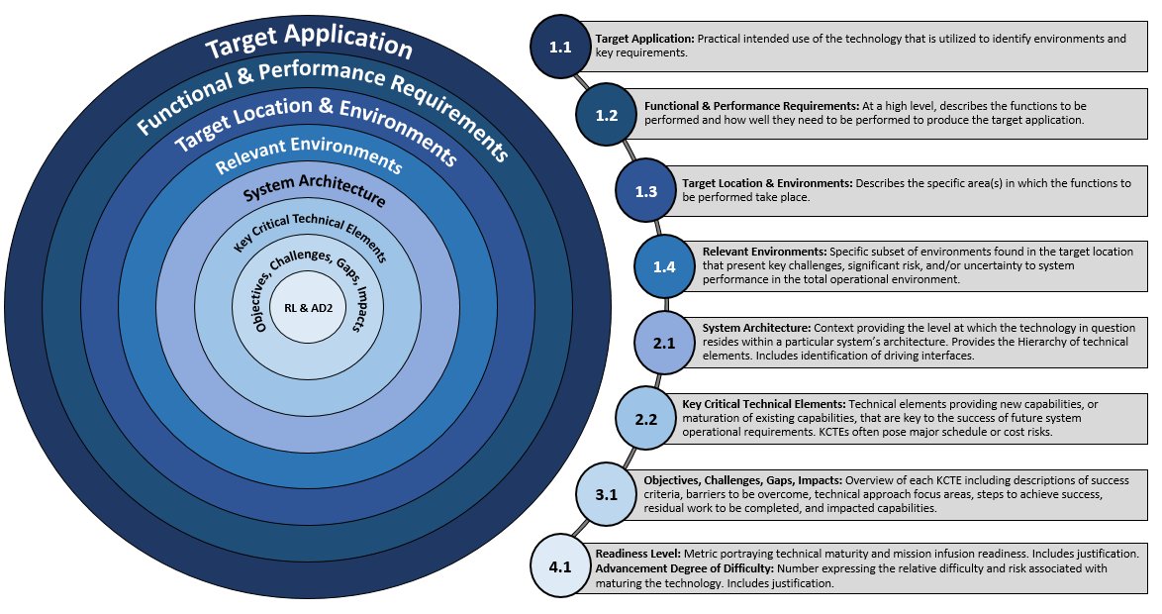
What are the Tools?
The IDC² depends on a specialized and unique set of tools for outstanding efficiency and productivity.
Concurrent Collaboration Tools: Data exchange platforms, in-lab audiovisual tools, remote presence tools, Kanban Boards
Engineering Tools: System level tools, subsystem and discipline design tools (parametric sizing and estimation tools, analysis, and modeling and simulation tools), and engineering databases
Customer Interface and Data Transfer Tools: Support personnel assignment tools, shared use repositories, Teams
Lab Management Tools: IT and web tools, procedure, administrative, procurement, and financial support tools
Programmatic Tools: Parametric and grassroots costing tools, scheduling tools and risk tools
TRAIT Tool: Technology Readiness Assessment Insight Template (TRAIT) Tool is a standardized tool that outlines the technology readiness assessment process to assess technical maturity, identify technology gaps and potential risks, as well as plan and execute a technical approach to achieve technology maturation and implementation goals.

Slide 6
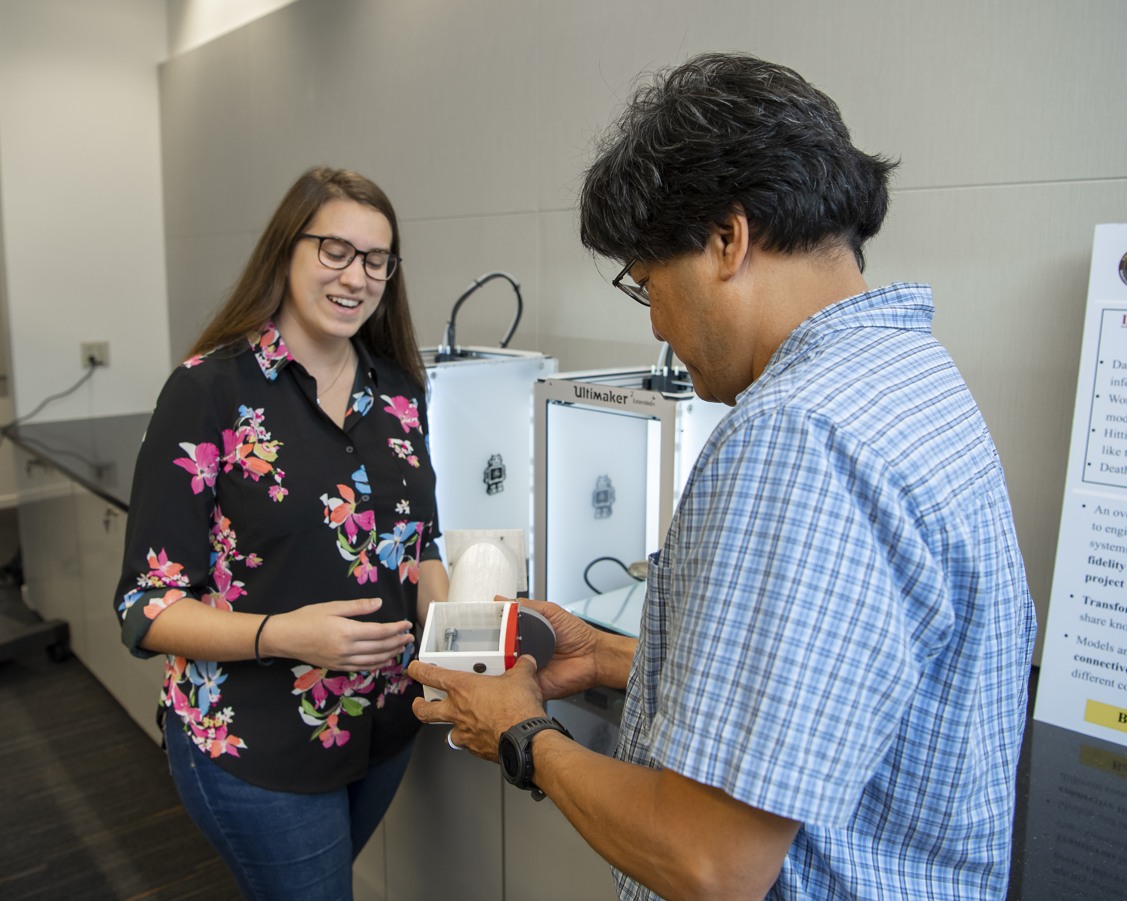
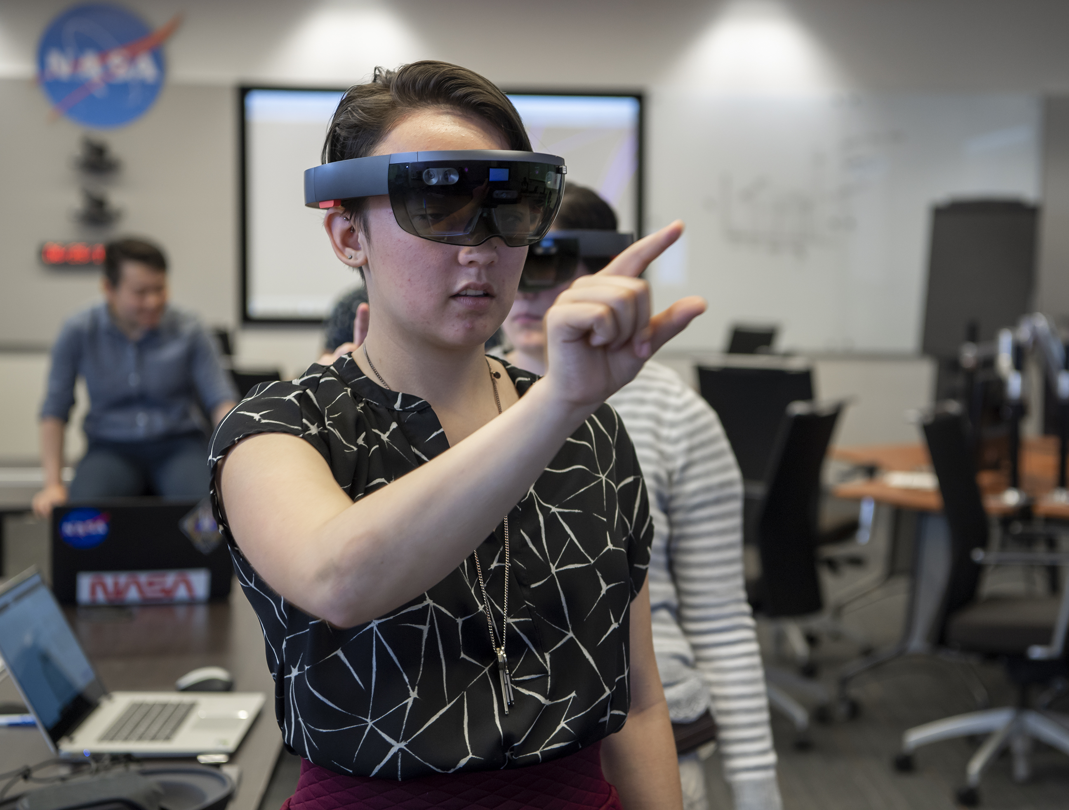
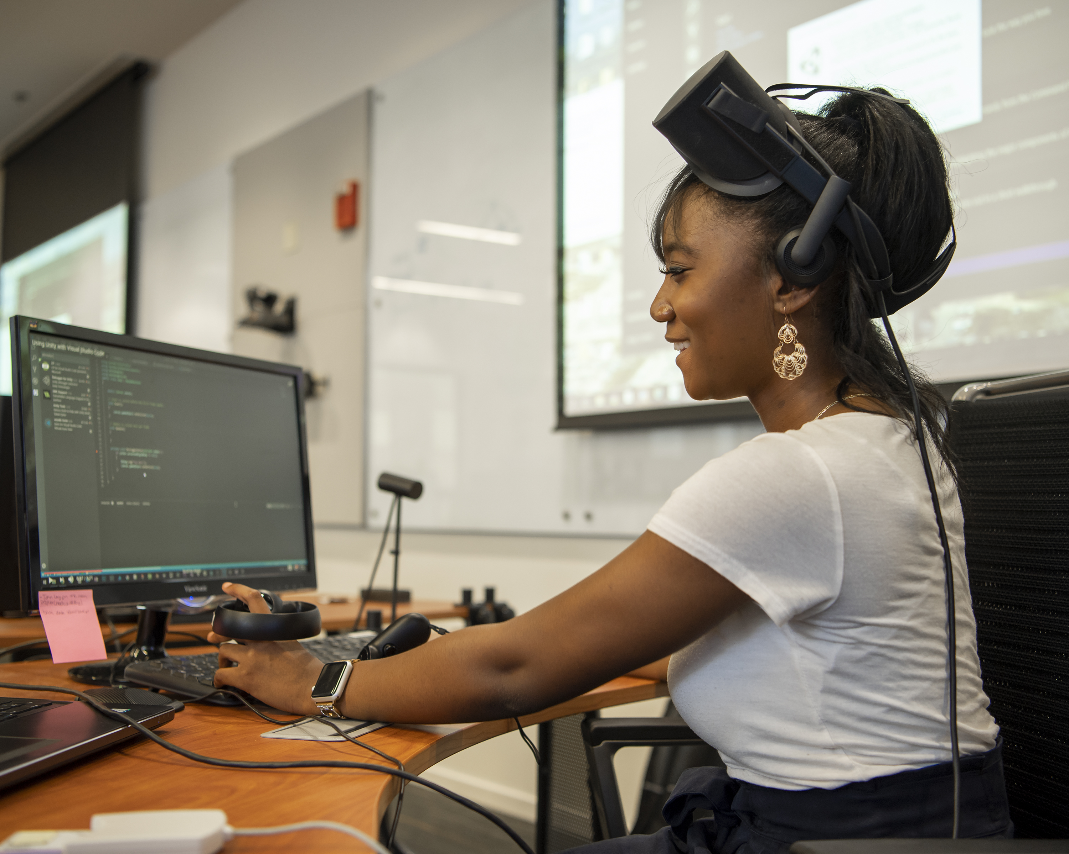
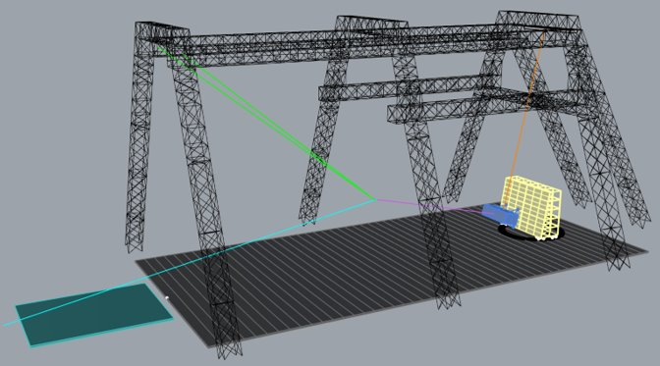
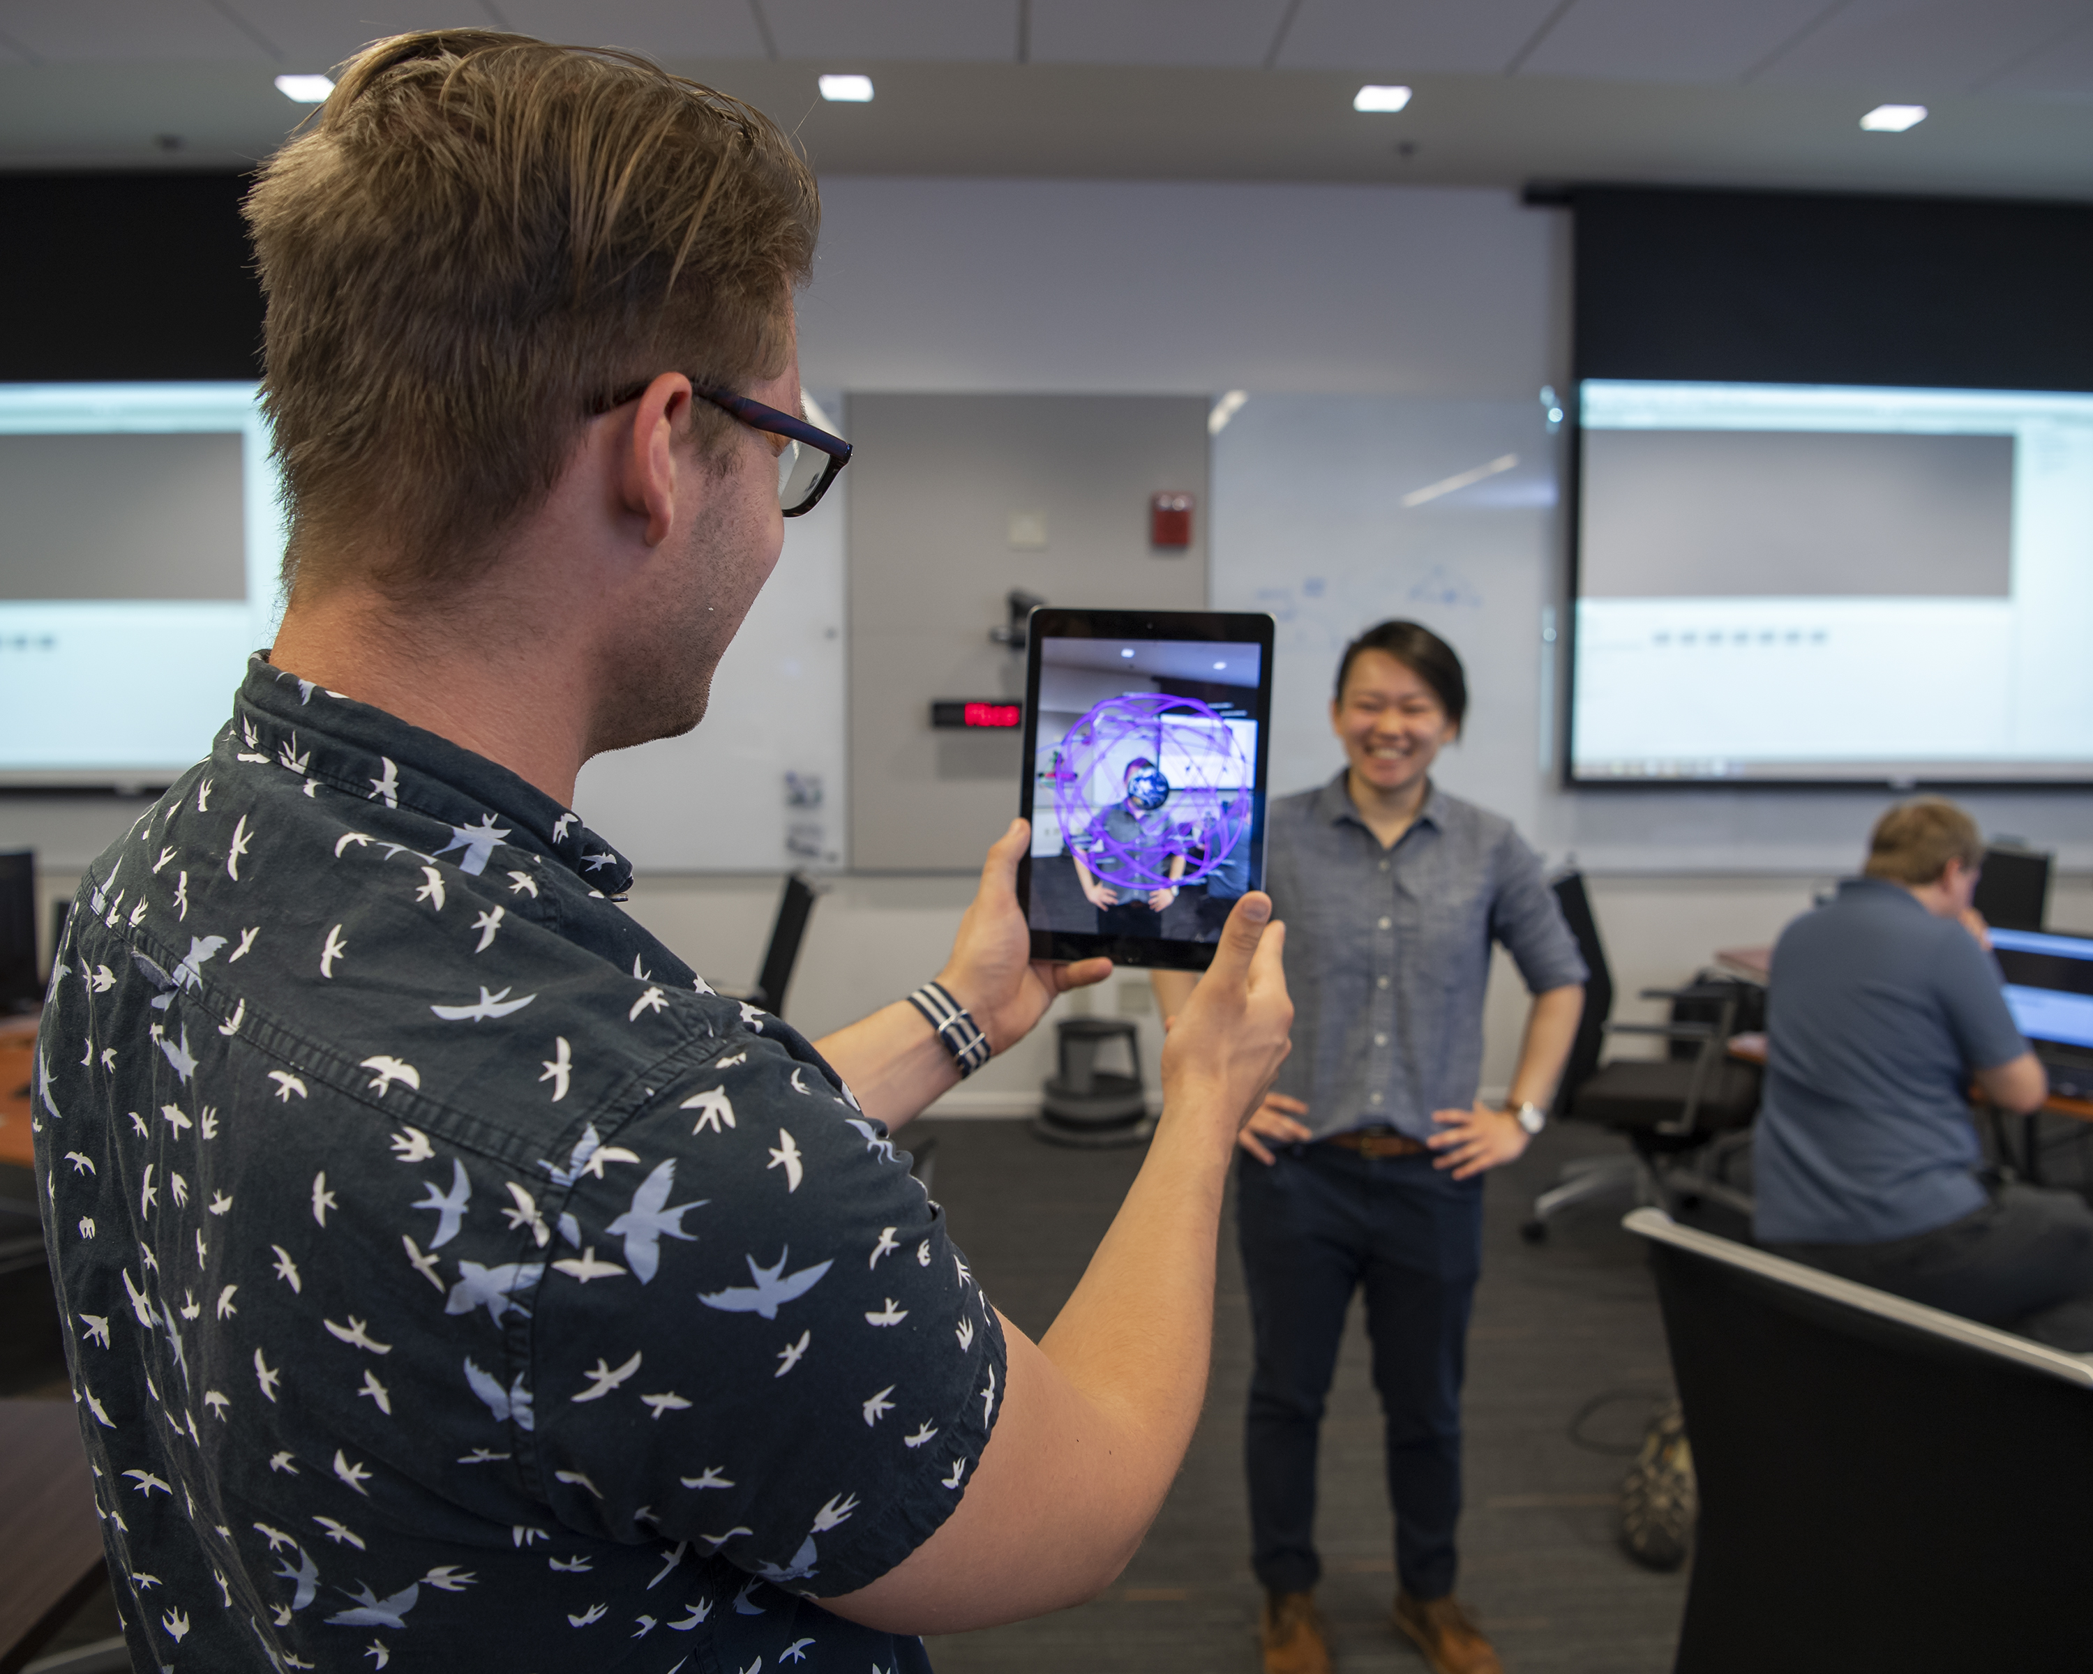
What are the IDC² Tools?
  3D Printing Capability
  Augmented Reality/Virtual Reality (AR/VR)
  CAD Modeling

Slide 7
What are the new IDC² Use Cases?
TECHNICAL
PROGRAMMATIC
ORGANIZATIONAL
Cost Estimates
Design Sessions
Design Studies
Focus Studies
Mission Architecture
Proposal Development
Target Studies
Trade Studies
Advanced concepts
TRL/MRL Maturation
Concept of Operations
Technology Road mapping
Airborne Campaign Planning
Brainstorming
Budget Formulation
Design Reviews
Failure Investigations
Risk Assessments
Idea Sharing
Lessons Learned
Development Planning
Project Support
PUD Integration
Reimbursable Work
Tiger Teams
Retreats
Partnerships
Roadmap Development
Schedule Integration
Strategic Planning
Team Building
Tool Development
Tours & Demos
WBS Planning
Workforce Planning
Logistics Coordination

Slide 8



IDC² Completed Sessions: Advanced Concept Planning
  Advance Concept Instrument/Mission Planning Sessions
  ERIICA Instrument EVI-6
    Virtual Session, Architecture design
  (External) Surface Deformation and Change Study (SDC) with focus on L1C Instrument Design (JPL)
    Advanced concept instrument/mission design
  High Spectral Resolution Lidar (HSRL) Tech Demo Concept
    Architecture design and costing session
  Demeter #1: DEMonstrating the Emerging Technology for Measuring the Earth’s Radiation Earth Venture Continuity (EVC) Planning Session
    Examine/review full system architecture, key components, science objectives, and mission design.
  DEMETER #2: DEMonstrating the Emerging Technology for Measuring the Earth’s Radiation
    Refined Architecture definition, defining capabilities and requirements, identifying science NGOs
  (External) Psionic #1: Commercial Wind Measurement Constellation
    NGOs, ConOps, measurement techniques
  (External) Psionic#2: Commercial Wind Measurement Constellation
  (External) Psionic#3: Commercial Wind Measurement Constellation

Slide 9
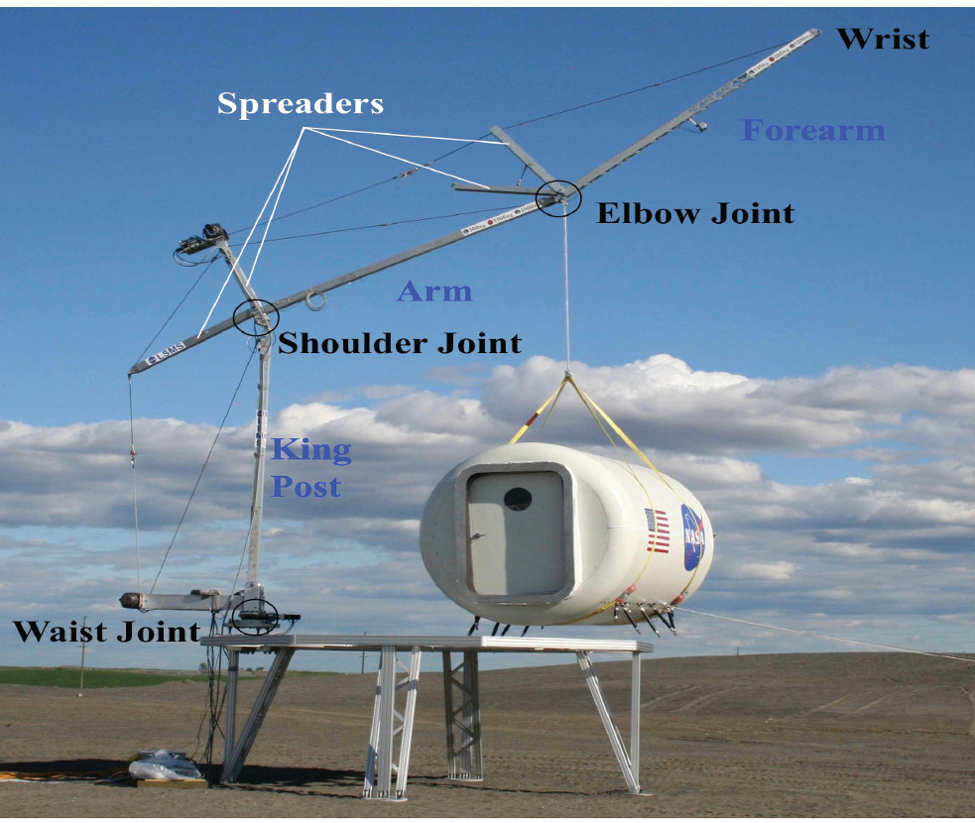
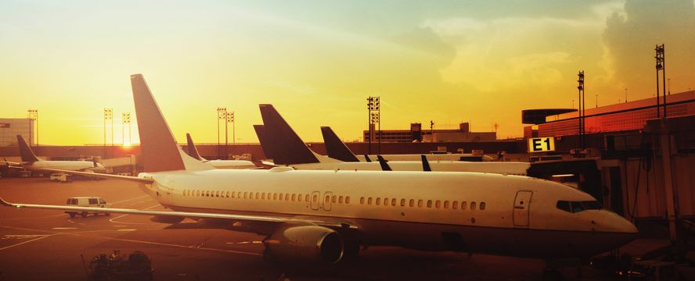
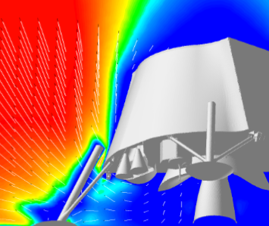
IDC² Completed Sessions: Technical Disciplines
  Technical Approach/Scope/Concept of Operations Planning Sessions
  Lightweight Surface Manipulation System (LSMS)
    Cost, Schedule, and Risk Assessment following an AI&T discussion
    LaRC Technology Readiness Assessment Insight Template (TRAIT) Tool
  Lunar Lander Base Instrument (LLBI) on PLUMES
    Collaborative Sensor Team Meeting to better develop their concept of operations, science measurements, requirements, and preliminary schedule
    Two-day facilitated scoping and planning session
  Dust Ejecta Radar Technology (DERT) on PLUMES
    LaRC Technology Readiness Assessment Insight Template (TRAIT) Tool for Concept Development and TRL maturation, requirements development, and preliminary schedule assessment
  Particle Impact Event (PIE) on PLUMES
    LaRC Technology Readiness Assessment Insight Template (TRAIT) Tool
  Shadow Chaser Mission – Point Design
  HiCAM – Hi-Rate Commercial Aircraft Manufacturing
    Success Criteria, Lessons Learned, Criteria for Down-Select
  SPARTA: Smart Projects and Reviews with Transformative Analytics

Slide 10
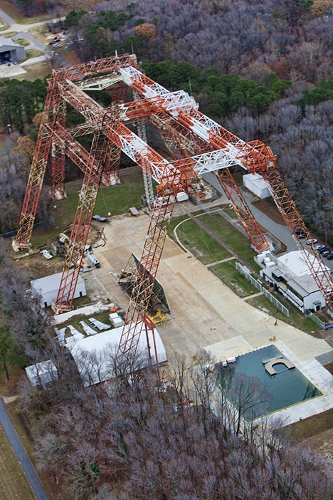
LandIR-HLS IDC² Session: Facility Usage
Facility Revitalization
(STED) LandIR –Revitalizing the gantry to support upcoming lunar landing testing
The Human Landing System (HLS) portion of the Artemis Program asked to use the Landing and Impact Research (LandIR) facility at NASA Langley.
The IDC² team was formed to brainstorm how to update the LandIR in three ways to support full-scale testing: construction of a new static backboard, installation of a new high-capacity crane, and creation of a boilerplate lander for practicing operations.
The goal of the session was to augment LandIR’ s existing capabilities to allow for full-scale testing of HLS vendor’s Lunar landers in Lunar gravity conditions.
The results of this studio session has resulted in HLS funding for Gantry Revitalization.

Slide 11
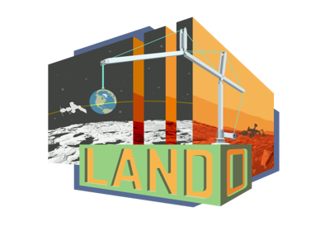


IDC² Completed Sessions: Technical Planning
  Technology Readiness Assessments/ Technology Maturation
  LANDO - LANDO/LSMS path to flight brainstorming and plan
    TRAIT ​, Define technical status and maturity
    Align with Commercial Partner and meeting stakeholder needs
    Plan for follow on efforts
  ECI MARVL: Modular Assembled Radiators for NEP VehicLes
    TRAIT
    Define technical scope
  ECI FOCUS Proposal Development
    Blue Team/Red Team Review
  Tall Lunar Tower
    TRAIT, Define technical status and maturity
    Plan for follow on efforts
  Standoff Ultracompact Micro-Raman Sensor for Planetary Surface Exploration (SUCR)
    TRAIT
  Convergent Aeronautics Solutions (CAS) Synthesis Sprint: Emergency Services
  Convergent Aeronautics Solutions (CAS) Two-day workshop
  Convergent Aeronautics Solutions (CAS) System Outbrief
  PolCube - Polarimeter Camera
  ACERO: Advanced Capabilities for Emergency Response Operations
  Shadow Chaser Mission
    Point Design

Slide 12
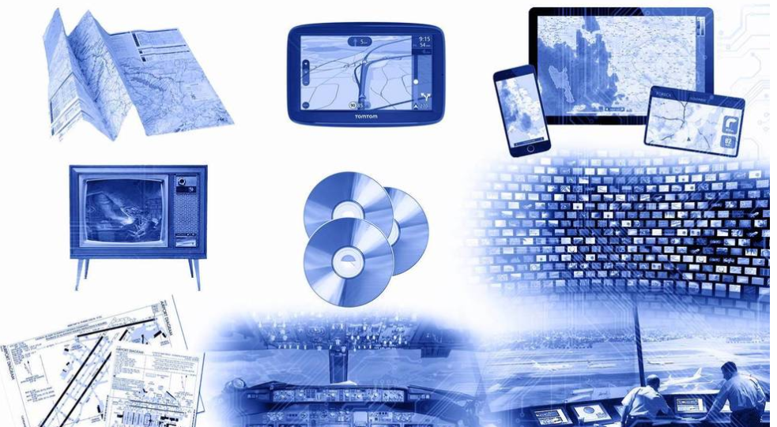
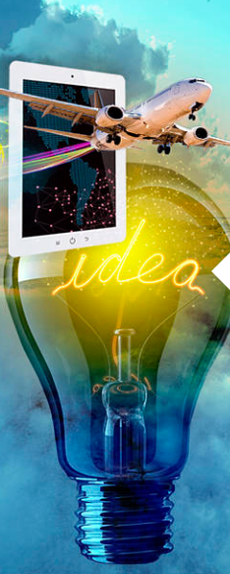
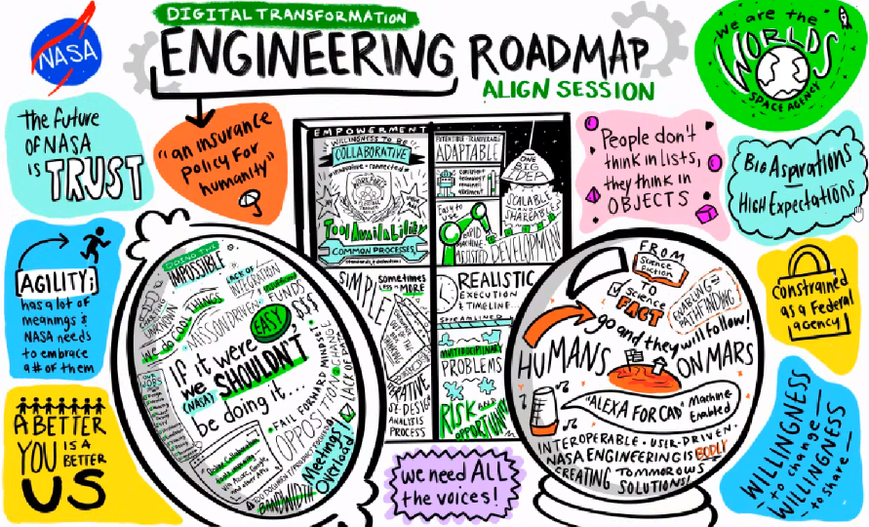
IDC² Completed Sessions Session: Organizational
  Strategic Planning/Logistics Coordination/Organizational
  Summer Intern Tours and AR/VR demonstration
  Systems Engineering Training
  Organizational Langley Near-Term Workplace Revitalization
  Systems Design Innovation
  Shared Space Usage within Teams
  I2C for Branch Strategic Planning Retreat
  Enhanced Virtual Environment for Collaborative Learning
  Agencywide Smart Center
  Center’s Transformation Initiative
  Agency Digital Transformation F2F (Multiple Sessions)

Slide 13
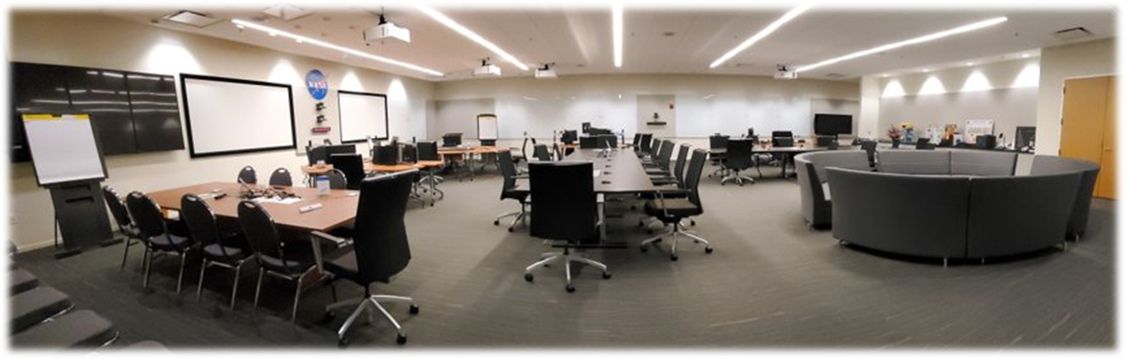
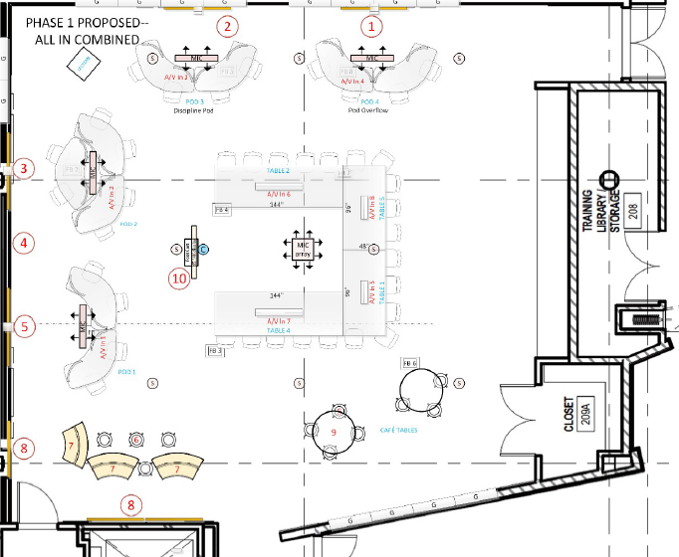
State of the Art Facility
New State of the art facility based on 20+ years experience.
Technology and Room upgrade:
New AEGIS “core” technology set (wireless collab, VITS, hybrid conferencing) for overall room
Updated speakers
Ceiling microphones to replace table mics
New wall mounted displays with casting capability
Updated cameras for video conferencing
Enhanced overhead highly directional speaker system to support multiple configurations
Physical reconfiguration of the room and removal of decommissioned CAS Mezzanine system

Slide 14

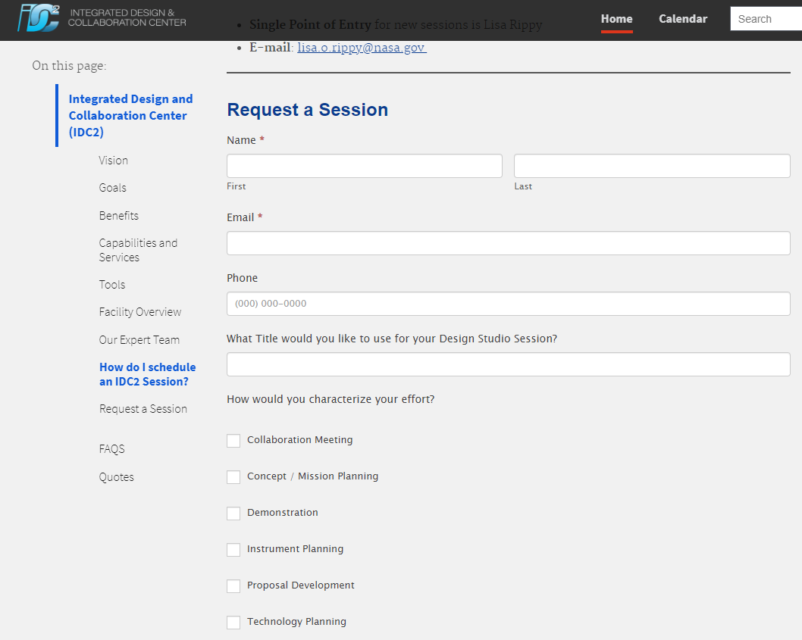
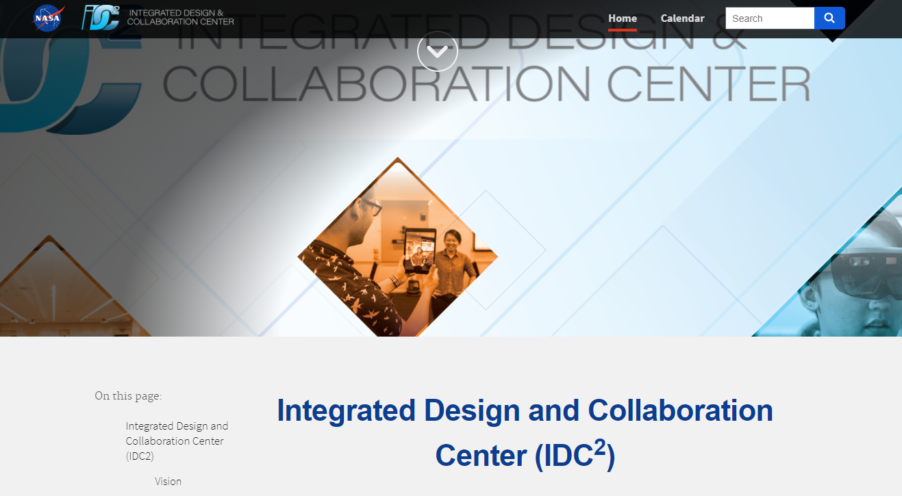
IDC² Website
IDC² Website information:
https://eds.larc.nasa.gov

Slide 15
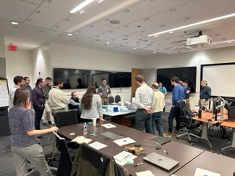
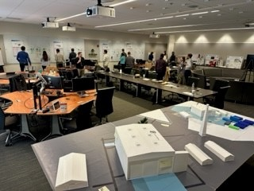
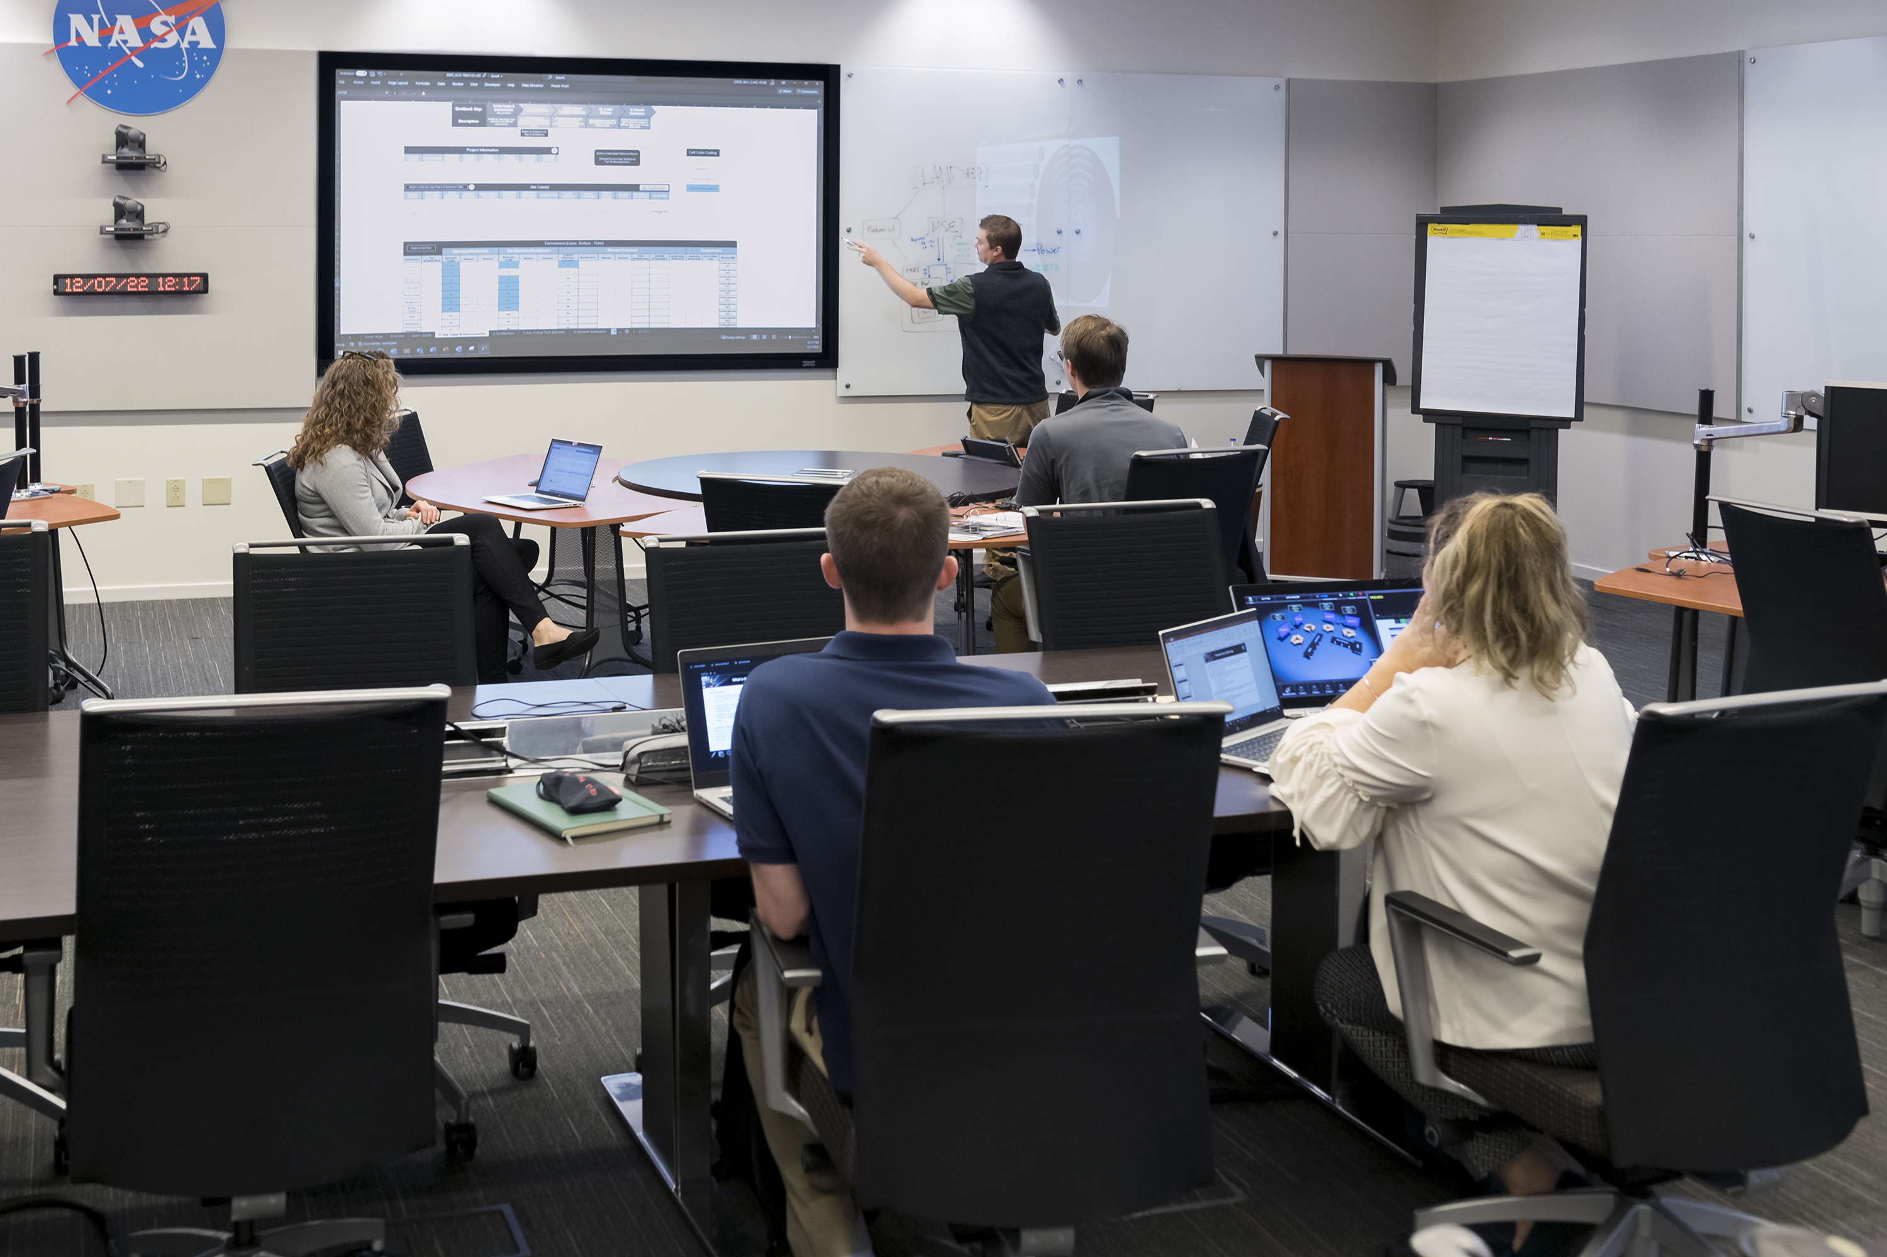
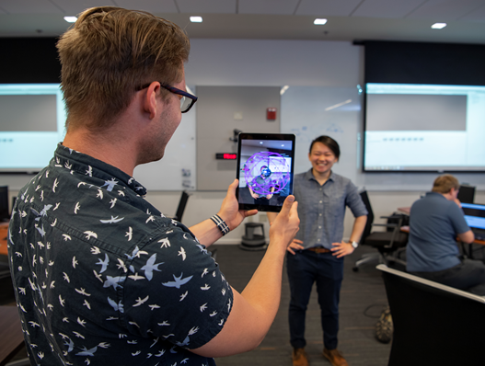
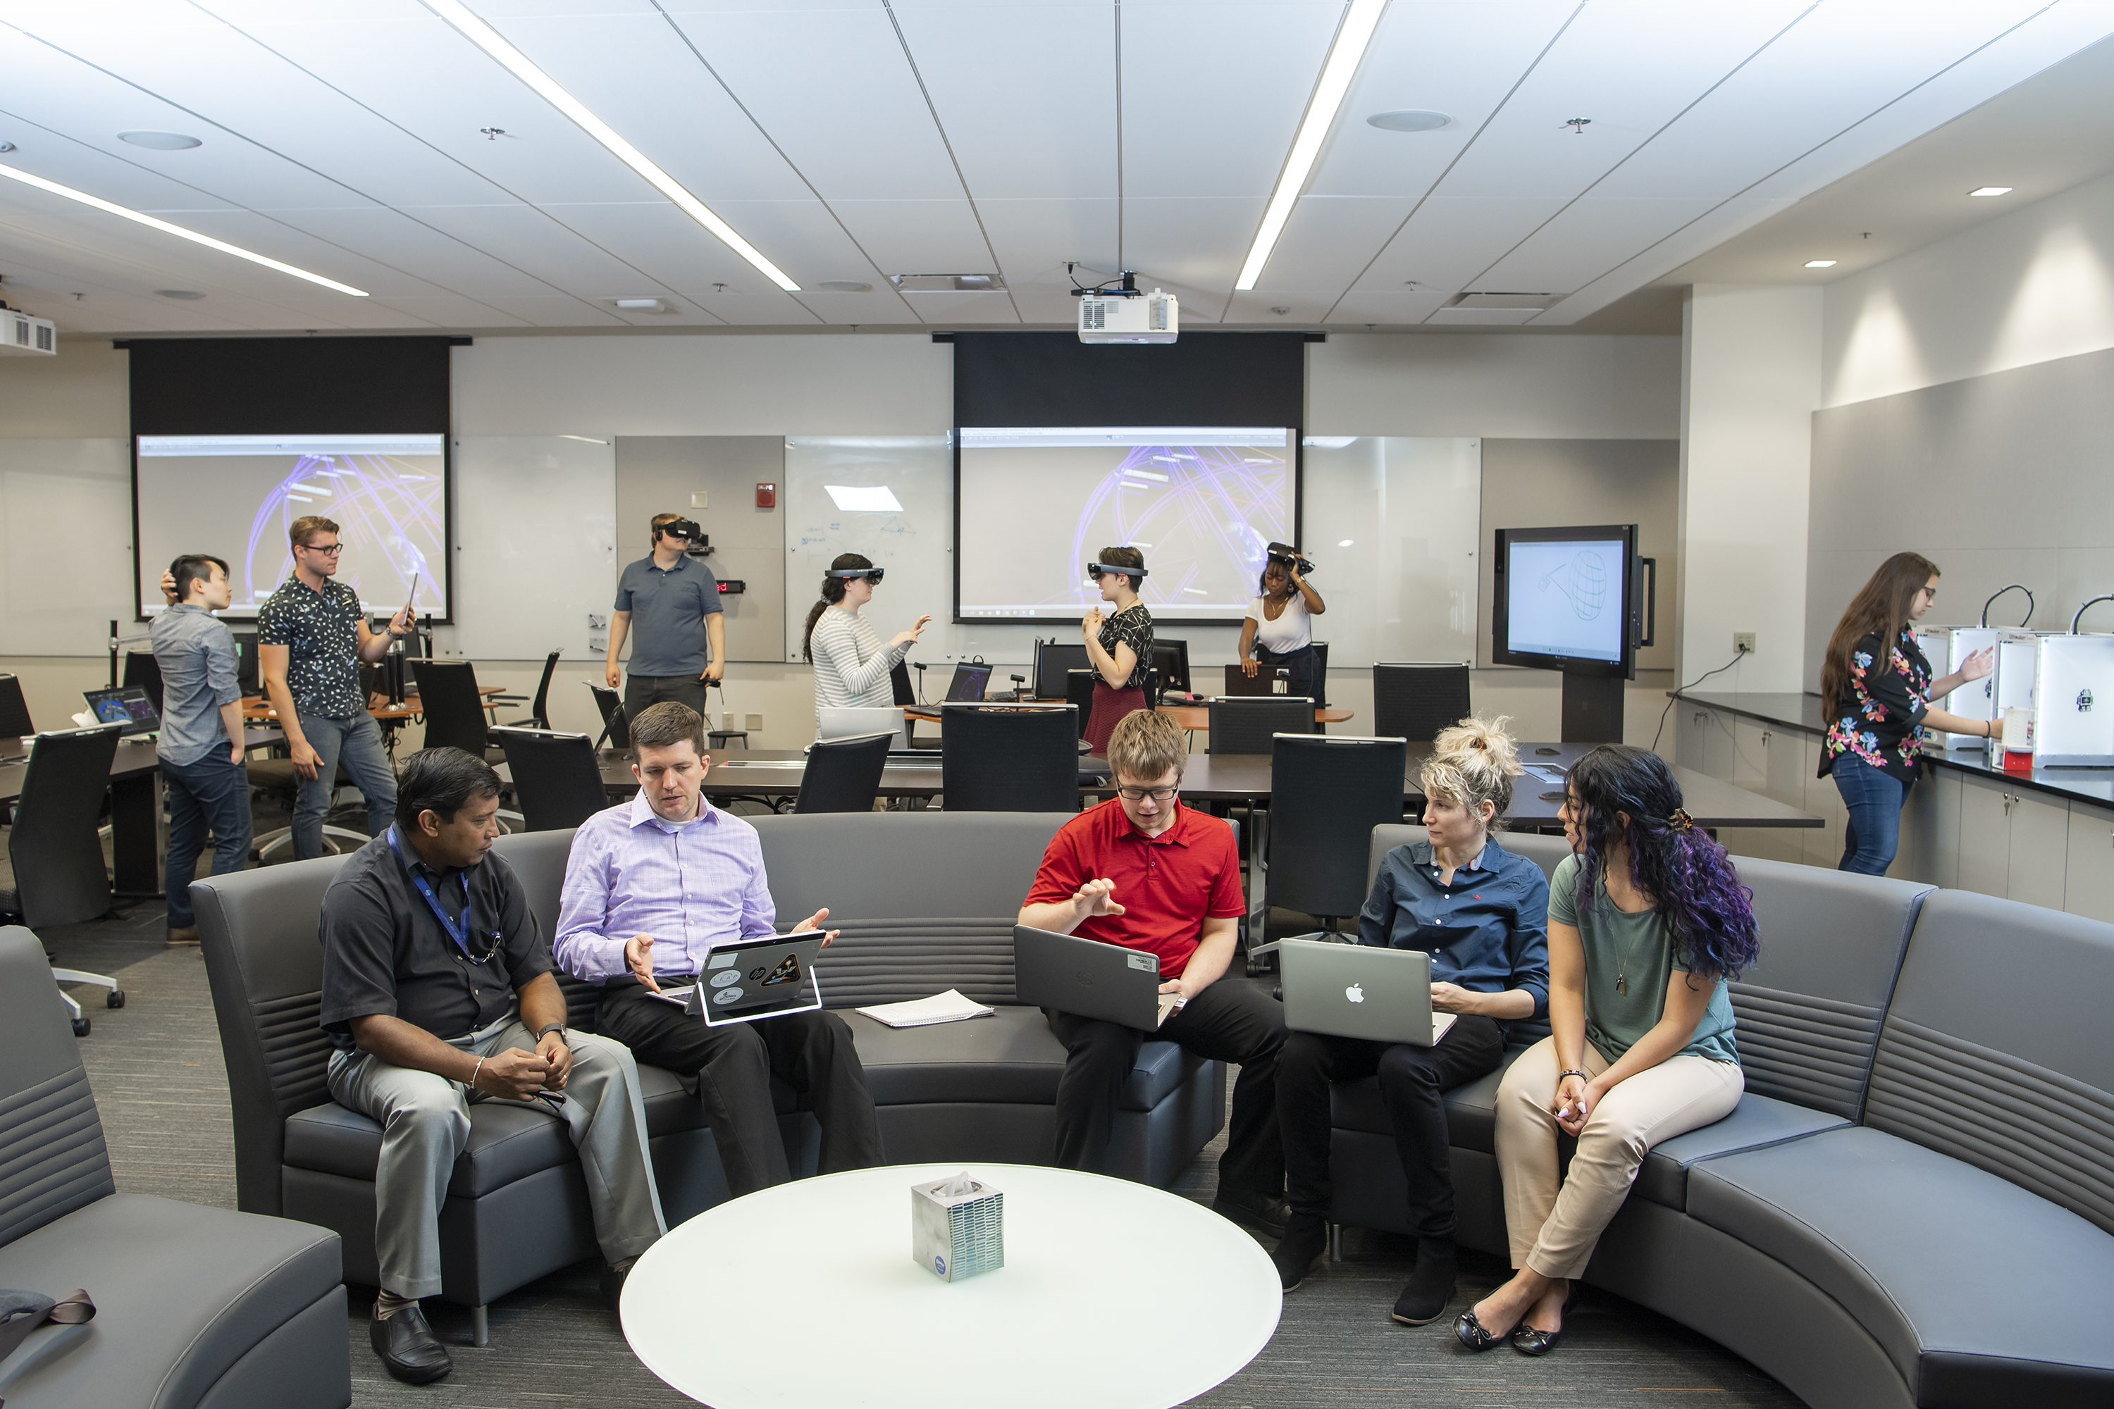
IDC² Study Sessions in Action!

Slide 16
IDC² Promo Video
IDC² Promo Video

