Slide 1

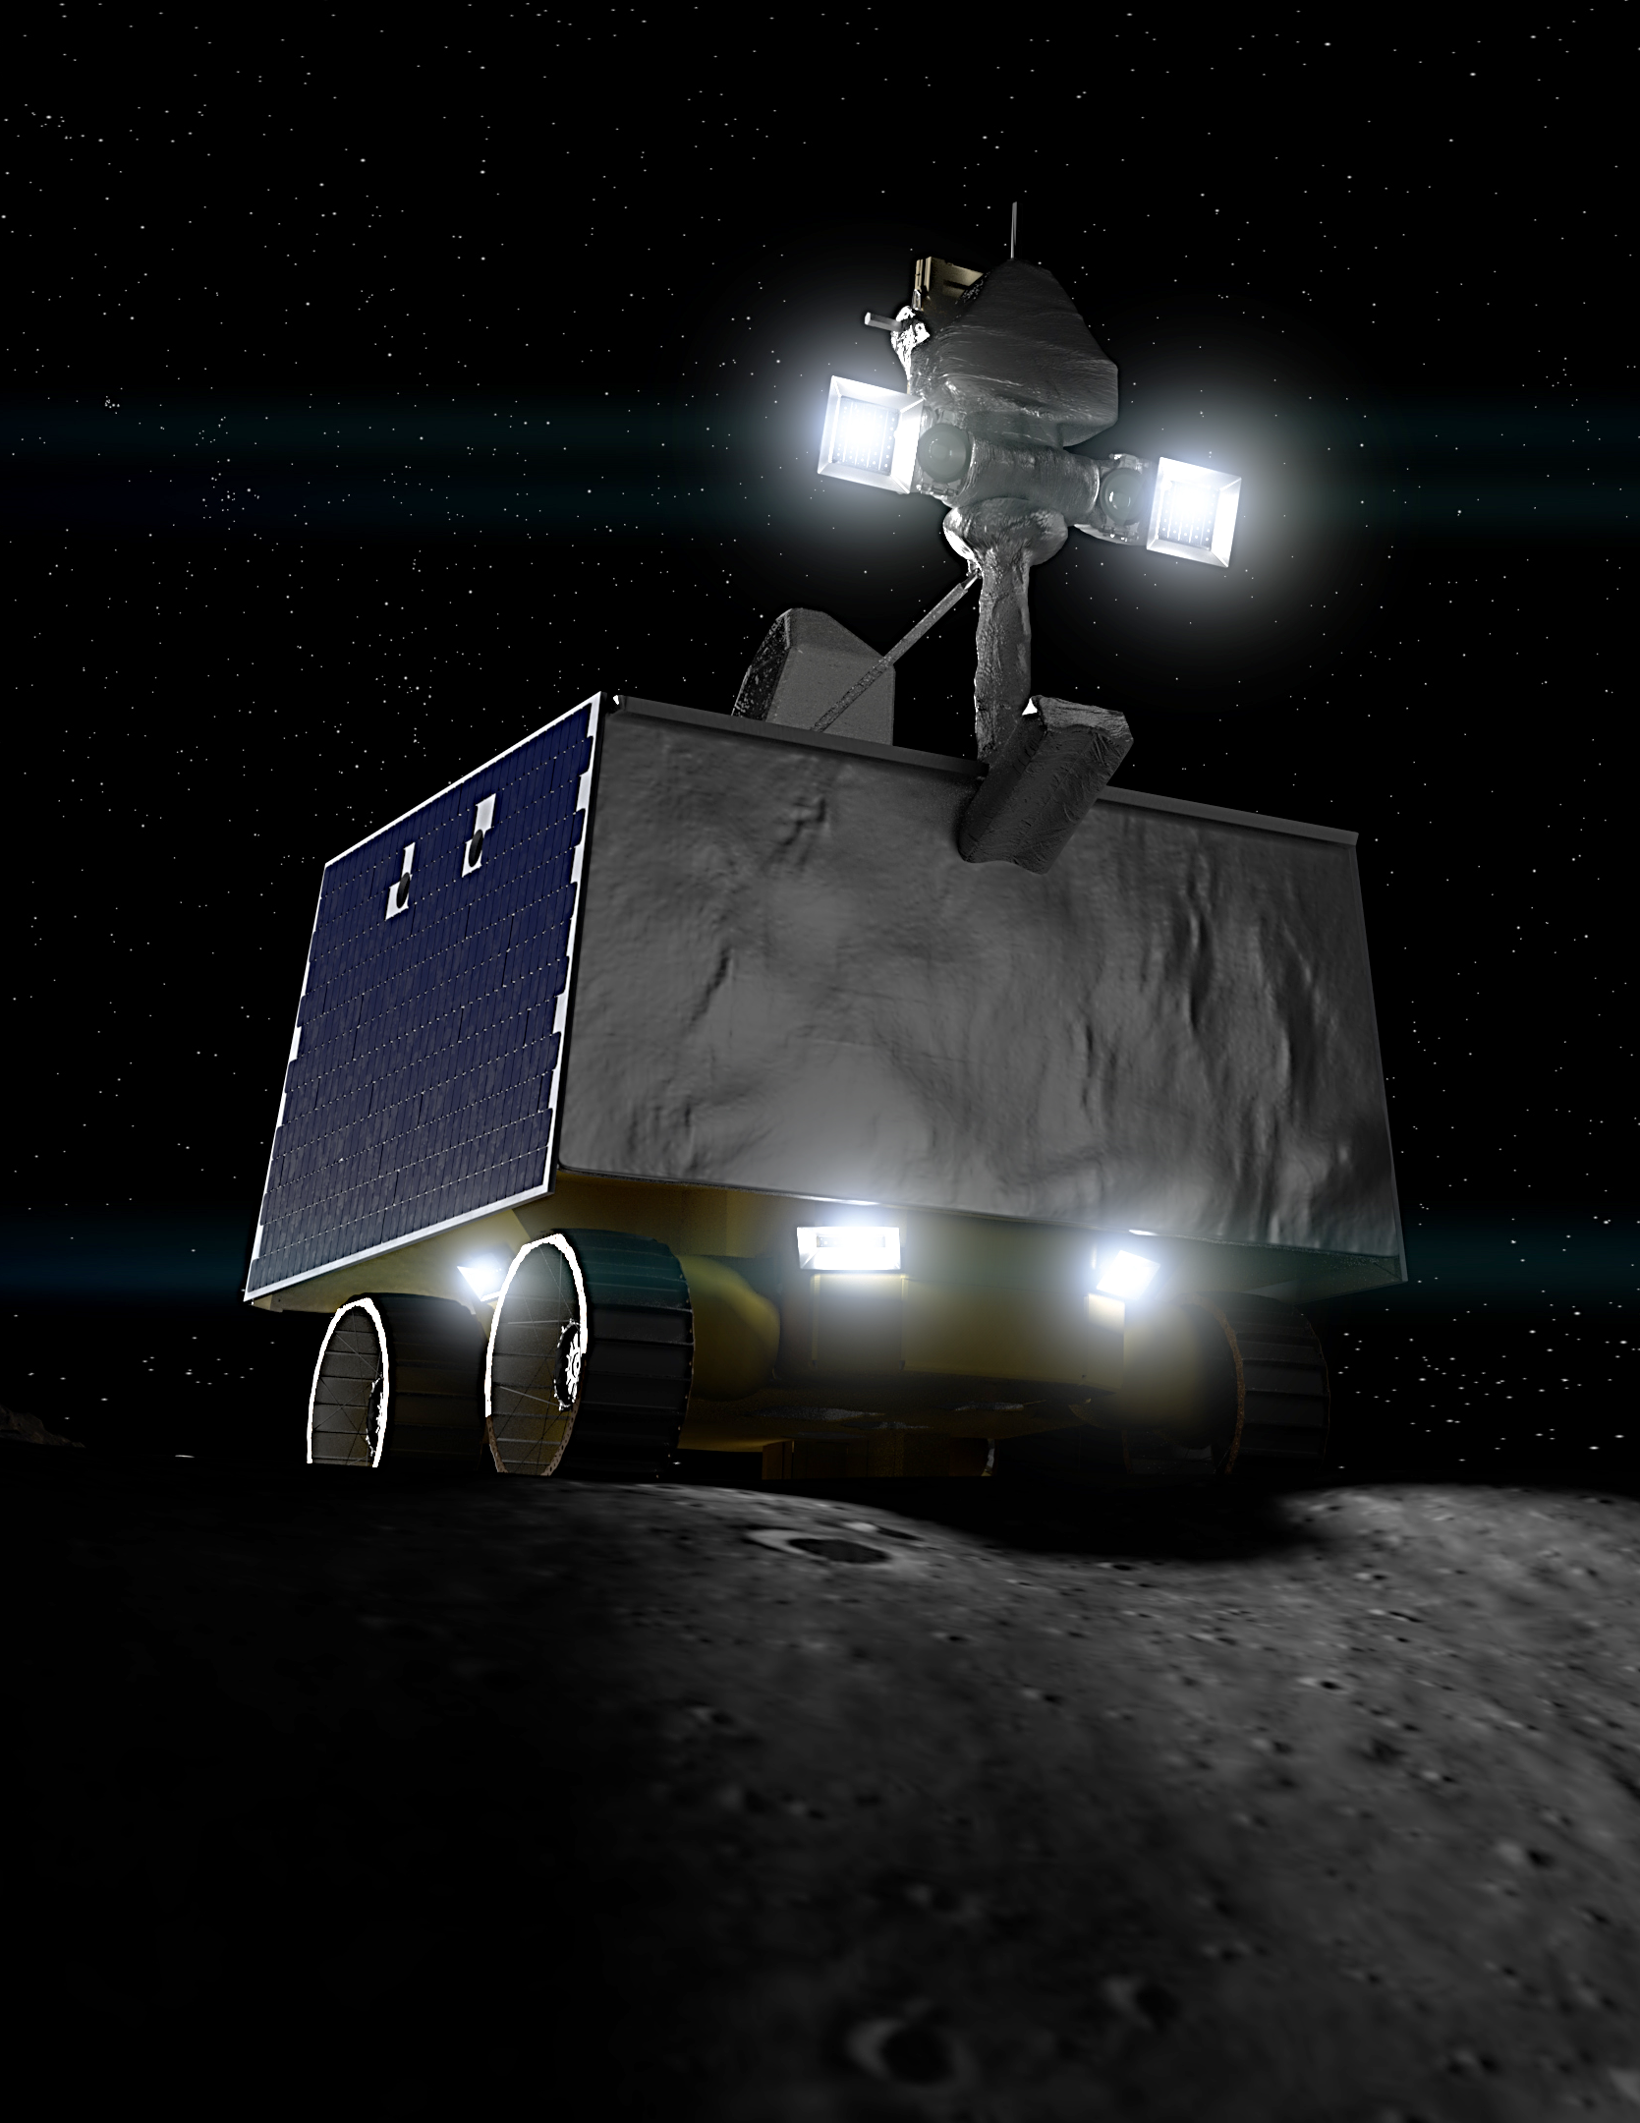
VIPER – NASA’S MOON ROVER
Emily Certain

Slide 2
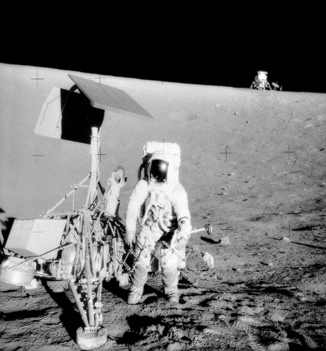
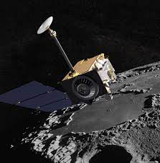
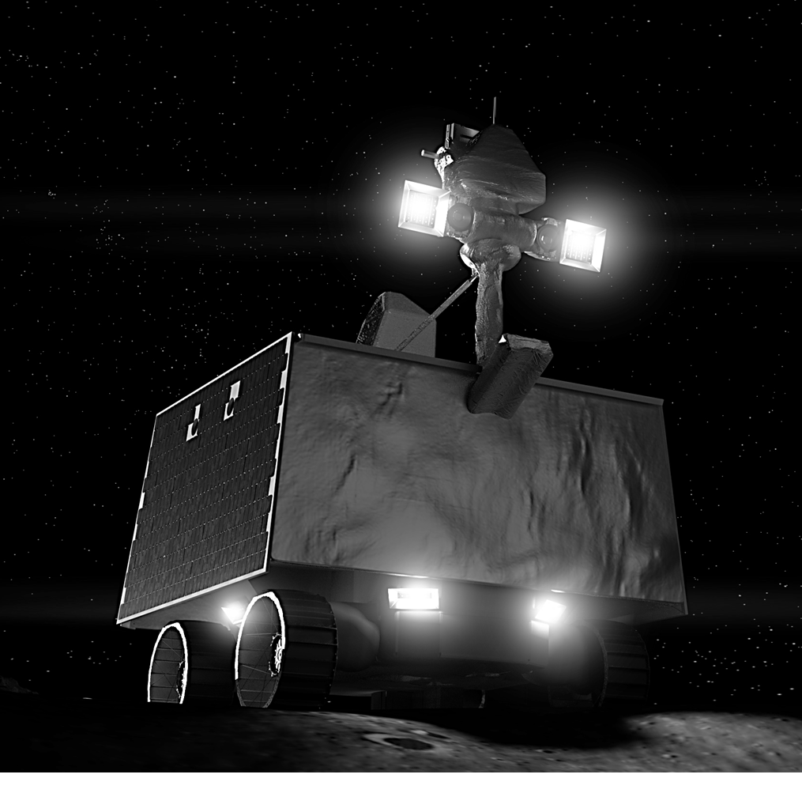
TIMELINE
1969
The 1st Leap
Humans voyaged to the moon from 1969 - 1972.
2009
The 2nd Leap
Water is discovered on the moon in large quantities near the poles.
2024
The 3rd Leap
VIPER will land on the South pole of the moon in search Lunar Volatiles.

Slide 3
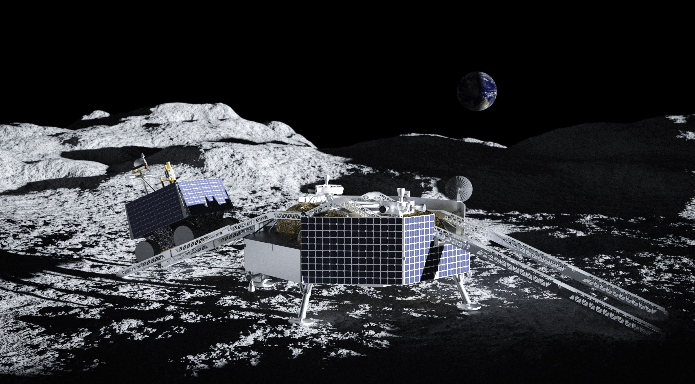
2024
Launching in 2024 as part of the Artemis program, VIPER is NASA’s first lunar mobile robot.
VIPER will land on the South pole of the moon in search Lunar Volatiles such as water and ice that will allow us to determine how to harvest the Moon’s resources for future human space exploration

Slide 4
.Volatiles
Investigating
Polar
Exploration
Rover

Slide 5
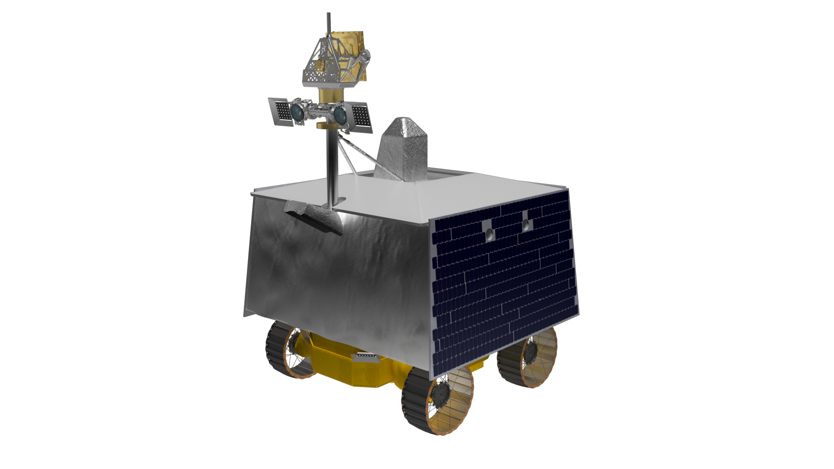
MEET VIPER
VIPER is NASA’s first lunar mobile robot
VIPER is the first rover with headlights
VIPER is the first resource-mapping mission on another celestial body.
The VIPER mission will mark the first time since the Apollo missions that drilling has been done on the Moon.
VIPER will robotically drill deeper than any other on a celestial body.

Slide 6
MEET VIPER
Launch: Late 2024
Landing site: Nobile Region of Moon's South Pole
Delivery to the Moon: Launch vehicle and lander provided by a NASA Commercial Lunar Payload Services partner
Mission duration: 100 Earth days, covering 3 cycles of lunar day and night
Distance goal: 12 miles (20 kilometers)
Rover size: Similar to a golf cart: 5 feet by 5 feet by 8 feet (1.5 meters by 1.5 meters by 2.5 meters) and 992 pounds (450 kilograms)
Onboard instruments: 3 spectrometers and a 3.28-foot (1-meter) drill
Power: Solar-charged battery, peak power of 450 watts
Top speed: 0.45 mph (0.72 kph)
Communications: X-band direct-to-Earth (no relay) over the Deep Space Network

Slide 7
VIPER Challenges
Extreme temperatures: The rover's hardware will need to withstand surface temperatures varying by 500 degrees Fahrenheit between sunlight and shade.
Real-time drivers: The Moon is much closer to Earth than Mars, so there will be little delay when transmitting commands to the rover. That means drivers on Earth can operate VIPER interactively.
Mobility: We can't be exactly sure what the soil in the Moon's polar regions will be like – hard and compacted, fluffy, or somewhere in between? As a result, VIPER is designed for unprecedented agility.
Complex route planning: The extreme swings in light and dark at the poles of the Moon are nothing like those on Earth or Mars – and produce extremely long and fast-moving shadows.
First rover with headlights: VIPER will explore inside dark craters where the Sun never reaches, making it the first NASA rover to need headlights. However, rover engineers face a brand-new challenge in building a lighting-plus-camera system to operate in the Moon's harsh temperatures and extreme conditions of light and dark.

Slide 8
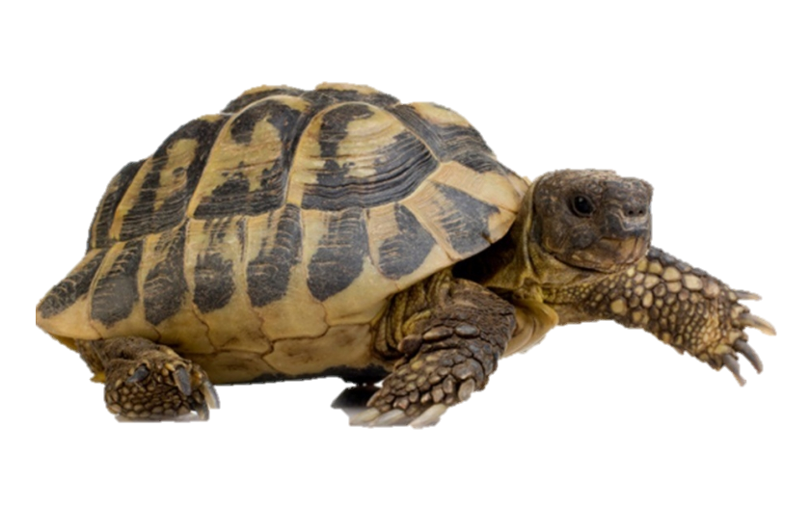
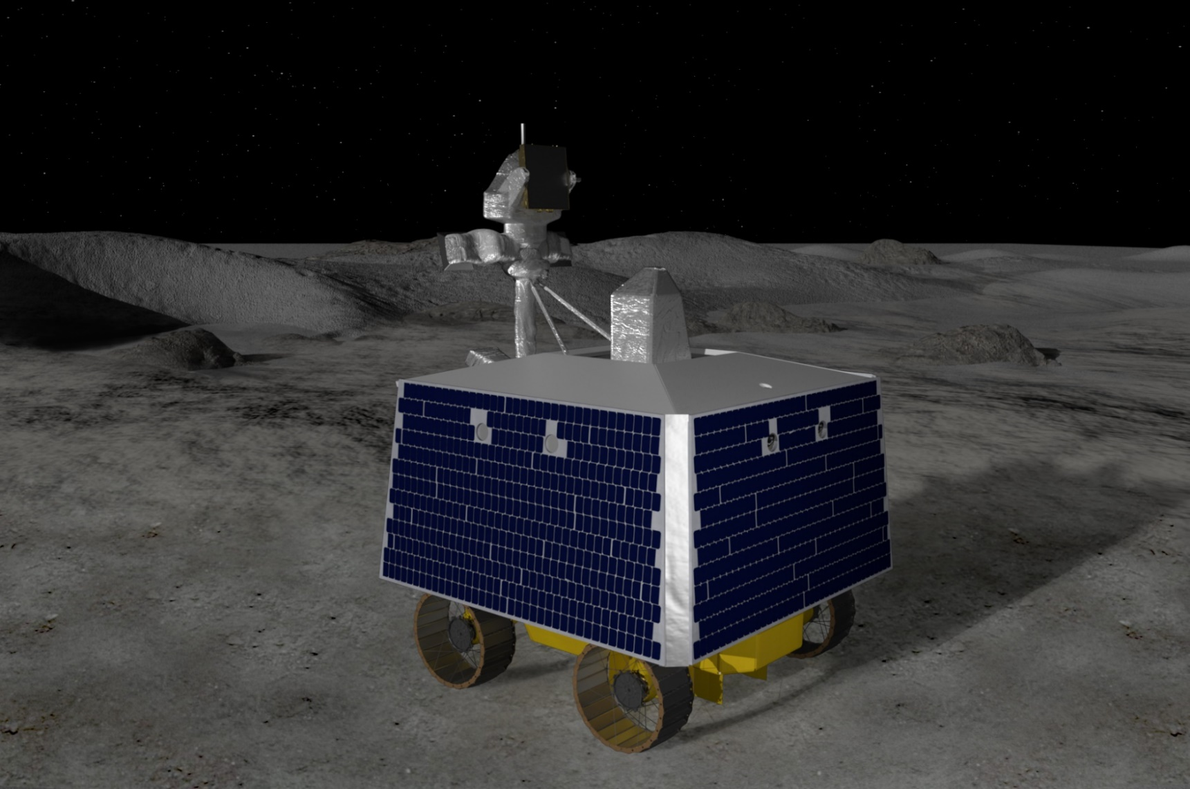
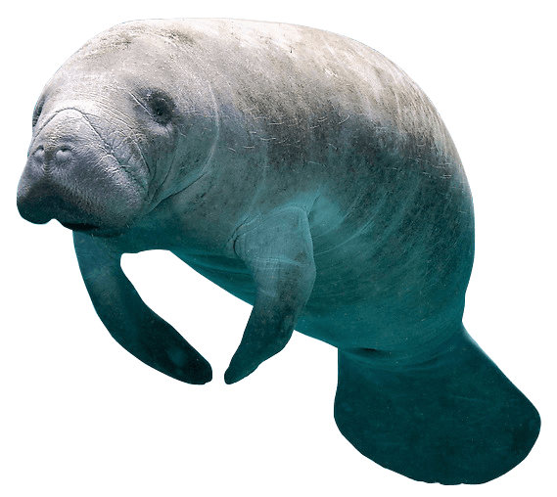
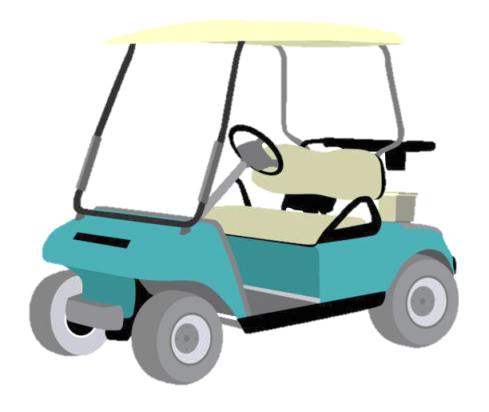
VIPER Specs
Speed: As fast as a Tortoise (~.45 mph)
Weight: A Manatee (~1000 lbs.)
Size : Golf Cart (~5 x 5 x 8 ft.)

Slide 9
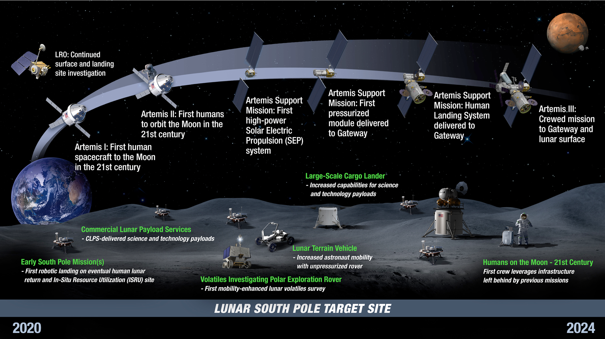
Concept of Operations

Slide 10
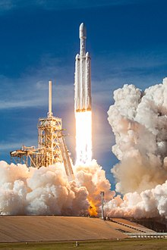
MISSION TIMELINE
Pre-launch activities: Preparation for the mission, including pre-project planning; science definition and instrument selection; landing site selection; and rover assembly and testing.
Delivery to CLPS partner: Rover delivery to the commercial partner responsible for sending VIPER to the Moon.
Launch: Lift-off from Earth aboard SpaceX's Falcon Heavy launch vehicle in late 2024.
Cruise: Voyage through space to the Moon.
Descent and landing: VIPER's arrival at the South Pole of the Moon aboard Astrobotic's Griffin lander.
Instrument checks and first drive: Tests to ensure the rover is fully operational and then driving off of the lander.
Surface operations: Rover operations on the Moon sampling ice from four types of lunar environments. VIPER collects data for about 100 Earth days, including multiple survival periods at designated safe havens.
Mission end: VIPER's mission ends when it encounters periods of cold and dark longer than four Earth days. In a planned location, the rover freezes in the very cold temperatures of the polar regions.

Slide 11
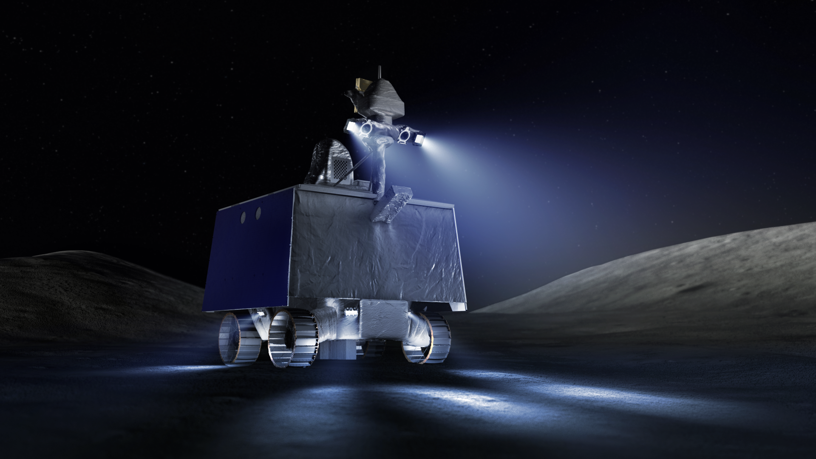
VIPER Systems
Antenna on Mast
Cameras & Lights
Subsurface Excavation
(TRIDENT)
Heat Rejection (Radiator on Top)
Heaters inside keep electronics warm
Prospecting (NSS)
Powered by
Solar Arrays and
Batteries
Mobility
Prospecting & Evaluation
(MSOLO)
Prospecting & Evaluation
(NIRVSS)

Slide 12
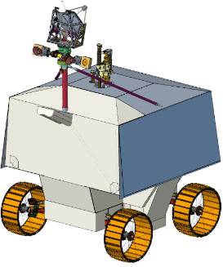



Prospecting: NSS, NIRVSS, MSolo
Surface Temperature
Epithermal Neutron Count Rate
H₂O/OH Band Strength
Galactic cosmic rays
Frosts / OH
Neutron leakage flux
Ice-bearing layer
12

Slide 13
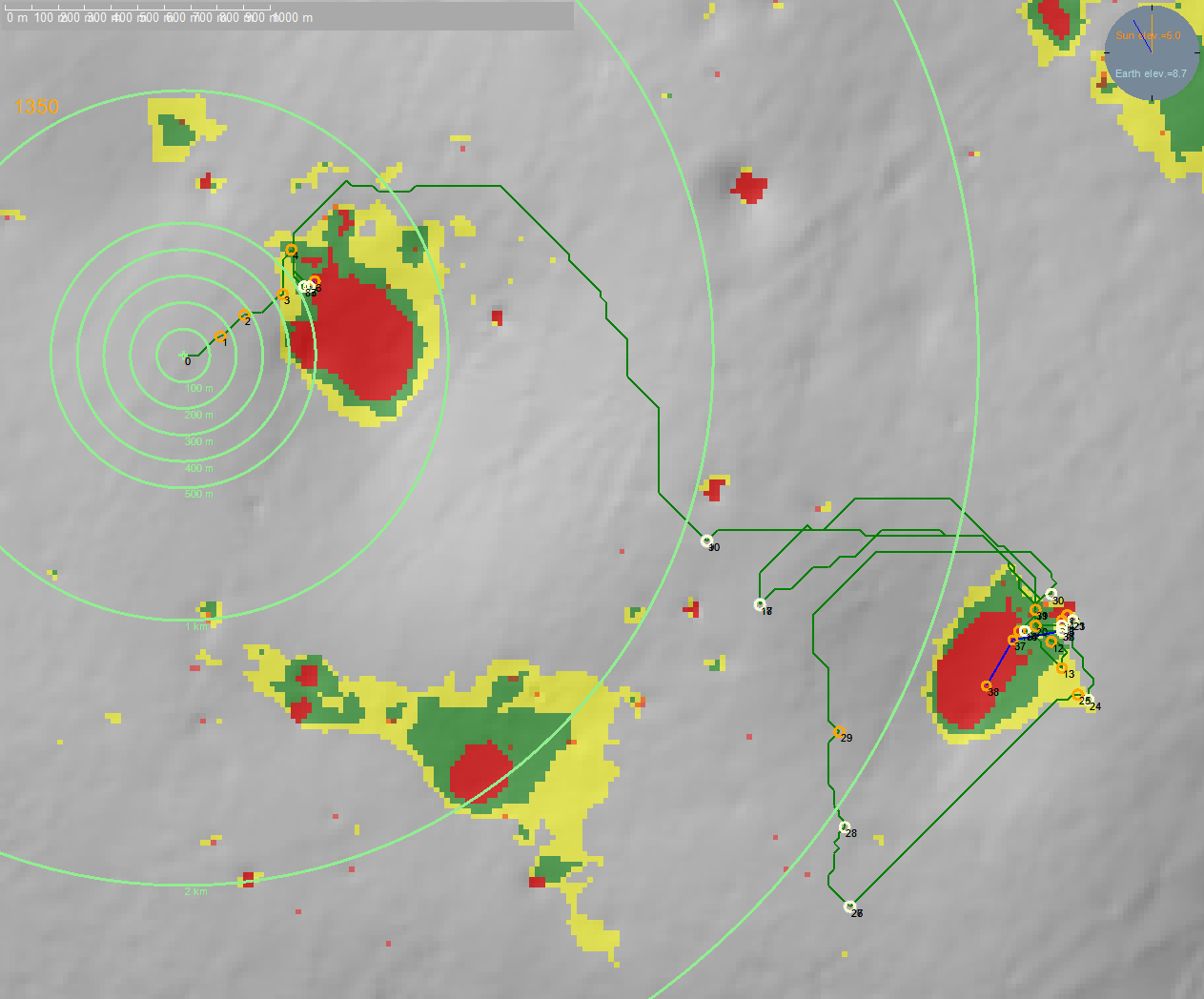
Mapping our Course to Find Resources
Surface Ice Depth (PSR)
Shallow Ice Depth (< .5 m)
Deep Ice Depth (< 1 m)
Dry (deeper than 1 m)

Slide 14
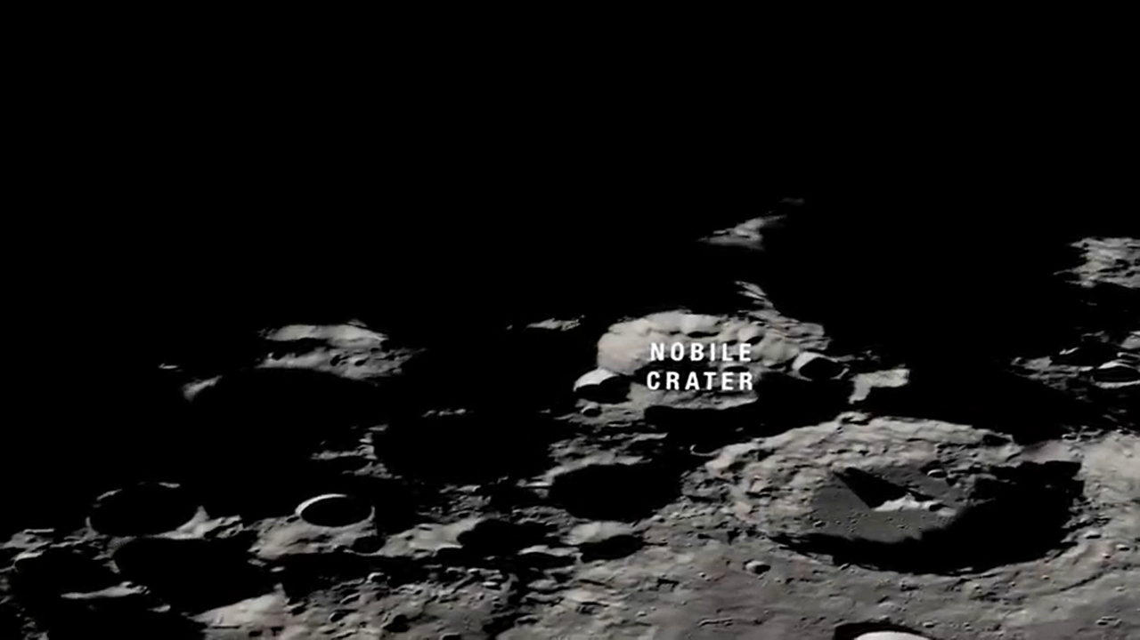
Navigate Craters to Prospect

Slide 15
VIPER – SI&T
VIPER SI&T addresses integration and test of all elements required for the Surface Segment to conduct mission operations on the lunar surface.
This includes:
Integration and test of the Science Instruments after installation
Integration and test of Rover components, subsystems, and subassemblies after installation
Integration and test of the VIPER Surface Segment
Support the CLPS Contractor for the Integration and Test of the Surface Segment with the Lander (Space Segment)
Support the CLPS for the Integration and Test of the Space Segment with the Launch Vehicle (Launch Segment)
15

Slide 16
VIPER Environmental Testing
Modal Survey Test
Modal testing is the process by which the spacecraft is dynamically excited at low levels over a specific frequency range.
Shakers are attached at different locations around the spacecraft to excite modes (ex. rocking and bending)
Vibration Test
The primary goal of vibration testing is to expose the spacecraft to the low- frequency dynamic launch environment
This will ensure that the system will perform as expected after being exposed during launch

Slide 17
VIPER Environmental Testing
Thermal Vacuum (TVAC) Test
Allows us to test mission critical events and the thermal management system at extreme temperatures
The test will ensure that the system operates in a simulated space environment
Acoustic Test
Allows us to test the spacecraft at a range of sound pressure levels
This will demonstrate VIPER capability margin over the launch and ascent acoustic environments

Slide 18
Thank you

