Slide 1
Utilization of AM for Sounding Rockets Flight Structures
Joseph Schreck
Mechanical Engineer/Code 548
Civil Servant

Slide 2


About Me
Hometown: Marion, OH
Joined Marine Corps in 2009
  Served as an F/A-18C mechanic
Bachelor’s degree in Mechanical
  Engineering from The Citadel
  Senior capstone project studied and built
  a mobile supersonic wind tunnel
Wallops Flight Facility
  Been with NASA for 5 year
  Mechanical Systems Branch
1

Slide 3
Overview
1. Background
2. Material Selection/Properties
3. Manufacturing Process
4. Heat Treat/Post Processes
5. Finite Element Analysis
6. Challenges
7. Accomplishments
8. Steps Forward
2

Slide 4
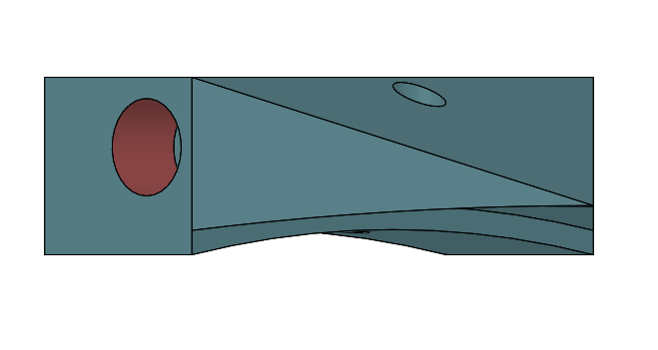
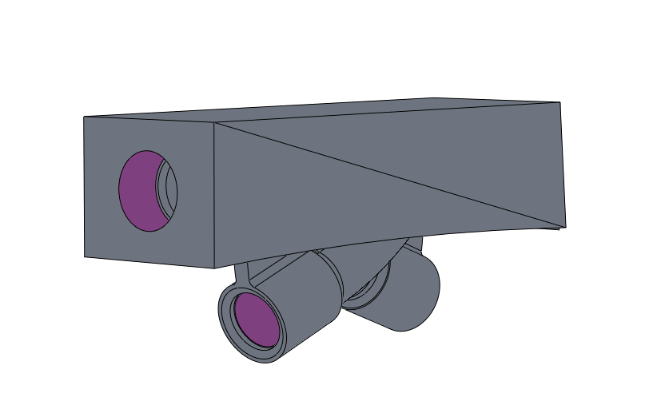
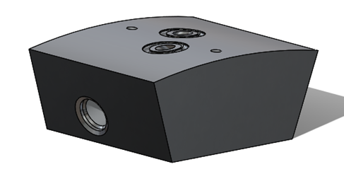
Background Info
Current Design
Proposed Design
3

Slide 5
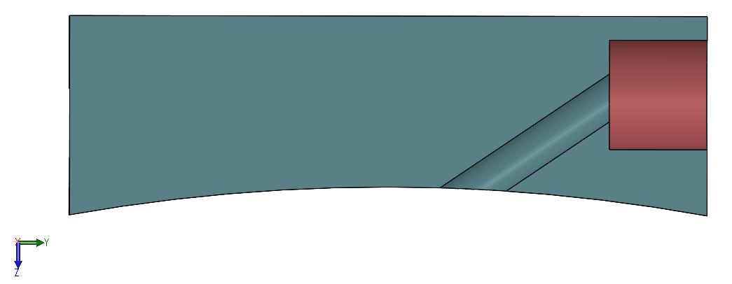
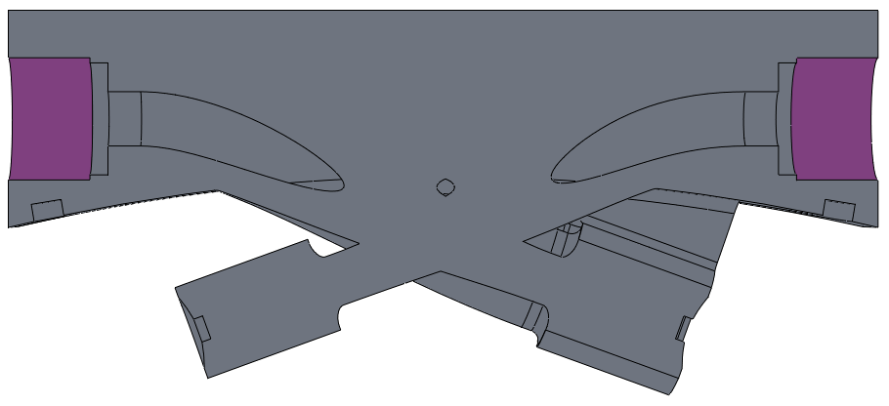
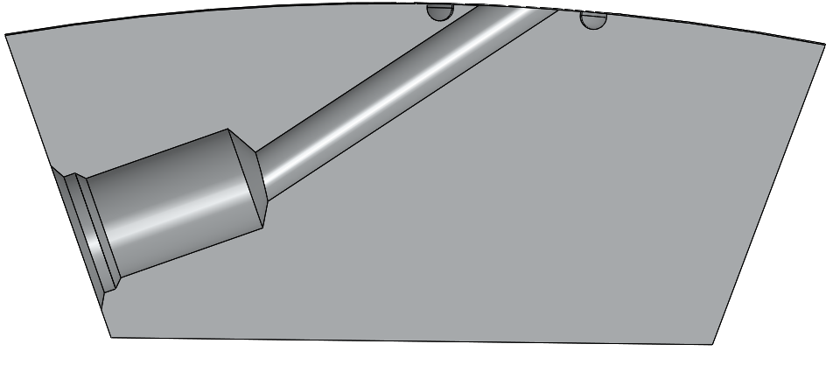
Background Info Cont.
Current Design
Proposed Design
4

Slide 6
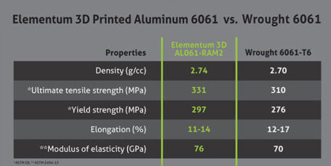
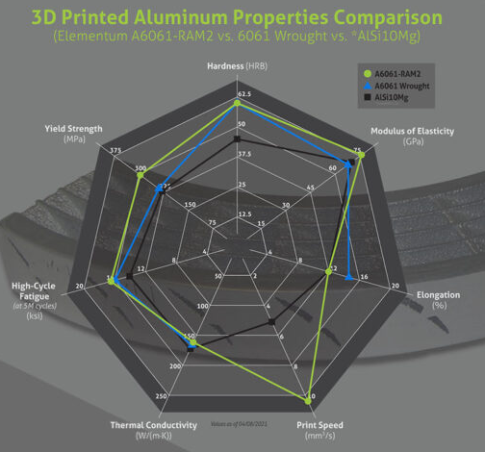
Material Selection/Properties
Current | Proposed
AL 6061-T6 | AL 6061-RAM2
Elementum 3D
5

Slide 7
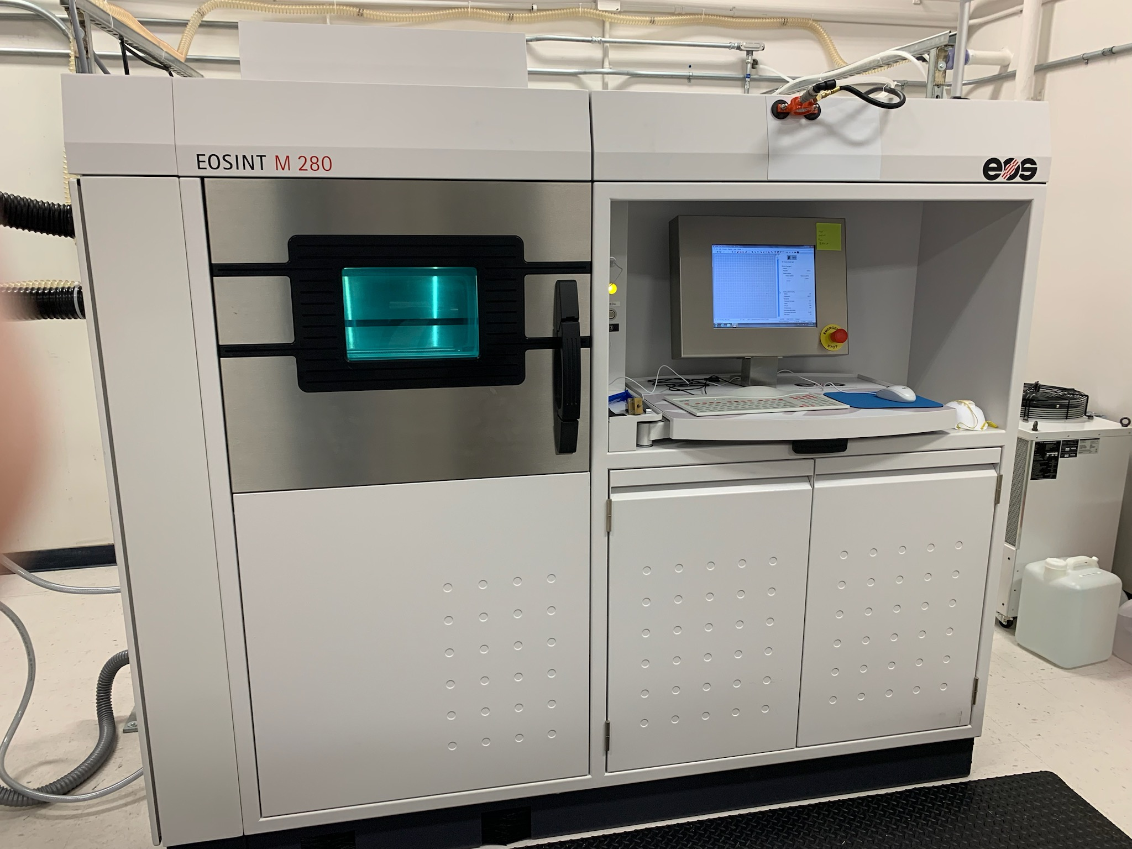
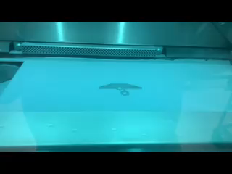
Manufacturing Process
6

Slide 8
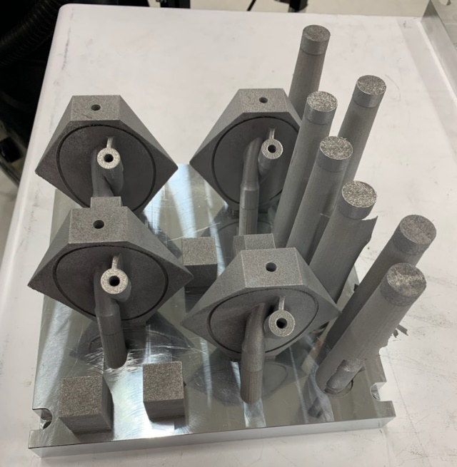
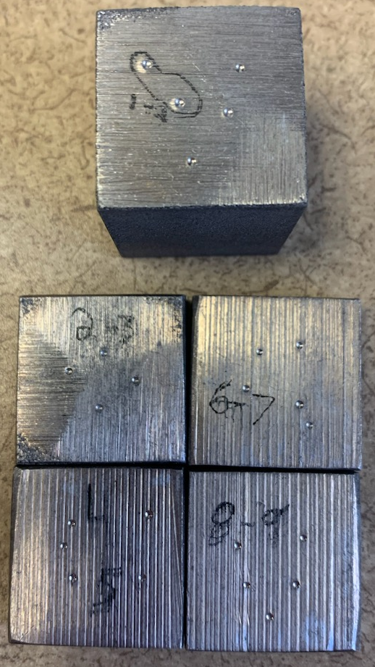
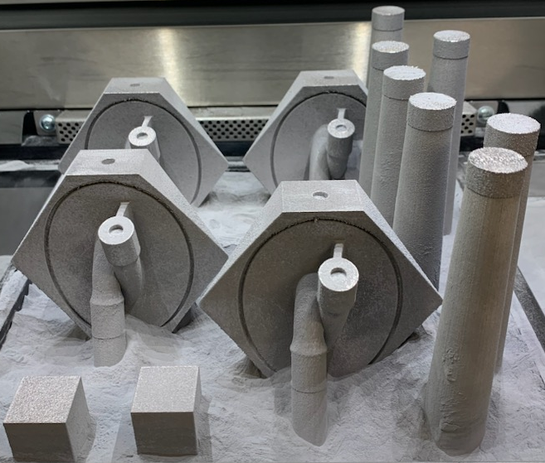
Heat Treat/Post Process
Sample | Rockwell Hardness
1 | 41.1
2 | 53
3 | 53.4
4 | 44.8
5 | 60.3
6 | 45.4
7 | 57
8 | 51.1
9 | 46.8

Slide 9
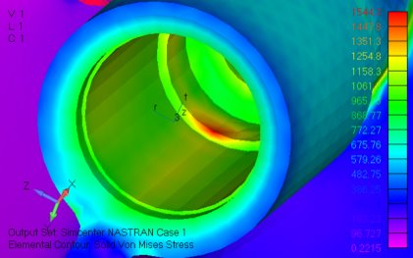
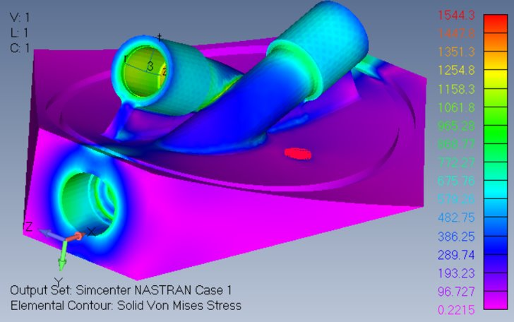
Finite Element Analysis
472 psi internal pressure
Max Von Mises stress is 1.54ksi
8

Slide 10
Challenges/Lessons Learned
Challenges
Working with new software to operate M280 machine
Setting up the machine and build plate layout
Lessons Learned
When setting up a build don’t place them in a straight line
Make sure that there is enough powder in the dispenser for the height of the build
Materialize Magics
Autodesk Netfabb
EOS PSW
9

Slide 11
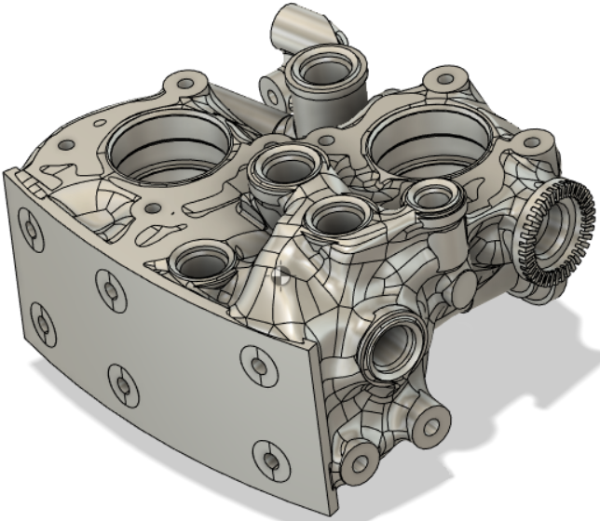
Accomplishments
Material selection for use in fabrication/testing
Performed FEA on nozzle block
Developed a test plan for acceptance and qualification
Created statement of work for testing nozzle
Successfully printed eight ACS nozzles
Heat treated three nozzles
Performed hardness testing
Generative design for ACS manifold

Slide 12
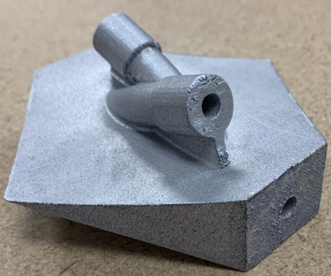
Steps Forward
Test at least 6 tensile coupons in different configurations (horizontal, vertical, and 45°)
Heat treat 4 nozzles and perform CT scanning on these parts
Conduct acceptance and qualification testing
Perform surface roughness checks
Perform vibration testing
Fabricate ACS manifold
Meet the requirements of AM NASA standards 6030 and 6033
11

Slide 13

Questions
12

Slide 14
References
Elementum 3D: https://www.elementum3d.com/wp-content/uploads/2021/11/A6061-RAM2-Web-Data-Sheets-2021-04-15.pdf
Matweb: https://asm.matweb.com/search/SpecificMaterial.asp?bassnum=ma6061t6
13

Slide 15
Abbreviations
ACS: Attitude Control System
AM: Additive Manufacturing
DMLS: Direct Metal Laser Sintering
NSROC: NASA Sounding Rocket Office Contractor
HRB: Hardness Rockwell B scale
14

