Slide 1

LaRC Structural and Thermal Systems Branch (D206)
Thermal Technology Highlight
Ruth Amundsen, Senior Thermal Engineer
23 August 2023
Notes:
STILL

Slide 2
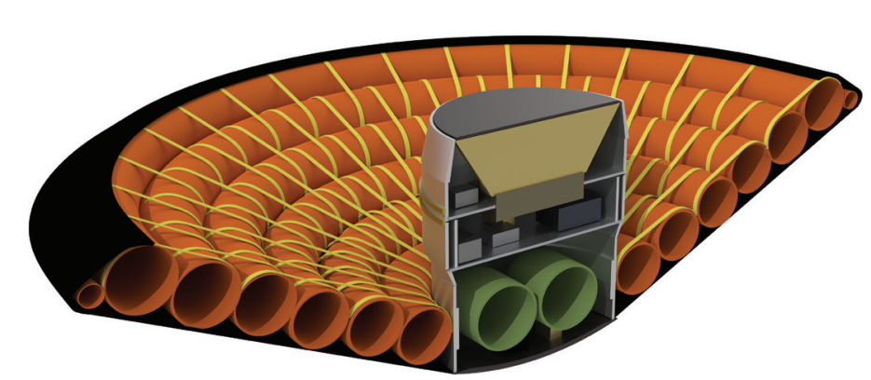
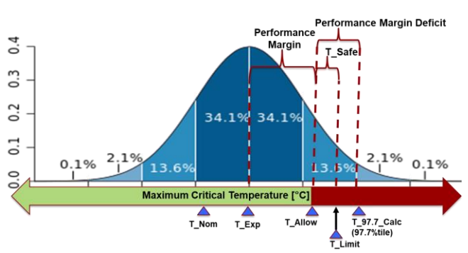
Flexible Thermal Protection System (FTPS)
The flexible thermal protection system (FTPS) was developed to enable large inflatable heatshields, which can land higher mass than existing heatshield technologies
FPTS consists of 3 layers: external woven ceramic fabric, middle layer of insulators, internal gas barrier
In Nov. 2022, the Low-Earth Orbit Flight Test (LOFTID) project demonstrated re-entry of 6-meter (~20 ft.) inflatable aeroshell from LEO
FTPS and trajectory design utilized a probabilistic margin process to reduce over-margining and ensure significantly severe thermal response for model correlation and material proofing
Example Maximum Critical Temperature Probability Distribution
Cross Section of Inflated LOFTID Payload and Heatshield
Toroid
Gas Barrier
Insulation
Ceramic Fabric
Re-Entry Flow
Inflatable Toroids
FTPS
LOFTID Centerbody
Probabilistic Risk Analysis and Margin Process for a Flexible Thermal Protection System - NASA Technical Reports Server (NTRS)
loftid_fact_sheet_layout_090922_508.pdf (nasa.gov)

Slide 3
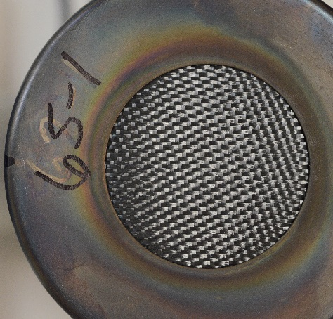
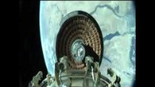
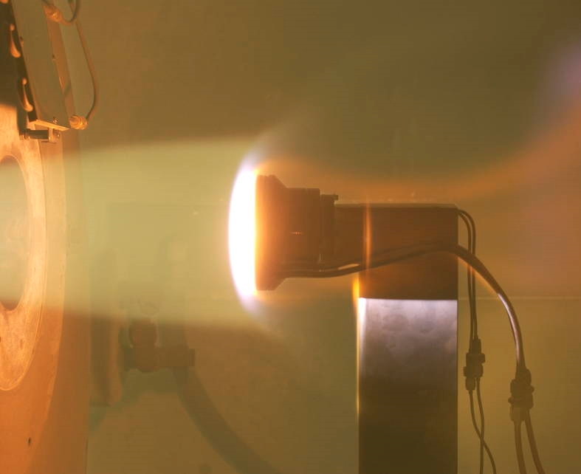
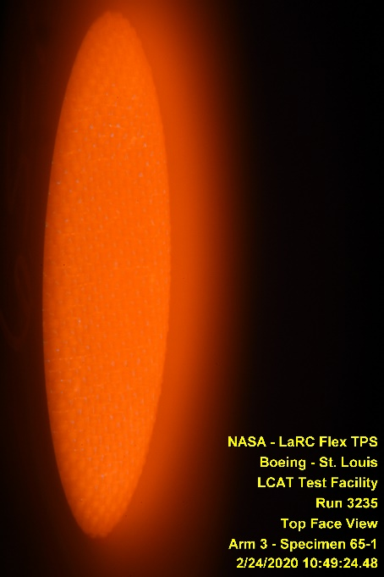
Flexible Thermal Protection System (FTPS)
Material layup underwent years of design and testing to reach current fidelity and readiness for flight
Testing at Boeing LCAT Arc Jet Facility
LOFTID Inflation and Separation
Test Coupon
Heated FTPS Material
Source: LOFTID Demonstration Images | NASA
Source: LOFTID project imagery.

