Slide 1


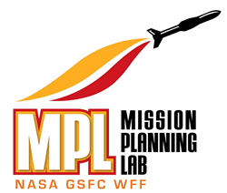

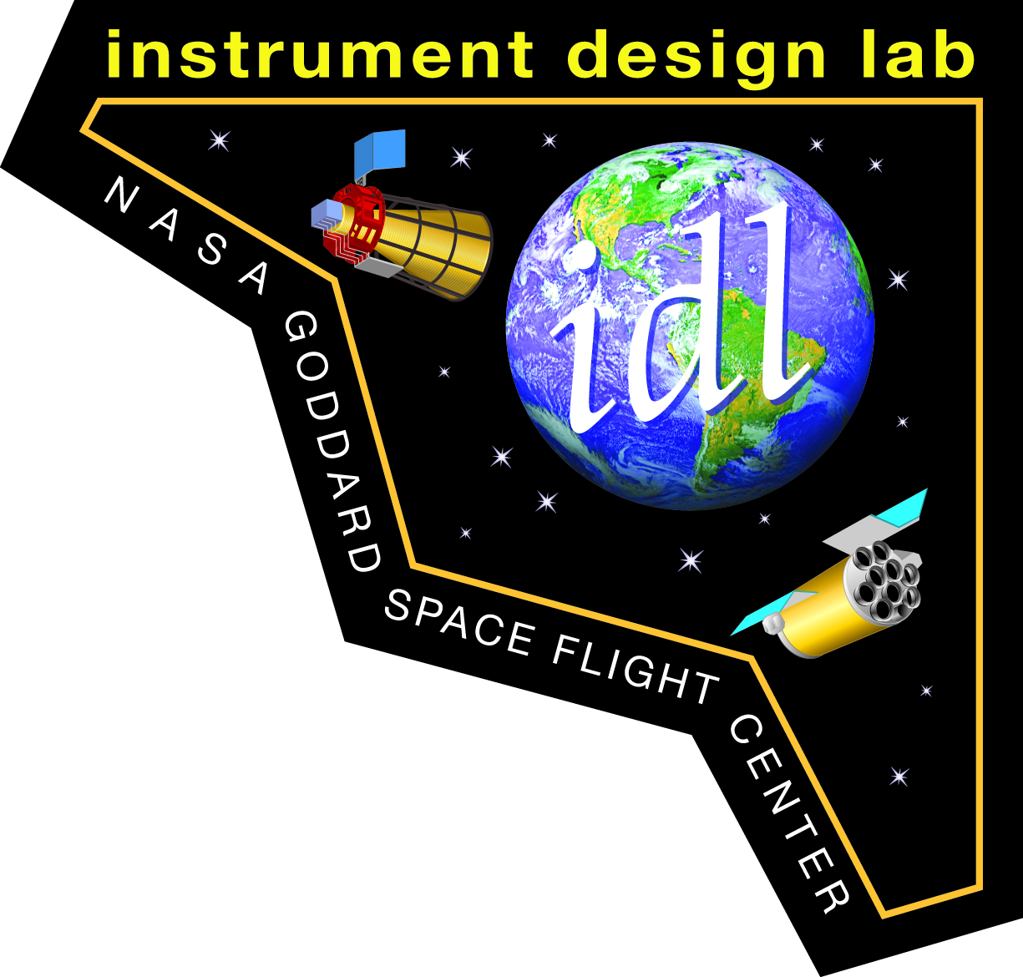

The Integrated Design Center (IDC) at Goddard Space Flight Center (GSFC)
Liz Matson (She/her)
IDC Manager
Civil servant, code 500, NASA GSFC

Slide 2
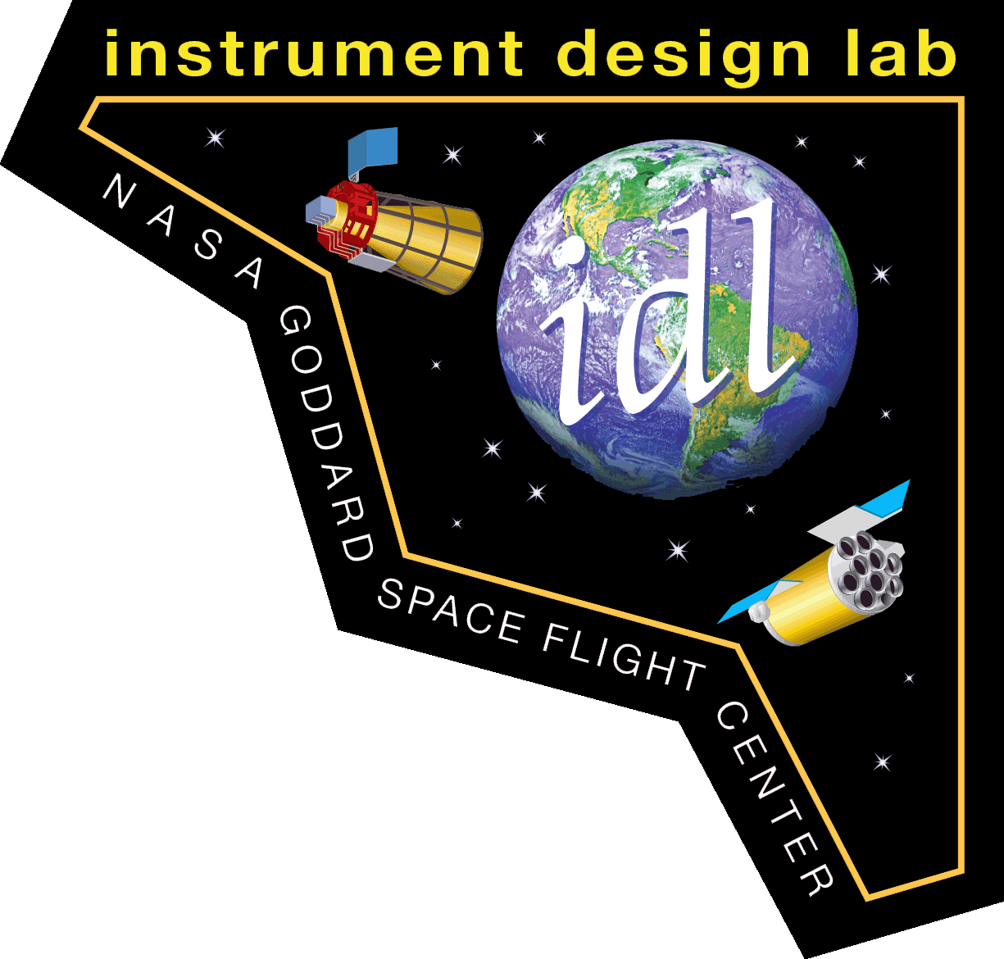



IDC Labs
Instrument Design Lab (IDL) | Mission Design Lab (MDL) | Architecture Design Lab (ADL) | Mission Planning Lab (MPL)
Conceptual design and analysis of instrument systems | Conceptual end-to-end spacecraft and mission design and analysis | Rapid mission level (ADLm) or instrument level (ADLi) trade space exploration and architecture options assessment | Conceptual end-to-end suborbital and small satellite mission design and analysis
Team Lead: Kan Yang | Team Lead: Mark McGinnis | ADLm Team Lead: Mark McGinnis ADLi Team Lead: Kan Yang | Team Lead: Ben Cervantes
Location: Greenbelt Building 23, Room C340 | Location: Greenbelt Building 23, Room C318 | Location: Greenbelt Building 23, room C310 | Location: Wallops Building E109, room 160

Slide 3
IDC Inception and evolution
Mission Design Lab (MDL)
Created in 1997
Initially known as the Integrated Mission Design Center (IMDC)
439 completed studies
Instrument Design Lab (IDL)
Created in 1999
Initially known as the Instrument Synthesis & Analysis Laboratory (ISAL)
301 completed studies
Integrated Design Center (IDC)
Created in 2001
Initially known as the Integrated Design Capability (IDC)
Grand total: 785 completed studies
Architecture Design Lab (ADL)
Created in 2012
Filled need for additional flexibility with broad types of architecture studies
45 completed studies
25 years of collaborative design Honing the process and products via continuous improvement
Mission Planning Lab (MPL)
Created in 2014
Filled need for suborbital and small satellite studies
42 completed studies
NASA Goddard Space Flight Center — Integrated Design Center
3

Slide 4
The IDC Business model
Self-funded and managed
Flat-Rate
Tailored Study Products
Customized end-to-end concept studies
Established Customer Base
GSFC IRAD (Internal Research and Development), LOB (Line of Business), NOO (New Opportunities Office)
HQ Decadal Survey Studies, AO (Announcement of Opportunity) formulation
Other NASA, Gov, DoD, Academic partners
Focused studies
Early concept consultations
Independent evaluations
Technology, risk, and cost assessments
Proven Tools and Resources
Experienced Lab Leads
Processes honed over time
Staffed with skilled GSFC Engineers and Specialists
Partners in Industry, Academia, other NASA & Gov
17-22 studies per year
Flexible Format and Facilities
Studies conducted fully remote or hybrid
Modern collaboration tools and facilities
Continuously taking feedback, adapting, improving

Slide 5

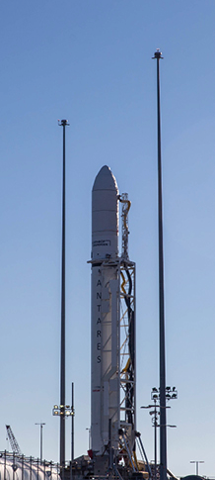
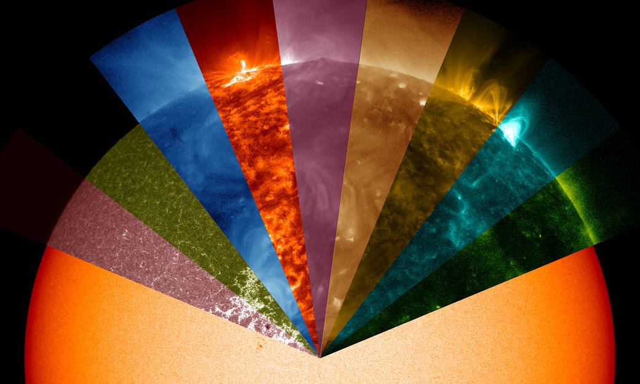

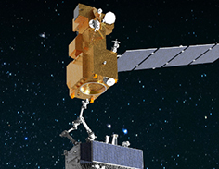
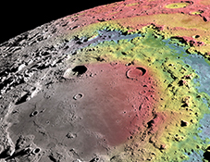
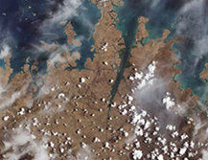
Lines of business supported
MPL
IDL, MDL, ADL
Heliophysics
Astrophysics
Space Communications & Navigation
Cross-Cutting Technology and Capabilities
Earth Science
Suborbital Programs & Range Services
Planetary & Lunar Science
Images Source: NASA

Slide 6
stats
 | Instrument Design Lab (IDL) | Mission Design Lab (MDL) | Architecture Design Lab (ADL) | Mission Planning Lab (MPL)
Study Type | Instruments | Spacecraft and Mission | Either Spacecraft and Mission OR Instrument | Small Sat, CubeSat, Suborbital (balloon
Typical Duration | 6.5 days | 6 days | Variable by scope. ~ 3 to 7 days | 5-6 days
# Studies per Year | 10 max (inc. ADLm) - 5 weeks between studies, Dec off | 11 max (incl. ADLi) - 4 weeks between studies, Dec off | See MDL/IDL | 4-8 per yr

Slide 7
IDC Process
What is involved in planning and preparation
of an IDC study?
The pre-work planning starts 12 to 16 weeks prior to study execution.
One or several face-to-face pre-work meetings are held with the customer.
Discussions take place to determine study goals/objectives/scope and to work out any scheduling issues.
The IDC starts long duration tasks (if any) before study execution. For example, the team may need to examine orbit design for some complicated missions or develop optical or antenna models for instruments.

Slide 8
Prework timeline - example*
*differs by lab, study type, and scope
Initial PI (Principal Investigator) Contact (IDC Manager only)
Month 1 Check-in
(IDL Core Team and IDC Manager)
Month 2 Check-in
(IDL Core Team and IDC Manager)
Office Hours
Initial Meeting with Customer Team (IDL Core Team and IDC Manager)
IDL Process Introductory Meeting, IDL vs. ADLi Study Discussion
ADLi Descope Options (Month 1)
ADLi Descope Options (Month 2)
Before 12 weeks | 12 | 11 | 10 | 9 | 8 | 7 | 6 | 5 | 4 | 3 | 2 | 1
Conops, Optical, Antenna, or RF design working meetings
Optics Design Lab (ODL) - or Antenna / RF Design, Conops, Thermal - Check-in(s) as needed
Pre-work meeting
All pre-study deliverables due
IDC Meeting with LOB manager for study selection, advising, cooperation
Intake form, pre-study deliverables, “soliciting vendor quotes” sent out by IDL Core Team to PI
Intake Form Walkthrough
First ODL (or Antenna / RF Design, Conops, Thermal) Meeting
ODL (or Antenna / RF) Design Review

Slide 9
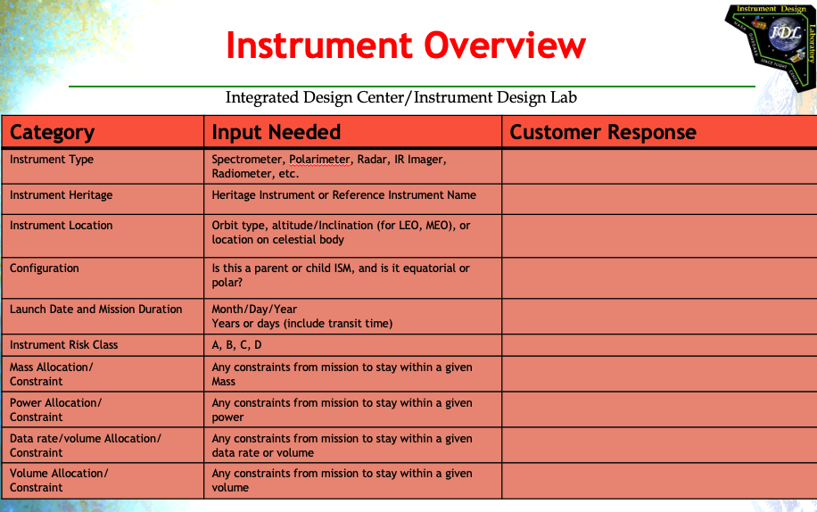
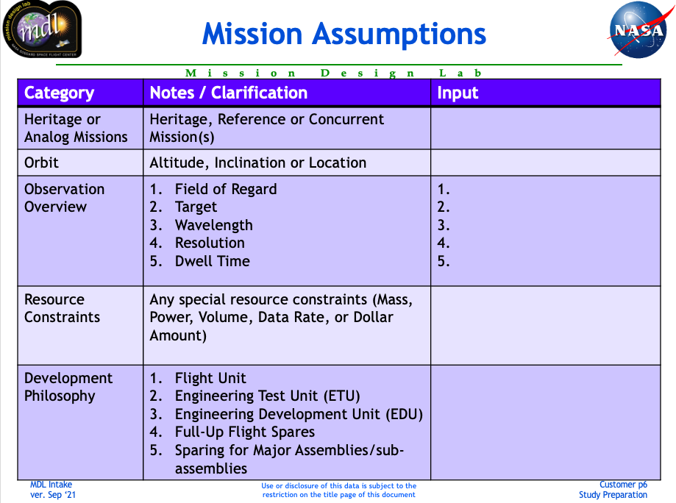
Customer interface
Requirement Gathering
Intake forms (PowerPoint or Excel)
Pre-work check in meetings
Study Participation
The more the better!
Required/encouraged for full-team kickoff, main study days 1 &2, and final report out.
Encouraged for daily tag-ups for status and quick questions.
Additional participation from Science Team may be Q&A via Email/Teams chat
Prefer one primary “Decider”

Slide 10
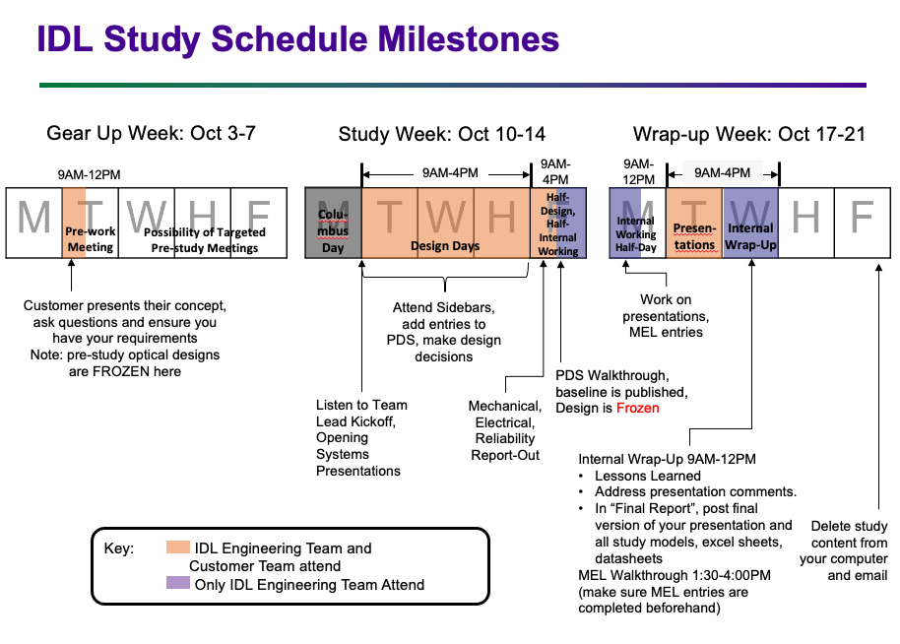
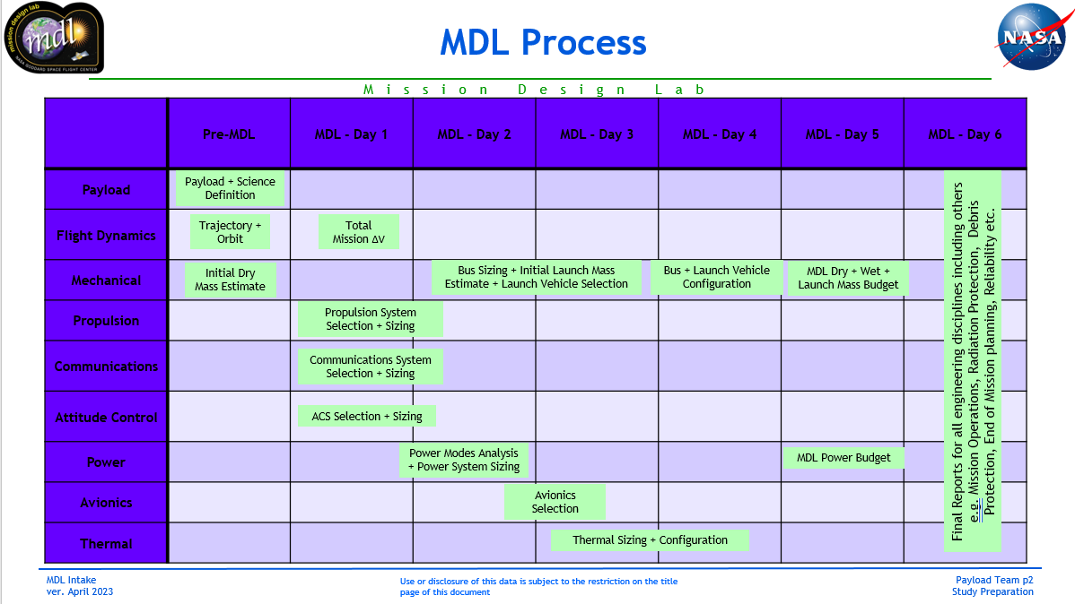
Milestones – examples
NASA Goddard Space Flight Center – Integrated Design Center
10

Slide 11
staffing
Full Time Core Team
Part Time Support Staff
Financial Manager (CS)
IT Support (Contractor)
Discipline Engineers
Rotating basis, assigned by branches
Lead Systems Engineers (CS)
IDC Manager (CS)
MPL Team Lead
MDL Team Lead (CS)
IDL Team Lead (CS)
IDL Deputy Team Lead (CS)
Mostly CS, some contractors
Funding Source:
Majority of labor (FTE and contractor dollars) covered by study fees
Limited overhead FTE available for IDC Core Team and Support Staff

Slide 12
Disciplines
Mission Design Lab (MDL/ADLm)
Instrument Design Lab (IDL/ADLi)
Lab Lead
MDL Systems Engineers (SE)
Lab Leads
IDL Systems Engineers (SE)
Mission Cost
Mission Planning Lab (MPL)
Instrument Cost
158
Mission Operations
158
Detectors
Structural
581
Lab Lead
MPL Systems Engineers (SE)
Reliability
553
542
Attitude Control
Mission Cost
371
Electro-optics/Lasers
Mechanical Systems
591
Flight Software
Materials
554
543
Orbital Debris
Mechanical Systems
541
Microwave Systems
Mechanical Designer
592
GNC/Attitude Control
Structural
555/567
547
Flight Dynamics
Mechanical Designer
542
Radiation Environment
Thermal
595
Flight Dynamics
Mechanical Systems
561
545
Propulsion
Thermal
543
Instrument Electronics
Radiation Environment
597
Team Lead
Electro-mechanical
564
561
Team Lead
Radiation Environment
544
Integration and Test
Power Systems
599
Systems Engineer
Thermal
568
563
Mission Systems Engineer #1
Power Systems
545
Flight Software
Avionics
599
Propulsion
Contamination
582
565
Mission Systems Engineer #2
Avionics
546
Fine Guidance
Communications
599
Communications
Mechanical Designer
591/595
566/567
547
Instrument Systems Engineer
Team Lead/
Deputy Team Lead
592
Specialty Subject Matter Experts (SMEs) may include reliability, optical comm, ground stations, RSDO (Rapid Spacecraft Development Office), rideshare, cryogenics, planetary protection, RPO (Rendezvous & Proximity Ops)
Specialty disciplines identified during study scope discussions and are requested from the appropriate branches during the discipline engineer staffing requests, with expected
550
Planetary Protection
Optics
592
551
Orbital Debris
Cryogenics
592
552

Slide 13
Labor breakdown – example*
*differs by lab, study type, and scope
Phase | Description | Timing | Total Hours (Approx)
 |  |  | Team Lead | SE | SME*
Pre-Work | Define scope, arrange staffing Requirements gathering from customer “Translate” customer provided info for discipline engineers Study Introduction meeting and prework meetings | 1-2 Months before | 6 | 2 | 0
 |  | 2 weeks before | 10 | 4 | 0
 |  | 1 Week before | 40 | 30 | 8
Study Week | 5 days of engineering 1 presentation day full time for 6 workdays | Week of study | 48 | 48 | 48
Wrap Up | Internal wrap-up meeting/lessons learned Reconcile discrepancies MEL handover to costing Final product delivery | Days after study week | 40 | 16 | 8
 |  | TOTAL | 144 | 100 | 64
NASA Goddard Space Flight Center – Integrated Design Center
13

Slide 14
Products
Typical end products:
  MDL, IDL, MPL: Point Design and Cost
  Architecture Study (ADLi, ADLm): Concept, Resource Summary, Trade Tree
A Science Traceability Matrix (STM) is an INPUT, not a product
  Feedback can be provided upon request
A Master Equipment List (MEL) is produced for Point Design Studies, not Architecture Studies
Costing:
  For point design: GSFC’s CEMA (Cost Estimating Modeling & Analysis) Office uses MEL to generate parametric cost model
  Some ROM cost estimates (by similarity) are possible for mission architecture studies

Slide 15
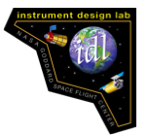
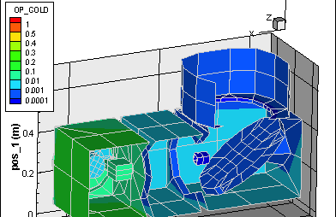
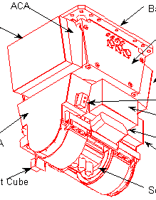
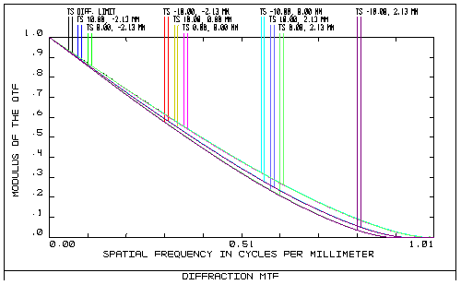
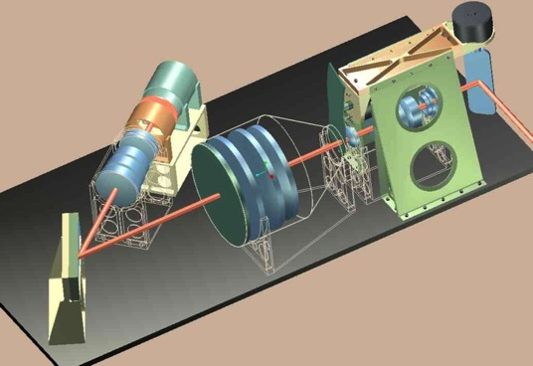
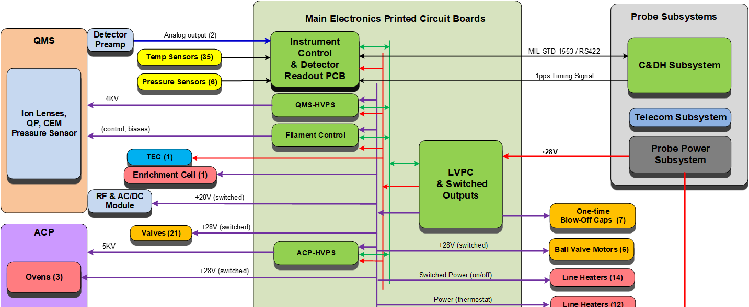
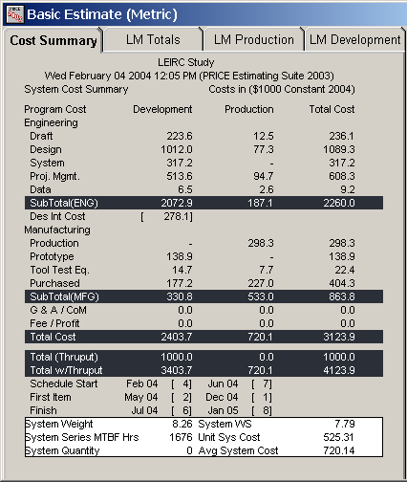
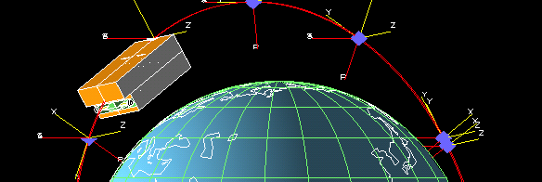
IDL Product Examples
Mechanical Packaging / CAD Model
Mechanism Design
Contamination Assessment
Optical Performance Assessment
Electrical Subsystem Architecture
Master Equipment List (MEL)
Cost Model
Thermal Model
15

Slide 16
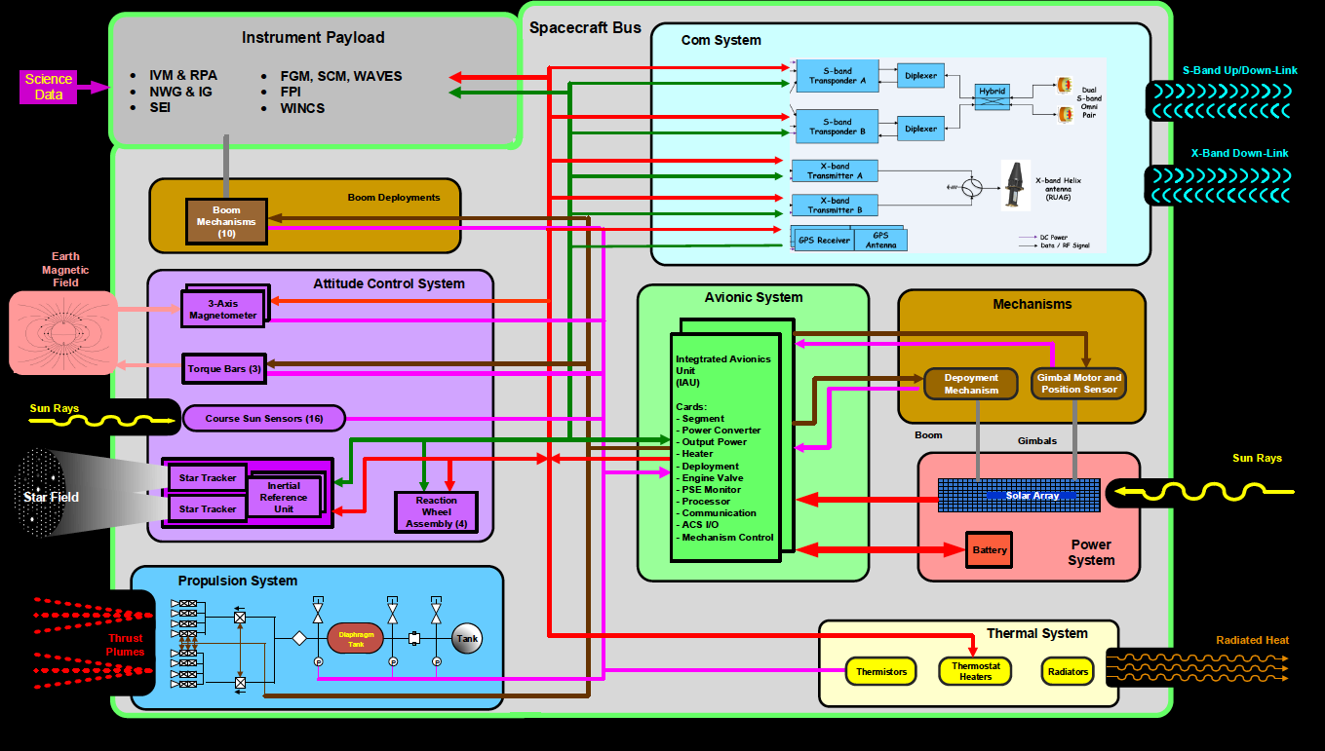
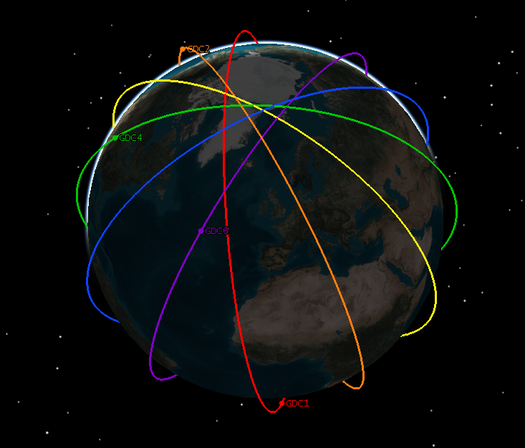
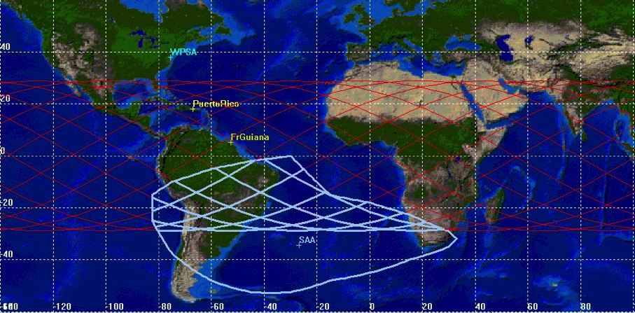
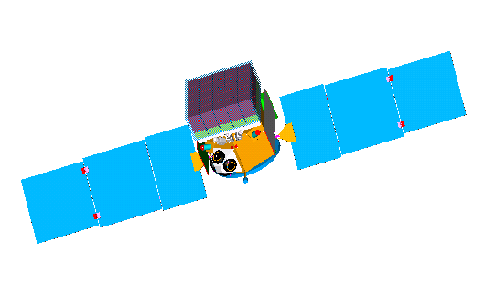
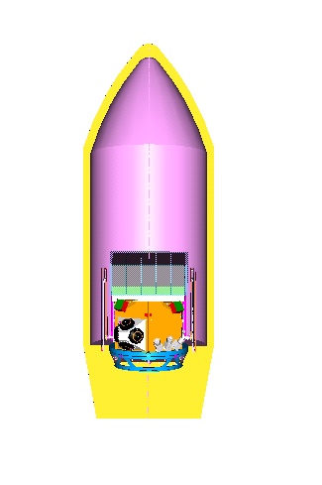
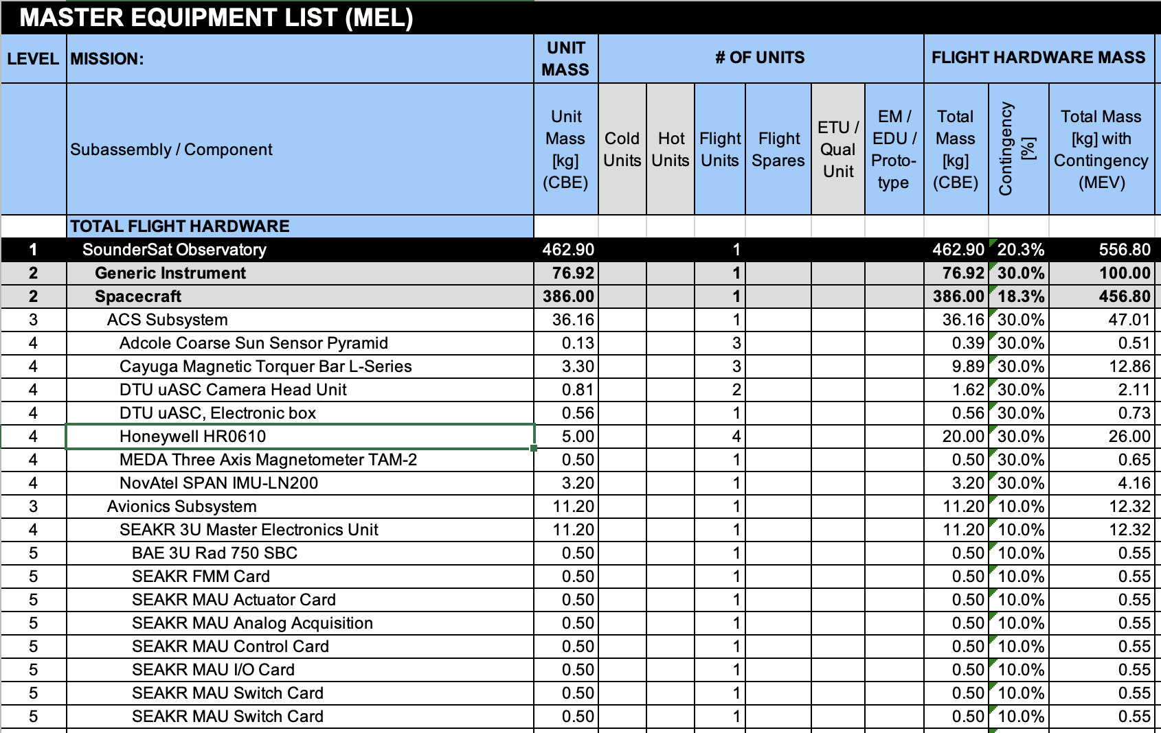
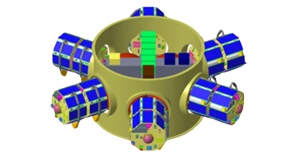
MDL Product Examples
Spacecraft Systems Block Diagrams
Orbit, Communications, Ground Systems, Environmental Analyses
Master Equipment List (MEL)
Mechanical Configurations
and Thermal Analyses
Launch Systems Accommodations
and Performance Analysis
16

Slide 17
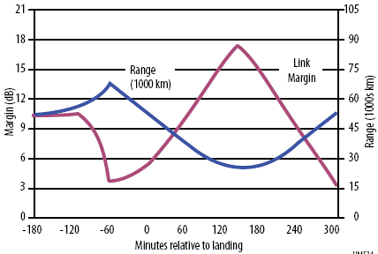
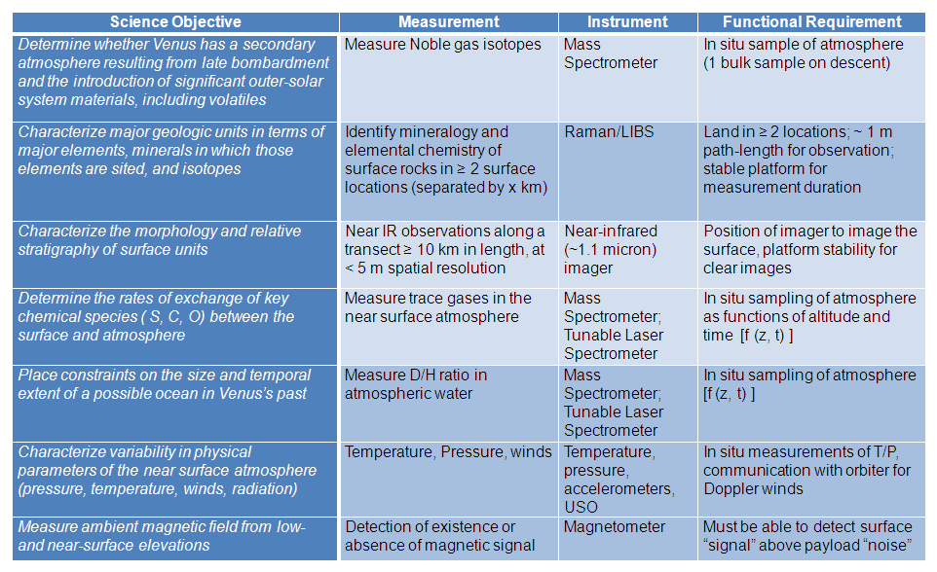
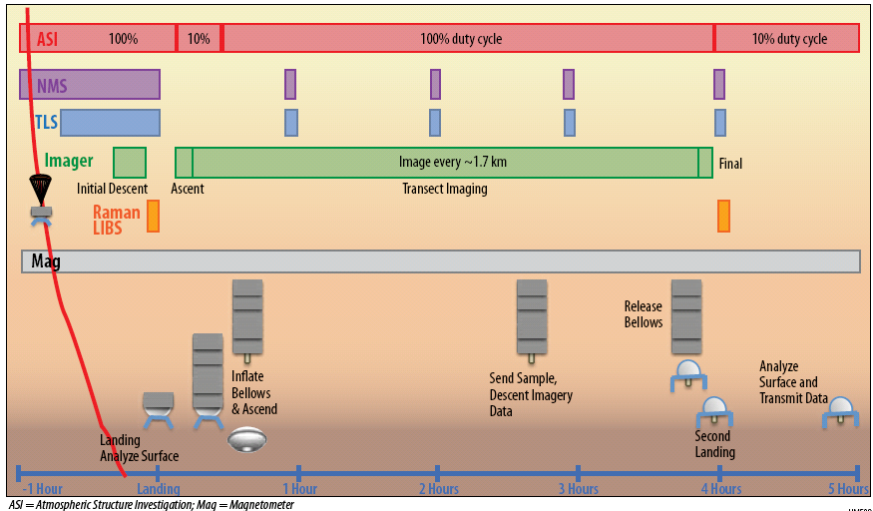
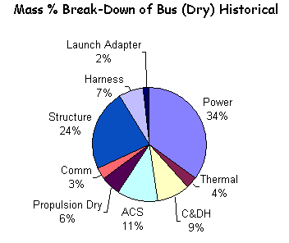
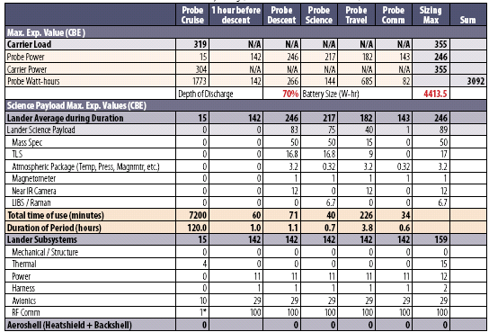
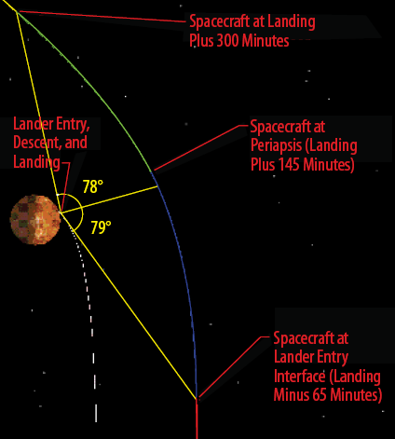
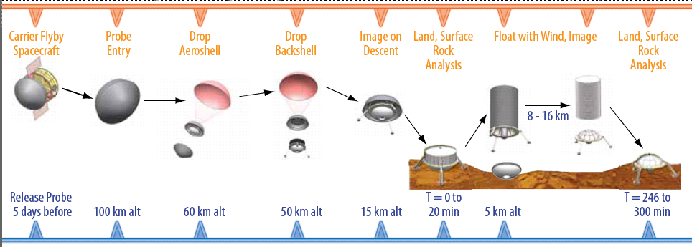
ADL Product Examples
17

Slide 18
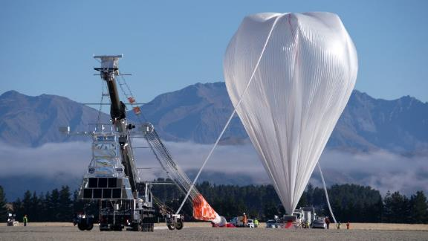
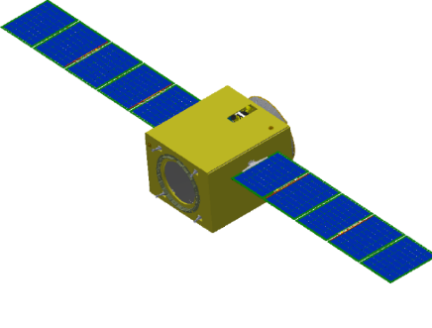
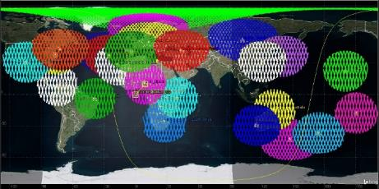
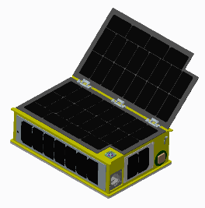
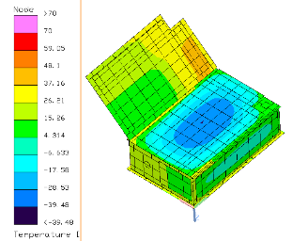
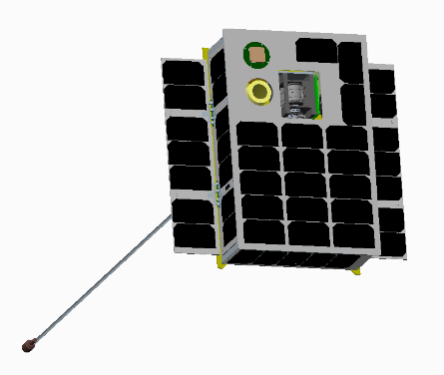
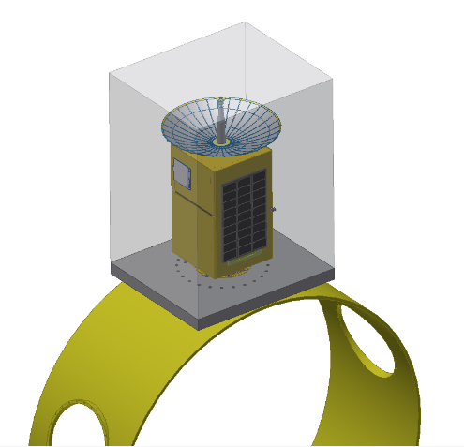
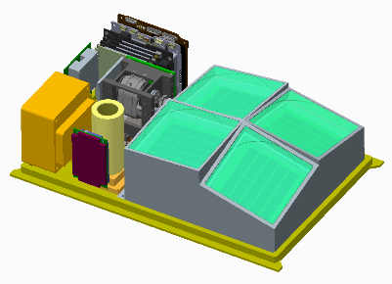
MPL Menu
Services and Capabilities
Expanded MPL capabilities to support end-to-end mission feasibility design studies for suborbital carriers (sounding rockets, balloons, aircraft) and CubeSats / Small Satellites
  Similar services as MDL
Augmented MPL by leveraging existing GSFC / WFF staff
Utilize MPL for pre-mission planning
Conduct and provide mission feasibility studies to PIs for suborbital and CubeSat / Small Sat missions
  Products from studies to assist with proposal development
Capabilities / Deliverables:
  Discipline engineering slides capture requirements, Concept of Operations, cost, trades, assumptions, block diagrams, analysis
  Master Equipment List (MEL)
  Mechanical CAD / STEP file
  Thermal Model & Analysis – thermal desktop files
  STK scenario / model & additional reports as requested
  Cost estimate (Code 158 parametric cost)
  Schedule estimate (high level input to cost estimate)
  Trajectory/Orbit design and mission orbit lifetime analysis
Partners with IDL/ MDL for constellations and hybrid missions that include small satellite and/or suborbital components
18

Slide 19
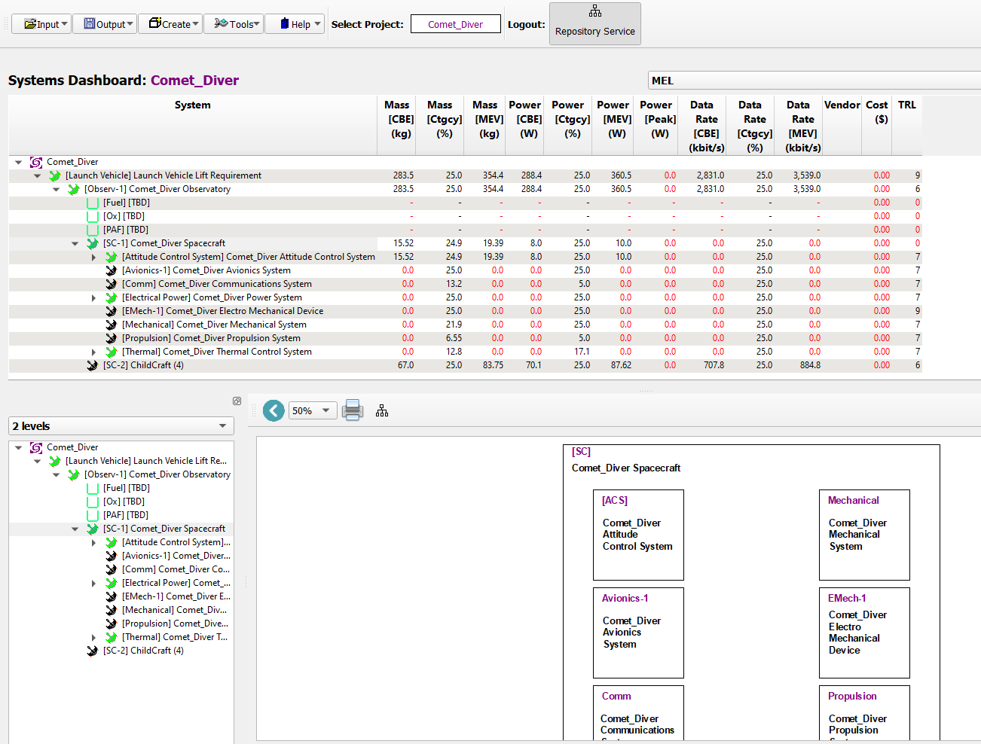
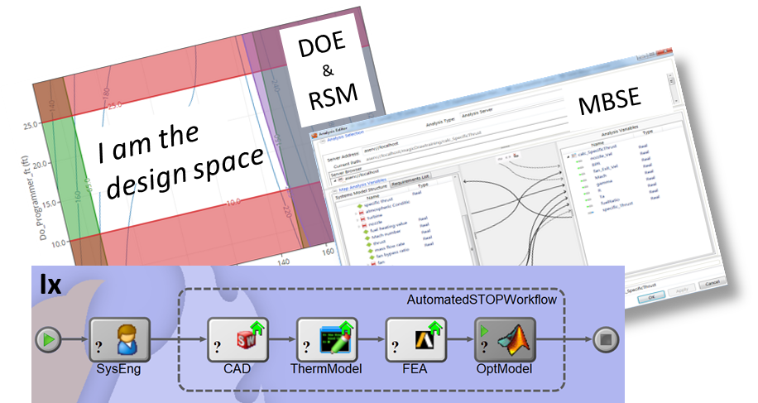
Digital engineering
Current State (MDL)
Home Grown Tool (CATTENS)
Near Term (MDL Pilots)
ConOps modeler in CATTENS linked to time-based power draw plots
Future State
Cloud-based Toolchain Automation
Explore ways streamline documentation and report outs via JupyterLabs applications
Automated Toolchain in Model Center
Extend use of Model Center
Build out capability in Jupyter
Hybrid of above tools plus CATTENS
CATTENS export to common COTS tool formats (SysML v2 compatibility)
Hardware library → Model Hierarchy → Resource Dashboards, MEL export
Source: NASA/A. Comis
Source: NASA/L. Matson
Source: NASA/A. Comis

Slide 20
Current challenges
In no particular order
Staffing
Customer Readiness
Hybrid meeting tech issues
Full time staff vacancies
Rotating SME support
Antiquated study tracking tool
Vague reliability guidance
PI requests to design to cost

Slide 21

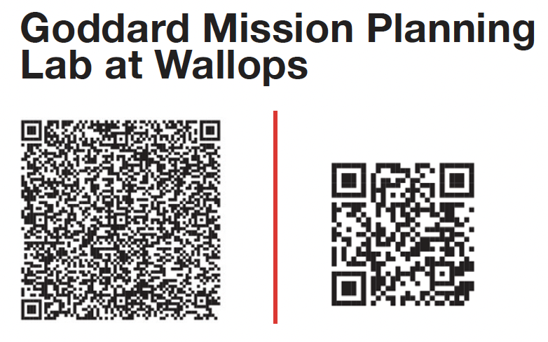
For More info
https://idc.nasa.gov/idc/
Contact Liz Matson, IDC Manager
E-mail: Elizabeth.A.Matson@nasa.gov
Phone: 301.286.1889 (or Teams)
https://sites.wff.nasa.gov/mpl/
Contact Ben Cervantes, MPL Manager
E-mail: benjamin.w.cervantes@nasa.gov
Phone: 757.824.1526 (or Teams)

Slide 22

Backup

Slide 23
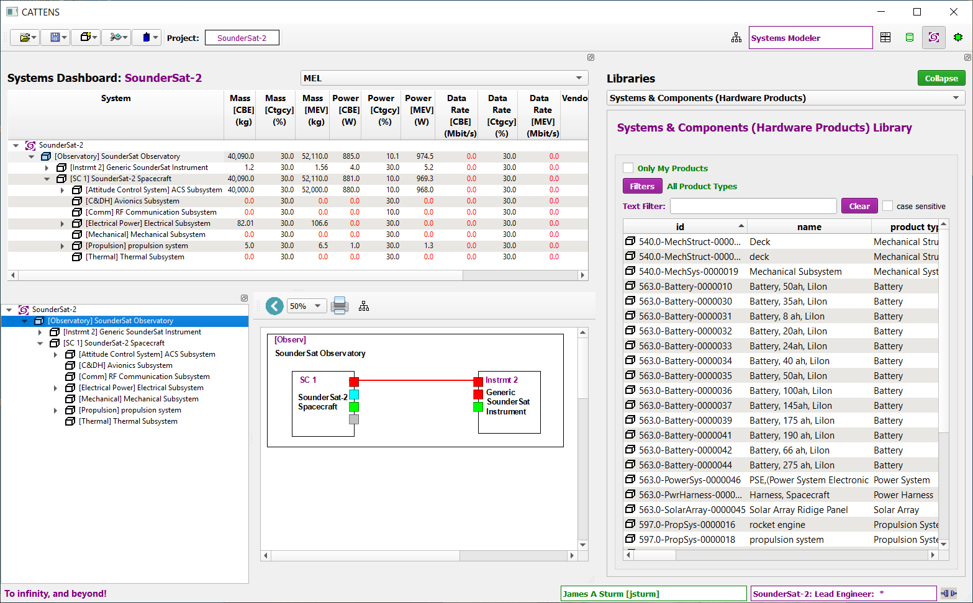
Tools
Software
Mix of Commercial-Off-The-Shelf (COTS) and homegrown engineering software such as:
  STK/Free Flyer - Working Model 2D
  NX - CREO
  FEMAP - SolidWorks
  MathCAD - SINDA
  Mathematica - Code V
  PATRAN/NASTRAN - ZEMAX
  MATLAB/Simulink - Thermal Desktop
Systems engineering integration software
  Automatic gathering, integration and display of engineering parameters (MS Teams Collaborative Excel)
  CATTENS collaborative engineering tool in MDL
Hardware
State-of-the-art computing platforms
Engineering Branch provided laptops
Independent, integrated IT solutions
  Servers, networks, web-drives
Communication and audio-visual
  Teams, Owl cameras, projection, product preparation
23

Slide 24
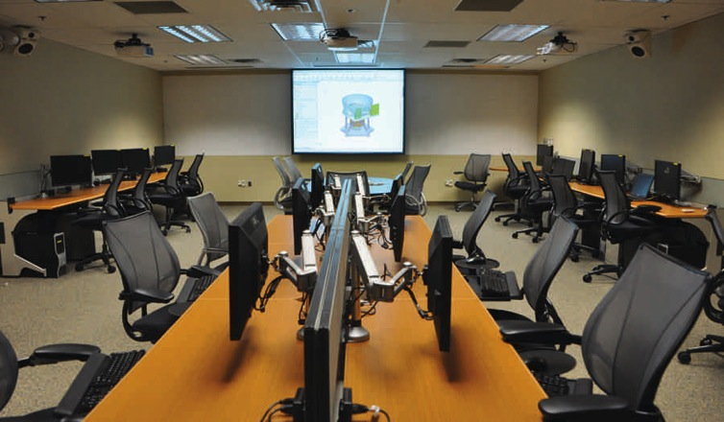
IDL menu
Services and Capabilities
Services:
End-to-end instrument concept development
Existing instrument/concept architecture evaluations
Trade studies and engineering evaluations
Technology, risk, and independent assessments
Requirement refinement and science traceability
Mass, power, data resource allocation
Vendor RFQ evaluation
Cost estimation
Capabilities:
Conceptualize instruments that make measurements at wavelengths across the entire electromagnetic spectrum, including x-ray, gamma ray, ultra-violet, visible, infrared, and microwave instruments
Address instrument families ranging from telescopes, cameras, lidars, spectrometers, polarimeters, coronographs, radiometers, mass spectrometers, etc.
Model various flight environments, including LEO, GEO, libration, retrograde, away, lunar, deep space, and planetary orbiters, landers, and probes
Realize instruments for different flight platforms, including space station, balloon, sounding rockets, and UAV instrument design environments
Consider non-distributed and/or distributed instrument systems as well as robotic servicing, planetary rovers, and sample return
.
24

Slide 25
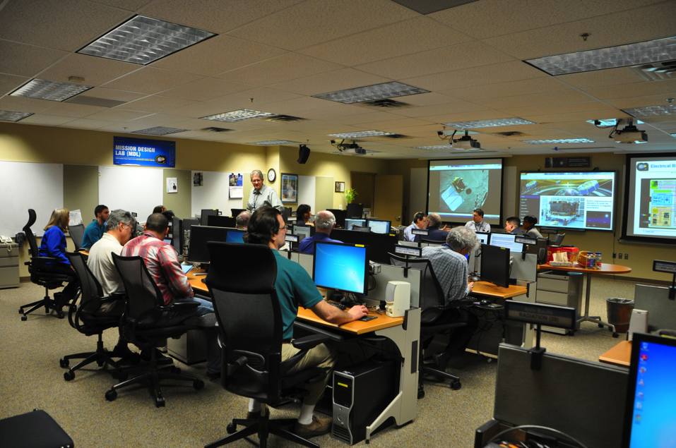
MDL Menu
Services and Capabilities
Services:
  End-to-end mission concept development
  Engineering evaluations
  Trade studies
  Technology, risk, and independent assessments
  Requirement refinement and science traceability
  Mass, power, data resource allocation
  Master Equipment Lists for cost modeling
Full Range of Capabilities:
  Standard and low thrust trajectory design to LEO, GEO, libration, lunar, and deep space locations
  Observatory design of single spacecraft, constellations, formation flying, and distributed systems
  Ground system concept development, including services and products
  Launch vehicle accommodations
  End-of-Mission considerations including controlled and uncontrolled de-orbit, reconnaissance and landing, sample return, etc.

Slide 26
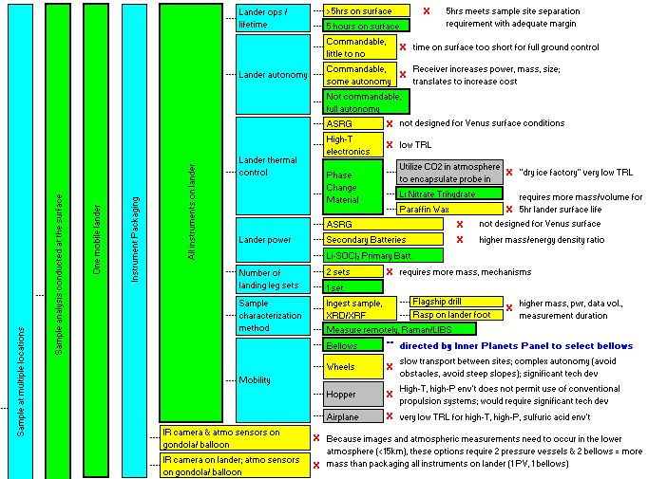
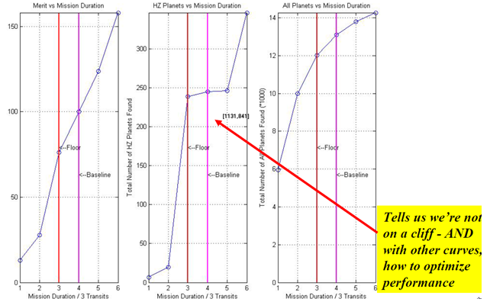
ADL Menu
Services and Capabilities
Trade space exploration, trade matrix
Utility functions, utility metrics assessment, selection criteria
Instrument selection
Con Ops, timeline, modes
Flight dynamics analysis
Conceptual architecture and design
Coverage analysis, data and link calculations
Functional block diagrams
Preliminary or parametric resource allocation and rack-ups
Technology research and assessment
ROM cost estimate
26

Slide 27








Mission Planning Lab (MPL) Background
Began as a pre-launch mission formulation and planning capability for WFF in ~2005
Automated RF link margin analysis for fixed and mobile ground assets
Developed mission simulations & visualizations
Supported sounding rockets, ELVs, and Antares
Requested to expand our capabilities…

Slide 28



Facilities: Remote → Hybrid
IDC studies have included remote participants since at least 2014
The IDC has adapted its processes for the telework environment and has successfully performed 59 all-virtual studies since March 2020
The TEAMS remote environment has allowed more efficient communication and information capture
Studies using a hybrid format can be scheduled to accommodate customers’ needs
In-person workspaces and technology designed to facilitate dynamic interaction within team
Goal is to leverage the TEAMS remote environment has allowed more efficient communication and information capture
Example of Collaborative Documents on MS Teams
Example of a “Telecon Schedule” worksheet to coordinate parallel sidebar discussions

Slide 29
IDC Process FAQs
When is an IDC product delivered?
An interim product is available immediately following the formal presentation.
The final product is delivered by MS Teams, BOX, or OneDrive 3 to 4 weeks following study execution.
Cost presentations are typically ~ 8 weeks after study execution.

Slide 30
Acryonym list
ADL Architecture Design Lab
ADLi Architecture Design Lab – instrument
ADLm Architecture Design Lab – mission
AO Announcement of Opportunity
CAD Computer Aided Design
CEMA Cost Estimating Modeling & Analysis
CS Civil Servant
DoD Department of Defense
FTE Full Time Equivalent
GSFC Goddard Space Flight Center
IDC Integrated Design Center
IDL Instrument Design Lab
IRAD Internal Research and Development
LOB Line of Business
MDL Mission Design Lab
MEL Master Equipment List
MPL Mission Planning Lab
NOO New Opportunities Office
ODL Optics Design Lab
PI Principal Investigator
RF Radio Frequency
RPO Rendezvous & Proximity Operations
RSDO Rapid Spacecraft Development Office
SE Systems Engineer
SME Subject Matter Expert
STM Science Traceability Matrix
WFF Wallops Flight Facility

