Slide 1
Future Interoperability and International Cooperation in Space Communications
WiSEE 2023
Dr. Harry Shaw
Staff Engineer, Telecommunication and Network Technologies Branch, NASA/GSFC
Advanced Communications Capabilities for Exploration and Science Systems (ACCESS) Project office
June 28, 2023

Slide 2
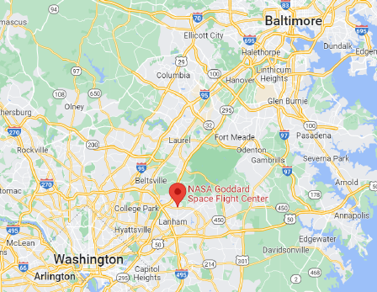


Introduction
I am Dr. Harry Shaw from NASA/Goddard Space Flight Center in Greenbelt, Maryland. NASA/GSFC is not quite as well known to the public as some other NASA Centers.
It is home to the nation's largest organization of scientists, engineers and technologists who build spacecraft, instruments and new technology to study Earth, the sun, our solar system and the universe.
There are approximately 10,000 government employees and contractors working at GSFC sites around the country.
The GSFC budget is about 4.7 Billion dollars (2022)
GSFC is operating more than 50 missions currently including
Hubble Space Telescope
James Webb Space Telescope

Slide 3
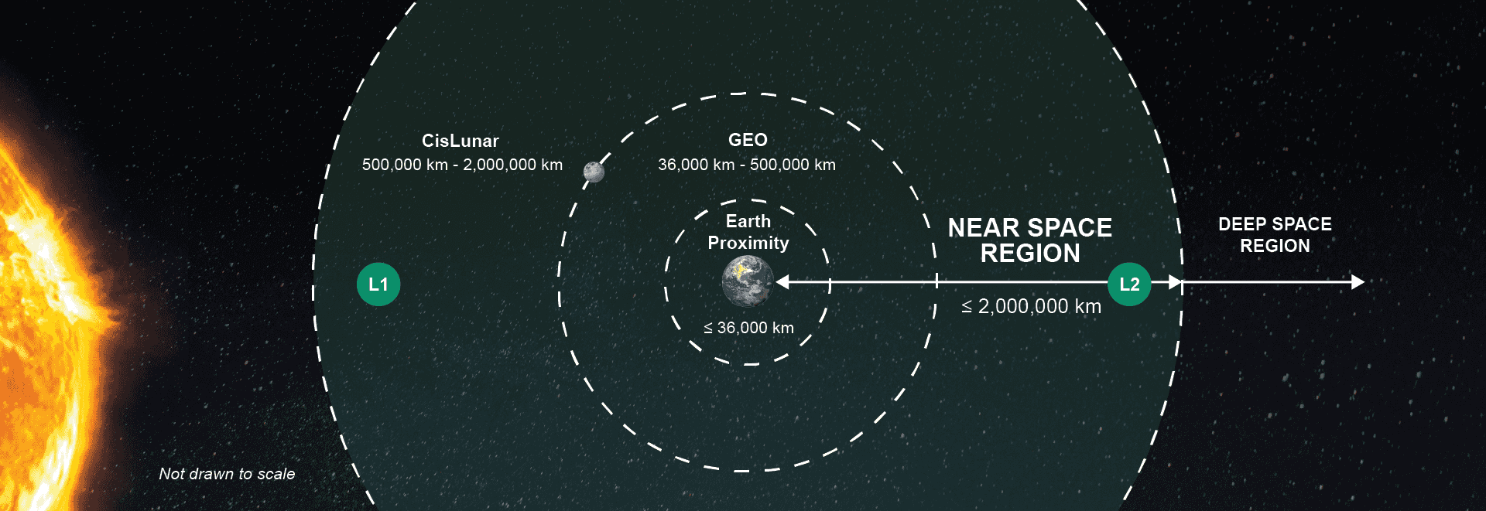
GSFC is a leader in space communications
A brief introduction to space communications within GSFC
The Exploration and Space Communications (ESC) Division is responsible for 11 different projects performing various aspects of space communications including
  Nine Tracking and Data Relay Satellites (TDRS) providing worldwide relay capabilities for a wide range of satellites and launch. Communications from the ISS is relayed through the TDRS network
  The Laser Communications Relay Demonstration (LCRD) which is demonstrating optical relay communications
  A network of government owned and commercial contract ground stations around the world
  Development of future worldwide communications capabilities to support lunar exploration and habitation
  A transition to the use of fully commercial communications services

Slide 4
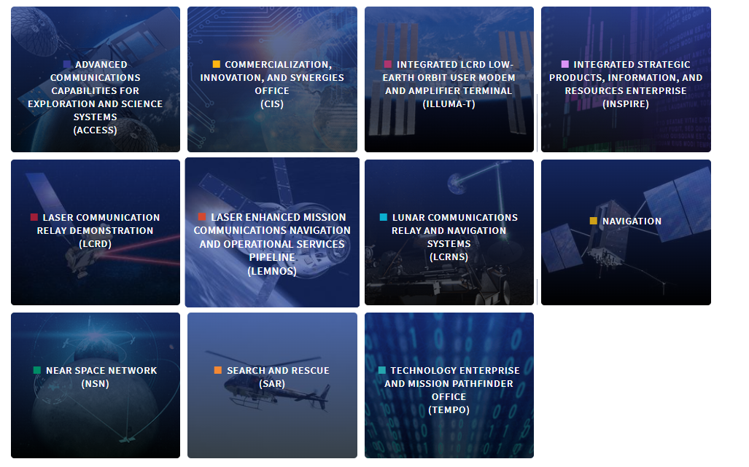
The Projects of the Exploration and Space Communications Division at GSFC
I am the Sustaining Engineering Manager for RF and optical communications satellite services which is under the ACCESS project
I am also the Principal Investigator for quantum communications and computing in the Exploration and Space Communications Division

Slide 5
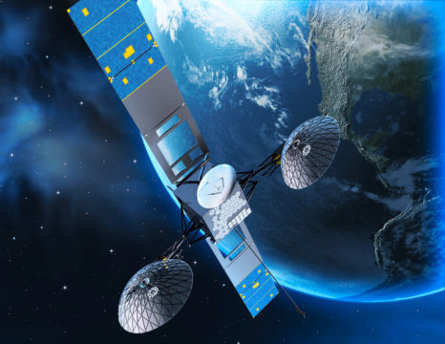
Commercialization
NASA is currently a heavy user of commercial space communications services from international providers
NASA under the leadership of the Space Communications and Navigation(SCaN) division at Headquarters is embarking on a push eliminate the government owned communications model which has served NASA for decades.
The mandate comes from the 2018 National Space Policy and is meant to energize the US space industry, but it will also increase the global market for space communications
The Near Space Network Project at GSFC is responsible for coordination of services for missions using an array of commercial assets.
The Commercialization, Innovation and Synergies Office at GSFC will lead outreach and engagement with commercial entities.
The Commercialization Services Project at Glenn Research Center in Cleveland, Ohio is pursuing demonstration of commercial space-to-space relay services into which new space users can be transitioned by 2030
The final TDRS, TDRS-M was launched August 8, 2017.
No replacements are planned
The oldest operational TDRS, TDRS-C was launched September 29, 1988
The transition off of the TDRS network is scheduled to happen by 2030

Slide 6

Artemis Accords and Interoperability
Interoperable communications is important for the peaceful use of space.

Slide 7
Lunar Communications using LunaNet
LunaNet is a network, akin to the internet. LunaNet has been adopted by ESA as well, and it is now a joint development of NASA and ESA. LunaNet is envisioned as a set of cooperating networks.
The LunaNet concept is based on a framework of mutually agreed-upon standards, protocols, and interface specification that enable interoperability.
LunaNet will have Delay/Disruption Tolerant (DTN) capabilities

Slide 8
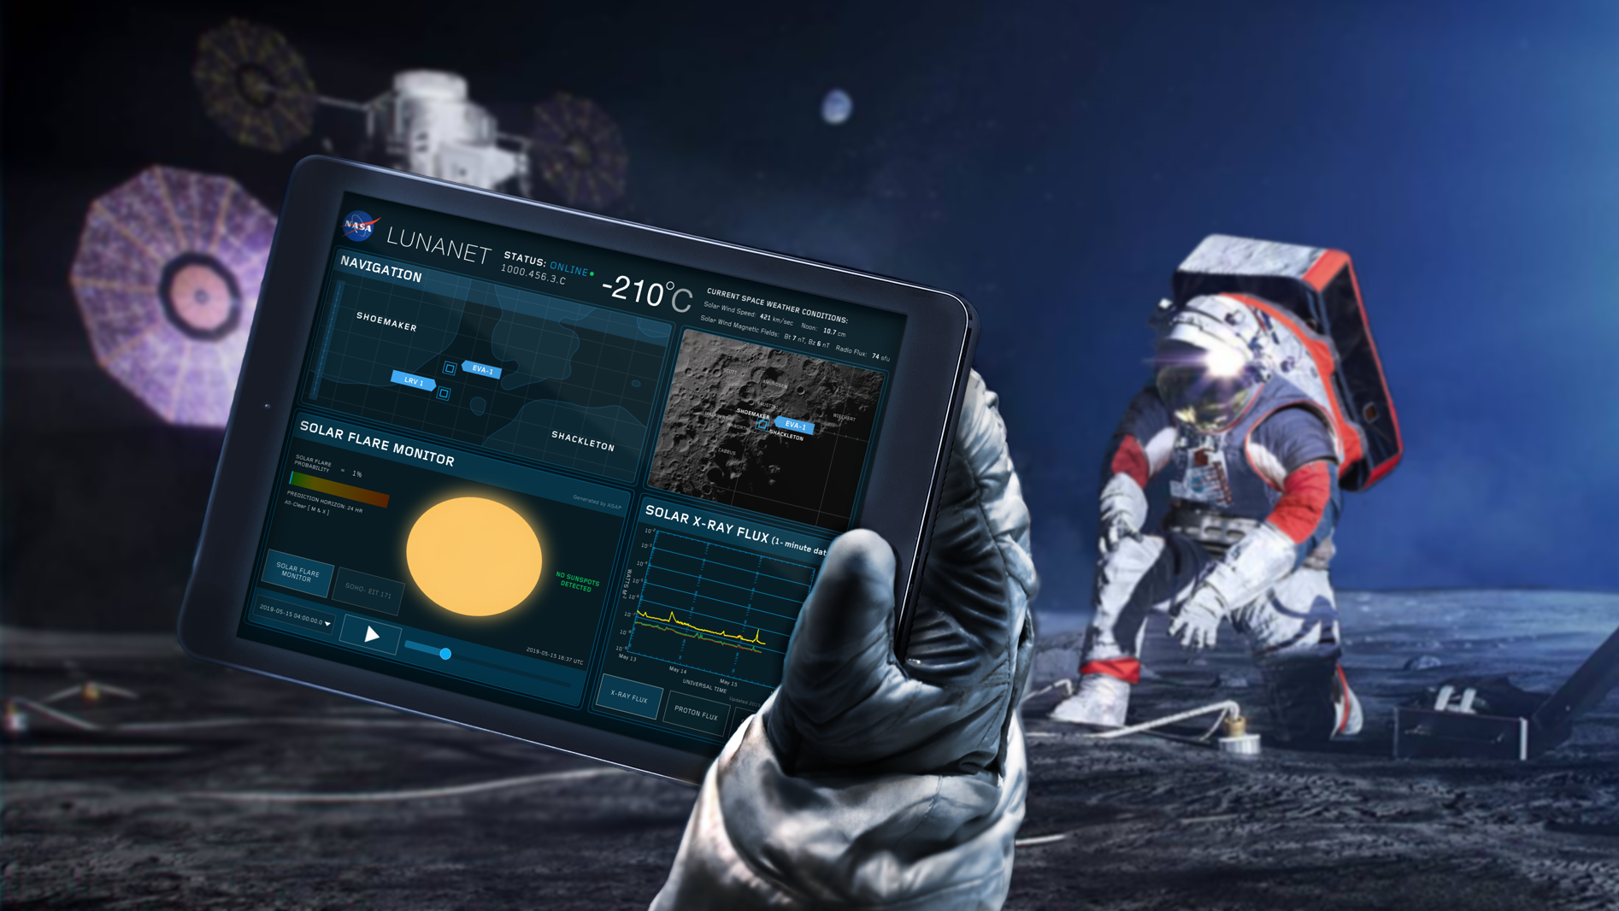
Keys to Lunar Interoperability
Utilization of services provided by the LunaNet service Providers (LNSPs)
  Networking
  Navigation
  Detection and Information
  Science
CCSDS based standards
Secure international communications for Telemetry, Tracking and Commanding as well as data flows
Spectrum compatibility
Ability to support the required coding and modulation schemes
Lunar Communications Relay and Navigation Systems | ESC Public Site (nasa.gov)
https://esc.gsfc.nasa.gov/static-files/LunaNet%20Interoperability%20Specification.pdf

Slide 9
Interoperability and International Cooperation
Issues
  Implementing cybersecurity for space and ground segments
  Having a durable trust model.
  Controlling Costs
Pros
  Geographic diversity ensures global coverage
  Ability to communicate with space vehicles during emergencies such as typhoons, space weather events, network outages
  Gives more countries a positive stake in smooth operations
Notes:
Allocating start up costs
Proficiency activities to maintain confidence that interoperability is working
Consider using a barter system to allow partners to swap services without transfer of funds

Slide 10

A developing international partnership for lunar communications
Lunar Exploration Ground Sites (LEGS)
Project Overview

Slide 11
ACCESS and LEGS Introduction
The NASA GSFC Advanced Communications Capabilities For Exploration And Science Services (ACCESS) Project is responsible for the planning and execution of the first three Lunar Exploration Ground Sites (LEGS)
ACCESS is a government communications service provider that operates, maintains, and sustains Government-Owned, Contractor-Operated (GOCO) ground and flight communications assets to provide NASA, other government agencies and partners communications services through the Near Space Network.
  ACCESS provides both direct-to-Earth (DTE) and space relay services including management of the TDRS fleet.
  The ACCESS Project is part of the Exploration and Space Communications (ESC) division at GSFC.

Slide 12
Project Goals and Objectives
Project
  NASA is delivering ground communications assets at three global sites in order to provide Direct-to-Earth (DTE) communications support for missions in the cislunar domain
    Consolidates efforts of Lunar Exploration Ground Sites (LEGS) at White Sands, New Mexico; Matjiesfontein, South Africa; and in Australia (final site is to be determined)
Project Goals
  Enable accommodation of future lunar orbit and surface missions
  Provide a flexible and extensible capability set that establishes a model for future DTE operations
  Offload Lunar missions from DSN 34m antenna assets for where a smaller aperture size is acceptable
Project Objectives
  Ensure each asset meets applicable LEGS specific and common requirements
  Leverage existing NASA infrastructure at White Sands to minimizes risk, cost, and system downtime
  Implement standardized external interfaces that reflect new organizational paradigm
  Address commonality across assets and extensibility of design

Slide 13
Project Scope
The LEGS project includes efforts to deliver the following end systems:
  LEGS 1: New dual-band X/Ka ground station to White Sands, New Mexico
    Includes all facilities and site preparation work
    Delivery of antenna, back-end electronics (e.g. Signal Processing System), and equipment for all subsystems defined in the architecture
  LEGS 2: New dual-band X/Ka antenna to Matjiesfontein, South Africa
    Includes all facilities and site preparation work, in cooperation with SANSA
    NASA to provide the antenna, backend electronics (e.g. Signal Processing System), and equipment for subsystems defined in the architecture for MTJ
  LEGS 3: New dual-band X/Ka antenna to TBD, Australia
    Includes all facilities and site preparation work, in cooperation with SANSA
    NASA to provide the antenna, backend electronics (e.g. Signal Processing System), and equipment for subsystems defined in the architecture for AUS
  A common Monitor and Control System (MCS) provides the control system for LEGS, with centralized operations at White Sands capable of managing station operations at all three sites

Slide 14
Project Stakeholders
Network Element Stakeholders
  NASA Advanced Communications Capabilities for Exploration and Science Systems (ACCESS)
  NASA Near Space Network (NSN) Project
  NASA Deep Space Network (DSN)
  NASA Goddard Spaceflight Center (GSFC) Flight Dynamics Facility (FDF)
  South Africa National Space Agency (SANSA)
  TBD Australia
Mission Stakeholders
  NASA Johnson Space Center (JSC) Flight Operations Directorate (FOD)
  NASA Gateway Program
  NASA Lunar Terrain Vehicle Program
  NASA Human Landing System (HLS) Program
NASA Space Communications and Navigation (SCaN)
NASA Exploration and Space Communications (ESC) Division (Code 450)
NASA Space Operations Mission Directorate (SOMD)

Slide 15
Project Management Responsibilities
Identifies and defines applicability of US Government and Partner level plans which include
  Systems Engineering Management Plans
  Safety and Mission Assurance Plans
  Safety and Health Plans
  Quality Assurance Plans
  Continuous Risk Management
  Configuration Management
Defines the project team and roles and responsibilities
Defines the internal and external communication plan and reporting
Identifies stakeholders
Cost collection, reporting and control
Schedule management

Slide 16
Key External Interfaces – Ground Systems
On the ground interface side, the System will be capable of interfacing will various external systems executing the external functions defined in the Functional Architecture diagram.
Due to ongoing definition and development of external systems, it is not confirmed what exact systems will be providing those external functions.
  To support ongoing ACCESS has begun development of standard interface definitions that it is expected the external systems will implement.
External ground interfaces (summary shown on next slides) address the following functions:
  Scheduling
  Mission data transfer (forward/return)
  Tracking and Acquisition data exchange
  In-service reconfiguration
  Status and performance data

Slide 17
LEGS Overview
LEGS will provide Direct to Earth (DTE) RF communications to missions in Lunar Surface/Orbit
A key objective is to offload Deep Space Network (DSN) 34m antenna assets for “near space” missions such as:
  Lunar Missions: Gateway, Artemis (HLS, Orion, SLS EUS, CLPS, Cubesats)
LEGS #1-3 will be Government Owned Contractor Operated (GOCO) sites
  LEGS GOCO sites will provide uplink / downlink at X and Ka-band frequencies
  Strategically located to provide continuous coverage to lunar missions
  The 1st LEGS Site will be located at WSC, near Las Cruces, NM USA
  The 2nd LEGS Site will be located at Matjiesfontein, South Africa
  The 3rd LEGS Site will be located in Australia at TBD location
Mission | DTE Frequency Bands | Need Dates
Gateway | X/Ka | October 2025
*Human Landing System (HLS) | S/Ka | December 2024
**Lunar Terrain Vehicle (LTV) | X/Ka | March 2027
* HLS for Artemis III provided by SpaceX uses S/Ka. Future HLS for Artemis IV and beyond may utilize different frequency bands.
** LTV currently in competitive procurement, may utilize S/X/Ka or subset thereof
LEGS Government Owned-Contracted Operated (GOCO) Sites
Site | Location | System Description
1 | WSC | 18-24m X/Ka Transmit/Receive Antenna High Data Rate (HDR) and Low Data Rate (LDR) Modems Central Timing and Frequency Subsystem (CTFS) Monitor and Control Subsystem (MCS) Facilities Infrastructure IT/Data Network to interface with NexTEra
2 | South Africa | 18-24m X/Ka Transmit/Receive Antenna Architecture TBD
3 | Australia | 18-24m X/Ka Transmit/Receive Antenna Architecture TBD

Slide 18
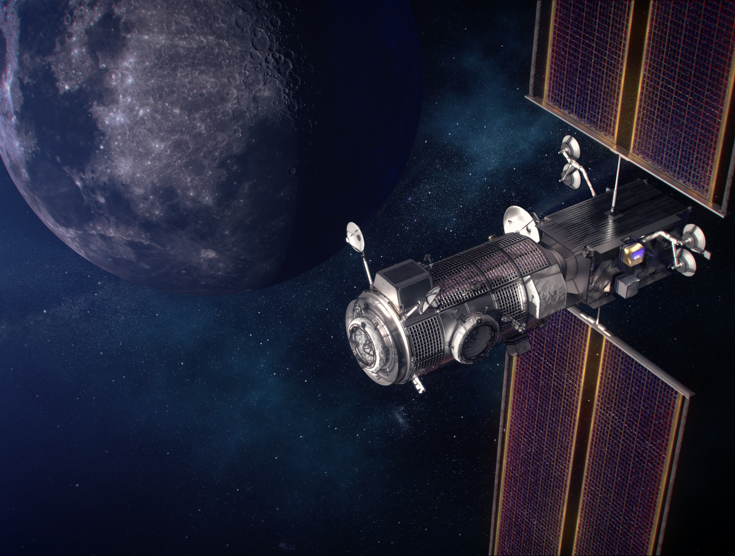
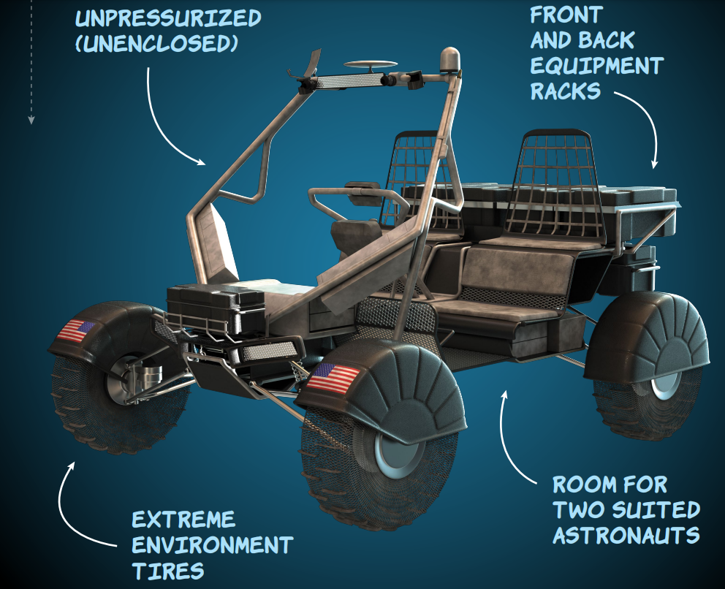
LEGS Mission Sets
NASA will install new dual band X/Ka antennas to provide Direct-to-Earth (DTE) communications support for the Gateway, LTV, and HLS missions
Gateway
  A vital component of NASA’s Artemis program, will serve as a multi-purpose outpost orbiting the Moon that provides essential support for long-term human return to the lunar surface and serves as a staging points for deep space exploration.
  First mission to be support by LEGS
Lunar Terrain Vehicle (LTV)
  An unenclosed rover being developed by NASA that astronauts can drive on the Moon while wearing their spacesuits. The development of the LTV is a part of NASA's Artemis Program which involves returning astronauts to the Moon, specifically the lunar south pole.
Human Landing System (HLS)
  The mode of transportation that will take astronauts to the lunar surface as part of the Artemis program
Gateway
LTV

Slide 19
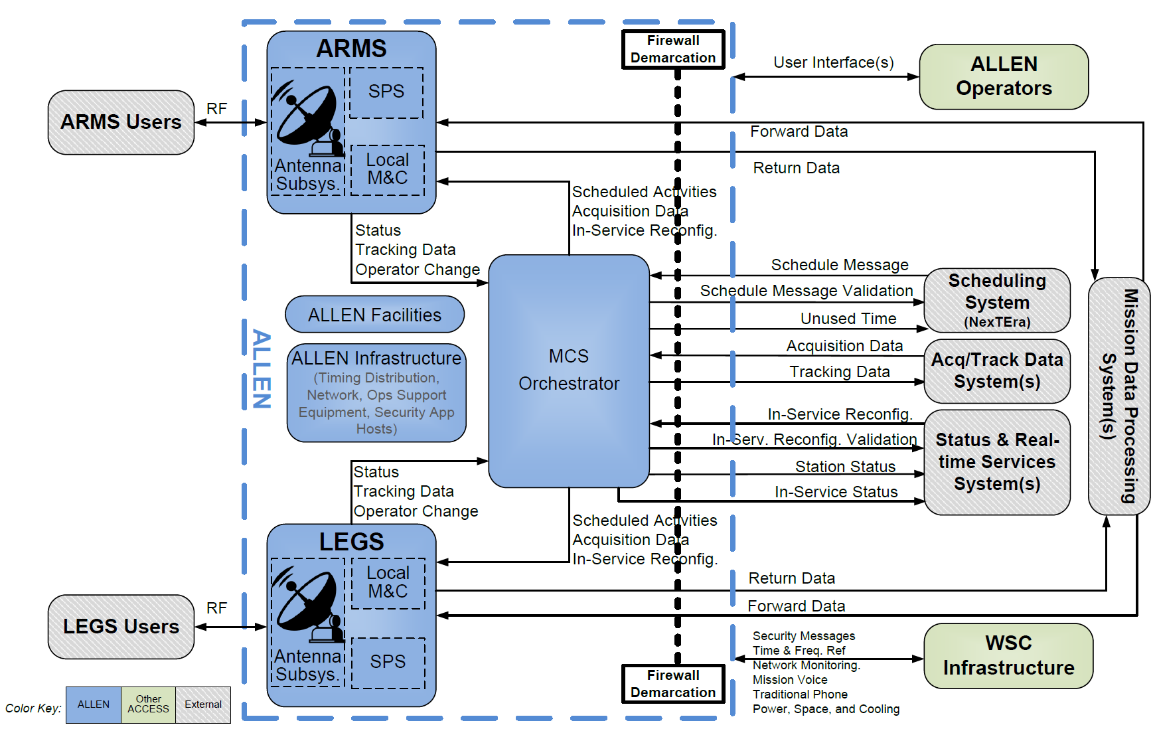
LEGS Architecture
ARMS | Antenna for Roman Mission Support (another GSFC project, the Nancy Grace Roman Space Telescope)
ALLEN | ACCESS Lagrange and Lunar Exploration Nodes (ALLEN has ARMS and LEGS)
WSC | White Sands Complex

Slide 20


LEGS Global View
NASCOM/CP Line
LEGEND
LEGS Government Site
User MCC
LEGS Commercial Site
TT&C
NexTEra
NexTEra
Data
Service
Mission Control Center (MCC)
Gov Site #1
TT&C
Data
JSC MCC
Service
NexTEra is the Virtual Network Manager serving as the single interface to missions for all LEGS ground stations (both Government and Commercial)
NexTEra provides the interface to NASA Artemis and JSC MCCs
TBD Trunk Line
TBD Trunk Line
The MCC’s interface to all LEGS Ground Stations is via NexTEra for Forward and Return Data (TT&C/Science) as well as ground station Service Management Functions (e.g. Status and Scheduling requests, etc…)
NexTEra will be the interface to all future User MCCs for Forward and Return Data, TT&C/Science Data
Gov Site #2
Gov Site #3
Gov Site #1 will be at the NASA White Sands Complex (WSC)
Gov Site #2 will be in MTJ, South Africa.
Gov Site #3 will be in Australia (Site selection TBC).

Slide 21
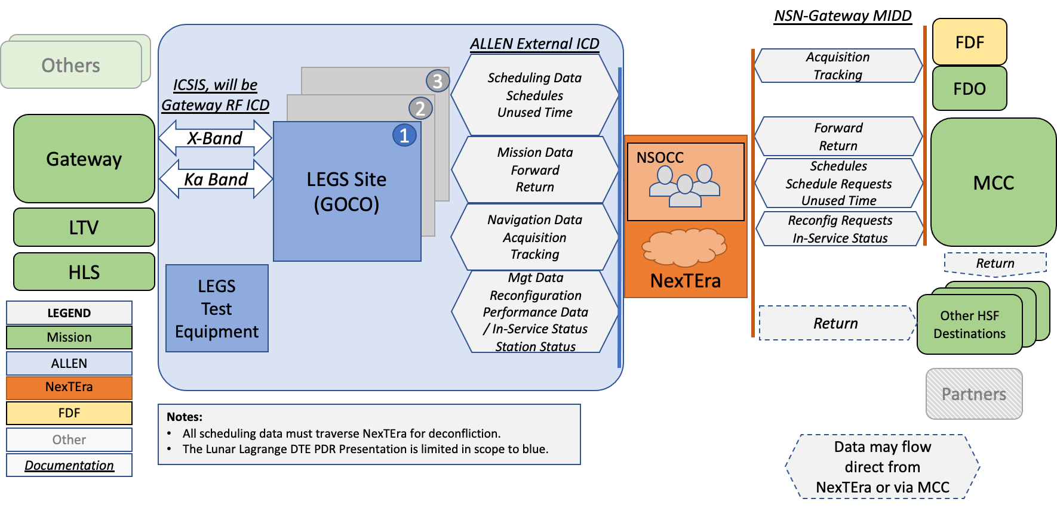
Lunar Gateway Flows

Slide 22

Lunar Gateway Support – A Day in the Life
0000Z
Local schedule rotates through the day across the lunar month
2359Z
LEGS S3
LEGS S2
LEGS S1
Handover
Handover
Handover
Legend
Lunar X/Ka Supports
Non Gateway Time / Maint
Approximate Daily In-view time (hours) (per Site)
Elev | Min | Max
>20 deg | 4 | 12
>10 deg | 7 | 14
During Gateway operation, LEGS antennas will be dedicated to Lunar Gateway/cislunar missions during the period of the day where the moon is above the local horizon
When the moon is below the horizon, asset is available for maintenance or other users

Slide 23
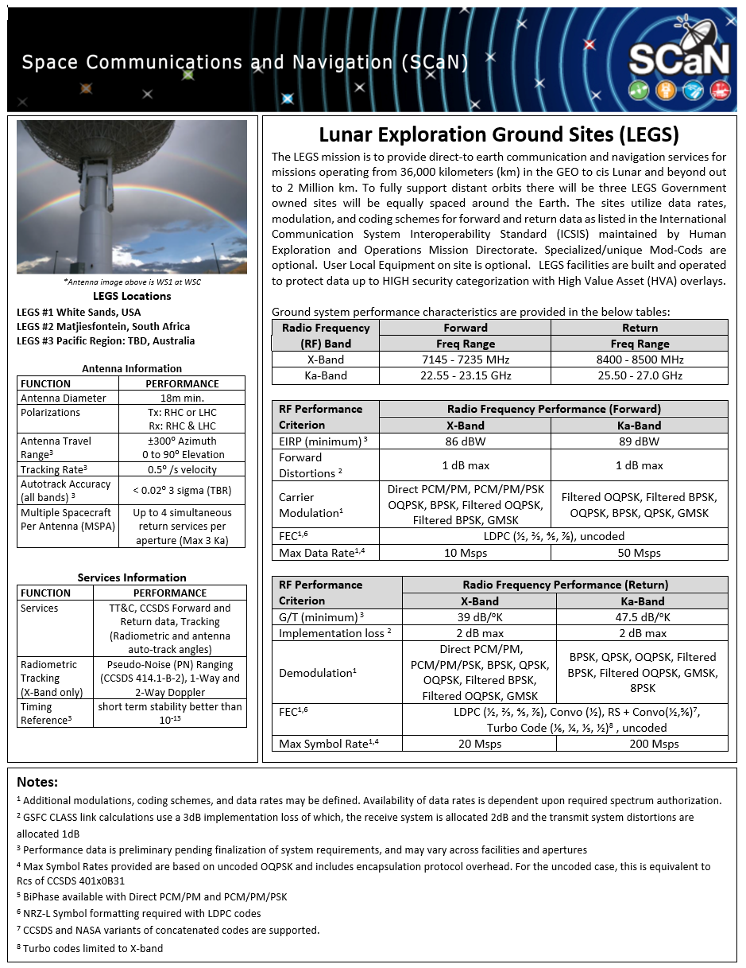

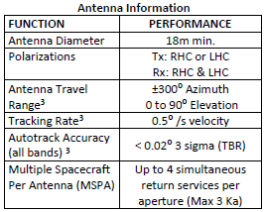
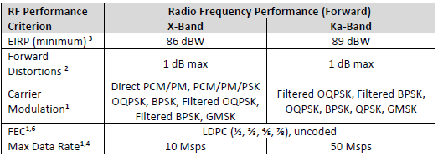
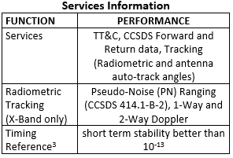
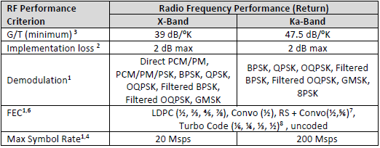
LEGS Antenna Performance

Slide 24
LEGS RF Performance
LEGS Forward RF Performance
RF Performance Criterion | Radio Frequency Performance (Forward)
 | X-Band | Ka-Band
EIRP (minimum) | 86 dBW | 89 dBW
Forward Distortions | 1 dB max | 1 dB max
Carrier Modulation | Direct PCM/PM, PCM/PM/PSK OQPSK, BPSK, Filtered OQPSK, Filtered BPSK, GMSK | Filtered OQPSK, Filtered BPSK, OQPSK, BPSK, QPSK, GMSK
FEC | LDPC (½, ⅔, ⅘, ⅞), uncoded
Max Data Rate | 10 Msps | 50 Msps
LEGS Return RF Performance
RF Performance Criterion | Radio Frequency Performance (Return)
 | X-Band | Ka-Band
G/T (minimum) | 39 dB/⁰K | 47.5 dB/⁰K
Implementation loss | 2 dB max | 2 dB max
Demodulation | Direct PCM/PM, PCM/PM/PSK, BPSK, QPSK, OQPSK, Filtered BPSK, Filtered OQPSK, GMSK | BPSK, QPSK, OQPSK, Filtered BPSK, Filtered OQPSK, GMSK, 8PSK
FEC | LDPC (½, ⅔, ⅘, ⅞), Convo(½), RS (255, 239) + Convo(½), RS (255, 223) + Convo(½), uncoded, Turbo Code (⅙, ¼, ⅓, ½) [Turbo codes are X-band only]
Max Data Rate | 20 Msps | 200 Msps

Slide 25
Current Project Status
The LEGS Project Preliminary Design Review (PDR) was conducted in December 2022
The LEGS Project Critical Design Review (CDR) targeted for end of 2023
Three 20-meter X and Ka-band antennas are on contract for delivery near end of 2025
Modems to be provided by Safran are on order.

Slide 26
Conclusion
NASA has embarked on an international cooperative lunar communications system based upon strong interoperability
The LEGS project will enhance lunar communications through a geographically diverse set of ground stations.
The activity supports the Artemis Accords.

