Slide 1
Streamlining Access to Earth Science Data with GraphQL
GraphQLConf 2023
Ryan Abbott
NASA EOSDIS Search & Discovery Architect
ryan.abbott@nasa.gov
This work was supported by NASA/GSFC under Raytheon Company contract number 80GSFC21CA001.
This document does not contain technology or Technical Data controlled under either the U.S. International Traffic in Arms Regulations or the U.S. Export Administration Regulations.
© 2023 Raytheon Company
GOVERNMENT RIGHTS NOTICE
This work was authored by employees of Element 84 Inc under Contract No. 80GSFC21CA001 with the National Aeronautics and Space Administration. The United States Government retains and the publisher, by accepting the article for publication, acknowledges that the United States Government retains a non-exclusive, paid-up, irrevocable, worldwide license to reproduce, prepare derivative works, distribute copies to the public, and perform publicly and display publicly, or allow others to do so, for United States Government purposes. All other rights are reserved by the copyright owner.

Slide 2
Agenda
Overview of Earthdata
Available APIs
Challenges
How GraphQL has streamlined access
Examples (Time Permitting)

Slide 3
Overview of Earthdata
A closer look at where the data comes from and where it goes.

Slide 4
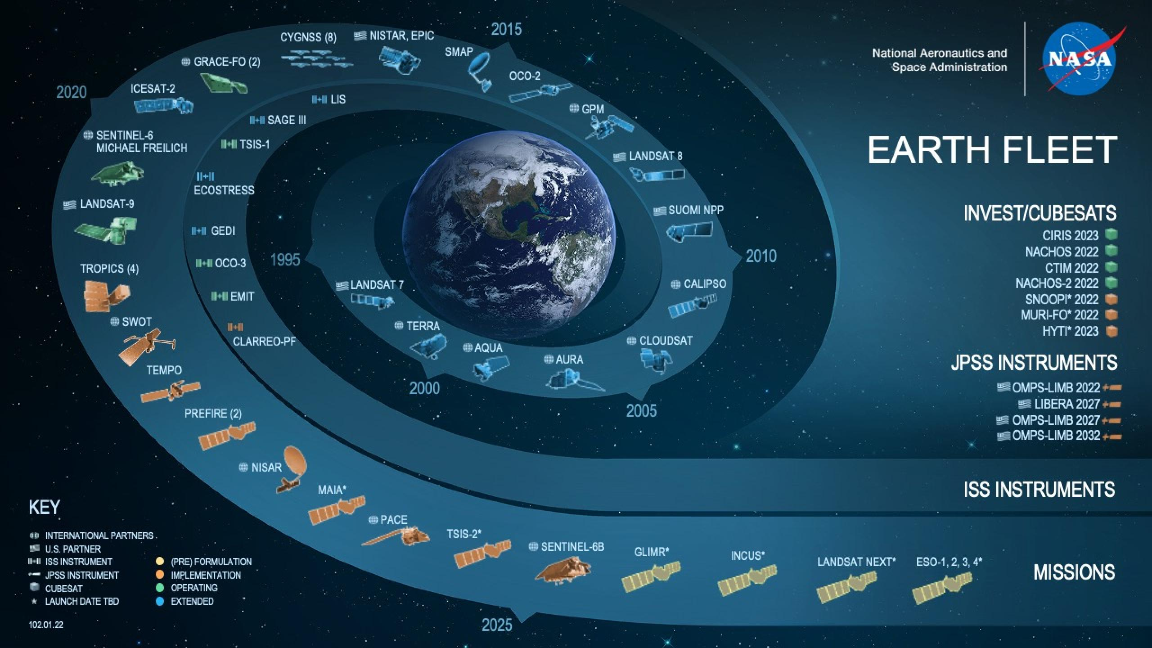
Image source: NASA / GSFC (https://science.nasa.gov/earth-science/earth-missions)

Slide 5
Storing and Accessing Data
Distributed Data Centers
  Raw data files
  72 Petabytes as of 2022
    Estimating 600 Petabytes by 2029
Common Metadata Repository (CMR)
  Ingest native formats with support for translations
    Based on the mission
  1.5 Billion metadata records

Slide 6
Available APIs
How is data in CMR accessed?

Slide 7
Accessing CMR
Core APIs
  Ingest
  Search
  Access Control
Ancillary APIs
  STAC (SpatioTemporal Asset Catalogs)
  Virtual Directory
  OpenSearch

Slide 8
Ingest
Preferred ingest format is Unified Metadata Model (UMM)
  Supported by a JSON schema
    Validations
    Known fields for applications
    Community agreed upon changes
    Versioned
  Migrations between versions
  Query for old versions
Non-UMM formats are stored as-is and later translated

Slide 9
Search
Multiple response formats offered
  JSON
  UMM JSON
  ISO
  ECHO
  DIFF
Response formats are coupled to unique request parameters and capabilities
95% of queries need to return within 1 second (sub-second search)

Slide 10
Challenges
What was the driver for implementing GraphQL?

Slide 11
Inconsistencies
Search parameters only available via one format
Keys not available across formats
Fields that contain the same data are named differently
  JSON UID is `id` while UMM UID is `concept-id`
  Redundancy (aliases)
    dataset_id and title
Determining the number of results available
Facets only available via a single format

Slide 12
Performance
Server Side
  ElasticSearch vs database queries
  Ingest (native) format translations
  Redundant / duplicative queries
  Paging (Deep)
Client Side
  Size of response
    API Gateway limits
  Volume of queries necessary
  Maintenance, overhead, institutional knowledge

Slide 13
Client Usage
API is not versioned
  Unable to make desired changes to solve known challenges
Inability to make drastic changes associated with the risk of breaking unknown, yet important applications.
Usage is known, but much of it is unidentifiable

Slide 14
Streamlined Access
How did GraphQL streamline access to earth science data?

Slide 15
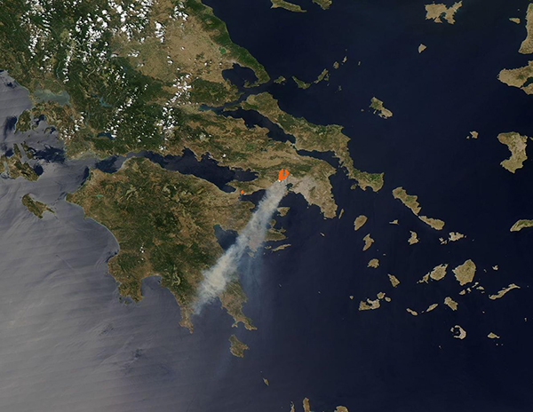
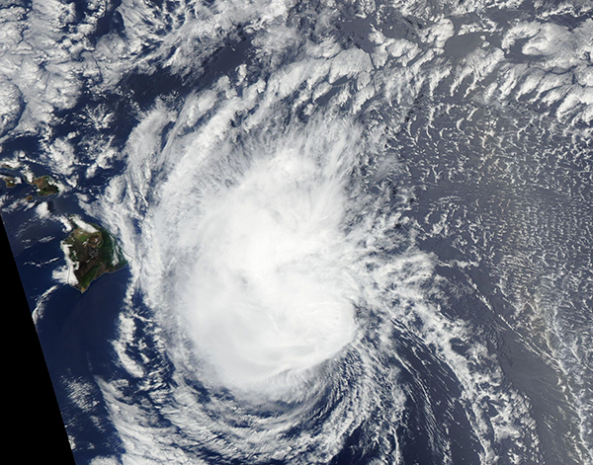
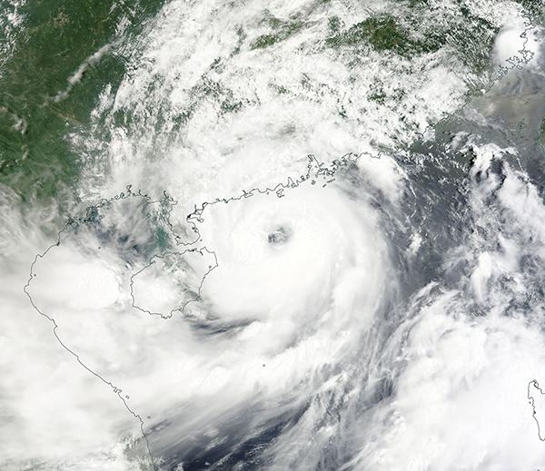
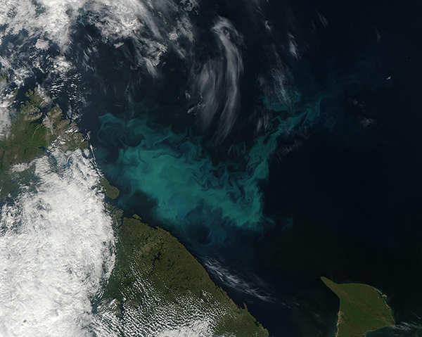
MODIS
Moderate Resolution Imaging Spectroradiometer
Wildfires in Greece
Hurricane Calvin (Hawaii)
Typhoon Talim (China)
Bloom (Barents Sea)
Image source: NASA / GSFC
https://modis.gsfc.nasa.gov/gallery/individual.php?db_date=2023-07-21
Image source: NASA / GSFC
https://modis.gsfc.nasa.gov/gallery/individual.php?db_date=2023-07-20
Image source: NASA / GSFC
https://modis.gsfc.nasa.gov/gallery/individual.php?db_date=2023-07-19
Image source: NASA / GSFC
https://modis.gsfc.nasa.gov/gallery/individual.php?db_date=2023-07-17

Slide 16
A Mile In Their Shoes
Find data collected by MODIS
ID
Title
DOI
Platforms
How many records
Ability to page through all records

Slide 17
JSON
{
"feed": {
"id": "https://cmr.earthdata.nasa.gov:443/search/collections.json?include_facets=v2&platform=AQUA",
"title": "ECHO dataset metadata",
"facets": {...},
"entry": [
{
"dataset_id": "ABoVE: Angular-corrected MODIS MAIAC Reflectance across Alaska and Canada, 2000-2017",
"title": "ABoVE: Angular-corrected MODIS MAIAC Reflectance across Alaska and Canada, 2000-2017",
"id": "C2192631093-ORNL_CLOUD",
"platforms": [
"Terra",
"Aqua"
]
}
]
}
}
https://cmr.earthdata.nasa.gov/search/collections.json
{
”include_facets": ”v2”,
"platform": "AQUA”
}
Notable Response Headers
{
"hits": ”1108”,
"search-after": "...”
}
143.89 kb

Slide 18
UMM
{
"hits": 1108,
"took": 47,
"items": [
{
"meta": {
"format": "application/echo10+xml",
"concept-id": "C2192631093-ORNL_CLOUD",
"concept-type": "collection"
},
"umm": {
"DOI": {
"DOI": "10.3334/ORNLDAAC/1858",
"Authority": "https://doi.org"
},
"EntryTitle": "ABoVE: Angular-corrected MODIS MAIAC Reflectance across Alaska and Canada, 2000-2017",
"Platforms": [
{
"Type": "Earth Observation Satellites",
"ShortName": "Aqua",
"LongName": "Earth Observing System, Aqua",
"Instruments": [
{
"ShortName": "MODIS",
"LongName": "Moderate-Resolution Imaging Spectroradiometer"
}
]
}
]
}
}
]
}
https://cmr.earthdata.nasa.gov/search/collections.umm
{
"platform": "AQUA"
}
Notable Response Headers
{
"search-after": "...”
}
164.29 kb

Slide 19
GraphQL
{
"data": {
"collections": {
"count": 1108,
"cursor": ”...",
"facets": {...},
"items": [
{
"conceptId": "C2192631093-ORNL_CLOUD",
"title": "ABoVE: Angular-corrected MODIS MAIAC Reflectance across Alaska and Canada, 2000-2017",
"platforms": [
{
"type": "Earth Observation Satellites",
"shortName": "Terra",
"longName": "Earth Observing System, Terra (AM-1)",
"instruments": [
{
"shortName": "MODIS",
"longName": "Moderate-Resolution Imaging Spectroradiometer"
}
]
}
],
"doi": {
"doi": "10.3334/ORNLDAAC/1858",
"authority": "https://doi.org"
}
}
]
}
}
}
https://graphql.earthdata.nasa.gov/api
query Collections($params: CollectionsInput) {
collections(params: $params) {
count
cursor
facets
items {
conceptId
title
platforms
doi
}
}
}
variables
{
"params": {
"includeFacets": "v2",
"platform": "AQUA"
}
}
129.55 kb

Slide 20
Obfuscated By Design
Based on the fields requested, intelligently determine where to fetch the data from
  Users no longer need to know which endpoint and/or format owns the data
  Allows us to prioritize endpoints and formats for performance, clarity, standards
  Normalizes parameter names and response fields

Slide 21
Abstraction
Allows changes to underlying APIs without impact to clients
Continuous optimization of underlying APIs
  Adopt as HTTP requests, work towards direct calls to back-end systems
Introduction of new services
Retirement of services

Slide 22
Specifications
Paging accomplished using a base64 encoded cursor
  Deep Paging
  Scroll Sessions
  Search After
Fe525e90f40f1135cde67fe2b8c2157604ea8b6f05646a8e2f49d67175610217
{
"json": "CURSOR_FROM_UMM_ENDPOINT”,
"umm": "CURSOR_FROM_UMM_ENDPOINT"
}

Slide 23
GraphQL
Reduced / Eliminated
  Response and Parameter inconsistencies
  Use / knowledge of multiple APIs
Future Proofing
  Changing underlying APIs
  Adding new APIs

Slide 24
Examples
How is this being used today?

Slide 25
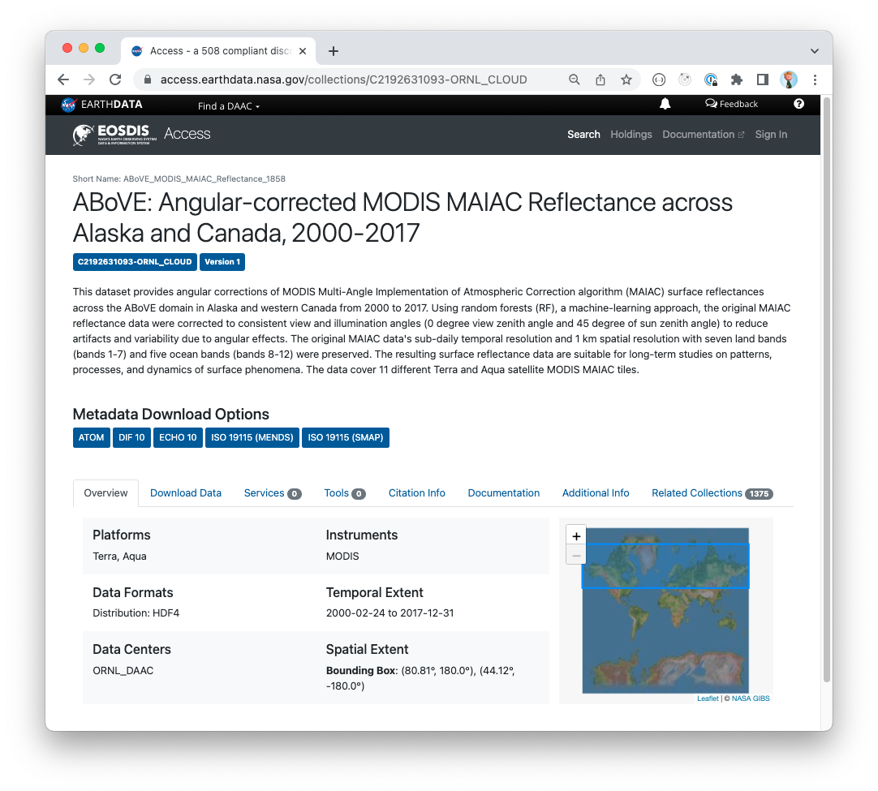
Access
Single GraphQL query per page load
Widget is utilized across NASA properties
Image source: NASA / GSFC
https://access.earthdata.nasa.gov/collections/C2192631093-ORNL_CLOUD

Slide 26
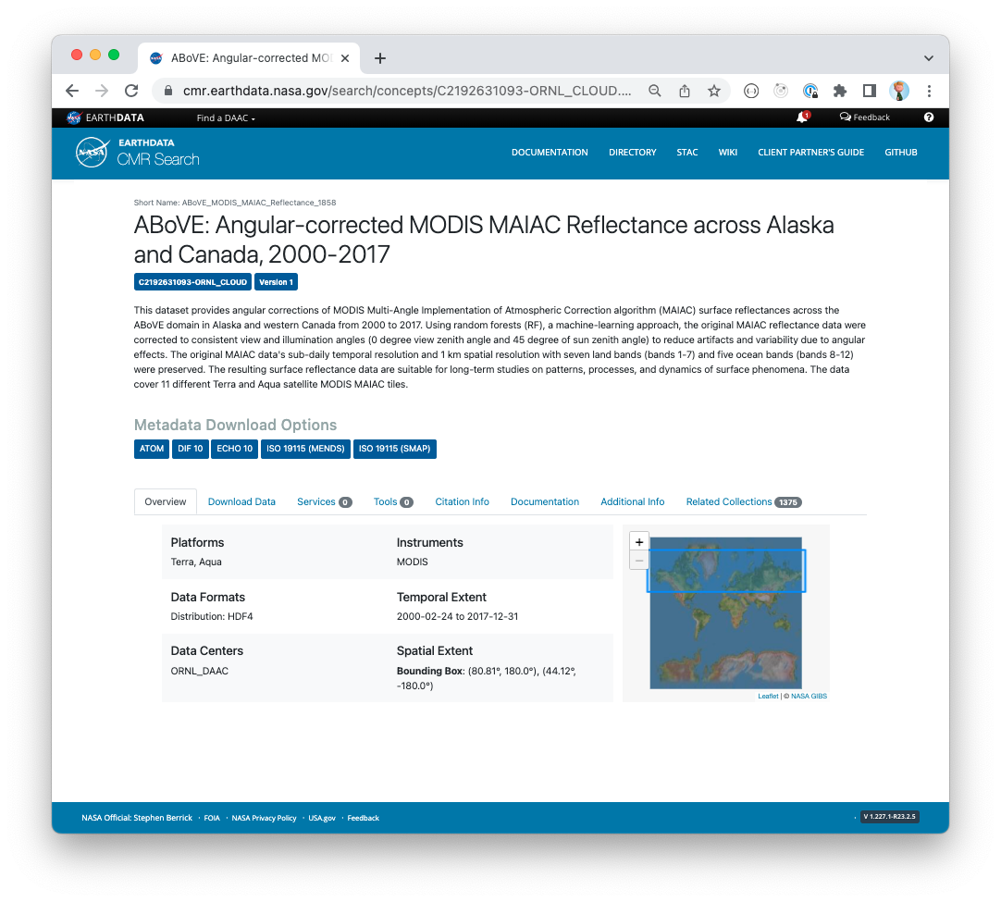
CMR
Loads the Access widget over HTTP
Utilizes schema.org attributes for discoverability
Image source: NASA / GSFC
https://cmr.earthdata.nasa.gov/search/concepts/C2192631093-ORNL_CLOUD.html

Slide 27
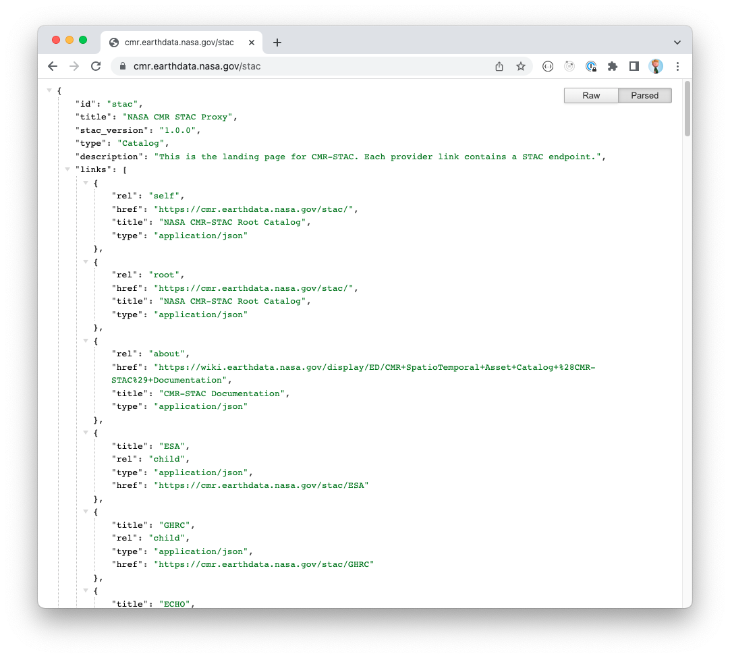
CMR STAC
STAC compliant API backed by GraphQL
Continual performance updates benefit the community
Image source: NASA / GSFC
https://cmr.earthdata.nasa.gov/stac

Slide 28
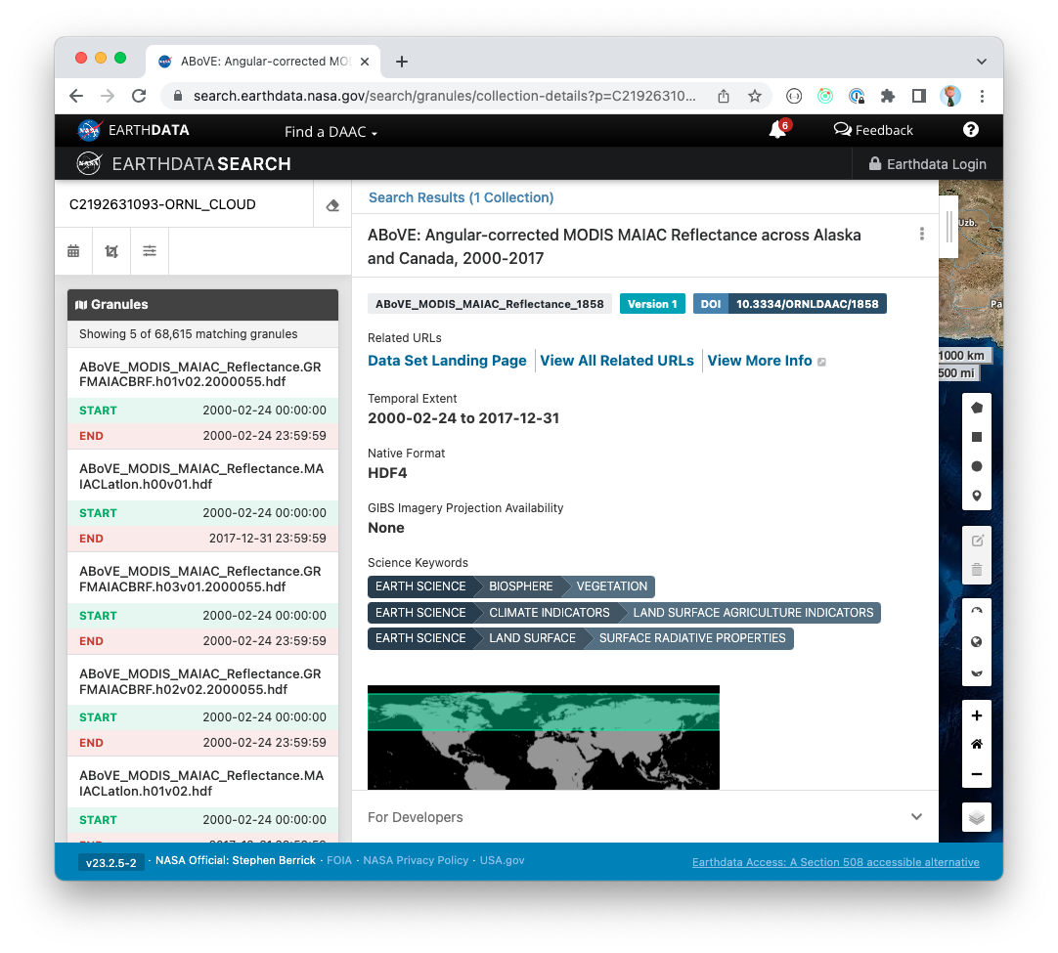
Earthdata Search
Flagship search and discovery tool utilizing GraphQL for all but 1 search query
Embraces the ability to query nested data
Utilizes types that no other application uses including those using different APIs and datastores
Image source: NASA / GSFC
https://search.earthdata.nasa.gov/search/granules/collection-details?p=C2192631093-ORNL_CLOUD&pg[0][v]=f&q=C2192631093-ORNL_CLOUD

Slide 29
This work was supported by NASA/GSFC under Raytheon Technologies contract number 80GSFC21CA001.

