Slide 1
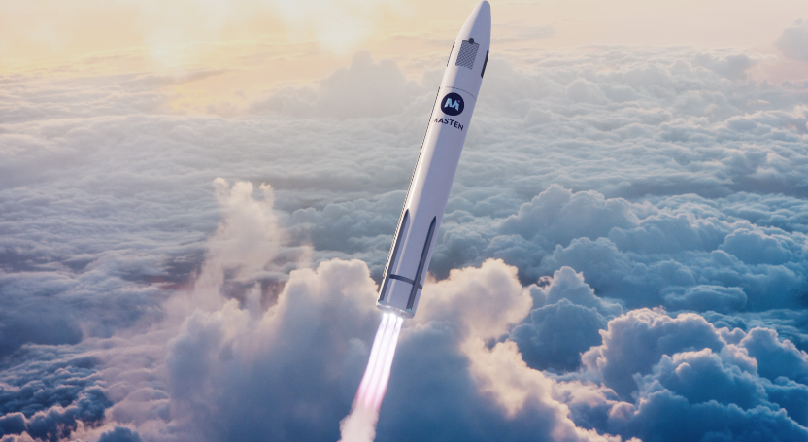
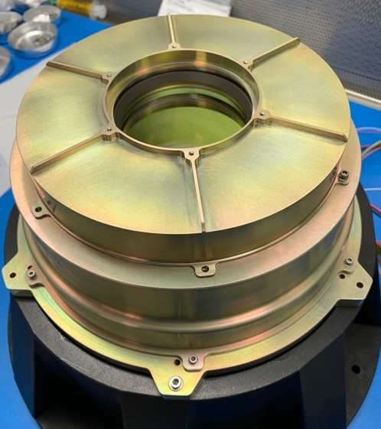
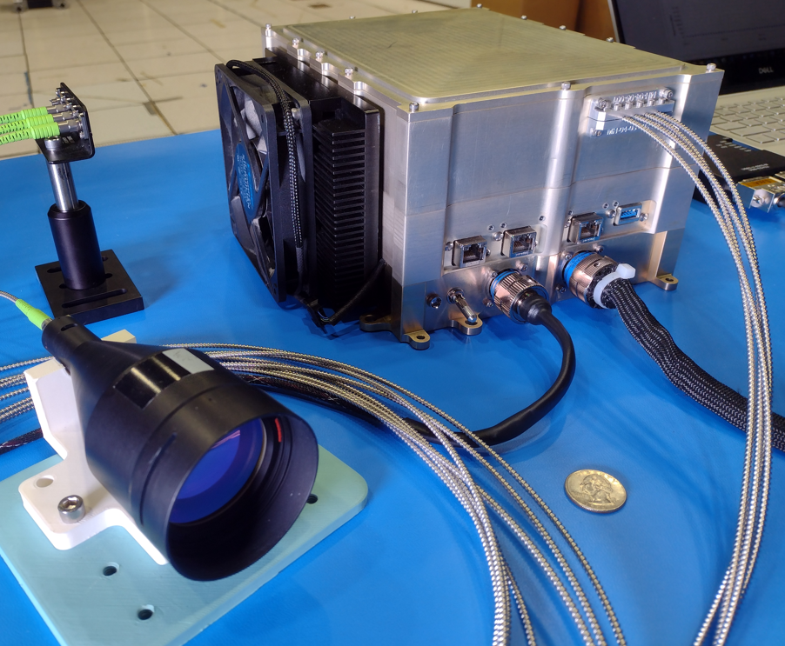
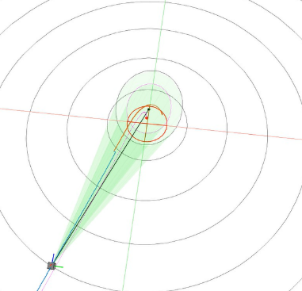
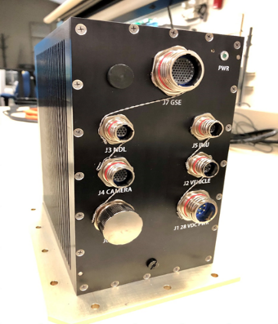
Space Technology Mission Directorate
Game Changing Development Program
Gavin Mendeck | Wade May | FY23 SPLICE Annual Review Presentation | 08.21.2023
gavin.f.mendeck@nasa.gov

Slide 2
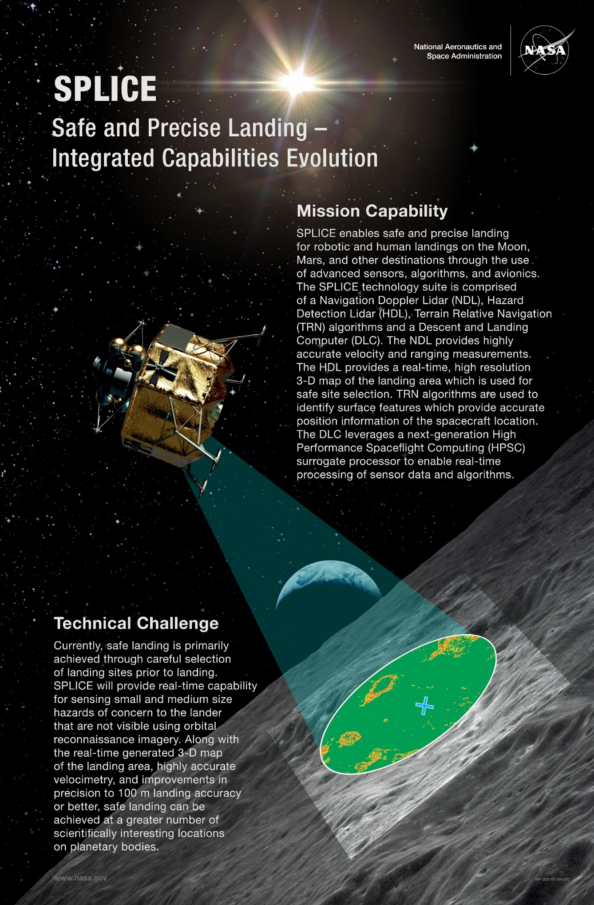
Project Overview
Technology Products Capability
SPLICE Precision Landing and Hazard Avoidance (PL&HA) technologies will improve landing precision by an order of magnitude and enable high-resolution real-time 3-D mapping for hazard detection and avoidance during descent.
Technical Capabilities
Portfolio of sensors, avionics and algorithms for PL&HA appropriate to be infused as individual technologies, or can be fully integrated
Hazard Detection (HD) Lidar - high resolution terrain mapping
GN&C/PL&HA Algorithms improving integrated functions and real-time performance
Descent and Landing Computer (DLC) with COTS HPSC surrogate for PL&HA+GN&C computing
Analysis and Test capabilities to mature PL&HA and GN&C technologies
Hardware-in-the-loop (HWIL) Simulation Testbed for development, low-cost V&V, and integrated testing (prior to costly field tests)
Flight Testbeds (terrestrial and suborbital) for component or integrated systems testing in relevant environments (risk mitigation and TRL maturation toward mission infusion)
Exploration & Science Applicability
Technologies enable precise, safe, and soft landing in close proximity to targeted surface locations (hazardous terrain, pre-positioned cargo, cached samples, etc.) on the Moon, Mars, or other solar system destinations
Technologies have commercial space applications for companies interested in landing payloads (and eventually people) on the Moon or Mars
INSERT OVERVIEW
PICTURE HERE
Notes:
Provide an overview of the Project
Pictures are encouraged, please provide new pictures as frequently as possible

Slide 3
Project Needs & Goals
Technology Development Needs Addressed by Project
HLS, STMD | How do we safely land near where we intend to? Develop precision landing & hazard avoidance sensor and software components for landers at Moon, Mars, and other destinations. | EDL & Precision Landing
HPSC | How do we leverage high performance computing development? Utilize a high performance space computing prototype for processing sensor data and algorithms to flight demonstration precision landing and hazard avoidance. | Advanced Avionics
DRAFT
Project Goals
Goal #1 | Design, integrate, and flight demonstrate a portfolio of sensor and software components that together or independently enable precision landings within 50m while avoiding landing hazards. The portfolio consists of: A descent guidance trajectory-planning software library that generates trajectory solutions within 3 seconds that achieve constraints on sensor pointing, position, and thrust bounds while minimizing propellant use. A Hazard Detection Lidar to scan and provide within 2 seconds a 1 MP digital elevation map of 100x100m area at 1.5cm (1σ) elevation precision. A hazard detection software library that processes a 1 MP DEM within 2 seconds, then provides a prioritized list of safe landing sites meeting lander-specific parameters. A Navigation & FSW architecture using these technologies fused with traditional Navigation sensors to achieve onboard position accuracy of 3m (3σ) relative to a safe site within the DEM.
Goal #2 | Design, integrate, and suborbital-flight demonstrate this portfolio of capabilities leveraging an HPSC-class terrestrial prototype computer.
Goal #3 | Achieve TRL 6 and SRL 6 for the portfolio components.
Notes:
Provide an overview of the Project
Pictures are encouraged, please provide new pictures as frequently as possible

Slide 4
Project Objectives
DRAFT
Project Objectives
Objective #1 | Design and implement a Descent and Landing Computer (DLC) Engineering Test Unit (ETU) capable of spaceflight that performs sensor fusion, runs GN&C computing applications, and can transfer, process, and store data at high speeds
Objective #2 | Complete a full set of flight software and firmware applications using cFS that includes navigation and guidance algorithmic technology advancements, navigation filter for sensor fusion, data processing, i/o, and storage
Objective #3 | Develop and implement a Hazard Detection Lidar that rapidly collects measurements to generate a digital elevation map (DEM) of the landing area.
Objective #4 | Develop and implement a long-range altimeter channel within the Hazard Detection Lidar, usable for active terrain relative navigation.
Objective #5 | Develop and implement software on DLC that processes the DEM, identifies a ranked list of safe sites, chooses a new landing target, and calculates and updated trajectory to the new landing target within modeled vehicle constraints
Objective #6 | Develop both guidance and hazard detection algorithm technologies as software C/C++ libraries that meet at least NASA Class C FSW standards, to ease infusion into flight projects.
Objective #7 | HWIL integration and testing of all SPLICE system components
Objective #8 | Flight test of the integrated SPLICE system and system components

Slide 5
SPLICE Project Organization
STMD Game Changing Dev
Program Executive
Niki Werkheiser – HQ
Kevin Somervill – HQ
EDL SCLT Lead
Michelle Munk – HQ
STMD TIM for Precision Landing
John M. Carson – HQ
STMD Flight Opportunities
Program Executive
Chris Baker – HQ
STMD Avionics PT
Wes Powell
GCD Program Manager
David Moore – LaRC
FO Program Manager
John Kelly – AFRC
Danielle McCulloch -- AFRC
Campaign Manager
PEM – Wade May -- LaRC
High Performance Spaceflight Computing (HPSC) Project
Safe & Precise Landing
Integrated Capabilities Evolution
(SPLICE) Project
Project Manager
Gavin Mendeck – JSC
Project Manager
Charles Dunn JPL
Project Chief Engineer
Sam Pedrotty – JSC
PAO + EPO
STMD-GCD/STMD-FO
S&MA
STMD-FO
Legend
Psionic, LLC
Direct Oversight
HWIL/Sim
Teming Tse
JSC
GNC
Kyle Smith
Draper
FSW
James Berck
JSC
HDL
DLC
David Rutishauser
JSC
PS-NDL
M. Cisewski
Sensor PI
Bryan Blair
GSFC
Proj Mgr
William Potter
GSFC
Coordination
Level 1 (Leadership)
Level 2 (Programs)
Level 3 (Projects)
Notes:
If you have submitted a Project Plan, you could utilize the Organizational Chart found in section 8.3 – Management Structure making sure to add in your assigned PEM and associated PT/SCLT

Slide 6
Collaborations & Partnerships
NASA Center
Terrain Relative Navigation demo
(V&V leverages SPLICE Trick Simulation)
Academia
Suborbital Testing 2020/1
SAA Adv. Guidance
Astrobotic
(STMD-TP, A-TRN)
Industry
Guidance Research
Blue Origin
(STMD-TP)
Terrain Relative Navigation
GN&C software
Univ. Washington
Draper
Suborbital Testing 2025
Hazard Detection Lidar (HDL)
cFS
Astrobotic Space Systems
(STMD-TP, Xogdor)
NASA GSFC
Hazard Detection algorithms
High Performance Space Computing (HPSC)
Psionic (SBIR & STMD-TP)
SBIR Navigation Doppler Lidar (NDL)
TP NDL Demo 2024 (potential)
NASA JPL
NASA MSFC
NASA AFRC
(STMD Flight Ops Program)
Inputs to Human Landing System (HLS) Oversight & Insight
Suborbital Test Coordination
NASA JSC
NASA KSC
Georgia Tech
Project Leadership
Descent & Landing Computer
HWIL Simulation Testbed
GN&C Software
HDL Flight Testing
Review of ECF Hazard Detection algorithms that leverage Machine Learning
Notes:
Infusion: An investment reaches a conclusion where a technology is handed off for use by a mission or other need. Infusions can be made to other NASA Mission Directorates, other Government Agencies, Commercial Entities, or International Partner.
Transition: An investment reaches a conclusion where a technology is handed off for further development. Transitions can be made to other STMD programs, other NASA Mission Directorates, academic institution, other Government Agencies, Commercial Entities, or International Partner.

Slide 7
SPLICE TRL & SRL Progression
Project Milestone
GCD (Key) Milestone
Controlled Milestone
TRL Progression
DRAFT
7
HDL Sensor
NDL Sensor
S/W Guidance
Xogdor
SPLICE
Flight Test
S/W Haz Detect
HDL
Env Testing
6
Guid on Suborbital
Test NS#2
PS-NDL Prototype Static & Dyn Tests,
Delivery
HDL ETU1 Delivery
HDL Dynamic Test
HDL Field Test
5
TRL & SRL
HD in Sim & Tested on DLC
HDL ETU1 complete
HDL EDU Assembled
HDL Static Test
4
3
Slowed Work
GCD FY22 budget adjustment & rescope
FSW+GNC “PDR”
FSW+GNC “CDR”
SPLICE Delivery
to Xogdor
SPLICE Final Review
DLC ETU complete
PPR
DLC ETU
HWIL
FY18
FY21
FY22
FY23
FY24
FY25
Notes:
Chart purpose: show TRL/SRL/MRL advancement over the project lifecycle schedule. Show TRL advancements as whole integer increases. Show how Key and Controlled milestones align with TRL advancement.
TRL/SRL/MRL may not advance at each milestone. Often several milestones are required to produce a step increase in TRL/SRL/MRL.
There can be one, or more, of these charts per project as needed.
For projects with fewer technical elements, the TRL/SRL/MRL data can be combined on one chart.
For more complex projects, the TRL/SRL/MRL progression can separated into multiple charts by project technical area.
Show TRL, SRL, and MRL data for each technical element on the same chart.
Delete TRL/SRL/MRL axis-labels that do not apply – e.g., remove SRL/MRL for projects/technical areas where SRL and MRL do not apply.

Slide 8
Accomplishments in FY23 Guidance Software
Project has partnered with University of Washington on Dual Quaternion Guidance (DQG) to provide real-time trajectory solutions that meet multiple constraints, including sensor pointing, while minimizing propellant use.
Initial implementation flew successfully as part of SPLICE “ride-along” payload on New Shepard flight in 2021.
Used UW custom second-order cone programming (SOCP) solver, with ~10k lines of code that were refactored into ~500k lines for run time efficiency.
Ran on single DLC ARM A53 processor with a simple constraint set, repeatedly providing valid solutions within 3 seconds each time.
UW SOCP generic software was never intended to meet spaceflight FSW standards. Software needed to be streamlined for review and reliability.
UW developed first-order proportional integral projected gradient (PIPG) solver in FY22-23 to simplify the software and improve performance. FY23Q4 prototype benchmark testing on DLC ARM A53 shows PIPG is ~20% the run time of SOCP and with less than 1k lines of code.
FY23 work added sensor constraints which, while successful, slowed down the SOCP solver beyond the project’s goal.
Project is proceeding with implementing PIPG as a software library meeting FSW Class C to meet goals and objectives
Project also supports Blue Origin SAA on advanced guidance development and implementation
6DOF lander simulation illustrating SPLICE DQG successfully points the HDL sensor field-of-view (green) within 50m of the site (red circle) and diverts to an identified safe site (red dot).
Notes:
SOCP = second order cone programming
PIPG = proportional integral projected gradient

Slide 9
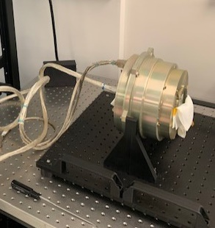
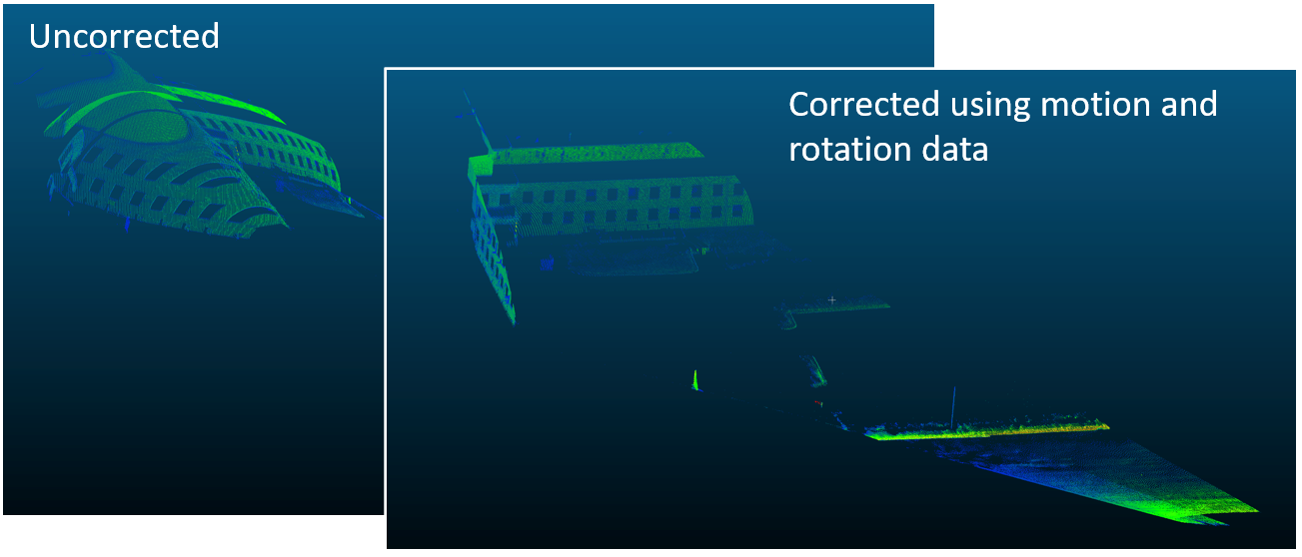
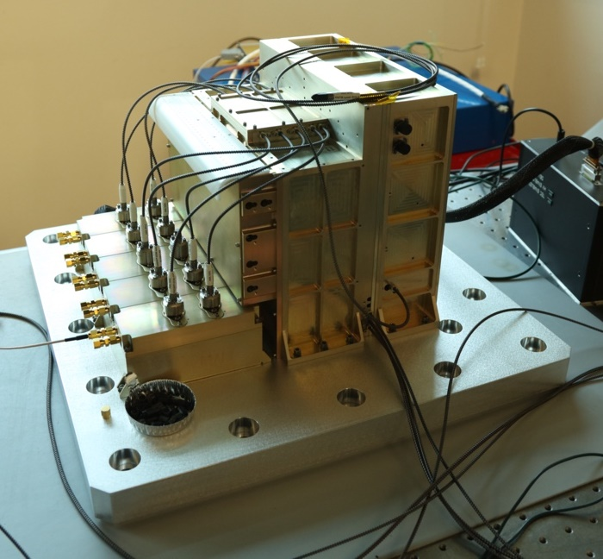
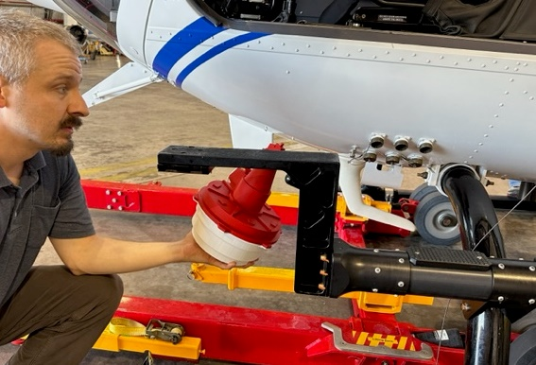
Accomplishments in FY23 Hazard Detection Lidar
Project partnered with GSFC to design, build, and test the Hazard Detection Lidar (HDL)
Design implements a scanning lidar with pointing controlled by two high-speed spinning Risley prisms to make millions of precise point measurements per second with <1.5 cm (1σ) range accuracy
HDL avionics compensate for motion while populating a 1 MP 100x100 m digital elevation map during the 2 sec scan, allowing hazards of 30cm diameter or larger to be identified
FY23 has focused on assembly and testing of the ETU1 for both Hazard Detection Lidar and Long-Range Altimeter
All components assembled except for the altimeter telescope. Completed: Detector and its electronics, altimeter laser electronics, master electronics unit, HDL interface harnesses, motor & power chassis, scanner assembly, main power interface board, fiber lasers and harnesses
Begun vibration acceptance testing of major subassemblies
Begun FPGA programming to process DEM
Planning underway for FY24 KSC helicopter flight tests, which reduces risk prior to Xogdor SPLICE flight in FY25Q3
HDL Scanner testing using Motor Controller Board (MCB) breadboard
HDL EDU Dynamic Testing w/ Truck (2021) With Post-Processed Motion Compensation
KSC helicopter flight concept for scanner mount
HDL ETU1 Detectors, Altimeter LEU Housing, Fiber Delay Box & Laser subassembly mounted to vibration plate

Slide 10
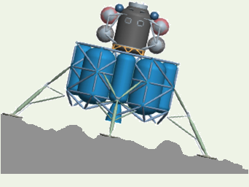
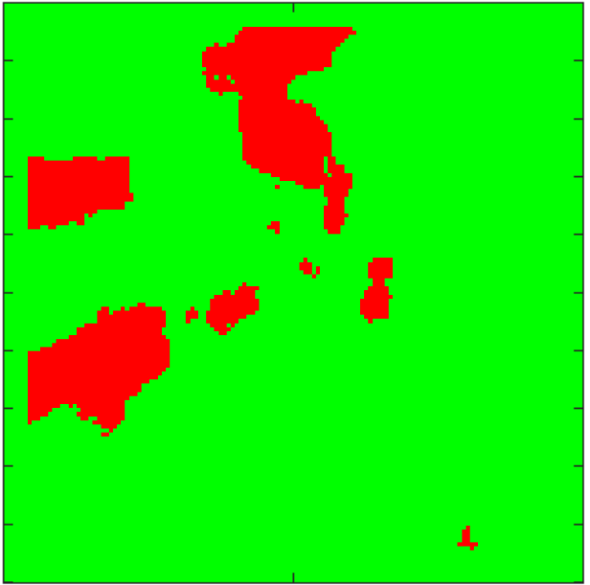
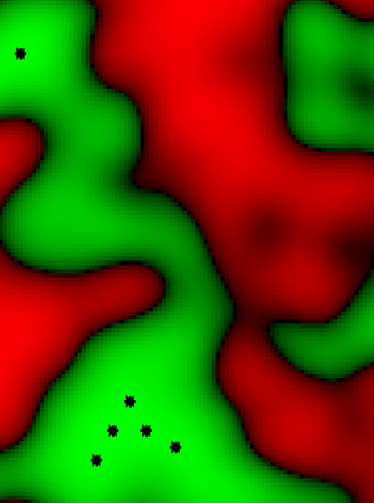
Accomplishments in FY23 Hazard Detection Software
Project has partnered with JPL to refine the hazard detection software used on the Morpheus PL&HA demonstration flights in 2013-2014.
This software processes a DEM against defined lander characteristics to identify sites most likely to avoid slope and roughness (lander clearance) hazards.
2013 implementation required parallelization on multiple CPUs to process within 6 seconds. Processor speed improvements (i.e., HPSC) since then have reduced the need to parallelize this algorithm.
FY22 work on algorithm development to improve performance (~60% of original execution time) and implement as a software library package.
FY23 focused on HD library code review, analyses, & testing
Deep-dive library code and documentation review by FSW and GNC peers, collecting ~300 comments on code, ~100 comments on documentation and design. 99% of all comments now closed. Updated library delivered.
Quantifying technical and execution time performance with combinations of different algorithm parameters, including small to large lander sizes
Evaluating algorithm performance using simulated HDL DEMs from Blue Origin 2021 ACO to compare with published Blue results. Evaluating LuNaMaps DEMs.
Testing a 1 MP DEM on DLC ARM A53 achieved 2 second goal for a 5m diameter lander, with <0.1% false positive rates
FY24 will include further analysis, flight test planning support, and testing this algorithm real-time on the HDL helicopter tests using the DLC
Depiction of
Lander Hazards
roughness
slope
Hazard Detection Processing Steps of DEM
Slope Hazards
Combined Hazards
Combined Hazards w/ Landing Accuracy
Roughness Hazards

Slide 11
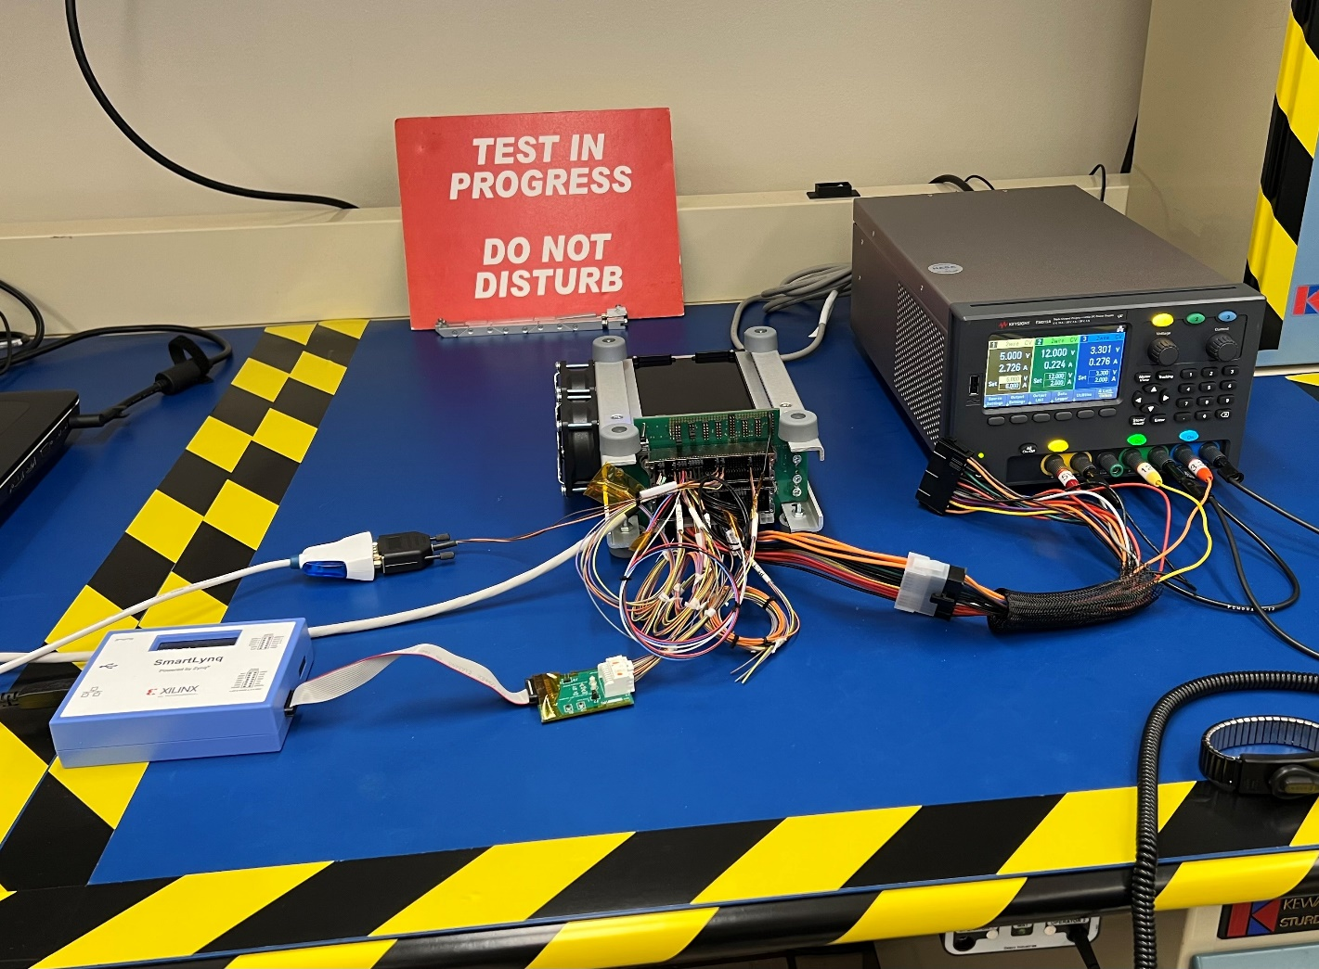
Accomplishments in FY23 Descent Landing Computer
Project previously developed and qual’d a Descent Landing Computer EDU for New Shepard flights
Four ARM A53 processors running 64-bit cFS on a Pentalinux OS
FY23 has Descent and Landing Computer (DLC) ETU design in fabrication and testing
ETU design corrects time synchronization deficiencies that were accepted to ride-along on New Shepard. These deficiencies must be corrected for Xogdor, as that vehicle will respond to SPLICE guidance commands.
DLC main processor boards in second round of fabrication and evaluation. DLC FPGA board preparing for procurement. O/S and firmware updates for ETU. Mercury solid state data recorder (SSDR) interfacing in development.
Now participating in industry consortium to influence SpaceVPX development towards future NASA needs
FY24 will complete assembly and testing of two DLC ETU assembly, and include applying ETU firmware updates to existing DLC EDU units to support HDL and potentially NDL flight tests
DLC SSDR Testing

Slide 12
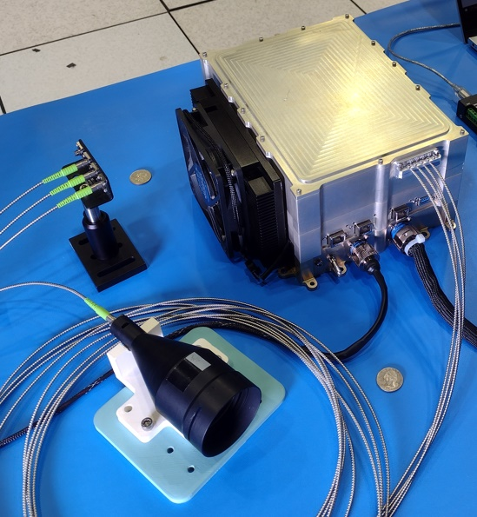
Accomplishments in FY23 Psionic NDL
Project partnered with Psionic, LLC. to develop and deliver commercial Navigation Doppler Lidar unit
Sensor provides softer controlled touchdown with low lateral velocity and significantly reduced navigated position error, improving precision landing
SBIR Phase 3 to develop of two photonic integrated circuit (PIC) upgrades and build a 5th Generation NDL EDU, reducing mass by 70% from prototype and more redundancy. EDU mass target is 3 kg.
FY23 accomplishments
Developed sensor software and early integrated testing
Prototype w/o PIC delivered in FY23Q4
Potential for project to minimally support Psionic Tipping Point flight testing in FY24. Utilizing project hardware previously flown on New Shepard.
PPBE25 funding constraints descoped Psionic NDL from project. Expect its descope will negatively impact suborbital flight testing as onboard position knowledge will be degraded relative to identified safe sites.
Psionic NDL Prototype

Slide 13
Project Assessment Summary
Project Name | Performance |  |  |  | Comments
 | C | S | T | P
Mid Year | G | Y | G | Y | Schedule – Projected ~3mo delays to HDL and DLC completion milestones Programmatic – GSFC and JSC workforce support reduced in late FY22 and has not recovered fully; competing with other projects.
Annual | G | Y | G | Y | Schedule – Mitigations to HDL delays in work. DLC completion milestone slipping ~3 mo due to both redesign after pathfinder testing and to critical resources supporting flight tests with DLC EDU for HDL; not critical path to Xogdor TP. Programmatic – GSFC and JSC workforce support reduced in late FY22 and has not recovered fully; competing with other projects. Budget for FY24-26 descoped Psionic NDL.

Slide 14
SPLICE Infusion & Partnerships
EDL/PL&HA domain goal is to address capability gaps and promote infusion and commercialization by achieving TRL 9 for the following technologies via lunar flight demo. These technologies may be infused separately or collectively.
SPLICE Component | Component Description | Commercial/Mission Infusion Targets | Development Partnerships
Hazard Detection Lidar (HDL) | A scan-array lidar capable of short- and long-range mapping to support HD applicable to Moon, Mars, Icy Moons, Ocean Worlds, etc. Long-range altimeter to support active TRN. | Pursuing potential lunar demo. Several New Frontiers proposals. Interest with several companies regarding use or licensing. | One RSAA, GSFC SAA
Psionic Navigation Doppler Lidar (PS NDL) | An evolved commercial NDL with SBIR Photonic Integrated Circuits which provide ~70% reduction in mass & more redundancy | LaRC NDL on IM-1 & AB-1 CLPS. Psionic NDL on VIPER. | Army-PNT & Army-ERDC
Dual Quaternion Guidance (DQG) FSW | A 6-DOF trajectory planner software with integrated control & state constraints to perform hazard detection & precision landing. | Two RSAAs. Collaborating with HLS. Licensing available through partner. | Univ. of Washington
Hazard Detection FSW | ALHAT-evolved hazard detection software application and library | JPL/SMD (Europa Lander). Licensing available through partner. | JPL/Caltech
Navigation S/W | Incorporates NDL data and fault logic, TRN/AFP measurements, and hazard/site relative navigation (SRN) | Potential CLPS/HLS & Orion Artemis/OpNav. Blue RSAA. AFP TT patent. | Draper
Core Flight S/W (cFS) | Ported onto DLC to process all SPLICE sensor data and algorithms. SPLICE was early adopter of 64-bit cFS, which eases migration to HPSC. |  | GSFC
Descent Landing Computer (DLC) | A SpaceVPX architecture including internal redundancies, COTS multicore processor (with rad-tolerance provisions), and PL&HA I/O for sensor fusion and algorithms processing during EDL/DDL | Interest by two companies in tech transfer patents | HPSC

Slide 15
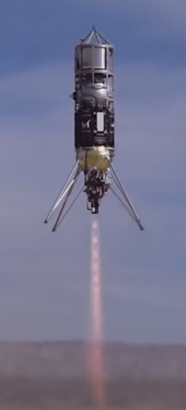
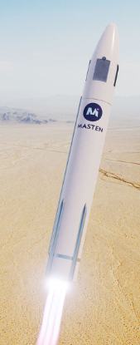
Xogdor Tipping Point
Astrobotic/Masten awarded a Flight Opportunities Tipping Point in 2021
“...to conduct flight tests demonstrating the capability to conduct testing of Precision Landing and Hazard Avoidance (PL&HA), plume surface interactions, and other technologies and phenomena.”
Masten has previously flown third-party GNC algorithms while employing an independent monitoring algorithm and vehicle GN&C that will override for vehicle and range safety
Technical and management team has ramped up after Astrobotic acquisition of Masten in late 2022
SPLICE Xogdor flight scheduled for late FY2025
Closed-loop suborbital flight test of PL&HA sensors and software that include navigation, guidance, hazard detection
SPLICE provides the anchor payload for the Astrobotic/Masten Xogdor Tipping Point
The mutual benefits to NASA (GCD+FO) and Astrobotic of flight validating SPLICE on Xogdor
NASA PL&HA strategy closes several high-priority gaps: provides relevant & real sensor/software data and maps benefiting partners
Astrobotic showcases Xogdor closed-loop capabilities and relevance to EDL maturation
Provides performance data on Xogdor PL&HA-specific test profiles (2+km altitude & lunar-relevant trajectory)
Provides flight validation of Xogdor ability to inject third-party guidance and navigation inputs (i.e., closed loop)
Develops Xogdor payload interfaces (electrical, mechanical, telemetry, comm and onboard C&DH)
Identifies flight operations locations for PL&HA-relevant testing (i.e., terrains for good TRN & HD field testing)
Xodiac flying COBALT, 2017
Xogdor, 2025

Slide 16
Education/Public Outreach
EPO Involvement
EPO Calendar Outlook (High Priorities):
6 Month Look-Ahead
2024 AIAA SciTech Forum, Orlando, FL | Jan 8 – 12
JPL Hazard Detection algorithm presented at 3rd Space Imaging Workshop @ Atlanta, GA, October 2022
SPLICE poster and booth at the SMD Technology Showcase in January 2023
SPLICE Guidance paper presented at AIAA SciTech in January 2023
“Customized Real-Time First-Order Methods for Onboard Dual Quaternion-based 6-DoF Powered-Descent Guidance “, Kamath, A.; Elango, P.; Kim, T.; Mceowen, S.; Meshabi, M.; Acikmese, B.; Yu, Y.; Carson, J.
SPLICE DLC paper presented at IEEE Space Computing Conference @ Pasadena, CA, July 2023
“A System to Provide Deterministic Flight Software Operation and Maximize Multicore Processing Performance: The Safe and Precise Landing – Integrated Capabilities Evolution (SPLICE) Datapath”, Rutishauser, D.; Prothro, J.; Fail, J
Upcoming Notable Events in FY24
HDL Helicopter Testing @ KSC, FY24Q2-3
(potential) Psionic Tipping Point Testing @ AFRC, FY24Q3
DLC ETU hardware-in-loop testing @ JSC, FY24Q4
Notes:
Summary of the EPO activities (papers, conferences, outreach events) participated in over the last 6 months and the forward outlook for 6 months

Slide 17
Summary
Major Accomplishments for the Year
Hazard Detection Lidar assembly nearly complete and testing well underway
Hazard Detection FSW meeting accuracy and time execution goals on target hardware, completed formal code review
Guidance FSW development on track to meet time execution goals
Navigation architecture maturation to support precision landing and hazard avoidance goals
DLC ETU components maturing
Psionic NDL prototype delivered
SPLICE is building up to a suborbital, closed-loop test flight with the Astrobotic Xogdor vehicle, to demonstrate all technology components in real-time
SPLICE payload on track to be ready by FY25Q1 for functional fitchecks before FY25Q3 flight
HDL will close at TRL6 with environmental testing, with multiple infusions and transitions routes.
FSW Guidance and Hazard Detection technologies will close at TRL6, meeting at least NASA Class C FSW standards, and be available for licensing. Both have multiple infusion routes.
Project post-flight report and flight data will be released after the Xogdor flight.

