Slide 1



Modeling Spacecraft Power Systems
Using the SPACE Code
12 Sep 2023
SPENCER FURIN | NASA GLENN RESEARCH CENTER
BRANDON KLEFMAN | NASA GLENN RESEARCH CENTER

Slide 2
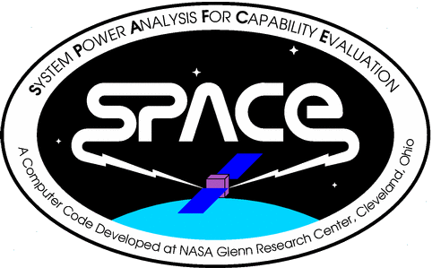

What is SPACE?
SPACE (System Power Analysis for Capability Evaluation) is a computer code used to model the electrical performance of space-based power systems
SPACE was developed entirely at NASA GRC (then LeRC)
Originally designed to model the ISS EPS which is still a primary use
Critical to ISS as end-to-end EPS could not be assembled and tested on the ground
Gateway is similar
Given orbital conditions and EPS config, SPACE determines EPS capability
Also has load-driven mode (called ECAPS) to predict EPS state when supplying a time-varying load profile
SPACE was Runner-Up for NASA Software of the Year in 2003

Slide 3
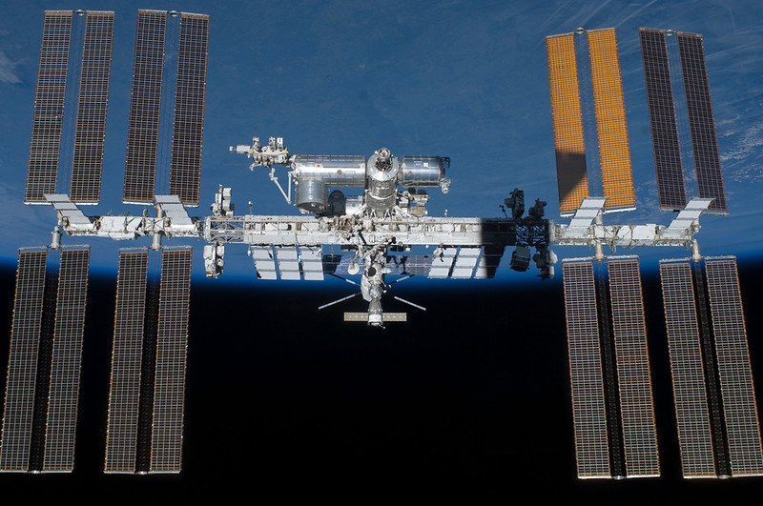
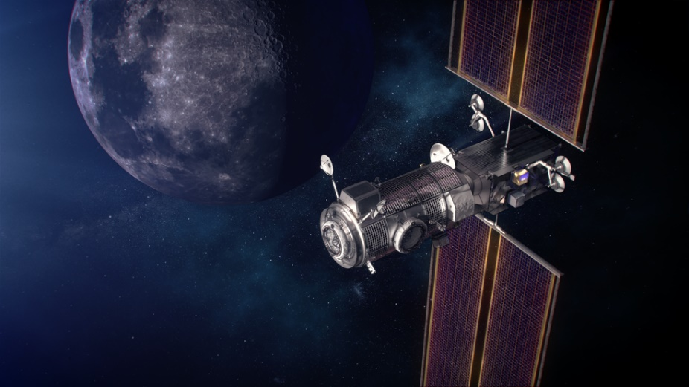
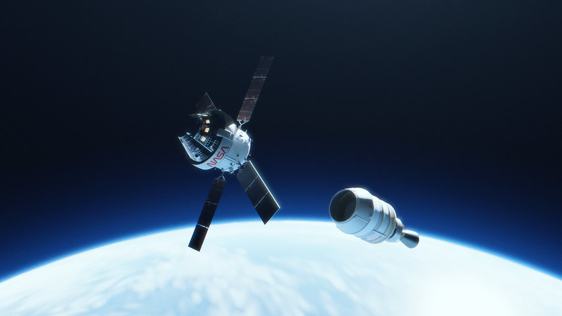
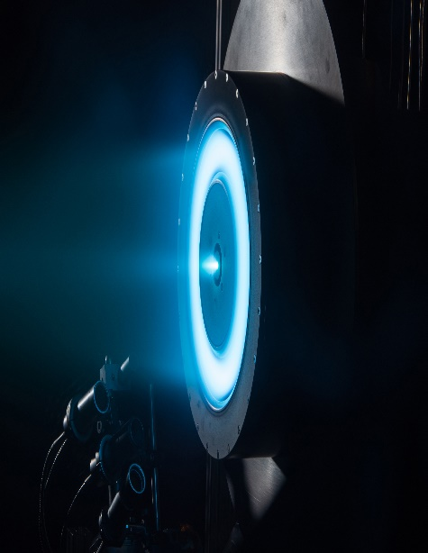
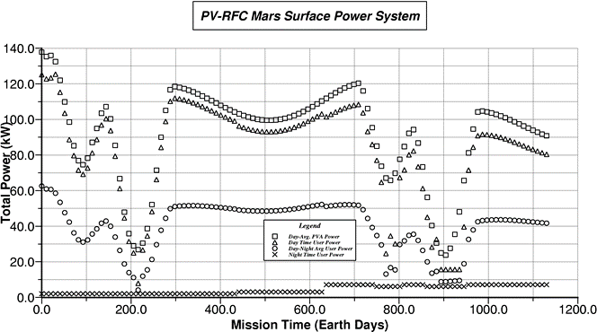
SPACE Versions
ISS
1988-present:
Originally designed to model the Space Station Freedom (and later ISS) EPS;
Still used for ISS today.
Validated many times with ISS on-orbit telemetry measurements.
Gateway PPE
2003:
Runner-Up for NASA Software of the Year
2010’s-present:
“ECAPS” mode expanded to model various spacecraft (including MPCV and PPE) in support of NASA’s new crewed programs
Derived Tools
MSEPS
(Mars Surface Electric Power System)
SEPSim
(Solar Electric Propulsion Simulator)
Integrates orbital mechanics for EP trajectories
Orion MPCV
Predicts Mars solar EPS performance, incl. dust storm effects

Slide 4

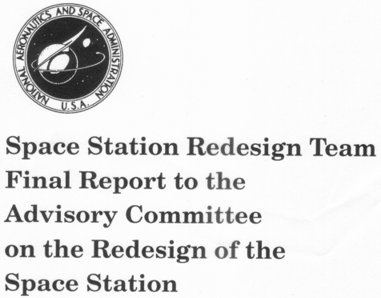
Brief History of SPACE use for ISS
Originally a tool for NASA IV&V of Rocketdyne EPS predictions
Unique features made it useful for in-line DDT&E work
Major architecture trades (e.g. Space Station Redesign of 1993)
Assembly planning (e.g. P6 SAW retraction/ relocation/ redeploy)
Design analyses at the request of Boeing, ESA, RSA and others
DAC and VAC analyses for the VIPER team
Validation of Boeing’s EPSOP EPS model

Slide 5
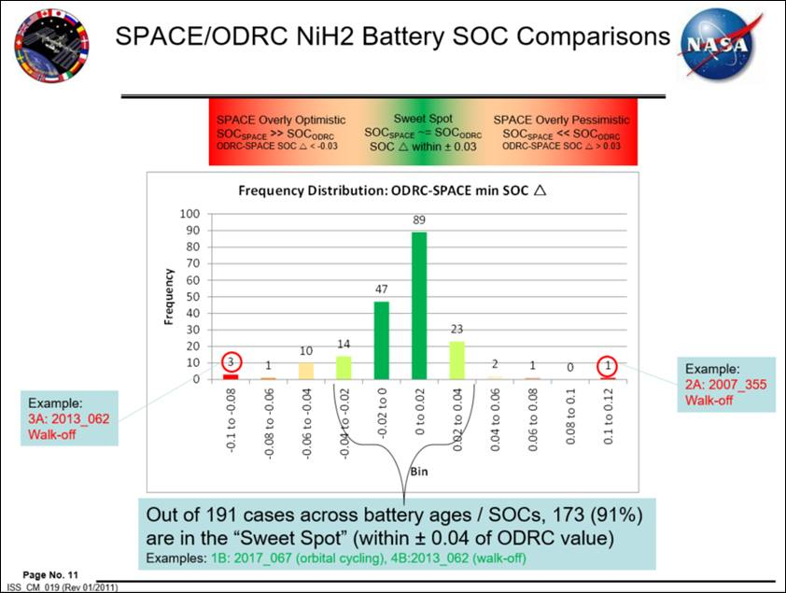
History of SPACE use for ISS (cont.)
SPACE has been validated using on-orbit telemetry
9 validation episodes performed
Input: telemetered load profiles, orientations, SAW positions
Output: currents and voltages, battery SOC
Results typically match telemetry within favorable ranges
CoFR analyses
Prior to most visiting vehicle missions
Load profiles from JSC/Boeing STELAR; SAW positions from SACM
Predict battery SOCs; Check for voltage/current/power exceedances
Results presented to VIPER team

Slide 6
SPACE and Real-Time Operations
SPACE team has a close working relationship with JSC MOD/FOD
SPACE was used to help validate performance of the Power Resource Officer’s (PRO) BSAM power model
SPACE source code delivered to JSC for incorporation into BSAM/ PLATO, including:
Thermal model of heritage ISS solar arrays
Lithium-Ion battery models
Performance and thermal model of the new IROSA solar arrays (model validation ongoing)
SPACE will be used by FOD Mechanisms and Power Officer (MPO) for Gateway operations

Slide 7
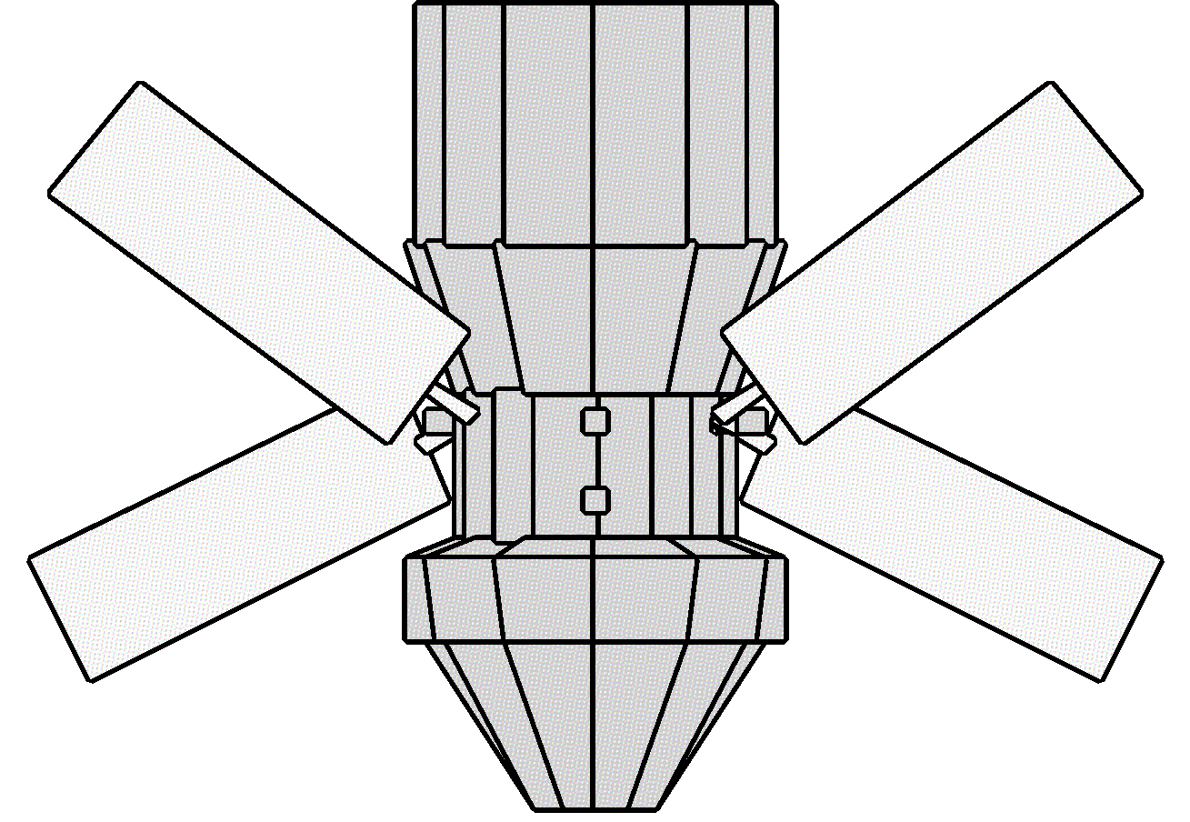
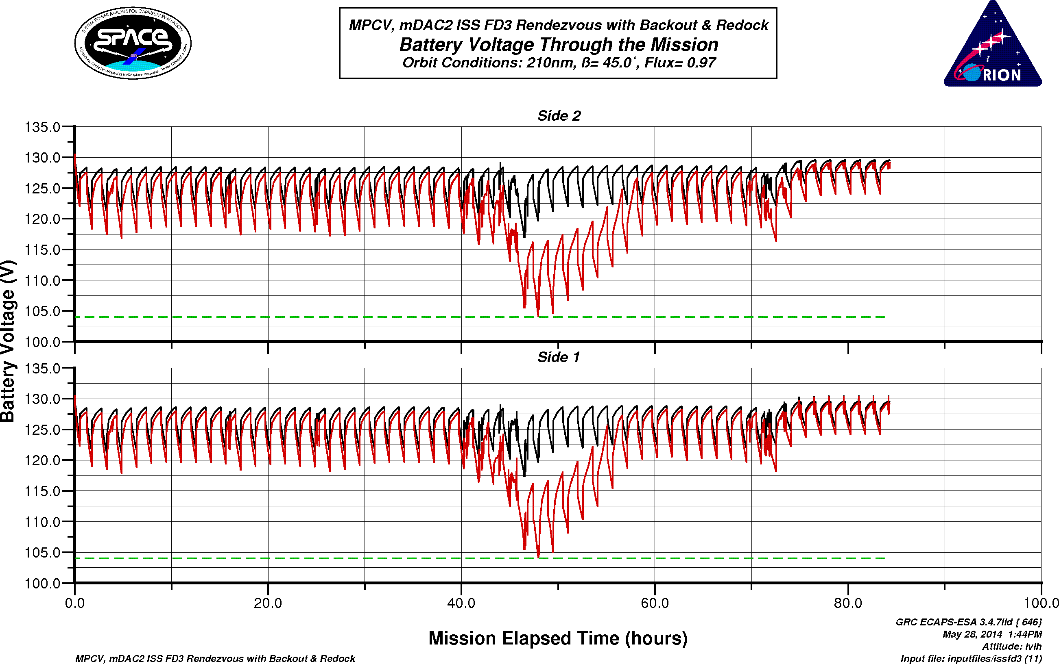
History of SPACE on MPCV
SPACE modified to model the Orion power system
Added capabilities: Lunar orbits, TJ solar cells, etc.
Use to support EPS development:
Assisted LM in validating their early power model predictions
Assessed Orion ISS missions with shadowing from ISS elements
Orion ESM development
SPACE results set ESM power requirements
Special studies (e.g. SAW position trades)

Slide 8
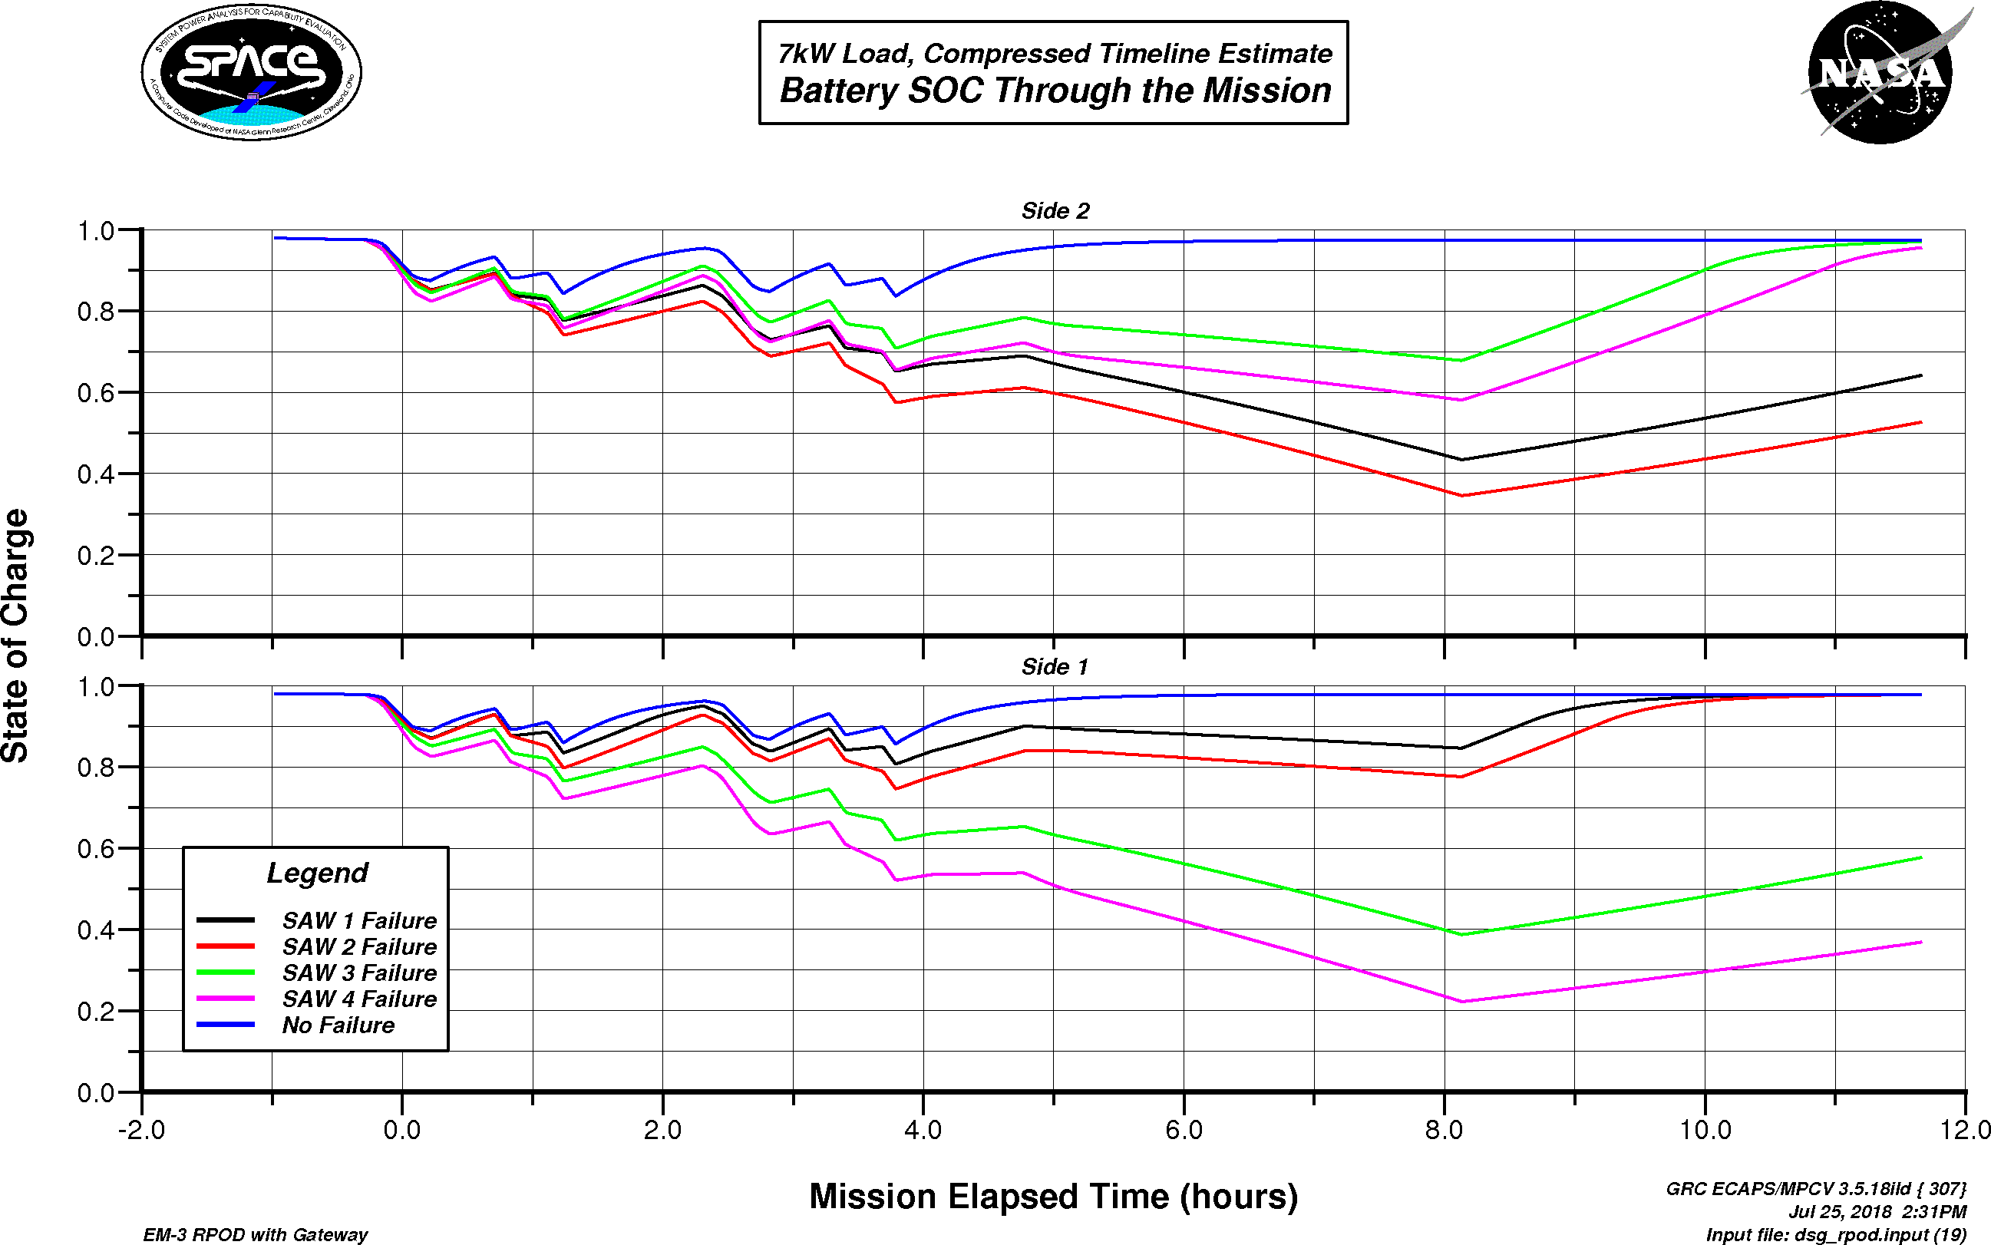
History of SPACE on MPCV (cont.)
Co-validated with LM’s SPOC code
LM used model comparison to SPACE for their validation
Current validation against Artemis I flight data is ongoing
SPACE pointing algorithms assisted in LM developed FSW algorithms
MAIA activities
Used for NASA internal studies for out-year missions
MPCV docking with co-manifested payload and Gateway
Alternate orbit and attitude trade studies
Impact of SAW burn position constraints on power generation

Slide 9
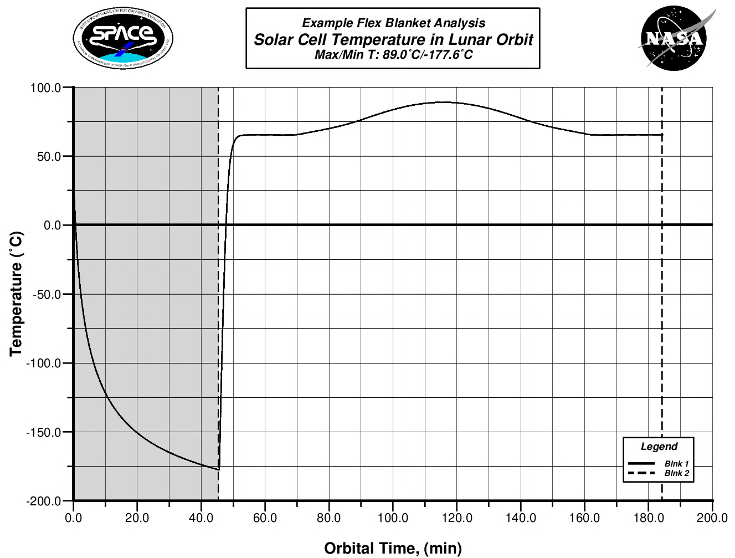
Types of Power Analyses SPACE Can Do
Power Generation
Max power capability as a function of orbit, array constraints, age, etc.
Energy Balance
Ability of EPS to meet time-varying load demand and stay in energy balance
Optimal Gimbal Lock Angles
Determine best angle to park SAW within constraints
Eclipse Times
Predict eclipse times for specific orbits
SAW Temperatures
Max/min temperatures to assess hardware survivability
Long Term Degradation
Power degradation curves over life of the spacecraft
Parametrics
Performance as a function of various inputs: altitude, age, β angle, eclipse time, etc.

Slide 10
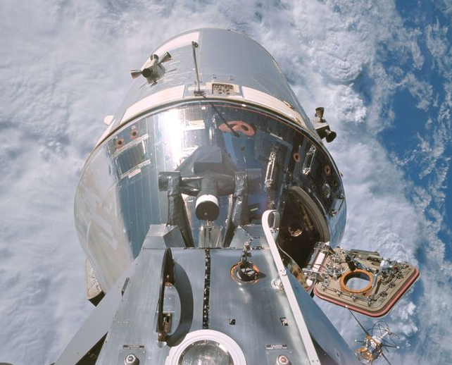
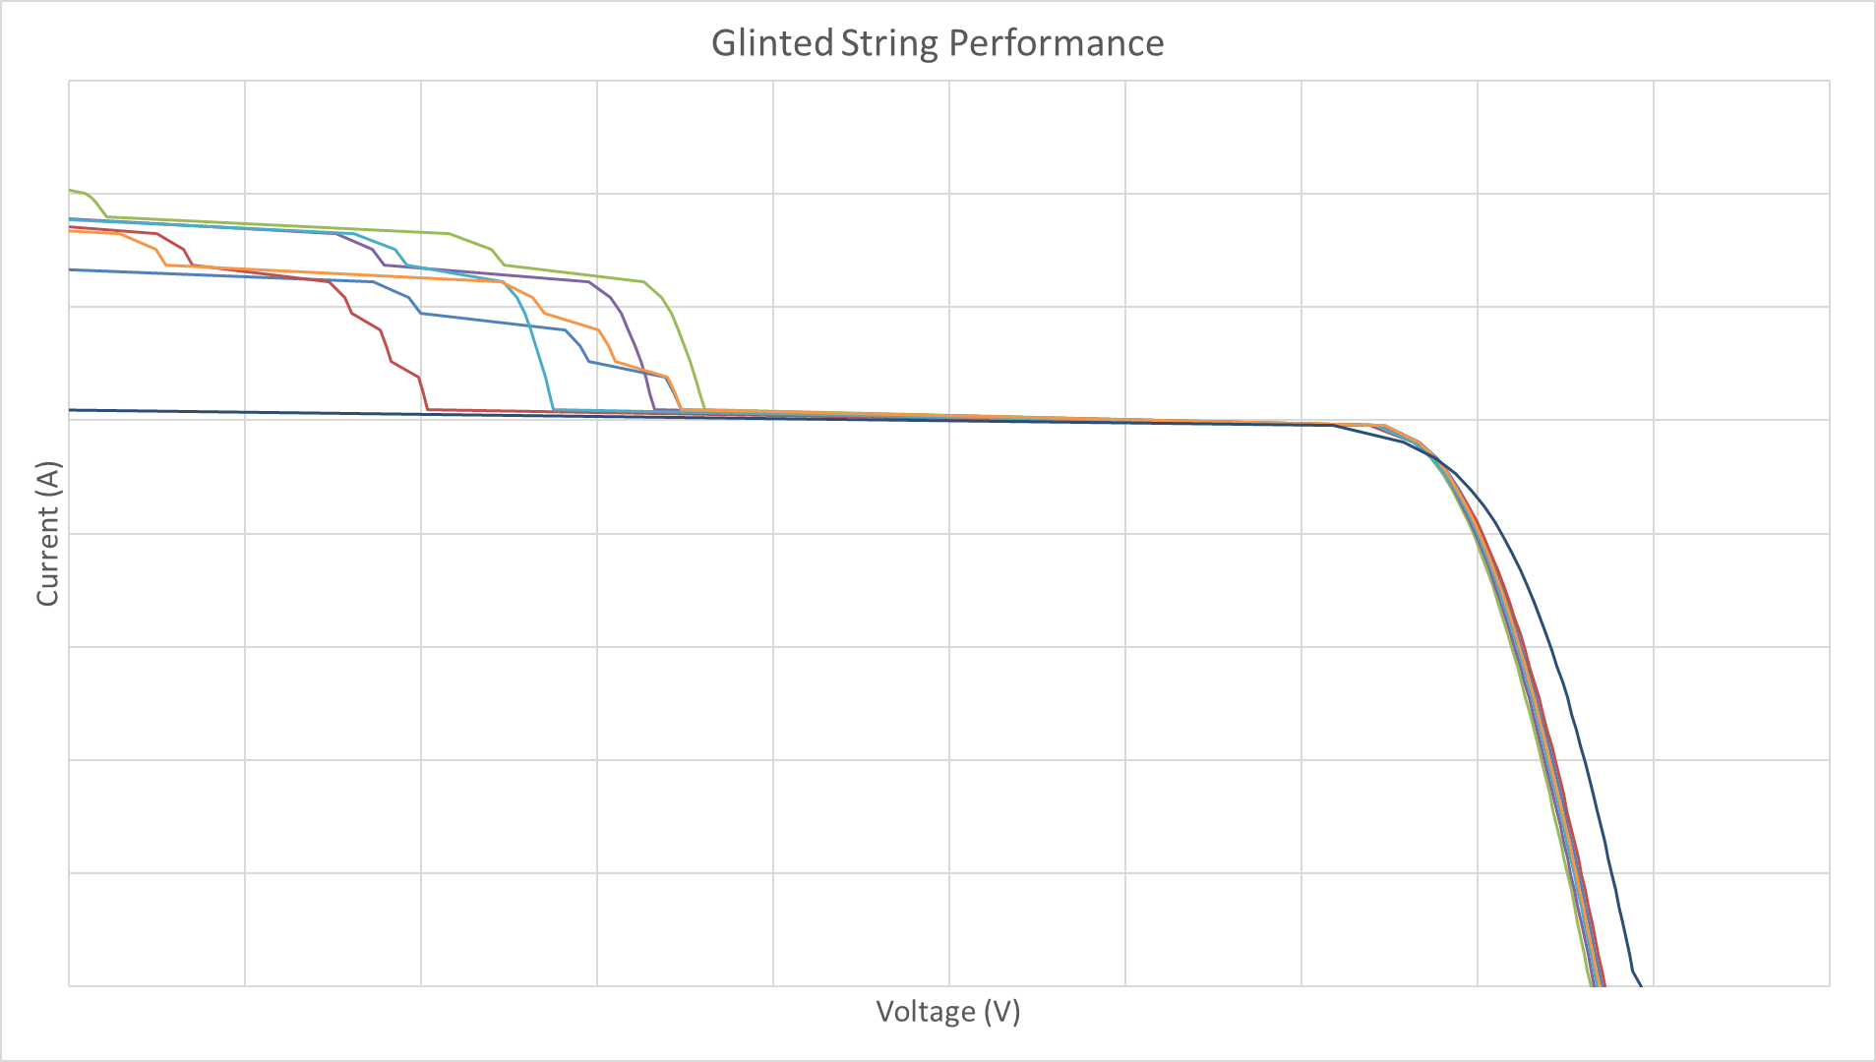
Solar Array “Glint”
Localized high-flux intensities can occur when sunlight is reflected off specular (mirror-like) surfaces in the spacecraft design
Often referred to as “glint” or “spacecraft albedo”
Highly interdisciplinary issue
SPACE can be used to perform such assessments
SPACE can model varying flux levels across a set of cells to determine the combined solar array string performance
SPACE’s integrated thermal model can be used to determine the resulting increase in cell operating temperatures – does this violate qualification limits?
While extra flux leads to more power generation, upstream components may not be designed to handle these higher current levels (derating and thermal issues)

Slide 11
SPACE is a Complex Integrated Model
Orbit Mechanics
Orbit position
Spacecraft attitude
SAW pointing
Environments
(VF, heating rates)
Solar flux level (min, max, avg)
Planet heating (albedo, OLR)
View factors of front/back of SAW surfaces
Solar cell IV model
String/circuit configuration (channel map)
Cell operating temperatures
Cell degradation
Harness and diode losses
Shadowing
Power System Model
Solar Array Model
(IV, temperature)
PMAD Hardware Component Models
(SSU, MBSU, BCDU, etc.)
Efficiency curves based on power/voltage
Resistive losses
Model Outputs (Plots, graphs)
Battery SoC/capacity
Predicts battery voltage based on test data
Life modeling (degradation)
Battery Model
(I, V, SoC)
PMAD Load Flow Model

Slide 12

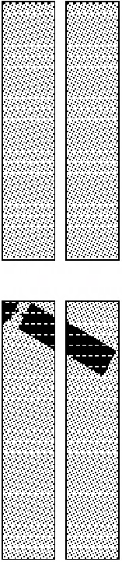
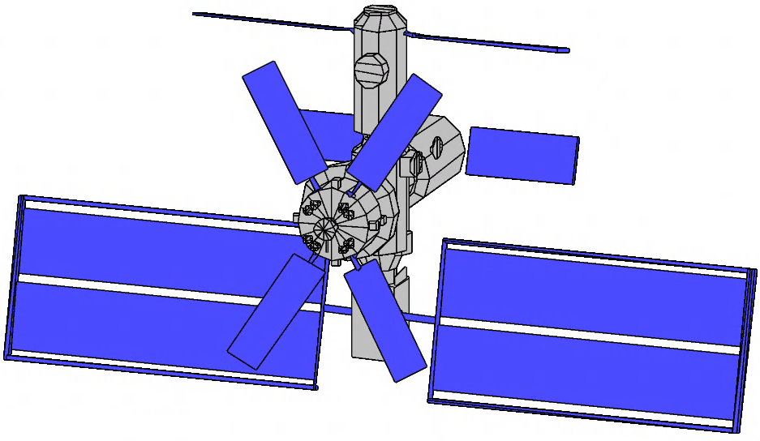
Shadowing Model
Calculates shadows cast by nearby hardware to compute realistic array power
Uses actual solar cell and wiring layout
Properly computes string-by-string power loss (not just shadowed area)
SPACE shadowing process:
Model external spacecraft geometry on-orbit
Incorporate electrical layout for array(s) of interest
Orient vehicle (attitude) and gimbal components
Optimize array/radiator pointing within constraints
Account for gimbal locks, keep-out zones, etc.
Calculate solar array shadow patterns
3D ray intersection method
Every solar cell checked for shadowing
Assess array performance from shadow patterns
(4)
(5)
(1, 2, 3)

Slide 13
SPACE as Digital Engineering
SPACE models performance that cannot be fully tested on the ground
Spacecraft EPS performance depends on environmental factors that cannot be fully replicated
In the case of ISS and Gateway, components may be physically too large to test the full system under flight-like conditions
Integrated, interdisciplinary modeling allows SPACE to provide accurate, timely results
Modeling non-electrical inputs makes for a more accurate model
Incorrect assumptions on something like solar cell temperature could have major impacts on the bottom-line results
One integrated code allows for faster analysis turnaround
Focus on the fidelity necessary for power analysis, without getting bogged down
Ex: modeling solar array temperature, but without running a full vehicle-level thermal model
Speeds up code execution time and reduces inputs required
Makes SPACE an ideal tool for “what if” studies or parametric comparisons
Allows power analysts to quickly modify inputs and assumptions without requiring additional work or modeling from other teams

Slide 14
SPACE in the Future
Continuous ongoing development effort to expand SPACE’s capabilities
Known as SPACE Next Gen
Goal is to modularize and generalize
Clearly define interfaces between functions/models within the code
Allow for a “plug and play” approach where higher-fidelity models can be swapped in when necessary
Maintains advantages of one integrated code while adding flexibility for more complicated cases
Ex: recently added ability to read a trajectory file, bypassing built-in orbit mechanics
Modeling of spacecraft power systems is an ongoing need
Larger, more complicated systems and missions will require careful evaluation
Incorporating tools like SPACE early in the lifecycle can help inform and improve the design
Simulation of near-term future is an important function for operations
Generalizing SPACE will increase its utility and decrease development time when modeling a new project

Slide 15



Questions?
Spencer Furin
Power Architecture and Analysis Branch
NASA Glenn Research Center
spencer.c.furin@nasa.gov

Slide 16

Backup

Slide 17
Selected SPACE References
Klefman, Brandon, Tian, Lucia, “SPACE-Gateway: Modeling the Electrical Performance of the Gateway Power and Propulsion Element (PPE) Solar Arrays”, SPRAT 27, SPACE-Gateway: Modeling the Electrical Performance of the Gateway Power & Propulsion Element (PPE) Solar Arrays - NASA Technical Reports Server (NTRS)
McKissock, D.B., “Development and Use of the SPACE Computer Code for Analyzing the Space Station Electrical Power System”, NASA SP-2018-639
Miller, S.G., et. al., “The SPACE Computer Code for Analyzing the International Space Station Electrical Power System: Past, Present, and Future”, AIAA 2018-4635
Delleur, A.M. and Propp, T.W., "Space Station Power Generation in Support of the Beta Gimbal Anomaly Resolution", NASA TM-2003-212012
Delleur, A. and Kerslake, T., "Managing ISS US Solar Array Electrical Hazards for SSU Replacement via EVA", AIAA-2004-5500
Delleur, A.M. and Kerslake, T.W., "Electrical Performance From Bifacial Illumination International Space Station Photovoltaic Array", AIAA Journal of Spacecraft and Rockets, Vol. 42, No. 1, p. 171-176, January-February 2005
Fincannon, J., "Analysis of Shadowing Effects on Spacecraft Power Systems", NASA TM-106994, 1995
Fincannon, J., et. al., "Load-Following Power Timeline Analyses for the International Space Station", NASA TM-107263, 1996
Fincannon, J., "Comparison of ISS Power System Telemetry with Analytically Derived Data for Shadowed Cases", NASA TM-2002-211715
Hoffman, D.J. and Kolosov, V., "Zarya Energy Balance Analysis: The Effect of Spacecraft Shadowing on Solar Array Performance", NASA TM-1999-209299
Hojnicki, J.S., et. al., "Space Station Freedom Electrical Performance Model", NASA TM-106395, 1993
Hojnicki, J.S., et. al., "Adaptation and Re-Use of Spacecraft Power System Models for the Constellation Program", NASA TM-2008-215425
Jannette, A.G., et. al. "Validation Of International Space Station Electrical Performance Model Via On-Orbit Telemetry", NASA TM-2002-211803
Kerslake, T.W., et. al., "System Performance Predictions For Space Station Freedom's Electrical Power System", NASA TM-106396, 1993
Kerslake, T.W. and Gustafson, E.D., "On-Orbit Performance Degradation of the International Space Station P6 Photovoltaic Arrays", NASA TM-2003-212513

Slide 18
Acronyms
AMPS: Advanced Modular Power Systems
APC: Autonomous Power Controller
CDF: Common Data Format
DAC: Design Analysis Cycle
DDT&E: Design, Development, Test and Evaluation
EPS: Electrical Power System
ESA: European Space Agency
ESM: European Service Module
EVA: Extra-Vehicular Activity
EVR: Extra-Vehicular Robotics
FSW: Flight Software
GRC: Glenn Research Center
HALO: Habitation And Logistics Outpost
ISS: International Space Station
IROSA: ISS Roll Out Solar Array
IV&V: Independent Verification and Validation
LeRC: Lewis Research Center
LM Lockheed Martin
MAIA: Mission Analysis and Integrated Assessments
MPCV: Multi-Purpose Crew Vehicle
MSEPS: Mars Surface Electric Power System
NRHO: Near Rectilinear Halo Orbit
PLATO: Power Planning and Analysis Tool
PMAD: Power Management and Distribution
PPE: Power and Propulsion Element
ROSA: Roll-Out Solar Array
RSA: Russian Space Agency
SACM: Solar Array Constraints Matrix
SAW: Solar Array Wing
SEPSim: Solar Electric Propulsion Simulator
SOC: State of Charge
SPACE: System Power Analysis for Capability Evaluation
SPOC: Spacecraft POwer Capability
STELAR: Spacecraft Time-phased Electrical Loads Analysis and Resources
VAC: Verification Analysis Cycle

