Slide 1
Enabling Map Data Interoperability within Artemis Lunar Surface Operations
Presenter: Matthew Miller, Ph.D.
Artemis Internal Science Team – Software Systems Lead
Virtual Session 20: Geological Mapping to Support Artemis Strategic Decisions
August 17, 2023

Slide 2
Enabling Artemis Science
HQ Leadership
(Sarah Noble and Jake Bleacher
w/Amanda Nahm and Debra Needham)
Project Science (Deputy TBD)
Art. Internal Science Team (AIST)
Geology Team
Deployed Instruments (Competed and Contributed)
Participating Scientists
Science Mission Directorate (SMD) is actively building the team(s) of people to ensure Artemis missions are scientifically successful
Today’s talk specifically focuses on the work happening within the Internal Science Team regarding the topics of Data and Software
Ultimately, lunar map data is a foundational to ensure mission operations and decision-making
PE Support
Science Reports
Planning & Data
Training & Ops
Samples
Payloads

Slide 3
AIST Data and Software Mission & Vision
MISSION: What are we trying to achieve?
The AIST Data and Software Team mission is to organize and make science mission data useful for Artemis mission personnel and the broader public scientific community.
VISION: What does the world look like when we’ve achieved this mission?
Interoperable science mission data and software capabilities are created and made available for mission personnel to support Artemis missions.
All phases of Artemis missions, from concept formulation to post-mission execution, leverage traceable, consistent, applicable, valid, and necessary scientific data.
Science mission data is made available for all internal/vendor mission support and the broader public scientific community
  As much Artemis Mission data as possible is exposed to the public via an Artemis Mission Data - Application Programming Interface (API)
  Long term archiving/curation systems connects to this API

Slide 4
AIST Data and Software Mission & Vision
STRATEGY: What’s our plan for achieving the vision?
Consolidate, create, and curate lunar science data.
Distribute lunar science data to support Artemis mission activities.
Create and deploy interoperable data and software functionality needed for Artemis mission personnel.
Lower the barrier to accessing lunar science data for mission operations personnel and the broader public scientific community by creating an Artemis Mission Data API endpoint for internal NASA/vendor users and the public.
Artemis Geospatial Data Team
EVA Mission System Software
For today’s conversation and venue, science data here specifically emphasizes geologic mapping focused data products

Slide 5
Artemis Geospatial Data Team
The Artemis Geospatial Data Team was established in 2022 to coalesce agency-wide geospatial data creation and analysis skillsets to meet the growing demand for lunar surface map products and analyses.
  This team is comprised of personnel that span many NASA directorates and centers.
    See references HERE and HERE for more detail authored by my colleagues Dr. Lawrence and Dr. Petro.
Artemis III site selection process is ongoing and AGDT is ensuring decision-makers have the highest-resolution and most scientifically valid lunar surface data products and analysis results
Artemis geospatial data management system is being built to host, curate, and distribute Artemis data.
  Server hardware and infrastructure is under active development to ensure the geospatial products necessary for Artemis can be controlled for quality, accuracy, and availability to all relevant parties.
  This capability will ensure the correct data can reach the correct Artemis members to inform mission development and ensure we can get these products back out to the scientific community
Documentation of products and processes is underway.
  For example, see the ACD-50044 Rev A Lunar Surface Data Book publicly available on the NTRS
  Geologic Maps are currently Reserved for future development

Slide 6
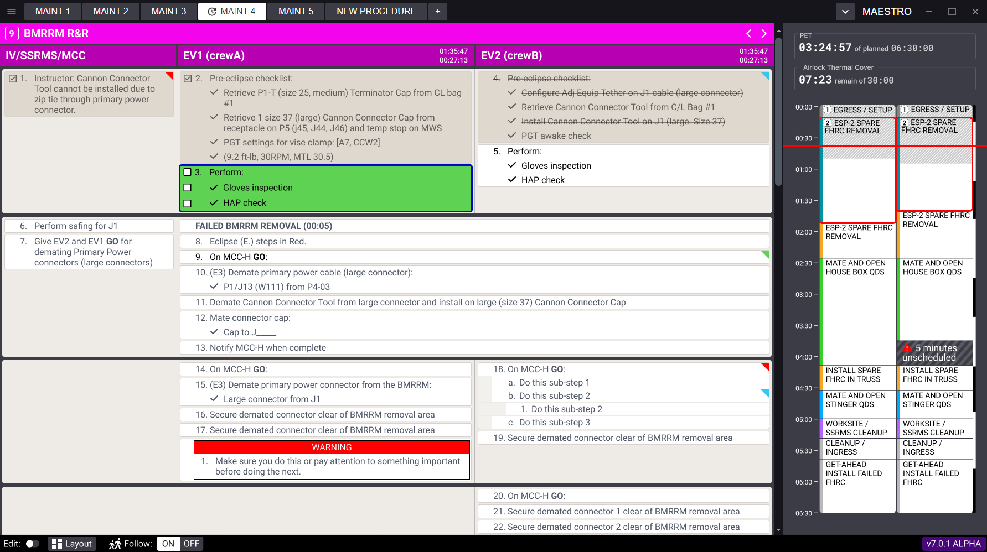
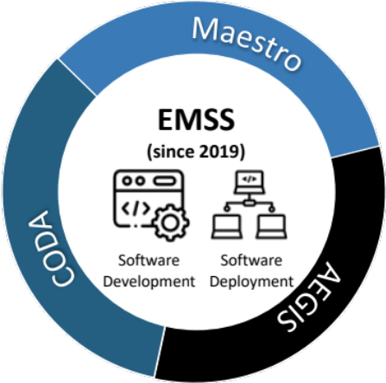
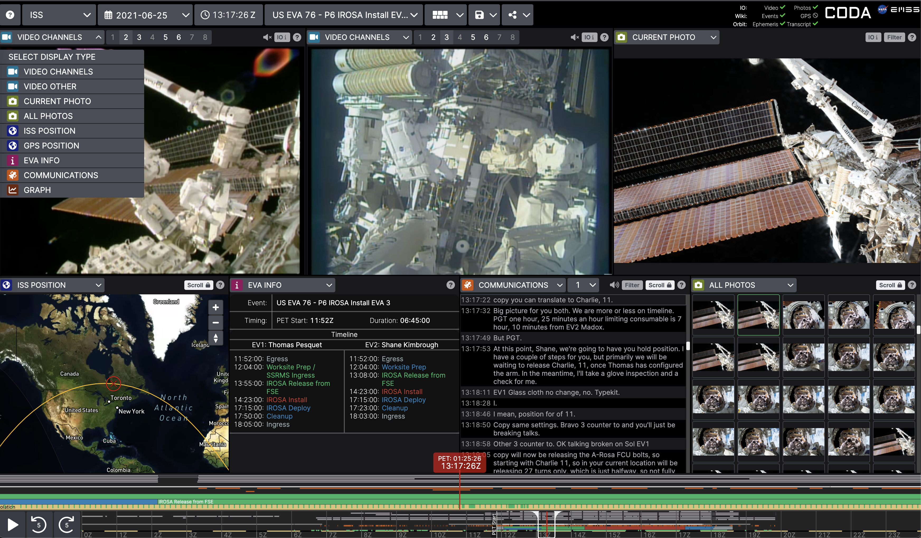
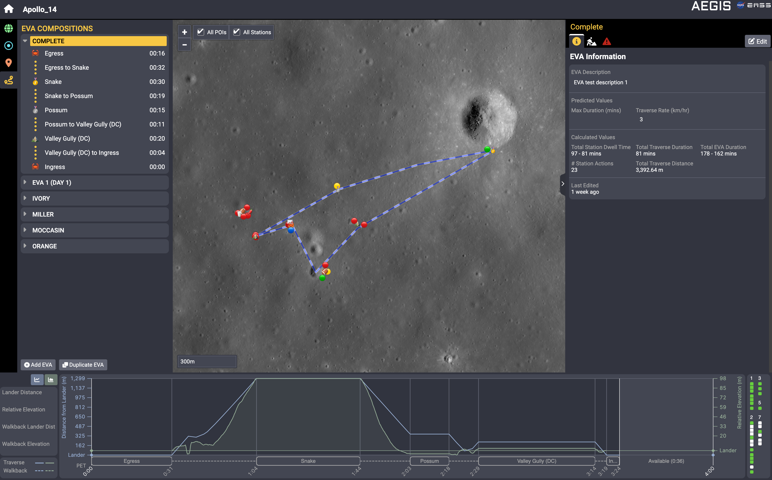
EVA Mission System Software (EMSS) Initiative
Digitizing EVA Procedure
Authoring and Execution
Developing new software systems via the EVA Mission System Software (EMSS) Effort for the Artemis era
  Near-term: Mission support systems development that unite spatial and temporal data to enable both mission personnel and the broader scientific public
  Future: Advanced informatics such as spacesuit augmented reality for crewed EVAs
Software systems development is integrated with the EVA Human and Surface Mobility Program (EHP) testing program
  Using analog and testing opportunities, like JETT-5 to refine needs and improve software tools to meet science needs
Putting Mission Data into Mission Context
Enabling spatiotemporal awareness for EVA Procedure Authoring and Execution
EMSS is enabling Science and Operations dialog via the data connections we’re enabling in our tools
See for More Detail: Miller, M.J., et al., (2023) Supporting Exploration Missions by Enabling Exploration Mission System Software, 52nd International Conference on Environmental Systems ICES-2023-242, 16-20 July 2023, Calgary, Canada

Slide 7
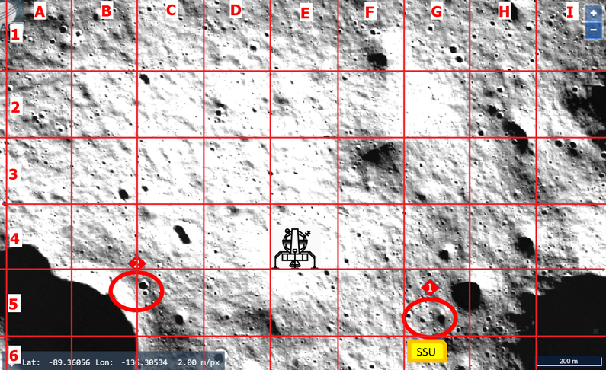
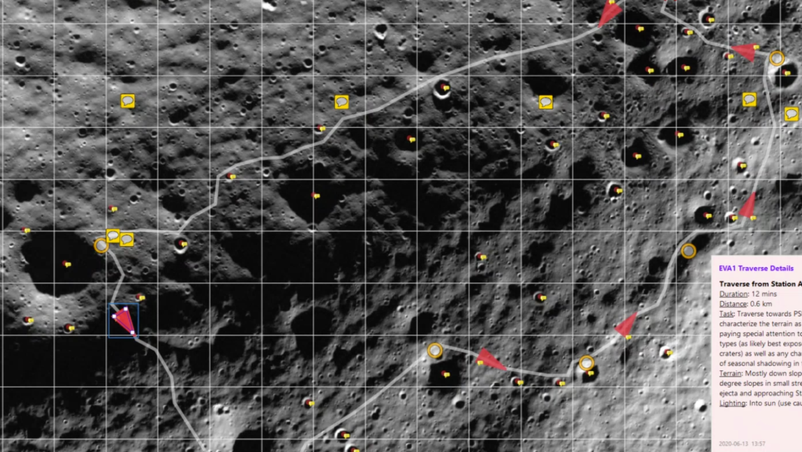
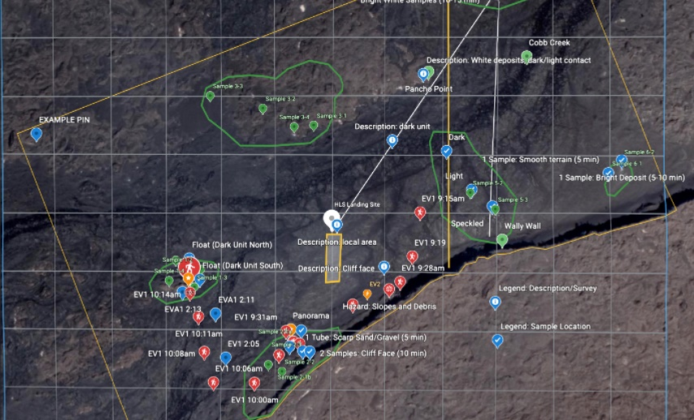
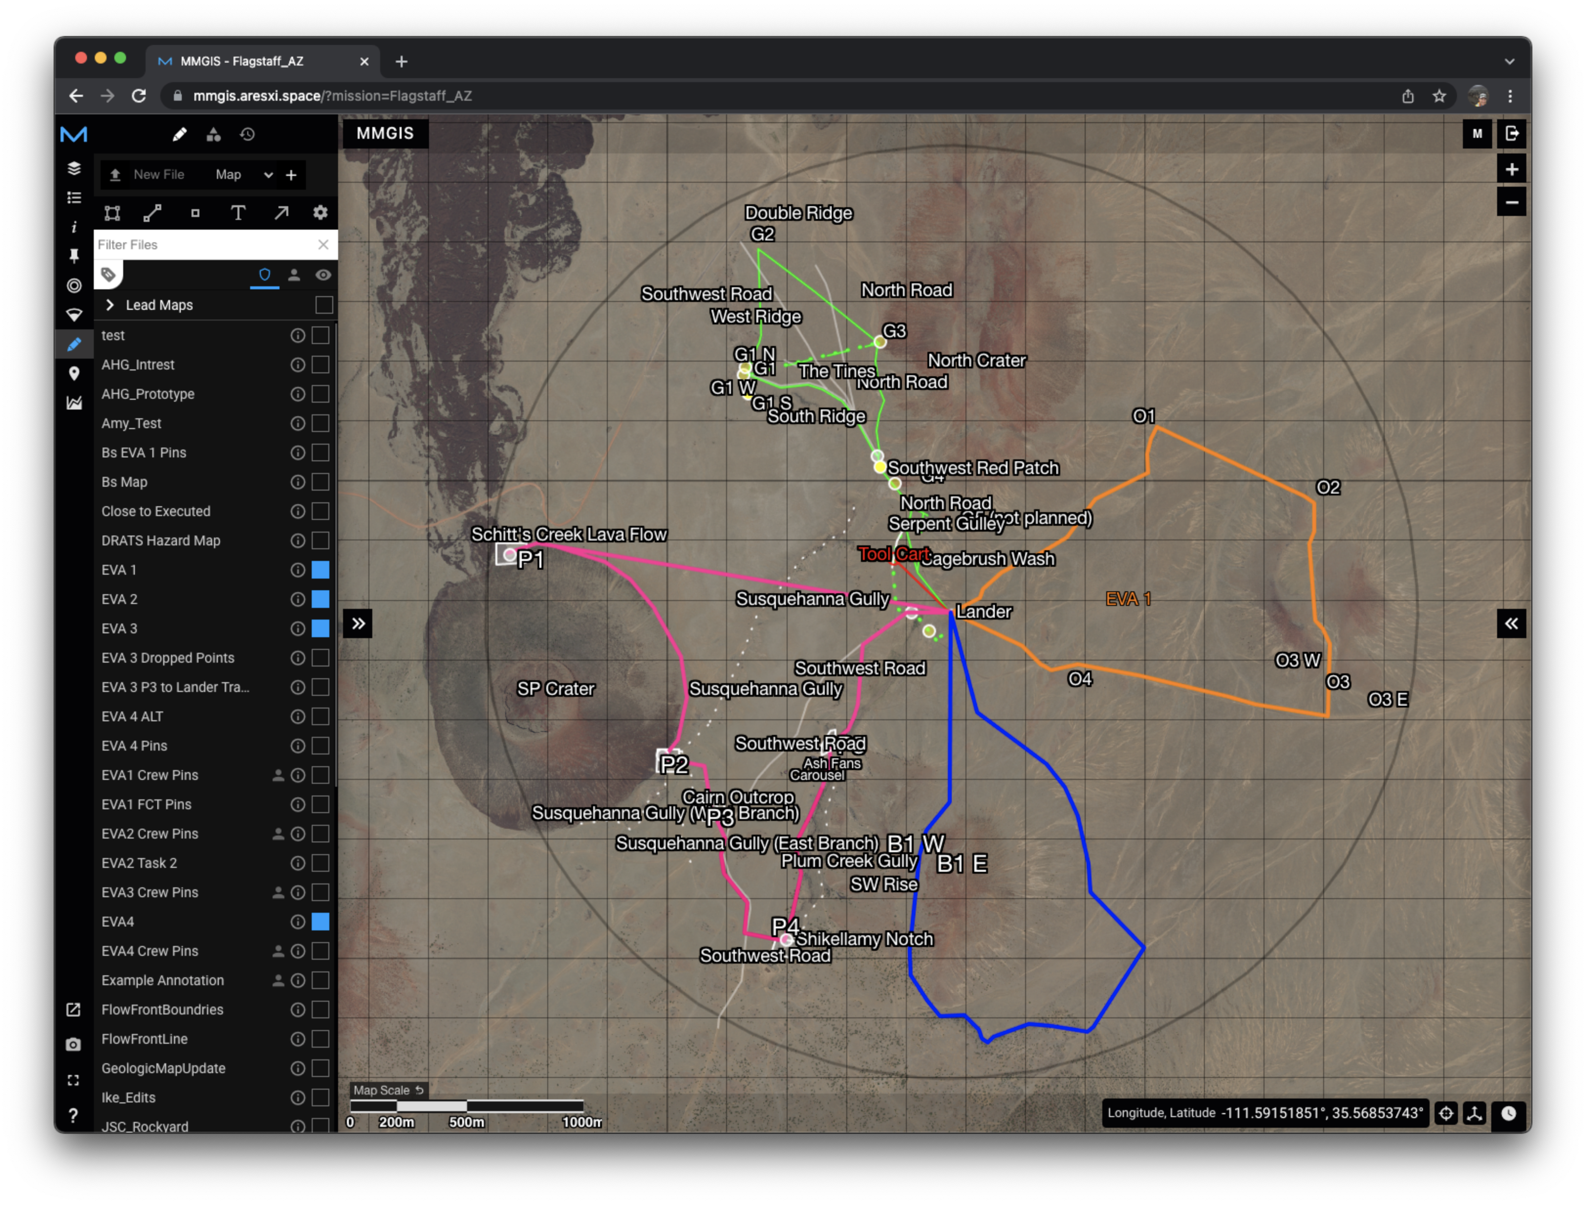
Discovering EVA Traverse Planning Capabilities
Iterative Design and
Test Philosophy with EVA Flight Operations Personnel
Plain image
Feb 2020 FCPTT
Annotated PDF
Jun 2020 FCPTT
Google Web Earth
April 2021 FCPTT
MMGIS prototype for DRATS 2021, JETT2/3 2022
EMSS Team has been iteratively discovering and enabling relevant EVA mission operations capabilities on top of and interacting with underlying map data
AEGIS for JETT5+ 2023

Slide 8
Enabling Science Throughout the EVA Development Process
Science Team Consult
If required, EVA Science consults SER on specific priority science questions.
Mission Architecture Assumptions
Test Team Definition of traverse constraints
Science Team Prep Work
Points of Interest Definition
Science Team Prep Work
Station Definition and Prioritization
EVA Composition
Inputs
Points of Interest
Stations
Flight Products
Science Team Prep Work
Science Team Onboarding
Exploration Area First Impressions
Geologic Mapping
Science Question Definition (STM)
Task Traverse Drafting
Task identifies traverse routes between stations
Drafting of EVA timelines
Traverse Review
ESO and Task review traverse options
EVA Science returns priority questions to Science Team (as needed)
Geologic Maps become a foundational input upon which EVA plans are developed

Slide 9
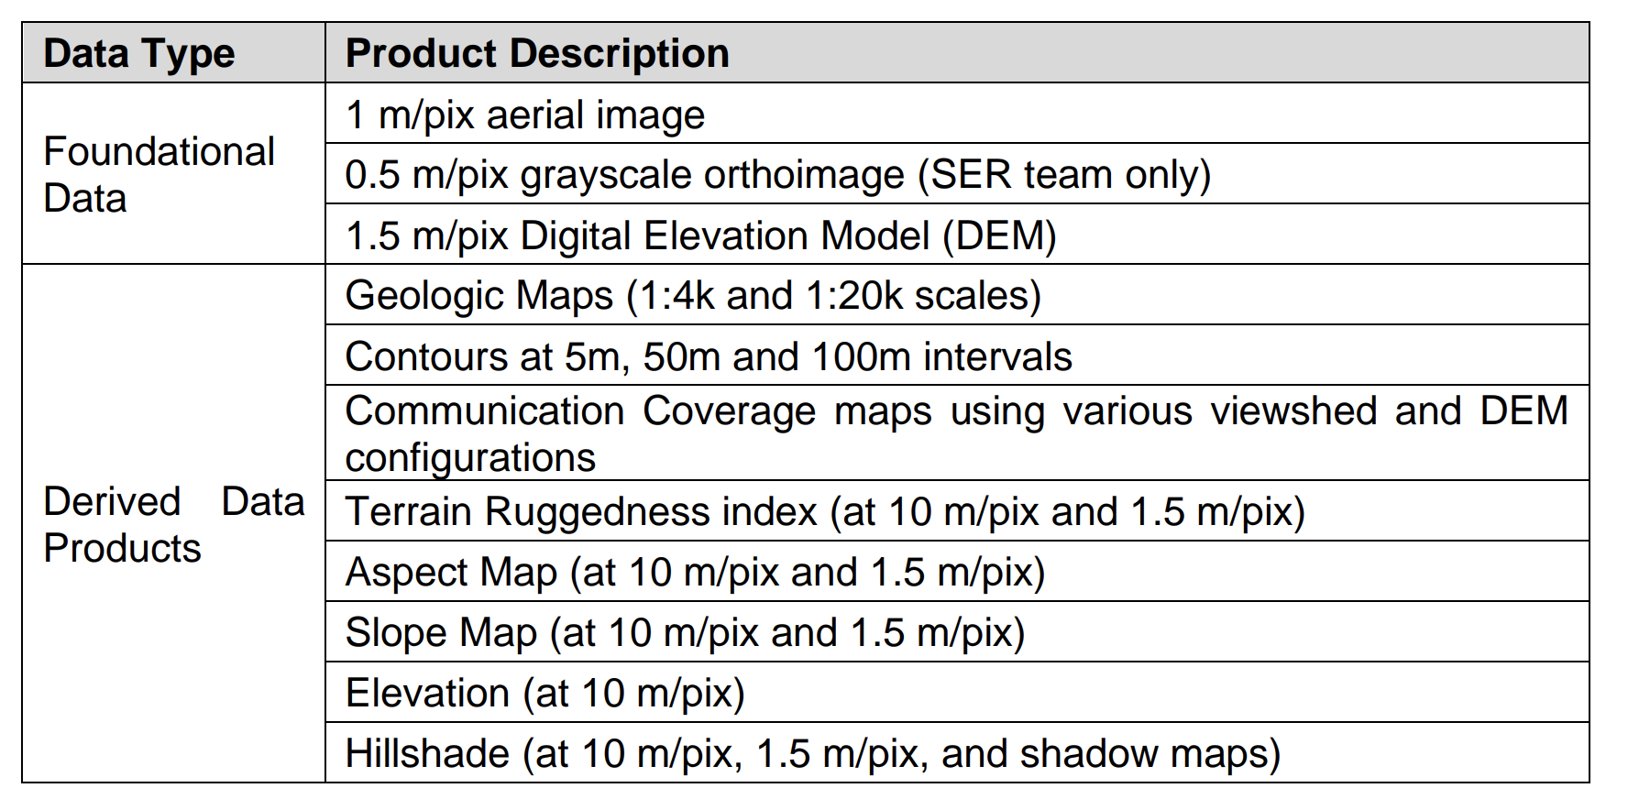
Specific Map Products Currently being Handled in Field Testing
JETT3 Map Product Summary
JETT5 Map Product Summary (in work)
two 1:5,000-scale geologic maps (one for each site) using expected lunar equivalent data and spatial resolution:
  GeoEye grayscale orthoimagery (1 m/px) and associated digital elevation model (DEM; 1.5 m/px);
  Maxar grayscale ortho-imagery (1 m/px) and DEM (1.5 m/px);
  National Agricultural Imaging Program (NAIP) contrast-stretched 3-band color aerial images (1 m/px);
  NEXT Map X-band (3 cm) radar imagery (1 m/pix).
Contacts and features were exclusively drawn on a grayscale image base (NAIP Band 3 (red) data for Primary, GeoEye for Secondary) comparable to lunar images from the Narrow Angle Camera.
Units and outcrops were defined and described using all the data available.
Citations of Interest, See Joint EVA Test Team 3 (JETT3): Preparing for the Artemis III Campaign at the LPSC 2023 website, see References HERE and HERE
See Upcoming LEAG 2023 paper: JETT5 Geologic Mapping In Support Of Simulated Artemis Surface Operations: Process And Preliminary Products. Additional publications summarizing JETT5 mapping efforts will follow

Slide 10

Artemis is not Apollo. We live in a world of 21st century digital capabilities and we need to apply these skills to the advancement and success of Artemis missions
Geospatial data is paramount to underpinning the development and execution of Artemis missions.
Contact matthew.j.miller-1@nasa.gov if you have suggestions on how geologic mapping products and capabilities can enable the endeavor.
With Us

Slide 11





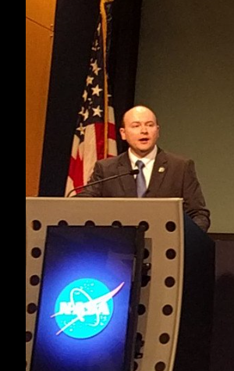
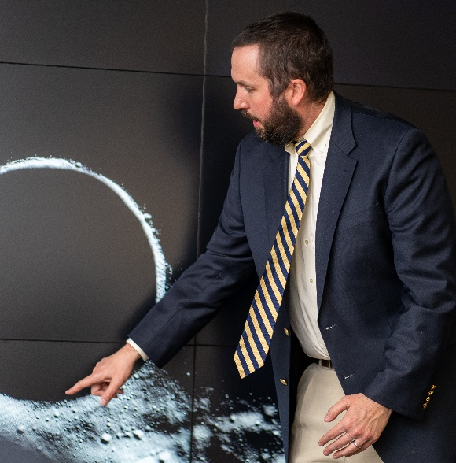

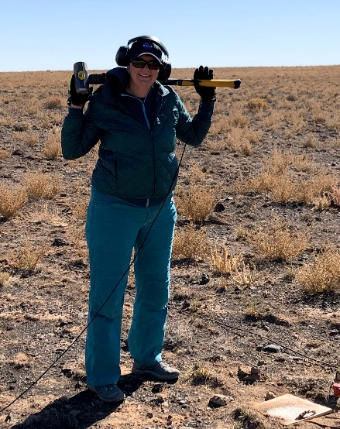
Artemis Internal
Science Team
Artemis Lunar Science Lead: Sarah Noble
Deputies: Debra Needham, Amanda Nahm
        Training and Strategic Integration Lead - Cindy Evans
        Science Flight Operations Lead - Kelsey Young
        EVA Hardware and Testing Integration Lead - Trevor Graff
        Sample Integrity Lead - Barbara Cohen
        Contamination Control Scientist - Andy Needham
        Artemis Curation Lead - Ryan Zeigler, Acting
        Mission Planning and Science Implementation Lead - Sam Lawrence
        Spatial Planning and Data Lead - Noah Petro
        Software Systems Lead - Matthew Miller
        SMD Payload Integration Officer - Renee Weber
Training and Ops
Samples
Planning and Data
Payloads

