Slide 1
GFSSP Training Course
André LeClair & Alok Majumdar
Propulsion Systems Department
NASA/Marshall Space Flight Center
alok.k.majumdar@nasa.gov
andre.c.leclair@nasa.gov
Thermal & Fluids Analysis Workshop
August 21-25, 2023
NASA/GSFC

Slide 2
Course Outline
Introduction
Hands-on Demonstration Problems
  Steady-state (Pipe System)
  Transient (Tank Blowdown)
Brief Overview of Mathematical Formulation and Resistance Options
Tutorials
  Waterhammer
  Pipe Chilldown
For more information about GFSSP:
https://www.nasa.gov/gfssp

Slide 3
Background
Generalized Fluid System Simulation Program (GFSSP) Objective
    Provide a generalized and easy-to-use flow analysis tool
Started development in 1994
      General purpose computer program to compute flow network parameters
            Pressure
            Temperature
            Flow distribution in flow network
            With solid to fluid (conjugate) heat transfer
        Initially developed to analyze
          Turbopump Internal Flow
          Propulsion Systems Transient Flow

Slide 4
Navier Stokes or Network Flow Analysis
Computational Fluid Dynamics
(CFD)
Navier Stokes Analysis
(NSA)
Network Flow Analysis
(NFA)
Finite Volume
Finite Difference
Finite Element
Finite Volume
Finite Difference
GFSSP

Slide 5
Navier Stokes or Network Flow Analysis
Navier Stokes Analysis
Suitable for detailed flow analysis within a component
Requires fine grid resolution to accurately model transport processes
Used after preliminary design
Network Flow Analysis
Suitable for flow analysis of a system consisting of several components
Uses empirical laws of transport processes
Used during preliminary design

Slide 6
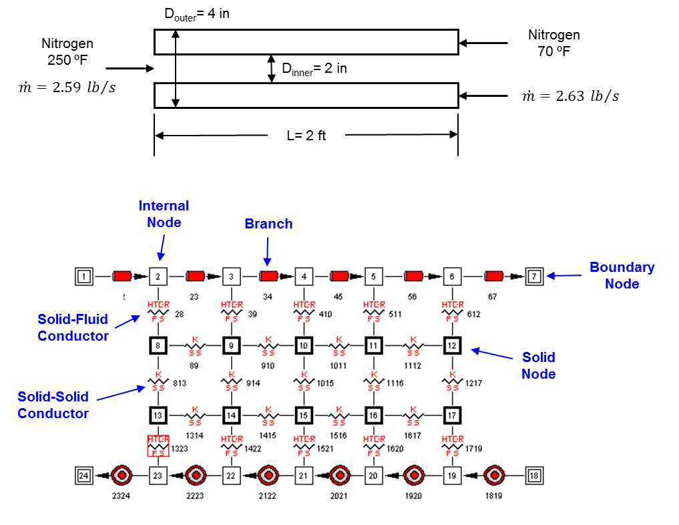
Network Definition
Flow Problem
GFSSP Model

Slide 7
Units and Sign Conventions
Units
External Internal
(input/output) (inside GFSSP)
        Length inches feet
        Area inches² feet²
        Pressure psia psf
        Temperature °F °R
        Mass Injection lb_{m}/sec lb_{m}/sec
        Heat Source Btu/s OR Btu/lb_{m} Btu/s OR Btu/lb_{m}
Sign Conventions
        Mass Input to Node: positive (+)
        Mass Output from Node: negative (-)
        Heat Input to Node: positive (+)
        Heat Output from Node: negative (-)

Slide 8
Mathematical Formulation (1/2)
Principal Variables
  Unknown Variables Available Equations to Solve
  1. Pressure 1. Mass Conservation Equation
  2. Flowrate 2. Momentum Conservation Equation
  3. Fluid Temperature 3. Energy Conservation Equation of Fluid
  4. Solid Temperature 4. Energy Conservation Equation of Solid
  5. Species Concentration 5. Conservation Equations for Mass Fraction of Species
  6. Mass 6. Thermodynamic Equation of State

Slide 9
Mathematical Formulation (2/2)
Auxiliary Variables
              Thermodynamic Properties
              Flow Resistance Factor
              Heat Transfer Coefficient
  Unknown Variables Available Equations to Solve
  Density
  Specific Heats Equilibrium Thermodynamic Relations
  Viscosity [GASP, WASP & GASPAK Property Programs]
  Thermal Conductivity
  Flow Resistance Factor Empirical Relations
  Heat Transfer Coefficient

Slide 10
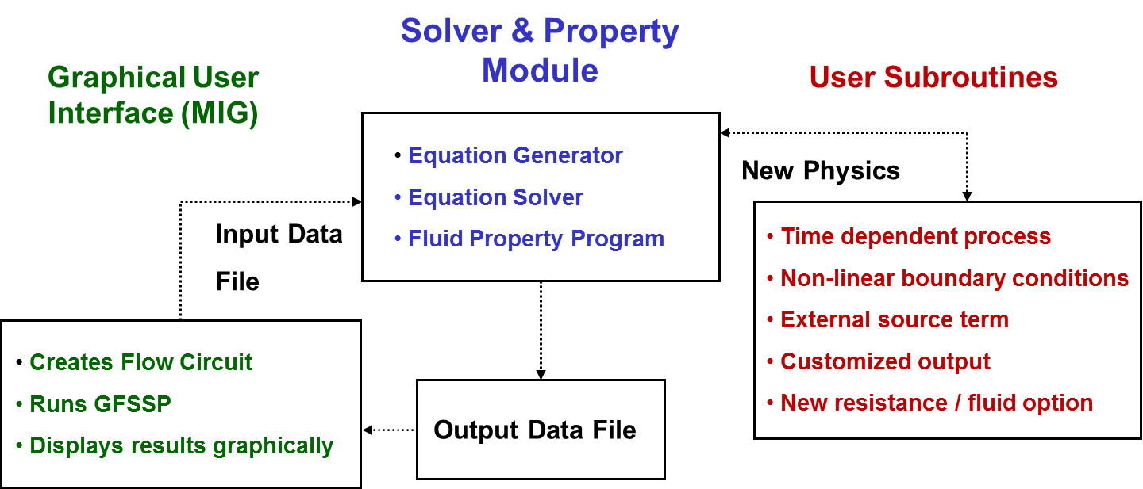
Program Structure

Slide 11

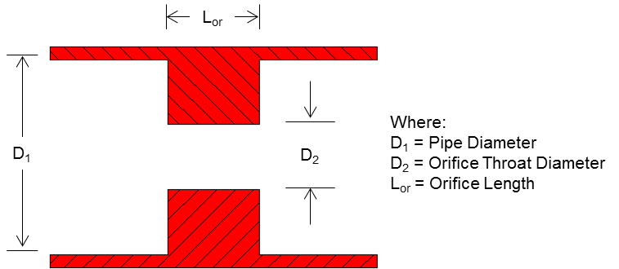

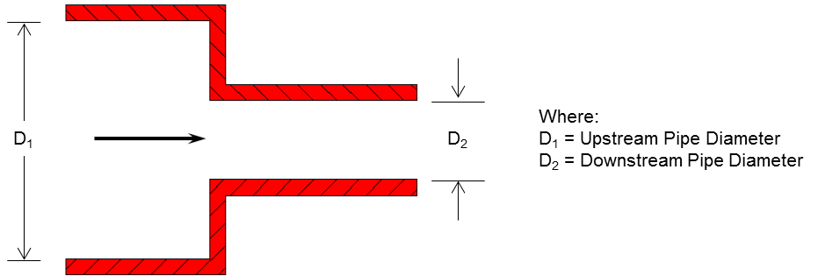
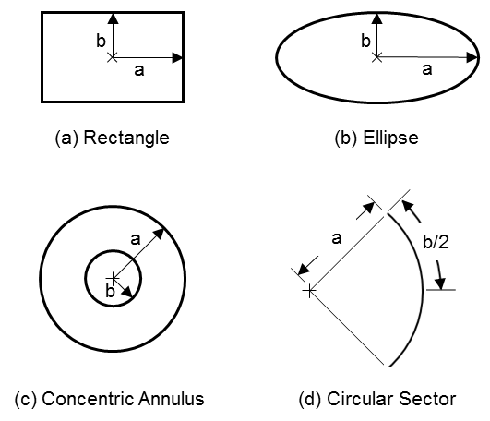
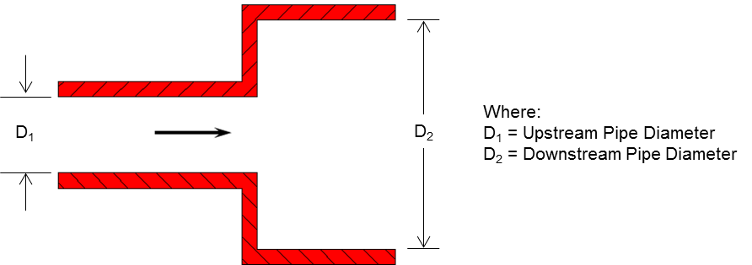
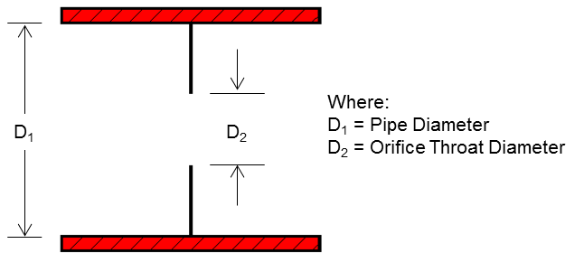
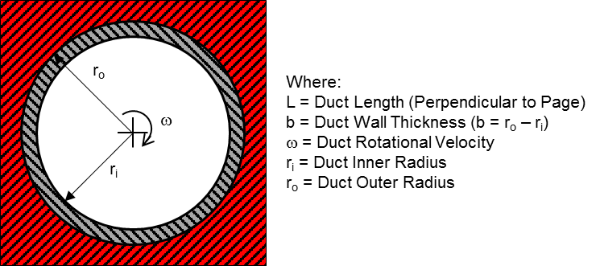
Resistance Options (1/3)
1. Pipe Flow
6. Thick Orifice
2. Flow Through a Restriction
7. Square Reduction
3. Non-Circular Duct
8. Square Expansion
4. Pipe Flow with Entrance
& Exit Losses
5. Thin, Sharp Orifice
9. Rotating Annular Duct

Slide 12
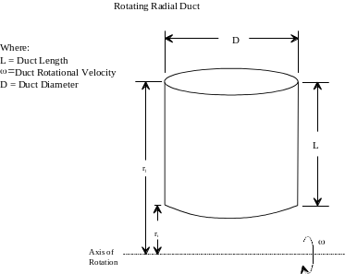
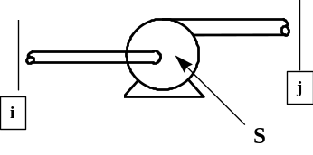
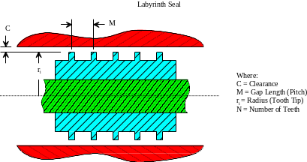
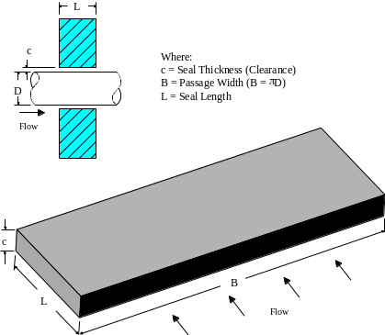
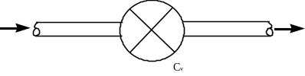
Resistance Options (2/3)
13. Common Fittings
& Valves
10. Rotating Radial Duct
14. Pump Characteristics
11. Labyrinth Seal
15. Pump Power
16. Valve with Given Cv
12. Face Seal
17. Viscojet
18. Control Valve
P

Slide 13


Resistance Options (3/3)
U
24. Fixed Flowrate
19. User Defined
25. Cartesian Grid
20. Heat Exchanger Core
21. Parallel Tube
22. Compressible Orifice
23. Labyrinth Seal (Egli Correlation

Slide 14
Fluid Options (1/2)
GFSSP requires the following thermodynamic and thermophysical properties of fluids for the solution of the governing equations
      Density [ρ (T, p)]
      Absolute Viscosity [μ (T, p)]
      Thermal Conductivity [k (T, p)]
      Specific Heat at Constant Pressure [C_{p} (T, p)]
      Specific Heat Ratio [γ (T, p)]
GFSSP requires these properties at every node, at each iteration
Properties are supplied by thermodynamic property programs integrated into GFSSP
  GASP/WASP
  GASPAK
User can also supply these properties with:
  Interpolation tables
  Calls to user-supplied Fortran code
  Ideal gas properties

Slide 15
Fluid Options (2/2)
ID Number | SOURCE / FLUID | ID Number | SOURCE / FLUID | ID Number | SOURCE / FLUID
1 | GASP He | 51 | GASPAK He | 69 | GASPAK Kr
2 | GASP CH₄ | 52 | GASPAK CH₄ | 70 | GASPAK Propane
3 | GASP Ne | 53 | GASPAK Ne | 71 | GASPAK Xe
4 | GASP N₂ | 54 | GASPAK N₂ | 72 | GASPAK R-11
5 | GASP CO | 55 | GASPAK CO | 73 | GASPAK R-12
6 | GASP O₂ | 56 | GASPAK O₂ | 74 | GASPAK R-22
7 | GASP Ar | 57 | GASPAK Ar | 75 | GASPAK R-32
8 | GASP CO₂ | 58 | GASPAK CO₂ | 76 | GASPAK R-123
9 | GASP F₂ | 59 | GASPAK H₂ (para) | 77 | GASPAK R-124
10 | GASP H₂ (para) | 60 | GASPAK H₂ (normal) | 78 | GASPAK R-125
11 | WASP H₂O | 61 | GASPAK H₂O | 79 | GASPAK R-134A
12 | RP-1 Tables | 62 | GASPAK RP-1 (liq) | 80 | GASPAK R-152A
 |  | 63 | GASPAK Isobutane | 81 | GASPAK N₂F₃
33 | Ideal Gas | 64 | GASPAK Butane | 82 | GASPAK NH₃
 |  | 65 | GASPAK Deuterium | 84 | GASPAK H₂O₂
37 | User Fluid 1 | 66 | GASPAK Ethane | 86 | GASPAK Air
38 | User Fluid 2 | 67 | GASPAK Ethylene
39 | User Fluid 3 | 68 | GASPAK H₂S

Slide 16
Additional Options
Variable Geometry
Variable Rotation
Variable Heat Addition
Turbopump
Heat Exchanger
Tank Pressurization
Control Valve
Valve Open/Close
Conjugate Heat Transfer
Pressure Regulator
Flow Regulator
Relief Valve
Multi-dimensional flow
Fluid Mixture
Psychrometric Calculation
Multi-Layer Insulation

Slide 17
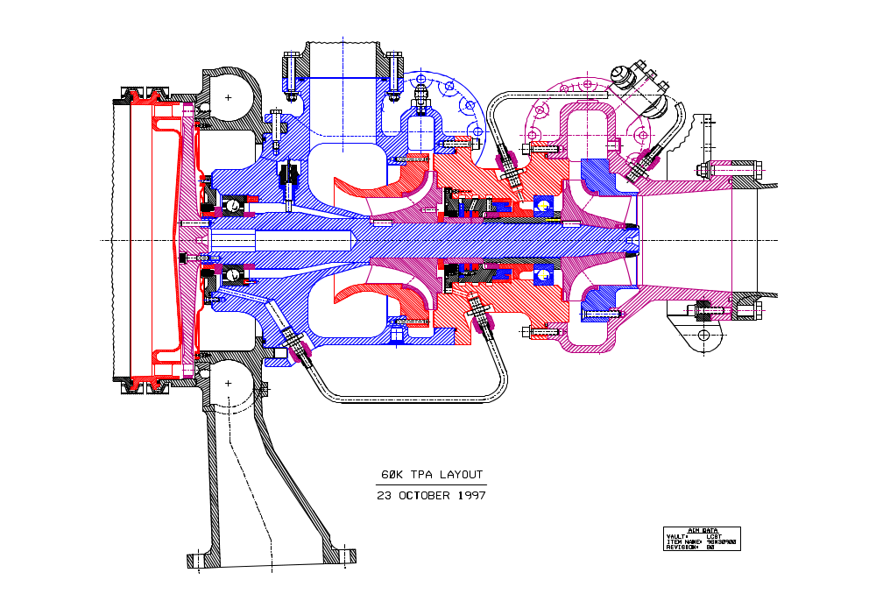
FASTRAC Turbopump (1/4)

Slide 18
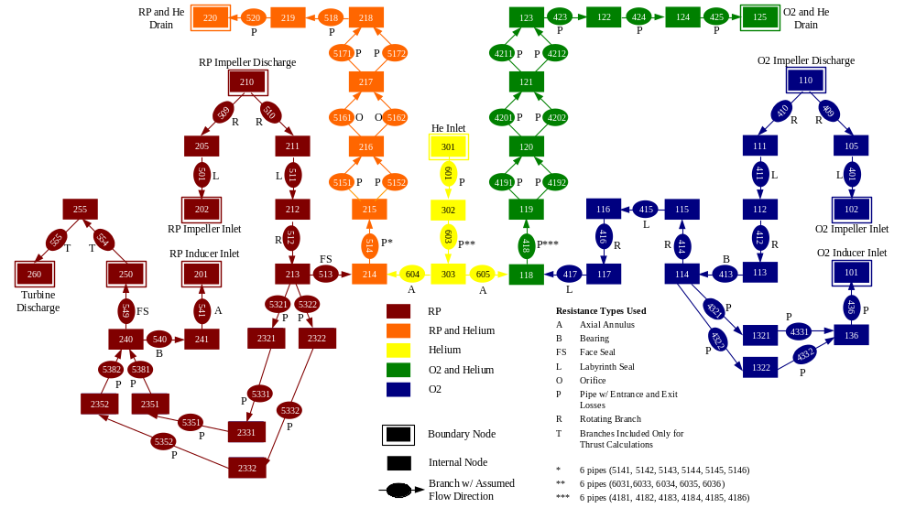
FASTRAC Turbopump (2/4)
GFSSP Model of the Fastrac Turbopump

Slide 19
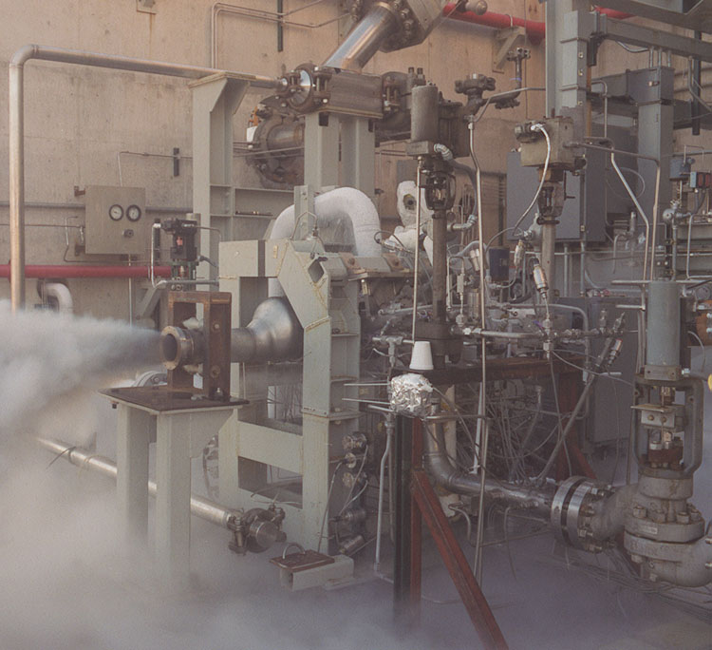
FASTRAC Turbopump (3/4)
Turbopump Test to 20000 RPM with Gas Generator

Slide 20
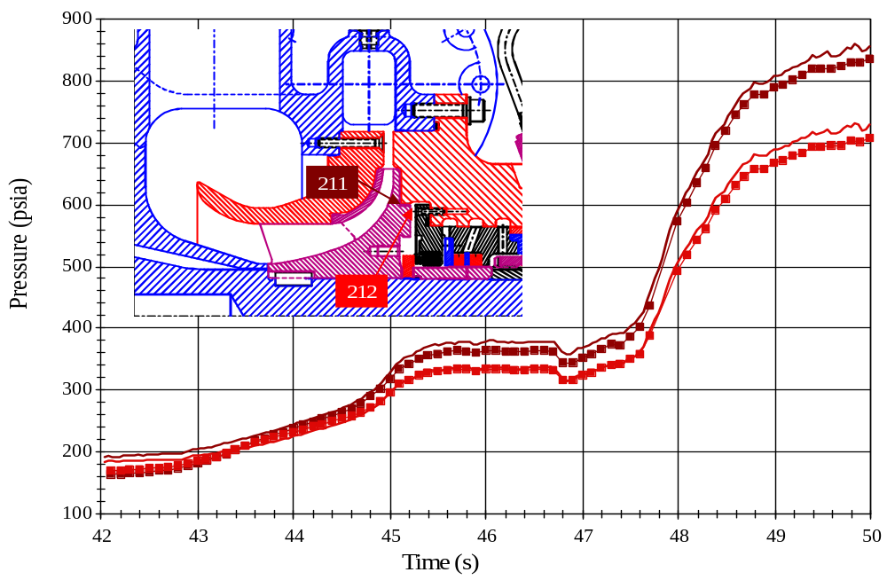
FASTRAC Turbopump (4/4)
FASTRAC Turbopump Model Results
Pressure History Comparison at RP-1 Impeller Back Face
[Labyrinth Seal Inlet (211) and Outlet (212)]

Slide 21
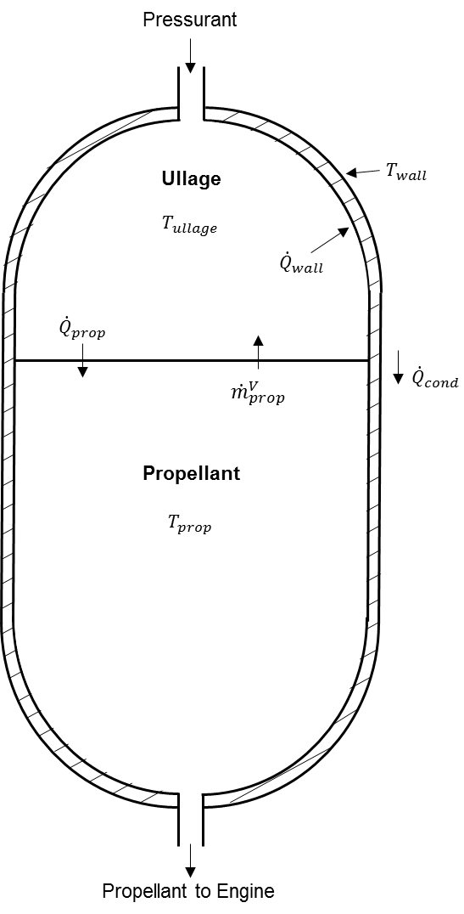
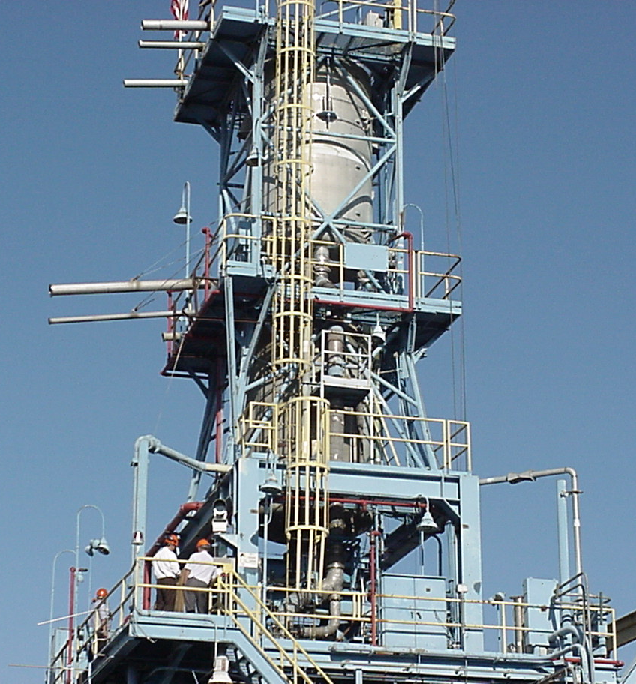
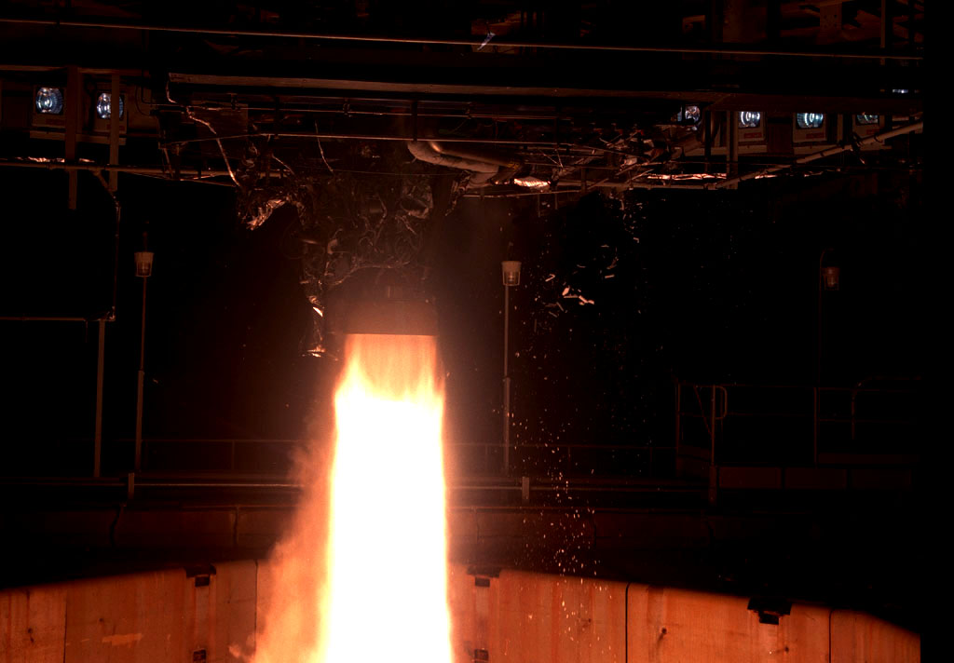
Tank Pressurization (1/3)
LOX Tank
RP-1 Tank
Engine
Interface

Slide 22
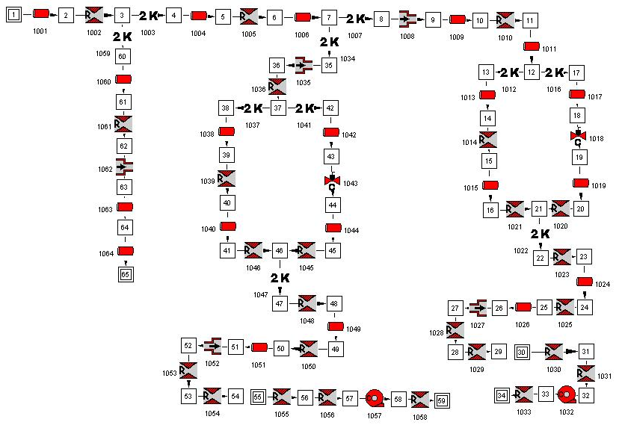
Tank Pressurization (2/3)
Example 12 – MIG Canvas
Engine
Interface
LOX Tank
RP-1 Tank

Slide 23
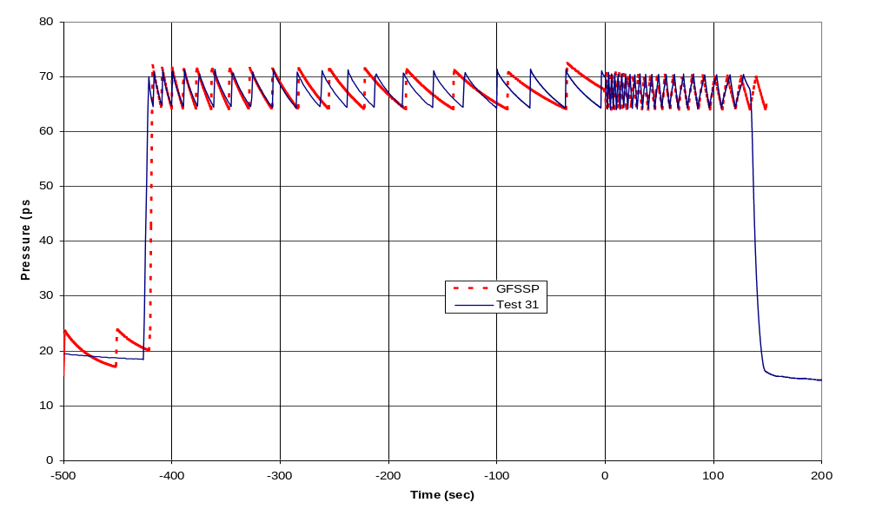
Tank Pressurization (3/3)
Comparison of GFSSP Predicted LOX Ullage Pressure with Test Data
Engine Cut

Slide 24
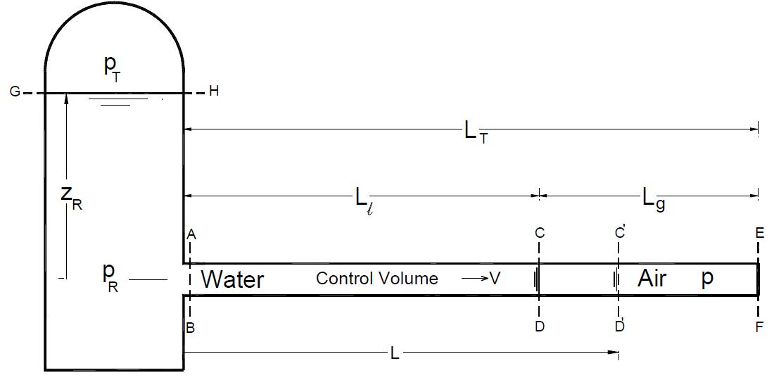
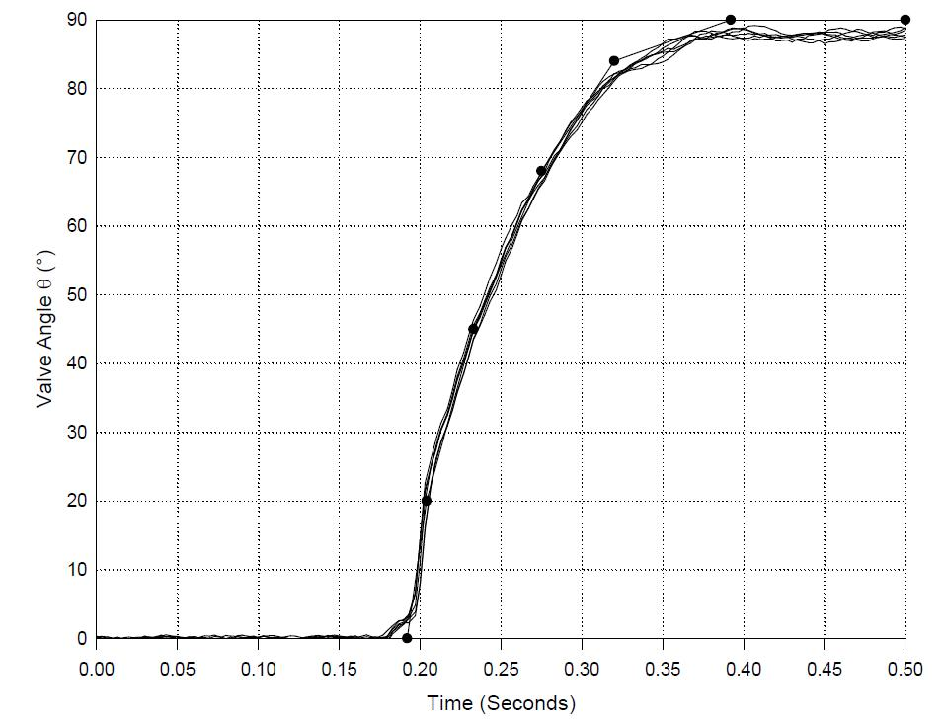

Rapid Valve Opening (priming)
Schematic of Pipeline System with Ball Valve location
Ball Valve Opening History Parameters
α = L_{g}/L_{T}
P_{R} = p_{R}/p₀

Slide 25
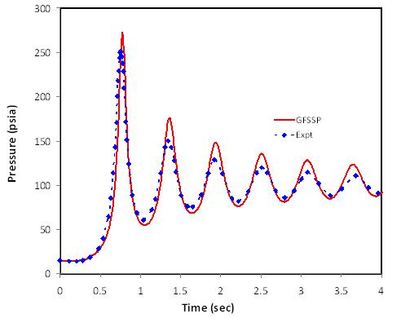
Results (priming)
Pressure at Dead End (entrapped air pressure)
Ball Valve
Opening History
Parameters
α = L_{g}/L_{T} = 0.45
P_{R} = p_{R}/p₀ = 7

Slide 26
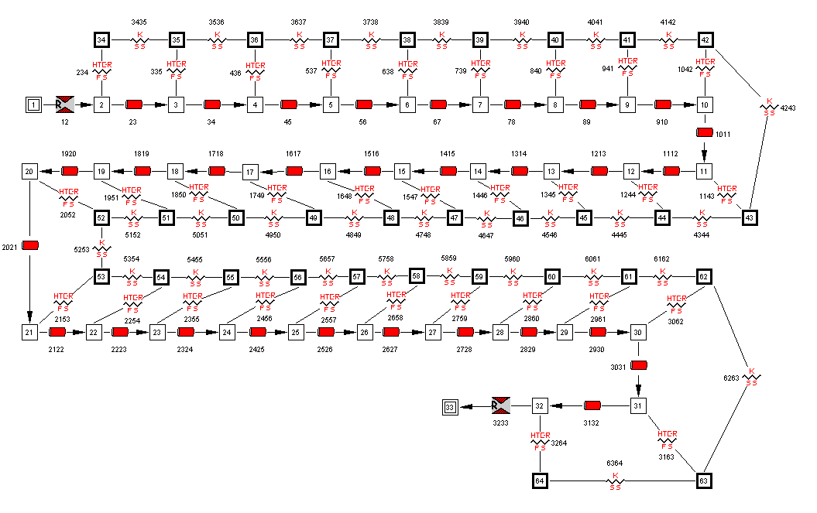
Ex14: GFSSP Model of Cryogenic Transfer Line

Slide 27
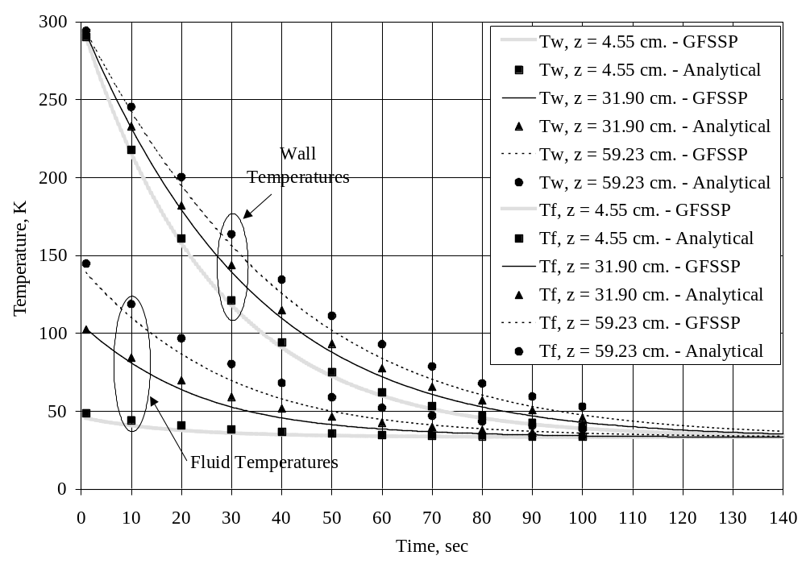
Ex14: Comparison with Analytical Solution

Slide 28
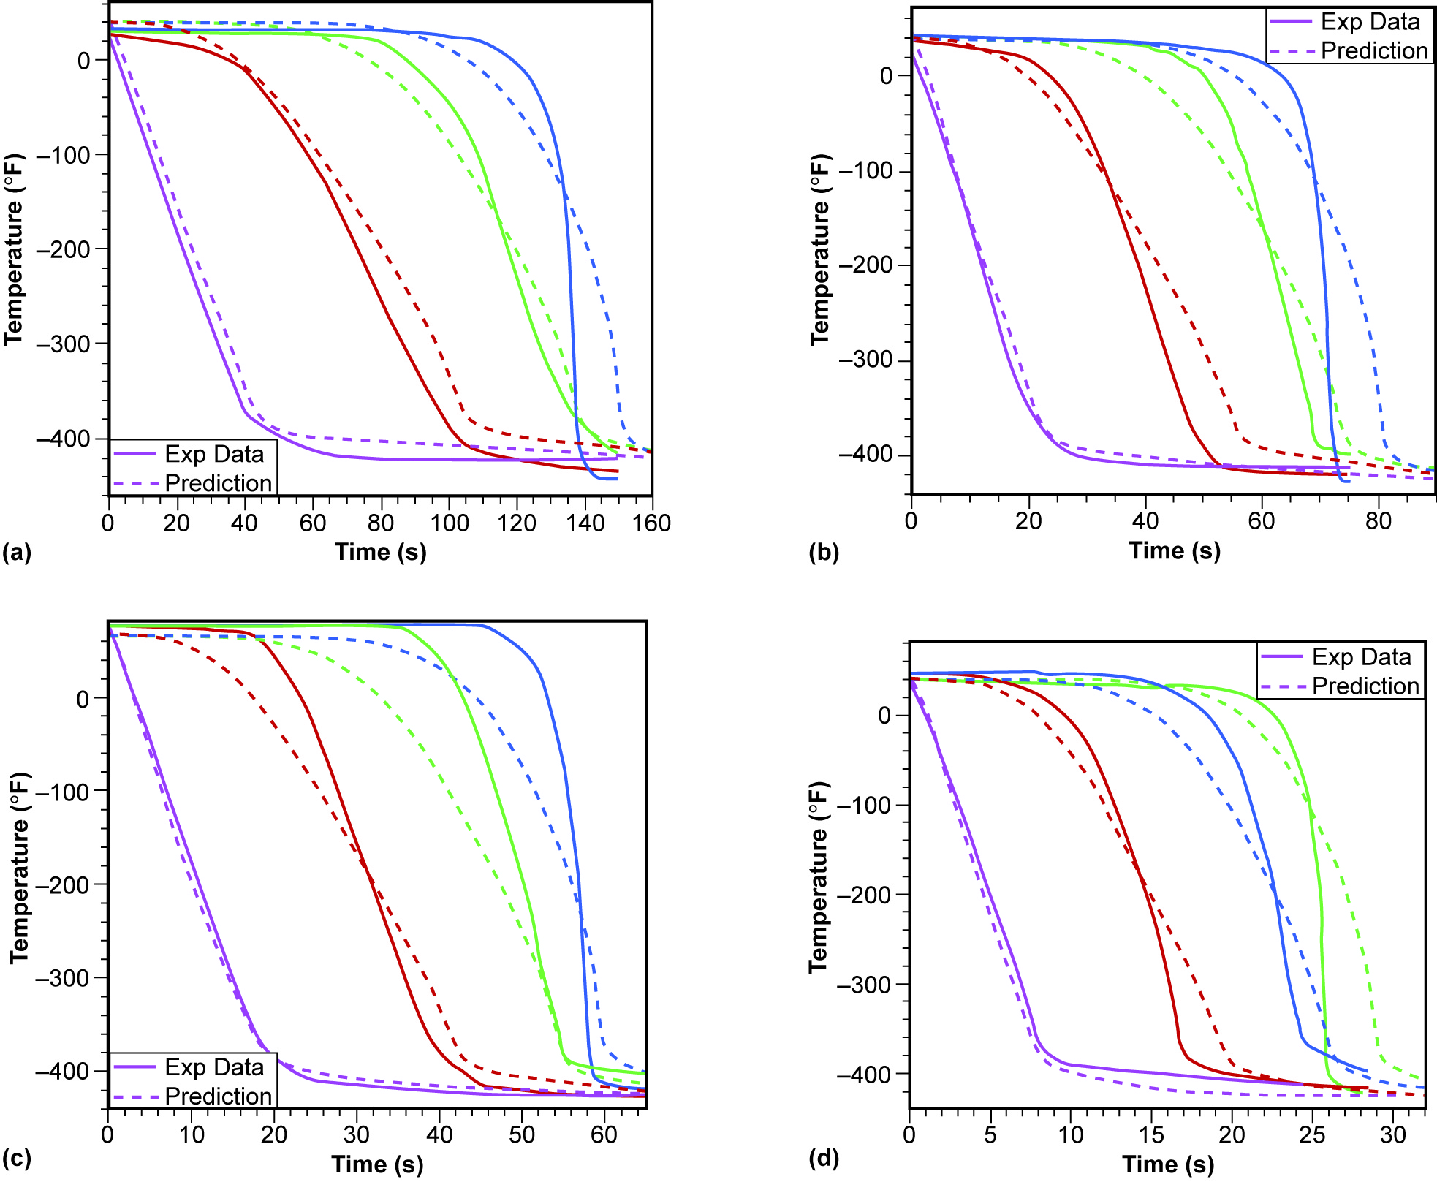
Ex14: Comparison with Test Data
Subcooled LH₂ for various driving pressures
p = 36.74 psia
p = 61.72 psia
Station #1 (violet)
—20 ft from tank inlet
Station #2 (red)
—80 ft from tank inlet
Station #3 (green)
—141 ft from tank inlet
Station #4 (blue)
—198 ft from tank inlet
p = 86.7 psia
p = 161 psia

Slide 29
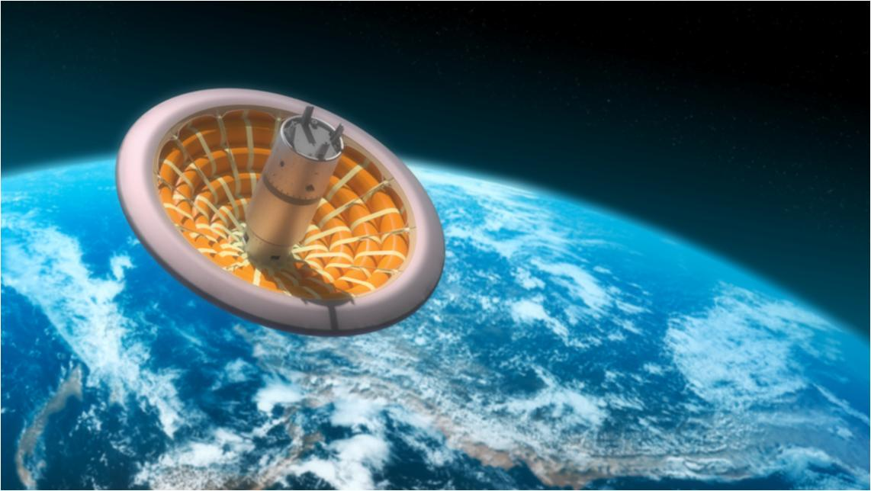
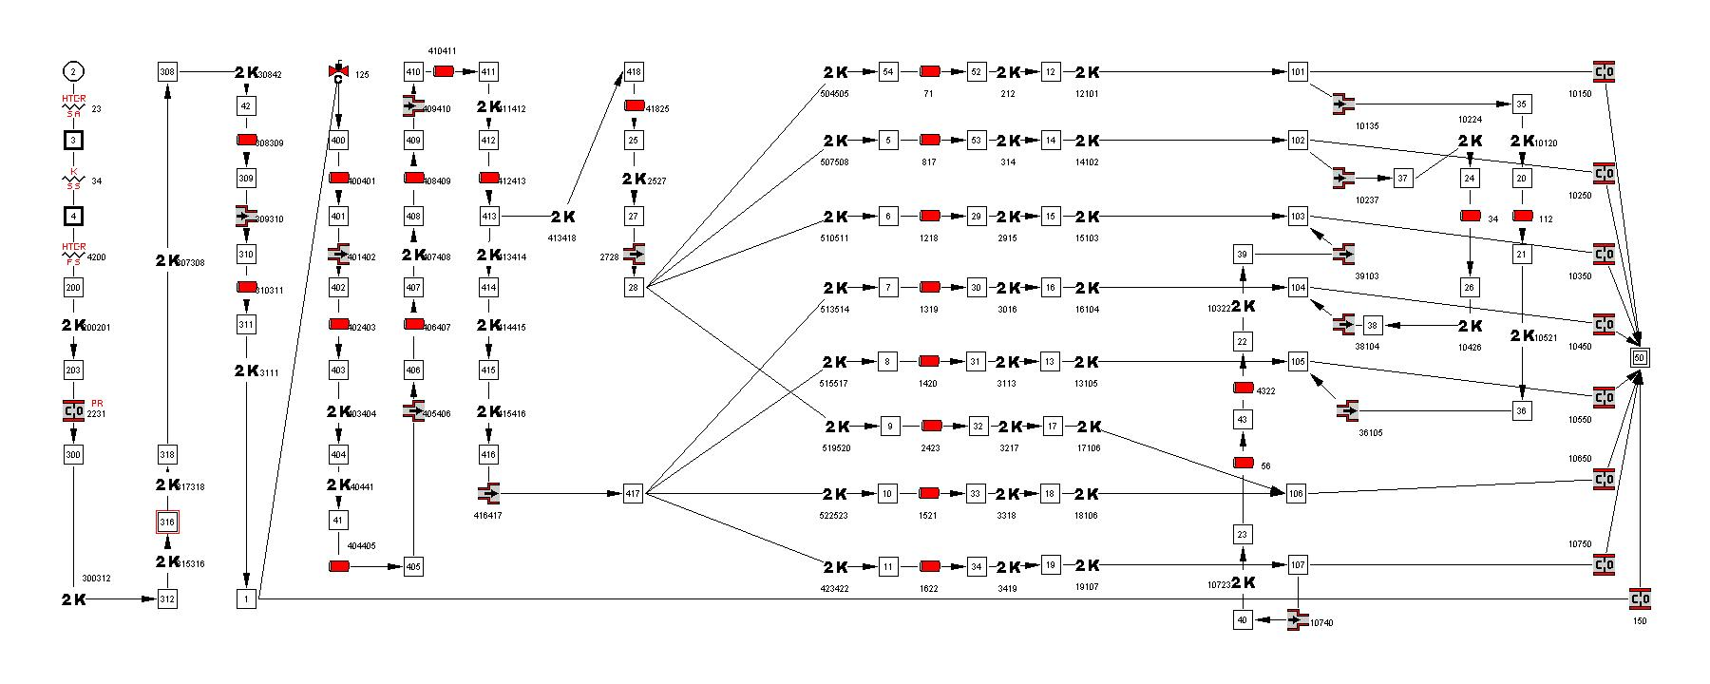
Inflatable Re-Entry Vehicle (IRVE3) (1/2)
Control Valve
Ballutes (x7)
N₂ Tank
Pressure
Regulator

Slide 30
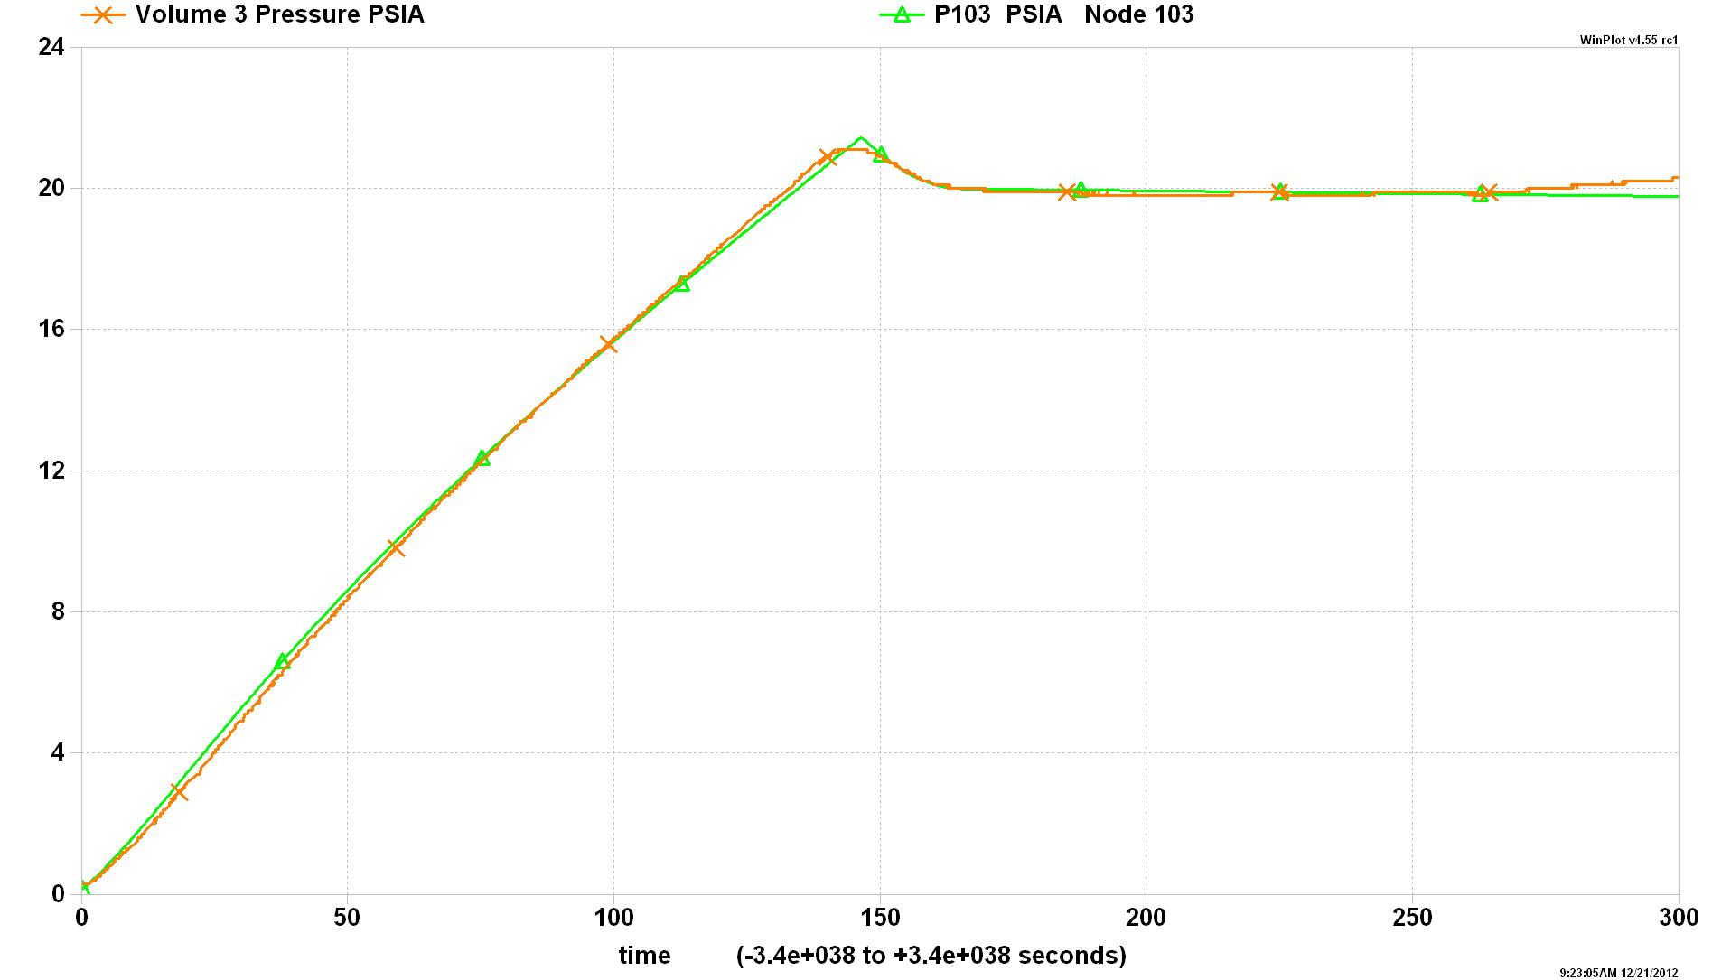
IRVE3 (2/2)
Pressure in Ballute 3
Orange: Flight Data
Green: GFSSP Prediction

Slide 31
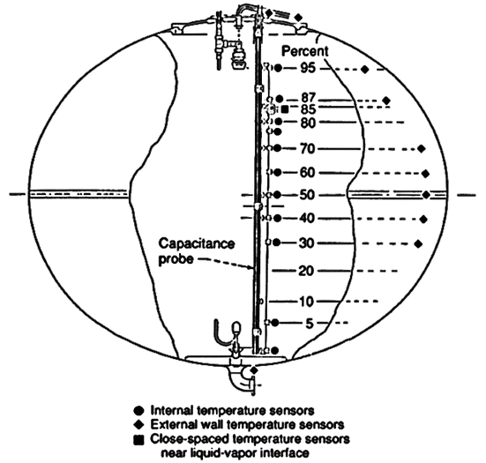
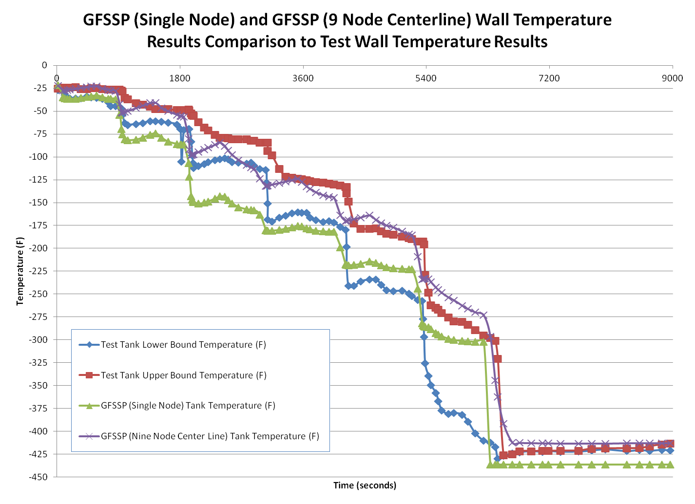
Ex28: Charge-Hold-Vent Chill & Fill
K-site LH2 tank test data
GH2 vented:
  32 lb (test)
  32.5 lb (GFSSP prediction)

Slide 32
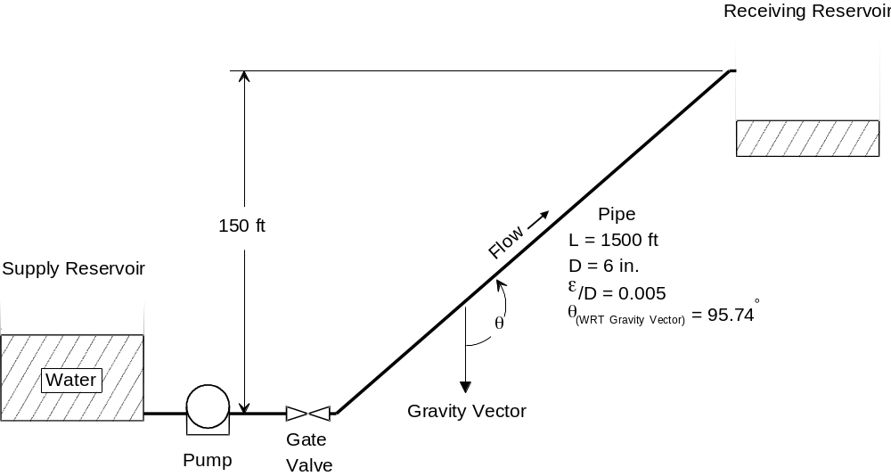
GFSSP Demonstration Problem 1

Slide 33
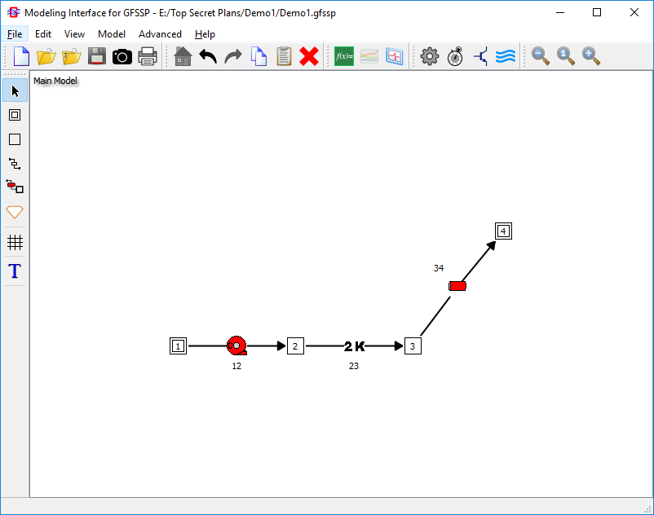
Build Model on MIG Canvas

Slide 34
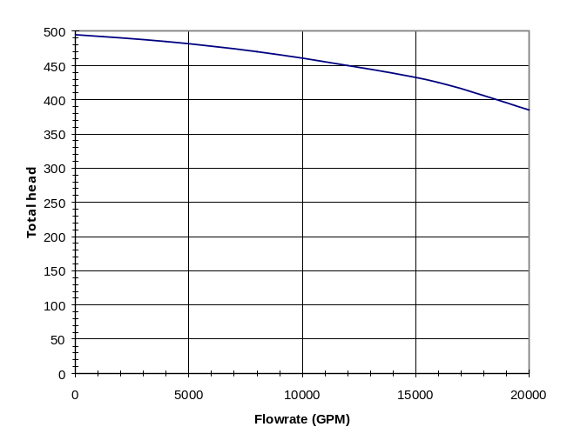
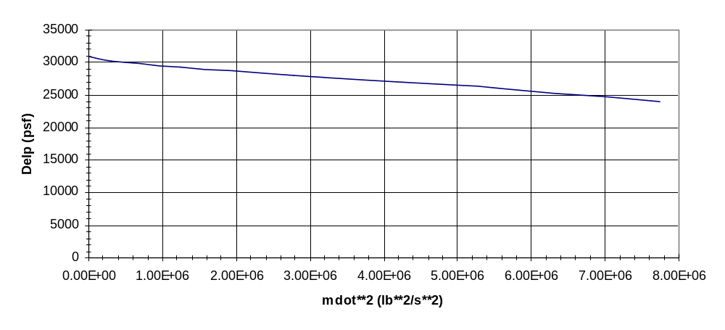
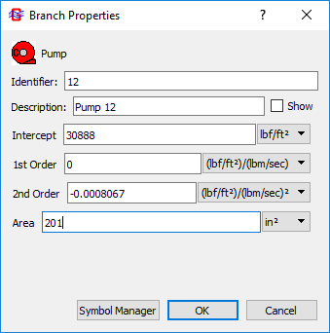
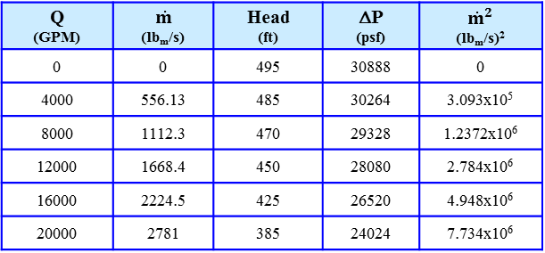

Determination of Pump Characteristics
Manufacturer’s Pump Curve
(Head vs. Flowrate)
2) Convert to lb/s and psf
Q (GPM) | $$\dot{m}$$ (lb_{m}/s) | Head (ft) | ΔP (psf) | ${\dot{m}}^{2}$ (lb_{m}/s)²
0 | 0 | 495 | 30888 | 0
4000 | 556.13 | 485 | 30264 | 3.093x10⁵
8000 | 1112.3 | 470 | 29328 | 1.2372x10⁶
12000 | 1668.4 | 450 | 28080 | 2.784x10⁶
16000 | 2224.5 | 425 | 26520 | 4.948x10⁶
20000 | 2781 | 385 | 24024 | 7.734x10⁶
4) Curve fit
3) Plot ΔP vs. ${\dot{m}}^{2}$
$$ΔP=30888 −8.067x{10}^{−4}{\dot{m}}^{2}$$

Slide 35
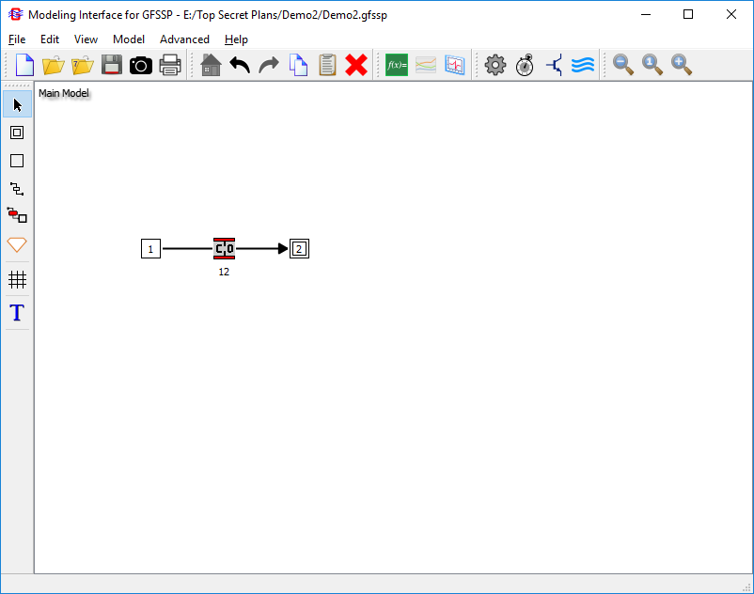
GFFSP Demonstration Problem 2
Tank
V = 10 ft³
Initial Conditions
P_{i} = 100 psia
T_{i} = 80°F
Tank
Atmosphere
d = 0.1 in
P_{atm} = 14.7 psia

Slide 36
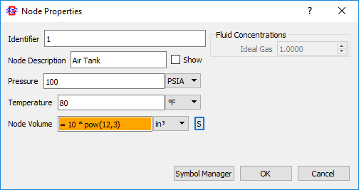
Internal Node Initial Conditions
Initial P, T
Tank Volume

Slide 37
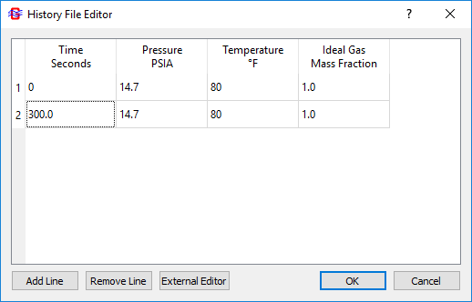
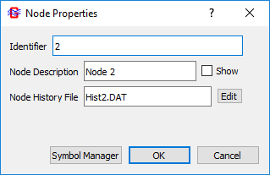
Transient Boundary Conditions
Specify History Filename
GFSSP will interpolate transient boundary conditions from the history file
Even if boundary conditions are constant, at least two lines must be given

Slide 38
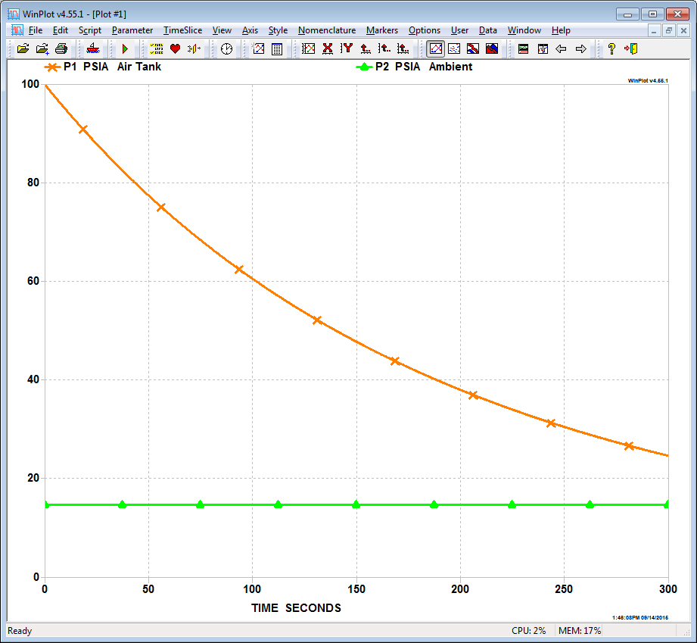
Plotting Transient Results
Select Parameters
Start Winplot

Slide 39
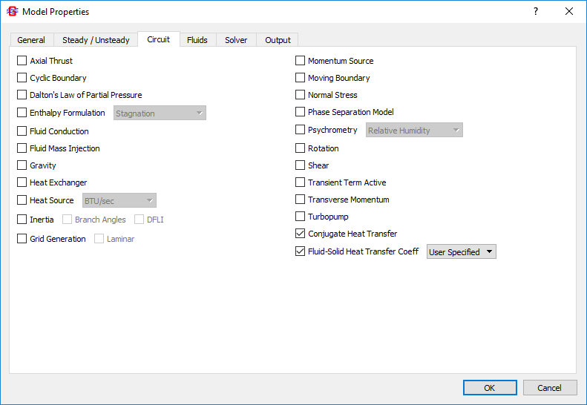
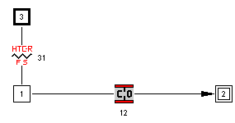
Demo 3: Tank Blowdown with Heat Transfer (1/2)
Add Conjugate Heat Transfer (1/2)
    Enable Conjugate Heat Transfer with User-Specified Solid-to-Fluid heat transfer coefficient
    Add Solid Node 3, and Fluid-to-Solid Conductor 31

Slide 40
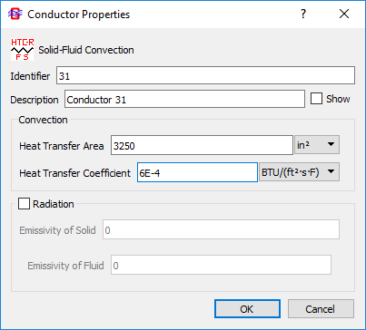
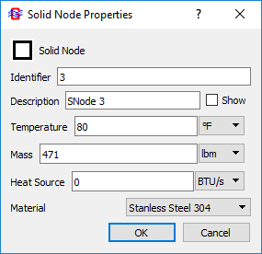
Demo 3: Tank Blowdown with Heat Transfer (2/2)
Add Conjugate Heat Transfer (2/2)
    Tank material, mass: SS304, 471 lb_{m} ; initially at 80 °F
    Tank surface area: 3250 in²
    Heat transfer coefficient value of 6×10⁻⁴ BTU/ft²-s-F (= 2.2 BTU/ft²-hr-F) will be entered as a placeholder
        Value can be overwritten by the value calculated by the user subroutine

Slide 41
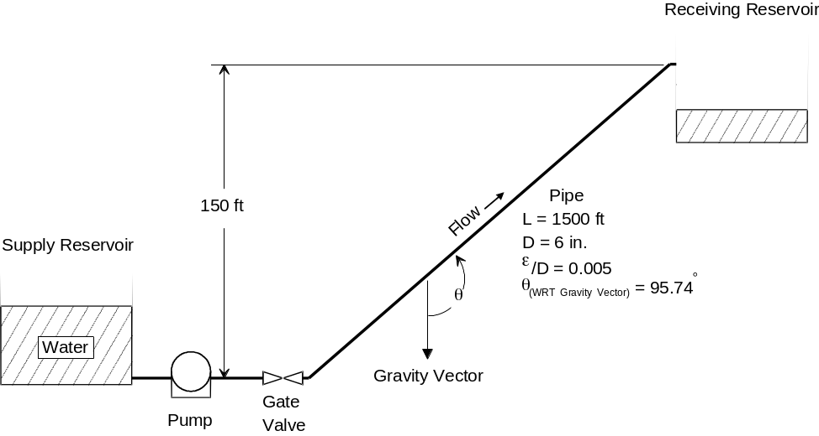
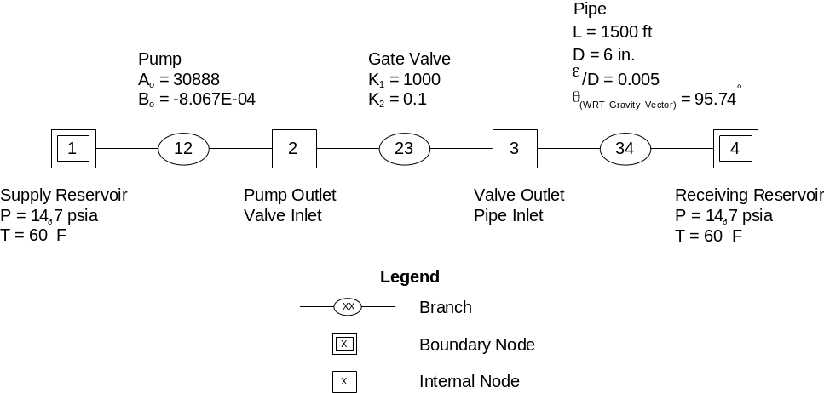


Mathematical Closure (1/2)
Problem of a Steady State Flow Network
Given: Boundary Node Pressures and Temperatures
Find: Internal Node Pressures and Temperatures; Flowrates in Branches
Primary Variables
$$p_{2}, p_{3}, T_{2}, T_{3},{\dot{m}}_{12},{\dot{m}}_{23}, {\dot{m}}_{34}$$
Secondary Variables
$$ρ_{2}, ρ_{3}, μ_{2}, μ_{3}$$

Slide 42



Mathematical Closure (2/2)
Problem of an Unsteady Flow Network
Given: Boundary Node Pressures and Temperatures; Initial Values at Internal Nodes
Find: Internal Node Pressures and Temperatures; Flowrates in Branches with Time
Primary Variables
Tank
$$p_{1}\left(τ\right), T_{1}\left(τ\right), {m_{1}\left(τ\right),\dot{ m}}_{12}\left(τ\right)$$
V = 10 ft³
Secondary Variables
Initial Conditions
P_{i} = 100 psia
$$ρ_{1}\left(τ\right), μ_{1}(τ)$$
T_{i} = 80°F
d = 0.1 in
P_{atm} = 14.7 psia

Slide 43


Governing Equations (1/4)
Mass Conservation Equation
$$\frac{{m_{τ+Δτ}−m}_{τ}}{∆τ}=−\sum_{j=1}^{j=n}{{\dot{m}}_{ij}}$$
Note: Pressure does not appear explicitly in Mass Conservation Equation although it is earmarked for calculating pressures

Slide 44


Governing Equations (2/4)
Energy Conservation Equation
    Can be written in terms of Enthalpy (h) or Entropy (s)
    Based on Upwind Scheme
Enthalpy Equation
Rate of Increase of Internal Energy = Enthalpy Inflow - Enthalpy Outflow + Heat Source
$$\frac{{m\left(h−\frac{p}{ρJ}\right)}_{τ+∆τ}−m{\left(h−\frac{p}{ρJ}\right)}_{τ}}{Δτ}=\sum_{j=1}^{j=n}{\left\{MAX\left[−{\dot{m}}_{ij},0\right]h_{j}−MAX\left[{\dot{m}}_{ij},0\right]h_{i}\right\}+Q_{i}}$$
Note: J = 778.17 ft-lb_{f}/Btu

Slide 45






Governing Equations (3/4)
Ambient Node
Solid Node
Fluid Node
Conservation Equation
Successive Substitution Form

Slide 46

Governing Equations (4/4)
Momentum Conservation Equation
    Represents Newton’s Second Law of Motion
j
Node
mass * acceleration = forces
Branch
Pressure
Gravity
Friction
Centrifugal
Shear Stress
Moving Boundary
Normal Stress
External Force
$${\dot{m}}_{ij}$$
Unsteady
Longitudinal Inertia
Transverse Inertia
q
Node
i
g
r_{i}
r_{j}
ω
Axis of Rotation

Slide 47





Momentum Conservation Equation (1/2)
Mass x Acceleration Terms in GFSSP
    Unsteady
    Longitudinal Inertia
    Transverse Inertia
$$\frac{{(mu_{ij})}_{τ+Δτ }−{(mu_{ij})}_{τ}}{g_{c}Δτ}$$
$$u_{u}$$
$$u_{ij}$$
i
j
$${\dot{m}}_{trans}$$
$MAX$ $\left|{\dot{m}}_{ij},0\right|\left(u_{ij}−u_{u}\right)−MAX \left|−{\dot{m}}_{ij},0\right|\left(u_{ij}−u_{u}\right)$
$$u_{p}$$
$$+MAX\left|{\dot{m}}_{trans},0\right|\left(u_{ij}−u_{p}\right)−MAX\left|−{\dot{m}}_{trans},0\right|\left(u_{ij}−u_{p}\right)$$

Slide 48




Momentum Conservation Equation (2/2)
Force Terms in GFSSP
    Pressure
    Gravity
    Friction
    Centrifugal
j
Node
$$\left(p_{i}−p_{j}\right)A_{ij}$$
Branch
$${\dot{m}}_{ij}$$
q
$$\frac{ρgV\cos{Θ}}{g_{c}}$$
Node
i
g
$${−K}_{f} {\dot{m}}_{ij} \left|{\dot{m}}_{ij}\right|A_{ij}$$
r_{i}
r_{j}
ω
Axis of Rotation
$$\frac{ρ{ K}_{rot}^{2}ω^{2}A\left(r_{j}^{2}−r_{i}^{2}\right)}{g_{c}}$$

Slide 49




Friction Term in GFSSP’s Momentum Equation
In classical fluid mechanics, pressure drop can be related to dynamic head by a dimensionless constant K
GFSSP’s momentum equation expresses friction losses in terms of flow rate
The relationship between K and K_{f}
Note that K_{f} is not dimensionless
    Units: $\left({{lb}_{f}}/{{ft}^{2}}\right)/{\left({{lb}_{m}}/s\right)}^{2}$
$$ΔP=K\left(\frac{1}{2}ρu^{2}\right)$$
$$∆P= K_{f}{\dot{m}}^{2}$$
$$K_{f}=K\left(\frac{1}{2ρA^{2}}\right)$$

Slide 50




Resistance Option 1
Pipe Flow
For Re < 2300, Friction Factor (f )
For Re > 2300, Friction Factor
(using Colebrook Equation)
Flow Resistance Factor
$$f=\frac{64}{{Re}_{D}}$$
$$K_{f}=\frac{8fL}{ρ_{u}π^{2}D^{5}g_{c}}$$
$$\frac{1}{\sqrt{f}}=−2 log\left[\frac{ε}{3.7D}+\frac{2.51}{Re\sqrt{f}}\right]$$

Slide 51


Resistance Option 2
Flow Through a Restriction (1/2)
Loss Coefficient: C_{L}
      Sometimes called “Flow Coefficient” or “Discharge Coefficient”
      Smaller values of C_{L} indicate greater resistance
      K and C_{L} are related by:
      If User sets C_{L} = 0
            GFSSP will set K_{f} to 0 (inviscid flow through the branch)
$$K_{f}=\frac{1}{2g_{c}ρ_{u}C_{L}^{2}A^{2}}$$
$$C_{L}=\frac{1}{\sqrt{K}}$$

Slide 52


Resistance Option 13
Common Fittings and Valves
Types of Fittings and Valves
Flow Resistance Factor
$$K_{f}=\frac{\frac{K_{1}}{Re}+K_{∞}\left(1+\frac{1}{D}\right)}{2g_{c}ρ_{u}A^{2}}$$
where:
K₁ = K for the fitting at Re = 1
K∞ = K for the fitting at Re = ∞ (K₂ in GFSSP)
D = Internal diameter of attached pipe (in)
Two-K Method
45°, 90°, and 180° Elbows
Tees
Valves
Standard
Long
Mitered
Screwed
Flanged/Welded
Stub-in-Type
Gate/Ball/Plug
Globe [Std., Angle/Y-Type]
Diaphragm [Dam Type]
Butterfly
Check [Lift, Swing, Tilt]

Slide 53





Resistance Option 14
Pump Characteristics
        Option 14 considers the branch as a pump with given characteristics
        Pump Characteristics are expressed in the pressure rise
        Momentum Source (S) used to induce the desired flow
$$Δp= A_{0}+B_{0}\dot{m}+C_{0}{\dot{m}}^{2}$$
Δp
where:
Δp = Pressure Rise (lb_{f}/ft²)
$\dot{m}$ = Flow Rate (lb_{m}/sec)
$${\dot{m}}^{2}$$
$$S=ΔpA$$

Slide 54

Resistance Option 15
Pump Power
      Considers the branch as a pump with a given horsepower (P) and efficiency (η )
      Momentum Source (S ) used to induce the desired flow
$$S=\frac{550ρ_{u}PηA}{\dot{m}}$$

Slide 55


Resistance Option 16
Valve with Given C_{v}
    Branch considered as a valve with a given C_{v}
Flow Resistance Factor
$$K_{f}=\frac{4.6799 x {10}^{5}}{ρ_{u}C_{v}^{2}}$$

Slide 56

Resistance Option 22 (1/2)
Compressible Orifice (1/2)
  Option 22 considers branch as an orifice for compressible flow
  Flowrate is calculated from a simplified momentum equation
  Input is identical to Option 2 (Restriction)
  Flow will choke at the critical pressure ratio (P_{down}/P_{up})
$${P_{cr}=\left(\frac{2}{γ+1}\right)}^{\frac{γ}{γ−1}}$$

Slide 57



Resistance Option 22 (2/2)
Compressible Orifice (2/2)
  If $\frac{P_{down}}{P_{up}}≤P_{cr}$ (choked flow)
  If $\frac{P_{down}}{P_{up}}>P_{cr}$
$\dot{m}$ = $C_{L}A\sqrt{P_{up}ρ_{up}g_{c}\frac{2γ}{γ−1}{\left(P_{cr}\right)}^{\frac{2}{γ}}\left[1−{\left(P_{cr}\right)}^{\frac{γ−1}{γ}}\right]}$
$\dot{m}$ = $C_{L}A\sqrt{P_{up}ρ_{up}g_{c}\frac{2γ}{γ−1}{\left(\frac{P_{down}}{P_{up}}\right)}^{\frac{2}{γ}}\left[1−{\left(\frac{P_{down}}{P_{up}}\right)}^{\frac{γ−1}{γ}}\right]}$

Slide 58
Thank You!
For more information:
  https://www.nasa.gov/gfssp
Contact:
  alok.k.majumdar@nasa.gov
  andre.c.leclair@nasa.gov
Videos of GFSSP 3-day training class:
  https://nescacademy.nasa.gov

