Slide 1
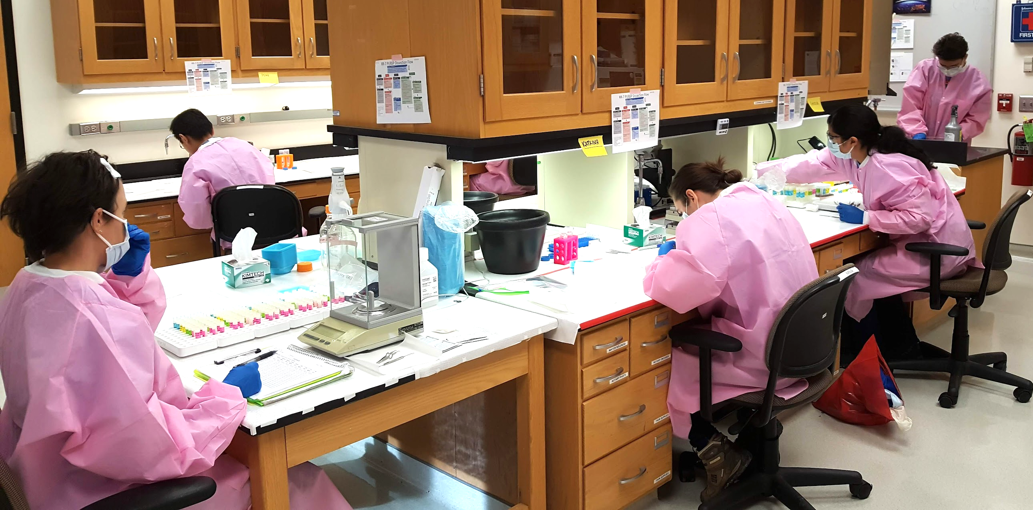
Summary of the Virtual Space Radiation
“2022 Biospecimen and Tissue Sharing Summit”
Shelita Hall Augustus¹, America Reyes Wang², Yi Chun Chen², Joseph Varelas², Danielle K. Lopez², Dawn E. Bowles³, Gayle Woloschak⁴, Cruz P. Torres⁵, S. Robin Elgart⁶
¹NASA Johnson Space Center, Houston, TX, ²KBR, Moffett Field, CA, ³Duke University, Durham, NC, ⁴Northwestern University, Evanston, IL, ⁵KBR, Houston, TX, ⁶University of Houston, Houston, TX.
Contact: jsc-hrp-space-radiation-element@mail.nasa.gov
WORKSHOP OBJECTIVE AND GOALS
Day 2
The Space Radiation Element (SRE) of the Human Research Program (HRP) aims to establish a biospecimen and tissue sharing collection (BTSC) to improve sample collection, tracking, access, distribution, and usability to maximize scientific return.
SRE organized and held a three-day virtual workshop September 13-15, 2022, to engage with the research community to share information about the SRE’s current BTSC project; software implementation to track biospecimens; NASA resources and institutional knowledge; and collect community feedback on how to develop, streamline, and optimize accessible and usable processes.
Days one and two featured speakers both internal and external to NASA who presented information on current resources, sample archive best practices, lessons learned, and researcher perspectives. Participants were asked to think about key questions about samples and processes during the summit presentations promote constructive and thoughtful discussion. Time was allotted at the end of each of the first days to allow for questions to the speakers and discussion. On the third day, key questions were re-presented, and participants were invited to discuss and provide constructive input. Over 140 individuals participated in the summit over the three days.
Duke University’s Heart Repository: A Space Radiation Element-Funded Principal Investigator Perspective. Bowles DE. As a NASA-funded researcher as well as the Co-Director for the Duke Human Heart Repository (Fig. 3), Dr. Bowles has invested in robust tissue collection to support future work into the health impacts of space radiation (Davis et al. 2021). Bowles et. al. developed and deployed an inexpensive processing aid device (Fig. 4), to increase productivity for rodent sample biobanking. These samples are currently held at Duke University and are available for tissue sharing opportunities.
Figure 3. Overview of Duke Human Heart Capabilities
Sources:
Heart Tx
LVADs and other procedures
Unused donor hearts (OPO)
Current inventory of the DHHR: 40,000 individual specimens from approximately 1,350 patients
+
Types:
Cardiac tissue
Longitudinal blood + derivatives
Longitudinal urine
Preservation solution
Clinical data
Figure 4. An inexpensive mouse processing aid device – Mouse PAD to support efficient and effective dissection was developed by Bowles and her team at Duke University (Brown et al. 2020). The Mouse PAD consists of a base and lid that are designed to hold sample tubes aligned with the general location of tissues within the mouse.
SAMPLES
PROCESSES
What tissues need to be saved? Which tissues should be collected/preserved and why?
How should tissues be preserved?
Should tissues be centralized (or not)?
What metadata needs to be collected
What changes to proposals/solicitations might need to be made?
How do we prioritize tissue distribution?
Who is responsible for the resources/support?
Best Practices. Woloschak G. The Northwestern University Radiobiology Archives (NURA) is a sample and data archive consisting of digitized metadata, laboratory notes, records, and paraffin-embedded animal tissue samples from various laboratories across the United States the conducted radiation studies (Fig. 5). Samples in NURA include those from rodents, primates, and beagle dogs. The goal of the archive is to deepen the understanding of biological radiation response by providing access to data and samples across the scientific community.
Figure 5. Northwestern University Radiobiology Archives (NURA)
Day 1
Welcome and Introduction. Elgart SR. Tissues collected from space radiation research has created a valuable resource but currently, collection and tracking is relatively informal and relies heavily on individual principal investigators (PIs) to manage samples. The BTSC project aims to modernize sample collection, access, and distribution to maximize scientific return by leveraging and expanding existing resources.
Space Biology Biospecimen Sharing Program (BSP) Overview. Reyes-Wang A. The NASA Space Biology BSP aims to encourage and broaden participation in space biology-related research. The BSP team supports planning, harvesting, and collection of biospecimens from spaceflight and associated ground-based investigations that are not utilized by the PI for primary research aims (Figure 1). Biospecimens are then made publicly available to maximize scientific return.
JSC Human Repositories. Torres C. Three human sample archives, Human Specimen Repository (HSR), NASA Biological Specimen Repository (NBSR or Repo 1), and NASA Omics Archive (NOA), aim to ensure preservation of residual samples for improved collection, access, and management to support additional research opportunities. There are currently 16,691 and 5,124 samples in the HSR and NBSR inventories, respectively, dating back to 1973. Samples include urine, saliva, whole blood, serum, plasma, and extracellular fluid from missions such as Apollo, NASA-Mir, Skylab, Shuttle, and the International Space Station.
Fig 1. The Biospecimen Sharing Program (BSP) team performing dissections in support of the RR-7 at Northwestern University.
Laboratory Inventory Management System (LIMS) Overview. Chen Y. A LIMS has been implemented by BSP to collect, curate, and organize biospecimen metadata storage and transfer in a centralized database. The system manages sample location information and is utilized by four different projects under the Space Biology and Human Research Programs (Fig 2). The LIMS can also produce barcodes and labels for streamlined sample registration and data entry. The system has the potential to communicate with external storage systems and track sample requests from initiation to delivery and fulfillment.
Major Key Lessons and Future Directions
The following were noted from presentations and robust community discussion:
Provide flexible requirements and guidelines
Integrate tissue and data sharing planning into overall granting process and start early
Adequate resources, including trained personnel, are required to ensure success
Be explicit and intentional about what samples will be collected and how
Avoid negatively impacting primary science
Preserve tissues by at least two methods where possible to maximize science
Aim for a balance collection (samples in ≈ samples out)
Collect samples of interest
Encourage and broaden participation
Develop community education and resources
Other organizations use commercial archival facilities and can potentially provide further input to improve NASA processes
Develop a sample distribution prioritization and approval process
Overall, adequate planning is critical to successfully establish and maintain an effective sample archive. The SRE plans to incorporate the above recommendations into organizational processes continue to understand how to leverage available resources. Furthermore, a second summit is being planned to focus on standardizing dissection and preservation methods in larger animals to support future research goals.
Space Radiation Biospecimen & Tissue Sharing (BTS)
Fig 2. Multiple organizations work together to collect, document, preserve, store, and utilize samples with the associated metadata and to broaden scientific participation in NASA’s scientific mission.
NASA Biological Institutional Scientific Collection (NBISC) & Ames Life Sciences Data Archive (ALSDA) Overview. Varelas J and Lopez DK. NBISC is a biorepository for non-human biospecimens derived from NASA spaceflight and ground investigations. Currently, the collection consists mainly of samples from NASA's Space Biology Program. NBISC receives, stores, documents, preserves, and makes the collection available to scientists. Over 90,000 biospecimens are currently preserved in the collection, primarily from mouse and rat subjects to support standard and novel research (Figure 2).

