Slide 1


DAWN CPEX-CV Data Summary
Kristopher Bedka, Zhaoyan Liu, John Cooney, Michael Kavaya
NASA Langley Research Center
Steven Greco and Dave Emmitt
Simpson Weather Associates
The DAWN, HALO, and AVAPS Engineering and Science Teams
Contact kristopher.m.bedka@nasa.gov for questions/collaborations
10 September 2022 Along Aeolus Underpass, Photo by K. Bedka

Slide 2
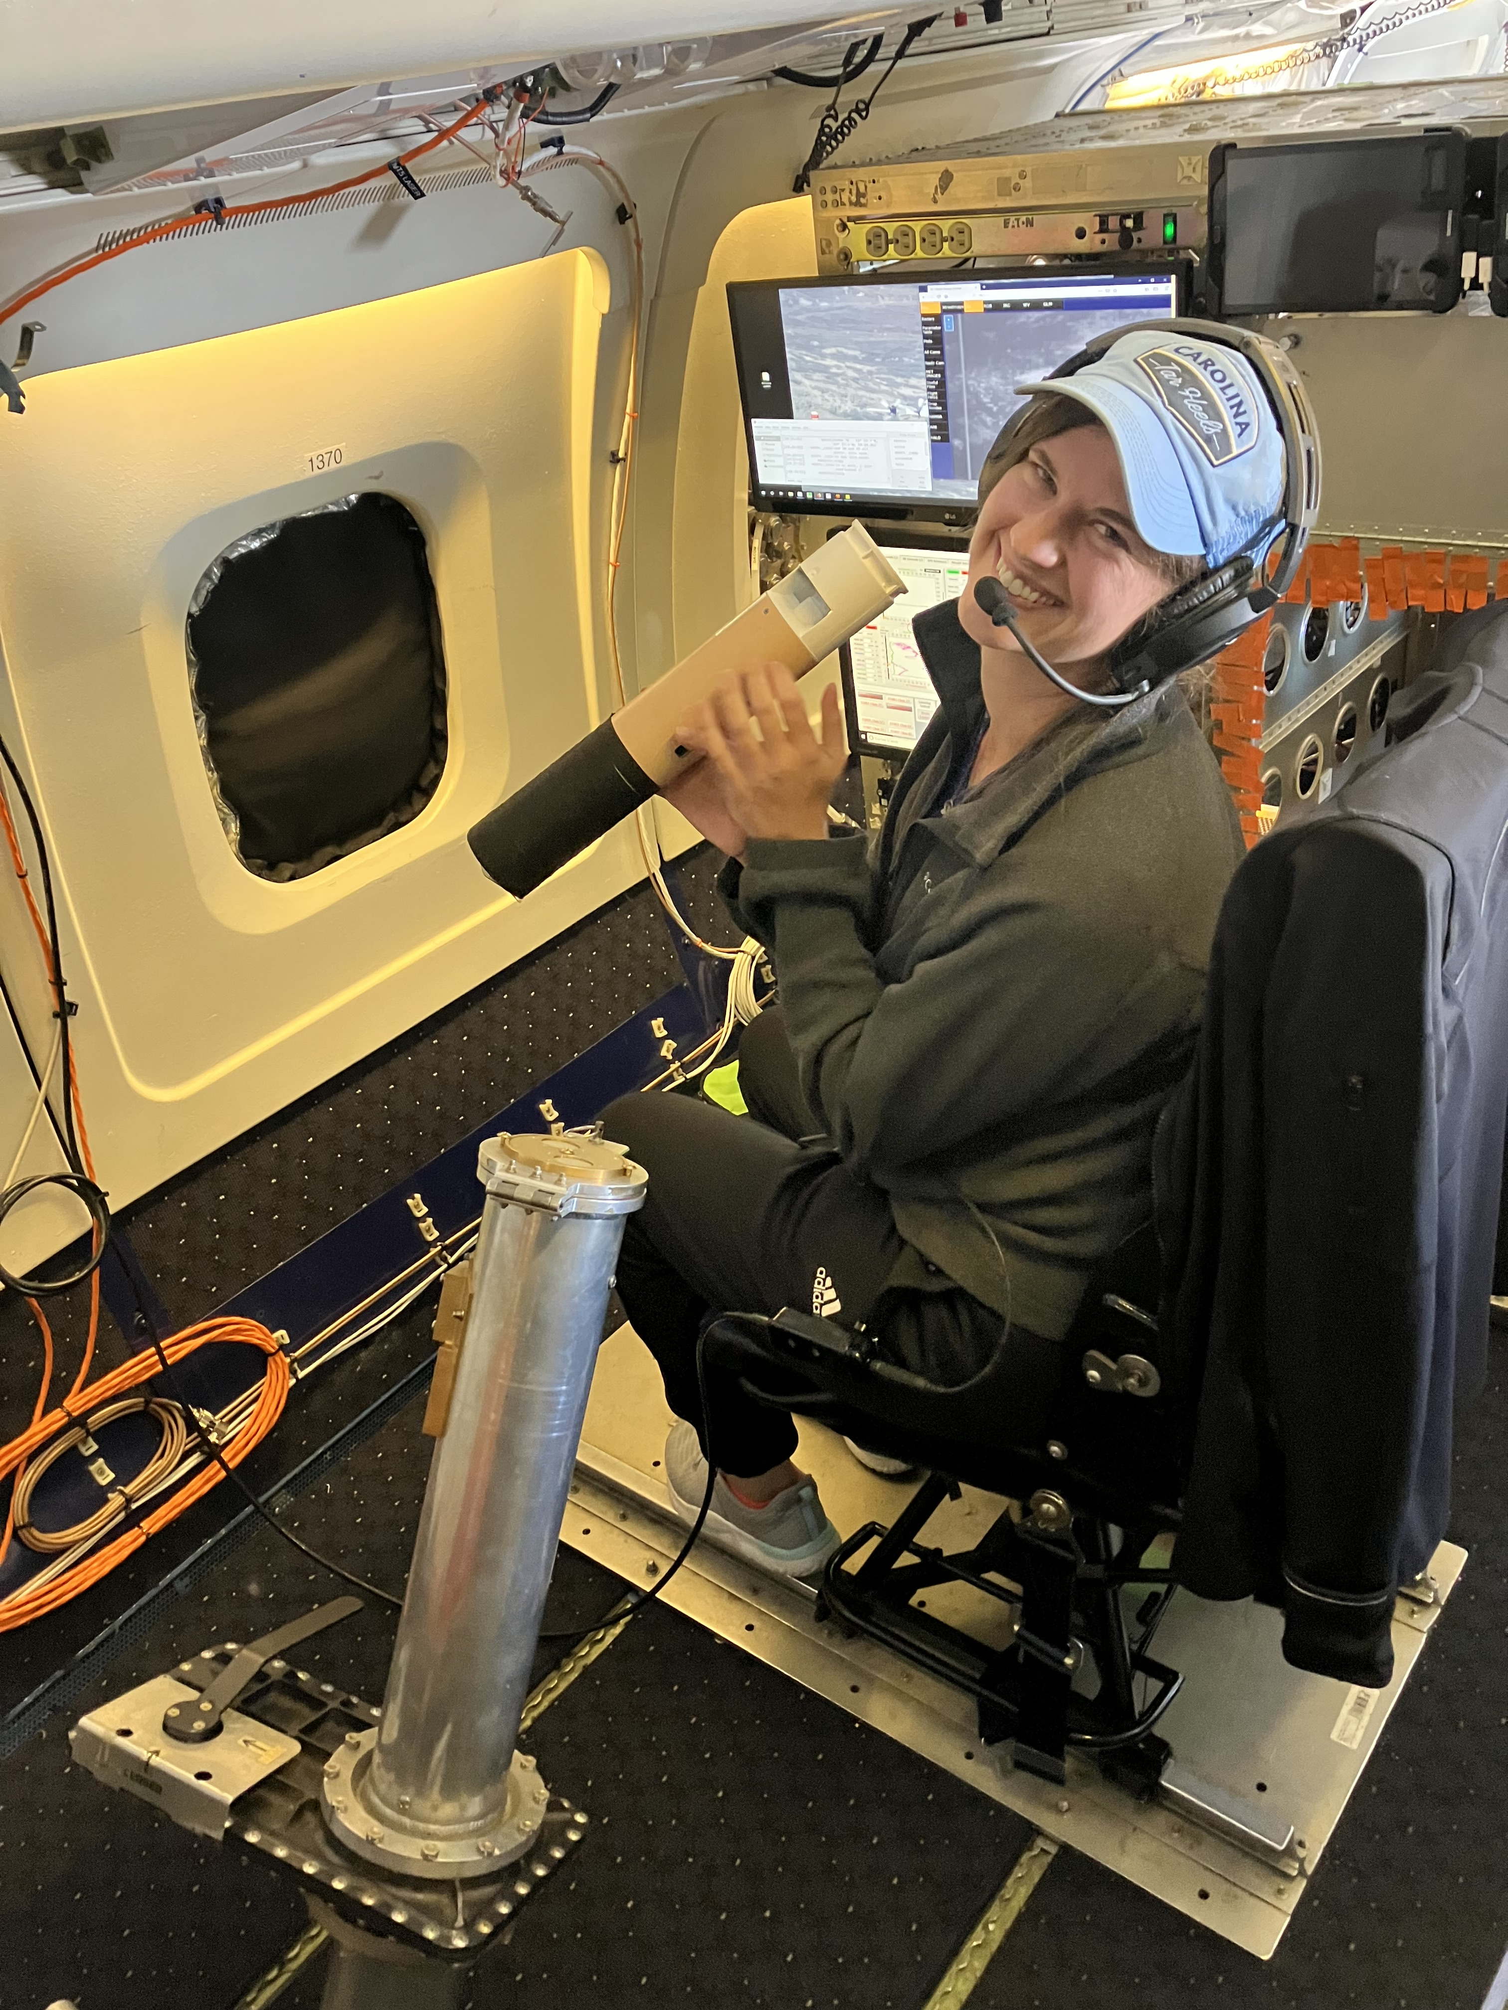
In Memory of Claire Robinson
Claire showing her always cheerful and positive attitude while preparing to release the final sonde during the CPEX-CV transit flight back to the U.S.
She will be forever loved and missed by everyone who had the pleasure of meeting her

Slide 3
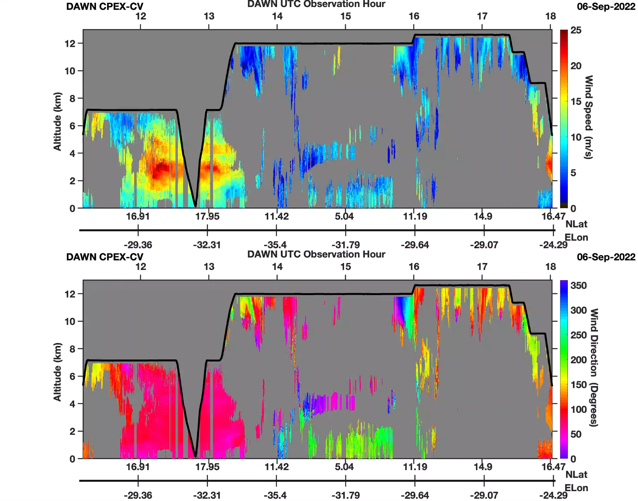
CPEX-CV DAWN Observations Summary
DAWN collected data continuously on all 13 science flights throughout CPEX-CV
Data collected with a variety of scan patterns: 2 LOS vs 5 LOS and 10-40 pulses/LOS, yielding vector wind profiles with 1.5 - 7.5 km spacing
Saharan Air Layers were observed to reach up to 6.25 km
Upper troposphere above 6 km was found to be very clean, limiting wind retrieval coverage in the 6-9 km altitude layer
Flight through deep convection and cirrus outflow typically limited wind coverage to 2 km below aircraft
Data delivered in NetCDF-4 format to the NASA Atmospheric Science Data Center
https://www-air.larc.nasa.gov/cgi-bin/ArcView/cpex.2022
Vertical grey stripes -> Aircraft roll > 3 degrees
Other grey areas -> Insufficient aerosol backscatter for wind retrieval

Slide 4
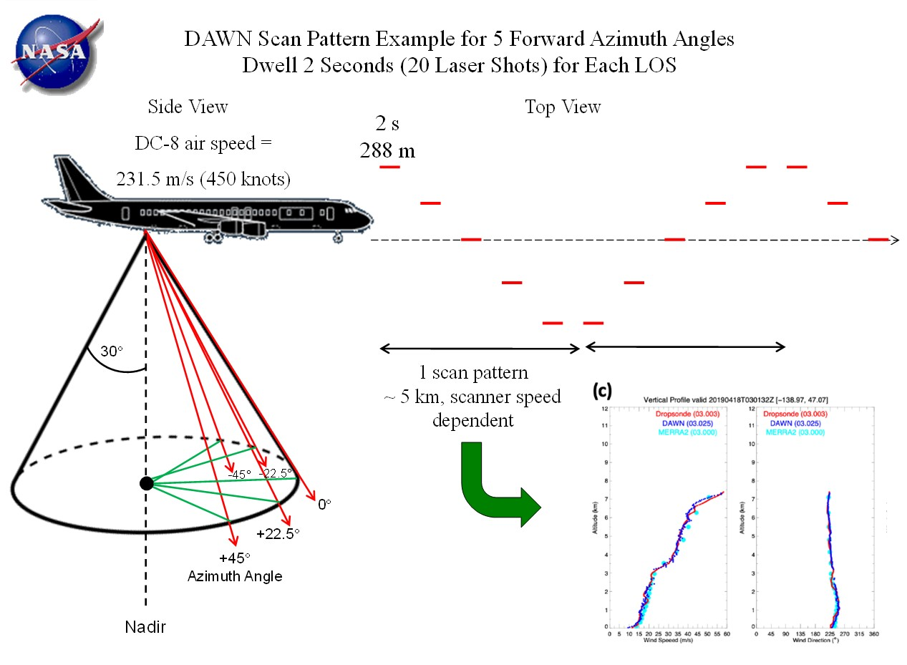
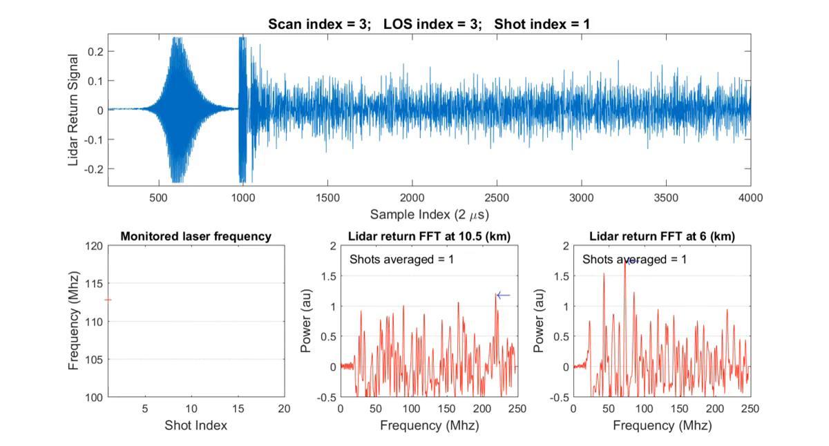

Monitor detector
Lidar atmospheric return (55,000 samples, ~16.5 km)
How Does DAWN Measure Winds?
DAWN generates 10 laser pulses per second with a circularly polarized beam and 80-100 mJ per pulse
To retrieve a wind vector, two or more line of sight (LOS) velocity measurements are needed at differing azimuth angles, ideally 90° apart
DAWN observed a given LOS for 1-5 seconds during CPEX-CV. Greater dwell time typically equates to better sensitivity to aerosol, at the expense of poorer spatial resolution and greater velocity variance in the measurement volume
DAWN observed with either 2 or 5 LOS’s. Lasing duration per LOS, time for the scanner to move between LOS’s, and onboard computing time, resulted in vector wind profiles with ~1.5 to 7.5 km spacing
If aerosol loading is insufficient at a particular height, then there can be no wind retrieval. Vertical signal integration done to try to detect sufficient aerosol signal
DAWN pulse length is ~66 meters long but data oversampled to a 30 meter fixed altitude grid for ease of use of wind retrieval products
Lidar atmospheric return
256 Lidar Samples Used To Derive Doppler Shift Per Altitude Bin
Transmitted Lidar Pulse Frequency

Slide 5
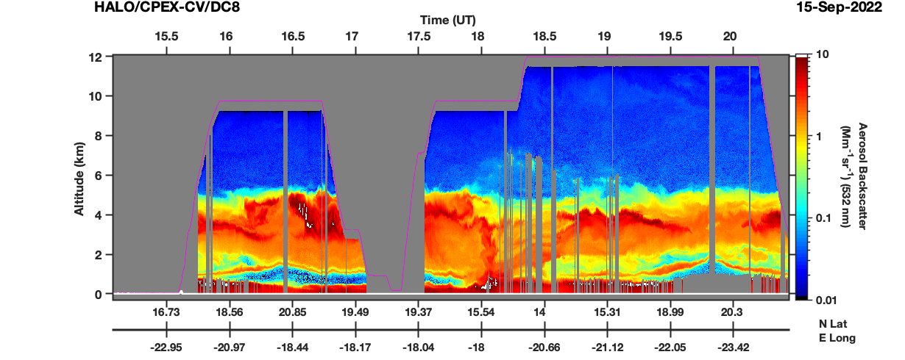
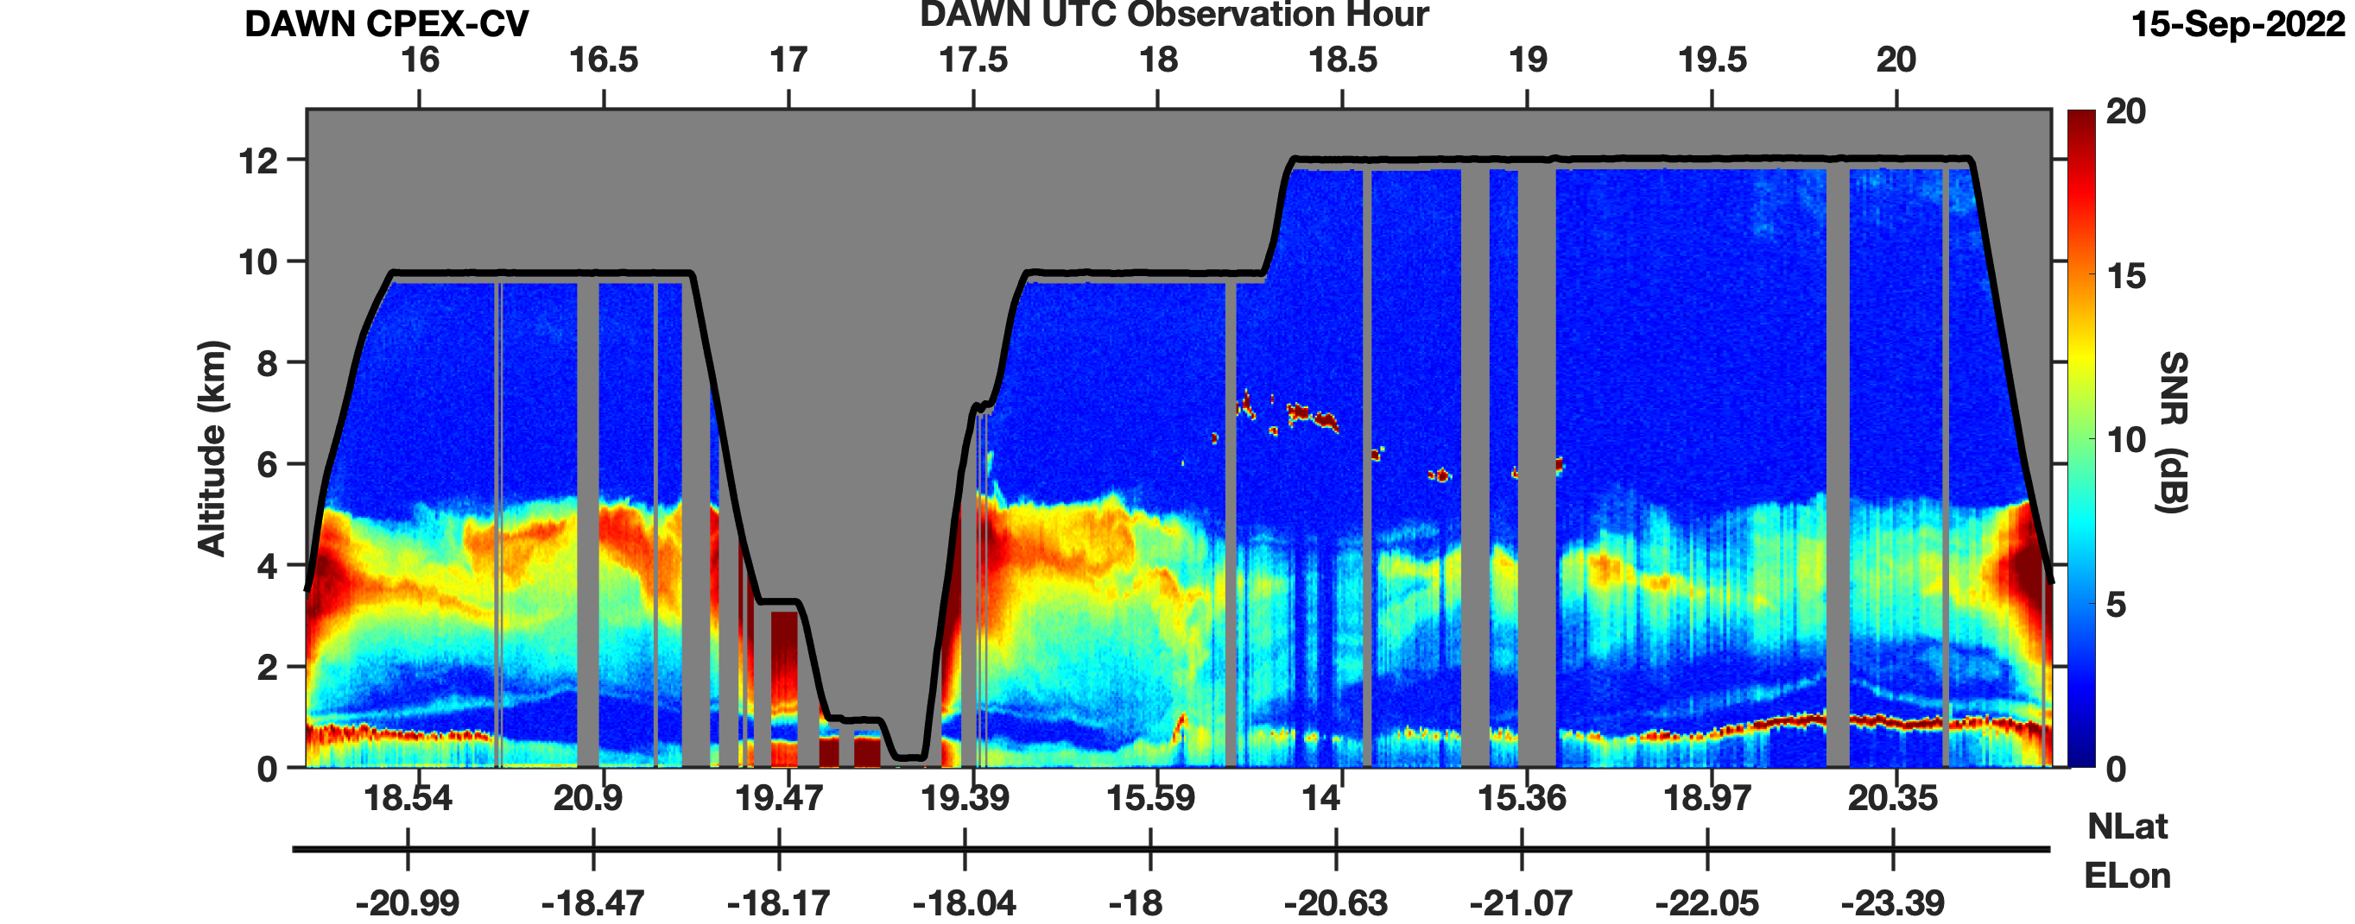
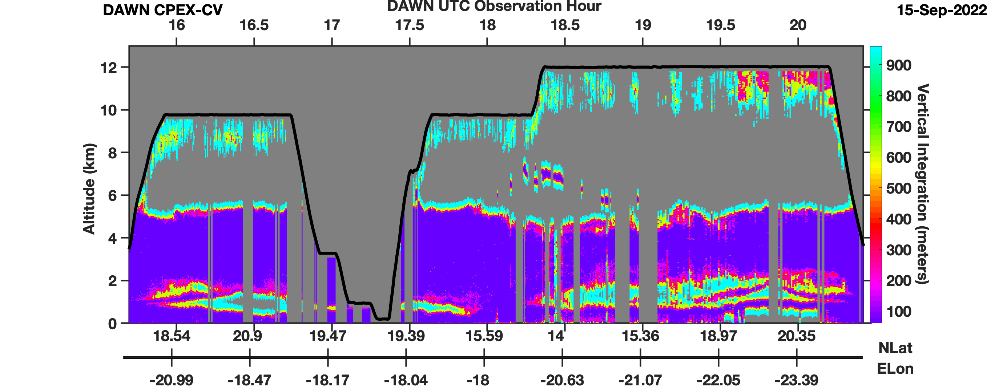
Examples of DAWN Data Products
HALO 532 nm Aerosol Backscatter
HALO aerosol backscatter is range-corrected, and serves as “truth” for what DAWN should be detecting
DAWN measures relative aerosol backscatter that is not (yet) range-corrected
  This measurement is processed with Fourier transform analysis to derive signal intensity above the detector noise level, a product we call “Signal to Noise Ratio” (SNR)
In this example, DAWN is retrieving winds well where 532 nm HALO backscatter > ~1 Mm/sr (1e-6, yellow), but requires vertical signal integration to retrieve where backscatter is lower
Signal to Noise Ratio (SNR) -> Aerosol Backscatter
(Not normalized for range or laser energy output)
Laser energy decrease while DAWN impacted by cold cargo bay environment
Vertical Integration Required for Wind Retrieval (meters)
DC-8 closer to dust layer
DAWN SNR increases

Slide 6
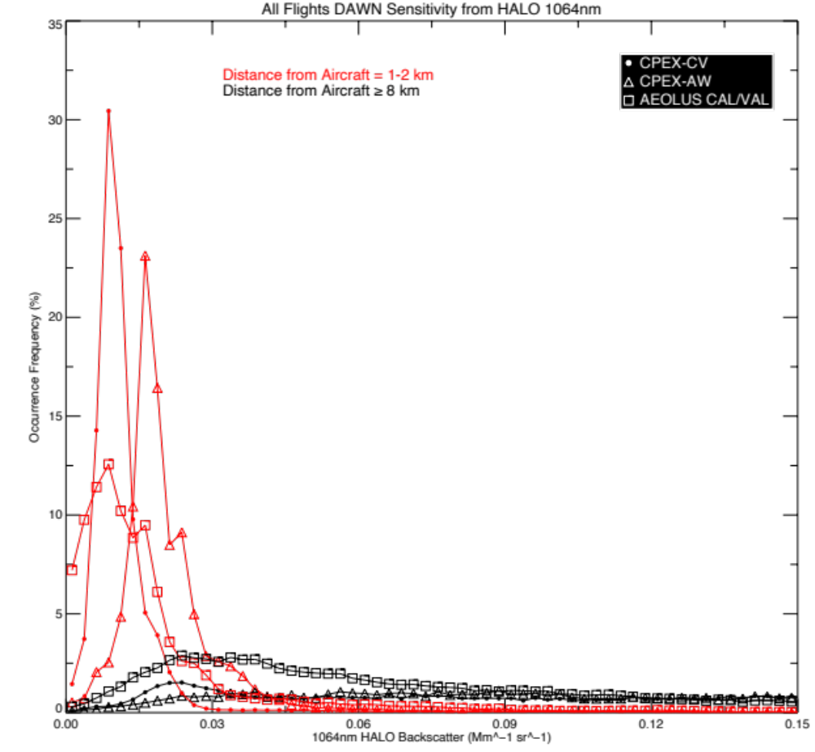
DAWN Backscatter Sensitivity Relative to HALO
Common Question: Why are there vertical gaps in the DAWN wind products?
Answer: DAWN requires cloud/aerosol detection for wind retrieval. No Aerosol -> No Wind But...”how much” aerosol is required depends on lidar system performance which is not a constant
To analyze performance, bins with successful DAWN retrievals are matched in time/space with cloud-cleared HALO data, both near and far from the plane, to derive histograms of 1064 nm backscatter
  Lower backscatter detection -> Better DAWN performance
Analysis shows that DAWN was more sensitive during CPEX-CV than CPEX-AW, but not as sensitive as during the 2019 Aeolus Cal/Val Test Flight campaign

Slide 7
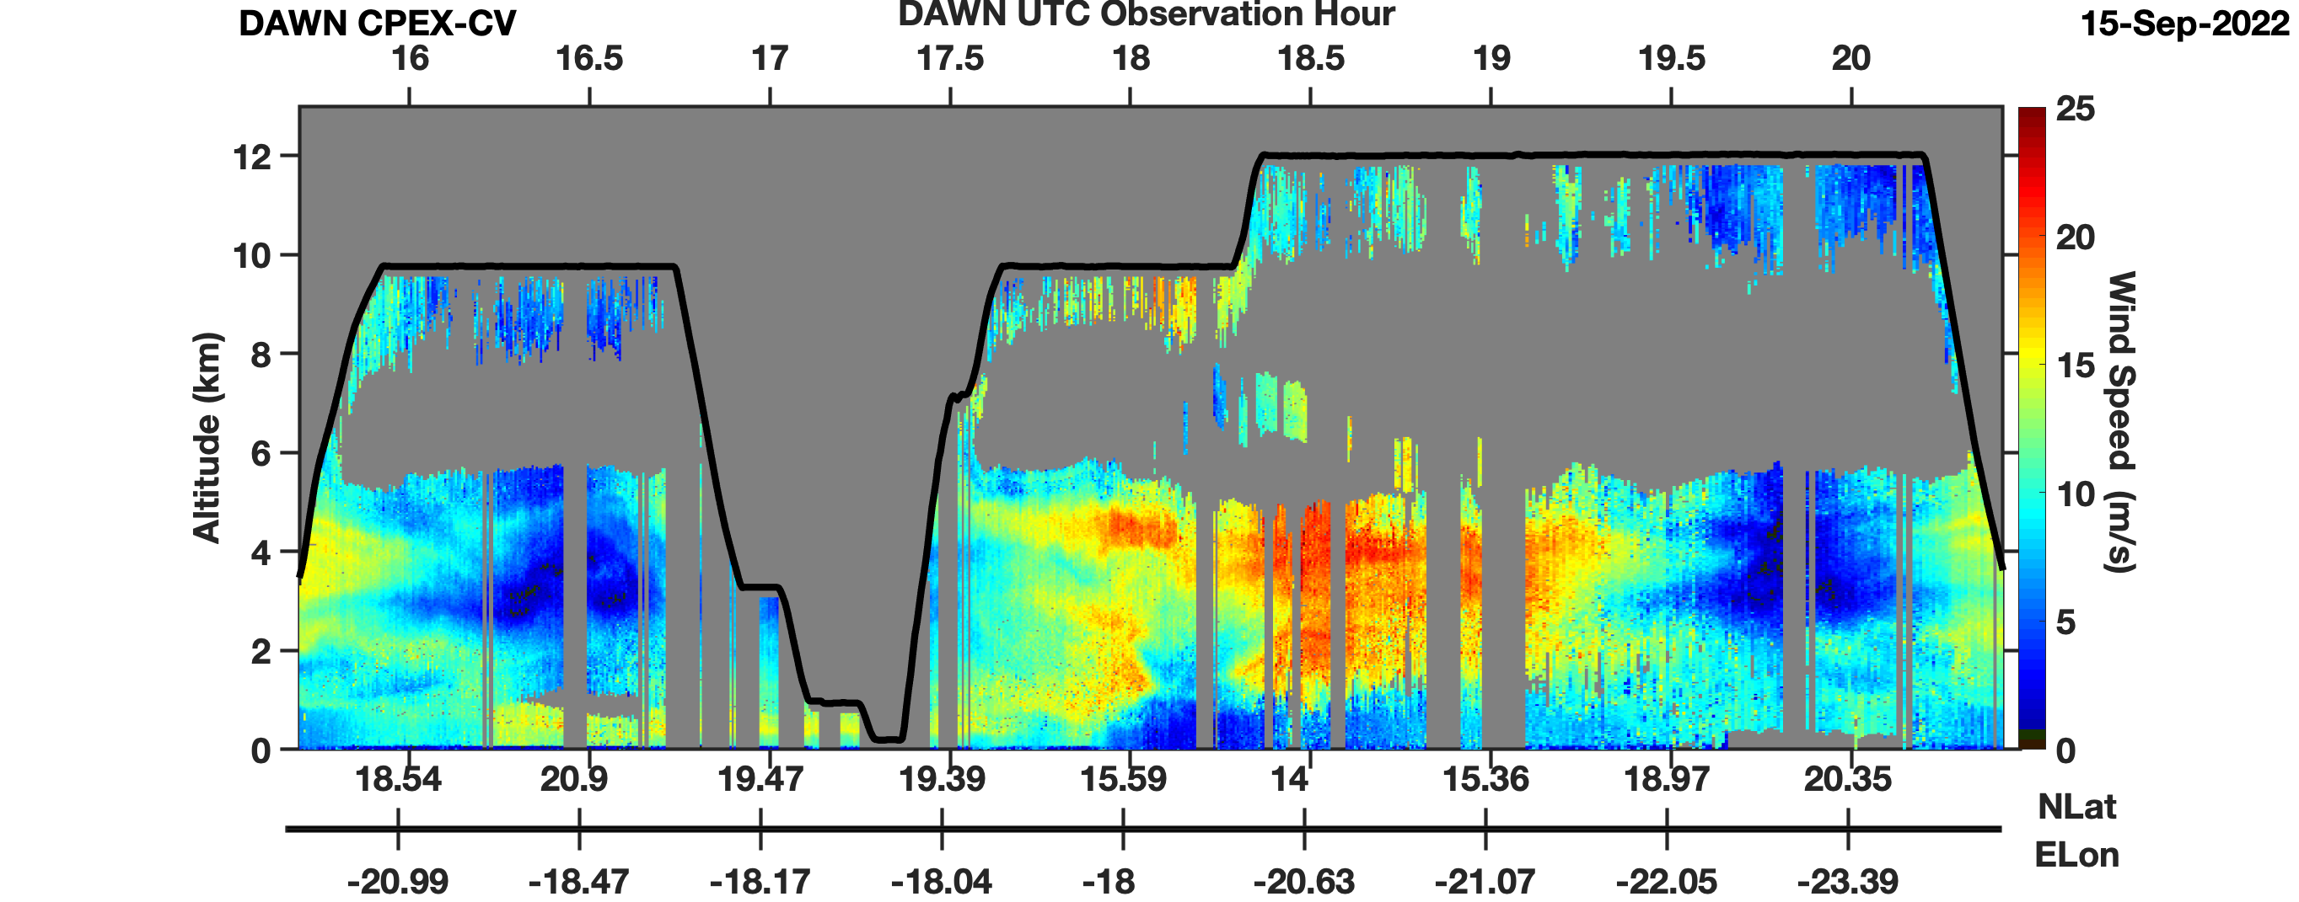
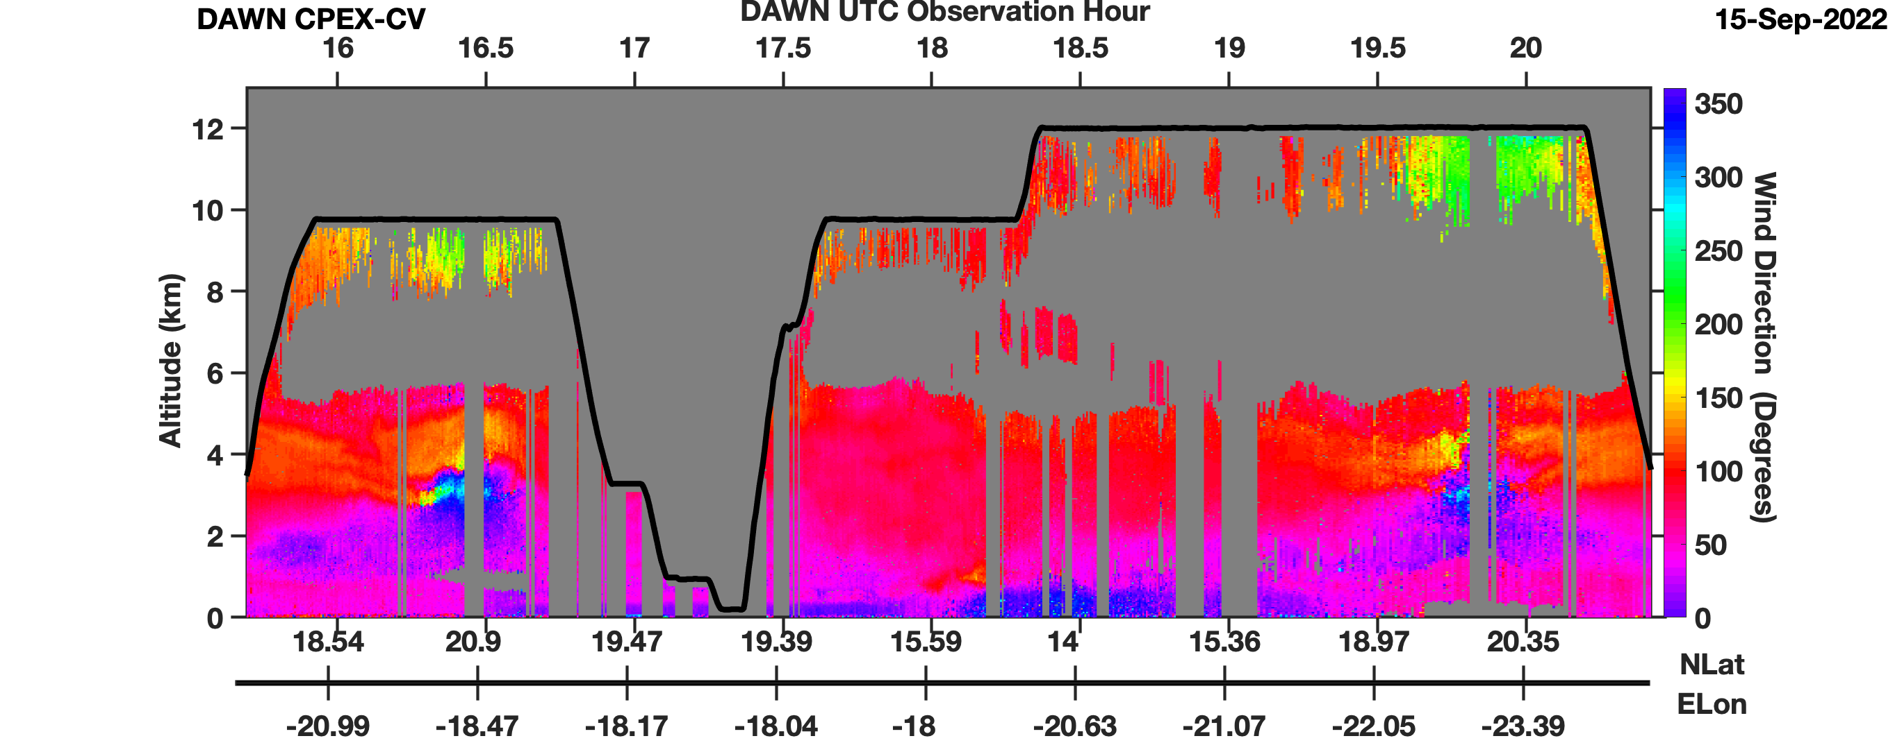
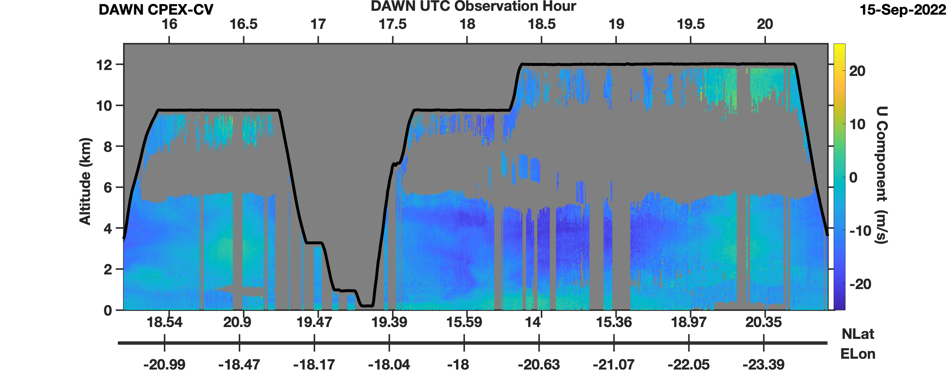
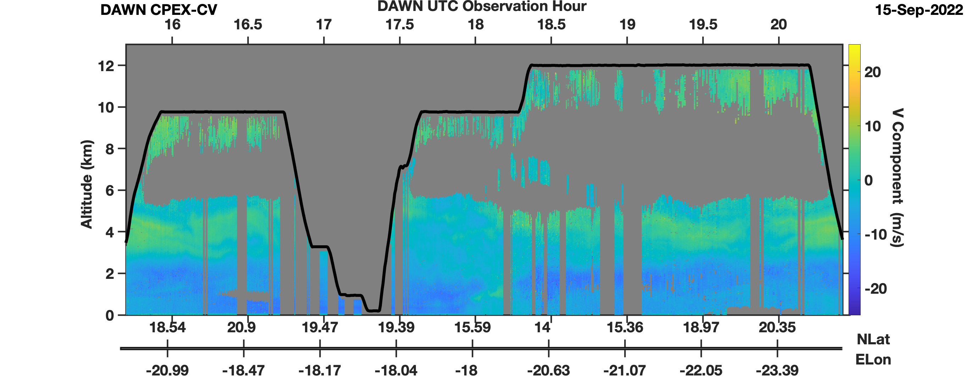
Examples of DAWN Data Products
Wind Speed (m/s)
Wind Direction (°)
U-Component (m/s)
V-Component (m/s)

Slide 8
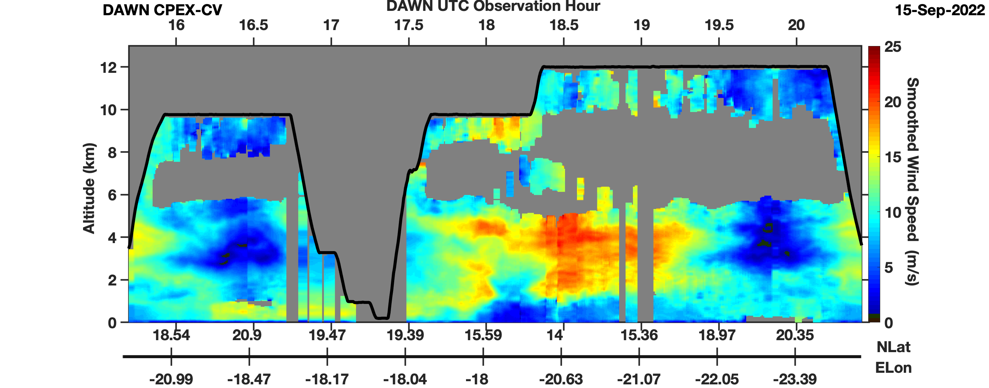
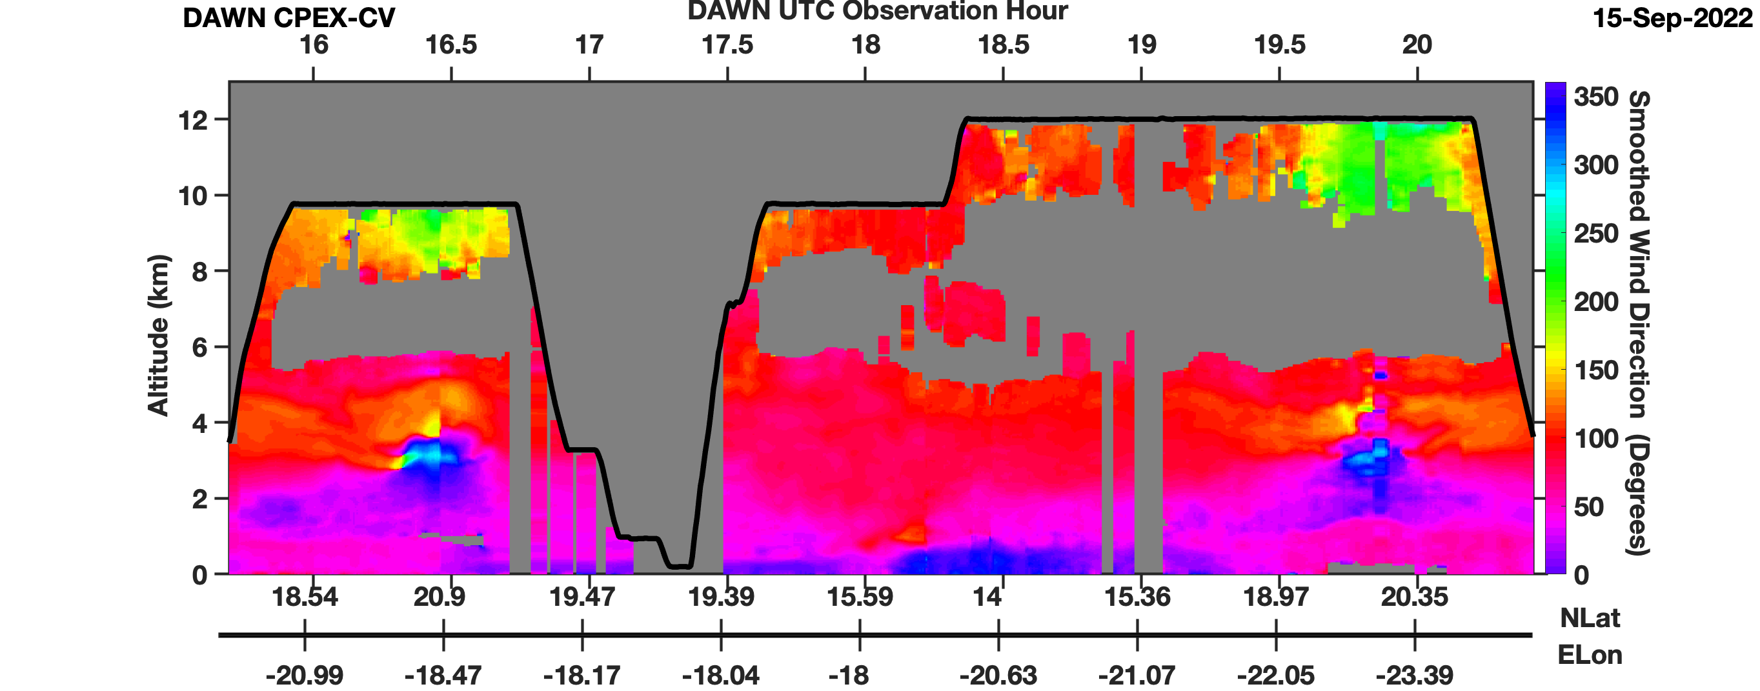
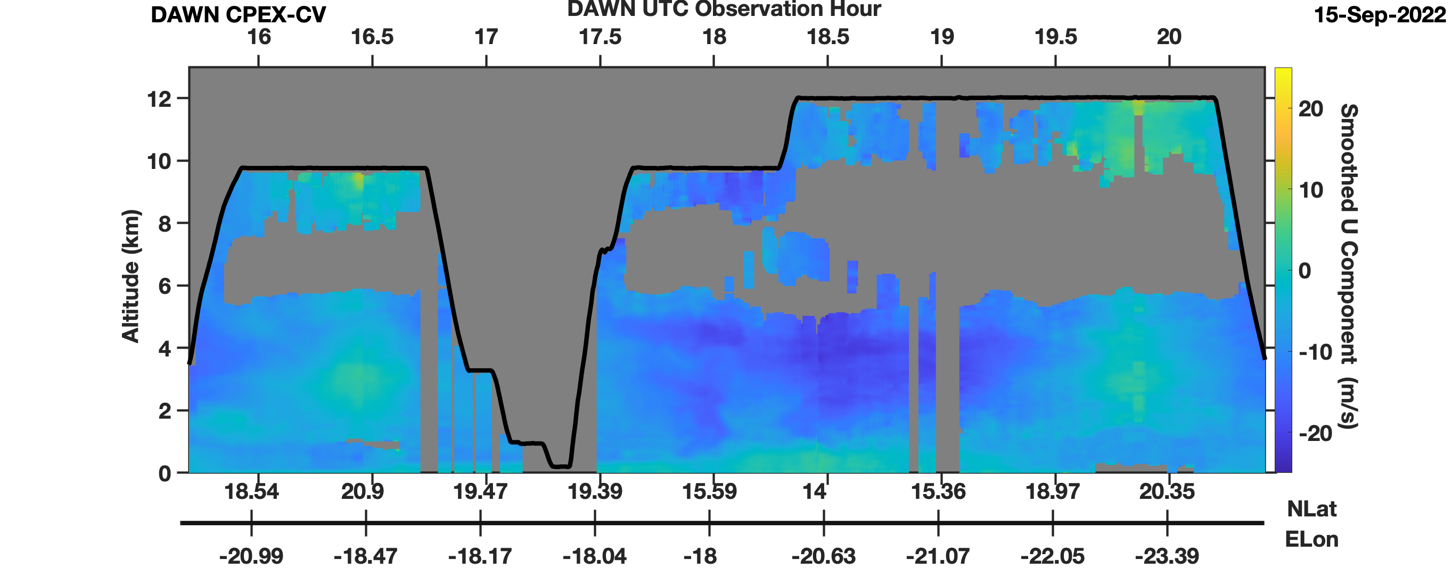
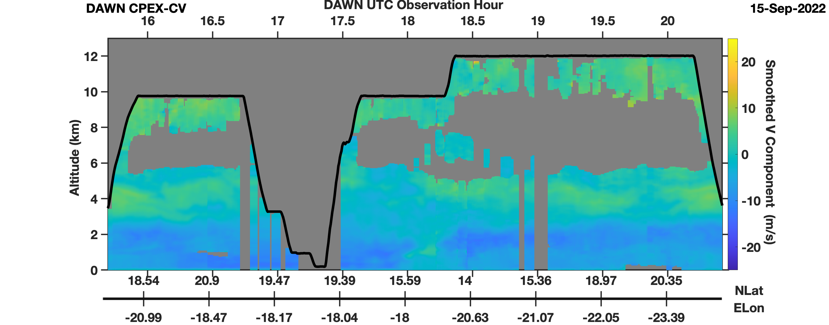
Examples of DAWN Data Products
150 sec kernel = 30 km
5 Vertical Bins
(150 m)
A smoothed/interpolated wind product is provided to fill in most gaps during DC-8 turns and to reduce spatial variability
Highest Weight In Middle
Smoothed Wind Speed (m/s)
Smoothed Wind Direction (°)
Smoothed U-Component (m/s)
Smoothed V-Component (m/s)

Slide 9
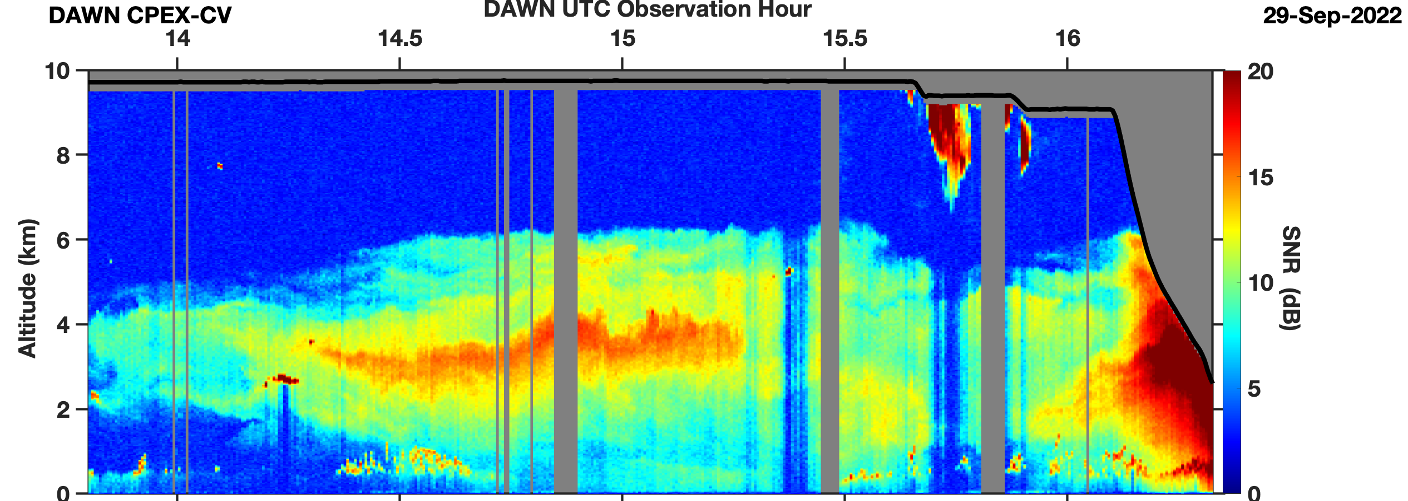
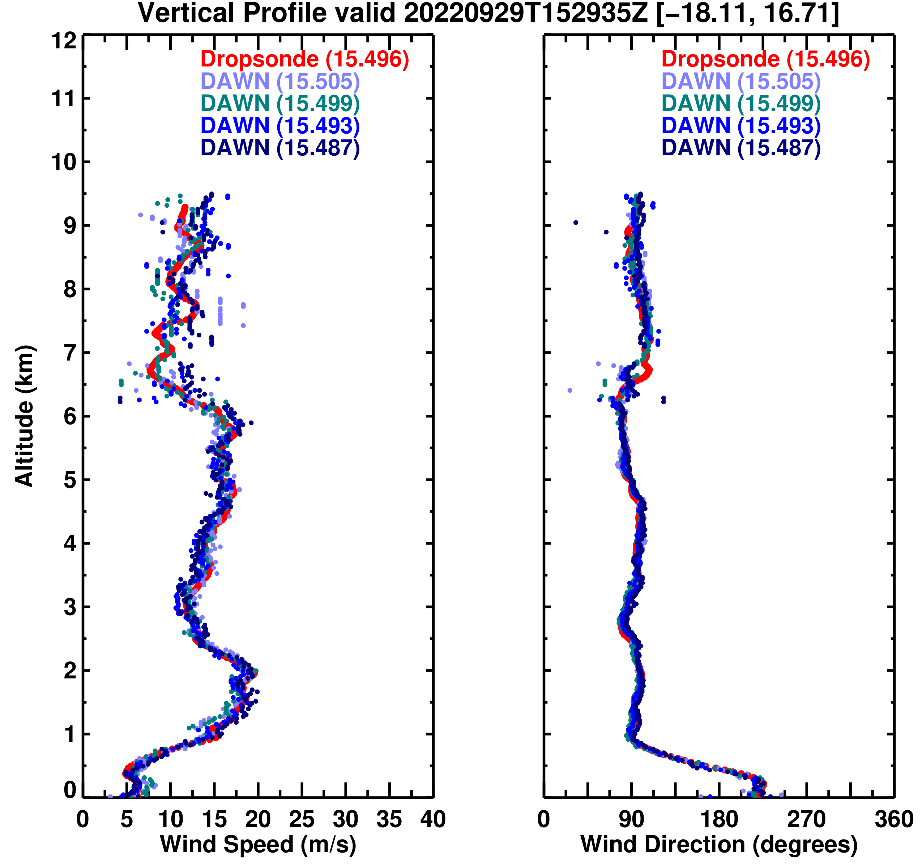
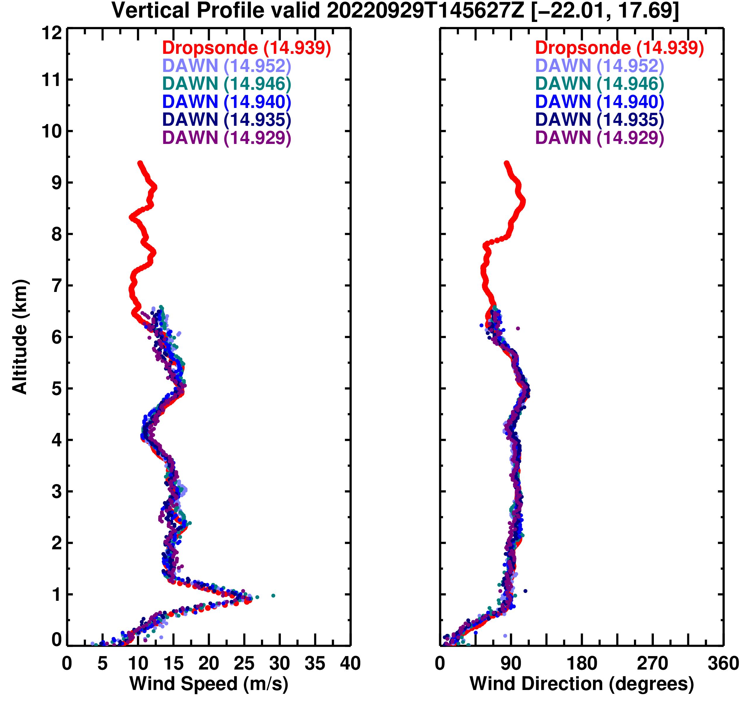
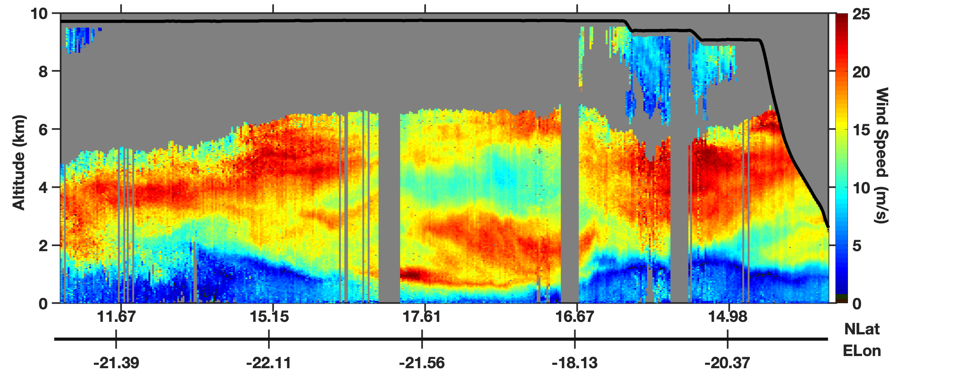
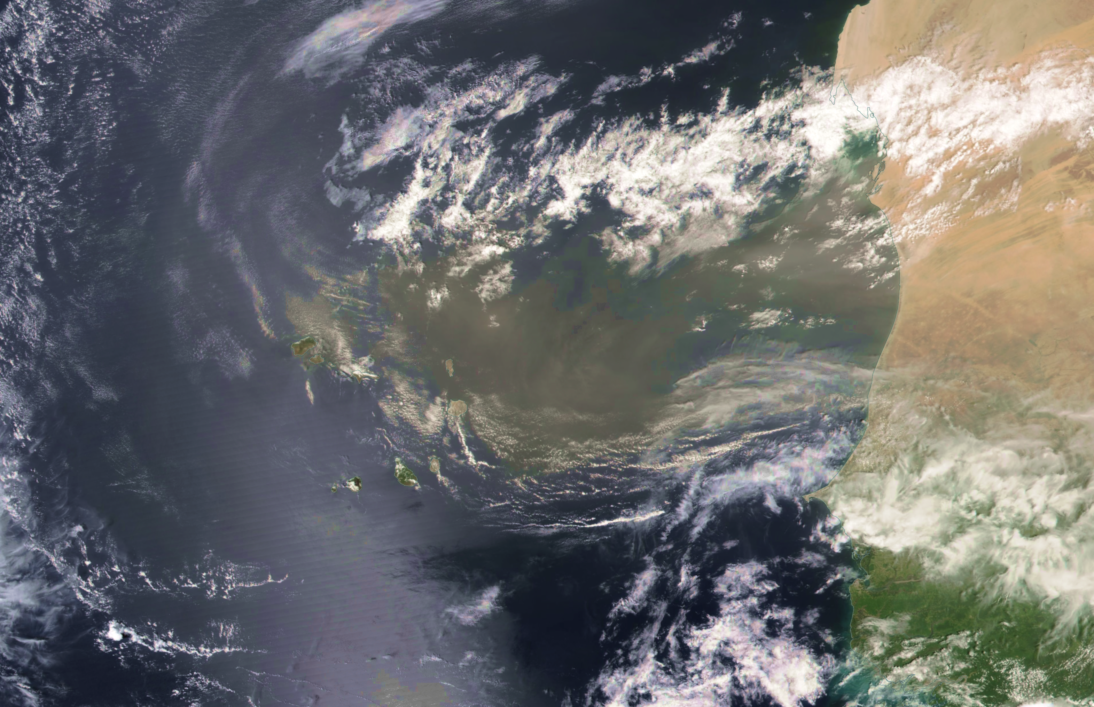
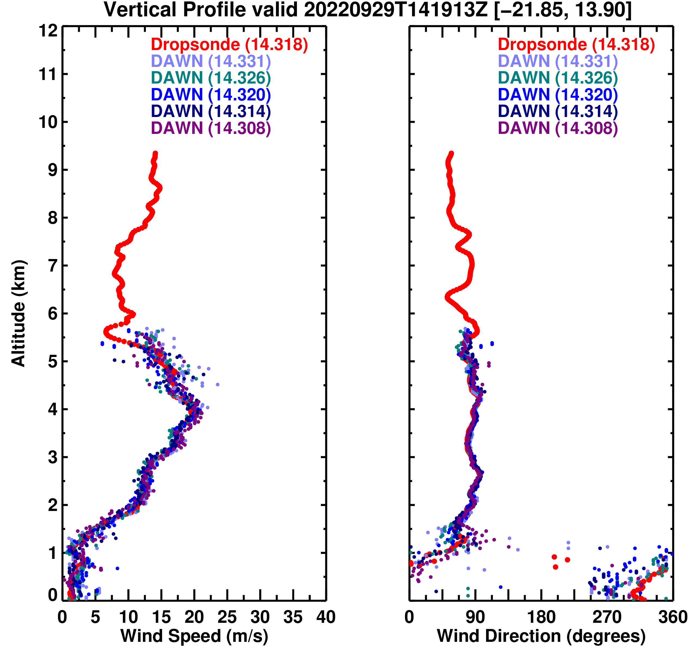
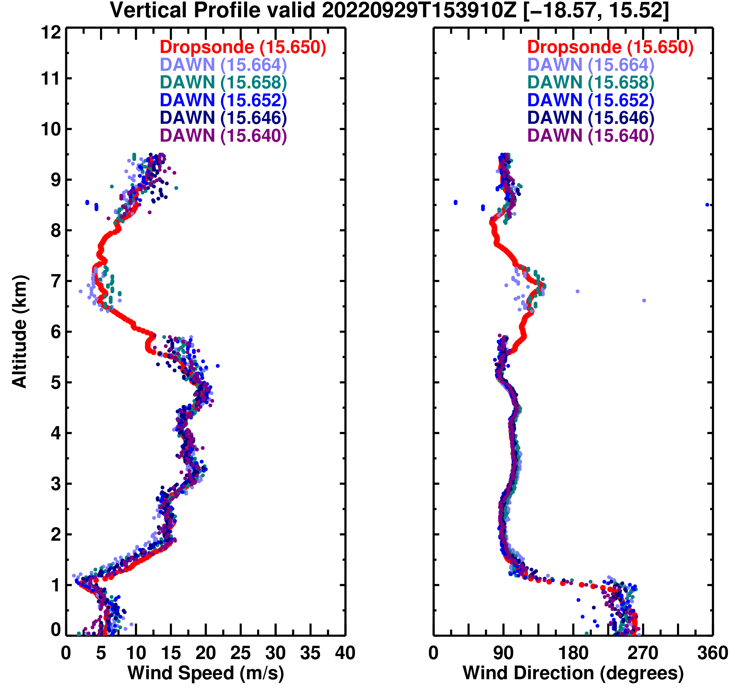
CPEX-CV DAWN – Dropsonde Comparisons
DAWN Backscatter
Examples of DAWN Wind Lidar and Dropsonde Comparisons During CPEX-CV
DAWN Wind Speed
Saharan
Dust Plume
DAWN Validation Statistics Throughout CPEX-CV
(See J. Cooney Talk For More Details)
NOAA-20 VIIRS: 29 September 2022
NASA DC-8 CPEX-CV Flight 12 (From NASA WorldView)
Number of DAWN-AVAPS Matched Samples: 32117 | Bias (m/s) | RMS Difference (m/s)
DAWN Wind Speed | -0.221 | 1.79
DAWN U-Component | -0.015 | 1.95
DAWN V-Component | 0.030 | 1.77

Slide 10
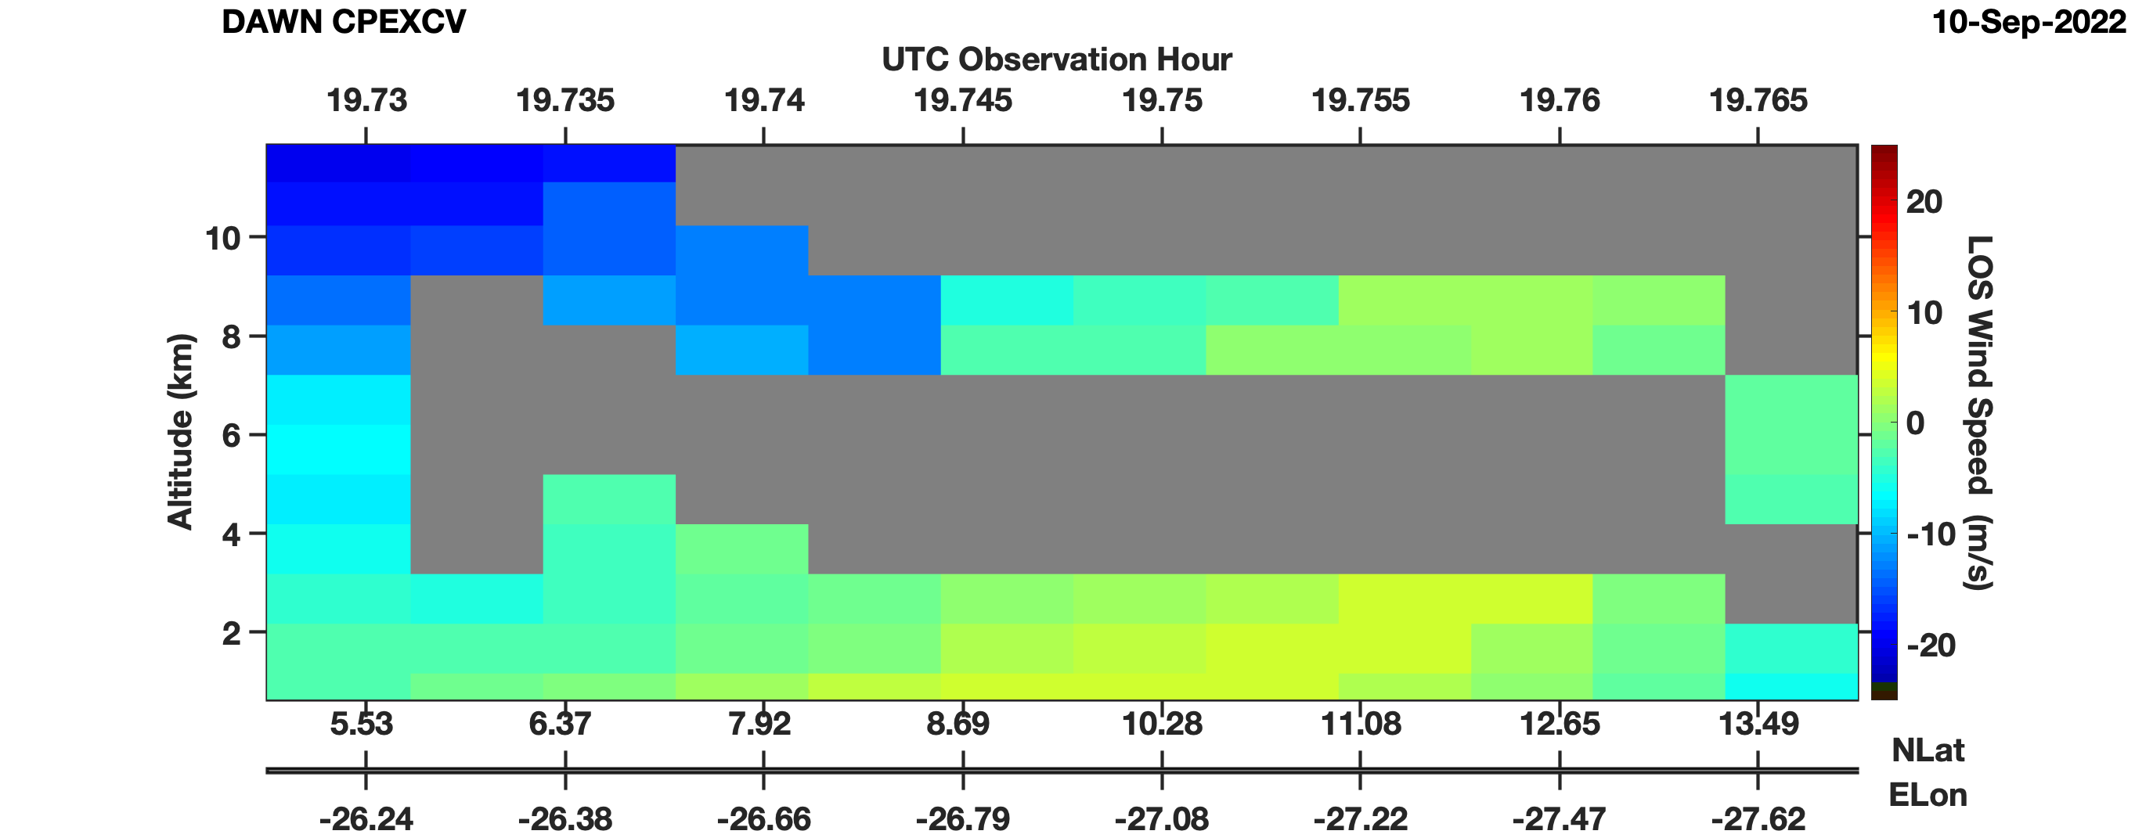
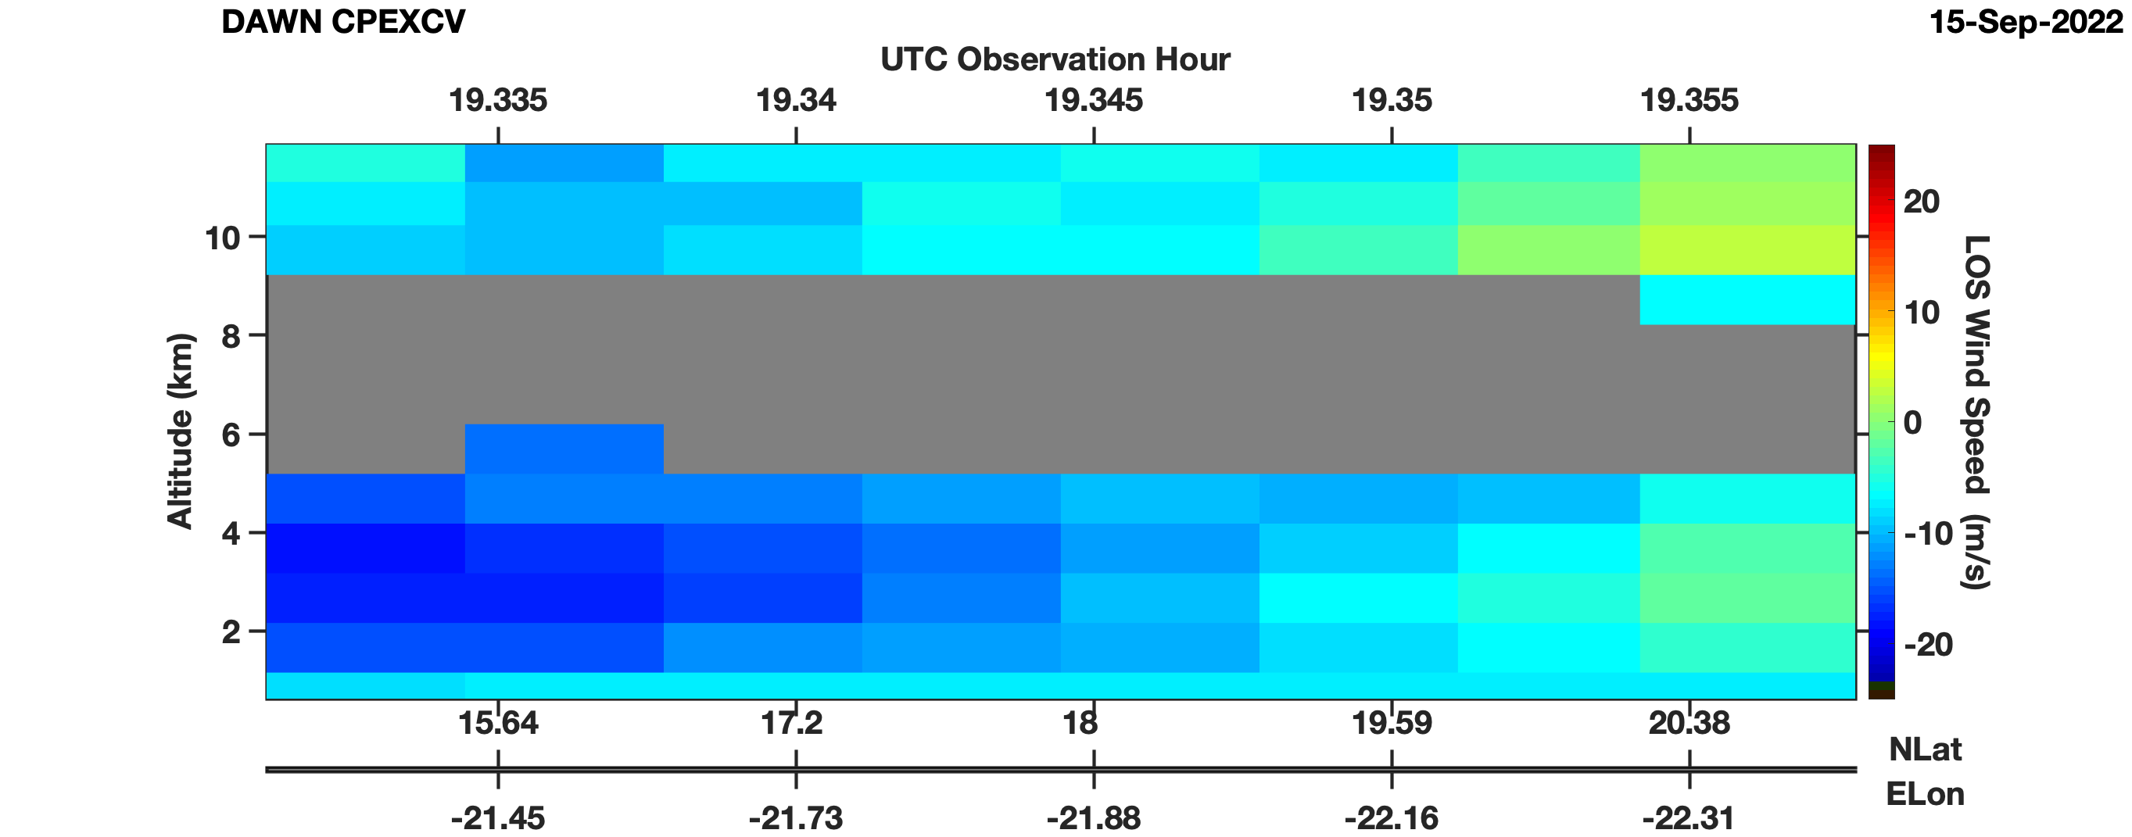
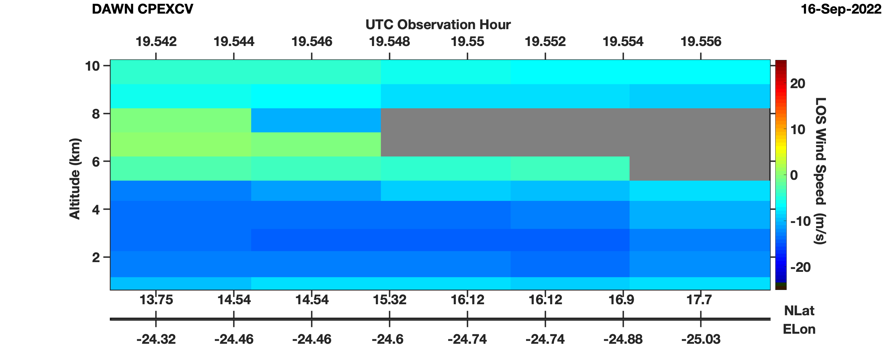
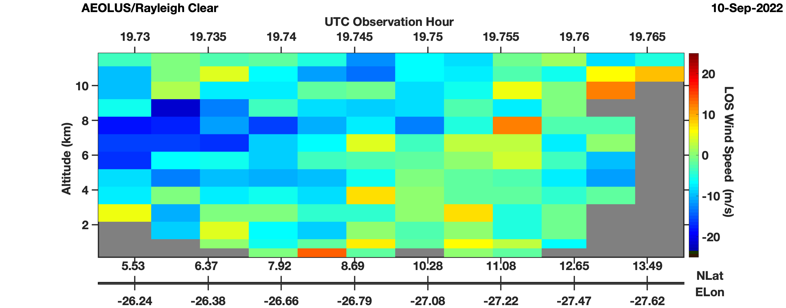
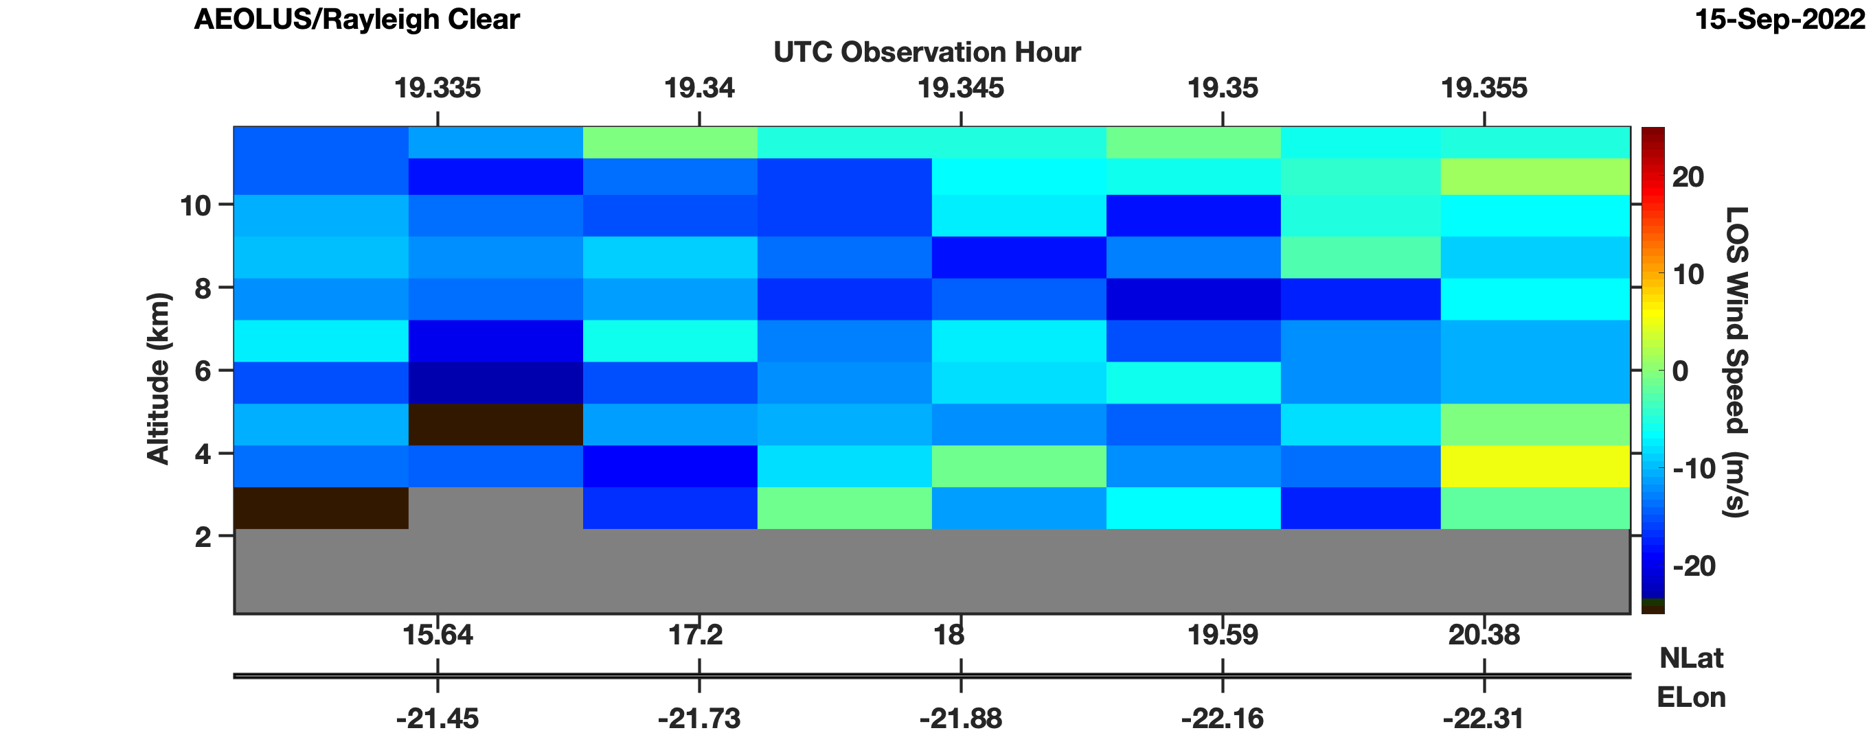
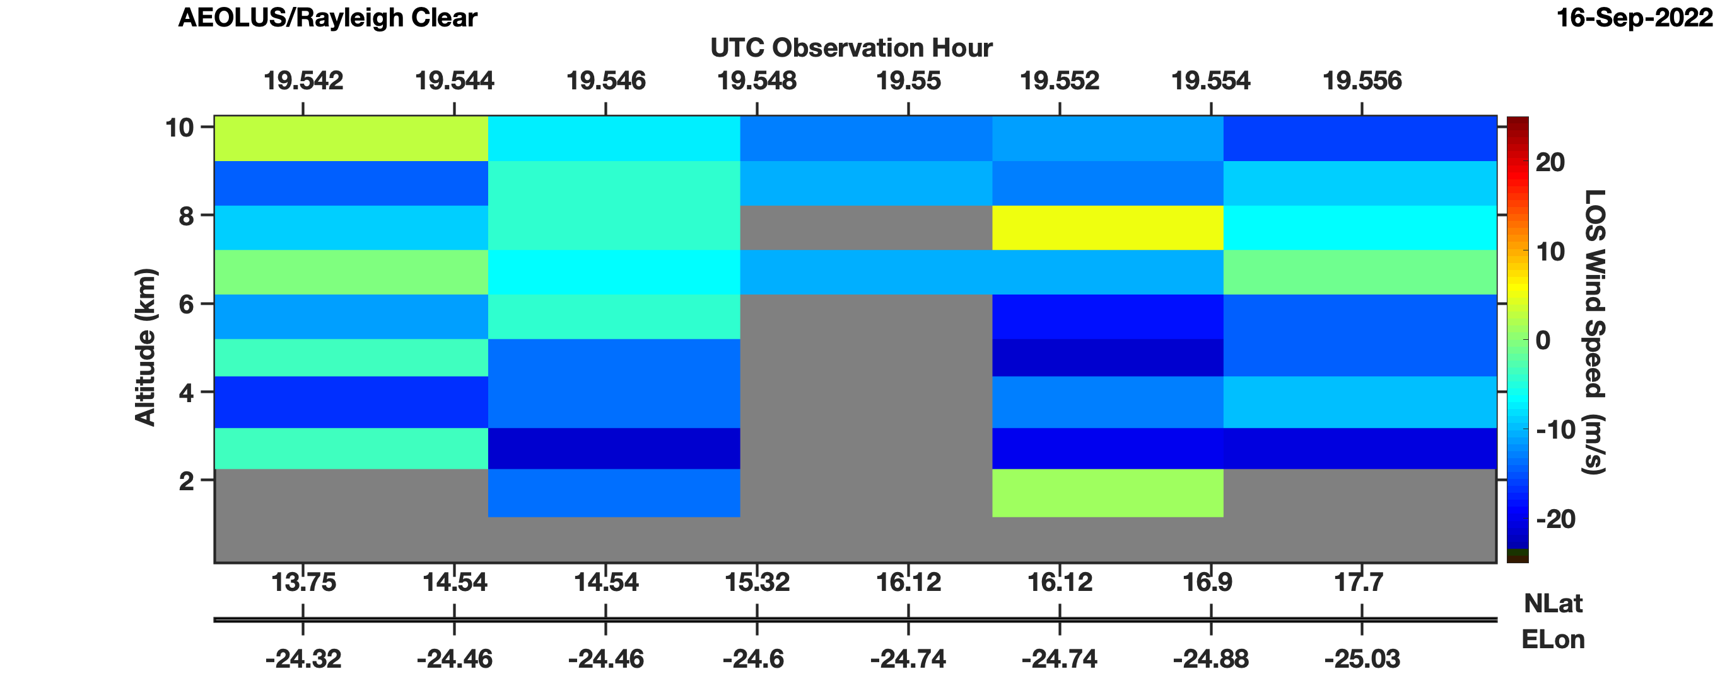
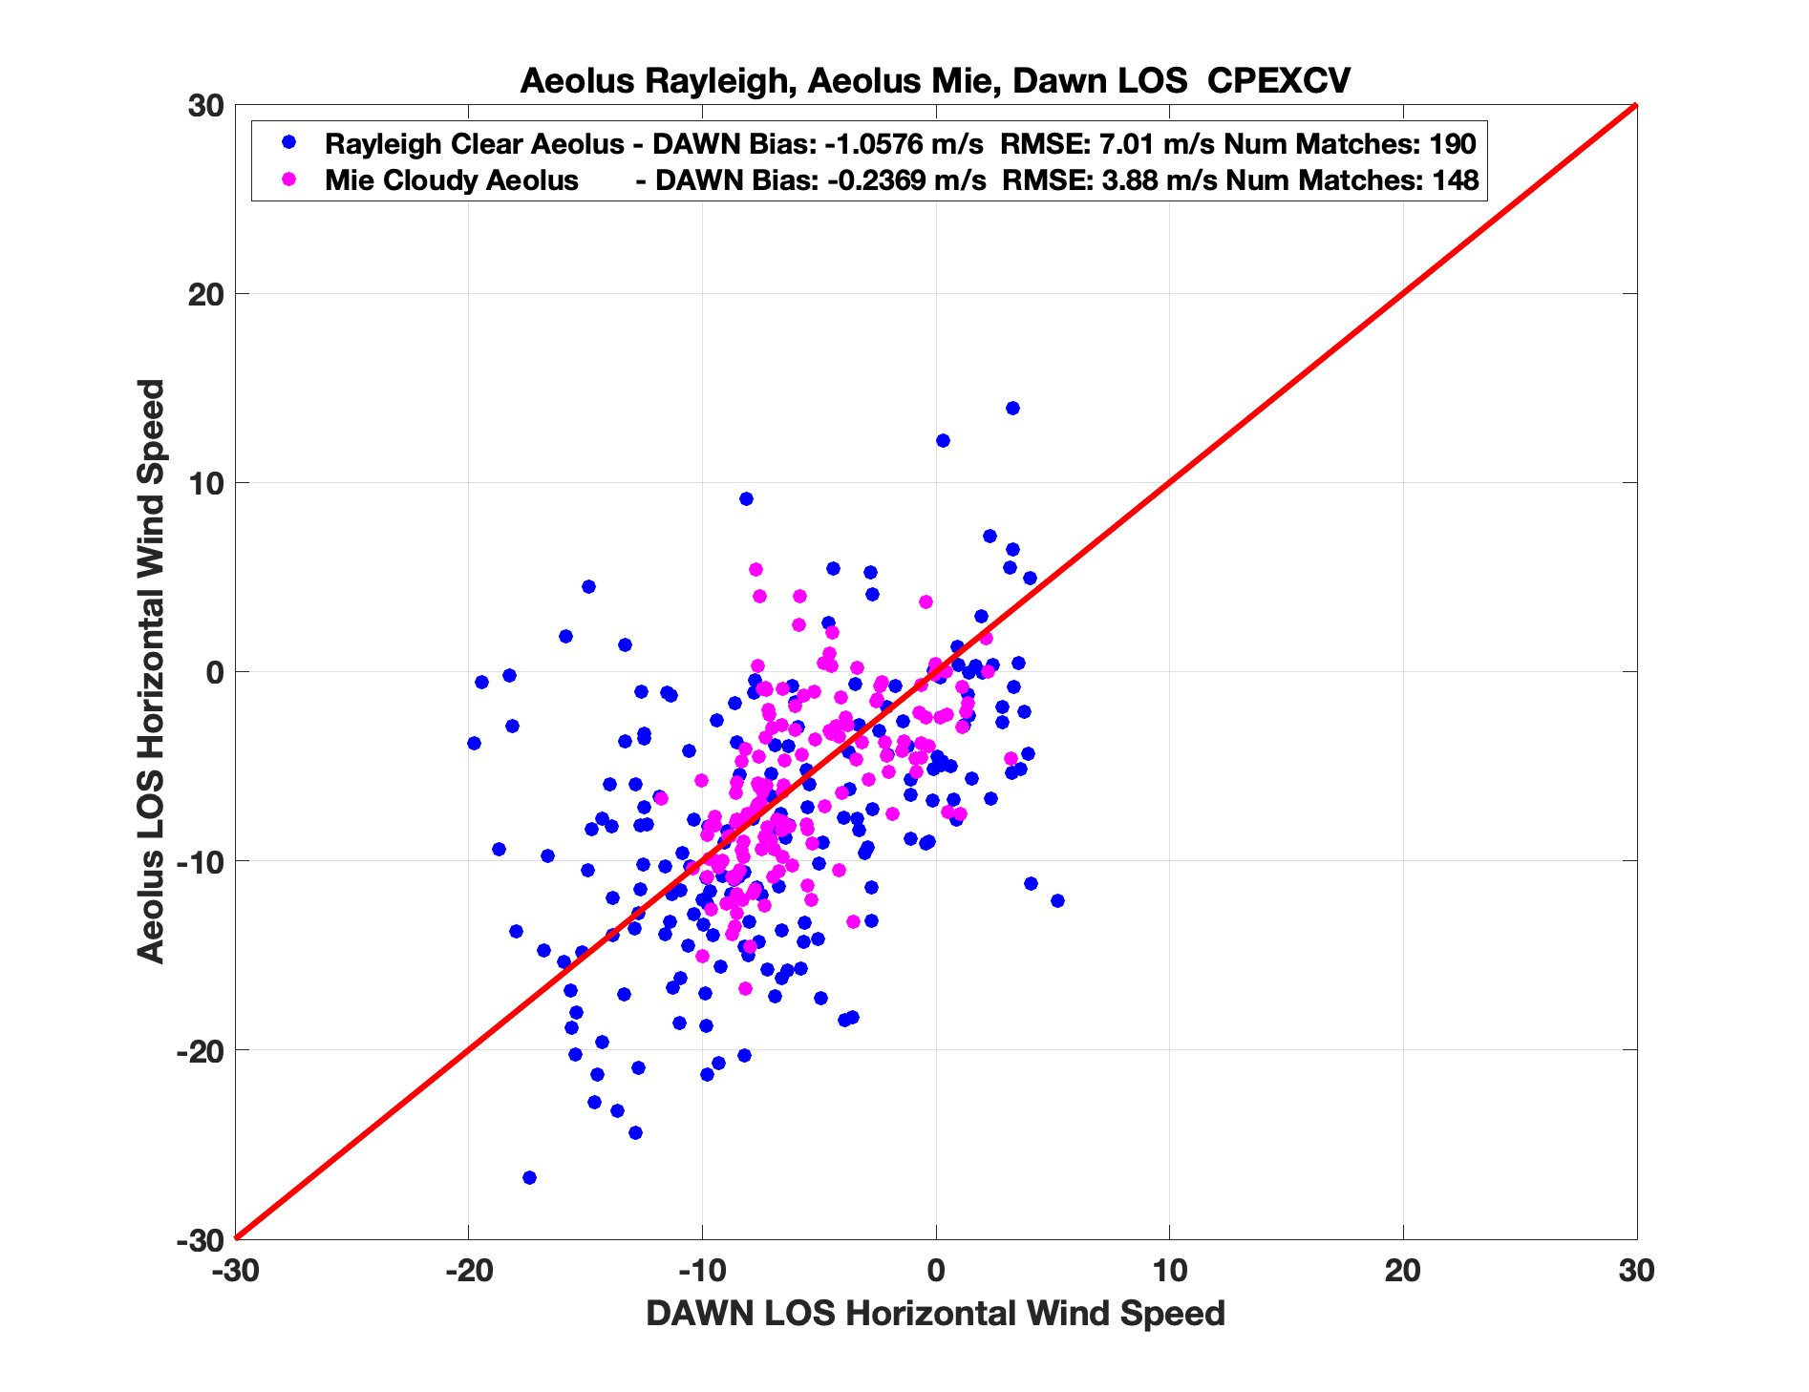
DAWN
10 September
15 September
16 September
AEOLUS
DAWN – Aeolus Comparisons During CPEX-CV
Four DC-8 Aeolus underpasses were executed during CPEX-CV, 9, 10, 15, and 16 September
DAWN LOS wind speeds along Aeolus underpass did not exceed 20 m/s
Dust layers present during all underpasses. A clean layer present in the ~5 to 8 km layer
Rayleigh Clear – DAWN Bias: -1.06 m/s RMS: 7.01 m/s
Mie Cloudy – DAWN Bias: -0.24 m/s RMS: 3.88 m/s

Slide 11
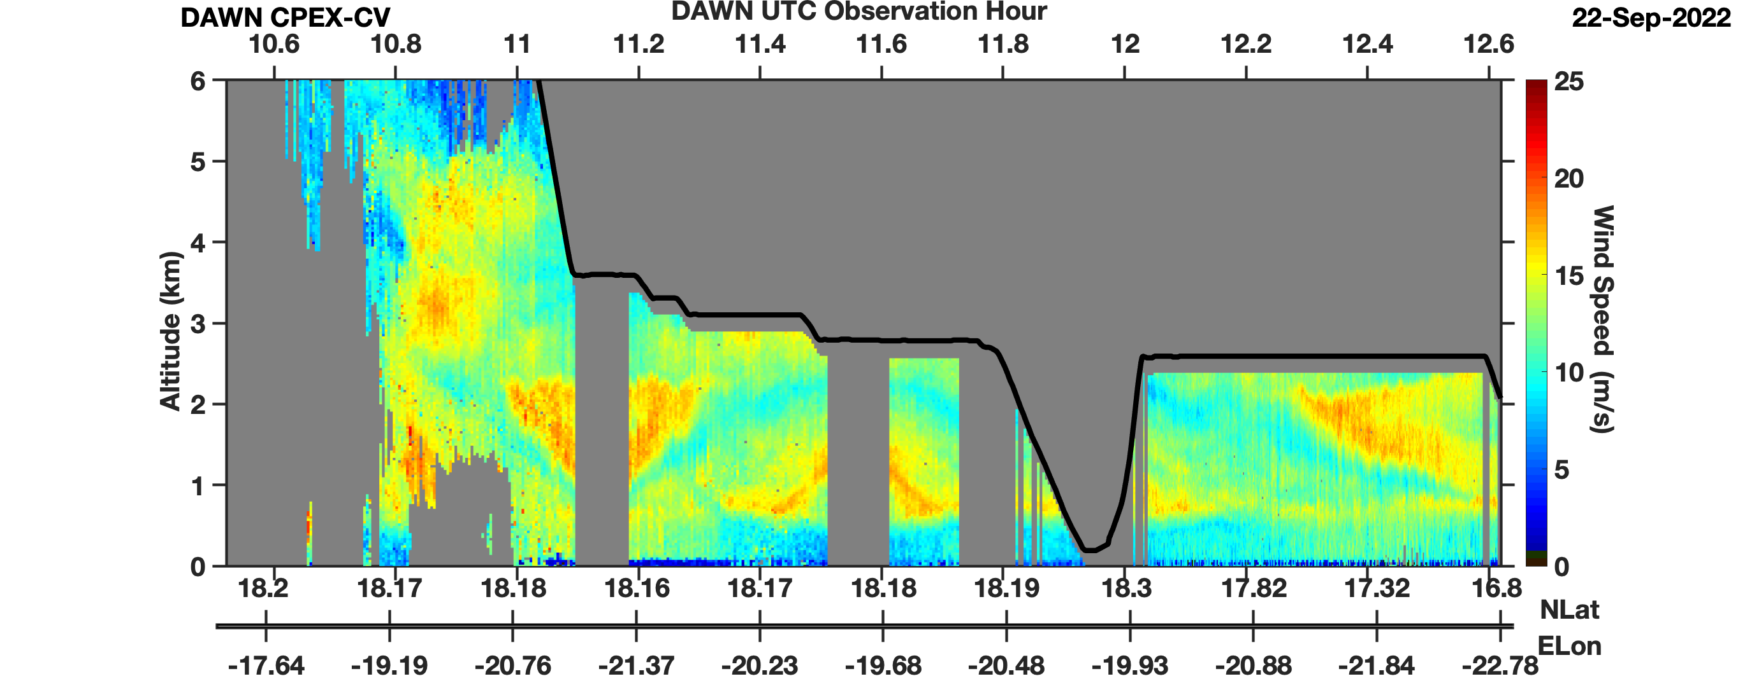
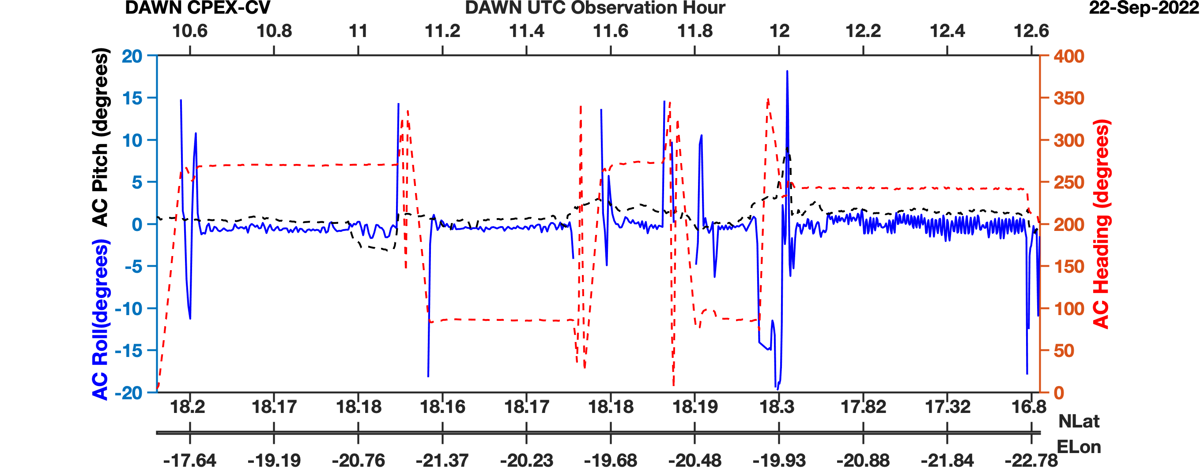
Areas Of Caution With
DAWN Wind Products
Winds below 100 meter altitude can be contaminated by surface, where velocity is zero
Winds with slowest wind speed (0-5 m/s) are ~0.4 m/s more uncertain than faster winds (15+ m/s)
  Is difference driven by DAWN or AVAPS uncertainty?
Winds with the deepest vertical integration (~1 km), or with only 2 out of 5 LOS with sufficient aerosol signal, have the greatest uncertainty (~2.3 m/s)
Winds are not retrieved during spiral maneuvers due to constant turning
ALWAYS USE QC_flag=1 to filter out noisy retrievals, and ABS(roll) ≤ 3°
5 LOS x 10 Pulses
2 LOS x 10 Pulses
“Stripes” in Winds
Surface Contamination?
Auto-Pilot on Return to Sal Caused Constant Roll and Difficulty with Retrieval

Slide 12
Summary
DAWN successfully operated with high laser energy and a variety of scan modes throughout CPEX-CV, without any notable instrument anomalies
  Some reduction in laser energy at times during long durations of ~12 km altitude flight from very cold cargo bay
6-9 km altitude layer found to be very clean, limiting DAWN ability to retrieve wind
DAWN aerosol sensitivity found to be comparable to or better than CPEX-AW based on comparison with HALO
Given its relatively high precision and resolution, we expect DAWN data to be very impactful when assimilated into models, both for dust and convection flights
Dust-centric or low-altitude (~8 km) flight segments provide the best vertical coverage of winds and most interesting data for process studies
Flights through deep convection and AEW sampled mostly cirrus outflow and mid-level clouds, hard to penetrate down into PBL. Precip scavenging also reduced aerosol loading and wind profile vertical coverage
Some interesting mesoscale phenomena observed such as terrain-induced flows and mountain waves, and PBL wind variability
See John Cooney talk tomorrow for more details on DAWN validation, comparisons with models and other satellite-derived winds

Slide 13
BACKUP SLIDES

Slide 14
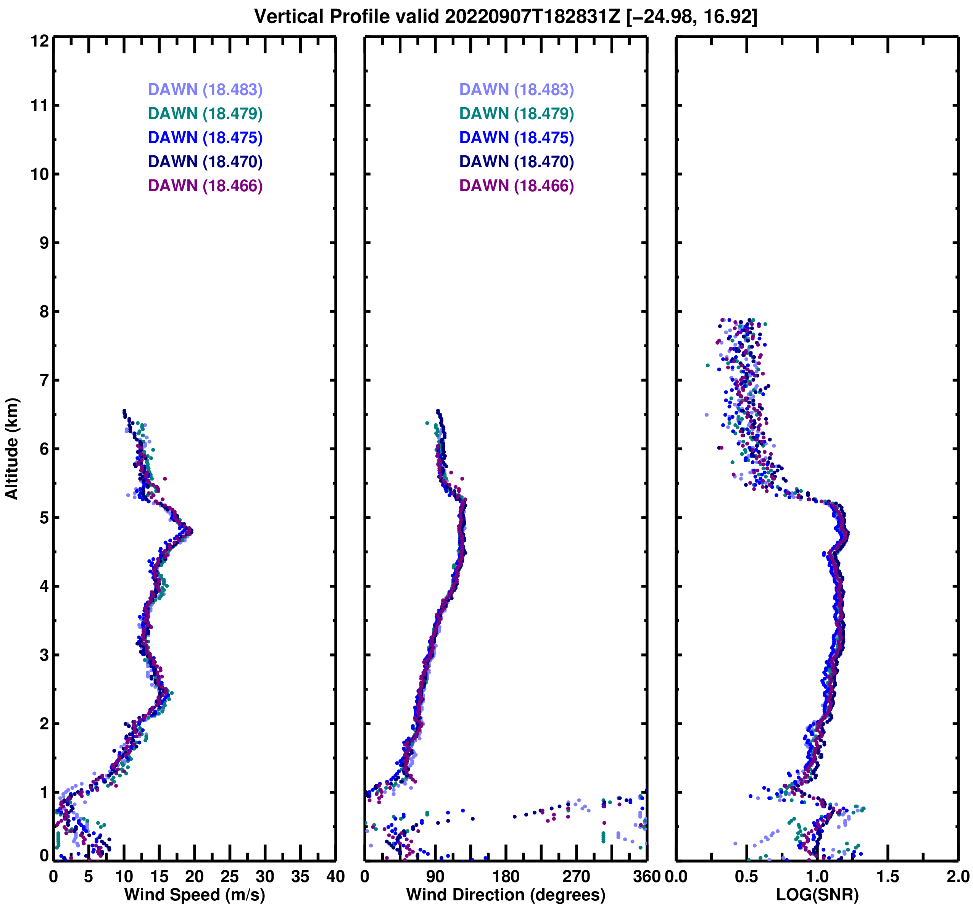
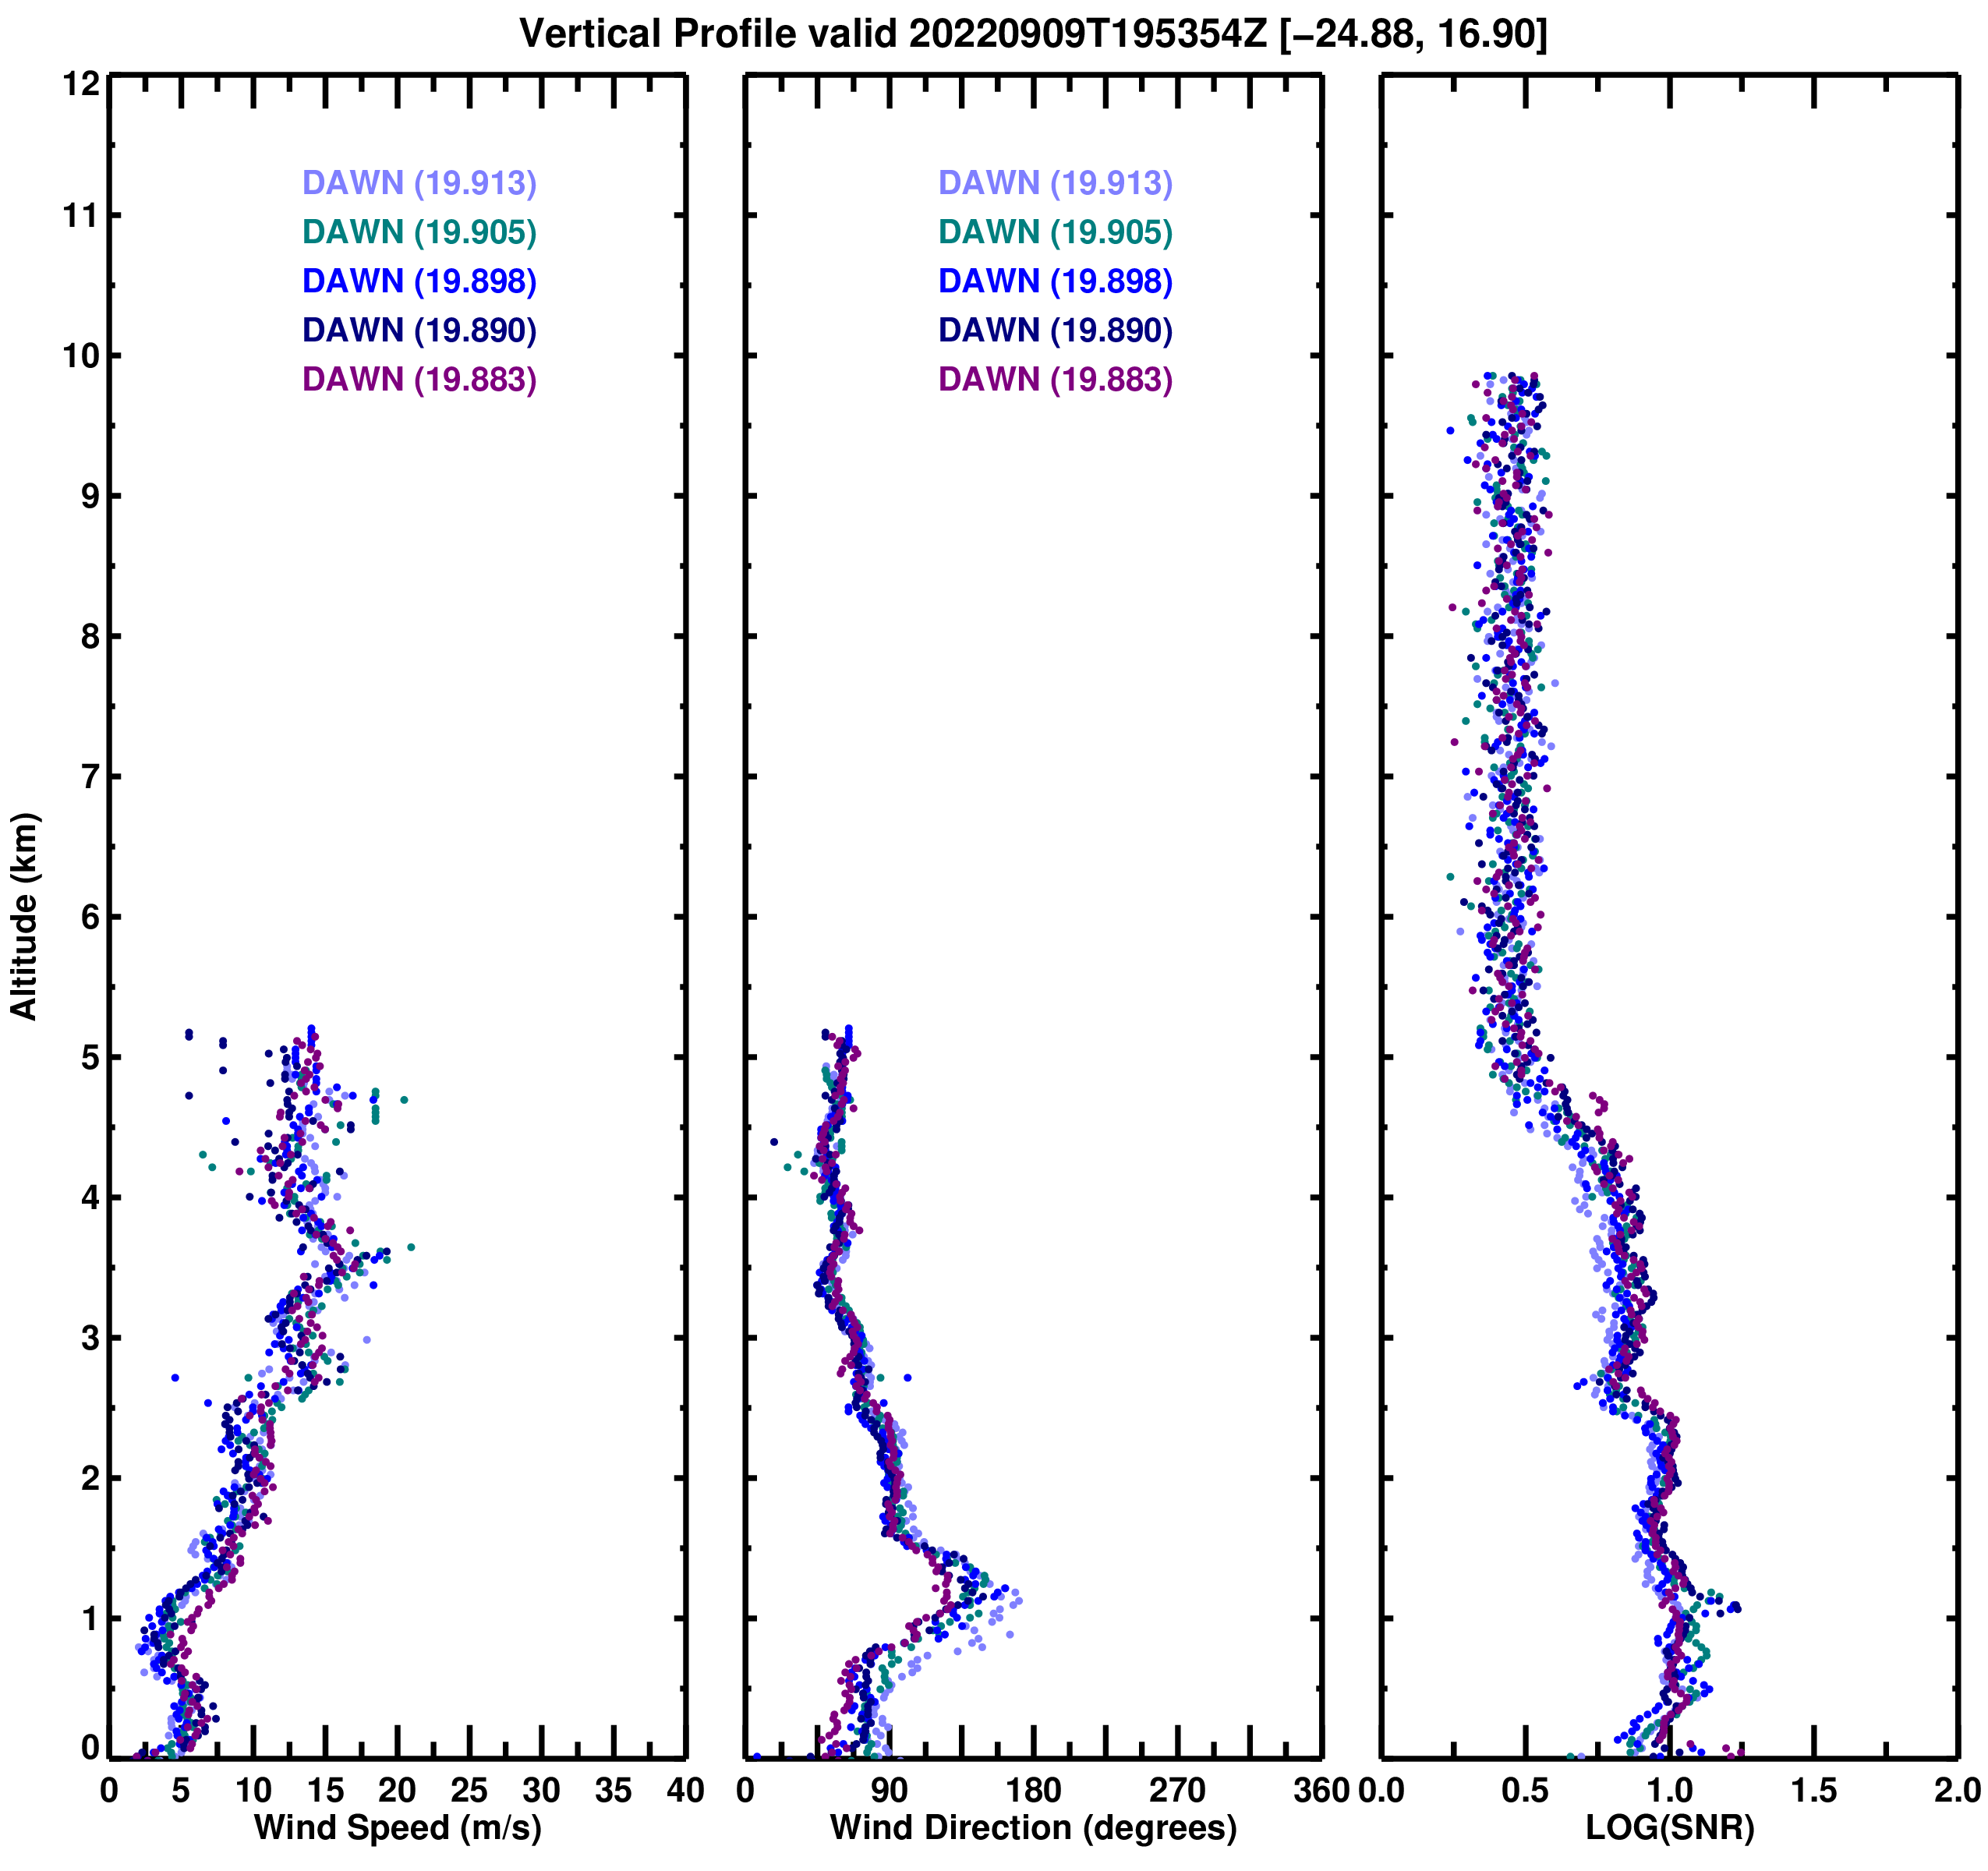
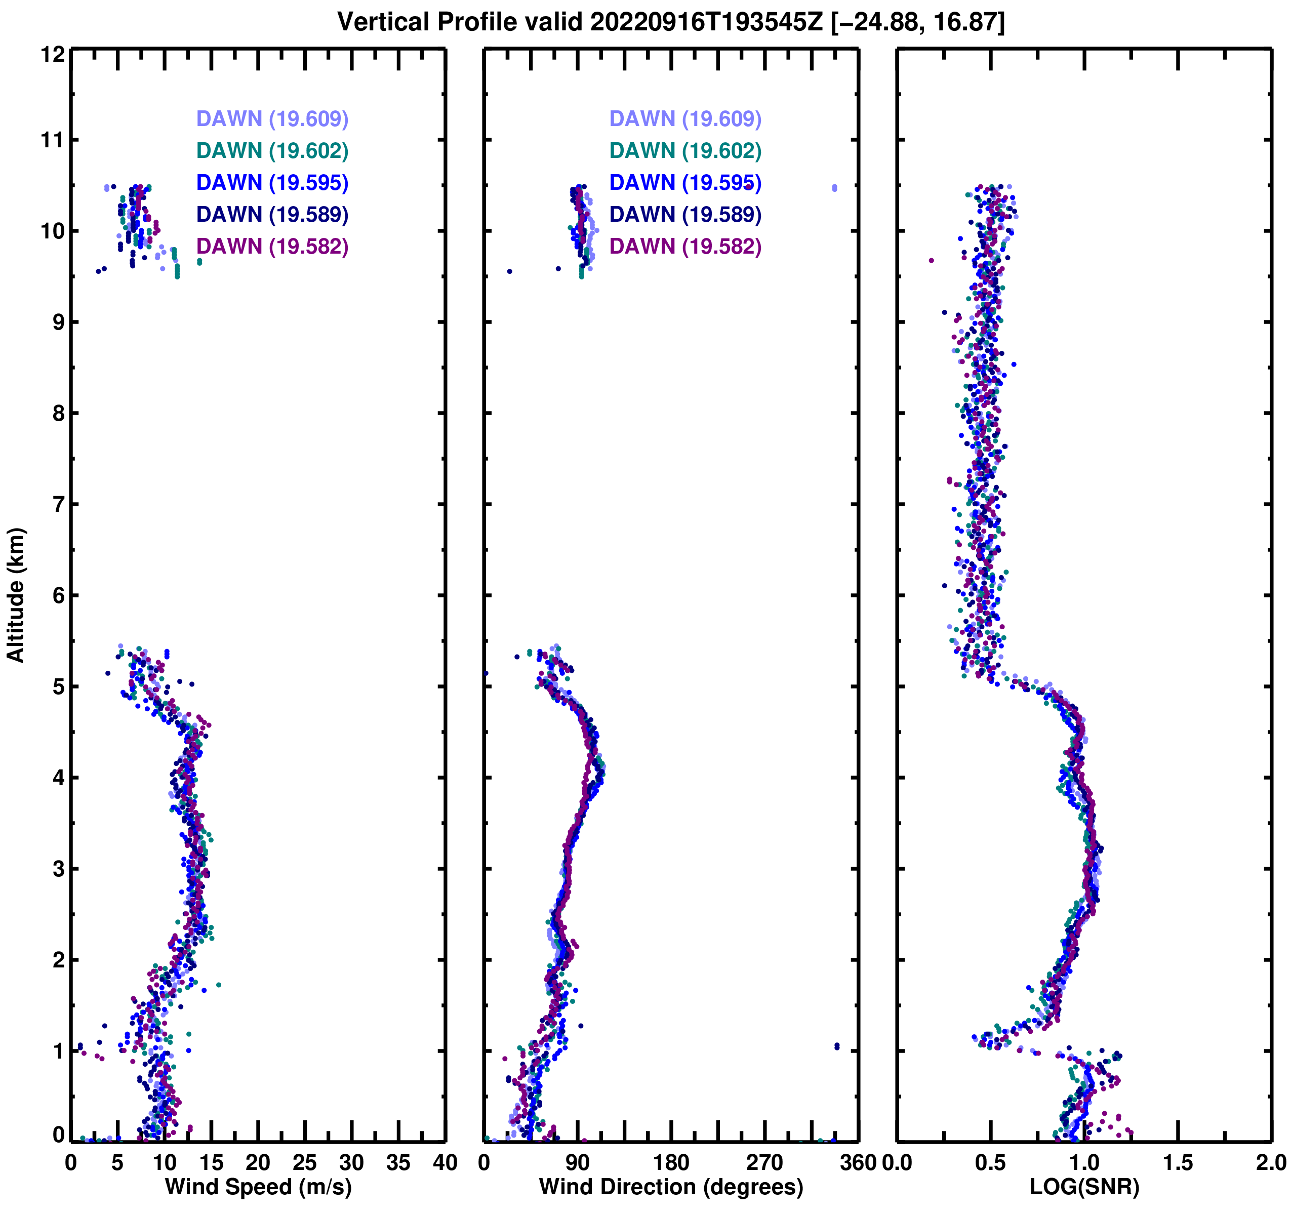
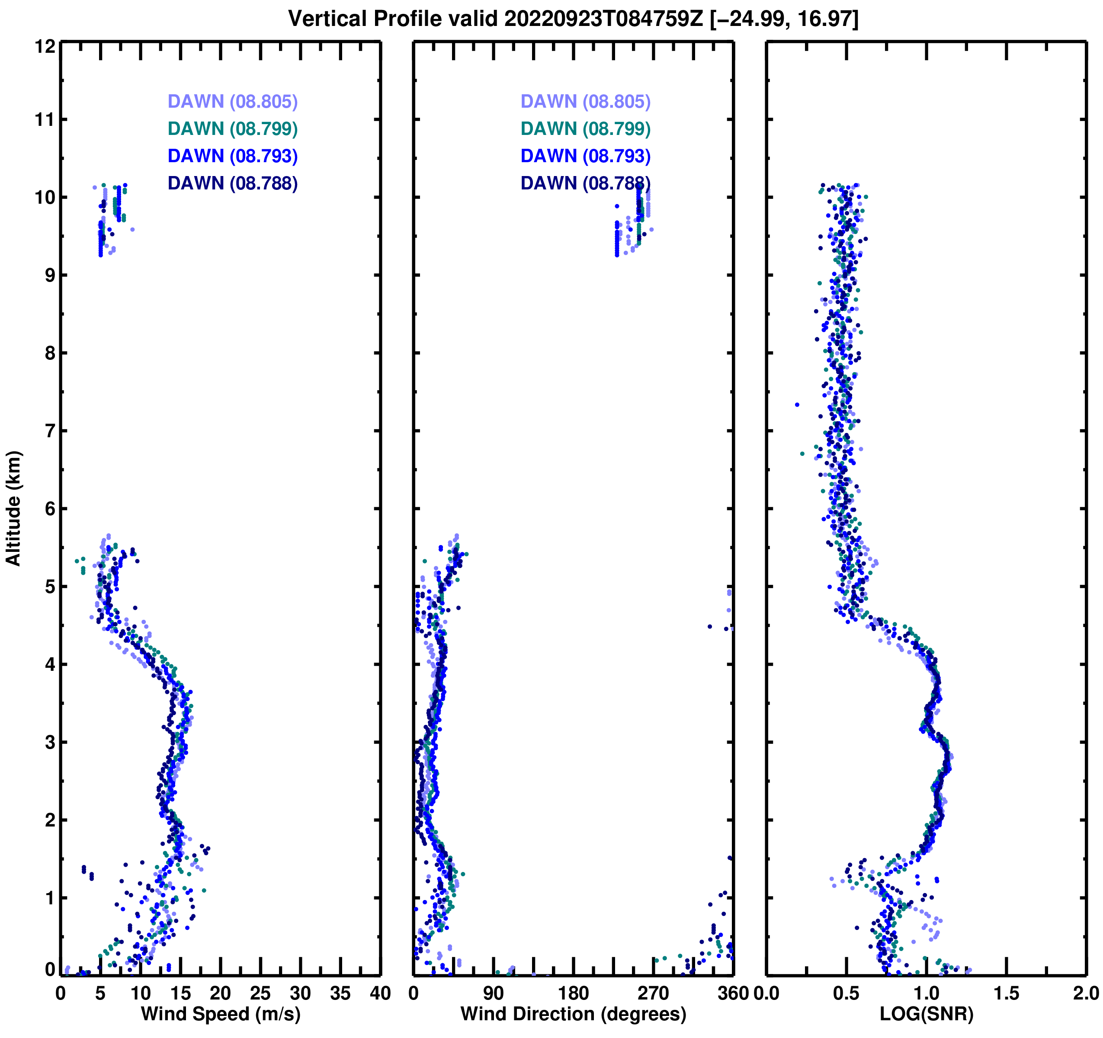
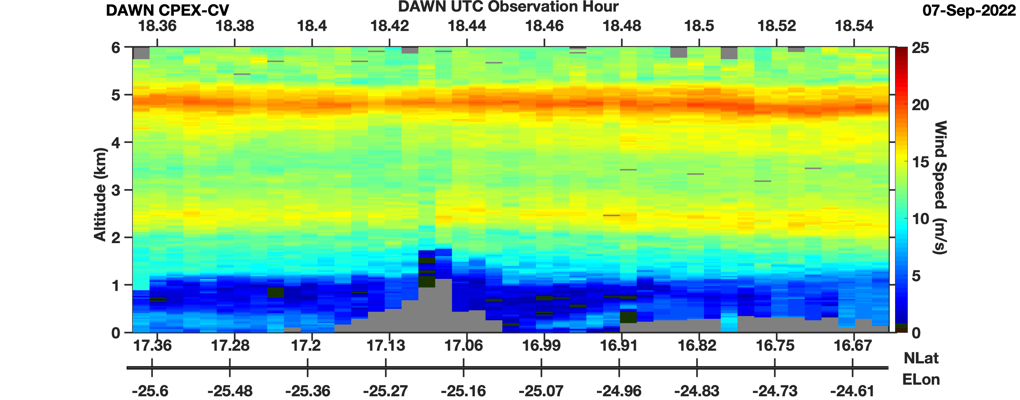
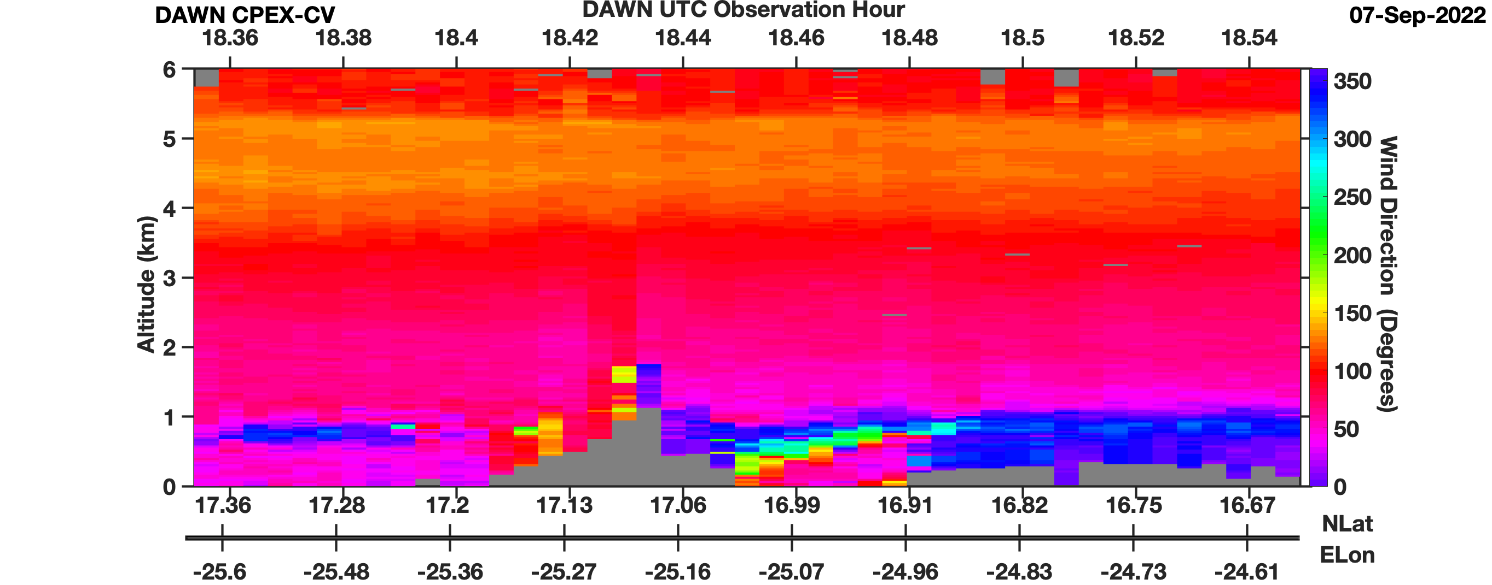
DAWN Profiles During Mindelo Overpasses
Sept. 7
Sept. 9
DAWN scan strategies employed during Mindelo overpasses yielded wind retrievals every ~4-6 km along flight track
Dust layers found during all 4 DC-8 overpasses over Mindelo, enabling continuous DAWN wind retrievals from ocean surface up to a ~5 to 6.25 km altitude
Interaction of wind with terrain of Sao Vincente and Santo Antao generated interesting PBL wind variations on 7 September (below)
Santo Antao
Sao Vincente
Sept. 15
Sept. 23
PBL Wind Variability
Wind Speed (m/s)
Wind Direction (°)
LOG₁₀(SNR)

