Slide 1
Shadowgram Technique for Recovering Pupil Mask Alignment in the Wide Field Instrument in the Nancy Grace Roman Space Telescope
Scott Rohrbach, Samuel Nissim
NASA/GSFC
August 22, 2023

Slide 2
Outline
Review of the Nancy Grace Roman Space Telescope (“Roman”) the Wide Field Channel.
Hardware relevant to the pupil and the impact of pupil wander/clocking in the optical design
WFI pupil mask alignment requirements
Test configuration
Shadowgram test concept.
LEDs and their placement
Test flow from data collection to mask alignment recovery
Recovery simulations and Monte Carlo analysis of alignment tolerances and uncertainties
Notes:
Hi Missie, Katie and Betsy;
I have a meeting at 10:30 so won’t be able to call into your final walk through, but heres’ a couple of comments:
Chart 10, 3rd bullet – need to add context, what RFI?
4th bullet – delete: “resolved roles and responsibility questions” and state the fact. The OBA …
Chart 11, 1st bullet, delete “Need to”
Last bullet – change to read “being sent to LSP”, ie LSP will work with us and Sx
Looks good. Please send update package. Good luck tomorrow.
TJG

Slide 3
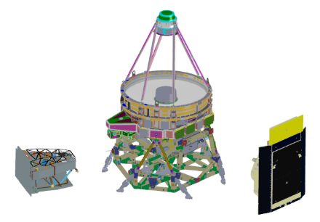
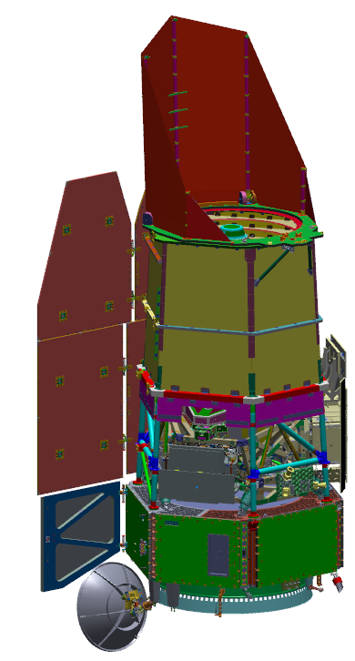
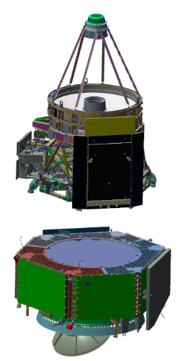
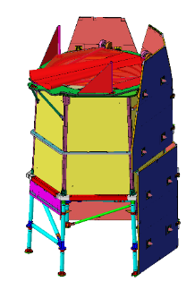
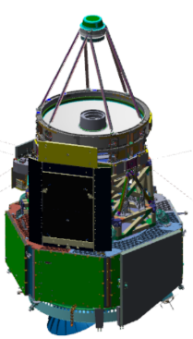
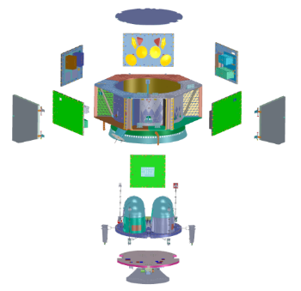
Observatory Description
Observatory = Spacecraft + Integrated Payload Assembly + OSD
Imaging Optics Assembly (IOA)
OSD (OBA/SASS/DAC)
Wide Field
Instrument (WFI) Cold Sensing Module (CSM)
Integrated Payload
Assembly (IPA)
Coronagraph
Instrument (CGI)
(outer enclosure
not shown)
Deployable Aperture Cover (DAC)
Solar Array Sun Shield (SASS)
Outer Barrel
Assembly (OBA)
Instrument Carrier (IC)
Spacecraft Bus Avionics Panels
Propulsion Module
Observatory
Communications
Module
Spacecraft Bus

Slide 4
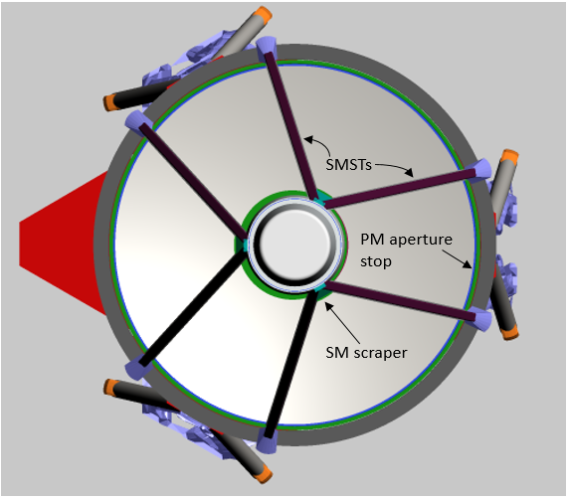
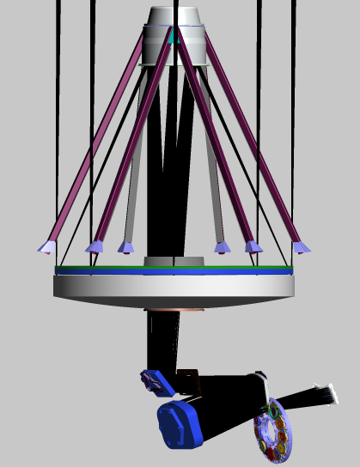
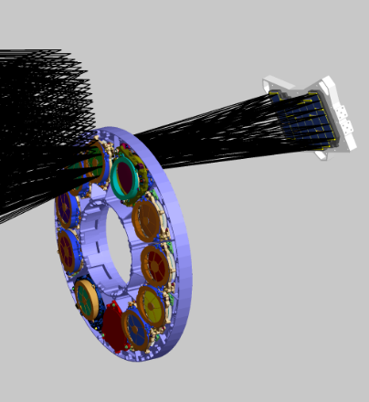
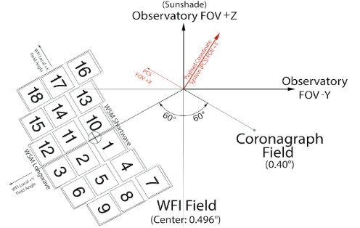
The Wide Field Channel
The Wide Field Channel = IOA + WFI
IOA is a three-mirror anastigmat: Primary (PM), Secondary (SM), and Tertiary Mirrors (TM), with two flat fold mirrors (FM1, FM2) between the SM and TM
WFI = Element Wheel Assembly (EWA) + Mosaic Plate Assembly (MPA)
The Mosaic Plate Assembly = 18 4096x4096 H4RG Sensor Chip Assemblies (SCAs)
The interface between the IOA and the WFI is at the exit pupil of the IOA, just upstream of the active element in the EWA.
265-270K
95K
16
13
4
7
17
10
1
8
220K
180K
18
14
11
2
5
9
15
12
3
6

Slide 5
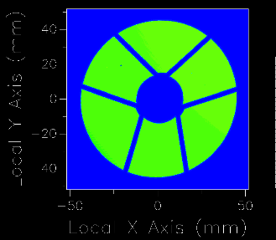
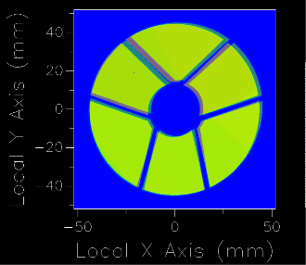
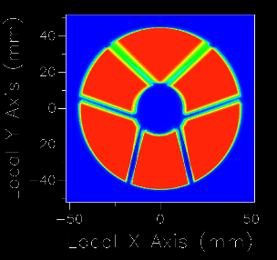
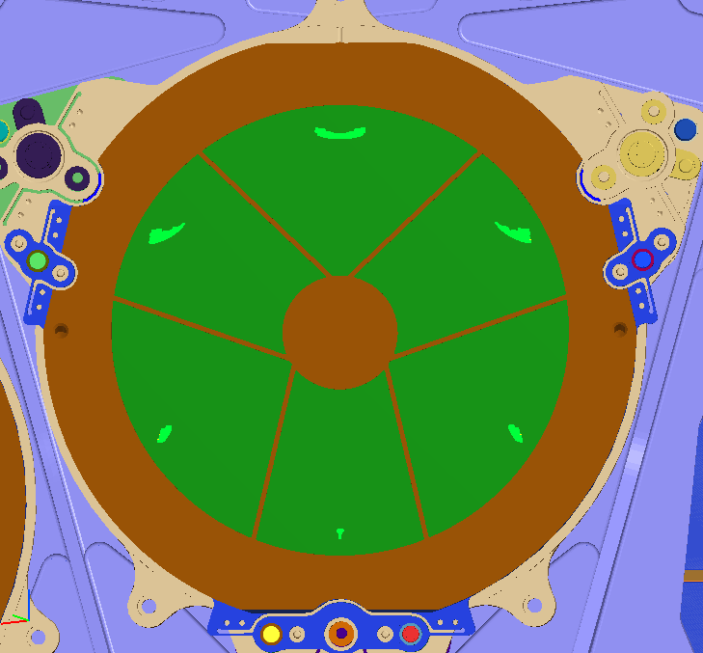
IOA exit pupil features and wander
The IOA exit pupil image contains shadows cast by the SM housing (the center obscuration) and the 6 Secondary Mirror Support Tubes (SMSTs).
This image shifts and rotates as a function of field.
Alternative demonstration of pupil wander/clocking - footprint at the exit pupil for a flood field from 6 points around the perimeter of the entrance pupil.
Center field
SCA 7
Center + SCA 7
All SCAs
Flood field at 6 points around the entrance pupil

Slide 6
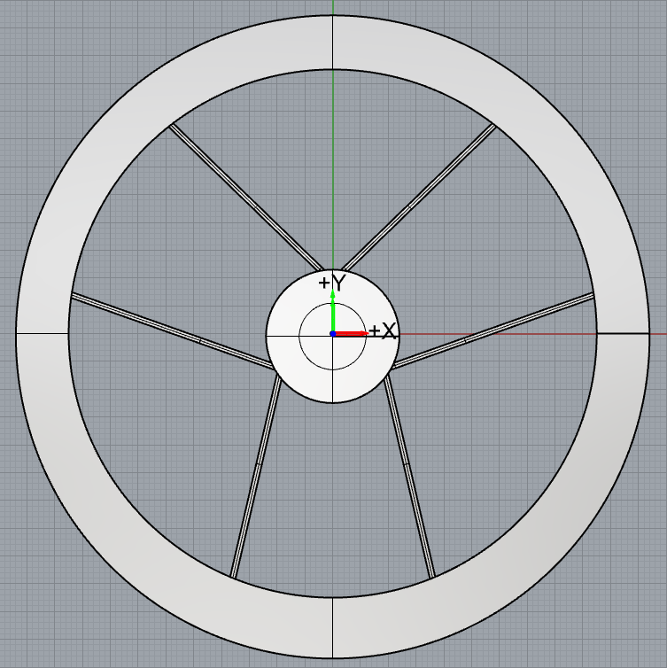
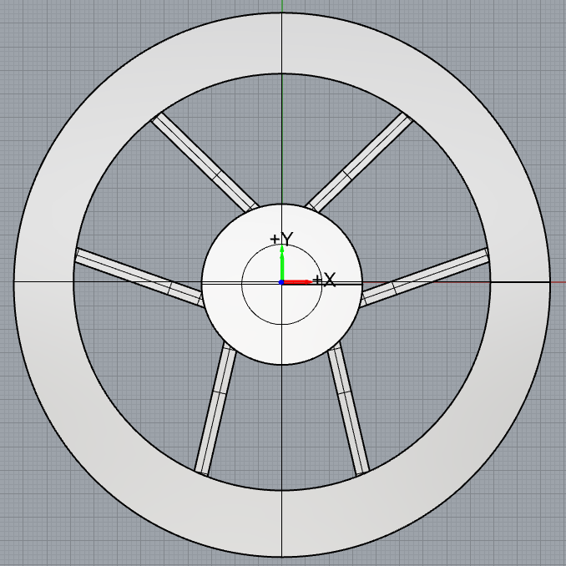
Thermal self-emission at the exit pupil
Short wavelength band mask design
Thermal self-emission (TSE) from the warm IOA components undergoes the same pupil wander/clocking vs field, broadening the background signal for the side and top SMSTs.
To block TSE background, pupil mask legs would need to be very wide, sacrificing throughput for the sake of lower thermal background.
Mask features in the longer F184 and F213 wavelength bands optimized for maximum signal-to-noise (SNR)
To maximize and balance SNR across the field we must align the masks optimally with the exit pupil image.
Mask alignment is also an important input to the wavefront sensing model used for Observatory optical alignment
TSE at the exit pupil
F184 / F213
mask design

Slide 7
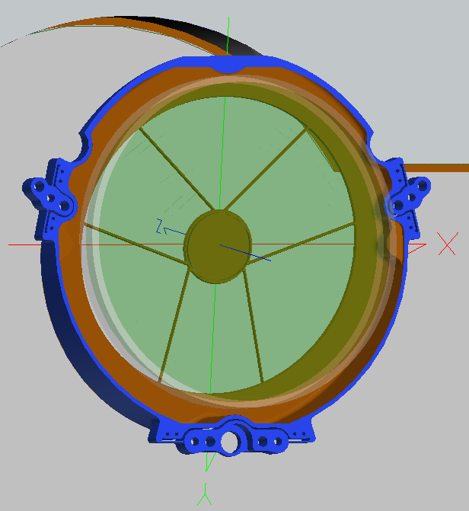
Pupil mask alignment requirements
On-orbit pupil mask alignment requirements:
±1 mm in shear (displacement in the x-y plane)
±6 mrad clocking around the local z-axis
Mask positions need to be determined during the Spacecraft / Integrated Payload Assembly (“SCIPA”) test.
Require knowledge to within ±0.1 mm in shear and ±2 mrad clocking

Slide 8
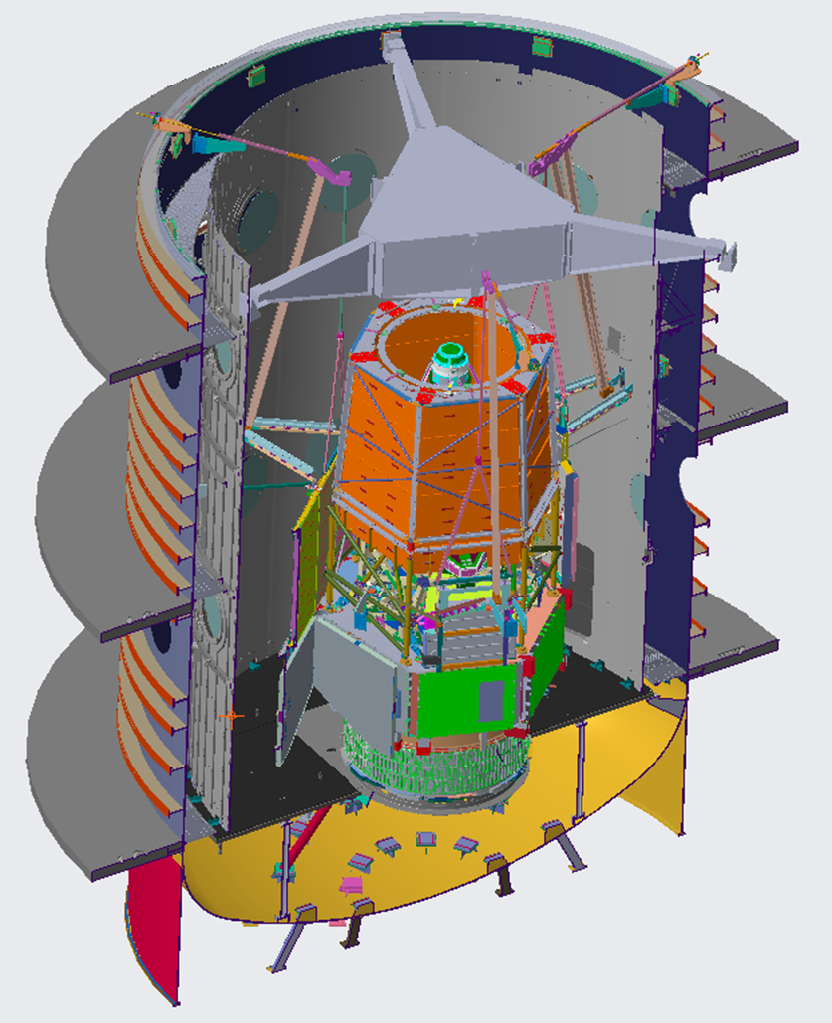
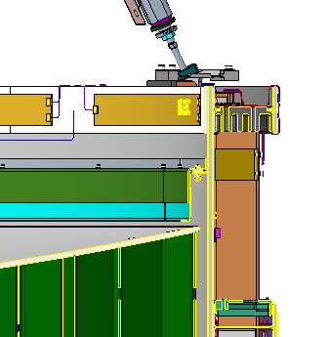
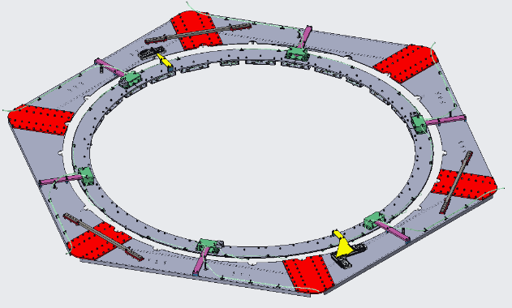
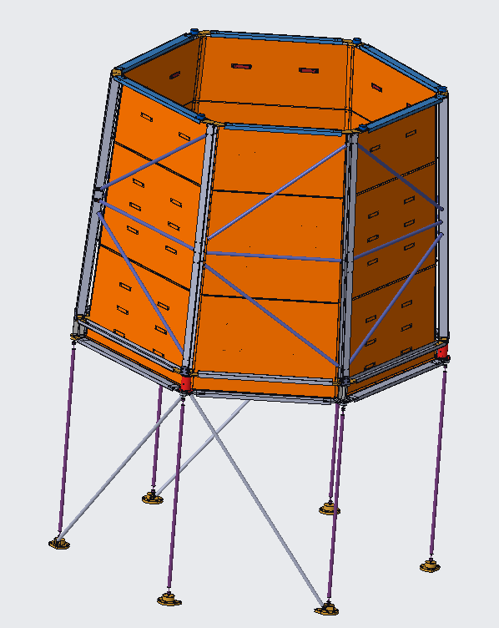
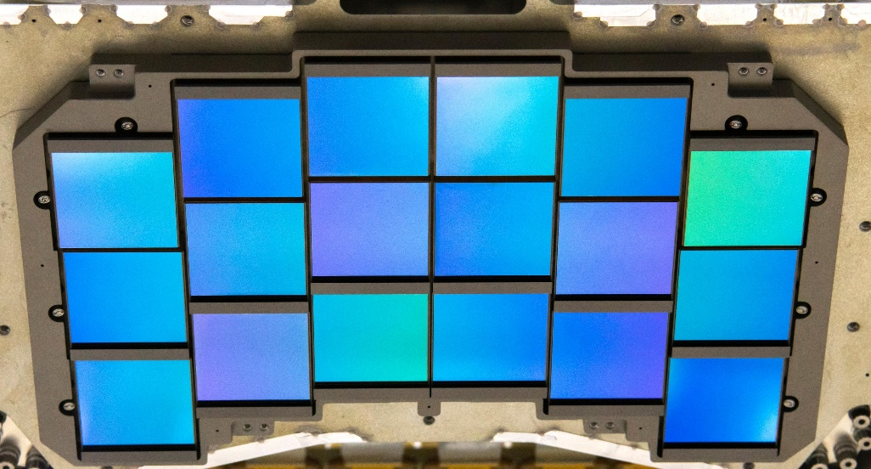
SCIPA Test Configuration
Upper Support Frame holds sub-aperture auto-collimating flat, photogrammetry cameras, and isolation system.
Non-flight fibers mounted around the perimeter of the primary mirror provide pupil sources for measuring CGI pupil alignment.
OBA-Sim top deck assembly supports LED System as well as photogrammetry targets
8 fibers mounted around the WFI focal plane array allow for double-pass testing of the system using focus-diverse phase retrieval.
Outer Barrel Assembly Simulator (OBA-Sim) provides thermal environment and supports photogrammetry cameras for system alignment.

Slide 9
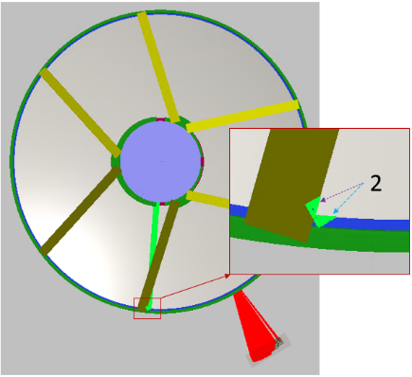
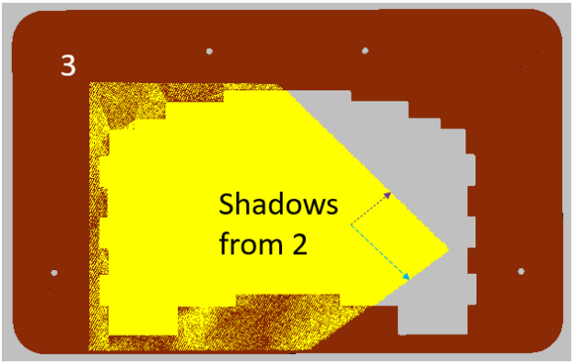
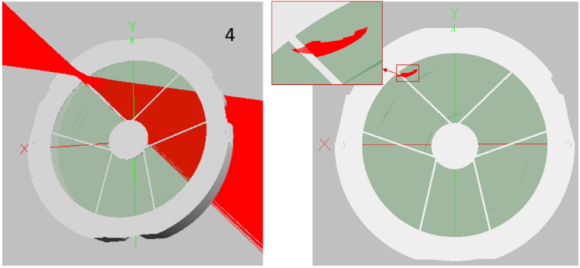
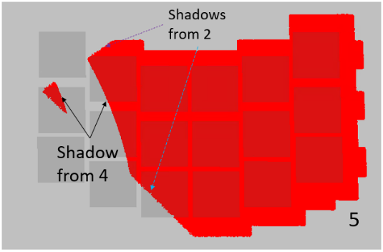
Shadowgram test concept
1. Consider a point source over the IOA near the PM aperture stop. (only a 1.0 x 0.8-degree cone is shown for clarity)
2. Some of that cone gets clipped by the PM aperture stop and/or the SMST scrapers.
3. Further out-of-field light gets blocked by the EAP at the intermediate focus
Ap stop
SMST
4. Ray bundle at the exit pupil:
Footprint can be clipped by mask features, producing another set of shadows seen at the focal plane (5).
5. Shadows at the focal plane are sensitive to the location of each object casting a shadow.
SMST
Ap stop

Slide 10
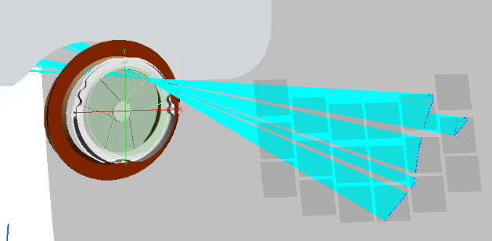
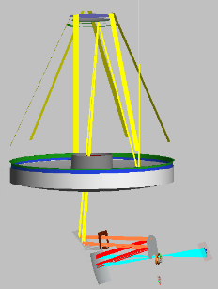
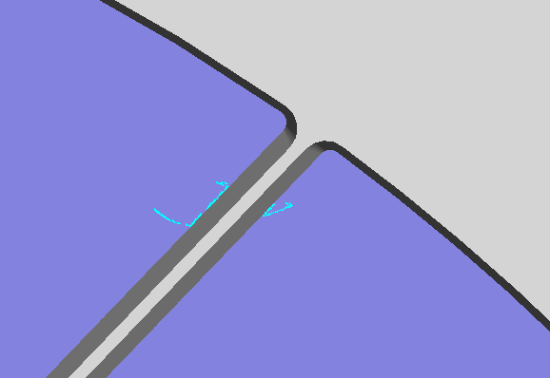
Shadowgram test concept, cont.
Isolate the pixels in the focal plane with 50-60% of the average irradiance in each SCA. (i.e., the pixels along the edge of each shadow
Trace rays from each point in the focal plane back to the source position above the IOA
Record ray intercepts at the pupil plane and overlay with the pupil mask. That collection of points limits where the mask features must be.

Slide 11
Shadow sensitivity to mask orientation
F158 mask shadows
Nominal alignment
Clocked 1 mrad
F184 mask shadows
Nominal alignment
Shifted 0.1 mm in X

Slide 12
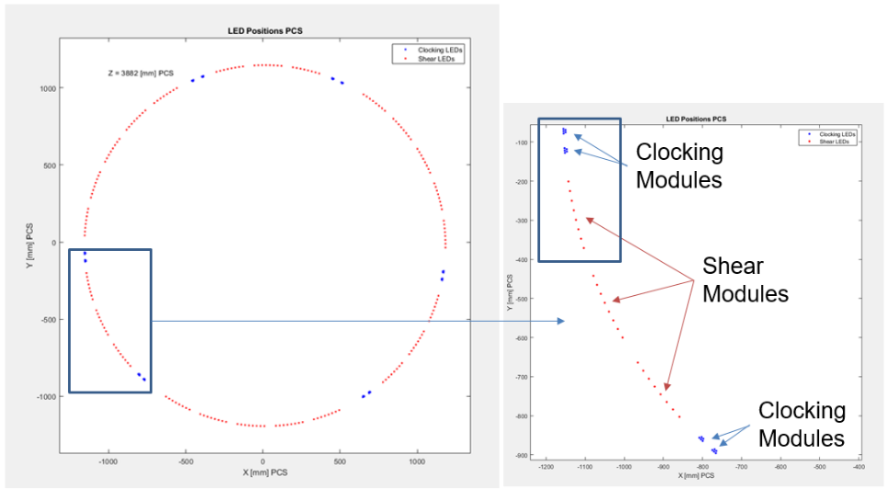
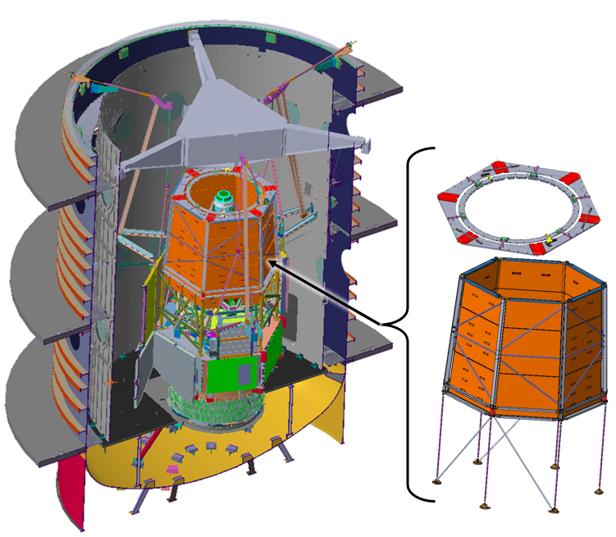
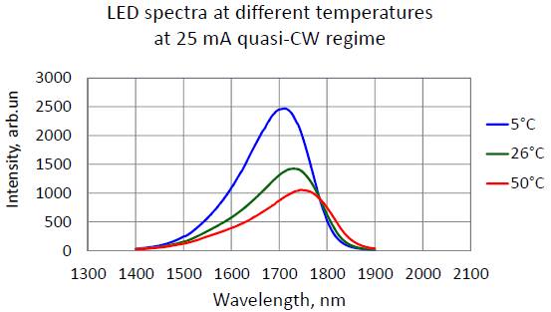
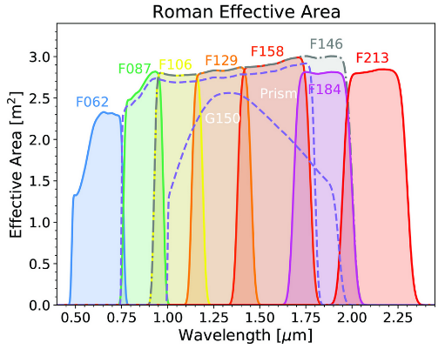
LED configuration
Complete test:
192 LEDs in modules of 8 above the perimeter of the aperture stop
60 LEDs in modules of 5 on either side of each SMST at approximately the same radius.
“Shear modules” with 8 LEDs primarily identify pupil shear misalignment.
“Clocking modules” with LED clustered around SMST primarily identify clocking alignment
LEDs have a wavelength range centered at 1.7 um, transmitting through both the F158 and F184 filters.
F158 has narrower legs and a larger diameter so we can see the IOA aperture stop and SMST shadows to get a reference.
F184 has wider legs and a smaller diameter than the projected IOA exit pupil, so we can sense pupil shear with respect to the IOA reference found with the F158 mask.

Slide 13
Complete test flow

Slide 14
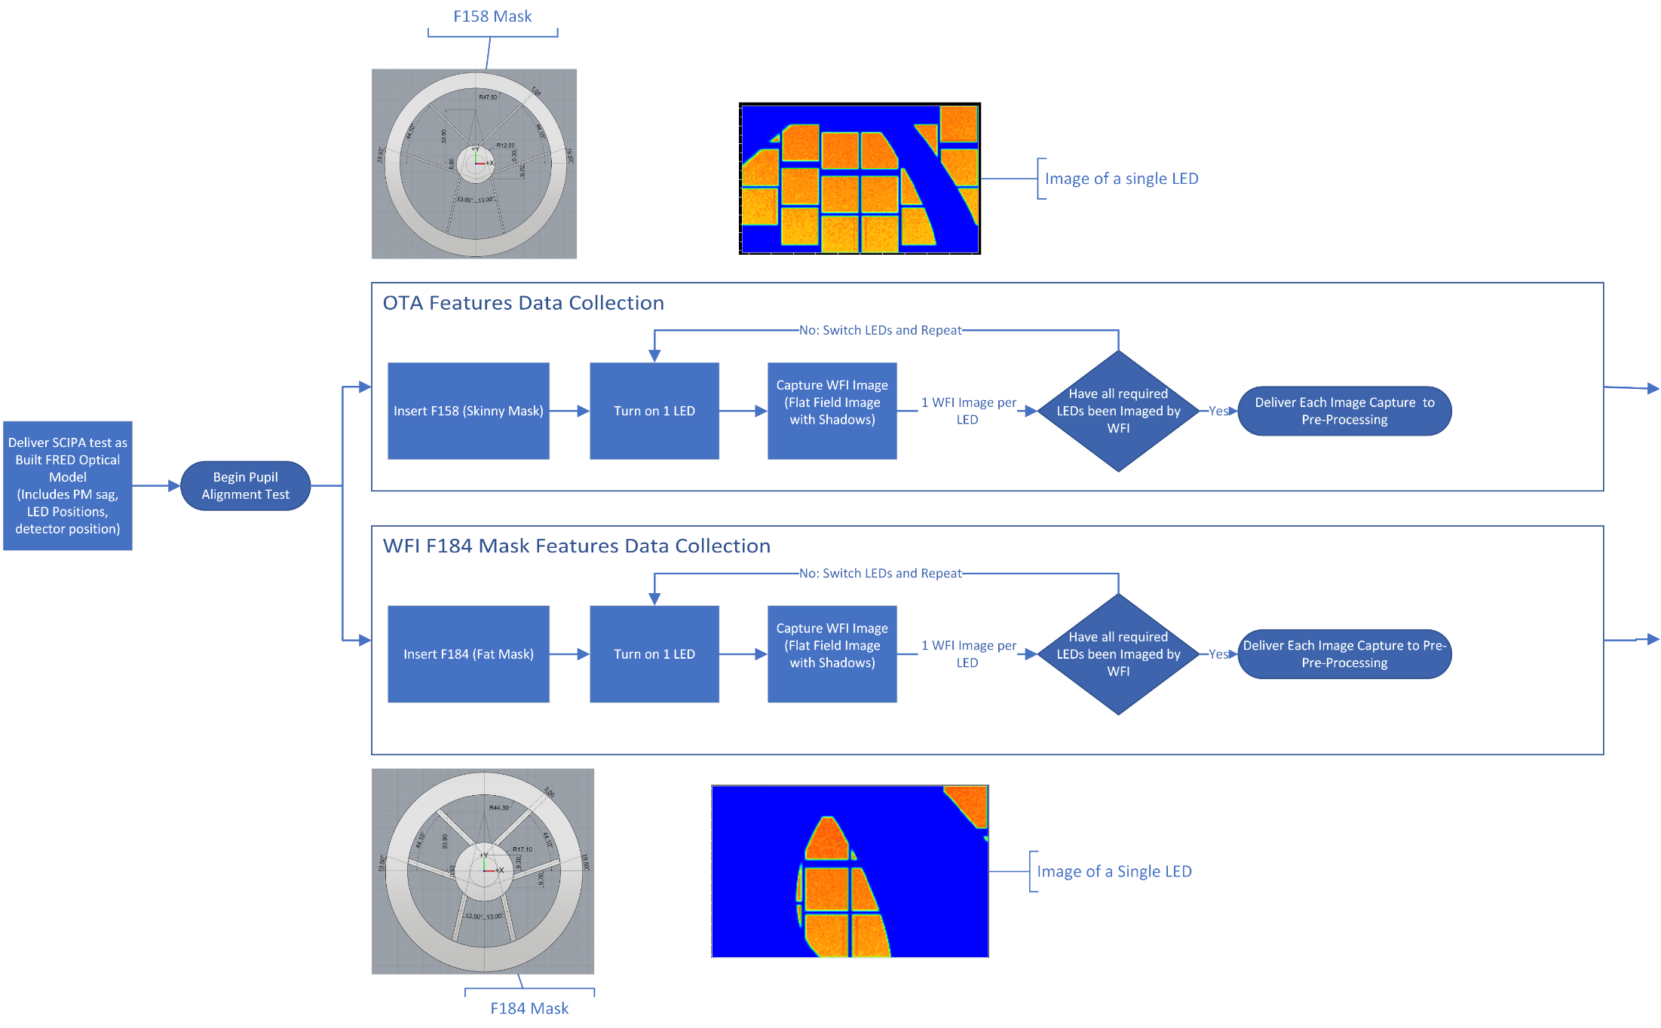
Data collection

Slide 15
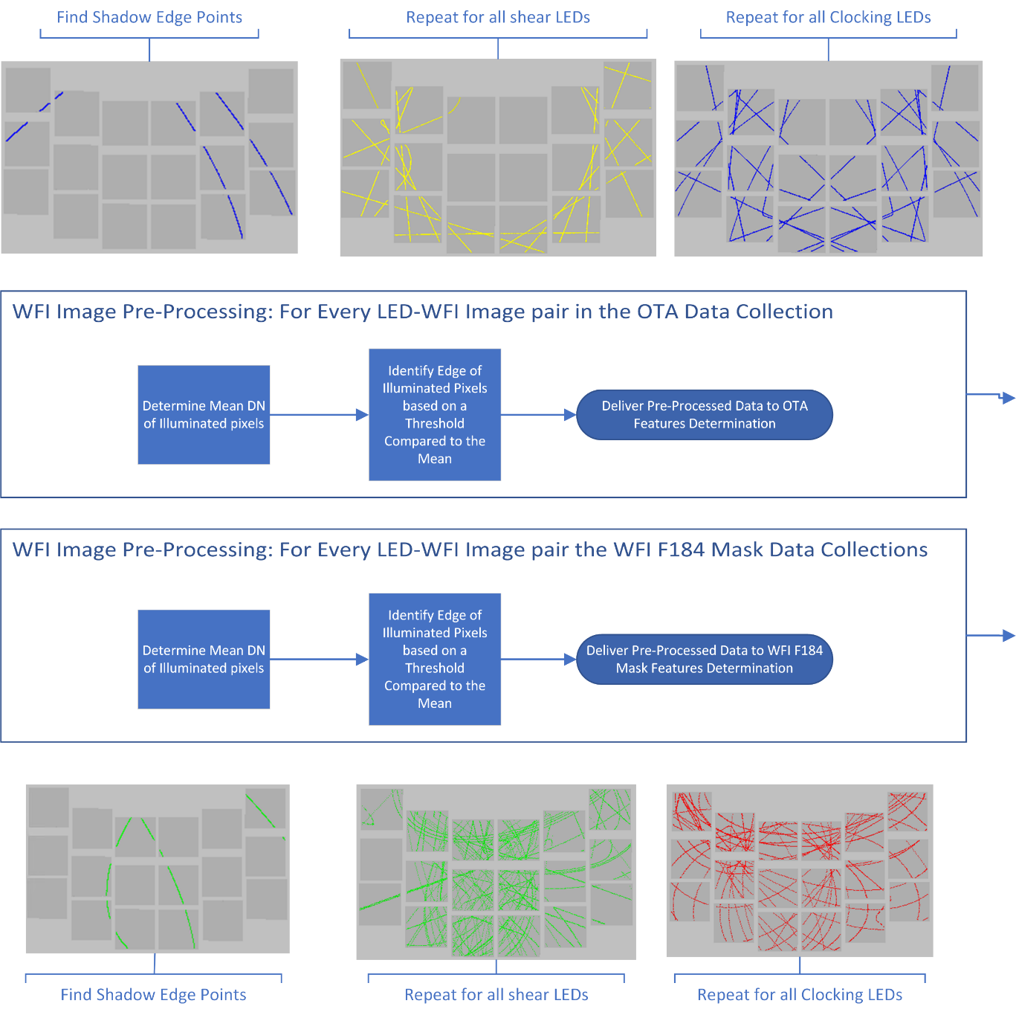
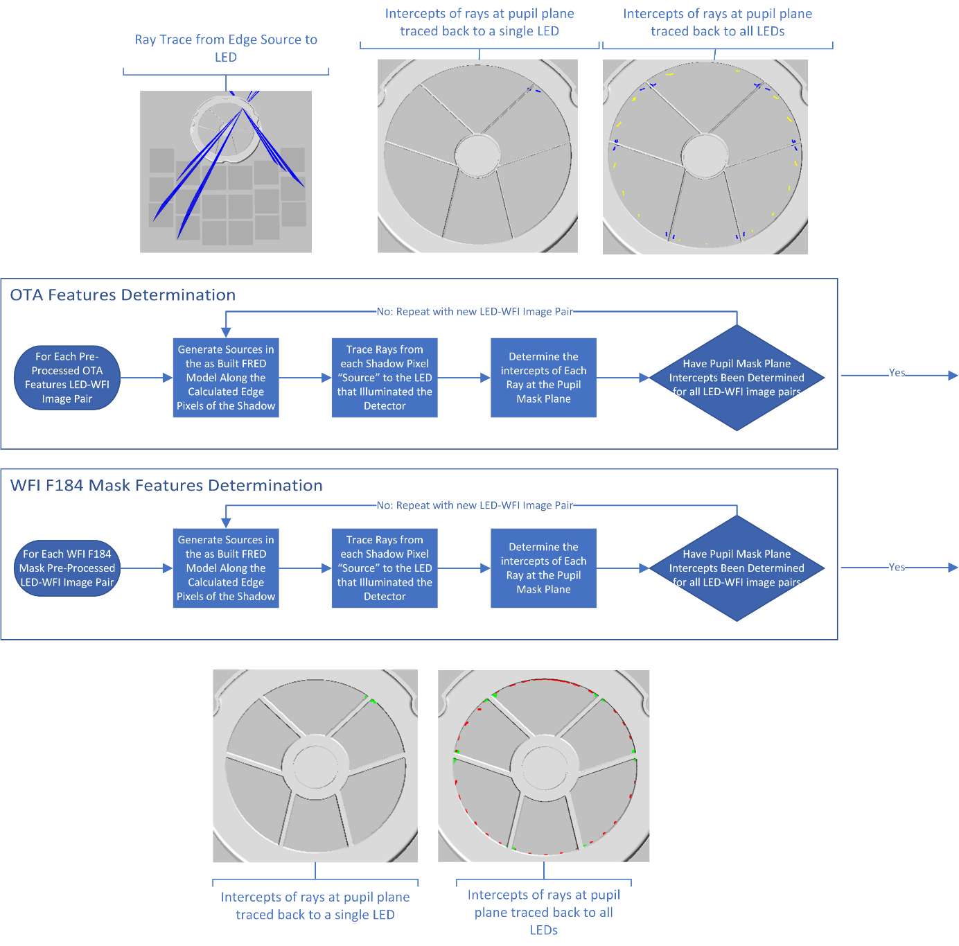
Feature determination

Slide 16
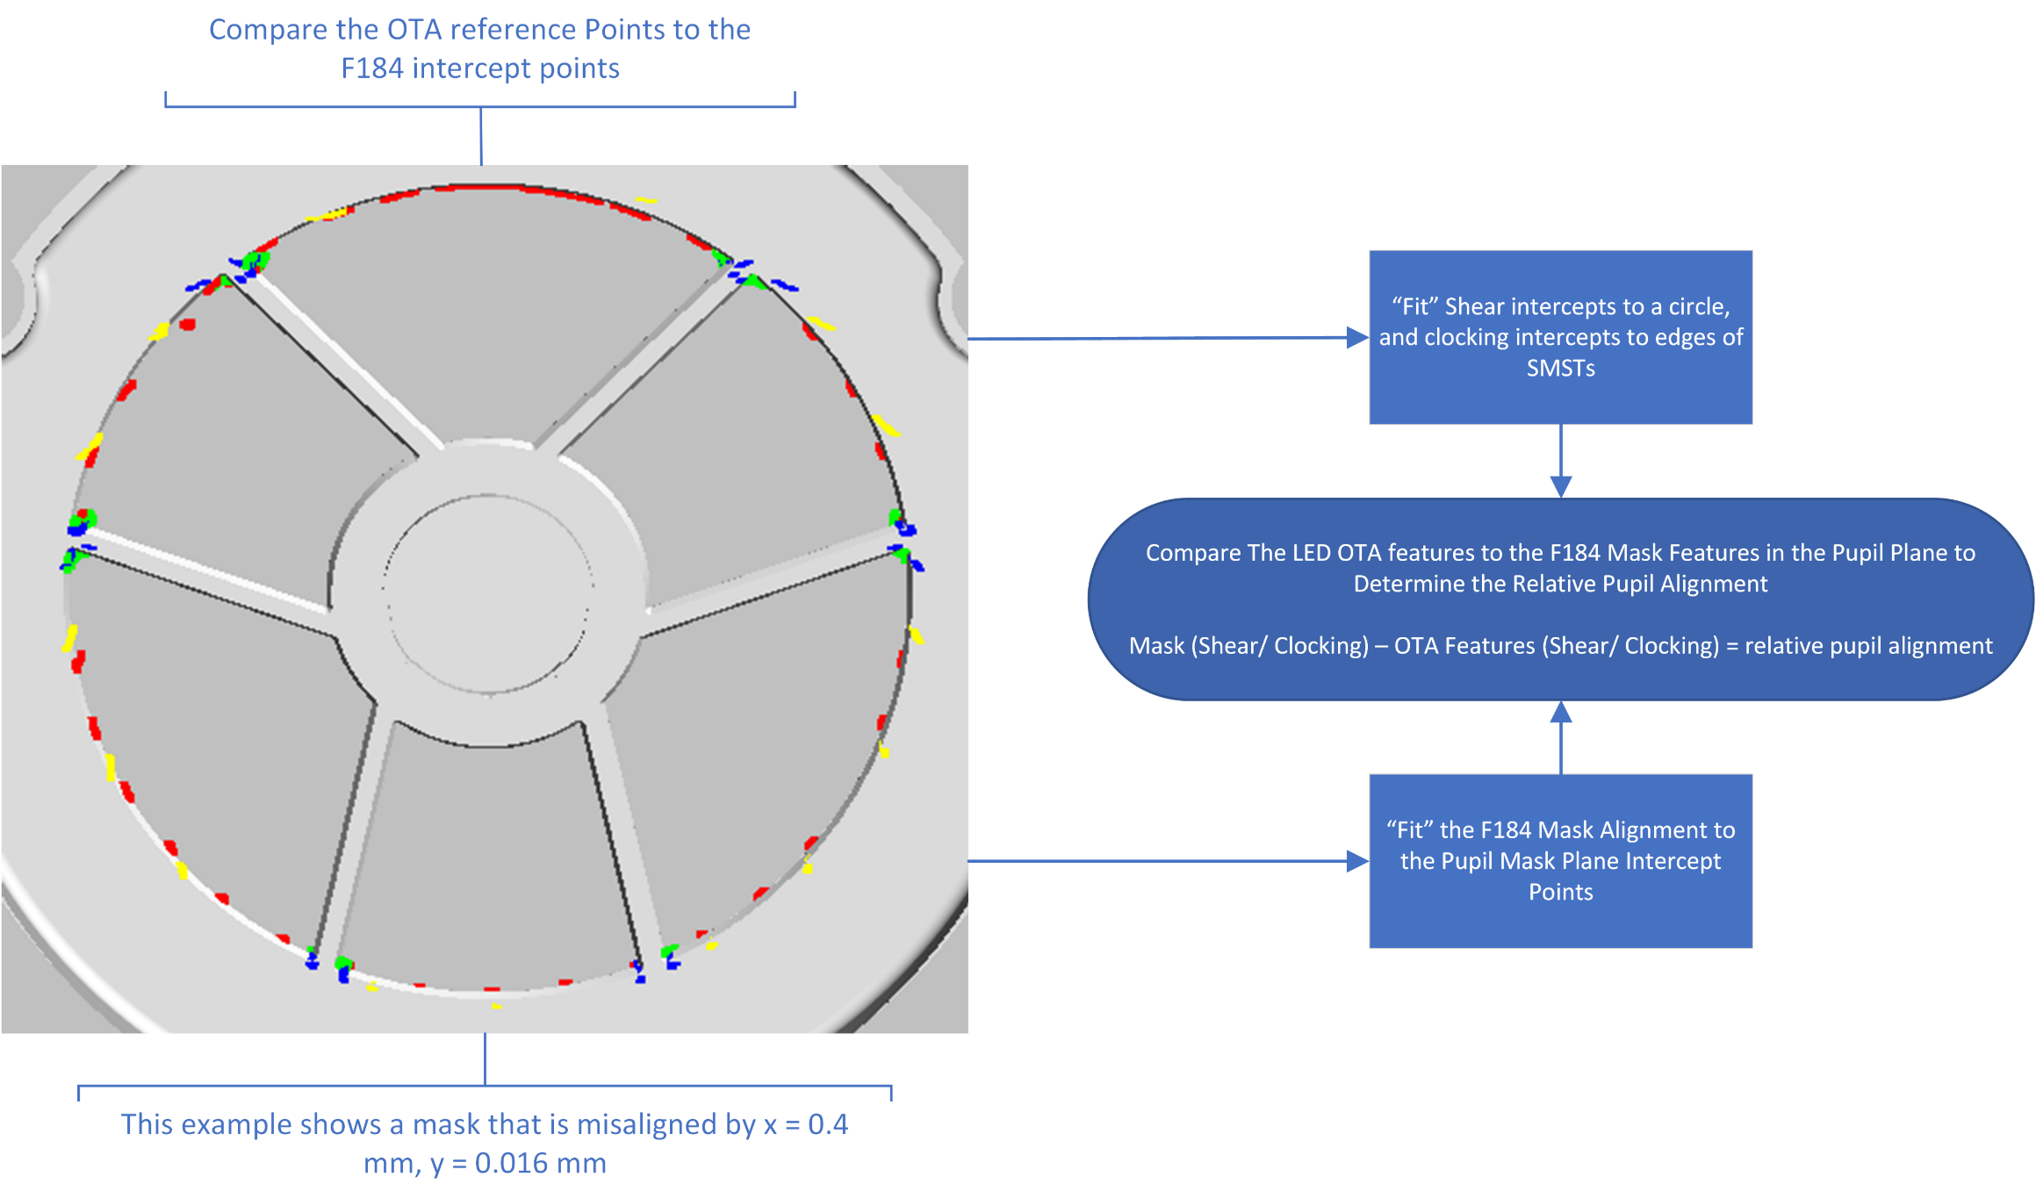
Relative alignment

Slide 17
Errors
Two dominant unknowns in the test:
Pupil mask knowledge uncertainty
LED position knowledge uncertainty
Pupil masks will be within ±0.68 mm of their ideal position in shear and ± 3.35 mrad in clocking.
LEDs knowledge uncertainty better than ± 3.15 mm in the plane of the LED ring.
Misplacement along the IOA optical axis has little impact on the test.
Other errors that have much smaller effects on the results are MPA location uncertainty and IOA uncertainty with respect to the Payload Coordinate System (PCS).
Knowledge error of the global LED ring location → systematic error in the shear recovery
Systematic error = LED ring shear knowledge error * exit/entrance pupil diameter
Knowledge error of the global LED ring clocking → systematic error in the clocking recovery
Systematic error = LED ring clocking knowledge error
Individual LED position knowledge error → blur in pupil plane intercept positions when multiple shadowgrams are analyzed. With “n” LEDs and shadowgrams, that error should reduce by $\sqrt{n}.$

Slide 18
Alignment recovery statistics
100 Monte Carlo recoveries performed randomly varying:
Pupil mask shear / clocking = ±0.4 mm / ±1 mrad
In-plane location of each LED by up to ±3.15 mm radially.
Alignment of the pupil mask for each iteration was blindly recorded and compared to the recovered alignment.
To account for LED knowledge error, reverse rays are traced back to ideal location of each LED, not the actual.
This introduces a small error in the pupil plane intercept for each ray and is the dominant error in the process.
Shear and clocking are recovered to within 0.063 mm and 1.9 mrad, 95th percentile.

Slide 19
Conclusions
Hardware in the Roman entrance pupil operates at near room temperature due to pre-existing limitations.
F184 and F213 bands will suffer signal-to-noise loss if TSE from the warm hardware is not captured using a cold pupil mask.
Alignment of these pupil masks balances TSE background across the field
Knowledge of any misalignment is an important input for the wavefront sensing alignment process.
The large IOA exit pupil wander is used in a novel shadowgram test to infer the alignment of the WFI pupil masks
MC simulations recover mask alignment to better than ±0.1 mm shear and ±2 mrad clocking.

