Slide 1


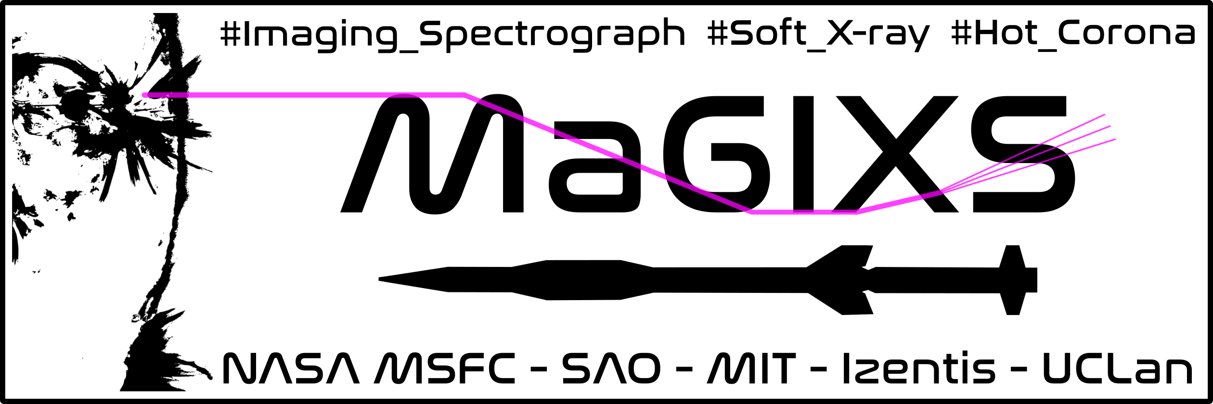
The Third Flight of the Marshall Grazing Incidence X-ray Spectrometer (MaGIXS-3)
P. S. Athiray
University of Alabama in Huntsville
NASA MSFC¹, SAO², Rice Univ.³, Polish Acad. of Sci.⁴, Univ. of Cambridge⁵, Astron. Inst. of the CAS⁶, UCLAN⁷
1 - Patrick Champey , Amy Winebarger, Ken Kobayashi, Sabrina Savage, Dyana Beabout, Genevieve Vigil, Adam Kobelski, Alphonse Sterling
2- Paola Testa, Peter Cheimets, Ed Hertz, Leon Golub
3- Stephen Bradshaw
4- Zaneta Szafroz, Janusz Sylwester
5- Giulio Del Zanna, Helen Mason
6- Jaroslav Dudik
7- Robert W. Walsh
Submitted for LCAS 2022 solicitation
Notes:
Add number to affiliation, put my

Slide 2
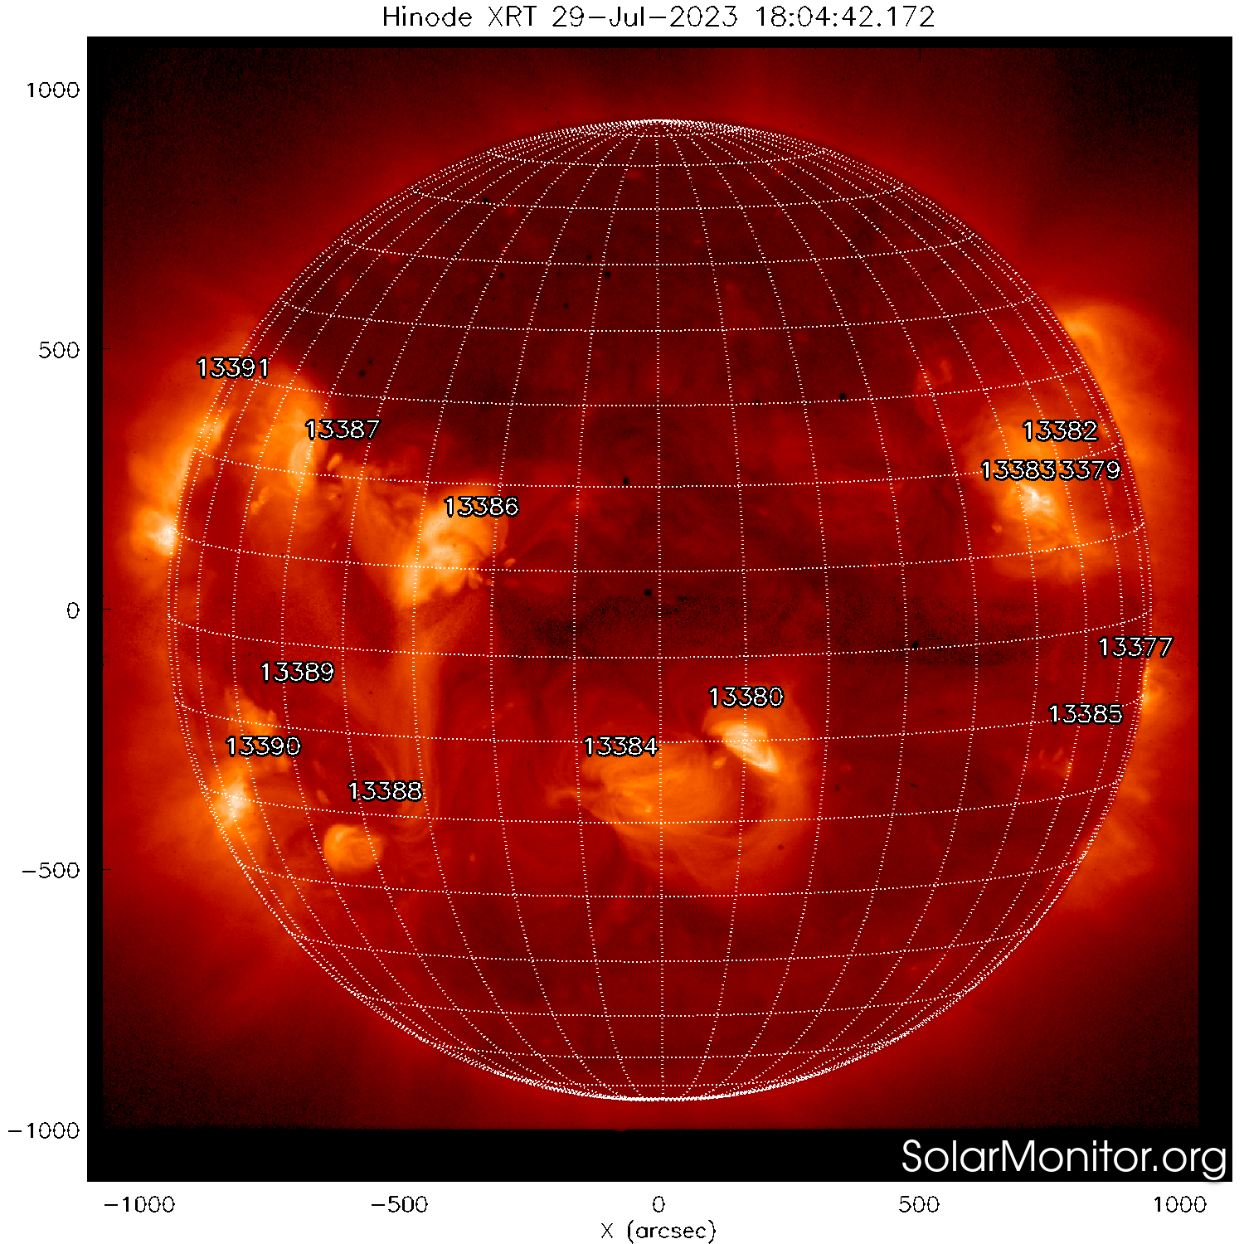
New generation MaGIXS : Science motivation
Goal: What dominates heating in the solar coronal loops?
Discriminating Observations
High temperature EM slope
Abundances
  Coronal, Photospheric
Plasma State – Ionization balance, Thermal
  Equilibrium, Non-Equilibrium
Notes:
Wehave ben looking for heating events signature, high temp, abundance, now we are convicned that state of plasma is an important discriminator
Highlight plasma state – driving
Ionizatino balance
Picture of xray sun

Slide 3
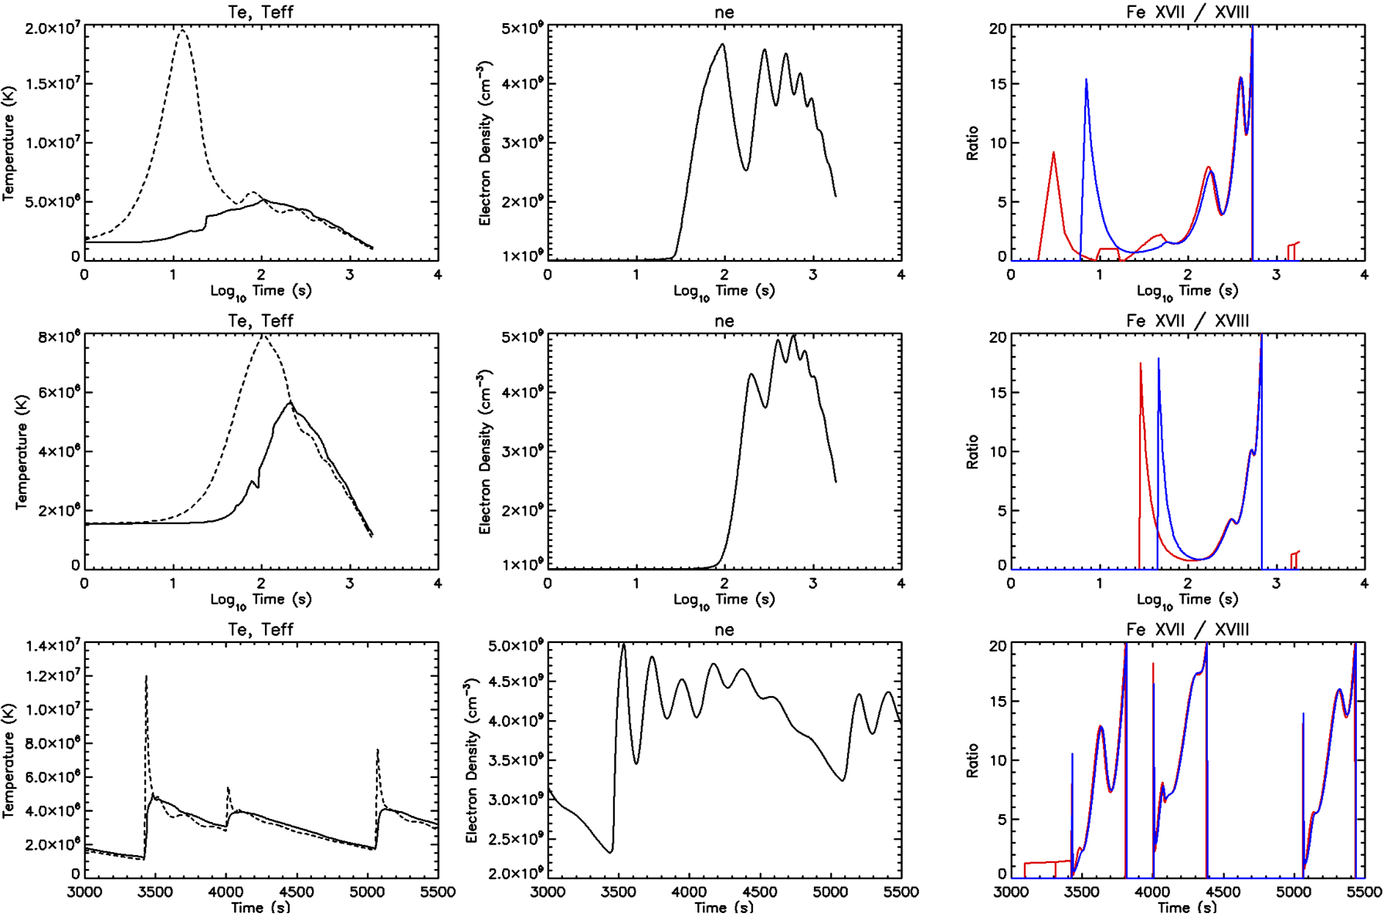
Significance of plasma state
Electron Temperature
Ion Temperature
Non-Equilibrium Ionization
Ionization Equilibrium
Ionization temperature lags behind electron temperature
Plasma is under-ionized
Difference in time lags can be on the order of 10s of seconds
20 sec
200 sec
High frequency
Bradshaw et al,2006, Barnes et al 2016
Notes:
Recombination tie is small than ioni
How do you measure the electron temperature?
Difference in time lags of the order of 10s of seconds.
Update text in figure
Spacing compressed in irght

Slide 4
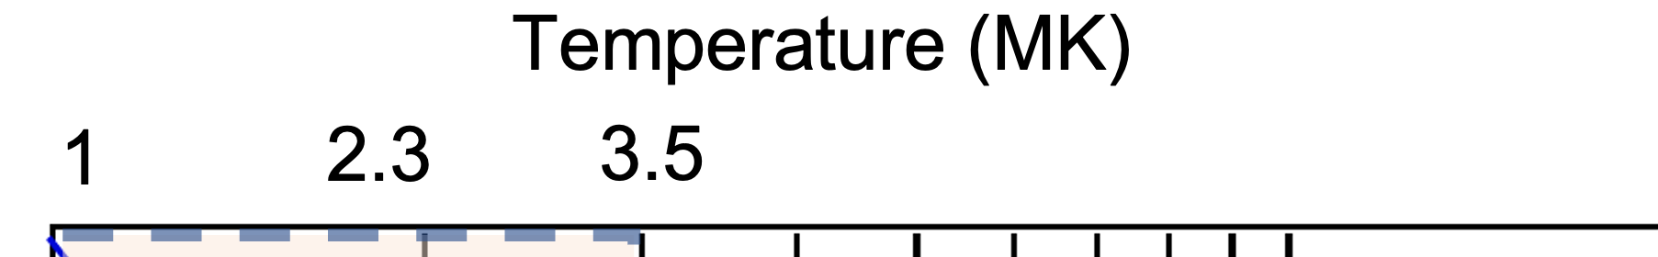
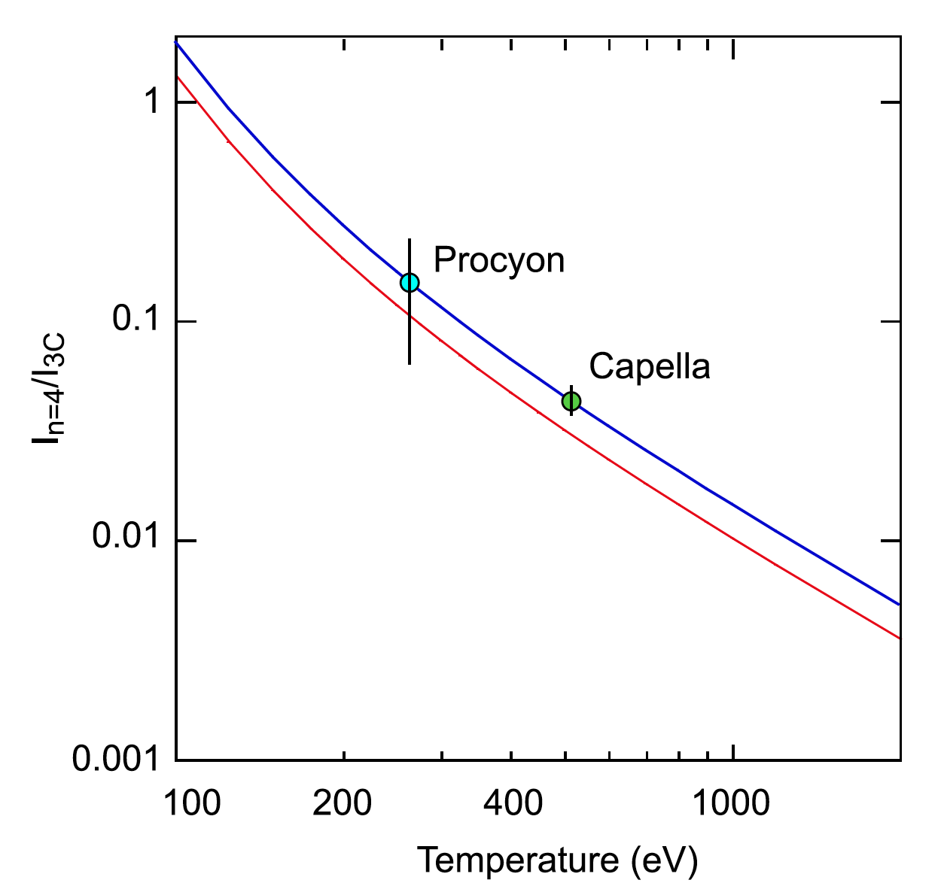
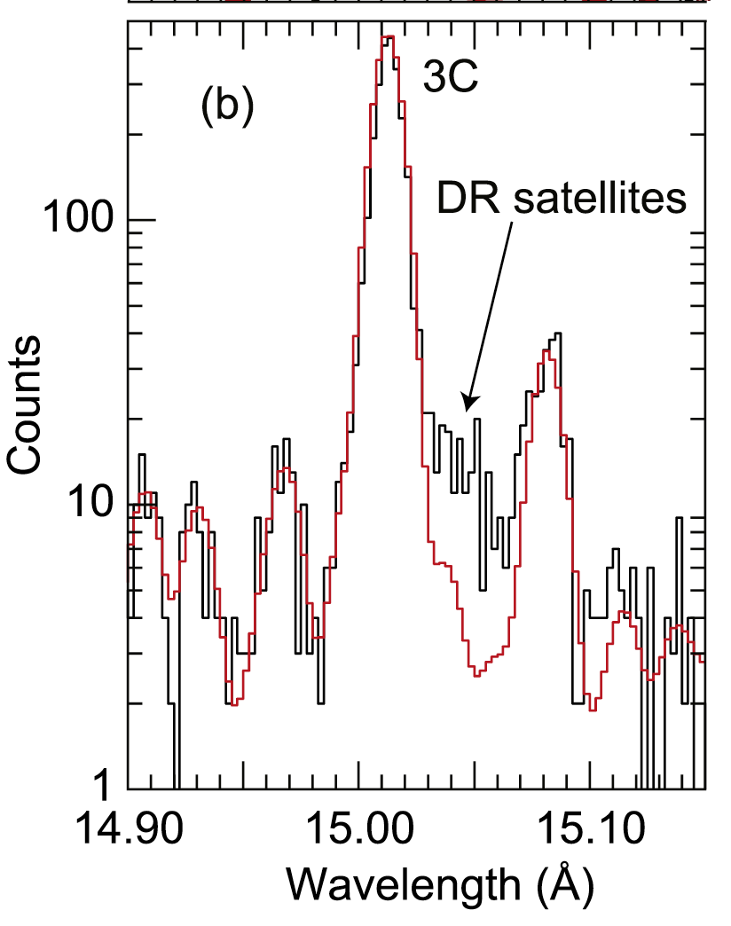
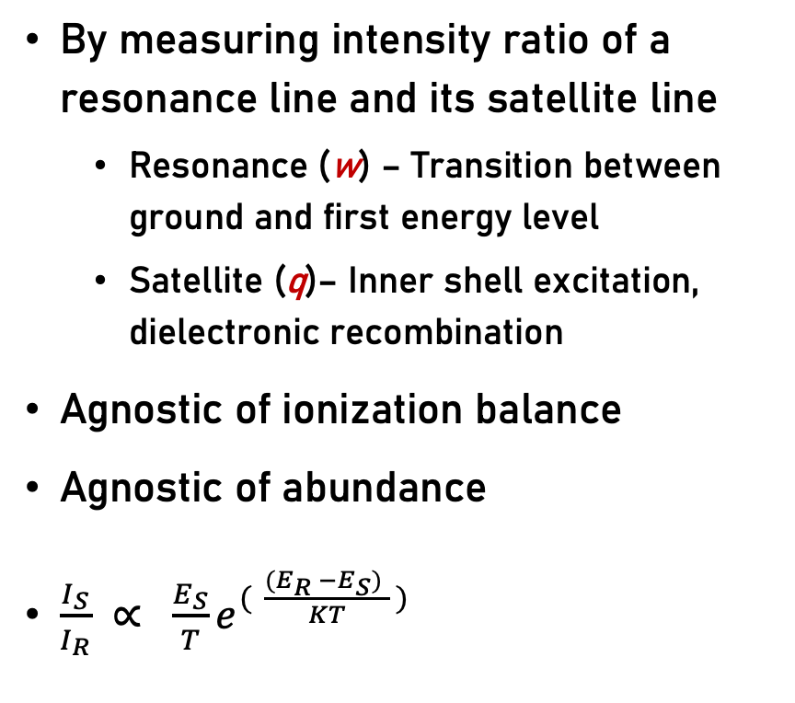
Electron temperature diagnostics
By measuring intensity ratio of a resonance line and its satellite line
  Resonance (w) – Transition between ground and first energy level
  Satellite (q)– Inner shell excitation, dielectronic recombination
Agnostic of ionization balance
Agnostic of abundance
$\frac{I_{S}}{I_{R}} ∝ {\frac{E_{S}}{T}e}^{( \frac{({E_{R} −E_{S})}_{ }}{KT} )}$
Chandra stellar X-ray observation
Biersdorfer 2012
Notes:
Recombination tie is small than ioni
How do you measure the electron temperature?
Difference in time lags of the order of 10s of seconds.
Temperature of Procyon ev to Kv and say Procyon temp

Slide 5
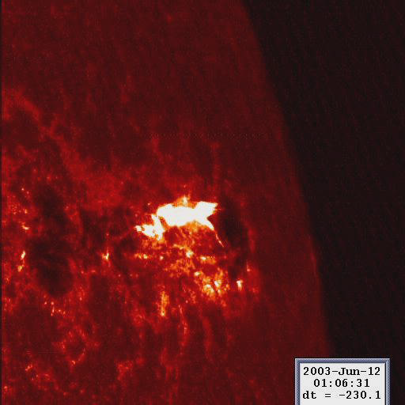
T_{e} measurement for the Sun - Flares
Crystal spectrometer
  SOLFLEX, SMM, Yohkoh
Designed for flare emission lines
  He like resonance lines ‘w’
  Li like satellite lines ‘q’
  Fe XXV – Fe XXIV ; Ca XIX – Ca XVIII
Results are inconclusive
Ionization timescales of He, Li – like ions are << 2 sec!
Doschek 1990
Notes:
Add flare

Slide 6
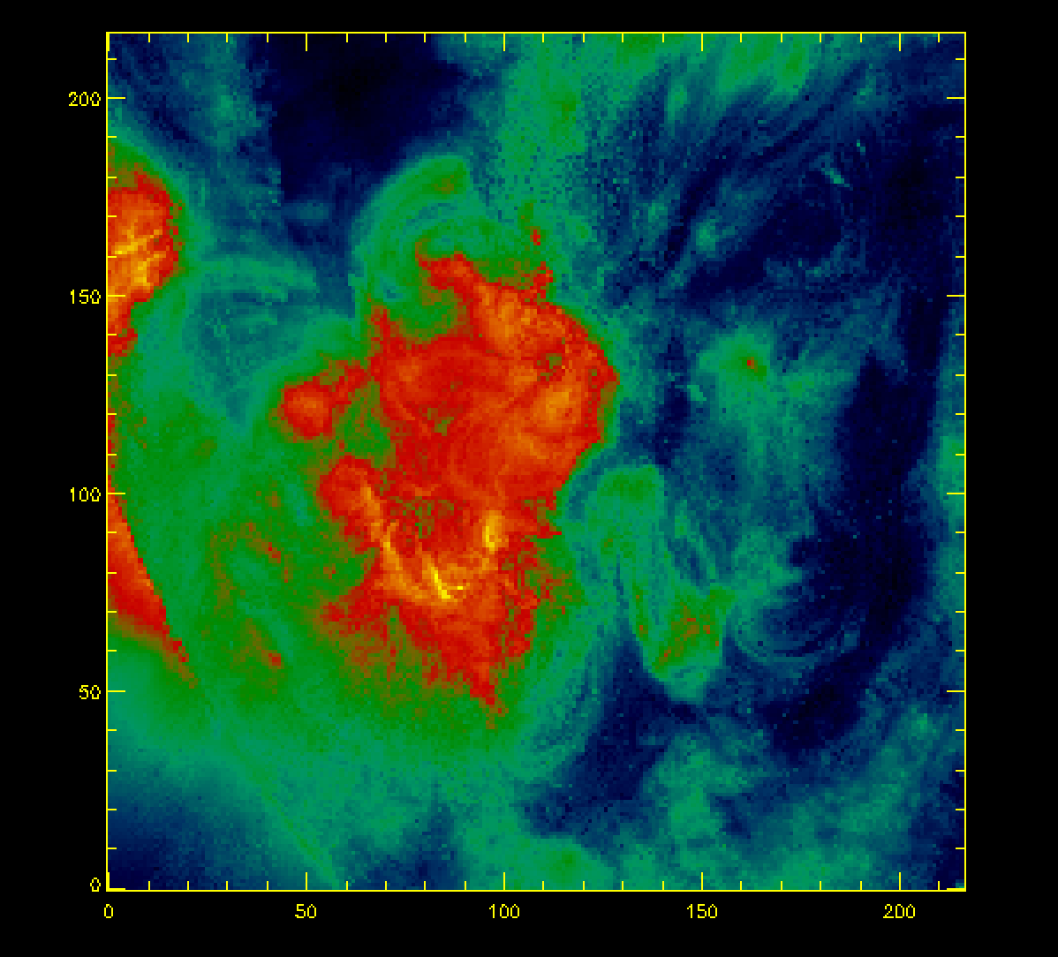
T_{e} measurement for the Sun - AR
No instrument is available for active region temperatures
Ideal spectral lines are
  Ne like resonance lines ‘w’
  Na like satellite lines ‘q’
  Fe XVII – Fe XVI
Ionization timescales of Ne, Na– like ions are 10s of seconds!
Weak intensity compared to He, Li like ions
Notes:
Add flare

Slide 7
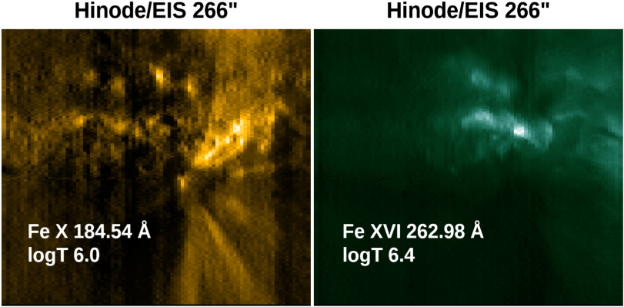
Significance of MaGIXS discovery
Two modes of inverting ‘spectroheliogram’ works
(see Poster 110.24, Hochedez et al)
Athiray et al, (under prep)
Notes:
Add magixs data image
Make Hinode eis appear use animation

Slide 8
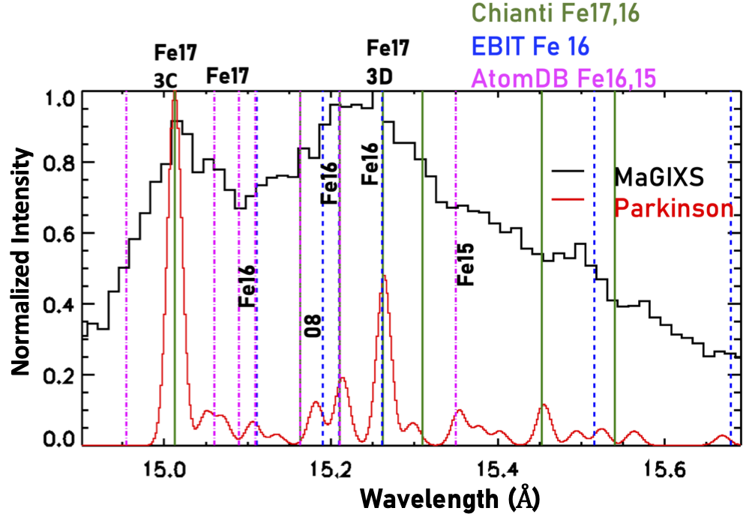
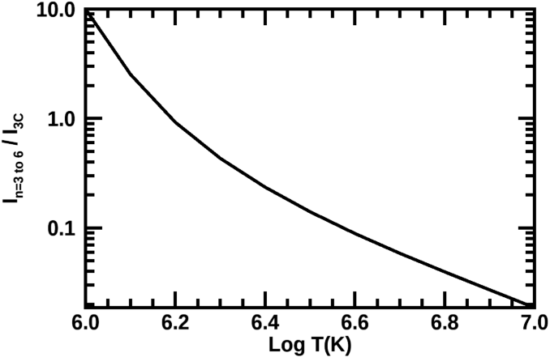
Significance of MaGIXS discovery
Discovery Space
Fe XVI (IS) / Fe XVII (3C)
MaGIXS-1
Critical to benchmark atomic database
Need independent spectral validation of these emission lines
AR Parkinson 1975
Athiray et al, (under prep)
Notes:
Add a dot for magixs
Serendipitous
Why do we need a new mission? ionization temperature magixs measured? What next?
Why we need magixs 3
Spatial spectral confusion
Make a big deal!!
Improving atomic database
Spending year to get these incorrect in chianti, how critical, we think we understand

Slide 9
Future MaGIXS-3
Can we determine if plasma is in ionization equilibrium?
Sounding rocket mission
Novel design - MaGIXS with a context high resolution spectrometer
The Resolving Inversion Context X-ray Bragg crystal spectrometer Spectrometer (TRICXS)
Submitted for Heliophysics Low Cost Access to Space (LCAS) 2022
Notes:
reduce tht 2nd bullet text
With context spectrometer – TRICXS

Slide 10
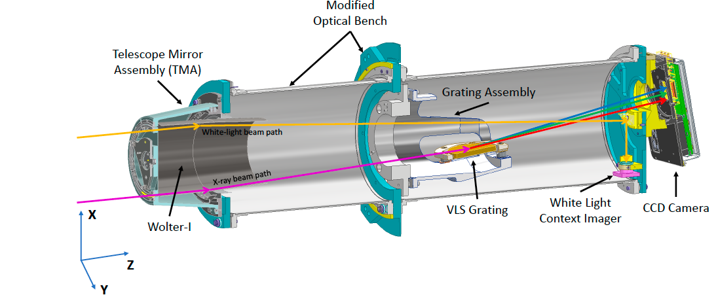
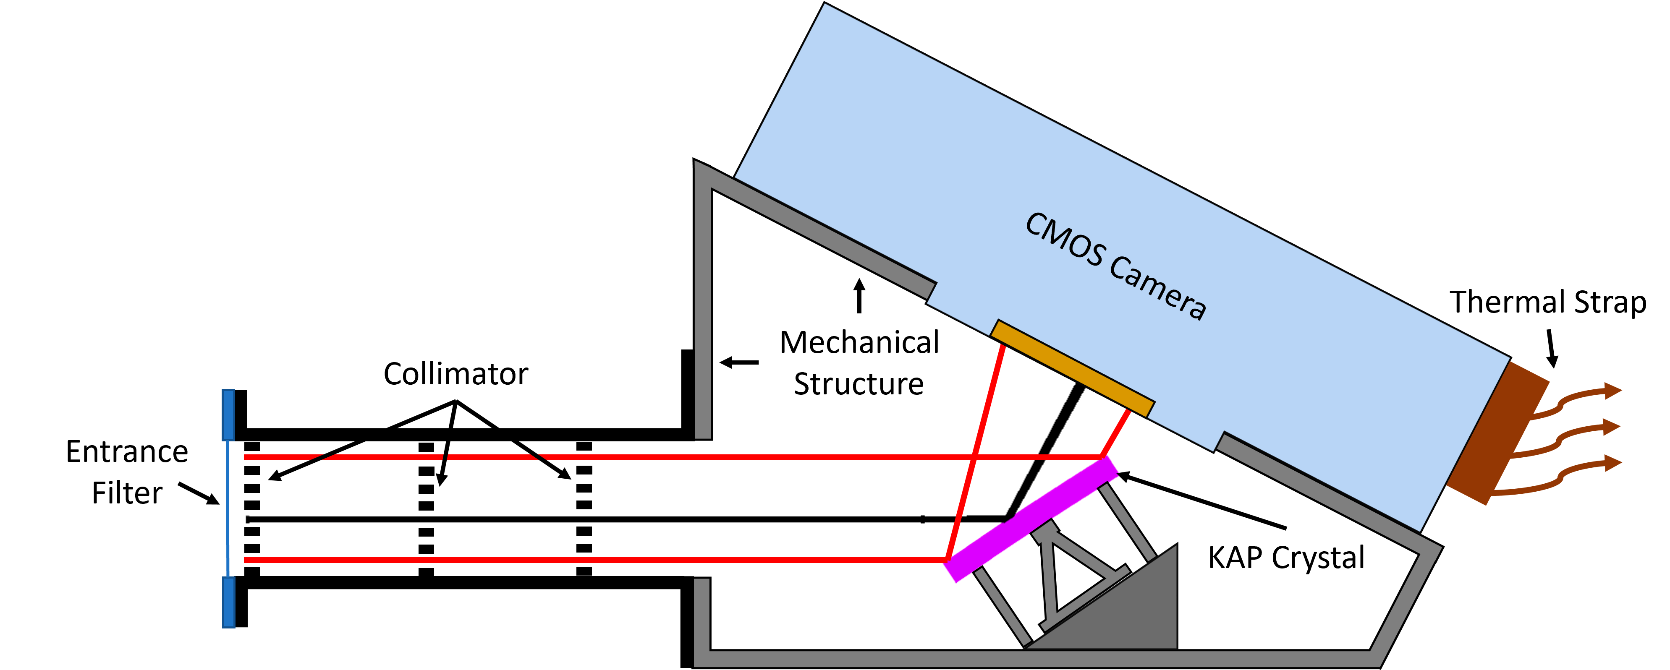
MaGIXS-3 Concept
MaGIXS optical design with new improved Telescope mirror
MaGIXS will employ
New high resolution telescope mirror (MSFC)
TRICXS will employ
Bent KAP crystal (UAH)
Fast read out CMOS sensor
TRICXS design with crystal and CMOS sensor

Slide 11
Instrument overivew
TRICXS
MaGIXS
Wavelength - 6 to 30A
Spot size – 10”
FOV – 18’ x 18’
Wavelength – 14.9 to 15.7A
FOV – 3’ diameter
KAP Bent crystal 2d = 26.64A

Slide 12
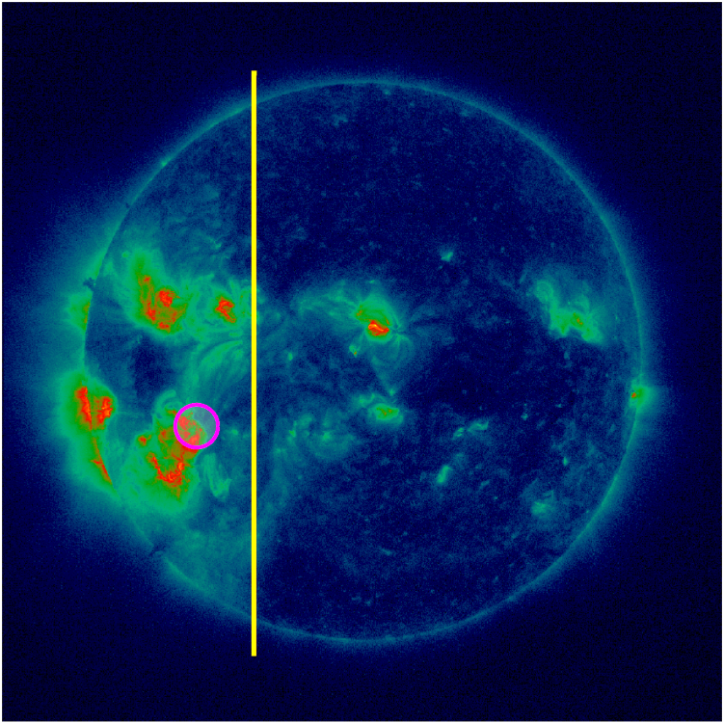
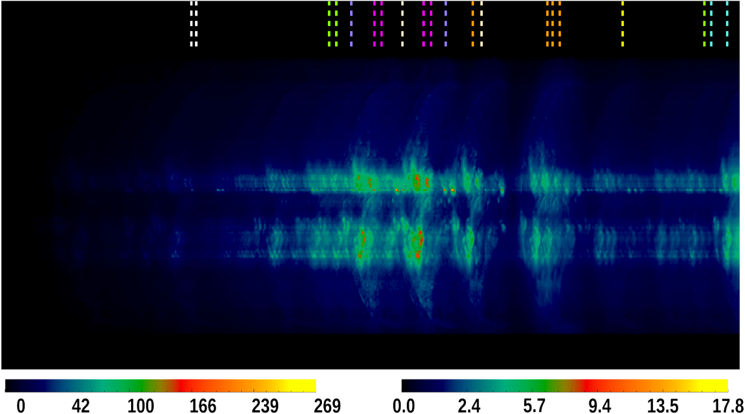
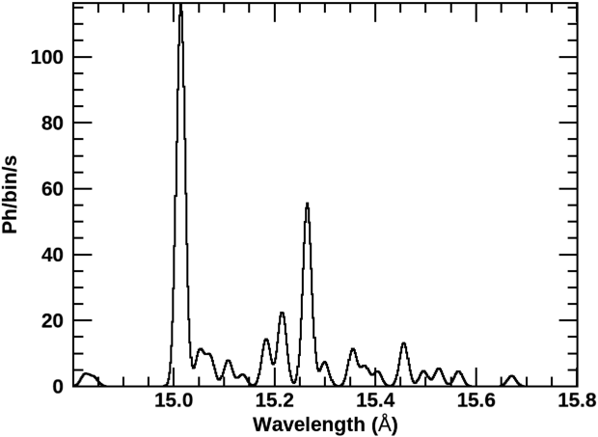
MaGIXS-3
MaGIXS optic axis
a b c d e f g h i
MaGIXS-3 will achieve
Validate the concept of diagnostic probe to study AR heating via plasma state
Help benchmark atomic database
Novel method to determine heating frequency in AR
TRICXS FOV
Sqrt(El/s/pix)
Sqrt(Ph/s/pix)
P1
a) Mg XI (6.4) b) Ne IX (6.2) c) Fe XVIII (6.8) d) Fe XVII (6.6) e) O VIII (6.4) f) O VII (6.3) g) N VII (6.2) h) N VI (5.8) i) C VI (6.0)
Notes:
With this data set we will validate the concept, achieve equilibrium / non-equa

Slide 13
Thank you

