Slide 1
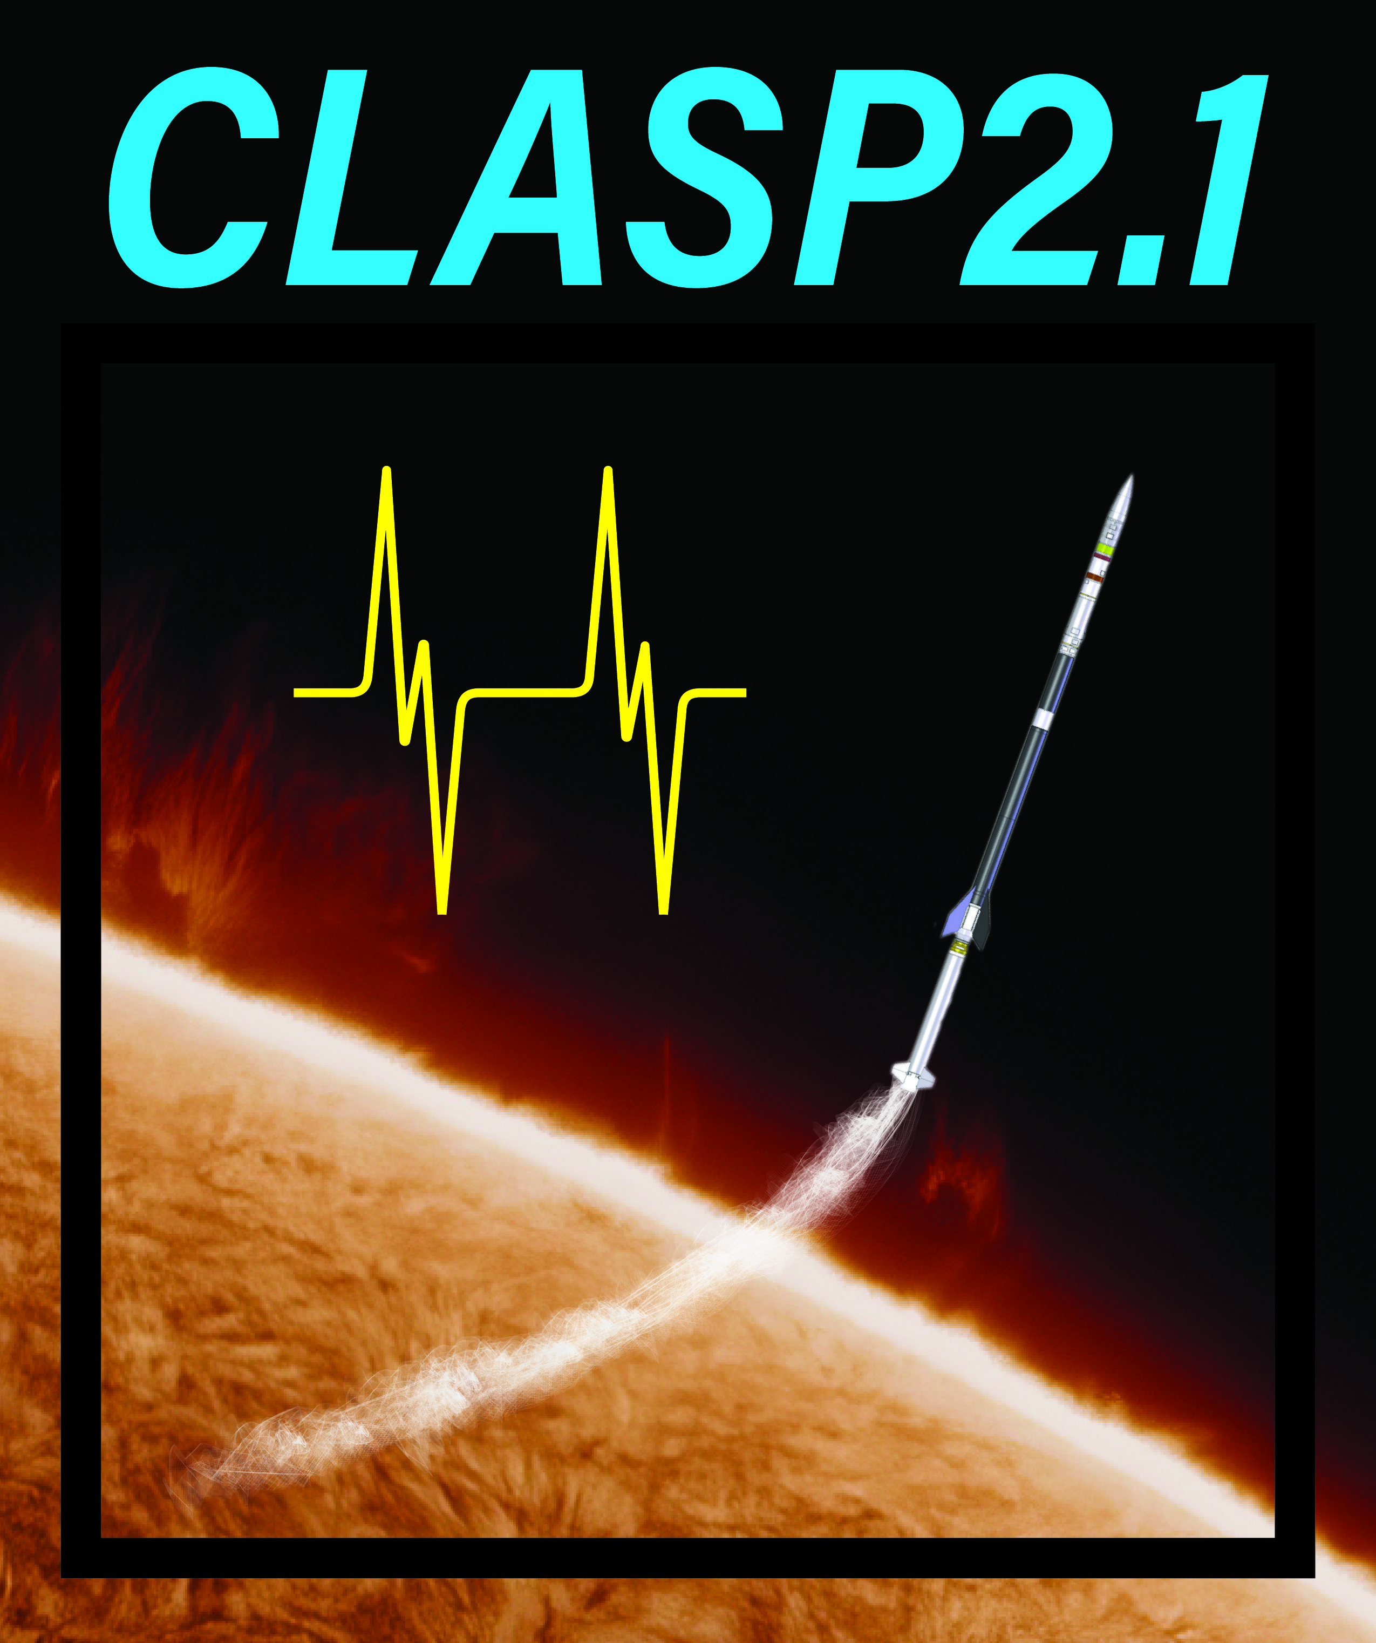
Demonstration of Chromospheric Magnetic Mapping
with CLASP2.1
David E. McKenzie¹, Ryohko Ishikawa², Javier Trujillo Bueno³, Frederic Auchere⁴, Ken Kobayashi¹, Amy Winebarger¹, Ryouhei Kano², Donguk Song^{2,5}, Takenori Joten Okamoto², Adam Kobelski¹, Laurel Rachmeler⁶, Bart De Pontieu⁷, Genevieve Vigil¹, Luca Belluzzi⁸, Ernest Alsina Ballester³, Tanausú del Pino Aleman³, Christian Bethge⁹,
Taro Sakao¹⁰, Jiri Stepan¹¹
¹NASA MSFC; ²NAOJ; ³IAC; ⁴IAS; ⁵KASI; ⁶NOAA; ⁷LMSAL; ⁸IRSOL; ⁹CU-Boulder; ¹⁰ISAS/JAXA; ¹¹Academy of Sciences of the Czech Republic

Slide 2

CLASP2.1 Team
David McKenzie (NASA/MSFC), PI
Ryohko Ishikawa (NAOJ), Co-PI
Javier Trujillo Bueno (IAC), Co-PI
Frédéric Auchère (IAS), Co-PI
Ken Kobayashi (NASA/MSFC), DepPI
Takenori Okamoto (NAOJ), PS
Donguk Song (KASI), IS
Anthony Guillory (NASA/MSFC), PM
Libby Creel (NASA/MSFC), PM
Howard SooHoo (NASA/MSFC), CE
Ryouhei Kano (NAOJ)
Amy Winebarger (NASA/MSFC)
Genevieve Vigil (NASA/MSFC)
Brent Beabout (NASA/MSFC)
Dyana Beabout (NASA/MSFC)
Andy Young (NASA/MSFC)
Harlan Haight (NASA/MSFC)
William Hogue (NASA/MSFC)
Adam Kobelski (NASA/MSFC)
Laurel Rachmeler (NOAA)
Christian Bethge (U.Colo.)
Bart De Pontieu (LMSAL)
Taro Sakao (JAXA)
Luca Belluzzi (IRSOL)
Jirí Štêpán (ASCR)
Tanausú del Pino Alemán (IAC)
Ernest Alsina Ballester (IAC)
Notes:
This team list illustrates a few things: First, we have a great collaboration spanning multiple institutions.
Also, the CLASP missions are thoroughly international, spanning 7 countries, with each partner bringing something critical for the success of the mission.
And, we have not one PI, but 4 CO-PIs, emphasizing that we can’t do this without the contributions of each other.

Slide 3
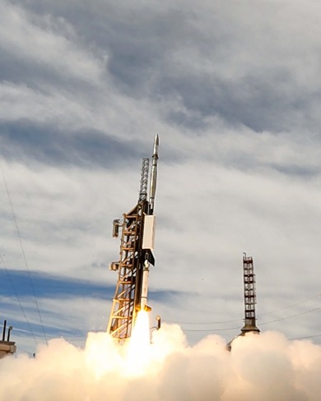
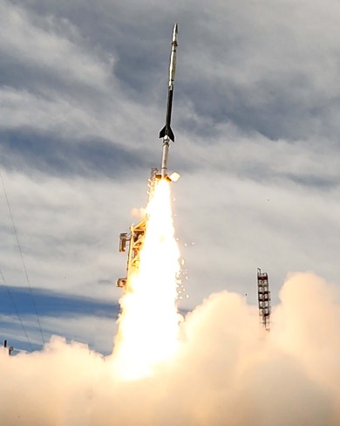

CLASP2.1 Launch: 08 October 2021
Image credits: WSMR Photo

Slide 4
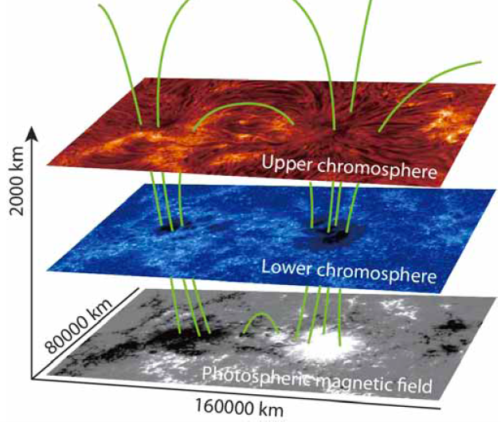
Goal of the CLASP missions
The CLASP missions have one primary objective: enable mapping of the magnetic field in the Sun’s chromosphere.
  See especially Belluzzi & Trujillo Bueno (2012); Alsina Ballester et al. (2016); del Pino Alemán et al. (2016)
Magnetic field is the source and storage medium of energy for solar flares, mass ejections, and space weather. Magnetism is everything.
The chromosphere is a key layer of the Sun’s atmosphere, and yet we do not have measurements of the magnetic field there – we only measure the magnetism in the photosphere, the “surface” of the Sun, and it’s not sufficient.

Slide 5
Goal of the CLASP missions
Chromosphere contains more mass than the interplanetary heliosphere, requires a heating rate higher than the corona’s and mediates all energy driving the solar wind.
  How to constrain energy flux of Alfvén waves propagating through the chromosphere?
  What is the height of the 𝞫=1 transition?
  Provide a more suitable basis for non-linear force-free extrapolations
CLASP, CLASP2, and now CLASP2.1 have developed and demonstrated a technique for making these measurements, as pathfinders for a future satellite chromospheric observatory

Slide 6
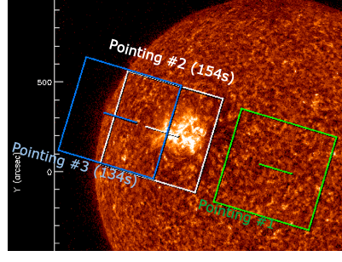
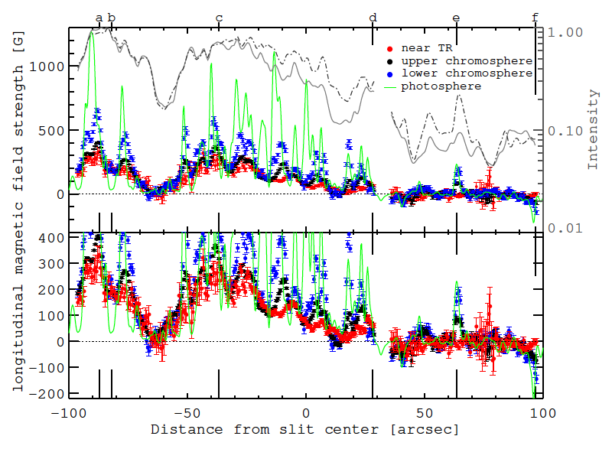
CLASP2 to CLASP2.1
What CLASP2 did:
  Weak-field approximation yields B_{los}, shown in Ishikawa et al. (2021) Science Advances, vol.7, issue 8, pg. eabe8406
  Full inversion with Tenerife Inversion Code (TIC), shown in Li et al. (2023), ApJ, 945, 144. Recovers stratification of T, B_{los}, density, and macroscopic velocity at each spatial point along the slit.
  Demonstrated evidence of Hanle and magneto-optical effects, in Ishikawa et al. (2023), ApJ, 945, 125.
  Confirmed center-to-limb variation in quiet Sun as first observed in CLASP-1, in Rachmeler et al. (2022), ApJ, 936, 67.
The result is a 1-dimensional magnetogram, a measure of magnetic field strength along a narrow track on the Sun.
Notes:
Minimum required times:
d.c., 13s
plage, 63s
QS, 33s

Slide 7
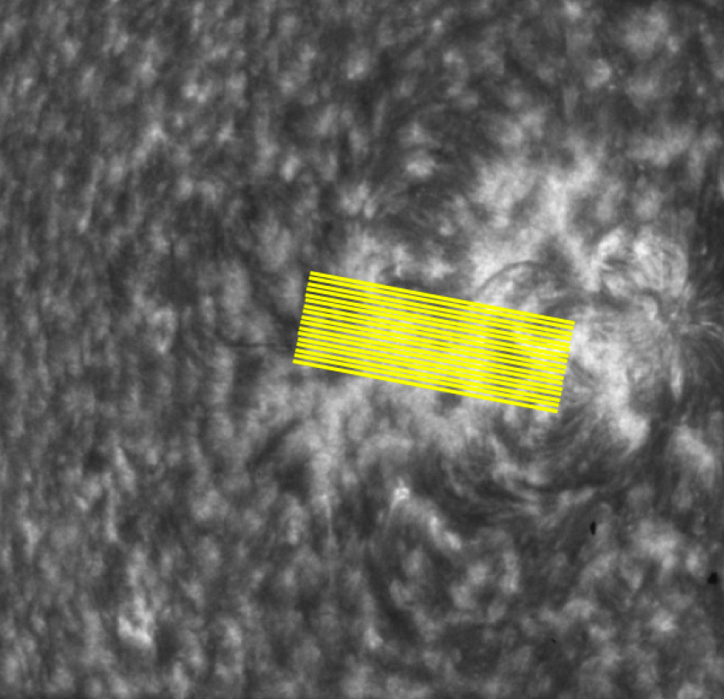
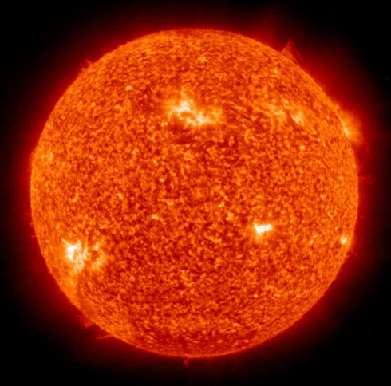
CLASP2 to CLASP2.1
CLASP2.1 objective: Expand the 1-D “magnetogram” of CLASP2 over a 2-D area.
Solution: Scan the spectrograph slit over the target.
  For adequate signal/noise, we require at least 16 seconds “dwell” at each slit location
  To make a useful/compelling data product, we require at least 8 pointings, approximately 2 arcsec apart
CLASP2
CLASP2.1 concept
Notes:
Emph: We started with an idea, which worked. Then the NSROC tech thought of a way to make it BETTER. That worked too!
We required at least 8 pointings, figured we should get 12+. We actually got 16. ☺

Slide 8
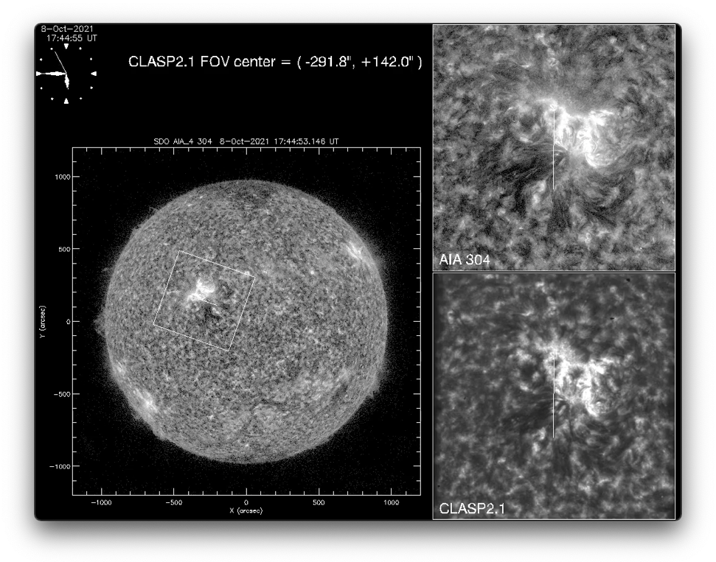
CLASP2.1 Preliminary results
Analysis by Joten Okamoto

Slide 9
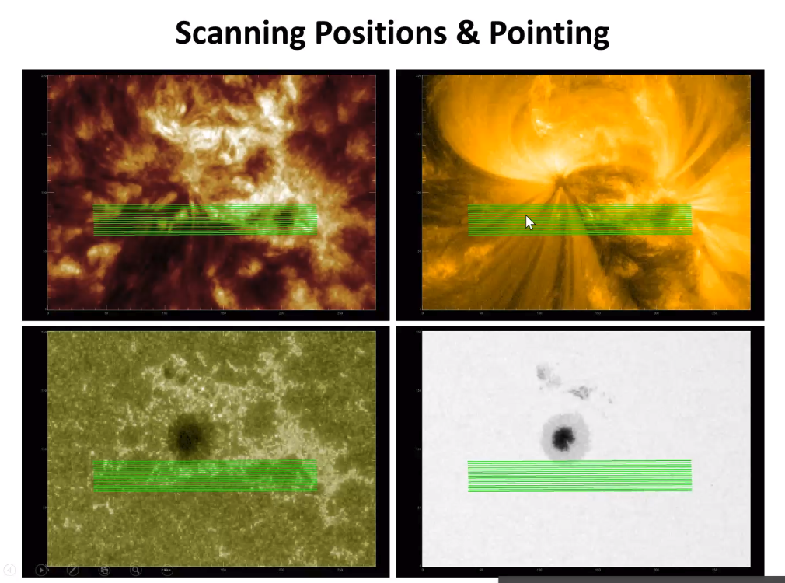
CLASP2.1 Preliminary results
Analysis by Donguk Song

Slide 10
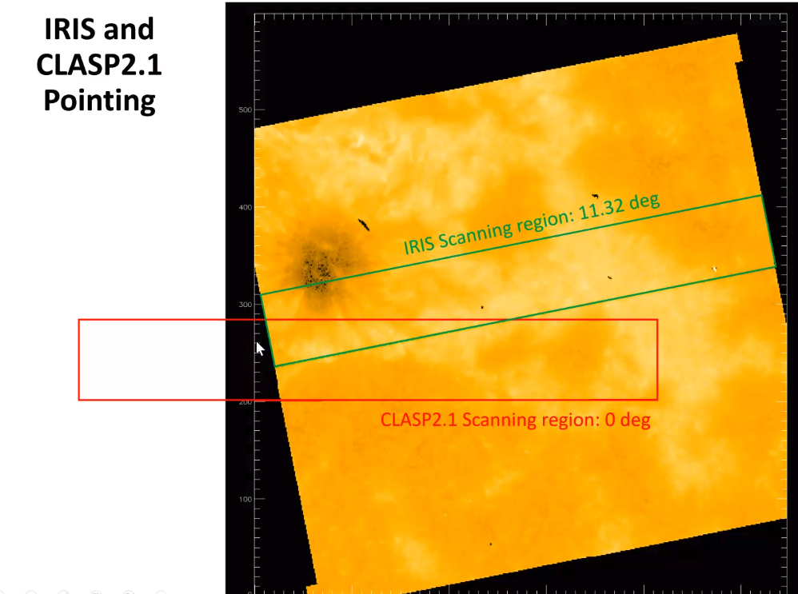
CLASP2.1 Preliminary results
Analysis by Donguk Song

Slide 11
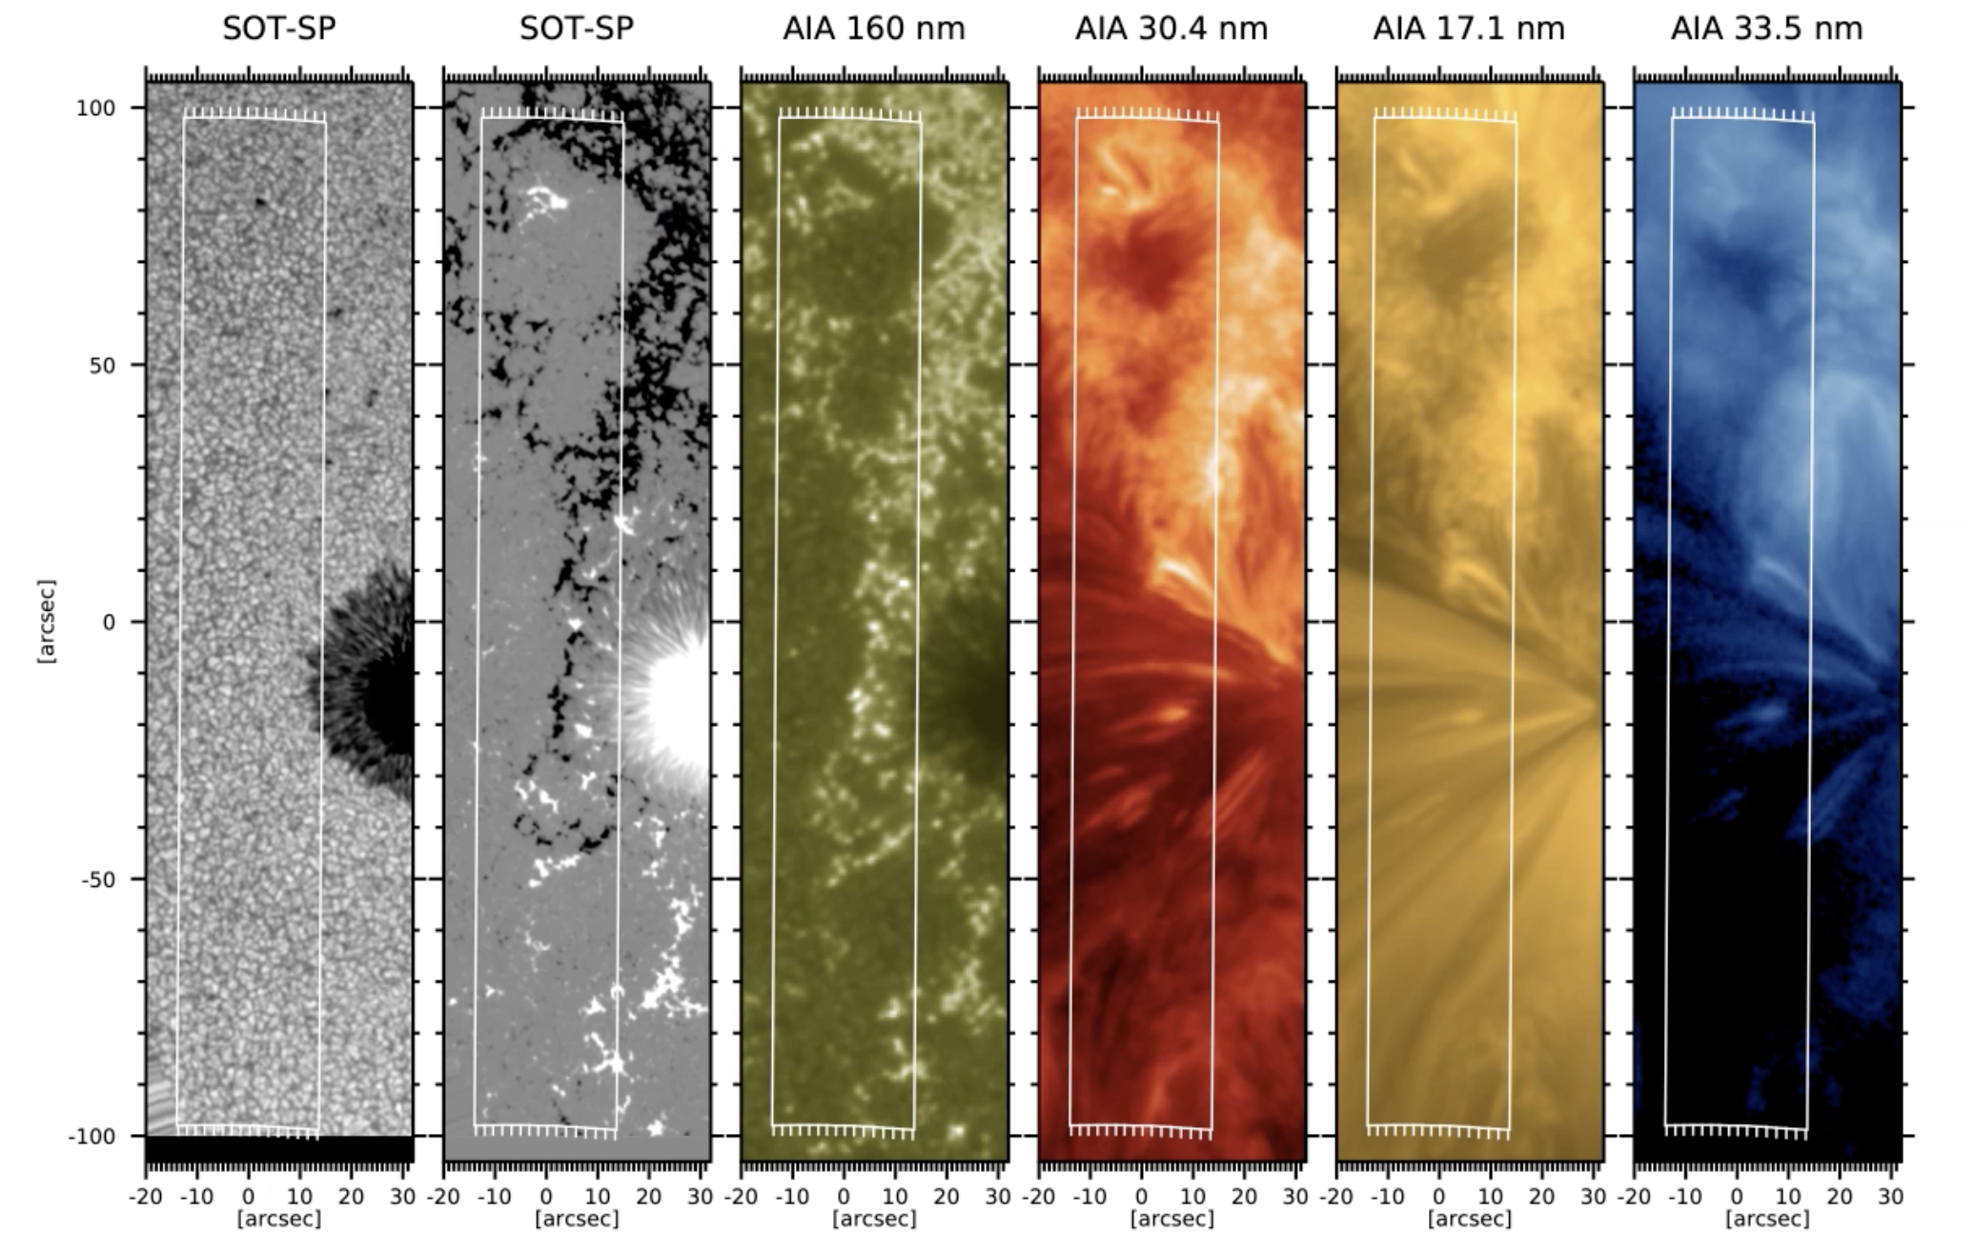
CLASP2.1 Preliminary results
Analysis by Ryohko Ishikawa

Slide 12
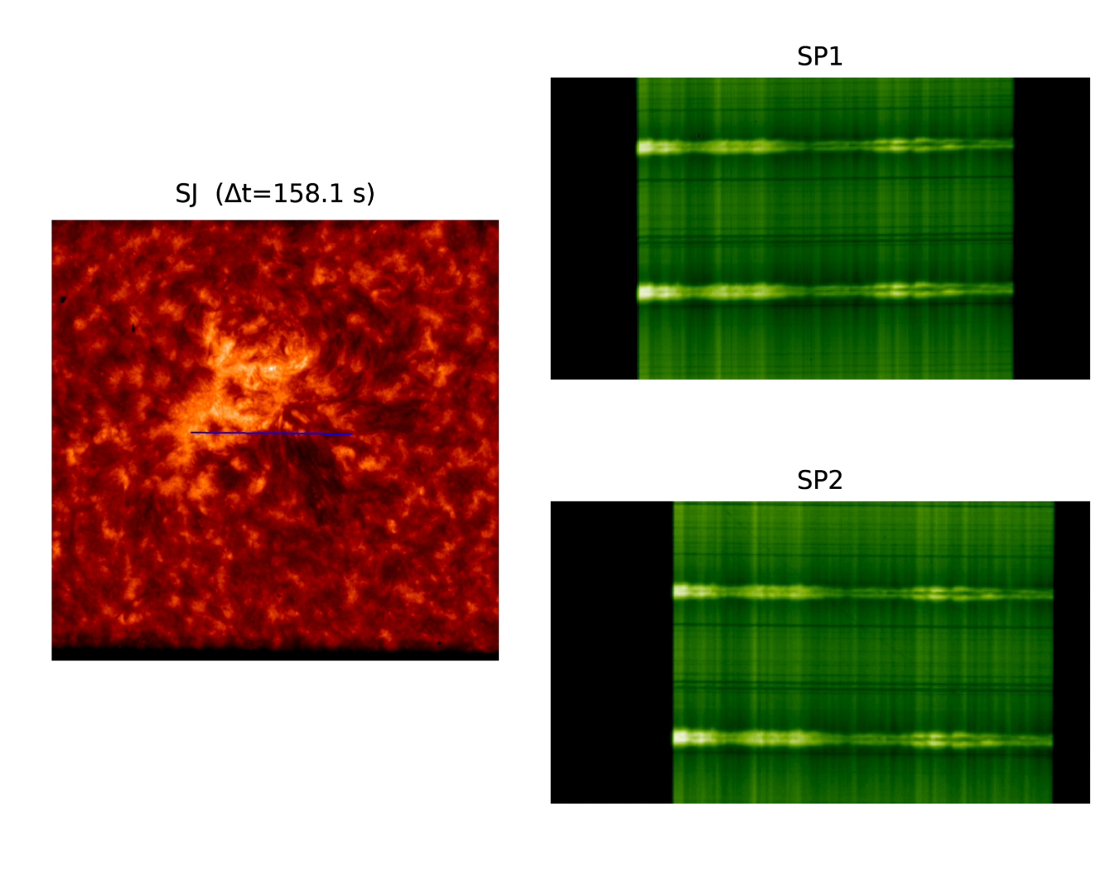
CLASP2.1 Preliminary results
Direction of slit scan
Raw data from CLASP2.1

Slide 13
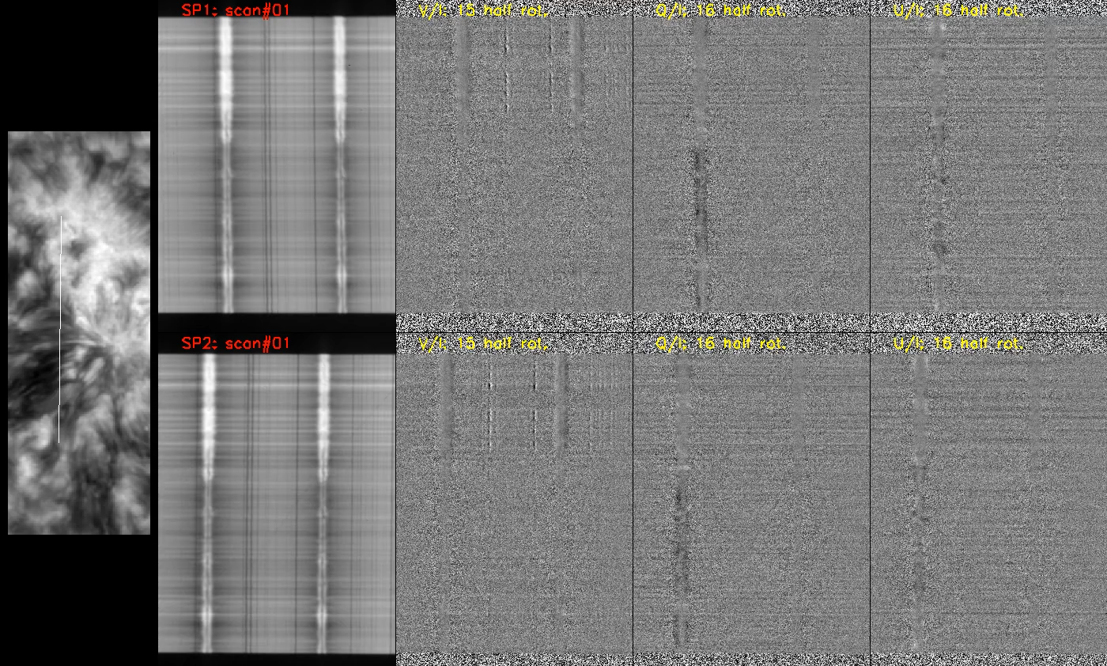
CLASP2.1 Preliminary results
Direction of slit scan
Demodulated I, V, Q, U from CLASP2.1
(Analysis by Ryohko Ishikawa)

Slide 14
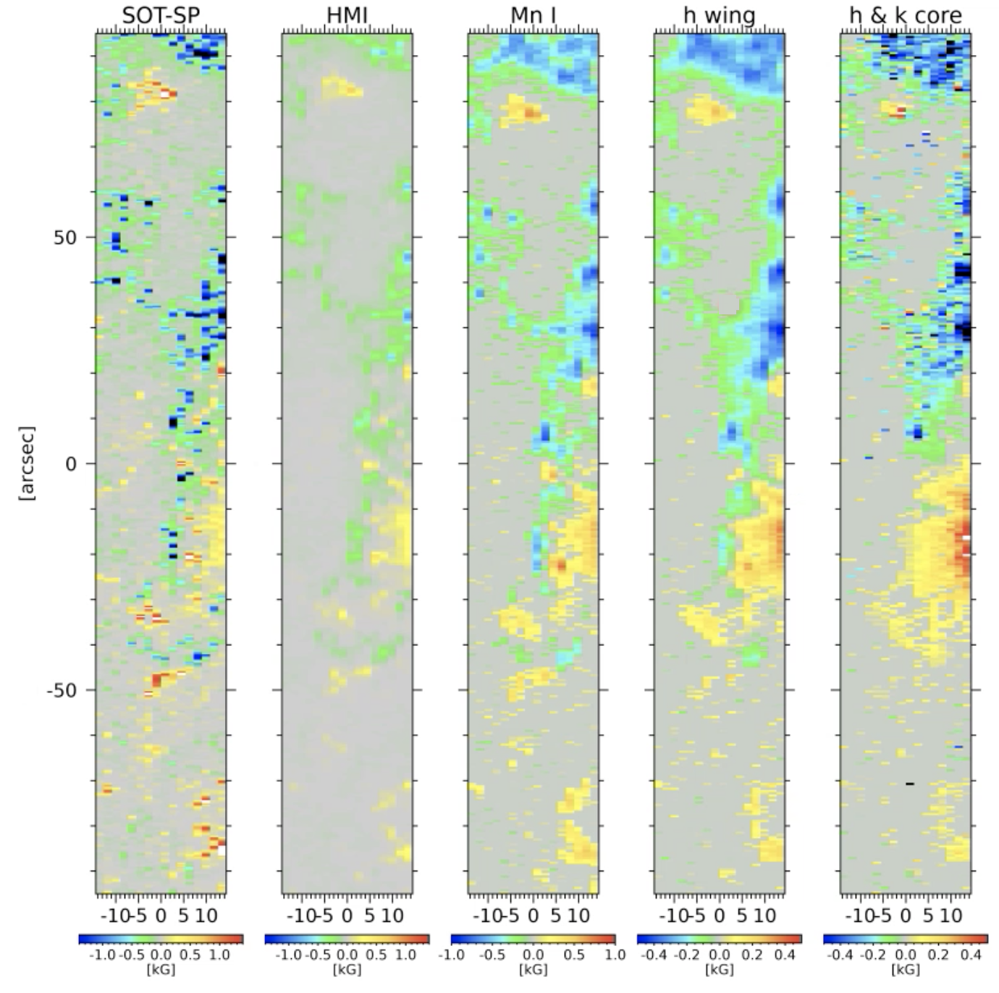
CLASP2.1 Preliminary results
Analysis by Ryohko Ishikawa (papers in preparation)
Notes:
Concerning the advance of our CLASP2.1 results to quote as Ishikawa et al. (2023; in preparation), and to say that there will be an extra paper by Li et al. resulting from the application of TIC to the whole observed plage area, giving maps at multiple heights of T, BLOS, density, macroscopic velocity.

Slide 15
Goal of the CLASP missions
Now that we have the magnetograms, in principle one should be able to interpolate/extrapolate to make full “cube” of the field.
Will need to extract the full vector field at each location first. That’s in progress.

