Slide 1
Dragonfly Entry Aerosciences Measurements (DrEAM) Suite Science Objectives
2023 IPPW
Aaron Brandis, DrEAM Investigation Lead
NASA Ames Research Center
Eric Stern, Jose Santos, Helen Hwang, Ali Gulhan, Chris Karlgaard, Tomo Oishi, Ruth Miller, Joseph Schulz, Thomas Thiele, Frank Siebe, Niklas Wendel, and Dominic Neeb
NASA Ames, NASA Langley, DLR, Jacobs, AMA

Slide 2
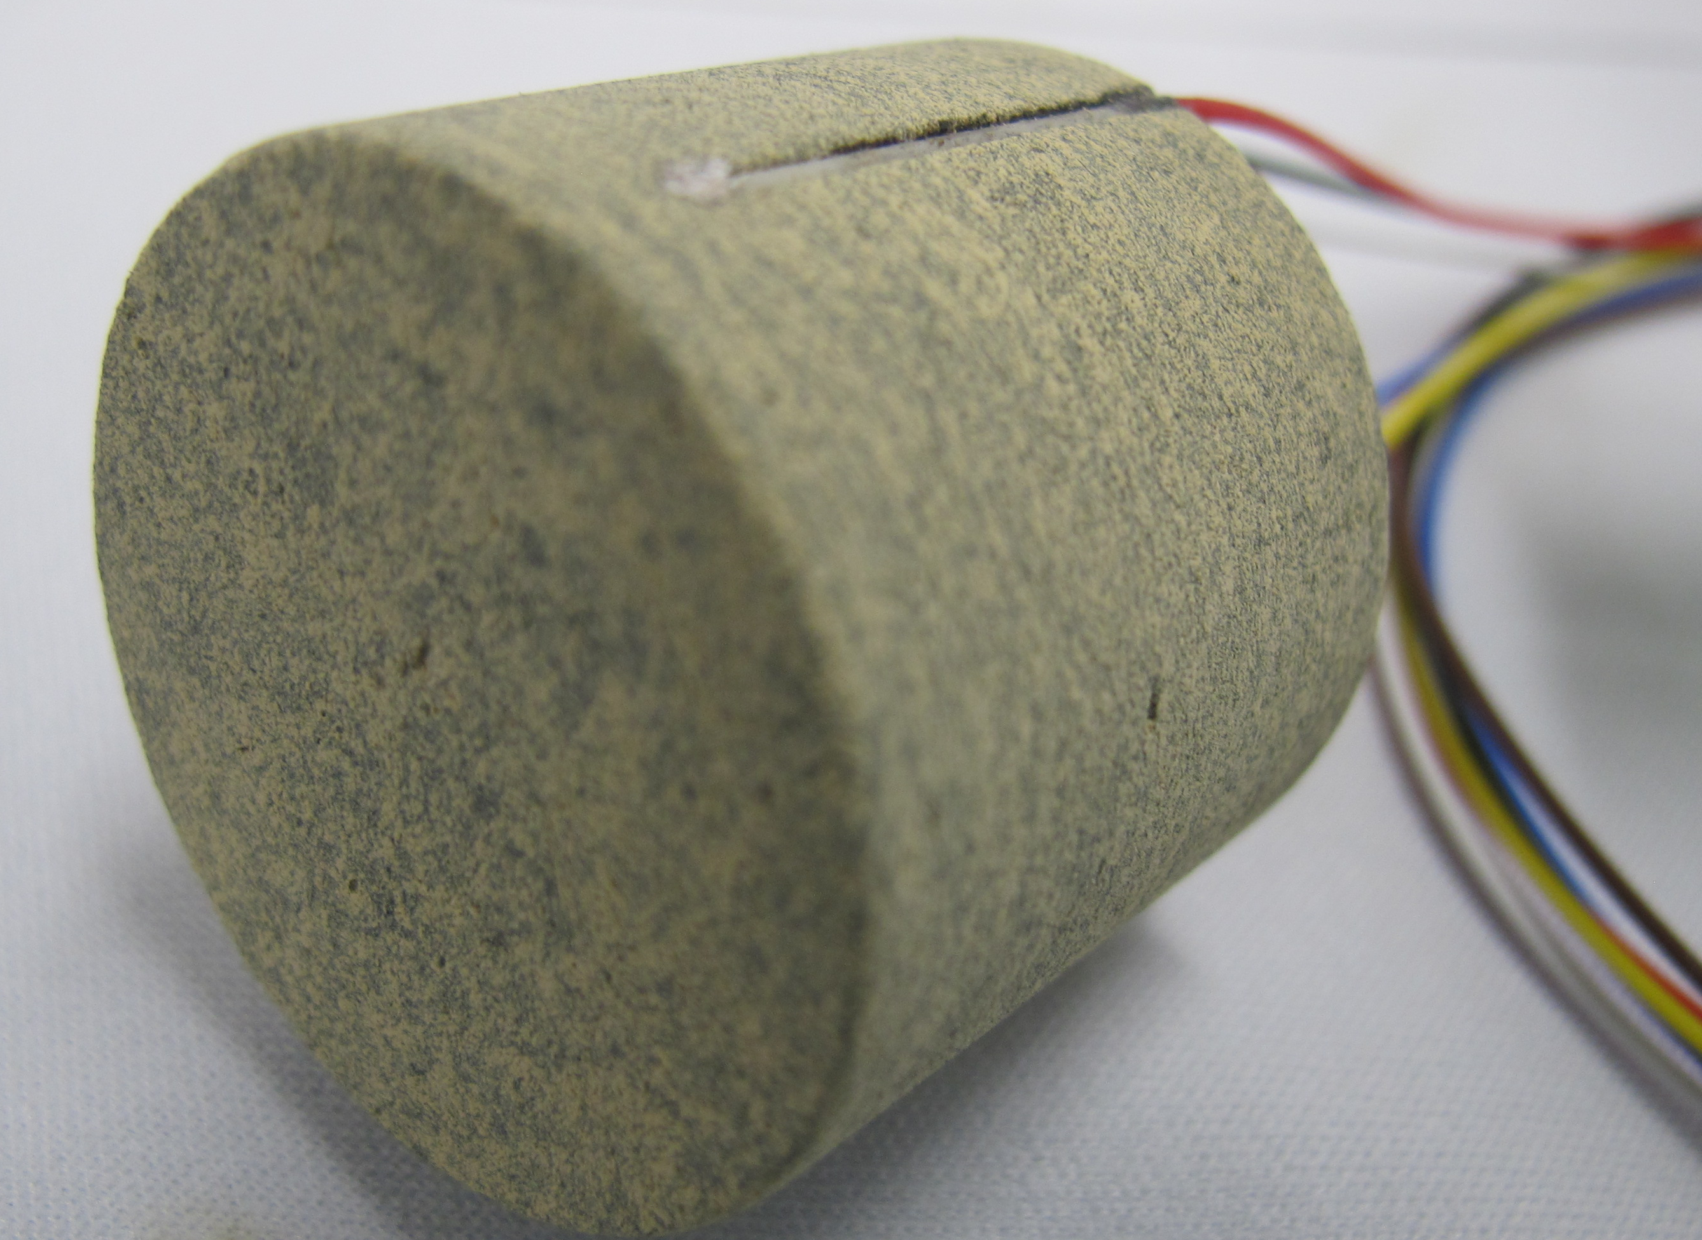
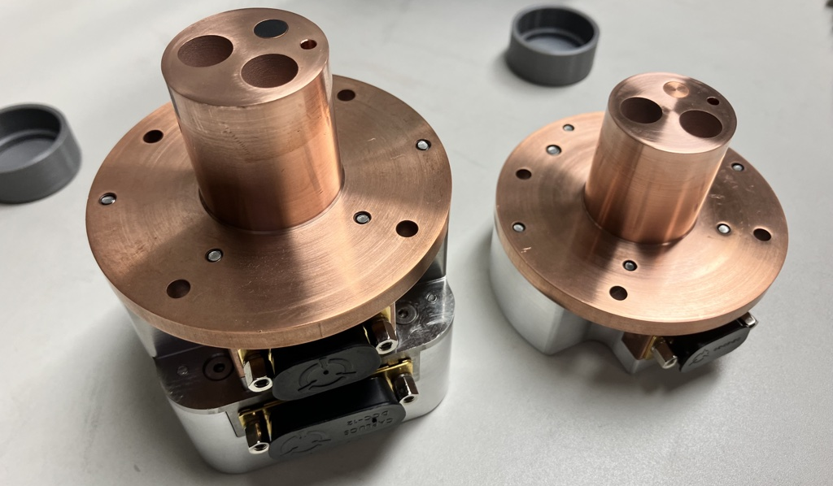
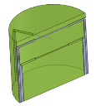
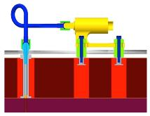
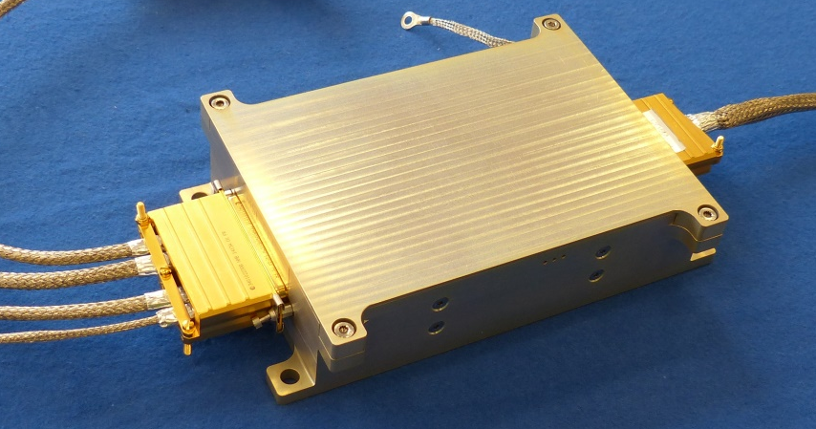
What Makes Up DrEAM?
Dragonfly Sensors for Thermal Reconstruction (DragSTR)
  In-depth thermocouples to back out the aerothermal environment and understand the material response of the thermal protection system (TPS)
Dragonfly Atmospheric Flight Transducers (DrAFT)
  Surface pressures on heatshield to understand flow and dynamics
COmbined Sensor System for Titan Atmosphere (COSSTA)
  Backshell sensors for radiative & total heat flux and pressure. Main focus to understand radiative heating from CN and vehicle dynamics (thanks to FMI add)
Data Acquisition System (DAS)
  DLR is providing the data acquisition system for all the DrEAM instruments

Slide 3
Sensor Layout (FMI Pressure Sensor Baselined*)
Same TPS materials and standard substructure as used by Mars 2020 & MSL:
  4.5m aeroshell
  Tiled PICA on forebody
  SLA 561V on aftbody
Dragonfly Sensors for Thermal Reconstruction (DragSTR):
  5 forebody TC plugs, 1 aftbody TC plug
Dragonfly Atmospheric Flight Transducers (DrAFT):
  4 forebody pressure transducers
COmbined Sensor System for Titan Atmosphere (COSSTA):
  3 combined total heat flux, narrow band radiometers and pressure sensors
  1 radiometer
* see poster for more details

Slide 4
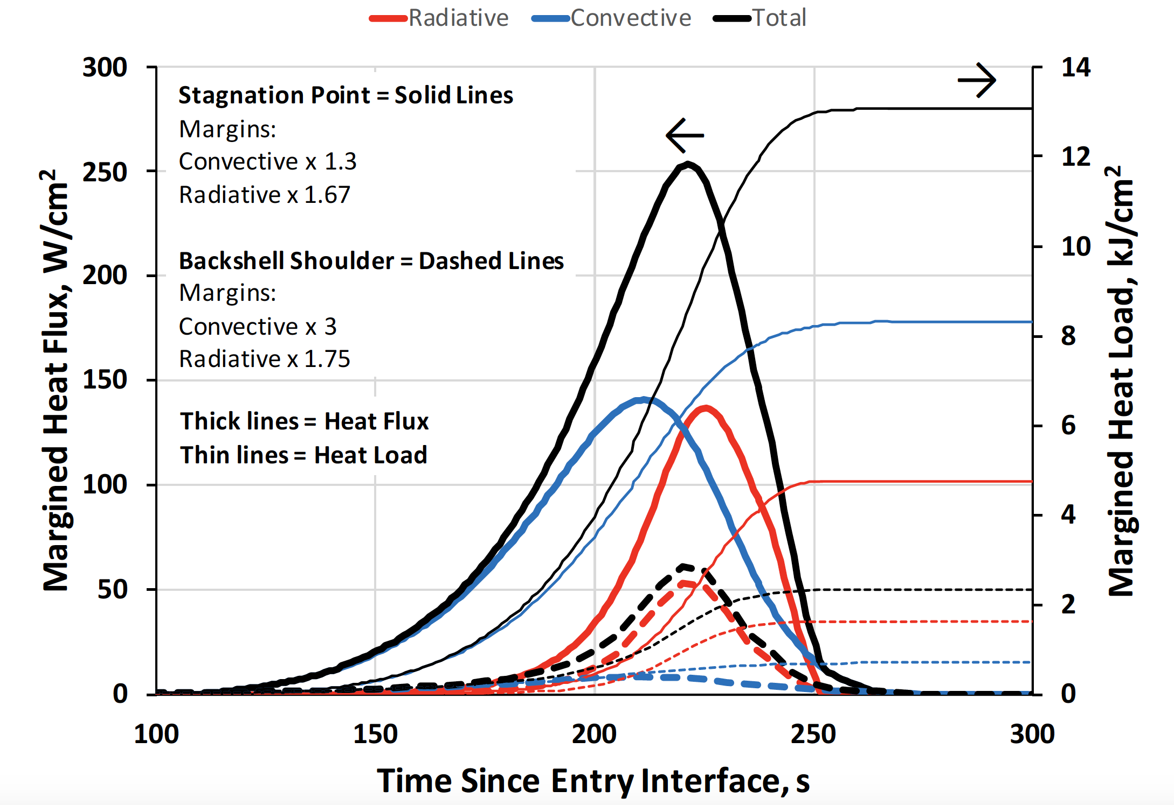
Science Objectives: DragSTR
Infer the forebody aerothermal environment across the acreage of the heatshield through inverse analysis. (near surface TCs for heat pulse)
Assess the heatshield material response performance in a non-oxidizing environment. (near & in-depth TCs for heat pulse)
Improve Titan aerothermal and non-oxidizing material response models

Slide 5
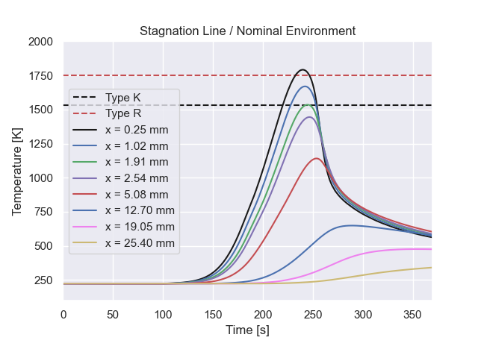
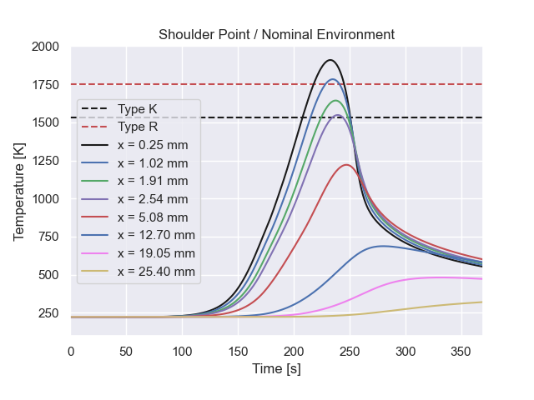
Science Objectives: DragSTR
Assess whether excessive recession of the NuSil coated PICA heatshield occurred. (near surface TCs for heat pulse)
Understand when and how the flow across the acreage of the heatshield transitions away from being laminar to either transitional or turbulent flow. (multiple plugs with near surface TCs for heat pulse)
Understand the impact of convective cooling as the Dragonfly spacecraft descends for up to two hours through the cryogenic Titan atmosphere. (multiple in-depth TCs until heat shield sep.)
Further insight into tiled heatshield turbulent flow transition and impact of convective cooling (unique to Titan data)

Slide 6
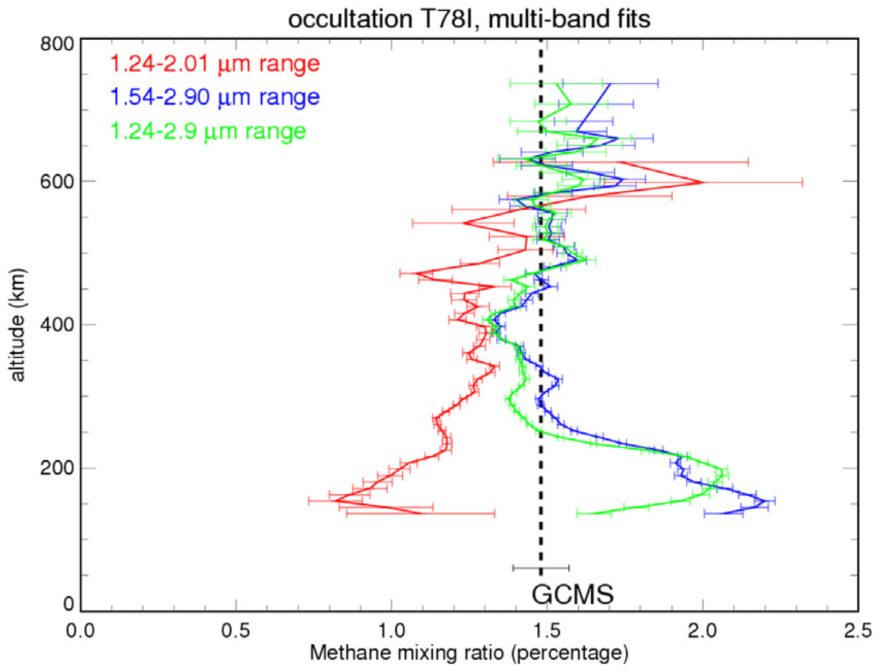
Science Objectives: COSSTA
Infer the abundance of methane in Titan’s upper atmosphere by analyzing measurements made of CN Red and CN violet by narrow band radiometers in different flow regimes on the aftbody. (narrow band radiometers)
Determine if/when flow attachment occurs on the backshell by examining any discontinuities in aftbody surface pressure measurements and assess the impact on dynamic stability. (multiple COSSTA pressure transducers)
Provide critical data for DrEAM reconstruction: Freestream CH₄ and backshell flowfield topology
Maltagliati et al “Titan’s atmosphere as observed by Cassini/VIMS solar occultations: CH₄, CO and evidence for C₂H₆ absorption” Icarus 248 (2015)

Slide 7
Science Objectives: COSSTA / DragSTR
Infer the aftbody aerothermal environment through the data fusion of three different measurement types: 1) near-surface and in-depth TPS temperature, 2) total heat flux and 3) radiative heat flux. (radiometers, total heat flux)
Quantitatively assess the contribution of CN Violet and CN Red bands to the aftbody radiative. (narrow band radiometers)
Improve Titan entry backshell aerothermal models

Slide 8
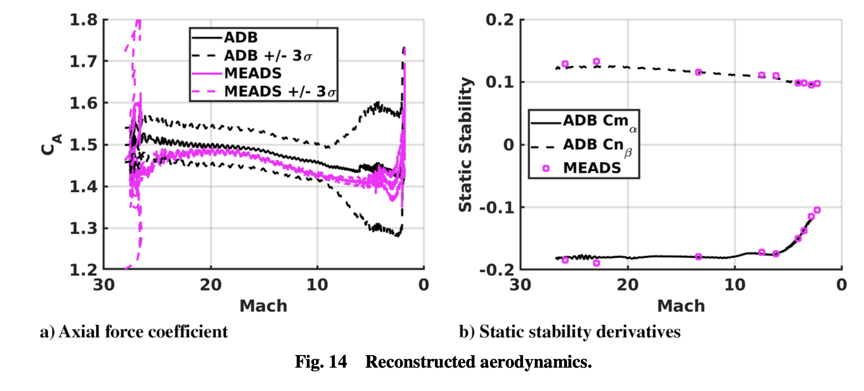
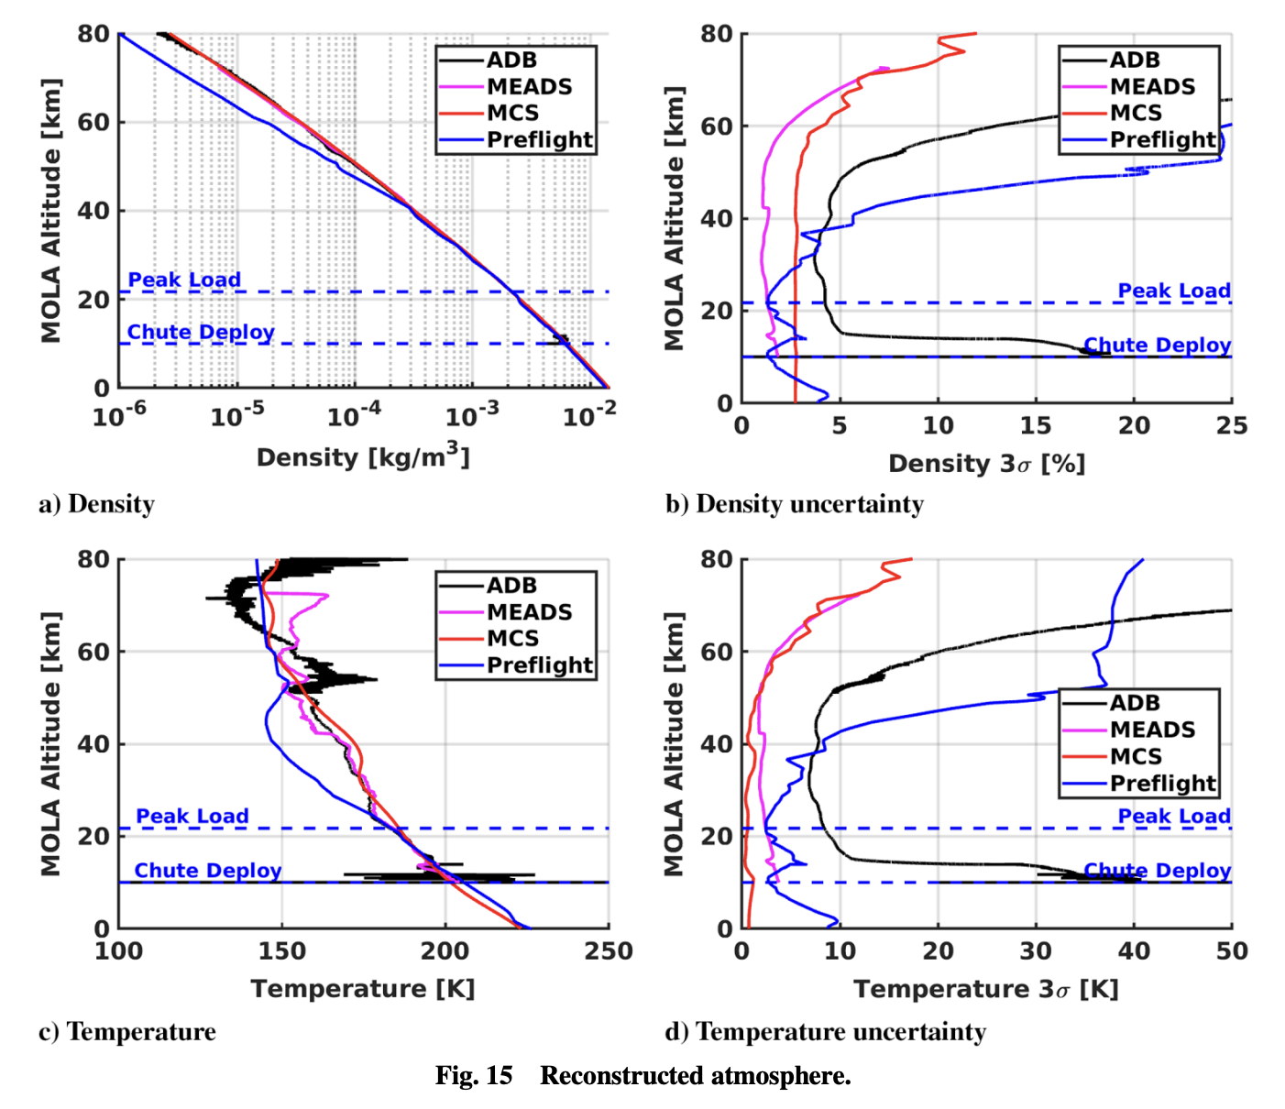
Science Objectives: DrAFT / COSSTA
Determine the aerodynamic force coefficients and vehicle orientation, both angle of attack and side-slip angle, and integrate with the Dragonfly IMU data. (heatshield/backshell pressures)
Calculate the upper atmospheric Titan density and winds during entry and descent. (stag. pressure)
Assess the coupling of the unsteady wake flow with the dynamic (in)stability of passive entry vehicles during entry and descent. (low pressure backshell: FMI)
Unique opportunity to provide Titan upper atmosphere data and benchmark flight dataset for dynamic stability
Karlgard et al “Mars Entry, Descent, and Landing Instrumentation 2 Trajectory, JSR (2023)

Slide 9
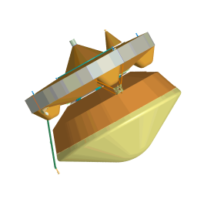
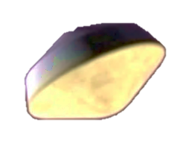
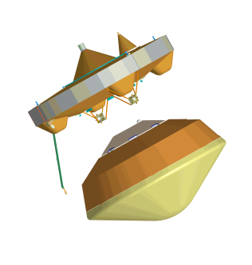
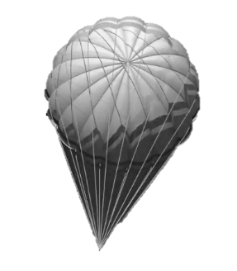

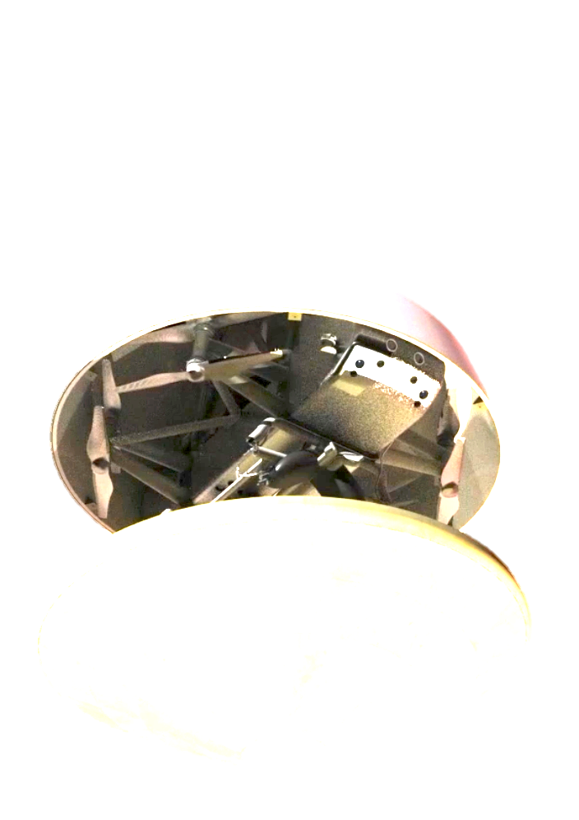

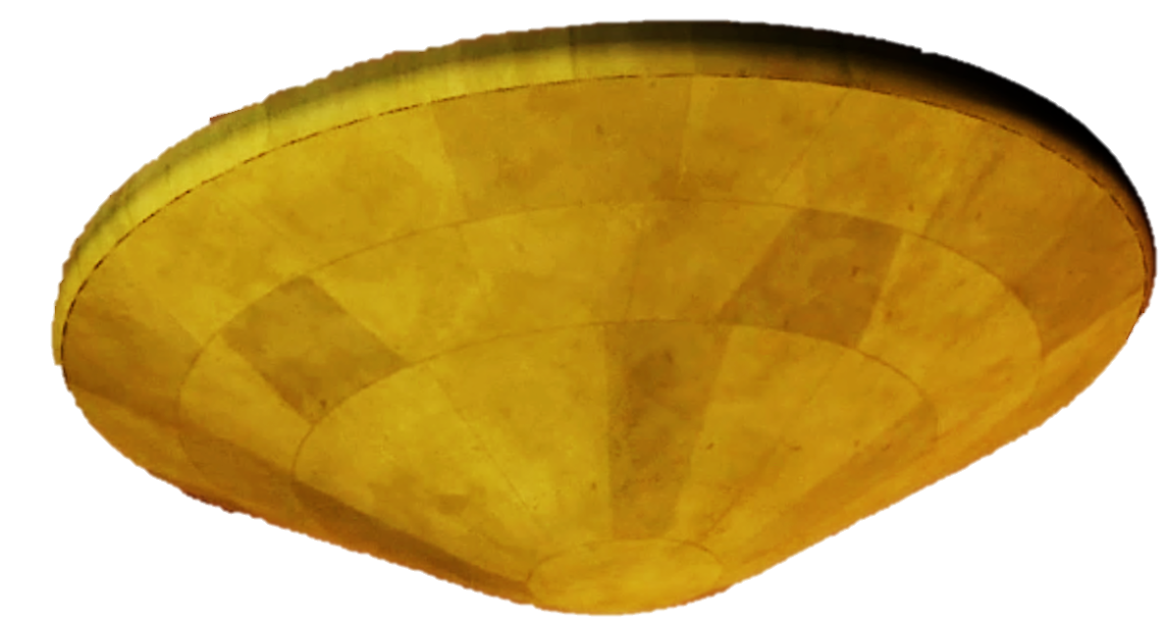
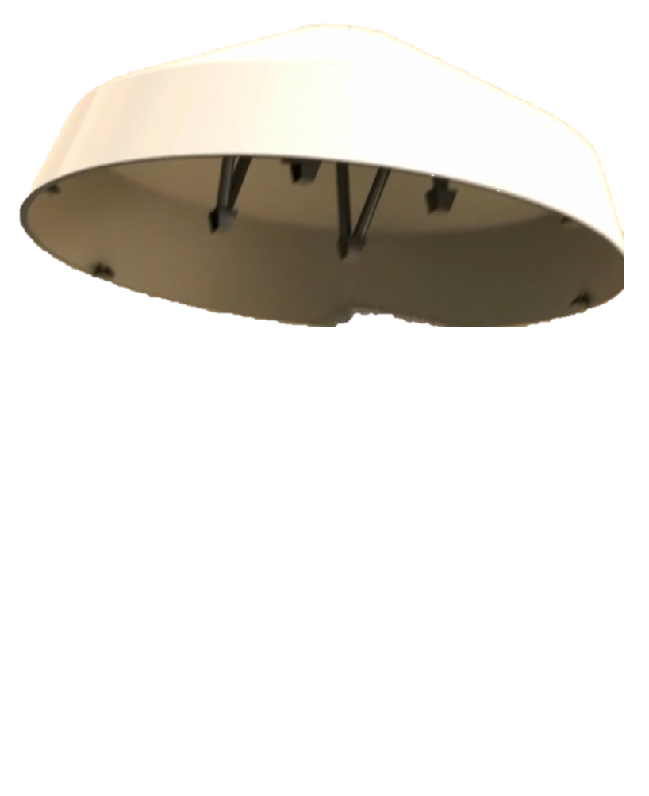
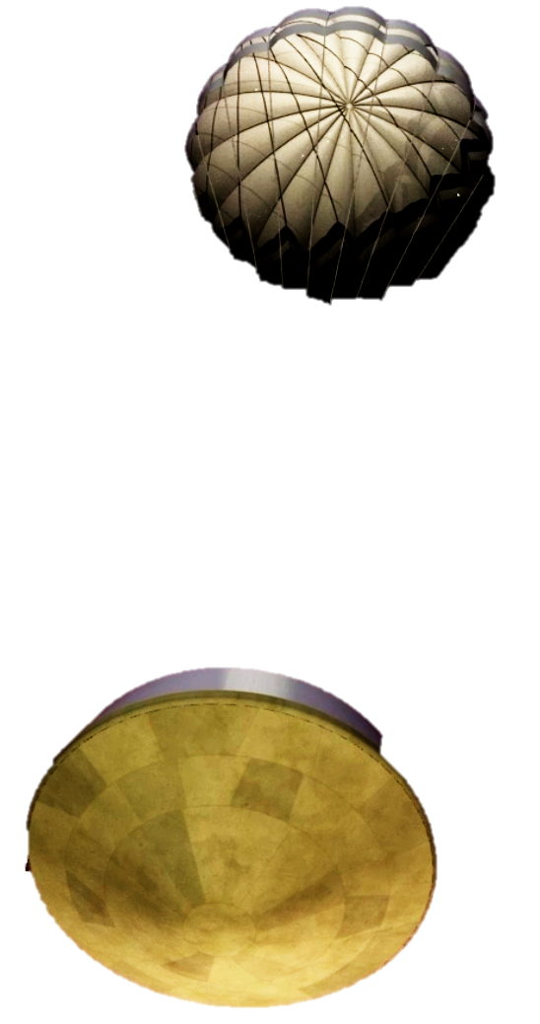
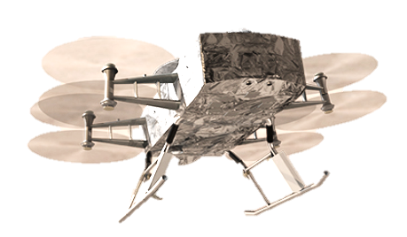
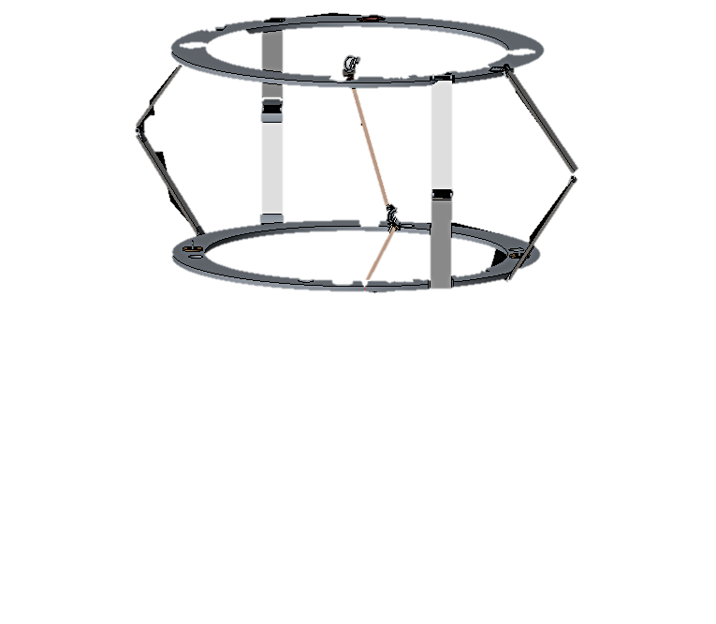

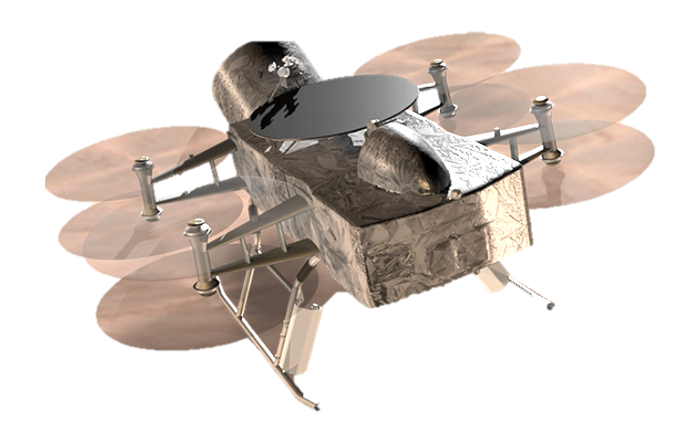
Wake up; E-250 min
Entry and Descent Con-Ops
Turn to entry, spin up to 2 rpm; E-27 min
Cut thermal loop; E-22 min
MDNav to EDL Handoff (7800 km); E–10 min
Cruise Stage Separation; E–10 min
Entry Interface (1270 km); E=0
Peak heating
247 km; E+228 s
Peak deceleration
219 km; E+241 s
Main parachute deployment 4km; E+94 min
Heatshield separation
3.6 km; E+96 min
Reconfigure EDL thermal loop;
2.5 km; E+106 min
Lander Pose
2.3 km; E+108 min
FMI
90 min Descent under drogue
Drogue deployment
142 km; E+374 s
Despin
2.3 km; E+109 min
Kulite
FMI sensors:
Capture pressure data from entry interface through drogue deployment
Coupling of wake flow and dynamic (in)stability
Kulite sensors:
Pressure data under drogue
Lidar Ground Lock
2 km; E+111 min
Lander Separation
1.2 km; E+119 min; 2.9 m/s
Transition to Powered Flight
Release + 1 s
Notes:
Wake up from hibernation EI-4h

Slide 10
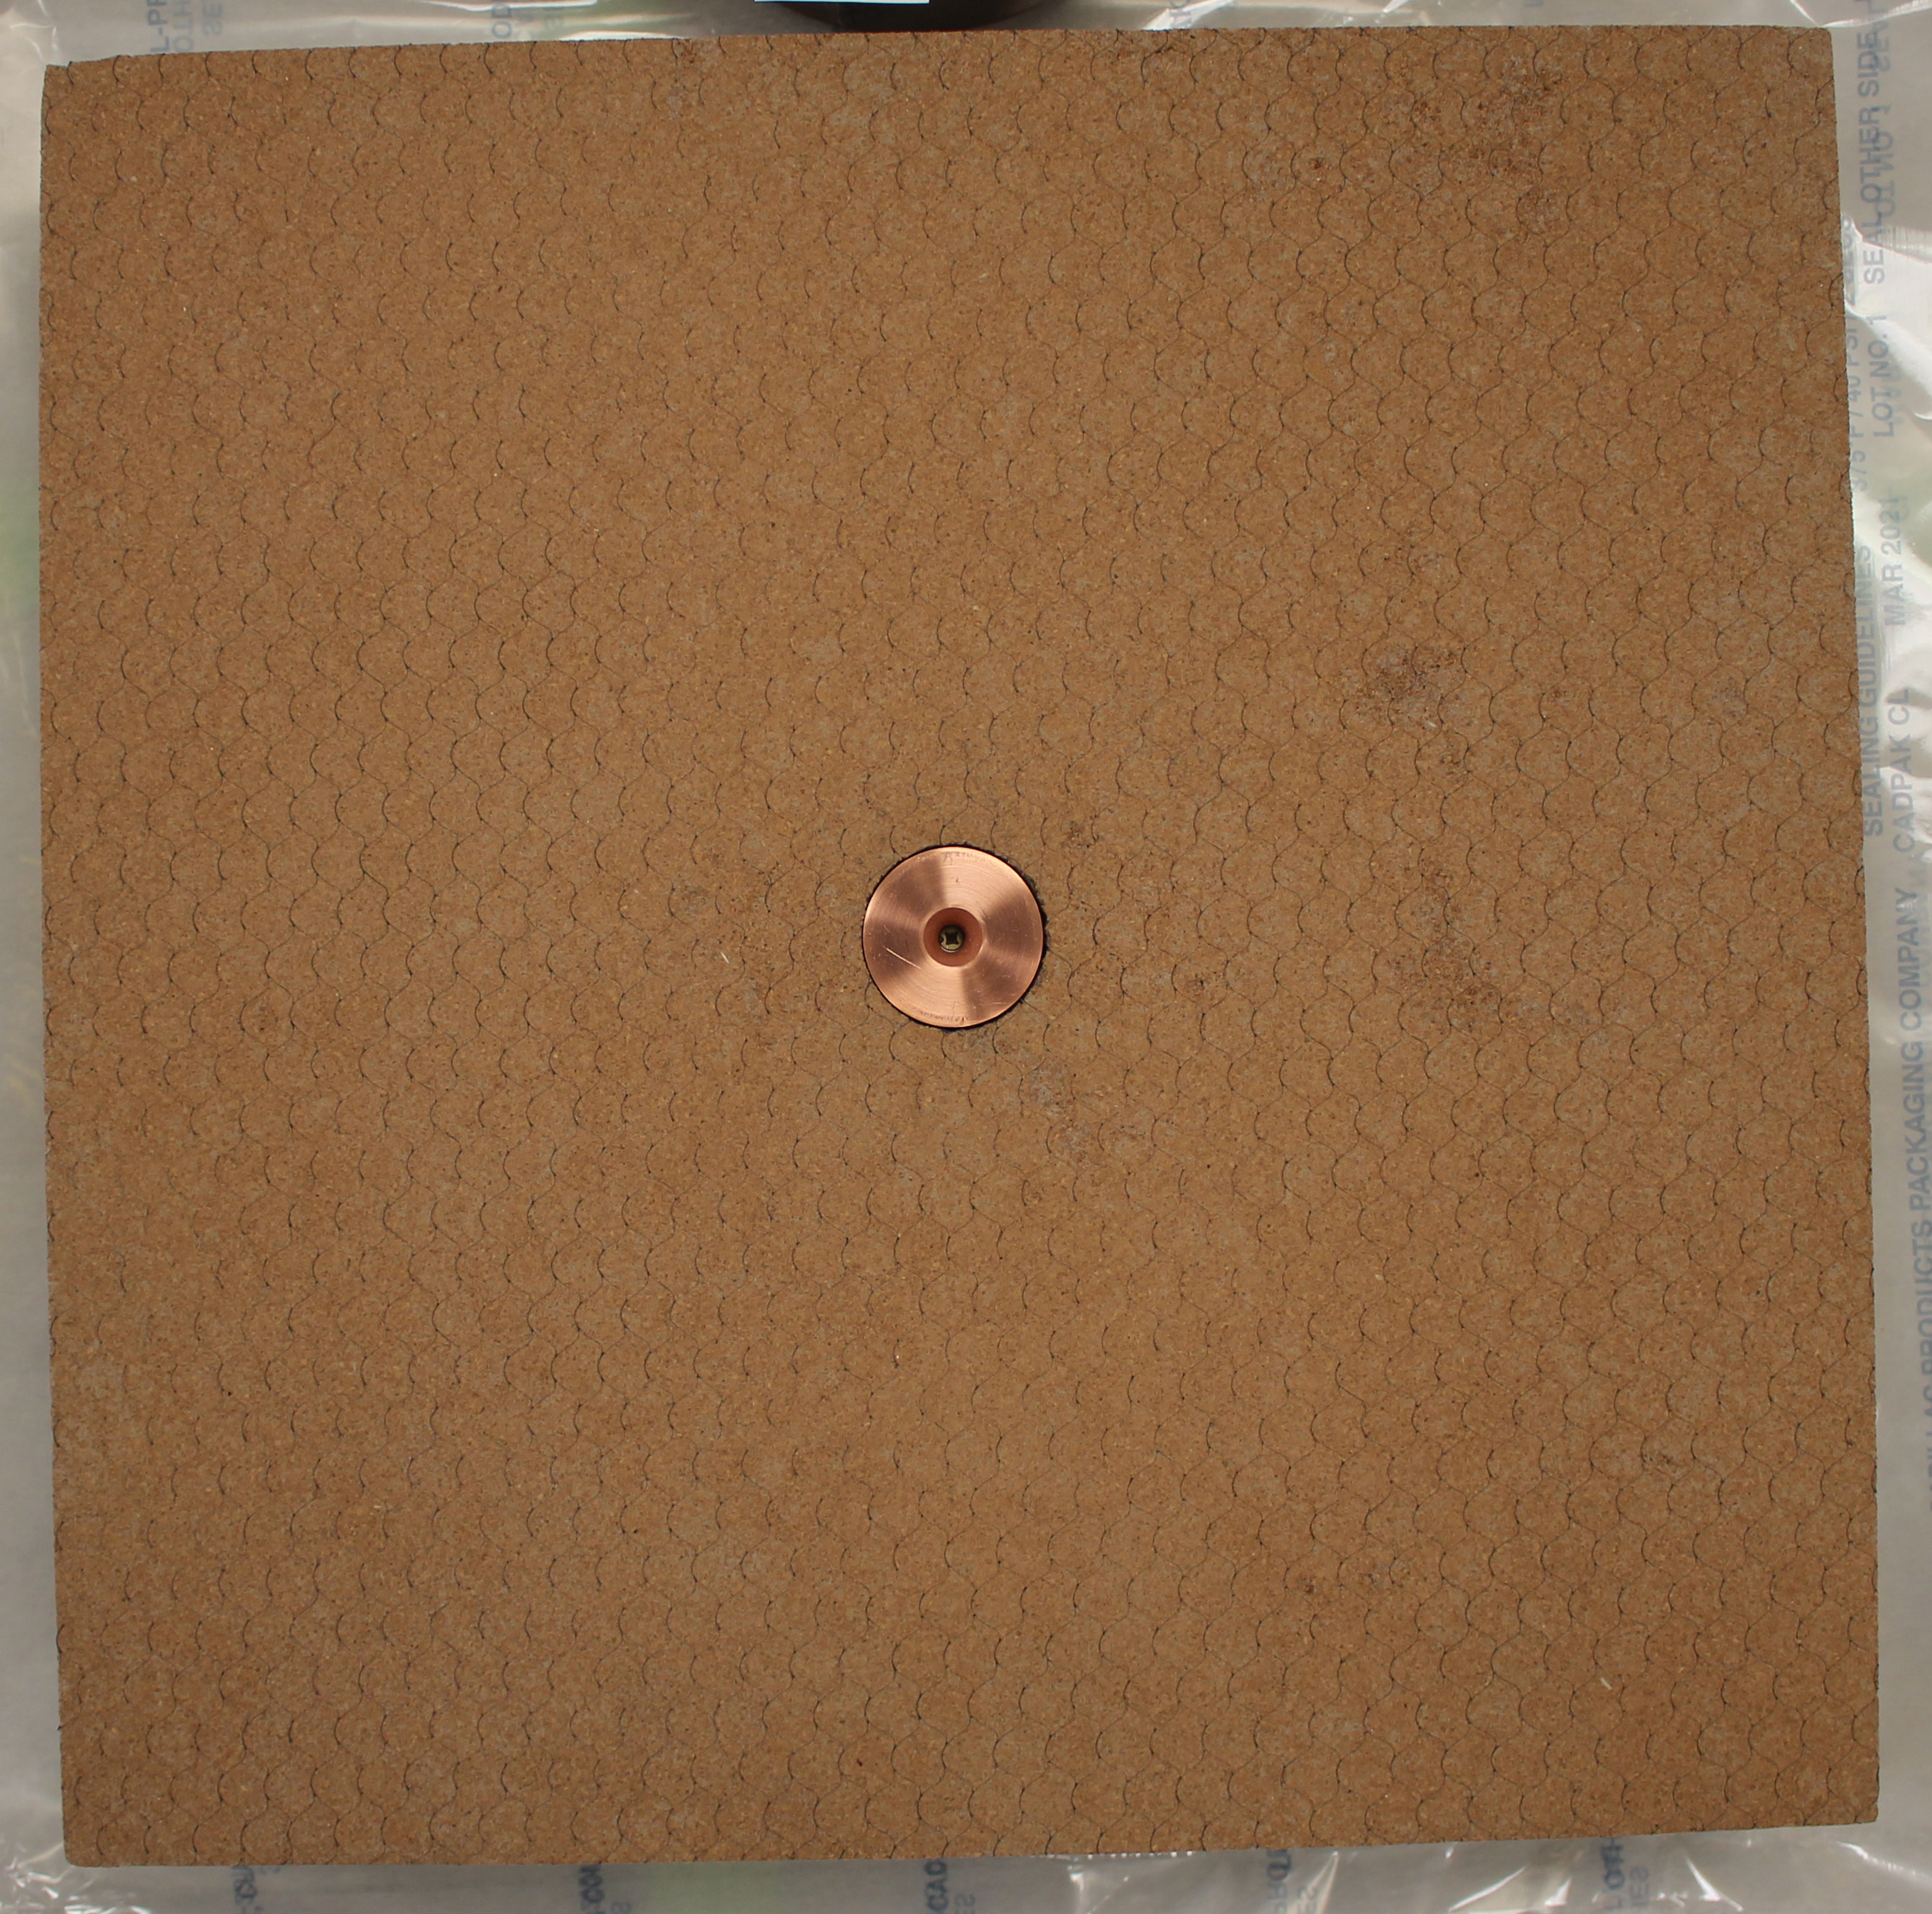
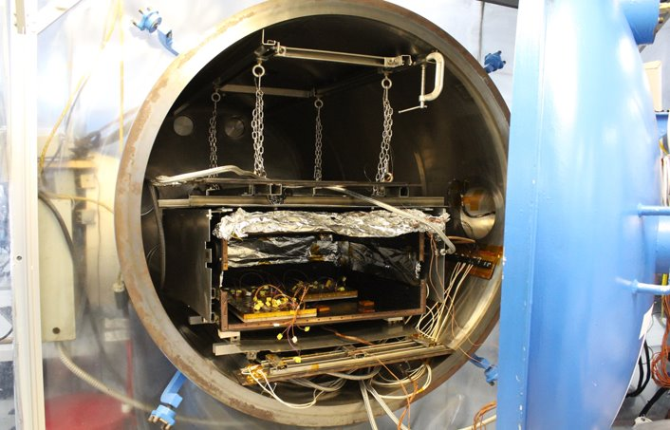
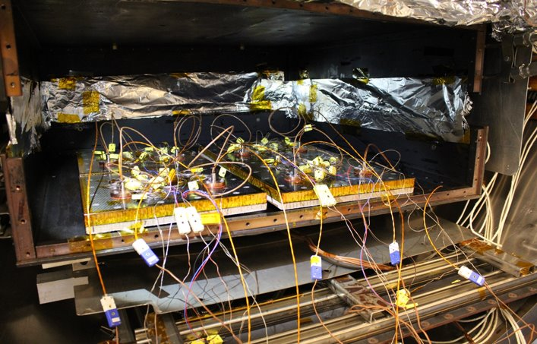
Current Instrument Status and Do No Harm testing
Sensors received from DLR and installed in SLA panels by Lockheed
Do no harm test readiness review conducted June 15th
Shock testing completed
Vibe & TVAC testing scheduled for August
Do no harm Arc Jet testing upcoming
COSSTA radiometer installed in SLA test panel
Example test setup from MEDLI2 backshell panel qualification TVAC testing at NTS LAX​
COSSTA integrated plug with and without FMI sensor housing

Slide 11
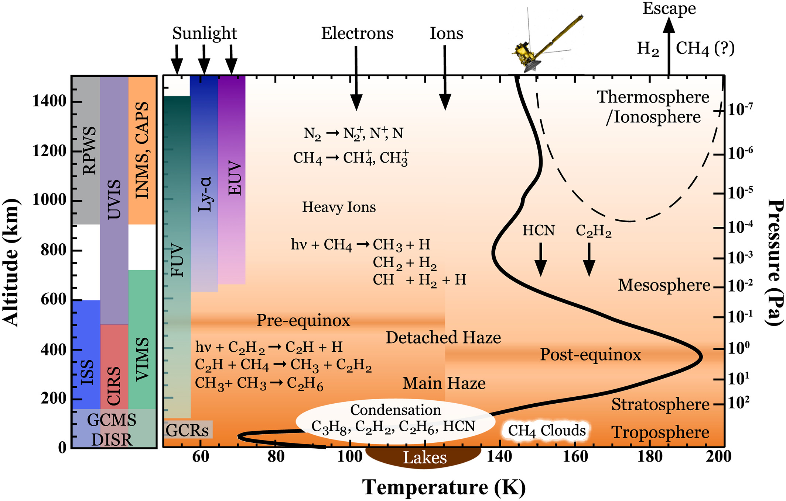
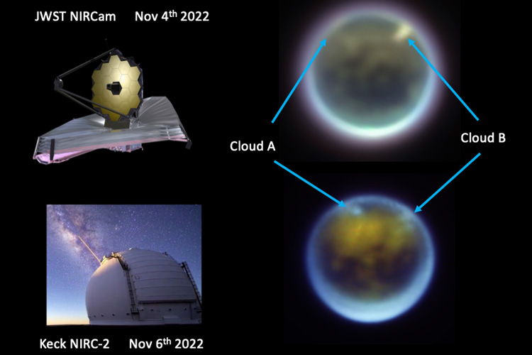
Other Science Considerations
Potential opportunity: The Keck observatory made measurements of Huygen’s entry at Titan. The signal would be expected to be significantly larger for Dragonfly – so should be in consideration.
Value for Titan atmosphere science: By inferring CH₄ abundance, provide insight into chemistry mechanisms found in Titan’s mesosphere.
Hörst.“Titan's atmosphere and climate” Journal of Geophysical Research: Planets (2017)
JWST & Keck observatory, Hawaii

Slide 12
Wake up; E-250 min
Turn to entry, spin up to 2 rpm; E-27 min
Cut thermal loop; E-22 min
MDNav to EDL Handoff (7800 km); E–10 min
Cruise Stage Separation; E–10 min
Entry Interface (1270 km); E=0
Peak heating
247 km; E+228 s
Peak deceleration
219 km; E+241 s
Main parachute deployment 4km; E+94 min
Heatshield separation
3.6 km; E+96 min
Reconfigure EDL thermal loop;
2.5 km; E+106 min
Lander Pose
2.3 km; E+108 min
FMI
90 min Descent under drogue
Drogue deployment
142 km; E+374 s
Despin
2.3 km; E+109 min
Kulite
Lidar Ground Lock
2 km; E+111 min
Lander Separation
1.2 km; E+119 min; 2.9 m/s
Any questions???
Transition to Powered Flight
Release + 1 s
Notes:
Wake up from hibernation EI-4h

Slide 13
Back Up

Slide 14
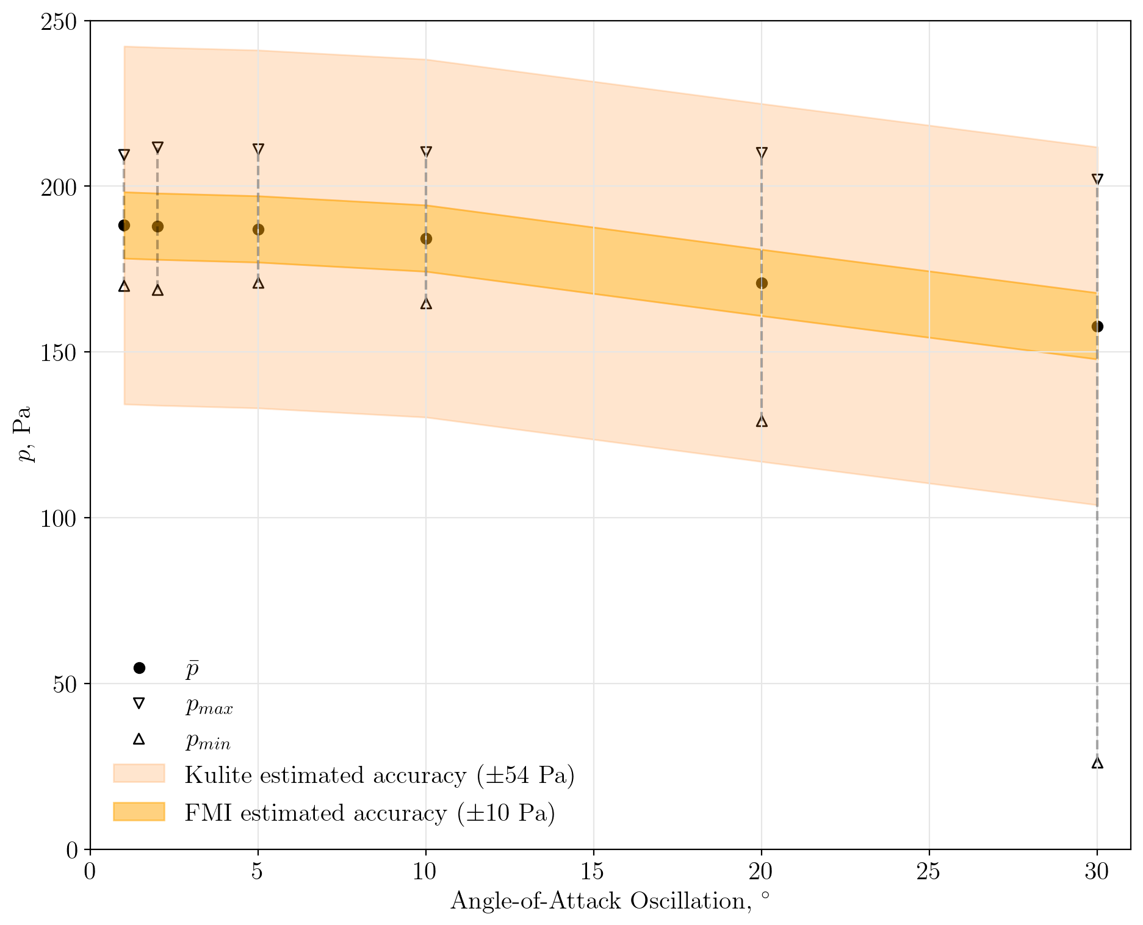
Science Objective: Understand Vehicle Orientation and Dynamics
Dragonfly requirement < 15º
Super/Transonic instability of entry capsules is driven, in part, by hysteresis between the fore- & aftbody pressure distribution.
DrEAM pressure data will be used to inform new models for vehicle dynamic stability.
Aftbody pressure sensor must be sufficiently accurate to resolve mean pressure differences due to angle of attack oscillations.
+/- 10 Pa needed for dynamics
Pressure oscillation magnitude due to vehicle dynamics beyond Kulite limits
No Kulite data for hypersonic phase (i.e. peak heating)
Min pressure Kulite: ~200 Pa, for FMI: ~ 5-10 Pa
Representative oscillatory backshell pressures for COSSTA 2 at drogue deploy from CFD
Notes:
Minimum pressure measurement:
Kulite: ~200 Pa
FMI: ~5 to 10 Pa

Slide 15
Reconstruction of DrEAM data
To reconstruct the DrEAM data, we will need to know the Titan atmospheric composition. Radiation is very sensitive to the amount of CH₄
The uncertainty in CH₄ for upper altitudes (~500 to 180 km) is about 0.9 to 2.2%.
How can we get a better estimate of CH₄ concentration to analyze DrEAM data?
Obviously can’t be measured directly…
Q: Could we infer CH₄ concentration from narrow band radiometers?
  Preferably a way to do this where you don’t have to assume the model is correct and allow for errors in sensor calibration, i.e. look at ratios
Maltagliati et al “Titan’s atmosphere as observed by Cassini/VIMS solar occultations: CH₄, CO and evidence for C₂H₆ absorption” Icarus 248 (2015) 1-24
Notes:
in order to reconstruct the dream data. As alluded to on our objectives, we really need to understand what is the level of methane in the upper atmosphere. Radiation is very sensitive to the amount of methane in the formation of CN, and the uncertainties and altitudes of interest between, say, 500 - 180 kilometers is about 0.9 to 2.2% So really, how can we get a better estimate of this methane concentration to analyze the dream data
Data can't be measured directly, but it's sort of an open question. I think we can infer this methane concentration from our narrowband radiometers, and I think this is really an interesting research area in the years to come. We have some time we won't get this data back for until the mid 2030s. But I think this is an interesting question for the research community.

