Slide 1
Evolution to Sustainable Lunar Habitation – Fall 2023 Project
Paul Kessler, James Johnson
Habitation Systems Development Office, NASA/MSFC
Aug 23, 2023

Slide 2

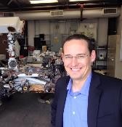


NASA’s Habitation Systems Development Team POCs
NASA Marshall Space Flight Center – Habitation Systems Development Office
Paul Kessler
Surface Habitat Technical Lead
James E. Johnson
Lunar Habitation Architecture Lead
Dr. Tracie Prater
Habitation Tech Advancement
Krystofer Moreira Dudzinski
Habitation Advanced Concepts

Slide 3
Background
NASA’s Moon to Mars Current Habitation Efforts

Slide 4

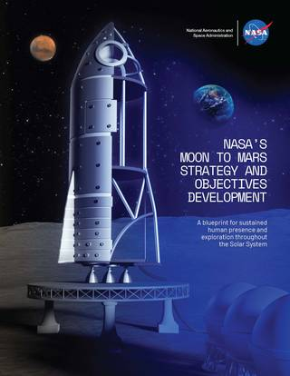



NASA’s Moon to Mars Strategy and Objectives
A blueprint for future human exploration (Architecting from the Right)
Goals and Objectives
SCIENCE
TRANSPORTATION AND HABITATION
ARCHITECTURE
Iterate and evolve
through annual
Architecture Concept Reviews
LUNAR AND MARS INFRASTRUCTURE
OPERATIONS
go.nasa.gov/3zzSNhp
Requested feedback on these objectives in summer 2022 from the following key stakeholders:
NASA workforce: our greatest asset
International partners: our key current and future, anticipated collaborators
U.S. industry, academia, DOE, NIH,
NSF, etc.: our national leaders in
space research and capabilities

Slide 5
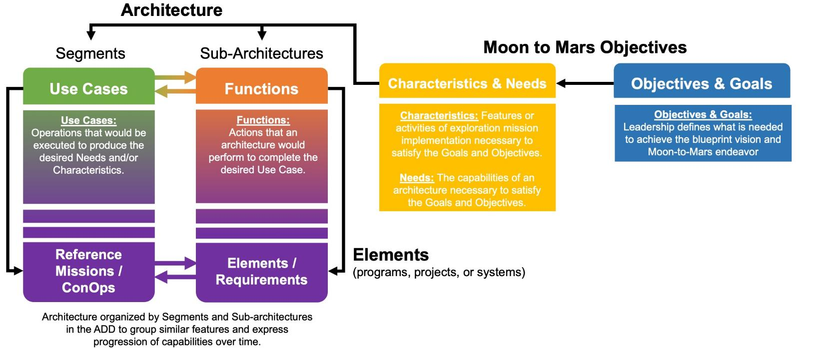
Architecting from the Right
The Architecture process requires a decomposition of Moon to Mars Objectives to
element functions and mission use cases to complete the process of “architecting from the right.”
This establishes the relationship of executing programs and projects to the driving goals and objectives.

Slide 6
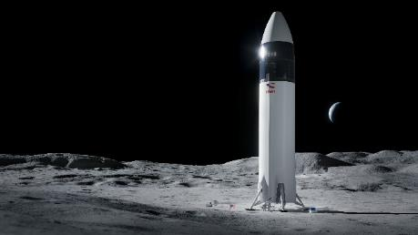
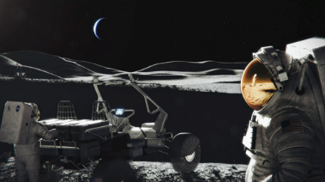
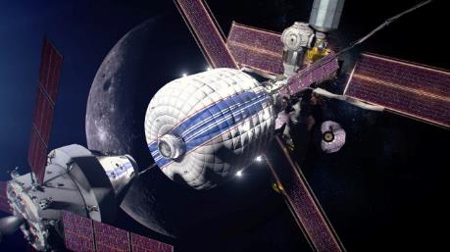
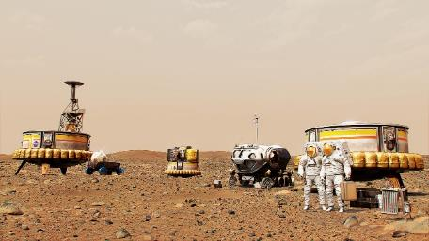
Executing from the Left:
Segments and Sub-architectures
Segment: A portion of the architecture, identified by one or more notional missions or integrated use cases, illustrating the interaction, relationships, and connections of the sub-architectures through progressively increasing operational complexity and objective satisfaction.
Human Lunar Return | Foundational Exploration | Sustained Lunar Evolution | Humans to Mars
Initial capabilities, systems, and operations necessary to re-establish human presence and initial utilization (science, etc.) on and around the Moon. | Expansion of lunar capabilities, systems, and operations supporting complex orbital and surface missions to conduct utilization (science, etc.) and Mars forward precursor missions. | Enabling capabilities, systems, and operations to support regional and global utilization (science, etc.), economic opportunity, and a steady cadence of human presence on and around the Moon. | Initial capabilities, systems, and operations necessary to establish human presence and initial utilization (science, etc.) on Mars and continued exploration.
Focus for ACR 22
Focus for ACR 23
Sub-architecture: A group of tightly-coupled systems, functions, and capabilities that perform together to accomplish architecture objectives.
Communication, Positioning, Navigation, and Timing • Habitation • Human Systems • Logistics • Mobility Systems • Power • Transportation • Utilization Systems

Slide 7
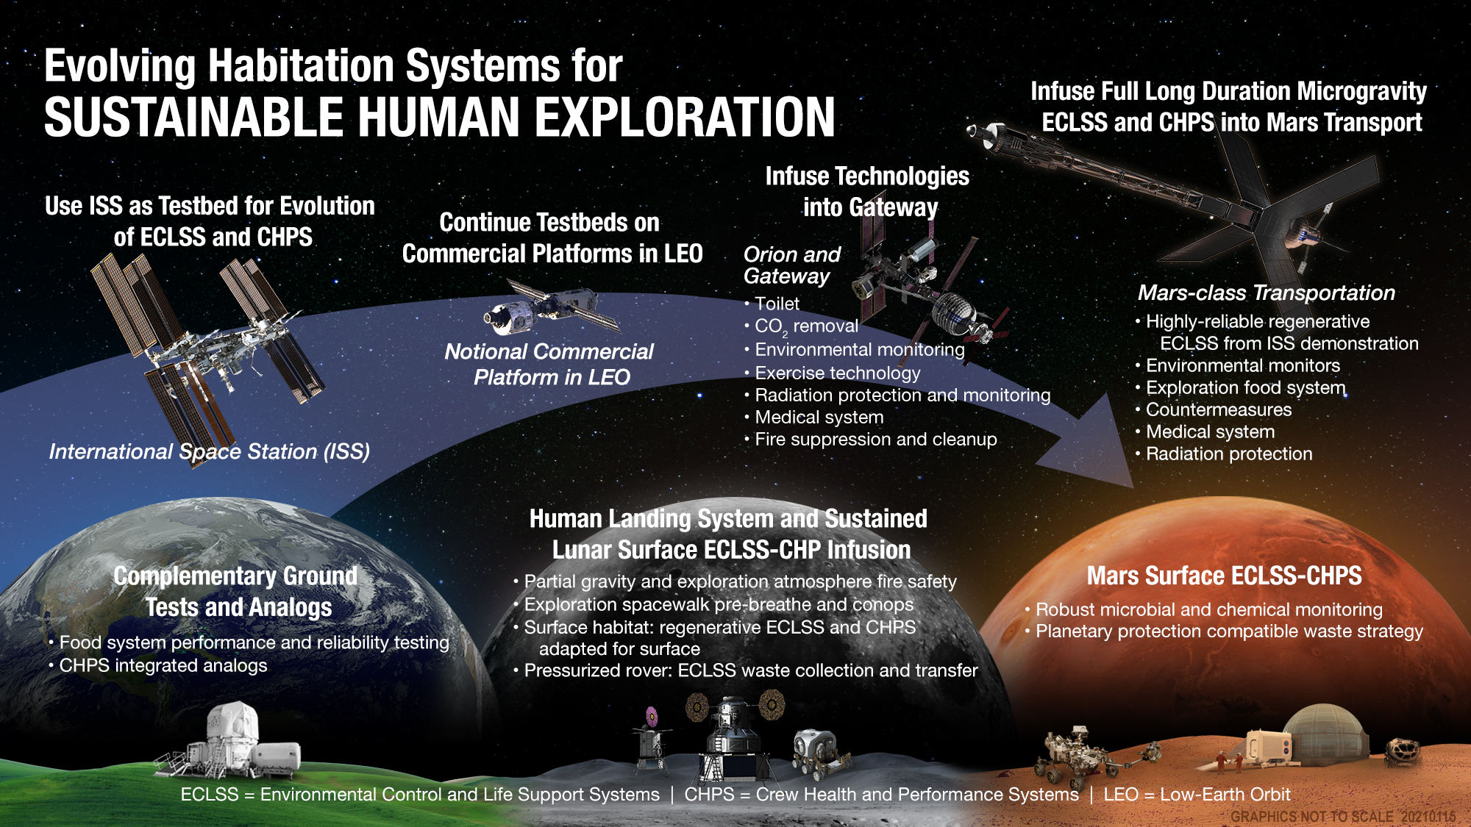

Slide 8
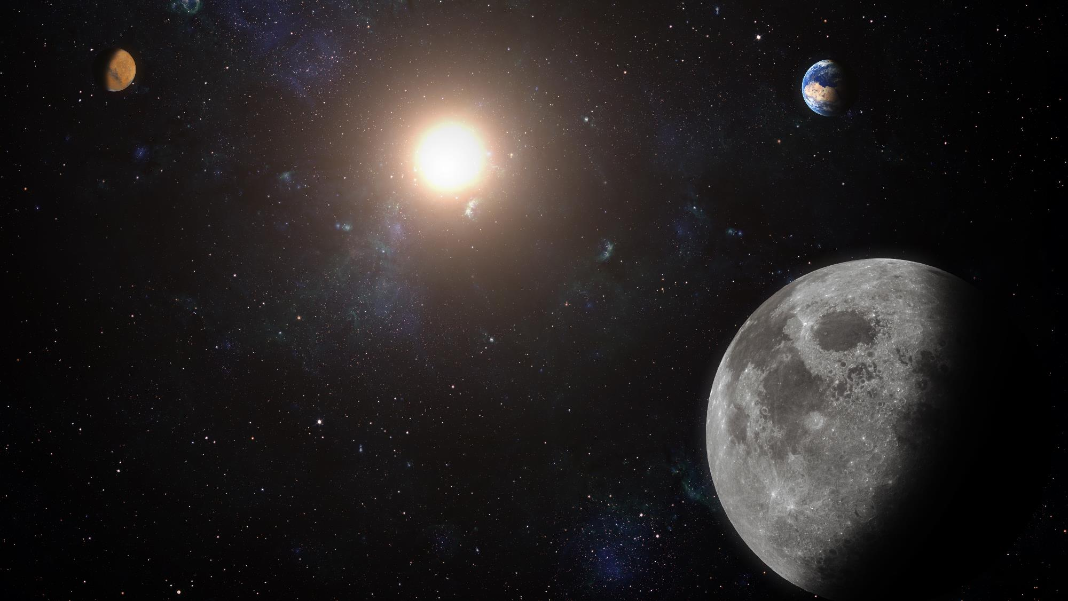
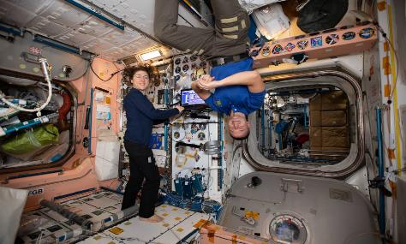
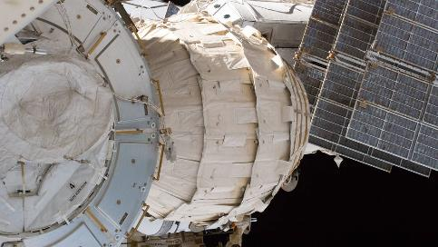
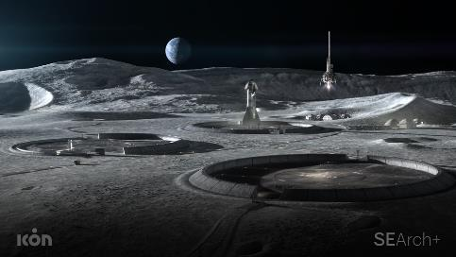
Definitions: Types of Space Habitats
A class I habitat is a pre-integrated habitat, manufactured and integrated prior to launch
Example: ISS
A class II habitat is pre-fabricated prior to delivery, but deployed in space or on a planetary surface
Example: Inflatable ISS BEAM module
A class III habitat is built in situ using local resources
Example: 3D Printed Habitat on planetary surface
Marc Cohen and Kriss Kennedy, “Habitats and Surface Construction Technology and Development Roadmap”. Sept 4, 1997
Image from ICON and SEArch+.
Notes:
Cite Paper from Chris Kennedy

Slide 9
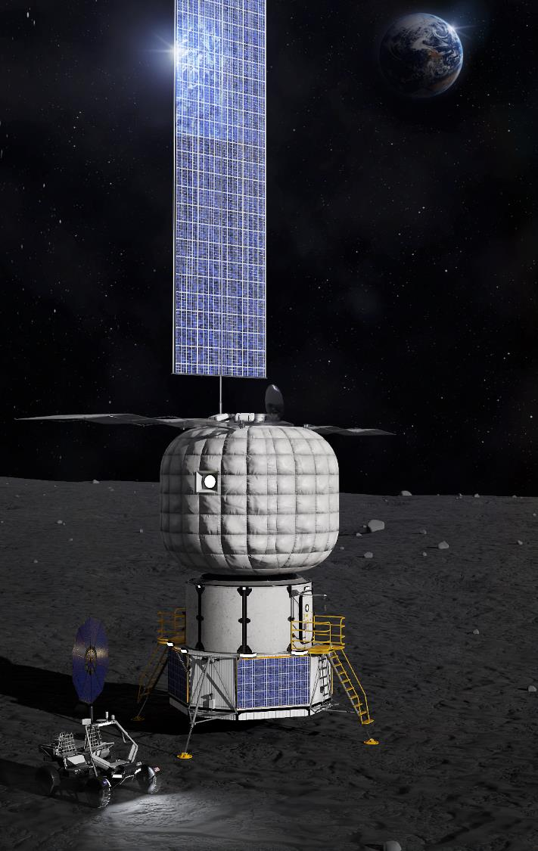
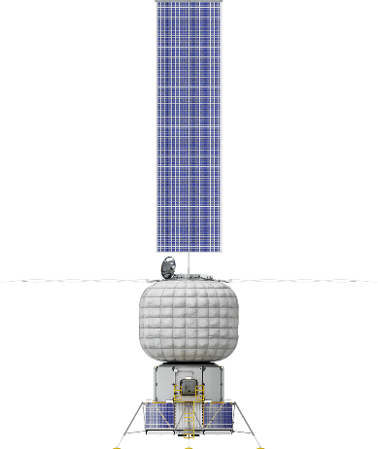
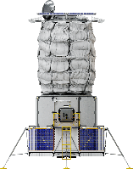
Surface Habitat Reference Concept
NASA’s surface habitat concept serves as a central hub for building & initial sustainment of Artemis’ Foundational Exploration activities
Key Surface Habitat functions:
Power generation & energy storage (100 hrs)
Open/Regenerative Environmental Control & Life Support (ECLS)
Extravehicular Activity (EVA) support & suit maintenance
Communications & data relay
Medical support
Surface Habitat Ground Rules & Assumptions¹
Crew Size | 2 crew (nominal) – 4 crew (surge)
Mission Duration | 7 days (initial) – 60 days (extended)
Lifetime | 15 years
Mass Target | 12 mt (goal)
Pressurized Volume | 190 m³
Operating Pressure | 8.2 – 10.2 psia (70.3 – 56.5 kPa)
Oxygen Composition | 26.5-34% (limits for 8.2-10.2 psia)
¹ Harris, Danny W., et al. Moon to Mars (M2M) Habitation Considerations: A Snap Shot As of January 2022. No. M-1538. 2022.

Slide 10
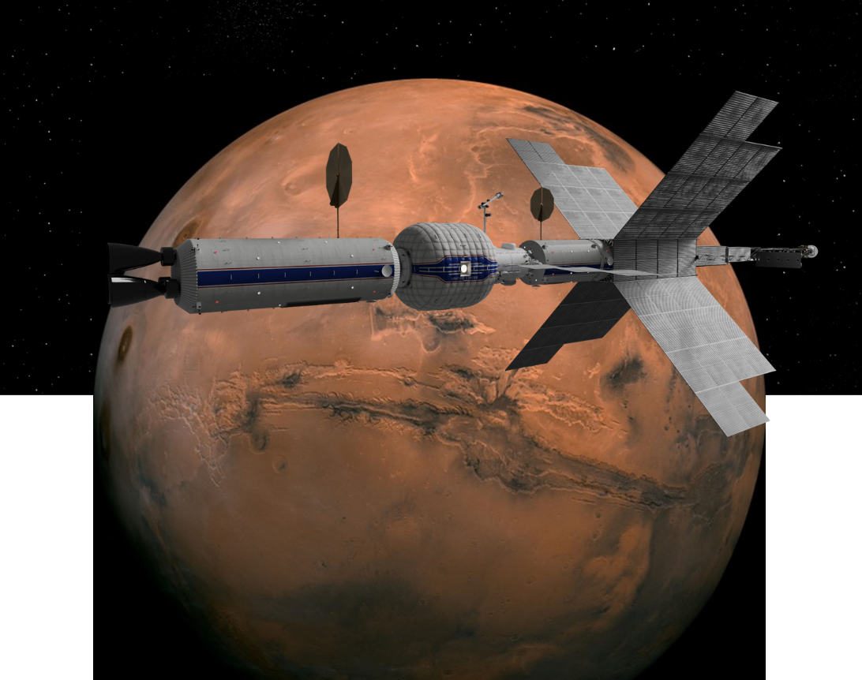
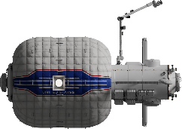

Transit Habitat Reference Concept
NASA’s transit habitat serves as crew living quarters during Mars analog and exploration missions during Artemis’ Foundational Exploration through Humans to Mars activities
Key Transit Habitat functions:
Resource sharing and interfaces with Gateway
Radiation and Solar Proton Event (SPE) protection
Docking capabilities
Regenerative ECLS
Logistics storage
Transit Habitat Ground Rules & Assumptions¹
Crew Size | 4 crew
Mission Duration | Up to 1,200 days
Solar Orbital Range | 0.6 – 1.6 AU
Lifetime | 15 years
Mass Target | 26.4 mt (dry, ~50 mt departure mass)
Pressurized Volume | ~400 m³
Operating Pressure | 10.2 – 14.7 psia (56.5-101.4 kPa)
Oxygen Composition | 26.5-24.1% (limits for 10.2-14.7 psia)
¹ Harris, Danny W., et al. Moon to Mars (M2M) Habitation Considerations: A Snap Shot As of January 2022. No. M-1538. 2022.

Slide 11
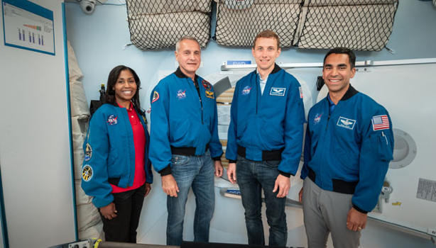
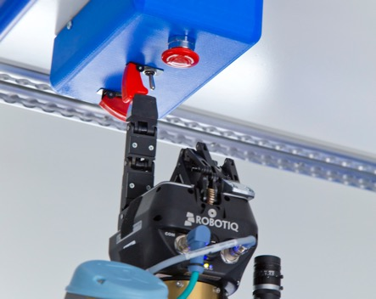
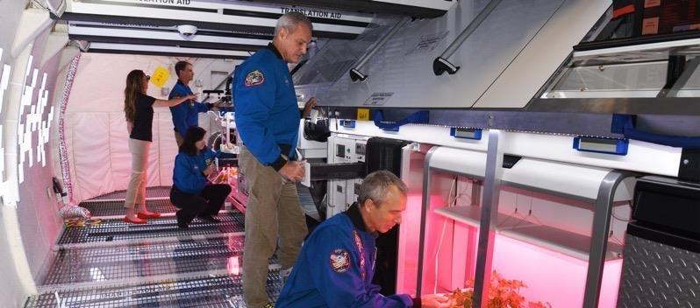
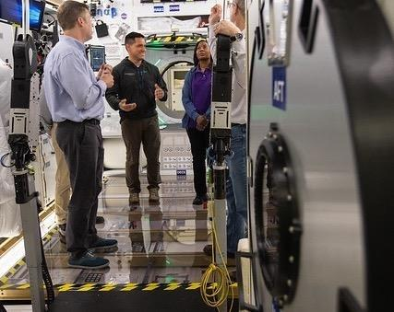
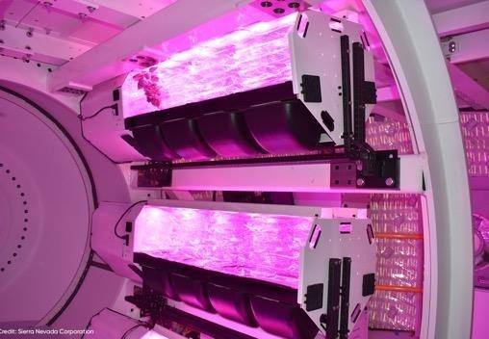
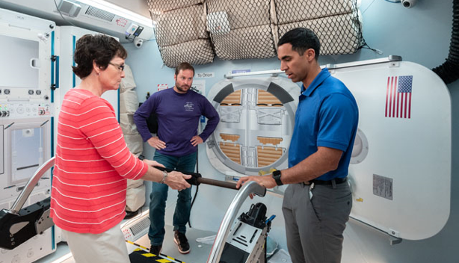
NextSTEP Appendix A: Habitation Systems
Phase 1 – 2015-2016: Concept Designs and Operations
Phase 2 – 2016-2019: Prototype Development and Testing
Phase 3 – 2019-2023: Concept maturation and focus on long-duration, in-space and surface habitats

Slide 12
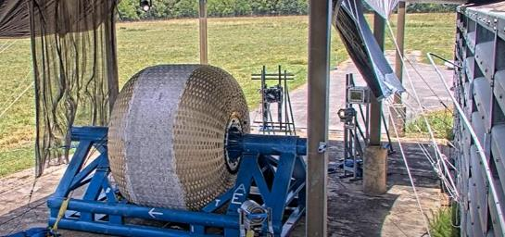
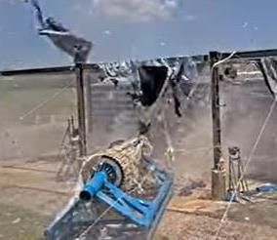
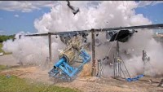
NextSTEP Appendix A - Habitation
Advancing near-term habitation reference concepts through collaborative public-private partnerships
Current contracted partners
  Boeing
  Lockheed Martin
  Sierra Space
Softgoods (inflatable) advancement
  Burst testing – determine ultimate burst pressure of article
  Creep testing – determine material deformation under load
Additional efforts:
  Habitat concept design & maturation
  Composite structures
NASA before/after images from test conducted at Johnson Space Center in collaboration with Sierra Space and ILC Dover

Slide 13
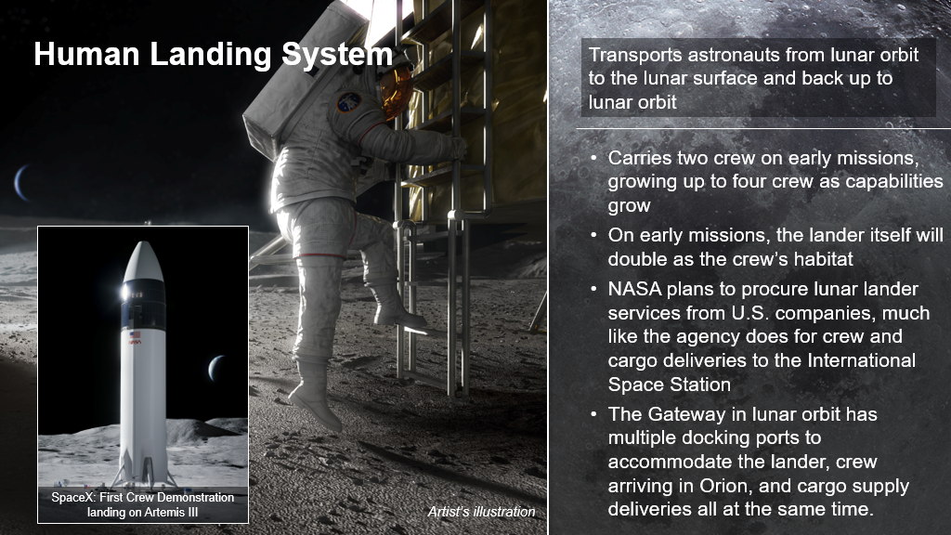

Slide 14
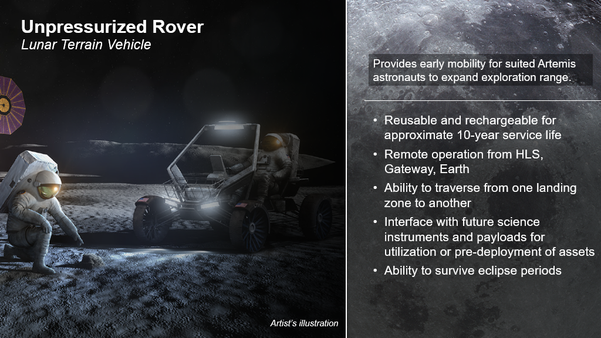

Slide 15
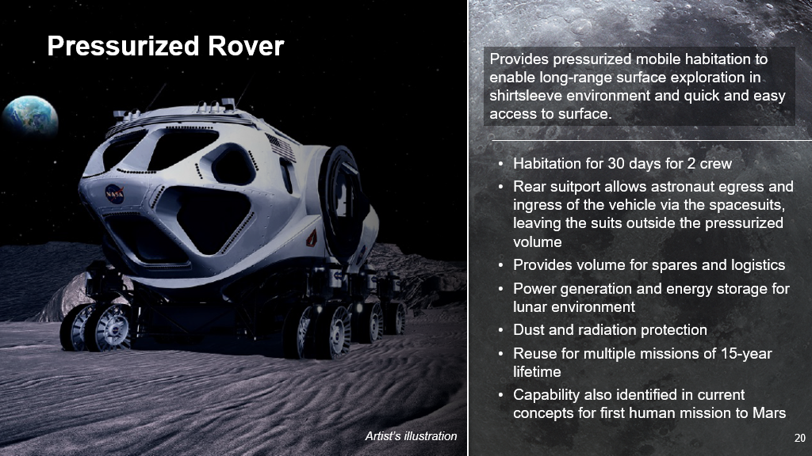

Slide 16
The Project
Architecting an evolvable lunar habitation architecture

Slide 17
Questions We’re Trying to Answer
How do we consider “livability” in habitat design?
What does the transition from meeting functional needs to including comfort and psychological needs look like?
When and how do you add in social spaces?
What are the hooks early on for making a smoother transition?
What might be the “drivers” for incrementally evolving lunar habitation?
What are various crewed use cases?
Will we see industrial workers, scientific crews, visiting tourists, some combinations?
When might different user communities arrive and thereby dictate changes in habitation?
How do we best incrementally “evolve” lunar habitation?
Would you reconfigure existing class 1 or 2 habitats?
When does it make sense to include a class 3 habitat and at what differentiating capabilities?
Would it be better to integrate class 3 with existing class 1/2 modules or better to fully transition to class 3 only?
What are approaches for achieving “sustainable” lunar habitation?
How would you define sustainability in lunar habitation?
What capabilities need to be advanced and when?

Slide 18
Project Vision and Goals
Vision Statement
Develop a phased habitation architecture that includes a build-up of integrated and progressively advanced habitation capabilities that lead to sustained lunar operations.
Goals
Develop an integrated lunar habitation roadmap, that:
Identifies the most critical architectural advancements needed at least cost to enable transition to Class 3 habitats
Considers scavenge and reuse of habitats and other lunar surface elements in comparison to new, independent elements
Shows transition from Class 1 and Class 2 to Class 3 habitats
Considers approaches to decrease logistical dependency on Earth resupply for habitation systems
Defines sustainable habitation and identifies attributes that facilitate growth to a sustainable state (e.g., common interfaces, capabilities)
Captures common challenges and development opportunities between habitat classes
  Note/Guidance: Not focused on developing detailed mass properties of major elements. Keep the focus on habitation/habitation systems vice ‘lunar base’ planning.

Slide 19
Objectives
Include livability/psychosocial considerations in interior design and layout
Develop MOEs (Measures of Effectiveness) to characterize habitation sustainability
Reduce resupply logistics mass over missions (see references for logistics information)
Develop and deliver a report on the work
Present findings to members of the Habitation Systems Development office at Marshall Space Flight Center

Slide 20
Ground Rules
Consider usage of various landing vehicles and associated capabilities (i.e., avoid full reliance on 100t “Starship Class” lander)
Constrain to lunar south pole environment with following assumptions:
  Identifying specific site location is not a goal of this project
  Site location between 84 degrees south to 90 degree south
  Site slopes won’t exceed 5 degrees without improvement
  Site can be assumed to have a maximum of 100 hours of continuous darkness at 10 m above surface
All other project assumptions will be documented

Slide 21
Habitation Evolution
Primary focus of project
Buildup
Architecture Starting Point
Sustainment Target
Based upon reference material, following guidance, & team assumptions

Slide 22
Architecture Starting Point
Supporting Elements
Lunar Terrain Vehicle
Foundational Habitation Capabilities
Open Loop ECLSS
Class 1, small metallic habitation module (~30 – 60 cubic meter pressurized volume)
Human Landing System
Fission Surface Power – 40 kW per system
Vertical Solar Array Technology – 10 kW per array
Operations
1 crew launch per year
4 crew (can be split between SH & PR)
Up to 30-day operational duration
3-year max dormancy on systems
All other elements should be documented in assumptions
Cargo delivery assumptions to be documented (mass + cadence)
Transient support at beginning and end of mission
Crewed vehicle with remote capabilities
15-year service life of elements
Class 2 Surface Habitat (see SH references) – inflatable metallic hybrid
Proposed deviations/design changes can be documented
Pressurized Rover (Class 1)

Slide 23
Minimal Sustainment Target
Supporting Elements
Lunar Terrain Vehicle – additional as envisioned
Site Information
No change
Core Habitation
Regenerative ECLSS (95+% water recovery from urine and condensate, high pressure oxygen generation, ISS-as-baseline)
Surface Habitat (SH paper, Class 2) – inflatable metallic hybrid
Additional small modular metallic habitation as needed (30 – 60 cubic meter pressurized volume copies)
Pressurized Rover (Class 1) – additional as envisioned
Human Landing System – Transient (Supports beginning and end of mission)
Fission Surface Power – 40 kW, additional as envisioned
Vertical Solar Array Technology – 10 kW each
Operations
3 crewed launches per year
No dormancy on systems
8 crew (continuous presence including darkness periods)
Minimal Earth resupply (to be defined by team)
12 crew / 30-day surge capability
Additional habitation elements including constructed habitat(s) as envisioned by team, but at least one constructed habitat
Other elements as envisioned

Slide 24
Other Considerations
Contingency operations – consider these scenarios and document expected response or mitigations:
  Rapid depress
  Fire
  Complete loss of cooling/heating
  Radiation/Solar Particle Event (SPE)
Contingencies and other failure modes might best be captured as risks via matrices and high-level mitigation plans

Slide 25
Timeline
21 Aug.
Semester Start
23 Aug.
Kickoff Discussion
Project Overview
8 Nov.
Mid-term Review
PowerPoint delivery
Present status
Address questions
8 Dec.
Final Delivery
Presentation to Habitation Office
Final Written Report

Slide 26
Deliverable Specifications
Summary Presentation
Based on final report
20 minutes for presentation
8 minutes for questions
Final Report Deliverables
25 page maximum at single spacing NTE 12pt font
Count excludes appendices & reference list
Includes 1-2 page executive summary
Document:
Constraints (hard, un-changing limitations beyond what is provided in Ground Rules)
Assumptions (changing variables that are defined to better scope analysis)
Depictions of interior habitat layouts/renders and external interfaces
Include:
Habitation Evolution Concept of Operations
Timeline expected for evolution & dependencies
Listing of challenges & opportunities
Top 10 risks to the evolved habitation state with notional mitigation plans/actions

Slide 27
Back-up & Reference Material

Slide 28
Terms and Acronyms
ECLSS – Environmental Control and Life Support System
SH – Surface Habitat (see references)
Pressurized Rover – rover capable of transporting crew in a habitable volume
Lunar Terrain Vehicle – moon rover for transporting crew in space suits
Human Landing System – landing vehicle to bring crew to the surface of the moon
Fission Surface Power – a nuclear power vehicle that provides power to surface systems
Vertical Solar Array Technology – a solar array power grid that provides power to surface systems

Slide 29
References
NASA. (2023). Architecture Definition Document
Howard, D., et al. "Regenerative Life Support Systems for Exploration Habitats: Unique Capabilities and Challenges to Enable Long-Duration-Mission Habitats Beyond Low Earth Orbit". ICES 2022. July 2022.
Kessler, P., et al. "Artemis Deep Space Habitation: Enabling a Sustained Human Presence on the Moon and Beyond". IEEE Aerospace Conference. Mar 2022.
Harris, D., Kessler, P., et al. "Moon to Mars (M2M) Habitation Considerations: A Snap Shot as of January 2022". NASA Technical Memorandum. January 2022.
Anderson, Molly S., Michael K. Ewert, and John F. Keener. Life support baseline values and assumptions document. No. NASA/TP-2015-218570/REV1. 2018.
Burke, Callie, Robert L. Howard Jr, and Paul Kessler. "Internal Layout of a Lunar Surface Habitat." 2022 ASCEND.
Clinton Jr, R. G., et al. "Moon to Mars Planetary Autonomous Construction Technologies (MMPACT)." ASCEND, Planetary Construction technologies (2021).

Slide 30
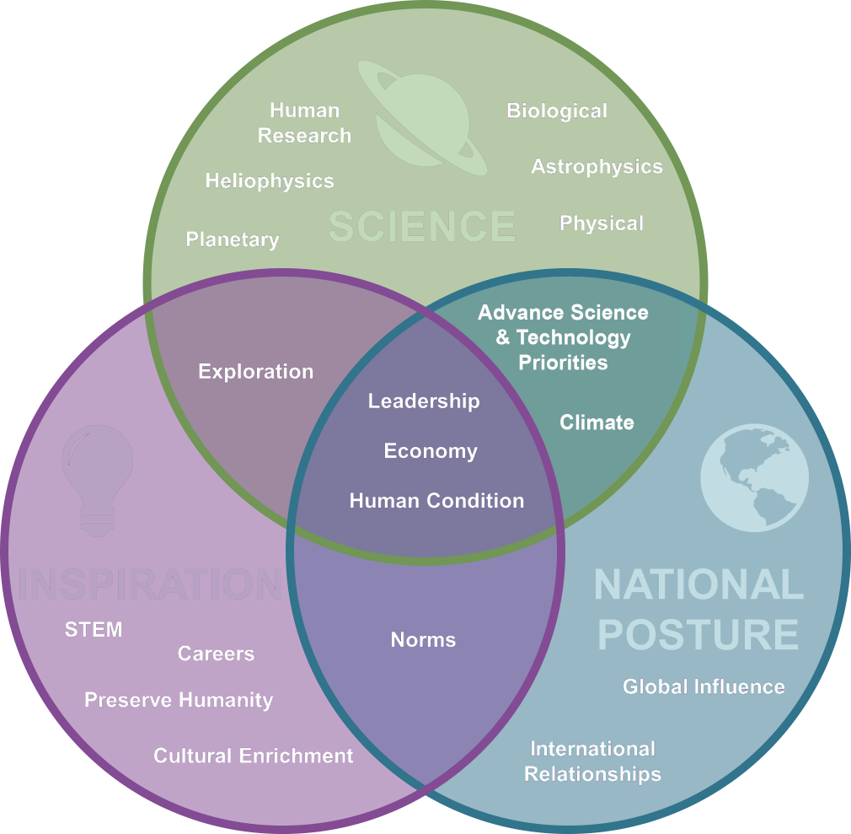
Benefits to
Humanity
Investigations in deep space, on the Moon, and on Mars will enhance our understanding of the solar system, Earth, the human body, and how to perform new operations while we are out there exploring.
Why We Explore
Accepting audacious challenges and succeeding through perseverance and tenacity in the face of adversity motivates current and future generations to dare mighty things.
What we choose to do, how we do those things, and who we do them with greatly impacts our place in the world today, our quality of life, and our possibilities for the future.

Slide 31
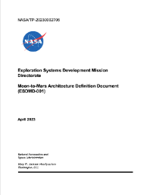

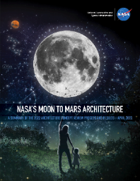
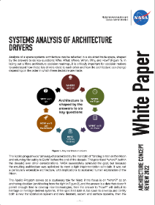
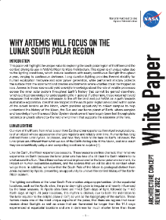
Architecture Concept Review Products
Architecture Definition Document
Detailed documentation snapshot of NASA’s human spaceflight architecture and exploration strategy
Moon to Mars Architecture Summary
High-level overview of NASA’s Moon to Mars architecture and exploration strategy
White Papers
Six papers on architecture study details for frequently discussed topics
www.nasa.gov/MoonToMarsArchitecture

Slide 32

Key Design Considerations
Delivery mass
Functional volumes
ECLSS loop closure

Slide 33
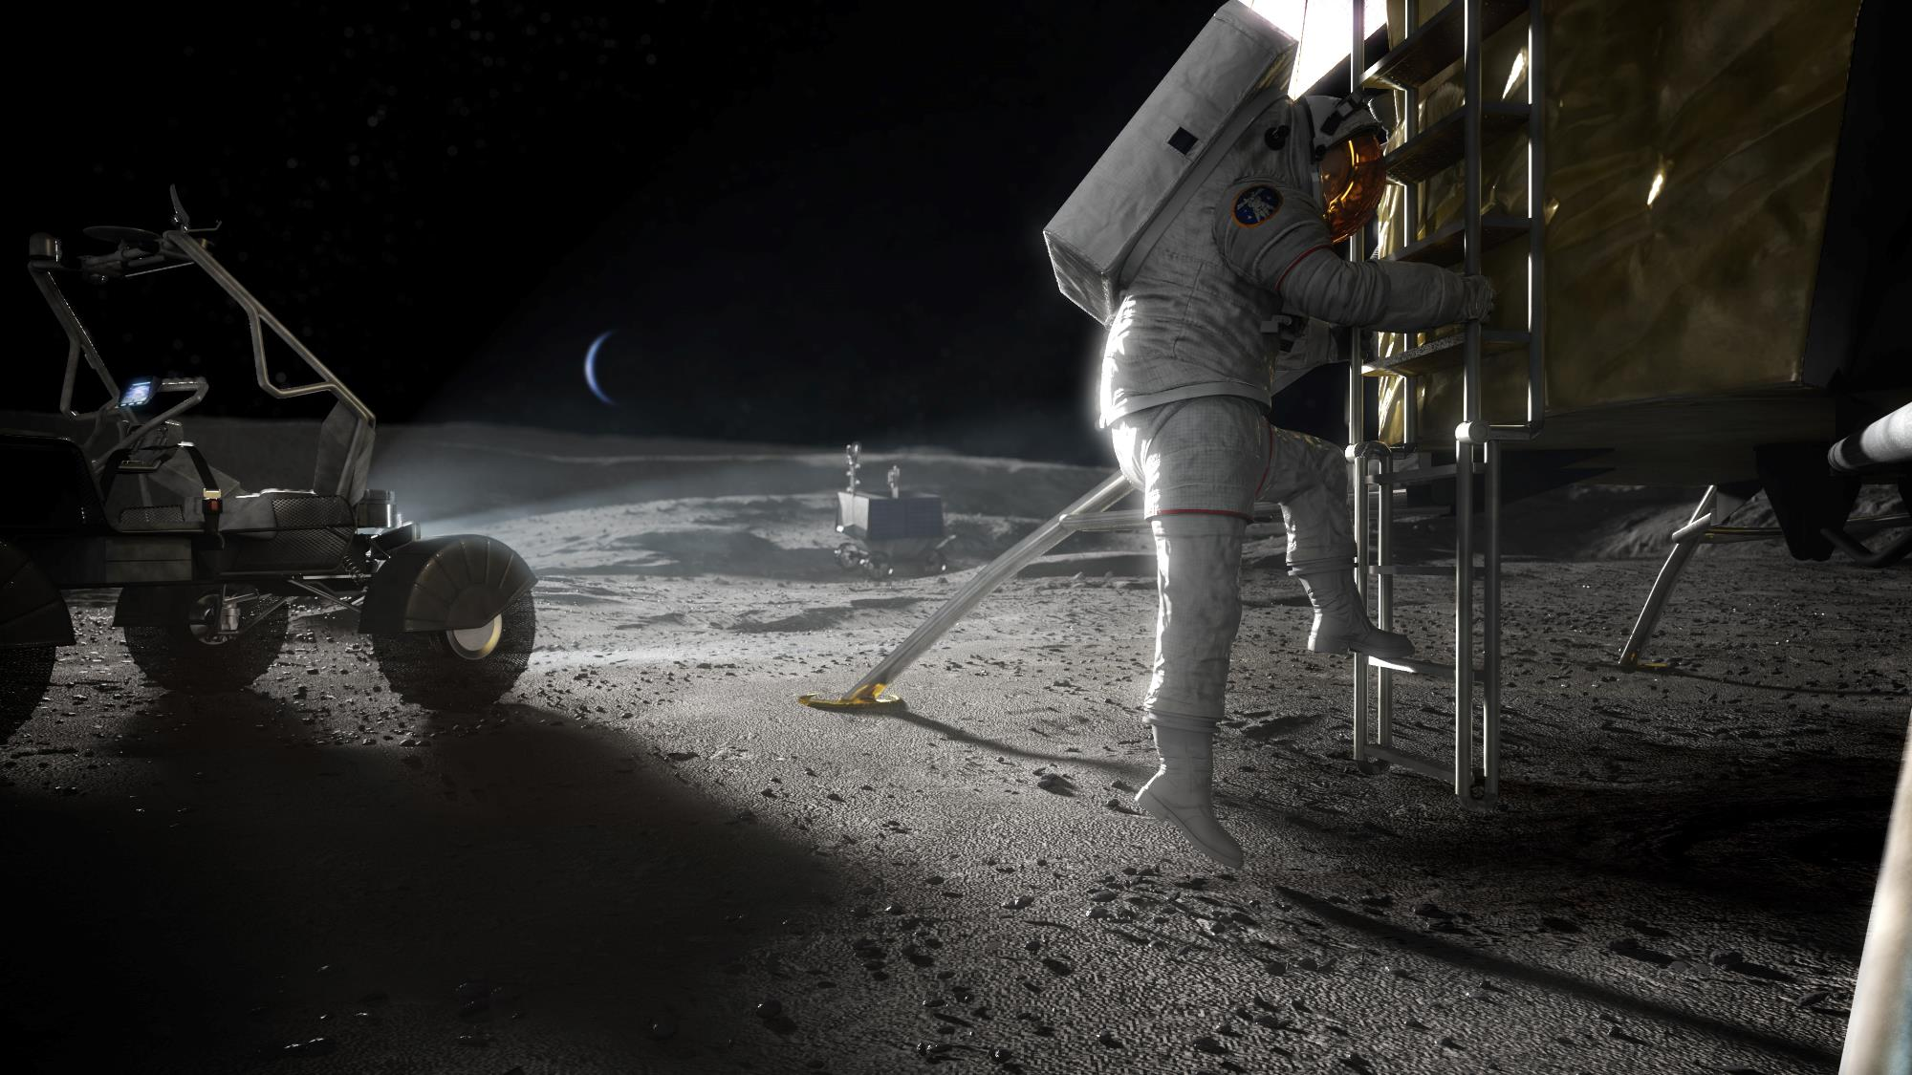
Challenges
Thermal
Dust
Lighting/Eclipse
Radiation
Gravity
Terrain
Outfitting
Logistics transfer

Slide 34
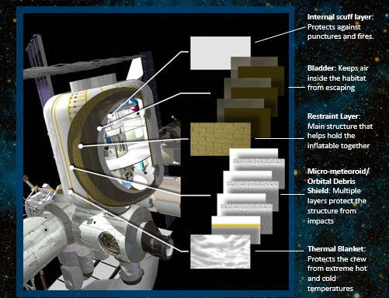
Inflatable Material System

