Slide 1
Optimizing the electroforming process to enhance the thickness uniformity of full shell X-ray optics
Presenter: Panini Singam, NASA postdoctoral fellow at MSFC, ORAU.
Co-authors: Chet Speegle, Amy Meekham, Jeffery Kolodziejczak, Wayne Baumgartner, Grant Davis, David Banks, Jessica Gaskin, Stephen Bongiorno, and Brian Ramsey.
NASA- Marshall Space Flight Center (MSFC)

Slide 2
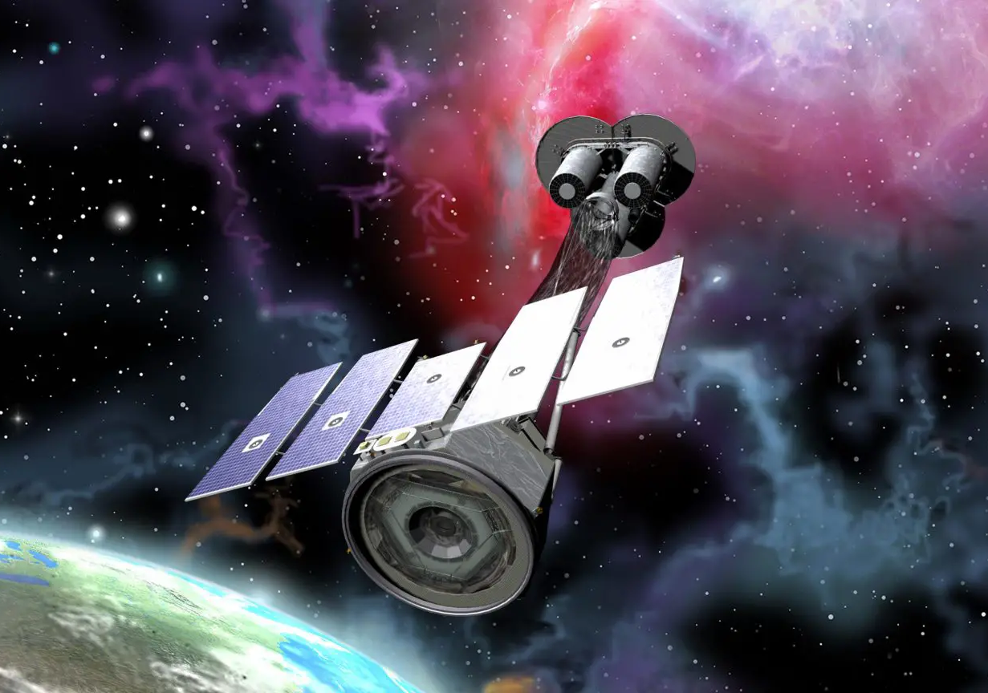
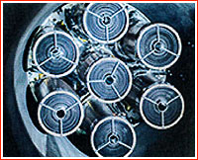
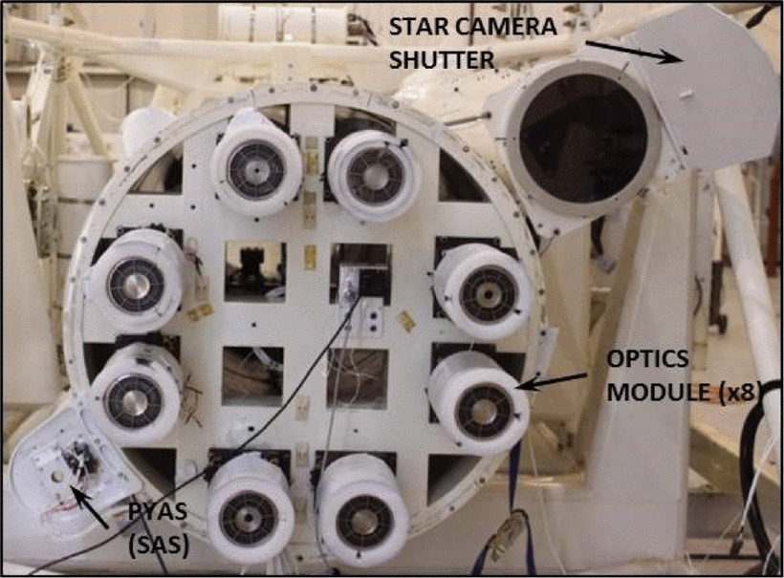
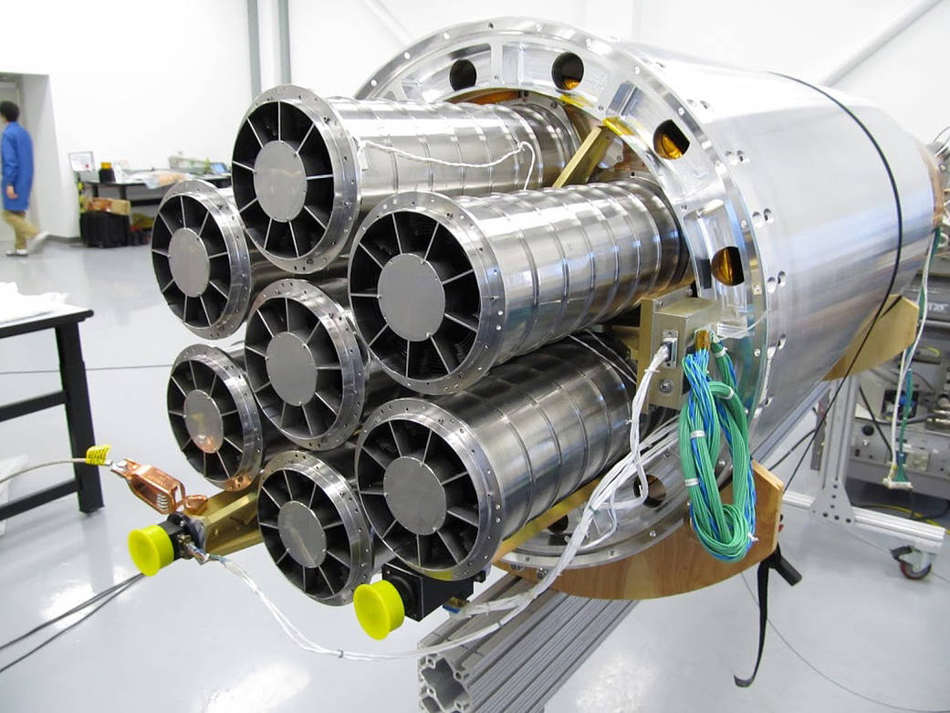
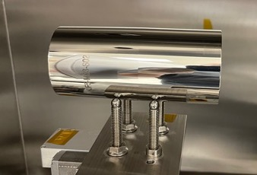
MSFC Full shell X-ray optics heritage
Over 3 decades of developmental efforts.
Proven track record of optics development for
balloon flights, rocket flights and orbiting satellites.
IXPE
ART-XC
Year | Optics | HPD
2001 | HERO (Balloon) | 45” (Conical)
2007 | HERO (Balloon) | 26” (Conical)
2012 | FOXSI-I (Rocket) | 27”
2014 | FOXSI-II (Rocket) | 27”
2018 | FOXSI-III (Rocket) | 17”
2019 | ART-XC (Satellite) | 25” (Requirement limited)
2021 | IXPE (Satellite) | 20” (Requirement limited)
2022 | NIF (Ground based) – Single Shell | 4.8”
2023 | FOXSI-IV (Rocket) | < 10” (More on it in the next talk)
HERO
NIF
FOXSI
Notes:
HERO

Slide 3
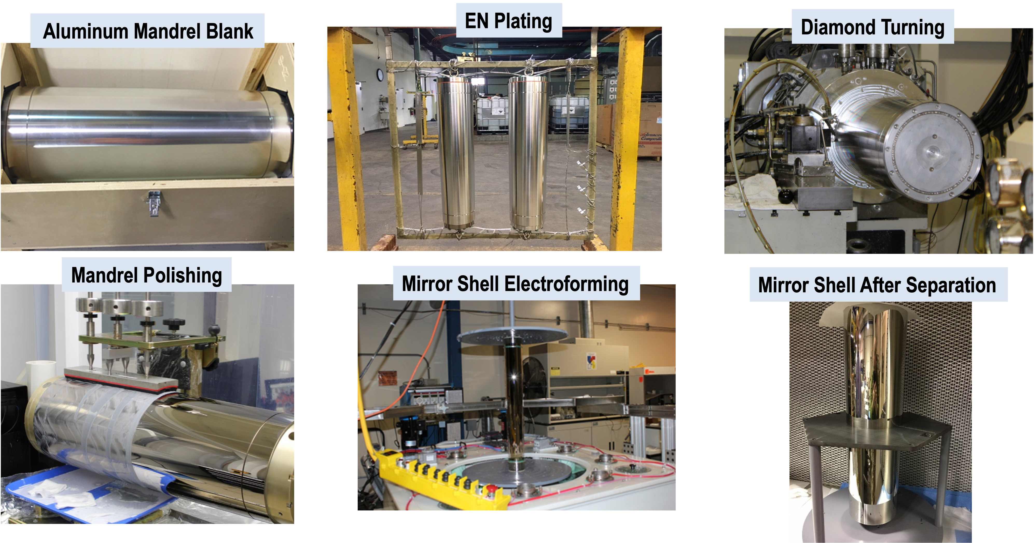
Full shell X-ray optics production process

Slide 4
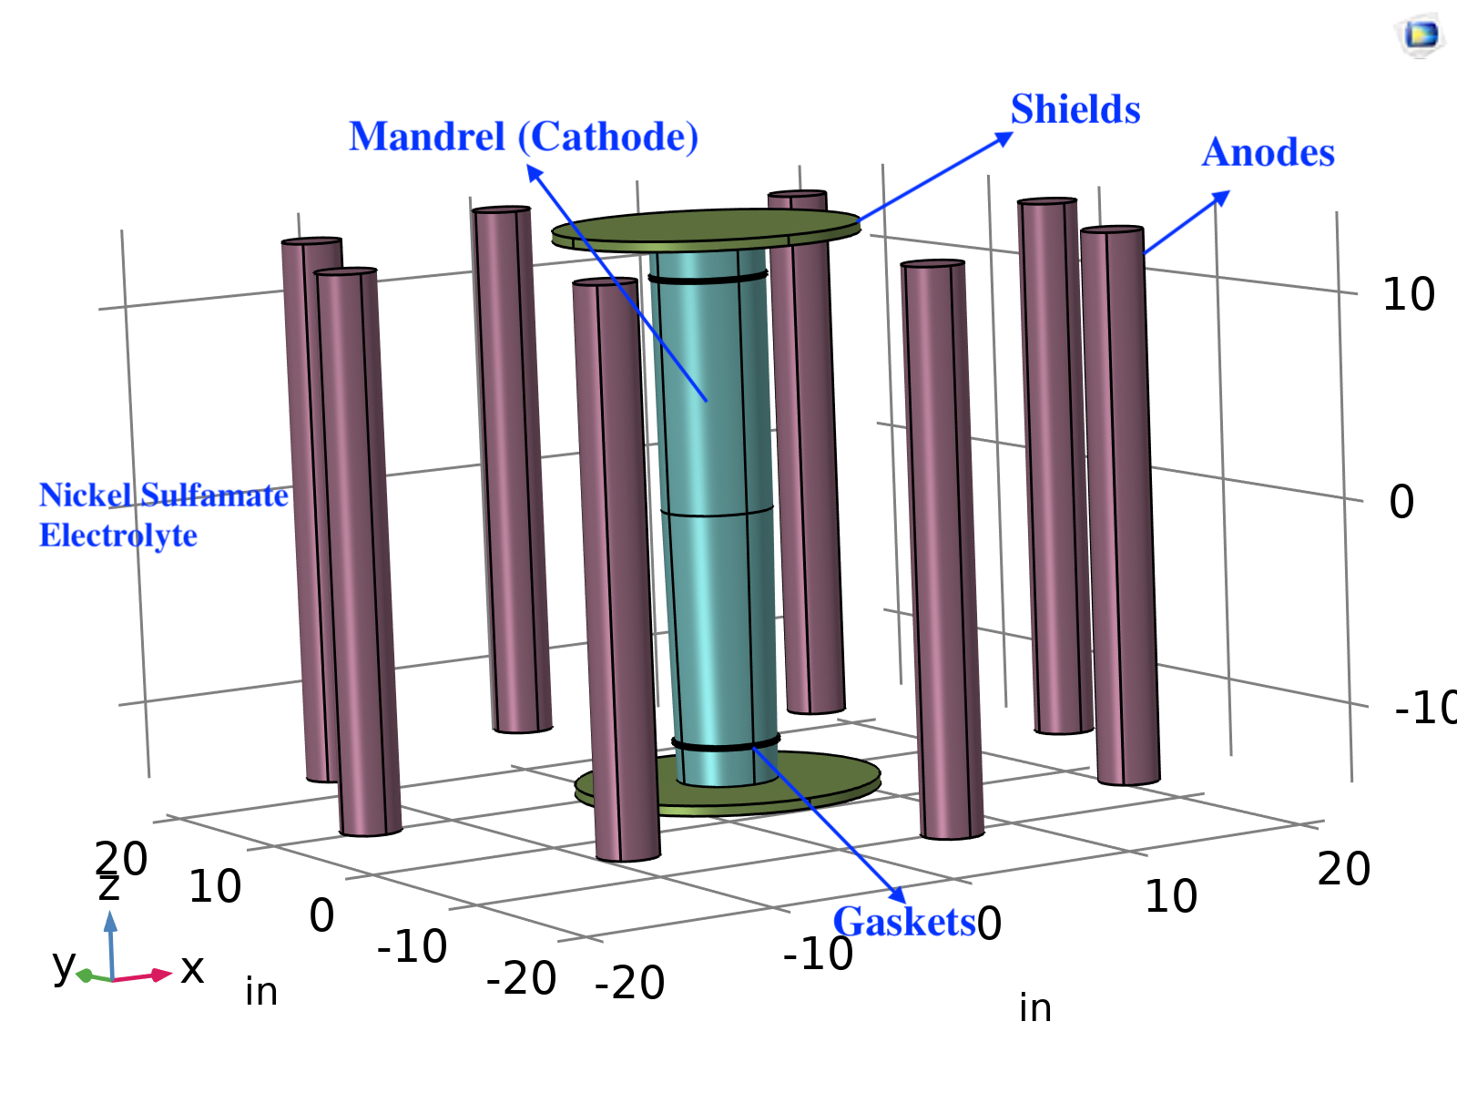
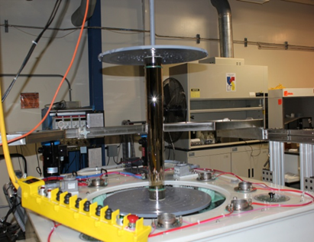
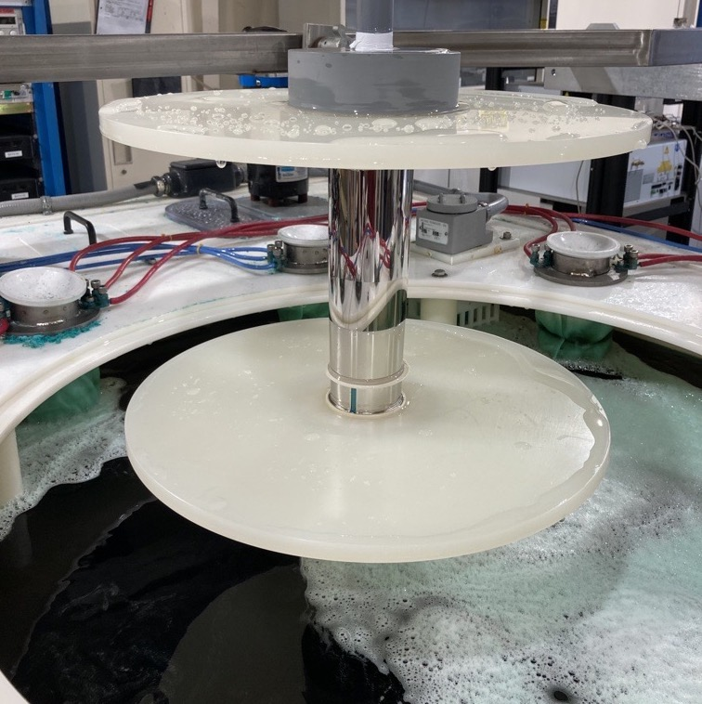
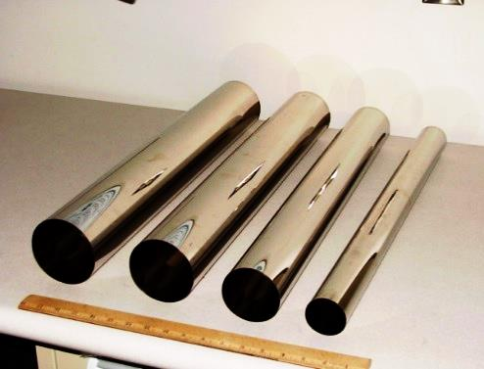
Electroformed Replication Technology
Material from anodes deposits on mandrel taking its shape.
Alloys like Ni-Co, Ni-P, Ni-Co-P are used by using different anodes simultaneously.
Optics is separated from mandrel using ice water bath.
Excellent reproducibility with predictable performance.
Plating tank configuration
4. NiCo electroformed optics
1. Loading mandrel
2. Mandrel with NiCo Plating
3. Shell separation

Slide 5
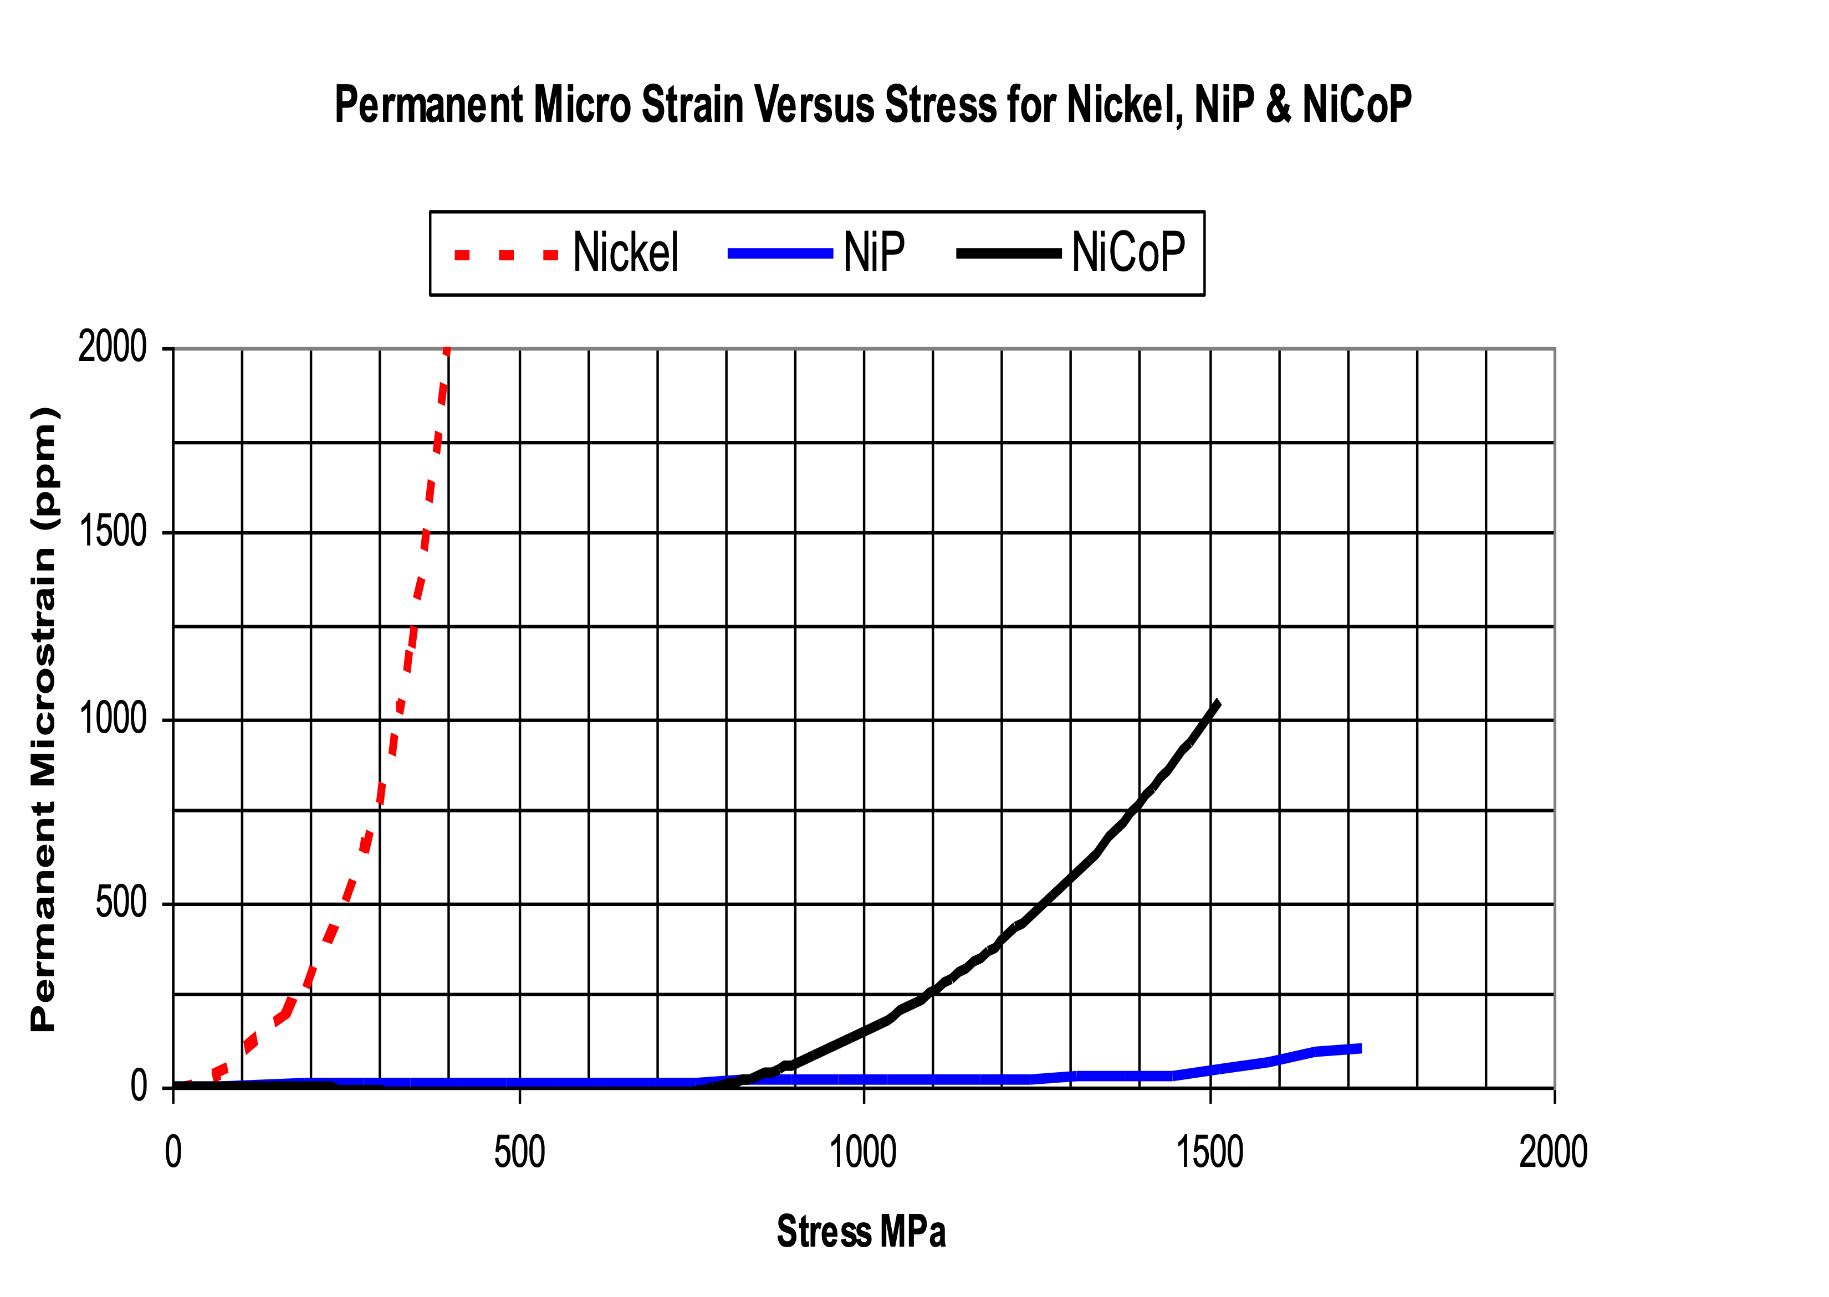
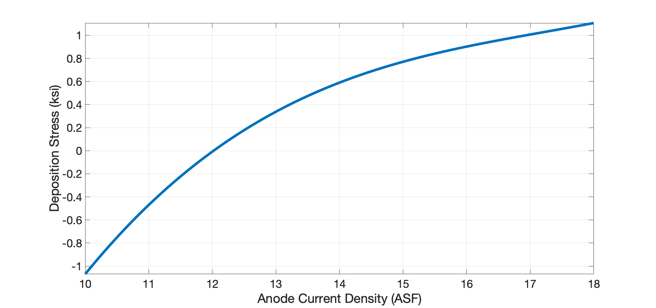
Quality control for replication process
Alloy composition of plating material.
  NiCo, NiP, NiCoP with different percentages to maximize
  the strength hardness of the optics.
  Passivating the mandrel to reduce the adhesion.
  Controlling the deposition stress during plating.
  Ensuring the uniform release of the shell from the mandrel.
  Optimal flow and chemistry of the electrolyte.
  Electric field uniformity across the mandrel during the
  plating process.
    We use COMSOL modelling to study the field uniformity inside
    the plating tank.
    Optimize the dimensions of gaskets and shields to improve the thickness
    Uniformity of the shell.

Slide 6
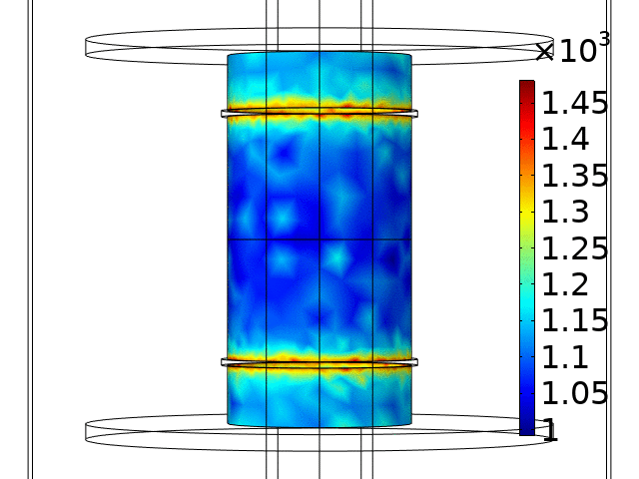
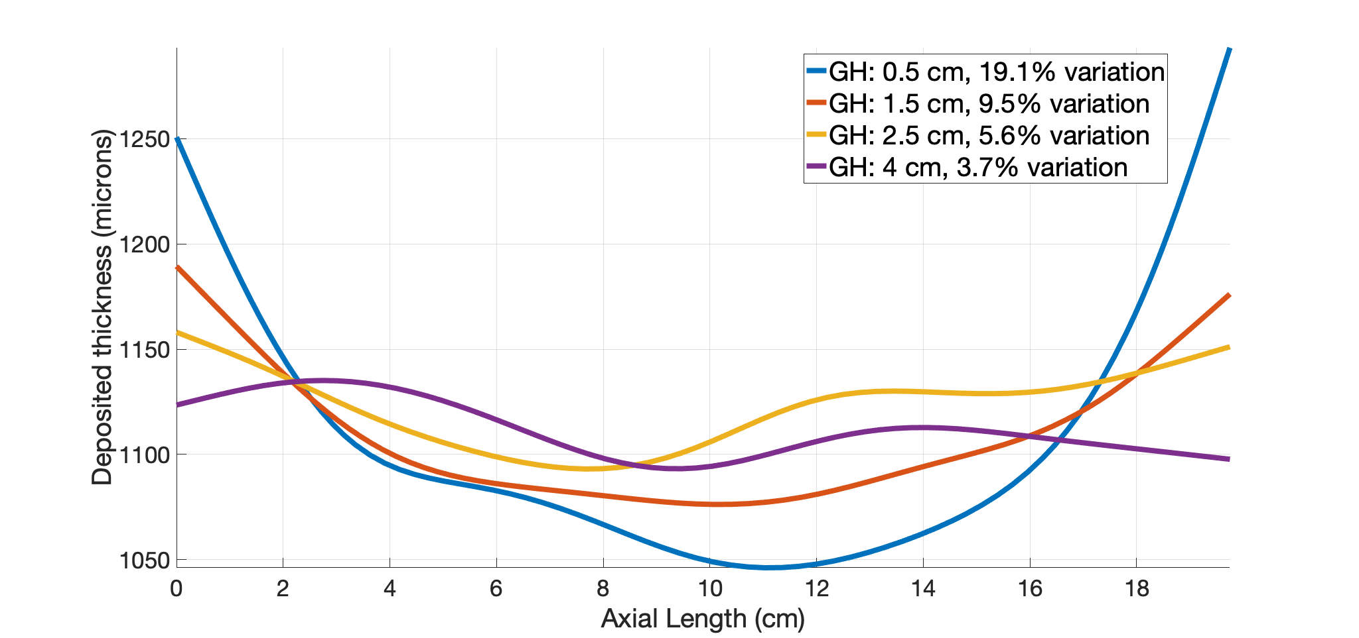
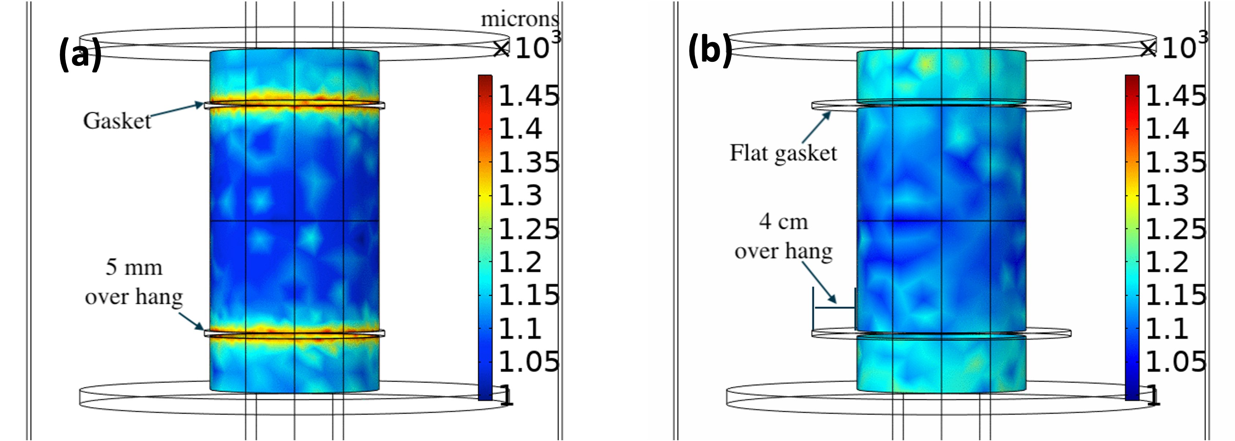
Thickness uniformity at shell boundaries
Microns
Electric field concentrates in excess at the shell boundaries.
This results in higher thickness at the edges.
Optimizing gasket dimensions help improving the thickness uniformity.
Microns
Notes:
Electric field concentrates in excess at the shell boundaries.
This results in higher thickness at the edges.
Optimizing gasket dimensions help improving the thickness uniformity.

Slide 7
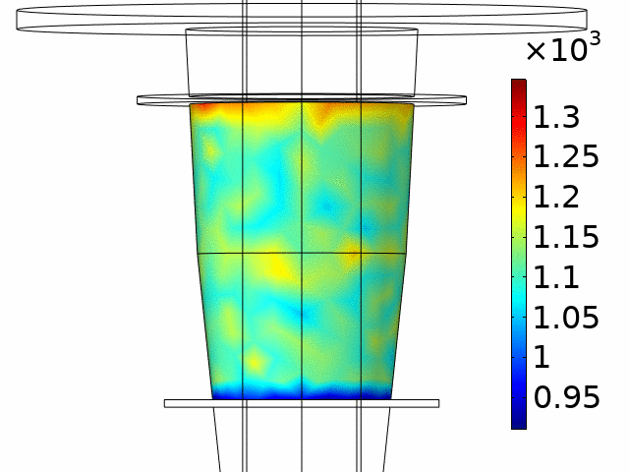
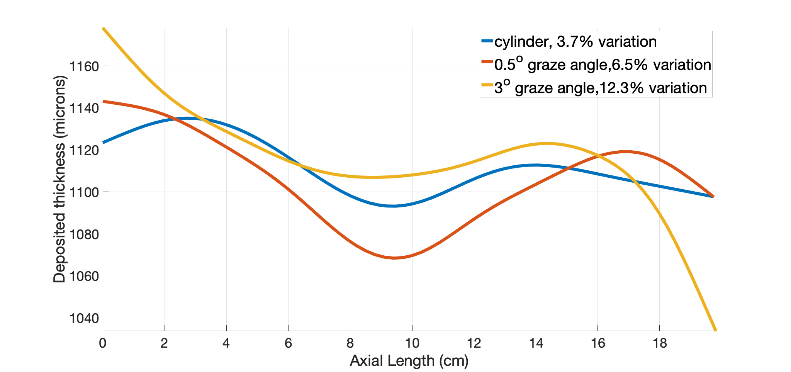
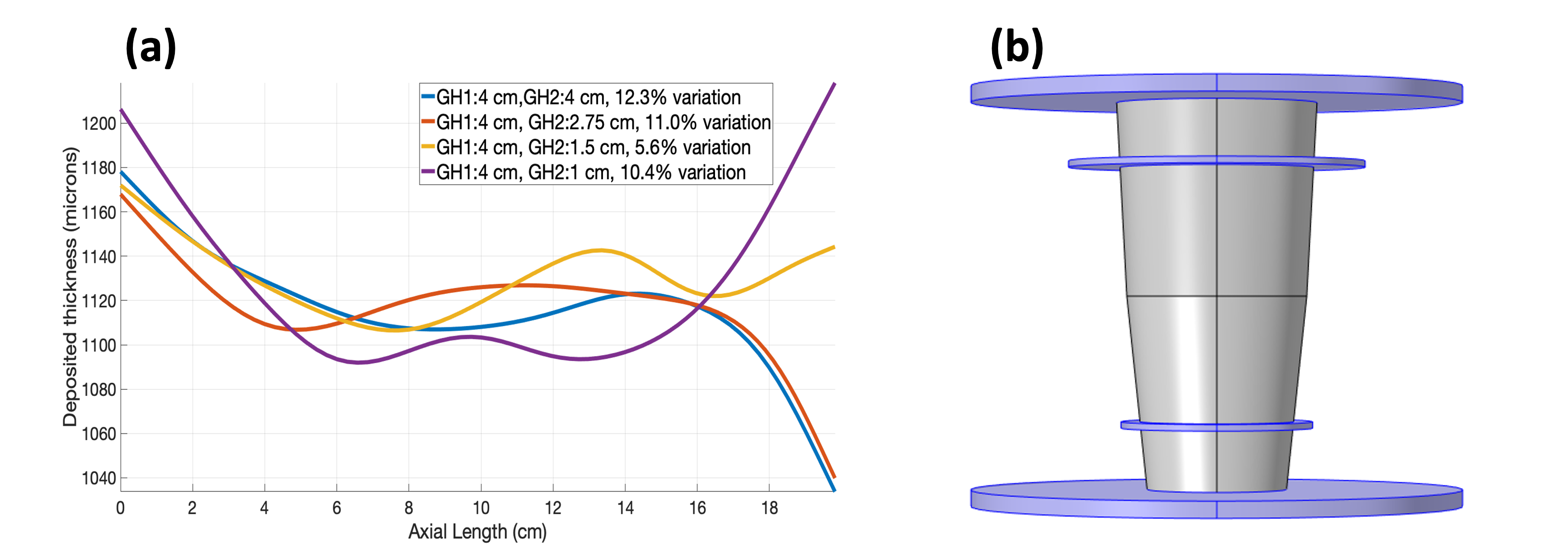
Effect of graze angle on thickness uniformity
Microns
Slope of the mandrel affects the thickness distribution of the mandrel across the axial length.
This can be adjusted by differentially changing the gasket diameters.
Notes:
Slope of the mandrel affects the thickness distribution of the mandrel across the axial length.
This can be adjusted by differentially changing the gasket diameters.

Slide 8
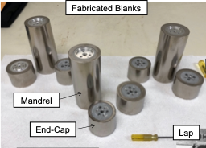
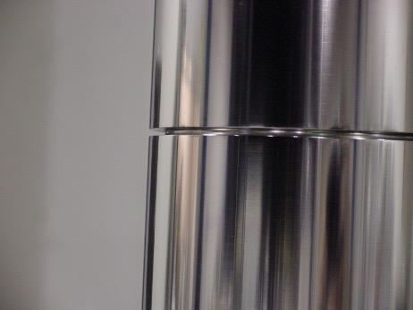
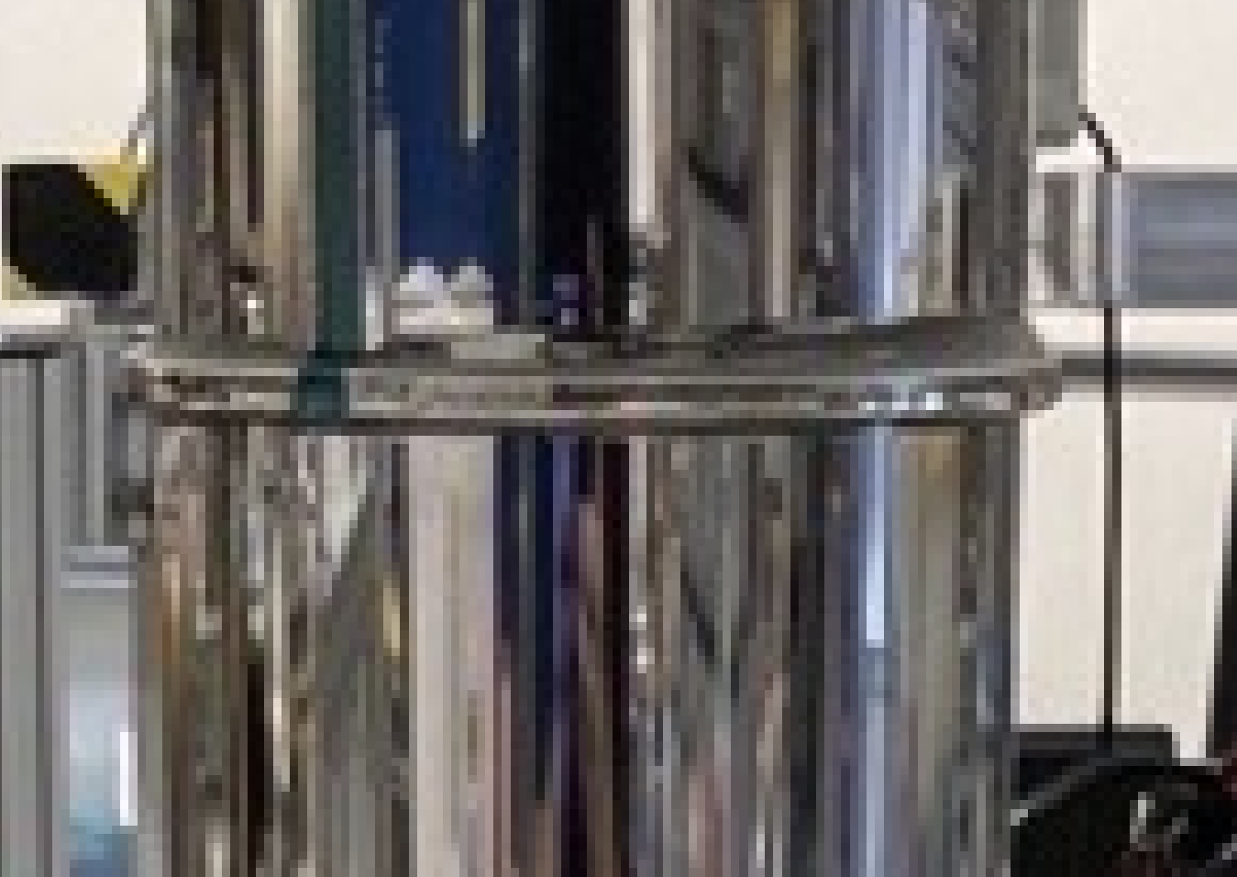
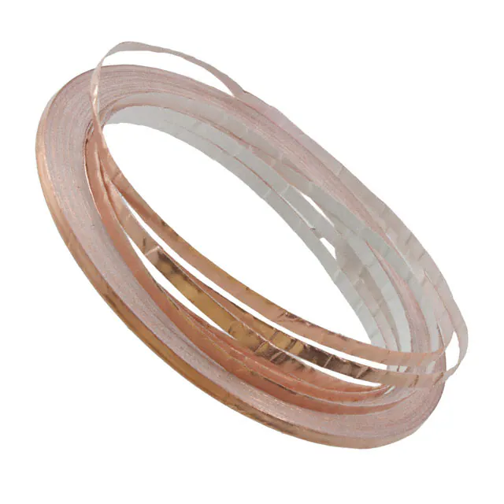
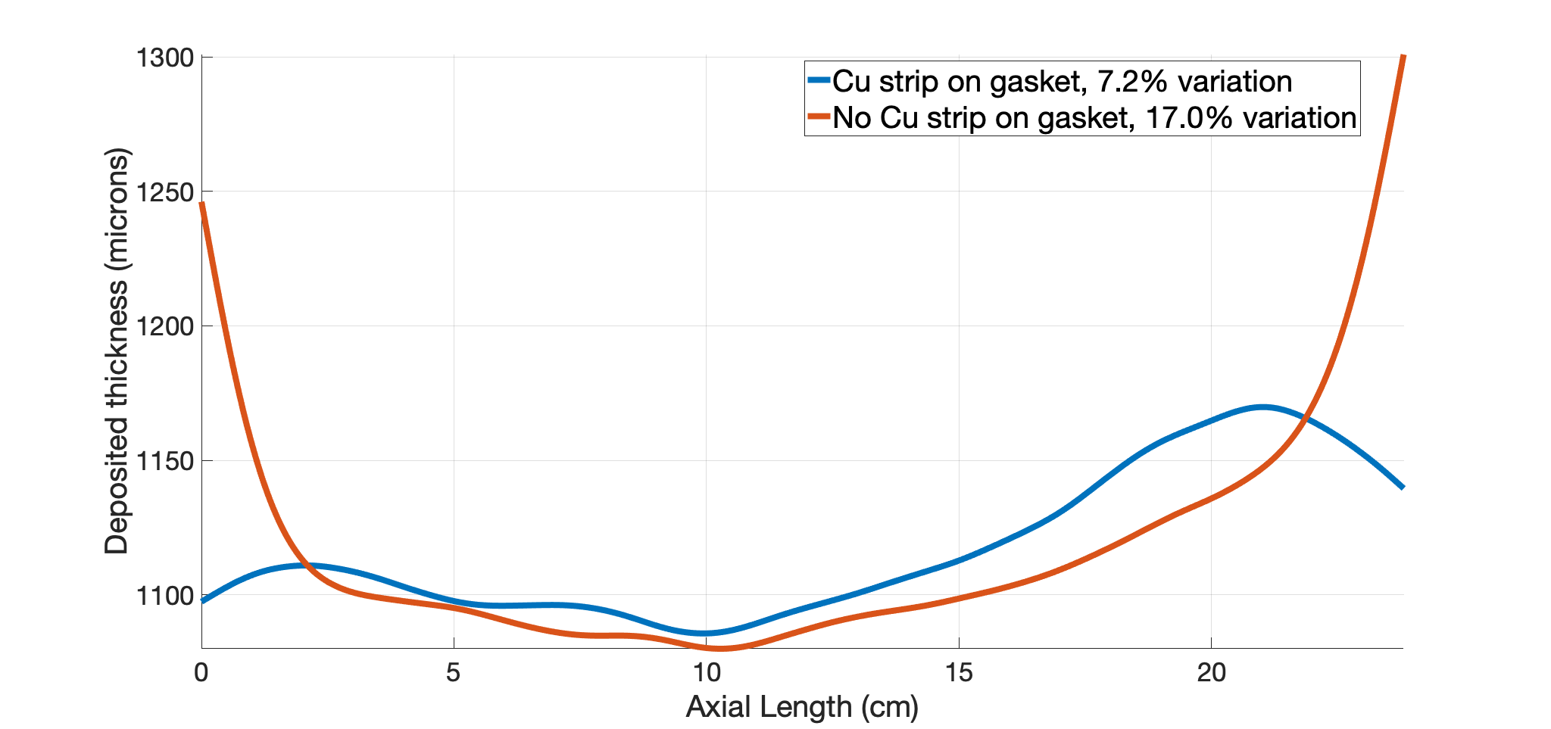
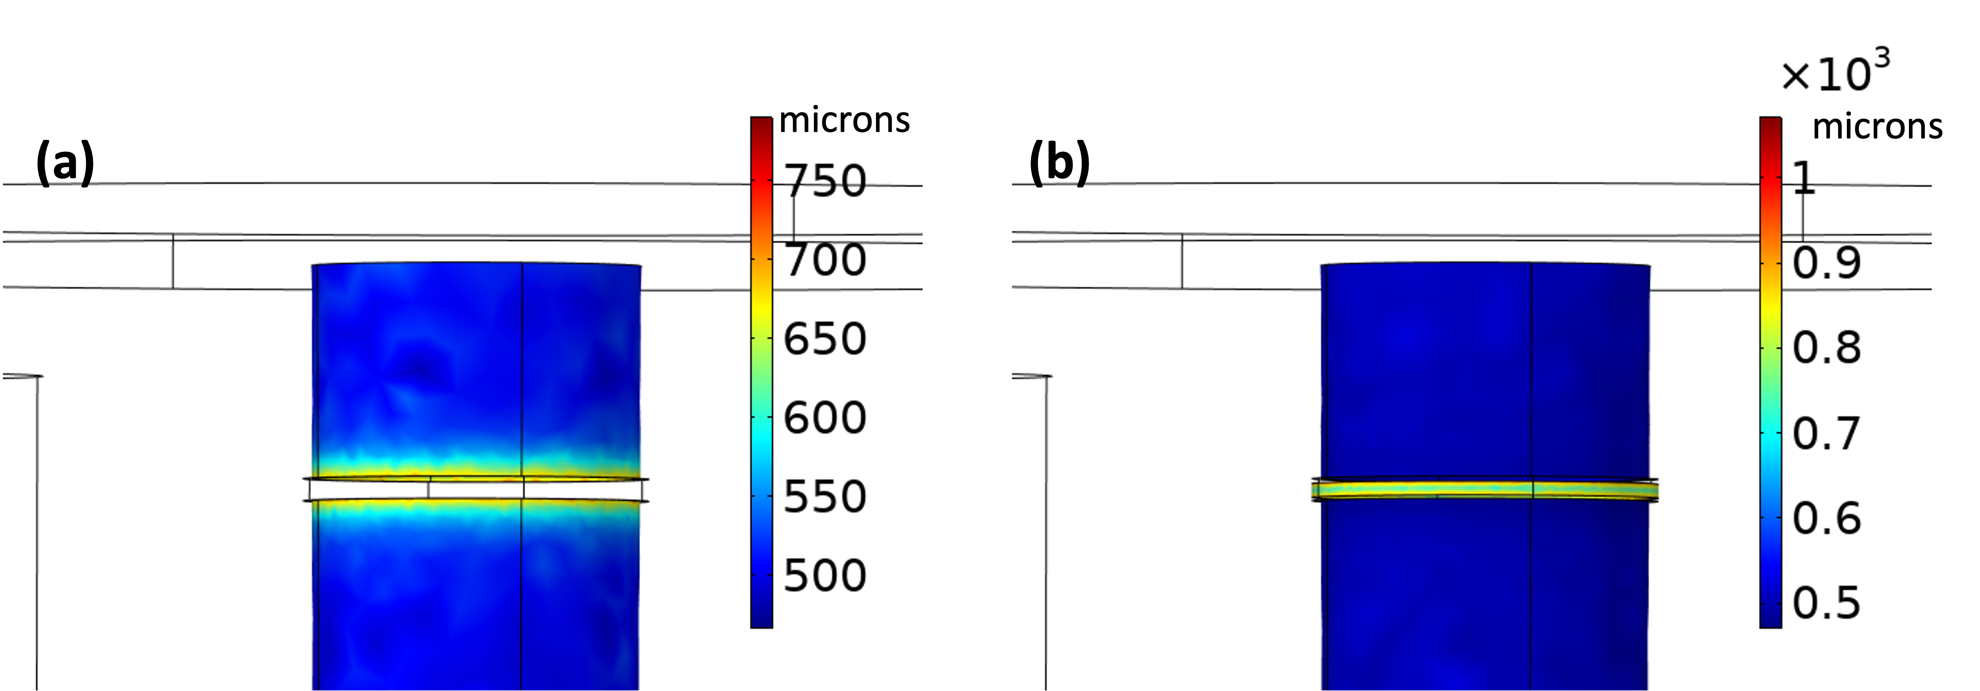
Gasket design for a single piece mandrel
It is hard to safely place large flat gaskets for a single piece mandrel.
We place the Cu strip on the gasket to act as cathode to regulate the field.
Groove to place gasket
Plated Cu strip
Notes:
It is hard to safely place large flat gaskets for a single piece mandrel.
We place the Cu strip on the gasket to act as cathode to regulate the field.

Slide 9
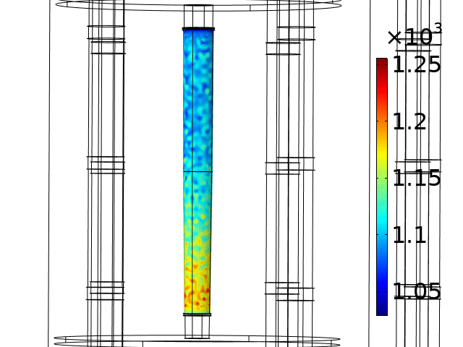
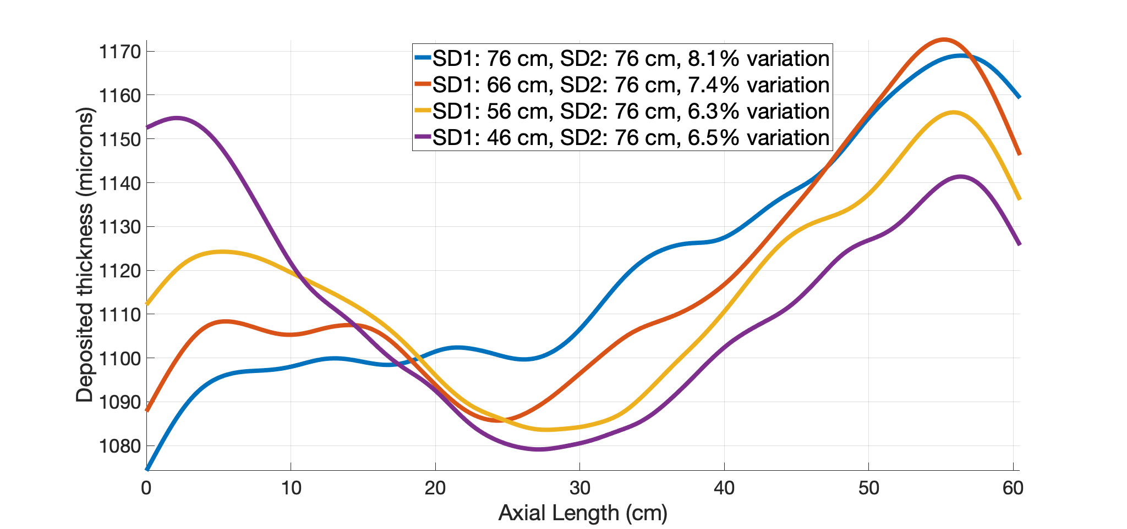
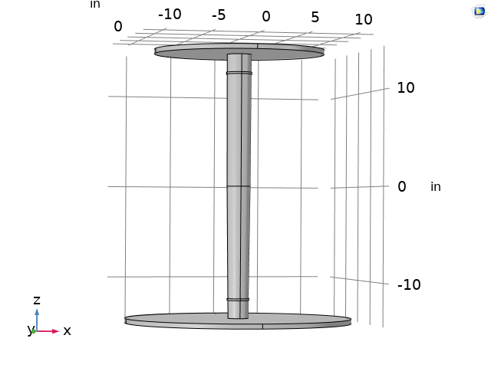
Optimizing shields for large mandrels
Microns
For large axial length mandrels, gaskets only influence the localized fields.
Hence we use differential shield diameters to regulate the fields across larger length.
Notes:
For large axial length mandrels, gaskets only influence the localized fields.
Hence we use differential shield diameters to regulate the fields across larger length.

Slide 10
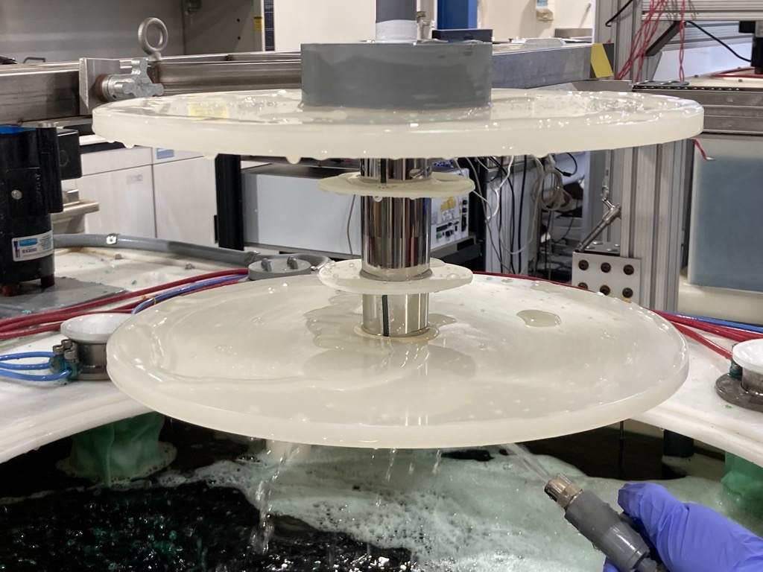
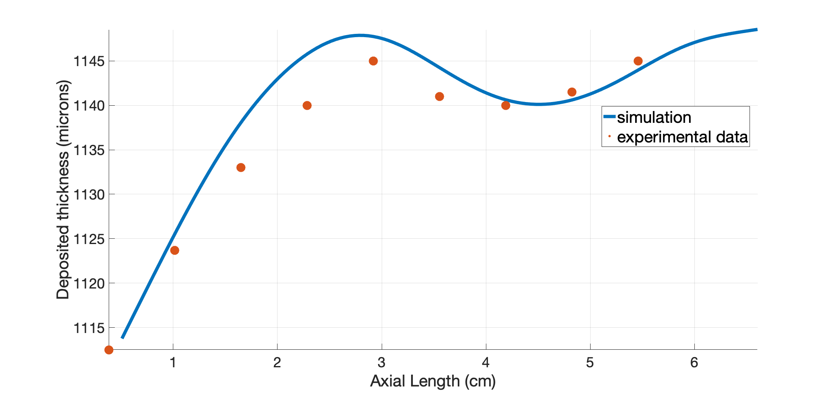
Experimental validation of the simulations
3-piece mandrel with optical length of 6.1 cm.
Maximum and minimum diameters are 4.6 cm and 4.52 cm.
End caps of 3.9 cm on either sides of the optics.
We used flat gaskets with gasket height of 2 cm above the surface.
Experimental thickness variation is 2.6% in comparison to 2.9% from simulations.
Notes:
3-piece mandrel with optical length of 6.1 cm.
Maximum and minimum diameters are 4.6 cm and 4.52 cm.
End caps of 3.9 cm on either sides of the optics.
We used flat gaskets with gasket height of 2 cm above the surface.
Experimantal thickness variation is 2.6% in comparision to 2.9% from simulations.

Slide 11
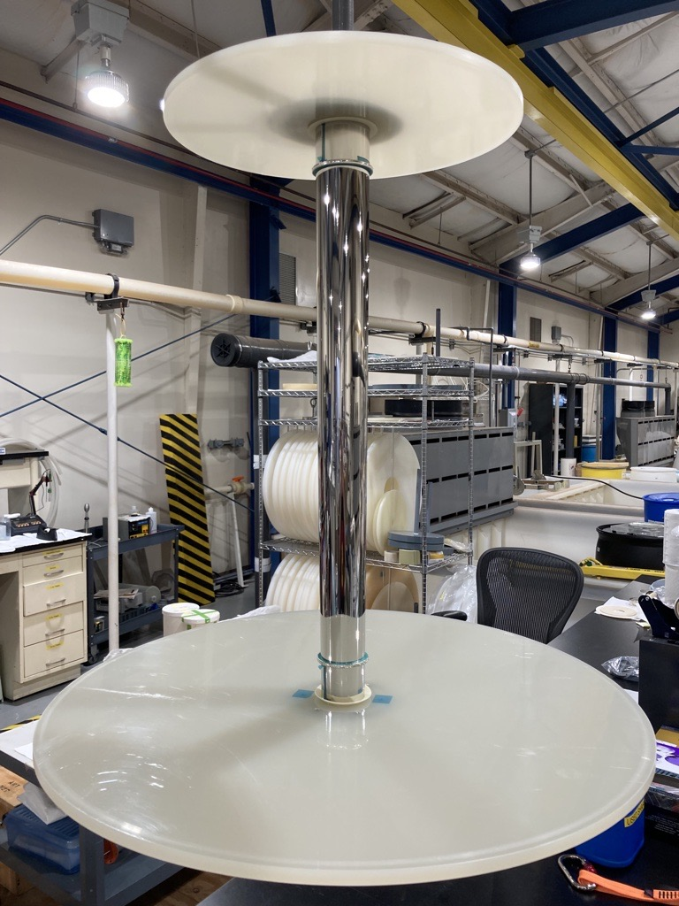
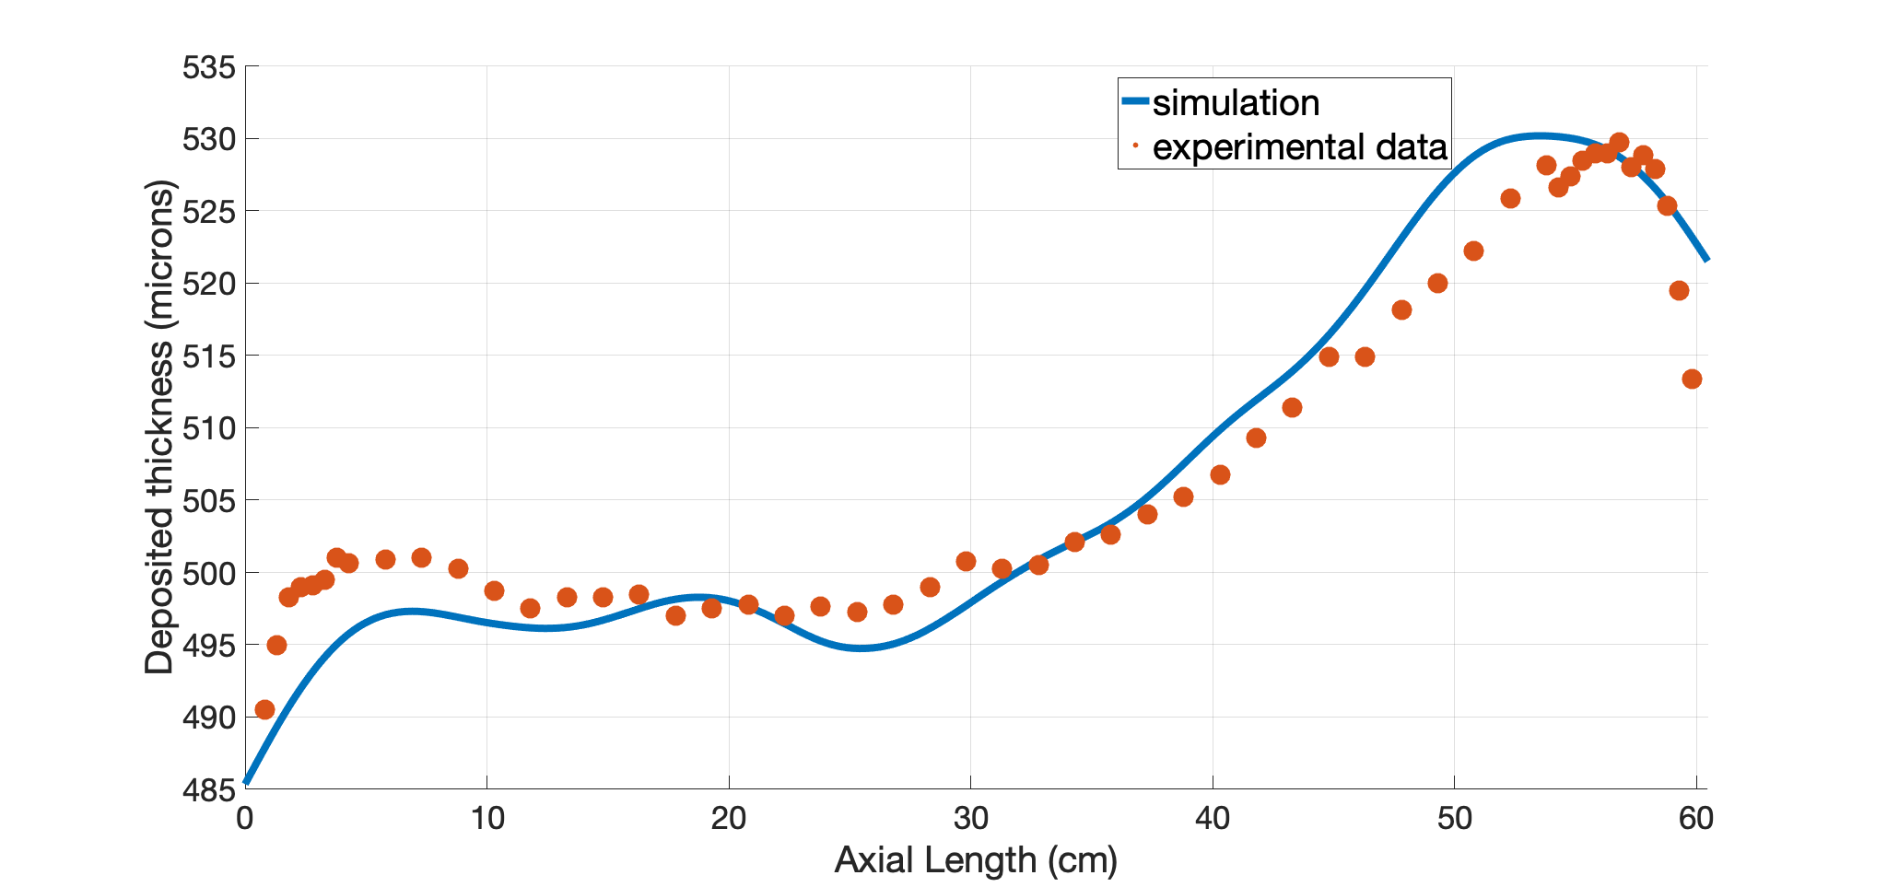
Shield optimization
Single piece mandrel with optical length of 60 cm.
End cap of 5 cm on either sides.
Maximum and minimum diameters are 7.6 cm and 6.2 cm.
We used Cu strip to the gasket for edge thickness uniformity.
Experimental thickness variation is 7.5% and agrees very closely to the simulations.
Notes:
Single piece mandrel with optical length of 60 cm.
End cap of 5 cm on either sides.
Maximum and minimum diameters are 7.6 cm and 6.2 cm.
We used Cu strip to the gasket for edge thickness uniformity.
Experimental thickness variation is 7.5% and agrees very closely to the simulations.

Slide 12
Summary and future work
COMSOL simulations helped to understand the field distribution inside the plating tank.
Optimizing gaskets and shields proved advantageous for improving the thickness uniformity of the optics.
We consistently produce shells with axial thickness variation under 5% with the help of modelling.
We design and fabricate custom made gaskets and shields for each unique mandrel deisgn based on simulations.
We are currently investigating the effect of thickness nonuniformity on the axial profile variation of the optics shell.
We are working on understanding the relation between the shell release mechanism, thickness uniformity and the axial profile errors.
Investigating the origin of shell non circularity in replication process.

Slide 13

Email: srikanthpanini.singam@nasa.gov
Notes:
Email: Srikanthpanini.singam@nasa.gov

Slide 14
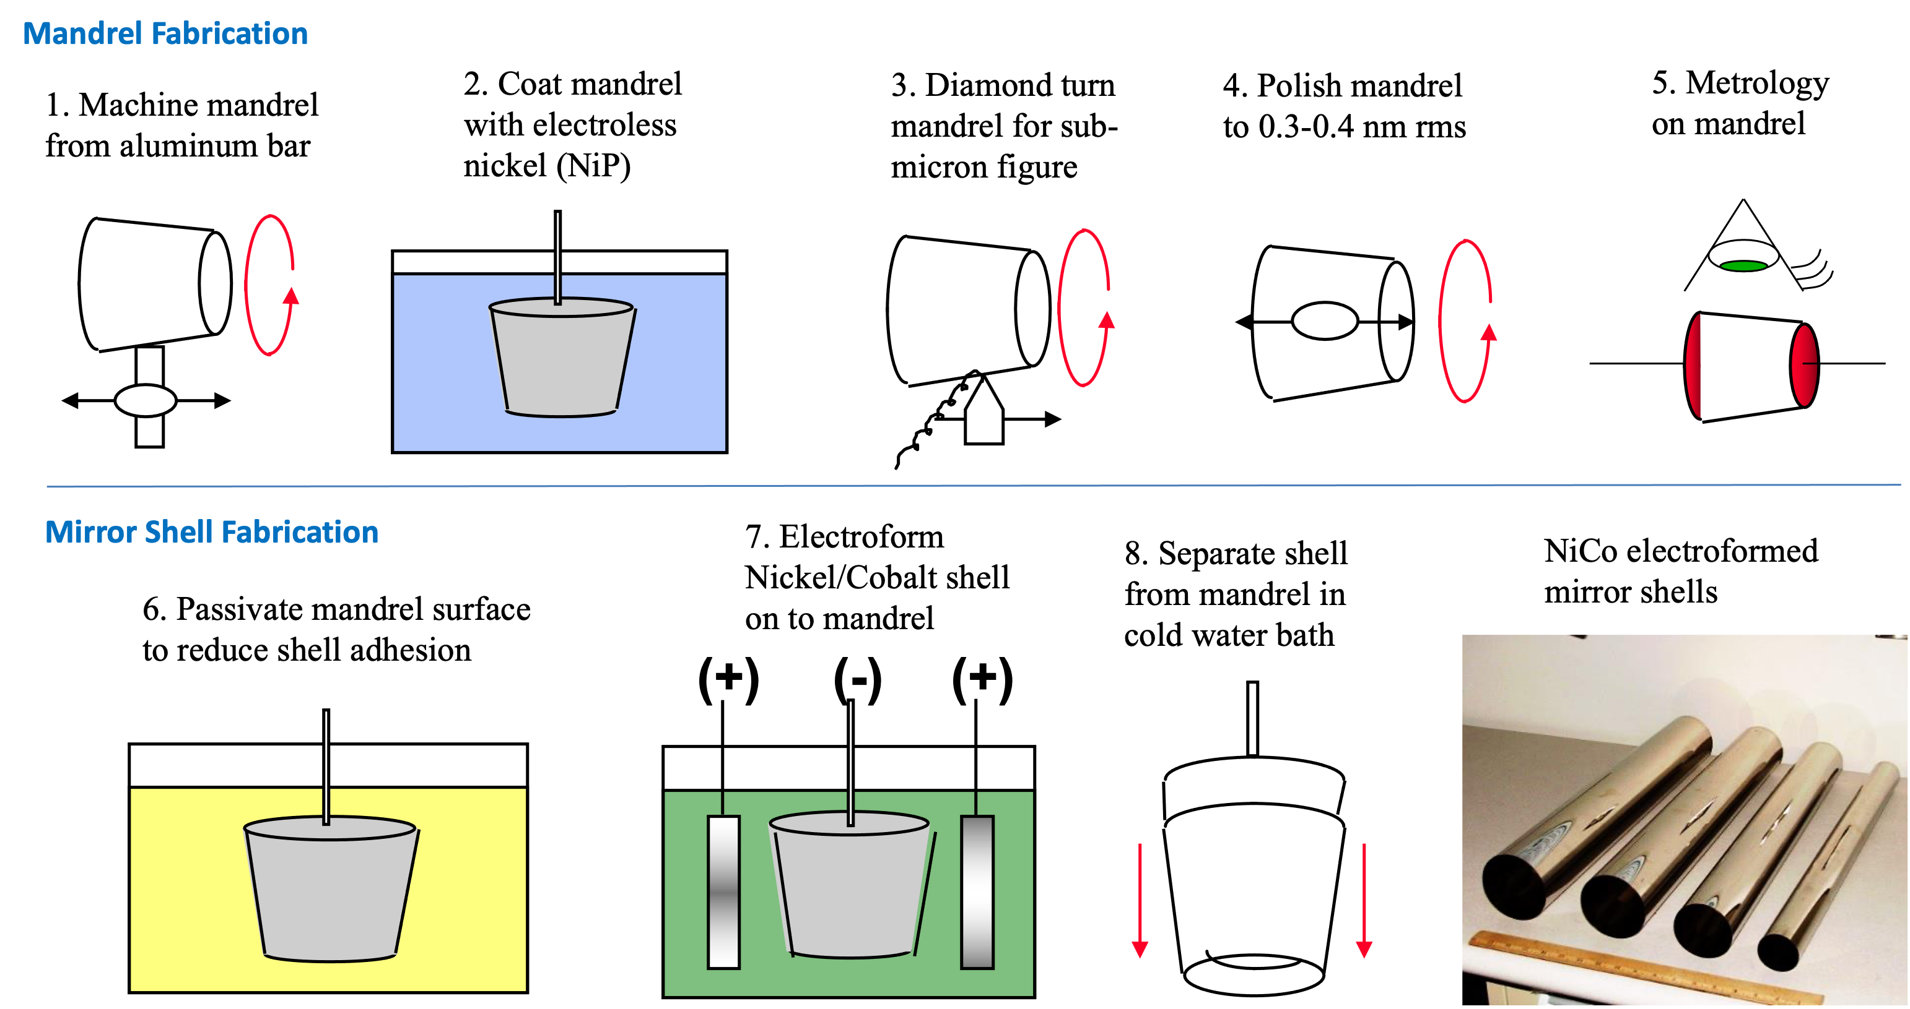
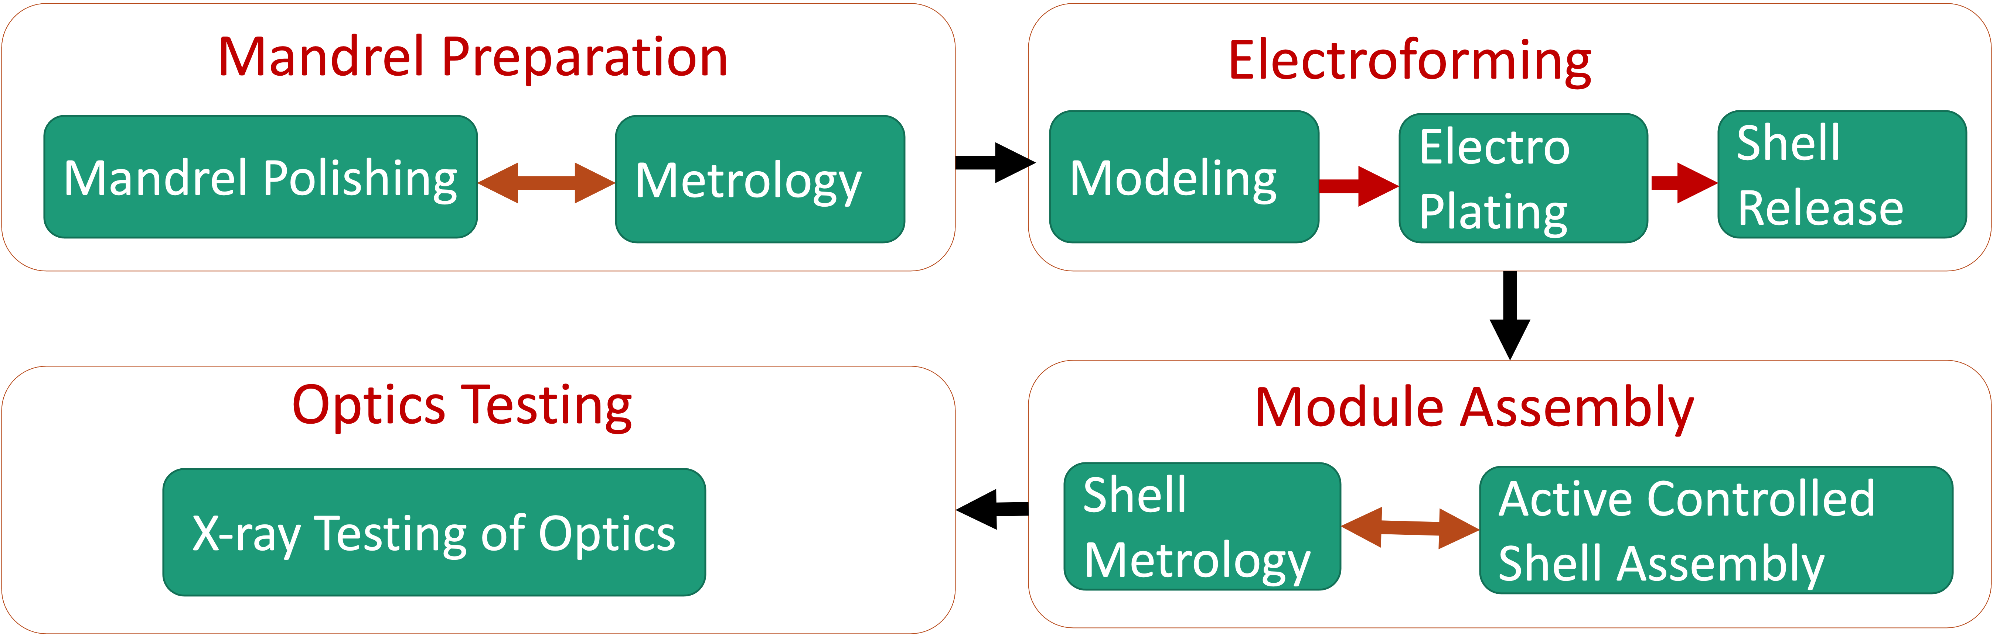
Full shell X-ray optics development at MSFC
Electroforming replication to fabricate thin, full shell optics.
Over 3 decades of developmental efforts.
Suitable for versatile applications from flagship X-ray astronomy telescopes to laboratory microscopes.

