Slide 1
1st Annual Mexican Aerospace Forum
September, 2023
In Situ Resource Utilization (ISRU)
Overview 2023
Aaron Paz
NASA - Johnson Space Center
Propulsion and Power Division

Slide 2
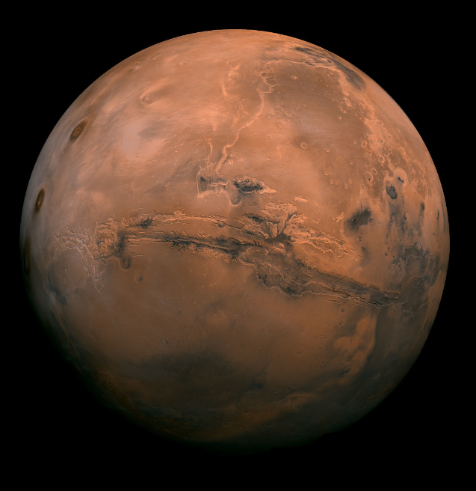
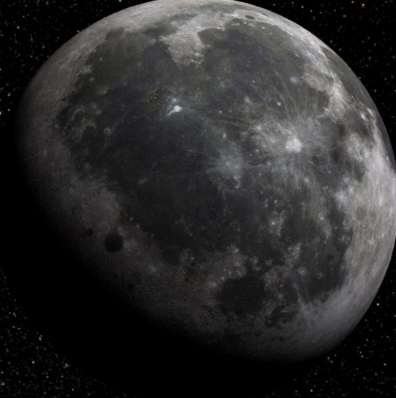
In-Situ Resource Utilization
The Moon
Oxygen – Lunar regolith is ~45% oxygen
Water Ice- Located at the poles
Metals – Iron, Aluminum, Titanium, Magnesium
Metalloids – Silicon
Regolith – Can be used as a construction material
Solar Wind Volatiles – Helium 3 can be used for nuclear fusion
Abundant solar energy
Mars
Oxygen – Can be extracted from CO₂ atmosphere
Water in Regolith – Anywhere on the surface
Water Ice – Under the surface in some locations
Metals – Iron, Aluminum, Titanium, Magnesium
Metalloids - Silicon
Regolith – Can be used as a construction material
Image Credit: NASA
Notes:
Analysis of Luna 24 samples showed the samples contained ~0.1% water by mass
Clementine indicated the presence of water ice at the poles based on the response of radar interactions with the surface
Lunar Prospector detected hydrogen using a neutron spectrometer and estimated the content of water ice to be 300 million metric tons
Chandrayaan-1 puts the estimate at 600 million metric tons
In 2008, an analysis of Apollo samples indicated the presence of water, with some debate over whether is was terrestrial contamination
LCROSS provided definitive proof of water in cabeus crater

Slide 3
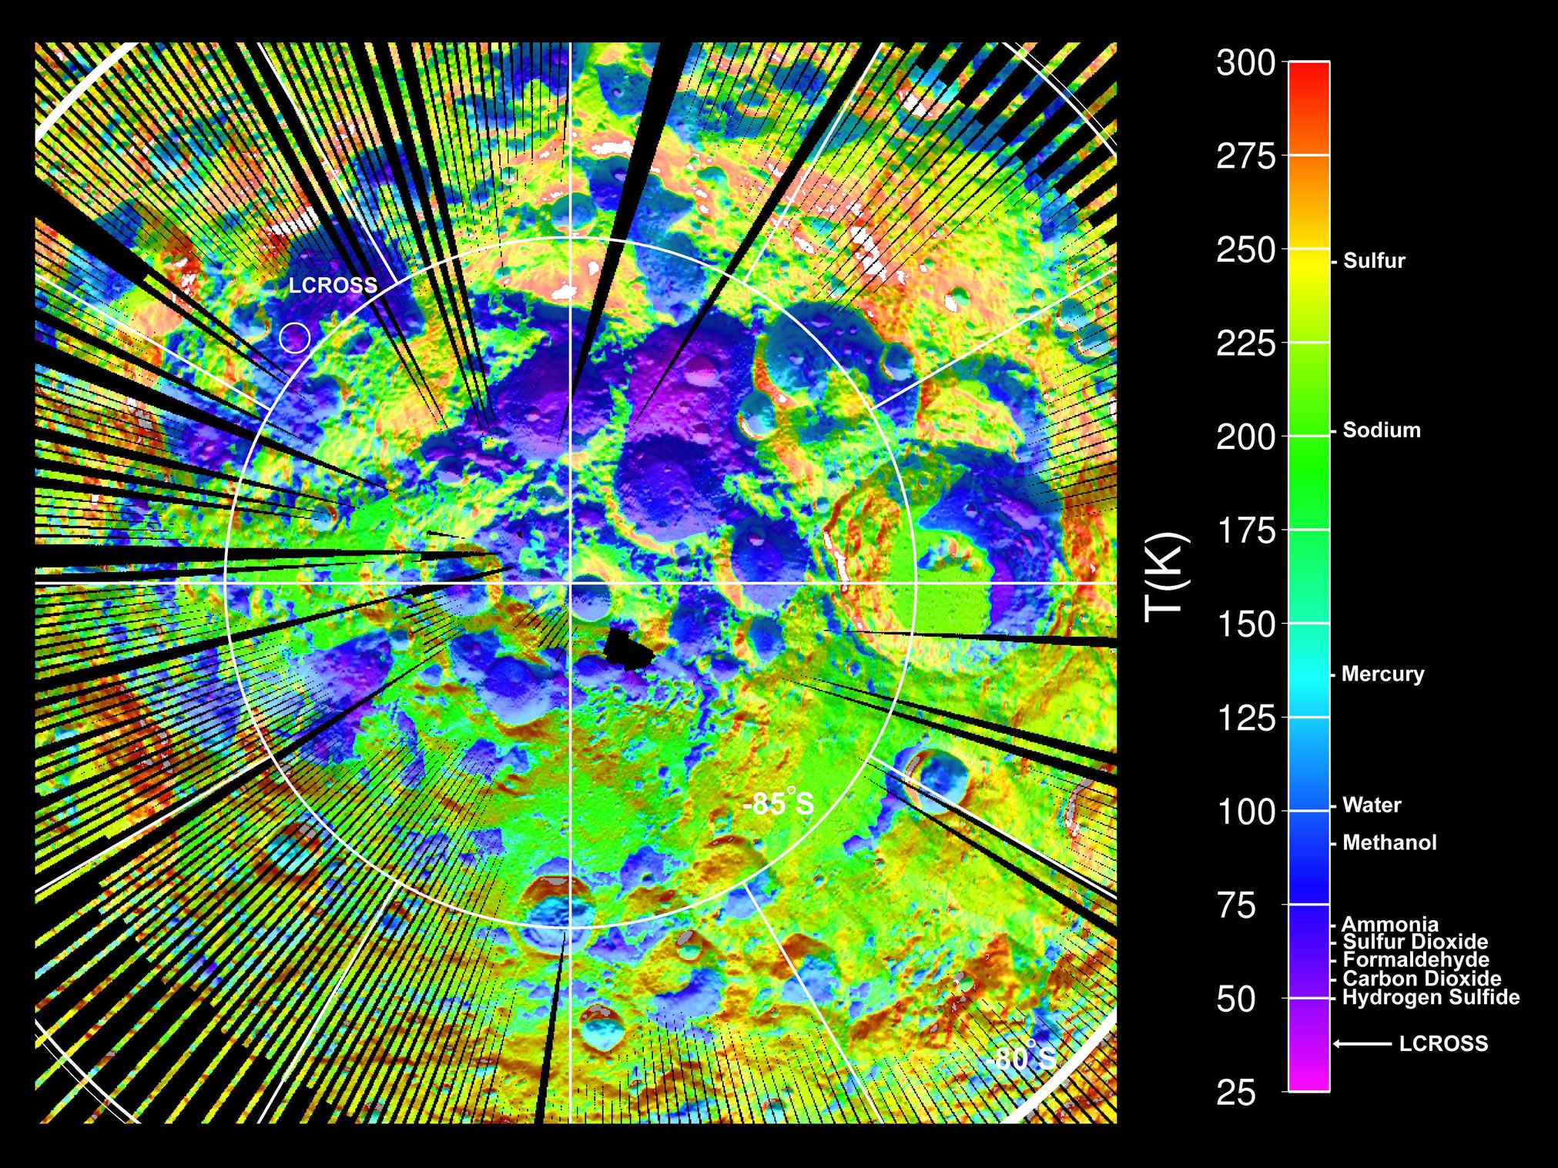
Water on the Moon
1994 : Clementine indicated the presence of water ice at the poles based on the response of radar interactions with the surface
1998: Lunar Prospector detected hydrogen using a neutron spectrometer and estimated the content of water ice to be 300 million metric tons
2008: Chandrayaan-1 puts the estimate at 600 million metric tons (240,000 Olympic swimming pools)
2009: LRO/LCROSS provided definitive proof of water ice in Cabeus cratercrater
Image Credit: NASA/GSFC
Image Credit: UCLA/NASA/JPL/GSFC
Notes:
Analysis of Luna 24 samples showed the samples contained ~0.1% water by mass
Clementine indicated the presence of water ice at the poles based on the response of radar interactions with the surface
Lunar Prospector detected hydrogen using a neutron spectrometer and estimated the content of water ice to be 300 million metric tons
Chandrayaan-1 puts the estimate at 600 million metric tons
In 2008, an analysis of Apollo samples indicated the presence of water, with some debate over whether is was terrestrial contamination
LCROSS provided definitive proof of water in cabeus crater

Slide 4
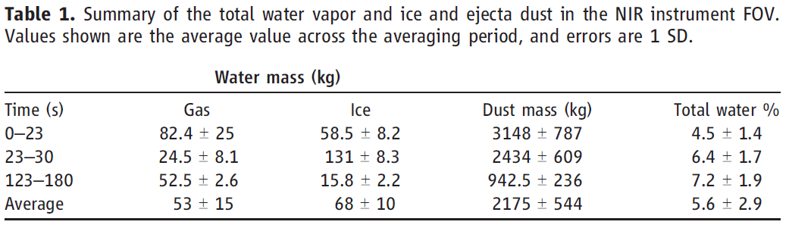
LRO/LCROSS
Lunar Reconnaissance Orbiter (LRO)
  Launched June 18, 2009
  Still active
Lunar Crater Observation and Sensing Satellite (LCROSS)
  Launched June 18, 2009
  Centaur crashed into the surface of Cabeus crater at 11:31 UT October 9th, 2009
  LCROSS crashed into the surface 4 minutes later after analyzing the impact plume
  LRO analyzed plume from orbit
Colaprete, A., Schultz, P., Heldmann, J., Wooden, D., Shirley, M., Ennico, K., ... & Sollitt, L. (2010). Detection of water in the LCROSS ejecta plume. science, 330(6003), 463-468.

Slide 5
Actual presentation will play the video from the link below
https://www.youtube.com/watch?v=l2CfQV0UCAk
Video Credit: NASA/GSFC
Notes:
LCROSS Provided definitive proof of water on the moon by slamming the centaur upper stage from LRO into Cabeus crater. The LCROSS instrument suite trailed the centaur stage so that it could analysis the plume created by the impact.

Slide 6
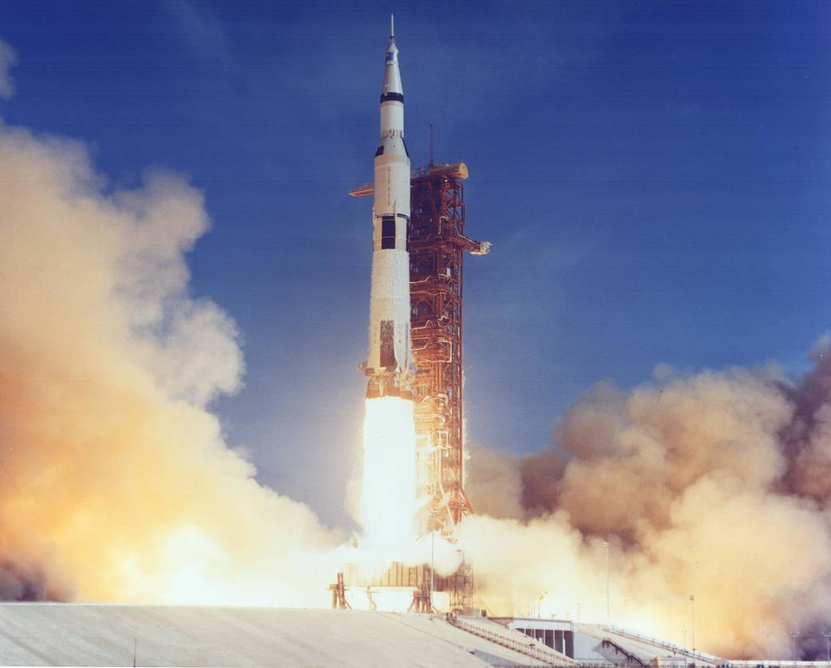
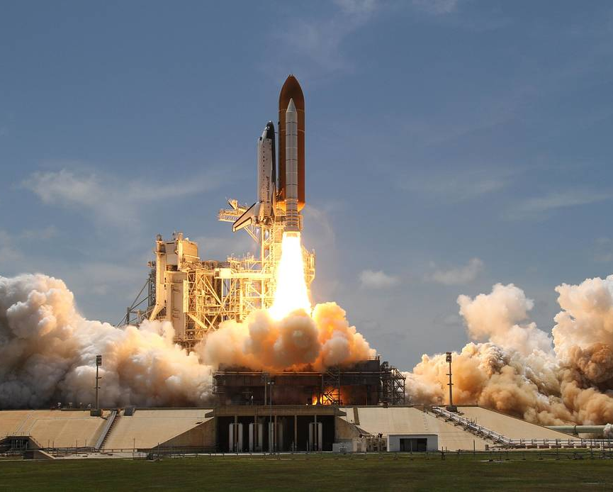
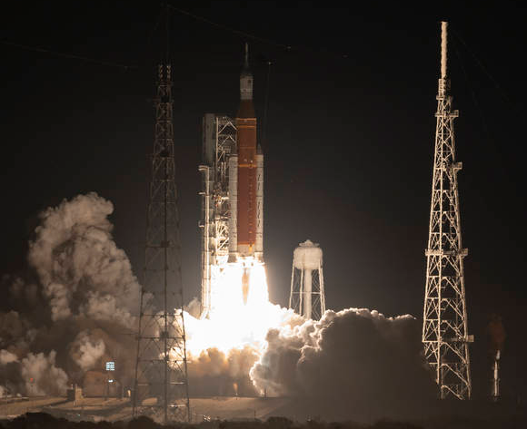
Water on the Moon
Water electrolysis can be used to convert water into hydrogen and oxygen using an electric current from a solar panel or other source of power
2H₂0
2H₂ + O₂
Oxygen gas can be used for breathing
Oxygen and hydrogen gas can be used to run a fuel cell
Liquid hydrogen and liquid oxygen can be used as rocket propellant
Saturn V , Space Shuttle , and SLS all use LOX/LH2 propellant
Image Credit: NASA

Slide 7
Actual Presentation will play Bill Nelson Video (uploaded separately to STRIVES)
Video Credit: NBC Nightly News

Slide 8
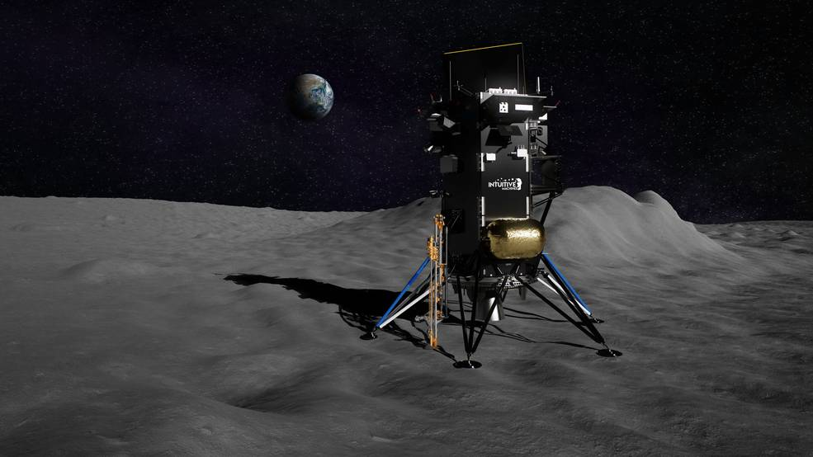
Water on the Moon – PRIME 1
As of now, the LCROSS impact data is the single data point we have on the relative concentration of water ice anywhere on the moon
The Polar Resources Ice Mining Experiment – 1 (PRIME-1) is scheduled to launch in November 2023
Image Credit: Intuative Machines

Slide 9
Actual presentation will play the video from the link below
https://www.youtube.com/watch?v=w7f5Jm7uxaY
Video Credit: NASA/KSC

Slide 10
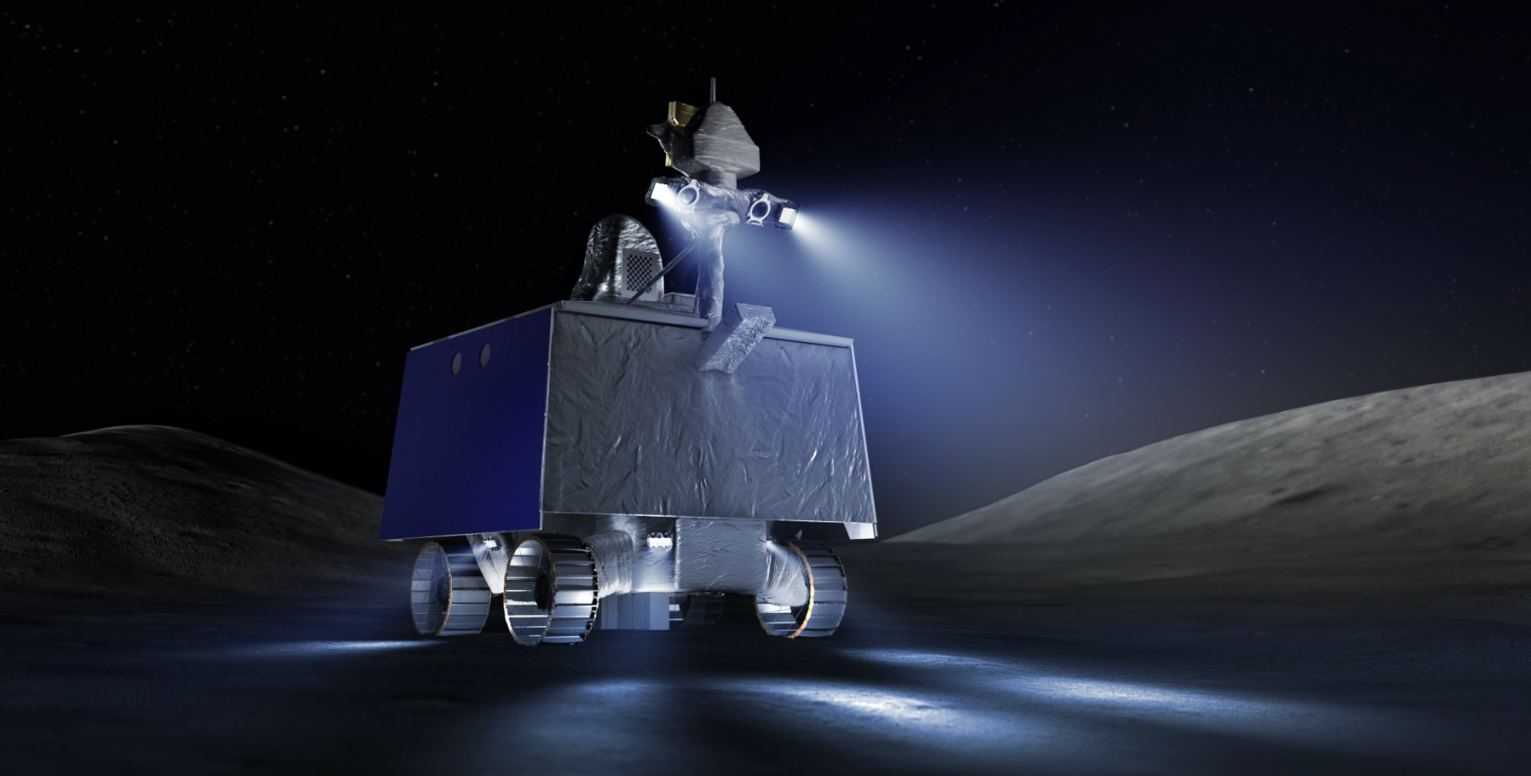
Water on the Moon – VIPER
The Volatiles Investigating Polar Exploration Rover (VIPER) is scheduled for a launch in late 2024
Image Credit: NASA/Daniel Rutter

Slide 11
Actual presentation will play the video from the link below
https://www.youtube.com/watch?v=pvf1Csn1wRU
Video Credit: NASA/ARC

Slide 12
Water on the Moon – Light WAVE
Both PRIME-1 and VIPER will not capture water. Instruments will observe water vapor and other volatiles as they sublime and are released to the vacuum of space.
The Light Water Analysis and Volatiles Extraction (Light WAVE) subsystem is designed to quantify and capture water ice extracted from the lunar surface.
Image Credit: NASA/Daniel Rutter

Slide 13
Actual Presentation will play OVEN video (uploaded separately to STRIVES)
Video Credit: NASA/JSC

Slide 14
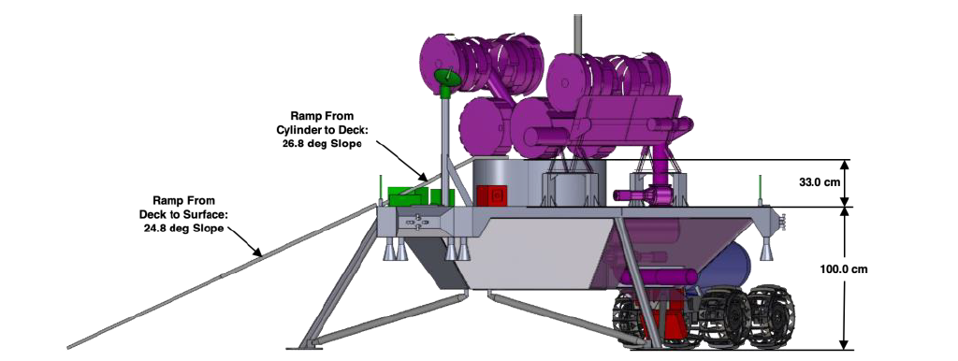
Lunar Ice Mining
RASSOR Excavator
Hopper
Water Capture and Transport
Auger Dryer
Linne, D. L., Kleinhenz, J. E., & Paz, A. (2020). Lunar water pilot plant conceptual design. In ASCEND 2020 (p. 4236).
Image Credit: NASA/JSC

Slide 15
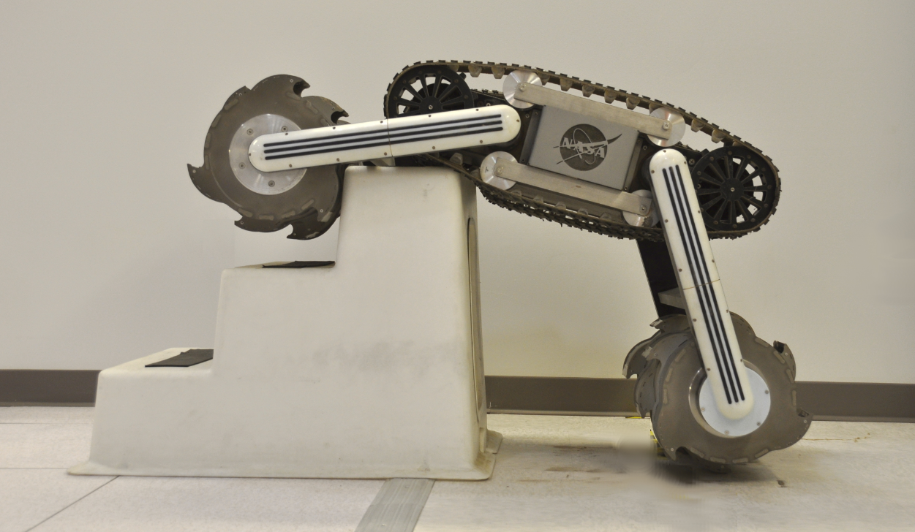

Lunar Ice Mining - Excavation
10 Tonnes (1000kg) of oxygen per year is considered a full-scale production rate until more information becomes available on lunar landers
10 Tonnes of oxygen per year requires 15 Tonnes of water
Assuming 5% water ice, with a density of 1.25 g/cc and an excavation depth of 5 cm, it would take ~67% of the area of a football pitch to produce 15 Tonnes of water
5% and 5cm deep
Regolith Advanced Surface Systems Operations Robot (RASSOR)
Image Credit: NASA/KSC
Video Credit: NASA/KSC

Slide 16
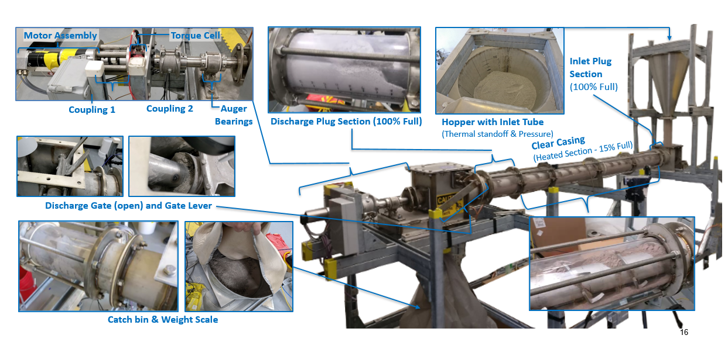
Lunar Ice Mining – Water Extraction

Slide 17
Water Purification and Deionization
Conductivity (microsiemens/cm^2) | Resistivity (Mega Ohm/cm^2)
0.056 | 18
0.063 | 16
0.071 | 14
0.083 | 12
0.100 | 10
0.133 | 7.5
0.200 | 5
0.500 | 2
1.000 | 1
1.333 | 0.75
2.000 | 0.5
4.000 | 0.25
10.000 | 0.1
20.000 | 0.05
40.000 | 0.25
100.000 | 0.01
200.000 | 0.005
500.000 | 0.002
1000.000 | 0.001
2000.000 | 0.0005
5000.000 | 0.0002
10000.000 | 0.0001
Acronyms:
EDI: Electrodeionization
IHOP: ISRU water purification and Hydrogen/Oxygen Production
ICICLE: ISRU Collector of Ice in a Cold Environment
LHS: Lunar Highlands Simulant
PEM: Proton Exchange Membrane
WIPE: Water, ISRU-derived, Purification Equipment
Typical PEM electrolyzer feedwater requirements
(deionized water)
EDI performance
(0.84 at inlet, 13.25 at outlet)
Distilled water
Water from IHOP (WIPE 1.0) ^{[2]}
Water mixed with LHT simulant, distilled and filtered to <0.5 microns
Mixed volatile stream (CO, H₂, H₂S, NH₃, SO₂, CH₃OH, CH₄, CO₂) after freeze distillation (ICICLE) ^{[1]}
Tap water
References:
[1] Holquist, J., Gellenbeck, S., Bower, C., & Tewes, P. (2021, July). Experimental Proof of Concept of a Cold Trap as a Purification Step for Lunar Water Processing. 50th International Conference on Environmental Systems.
[2] Holquist, J., Gellenbeck, S., Connor, J., Rivera, R., Bower, C., & Tewes, P. (2022, July). Demonstration of Paragon’s Water Purification Assembly for Lunar Water Processing. 51st International Conference on Environmental Systems.
Image Credit: NASA/JSC

Slide 18
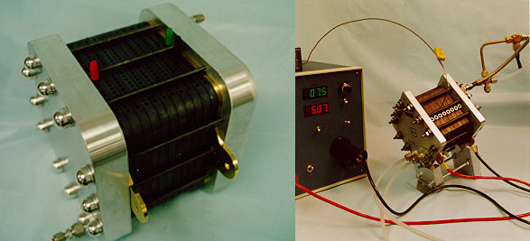
Water Electrolysis
Proton Exchange Membrane
Solid Oxide
Pros
Flight heritage (ISS)
Efficient gas compression
High operating pressures
Relatively low operating temperature
Pros
Does not require deionized feedwater
Oxygen is dry and pure
Flight heritage (MOXIE)
Should be able to survive lunar night with minimal power
Waste heat can be used to keep stack at operating temperature
Cons
Liquid water must be kept above 0º C during lunar night
Feedwater must be deionized
Radiator is required to reject waste heat
Oxygen dryer is required
Cons
Low operating pressure (< 30 psia)
High operating temperature (~800 º C)
Output gases are hot and may require more liquefaction power
Water will need to be vaporized twice, once for extraction and again for electrolysis
-
+
H₂
Solid Oxide
O₂
Cathode
Anode
H₂O
Image Credit: NASA/SBIR

Slide 19
Propellant from Lunar Water Concept
H₂O(g)
Volatile mixture discarded with periodic venting
H₂ Dryer
H₂(g)
H₂
Liquefaction
H₂(l)
H₂
Storage
Volatile mixture with residual water vapor
Hydrogen with residual water vapor
Water delivered from permanently shadowed region (PSR)
Boiler
Nafion Membrane
SOE
O₂ Liquefaction
O₂
Storage
O₂(g)
O₂(l)
Saturated volatile mixture
Saturated hydrogen
Subsystems identified for laboratory demonstration in 2024
Simplified flow diagram for a lunar propellant production plant that uses no consumables

Slide 20
Hydrogen Liquefaction
HYDROGEN LIQUEFACTION
Oxygen Mass | 10 | tonnes
LOX/Fuel Ratio | 6
H2 Mass Required | 1.67 | tonnes
Mass of 20W/20K crycooler | 106.3 | kg
Fuel Liquefaction Thermal Lift Required | 429 | W
Number of Cryocoolers Required | 22
Mass of Cryocoolers & Radiators | 2.34 | tonnes
Return on Landed Mass in 1 year | 0.71
One of the biggest challenges with using water to make propellant is hydrogen liquefaction. Using the current state-of-the-art liquefaction technology, it would take 2.34 Tonnes worth of liquefaction hardware to produce 1.67 Tonnes worth of liquid hydrogen per year.
Nugent, B. T., Grotenrath, R. J., & Johnson, W. L. (2022). 20 Watt 20 Kelvin Reverse Turbo-Brayton Cycle Cryocooler Testing and Applications.

Slide 21
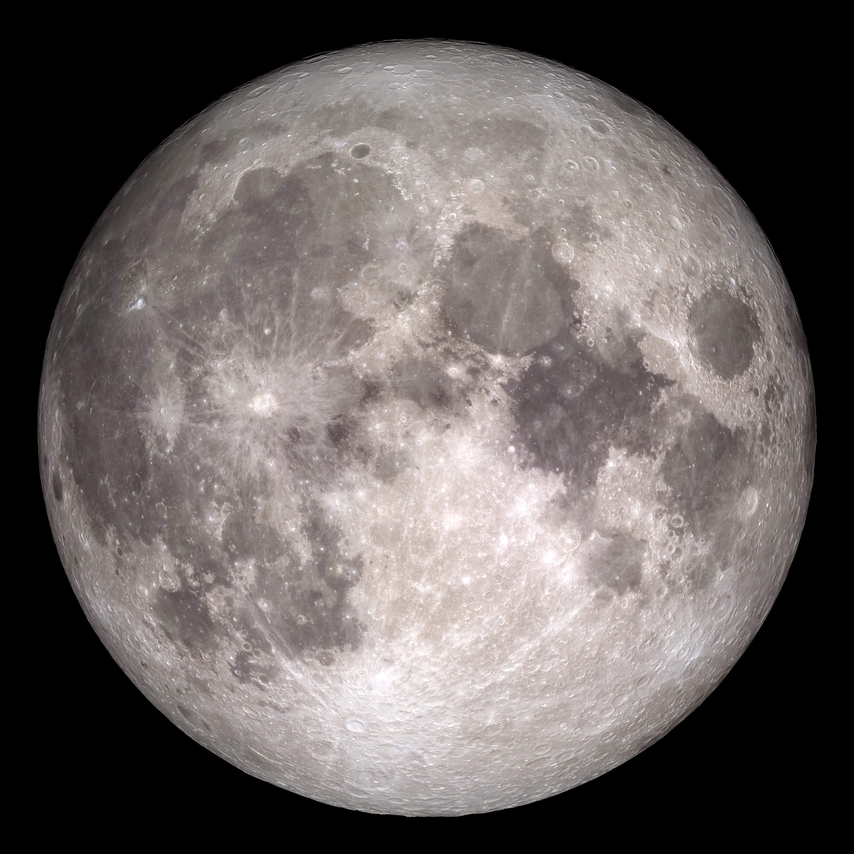
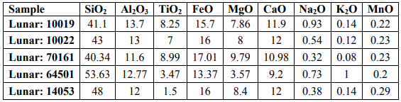
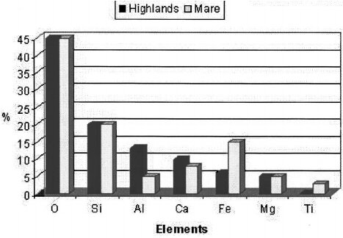
Oxygen from Regolith – Chemical Composition
Examples of Lunar Regolith Chemical Composition
Loftus, D. J., Tranfield, E. M., Rask, J. C., & McCrosssin, C. (2008). The chemical reactivity of lunar dust relevant to human exploration of the Moon.
Image Credit: NASA
The darker areas of the Moon are called Mare
The lighter areas of the Moon are called Highlands
Ruess, F., Schaenzlin, J., & Benaroya, H. (2006). Structural design of a lunar habitat. Journal of Aerospace Engineering, 19(3), 133-157.

Slide 22
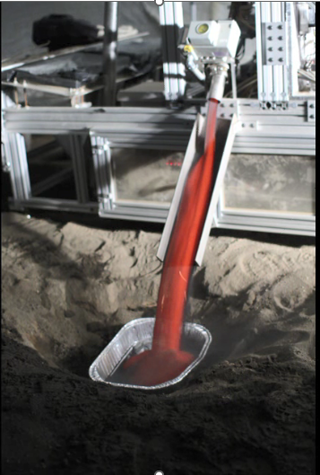
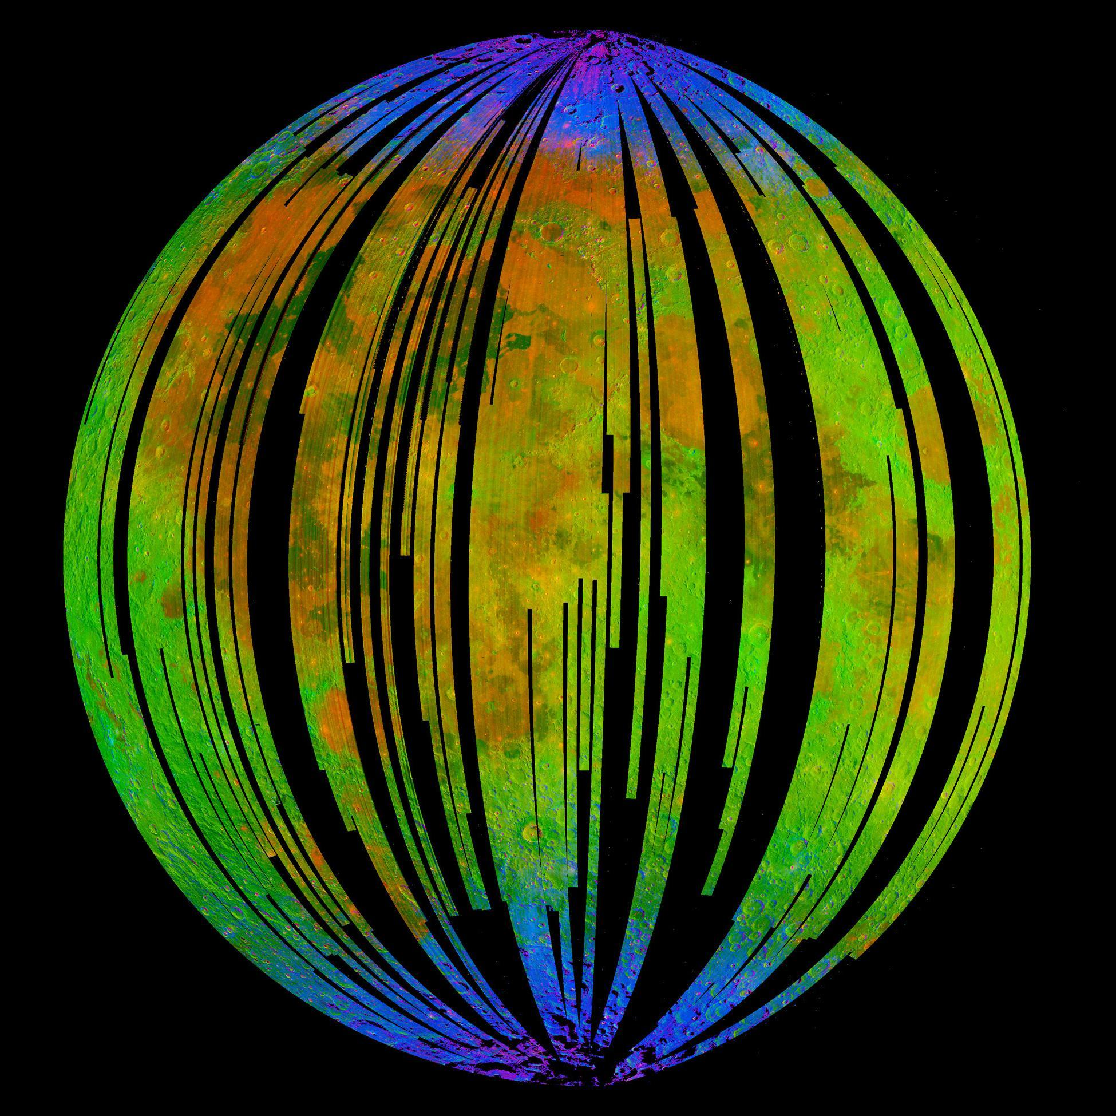
Oxygen from Regolith – Hydrogen Reduction
Fe0 + H₂
Fe + H₂O
Image Credit: ISRO/NASA/JPL-Caltech/Brown Univ./USGS
Notes:
Left: Image from NASA’s Moon Mineralogy Mapper, an instrument on the Indian Space Research Organization's Chandrayaan-1 mission.
Blue shows the signature of water, green shows the brightness of the surface as measured by reflected infrared radiation from the sun and red shows an iron-bearing mineral called pyroxene.
Right: Video of reduced tephra (Soil found on Mauna Kea) being removed from ROxygen reactor during 2008 field demonstration

Slide 23
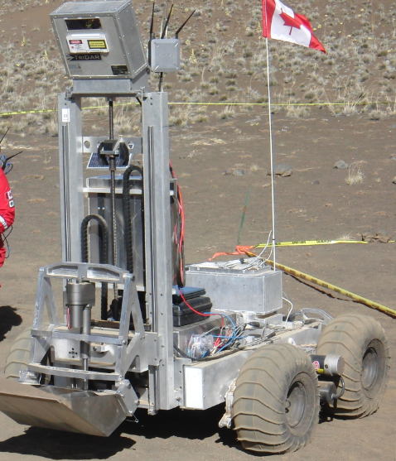
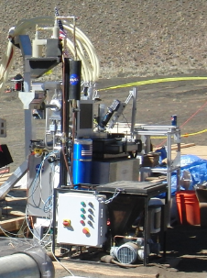
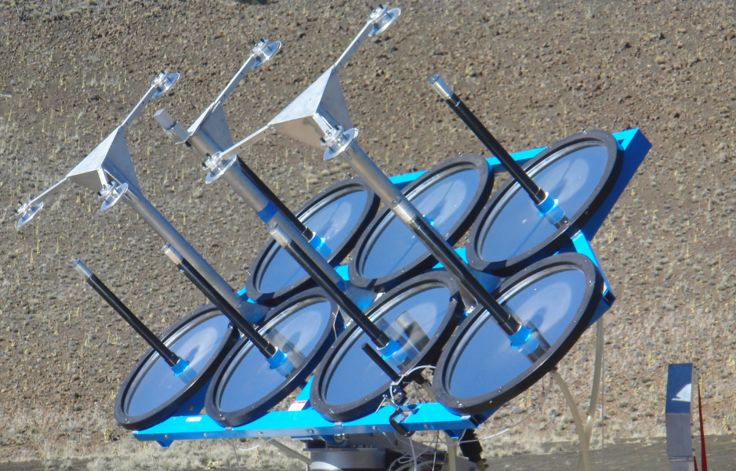

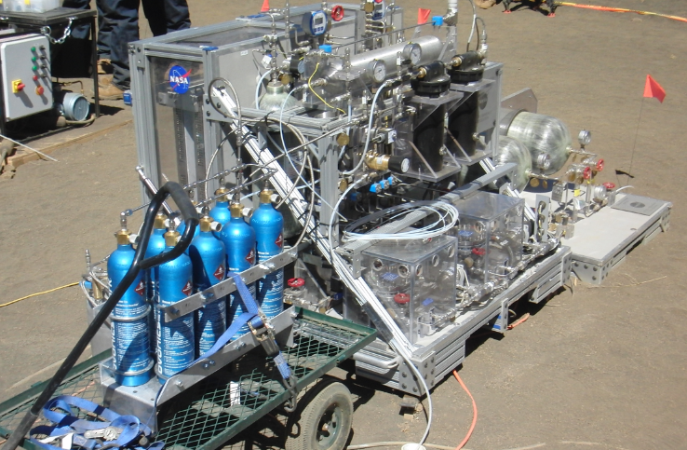
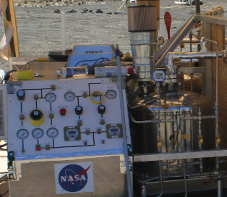
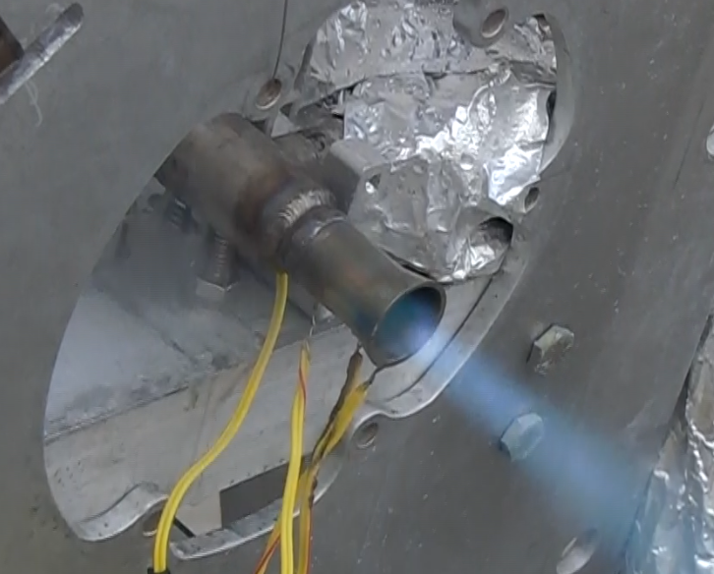
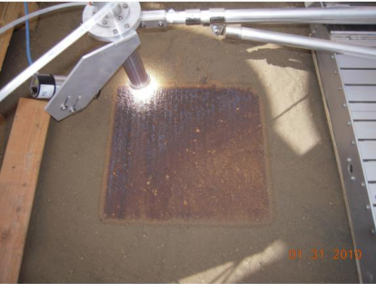
Oxygen from Regolith : Solar-Carbothermal Reduction
2H₂O
Tephra
Heat
Excavator
Canadian Space Agency
Carbothermal Reactor
Orbitec (Now Sierra Space)
Solar Concentrator
Physical Sciences Inc.
Si0 + C H₄
Si + CO+ 2H₂
H₂O
CO + 4H₂
CH₄+H₂O
Heat
2H₂O
2H₂ + O₂
O₂
LOX
Plume
Water Electrolysis
Johnson Space Center
Liquefaction
Johnson Space Center
Propulsion
Johnson Space Center
Sintered Pad
Physical Sciences Inc.
NORCAT
Notes:
Left: ROxygen electrolyzer and gaseous oxygen storage in the foreground. Solar Concentrator in the background
Upper Right: Melted tephra produced with solar concentrator
Lower Right: Sintered tephra using solar concentrator

Slide 24
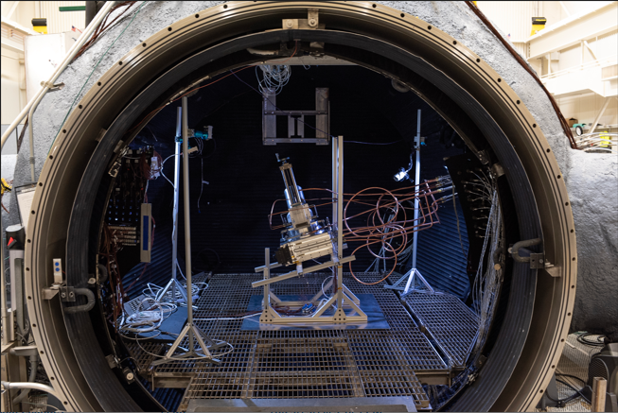
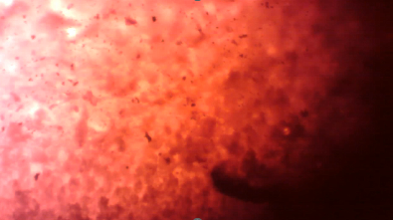

Oxygen From Regolith : Solar-Carbothermal Reduction
Test Number | g/KWh*
CaRD Ambient | 13.42
CaRD Vacuum 1 | 11.53
CaRD Vacuum 2 | 15.79
CaRD Vacuum 3 | 10.77
This test will be repeated in 2024 with an automated reactor being developed by Sierra Space through the Carbothermal Oxygen Production Reactor (COPR) Tipping Point project
Image Credit: NASA/JPL-Caltech
Notes:
Overlay of water equivalent hydrogen abundances and a shade relief map derived from MOLA topography. Mass percents of water were determined from epithermal neutron counting rates using the Neutron Spectrometer aboard Mars Odyssey between February 2002 and April 2003.
Image Source: https://mars.jpl.nasa.gov/odyssey/gallery/latestimages/20030724a.html

Slide 25
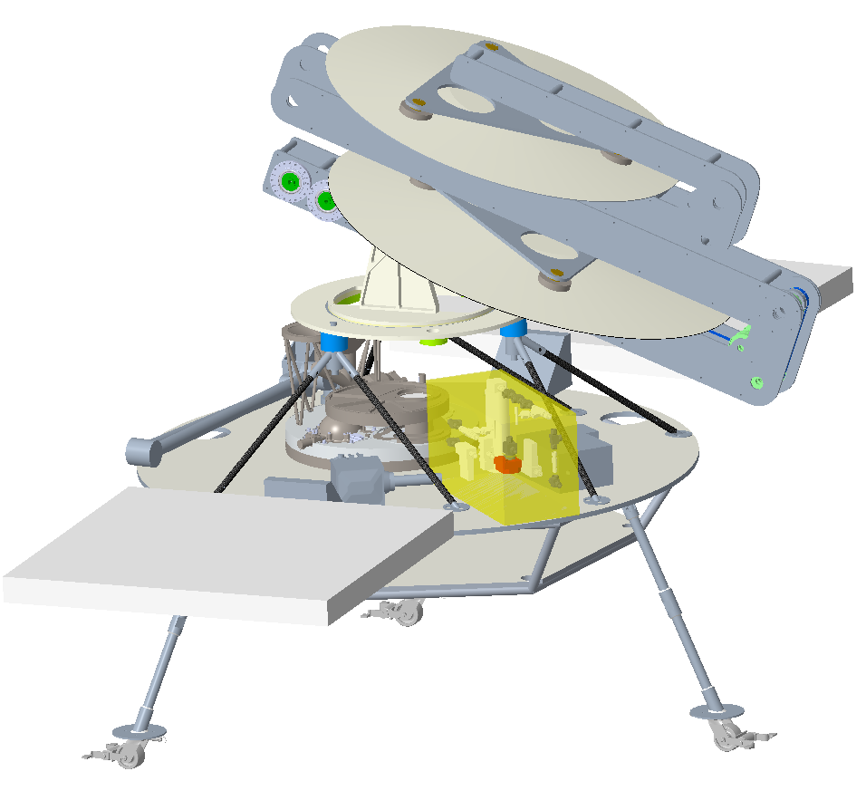
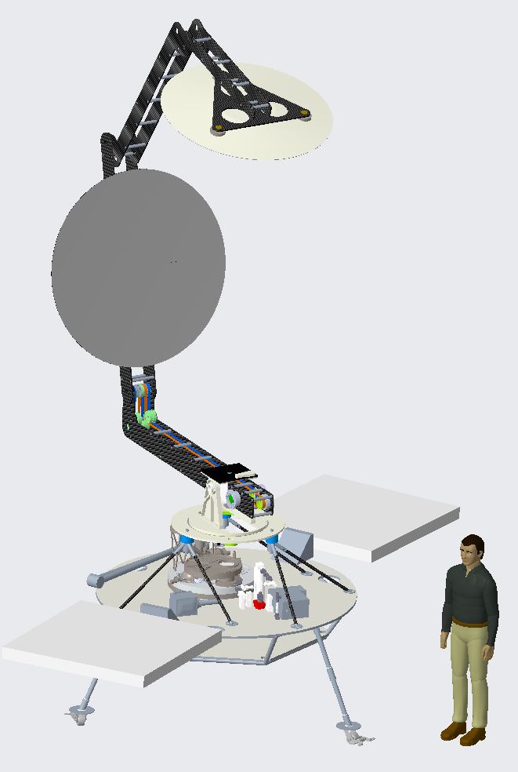
Oxygen From Regolith : Solar-Carbothermal Reduction
Solar Concentrator
Reactor
Arm Mockup
Avionics/Software
Gas Analysis
Lander Mockup
Thermal Management
Reactor Fluid System

Slide 26
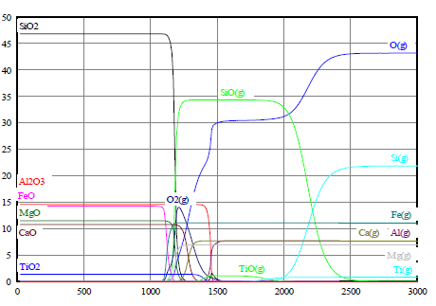
Oxygen From Regolith : MRE and Vacuum Pyrolysis
Molten Regolith Electrolysis is being developed by multiple teams
Blue Origin’s Blue Alchemist technology is using Molten Regolith Electrolysis to produce solar panels.
  See press release: https://www.blueorigin.com/news/blue-alchemist-powers-our-lunar-future
Vacuum Pyrolysis has been demonstrated to separate oxygen from various metals found in lunar regolith
%
^{O} C
Matchett, J. O. H. N. (2006). Production of lunar oxygen through vacuum pyrolysis. George Washington University: Washington, DC, USA.

Slide 27
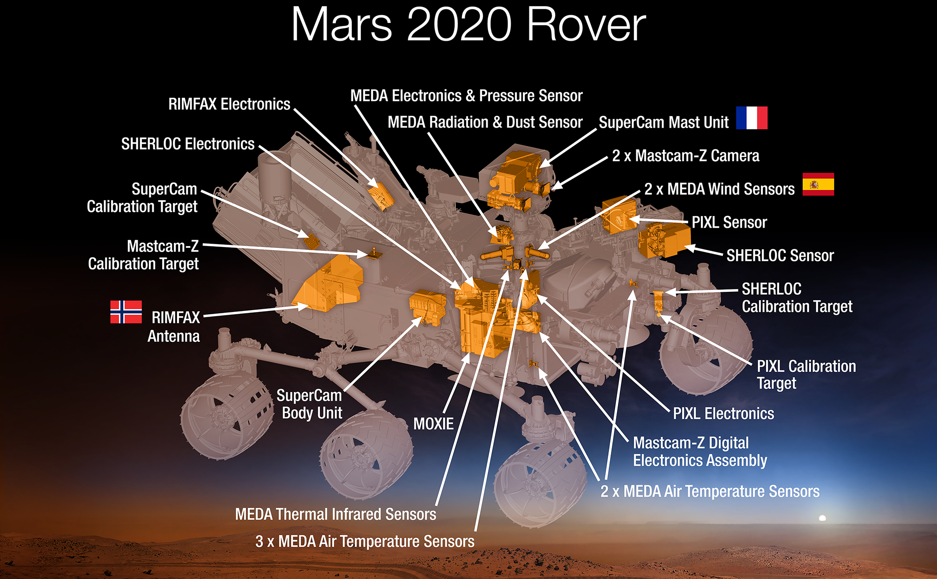
Martian Atmosphere
Image Credit: NASA/JPL

Slide 28
Actual presentation will play the video from the link below
https://www.youtube.com/watch?v=n1viNk1eNnM
Video Credit: NASA

Slide 29
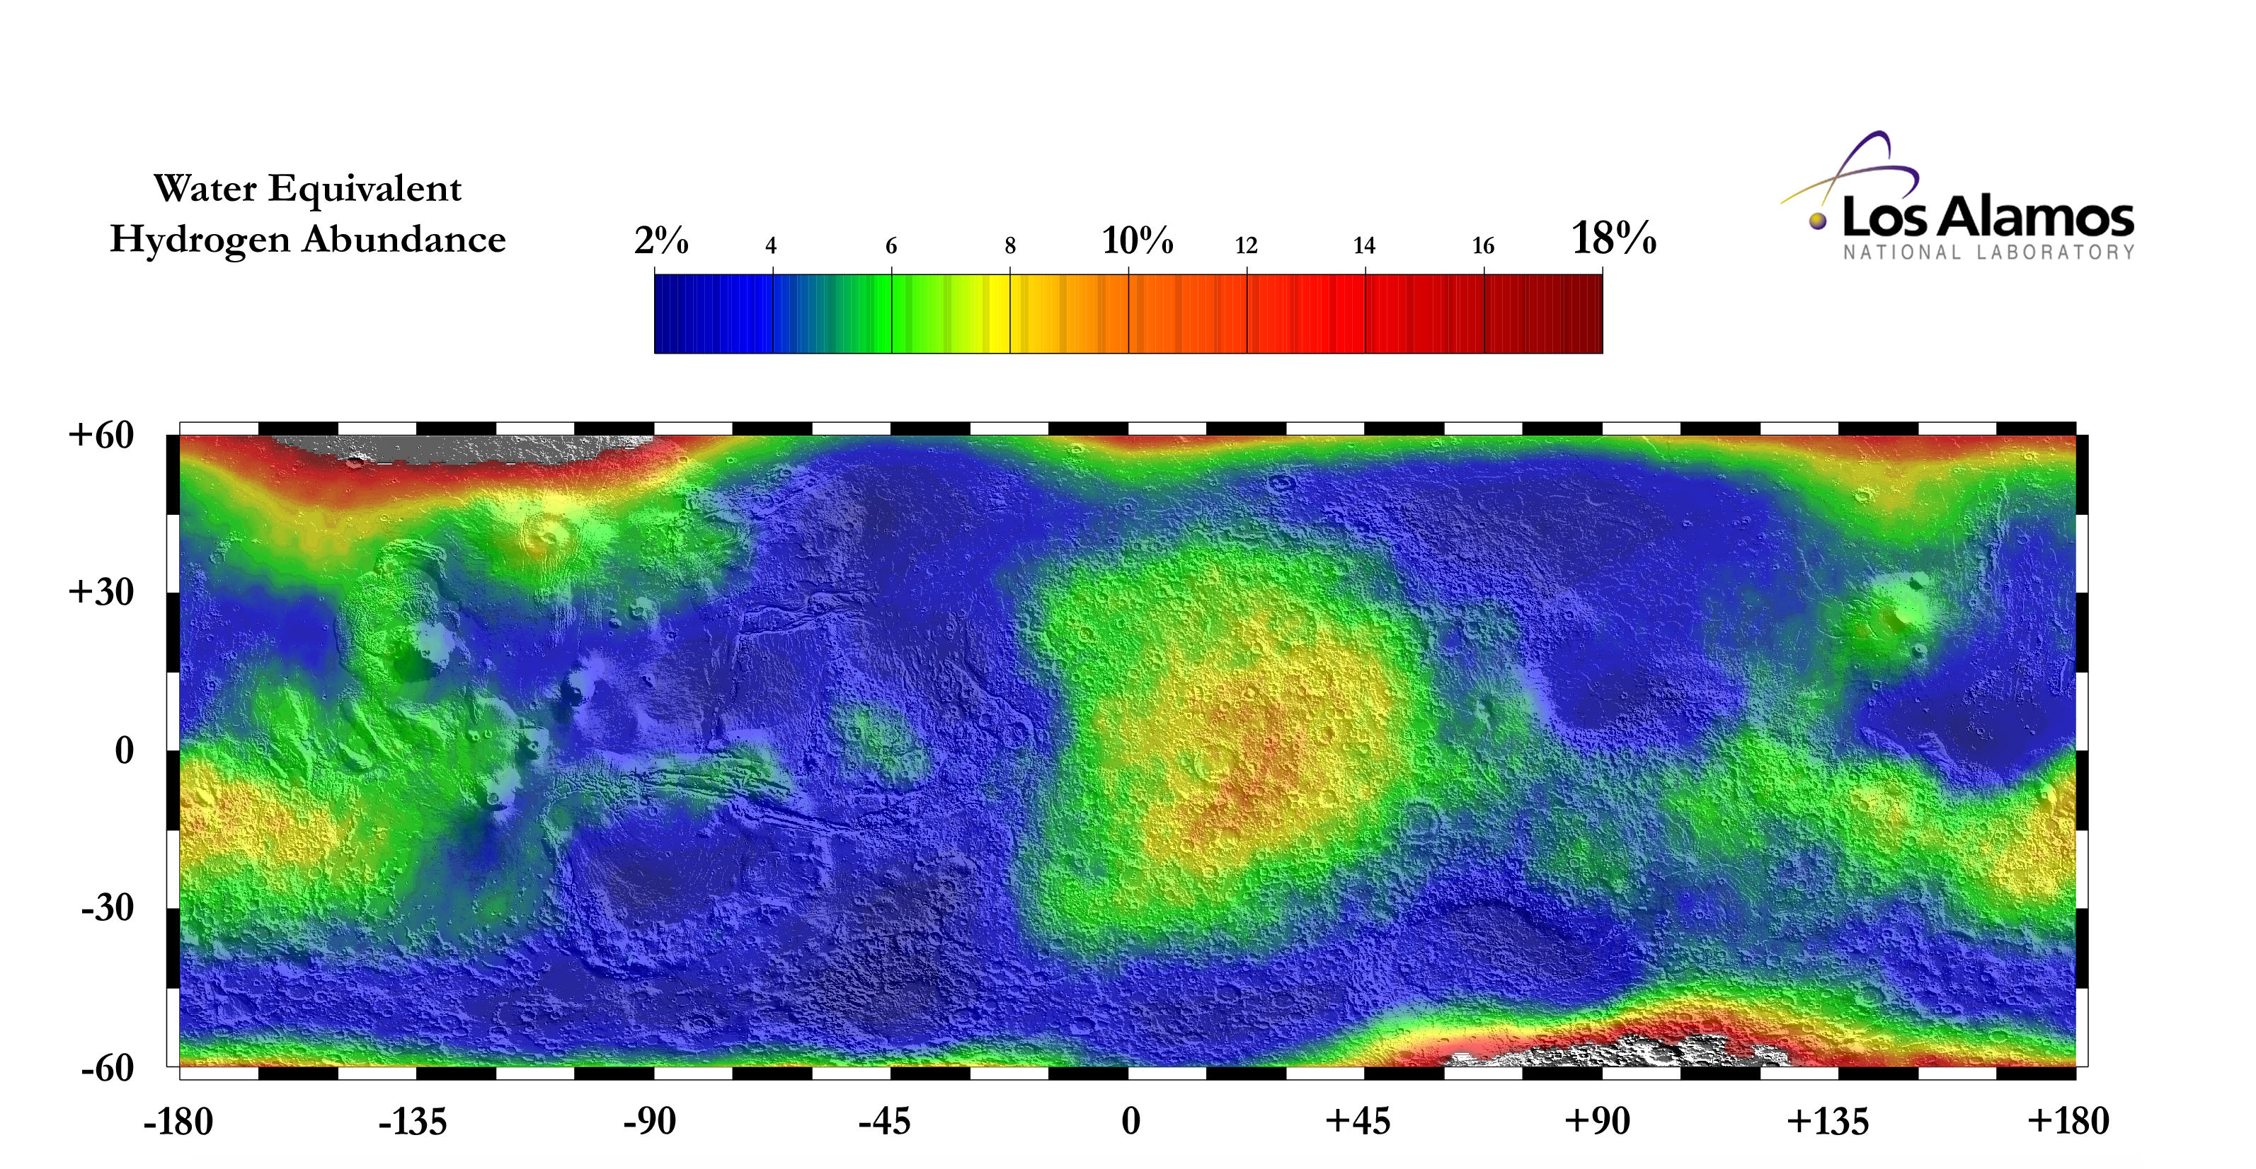
Water on Mars
Image Credit: NASA/JPL-Caltech
Notes:
Overlay of water equivalent hydrogen abundances and a shade relief map derived from MOLA topography. Mass percents of water were determined from epithermal neutron counting rates using the Neutron Spectrometer aboard Mars Odyssey between February 2002 and April 2003.
Image Source: https://mars.jpl.nasa.gov/odyssey/gallery/latestimages/20030724a.html

Slide 30
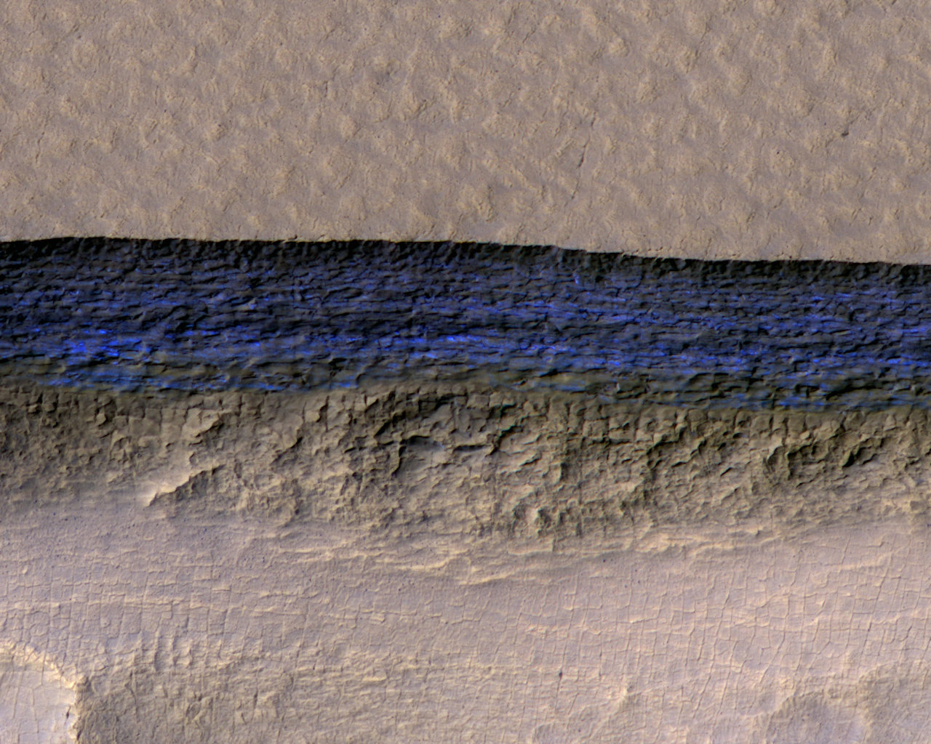
Water on Mars
Image Credit: NASA/JPL-Caltech/UA/USGS
A cross-section of underground ice is exposed at the steep slope that appears bright blue in this enhanced-color view from the HiRISE camera on NASA's Mars Reconnaissance Orbiter. The scene is about 550 yards wide. The scarp drops about 140 yards from the level ground in the upper third of the image.

Slide 31
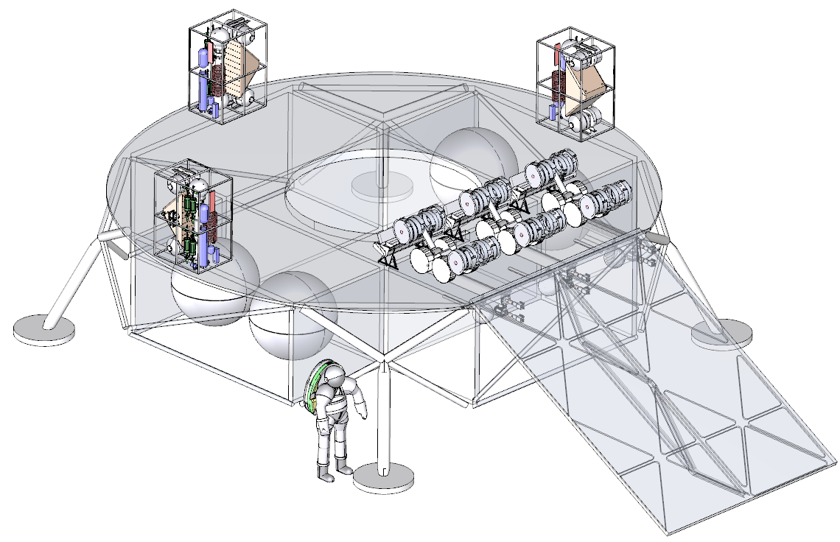
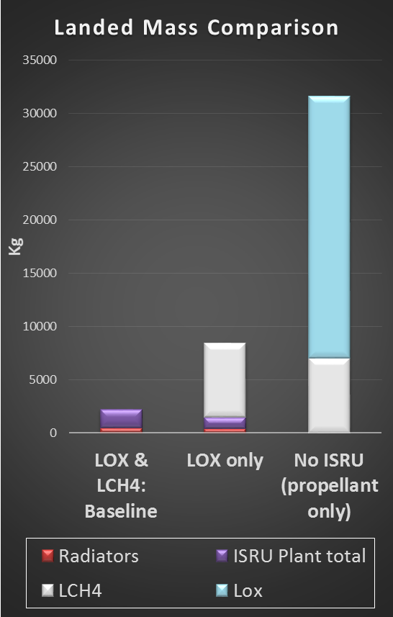
Propellant Production on Mars
CO₂
LOX
LCH₄
H₂O
ISRU Propellant Production Plant
An Oxygen-only propellant production plant on Mars could make ~3 times its own mass in oxygen in 480 days
An LOX/LCH4 propellant production plant on Mars could make ~ 18 times its own mass in propellant in 480 days
Kleinhenz, J. E., & Paz, A. (2017). An ISRU propellant production system for a fully fueled Mars Ascent Vehicle. In 10th Symposium on Space Resource Utilization (p. 0423).
Notes:
Terrestrial propellant alone (Lox and Methane propellant mass, not including additional tankage) is
18x the mass of a Lox/LCH₄ ISRU landed mass
4x the mass of a LOX ISRU landed mass

Slide 32
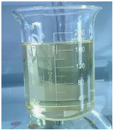
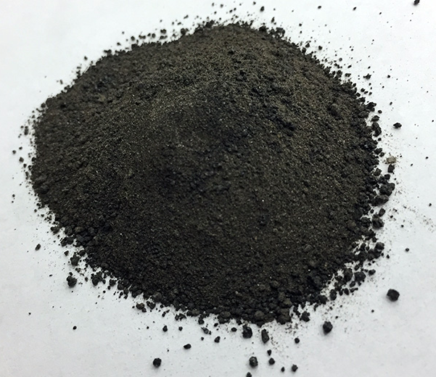
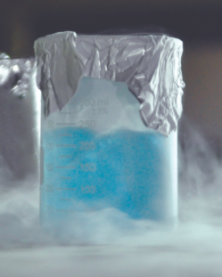
Moon to Mars
Modified Lunar Carbothermal Concept
Carbon
Methane Pyrolysis
Common to Mars ISRU and Life Support Systems
CH₄
Common to Mars ISRU
Carbothermal Reactor
CH_{4,} CO, H_{2,} CO₂
Sabatier Reactor
CH₄
CH₄ Liquefaction & Maintenance
Soil Excavation
Inlet Hopper
H₂O
Condenser
CH₄
CH₄ Dryer
H₂O
H₂
Spent Soil Disposal
Outlet Hopper
Water Cleanup
Water Electrolysis
O2 Dryer
O2 Liquefaction & Maintenance
O₂
HYDROGEN LIQUEFACTION
Oxygen Mass | 10 | tonnes
LOX/Fuel Ratio | 6
H2 Mass Required | 1.67 | tonnes
Carbon Mass Required (tonnes) | 0 | tonnes
Mass of 20W/20K crycooler | 106.3 | kg
Fuel Liquefaction Thermal Lift Required | 429 | W
Number of Cryocoolers Required | 22
Mass of Cryocoolers & Radiators | 2.34 | tonnes
Return on Landed Mass in 1 year | 0.71
METHANE LIQUEFACTION
Oxygen Mass | 10 | tonnes
LOX/Fuel Ratio | 3.6
CH4 Mass Required | 2.78 | tonnes
Carbon Mass Required (tonnes) | 2.08 | tonnes
Mass of Cryotel GT | 3.1 | kg
Fuel Liquefaction Thermal Lift Required | 169 | W
Number of Cryocoolers Required | 8
Mass of Cryocoolers & Radiators | 0.065 | tonnes
Return on Landed Mass in 1 year | 1.30
Water from Icy Regolith
If we bring carbon to the Moon
1) We can test all of the technologies required to produce propellant on Mars
2) We can utilize hydrogen from water by feeding water into a system that is already in place to extract oxygen from regolith
3) It will much easier to liquefy and store methane than hydrogen.
Notes:
This image was produced for the Evolvable Mars Campaign and has already cleared the DAA process

Slide 33
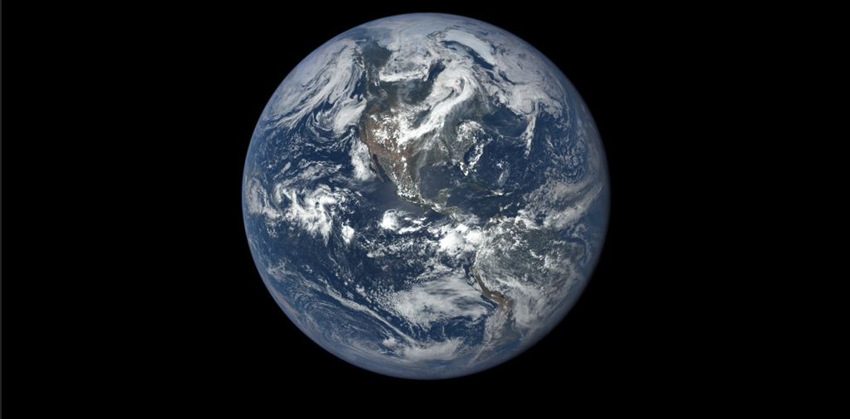
ISRU Technology Impact on Earth
Water electrolysis can be used to produce hydrogen at a large scale
Hydrogen reduction of iron oxides is being used to make steel with no carbon emissions
Solar-carbothermal reduction and molten regolith electrolysis can be used to produce silicon with no carbon emissions
Sabatier process can convert carbon dioxide and hydrogen into methane
Carbon dioxide and water can be used to make plastics
Image Credit: NASA

Slide 34

Thank You!
“Exploration is in our nature. We began as wanderers, and we are wanderers still. We have lingered long enough on the shores of the cosmic ocean. We are ready at last to set sail for the stars.”
-Carl Sagan
Image Credit: NASA

Slide 35
Backup
“Exploration is in our nature. We began as wanderers, and we are wanderers still. We have lingered long enough on the shores of the cosmic ocean. We are ready at last to set sail for the stars.”
-Carl Sagan
Image Credit: NASA

Slide 36
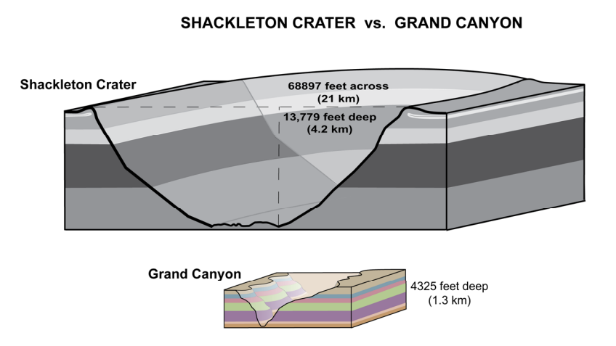
Lunar Ice Mining
Image Credit: Lunar Planetary Institute
https://www.lpi.usra.edu/exploration/multimedia/LunarLandscapesShackleton%20Crater.pdf

Slide 37
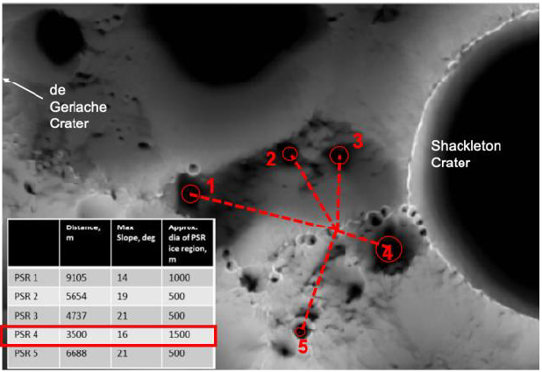
Lunar Ice Mining
Conceptual ISRU Plant Location
Linne, D. L., Kleinhenz, J. E., & Paz, A. (2020). Lunar water pilot plant conceptual design. In ASCEND 2020 (p. 4236).

Slide 38
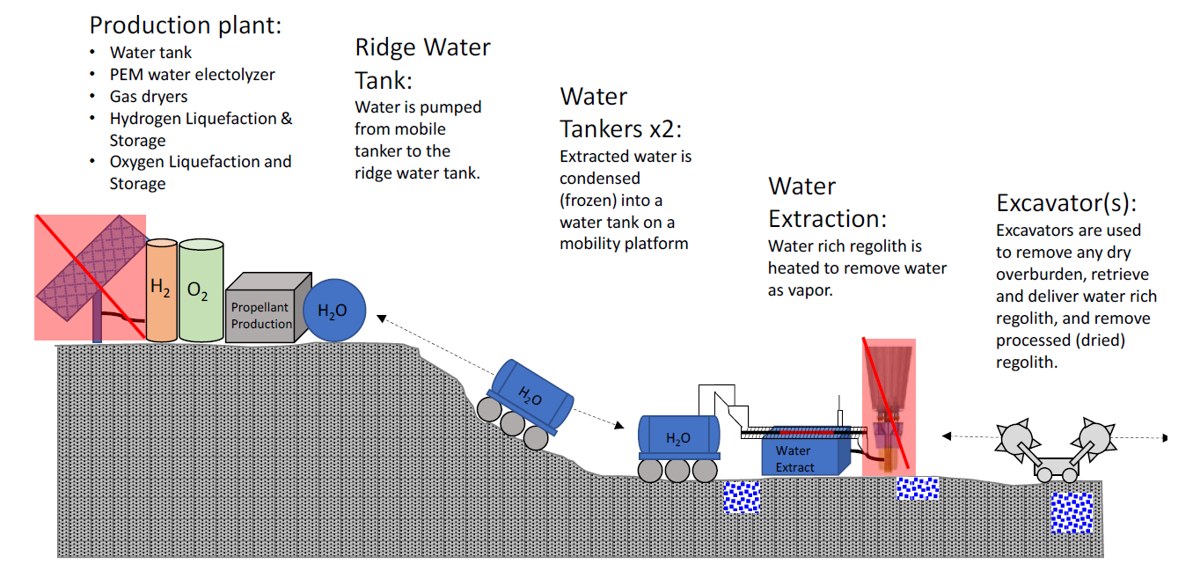
Lunar Ice Mining
Kleinhenz, J. E., & Paz, A. (2020). Case studies for lunar isru systems utilizing polar water. In ASCEND 2020 (p. 4042).
Image Credit: NASA/JSC

