Slide 1
Outer Planets Exploration:
Considerations for International Cooperation
Kunio M. Sayanagi (NASA Langley Research Center)
ISAS Planetary Exploration Workshop 2023（August 28-30, 2023）
https://www.isas.jaxa.jp/en/researchers/info/003437.html
Background: Voyager 2 Image of Uranus (NASA Image Release PIA00143)

Slide 2
Goals of this talk
From the Meeting Announcement:
https://www.isas.jaxa.jp/en/researchers/info/003437.html
“One of the other purposes of this workshop is to build a cross-sectoral team across universities, international organizations, and JAXA that will lead to mission proposals to help create our own exploration roadmap for the next few years or even future decades.”
Perspective:
Ideas presented in this presentation are what I want to see as an individual scientist.

Slide 3
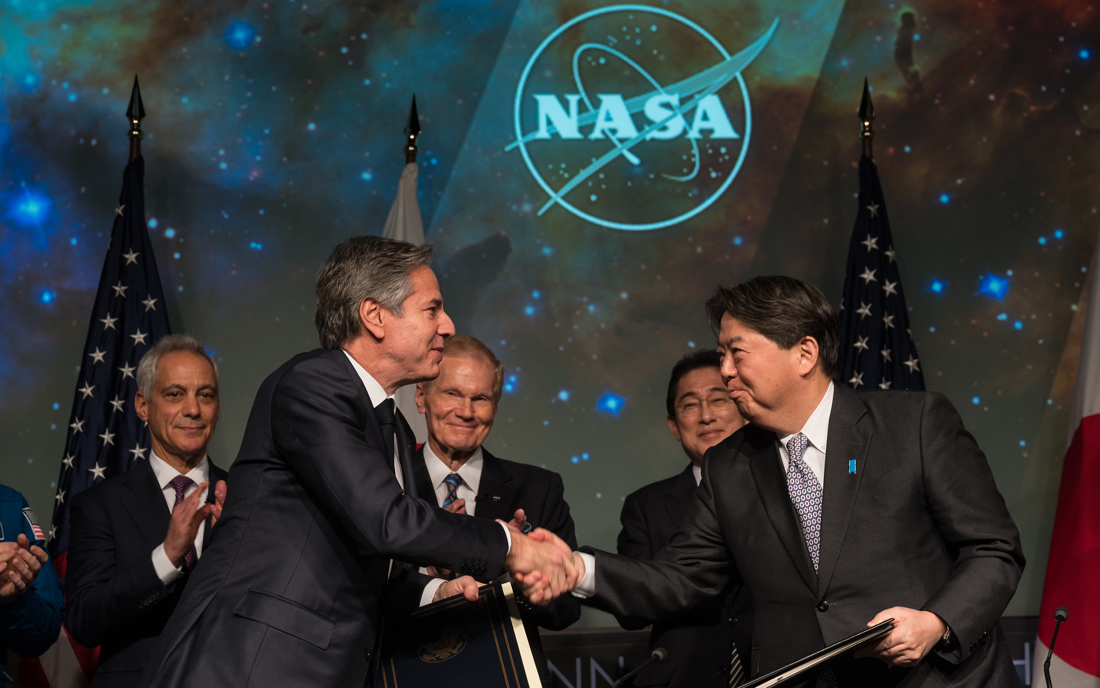
Japan-US Space Collaboration Agreement
On January 13, 2023, Japan and US signed: “Framework Agreement between the Government of Japan and the Government of The United States of America for Cooperation in the Exploration and Use of Outer Space, Including the Moon and Other Celestial Bodies, for Peaceful Purposes”
Signed by US Secretary of State Anthony Blinken and Japanese Foreign Minister Yoshimasa Hayashi at NASA HQ
NASA Press Release:
https://www.nasa.gov/press-release/us-japan-sign-space-collaboration-agreement-at-nasa-headquarters
Full Text available at Japanese Ministry of Foreign Affairs website:
https://www.mofa.go.jp/mofaj/ila/st/page24_002128.html

Slide 4
Scopes of Japan-US Framework Agreement
Activities Areas:
Space science, including lunar science;
Earth science;
Space operations and exploration, including lunar operations and exploration;
Aeronautical science and technology;
Space technology;
Space transportation;
Safety and mission assurance; and
Other relevant areas as mutually determined.
Forms of Cooperation:
Use of spacecraft and space research platforms;
Use of scientific instruments onboard spacecraft and space research platforms;
Crewed spaceflight operations;
Use of sounding rockets and scientific balloons;
Use of aircraft;
Use of ground-based antennas for tracking and data acquisition;
Use of ground-based space research facilities;
Exchanges of scientists, engineers, or other experts on general or specific subjects;
Exchanges of scientific data;
Space education;
Public outreach activities; and
Other forms of cooperation as mutually determined.

Slide 5
Action Item
Find out what is needed to leverage this Framework Agreement to do more Science!

Slide 6
Considerations for Instruments
Example: Uranus Orbiter and Probe (UOP) Imaging Instrument
  UOP Report: https://tinyurl.com/2p88fx4f
  Originally presented at Uranus Flagship 2023 Meeting:
  https://www.hou.usra.edu/meetings/uranusflagship2023/pdf/8145.pdf

Slide 7
Measurement Requirement Summary (From UOP Decadal Study)
Science Measurement Requirements
Uranus:
  Imaging: 50 km/pix
  VIS/NIR Spectrometer:
  500 km/pix
  Rings/Small Moons:
  Imaging: 0.1 km/pix
  VIS/NIR Spectrometer:
  1 km/pix
Major Satellites:
  Imaging: 0.5 km/pix
  VIS/NIR Spectrometer:
  3 km/pix
Instrument Performance
Field of View (FOV; degree)
Resolution (degree/pix)
Wavelength Range
How many / Which filters?
Spectral Resolution
How many imaging instruments?
Must Translate to Instrument Performance

Slide 8
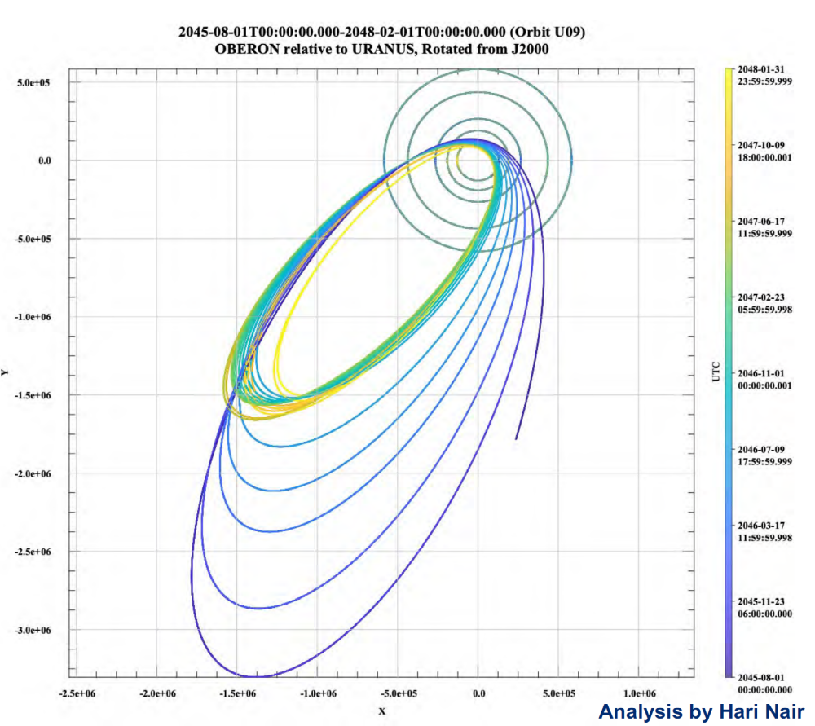
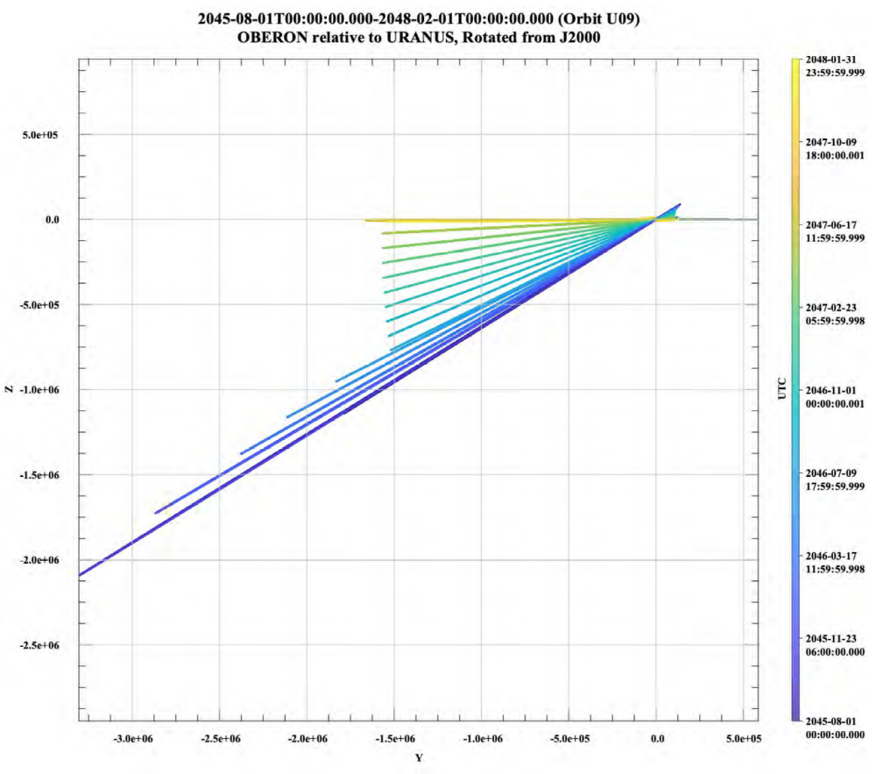
Uranus and Rings Imaging (Based on Decadal UOP orbits)
Uranus
Rings
Sunlight
Ring Obs. Opportunities
Initial Orbit: 30 deg Inclination
Uranus Obs. Opportunities
Obs. Range:
5e5 – 2e6 km
Imag. Res. (50 km/pix):
100 µrad/pix – 25 µrad/pix
VIS/NIR Res (500 km/pix):
1000 µrad/pix – 250 µrad/pix
FOV: Uranus Size varies:
5.8 deg – 1.5 deg
S/C Distance above ring plane:
50,000 km (30 deg orb)
17,000 km (10 deg orb)
3,500 km (2 deg orb)
Imaging Req: 0.1 km/pix
→ can be met at 3,500 km range with 28 µrad/pix
VIS/NIR Req: 1 km/pix
→ can be met at 3,500 km range with 280 µrad/pix
Sunlight

Slide 9
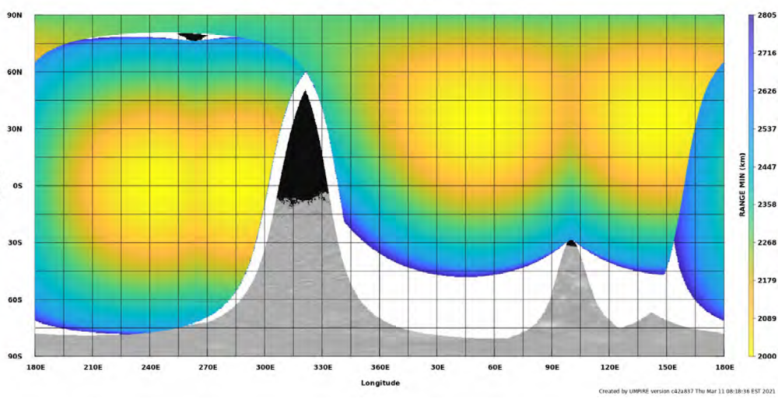
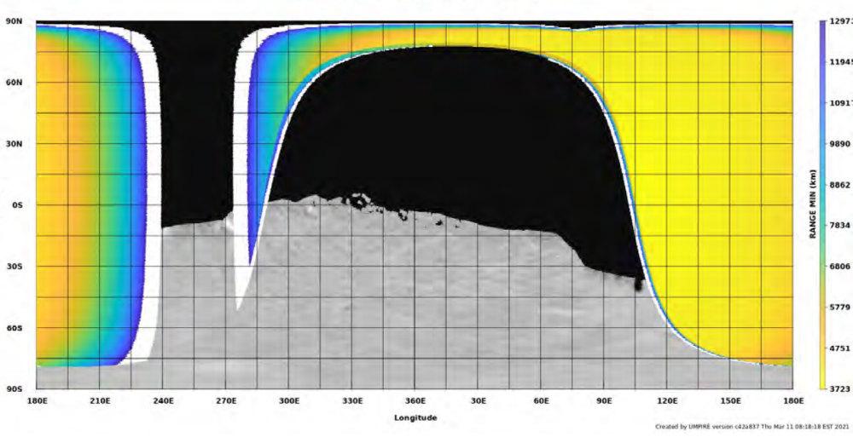
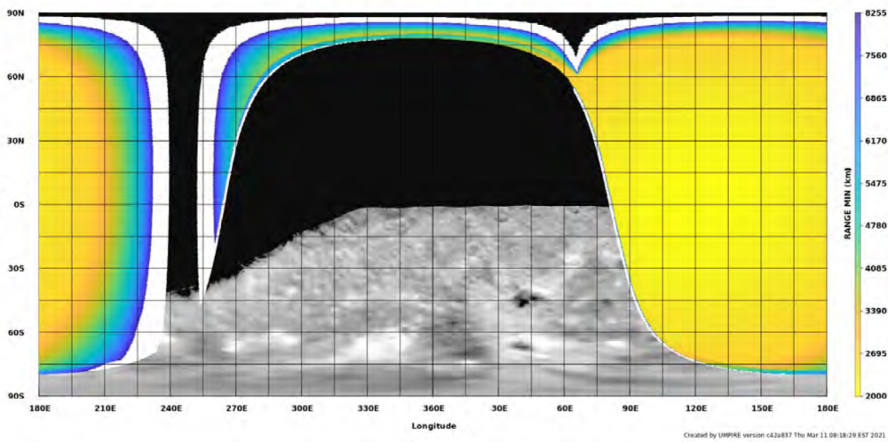
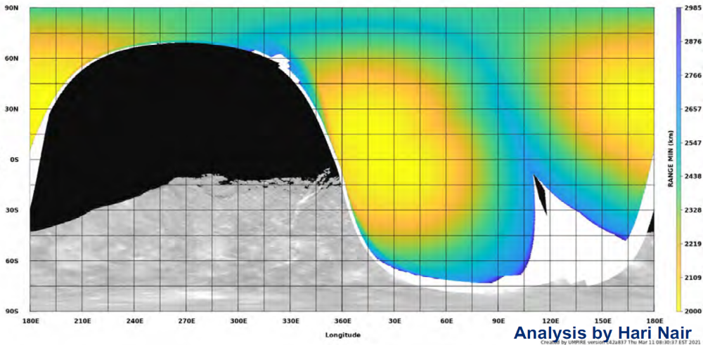
Major Satellites – Flyby Ranges in UOP Decadal Orbits
Ariel: Range: ~2500 km
Imaging 0.5 km/pix = 260 µrad/pix
VIS/NIR 3 km/pix = 1500 µrad/pix
Ang. Size = 26 degree
Umbriel: Range: ~6000 km
Imaging 0.5 km/pix = 92 µrad/pix
VIS/NIR 3 km/pix = 550 µrad/pix
Ang. Size = 11.1 degree
Steepest Req.
Oberon: Range: ~3500 km
Imaging 0.5 km/pix = 180 µrad/pix
VIS/NIR 3 km/pix = 1100 µrad/pix
Ang. Size = 25 degree
Titania: Range: ~2500 km
Imaging 0.5 km/pix = 290 µrad/pix
VIS/NIR 3 km/pix = 1700 µrad/pix
Ang. Size = 35 degree

Slide 10
Instrument Considerations Summary
Synthesized Imaging Instrument Requirements based on 2020 UOP Study Orbits:
NAC | WAC | VIS/NIR
Resolution <25 µrad/pix FOV: >3 degree | Resolution <92 µrad/pix FOV: >10 degree | Resolution: 250 µrad/pix FOV: >10 degree Spec. Res: 7 nm
Above “requirements” are dependent on the assumed orbits
During early mission panning, the process to tune the instrument performance is more important than any intermediate parameters
Early coordination between instrument + orbit design is important, especially in international cooperation mission

Slide 11
Considerations for SmallSats + Probes
Challenges for Outer Planets SmallSats + Probes:
  Power
    Juno’s solar panel: 350 kg for 400 W
  Thermal
    Juno’s electric heaters need 250W
    SNAP probe needs 3W heating for 30 days after separation from orbiter
  Large delta-V needs
    UOP’s total delta-V = ~ 2 km/s
  → SmallSats + Probes benefit from large carrier spacecraft
Examples:
  Small Next-generation Atmospheric Probe (SNAP)
  https://link.springer.com/article/10.1007/s11214-020-00686-7
  Outer Planet Rideshare Concept:
  https://www.hou.usra.edu/meetings/opag2020/pdf/6003.pdf

Slide 12

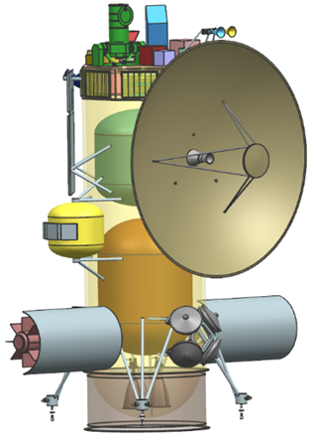
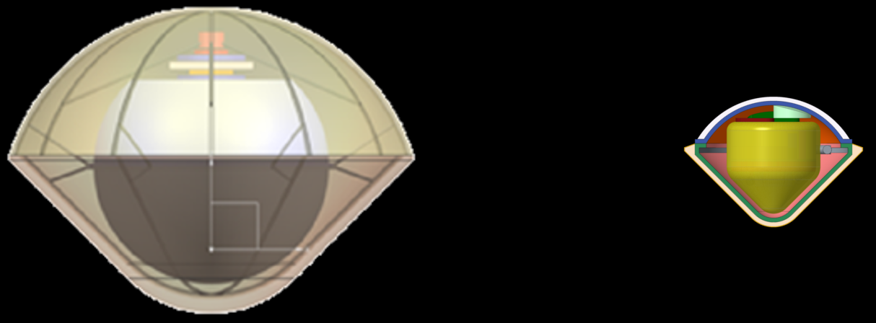
SNAP as a Second Probe
From 2017 Ice Giant SDT Study
SNAP
Not to scale with Orbiter
91 cm
37 cm
120 cm
50 cm
Mass: 321 kg
Diameter: 1.2 m, 45° sphere-cone
10-bar* pressure altitude
Probe release: ~60 days
EPFA: -20° to -50°
Mass: 30 kg
Diameter: 0.5 m, 45° sphere-cone
10-bar* pressure altitude
Probe release: 30–60 days
EPFA: -20° to -50°
Mass in orbit: 1913 kg
Payload Mass: 50 kg
UOI r_{p}: 1.05 R_{U}
Orbital Period: ~142 days
Primary Atm. Probe (PP)
SNAP
Orbiter
Baseline Orbiter and Probe: Ice Giant SDT Architecture #5
*10-bar is requirement for hardware operation for margin, science objective is to reach 5-bar.

Slide 13

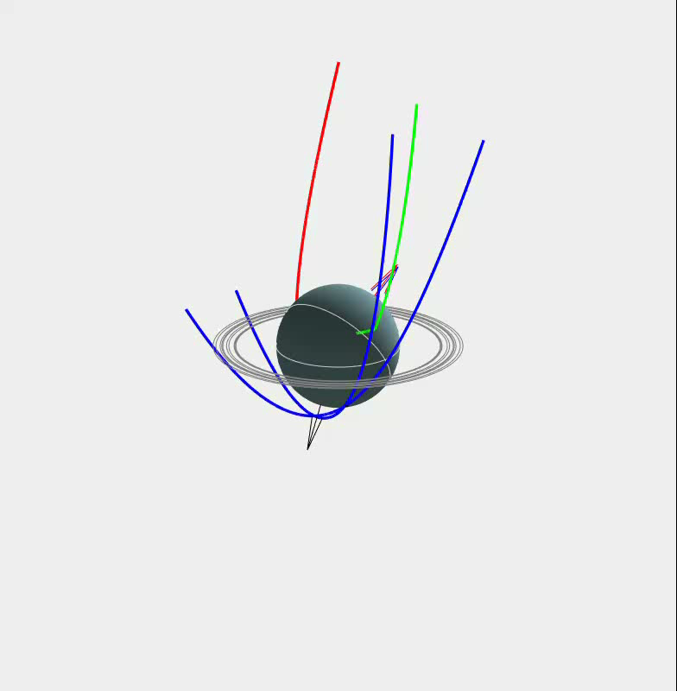
SNAP: Concept of Operations

Slide 14
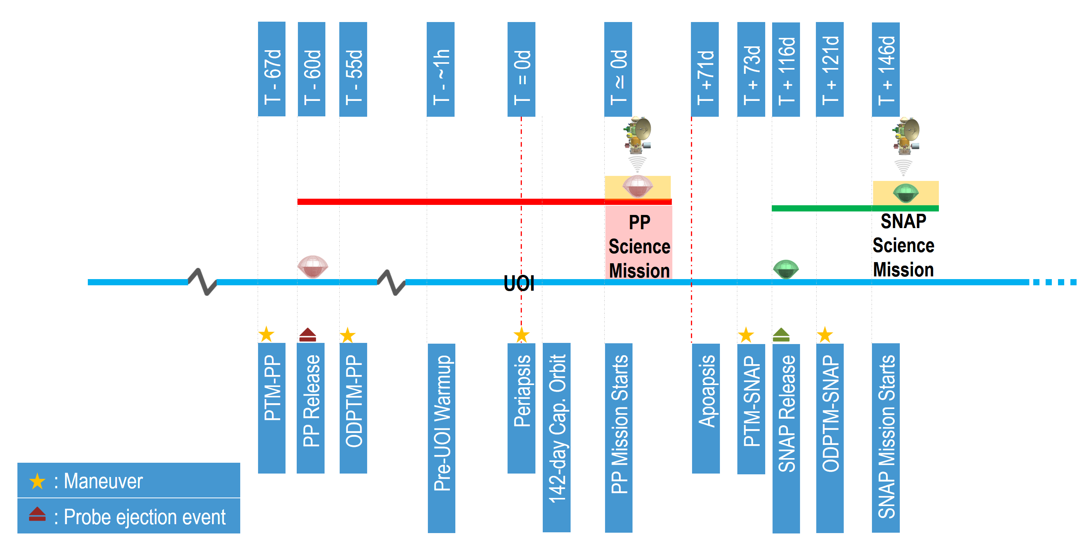
SNAP: Concept of Operations
UOI: T = 0 day
Not to Scale
Probe Separation

Slide 15
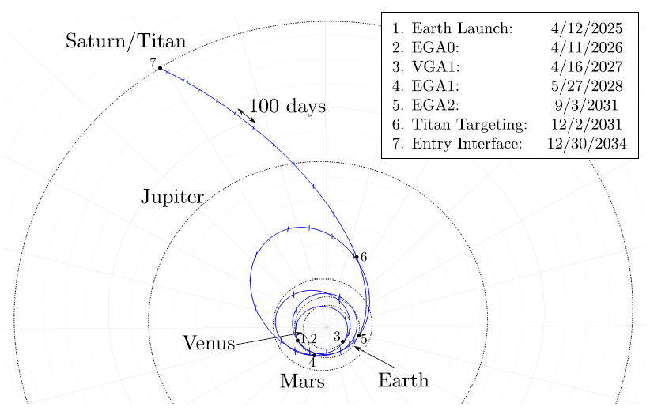
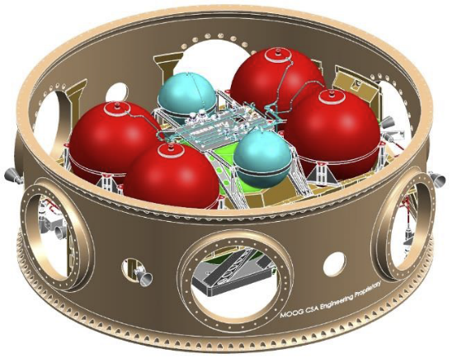
Rideshare to Outer Solar System
Case Study: Use Dragonfly launch to send small missions to Saturn
Study conducted at NASA Langley Research Center
Carrier-Relay Spacecraft (CRSC) based on a Propulsive ESPA Bus (Stender et al. 2015, 31st Space Symposium).
CRSC Subsystem | Mass
Structure (Estimate) | 391 kg
Solar Panels | 202 kg
TCS+ACS+CDH+Comm | 105 kg
RCS | 46 kg
SmallSats / Probe | 130 kg x2 = 260 kg
Dry Mass | 1,005 kg
Propellant (ΔV = 246.6 m/s) | 128 kg
Total CRSC Launch Mass | 1,132 kg
Dragonfly’s preliminary interplanetary trajectory:
Total ΔV = 217.7 m/s
Launch C3 = 16 km²/s²
(Scott et al. 2018, Advances in the Astronautical Sciences 18-416).

Slide 16
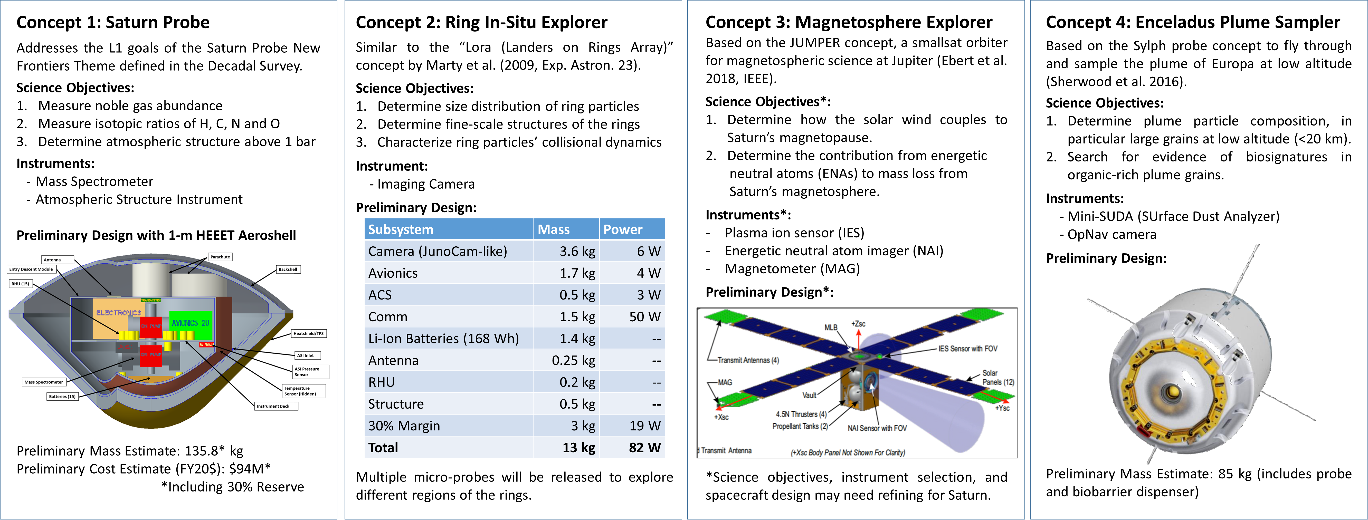
Potential Small Missions to Saturn
Case Study: Mission Concepts for the Saturn System Enabled by the Dragonfly Launch
¹Kunio M. Sayanagi, ²Cindy L. Young, ³Robert W. Ebert, ⁴Morgan L. Cable, ⁵Matthew S. Tiscareno, ⁶Matthew M. Hedman, ⁴David H. Atkinson, and ⁷Olivier Mousis
¹Hampton University, ²NASA Langley Research Center, ³SwRI, ⁴NASA-JPL/Caltech, ⁵SETI Institute, ⁶University of Idaho, ⁷Aix-Marseille Université https://www.hou.usra.edu/meetings/opag2020/pdf/6003.pdf

Slide 17
Considerations for SmallSats + Probes
Small missions and probes can be carried on a larger mission, or a dedicated carrier spacecraft
Potential model for international cooperation

Slide 18
Considerations for Earth-orbiting Missions
Valuable planetary observations are possible from Earth orbit
Examples:
  Shadow Chaser: Earth-orbiting Stellar Occultation Mission:
  https://agu.confex.com/agu/fm22/meetingapp.cgi/Paper/1104976

Slide 19
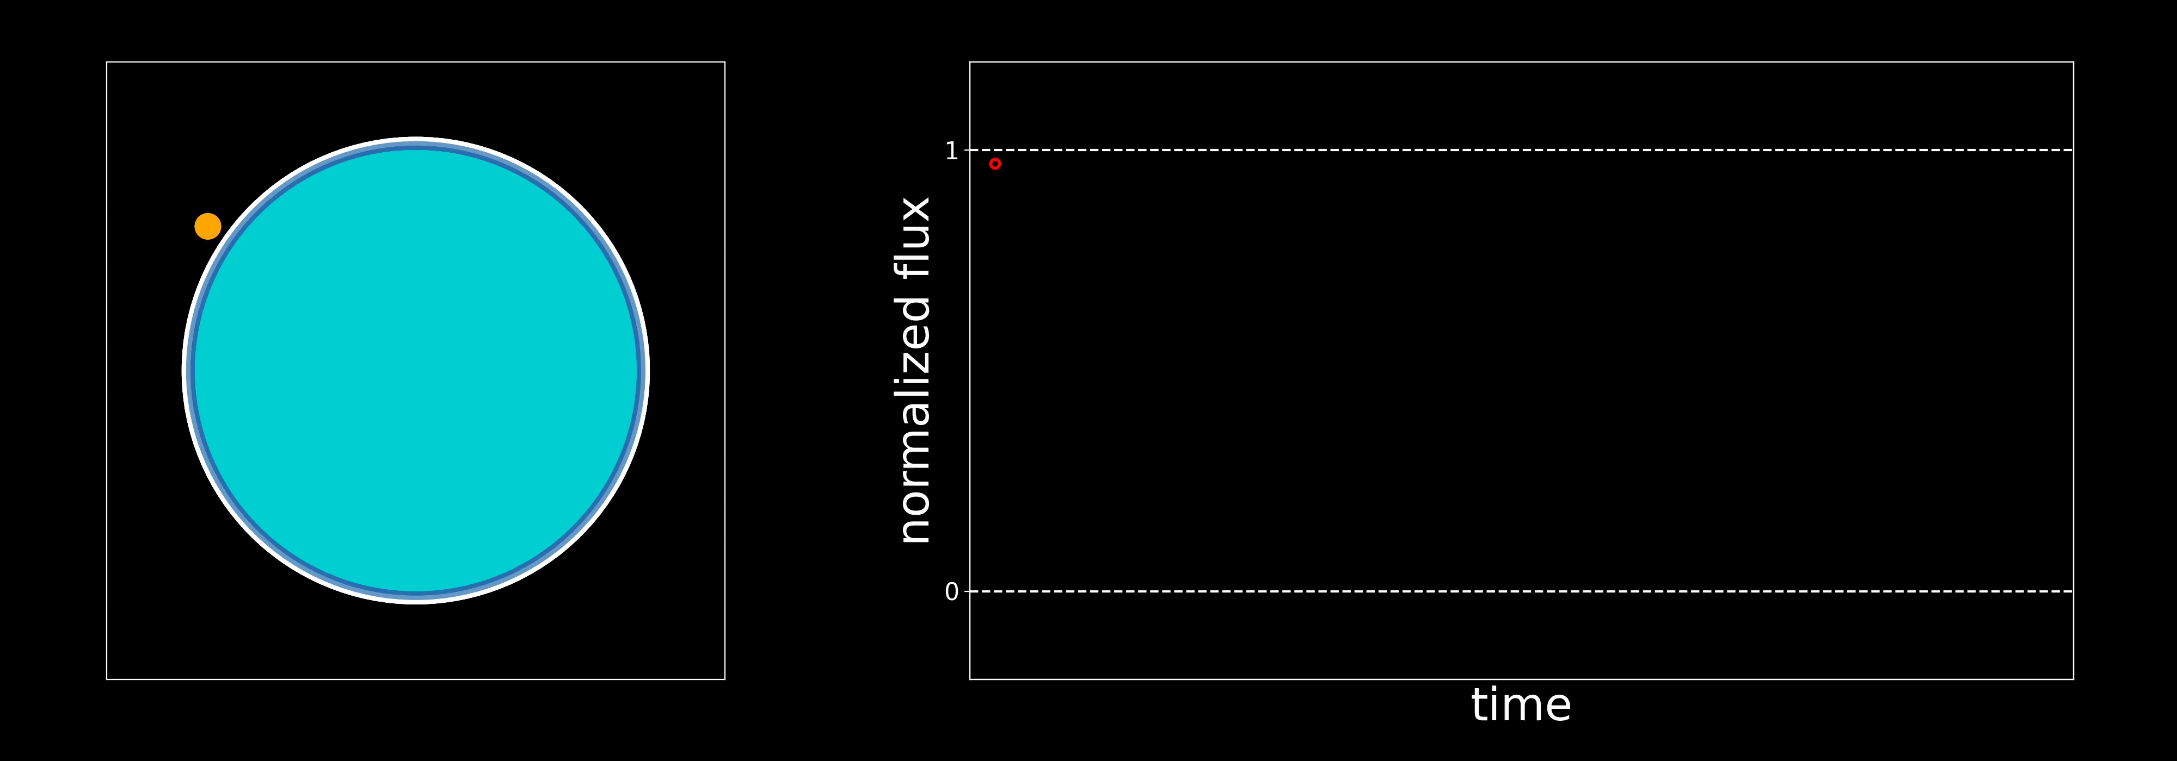
Shadow Chaser: a Stellar Occultation Mission
Measure the middle and upper atmospheric temperature and density of Uranus and Neptune through stellar occultation (SO) technique from Earth orbit.
Ingress
Egress
Animation by William Saunders (Boston University)

Slide 20
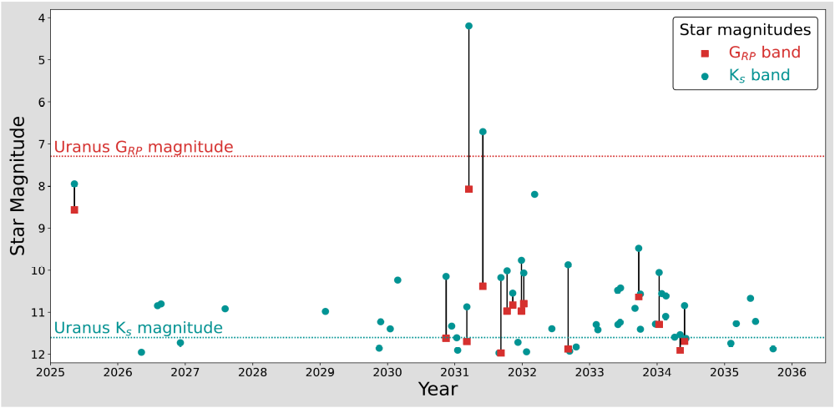
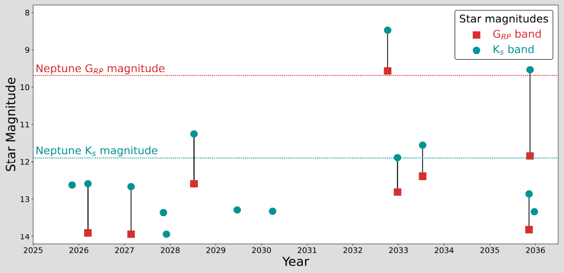
Stellar Occultation Predictions
  Predicted 56 Uranus and 14 Neptune Occultations between 2025-2035
  20 Uranus and 6 Neptune occultations are observable from the ground
    Demonstrated the value of future orbital mission
  Instrument Requirement: Threshold aperture size of 20 cm to measure vertical structure
  2031-2033 period has multiple viable SO events
  Published as Saunders et al (2022, Planetary and Space Science)
Magnitudes of occulted stars for Predicted SO events in 2025-2035
20 cm (S/N=100)
50 cm (S/N=100)
20 cm (S/N=100)
20 cm (S/N=30)
50 cm (S/N=100)
50 cm (S/N=30)
20 cm (S/N=30)
50 cm (S/N=30)
(Saunders et al. 2022, Planetary and Space Science)

Slide 21
Shadow Chaser: Potential for International Cooperation
Shadow Chaser has significant potential for international collaboration:
Launch RideShare?
  Shadow Chaser could be launched on RideShare on a Launch by an International Partner
Hosted Payload?
  Shadow Chaser could be an instrument on a host satellite in appropriate orbit
Satellite Constellation?
  Multiple Satellites launched by international partners can measure different locations on Uranus and Neptune

Slide 22
Summary: Enabling International Outer Planets Missions
Japan-US Space Collaboration Agreement:
  Find out how we leverage the agreement to enable more science
Instrument Collaboration:
  Early cooperation is crucial to design instruments and orbits
SmallSats and Probes to Outer Planets:
  Carrier Spacecraft may enable small missions to outer planets
Earth Orbiting Missions
  Unique opportunities (e.g. stellar occultations) enable high-value outer planet science from Earth orbits with international cooperation potential

