Slide 1
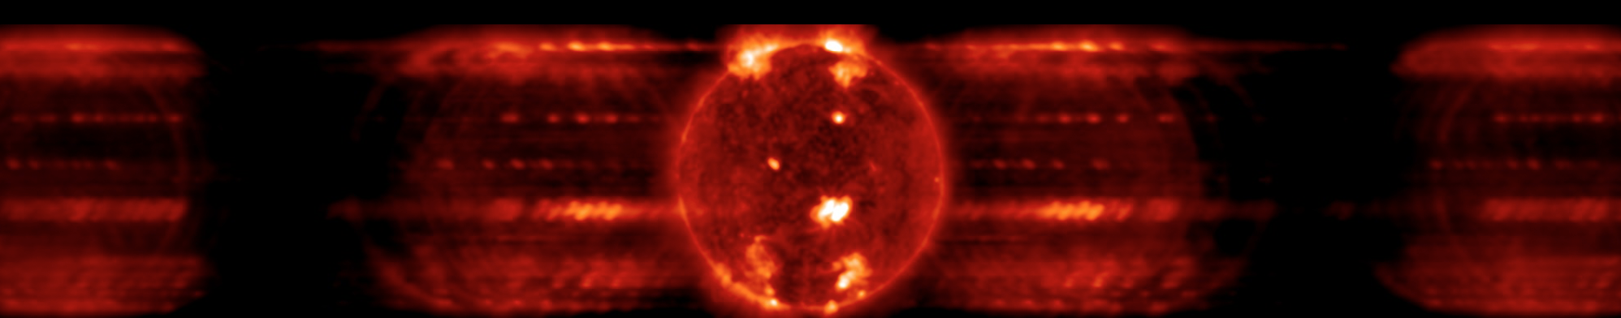
Probing the Sun with Imaging Spectrographs
Amy Winebarger¹, P. S. Athiray², Amir Caspi³, Patrick Champey¹, Ken Kobayashi¹, Charles Kankelborg⁴, Katharine Reeves⁵
¹NASA MSFC, ²University of Alabama Huntsville, ³Southwest Research Institute, ⁴Montana State University, ⁵Smithsonian Astrophysical Observatory
Predicted MOXSI data
CubeSat to be launch 2025

Slide 2
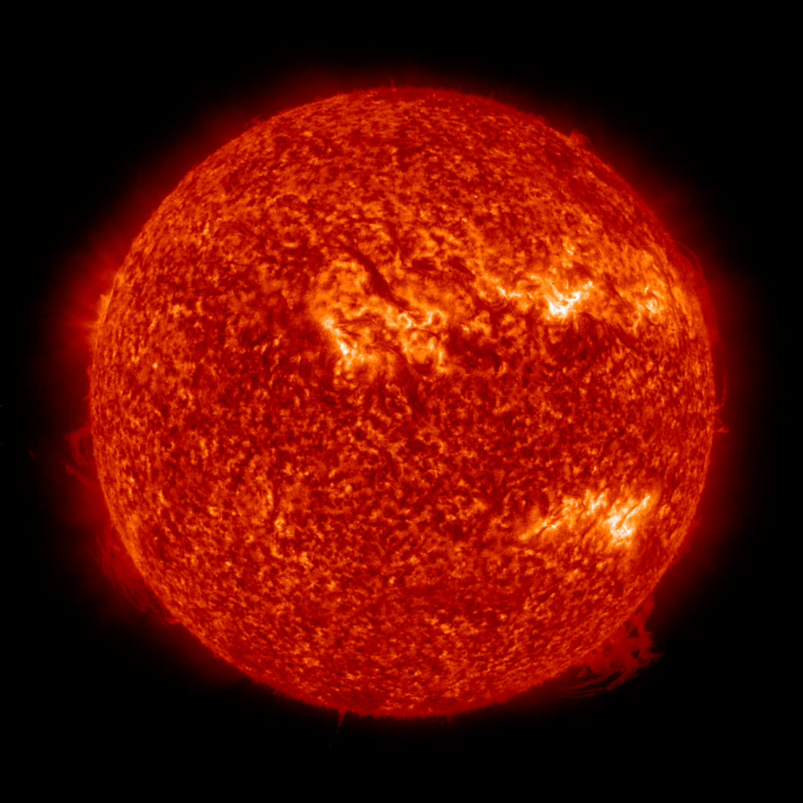
The problem
The solar atmosphere is
multi-dimensional
complicated
unpredictable
Solar observations are inherently limited.
Notes:
The solar atmosphere is multi-dimensional, complicated and unpredictable.
Three spatial dimensions structured by the magnetic field (not axisymmetric)
Structures in the corona can have strong temperature and density gradients and unique elemental abundances
The structures themselves as well as the density and temperature along the structure can vary at many time scales (sub-second to years)
Variation in elemental abundances from structure-to-structure as a function of time
Solar observations are inherently limited.
Two-dimensional detectors with limited number of pixels
Choose between spatial resolution and field of view
Time scales limited by detector readout time and SNR requirements on short side and instrument lifetime on the long side
Though we can make images with different temperature sensitivity, like arrowband EUV images or X-ray filtergrams. But these images can confuse the density and abundances. If you see something brighten in the image, it is because the plasma cooled or was heated into that passband? Or did the density of the structure increase? Or the abundances of iron increase in that structure?

Slide 3
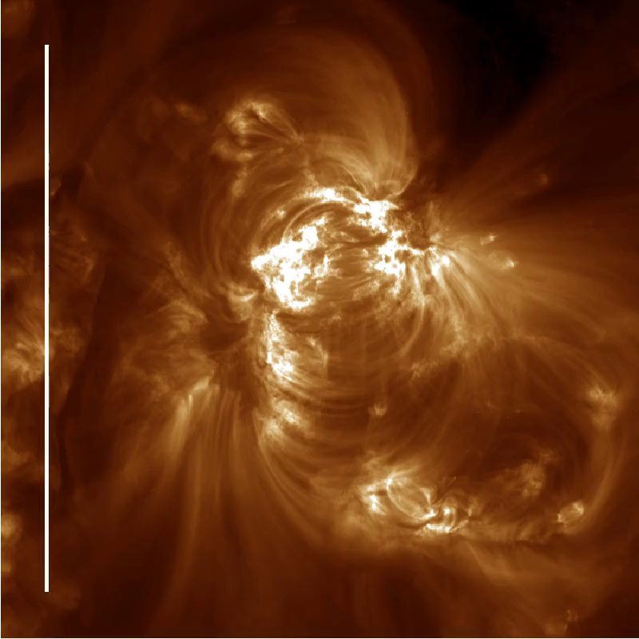
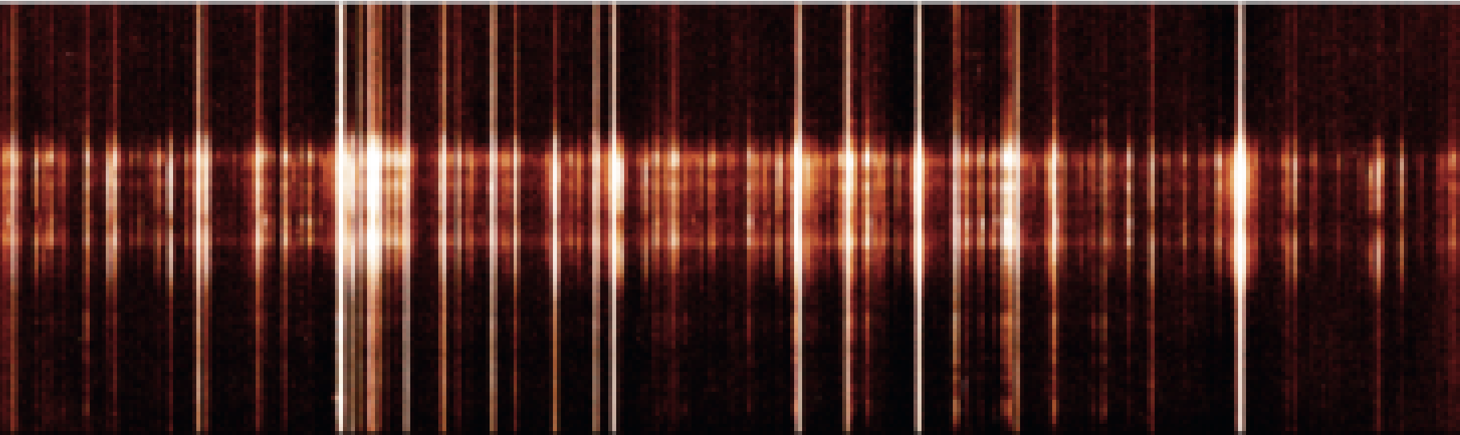
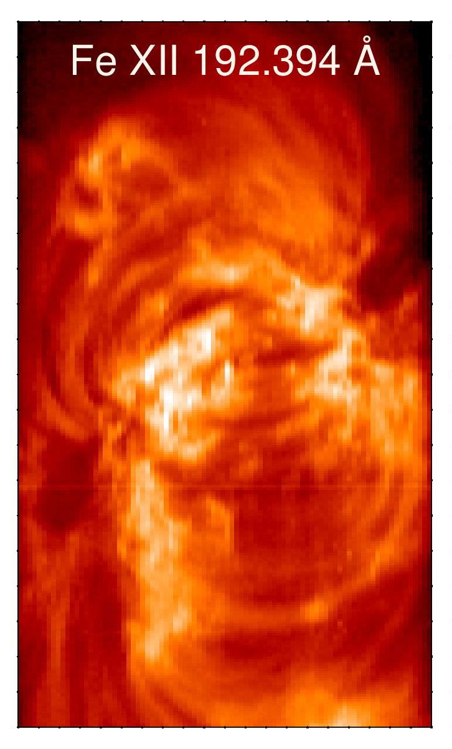
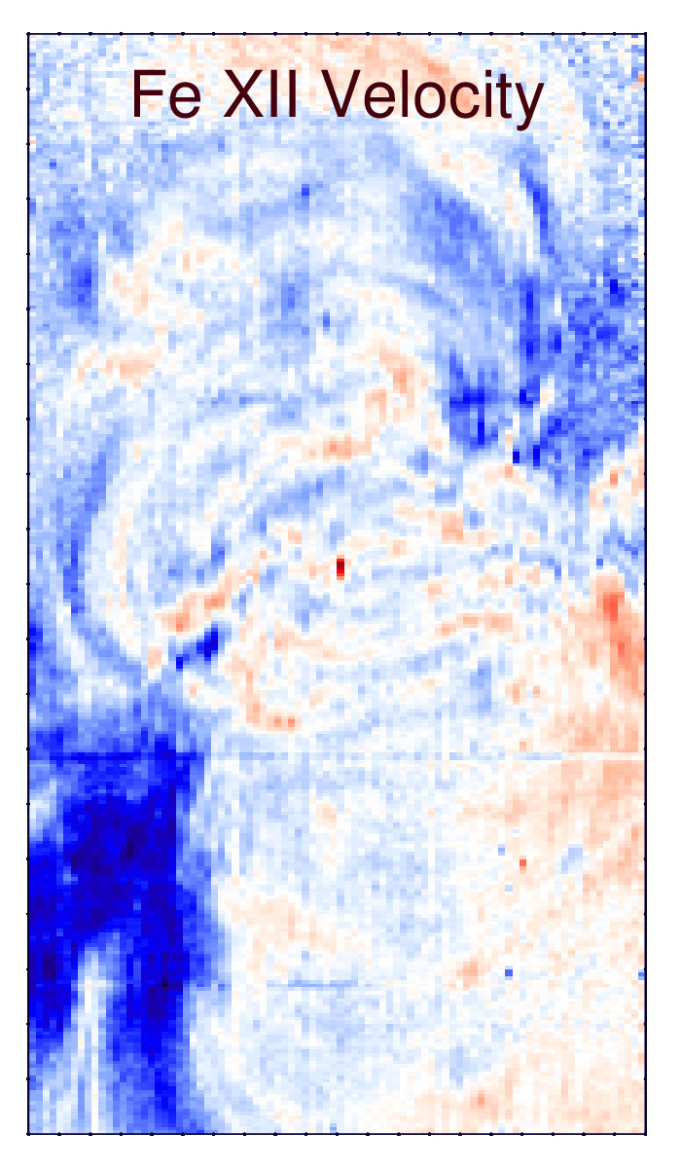
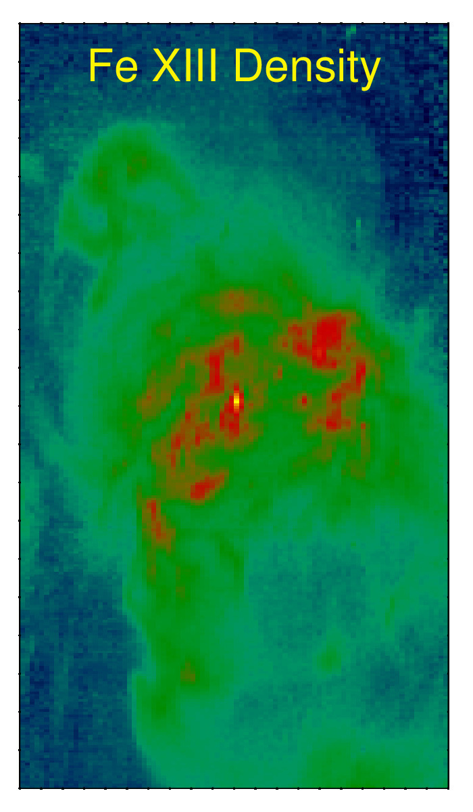
Slit Spectrographs

Slide 4
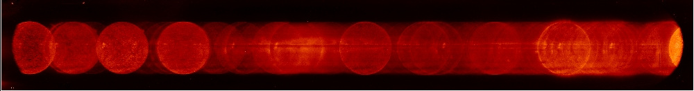
What is an Imaging Spectrograph?
An Imaging Spectrograph is instrument
with a grating
with spatial resolution
The Imaging Spectrographs in this talk are also slitless:
with large field of view
Spectroheliograms or “Overlappograms” - spatial and spectral data are overlapped.

Slide 5
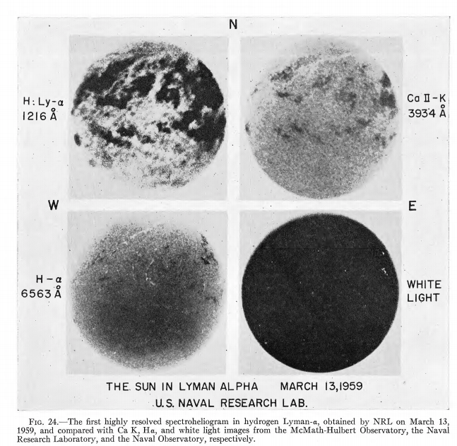
History
Subsequent rocket flights explored the solar spectrum and revealed the atmospheric structure.
First spectroheliogram in Lyman alpha observed on March 13, 1959.
Tousey, 1967, ApJ, 149
Notes:
On a rocket launch in 1959 was the first spectraheliogram in Lyman alpha. It was made with a slitless, objective type single grating spectrograph with an aluminum filter in the front.

Slide 6
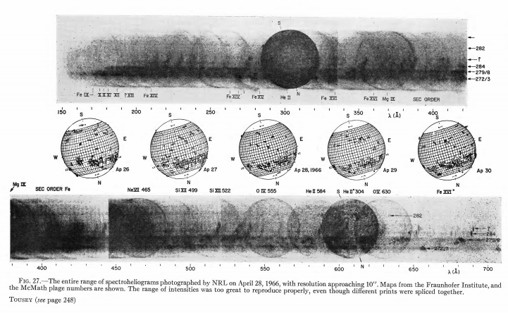
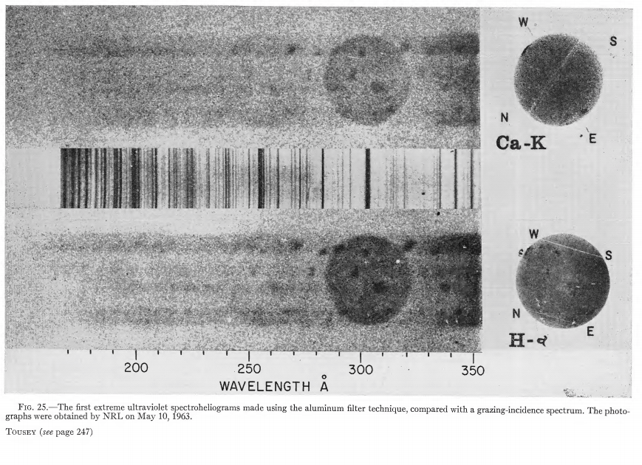
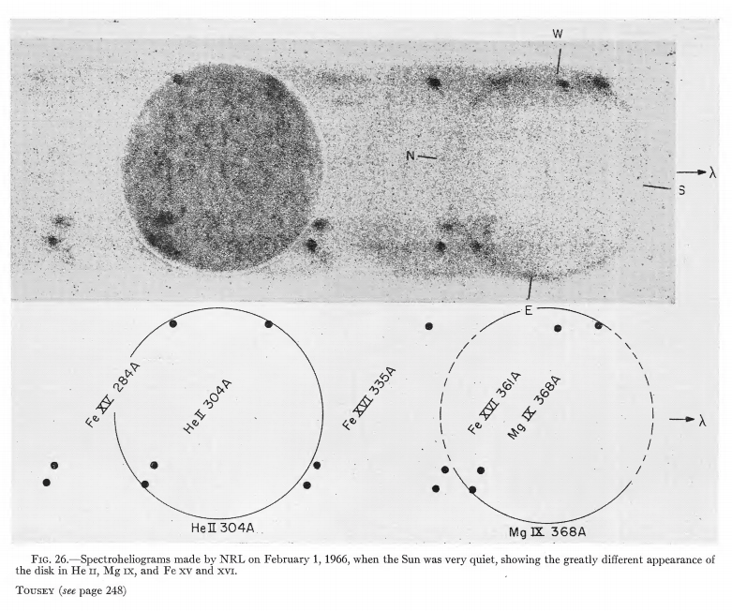
History
1963
1965
1966
“Therefore this image is not easy to interpret.” - R. Tousey
Tousey, 1967, ApJ, 149
Notes:
More spectroheliograms followed. In this paper, Tousey notes “At 256 Ang there is another good image. This is formed by a blend of three strong lines, one is the second line of the He+ Lyman series another is Si X and third is partly S X. Therefore this image is not easy to interpret

Slide 7
History
Skylab S082A – long wavelength range
O V 63 nm
He I 58.4 nm
O IV 55.5 nm
Si XII 50 nm
Ne VII 46.5 nm
Mg VII 36.7 nm
He II 30.4 nm
Spectroheliograms were obtained by astronauts from May 14, 1973 – February 8, 1974.
Skylab was the only time spectroheliograms were obtained by NASA on an orbiting satellite.
Skylab data have been digitized and are available: https://lasco-www.nrl.navy.mil/skylab/index.php?p=content/so82a
Notes:
Despite the difficulty in interpreting these images, an imaging spectrograph was flown in Skylab operational in the year of my birth, 1973. The instrument’s name was S082-A and it had two different wavelength ranges, I am showing the long wavelength range only. As far as I know this is the only time NASA regularly obtained this type of data, though there have been missions from other countries, but the data from those instruments aren’t readily available.

Slide 8
Unfolding Spectroheliograms
Write a set of linear equations:
Observations = Response Matrix # Solar Parameters(space, [T, ion, velocity])
y = Mx

Slide 9
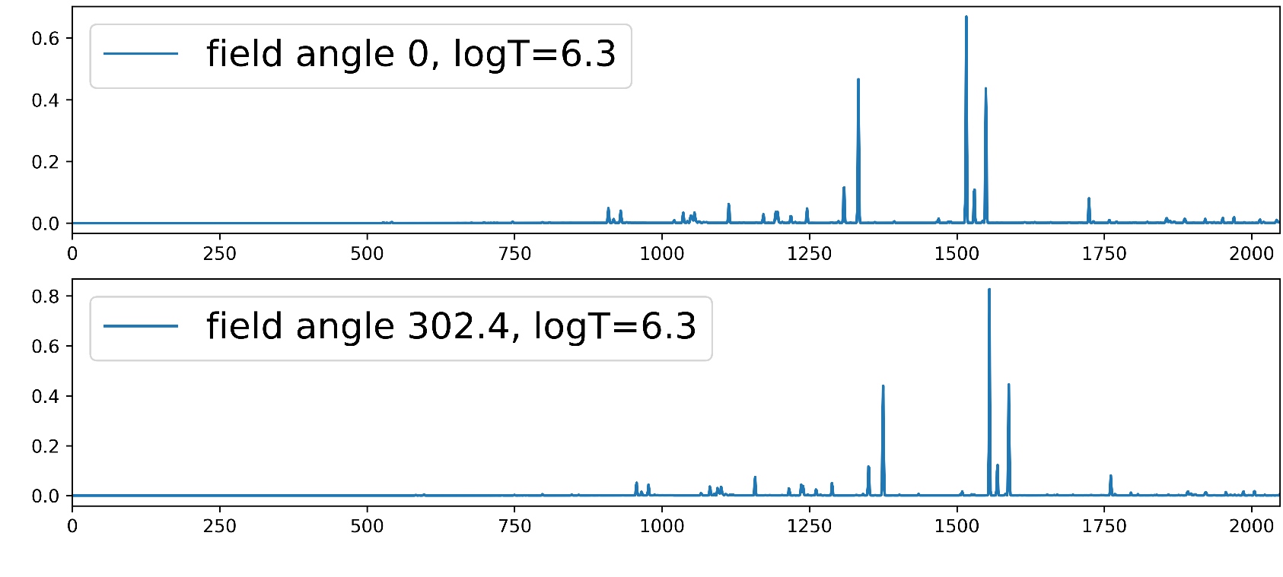
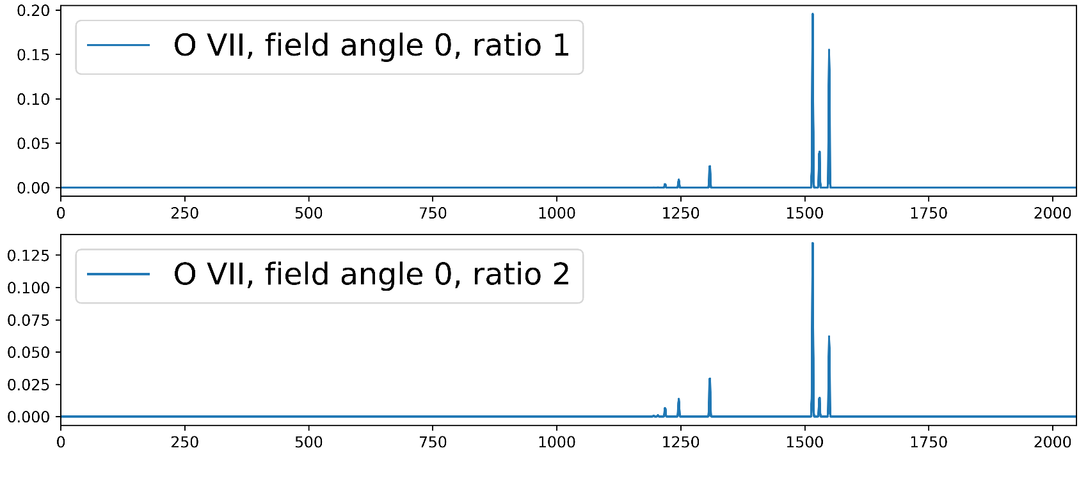
Unfolding Spectroheliograms
Write a set of linear equations:
Observations = Response Matrix # Solar Parameters(space, [T, ion, velocity])
y = Mx
Solar Parameters (space, Log T)
“Multi-Ion Model”
Solar Parameters (space, ion)
“Single-Ion Model”

Slide 10

Unfolding Spectroheliograms
Write a set of linear equations:
Observations = Response Matrix # Solar Parameters(space, [T, ion, velocity])
y = Mx
To find velocity, we find a sparse and smooth solution was best:
𝛒 = 1 -> sparse
solution
𝛒 = 0 -> smooth
solution
Standard least squares term
Penalty on total EM set by 𝛂𝛒
Penalty on square EM set by 0.5𝛂(1- 𝛒)

Slide 11
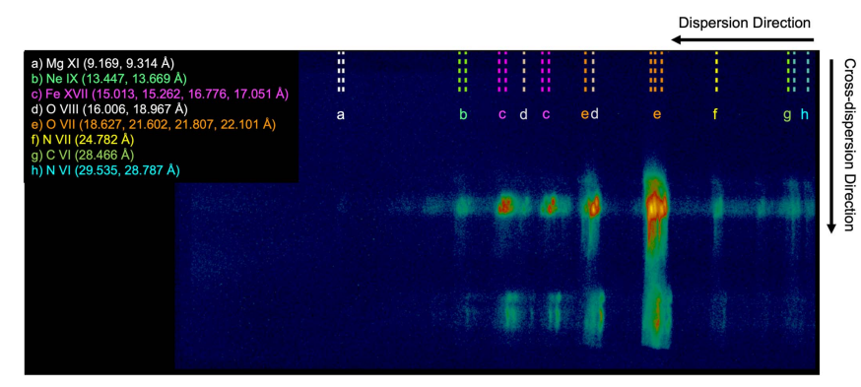
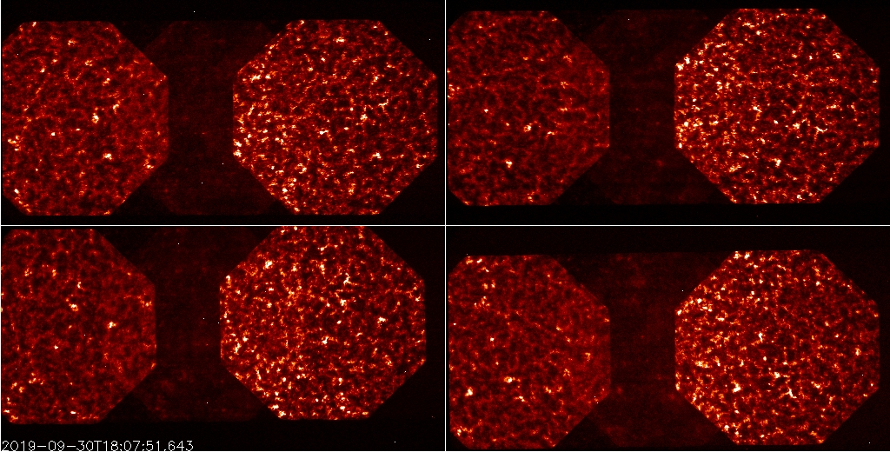
Current and Upcoming Imaging Specrographs
Observed MaGIXS Sounding Rocket data
Predicted MOXSI data
In Implementation for 2025 launch
Observed ESIS Sounding Rocket data
Predicted ECCCO data
Proposed SMEX to be launched 2028
Notes:
Today I am going to break the cardinal rule of giving a talk – I am not going to give you a highly focused talk on a single specific topic. I am going to cover a lot of different topics, a lot of different instruments and even talk about poorly constrained inversion problems. My main goal of today’s talk is to convince you that this type of data, data taken from a slitless spectrograph, is extremely useful and should be pursued in the next decade of solar observations.

Slide 12
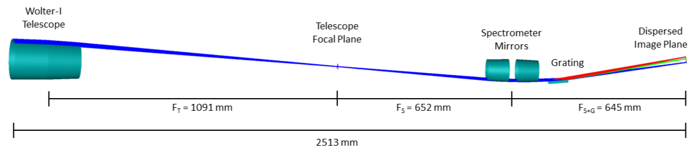
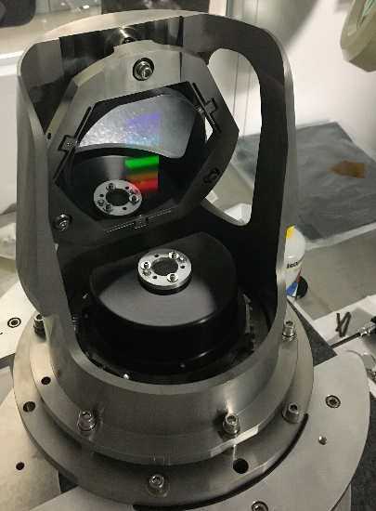
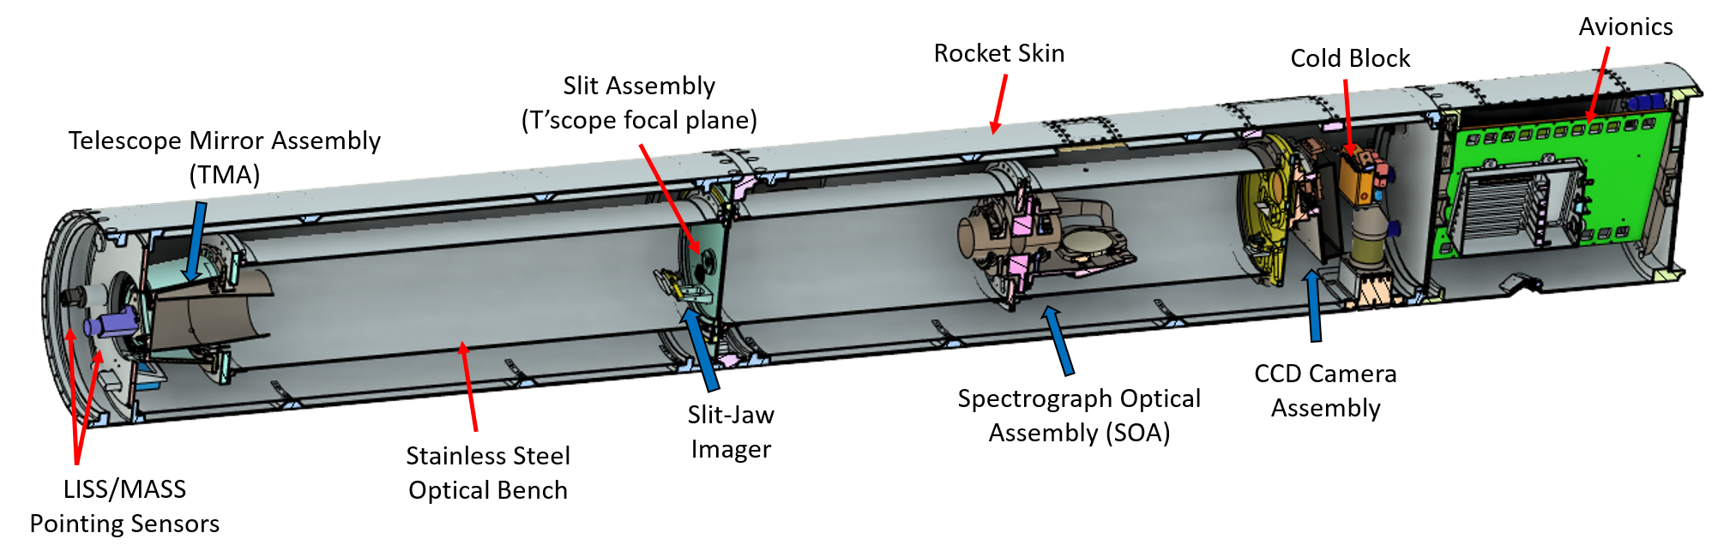
MaGIXS Instrument Design
Grating
Beam footprint subtends 34º
Avionics
Telescope section
Spectrometer section
Camera section
First mission to use replicated deterministic polished X-ray mandrels

Slide 13
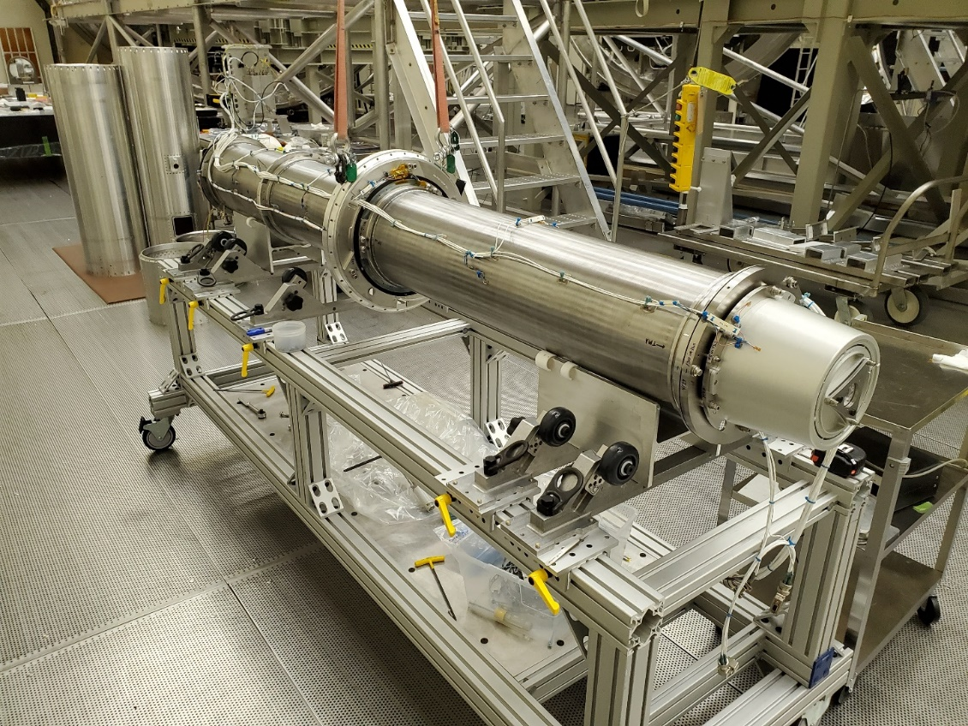
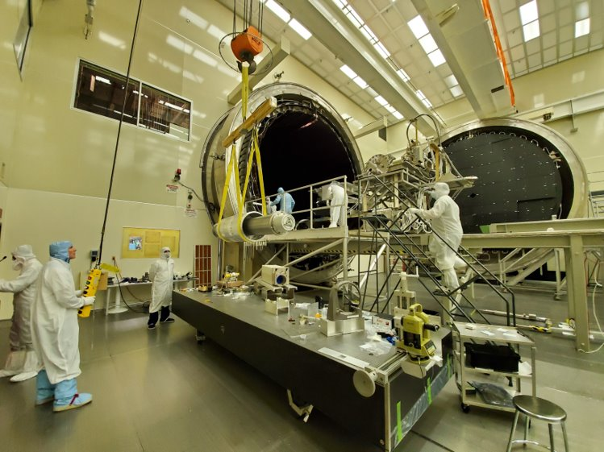
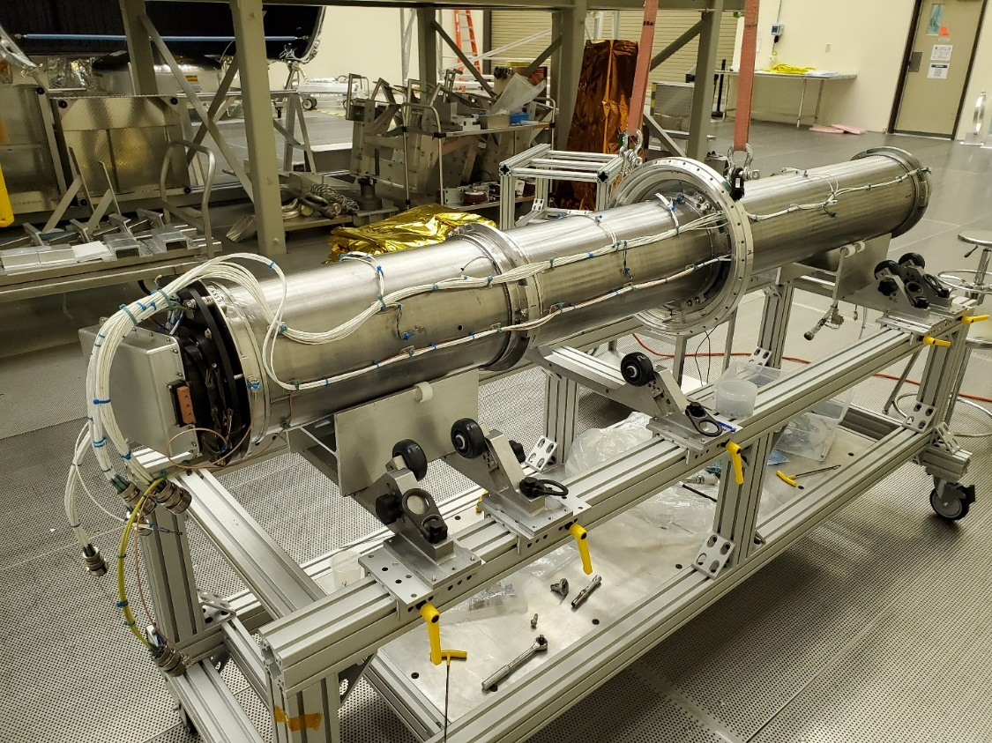
MaGIXS Instrument Alignment and Calibration
Telescope Mirror Assembly (TMA)
Telescope Mirror Assembly (TMA)
Slit interface Plate: Telescope focal plane, Slit-Jaw system, and interface to rocket skin
Slit interface Plate: Telescope focal plane, Slit-Jaw system, and interface to rocket skin
Science Camera
~1.5 m between TMA and SOA
Calibration activities at 500 m X-Ray beamline at MSFC.
SOA interface (embedded inside bench)

Slide 14
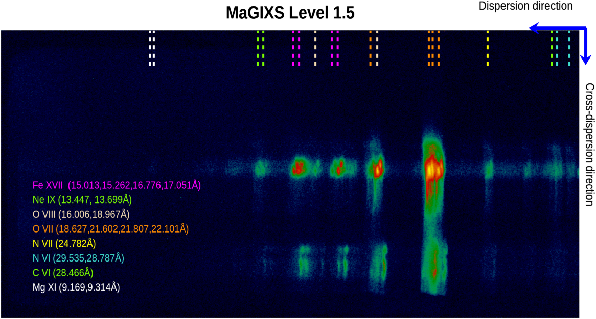
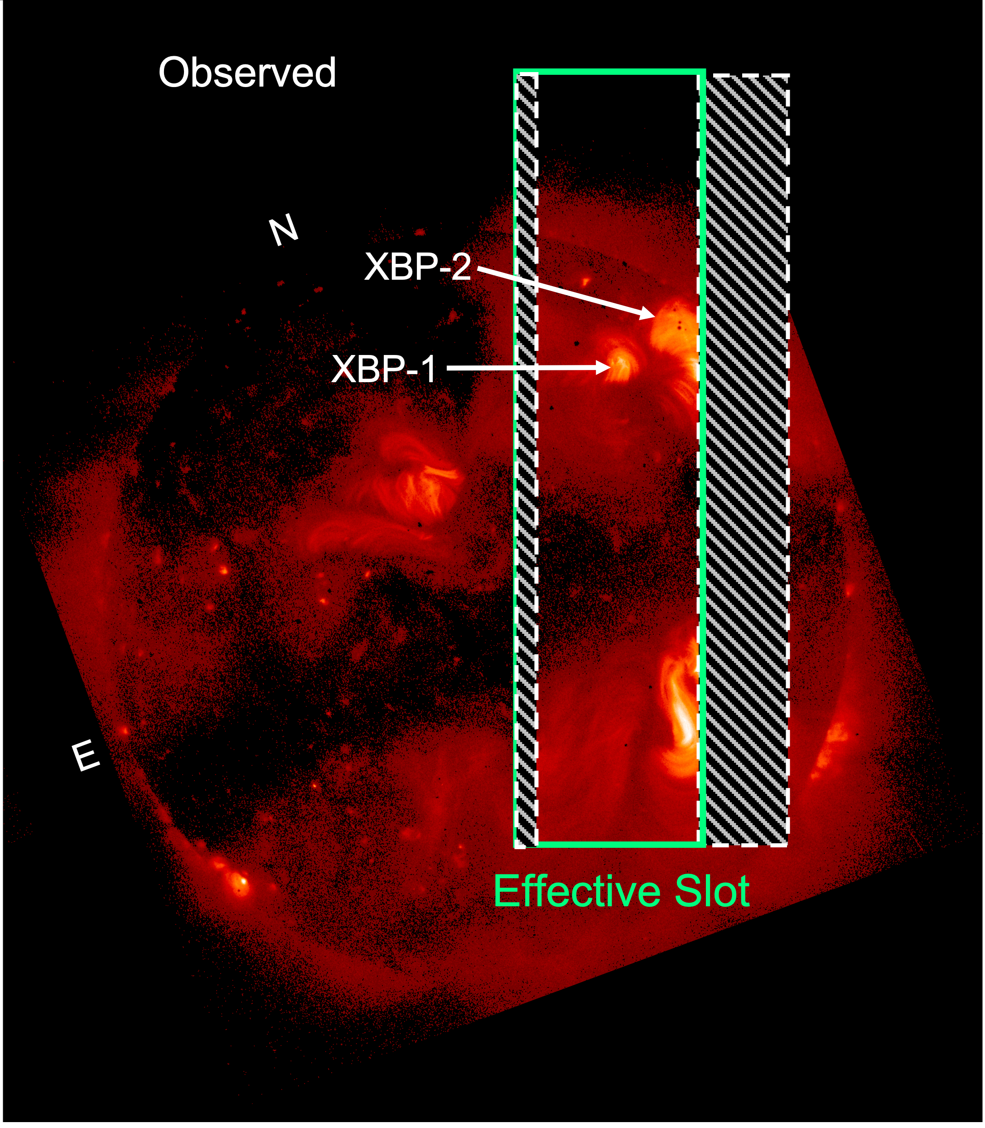
MaGIXS Flight Summary
30 July 2021, ~18:20 UT
~296 s science data
Notes:
Connect vignetting to strw

Slide 15
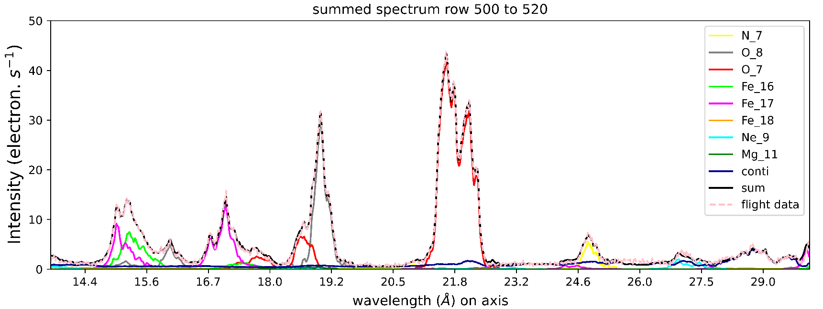
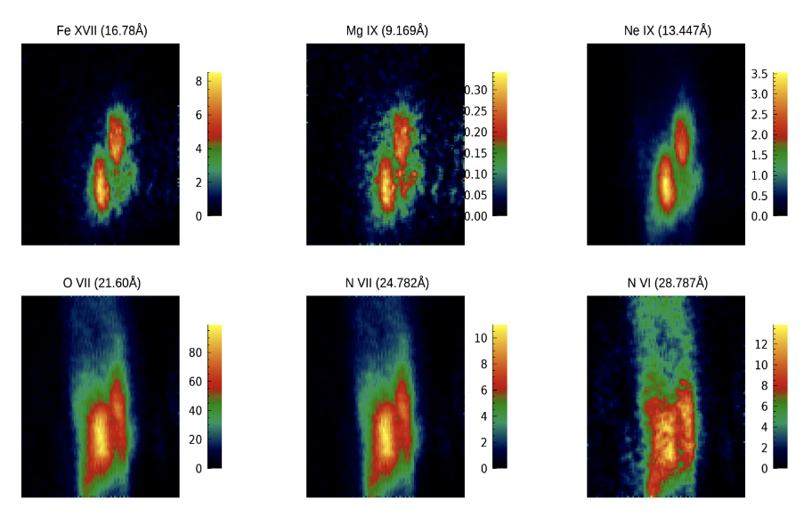
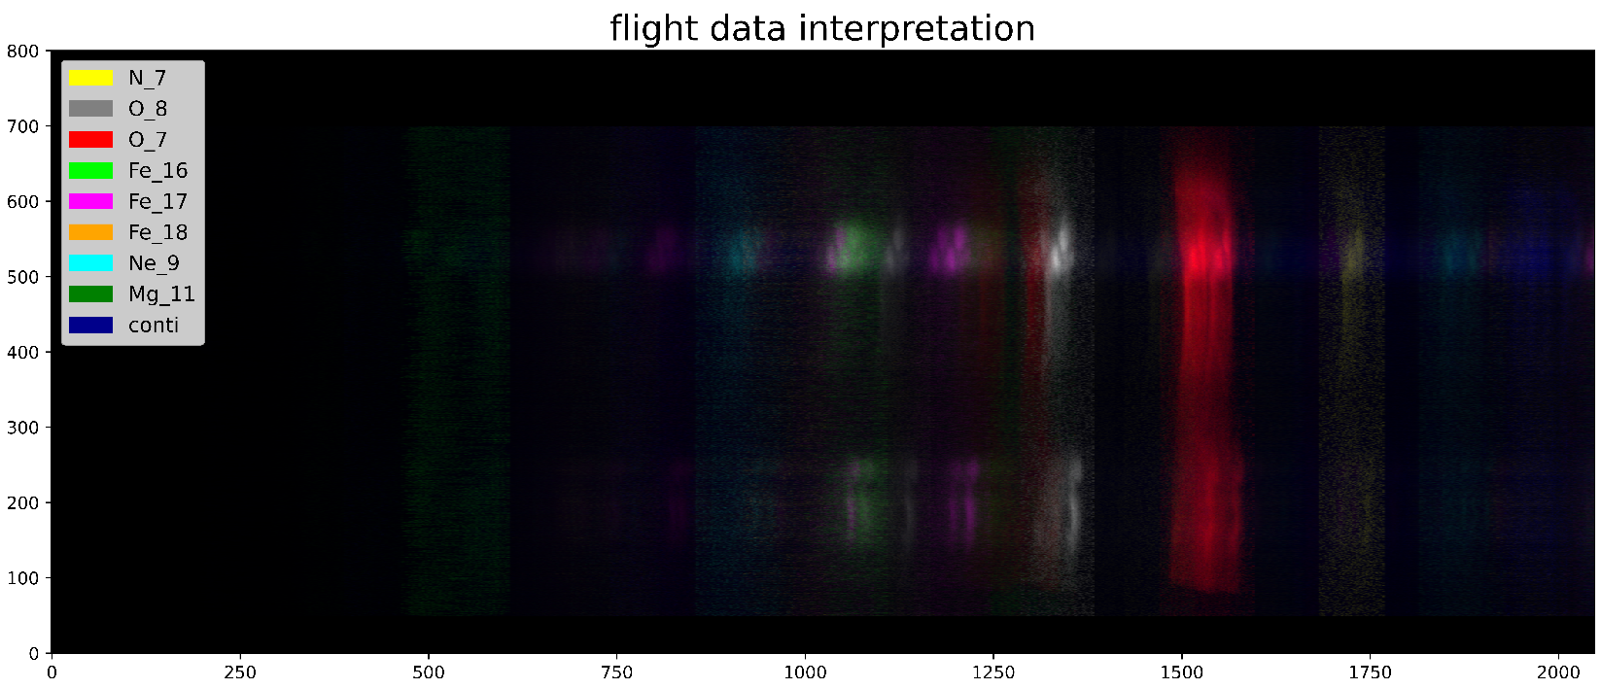
Unfolding Spectroheliograms – MaGIXS Outputs
Outputs include :
Fit Data
Spectra at each spatial pixel
Spectrally Pure Maps

Slide 16
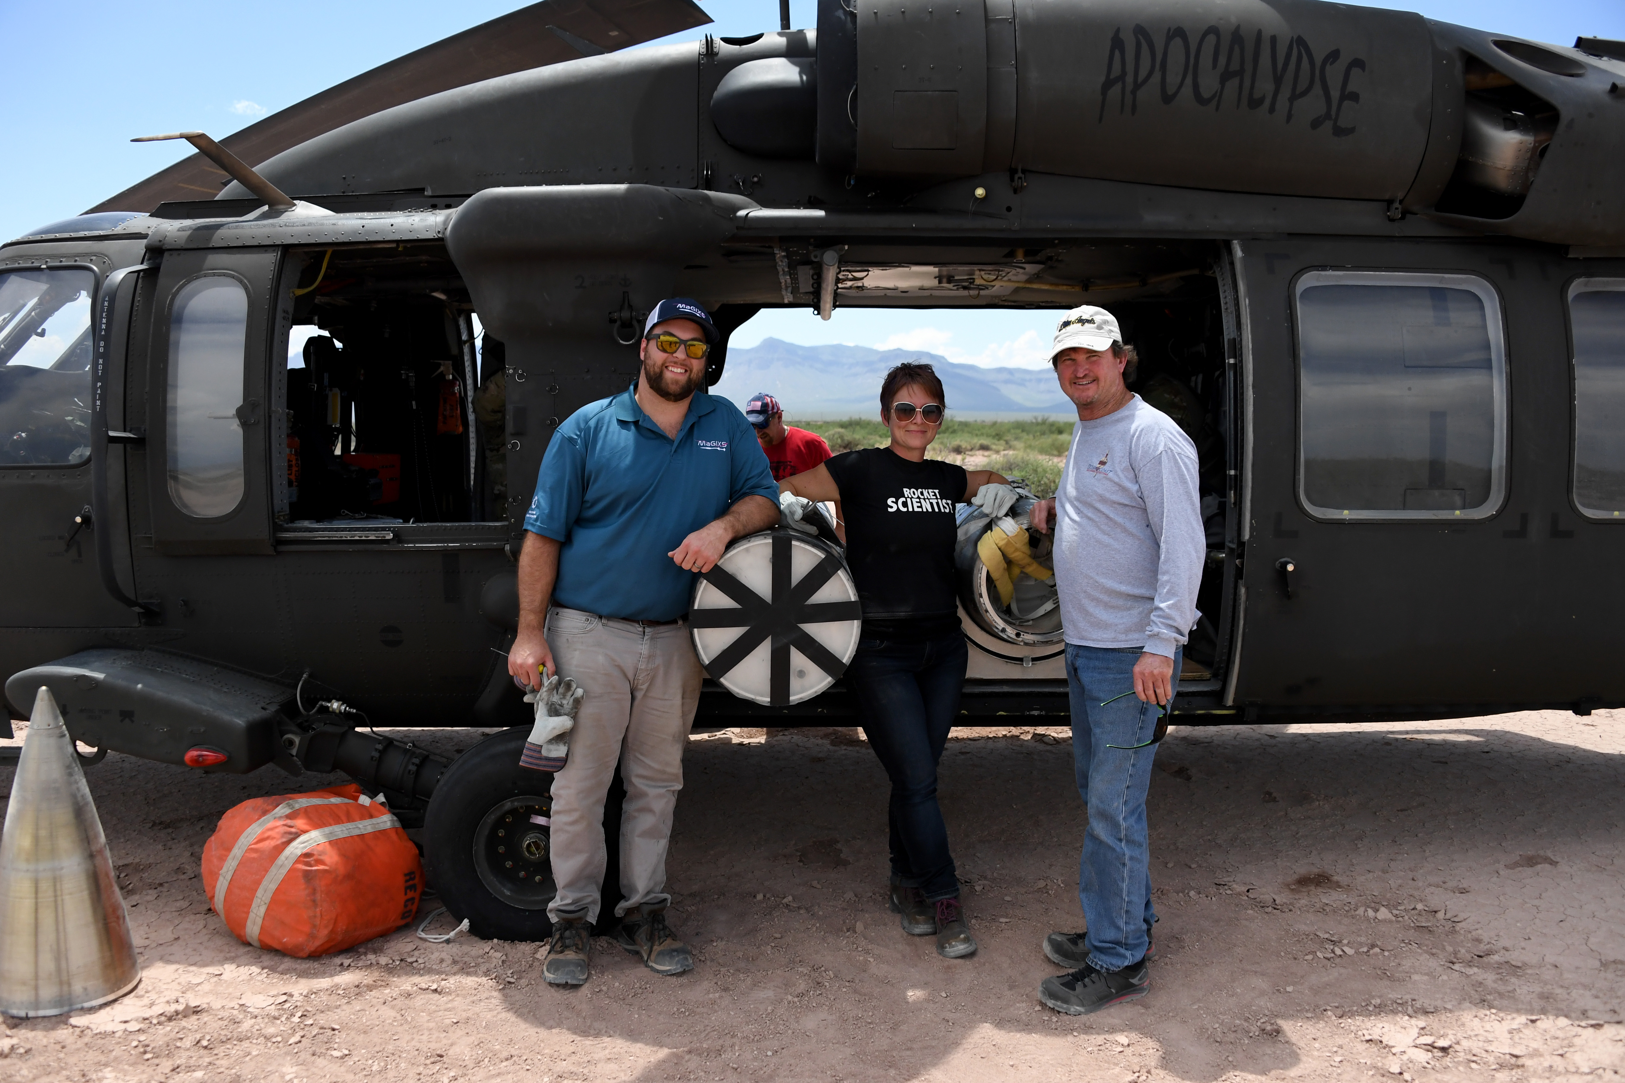
MaGIXS-2 instrument changes
MaGIXS-1 Recovery Team
MaGIXS–2 will have
Easier alignment process
Better spatial resolution (x4)
Better spectral resolution (x4)
Larger FOV (4’ –> 12’)
Higher throughput
MaGIXS 2 will launch Summer 2024

Slide 17
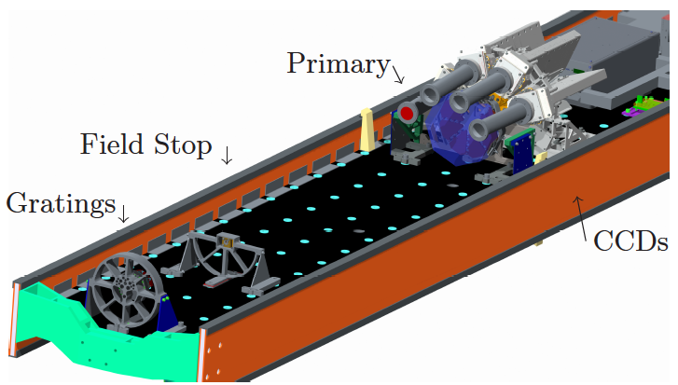
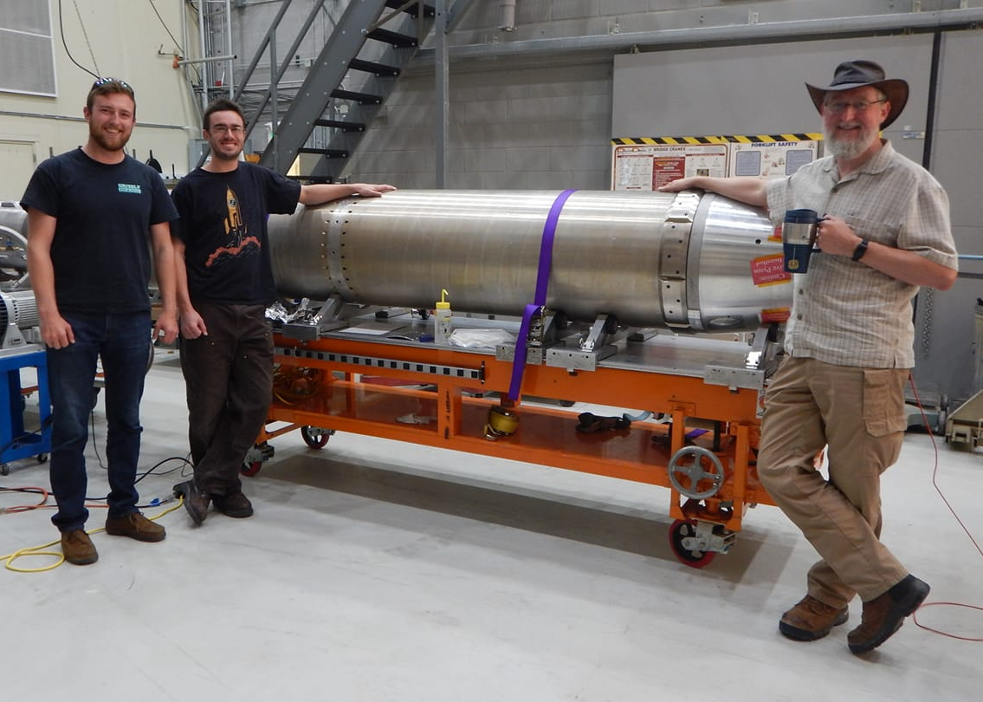
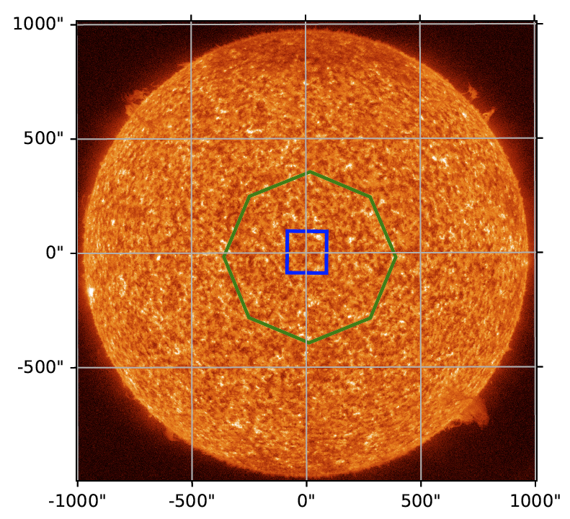
EUV Snapshot Imaging Spectrograph (ESIS)
N - 1
N - 2
Jake Parker, Roy Smart, ESIS, and Charles Kankelborg (ESIS PI)
Ch 2
O V
Ch 3
N - 3
Sounding rocket instrument
Flew September 30, 2019
300 s of data
Quiet Sun
O V 63 and He I 58.4 nm
N - 4
Ch 1
solar north
Ch 4
He I
dispersion

Slide 18
ESIS has 4 Imaging Spectrographs
Exploding Monochromatic Point Source on Sun
4
N
3
N
2
N
1
N
𝝺
𝝺
𝝺
𝝺
S
S
S
S
E
W
E
W
E
W
E
W
Combining the four channels allows for the measurement of velocity

Slide 19
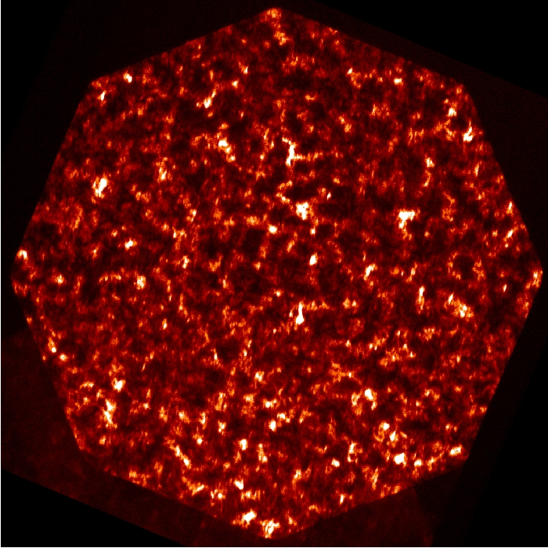
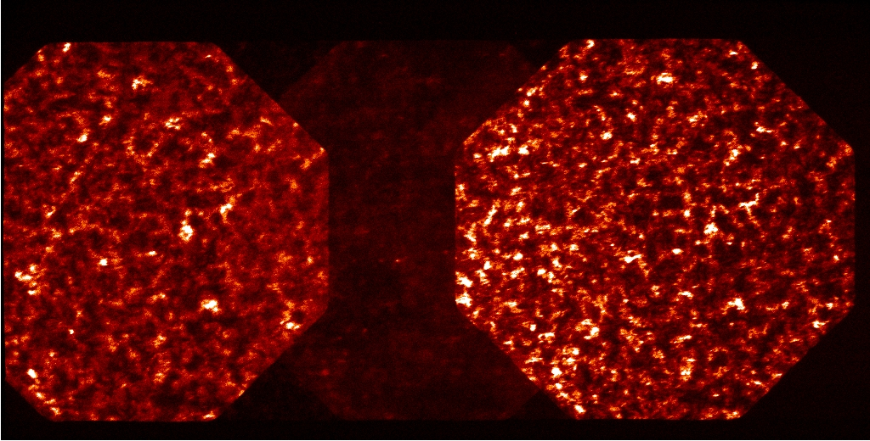
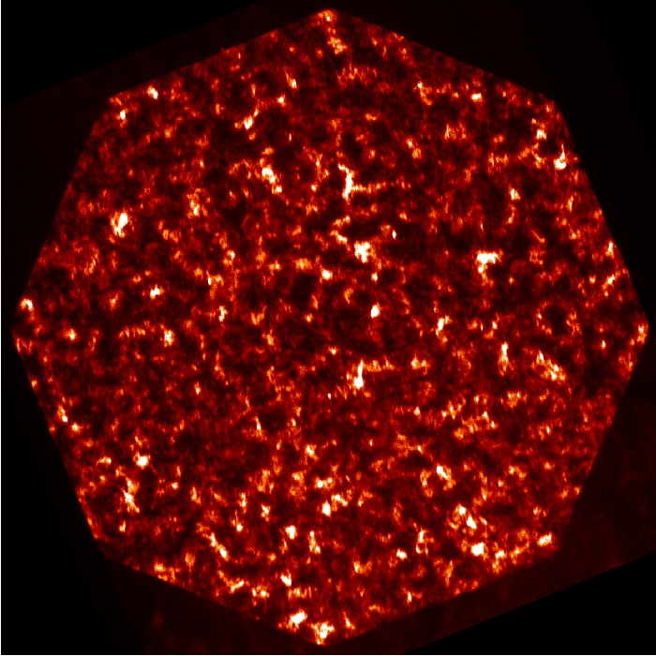
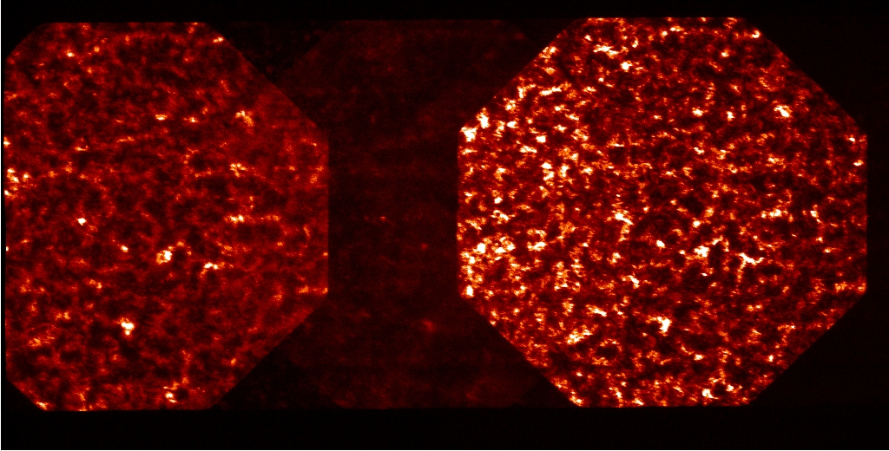
ESIS Data Processing
Level 1 data
2
N
2
Level 2 data
O V spectral line
N
3
𝝺₂
3
Level 2 data processing:
Remove optical distortions & vignetting
Extract single spectral line
Rotate solar north is up
N
𝝺₃

Slide 20
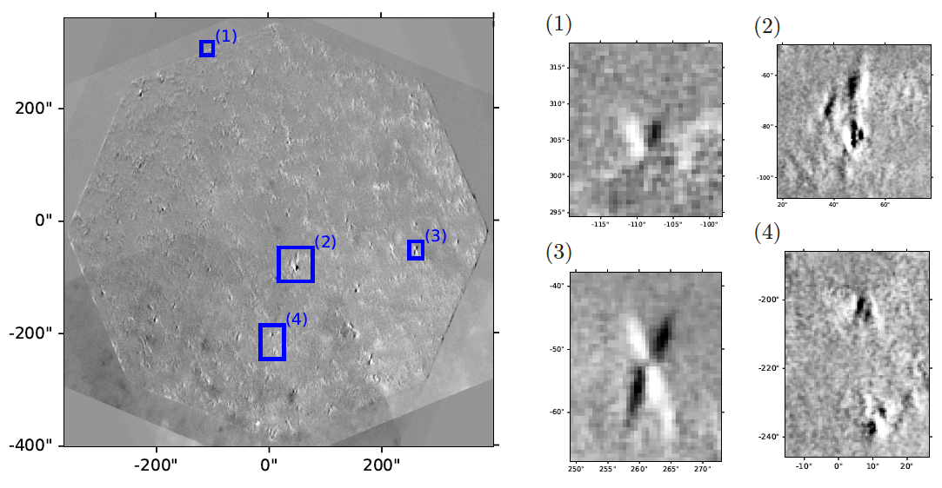
ESIS Difference Images – IS 3 – IS 2
Images courtesy of Jake Parker, MSU
N
𝝺₃
𝝺₂

Slide 21
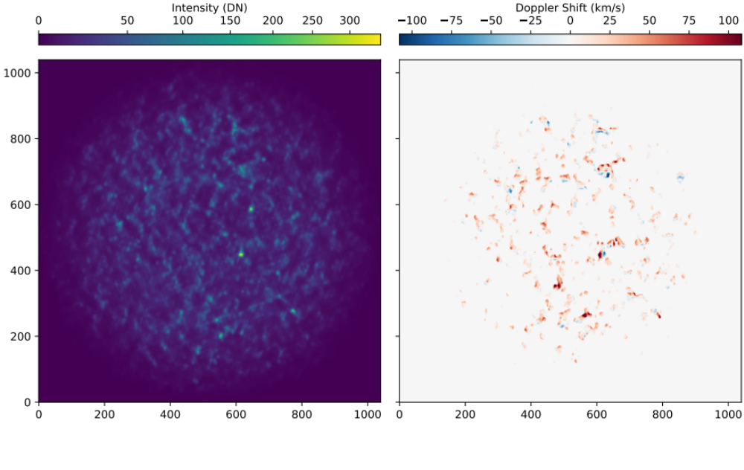
Preliminary results from MART
ESIS - 10 s
Slit spectrographs - ~ 1hr
Images courtesy of Jake Parker, Roy Smart, Charles Kankelborg (MSU)

Slide 22
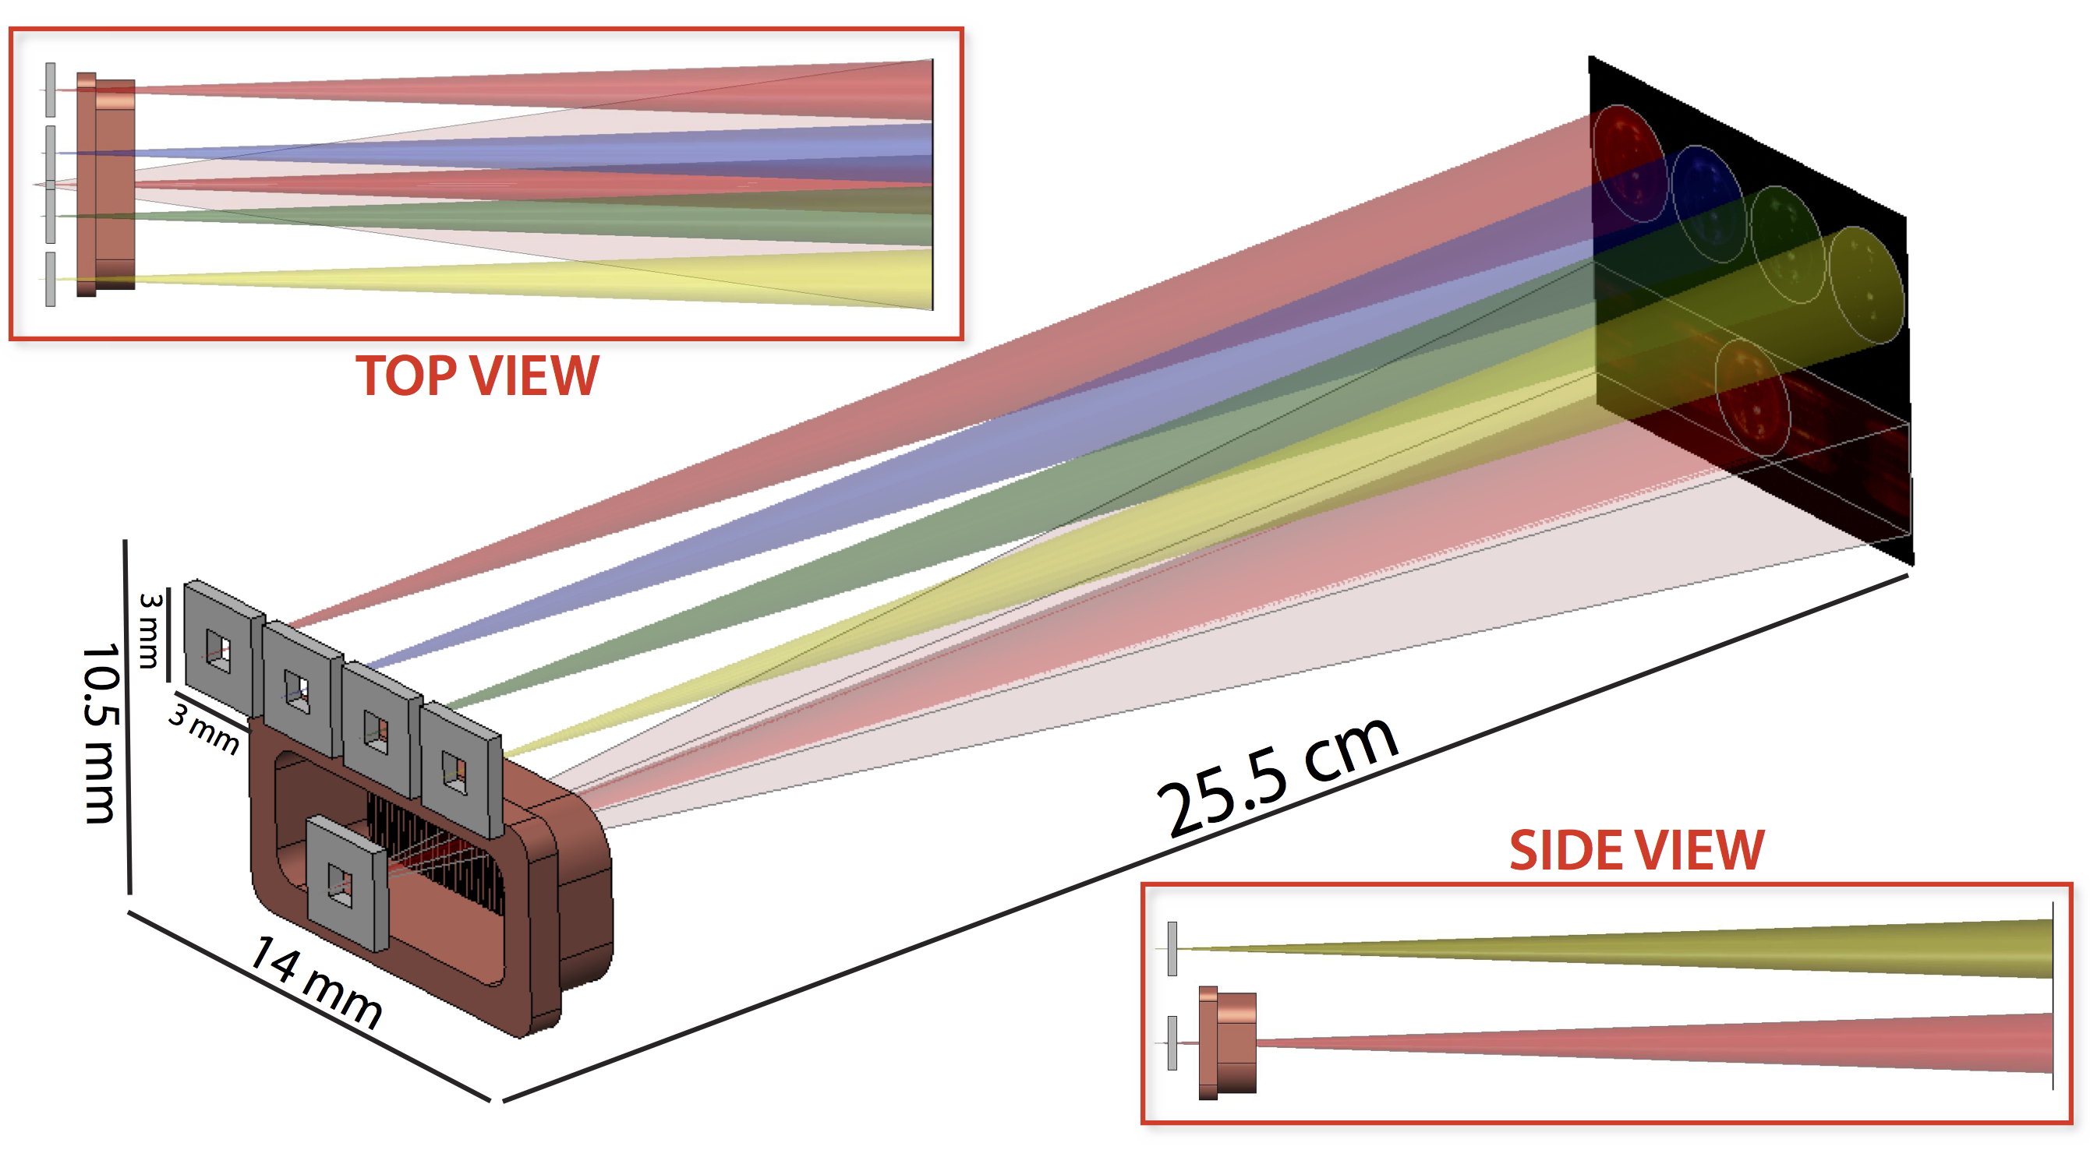
Multi-Order X-ray Spectral Imager (MOXSI) –
PI: A. Caspi (SwRI)
MOXSI is an instrument on CubIXSS
To be launch ___-
Soft X-ray wavelength range
Images courtesy of Amir Caspi (SwRI)
MOXSI uses a spare transmission grating from Chandra High Energy Transmission Grating (HETG).
Chandra HETG

Slide 23
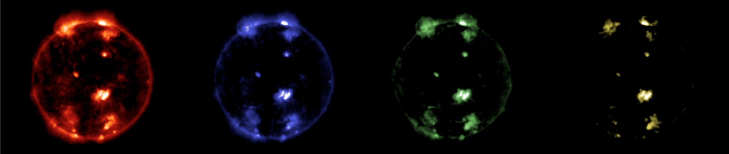
Multi-Order X-ray Spectral Imager (MOXSI) –
PI: A. Caspi (SwRI)
Expected data
Science goals:
Measure abundance and temperature distribution
-1, 2, 3 orders
0 order
+1, 2, 3 orders

Slide 24
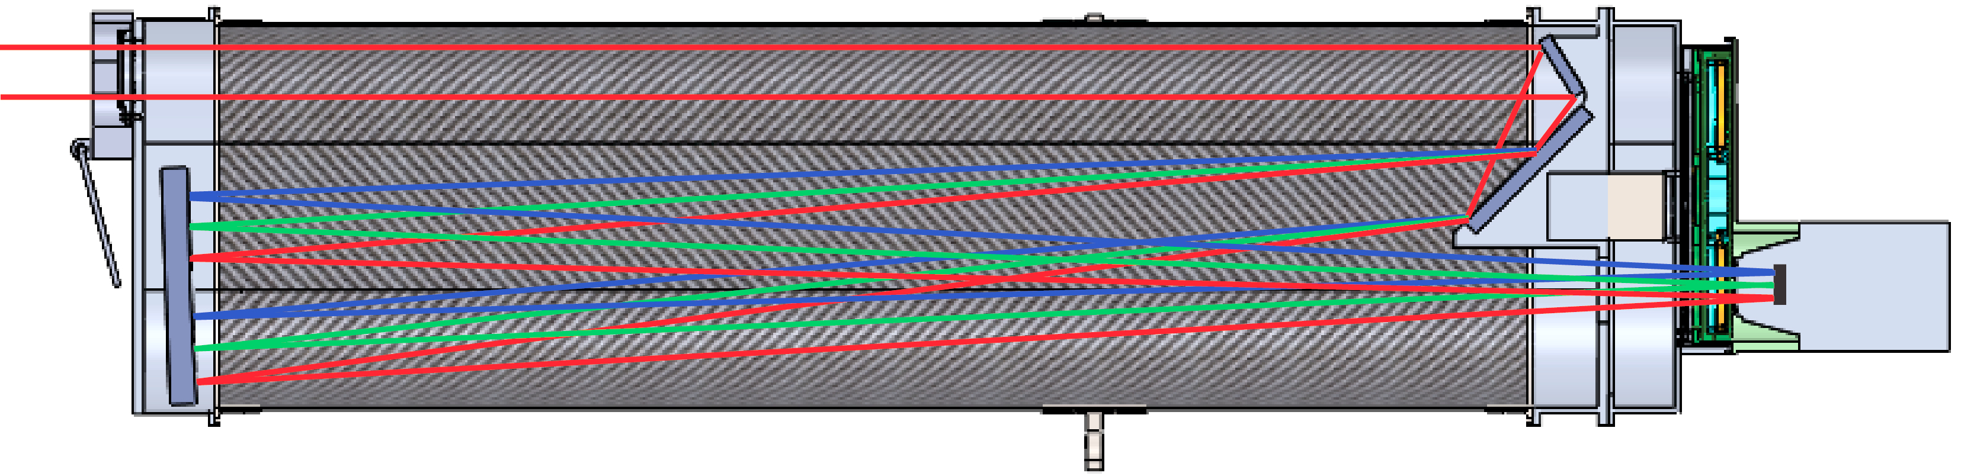
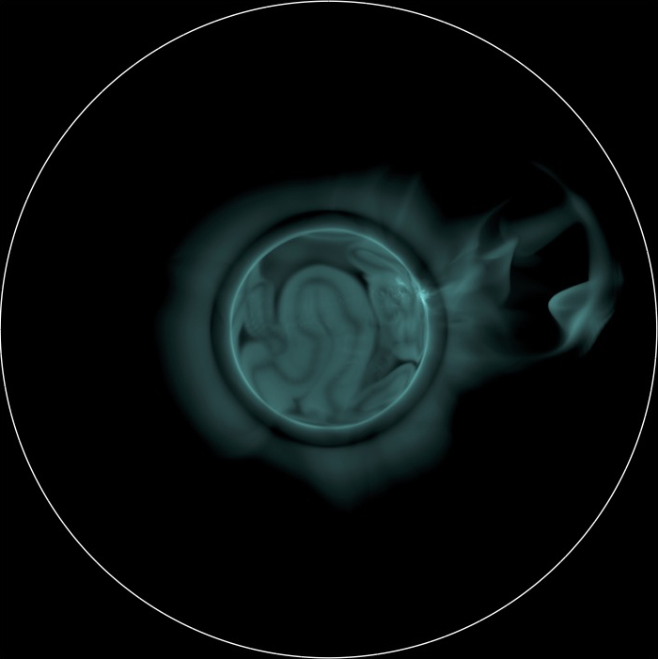
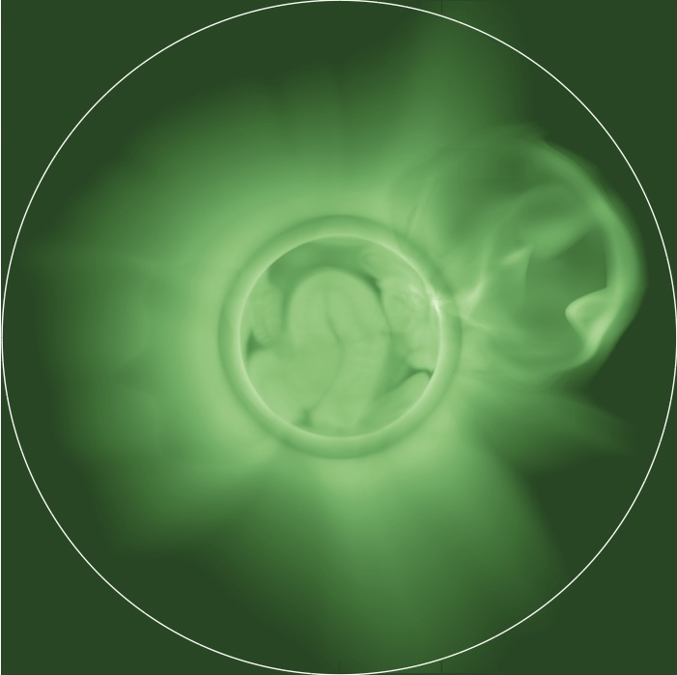
EUV CME and Coronal Connectivity Observatory (ECCCO) – PI: K. Reeves (SAO)
ECCCO proposed to SMEX 2022
Instrument complement includes:
Wide field EUV 2-channel imager
EUV Imaging spectrographs (2)
Prime Focus Reflective Grating Spectrometer
Filter Wheel
Shutter Assy
Entrance
Filter
Fold Mirror
Short channel
13.1 nm
Long channel
19.3 nm
Front
Hatch
Focus Mirror
RAL CCD
Camera

Slide 25
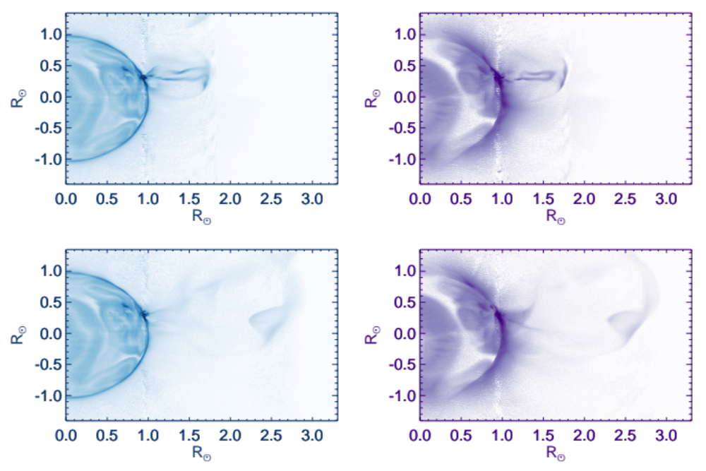
EUV CME and Coronal Connectivity Observatory (ECCCO) – PI: K. Reeves (SAO)
Simulated data
Spectrally pure images
South
Fe VIII
Fe VIII
Fe XIII
Fe XIII

Slide 26
Summary
Expected MOXSI data
“Therefore this image is not easy to interpret.” - R. Tousey

Slide 27
Summary
Expected MOXSI data
“Therefore this image is not easy to interpret.” - R. Tousey

Slide 28
What’s next?
Imaging spectrometer data allows for rapid measurement of temperature, density, abundances, and velocities over large FOV.
Inversion techniques can be applied to similar observations of extended astrophysical objects.
These diagnostics can be used to solve many open solar physics questions, develop space weather models and forecasting capabilities, and probe fundamental physics in the universe. These key capabilities are currently missing from the Heliophysics System Observatory.

