Slide 1
RST CGI: Final Verification and Calibration of Prism and Polarizer Flight Units
08/23/2023
Tyler D. Groff
Hari B. Subedi
Neil T. Zimmerman
Jim Lyons
Guangjun Gao
John Titus
Dylan Bell
Evan Bray
Toru Yamada
Motohide Tamura

Slide 2
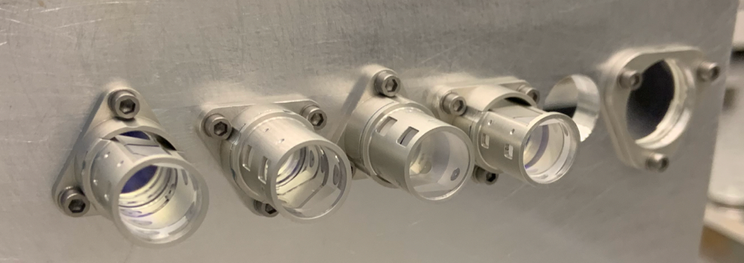
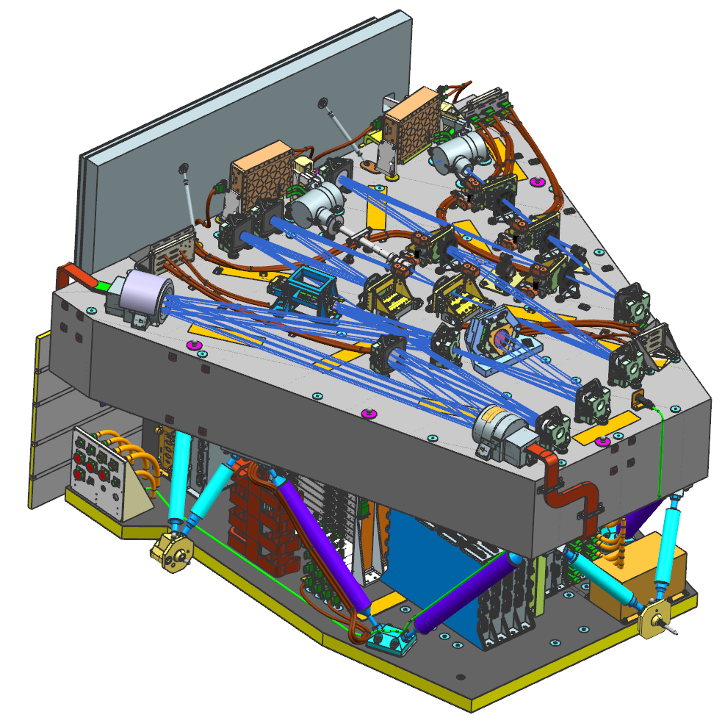
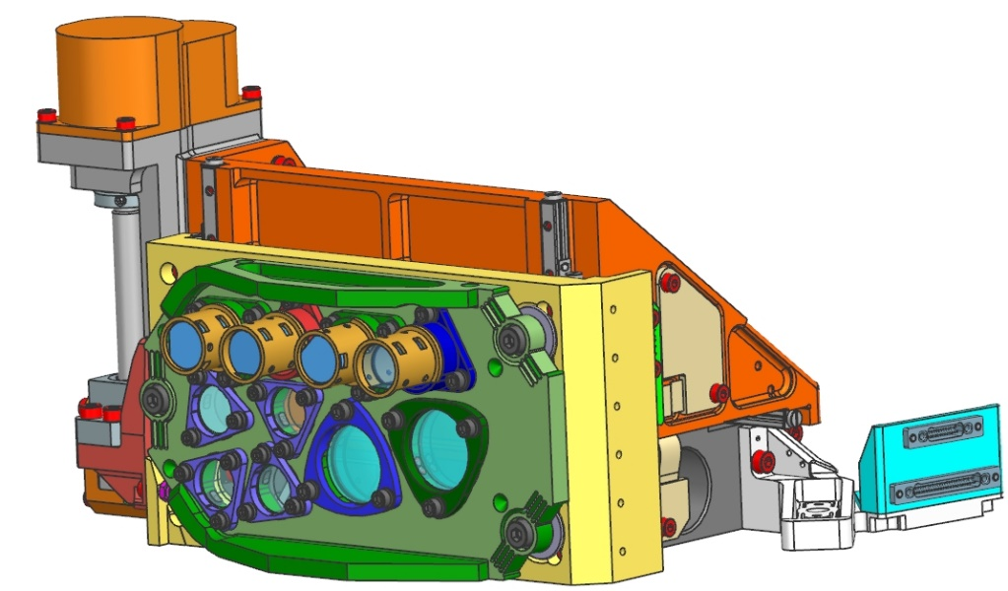
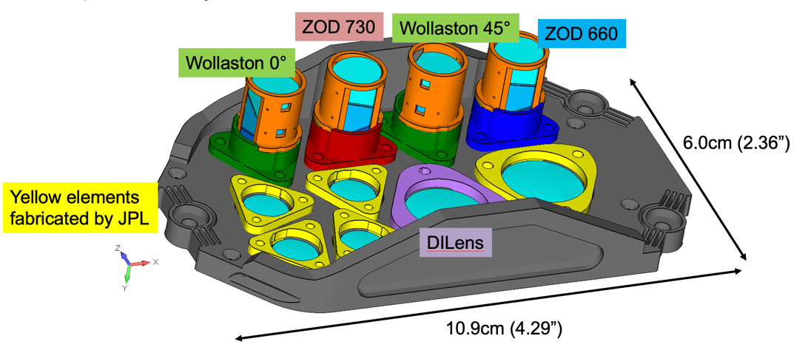
Introduction
DI Lens
The Roman Coronagraph Instrument is a Class D Technology Demonstration for exoplanet direct imaging via coronagraphy
Goddard delivered the final imaging modes in the
Precision Alignment Mechanisms (PAMs)
  Direct Imaging Lens for primary dark hole imaging mode
  Two Wollaston prism modes for disk science applications
  Two spectroscopy zero-deviation prisms for exoplanet slit spectroscopy
Imaging and polarization optics generously contributed by JAXA
ø17mm
Spec/Pol assemblies

Slide 3
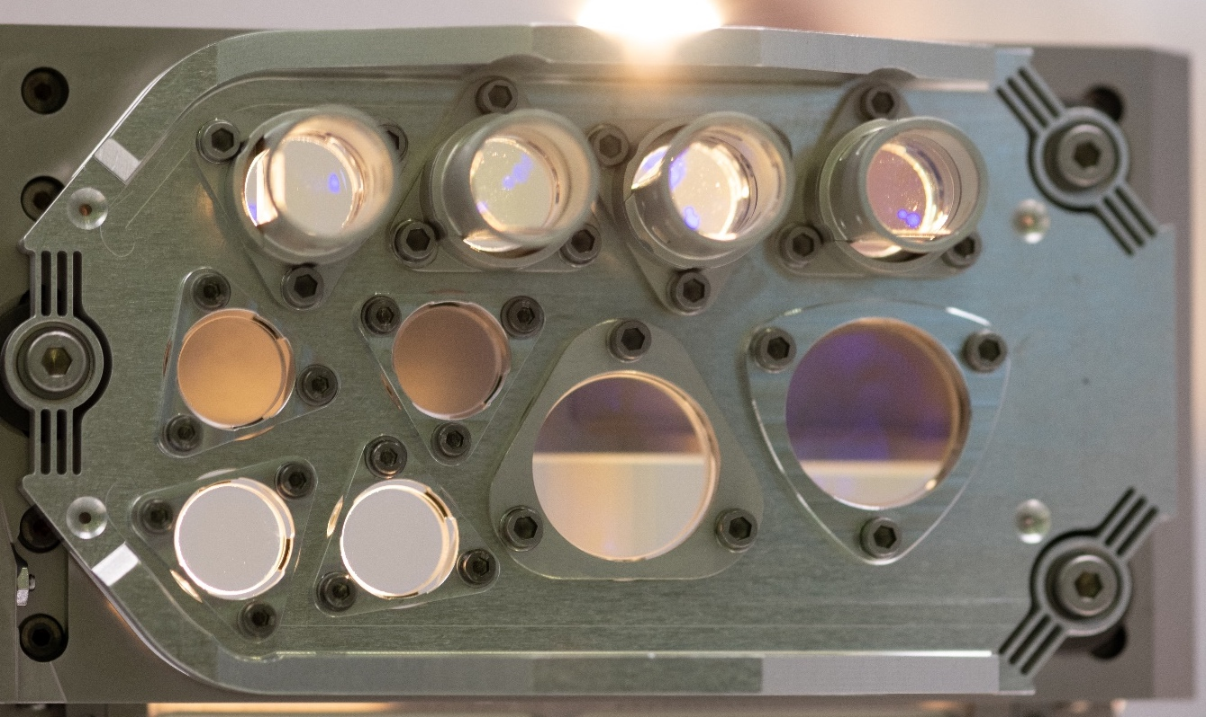
Spectroscopy and Polarization Modules for CGI
Zero Optical Deviation (ZOD) prisms
  730nm Band 3
  660nm Band 2
Wollaston Prism Assemblies
  Vertically oriented (0 deg)
  Diagonally oriented (45 deg)
Direct Imaging (DI) Lens
Calibration and spectral extraction algorithm
  Required for centroiding and calibrating spectra on CGI
  Not flight software
Wollaston 0°
Wollaston 45°
ZOD 730
ZOD 660
Baseline Filter Bands | Center | Cut-on | Cut-off | Bandwidth %
CGI Band 1 (Wollaston Prism) | 575 | 546 | 604 | 10.1
CGI Band 2 (Spectroscopy Shaped Pupil) | 660 | 610 | 710 | 15.2
CGI Band 3 (Spectroscopy Shaped Pupil) | 730 | 675 | 785 | 15.1
CGI Band 4 (Wollaston Prism) | 825 | 784 | 866 | 9.8
DI Lens
Remaining optics in DPAM for pupil imaging and phase retrieval

Slide 4
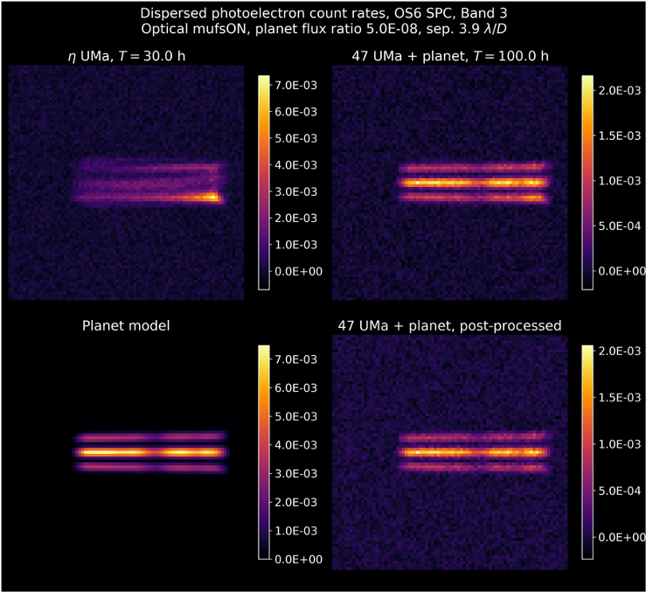
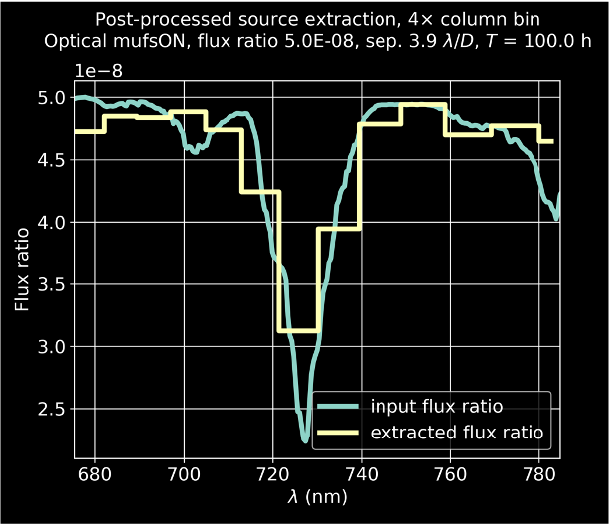
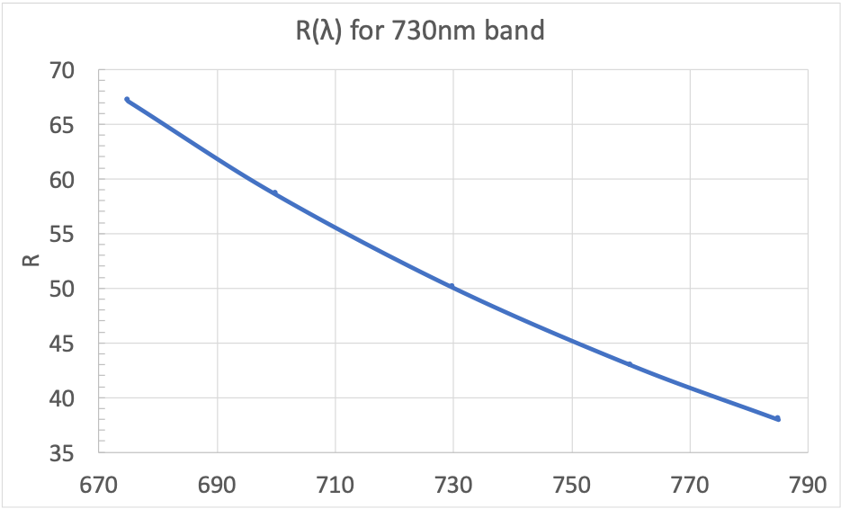
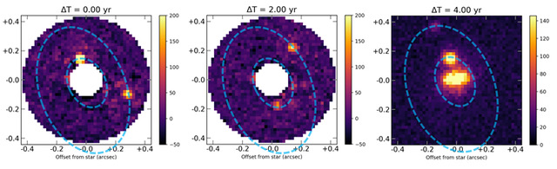
Science Objective

Slide 5
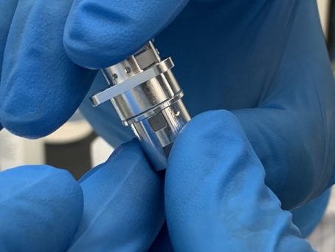
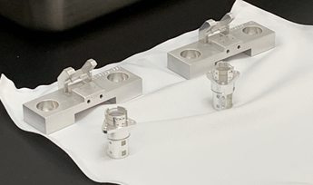
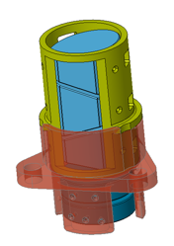
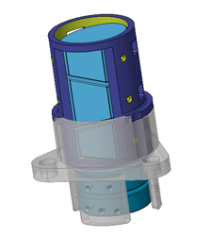
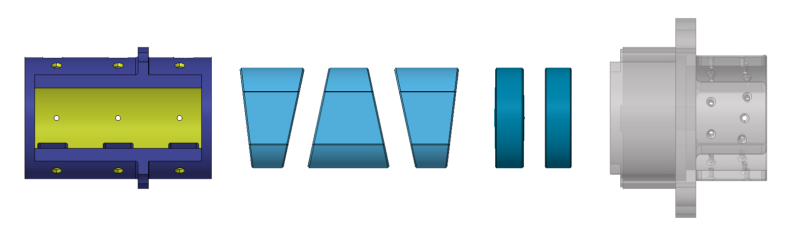
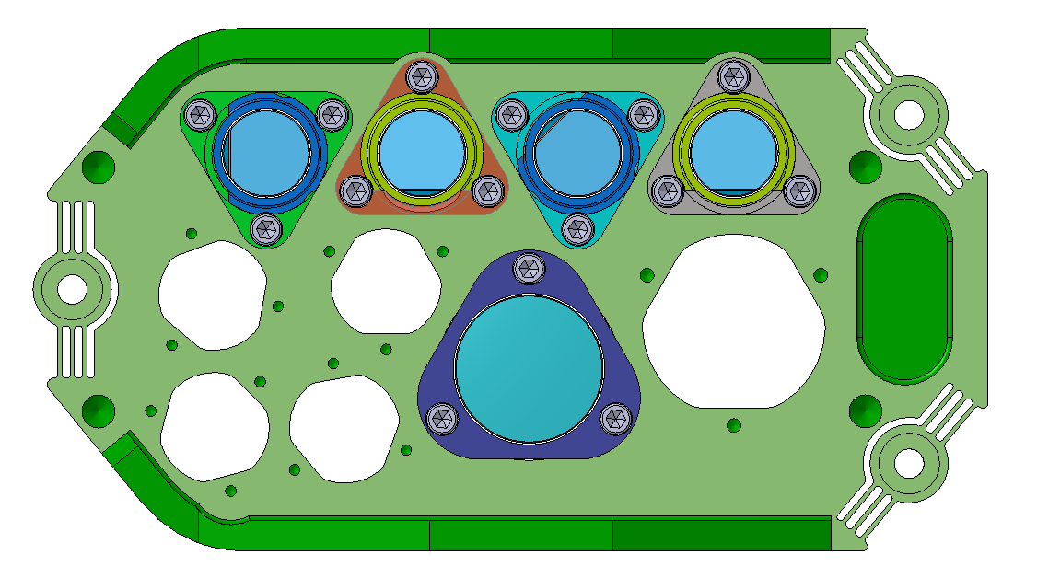
ZOD Assembly Optomechanical Design
Overview:
There are two variants – ZOD 660 and ZOD 730
Lenses and prisms have just 10 mm (.393 in.) diameter
Design is composed of an alignment Tube (1), three prisms (2,3,4), two lenses (5,6), and an alignment base (7)
ZOD 660/730 EDU’s fully assembled
1
2
3
4
5
6
7
ZOD 730
ZOD 660
Materials:
S-TIH1
S-BSL7R
AL 7075-T7351
AL 7075-T7351
Suprasil 3001
PBM2R
Suprasil 3001
DPAM plate

Slide 6
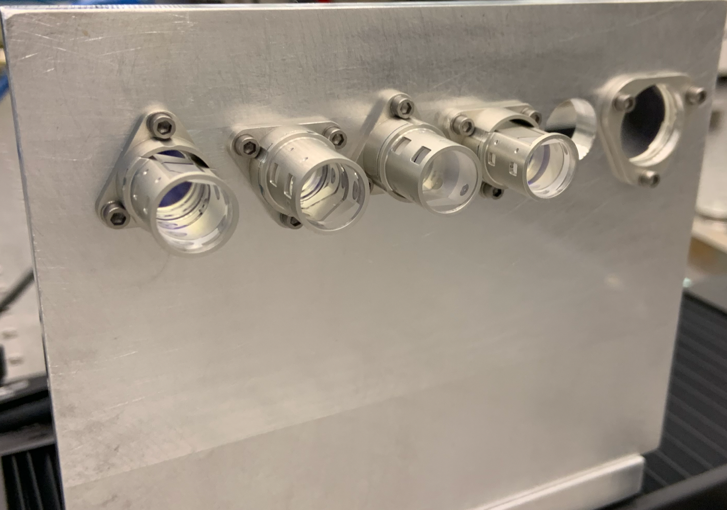
Final Flight Assemblies Under Test at GSFC
DI Lens
  7 key and driving requirements
    1 verified by analysis
  24 total requirements
    2 verified by analysis
  No non-compliance
Spectroscopy modes
  12 key and driving requirements
    1 verified by analysis
  25 total requirements
    3 Number verified by analysis
  No non-compliance
Wollaston modes
  12 key and driving requirements
    1 verified by analysis
  28 total requirements
    3 verified by analysis
  No non-compliance
DI Lens
WOL 45
WOL 0
ZOD 730
ZOD 660
 | Drawing Count | QTY Parts | QTY Optics
ETU | 7 | 152 | 47
GSE | 50 | 225 | 0
EDU | 31 | 147 | 108
Flight | 24 | 161 | 87
Total | 112 | 691 | 242

Slide 7
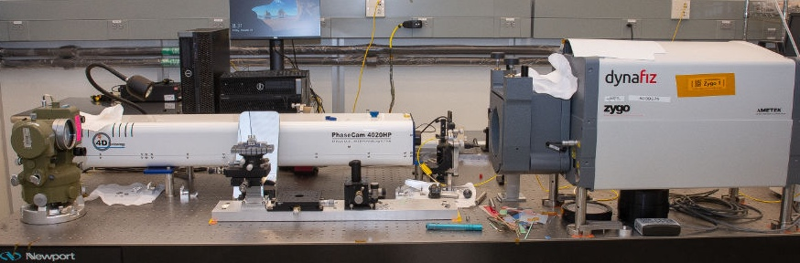
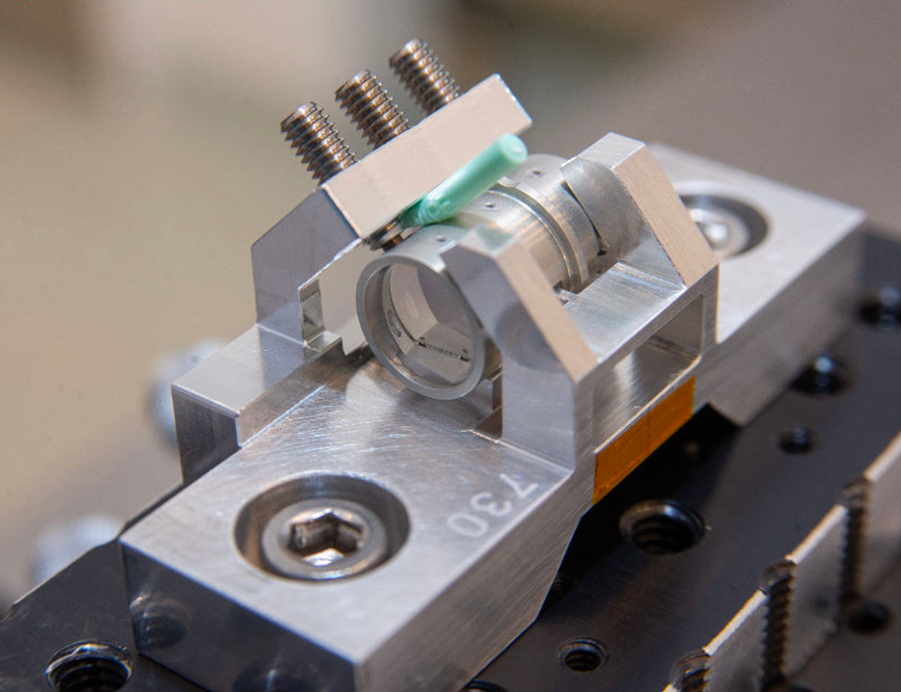
Alignment and Bonding Setup at GSFC
Theodolite co-witnesses Interferometer beam through and around prism assembly
  Dispersion directly verified with theodolite during alignment and bonding activities with extremely high fidelity
WFE Verified in double-pass during alignment
Flat reference used for prisms
Spherical reference and CaliBall swapped into setup for interferometric lens alignment in double-pass
  Focal lengths *well* within tolerance as a result

Slide 8
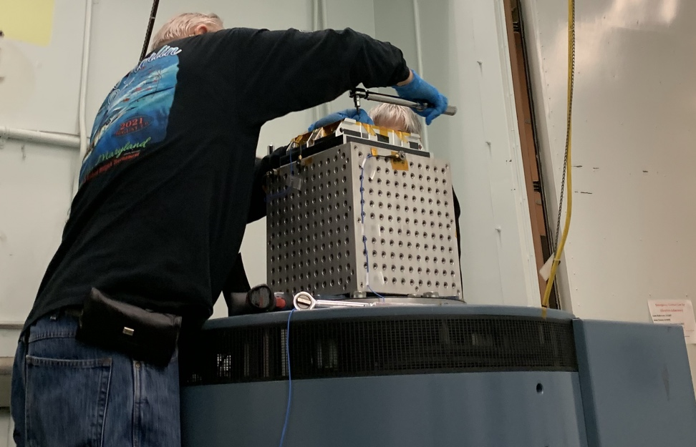
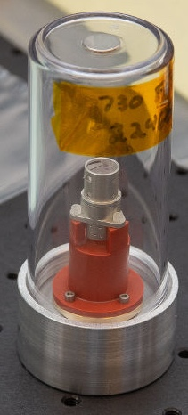
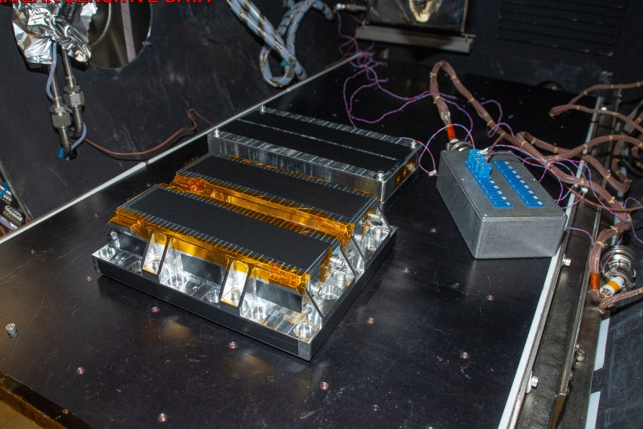
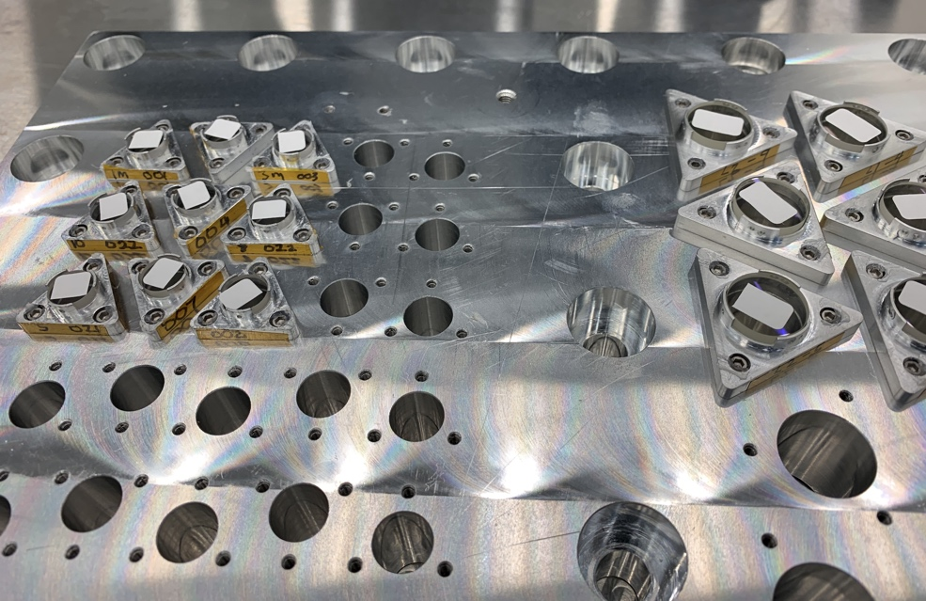
Flight Assembly Test Campaigns
Full bond qualification program
Laser vibrometer tests to experimentally validate damping coefficients
Thermal-vacuum (TVAC)and vibe to protoflight levels
Detailed optical and x-ray imaging to demonstrate survival
Vibration Testing
Damping Tests
X-Ray Scans
Thermal-Vacuum Testing

Slide 9
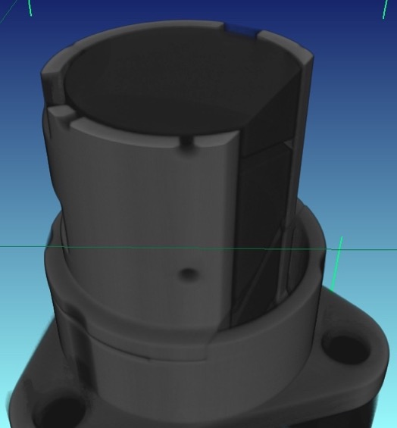

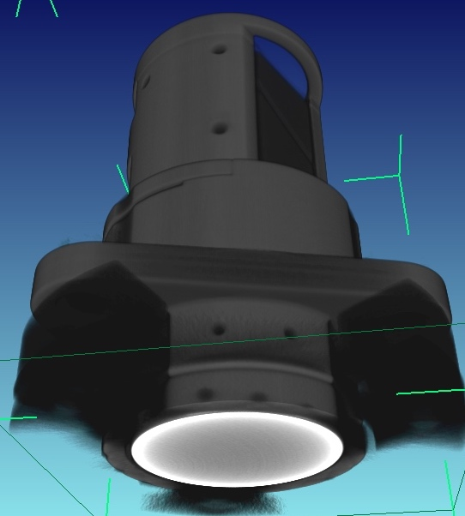
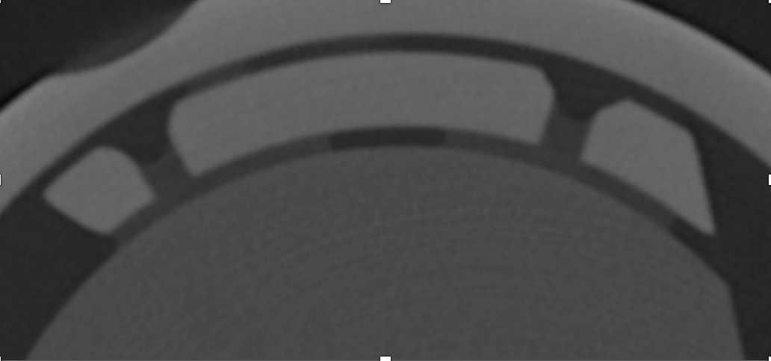
Example X-Ray Tomography Scans
X-ray scans allowed for detailed analysis to demonstrate pre- and post- environment survival
verify optic alignment in tubes
verify bond size, bubbles, delamination

Slide 10
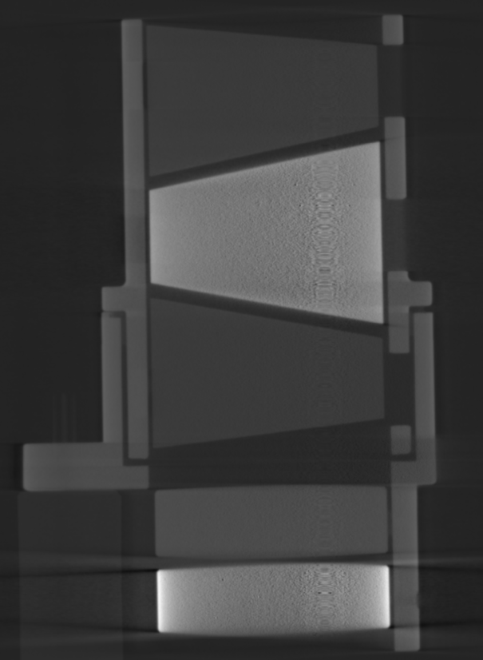
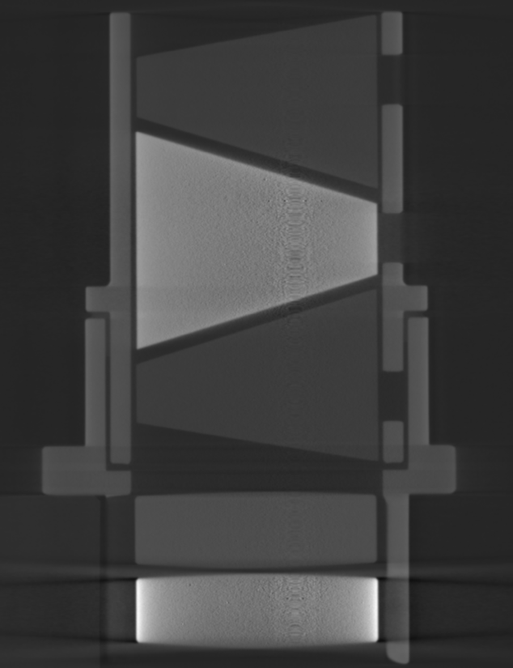
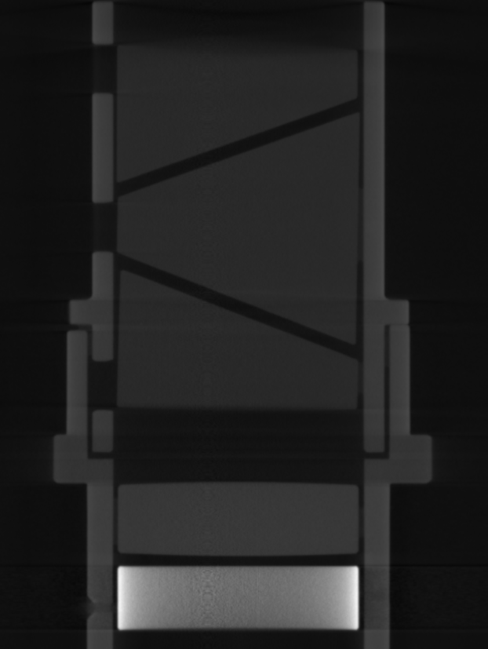
X-Ray Inspections: Full Cross-Section Inspections of Alignment
ZOD 660
ZOD 730
Wollaston

Slide 11
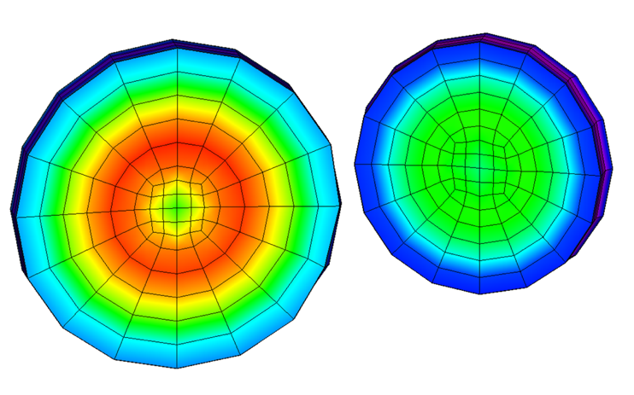
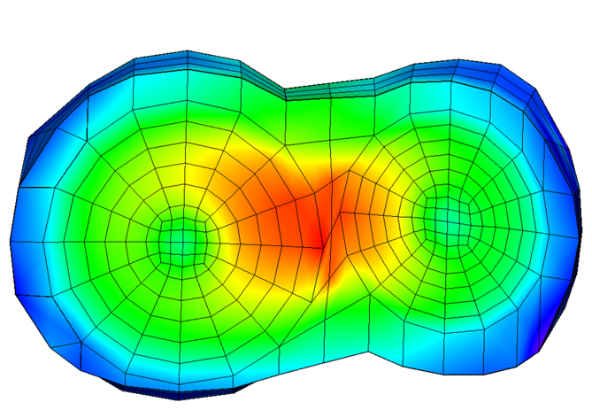
Value of Pre-Environment X-Ray: Revealed L2 Bond Pooling
One set of bond pads pooled together in one of the flight assemblies
3D Tomography enabled detailed structural-thermal analysis to prove healthy as-built flight survival margins
  Thermal stress margins decreased slightly, but random vibe margin increases significantly
Designed L2 bonds: separate, individual bonds
As-built L2 bonds: separate, individual bonds
✓

Slide 12
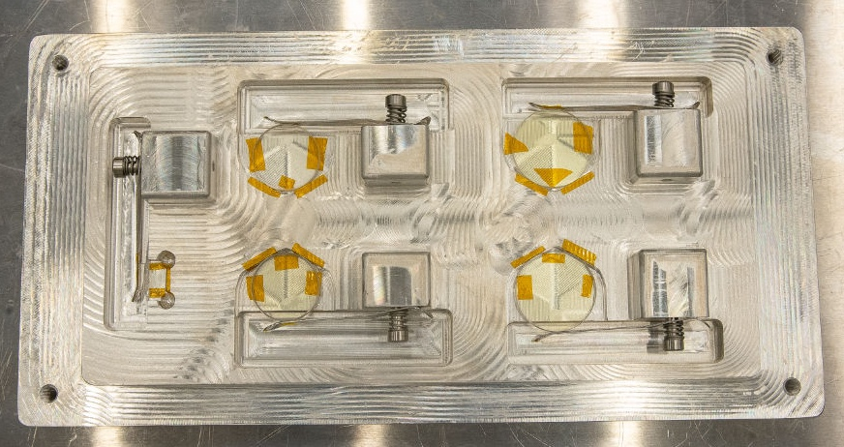
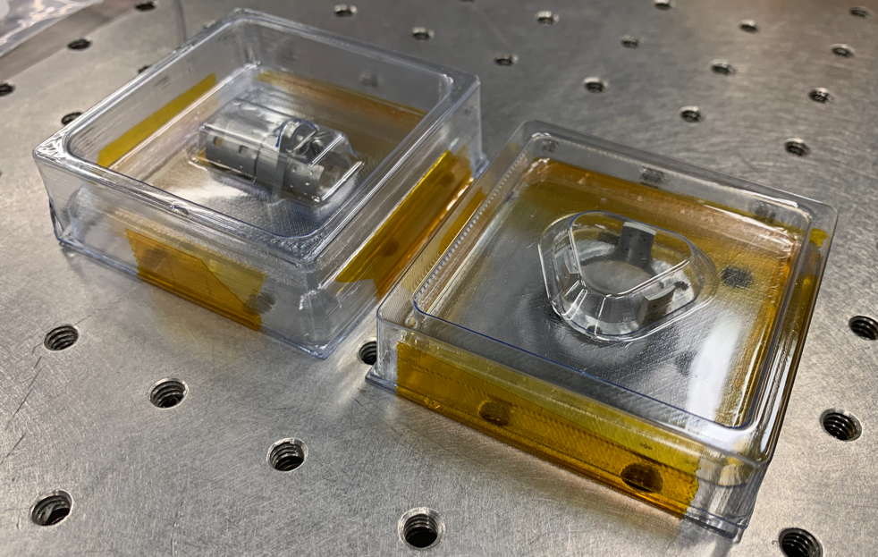
Contamination Control Through Process
Hardware inspected and directly verified particulate and non-volatile residue requirements
Outgassing verified by TQCM during TVAC survival tests and bakeout
  Specialized bakeout profile tailored to elevate glass transition temperature of the 9309 joint
Surface cleanliness verified as visibly clean to VC-10X-1000-1500UV specification for delivery
Coating and material witness samples traveled with flight/spare units through all assembly, testing, environmental testing, and transport for spectral verification, receiving inspection, and contamination witnesses during I&T
Specialized PET-G packaging for storage and transportation
All components under positive dry purge when not in use

Slide 13
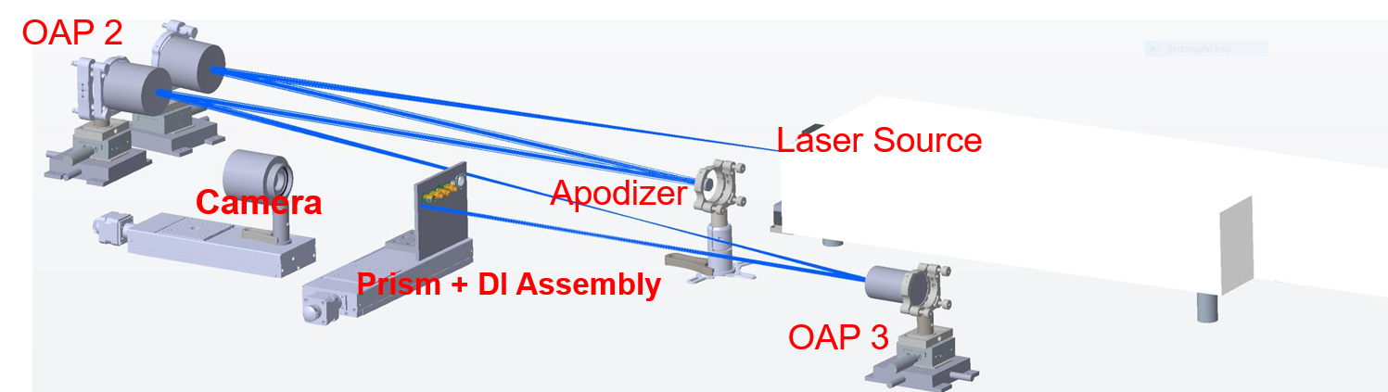
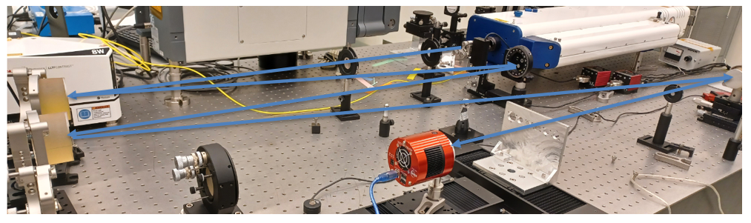
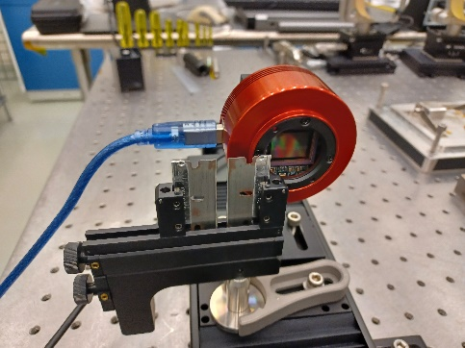
Performance Verification Lab Setup
Beam height 5.4’’
Lab Design
Beam Diameter: 5 mm
Built Lab
Polarizer as needed

Slide 14
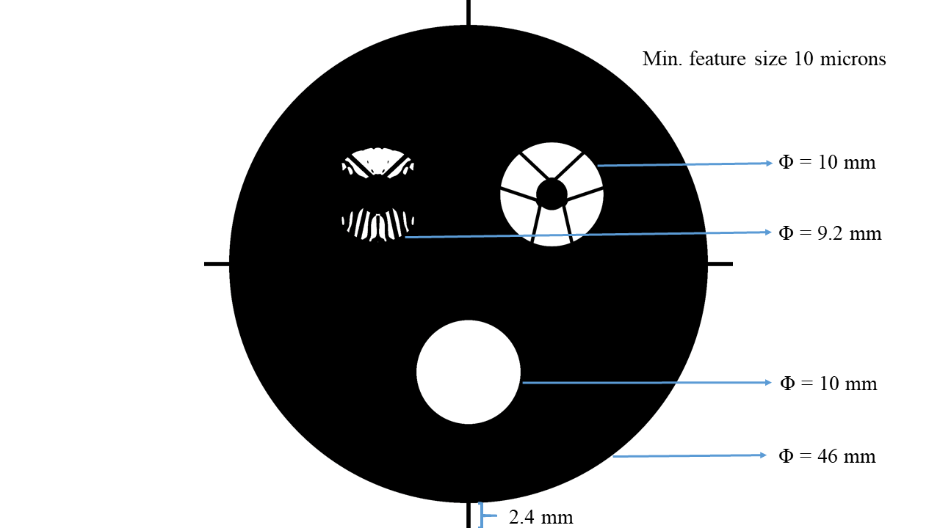
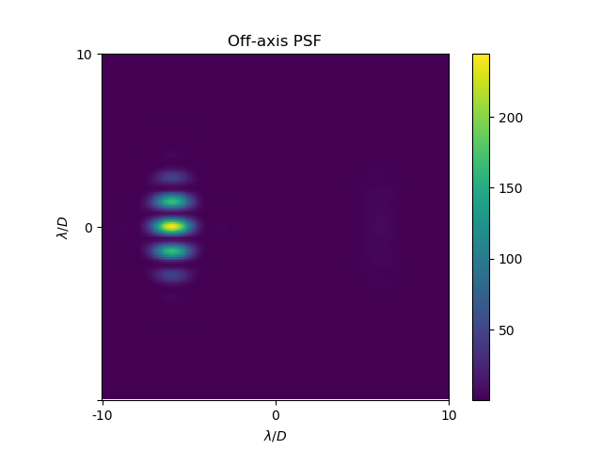
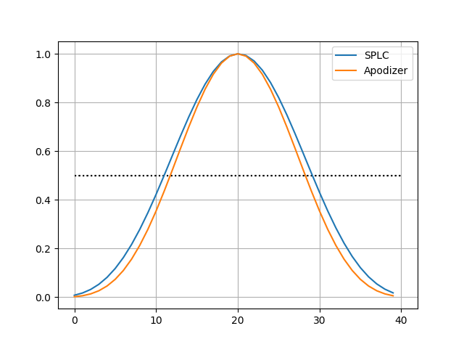
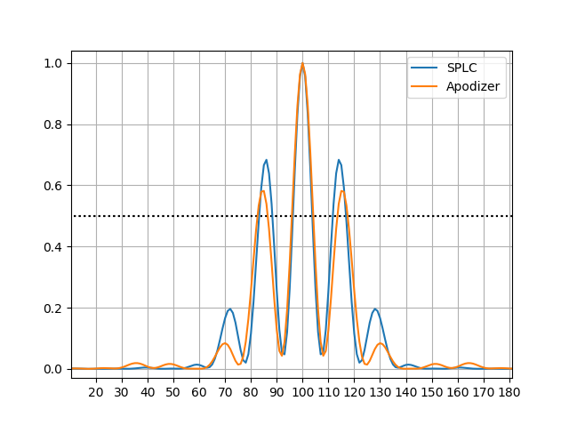
Optics Details - Apodizer Assembly
A single apodizer that has similar
PSF characteristics as the CGI
Coronagraph (except contrast)
5 μm black silicion feature size provides exceptional tolerances on pupil definition and aperture size. Simplifies hardware verifications

Slide 15
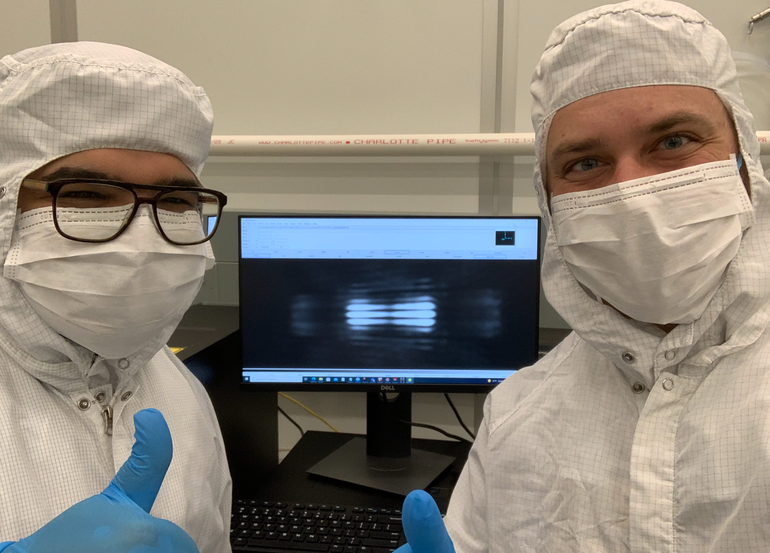
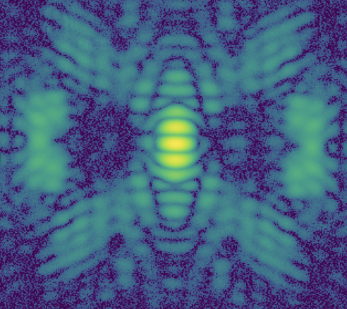
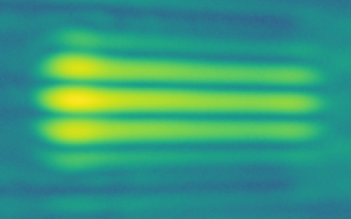
Real (Celebratory) Data

Slide 16
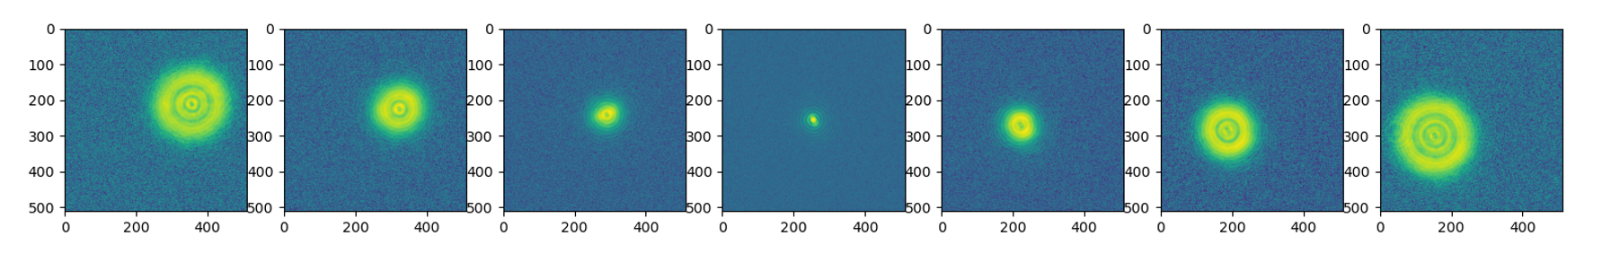
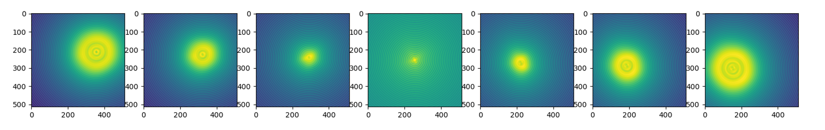
Pre and Post Vibe Wavefront Error
Optics | Pre (nm rms) | Post (nm rms) | Uncertainty (nm)
DI Lens | 14.67 | 14.40 | ±1.91
ZOD660 | 14.79 | 13.89 | ±1.91
ZOD 730 | 7.90 | 5.7 | ±1.91
Wollaston 0 | 30.2 | 27.83 | ±1.91
Wollaston 45 | 19.10 | 18.02 | ±1.91
Sources of Uncertainty
camera noise
interferometer accuracy
alignment error
Lab PSF
Fit PSF

Slide 17
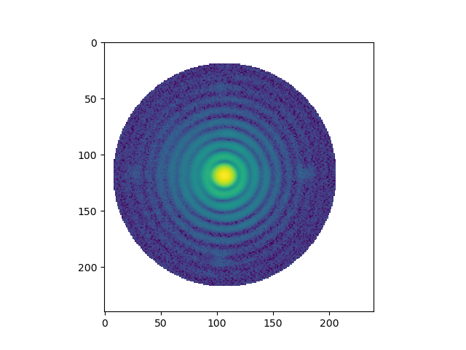
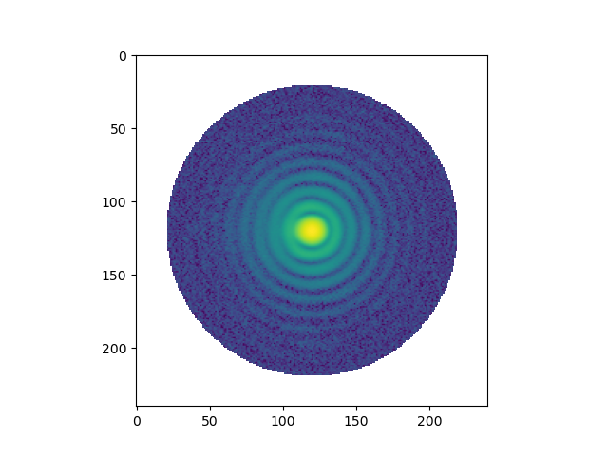
Spectral Dispersion Measurement
ZOD 730 @ 725 nm
ZOD 730 @ 735 nm

Slide 18
Ground Calibration
The spectroscopy mode has a 2-nm wavelength accuracy requirement and tolerances on final instrument spectral resolution
Both requirements are dependent on as-built filter parameters, beam angle of incidence, slit format, and as-built pupil observed looking back from the final focal plane
All subsystem level requirements have been verified but final calibrations are required to get final flight dispersion curves with flight pupil and wavelength calibration
  Interesting systems engineering side effect unique to pupil apodizing coronagraph:
  Since it is designed specifically to block/apodize the entire telescope pupil it is possible do true spectral resolution verification activities at the instrument level
Dispersion calibration with final flight pupil
Calibrate narrowband filter transmission profile in-situ with wavelength scans using a laser line tunable filter
  Narrowband filter knowledge critical to wavelength accuracy; since the slit and spectrum are deployable anywhere in the field the narrowband filter observation anchors the spectrum on detector
Verify spectral retrieval after calibration data taken using an NKT SELECT tunable filter

Slide 19
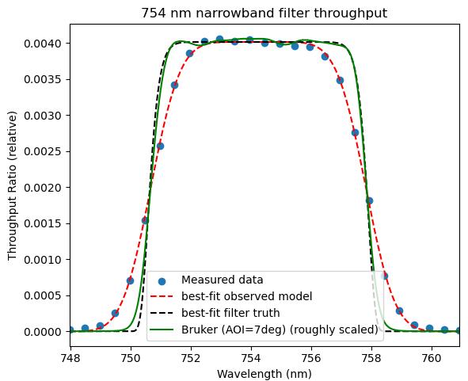
Filter Characterization Demonstration
Wavelength accuracy requirement of 2-nm at instrument level
  Requires careful dispersion calibration of prism
  Since slit deploys to arbitrary field position, also requires extremely careful calibration of the narrowband filters in as-assembled instrument configuration
Demonstration using flight reject filter prior to CGI I&T shows extremely precise calibration possible with designed test
  Tunable filter scan in CGI simulator testbed
  Compare to independent filter measurement with calibrated GSFC Bruker Fourier Transform Spectrograph in collimated light
Method | Center (nm) | Width (nm)
CGIsim testbed | 754.24 ± 0.01 | 7.19 ± 0.06
Bruker (AOI=7°) | 754.25 | 7.19

