Slide 1
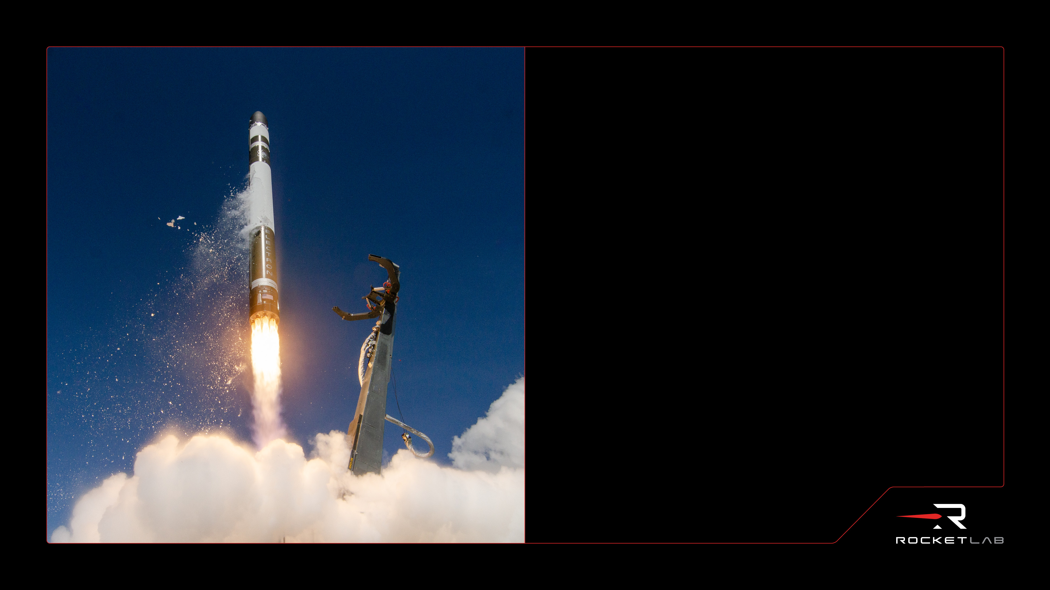
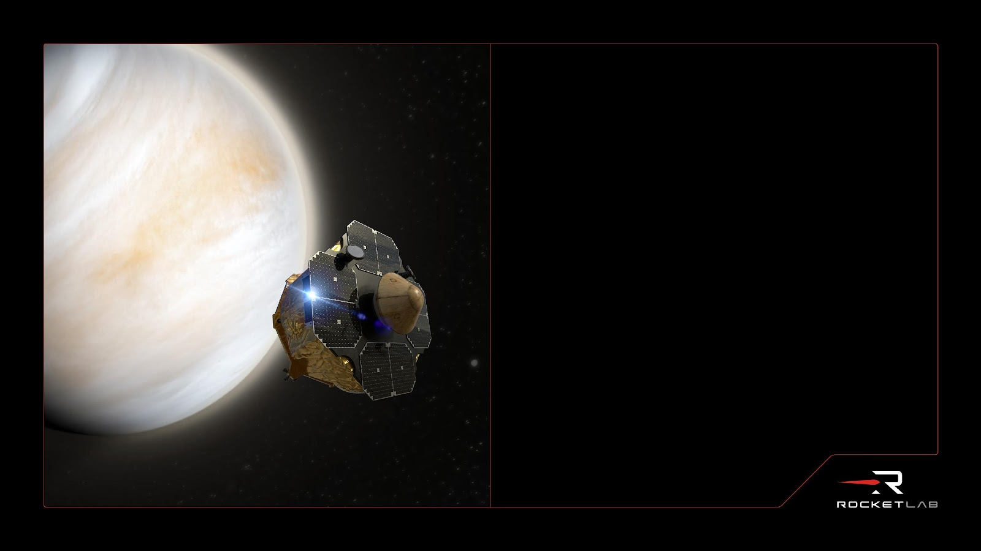
Rocket Lab USA, Inc.
Rocket Lab VENUS Probe TPS
Design, development, and future applications
August, 2023
rocketlabusa.com

Slide 2


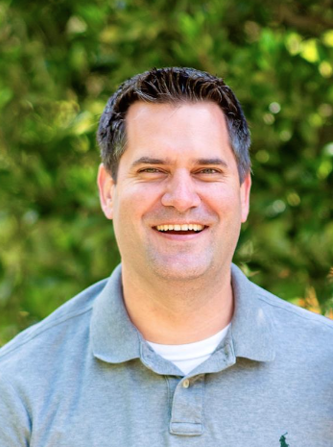
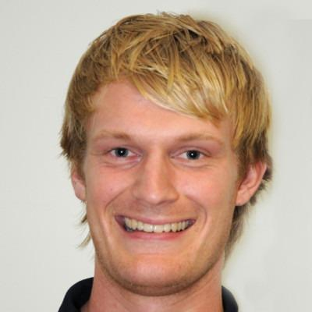
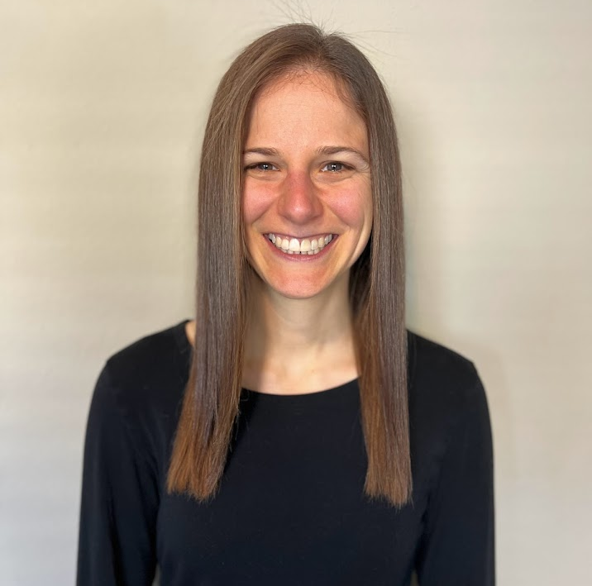
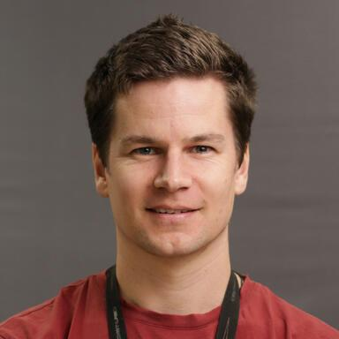
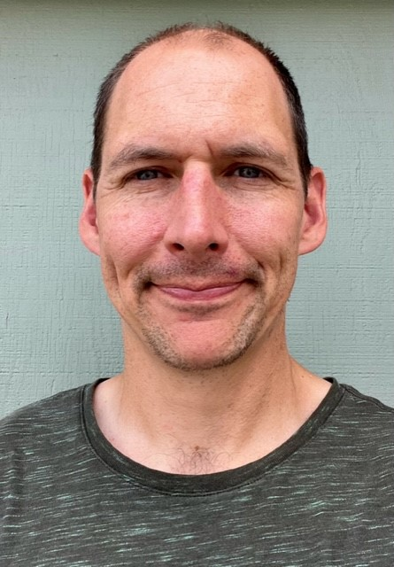
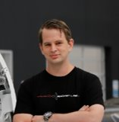
The TPS Team
Philipp Dahm
Rocket Lab, Neutron Thermofluids Analysis Lead
Keith Peterson
NASA Ames Research Center
Thermal Protection Materials Branch
Lyle Campbell
Rocket Lab, Development Engineer - TPS
Hannah Alpert
NASA Ames Research Center
Entry Systems and Vehicle Development Branch
Erwin Van Drunen
Rocket Lab, Space Systems Structures & Mechanical Systems Lead
Joshua Monk
NASA Ames Research Center
Thermal Protection Materials Branch
Christophe Mandy
Rocket Lab, Senior Spacecraft Systems Engineer

Slide 3
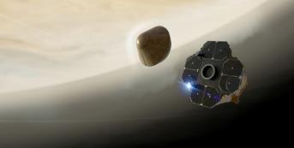



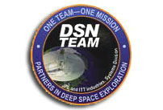
Rocket Lab Venus
Goals and Objectives
Science Goal
Search for habitable conditions in Venus’ cloud layer
Strategic Goals
Mature the interplanetary Photon spacecraft
Demonstrate high-performance, low-cost, fast-turnaround planetary entry mission delivering decadal-class science with small spacecraft and small launch vehicles
Mission Objectives
Search for organic material within the cloud-layer particles as a function of altitude
Seek anomalous cloud components, including aspherical particles and their relative abundance as a function of altitude
Program
Privately-funded Venus science mission
  Rocket Lab contributed launch, cruise stage, and entry probe
  MIT alumni-funded science instrument
  Volunteer science team
Launch in December 2024 to Low Earth orbit on Electron
Orbit raising, departure to Venus and deep space cruise with interplanetary Photon spacecraft
Hyperbolic trajectory and direct entry of probe in May 2025
Autofluorescing Nephelometer (AFN) to measure backscatter and induced fluorescence in the cloud layer in search of organics
Communications direct-to-Earth with Frontier-S radio and Deep Space Network (DSN)
Collaborators
MIT Venus Life Finder Missions

Slide 4
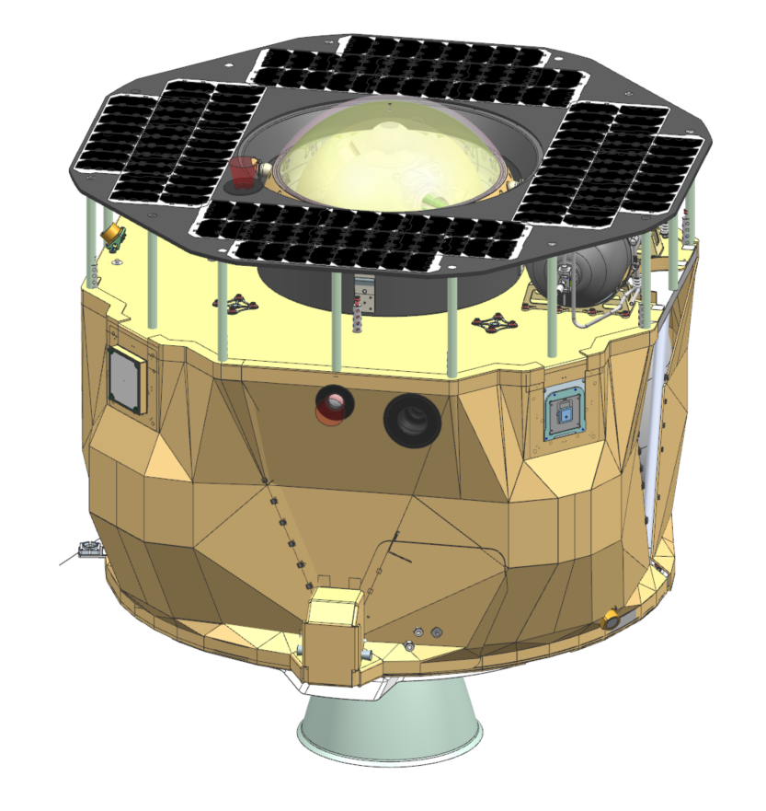
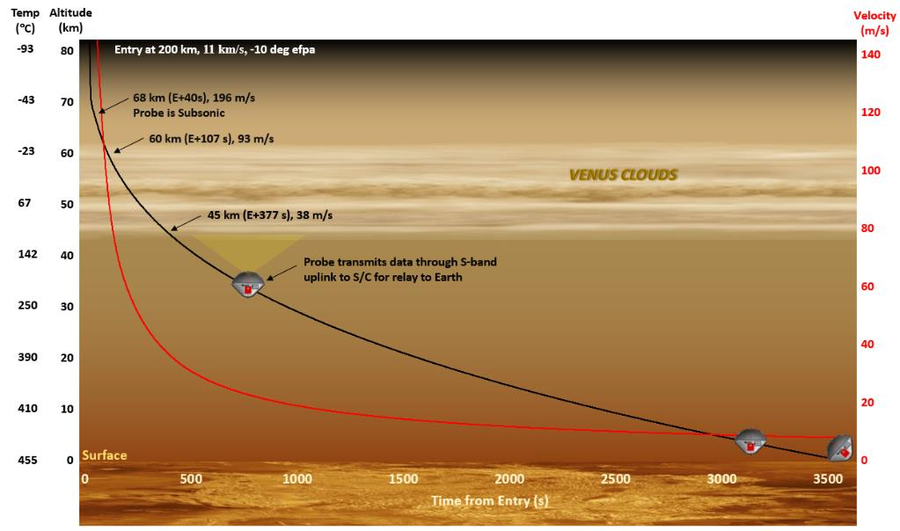

Mission Summary
2024.12.30
2025.01.05
2025.05.13
LEOPS
CRUISE
COAST
ENTRY
Launch
TVI
Probe Release
Range: 390,000km
Transfer time: 128 days
Range: 88,500,000 km
180s Supersonic phase
200km to 65km
-10deg EFPA, 11km/s
Supersonic
339s Measurement phase
65km to 45km
Nephelometer measurement
Mea-sure
Transmit
1280s Transmission phase
45 km to 22 km
Data transmission
☠
Pressure vessel design limit
4

Slide 5
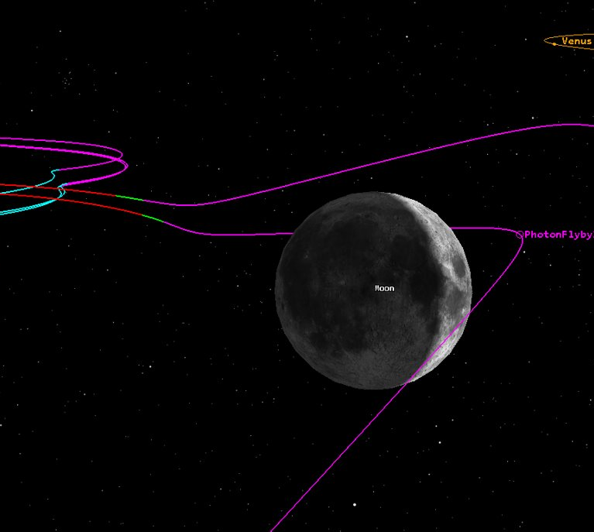
Driving Constraints
Mass budget
  Small launcher (Electron) results in smaller probe mass
    No budget for parachutes or heat shield ejection
    Limited delta-V driving ConOps decisions such as hyperbolic entry
  RF challenges with limited power and small antenna
Planetary environments
  Hypersonic deceleration phase (high heat load, pressure, acceleration)
  Venus atmospheric environments (high temperatures, high pressures, RF opacity)
  Distance to Earth (limited data rates, antenna boresight angles)
Programmatic constraints
  Internally funded mission, small team
  Rapid concept-to-launch cycle
  Re-entry TPS development is expensive and time consuming

Slide 6
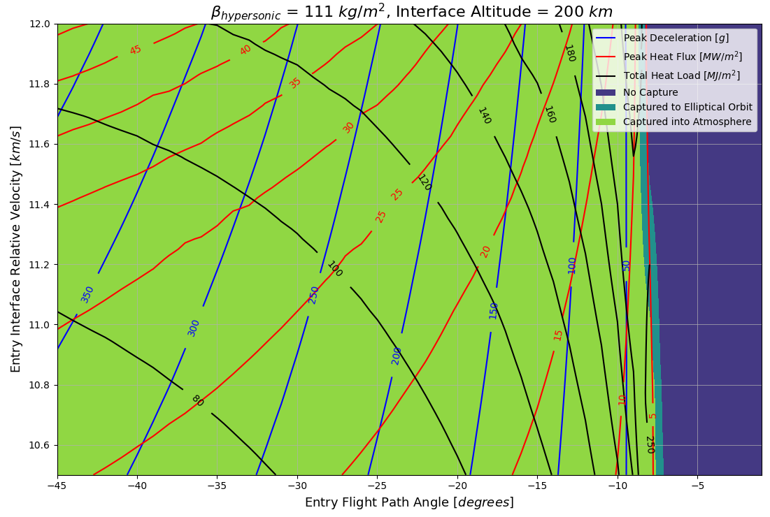
Entry Trajectory (1)
Low entry angle selected
Maximise fall time for sampling and communication
Limit peak deceleration
Peak flux compatible with ‘COTS’ low-density carbon-phenolic
High total heat load
Leads to high TPS mass fraction
Low β helps recover some ‘loss’
PV Night
PV Day
RL Venus
 | EFPA [deg.] | Β [kg/m²] | Peak Decel. [g’s] | Peak Heating [MW/m²] | Heat Load [MJ/m²]
PV North | -68.7 | ~ 190 | 458 | 62 | 105
PV Night | -41.5 | ~ 190 | 350 | 49 | 115
PV Day | -25.4 | ~ 190 | 223 | 35 | 133
RL Venus | -10 | ~ 111 | ~60 | 12 | 185

Slide 7
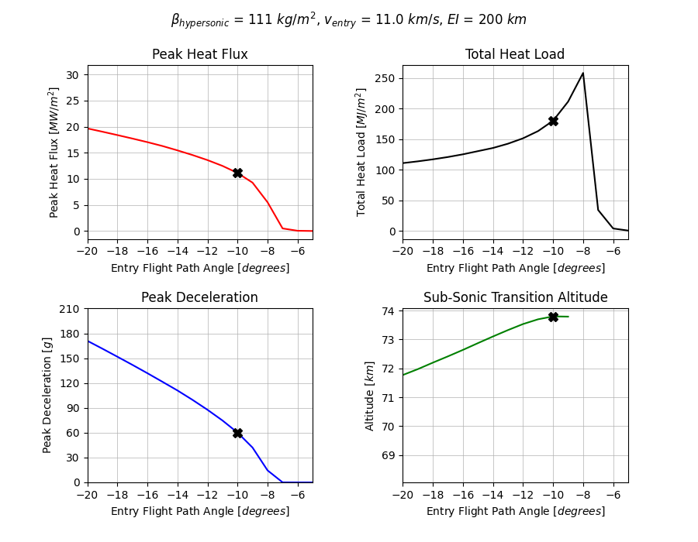
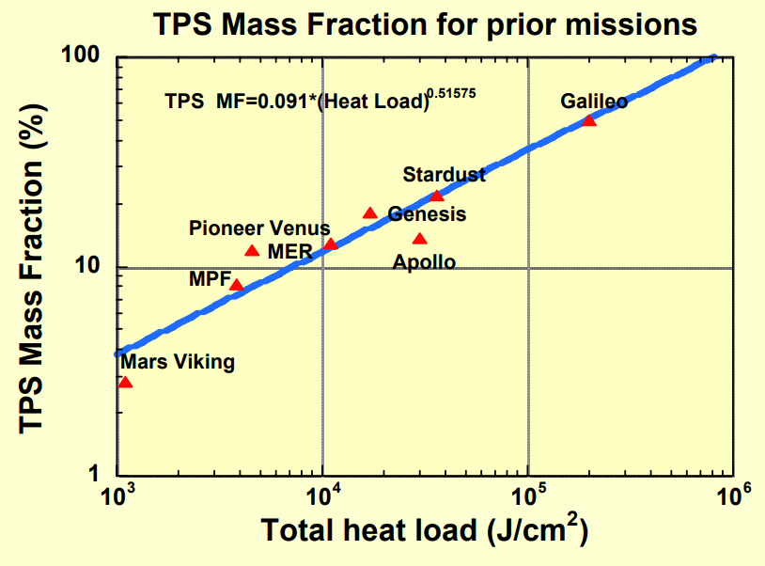
Entry Trajectory (2)
RL Venus
Trend suggests ~15% MF expected
Image from reference 1

Slide 8
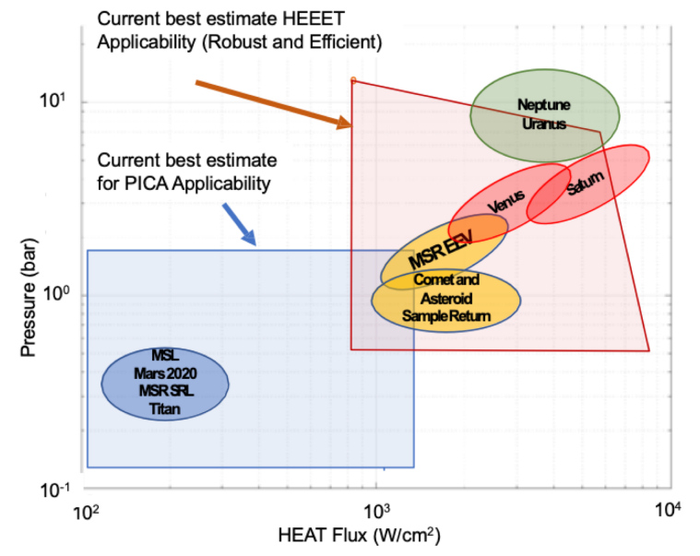
Investigated TPS OPTIONS
Full density CP forebody with SLA-220 back-shell
  MX-4926 (or similar) pre-preg construction
  Much too heavy for a low EFPA trajectory
  Challenging to qualify the manufacturing procedure and/or conduct accurate aerothermal tests with tight schedule and budget
Low/mid density CP forebody with SLA-220 back-shell
  Mild environments – PICA may be possible
  Several US and European suppliers of PICA and PICA-like materials
  Still some internal process development and qualification required
RL Venus
Image from reference 1

Slide 9
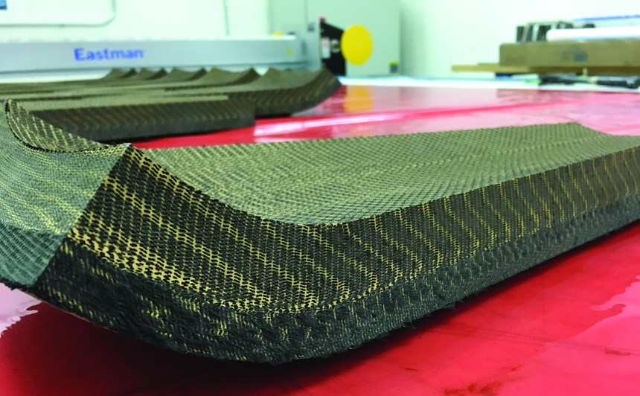
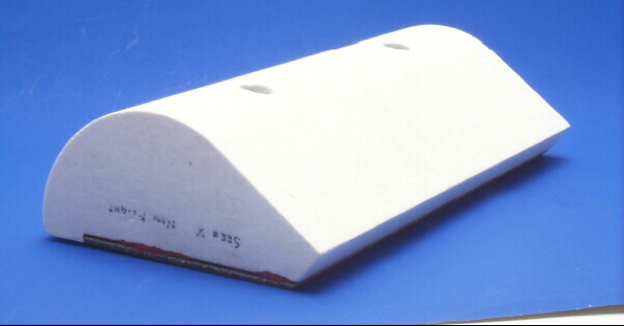
Selected TPS
HEEET insulation layer forebody
  Insulation layer of ‘HEEET’ alone is sufficient due to RL Venus shallow entry with low peak fluxes and pressures
  Lower density provides more efficient insulation per unit mass
  Small probe - single-piece forebody
  Well characterised material
SIRCA back-shell
  Low density, RF-transparent ablator
  Flight heritage
Dual-layer HEEET, image from reference 2
SIRCA specimen, image from reference 3

Slide 10
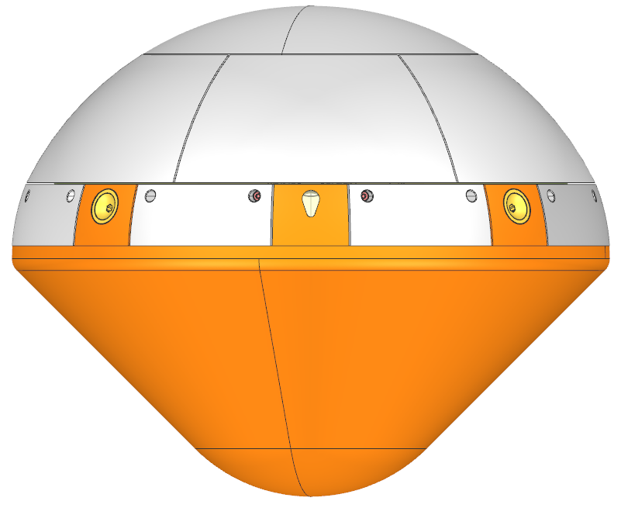
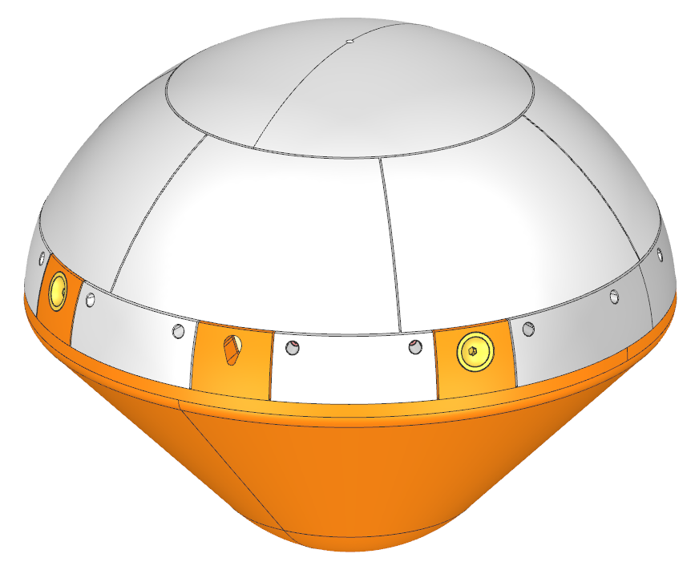
PROBE AND TPS DESIGN (1)
7x SIRCA aftbody tiles
R 228 mm
D 430 mm
45°
5x HEEET IL shoulder tiles
4x separation system hardpoints
1x instrument ‘window’
5x SIRCA shoulder tiles
R 118 mm
1x HEEET IL forebody

Slide 11
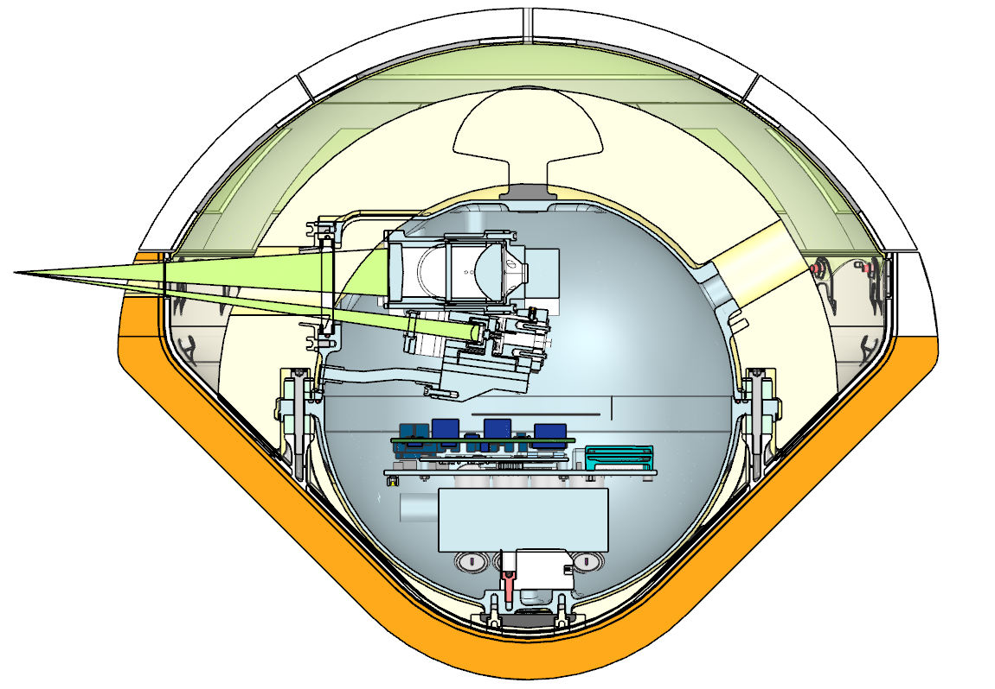
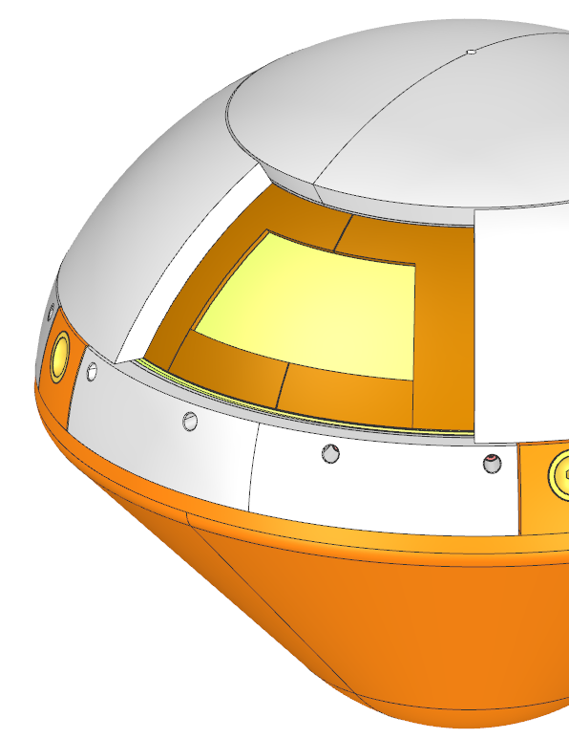
PROBE AND TPS DESIGN (2)
Antenna
Nephelometer laser and collection FOV
Foam insulation
E-glass structure
Forebody TPS
Printed Ti structure
SIP ‘picture frame’ underneath SIRCA
Pressure vessel
Continuous SIP under HEEET IL forebody

Slide 12

TPS Sizing Strategy
Assumptions
  Default Venus aerothermal margins
    Forebody: 1.5x convective, 1.0x radiative, 1.1x pressure
    Aftbody: 2x convective, 1.7x radiative, 1.1x pressure
  Material branch bond line margin of 50°C
    Nominal bond line temperature limit: 250°C
    Margined bond line temperature limit: 200°C
  Shoulder heating (driving case) margins
    1.77x convective heating, 0.62x pressure (from CFD analysis of shoulder vs. stagnation point convective heating and pressure profiles from other Venus missions of similar size)
  Initial temperature: 5°C
  Forebody re-radiation temperature: 100°C
  Aftbody re-radiation temperature 21°C
Sizing Approach
  T₁: Nominal branch – calculated using the unmargined environment and the unmargined bond line temperature limit
  T₂: Aerothermal branch – calculated using the margined environment and the unmargined bond line temperature limit
    Accounts for uncertainties in aerothermal analysis
  T₃: Material branch – calculated using the unmargined environment and the margined bond line temperature limit
    Accounts for variability in material properties
  T_{RSS}: RSS’ed thickness – calculated as
  T_{final}: 1.25x factor on T_{RSS}
$$T_{RSS}= T_{1}+\sqrt{{( T_{2}−T_{1} )}^{2} + {( T_{3}−T_{1} )}^{2}}$$

Slide 13
TPS Sizing Results
Material | Thickness (mm) | Temperature Limit (°C)
HEEET-IL | Sized
SIP | 0.25 | 250
Ti skin | 0.5
Ti core | 2.5
Ti skin | 0.5
Material | Thickness (mm) | Temperature Limit (°C)
SIRCA15 | Sized
RTV-560 | 0.25 | 260
SIP | 2.3
RTV-560 | 0.25 | 177
M55J Composite | 1.2
Region | Location | Initial Temperature (°C) | EFPA (°) | TPS Material | Nominal Sizing (mm) | RSS Sizing (mm) | Final Sizing (mm)
Forebody | Stagnation | 5 | -10 | HEEET-IL | 13.2 | 14.4 | 18.0
Forebody | Shoulder | 5 | -10 | HEEET-IL | 13.7 | 15.2 | 18.9
Aftbody | N/A | 5 | -10 | HEEET-IL | 7.5 | 9.6 | 12.0
Aftbody | N/A | 5 | -10 | SIRCA | 8.9 | 13.9 | 17.3
No dedicated CFD or arcjet testing conducted for this mission
  1.25x ‘additional margin’ added to compensate
‘Regular’ margining
‘Additional’ margining

Slide 14
R.L. Venus SUMMARY
Probe Diameter | 0.43 m
Probe Mass | ~17 kg
Probe β | 111 kg/m²
TPS Mass | ~4.5 kg
TPS Mass Fraction | ~25 %
Rocket Lab mission to Venus aims to demonstrate low-cost, fast-turnaround planetary entry capability
Rocket Lab CAPSTONE hardware leveraged to reduce bus cost and shorten delivery timeline
NASA technology and experience leveraged to expedite probe design and TPS delivery
Almost in ballistic aerocapture zone
FUTURE APPLICATIONS
Quasi “repeat” missions to Venus
  Additional scientific scouting
  Ballistic/drag-modulation aerocapture demonstration

Slide 15
References
Venkatapathy E., “Enabling In-Situ Science: Engineering of the Thermal Protection System for Future Venus Entry Missions”, 2006, https://www.lpi.usra.edu/vexag/chapman_conf/presentations/venkatapthy_thu_pm.pdf
Gardiner G., “Heatshield for Extreme Entry Environment Technology (HEEET): A Broader Mission”, 2018, https://www.compositesworld.com/articles/heatshield-for-extreme-entry-environment-technology-heeet-a-broader-mission
NASA Thermal Protection Materials Branch, “Low Density Ablators”, 2019, https://www.nasa.gov/centers/ames/thermal-protection-materials/tps-materials-development/low-density-ablators.html

Slide 16

THANK-YOU
Christophe mandy
Senior Spacecraft Systems Engineer
M. 123 456 789
E. c.mandy@rocketlabusa.com
Rocket Lab USA, Inc
rocketlabusa.com

