Slide 1

An overview of plume-surface interaction research
Wesley A. Chambers, Ph.D.
Deputy Principal Investigator, Plume-Surface Interaction Project
NASA Marshall Space Flight Center
University of Glasgow Seminar
24 August 2023

Slide 2
Outline
Introduction & Approach
Apollo and Viking
Research Since Apollo
Present and Future Efforts

Slide 3
Introduction & Approach to Plume-Surface Interactions

Slide 4
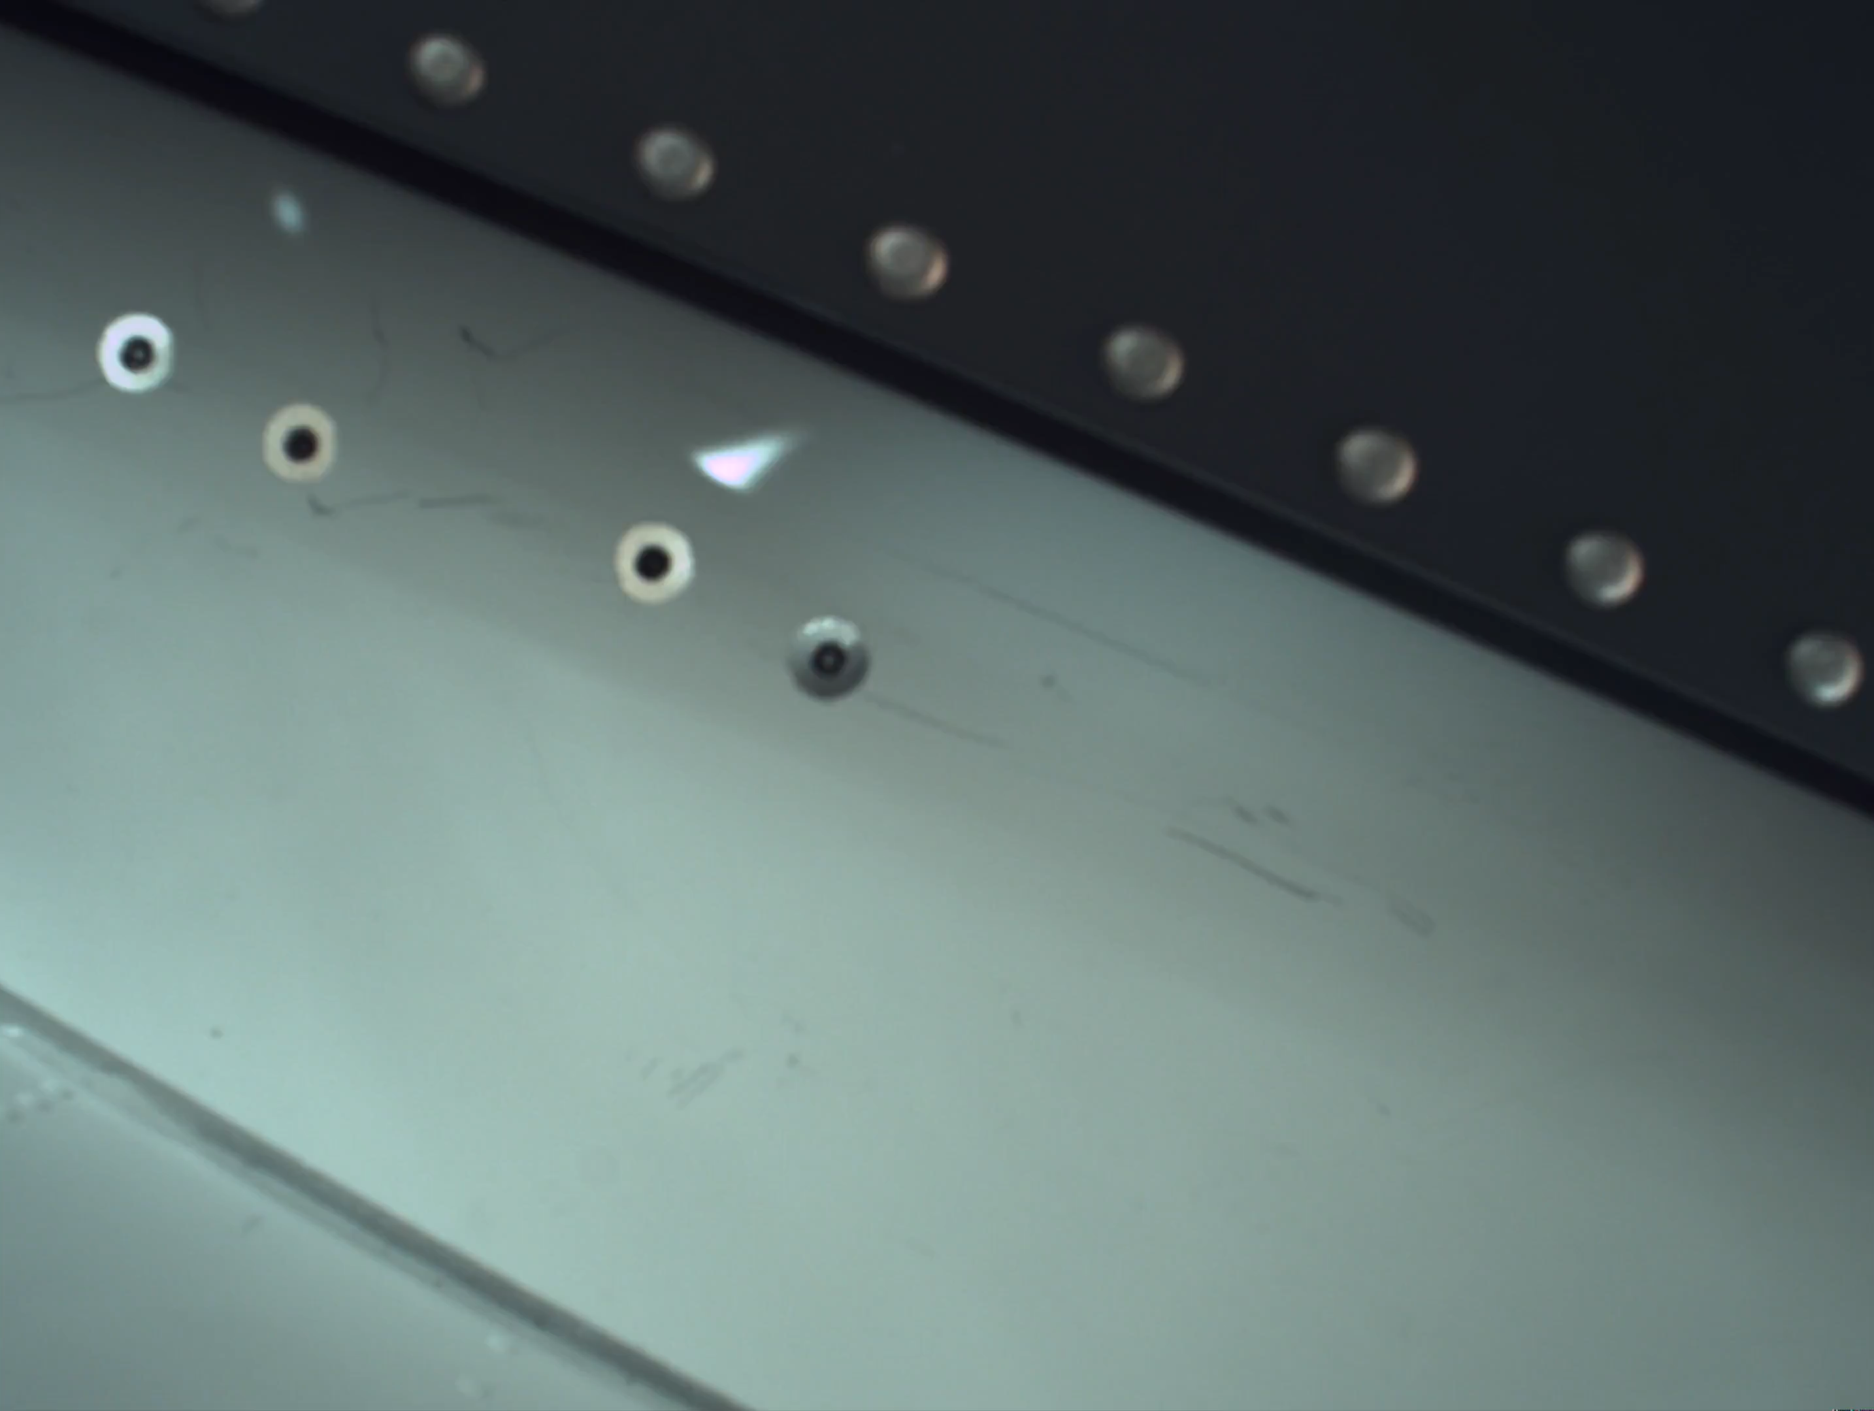
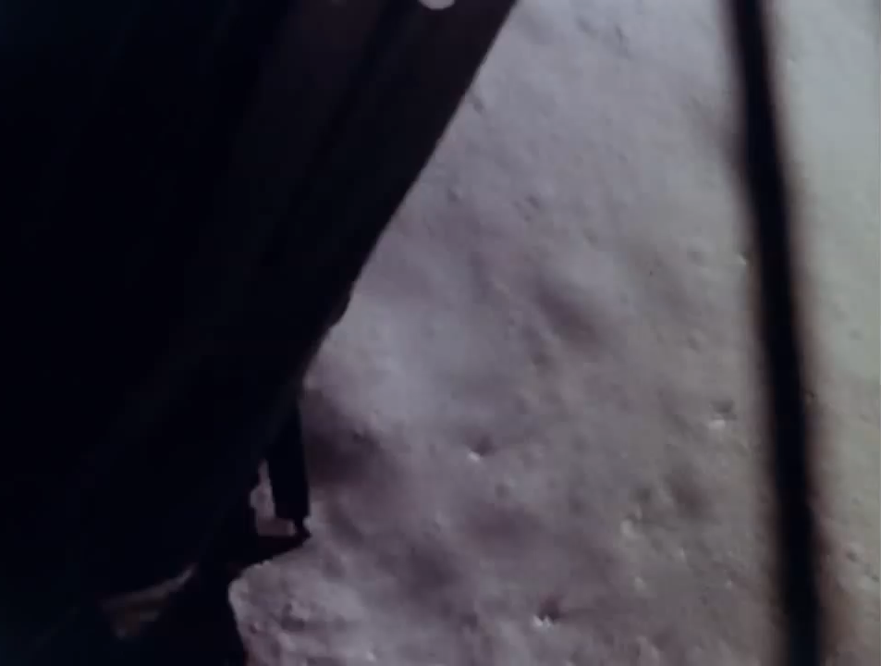
What are plume-surface interactions?
Mars 2020 (NASA/JPL)
Apollo 11 (NASA)
Notes:
Apollo video source: Apollo 11 45th Anniversary Resource Reel | NASA Image and Video Library (trimmed/compressed by the author)
M2020 landing video: NASA/JPL (trimmed/compressed by the author)

Slide 5
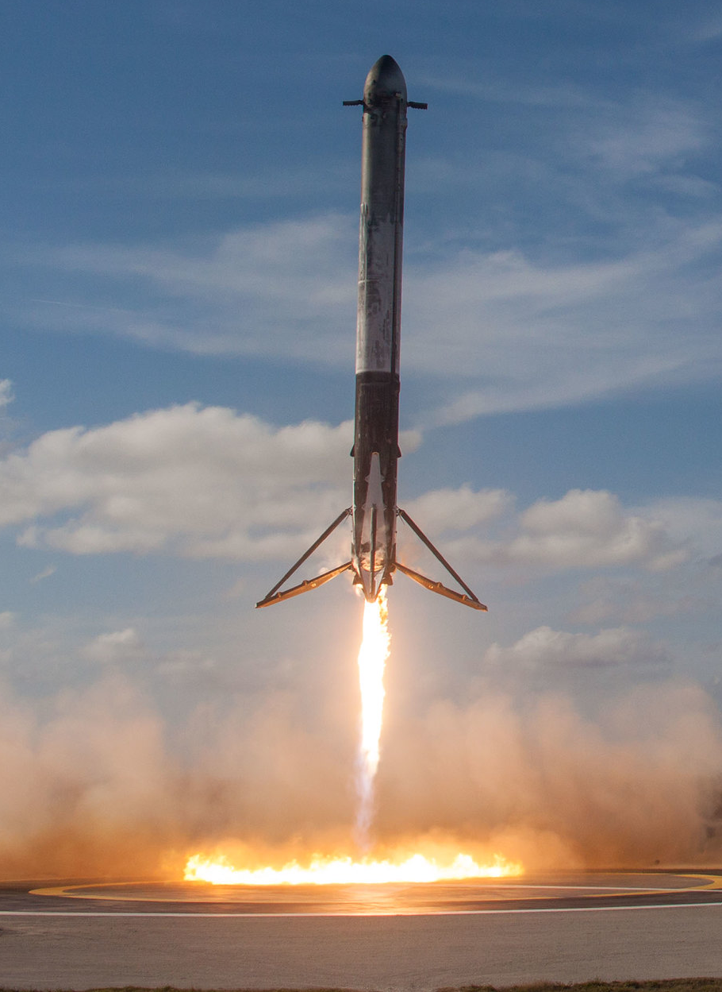
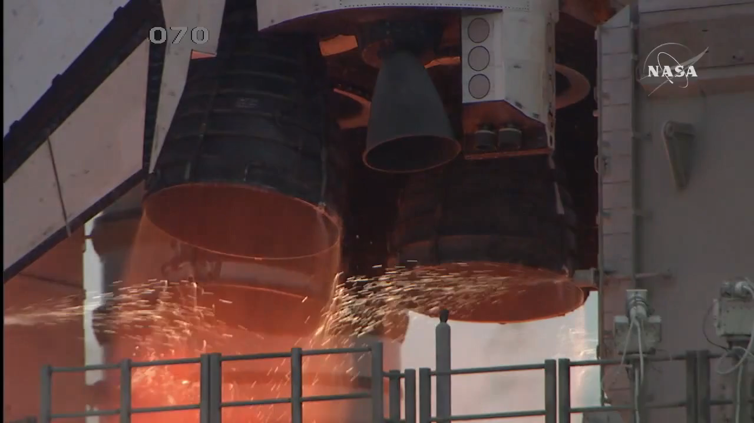
also plume-surface interactions (improved surface)
NASA
SpaceX (CC BY-NC 2.0)
Notes:
SpaceX Photo: Falcon Heavy Demo Mission | Official SpaceX Photos | Flickr / Creative Commons — Attribution-NonCommercial 2.0 Generic — CC BY-NC 2.0
Shuttle video source: NASA Image and Video Library (trimmed by author)

Slide 6
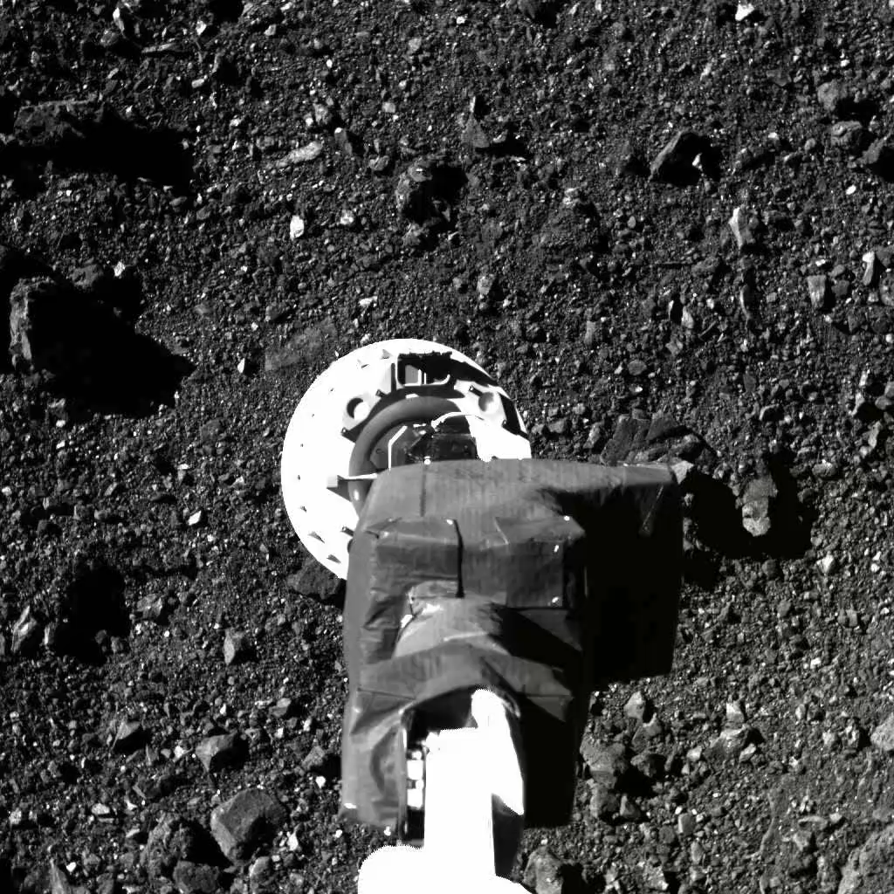
(intentional) plume-surface interactions
NASA/Goddard/University of Arizona
Notes:
NASA SVS | OSIRIS-REx Post-TAG Briefing

Slide 7
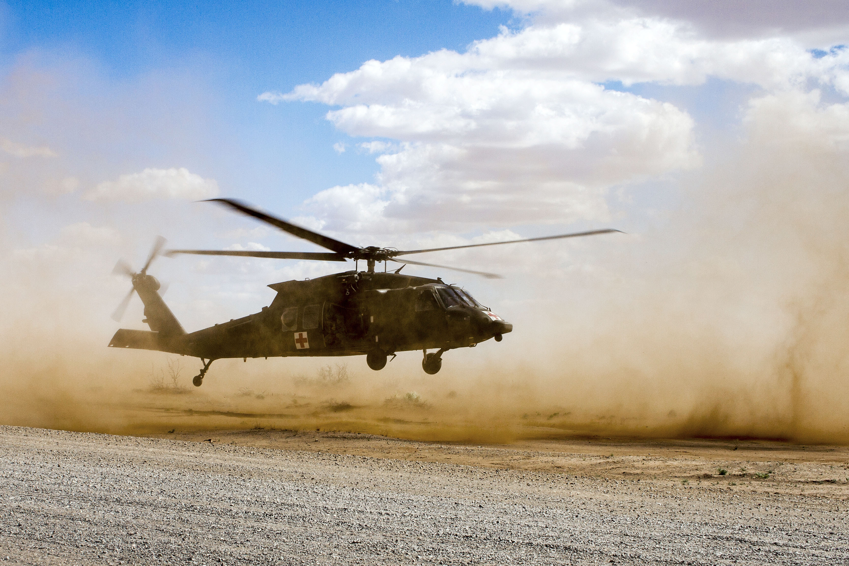
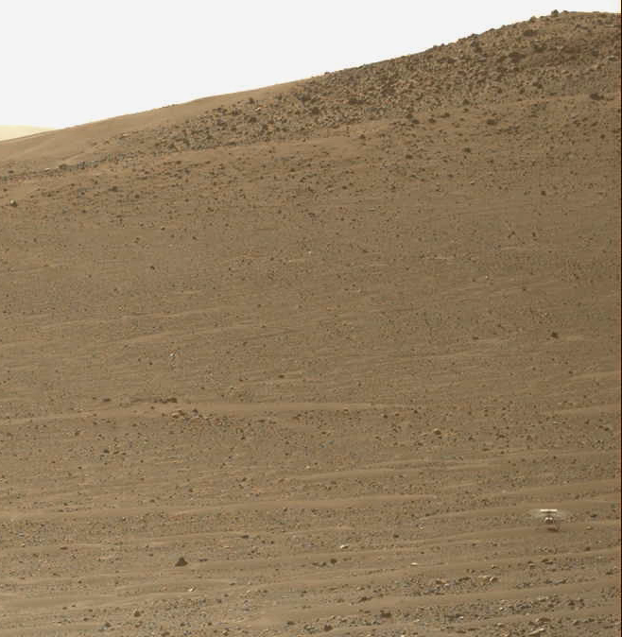
(rotor) plume-surface interactions
NASA/JPL-Caltech/ASU/MSSS
DOD/Army National Guard/Spc. Jovi Prevot
Notes:
DOD Photo: Black Hawk Landing (defense.gov)
Ingenuity video: Perseverance's Mastcam-Z Views Ingenuity's 47th Takeoff – NASA Mars Exploration

Slide 8
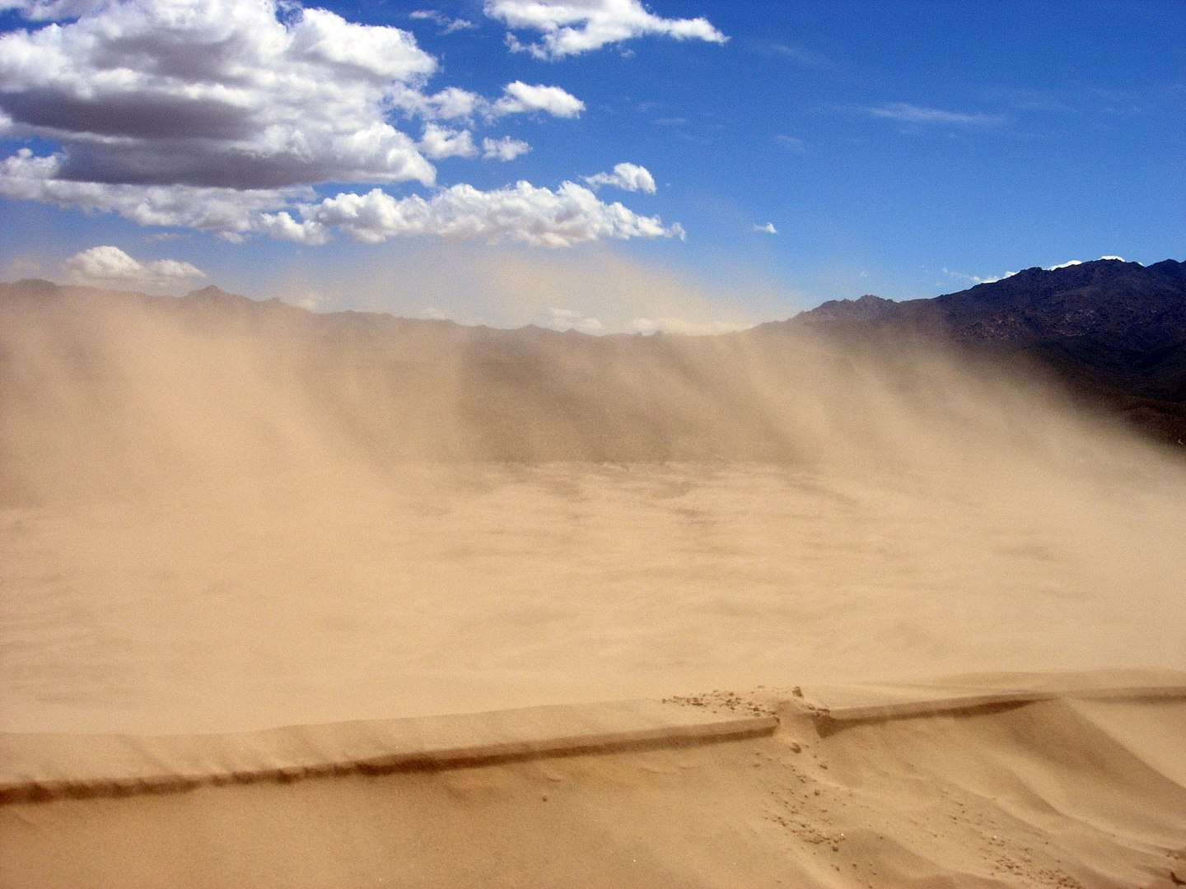
Wikimedia / Mark A. Wilson
Wikimedia/Mark A. Wilson/Public Domain
Wikimedia / Fir0002 / (CC BY-SA 3.0)
Notes:
Photo source: KelsoSand - Aeolian processes - Wikipedia

Slide 9
Which problem are we addressing?
spacecraft rocket exhaust interacting with unimproved planetary surfaces
plume-surface interactions
fluid-granular physics

Slide 10
Study of plume-surface interactions is a
complex, multi-discipline problem
Fluid physics
Planetary science & geology
Granular mechanics
Testing capability
Modeling & simulation
Mission planning & operations
Diagnostics & instrumentation
Fluid-granular physics
Facilities
Integrating diagnostics
Simulant handling & characterization
Simulant selection

Slide 11
The “3-Legged Stool” Approach
Modeling & Simulation
Experimental Data
Flight Data
Fills in testing and data gaps
Ground truth
Limited opportunities, data
Varying levels of fidelity
Better control, instrumentation
Large uncertainty, current tools need quantitative validation
Notes:
Experimental Data image source: PSI Project
M&S/Flight Data images sourced from: Plume-Surface Interaction: Maturing Predictive Environments for Propulsive Landing on the Moon and Mars - NASA Technical Reports Server (NTRS)

Slide 12
What are we trying to achieve?
An understanding of plume-surface interaction physics that enables predictive modeling so space missions can
  Conduct successful near-surface operations
    Spacecraft landing and ascent
    Sampling operations
  Mitigate surface alteration
    Physical and chemical
  Mitigate effects to surrounding assets
    Impact, abrasion
    Area of effect determined by vehicle, concept of operations, and environment of operations

Slide 13
Plume-Surface Interaction Research for Apollo and Viking

Slide 14
Apollo-Era PSI Research
Year | Modeling & Simulation | Test Data | Flight Data
1961 |  | PSI test w/underexpanded jets, Lewis (now Glenn) Research Center¹
1962 | Roberts’ model on surface erosion²
1963
1964 |  | First Technical Report written on PSI tests at the LaRC vacuum sphere³
1965
1966 | Alexander report presents a theoretical treatment of in-atmosphere PSI test⁵ | Surveyor Vernier engine PSI experiment in vacuum chamber⁴; Alexander report on in-atmosphere cold gas + hot fire testing⁵ | Surveyor I mission lands
1967 |  |  | Surveyor III, IV, V, and VI missions land; Surveyor V conducts in situ PSI experiment
1968 | Scott and Ko publish Darcy Law modeling on Edwards AFB/Surveyor engine test⁴; theoretical treatment of LaRC tests⁶ |  | Surveyor VII mission lands
1969 | Citations at end of presentation | Second Technical Report written on PSI tests at the LaRC vacuum sphere⁷ | Apollo 11, 12 missions land
A decade of Apollo PSI risk reduction included modeling, multiple tests, precursor missions, and an in situ PSI experiment

Slide 15
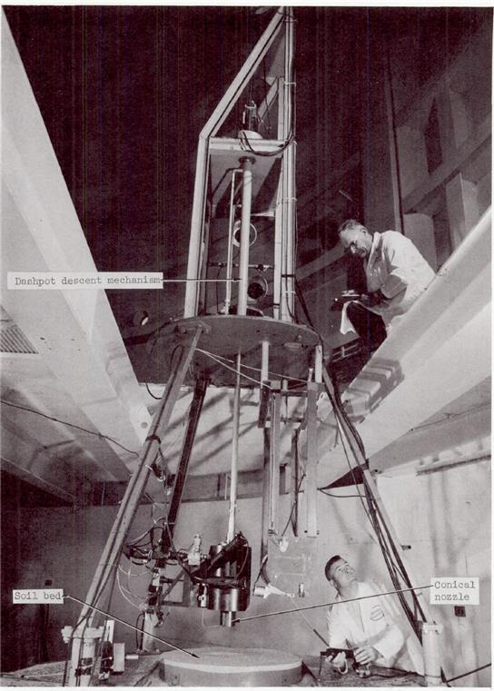
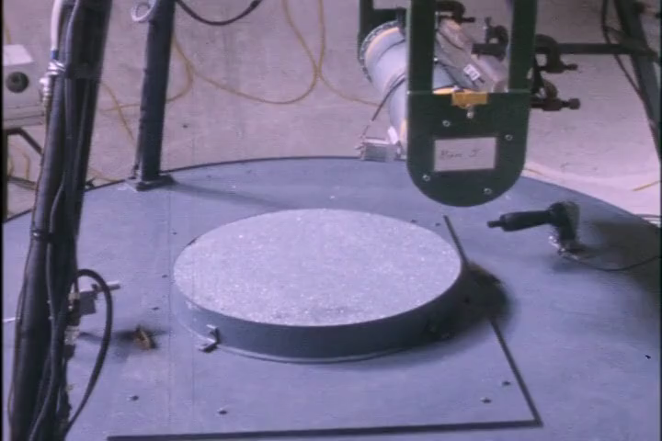
Apollo-Era Testing
Historical testing at NASA Langley Research Center
Land and Scholl (1969)
Land and Scholl (1969) Video Supplement
Notes:
Video clip: Scaled Lunar Module Jet Erosion Experiments - NASA Technical Reports Server (NTRS) (Converted/trimmed by the author)
Image: Scaled Lunar Module Jet Erosion Experiments - NASA Technical Reports Server (NTRS)

Slide 16
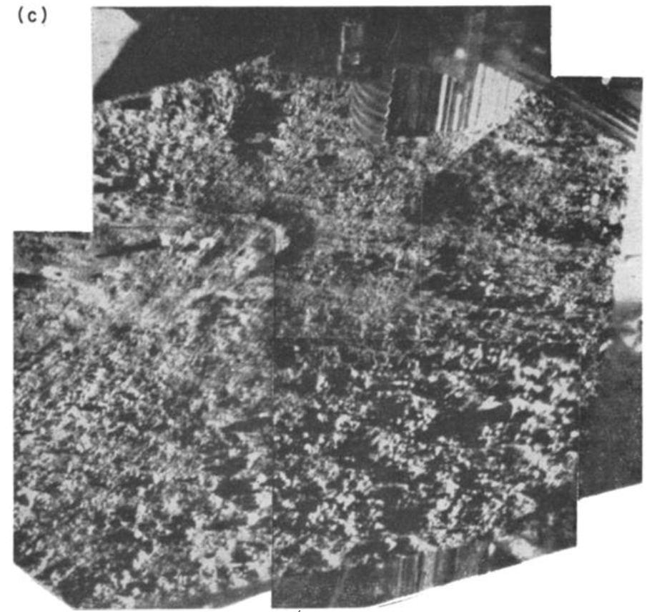
Apollo-Era Flight Data
Plume-surface interaction experiment on the lunar surface
  Surveyor 5 vernier engine fired, images taken before and after
  Eroded volume estimated from images; lunar permeability estimated using method from Scott and Ko (1968)
Lunar surface beneath Surveyor 5 after an engine static fire (Christensen et al., 1968)
Notes:
Image from Christensen et al. 1968: Lunar surface mechanical properties (wiley.com)

Slide 17
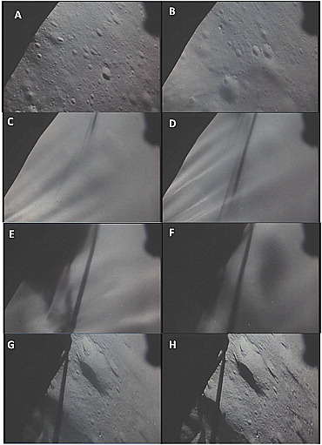
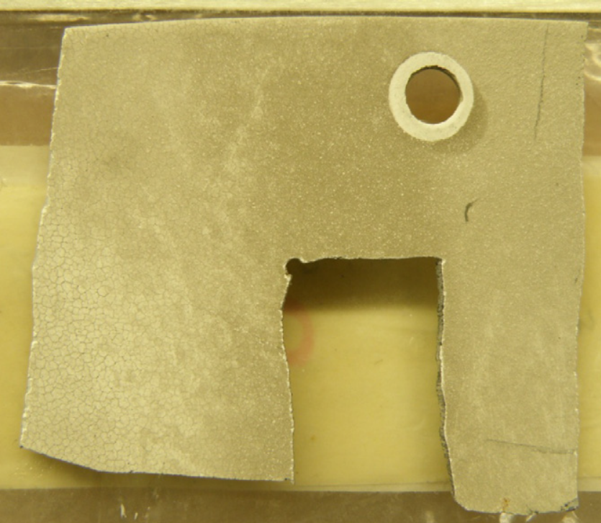
Apollo Flight Data
Apollo landing videos show erosion, visual obscuration
Images from Apollo 15; figure from Metzger et al. (2011)
Apollo 12 astronauts recovered damaged samples from Surveyor III
NASA/Immer et al. (2011)
Notes:
Descent sequence from Metzger et al. 2011: Phenomenology of soil erosion due to rocket exhaust on the Moon and the Mauna Kea lunar test site - Metzger - 2011 - Journal of Geophysical Research: Planets - Wiley Online Library
Image from Immer et al. 2011: Apollo 12 Lunar Module exhaust plume impingement on Lunar Surveyor III – ScienceDirect; NASA photograph

Slide 18
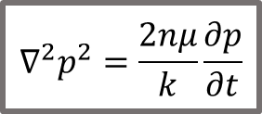
Apollo-Era Modeling and Mechanisms
Pressure
Erosion model proposed by Roberts (1962)
Gas diffusion modeled by Scott and Ko (1968), used to estimate lunar permeability and grain size (Christensen et al. 1968)
Mechanisms identified during Apollo era summarized by the Viking Site Alteration Effects report (Romine et al. 1977)
  Viscous erosion
  Diffused gas erosion
  Bearing capacity failure
Surface Boundary Condition
Radius
Darcy’s Law
$$∇^{2}p^{2}=\frac{2nμ}{k}\frac{∂p}{∂t}$$
Depth
Solid Boundary Condition
Illustration of the numerical method to estimate rocket exhaust flow in soil found in Scott and Ko (1968).
Notes:
Figure from Scott and Ko (1968): Transient rocket-engine gas flow in soil. | AIAA Journal

Slide 19
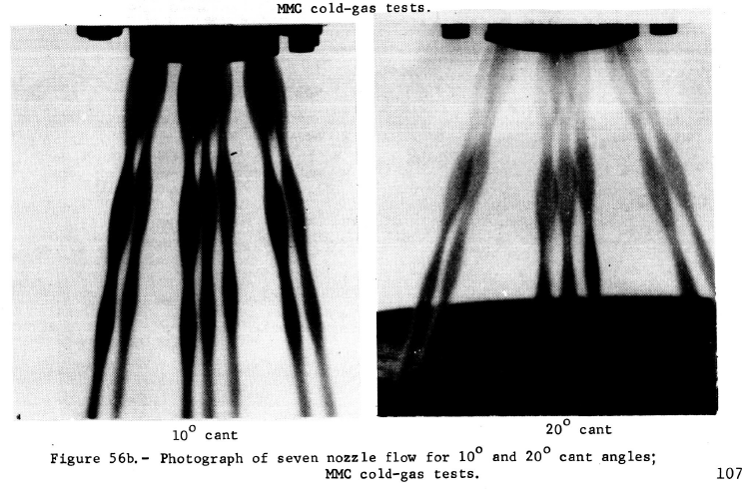
Viking PSI Research
Summarized by the Romine et al. (1977) Site Alteration Effects report
Tested multiple nozzle configurations to reduce PSI effects for Martian landing
Drove design of Viking engine configuration and established impingement pressure limit still used today
Cold-gas nozzle testing; figure from Romine et al. (1977)
Notes:
Site alteration effects from rocket exhaust impingment during a simulated Viking Mars landing. Part 1: Nozzle development and physical site alternation - NASA Technical Reports Server (NTRS)

Slide 20
Research Since
Apollo and Viking
Modern techniques, experiments, and modeling

Slide 21
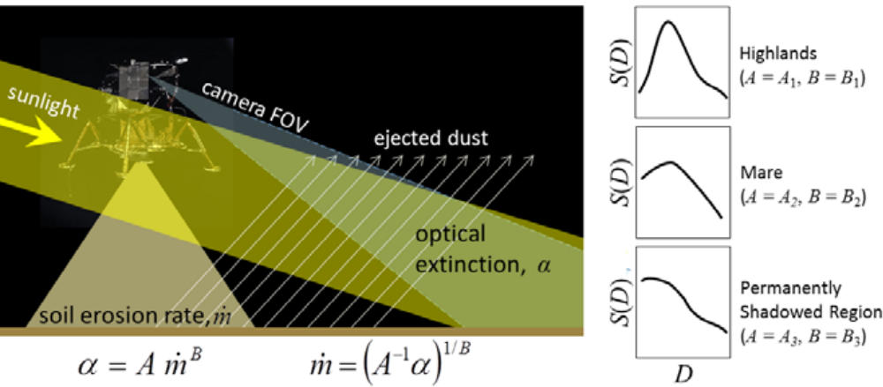
Erosion Rate Estimation from Apollo Descent Video
Ejecta video analyzed to estimate Apollo mass erosion rate
Image histogram matching technique used to determine optical extinction
Apollo 12 mass erosion estimate: 2600 kg
Figure from Lane and Metzger (2015)
Notes:
Figure from Lane and Metzger (2015): Estimation of Apollo Lunar Dust Transport using Optical Extinction Measurements | SpringerLink

Slide 22
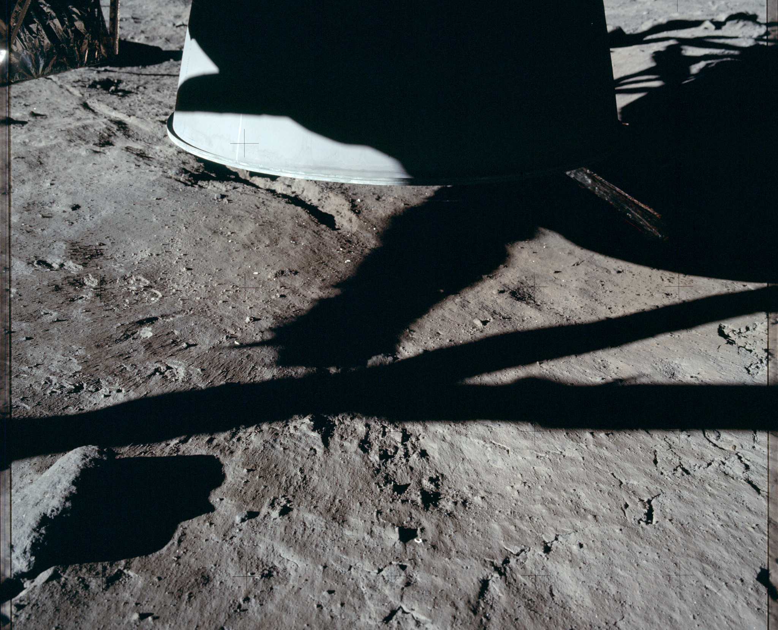
Apollo Cratering Characteristics and Mass Estimation
Metzger et al. 2009 identified discrete eroded layers in Apollo imagery
  Phenomenon also seen in Mauna Kea test
Also observe “erosional remnants”: surface features caused by PSI
Eroded mass estimate from crater images: 1800 kg
High estimate uncertainty means we can't rely on Apollo experience alone
Image: NASA/Apollo 11; annotations partially replicated from Figure 9 in Metzger et al. 2009 which show boundary of eroded layer
Notes:
Figure partially recreated from Metzger et al. 2009: Phenomenology of soil erosion due to rocket exhaust on the Moon and the Mauna Kea lunar test site - Metzger - 2011 - Journal of Geophysical Research: Planets - Wiley Online Library

Slide 23
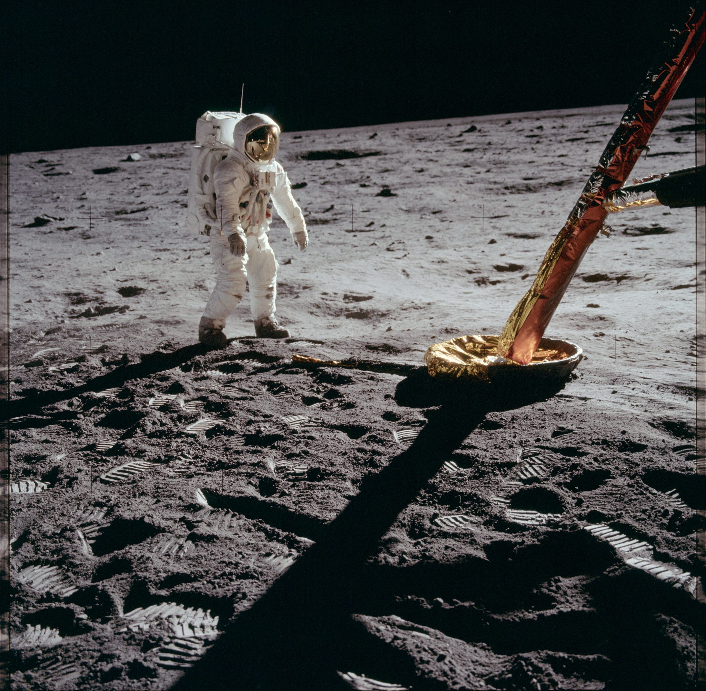
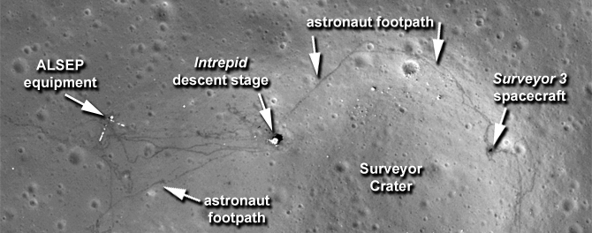
Lunar Surface Alteration
Descent engine plumes had a significant effect on the Apollo, Luna, and Surveyor landing sites
The effects of rocket exhaust on the lunar surface appear as photometric anomalies in Lunar Reconnaissance Orbiter Narrow Angle Camera imagery (Watkins, 2015)
NASA/Apollo 11/AS11-40-5902
Buzz Aldrin, footpad, and disturbed area, including possible exhaust brightening right to left (behind Aldrin)
NASA/Goddard Space Flight Center/Arizona State University
Notes:
Figure source: New Images Offer Sharper View of Apollo Sites | NASA
Image source: AS11-40-5902 | Apollo 11 Hasselblad image from film magazine… | Flickr

Slide 24
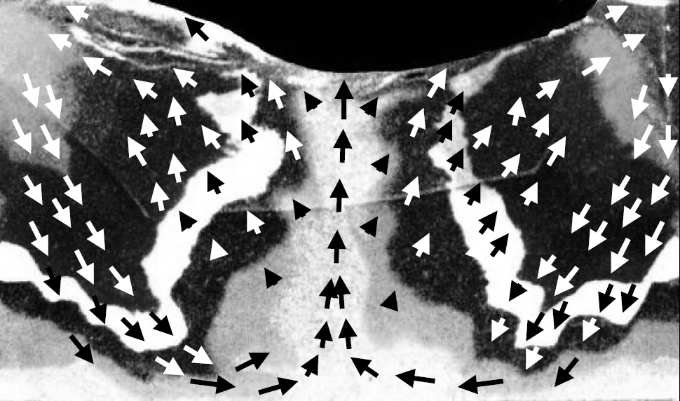
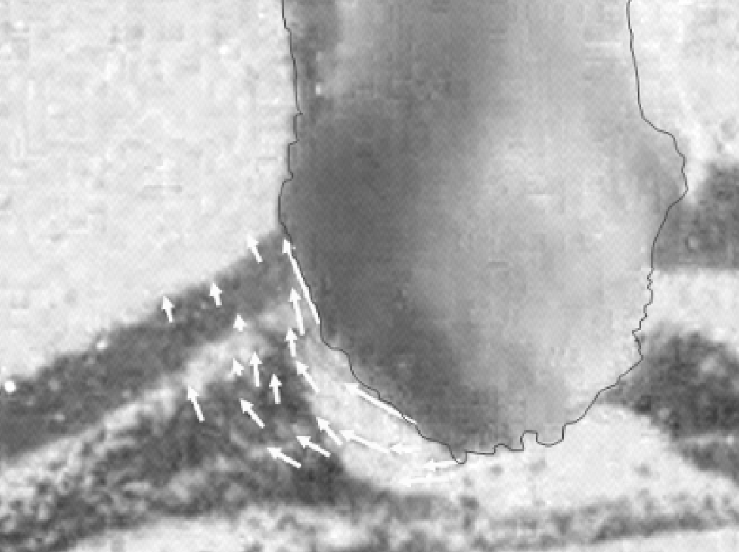
PSI Testing:
Diffusion-Driven Flow
Images from Metzger et al. 2009.
Layers of sand modified by PSI; arrows show direction of motion
Diffusion-driven flow parallel to the developing crater’s surface
Notes:
Figures from Metzger et al. 2009, sourced from this preprint, and are the work of a NASA employee: [0906.0196] Jet-induced cratering of a granular surface with application to lunar spaceports (arxiv.org)
Published here: https://doi.org/10.1061/(ASCE)0893-1321(2009)22:1(24)

Slide 25
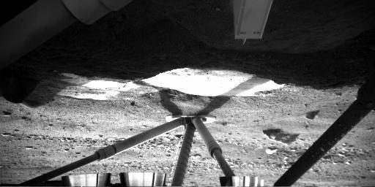
PSI Enhancement from Pulsed Jets
Mars Phoenix engines exposed ice underneath lander (Mehta 2011)
Experiments conducted by to simulate landing
  Pulsed jets cause enhancement of plume-surface interaction effects, leading to “explosive erosion” (Mehta 2011)
Image underneath the Phoenix Mars Lander, taken on Sol 5. (NASA)
Notes:
Image Source: NASA - Image from the Phoenix Lander

Slide 26
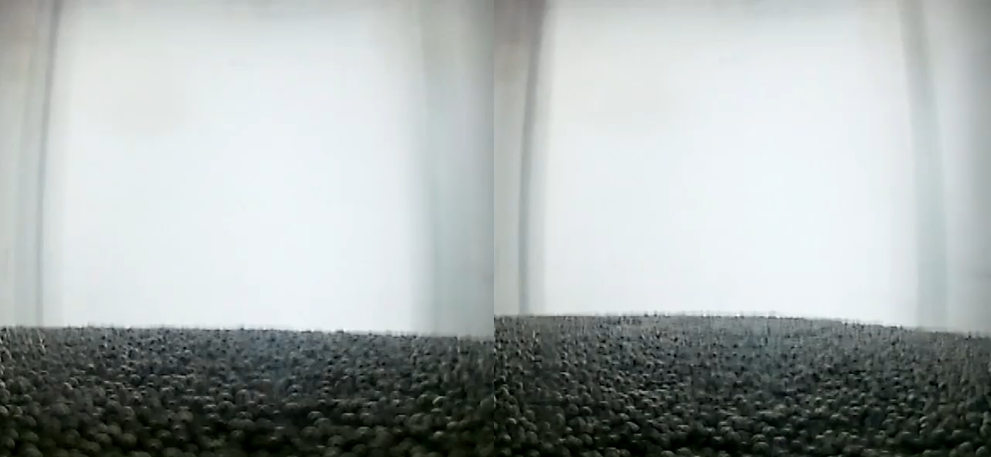
Effects of Reduced Gravity on PSI
UCF/CLASS/Chambers
Benchtop
Drop Tower

Slide 27
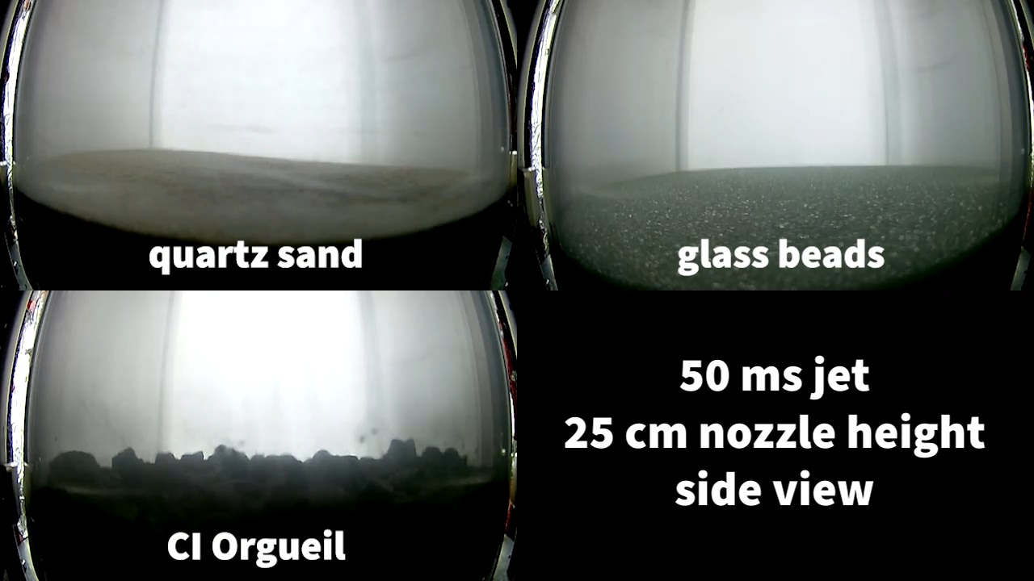
UCF/CLASS/ Chambers

Slide 28
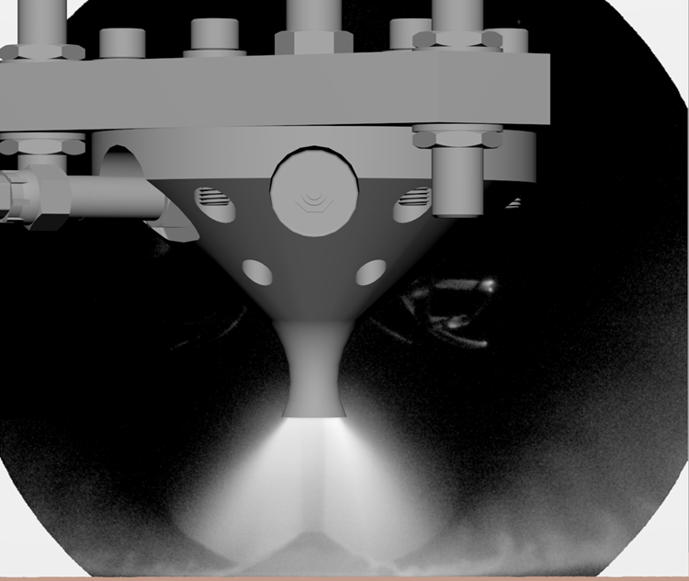
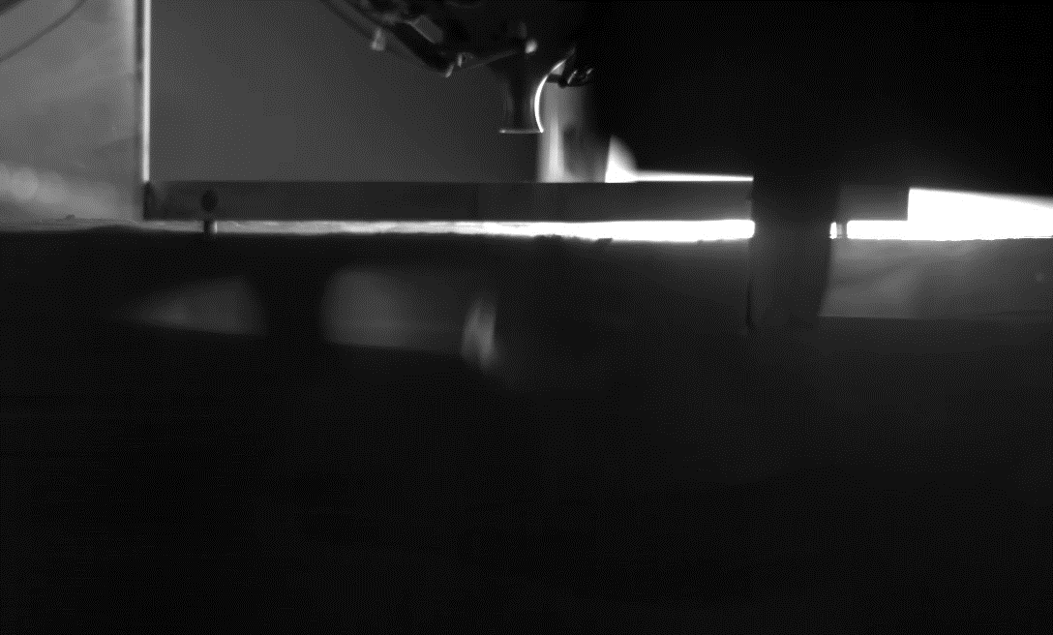
NASA Plume-Surface Interaction Test
Subscale, half-space, supersonic plume-surface interaction test
Six regolith simulants, variable mass flow rate, variable vacuum pressure
Variations in behavior observed across parameter space
Analysis ongoing
Plume flow visualization
Rodrigues et al. (2023)
Experiment with BP-1 regolith simulant
Test overview: https://doi.org/10.2514/6.2022-1811

Slide 29
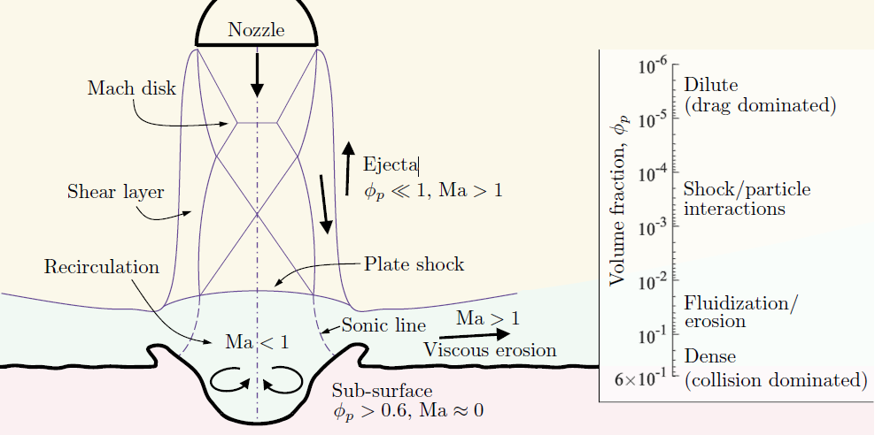
Computational Modeling
Generalized PSI modeling remains a challenge due to complex physics
Range of methods applied
  Simplified/semi-empirical
  One-way coupled CFD
  Two-way coupled CFD
Approaches
  Eulerian-Eulerian
  Eulerian-Lagrangian
Illustration of flow regime variation, which results in challenges for PSI modeling. Figure from Capecelatro (2022), (CC BY 4.0).
Notes:
Figure from Capecelatro (2022): [2109.02523] Modeling high-speed gas-particle flows relevant to spacecraft landings: A review and perspectives (arxiv.org)

Slide 30
Present and Future Work at NASA and around the world

Slide 31
Current PSI Research Efforts
Auburn University
  Vacuum chamber PSI testing, stereo diagnostics
JAXA
  PSI drop tower experiment and effects modeling
Johns Hopkins University
  Experimental/modeling work on particle-laden flows
NASA
  PSI testing, flight instrumentation, computational modeling of PSI effects
Stevens Institute of Technology
  Computational fluid dynamics applied to PSI effects
University of Central Florida
  Ground and drop tower PSI experiments; regolith characterization
University of Glasgow
  Vacuum chamber PSI testing
University of Illinois Urbana-Champaign
  Vacuum chamber PSI testing, ejecta tomography
University of Michigan
  CFD modeling of PSI effects

Slide 32
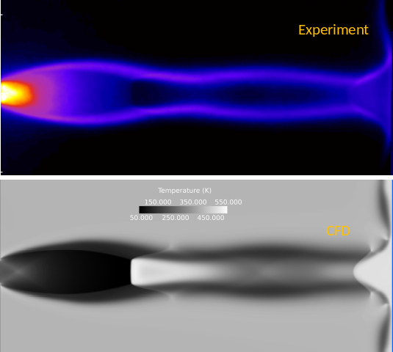
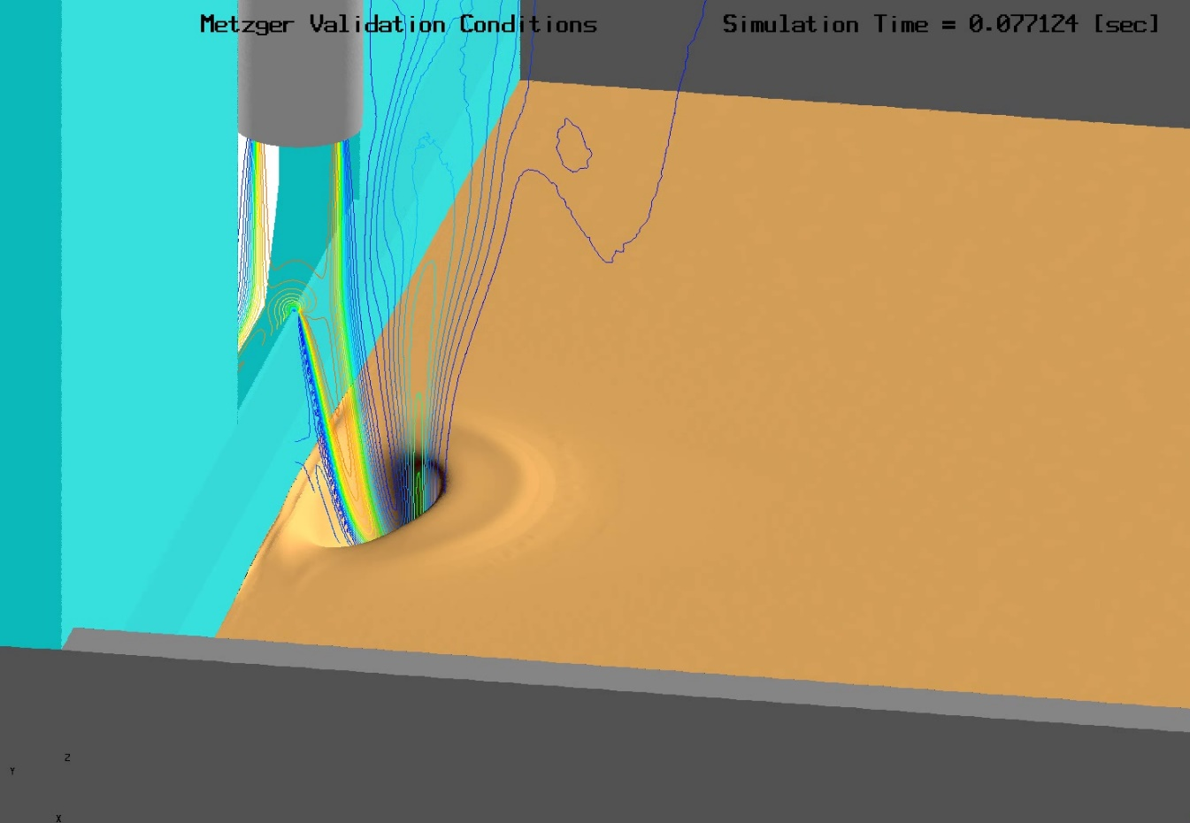
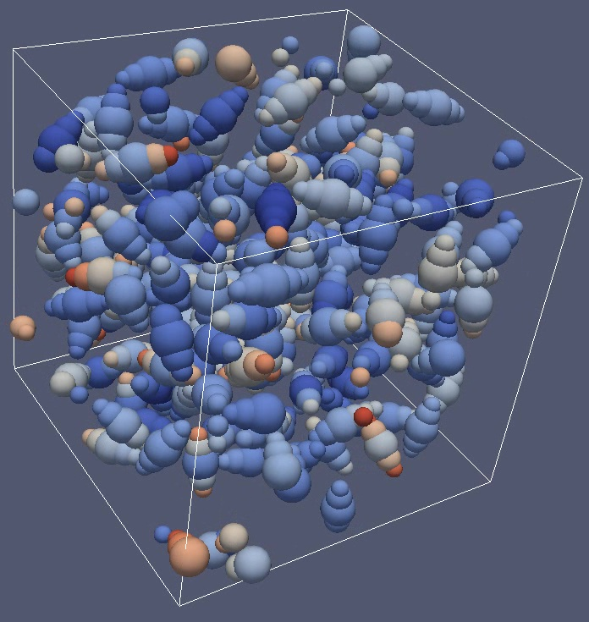
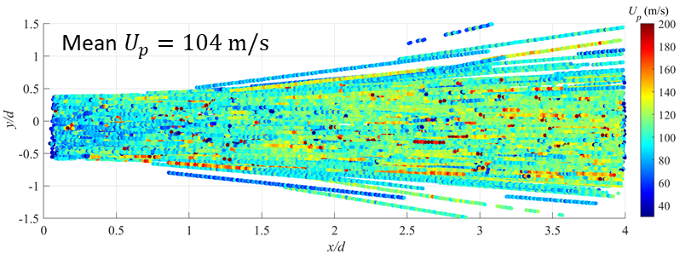
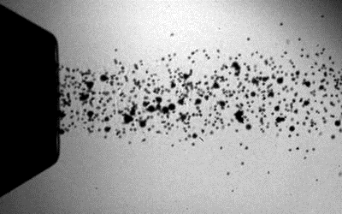
NASA Computational Modeling Efforts
Plume Flow in a Low-Pressure Environment
Effects of Multiple Flow Regimes
https://doi.org/10.2514/6.2022-2318
https://doi.org/10.2514/6.2022-2320
Granular Mechanics Modeling
Gas-Particle Interactions
https://doi.org/10.2514/6.2022-2317
https://doi.org/10.2514/6.2020-1326

Slide 33

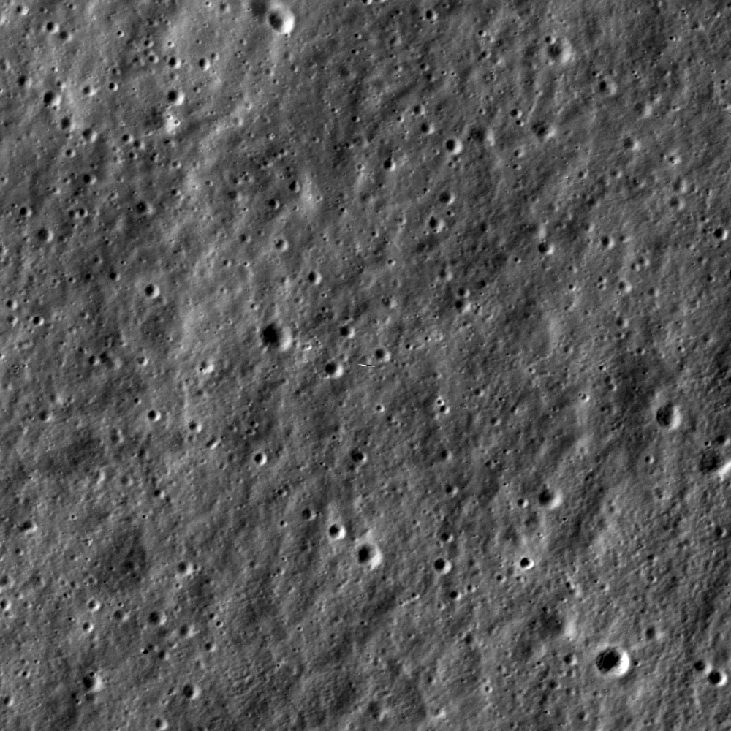
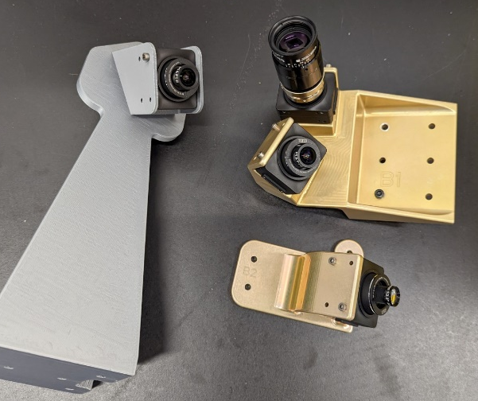
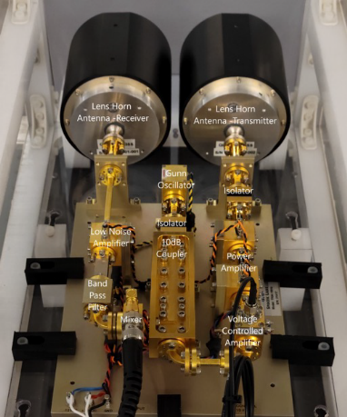
NASA Flight Instrumentation
Lander
Particle ejection
Stereo Cameras for Lunar Plume-Surface Studies (SCALPSS)
  Stereo imaging for PSI
Lunar Lander Base Instrumentation (LLBI)
  Measurement of environment induced below lander by thrusters and PSI, MEDLI-heritage
Particle Impact Event Sensor (PIE)
  Measurement of ejecta energy
Dust Ejecta Radar Technology (DERT)
  Millimeter-wave doppler radar measurement ejecta particle velocities
Mini-Suite Electronics (MSE)
  Centralized payload commanding
Crater formation
Lunar Surface
SCALPSS 1.0
SCALPSS 1.1
DERT Prototype

Slide 34
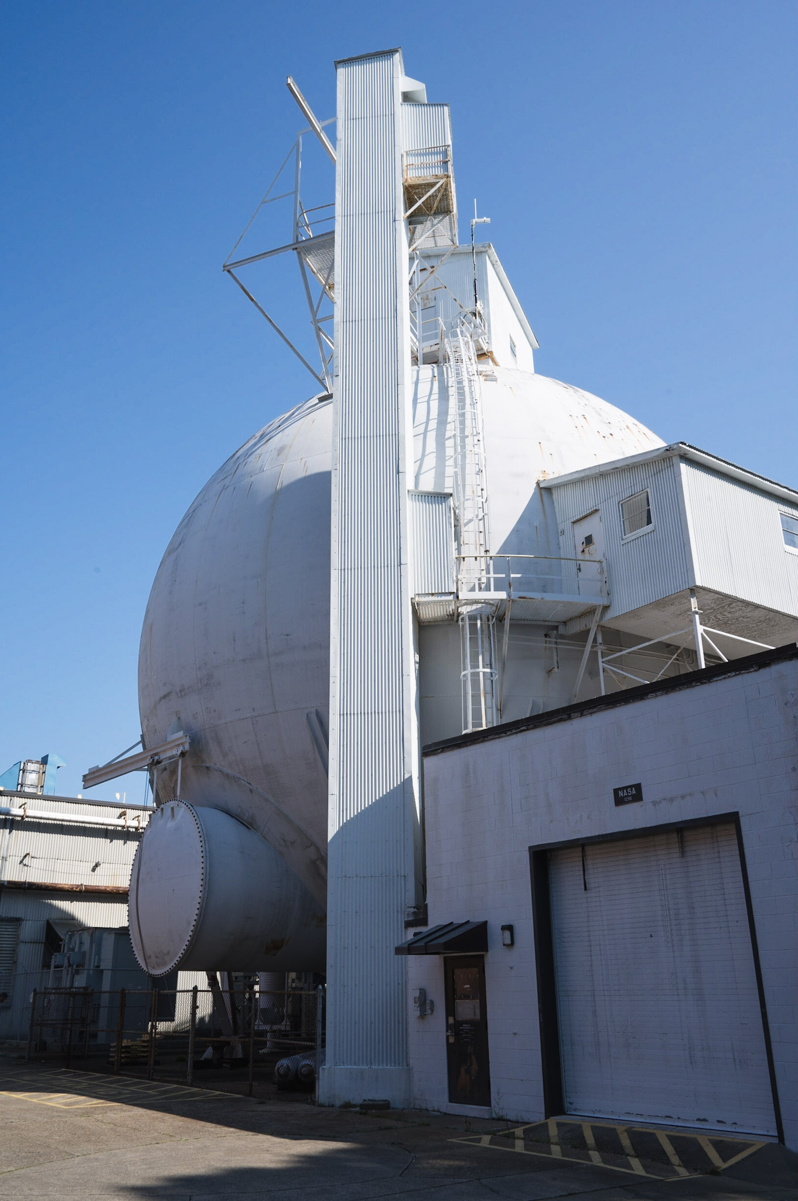
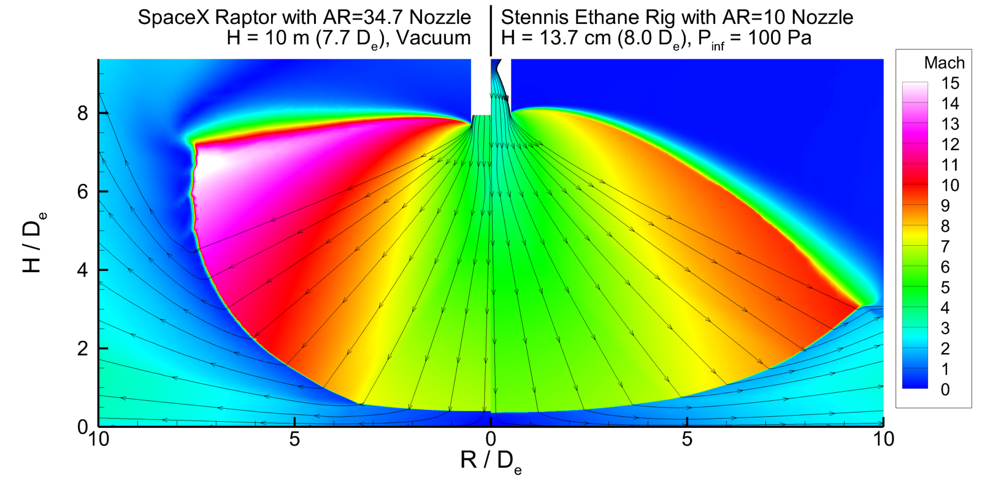
NASA PSI Testing for HLS Risk Reduction
Reduce risk to the HLS Landers by acquiring lunar-relevant test data to quantify and reduce modeling uncertainty
Targeting scaled flight conditions and an Apollo condition
Nozzle
Reduced pressure environment
Highly under-expanded plume
Regolith bed
60-ft Vacuum Sphere (NASA LaRC)

Slide 35
Conclusions

Slide 36
Conclusions
PSI phenomena remain resistant to generalized modeling
Available flight data have high uncertainties
  Apollo remains the largest lunar lander
Fundamental work still needed to understand plume-surface interaction phenomena and associated behaviors
There are significant current efforts into PSI research building off foundational work from Apollo and past two decades
Integrating these efforts will be critical to maturing the PSI discipline

Slide 37
Questions?

Slide 38
References for Apollo-Era PSI Research slide
Interaction of Highly Underexpanded Jets with Simulated Lunar Surfaces - NASA Technical Reports Server (NTRS)
Exhaust jet-dust layer interaction during a lunar landing. - NASA Technical Reports Server (NTRS) (citation only; conference took place in 1962, proceedings published 1964)
NASA TN D-2633 (written 1964, published 1965)
Transient Rocket-Engine Gas Flow in Soil
Soil erosion by landing rockets Final report - NASA Technical Reports Server (NTRS)
Comparison of soil erosion theory with scaled LM jet erosion tests - NASA Technical Reports Server (NTRS)
Scaled Lunar Module Jet Erosion Experiments - NASA Technical Reports Server (NTRS)

Slide 39
References
Capecelatro, J. (2022). Modeling high-speed gas–particle flows relevant to spacecraft landings. International Journal of Multiphase Flow, 150, 104008. https://doi.org/10.1016/j.ijmultiphaseflow.2022.104008
Chambers, W. A. (2020). Experimental and Computational Investigation of Plume Surface Interactions in Vacuum Microgravity [University of Central Florida]. https://stars.library.ucf.edu/etd2020/192
Christensen, E. M., Batterson, S. A., Benson, H. E., Choate, R., Hutton, R. E., Jaffe, L. D., Jones, R. H., Ko, H. Y., Schmidt, F. N., Scott, R. F., Spencer, R. L., & Sutton, G. H. (1968). Lunar surface mechanical properties. Journal of Geophysical Research, 73(22), 7169–7192. https://doi.org/10.1029/JB073i022p07169
Clegg, R. N., Jolliff, B. L., Robinson, M. S., Hapke, B. W., & Plescia, J. B. (2014). Effects of rocket exhaust on lunar soil reflectance properties. Icarus, 227, 176–194. https://doi.org/10.1016/j.icarus.2013.09.013
Clegg-Watkins, R. N., Jolliff, B. L., Boyd, A., Robinson, M. S., Wagner, R., Stopar, J. D., Plescia, J. B., & Speyerer, E. J. (2016). Photometric characterization of the Chang’e-3 landing site using LROC NAC images. Icarus, 273, 84–95. https://doi.org/10.1016/j.icarus.2015.12.010
Eberhart, C. J., West, J., & Korzun, A. M. (2022, January 3). Overview of Plume-Surface Interaction Data from Subscale Inert Gas Testing at NASA MSFC Test Stand 300 Vacuum Facilities. AIAA SCITECH 2022 Forum. AIAA SCITECH 2022 Forum, San Diego, CA & Virtual. https://doi.org/10.2514/6.2022-1811
Immer, C., Metzger, P., Hintze, P. E., Nick, A., & Horan, R. (2011). Apollo 12 Lunar Module exhaust plume impingement on Lunar Surveyor III. Icarus, 211(2), 1089–1102. https://doi.org/10.1016/j.icarus.2010.11.013
Kim, T., Ni, R., Capecelatro, J., Yao, Y., Shallcross, G. S., Mehta, M., & Rabinovitch, J. (2020, January 6). The dynamics of inertial particles in underexpanded jets: An experimental study. AIAA Scitech 2020 Forum. AIAA Scitech 2020 Forum, Orlando, FL. https://doi.org/10.2514/6.2020-1326
Lane, J. E., & Metzger, P. T. (2015). Estimation of Apollo Lunar Dust Transport using Optical Extinction Measurements. Acta Geophysica, 63(2), 568–599. https://doi.org/10.1515/acgeo-2015-0005
Liever, P. A., & West, J. (2022, January 3). Particle Interaction Physics Model Formulation for Plume-Surface Interaction Erosion and Cratering. AIAA SCITECH 2022 Forum. AIAA SCITECH 2022 Forum, San Diego, CA & Virtual. https://doi.org/10.2514/6.2022-2317

Slide 40
References
Mehta, M. (2010). Plume-Surface Interactions due to Spacecraft Landings and The Discovery of Water on Mars [University of Michigan]. https://hdl.handle.net/2027.42/78975
Mehta, M., Renno, N. O., Marshall, J., Rob Grover, M., Sengupta, A., Rusche, N. A., Kok, J. F., Arvidson, R. E., Markiewicz, W. J., Lemmon, M. T., & Smith, P. H. (2011). Explosive erosion during the Phoenix landing exposes subsurface water on Mars. Icarus, 211(1), 172–194. https://doi.org/10.1016/j.icarus.2010.10.003
Metzger, P. T., Immer, C. D., Donahue, C. M., Vu, B. T., Latta, R. C., & Deyo-Svendsen, M. (2009). Jet-Induced Cratering of a Granular Surface with Application to Lunar Spaceports. Journal of Aerospace Engineering, 22(1), 24–32. https://doi.org/10.1061/(ASCE)0893-1321(2009)22:1(24)
Metzger, P. T., Smith, J., & Lane, J. E. (2011). Phenomenology of soil erosion due to rocket exhaust on the Moon and the Mauna Kea lunar test site. Journal of Geophysical Research, 116(E6), E06005. https://doi.org/10.1029/2010JE003745
Romine, G. L., Reisert, T. D., & Gliozzi, J. (1973). Site alteration effects from rocket exhaust impingement during a simulated Viking Mars landing. Part 1: Nozzle development and physical site alternation (NASA CR-2252). Langley Research Center.
Rubio, J. S., Gorman, M., Diaz-Lopez, M. X., & Ni, R. (2022, January 3). Plume-Surface Interaction Physics Focused Ground Test 1: Setup and Preliminary Results. AIAA SCITECH 2022 Forum. AIAA SCITECH 2022 Forum, San Diego, CA & Virtual. https://doi.org/10.2514/6.2022-1809
Scott, R. F., & Ko, H.-Y. (1968). Transient rocket-engine gas flow in soil. AIAA Journal, 6(2), 258–264. https://doi.org/10.2514/3.4487
Shurtz, T. P., & West, J. (2022, January 3). Simulating Underexpanded Plumes in Martian and Lunar Environments. AIAA SCITECH 2022 Forum. AIAA SCITECH 2022 Forum, San Diego, CA & Virtual. https://doi.org/10.2514/6.2022-2318
Yao, Y., Shallcross, G. S., Ni, R., Kim, T., Mehta, M., Rabinovitch, J., & Capecelatro, J. (2020, January 6). The dynamics of inertial particles in under-expanded jets: A numerical study. AIAA Scitech 2020 Forum. AIAA Scitech 2020 Forum, Orlando, FL. https://doi.org/10.2514/6.2020-1327
Watkins, R. N. (2015). Photometric Investigations of Lunar Landing Sites and Silicic Regions using LRO Narrow Angle Camera Images. https://doi.org/10.7936/K7PG1PWK

