Slide 1

First Generation Parabolic Deformable Mirror for the ExoSpec Project
Hari Subediª
Tyler Groffª
Roser Juanola-Parramon^{a,b}
Scott Willª
ªNASA GSFC
^{b}UMBC

Slide 2
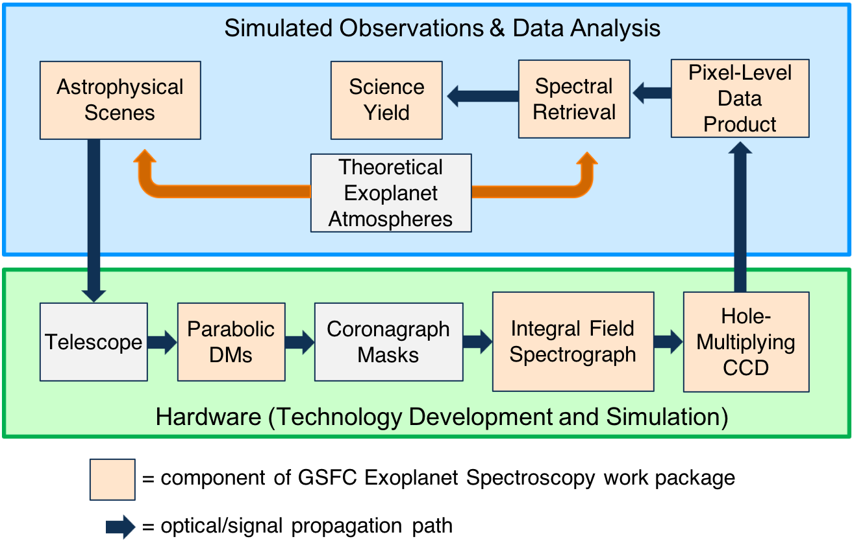
Exoplanet Spectroscopy (ExoSpec)
ExoSpec Project is a NASA Headquarters directed work package (PI: Michael McElwain/ NASA GSFC).
Goal: Develop exoplanet spectroscopy technologies, high fidelity end-to-end integrated modeling tools, and spectral retrieval algorithms to define science-driven systems level mission requirements.
Exoplanet Spectroscopy Technology Development
High Contrast Integral Field Spectroscopy
Photon-Counting Radiation Hard p-channel CCDs
Parabolic Deformable Mirrors
Subpackage leads:
Zimmerman (IFS)
Rauscher (CCD)
Groff (DMs)
Mandell (Retrieval)

Slide 3
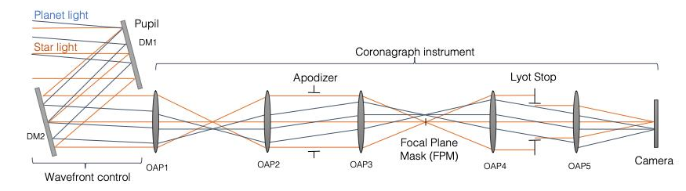
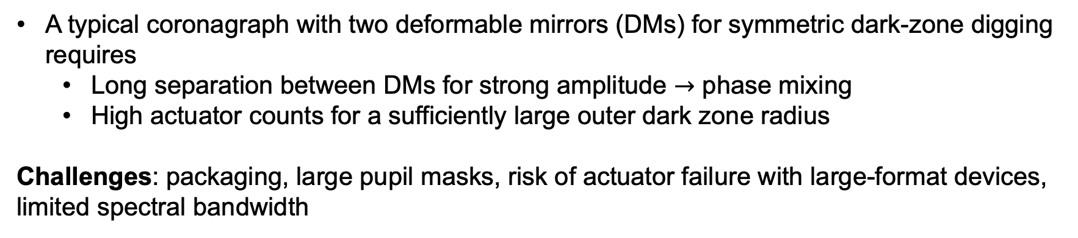
Optical Layout of Coronagraph
Juanola-Parramon et al. "The LUVOIR Extreme Coronagraph for Living Planetary Systems (ECLIPS) II. Performance evaluation, aberration sensitivity analysis and exoplanet detection simulations," Proc. SPIE 11117, 2019
A typical coronagraph with two deformable mirrors (DMs) for symmetric dark-zone digging requires
  Long separation between DMs for strong amplitude $→$ phase mixing
  High actuator counts for a sufficiently large outer dark zone radius
Challenges: packaging, large pupil masks, risk of actuator failure with large-format devices, limited spectral bandwidth

Slide 4
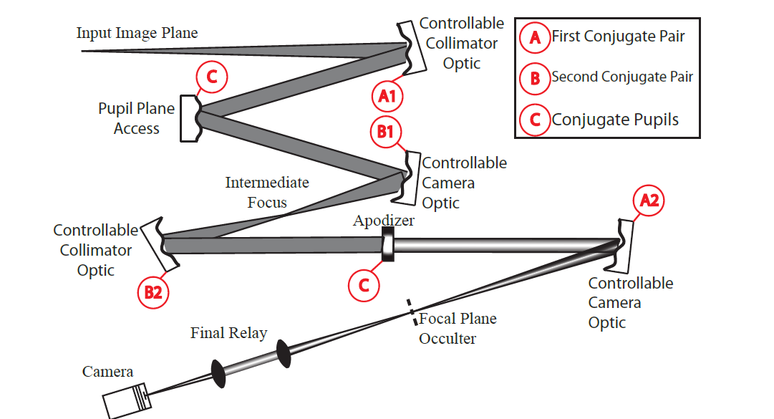
Low Actuator Count Parabolic DMs
In 2016, Groff et al. studied an alternative coronagraph optical architecture using deformable imaging elements in place of static off-axis parabolic mirrors
Main finding:
Low-actuator count parabolic mirrors augmented with a high actuator density mirror at the pupil plane can create symmetric dark holes with identical contrast values as compared to existing techniques that have two high-actuator density flat DMs.
Groff et al. 2016. A new deformable mirror architecture for coronagraphic
instrumentation. Space Telescopes and Instrumentation 2016: Optical, Infrared, and Millimeter Wave, volume 9904, pages 697- 704. International
Society for Optics and Photonics, SPIE, 2016.

Slide 5
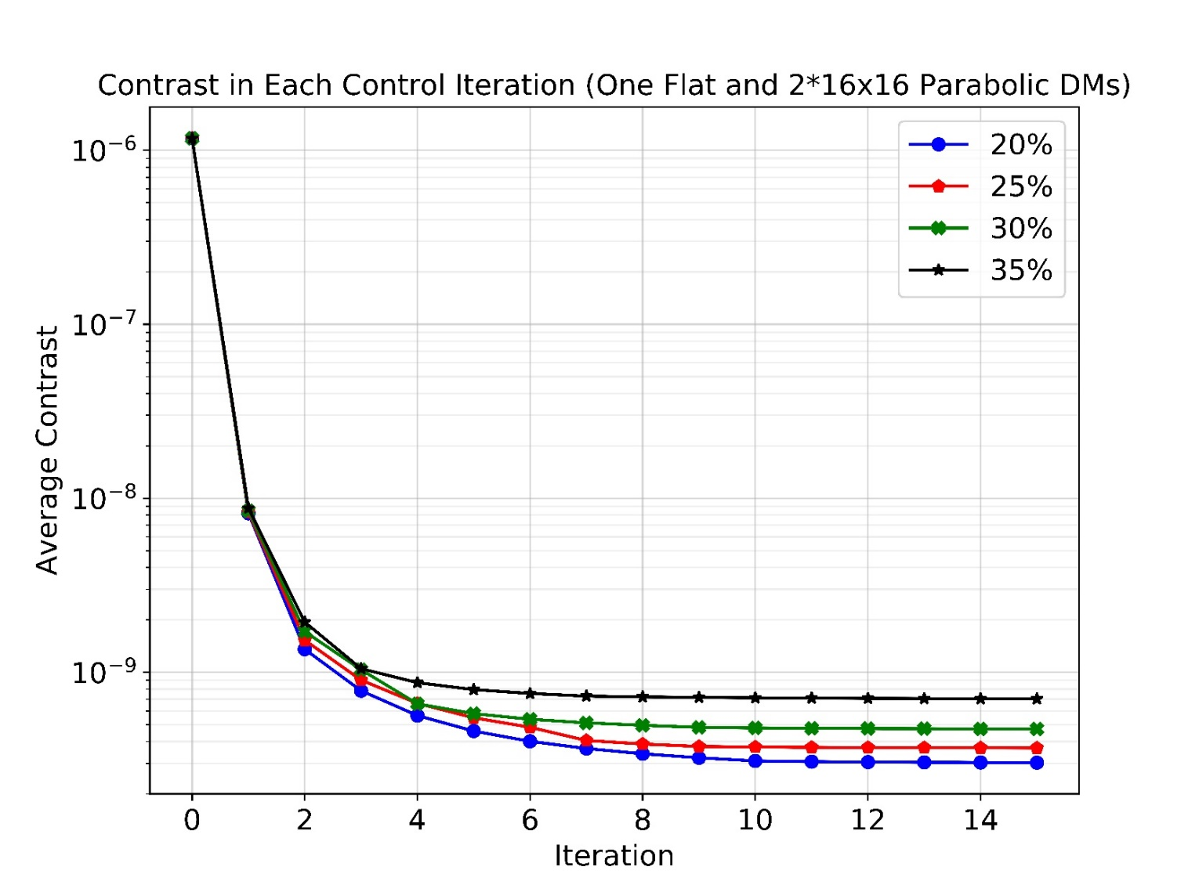
Controllable Bandwidth
Simulation parameters:
32x32 BMC DM at pupil plane
2 Parabolic DMs (Collimating and Focusing)
Two-Sided dark zone from 5-12 λ/D
20-35% band centered at 635 nm
Phase and amplitude aberrations at pupil, plus phase errors at OAPs
Results (contrast vs. bandwidth):
20%: 3e-10,
30%: 4.7e-10,
35%: 7.1e-10
Subedi et al. "Parabolic deformable mirror testbed for the ExoSpec project," Proc. SPIE 11443, Space Telescopes and Instrumentation 2020

Slide 6
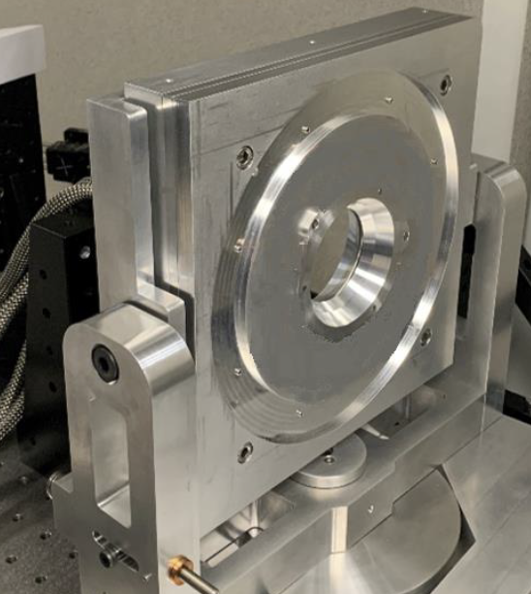
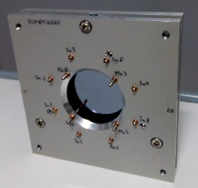
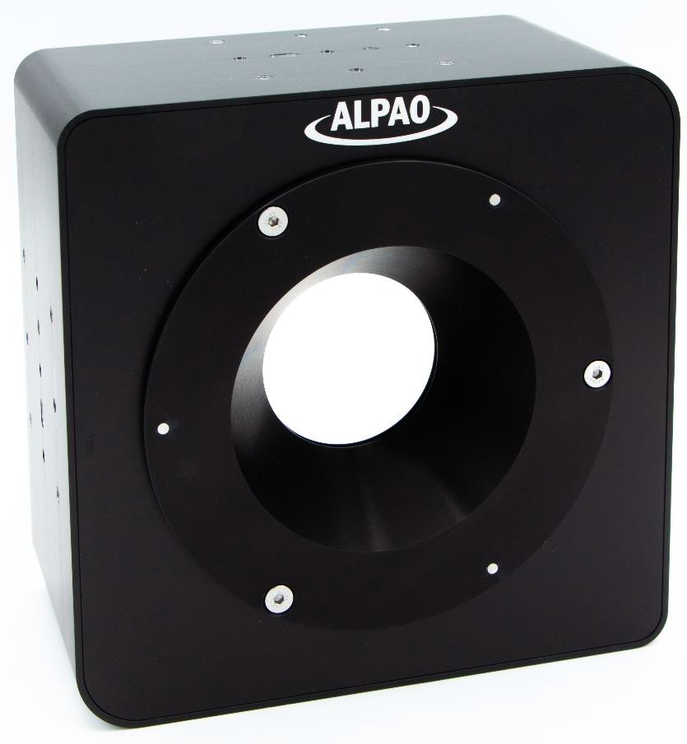
Parabolic DM Device Fabrication
  Worked with vendor (ALPAO, Grenoble, France) to manufacture first-generation off-axis parabolic DM (OAPDM)
  OAPDM delivered to Goddard in May 2023
First prototype
Validated curved membrane concept
Validated static + dynamic OAP control
Significant stability issue: complex thermo-mechanical interface caused membrane drift on the order of 30 μm RMS
Membrane benchtop
Thermomechanical redesign of membrane
Resolved membrane stability
Gen1 device (delivered)
Fabrication and performance complete
Device has 277 actuators
Device received by the team

Slide 7
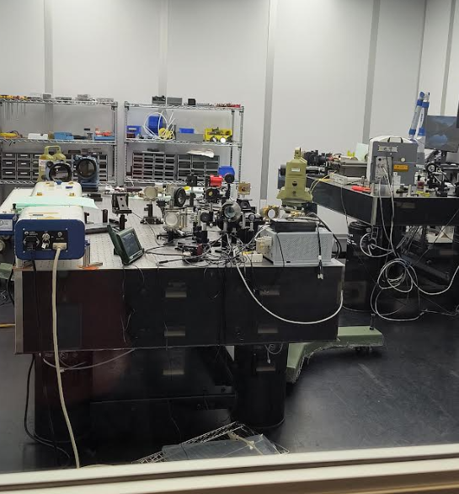
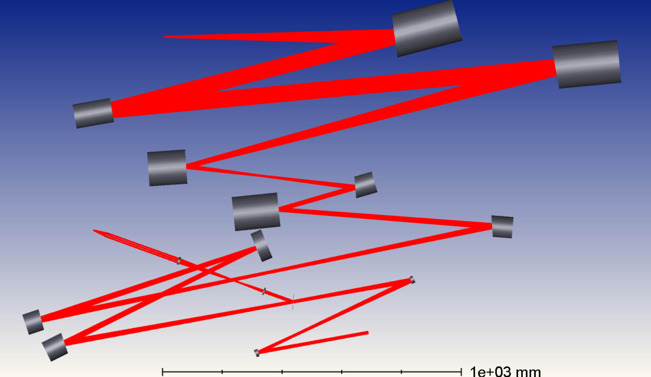
ExoSpec Lab: Verification Testbed
Designed testbed in Zemax, procured optics, completed initial alignment (2019)
Completed cleanroom and dehumidifier installation (2023)
Aligned using external metrology, 4D interferometer in double-pass configuration
Currently (08/23) redesigning the lab to accommodate PISCES IFS
Figure: NASA Goddard Exoplanet Spectroscopy (ExoSpec) testbed with low-order wavefront sensor (LOWFS) and integral field spectrograph (IFS)
PDM Surrogate
PDM
FSM
BMC DM 1
Table 2
BMC DM 2
Table 1
LOWFS
SPC
FPM
Science/IFS

Slide 8
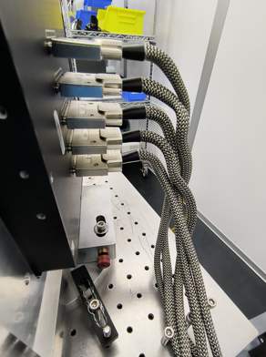
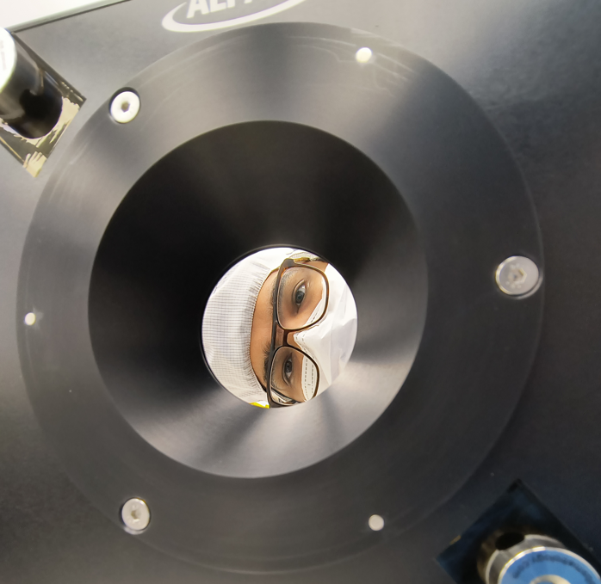
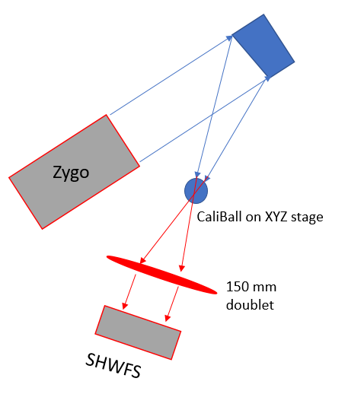
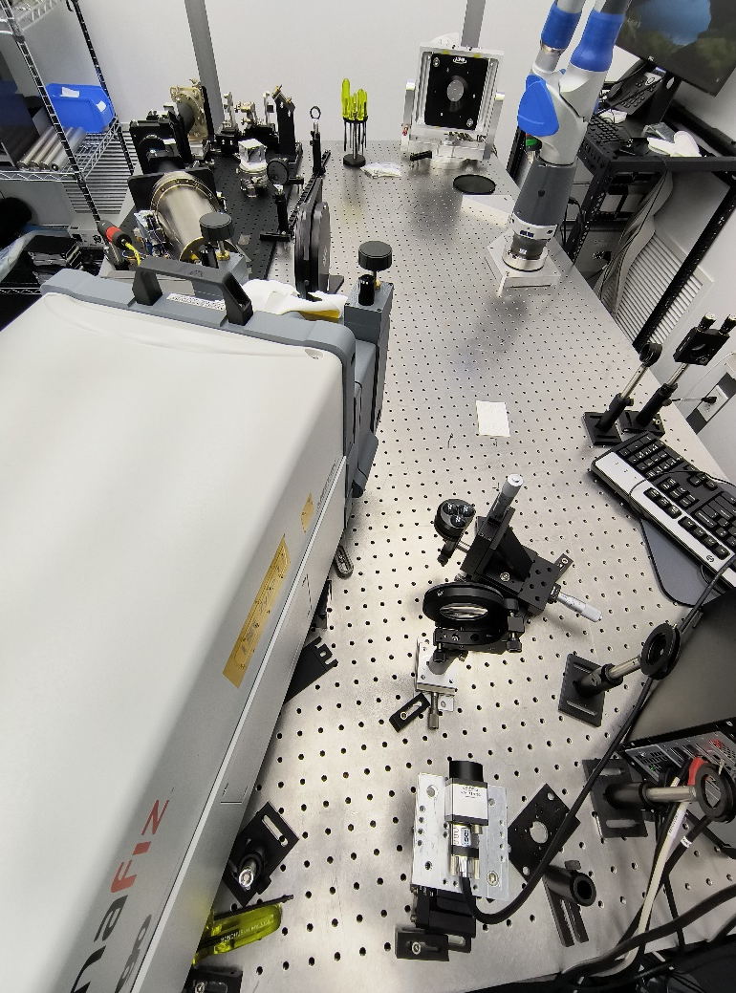
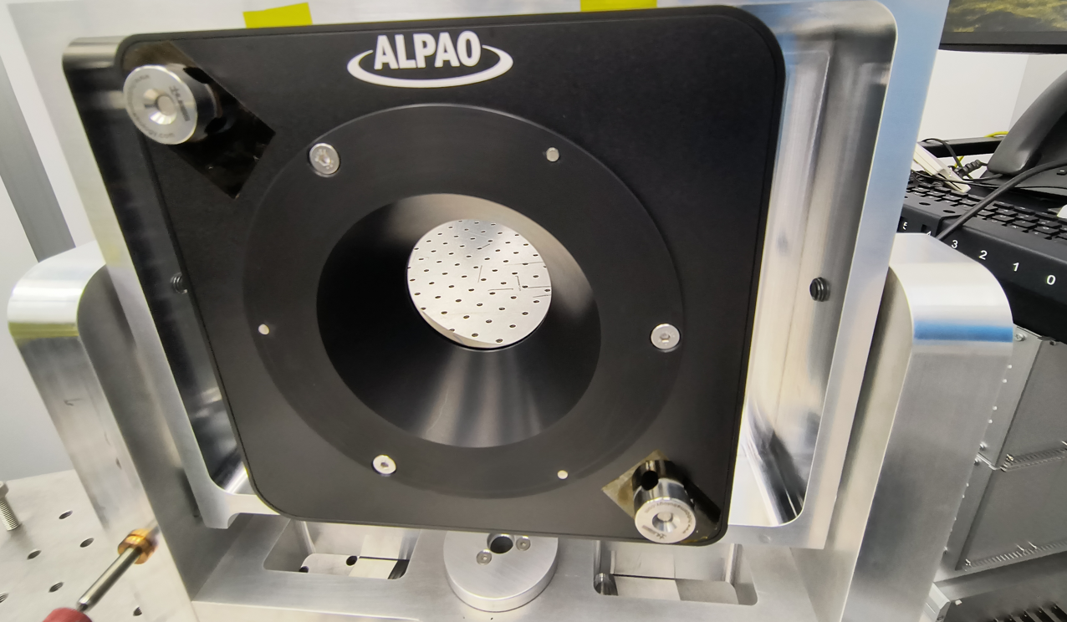
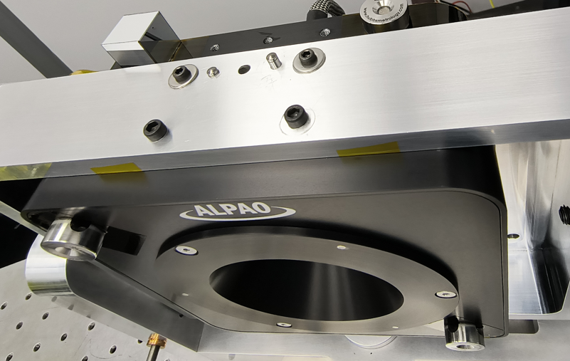
ExoSpec Lab: Characterization Bench
Zygo interferometer + Shack-Hartmann wavefront sensor (SHWFS)
Two-step verification: align static OAP using Zygo in double-pass configuration, use static OAP to align SHWFS
Additional calibration required for collimating lens
OAPDM
OAPDM
Electronic
Cables
OAPDM
Alignment Fiducials

Slide 9
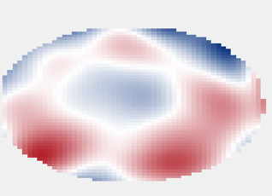

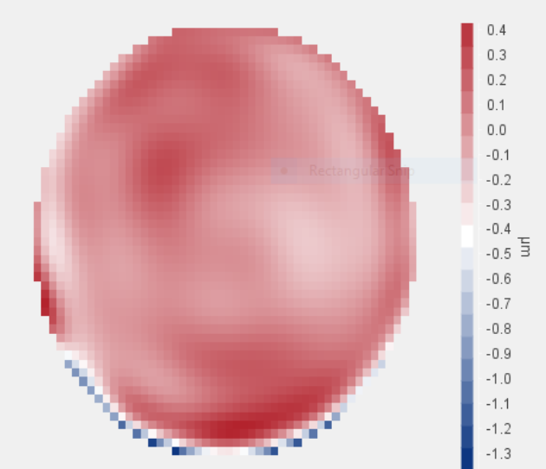
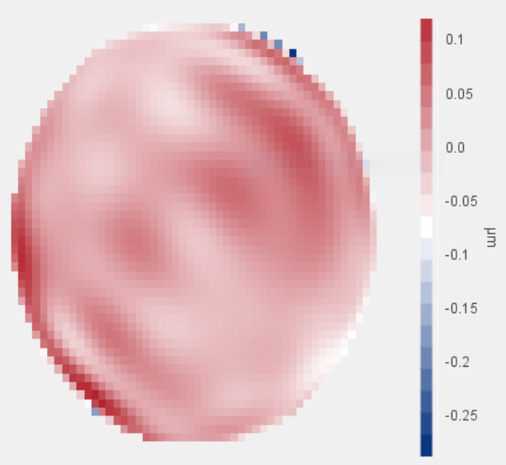
OAPDM Performance
Unpowered shape
~2 μm RMS wavefront error
Powered shape with initial voltage bias
~0.2 μm RMS wavefront error
Powered shape after flattening ~29 nm RMS wavefront error
Computed in closed loop using SHWFS

Slide 10
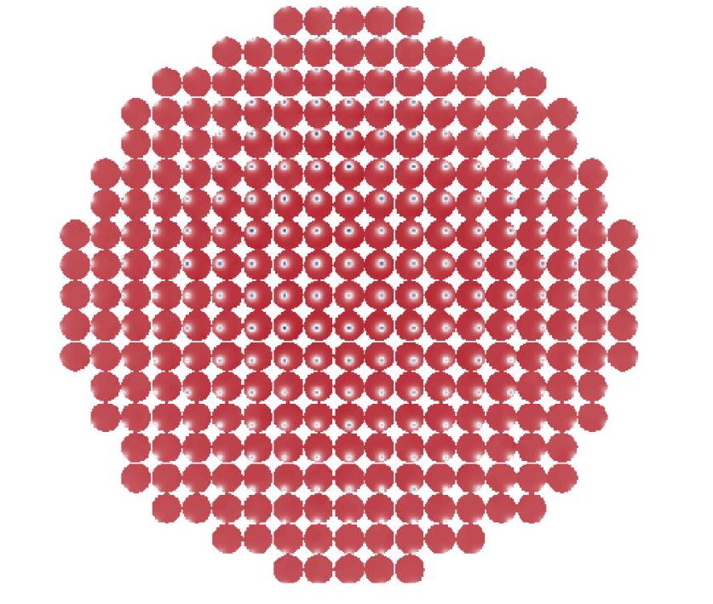
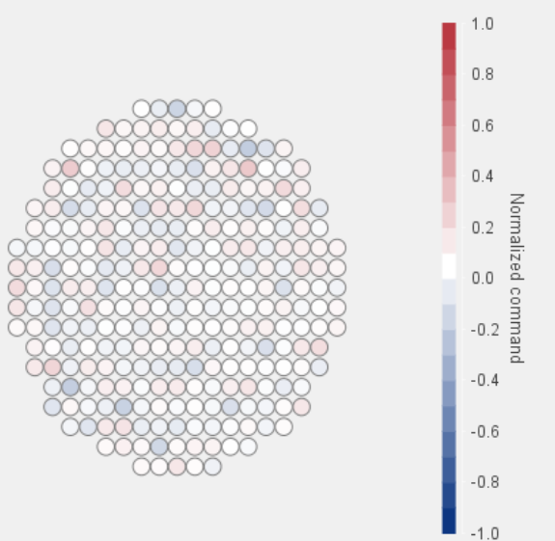
OAPDM Performance
Actuator flatmap voltages
Maximum actuator voltage occupies ~24% of available stroke
Measured influence functions

Slide 11
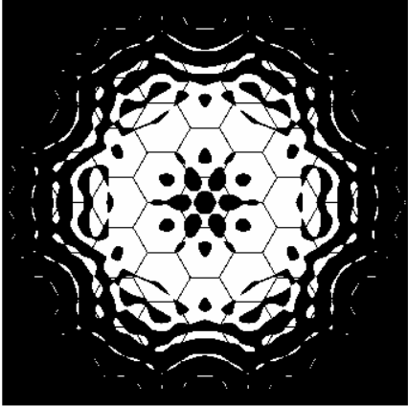
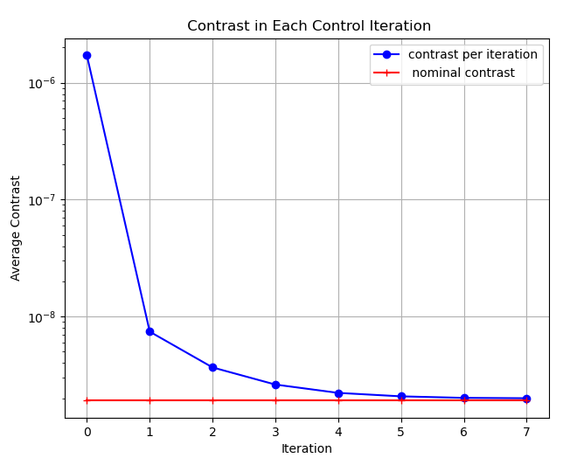
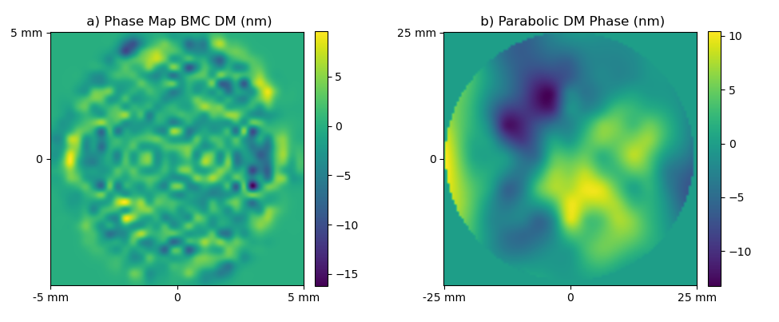
Experimental Challenges
Issue #1 – Stuck Actuator
Upon delivery to GSFC, OAPDM device exhibited a single actuator stuck in a maximally pulled position with limited control range
Simulated closed-loop control using OAPDM with a single free-floating actuator in corresponding position to determine acceptability of delivered device. Achieved the same level of contrast over 10% bandwidth as nominal device, with small stroke penalty at surrounding actuator locations.
Based on results, elected to physically remove the stuck actuator
Apodizer

Slide 12
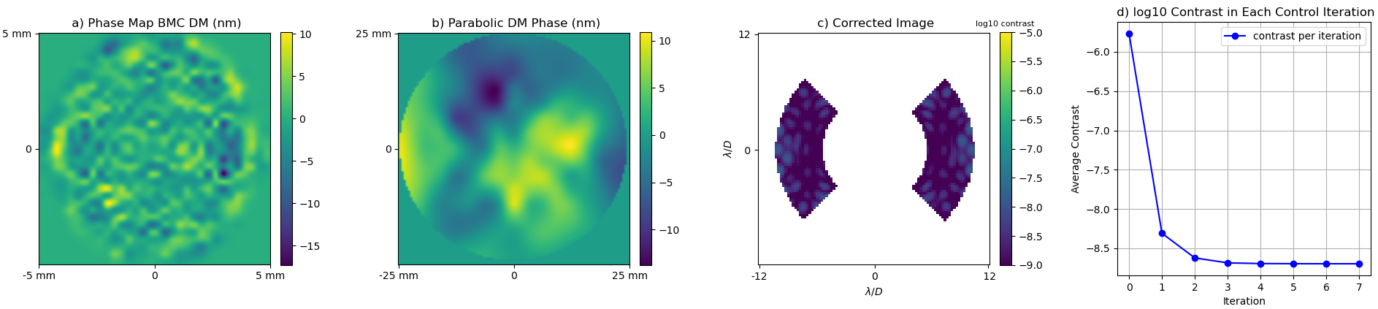
Free-floating Actuator Simulations
Case 2: Dead actuator near center of membrane
Case 1: Dead actuator at actual location on delivered device
Results:
Same contrast level as nominal device with no dead actuators
Surrounding actuators have slightly higher stroke

Slide 13
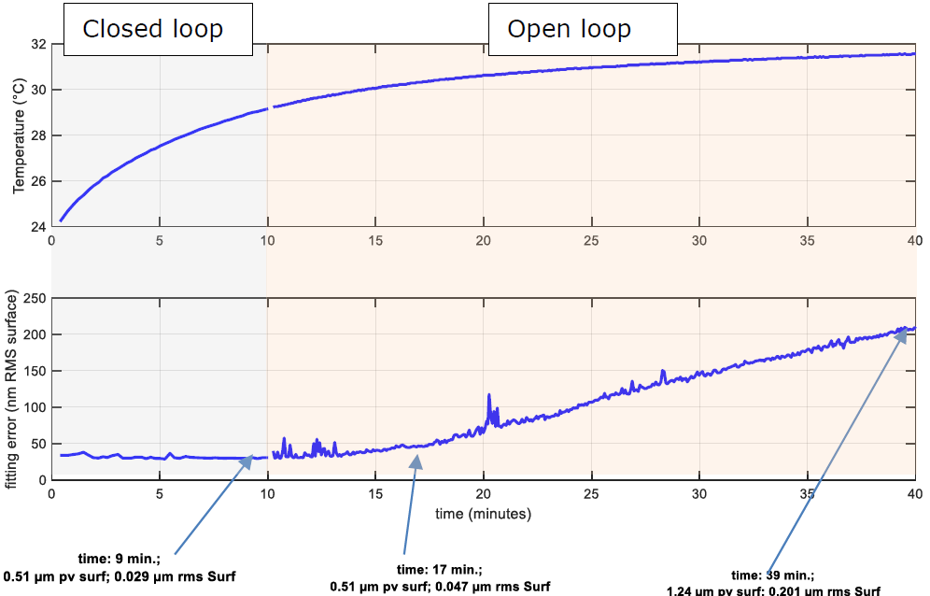
Experimental Challenges
Issue #2 – Actuator drift
~200 nm RMS drift in open loop during first hour after power-on due to creep + thermal effects
22 nm RMS drift during the second hour
Causes: thermo-elastic deformation of membrane and actuator plate (CTE mismatch)
Solution for Gen1 device: allow 1 hour for warm-up before using the DM
Solution for Gen2 device (planned):
Non-polymer spring (significantly reduces creep)
Improve thermo-elastic design (CTE matching)
Include heat sink for inductors in design
Credit: ALPAO Final Report

Slide 14
Conclusions and future work
Designing coronagraphs with deformable OAPs is advantageous for controllable bandwidth, packaging, risk, and cost
First-generation off-axis parabolic deformable mirror manufactured and delivered to Goddard
  Working on lab verification.
  Simulations using measured influence functions and residual error show that desired contrast level is achievable with delivered.
Actuator drift is significant in first-generation device, but design and planning for second-generation device is already underway
Goddard team is designing a multipurpose coronagraph testbed to test the parabolic DM, low-order and high-order wavefront sensing and control algorithms, and integral field spectroscopy techniques

Slide 15
Thank you
Thank you

Slide 16
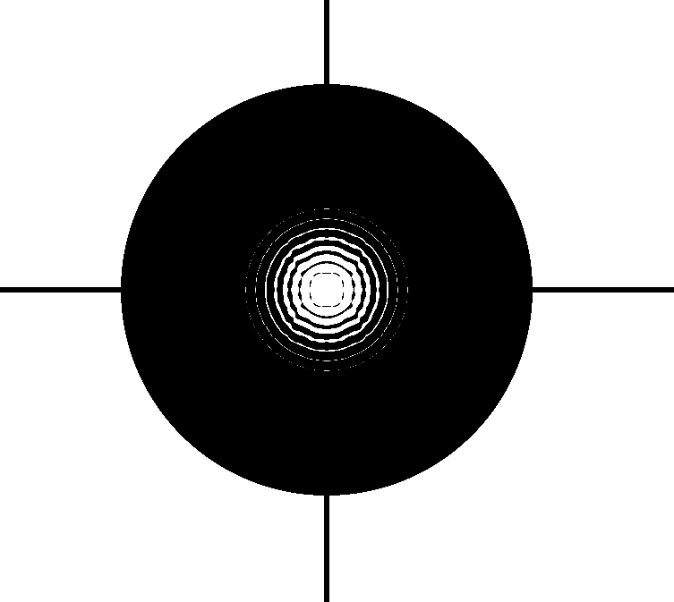
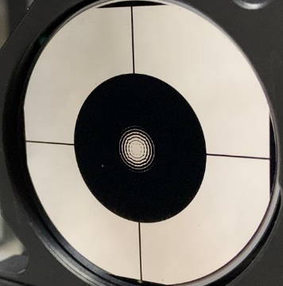

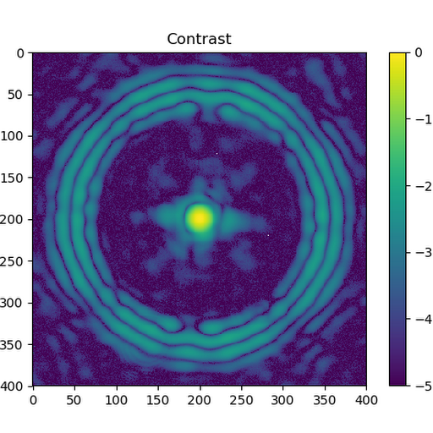
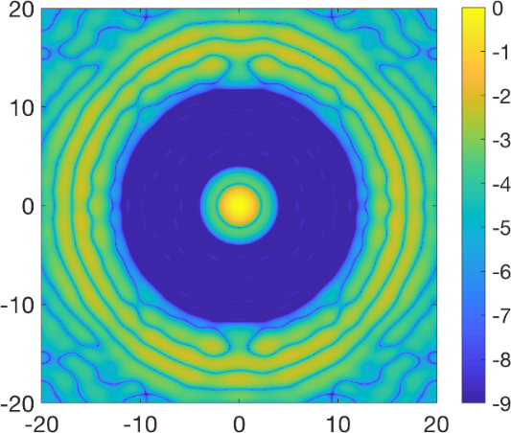
Baseline Testbed Masks
Baseline Coronagraph masks are shaped pupils
  Lyot-style masks are possible in the future
Reflective apodizer with carbon nanotube black mask
Bowtie-shaped focal plane mask (FPM) with a central Zernike phase mask for LOWFS
Mask Design by A J Riggs
Carbon Nanotube Apodizer made by John Hagopian, Lambda Consulting
Designed FPM
Manufactured FPM
Simulated PSF with 4-12 λ/D Annular Dark Hole
Lab PSF of the manufactured mask

Slide 17
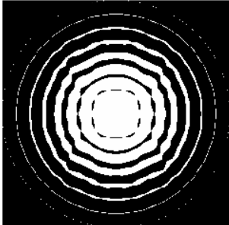
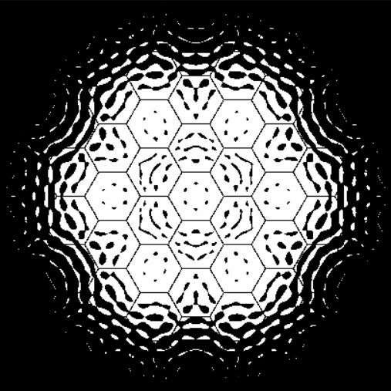
Mask # Coronagraphs IWA – OWA Contrast FoV
4 – 12 1e-9 360⁰
1
Mask 1 – circular aperture
Mask2 and 3 – LUVOIR-B
2
5 – 13 1e-9 360⁰
3
6 – 24 1e-9 360⁰

Slide 18
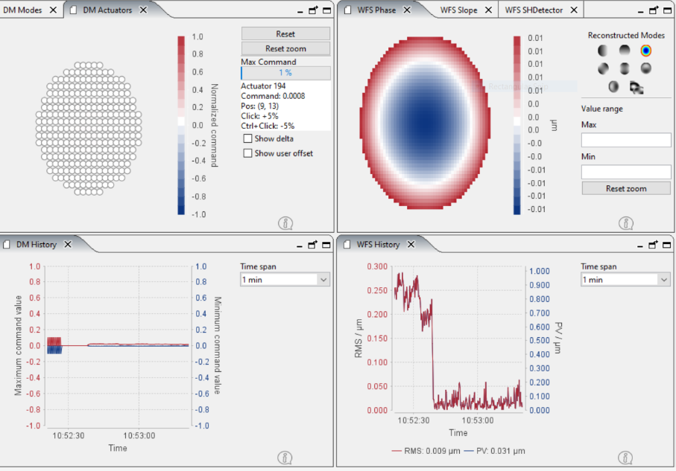
PDM- Focus Correction

