Slide 1
Early Artemis Surface Navigation: Challenges, Approaches, and Opportunities
Evan Anzalone, NASA/MSFC
Lemuel Carpenter, NASA/LARC
Cheryl Gramling, NASA/GSFC
Laurie Mann, NASA/GSFC
Thomas Moody, NASA/JSC
ION GNSS+
Denver, Colorado
September 2023

Slide 2
Outline
Artemis Mission Overview – Focus on Early Missions
Approach to Requirements Development
Trade Study Approach
Results and Recommendations for Near-term
Next Steps and Forward Work

Slide 3
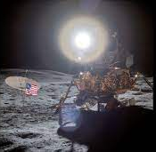
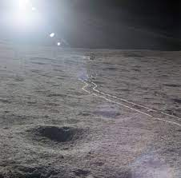
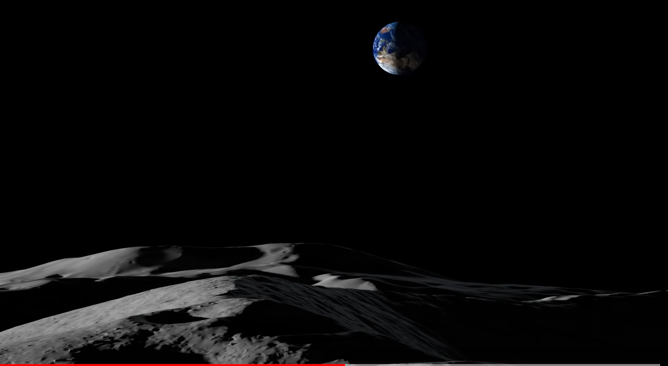
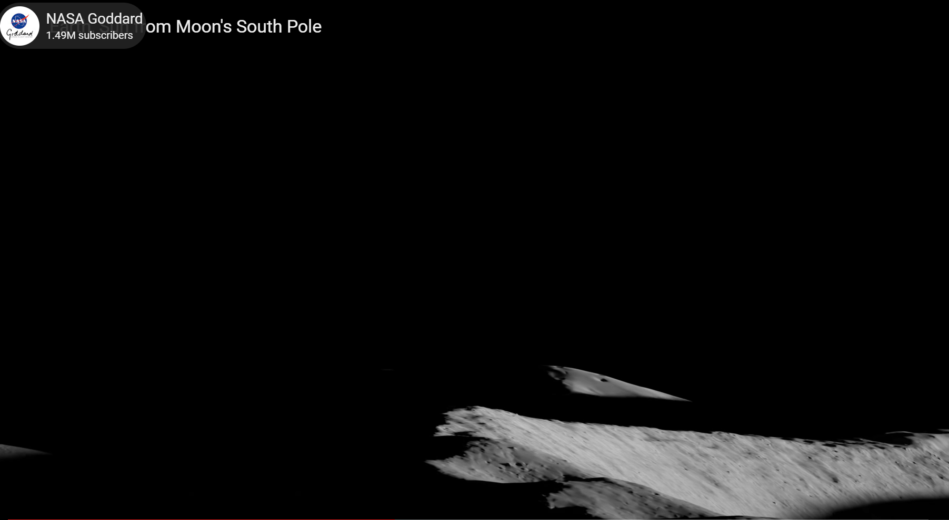
Artemis III and IV Navigation Needs
Apollo 14 - Low Sun
Needs and Focus of Mission
  On-Foot traverses within limited range of lander
  Gaining experience in new environments for expanded operations in future missions
  Sample collection and deployment of scientific payloads in South Pole Region
Near-term Challenges
  Lighting environment will involve low sun, sharp shadows, and dynamic range beyond human range
    May be mitigated by lightings constraints for early missions
  Time spent navigating during traverse will limit time spent doing science
Long-term Challenges
  Going into more challenging areas, such as shadows
  Increasing distances from lander
Artemis - Low Sun and low Earth

Slide 4
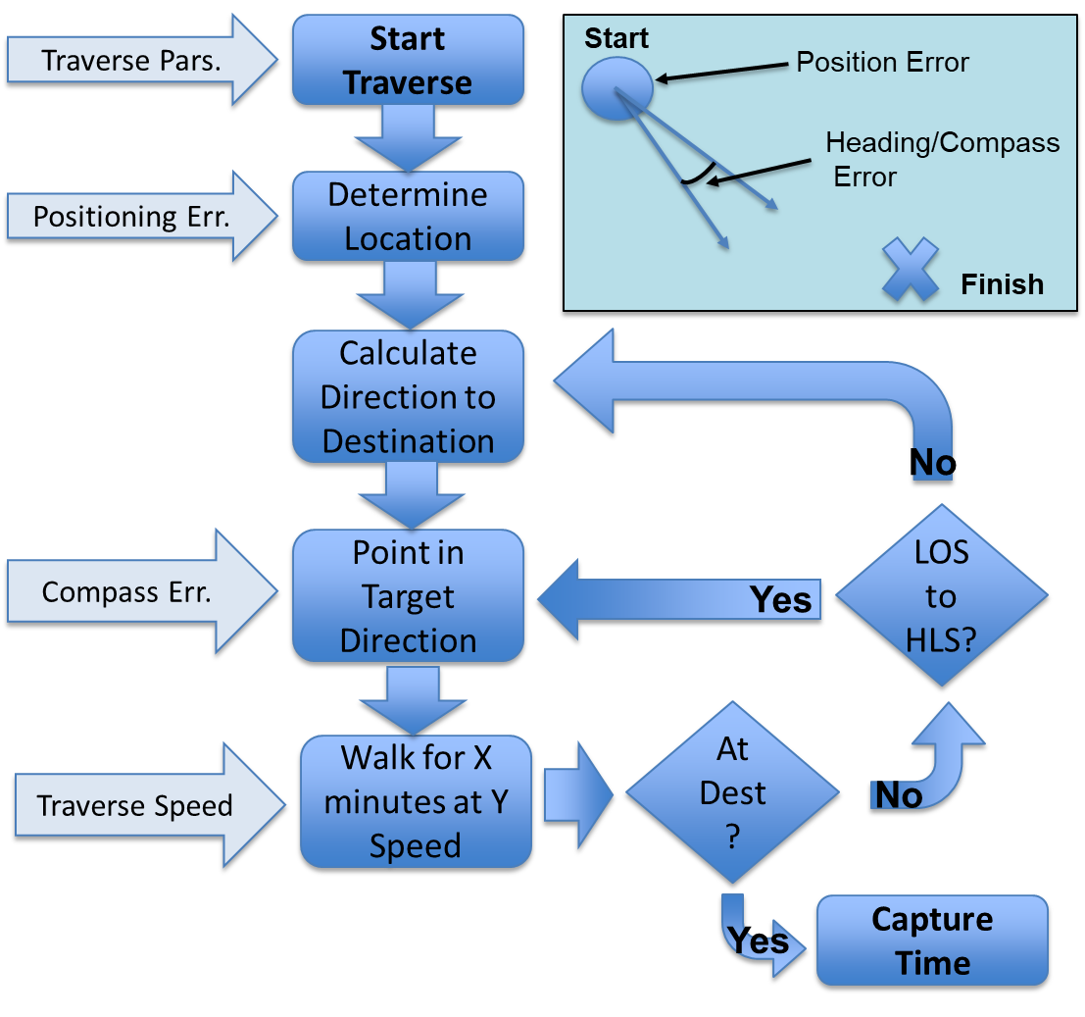
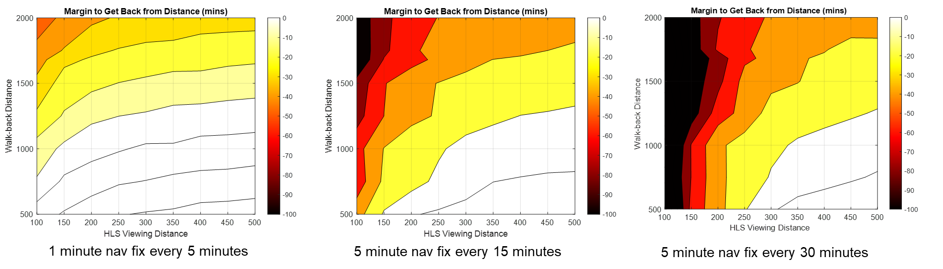
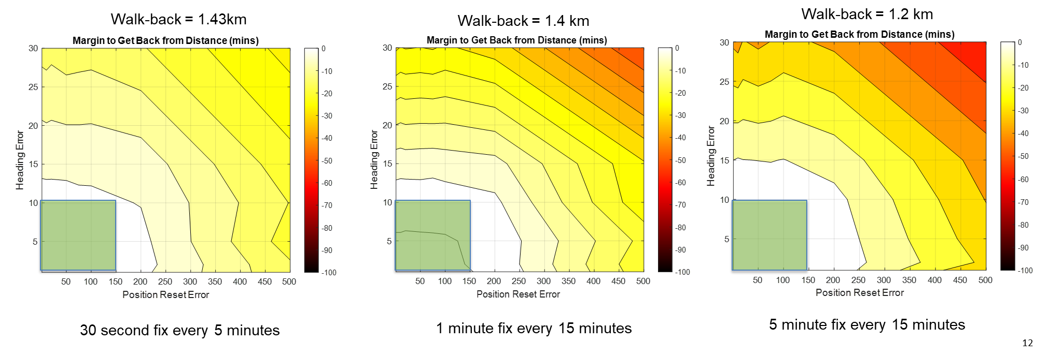
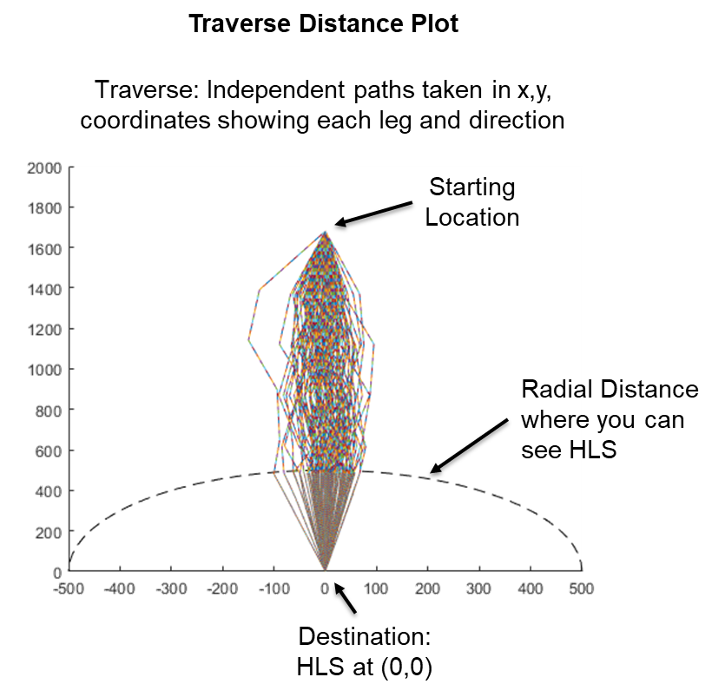
Approach to Development of Requirements via Simulation
Simulation of on-Foot Traverse
Sensitivity to Navigation Operational Parameters
Sensitivity to Navigation Accuracy

Slide 5
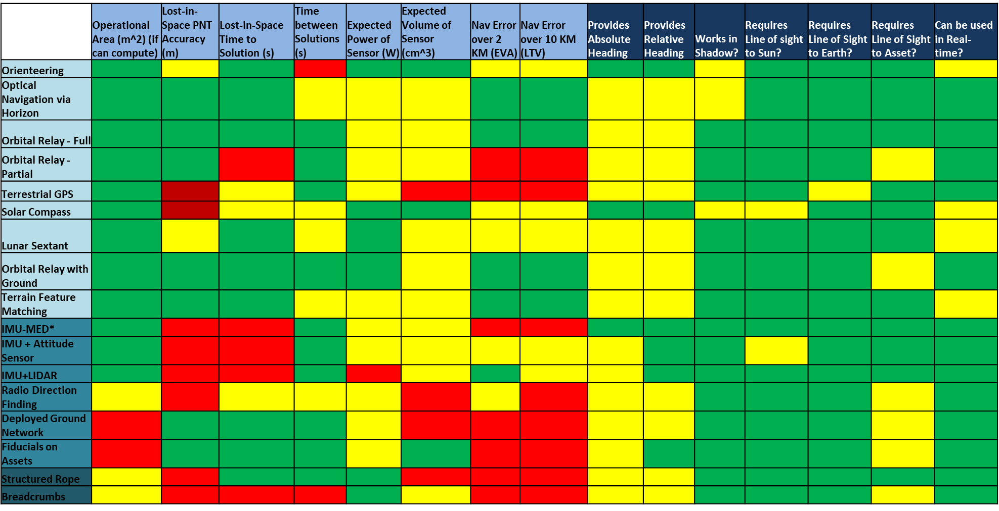
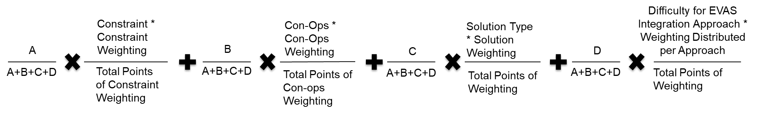
Technical Solutions and Metrics Considered
Qualitative Rankings from Element and functional navigation leads
  Operational preference
  Integration preference and difficulty
  Operational constraints
  Relative vs Absolute
Quantitative data on performance to assess ability to meet mission requirements and level of capability
Combined scoring into one integrated metric per Artemis mission
  Weightings allow for detailed what-if and robustness analysis

Slide 6
Recommended Solutions
Artemis III
Artemis IV
Takeaways:
  Difficult to integrate any hardware into/onto EVAS at this point in design
  Any HLS installed active payloads will require autonomous power and may have limited field of view
  More willing to accept mission constraints (i.e. stay in the light)
Recommendation:
  Orienteering as baseline approach
  Augment with heading measurement approach via handheld approach, Lunar compass
    Implemented via IMU or Attitude Sensor
  For Science Sampling, focus on post-processing using handheld camera with optical navigation
  Pursue deployment of fiducials to all elements
Takeaways:
  Can still rely on post-processing for science observations
  Increased potential to go into dark areas
  Ability to mod EVAS contract to integrate any hardware into/onto EVAS
  Ability to install elements to HLS with integrated power
Recommendation:
  Orienteering as part of baseline approach
  Augment with evolved inertial system for navigating in the dark and performing dead reckoning
    Attitude Sensor (Star/Sun Sensor) + IMU
    LIDAR great value, if can manage integration
Ability to augment orienteering with additional orientation/heading and optical navigation greatly enhances surface navigation. Deployment of initial hardware as GFE, followed by integration into suit itself.

Slide 7
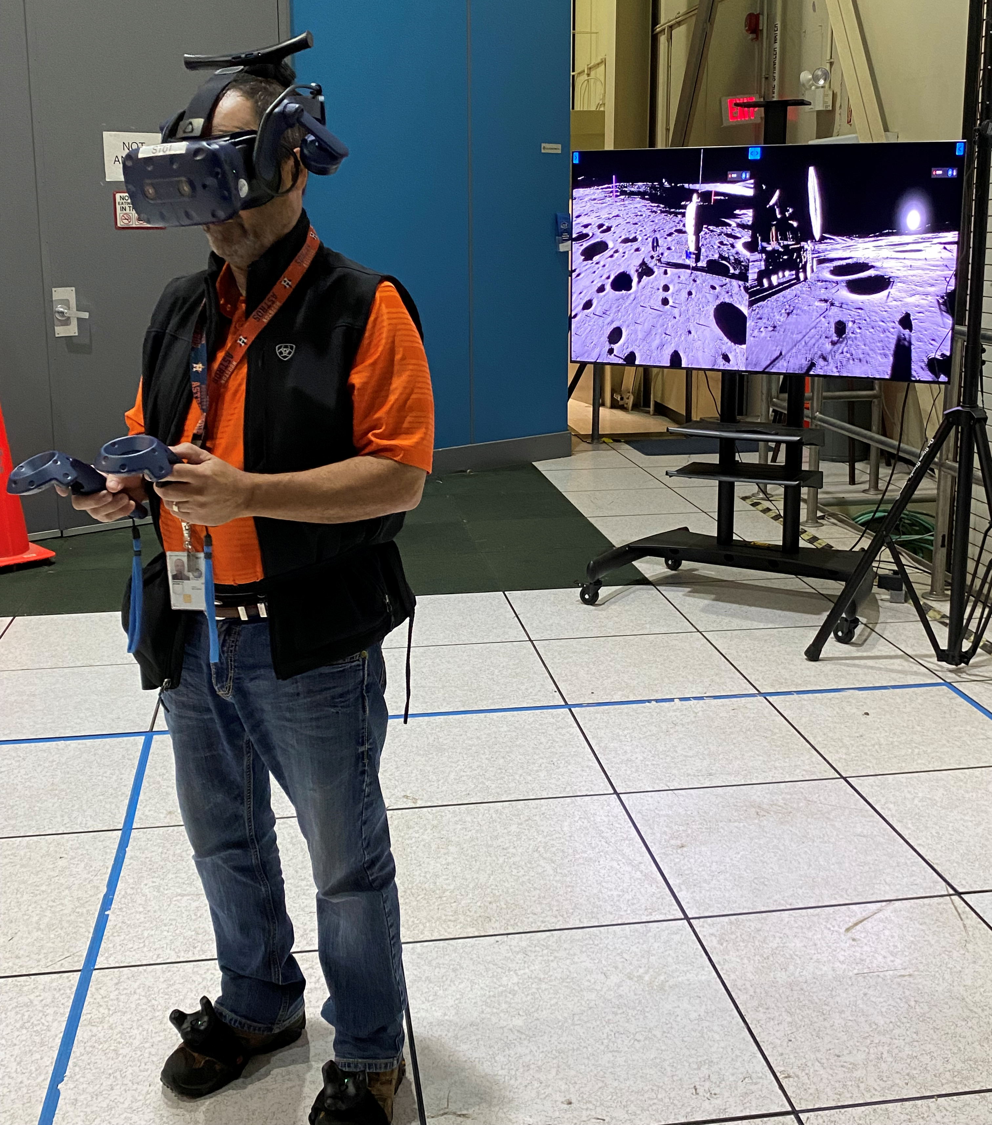
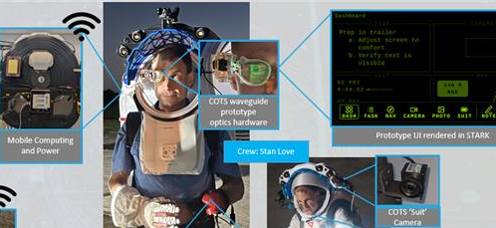
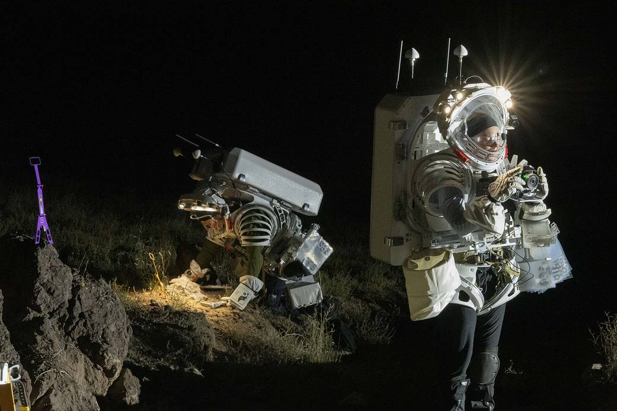
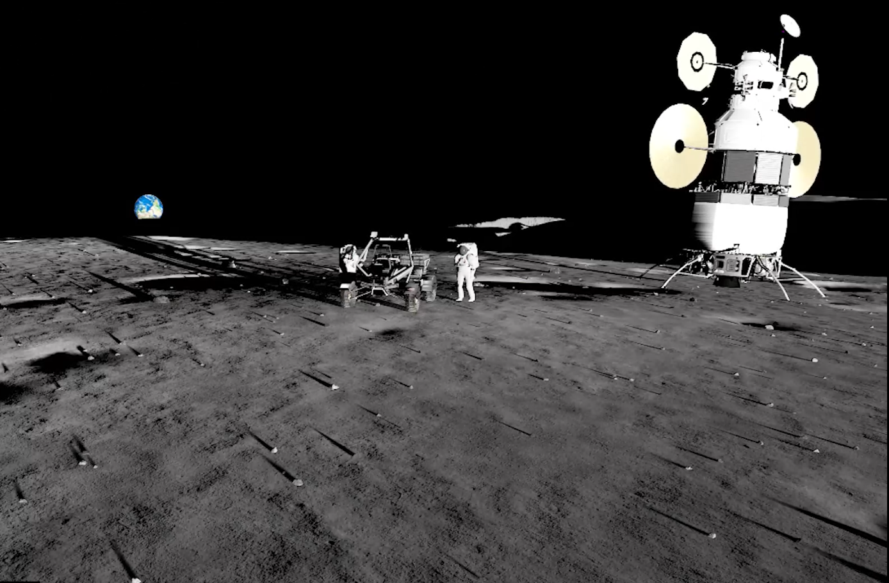
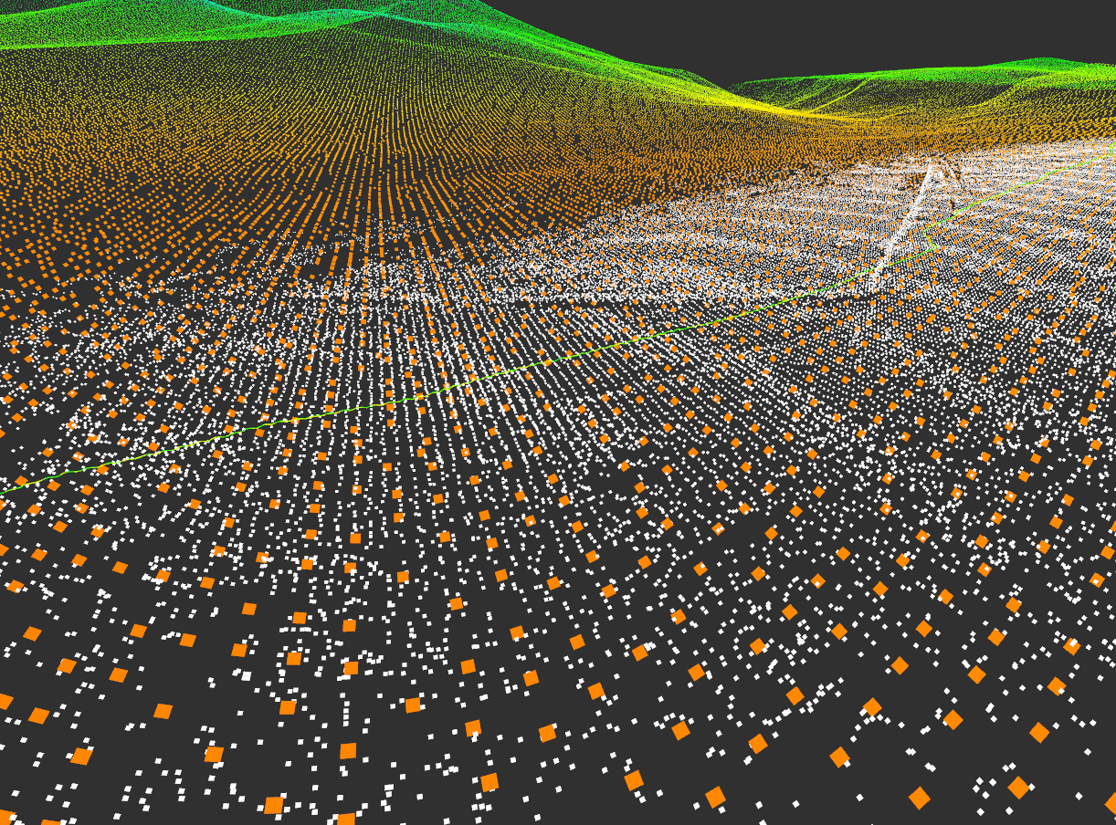
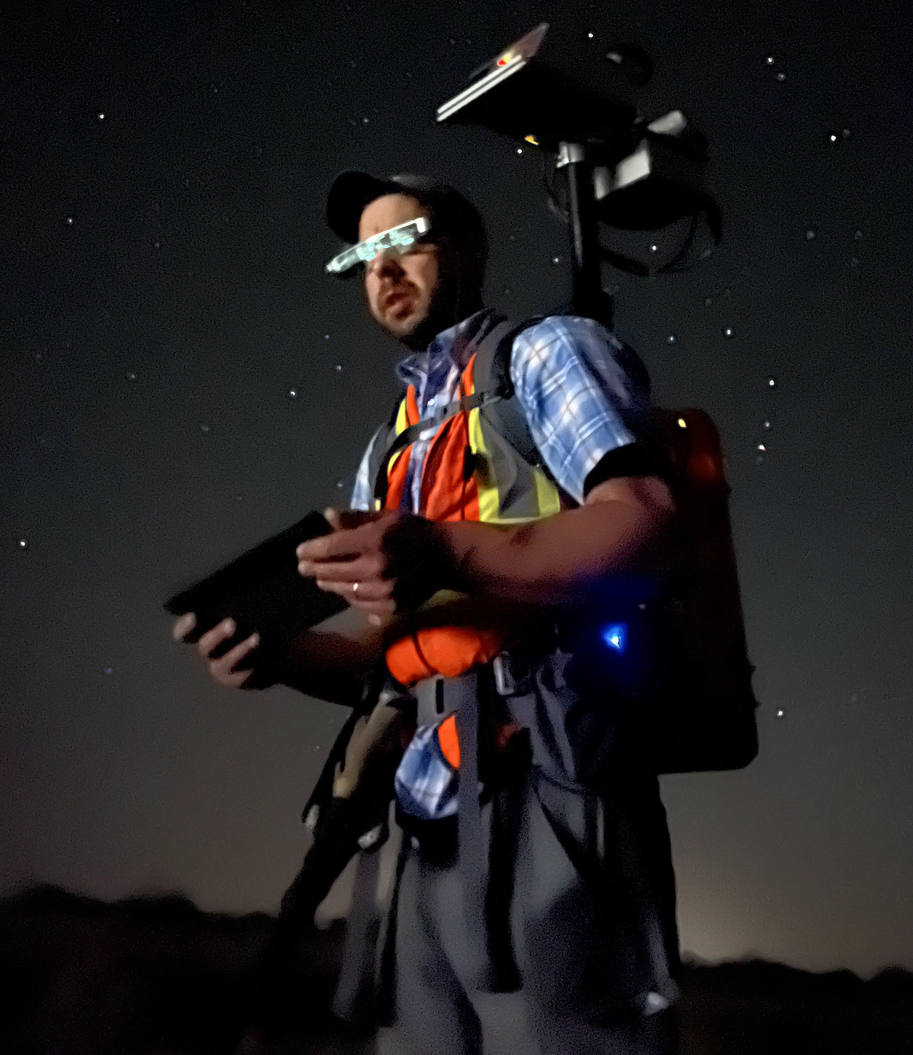
Next Steps
Conducting Market Surveys, internal NASA Research and Development, Vendor Discussions to guide implementation of hardware solutions
In-field and virtual-field simulations to assess crew navigation capability and future technology potential
Field Exercises
VR Evaluation
Technology Evaluation
User Navigation Heads-up Display
Image/NASA/JSC/Paromita Mitra
Assessment of Orienteering Approach in Field Studies
Image/NASA/Bill Stafford
VR Simulation of Lunar Surface
Image/NASA/JSC/Eddie Paddock
Application of User-Mounted LIDAR
Image/NASA/MSFC/Mike Zanetti

Slide 8
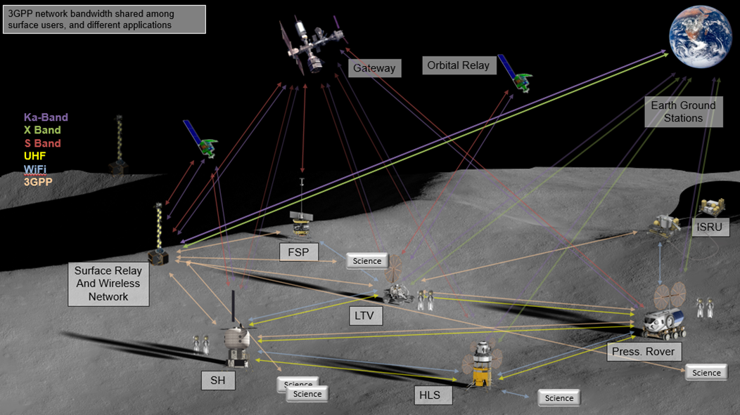
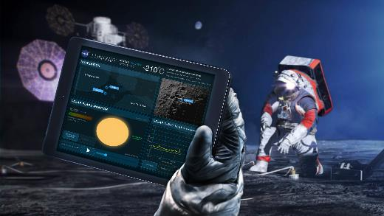
Path to Artemis V and Beyond
Solution will continue to evolve with architecture over future Artemis Missions
  LunaNet : continued development of standards for navigation and communication
  Lunar Communications Relay and Navigation System : initial deployment of South Pole-wide real-time positioning and timing capability enabling 10 m localization
  Deployment of local infrastructure enabling high bandwidth network access amount surface users that could provide additional timing and navigation references
Surface Communication Studies
Image/NASA/GRC
LunaNet Concept of Operations
Image/NASA/SCaN

Slide 9
Thank you very much! Any Questions?
Acknowledgements:
ACD/Steve Creech, Erika Alvarez, Brian McDonald, Larry Jones
EHP/Steve Nelson
All of the task team who provided inputs!

