Slide 1




Assembly of the FOXSI-4 Mirror Modules
SPIE Optics and Photonics 8/23/2023 12679-12
Stephen D. Bongiorno (Presenting)
Wayne H. Baumgartner
Jeffery Kolodziejczak
Charles G. Davis
Jagan Ranganathan
Nicholas Thomas
Jeff McCracken
Danielle Gurgew

Slide 2
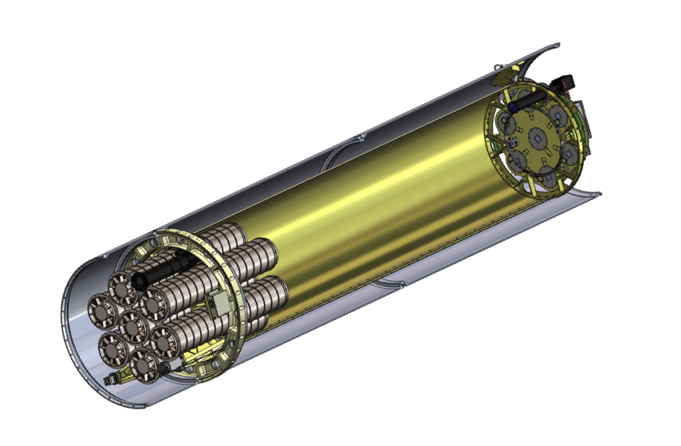
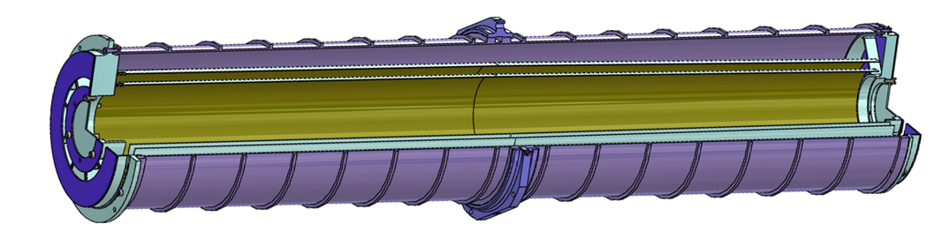
FOXSI-4 Mirror Module Assembly (MMA) Design
Mirror Modules x7
Focusing Optics X-ray Solar Imager (FOXSI-4) is a NASA sounding rocket experiment, the primary goal of which is to study the sun in X-rays using focusing optics. Seeks to understand mechanisms of energy transfer in solar flares and the solar corona.
Each MMA consists of 2 nested X-ray Mirror Shells bonded at the large end to a Front Spider:
  Design: Monolithic Wolter Type I
  Shell Material: Electroformed Nickel cobalt
  Reflective Coating: Iridium
  Shell Intersection Diameter Range: 63.4 – 103.02 mm
  Shell Length: 600 mm for Integral Parabola-Hyperbola
  Focal Length: 2.00 m
  Performance Goal: < 5 arcsec FWHM
  Centering Alignment Knowledge Goal: <5 µm
  Shell thickness: 520 µm
Shells are made from mandrels that are rough machined, EN coated, diamond turned, polished, passivated, electroformed, released and Ir-coated.
Post-shell assembly, the Outer Housing, Rear Spider, Mounting Flange, and Front and Rear masks were mounted.
Mirror Modules are labeled by FOXSI serial number: X9, X10, X11.
Rocket skin
Metering tube
Focal plane
Mirror Modules x7
Payload
MMA
Rear spider and mask
Mounting flange
Front spider and mask
Shells x2
Housing

Slide 3
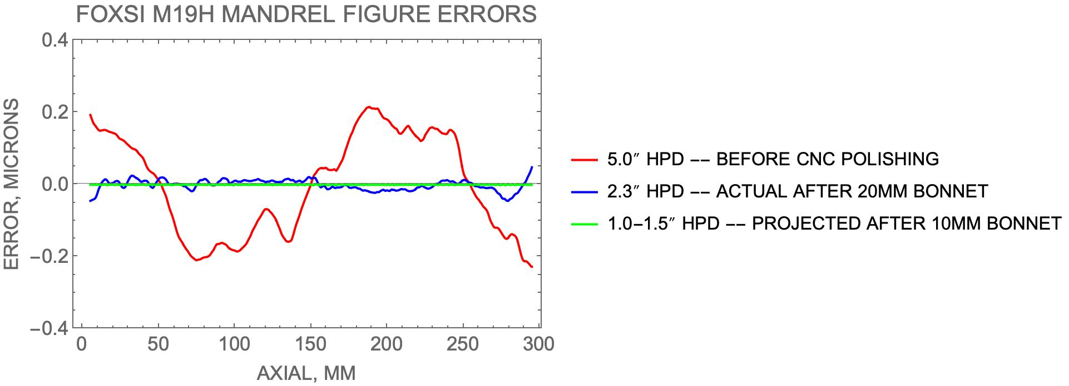
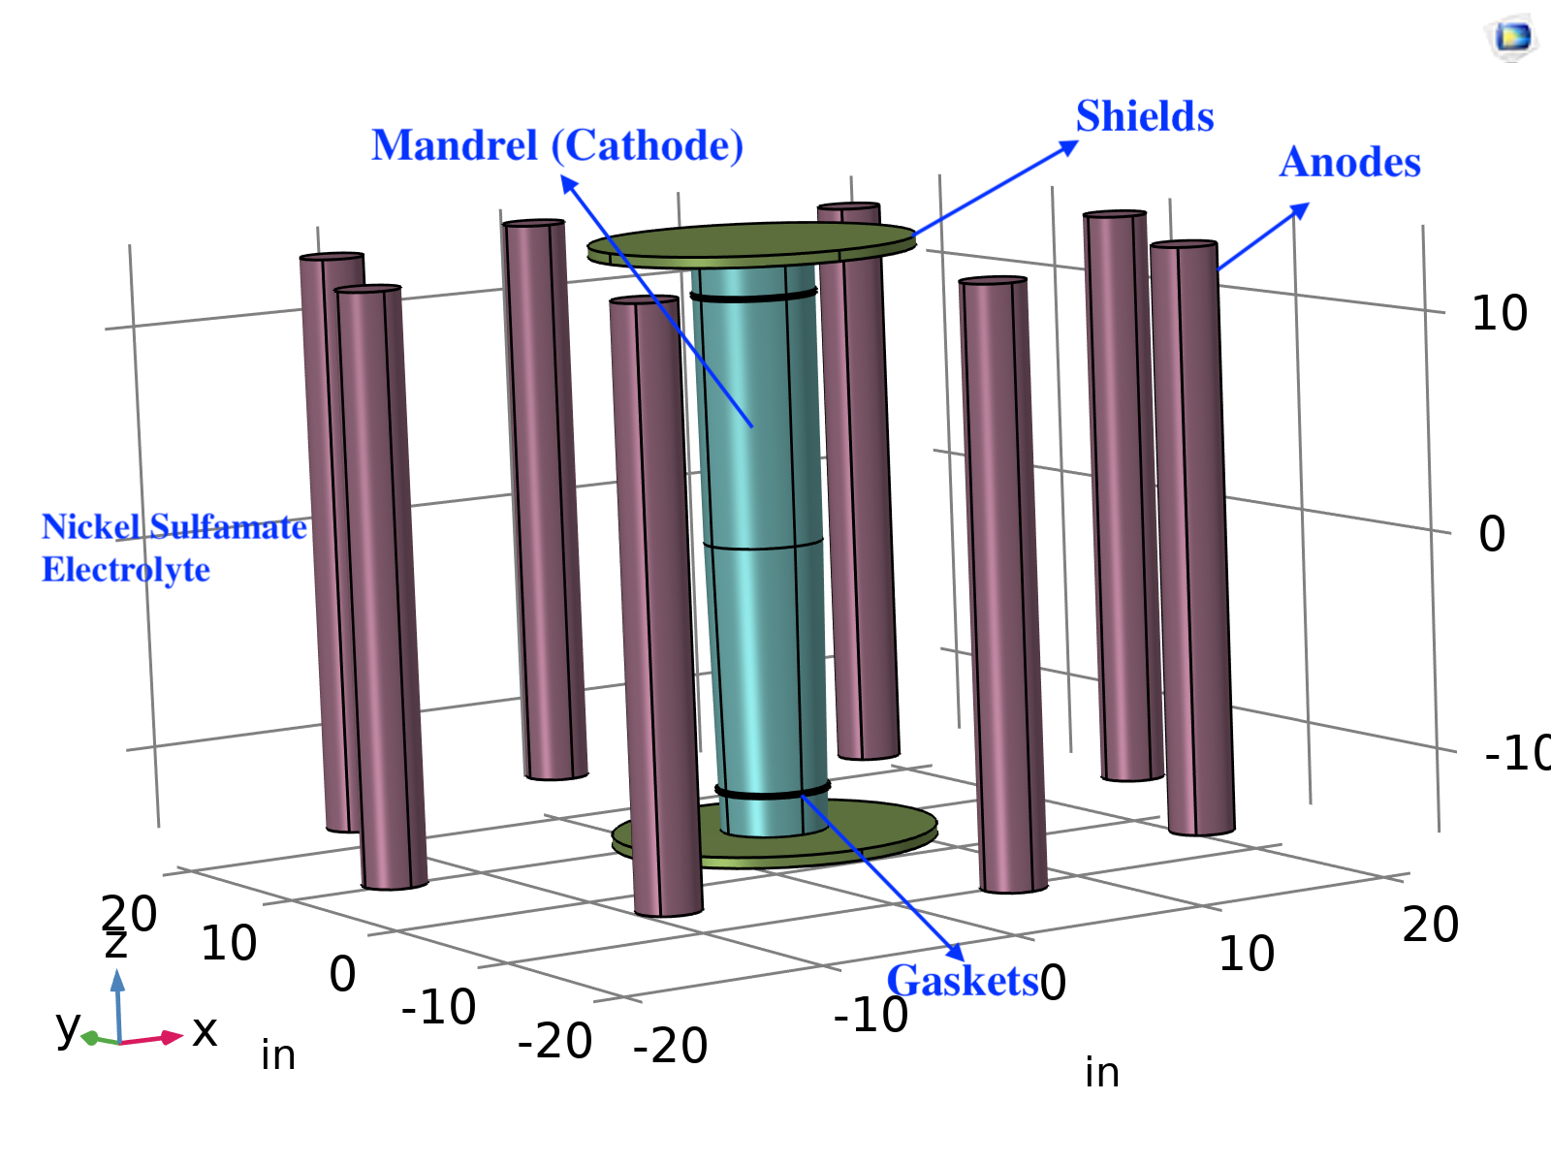
FOXSI 4 Development
The primary goal of FOXSI-4 development at MSFC was to produce mirror modules with higher angular resolution. Toward that goal, development focused on three main areas:
  Mandrel polishing – two FOXSI mandrels were repolished with the Zeeko IRP600X CNC polishing machine at MSFC. An iterative process of interferometer metrology and the use of progressively smaller polishing tools enables improvement of the optical figure. Details in 12679-11.
  Shell replication – electroforming bath was modeled and optimized with COMSOL multiphysics software. In the bath, E-field is proportional to deposition current, which is correlated to as-deposited stress of shell material. Minimizing electric field non-uniformity is the primary goal of the bath optimization. Details in 1269-10.
  Shell alignment and MMA assembly

Slide 4
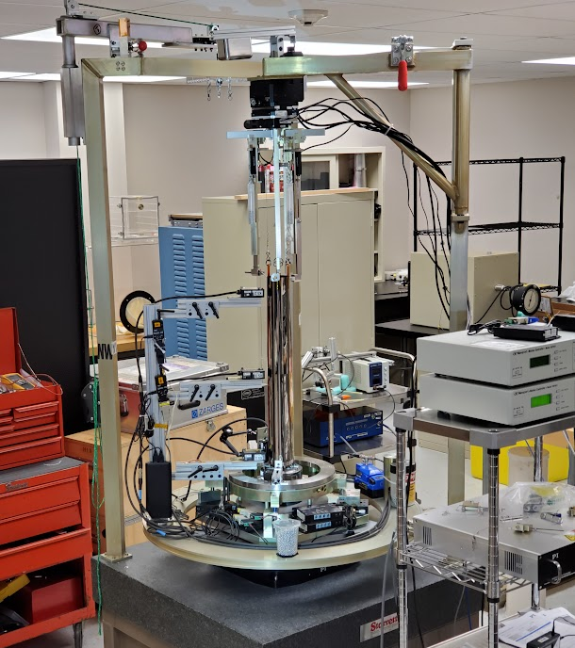
Alignment station improvements for FOXSI-4
The shell assembly station aligns, offloads, and stabilizes shells so that they can be bonded to the front spider assembly. Shell assembly progresses from smallest to largest shell.
The rotation axis of the spin table provides the center and tilt reference for the shells and spider-tube assembly throughout.
Three displacement sensors are mounted to the spin table and rotate around the shell to measure its center, tilt and circularity with submicron precision.
One proximity sensor measures a top surface of the spider
Once mounted to the assembly station, shells are supported by 3 direct support wires and 3 off-loader wires on a rig suspended from a three-axis stage
FOXSI 4 Improvements
IXPE heritage
3-axis shell translation stage
Shell rotary stage
Stiffened sensor support structure
Shell suspension wires and tip/tilt actuators
Lower stabilizers and shell circularity actuators
Shell mass off-loaders
Improved mirror module mount kinematics
Upper stabilizers
FOXSI 4 M11 shell
Improved bearing
3x displacement sensors
Granite base

Slide 5
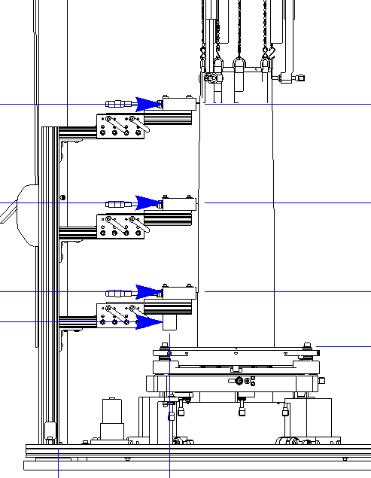
Shell Alignment Process
Circularity measurements are made with three sensors (right) to calculate shell tip and tilt angles, x and y centering, and ΔΔR (DDR).
The shell is first aligned above the spider in a free state where a small pendulum motion is observed from room air currents acting on the shell.
Stabilizers are carefully installed to stop the pendulum motion while minimizing any translation of the shell from the bottom of the gravity well, and the shell is realigned.
Shell is lowered to final position above the spider spoke and realigned.
Further alignment checks are performed after bonding, curing, and suspension release for verification.
A MATLAB application (above right) partially automates the iterative alignment process:
  Reads and analyzes sensor data and determines shell center, tilt, and ΔΔR performance estimate.
  Automatically adjusts 5 axes (3 axis Newport Stage and 2 of 3 picomotors supporting fixed wires) to align shell.
  Allows manual adjustment of stages
Typically 2-5 ~3 min iterations are required, depending on initial state to reach <5 arcsec tilt and <5 μm centering.

Slide 6
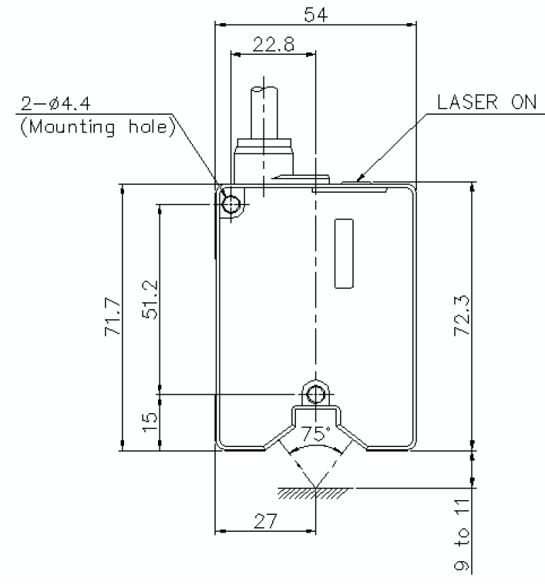
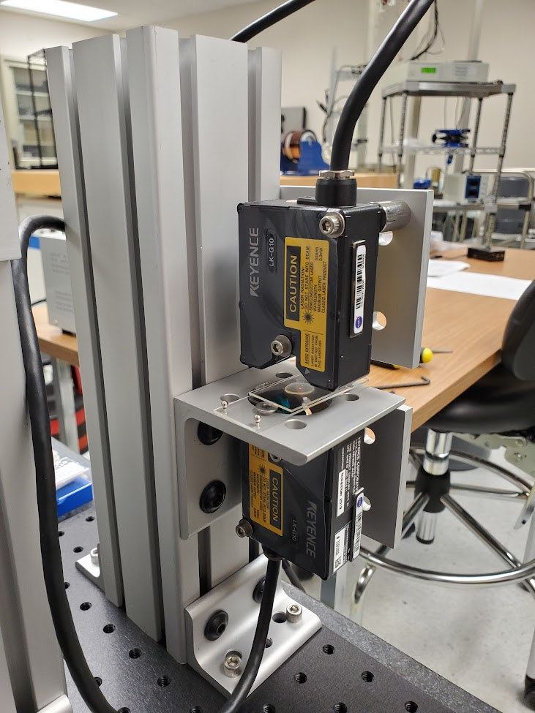
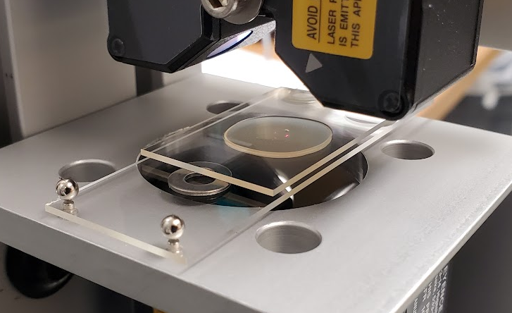
Epoxy Shrinkage Measurement Apparatus
X-ray optics are typically epoxy bonded to structure and, in general, epoxy shrinks when it cures.
Apparatus was built to measure shrinkage of two heritage epoxies.
Epoxy sample cures between glass slides spaced 0.79 mm.
Displacement sensors measure sample thickness change during cure.
Calculate strain to make relative comparison between epoxies.
Displacement sensor
Epoxy
3-point ball-magnet mount
Glass slides
Spacers

Slide 7
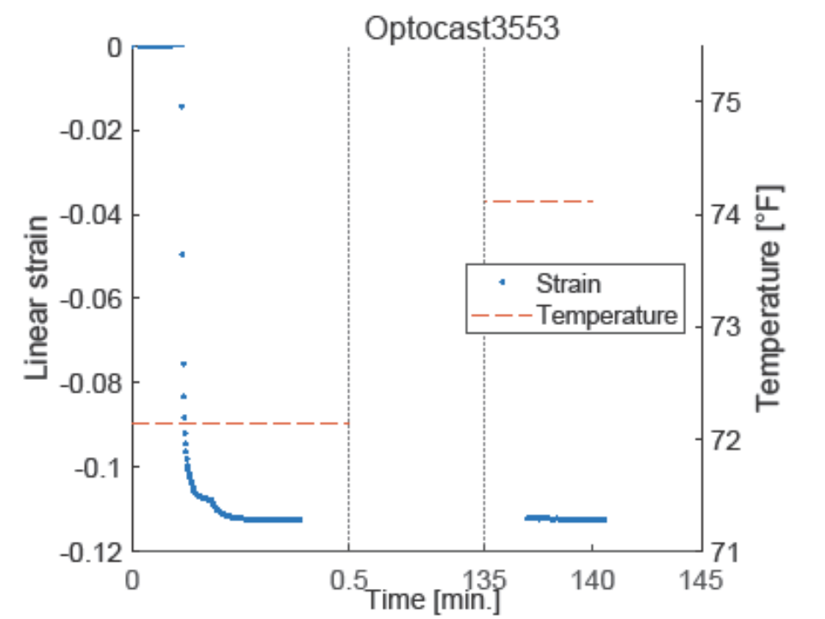
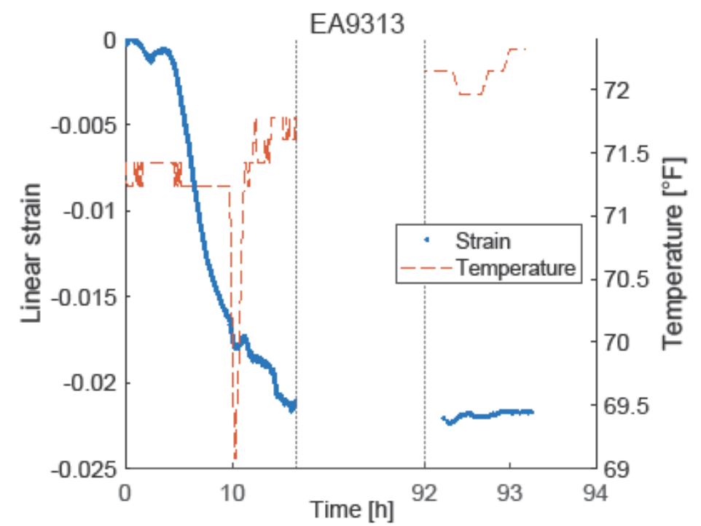
Epoxy Shrinkage Results
Measured shrinkage for EA9313 (RT cure 2-part epoxy, 5-day cure) and Optocast 3553 (UV cure epoxy). Waited until strain stabilized.
The linear shrinkage measured in EA9313 was 2.2% after 93 hours and 11.3% after 2.3 hours. The factor of 5.1 lower shrinkage exhibited by EA9313 prompted the project to switch from Optocast 3553 to EA9313 for bonding mirror shells.
Coverglass of cured samples observed to be curved concave, indicating largest shrinkage occurred in center, making measurement upper limits. Not expected to affect relative comparison between epoxies.
Remeasured with 1 mm thick glass (300x stiffness) and observed 10% drop in strain. Therefore, thin glass not expected to affect measurement.

Slide 8
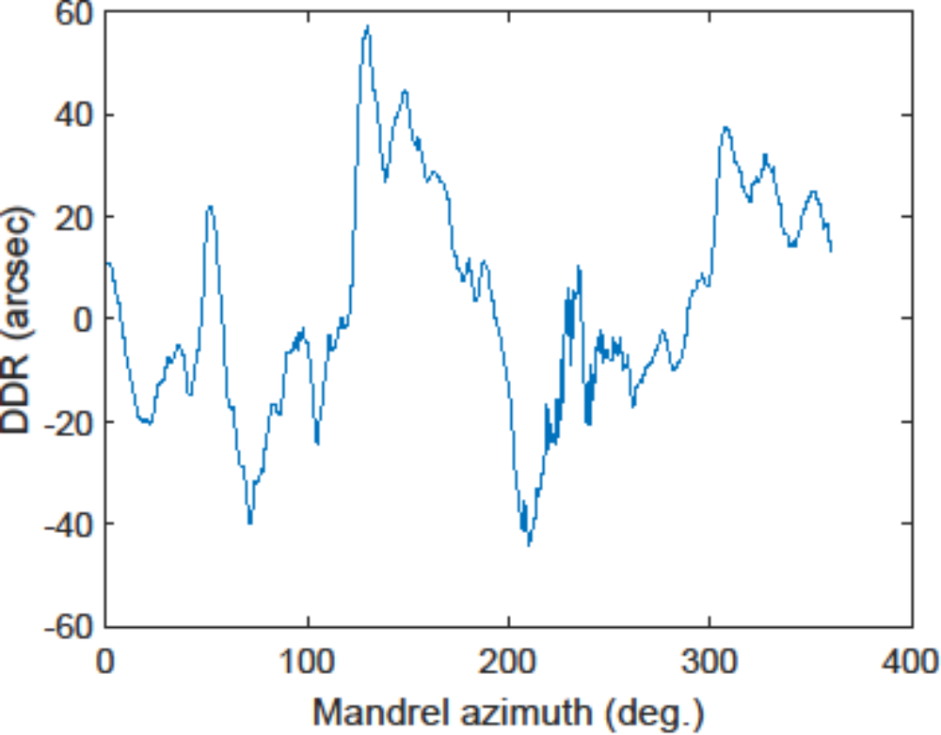
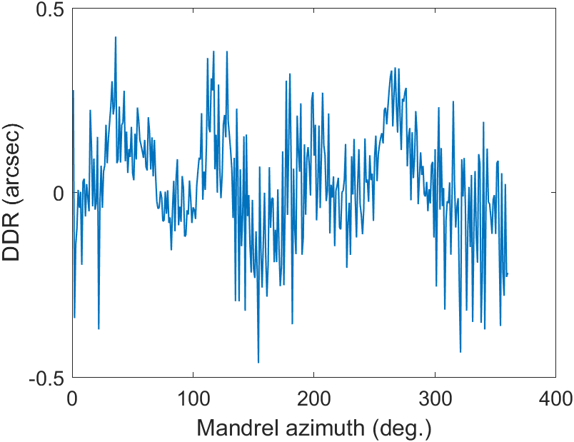
Alignment Station Commissioning
Bearing wobble – ART-XC mandrels measured on alignment station as circularity reference to characterize bearing
  IXPE shell alignment station commissioning data (left) exhibits 60.6 arcsec DDR HPD error.
  FOXSI-4 shell alignment station (new bearing) commissioning data (right) exhibits 0.4 arcsec DDR HPD error.
Offloader mass sensitivity – No significant change at ~1 arcsec level
Support position sensitivity – No significant change at ~1 arcsec level

Slide 9
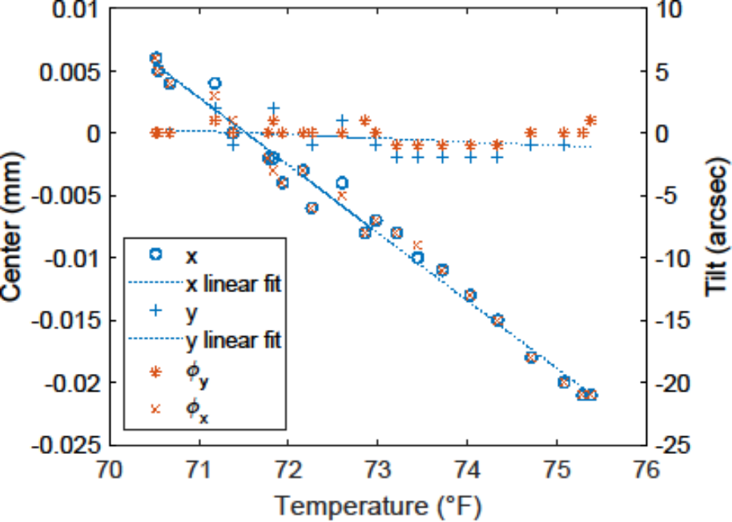
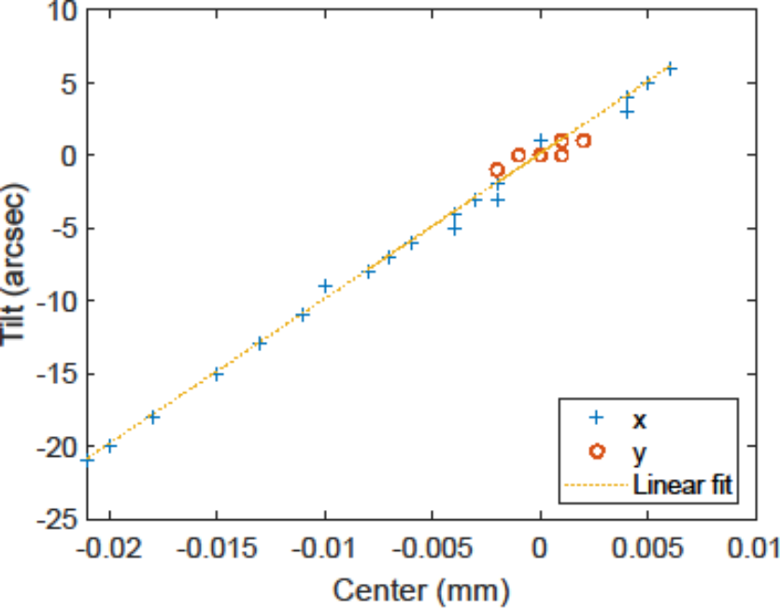
Alignment Station Thermal Stability
Observed that position of a suspended shell was correlated with the ambient air temperature.
To characterize, FOXSI4-M19S10 was measured with the alignment station as the room temperature changed.
Strong correlation (left figure) between node position and temperature in the x-direction, with the slope of a linear fit to the x optical node position being -5.4 µm °F⁻¹. In the y-direction, the slope is -0.3 m ° F⁻¹.
Correlation between the optical node position and the tilt (right figure), has linear fit slope and y-intercept 997 arcsec mm⁻¹ and 0.13 arcsec, respectively. Corresponds to rigid body motion of the shell rotating about a point on the optical axis located 207 mm from the optical node, toward the shell entrance aperture. This metrology-derived center of rotation is close to the position of the shell lower support points, which were positioned 275 mm from the optical node. Indicates that the temperature-induced drift of the shell is almost entirely due to movement of the upper shell alignment station structure.

Slide 10
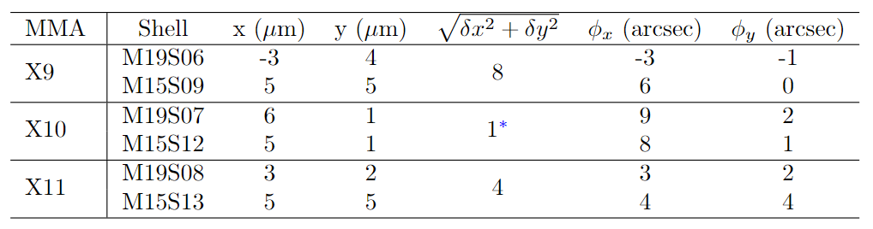
FOXSI-4 Flight Shell Assembly Results
6 optics were aligned and bonded to the Front spider.
M15 (larger) shell was aligned to the center and tilt of the previous shell in all MMAs
For MMAs X9 and X11, the shells were bonded at approximately 8 PM because the subsequent 8-hour period had best thermal stability. For MMA X10, shell M15S12 was continuously realigned as the epoxy cure, explaining the substantially improved co-alignment result.
x and y are the position of the optical node relative to the alignment rotation axis. +y points in the direction of the MMA alignment mark and +z points from the optical node to the exit aperture of the optics. Column 5 is the magnitude of position change between the optical nodes of the two optics. + φ_{x} is a rotation of the optical axis from +z toward +x and +φ_{y} is a rotation from +z toward +y.

Slide 11
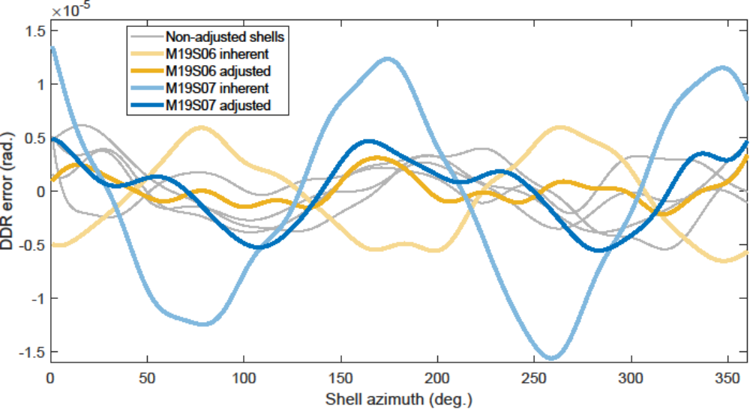
Shell Circularity Correction
Radially directed actuators were used to correct circularity error of the shells. Actuators were arranged such that they radially opposed one another, were aligned with the shape error of the shell, and inward travel of the actuators reduced shape error in the shell.
Apparatus was capable of correcting oval-shaped error in shell figure while still being able to adjust position of the shell optical node and alignment of the shell optical axis.
Luckily large spatial scale shape error in the shells was dominated by oval-shaped error.
Shell M19S06 was improved from 3.2 to 0.7 arcsec HPD and shell M19S07 was improved from 6.9 to 2.1 arcsec HPD circularity predicted performance.

Slide 12
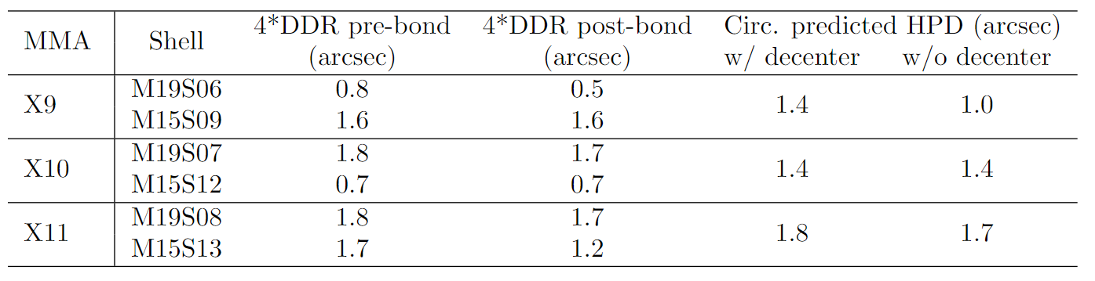
FOXSI-4 Flight Shell Assembly Results
Measured shell 4*DDR before and after epoxy cure shows no observable effect
Circularity predicted HPD for each module is shown with and without a decenter error term. Error contribution of each shell was weighted by the shell geometric effective area.
Note that the alignment station only probes the shell at three axial locations. Performance predictions only account for the largest figure distortions in the shell.
Given the 0.6 arcsec HPD DDR alignment station bearing performance, 1 µm and 1 arcsec shell alignment capability of the alignment station, and sub-arcsec contribution of epoxy shrinkage to the optical figure, we expect this hardware and these processes to be capable of assembling an optic with performance of approximately 1 arcsec HPD.

Slide 13
Summary
Three grazing-incidence X-ray mirror modules were assembled at MSFC for the upcoming FOXSI-4 sounding rocket flight.
For FOXSI-4, an IXPE-heritage alignment station was improved and commissioned
In two flight shells, the majority of oval-shaped figure error was corrected, placing their large spatial scale optical figure error in line with the remaining 4 flight shells.
Flight shell co-alignment of approximately 1 µm and 1 arcsec was demonstrated and, ultimately, the alignment and mounting process was predicted to contribute <1 arcsec HPD to the overall performance of the optics.

