Slide 1

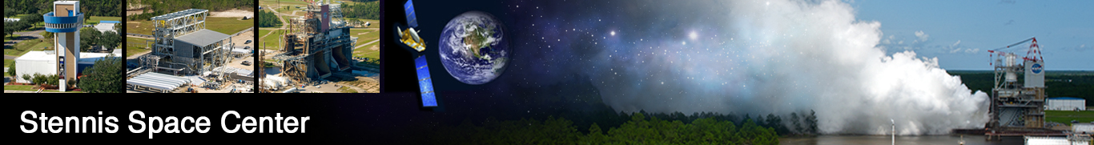
NASA Data Acquisition System
NDAS
2023

Slide 2
General Overview
System Overview
System Capabilities
Software Product Management

Slide 3
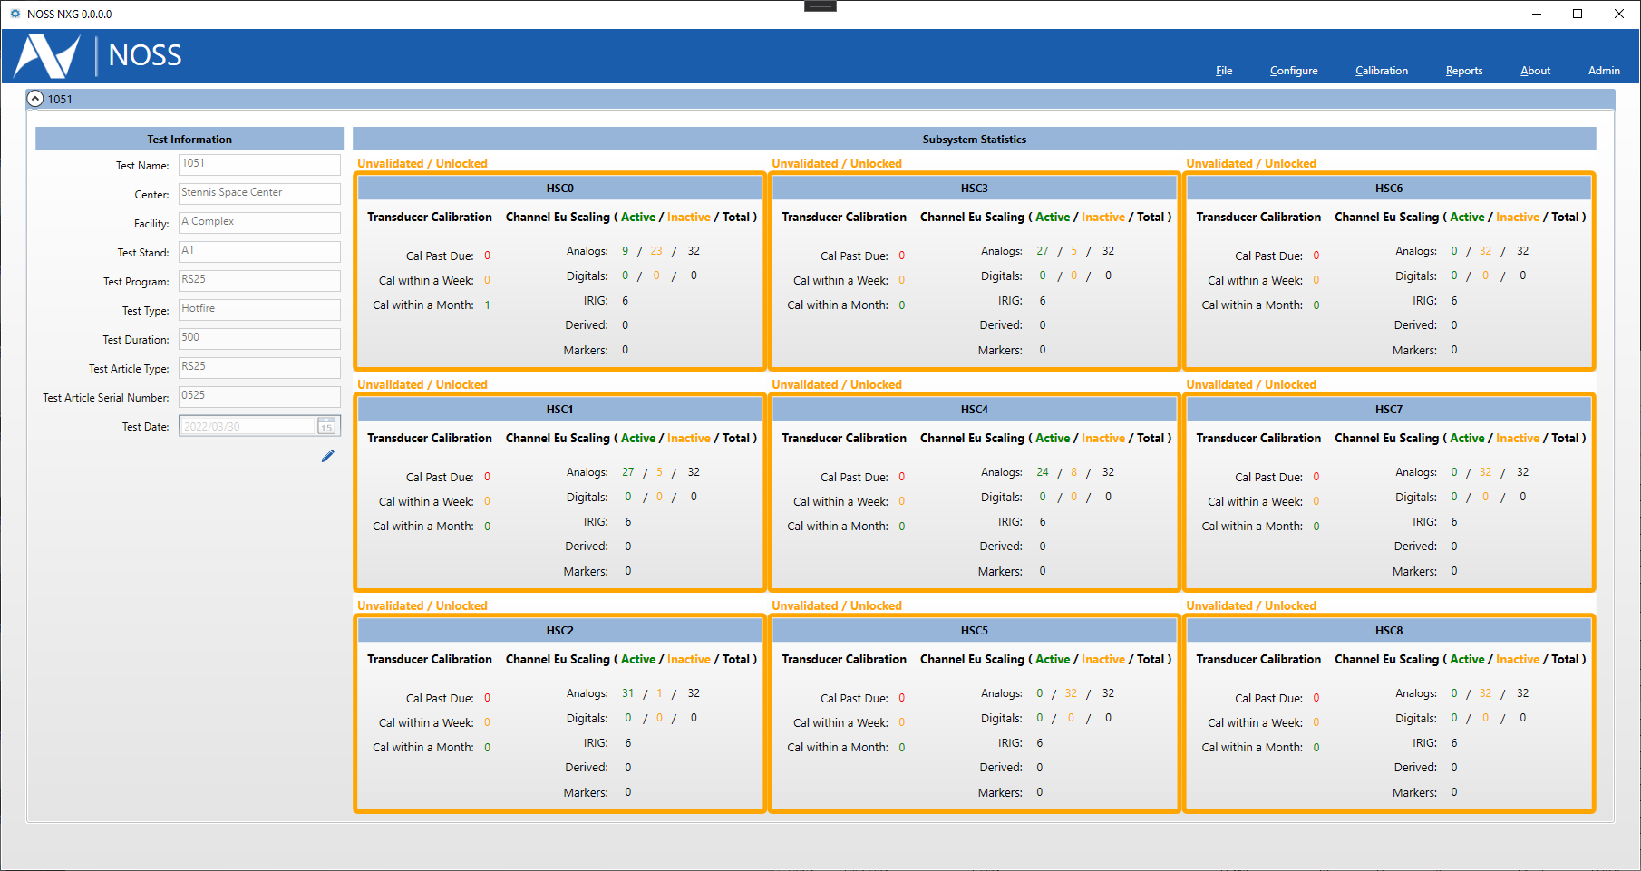
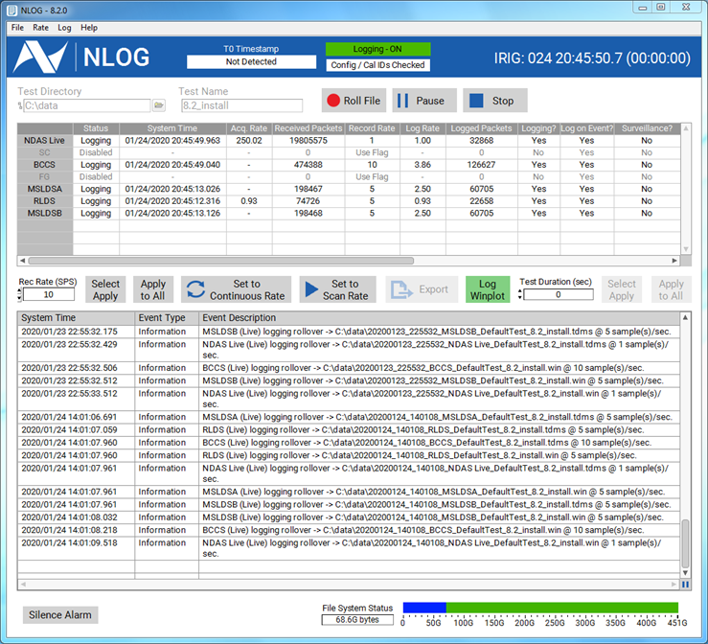
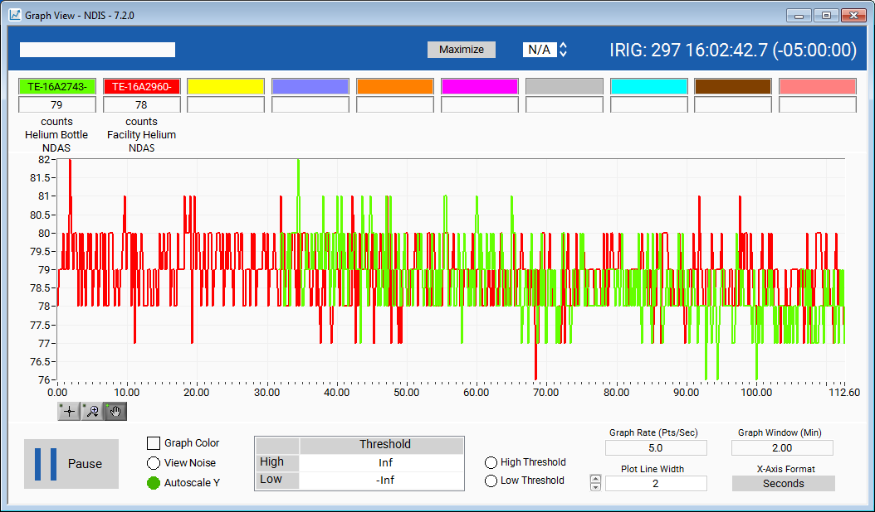
NDAS
NASA’s Data Acquisition Suite (NDAS) is a data collection and analysis software suite designed to support rocket propulsion testing.
  Project History
2011 : NDAS Project began as an RPT-level effort
2014 : Deployment to SSC A2 for J2X
2015 : Deployment to SSC A1 for RS-25
2016 : Deployment to SSC B2 for SLS Green Run
2017 : Deployment to SSC E2 for EUS
2018 : Deployment to WSTF Test Labs
2019 : Deployment to MSFC East 115 & 116
2020 : Deployment to SSC E1 and E3
2021 : Deployment to MSFC 400 Area & SSC HPGF
2022 : Deployment to MSFC 40k Area
2023 : Established Core Team
Project Goals
Provide a NASA-owned and maintained software platform.
Provide a modular and customizable software suite that supports multiple hardware platforms.
Provide a common user experience to drive consistency across test complexes and centers.
Software Engineering Team
Combined Civil Servant & Contractor Team
Expertise in software engineering, data acquisition instrumentation, embedded systems, electrical systems, and controls engineering.
Hold multiple NI LabVIEW certifications including Developer, Embedded Developer, Architect, and Champion.
Software Capabilities
Data acquisition, scaling, visualization, and recording of sensor data.
Software acquisition rates up to 400k sps provide flexibility for multiple project requirements.
Capable of communicating and display/recording external systems data.
Post processing into multiple file formats
Software Lifecycle Process
DevOps (Development and Operations) aims to integrate the work of development teams and operations teams by facilitating a culture of collaboration and shared responsibility.
Agile Scrum is an agile project management framework that helps teams structure and manage their work through a set of values, principles, and practices.
  NDAS Core Platform
Core software platform allows for software solutions within the NDAS ecosystem
Thrust Vector Control System (TVCS) and Liquid Level Gauge (LLG) utilize streaming, display, and recording capabilities from core platform
Potential to provide other solutions
Core NDAS Platform
NDAS
Configuration
Acquisition
TVCS
Logging
Display
Post Processing
Installation Management
Others..
Controls
LLG

Slide 4
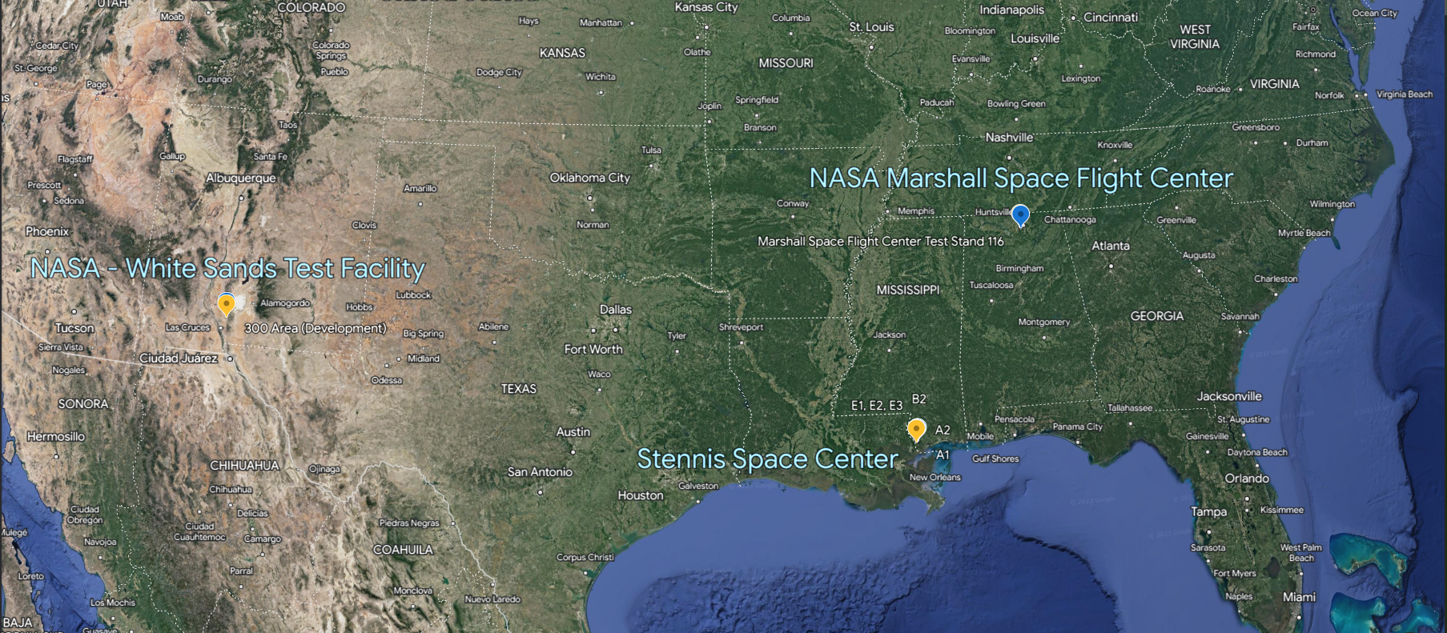
Presence
MSFC
TS 115
400 Area
CDA
TS 116
WSTF
300 Area
400 Area
Altitude
SSC
A1
E2
E3
B2
A2
A3
E1
B1
HPGF
Not Installed
Future Location
Operations
Installed Evaluation

Slide 5
System Overview

Slide 6
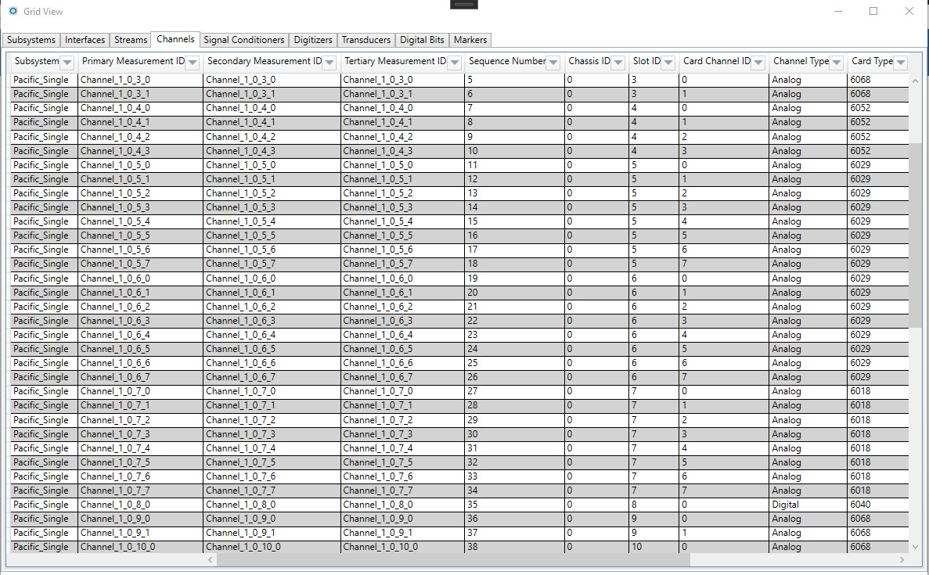
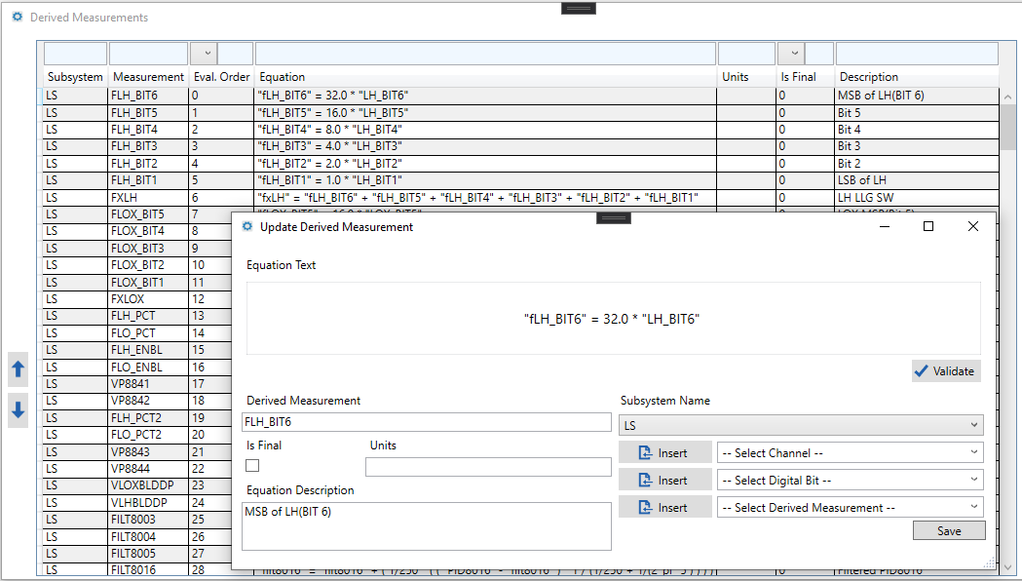
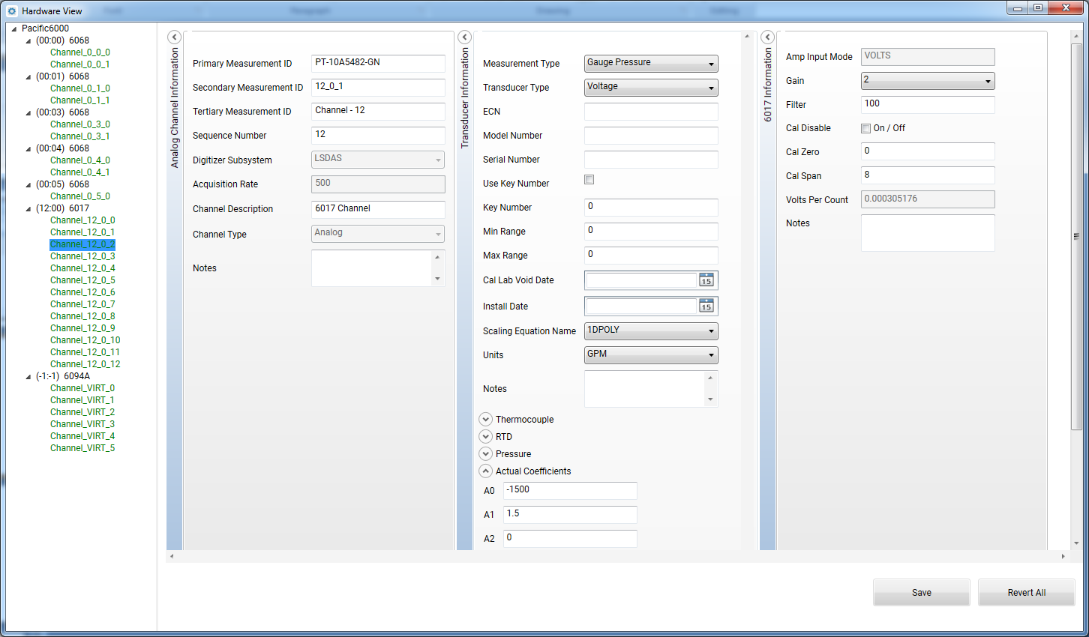
NDAS Applications
NOSS (System Configuration)
Role Based Access Control
Hardware initialization
Hardware Specific Data Displays
Import/Export Data
Calibration Setup
Derived Measurements
Reports
Actions
And more..

Slide 7
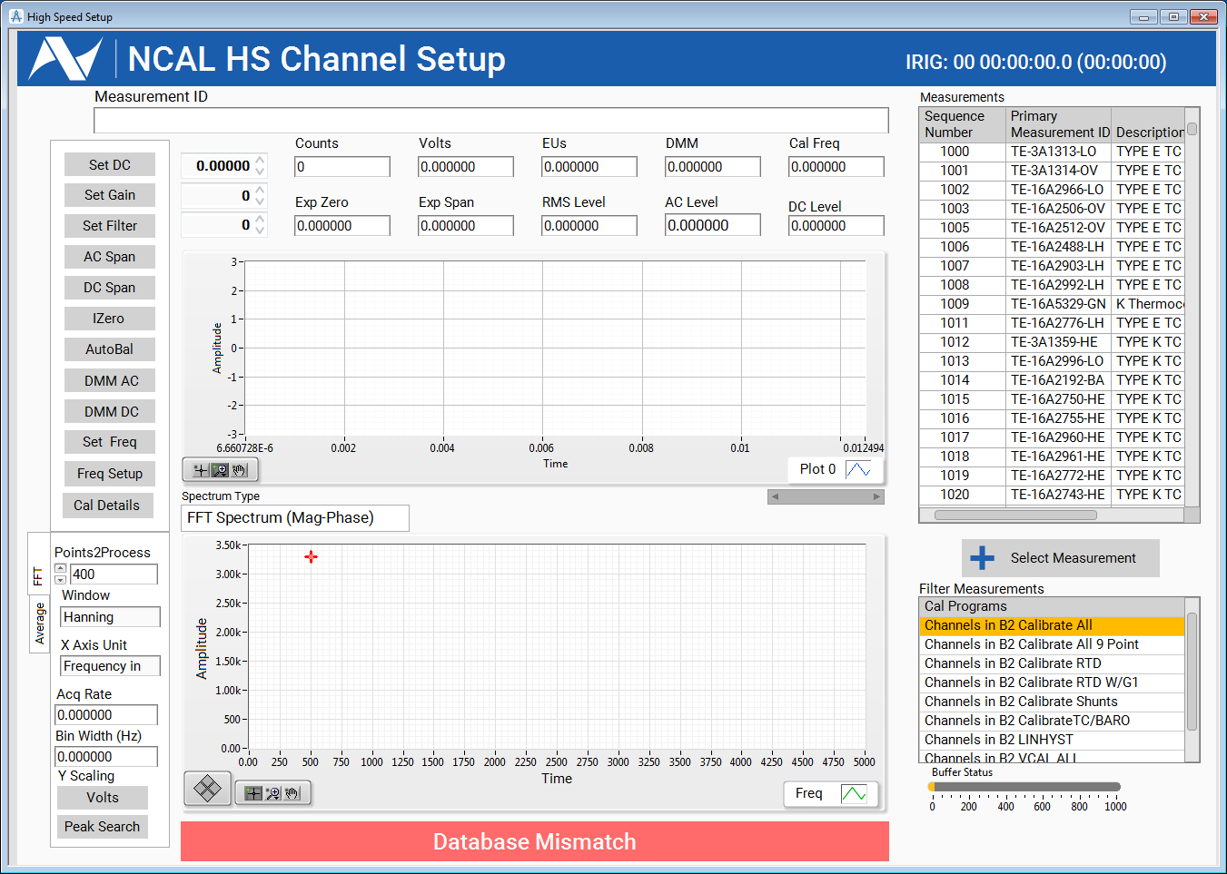
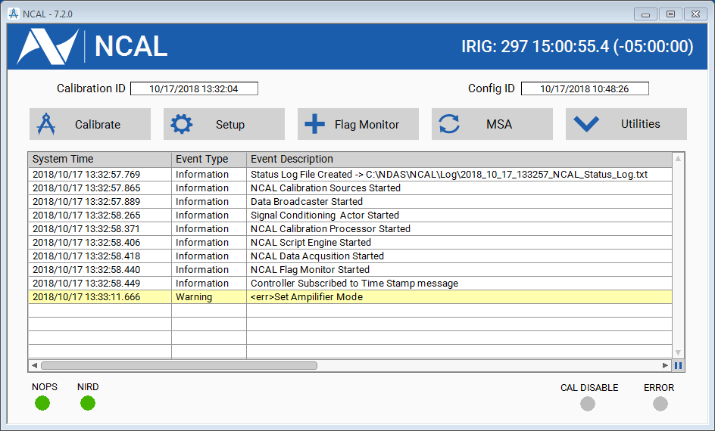
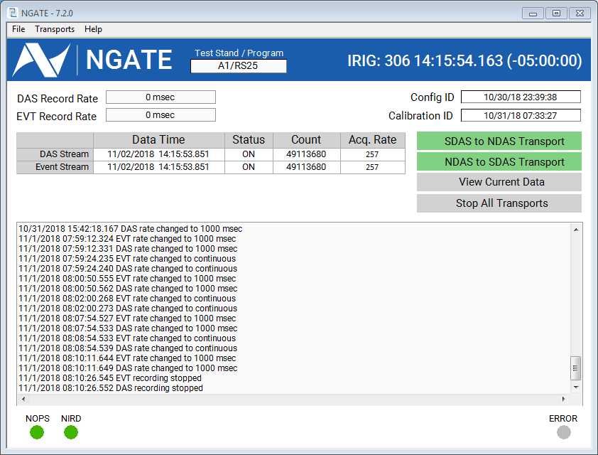
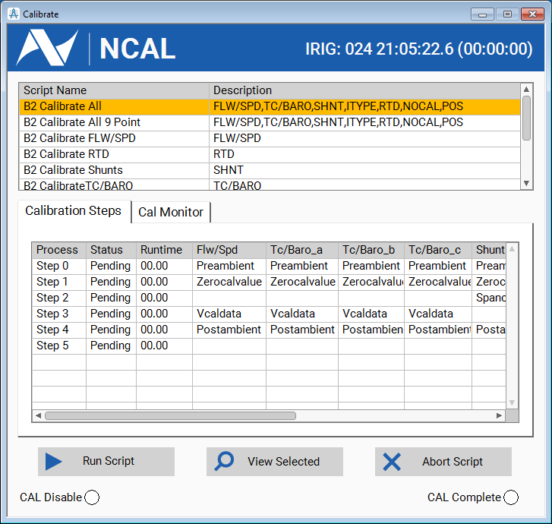
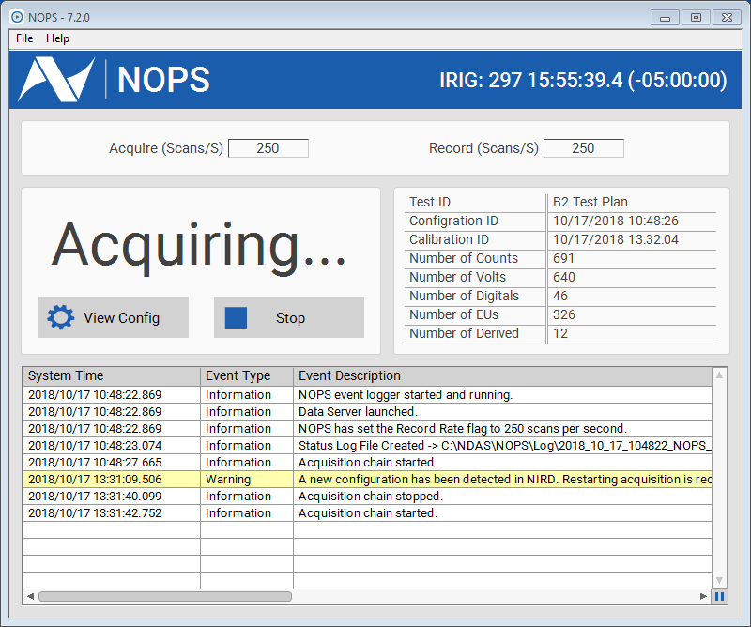
NDAS Applications
NCAL
Calibration Groups
Channel Setup / Troubleshooting
Control Cal Hardware
Measurement System Analysis (MSA)
And more…
NOPS
Data Acquisition
Scaling
Streaming
NGATE
Data Gateway
Interface with external systems

Slide 8
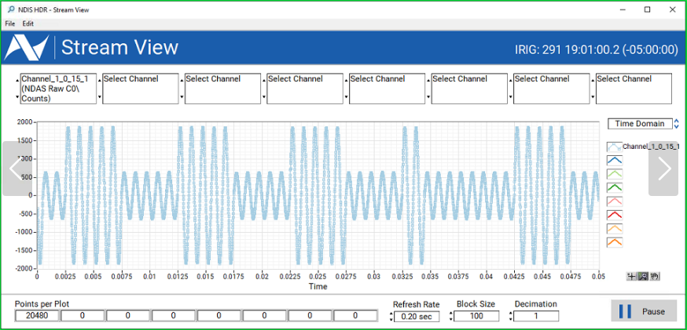
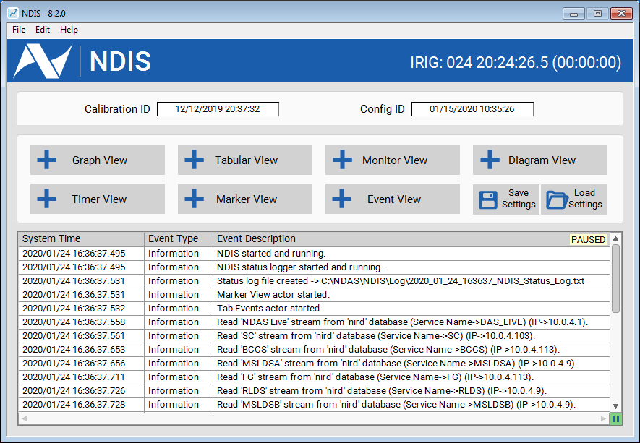
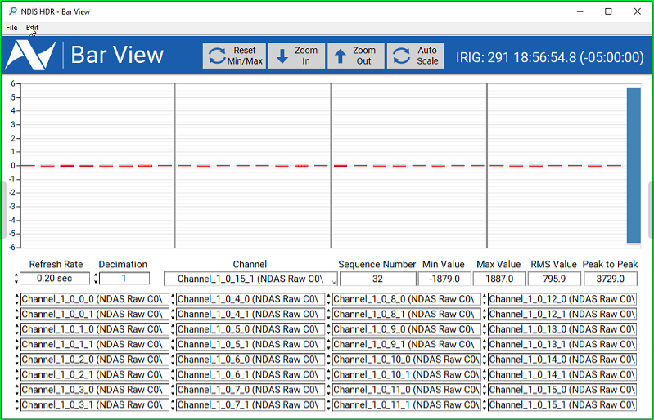
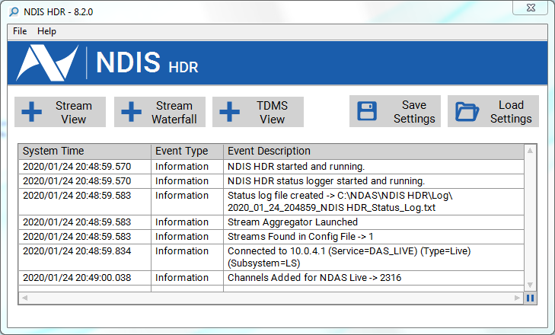
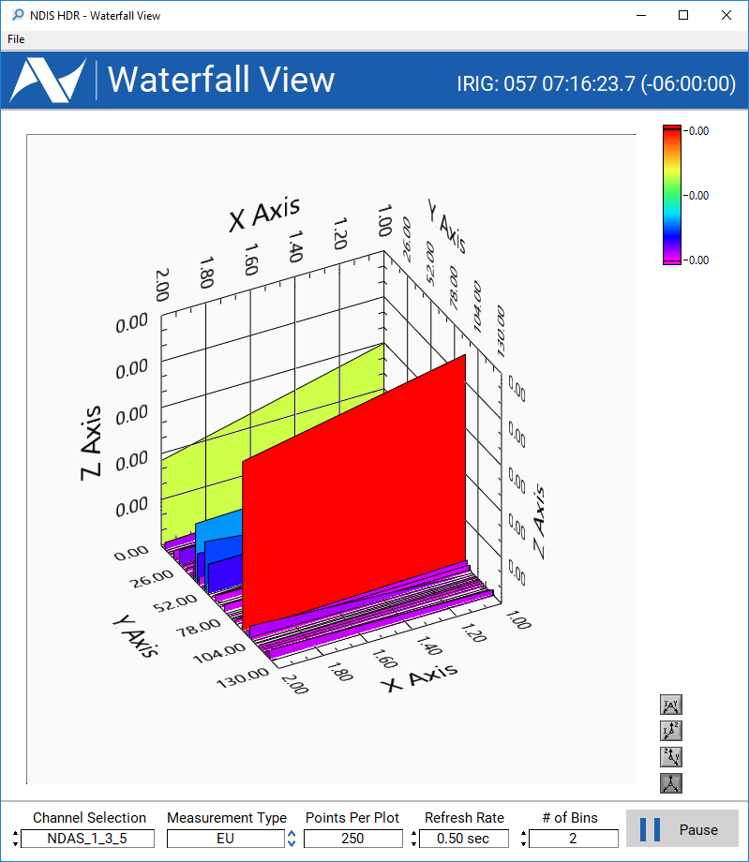
NDAS Applications
NDIS & NDIS HDR
Graphical/Tabular Displays
Time and Frequency Domains
Scroll back in time (up to 16hrs)
Pause and restart without data loss
Zoom into data
Hot keys for quick viewing
Save display configurations
And more..

Slide 9
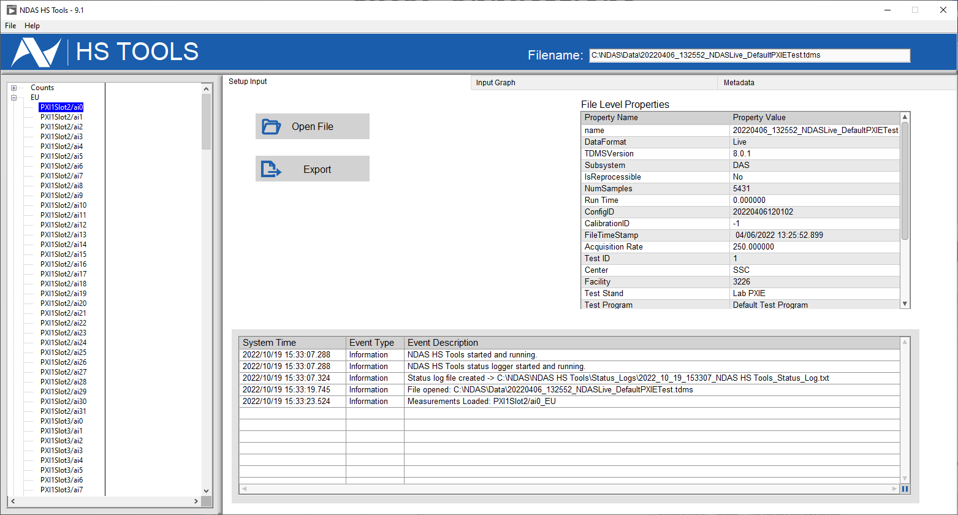
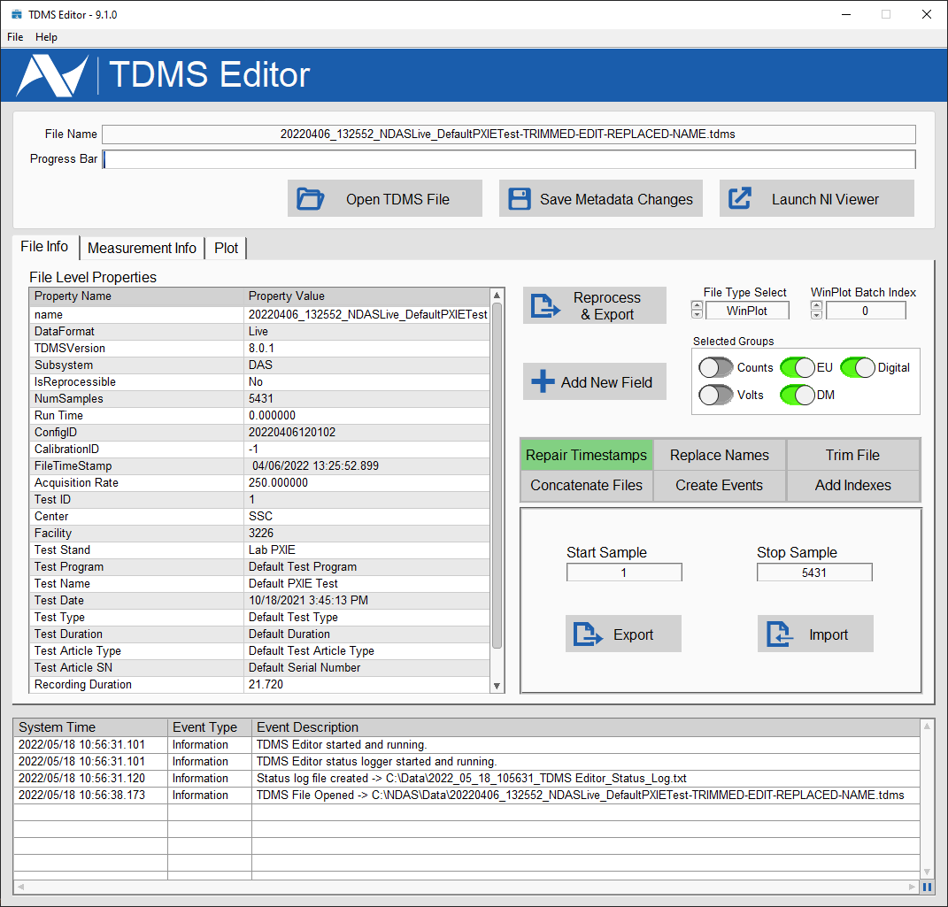
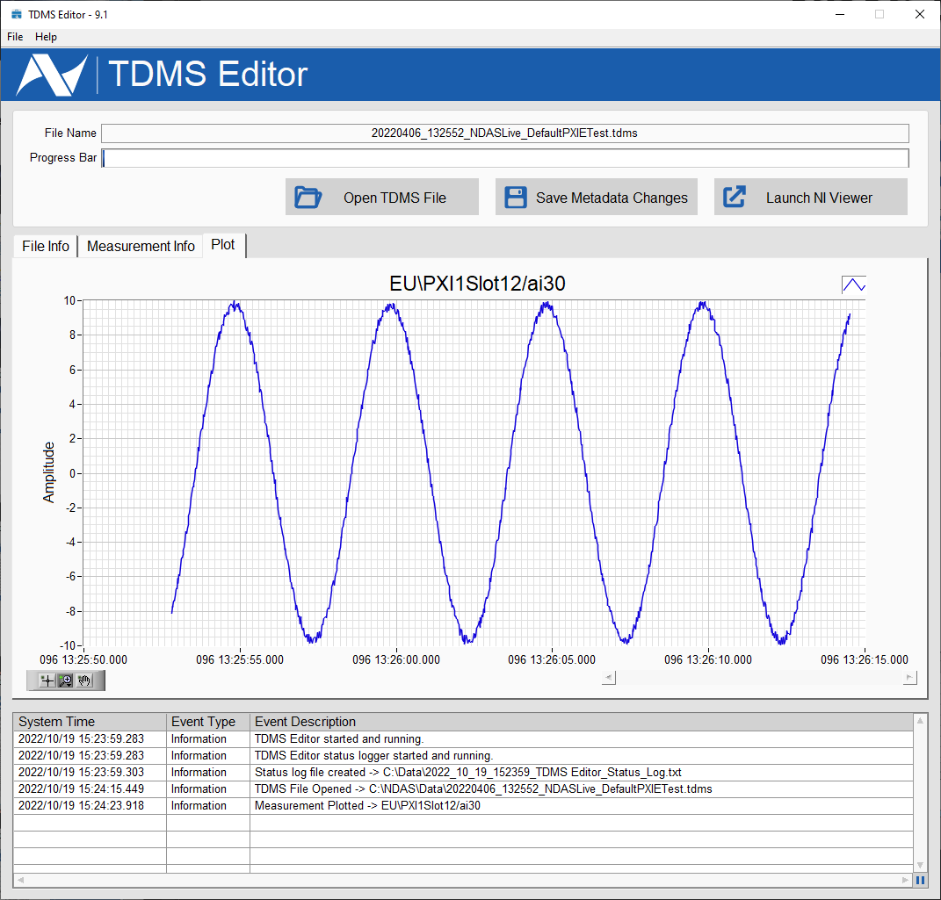
NDAS Applications
NLOG
Log multiple streams
Start, stop, pause, and roll files
Set log duration
Set log rates
Winplot on the fly logging
And more..
Post Processing Tools
View metadata
Update metadata and postprocess to new file
Plot channels
Export to other file types
And more..

Slide 10
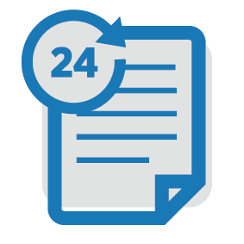

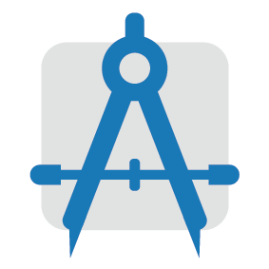
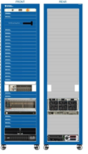

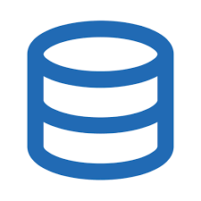


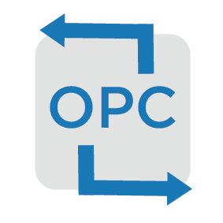
System Layout
NLOG
NLOG
NCAL
Configuration Data
Single System Layout
Single configuration
Single system aka NOPS
Client applications are configured to receive a single NOPS stream.
Single Calibration
Multiple loggers
Multiple Displays
Convert NDAS data to OPC for external system
Hardware Communication
HAL
Data Stream multiple SPS
External Stream Format
NOSS
NIRD
NOPS
Hardware Abstraction Layer
HAL
NDIS
NDIS
NDIS
NGATE
External System(s)
Ex. Control System, Distributor, etc..
Network

Slide 11

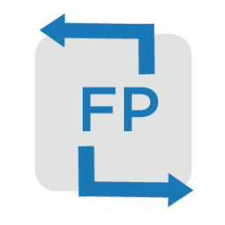
System Layout
Configuration Data
NLOG
Hardware Communication
NOPS
Multiple System Layout
Centralized configuration for all systems
Multiple systems aka NOPS
All client applications can be configured to receive multiple NOPS streams.
Centralized Calibration
Multiple Loggers with multiple systems being recorded
Multiple Displays with multiple systems being displayed
Convert OPC data to NDAS for display or recording
Convert NDAS stream to FastPac (proprietary type) stream for external system
Data Stream multiple SPS
External Stream Format
NDIS
Hardware Abstraction Layer
NOPS
NGATE
NDIS HDR
NOPS
NLOG
NOPS
External System(s)
Ex. Control System, Distributor, etc..
External System(s)
Ex. Control System, Distributor, etc..
NOSS
NIRD
NCAL
Network

Slide 12
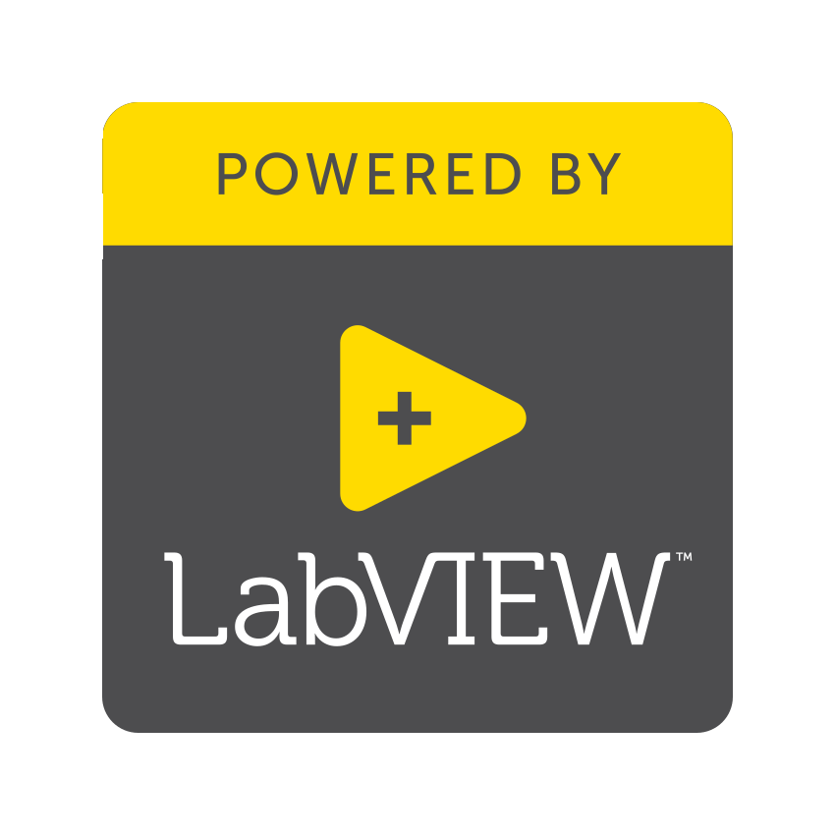


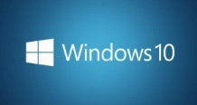
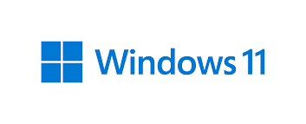
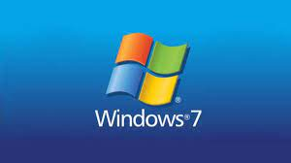
Capabilities
Suggested System Requirements
Operating System
Windows 10 fully supported including LTSC
Windows 11 is being tested
Windows 7 can be supported but not recommended.
Processor
Intel® Core™ i3 Processor, Intel® Xeon ® E5 comparable or better
RAM
8Gb DDR4 or more
Internal Storage
~512GB average.
Actual usually determined by use cases (ie Logging v. Display)
Network
1Gbe port or better
Software Dependencies: LabVIEW runtime, .NET, MySQL, various NI libraries for acquisition and calibration hardware
In-Field Examples: HP Z440, HP Z420, HP Z2 G9 Mini, HP Z6

Slide 13
System Capabilities

Slide 14
Capabilities
Supported Hardware Platforms
Preston 8300AU + Presys1000
Pacific6000 by Pacific Instruments
PFI 28000 by Precision Filters
PXIe by National Instruments
cRIO by National Instruments
cDAQ by National Instruments
Dewesoft (on the list)
Supported Calibration Equipment
Digital Multimeters
Function Generators
DC Sources
GPIB Switches
Data Rates
Low Speed (with EU’s)
~ 500ch @1-250sps
~ 90ch @1000sps
High Speed (Counts Only)
~ 209ch @ 10,000sps (PI)
~ 32ch @ 102,400sps (PI)
~ 96ch @ 200,000sps (NI)
~ 64ch @ 400,000sps (NI)
Supported Channel Types
Temperatures (TC, RTD)
Strain Gauges
Accelerometer
Microphone/Acoustic
Pressure
Flow Meters / Counter
Supported Streaming Protocols
Native NDAS
Data Exchange Message (DEM)
Shuttle Data Stream (SDS)
Open Platform Communications (OPC)
Supported Data File Formats
TDMS
WinPlot
On-the-fly WinPlot
Comma Separated Value (CSV)
Hierarchical Data Format (HDF5)
MATLAB
OISPS
Legacy File Type Support (on the list)

Slide 15
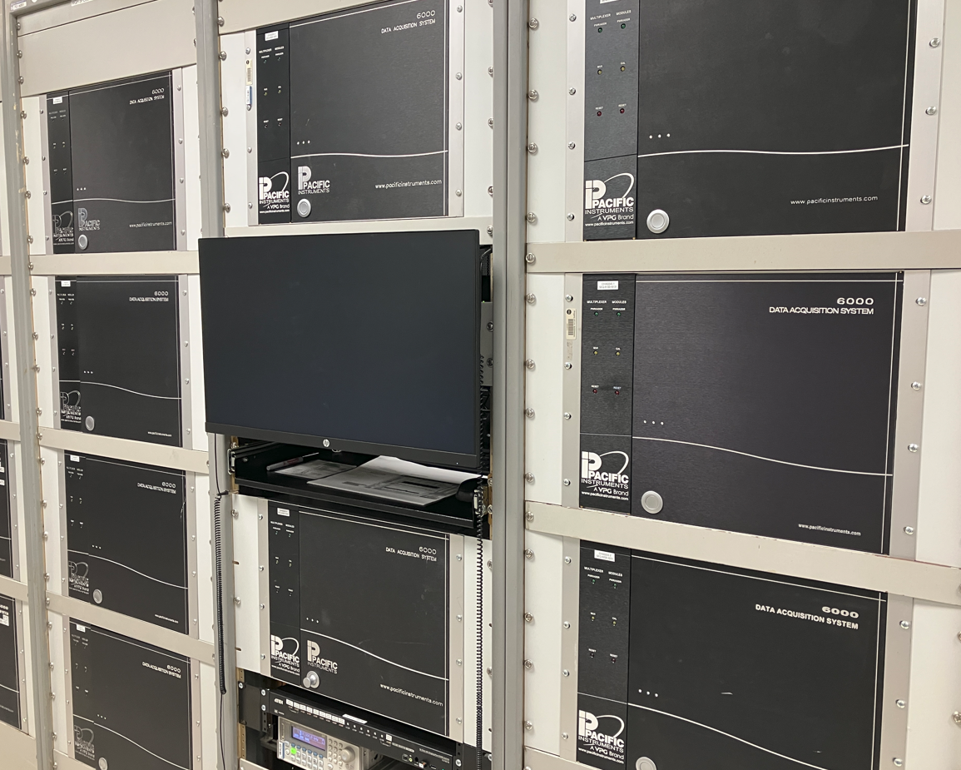
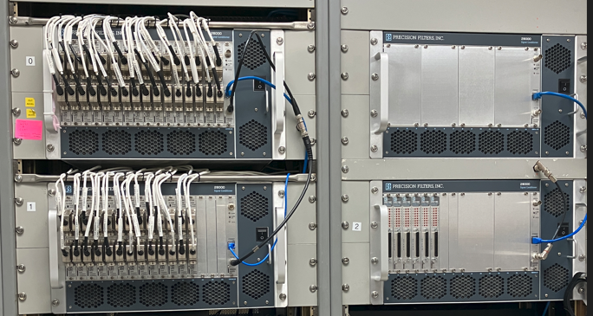
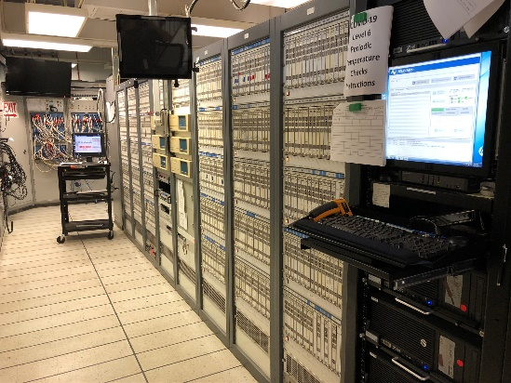
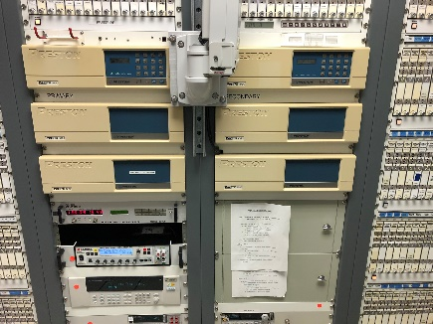
Capabilities
SSC DAS Hardware
Preston Presys 1000 Low Speed DAS
    Scaled EU Data
    512 Analog Channels including integrated signal conditioning
    736 Discrete Channels
    250 Samples per second
    ~500 sec tests
    IRIG-B True Time stamped data
Pacific Low Speed DAS
    Scaled EU Data
    512 Analog Channels including integrated signal conditioning
    320 Discrete Channels
    1-1000 Samples per second
    ~120 – 300 sec tests
    IRIG-B True Time stamped data
Pacific High Speed DAS
    Non-Scaled Raw Count Data
    64 Analog Channels including integrated signal conditioning
    102400 Samples per second
    ~120 – 300 sec tests
    IRIG-B True Time stamped data

Slide 16
Software Product Management

Slide 17
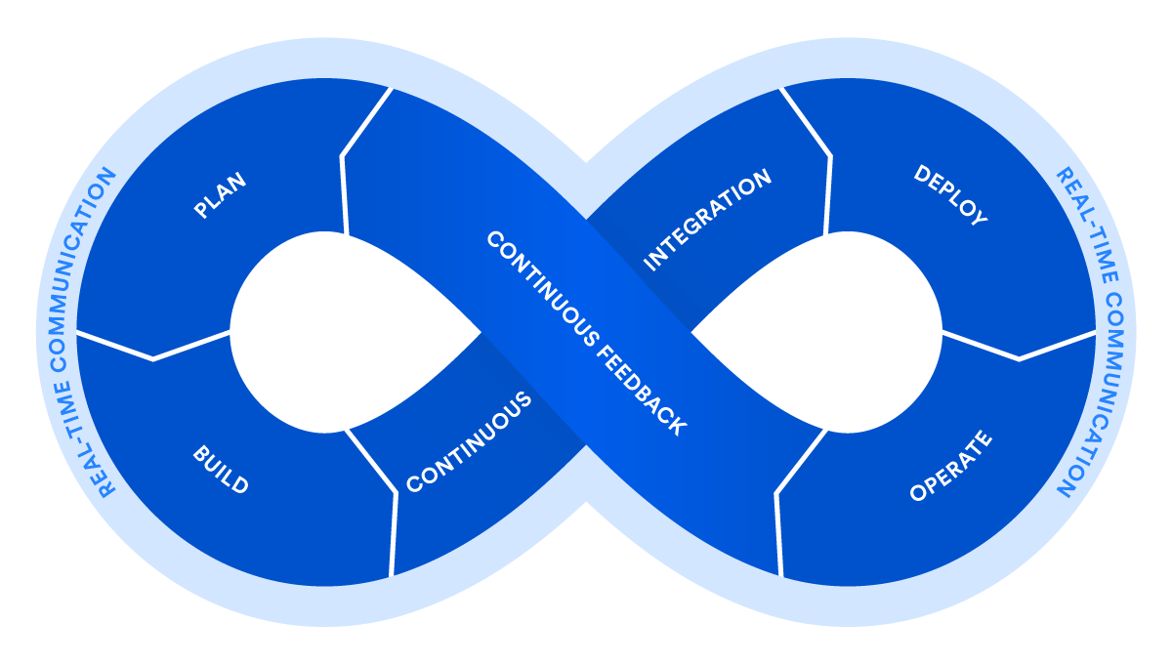
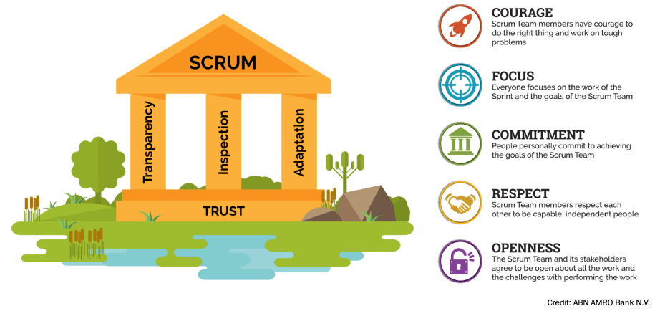
Software Product Management
DevOps
(Development and Operations) aims to integrate the work of development teams and operations teams by facilitating a culture of collaboration and shared responsibility.
DevOps best practices include Agile project management, shifting left with CI/CD, automation, monitoring, observability, and continuous feedback.
Agile Scrum
Scrum is a lightweight framework that helps people, teams and organizations generate value through adaptive solutions for complex problems.
Scrum is founded on empiricism and lean thinking. Empiricism asserts that knowledge comes from experience and making decisions based on what is observed. Lean thinking reduces waste and focuses on the essentials.

Slide 18
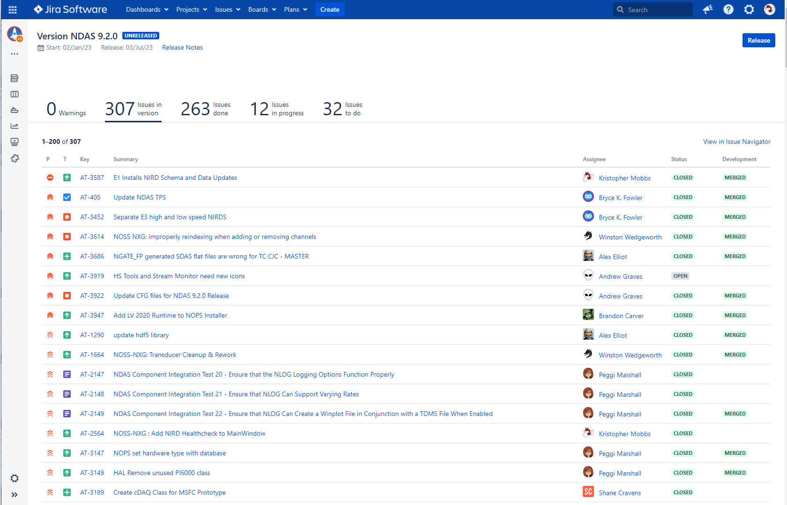
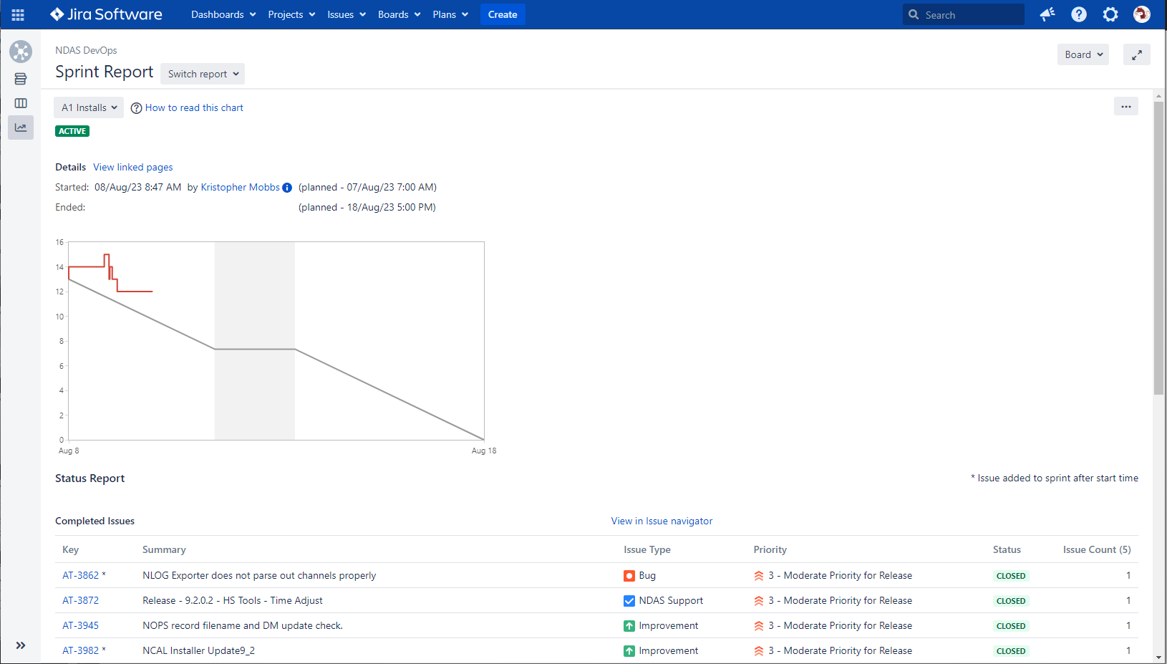
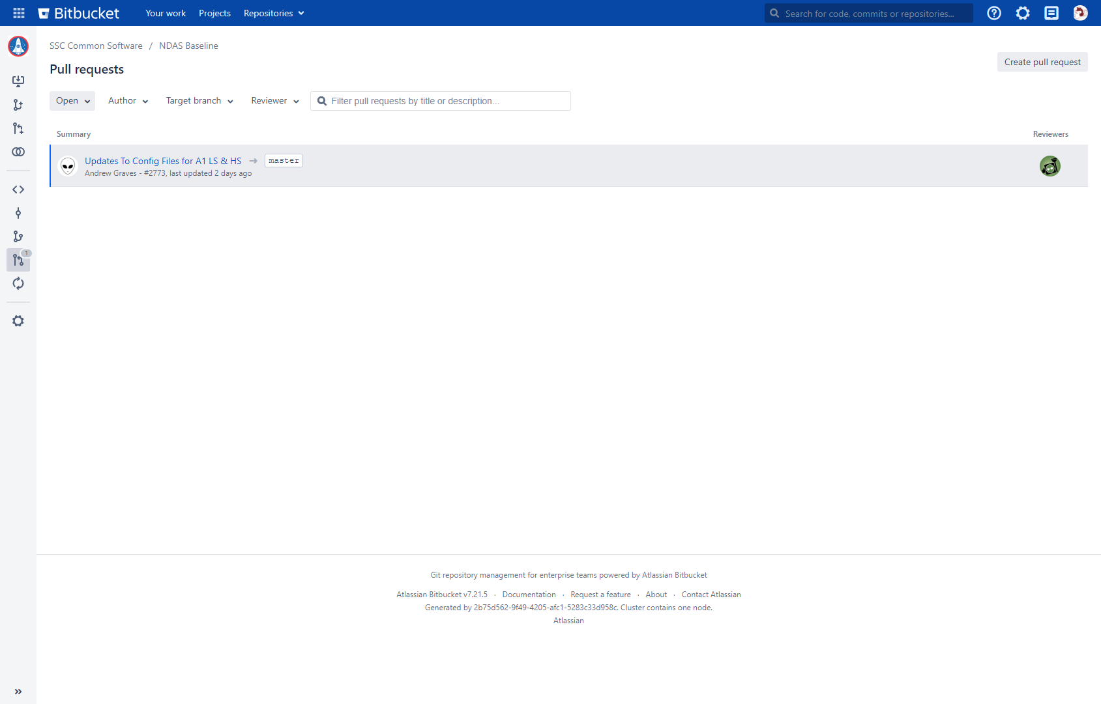
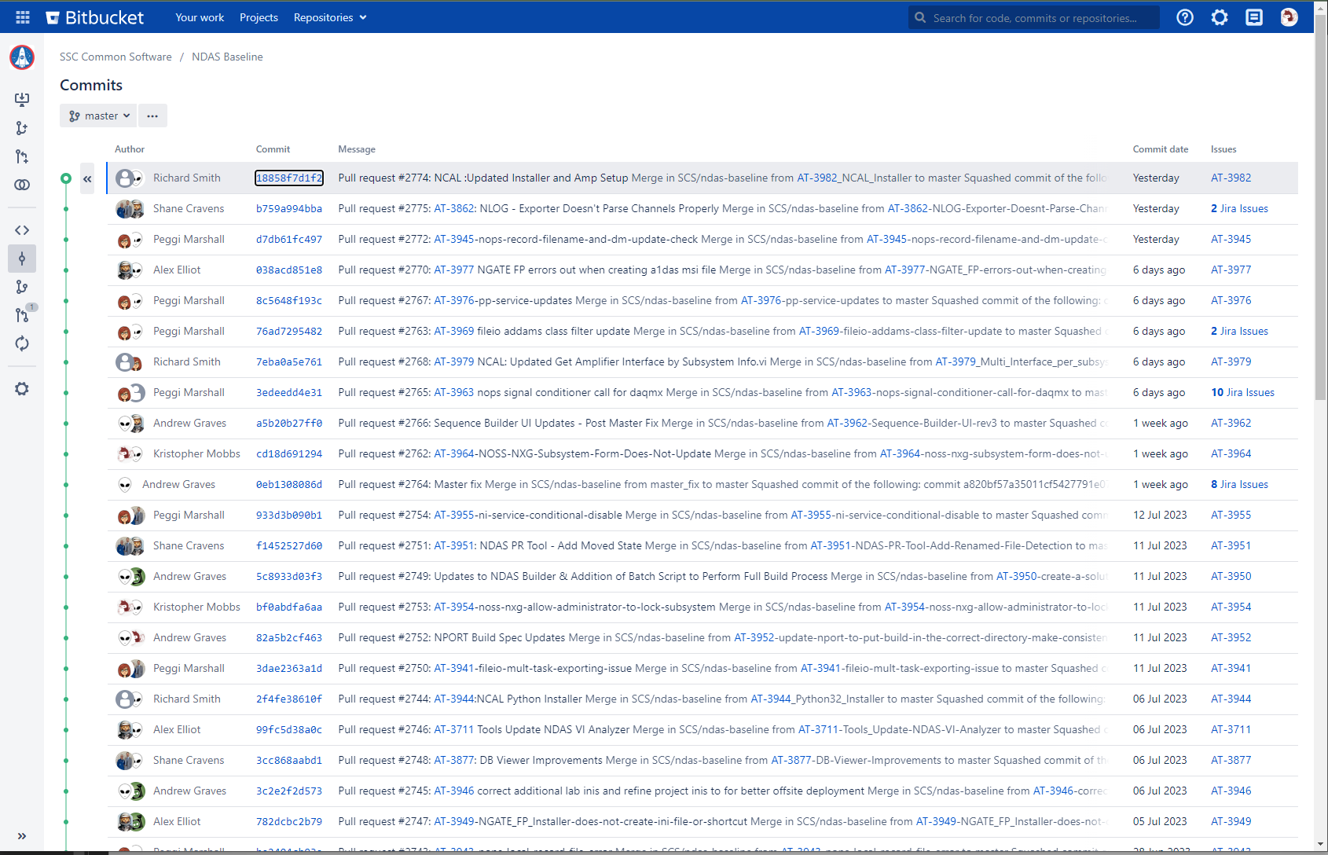
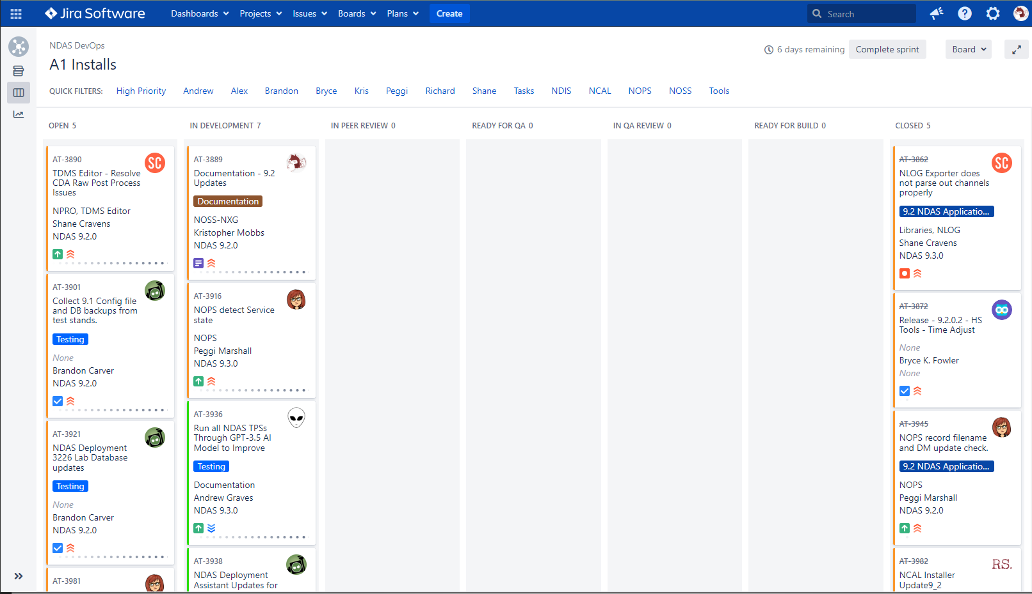
Software Product Management
Atlassian Tools
Jira Product Management
  Ticket Tracking
  Sprints
  Reporting
BitBucket
  Git Repository
  Software code and builds version control
  Peer Review / Pull Requests

Slide 19
Software Product Management
Project Manager
Software Design Lead
Software Safety
Tech Transfer
Product Management
Software Ops Lead
Product Management:
Recently Reorganized into group providing additional resources for improved product management
Management of product release content and release schedules
Ensures compliance for software engineering requirements (NPR 7150.2, etc..)
Utilizes Tech Transfer for software technology designation(s) (NTR, SRS)
Project Manager
Technical Community
MSFC Tech Liaison
WSTF Tech Liaison
SSC Tech Liaison
New NDAS Community (voluntary):
Provide training for local “Super Users” to enable high level of on-site technical capability.
Centralize group for relaying of features, improvements, bugs, and preventative software maintenance updates.
Collaborative efforts for standardizing software use cases and procedures (Cal procedures, GUI design, etc..)
Build networks for support and communication of needs

Slide 20
NASA Data Acquisition System
NDAS
2023

