Slide 1

ES6 Exit Presentation
Text is red has be edited to remove sensitive information for public release
Summer 2023, Raven St. Clair

Slide 2

Agenda
Personal Background
Summary of Projects at ES6 and lessons learned
Intern activities!
Future goals and plans
Acknowledge all my awesome colleagues
Questions

Slide 3



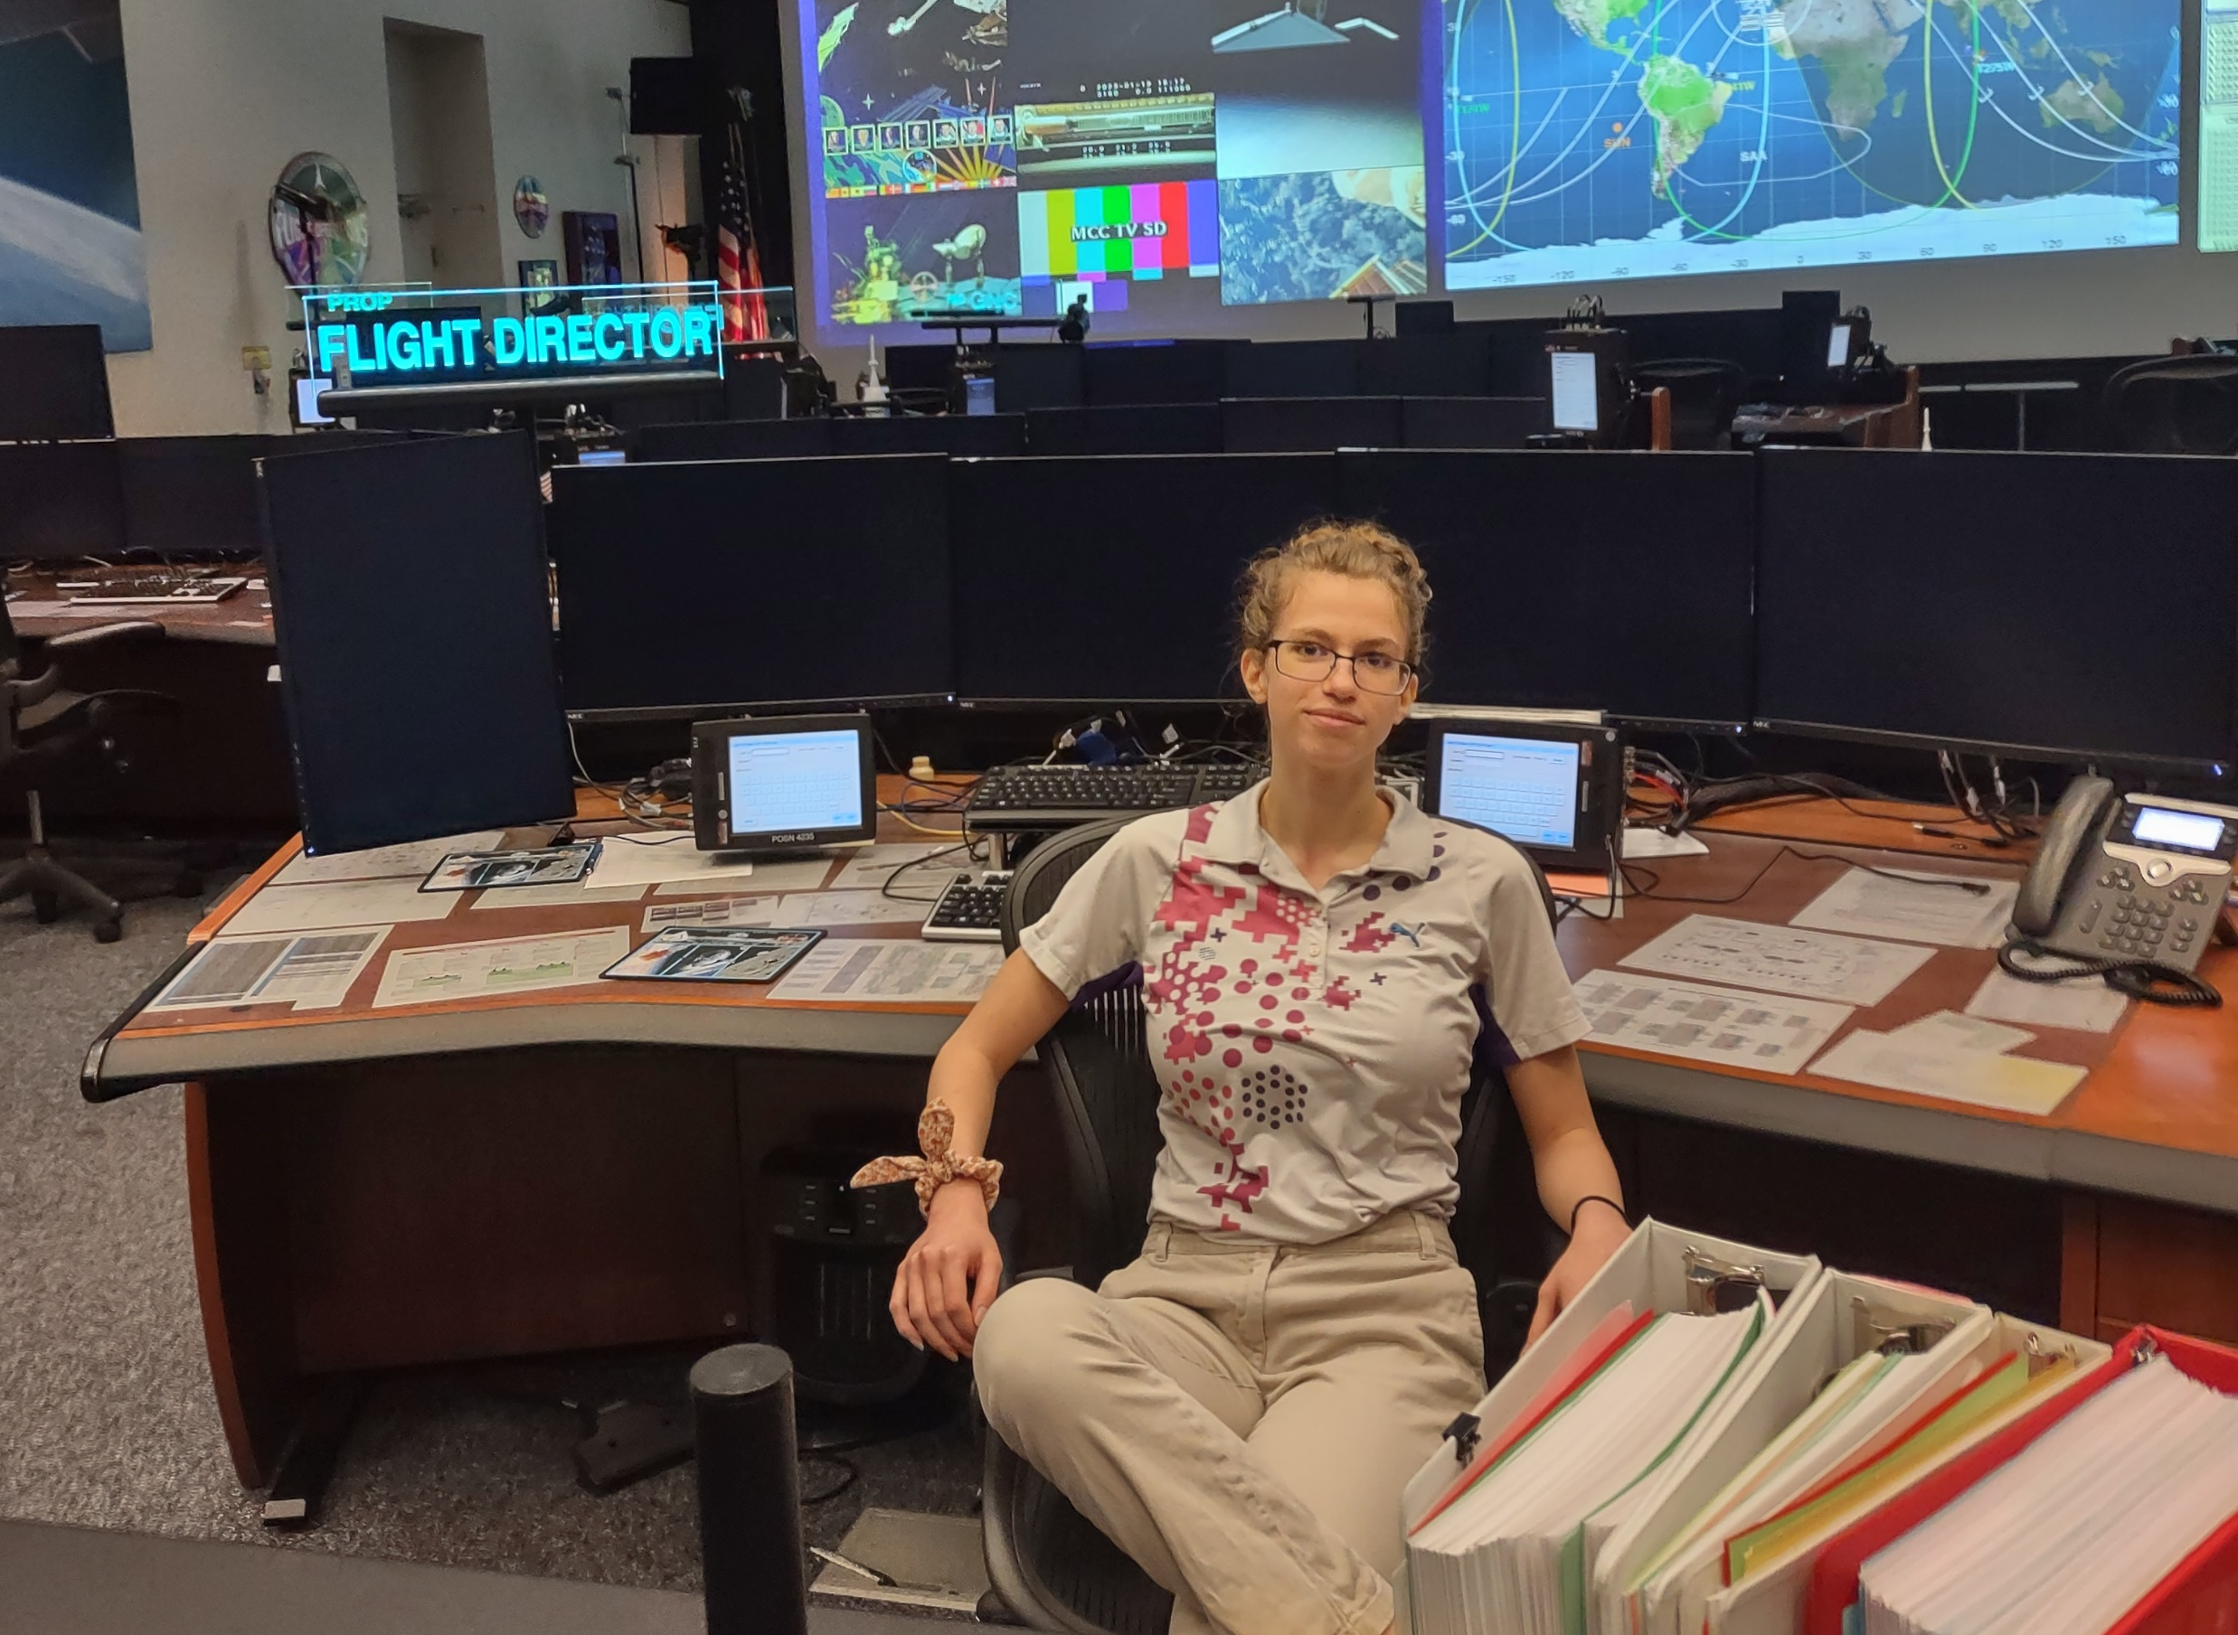

Personal Background
Notes:
Top left: My backyard in my childhood home in Michigan
Bottom left: My previous tour was in MCC! This is me in the training (Red) fcr
Center top: The 24 hour Duderstadt library at U-M, lovingly referred to as ‘The Dude’
Center Bottom: Go Blue!
Right: Hiking, botany, and amateur astronomy are some of my hobbies. At Big Bend with the interns last winter, I got to do a bit of all three!

Slide 4


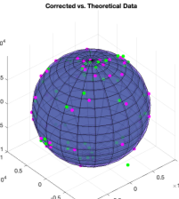
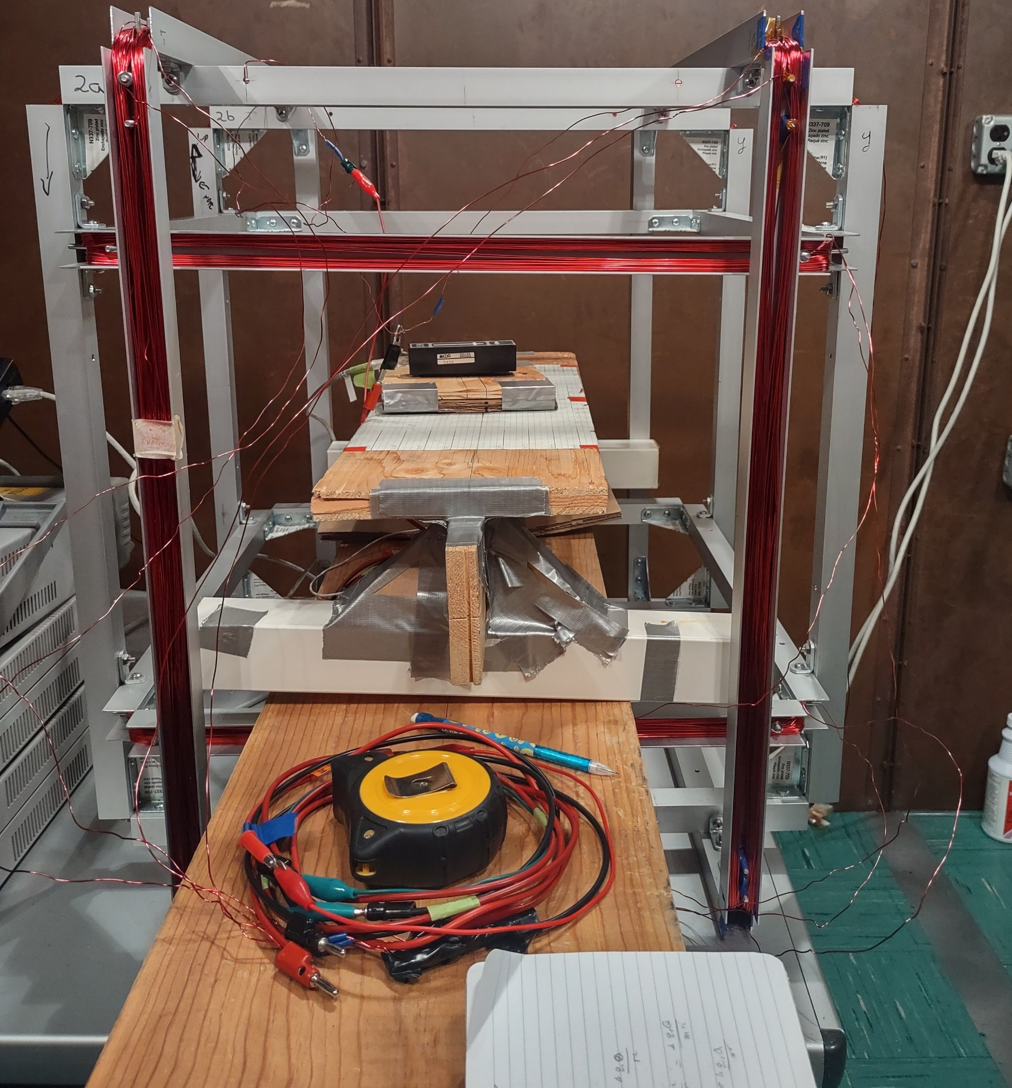

Past Education & Experience
University of Michigan (2021-2026):
Dual degree: Aerospace Engineering; Astronomy & Astrophysics
Expected graduation: April 2026
Research – U-M Mag Lab
Instrument programming and calibration
Helmholtz cage design and testing
data analysis with python & MatLAB

Slide 5
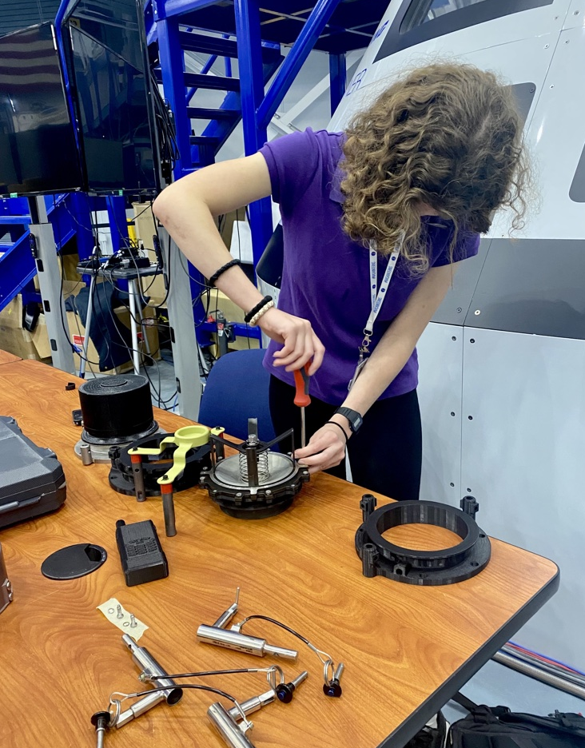
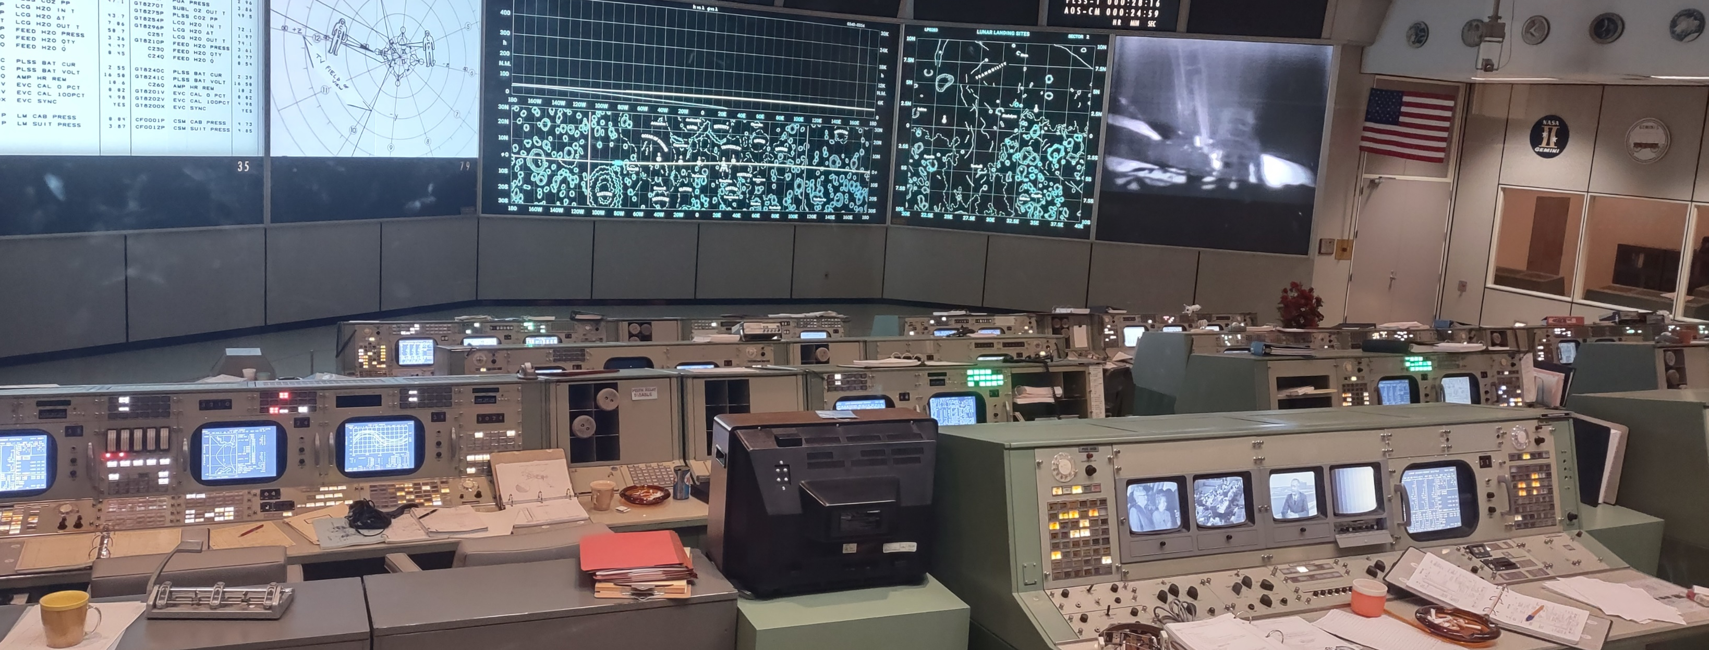
Previous Internship – FOD CD2
Dev Eco Dev
App Development
Part Design & Printing

Slide 6
Primary Projects: ES6
ERM Modelling & Analysis
Mooring Line Friction Test
Lunar E-Loads Testing
NASA produced FEM
Notes:
’

Slide 7

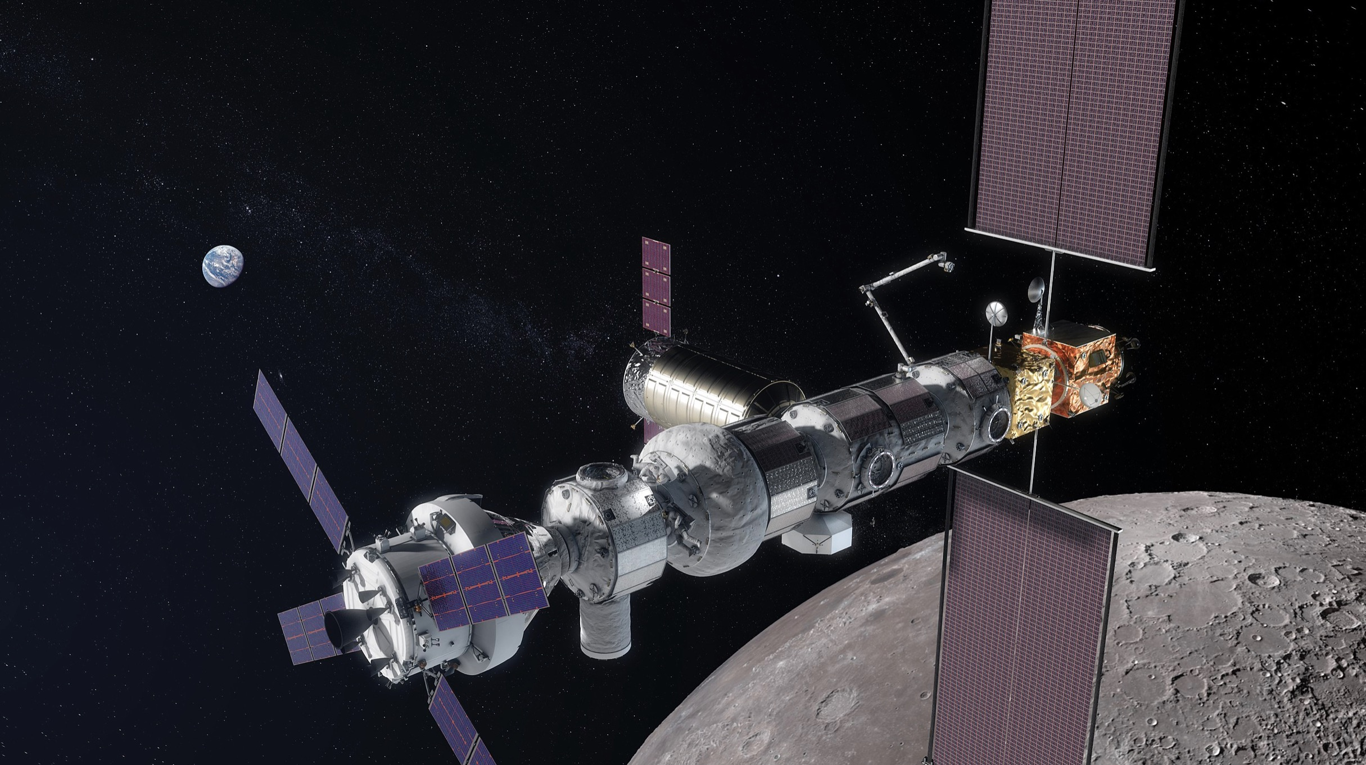
ESPRIT Refueling Module (ERM)
Problem: The ERM supplier did not provide an on-orbit model for the upcoming run-for-record coupled loads analysis cycle.
Objective: Determine if the International Habitat (I-HAB) model can be used as a substitute, if not create a stick model based on mass and frequency values provided by the ERM supplier.
Process: Ran fixed-base analysis on I-HAB model and attempted to modify to match provided ERM data.
Result: Determined that this was not feasible and designed a beam model of the ERM based on provided CAD and modal data.

Slide 8
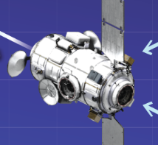
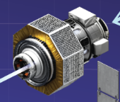
ERM Model: I-HAB vs ERM
IHAB vs. ERM
I-HAB (top) and ERM (bottom) have similar geometric properties
ERM houses fuel resupply systems
I-HAB
 | I-HAB | ERM
First modes (Hz)
Second mode (Hz)
CG (m)
Inertia
Mass (kg)
Proprietary Information Removed
ERM
https://www.nasa.gov/sites/default/files/thumbnails/image/np-2023-04-019-jsc-gateway-expanded-view-041423.png

Slide 9
ERM Model Attempt 1: I-HAB Modification
Available mass: The amount of mass that can be added to the I-HAB model to make its mass equal to that of the ERM.
Attempted Solution: Distribute available mass around I-HAB model (using point masses) to adjust mass and geometry properties.
Proprietary Information Removed – FEM
Proprietary Information Removed – FEM
Proprietary Information Removed – FEM
I-HAB model
I-HAB with extra mass added
Distribution of available mass to correct CG to ERM value

Slide 10
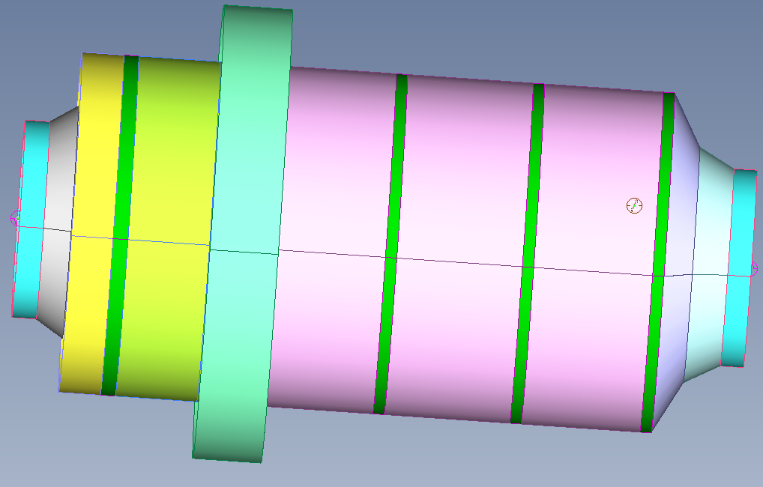
ERM Model – The Challenge
NASA produced FEM
Proprietary Information Removed – ERM CAD
Proprietary Information Removed – mass and frequencies
Combine geometrical information from a CAD model of the ERM…
With data about its mass properties and modes…
…to create an FEA model of the ERM

Slide 11
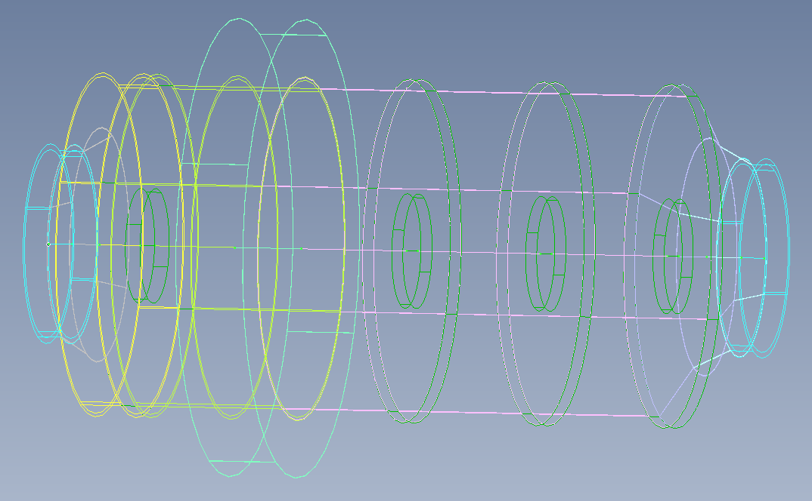
ERM Model Attempt 2: Beam model
Modelled ERM as a common spacecraft material structure based on dimensions of CAD
Included three major components:
  Inner tunnel
  Inner support rings
  Outer hull
Vary dimensions, densities, and mass to match true values
NASA produced FEM
Proprietary Information Removed – IHAB FEM
Proprietary Information Removed – Can replace with generic NASTRAN output
ERM CAD
Beam model of ERM
Resulting frequencies were initially a poor match to the model

Slide 12
ERM Model Attempt 2: Iteration
A series of runs were done modifying different properties of different portions, including wall thickness, elastic modulus, and density.
Final revision matches first two modes, center of gravity, and mass.
Proprietary Information Removed – Can replace with generic NASTRAN output
Proprietary Information Removed – Can replace with generic NASTRAN output
Proprietary Information Removed– Can replace with generic NASTRAN output
Early run, uniform beam
Recent run after initial adjustment of Young’s Modulus
Final revision matches first modes and mass properties

Slide 13
ERM Model: Lessons Learned
FEMAP:
  Creating geometry & analysis models
  Generating bulk data files for NASTRAN
  Visualizing analysis results
Nastran
  Theory of use
  Ran free-free and fixed base models
  Troubleshooting and reading output and f06 files
Aerospace structures theory
  Mentorship from subject matter expert to learn fundamentals of structural dynamics and model reduction
  Collaborated with senior engineers to inform design and troubleshoot runs
  Model Correlation – compare properties of I-HAB with ERM
Engineering Process
  Some iteration required!
  NASA’s role as an intermediate party between different contractors in Gateway

Slide 14
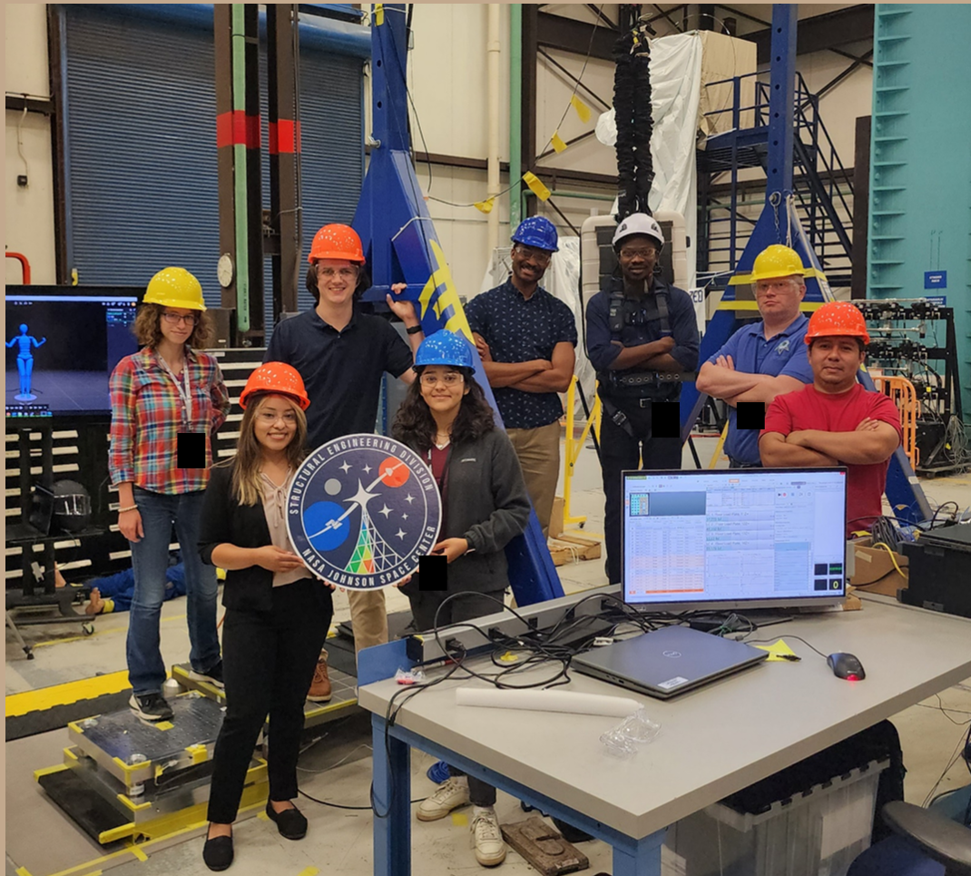
Lunar Loads Testing –Summary
Problem: Previous estimations of lunar loads based on conservative theories. To obtain more accurate estimations, the lunar loads team is conducting a series of tests to verify and improve these values.
Objective: Aid in series of tests characterizing loads induced by astronaut activities in lunar gravity 1/6th g.
Constraints: The acceleration due to gravity on earth is defined as 1 g, and weight offload systems had to be used to simulate the reduced gravity on the lunar surface. Additional factors include small sample size due to limited volunteer pool and time constraints.
Results: Volunteered as a test subject, supported testing, and directed a test set for the lunar loads team at ES6.

Slide 15

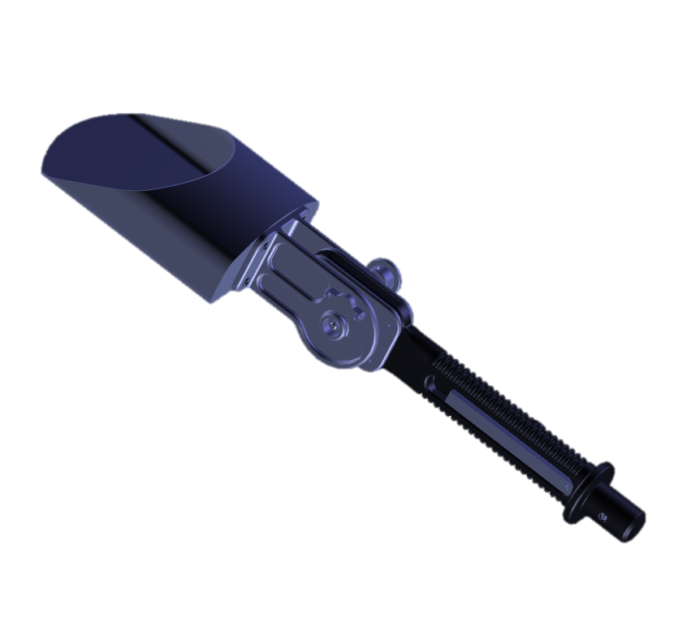
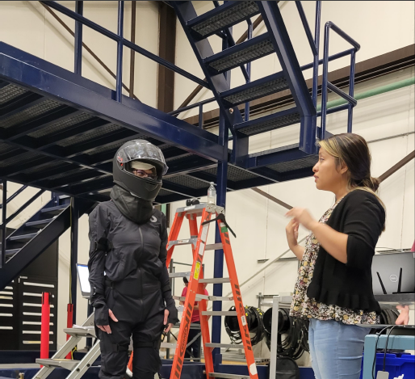
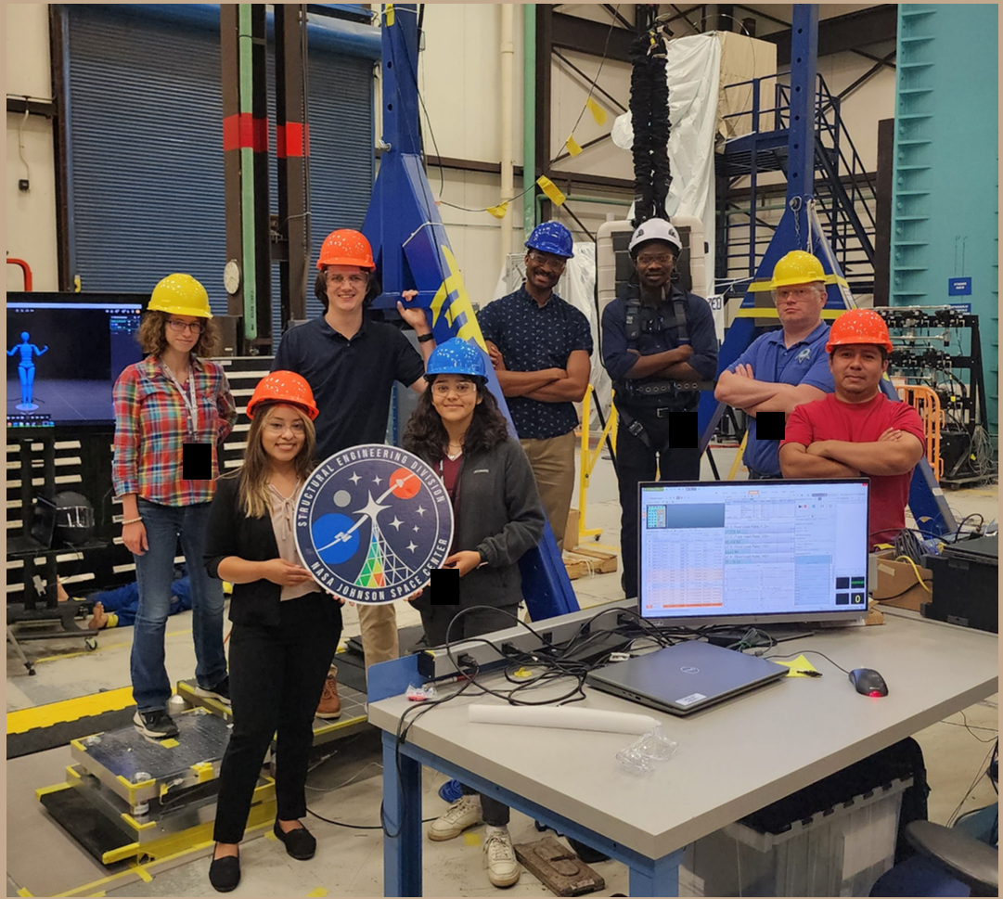
Lunar Loads – The Challenge
To experimentally characterize loads from tool handling and other crew activities in 1/6th g we need…
A standardized way to measure the dynamics of tools…
Volunteers to simulate astronaut activities…
…And a team of test conductors to direct and conduct the tests

Slide 16
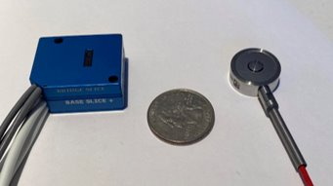
Lunar Loads – Testing Equipment
Futek Load Cells
Coin load cells that can measure force associated with impacts or activities

Slide 17
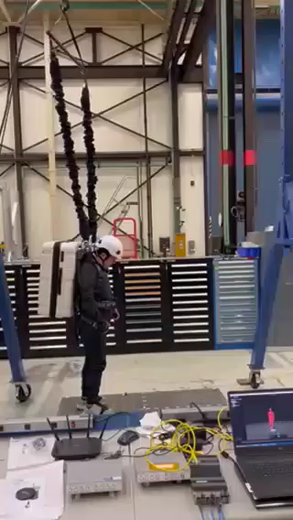
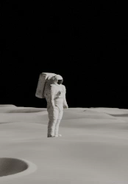
Lunar Loads – Testing Equipment
Gravity Offload System
A-Frame with bungee cords that can offload to 1/6th g based on subject’s weight

Slide 18
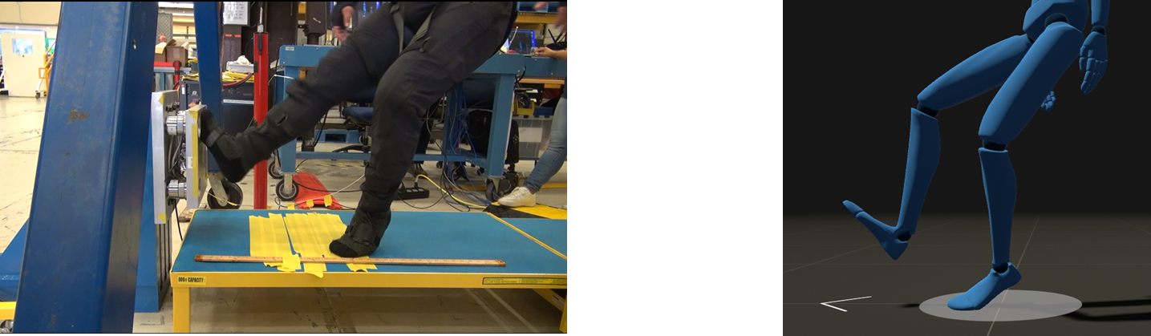
Lunar Loads – Testing Equipment
Rokoko
Full body tracking suit to capture velocity and aid in visualization

Slide 19
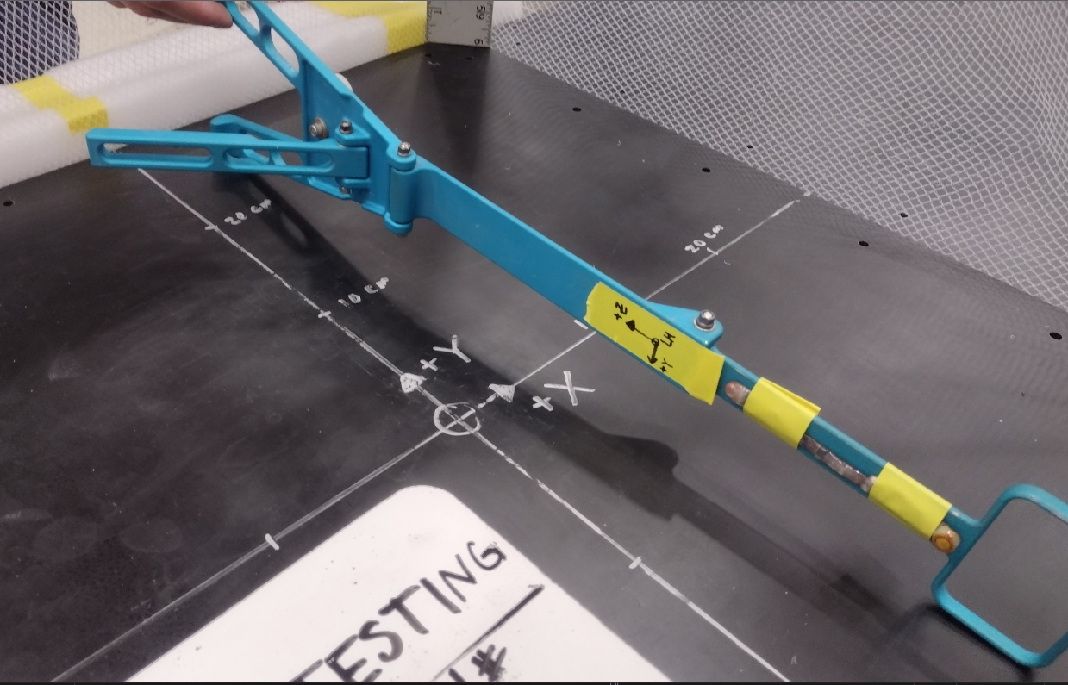
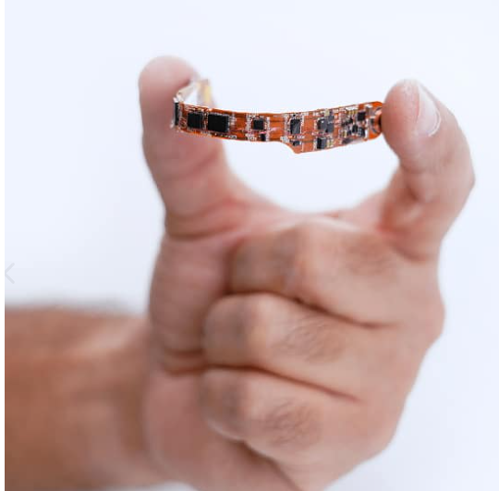
Lunar Loads – Testing Equipment
The DDR (Dynamic Data Recorder)
A flexible wireless 3D accelerometer

Slide 20
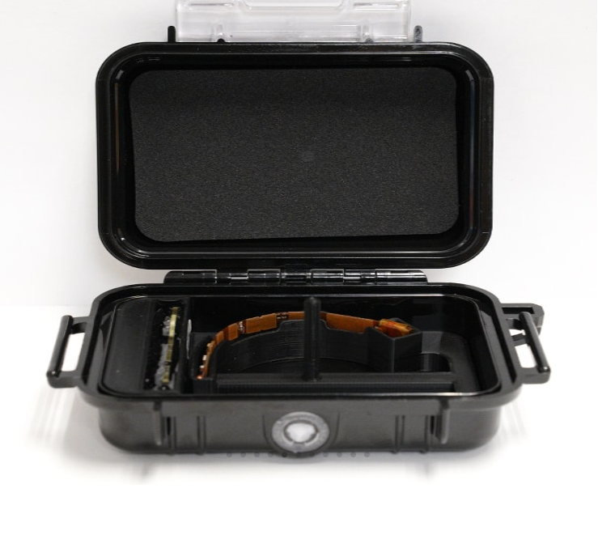
Lunar Loads – DDR & Placement
DDR – Dynamic data recorder. 3-axis, wireless, flexible accelerometer
Used in conjunction with Rokoko and load cell to estimate total energy of impacts, which is independent of the structures being contacted.
Attaches to tool surfaces to characterize the loads and dynamics they undergo during use/accidental impacts.
Records for specified trigger period when it detects an impact above specified threshold.
Objectives:
New system with very little documentation – coordinate system of readings unclear.
Develop standard way to detect coordinate system.
Learn principles and procedures of operation: How it is triggered, where it saves data, and where it logs error information in event of malfunction.

Slide 21
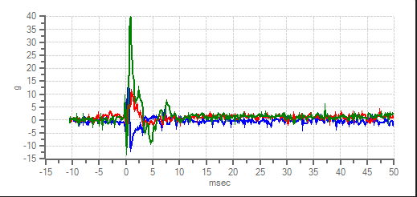

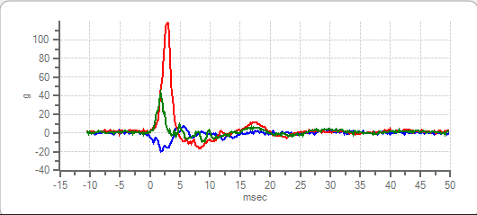
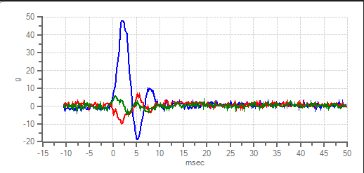
Lunar Loads – DDR Coordinate System
--x
--y
--z
F
DDR taped to pen, impacted against hard surface in the direction of 3 orthogonal axes
5 taps per orientation and a sanity check with the axis direction flipped
Axis label of reading with highest value for each set of taps noted
Coordinate System turned out to be left-handed
F
--x
--y
--z
--x
--y
--z
F

Slide 22
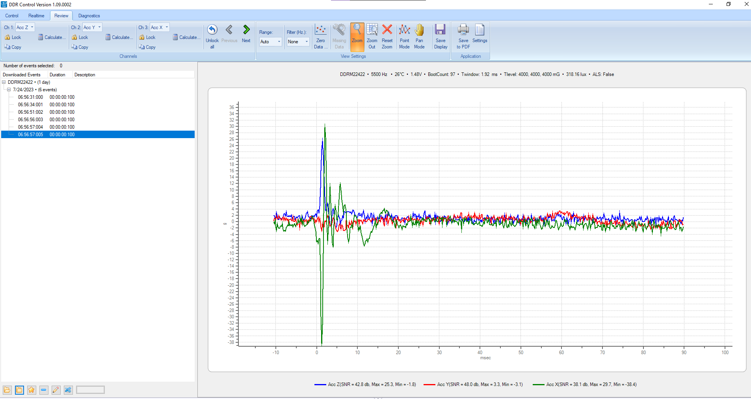
Lunar Loads – DDR Control Interface
DDR is initialized, or ‘armed’ in the control tab
Realtime data is also possible, but the sensor must be in its charging box
Data can be downloaded after the test when reconnected, and viewed in the Review tab

Slide 23
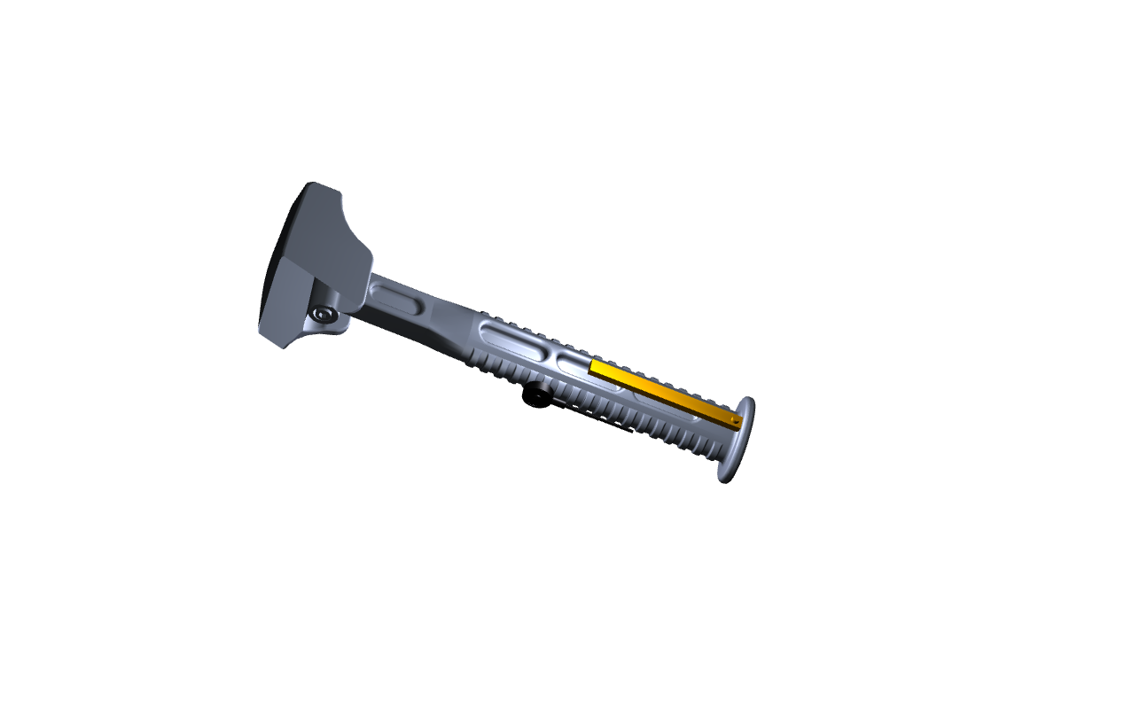
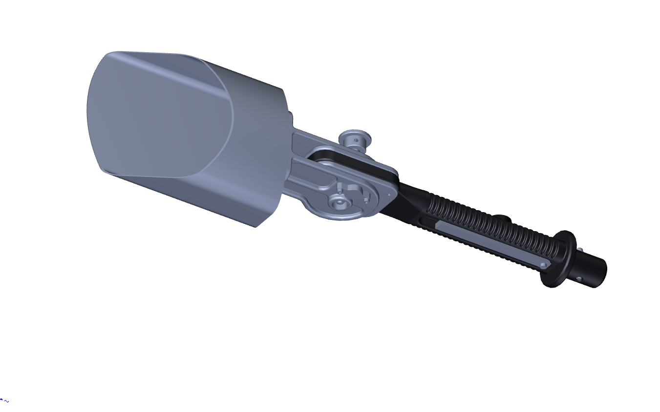
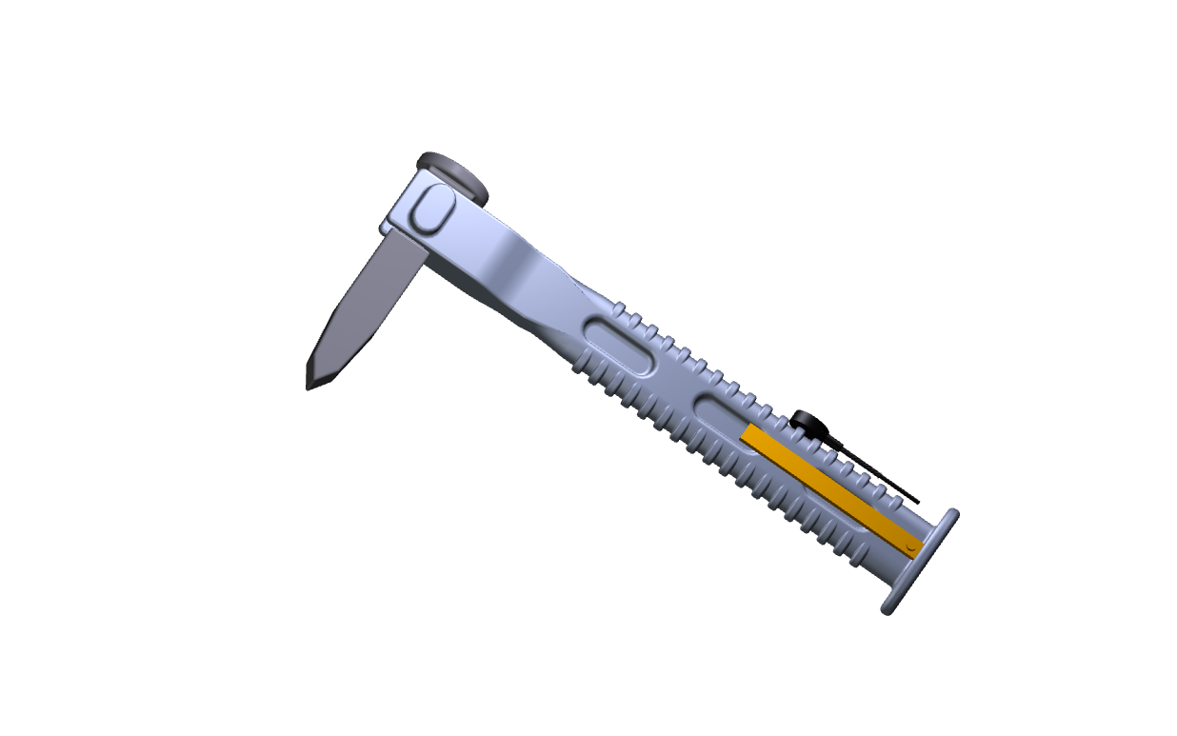
Lunar Loads – Sensor Placement
Determined placement of DDR and DAQ on tools based on CAD models, and added model of tools to assembly
Mapped out orientation of sensor coordinate system relative to coordinate system defined for each tool

Slide 24
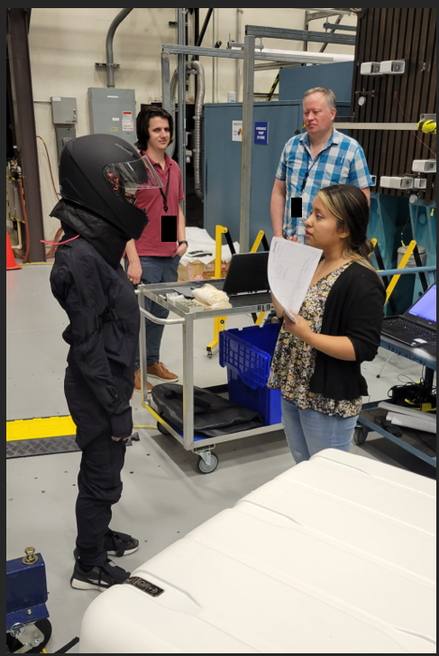
Lunar Loads – Test Subjects
Objective
Help characterize loads caused by upper body inadvertent crew induced loads on environment and astronaut.
Conducted without weight offload to determine if loads in earth gravity can be correlated with lunar gravity, thus reducing the number of necessary test runs.
Methods
Selected helmet and volunteered as test subject.
Walk into load plate at different effort levels.
Load cell captures force and moments, Rokoko suit captures velocity.

Slide 25
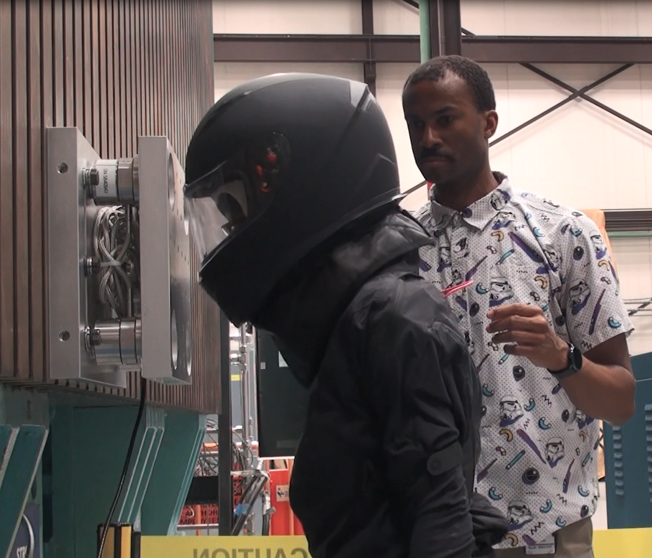
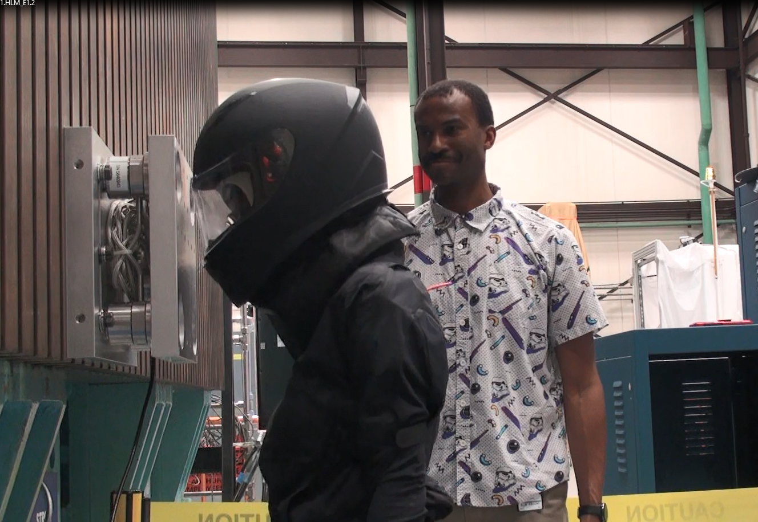
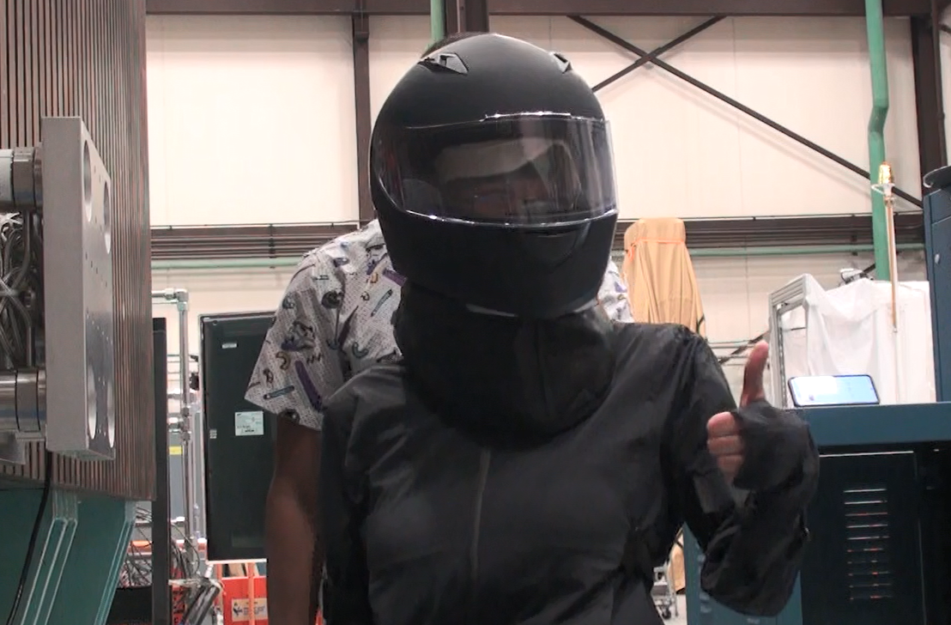
Lunar Loads – Test Subject
Objective
Help characterize loads caused by upper body inadvertent crew induced loads on environment and astronaut.
Conducted without weight offload to determine if loads in earth gravity can be correlated with lunar gravity, thus reducing the number of necessary test runs.
Methods
Selected helmet and volunteered as test subject.
Walk into load plate at different effort levels.
Load cell captures force and moments, Rokoko suit captures velocity.

Slide 26
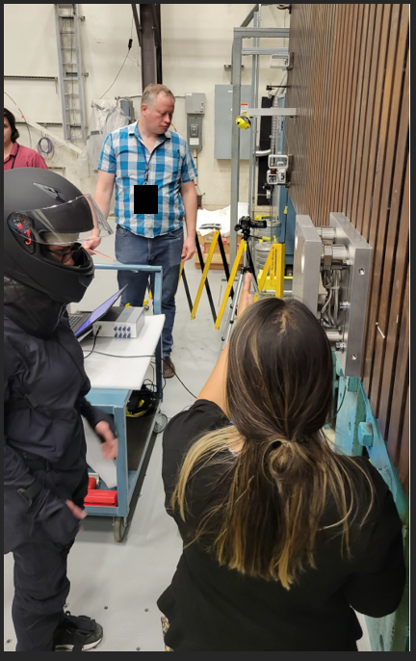
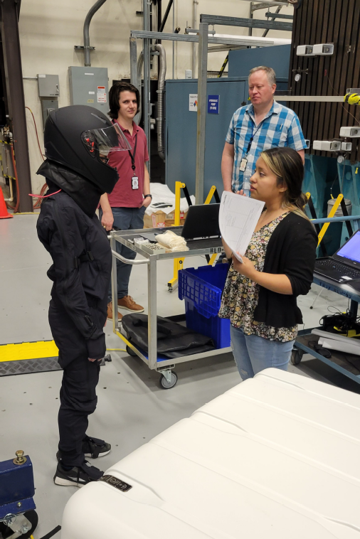
Lunar Loads –Test Subject

Slide 27
Lunar Loads – Test Conductor
Case 7B, tool handling – Test Subject simulates tool use for hammer, chisel, and shovel at different effort levels.
ARGOS Trailer – Trailer in Bldg. 9 containing sand and rocks selected to simulate lunar terrain.
Responsibilities:
  Worked with lunar loads team to create a game plan for test day and delegate responsibilities.
  Oversaw preparation, ensured equipment was gathered and working and written procedures were followed.
  Oversaw test, updated run matrix, and ran DDR sensor.

Slide 28
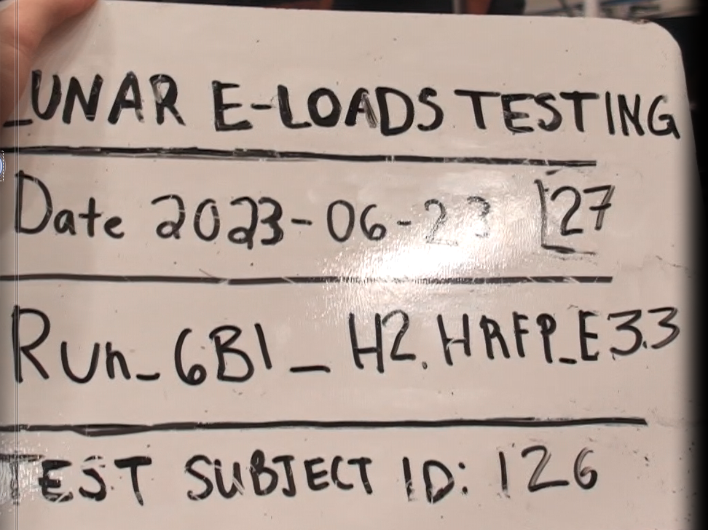
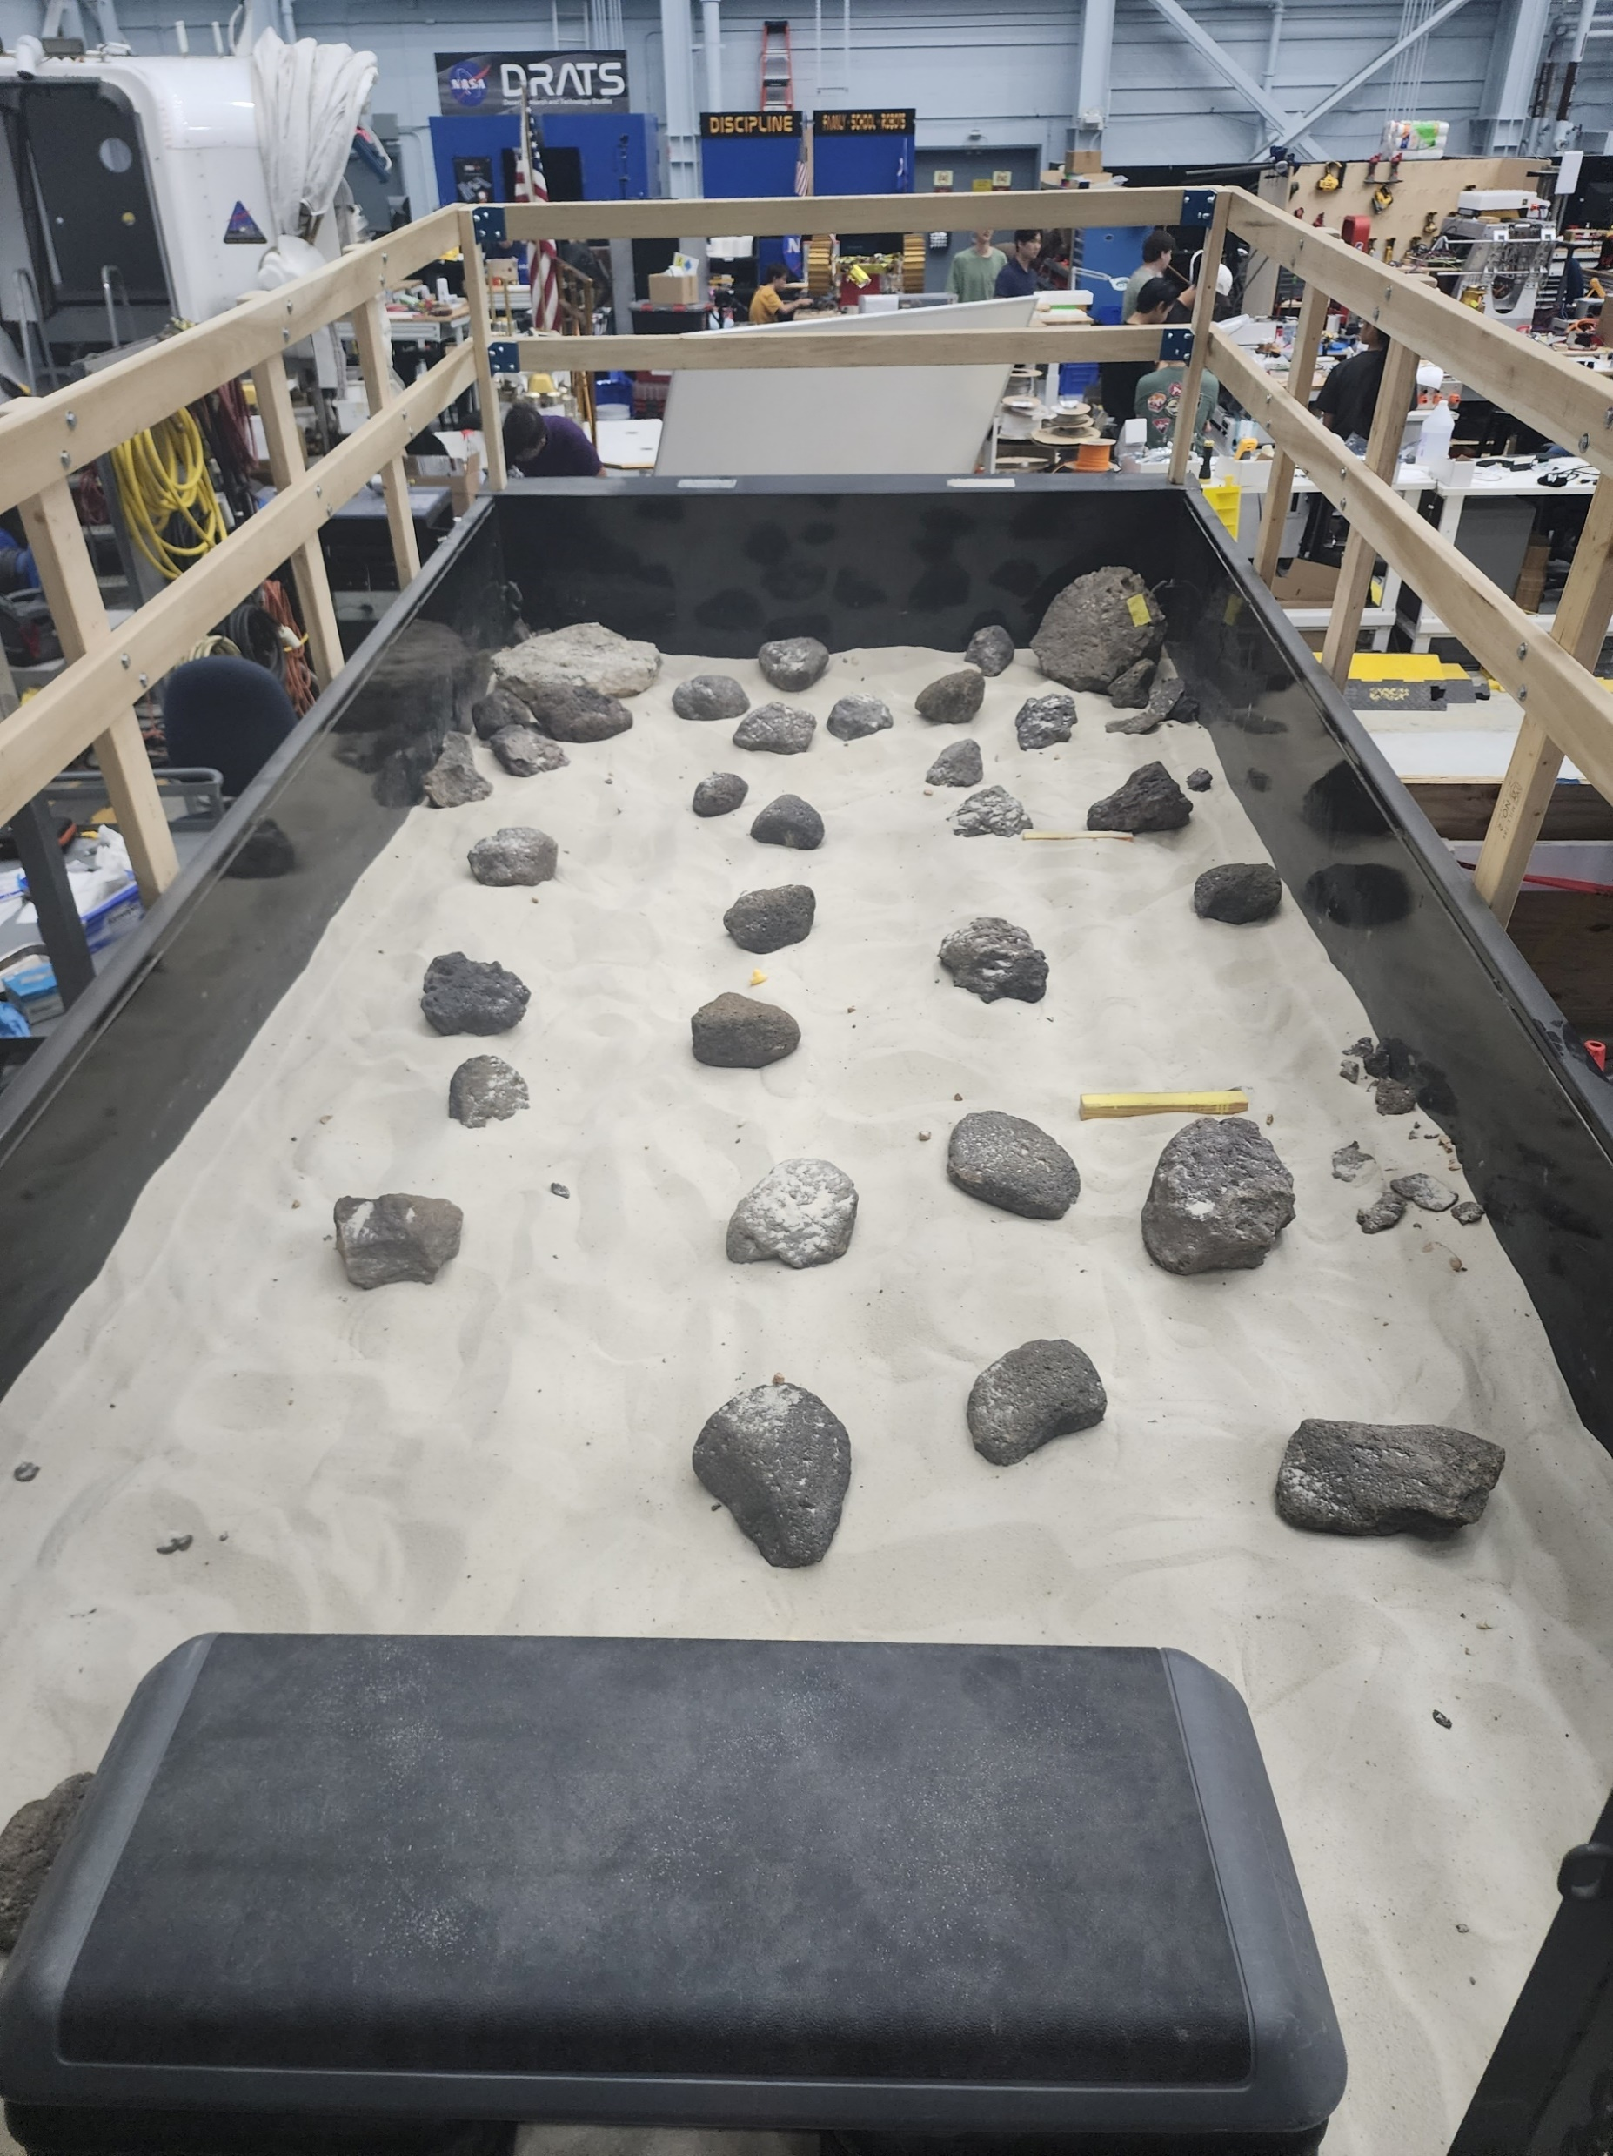
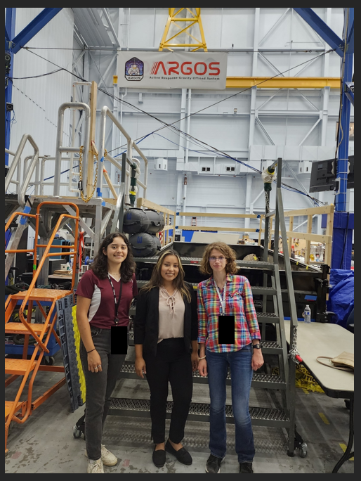
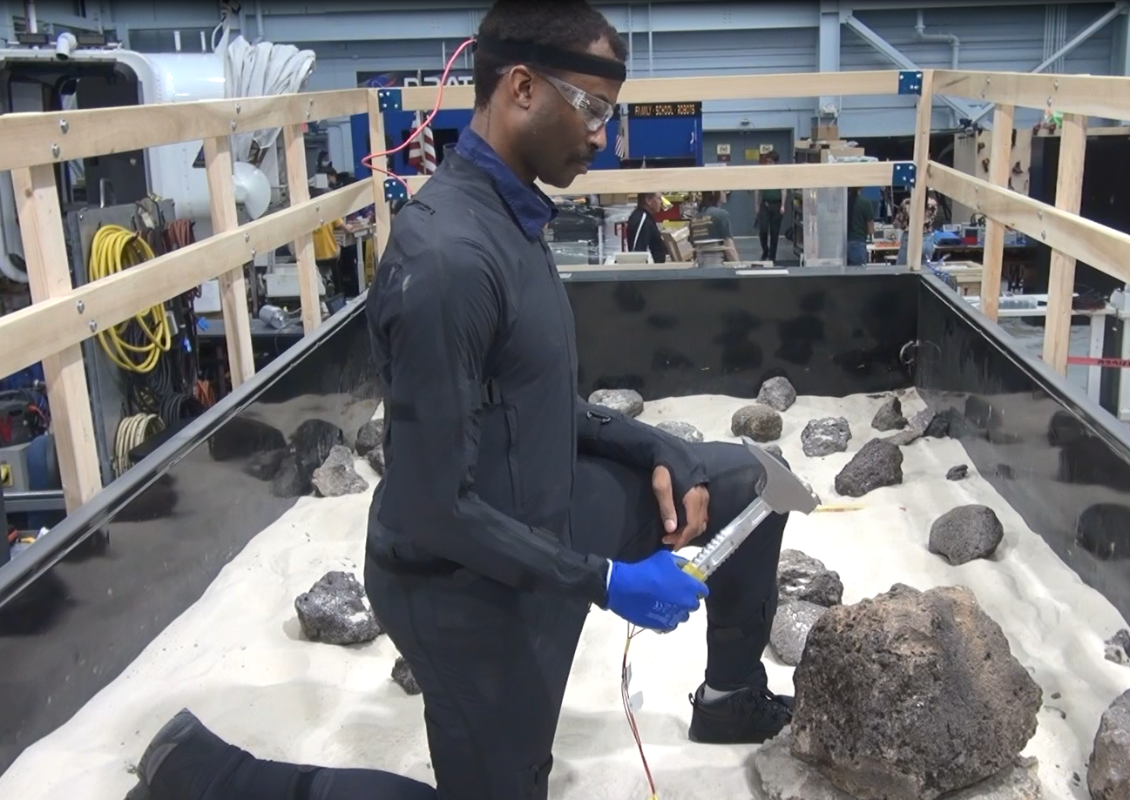
Lunar Loads – Test Conductor

Slide 29
Lunar Loads – Lessons Learned
Test Design Process
Experience with and exposure to procedures involved in formal engineering test processes
Learned about considerations for testing with human subjects
Experienced perspective of tests from the perspectives of a test subject, test conductor, and test director
Procedures for recording and analyzing test results, such as run matrices and a standard system for naming and organizing data
Teamwork
Collaborated with lunar loads team to support testing in a dynamic and fast-paced environment
Leadership
Coordinated and directed load case 7B with guidance from the lunar loads team
Instrumentation Control
Operation of Dynamic Data Recorder (DDR)
Operation of SLICE software and instruments (including load cells and accelerometers)

Slide 30
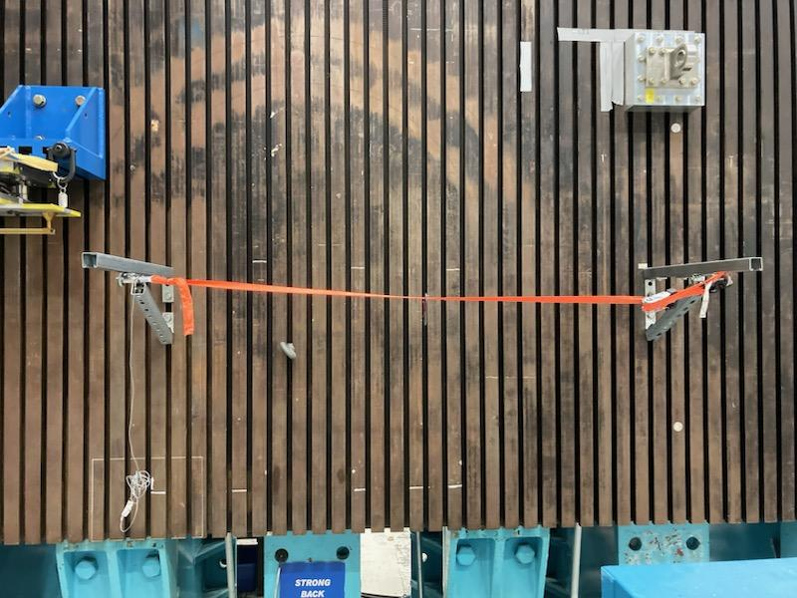
Mooring Line & Carabiner Friction Test
The Problem: Astronauts slide down a mooring line onto a raft in the event of emergency egress from the top hatch of the Orion capsule. The analytical tension of this line is sensitive to the coefficient of friction, which is unknown.
Objective: Design, setup, and conduct a test to characterize the material properties of the nylon webbing used for Orion top hatch egress.
Requirements: Must pass a Test Readiness Review (TRR) and hazards analysis and characterize the coefficients of friction of the mooring line.
Design: Worked with subject matter experts, STL techs, and ES personnel to design and conduct a test on the STL strongback that would look at the coefficient of friction of the mooring line and its dependence on factors such as tension, weight applied, and moisture. Used early results to inform future runs when unexpected trends were discovered.
Result: Series of tests that determined the coefficient of static and dynamic resistance.

Slide 31
Friction Test – Factors to Consider
Line tension – From astronaut weight, or from wind or waves pulling the raft away from the mooring line. Tension may alter the surface texture of the mooring line fabric.
Sag – Slack in the line if the raft is close to the capsule. Sag may have affect the measured coefficient of resistance by adding extra forces.
Moisture – The Orion capsule lands in the water. Fabric soaked in water or saline solution may have a different surface texture.
Load on line – From astronaut weight. The load on the mooring line may create local effects that alter the coefficient of resistance.
Pretension – The pretension on the line affects how the tension changes when a load is applied. This needs to be considered for safety reasons when designing the test.
Contact interface – From the line being inclined with respect to the direction gravity pulls the astronauts. If the carabiner has sharp corners, this could produce a different CoF.
Notes:
Rewrite to relate to orion

Slide 32
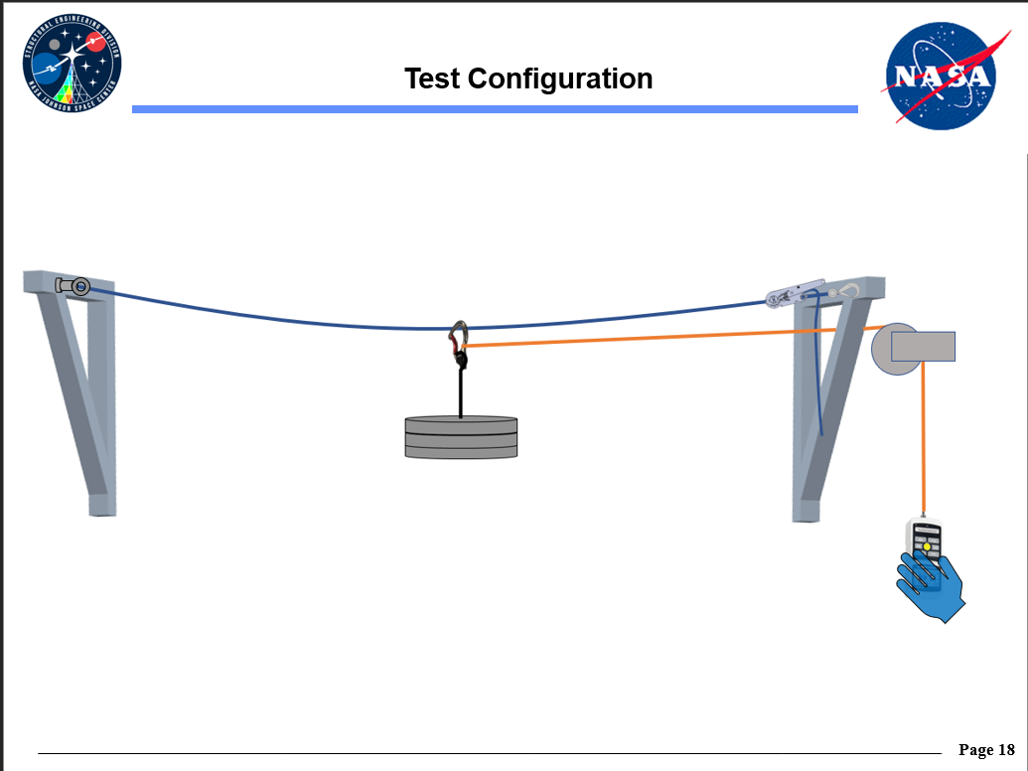
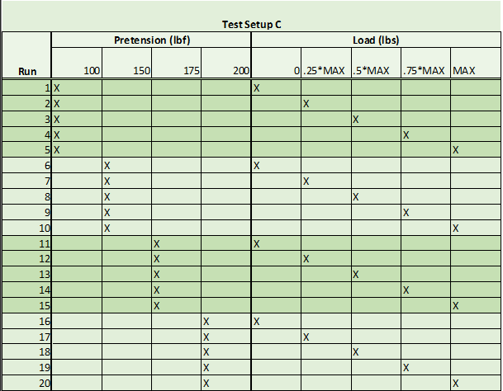
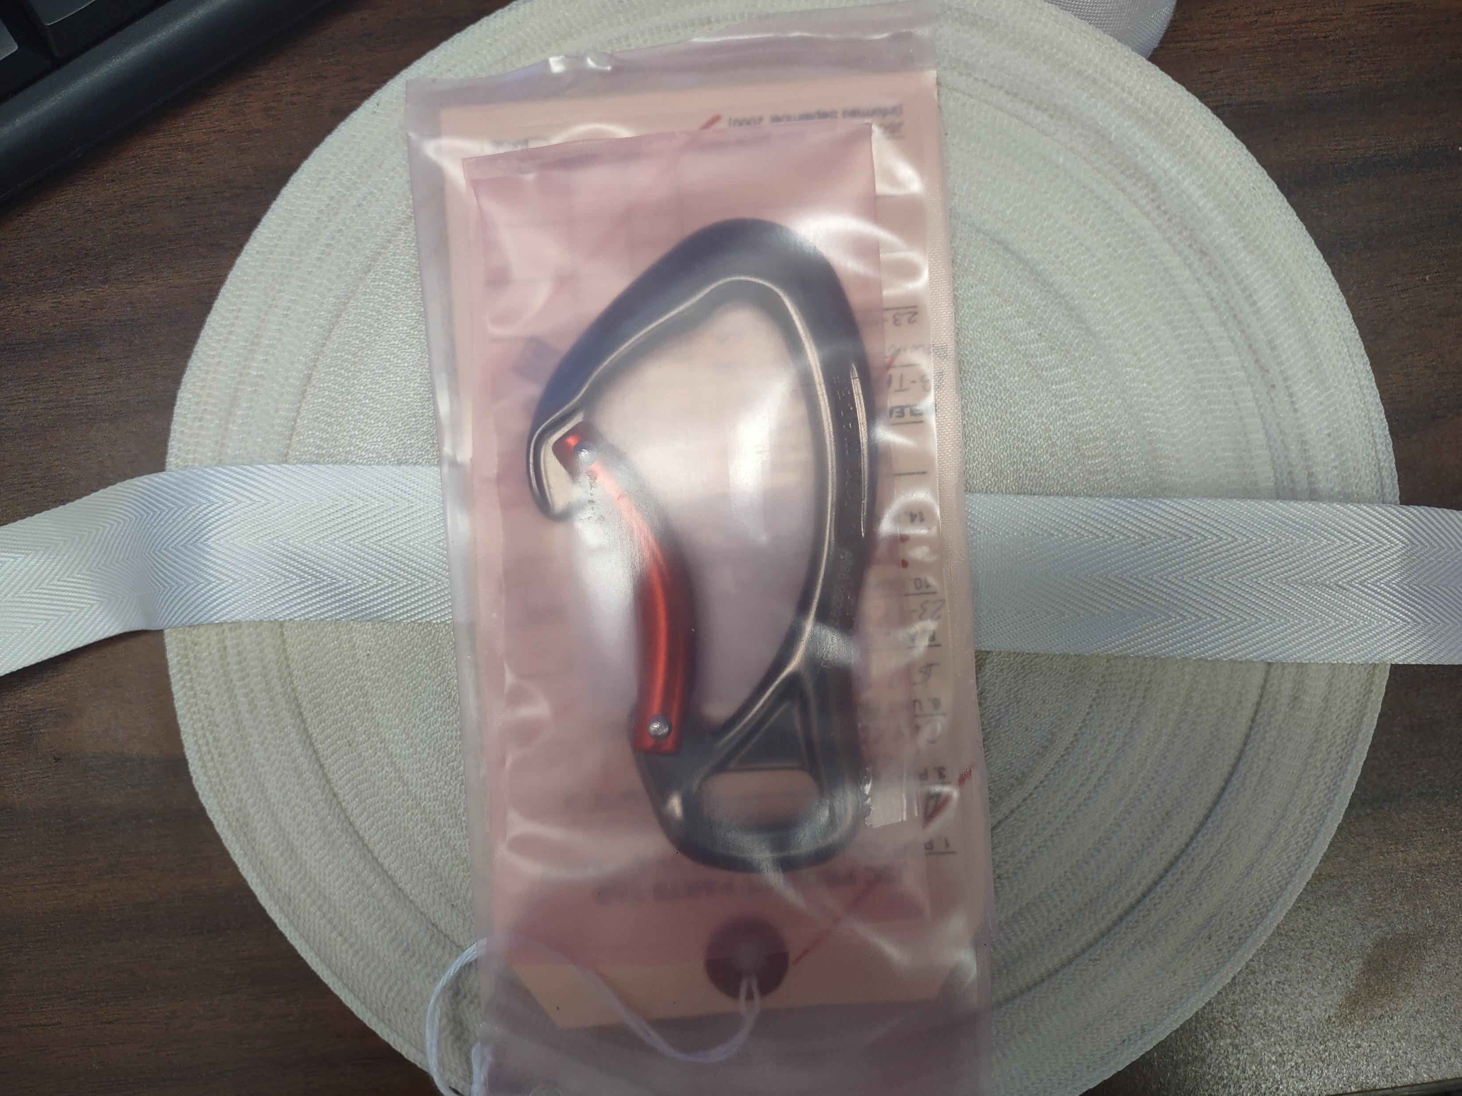
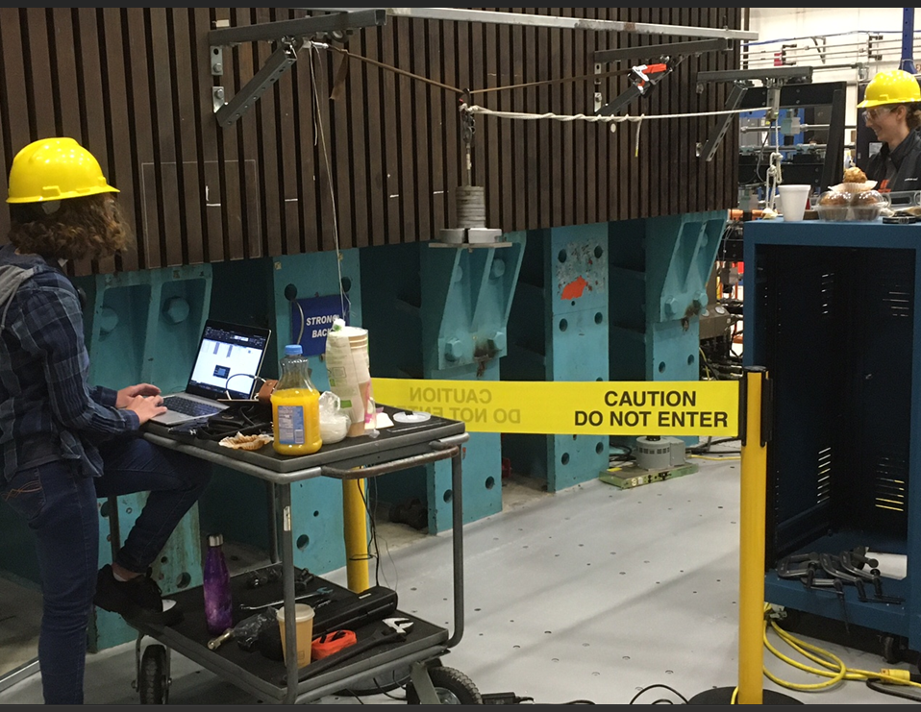
Friction Test – The Challenge
Design a test of the CoF between the line and carabiner…
Create and present a formal TRR and Hazard Analysis…
Acquire materials and test articles…
…And test and report findings

Slide 33
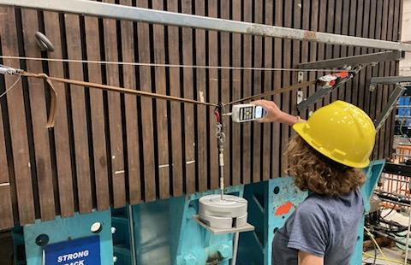
Friction Test – Test Setup
Line is stretched between two Unistrut supports
Weights loaded onto hook system connected to carabiner
Line is pretensioned using a ratchet
In-line load cell measures tension in line. Line is fastened to load cell using a climbing knot
Test conductor pulls spring scale and gets reading

Slide 34
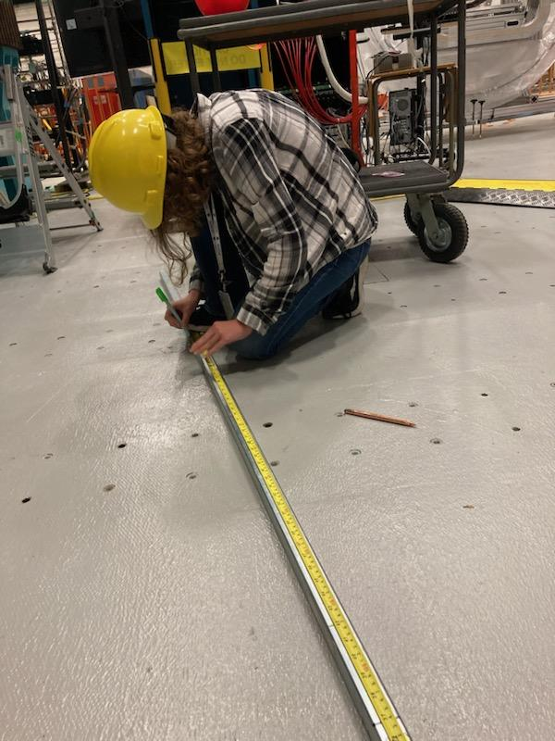
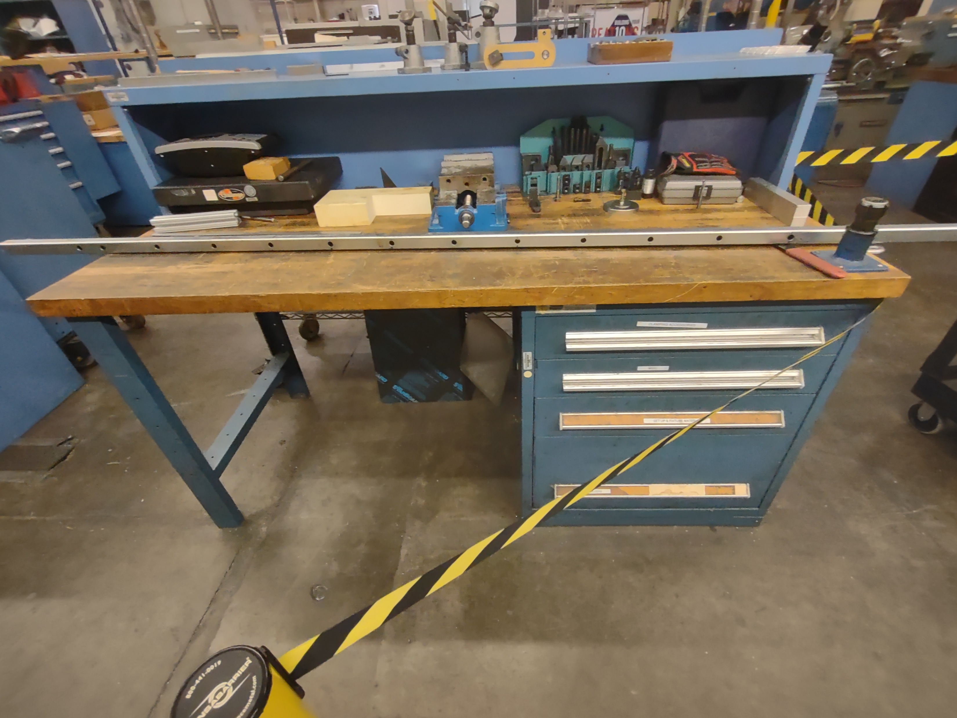
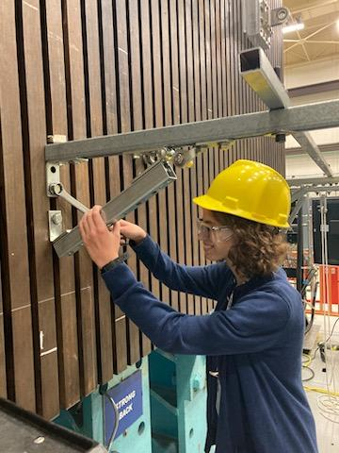
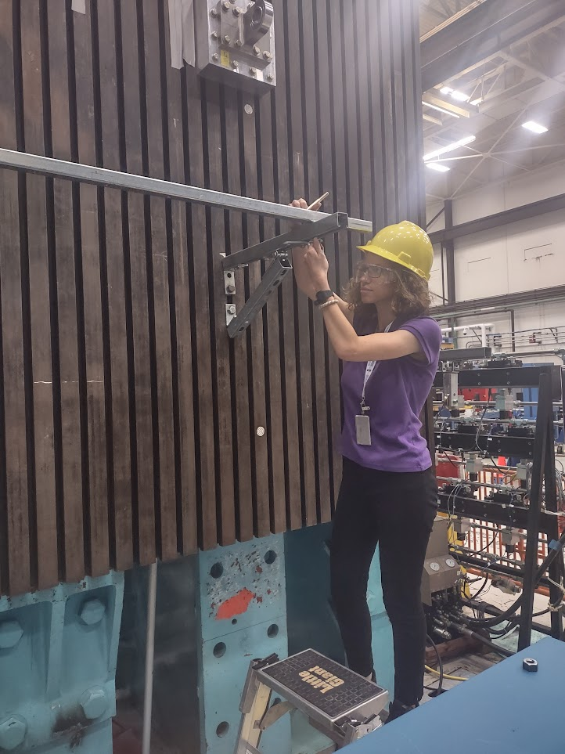
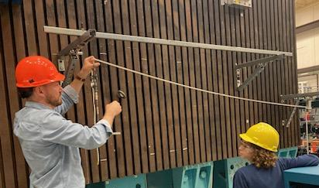
Friction Test – Setup Revisions
During setup, it was noted that the vertical support trusses did not prevent lateral bending of the Unistruts due to tensioning the line.
A steel beam was cut to length and drilled with holes to allow it to be secured overhead on top of the Unistruts at several points.
This beam goes into compression when the mooring line is tensioned, preventing the Unistruts from moving.

Slide 35
Friction Test – Setup Revisions
Initial tests showed unrealistic decrease in tension when weight was added
This was not offset when the tension was corrected for sag angle
Follow up tests showed perpendicular loads on the load cell resulted in a measured compressive force
The load cell was removed from the fixed mount and tied into the mooring line
Follow up tests demonstrated that the tension was changing in a reasonable manner when load was applied

Slide 36
Friction Test – Testing Process
Test Director – Fills in run matrix, monitors tension levels and oversees test process
Test Conductor – Loads and pulls weighted carabiner and gets reading
Secondary Test Conductor – The test process is easier and more accurate when a third person is present to aid in setup and to read off the scale

Slide 37
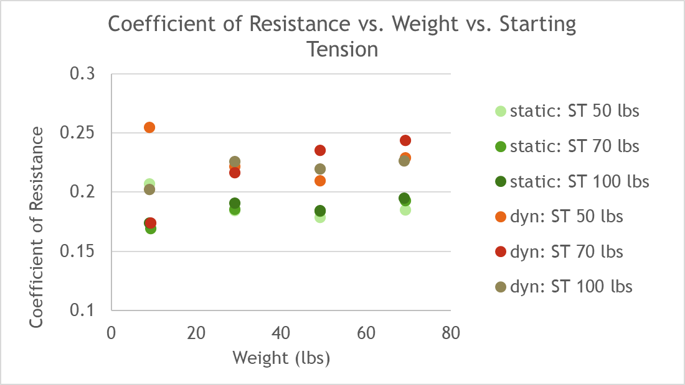
Friction Test – Coefficient of Resistance
Coefficient of Resistance (CoR): Cumulative effect of all resistive forces impeding motion of the carabiner along the line.
Starting Tension (ST): The tension the line was ratcheted to before tests began.
Data Displayed: Averaged Coefficient of Resistance (of 3 runs) for each starting tension plotted versus weight applied.
Results: Dynamic tends to be slightly higher than static coefficient, and both are under 0.3.
Notes: Dynamic friction increases rapidly as the carabiner is pulled further from the center of the line.
Limit
 | Static CoR | Dynamic CoR
Average value | 0.19 | 0.22

Slide 38


Friction Test – Wet vs. Dry
Limit
(ST – Starting Tension)
(ST – Starting Tension)
Methods: Line was wetted with a soaked paper towel before testing and rewetted periodically. Results were compared with dry line tests.
Results – The coefficients of friction were slightly higher for the wet line for both cases. Test conductors noted that they perceived the carabiner to be easier to move, but recorded values were higher.

Slide 39

Friction Test – Relaxation of Line
Relaxation of line – After a load is applied to the line, the line begins to “settle,” and the recorded tension in the line decreases over time. To account for this, a test conductor stressed the line prior to loading the line with the test weights to expediate the “settling.” The line continued to settle over the course of the test as new weights were applied.
Significance – The drift is a potential error source that should be noted.
Results – The unloaded tension in the line decreased after heavier weights were applied. This seemed to stabilize somewhat as weights continued to increase. Leaving the line undisturbed after unloading it would result in the line tension gradually increasing, but never to its value before the weight was applied.
(ST – Starting Tension)
Notes:
Add note that we tried to settle knot

Slide 40
Friction Test – Lessons Learned
Engineering Process
Followed formal process to get approval for test, including meetings with subject matter experts, a formal hazard analysis, and a Test Readiness Review (TRR).
Designed a test based on theoretical principles to experimentally verify an assumed value.
Researched factors influencing friction coefficients in soft goods.
Researched knots with high breaking strength for nylon webbing to reach informed decision on which to incorporate into test setup.
Processed data throughout testing and used preliminary results to modify experiment.
Technical Communication
Prepared procedural guides and run matrices for test setup and data recording.
Presented ideas and plans to subject matter experts, safety personnel, and ES6 management.
Worked with supplier to acquire a free sample of the mooring line for testing.
Presented technical data and results.
Machining and Hardware Setup
Cut and drilled steel beam to prevent lateral bending of Unistruts when line is under tension.
Worked with team to mount Unistruts on strongback and secure test components and test articles.

Slide 41

Other Projects: Shaker Table Setup
The Problem: A miniature shaker table useful for preliminary vibration testing and training, has been left exposed to the elements for a number of years.
Objective: Assess condition of shaker table, coordinate its repair, and write a procedural document detailing its use.
Constraints: The electrical components of the shaker require professional servicepeople to assess/repair, and the project must work around the needs of other STL testers and the schedule of B&K personnel.
Approach: Visually inspected interior for corrosion and damage. Coordinated purchase order (PO) with Jacobs, servicing with B&K, and location with the STL. Documented recommended operation procedures and learned and documented B&K’s training guides for theory and operation of shaker tables.
Result: Service contract finalized with B&K, location for shaker within STL determined, and a dedicated laptop set aside for shaker operation. Documentation passed on to next person who will be continuing this project.
Lessons Learned: Vibration shaker theory, operation, and application; Requesting purchases within NASA.

Slide 42
Other Projects:
Artemis IV Orion Responses Memo
Drafted memo based on template detailing acronyms and contents of data package for Artemis IV Orion Responses.
CUI Banner Script
Wrote script that inserts CUI banner into every sheet in every workbook of a directory unless specified to exclude.
Created functions to handle special cases such as merged cells, functions, and tables in order to preserve data format.
Rover Simulation – preliminary research
Aided in preliminary research for a hardware-in-the-loop driving test rig for rovers.
Compiled list of companies that may be able to provide service.
Met with MTS application engineer to discuss options offered and documented meeting.

Slide 43



Fun Stuff!

Slide 44



Fun Stuff!

Slide 45
What I’ve Learned
ERM Modelling
FEMAP for modelling and visualization
Mooring Line Test
Properties of soft good materials
Lunar Loads
Sensor operation for DDR and SLICE DAQ.
NASTRAN for modal analysis
Methodology for tests, including those with human subjects
Methods of characterizing loads and dynamics experimentally
Formal testing procedures
Machining and tool use

Slide 46
The Future
Subsequent Tours:
  EP4 – Propulsion, Summer 24
  EG5 – Orbital Mechanics & Trajectories, Fall 24
  Final Tour TBD, Summer 25
Graduation:
  April 2026
  Grad studies: Either through grad Pathways or at a local university, probably something aerospace/astrodynamics related

Slide 47
Acknowledgments
Claire Puccini – My wonderful mentor!
Mo Kaouk – Coolest branch chief!
Alex Tovar – For supporting my projects and helping facilitate the business side of things (and for the spring scale!)
Rodney Rocha – For being a wonderful teacher and for the assistance with the mooring line and shaker table projects
Herbert Silva – For guiding me through the lunar loads project and providing the resources I needed to succeed in many aspects of my tour
The E-Loads Team, including Ivette Malave, Herbert Silva, Celeste Villagran, Jeffrey Bell, Marcus Maiten, and Blake Pearson, for giving me opportunity to be part of such an incredible and talented team
Tony Ng – For the assistance and advice with the ERM project
Jeffrey Suhey – For the many hours of test conducting
Fern Thomassy – For many an interesting side project
Hamza Nadeem and the STL technicians for assisting with the mooring line project
All of you!

Slide 48
Thank you!
Ask me a question!

Slide 49
Back-up

Slide 50
Friction Test – TRR
TRR (Test Readiness Review): Formal presentation to customer representatives, management, subject matter experts and safety personnel to verify that test conductors are ready to begin testing
Introduce project background: purpose, deliverables, and why it is being done
Go over run matrix: table or tables cataloguing what will be tested, what parameters are to be altered, and how they are altered
Present Test Configuration: Schematics showing what materials will be used and how the systems will be setup
Present Integrated Hazard Analysis to board, discuss hazards, safety margins for equipment, and necessary PPE

Slide 51



Friction Test – Initial Plans & PRR
Test Setup | Pros | Cons
Inclined line | ✔Accurate to real world scenario ✔Captures effect of contact interface | ❌More setup needed/more complicated measurement process ❌Line sag could introduce severe systemic error
Pulley system | ✔Easy to run and setup ✔Separates conductors from moving parts | ❌Difficult to process data (requires precise loading ability or way to measure acceleration accurately)
Spring scale | ✔Most direct measurement ✔Very straightforward setup | ❌High measurement error ❌Test conductors in close proximity with moving test parts

Slide 52
Friction Test – Initial Plans & PRR
Test Option A
Carabiner slides down incline, measure force due to friction using angle and measured acceleration/force needed
Test Option B
Weighted carabiner attached to pulling line over pulley. Friction force measured by weights needed to start motion
Test Option C
Weighted carabiner pulled at constant rate by person with a spring scale. Friction force measured directly from scale
Notes:
Ppt art

