Slide 1



NASA GPM Status and Future Activities
George J. Huffman¹, Mircea Grecu^{1,2}, Christian Kummerow³, Stephen E. Lang^{1,4}, Adrian Loftus¹, William S. Olson^{1,5}, Erich F. Stocker¹
(1) NASA/GSFC, Greenbelt, MD, USA
(2) Morgan State University, Baltimore, MD, USA
(3) Colorado State University, Fort Collins, CO, USA
(4) Science Systems and Applications, Inc., Lanham, MD, USA
(5) University of Maryland Baltimore County, Baltimore, MD, USA
george.j.huffman@nasa.gov

Slide 2
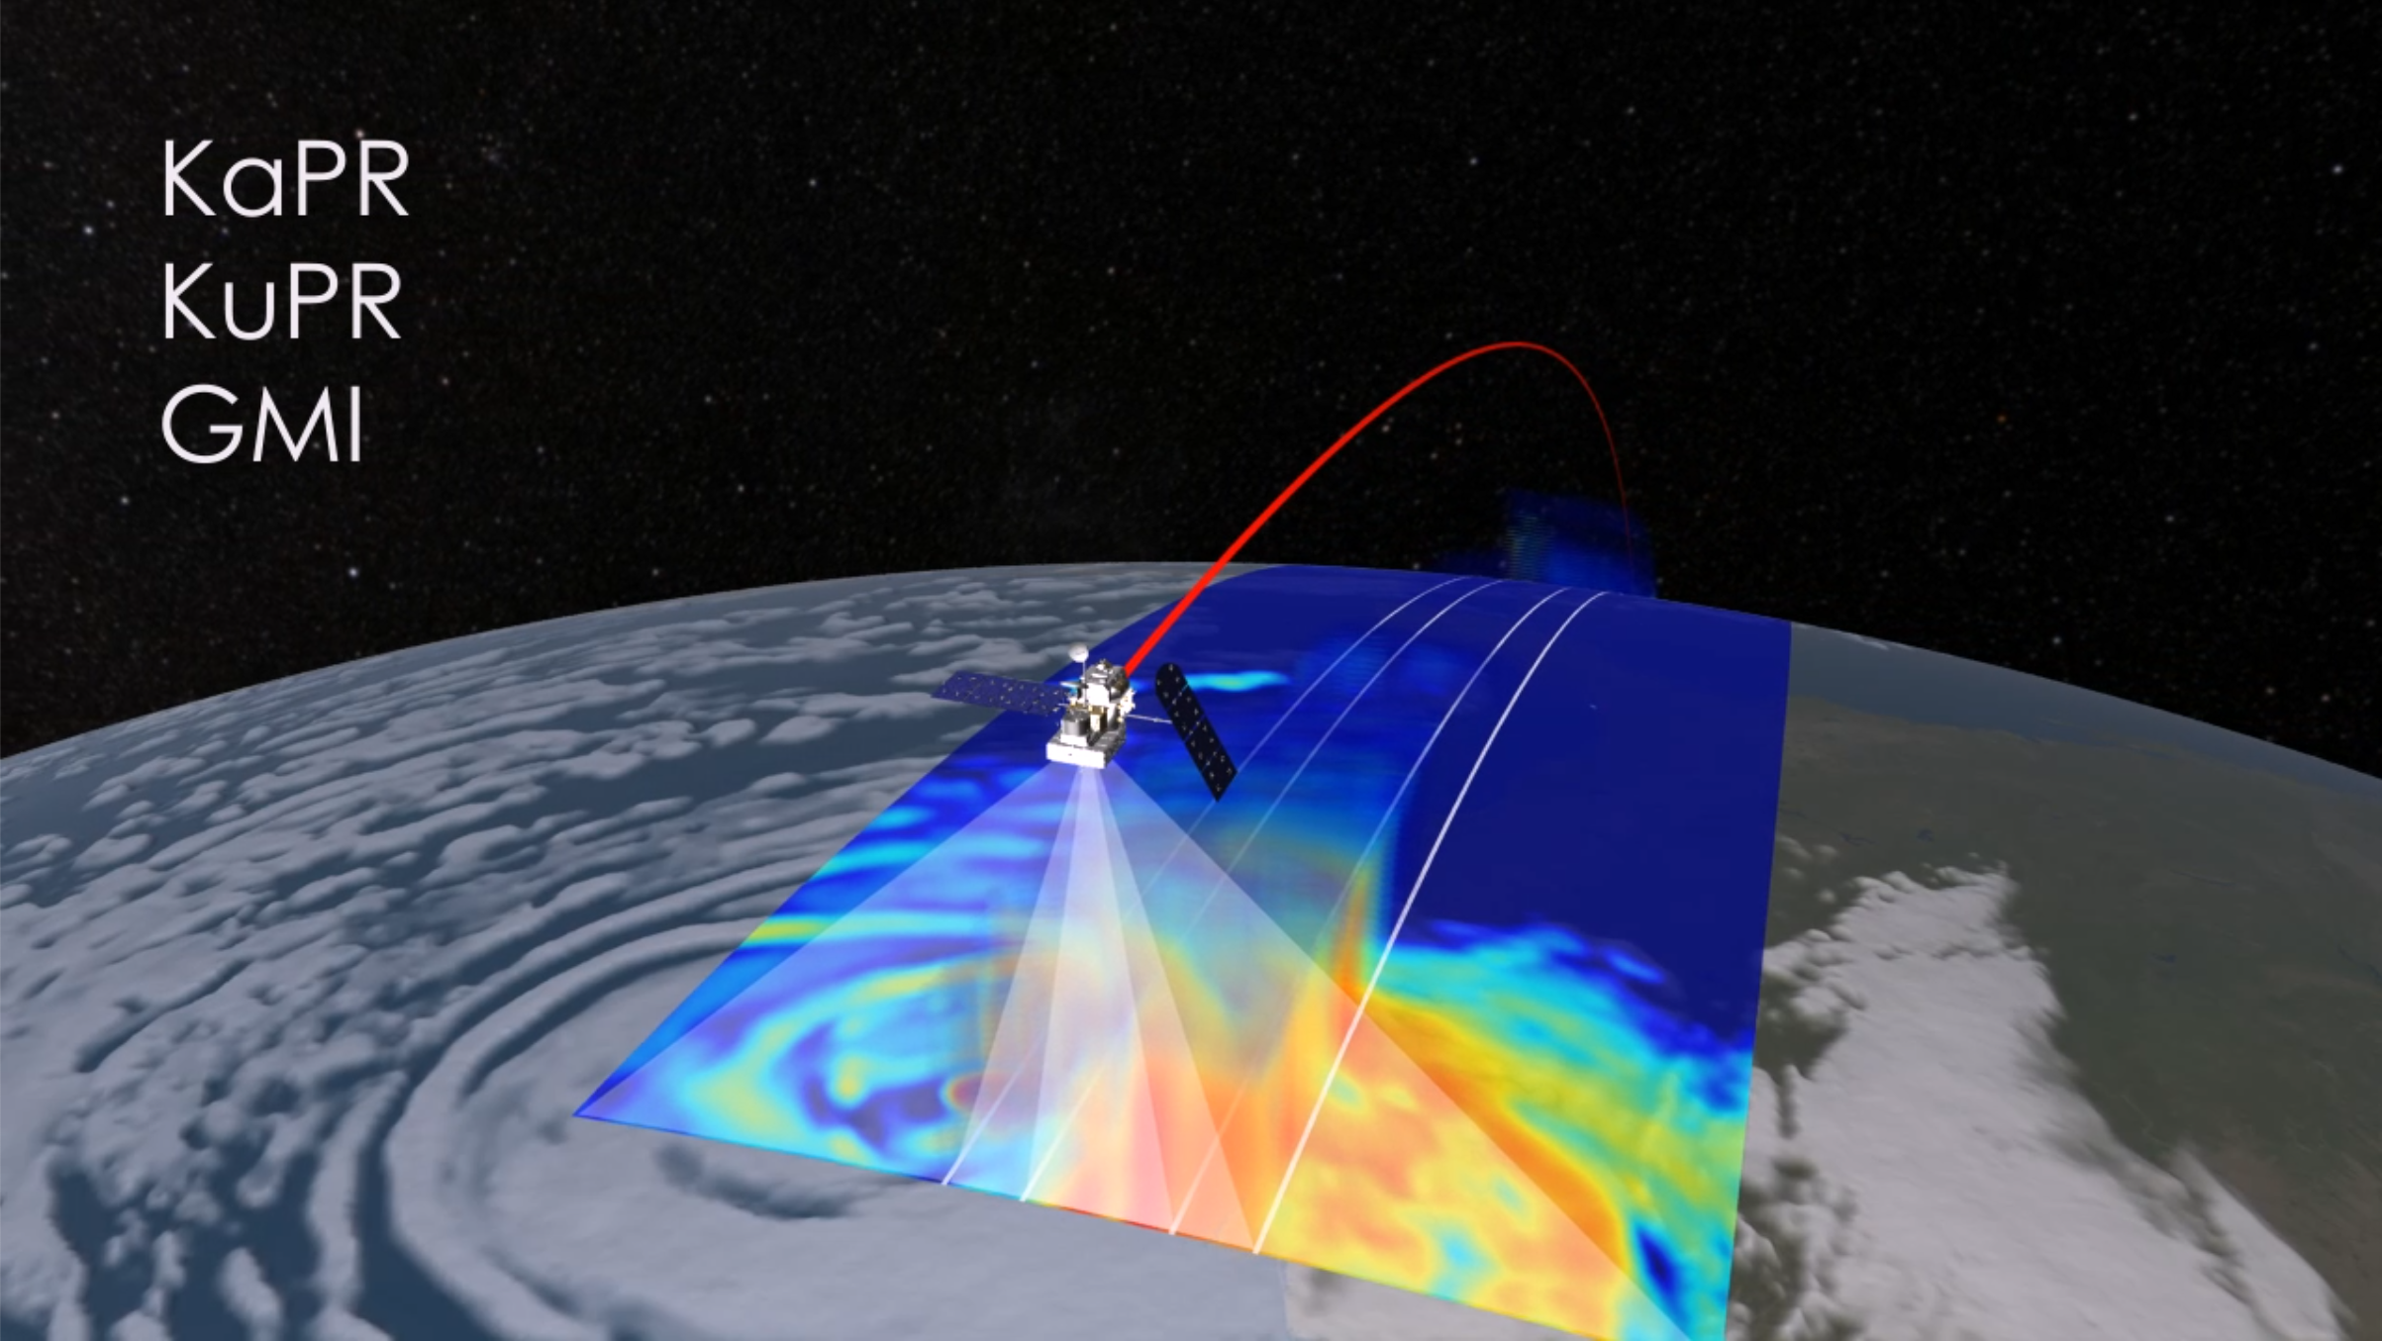
The GPM Core Observatory
Joint NASA-JAXA project
Launched in 2014
65º inclined orbit
• 83 day precession
Carries 2 sensors
• Dual-frequency Precipitation Radar (DPR)
• 3-D
• narrow swath
• GPM Microwave Imager (GMI)
• 2-D
• wider swath
swath width (km)
KaPR 120, 245 after 21 May 2018 KuPR 245
GMI 885
407 km

Slide 3
The GPM Core Observatory
Mission Operations Center is very busy
• collision avoidance
• GPM has 5 reaction wheels that help control spacecraft attitude
• 4 of 5 functioning, 1 has shown problems, rest are solid
• all other subsystems and the
instruments are all fully functional
swath width (km)
KaPR 120, 245 after 21 May 2018 KuPR 245
GMI 885
407 km

Slide 4
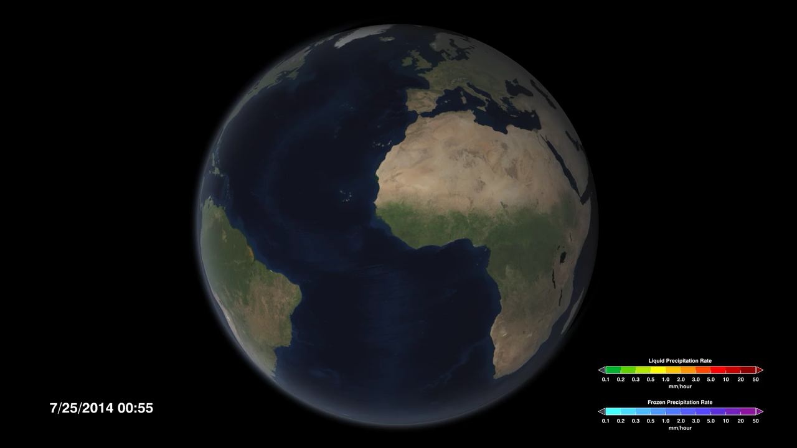
The GPM Constellation
The Core Observatory by itself gives really sparse coverage
• DPR gives 1 snapshot every 3 days
• GMI gives 1 snapshot per day
So, we asked other agencies to contribute data
• currently 11 passive microwave sensors
    • ~3-hourly observations
    • also geosynchronous infrared observations as a last-ditch fill-in
And then we do interpolation to fill in the gaps

Slide 5
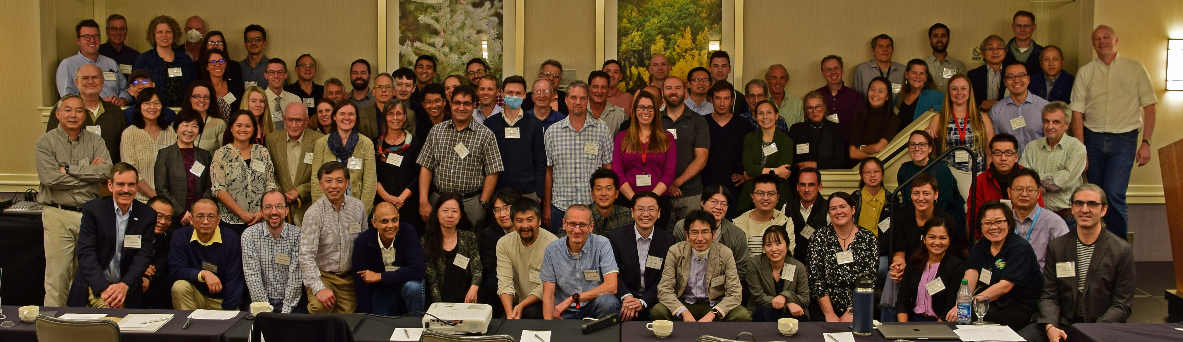
U.S. Science Team 2022-2024
36 PI projects, 8 PI ”work packages”, 20 “International Collaborators” from 17 countries
8 Working groups
• Applications • Cross-calibration (XCAL)
• Ground Validation (GV) • Hydrology
• Land Surface • Latent Heating
• Multi-Satellite • Particle Size Distribution (PSD)
Annual U.S. Science Team meeting, 3-7 October 2022, Denver, Colorado (hybrid)

Slide 6
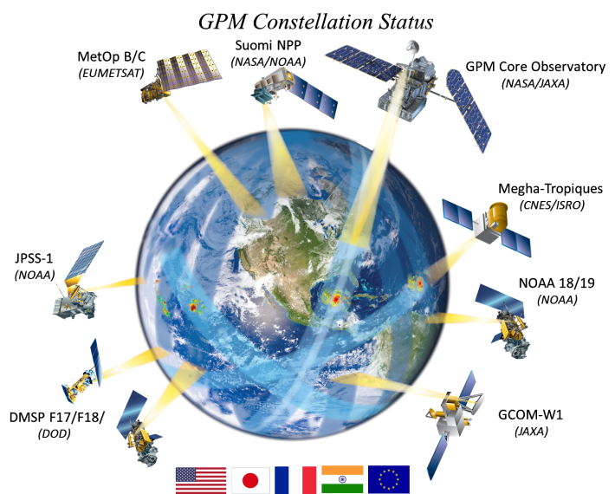
Algorithms
Version 07 core products are released
• improved mountains, polar regions
• improved continuity from TRMM to GPM
IMERG V07 multi-satellite products are being computed now
• Final Run retrospective processing should be done in early September
• near-real-time Early and Late Runs will go live in November
• Jackson Tan will give some early results
Version 08 is planned for early 2026
• V08 can introduce innovations, but Phase F should just be corrections for errors
• it is planned to make a final recomputation at the end of mission (Phase F)

Slide 7
Data Systems
Precipitation Processing System (PPS) does the heavy lifting for project computing
• core products (except Level 1 DPR), IMERG, U.S. latent heating product
• run Integration and Test Experiments to check out developers’ code and concepts
• access, store, and organize required input data
• compute products
• create “value-added” products
• make data available in multiple formats
Goddard Earth Science Data and Information Services Center (GES DISC) has long-term responsibility for archiving GPM products
• provides multiple schemes for accessing data
• hosts Giovanni on-line analysis and display web tool
• working toward Cloud-based operations
• IMERG was a pathfinder for Cloud testing
https://gpm.nasa.gov/data/directory catalogues all datasets in the Goddard archives

Slide 8
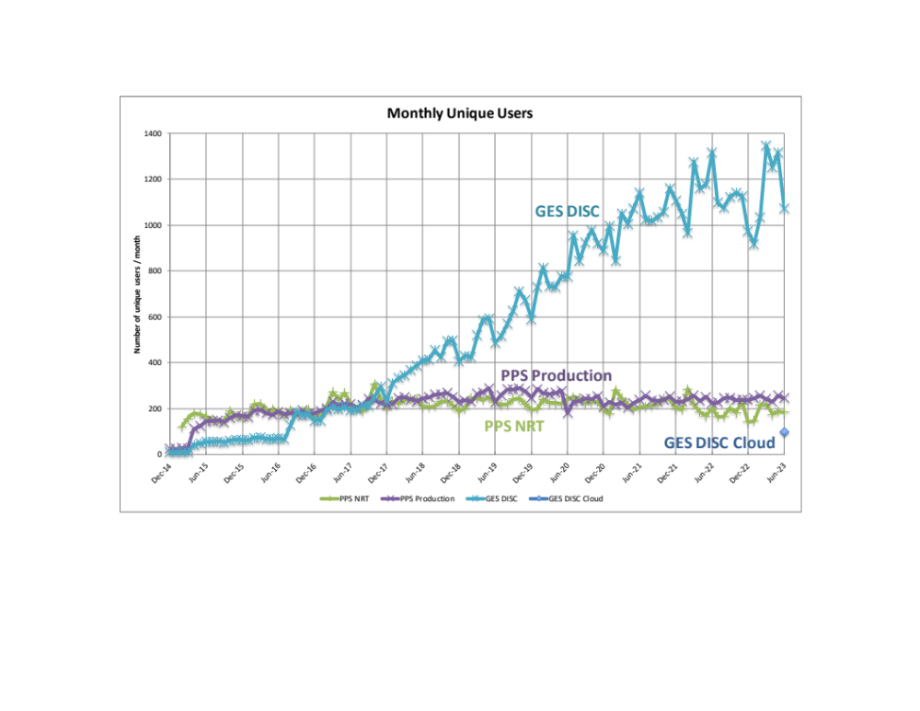
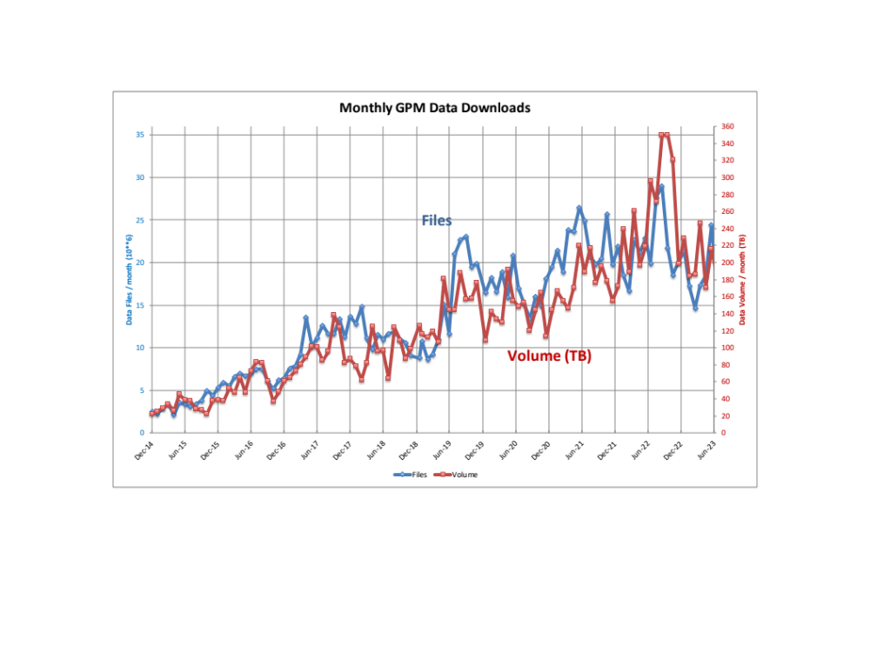
Data Systems
GPM product distribution by NASA continues to grow
• PPS and GES DISC file numbers and data volume can be combined
• they track together, but not closely – ratio is affected by sizes of products downloaded
• “unique” user counts can’t be combined, since there might be overlap
The total count of GPM-related papers over 800

Slide 9
Science studies
The lengthening TRMM/GPM record enables studies of intermittent or seasonal events
• Bai and Schumacher (2022) doi:10.1029/2021JD035905
• break out diurnal cycle rainfall patterns by location in the Maritime Continent by phase of Madden-Julian Oscillation (MJO)
• 89 MJO events during 2001-2019 using IMERG data
• Li et al. (2023) doi:10.1016/j.jhydrol.2023.129563
• evaluate precipitation events in IMERG product against GV-MRMS in the Continental United States
• develop statistics on difference in start, stop, duration, and detection by season
• Li et al. (2022) doi:10.1175/BAMS-D-22-0127.1
• survey reflectivity differences for 136 WSR-88D radar sites and the GPM DPR by season
• Liu et al. (2022) doi:10.1029/2021JD035785
• compute the total and directional momentum flux at 100 hPa for individual convective gridboxes
• TRMM Spectrum Latent Heating product and large-scale wind profiles from ERA-Interim
• geographical distribution of momentum flux at 100 hPa in the tropics and subtropics
• diurnal, seasonal, and interannual variations of the momentum flux

Slide 10

Applications
Engage user communities
• increase awareness of TRMM/GPM applications
• improve data/documentation access and user-friendliness
• capacity building
• training sessions
• mentor program
2023 applications summary

Slide 11
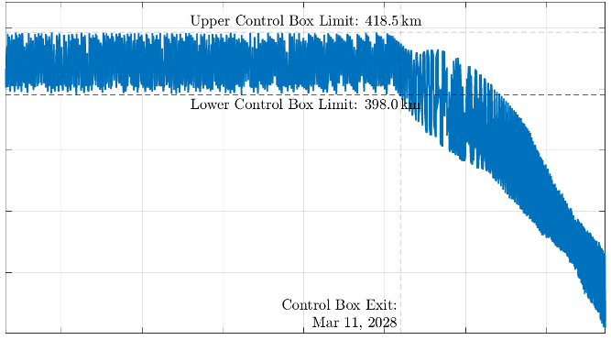
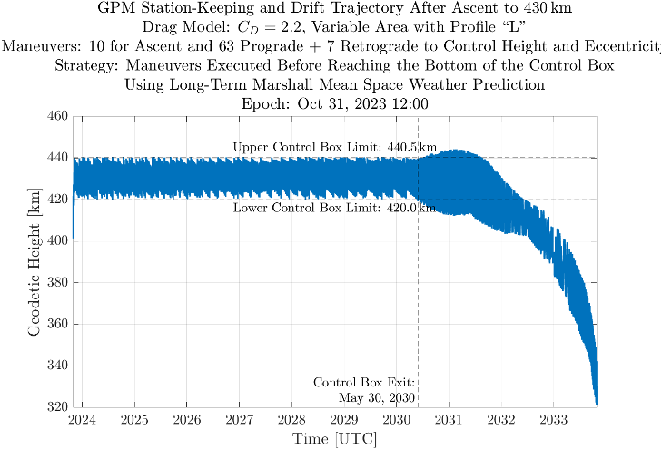
Core Observatory Lifetime
420
Forecasts of fuel use have trended faster than expected
• even at 400 km altitude there is atmospheric drag
• strongly affected by Solar activity
• current Solar activity is higher than expected
• lower-than-expected Solar activity would extend lifetime
• we will not get a TRMM-style pass on the re-entry requirement
• planning and approval for the orbit boost are proceeding
• 432 km forecast to take us into 2034
• but, drift-down forecast to start late in 2030
400
380
geodetic height (km)
360
340
control box exit
30 May 2030
320
2024
2025
2026
2027
2028
2029
2030
year
460
440
420
400
geodetic height (km)
380
360
340
control box exit
30 May 2030
320
2027
2029
2024
2025
2026
2028
2030
2031
2032
2033
year

Slide 12
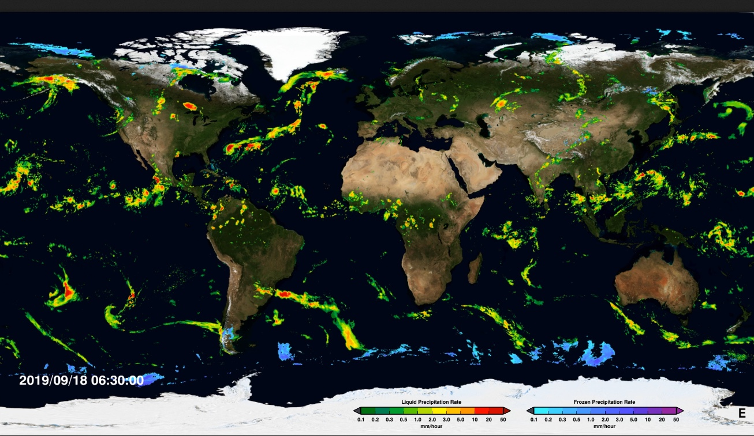
Closing Remarks
The Core Observatory is functioning well
The JAXA-NASA partnership is working well
GPM is contributing significantly to the precipitation community
• we still have more years for doing good research
I look forward to seeing how the legacy of TRMM and GPM continues into the AOS era
george.j.huffman@nasa.gov

