Slide 1

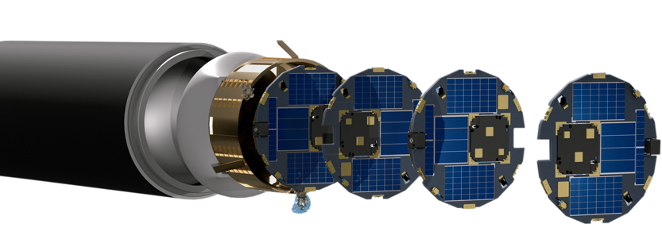
National Aeronautics and
Space Administration
National Aeronautics and
Space Administration
National Aeronautics and
Space Administration
NASA Small Spacecraft Technology Program
Roger C. Hunter
Program Manager
Indo-Pacific Space and Earth Conference Perth, Western Australia 23 October 2023
www.nasa.gov

Slide 2
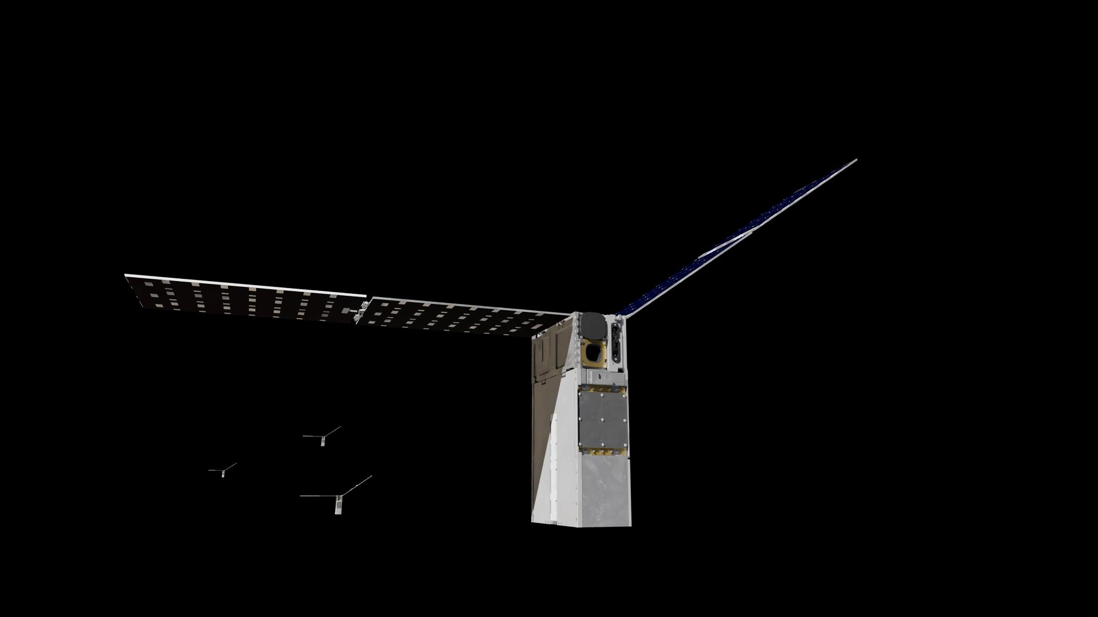
Small Spacecraft Technology Program Objectives
The Small Spacecraft Technology program expands U.S. capability to execute unique missions through rapid development and demonstration of capabilities for small spacecraft applicable to exploration, science and the commercial space sector.
Enable execution of missions at much lower cost than previously possible.
Substantially reduce time required for development of spacecraft.
Enable and demonstrate new mission architectures.
Expand the capability of small spacecraft to execute missions at new destinations and in challenging new environments.
Enable the augmentation of existing assets and future missions with
supporting small spacecraft.
Starling Spacecraft
Image Credit: NASA

Slide 3
NASA Organizational Chart

Slide 4
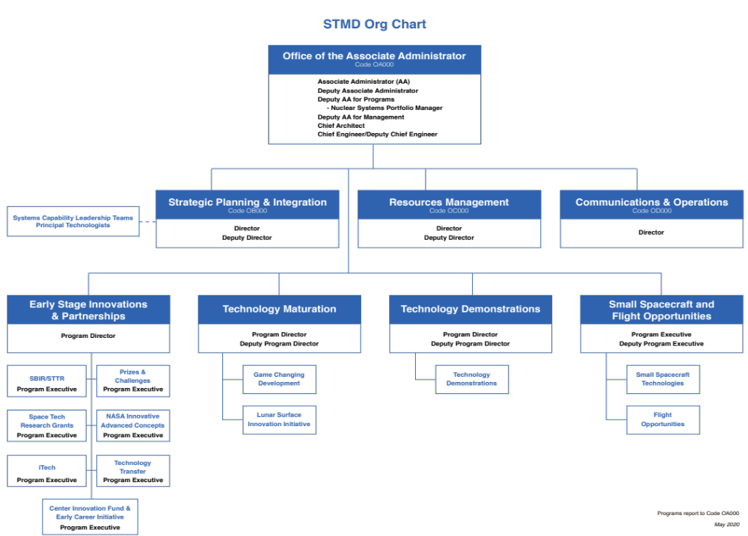
Space Technology Mission Directorate Organizational Chart

Slide 6
2023-2025 Launch Schedule
Technology Demonstrations | Launch Timeframe
Starling: Demonstration of Autonomous Swarm Technologies | Launched July 17, 2023
R5 (S2 and S4): Rapid Technology Maturation | Q1 2024
R5 (S3 and S5): Rapid Technology Maturation | Q1 2024
PY4: Four CubeSat Swarm of PYCubed-Based Spacecraft | NET 1 Feb 2024
DUPLEX: Dual Propulsion Experiment | 1 Feb 2024
ACS3: Advanced Composite Solar Sail System | Mar 2024
PTD-4: Pathfinder Technology Demonstrator-4: Payload: LISA-T High-Power Deployable Solar Array Antenna | NET Jun 2024
PTD-R: Monolithic UV/SWIR/VIS Camera | NET Jun 2024
Courier: Solar Electric Propulsion Module | Oct 2024
DiskSat: 2D, High-Power, High-Aperture Maneuverable Spacecraft | Q4 / CY2024
CLICK B/C: CubeSat Laser Infrared CrossLinK | NET Dec 2024
GPDM: Green Propulsion Dual Mode | 1st Half 2025

Slide 7
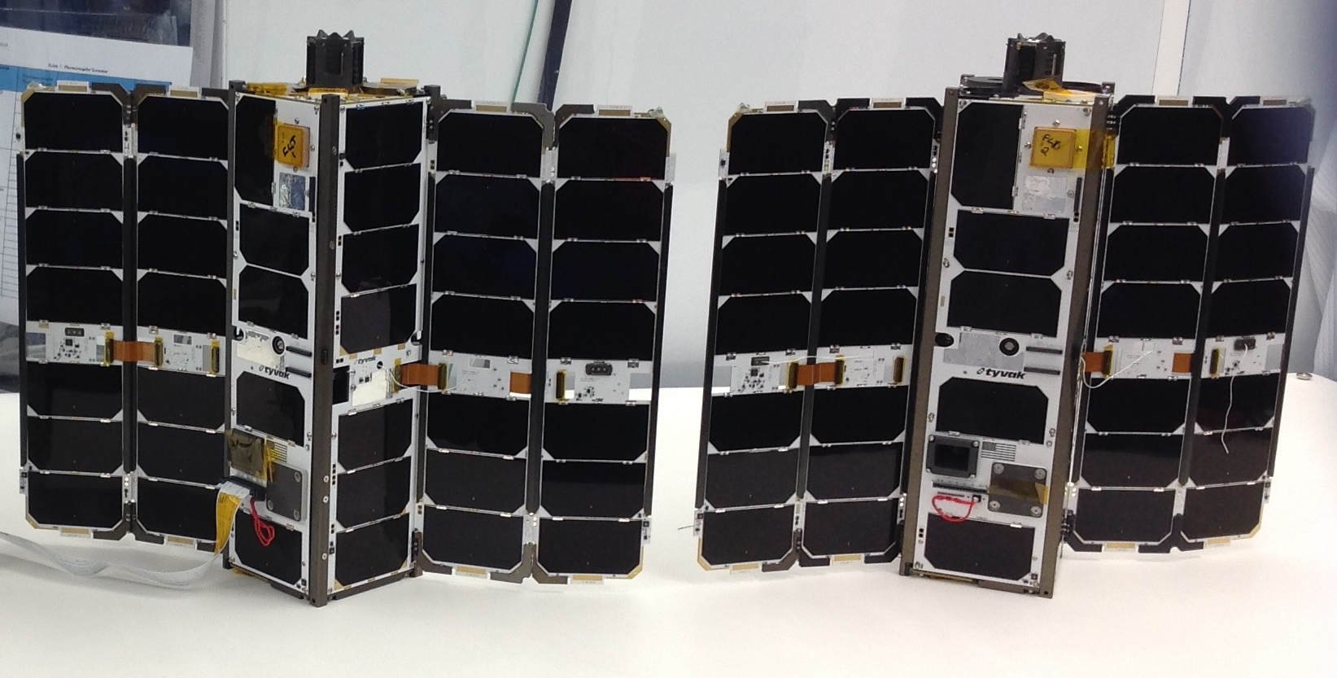
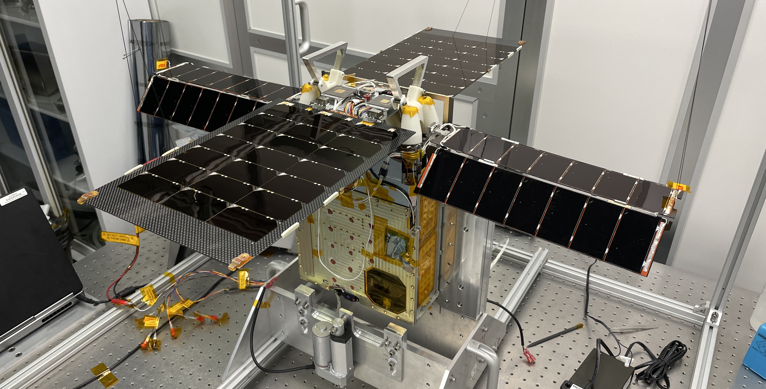
Spacecraft at End of Mission in 2023
CubeSat Proximity Operations
Demonstration (CPOD)
Launched: May 25, 2022
End of Mission: June 30, 2023
The mission was unable to demonstrate rendezvous, proximity operations and docking (RPOD) maneuvers as planned due to challenges with propulsion and GNC subsystems.
Lunar Flashlight
Launched : December 11, 2022
End of Mission: May 11, 2023
Spacecraft unable to generate enough thrust to complete maneuvers to stay in the Earth-Moon system to search for surface ice in the permanently shadowed craters of the South Pole.
Image Credits: Terran Orbital Corporation
Image Credits: NASA/JPL-Caltech
7

Slide 8
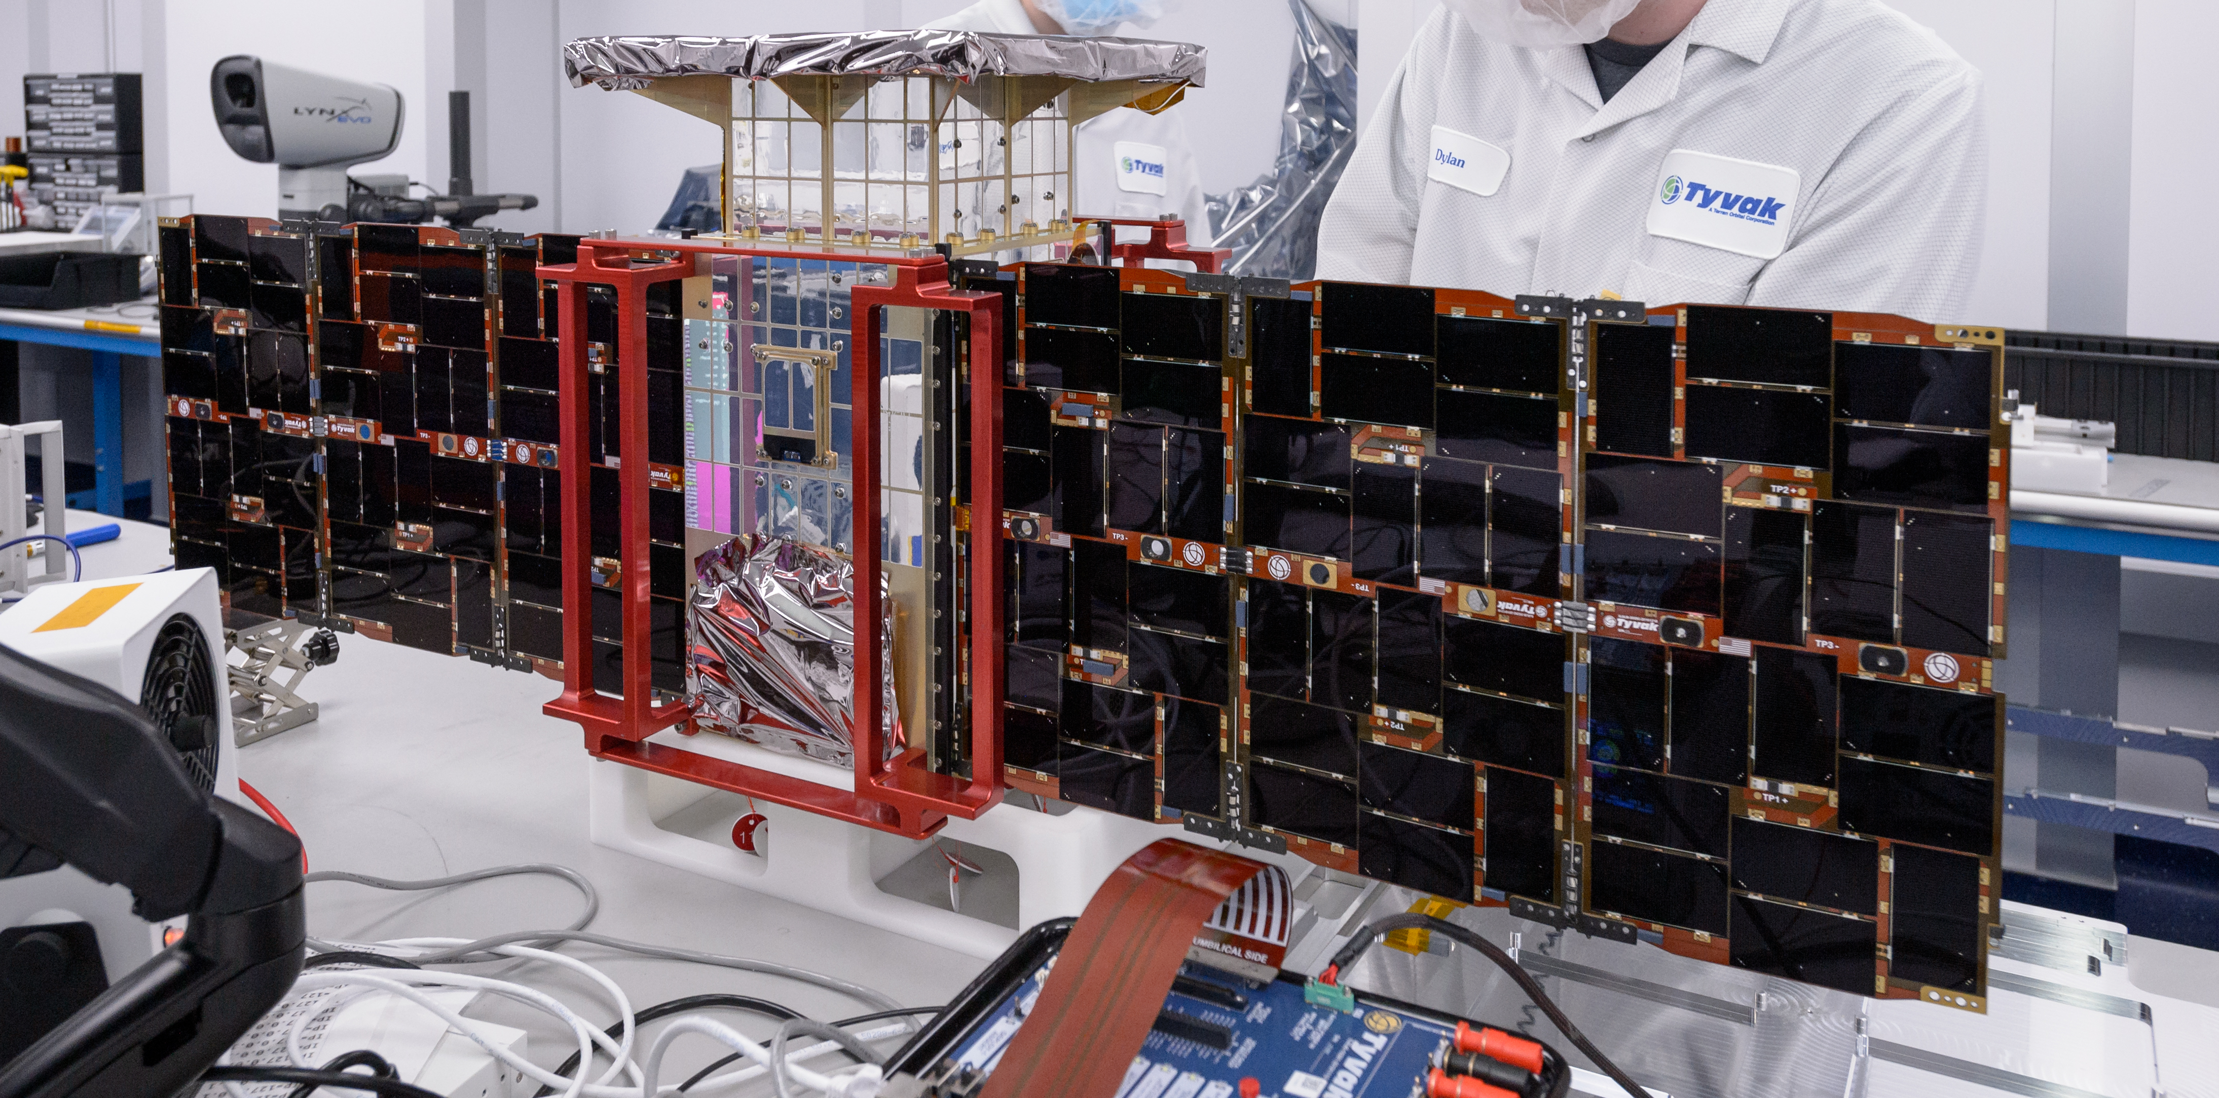
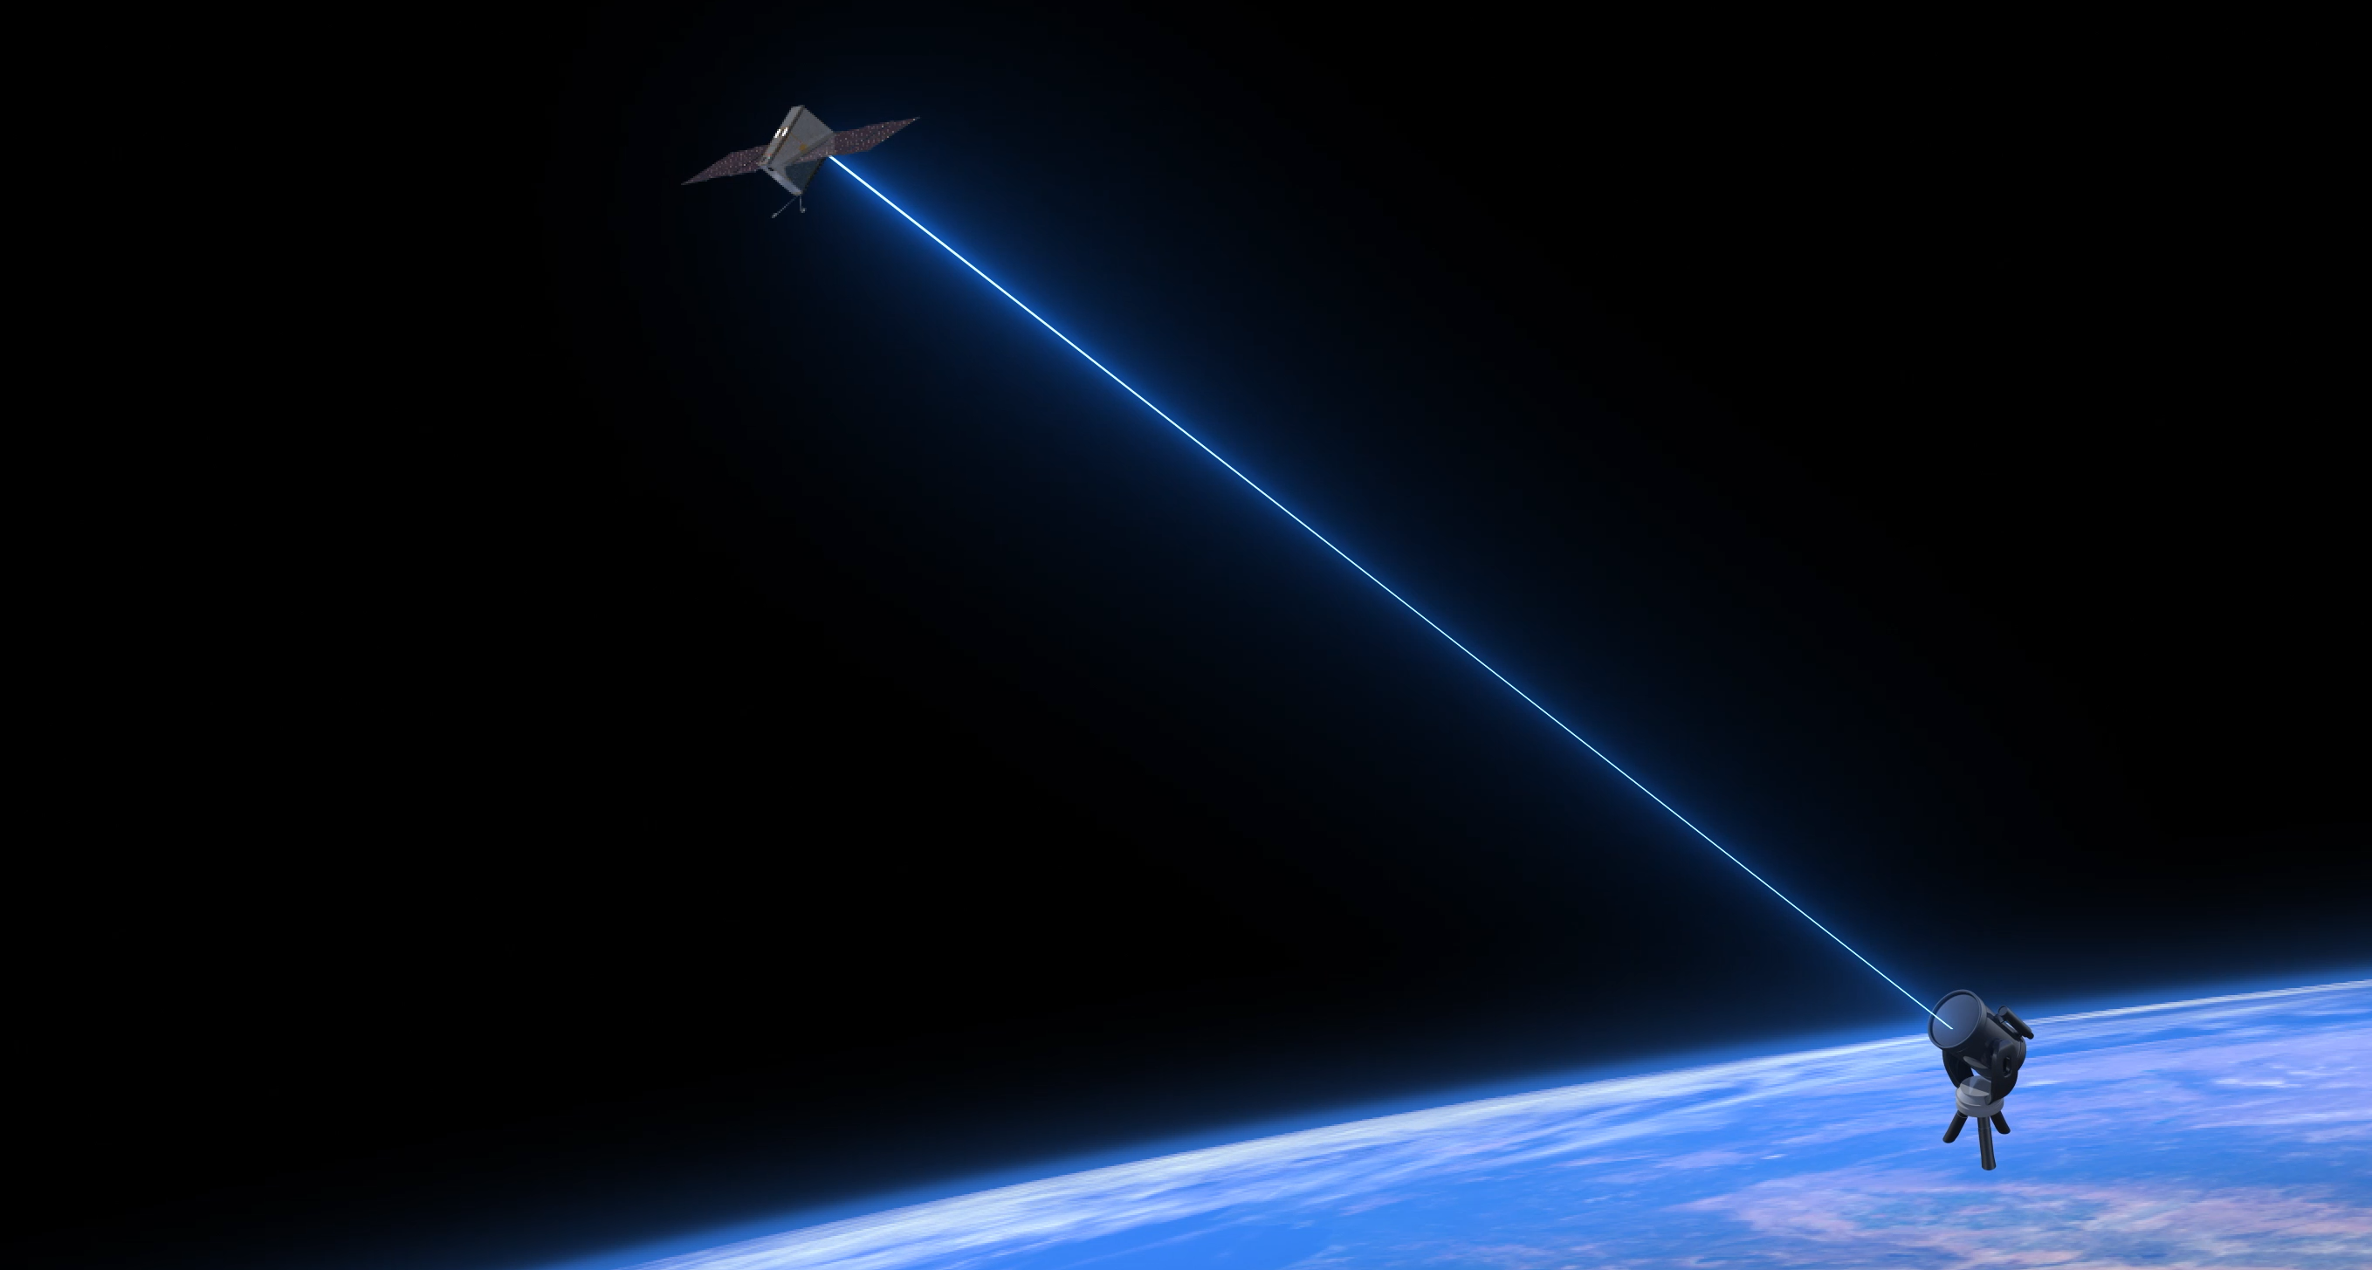
On-Orbit U-Class Technology Demonstration Missions
CAPSTONE
Launched: June 28, 2022
Status: Ongoing
Demonstrate ability to enter and maintain a near rectilinear halo orbit around the Moon. Demonstrate one & two way ranging and autonomous spacecraft navigation
Pathfinder Technology Demonstrator (PTD-3)
Launched: May 25, 2022
Status: Ongoing
Demonstrate TeraByte InfraRed Delivery (TBIRD) technology for high-bandwidth laser communications. Demonstrated 200 gigabit per second data downlink rate on April 28.
Image Credits: NASA
Animation Credits: NASA
8

Slide 9
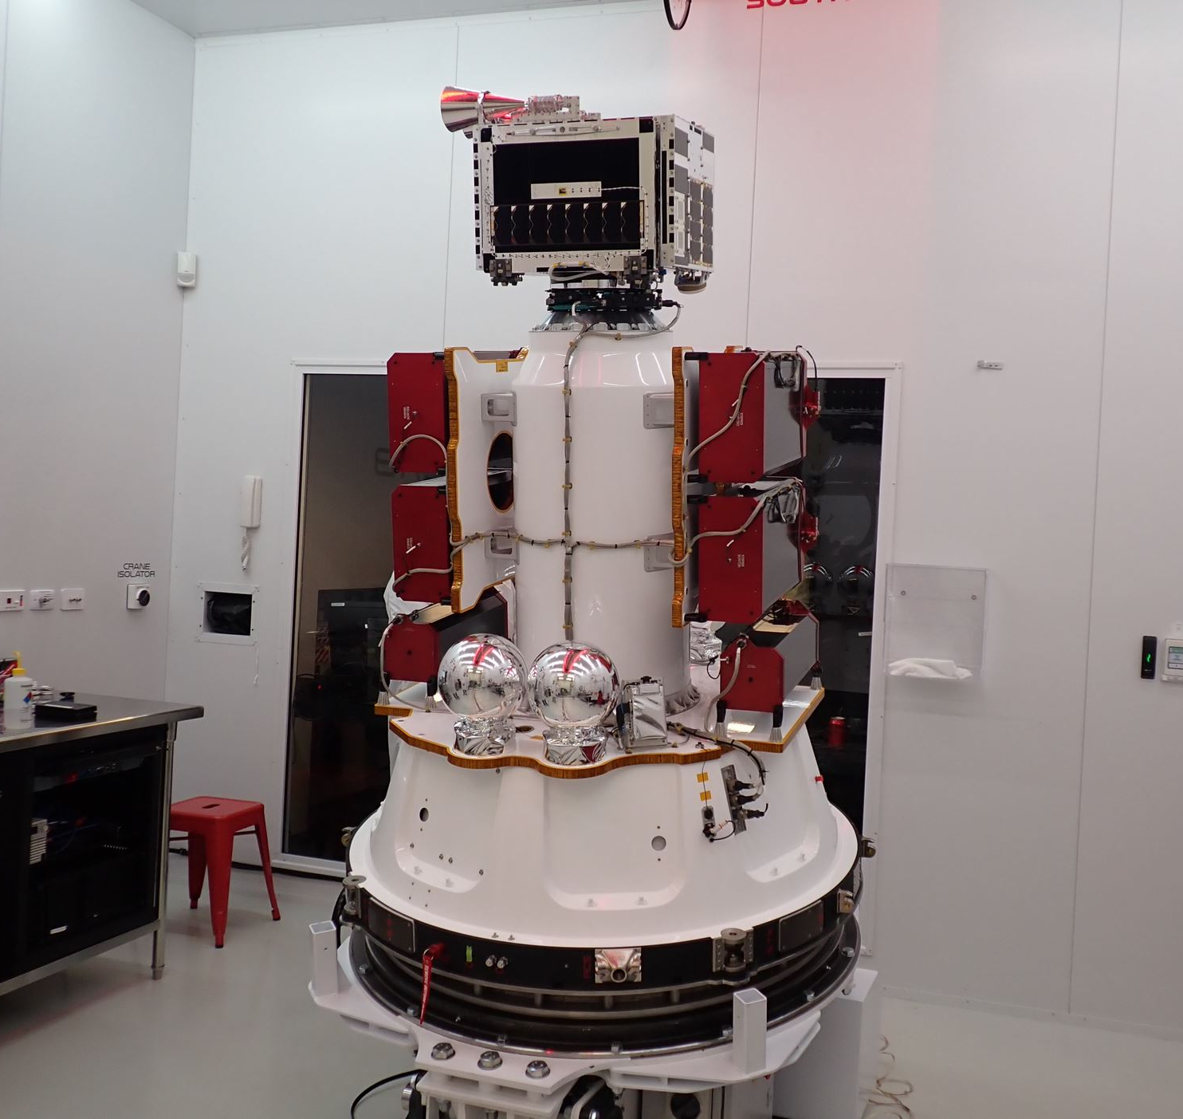
Starling
On-Orbit U-Class Technology Demonstration Missions
Starling’s four 6U CubeSats launched on July 17, 2023 from Rocket Lab Launch Complex 1 in Mahia, New Zealand. Starling will test swarm maneuver planning and execution, communications networking, relative navigation, and autonomous coordination between spacecraft. Image Credits: NASA. Inset Image Credits: Rocket Lab

Slide 10
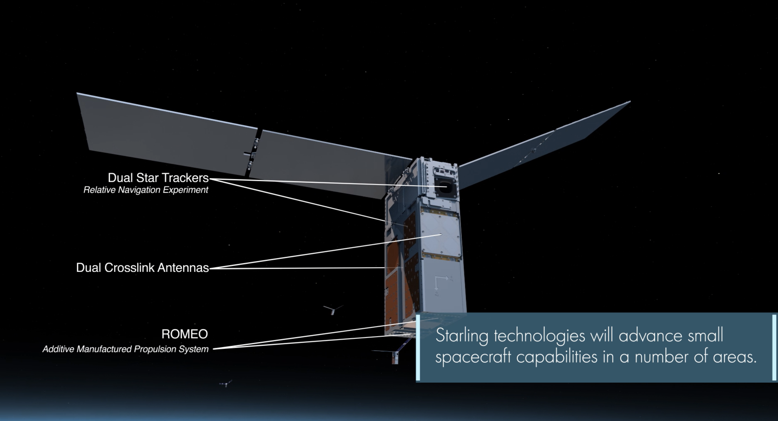
On-Orbit U-Class Technology Demonstration Missions
Please see separate
animation file

Slide 11
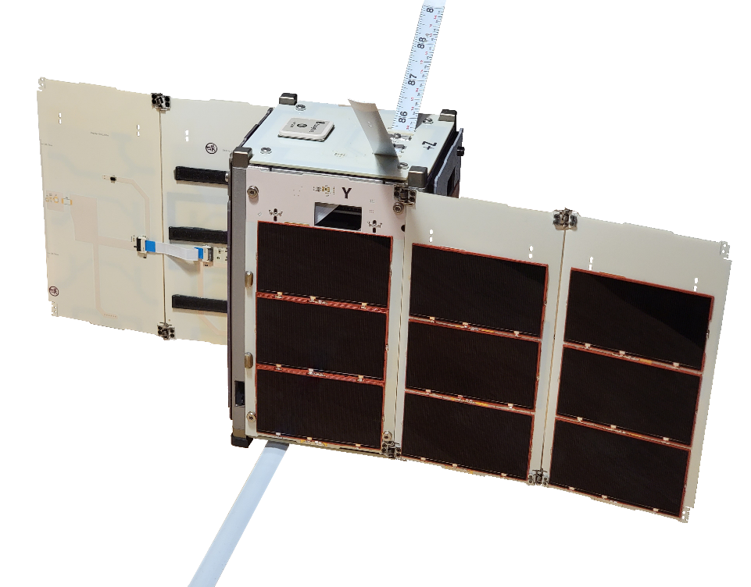
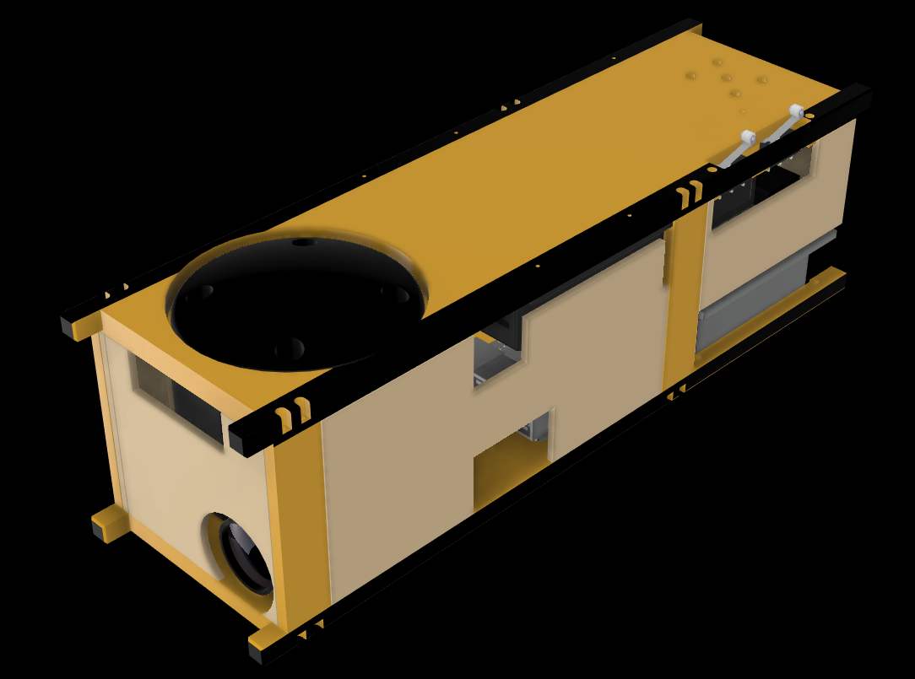
Upcoming U-Class Technology Demonstration Missions – 2023-2024
R5
Launch Timeframe:
CY 2024.
PY4
Launch Timeframe:
NET February 1, 2024.
Build and operate rapid, low-cost, highly-capable spacecraft platforms to demonstrate payloads of interest and technology relevant to human spaceflight .
Demonstrate low size, weight, power, and cost (SWaP-C) spacecraft-to-spacecraft ranging,
on-orbit relative navigation, and coordinated simultaneous multi-point radiation measurements.
Image Credits: NASA
Image Credits: Max Holliday, NASA Ames
11

Slide 12
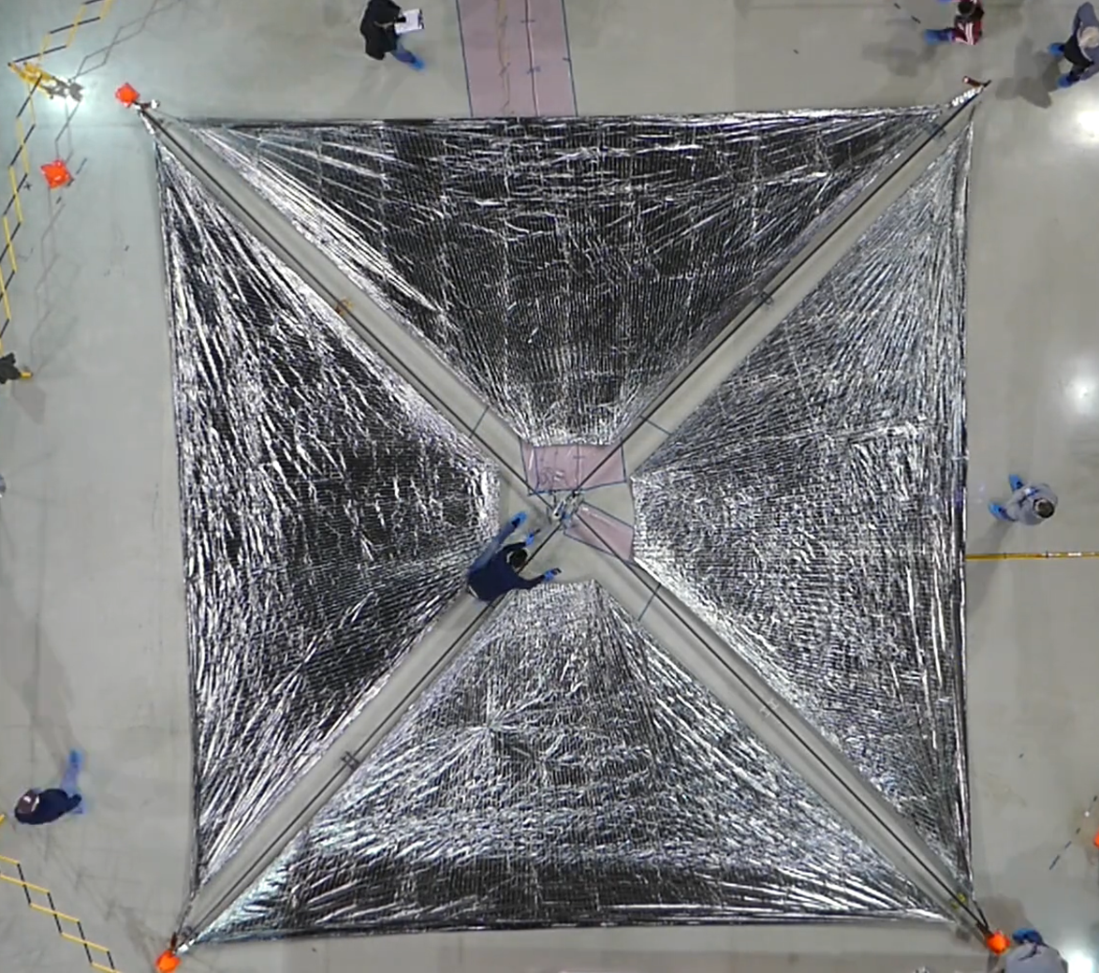
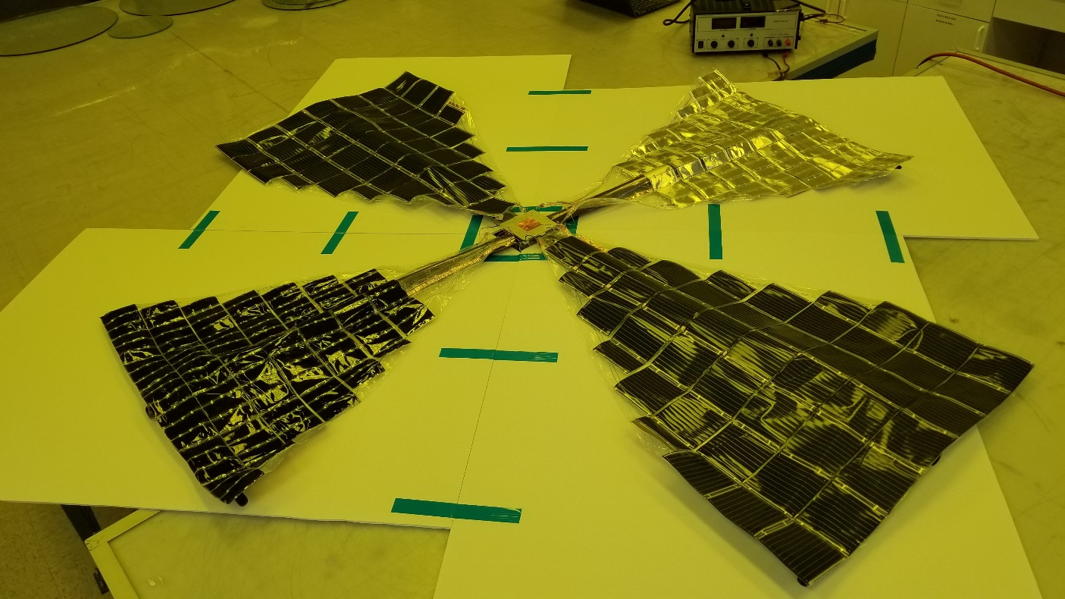
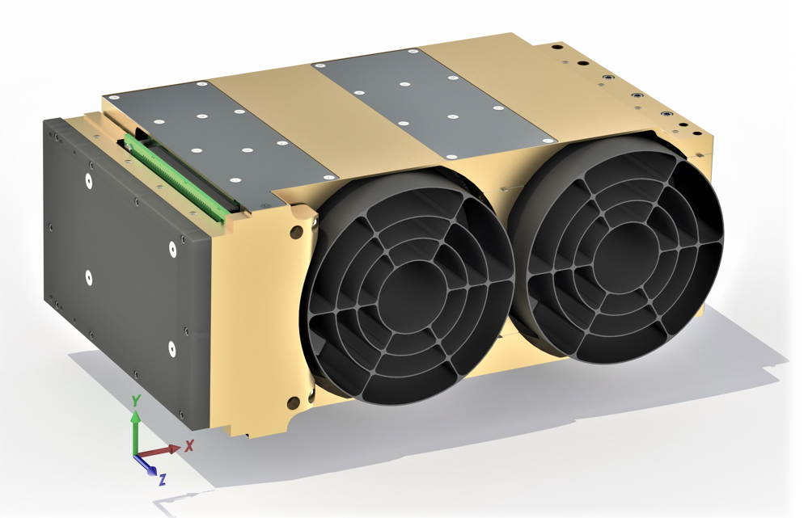
Upcoming U-Class Technology Demonstration Missions – 2024
Advanced Composite Solar Sail System (ACS3)
Launch Timeframe:
March 2024
Demonstrate deployment
of the composite boom
solar sail in low-Earth orbit. The unfurled solar sail will measure approximately 84 m²
Pathfinder Technology Demonstrator (PTD-4)
Launch Timeframe:
NET June 2024
Demonstrate Lightweight Integrated Solar Array and anTenna (LISA-T) – A high-power deployable solar array antenna
Pathfinder Technology Demonstrator (PTD-R)
Launch Timeframe:
NET June 2024
Demonstrate a new type of UV and SWIR Telescope that may be used in a wide range of applications.
Image Credits: NASA
Image Credits: Lawrence Livermore National Laboratory
12
Image Credits: NASA

Slide 13
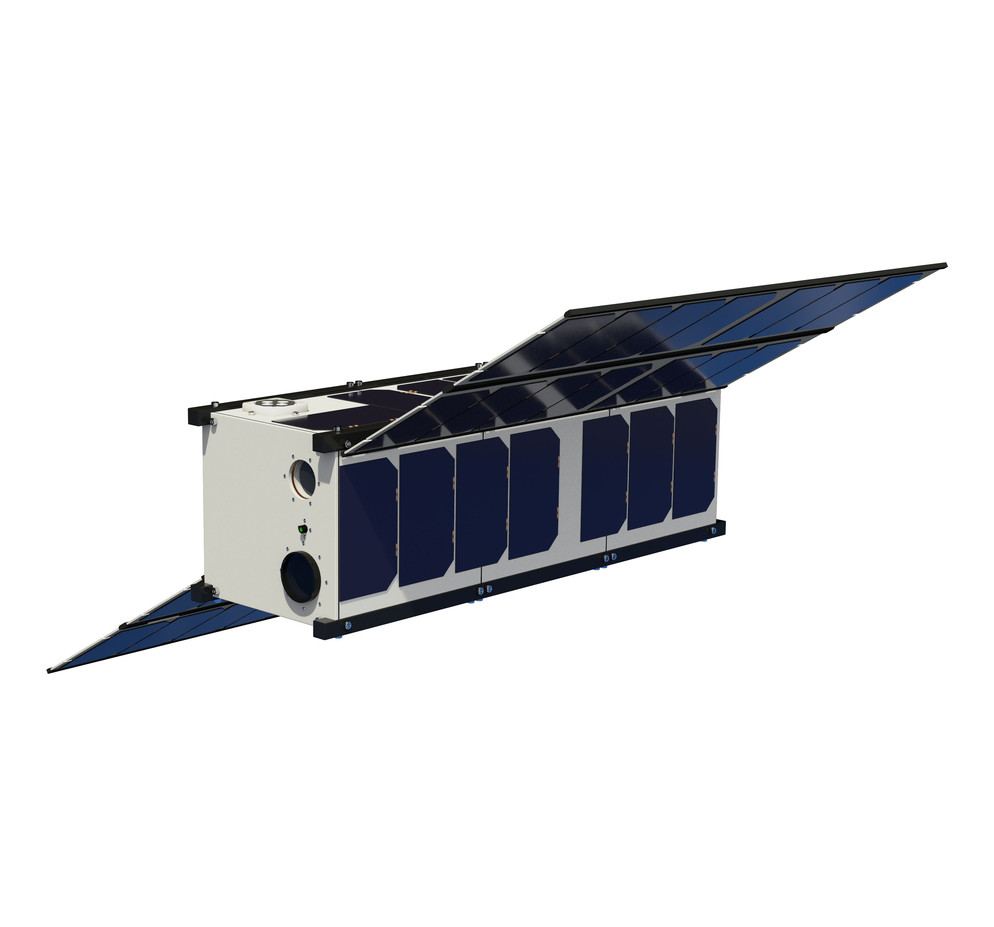
Upcoming U-Class Technology Demonstration Missions - 2024
CubeSat Laser Infrared CrosslinK
(CLICK B/C)
Launch Timeframe: December 2024
Demonstrate optical crosslink and precision ranging between two 3U CubeSats at a data rate of 20 Mbps and range up to 580 km
Image Credits: NASA

Slide 14
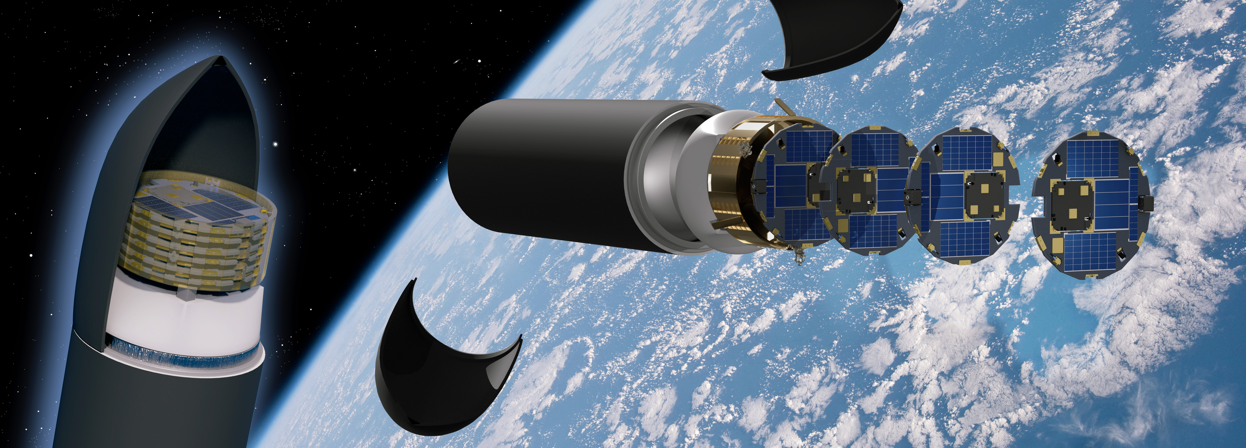
DiskSat
DiskSats are high-power and high-aperture alternatives to CubeSats. They are launched in tight stacks but are deployed individually to ensure no recontact between satellites. This first DiskSat demonstration is anticipated to launch no earlier than the last quarter of CY2024. Image Credit: The Aerospace Corporation

Slide 15

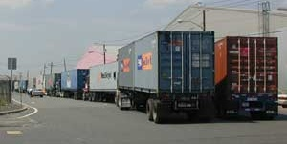
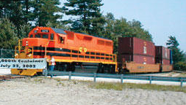
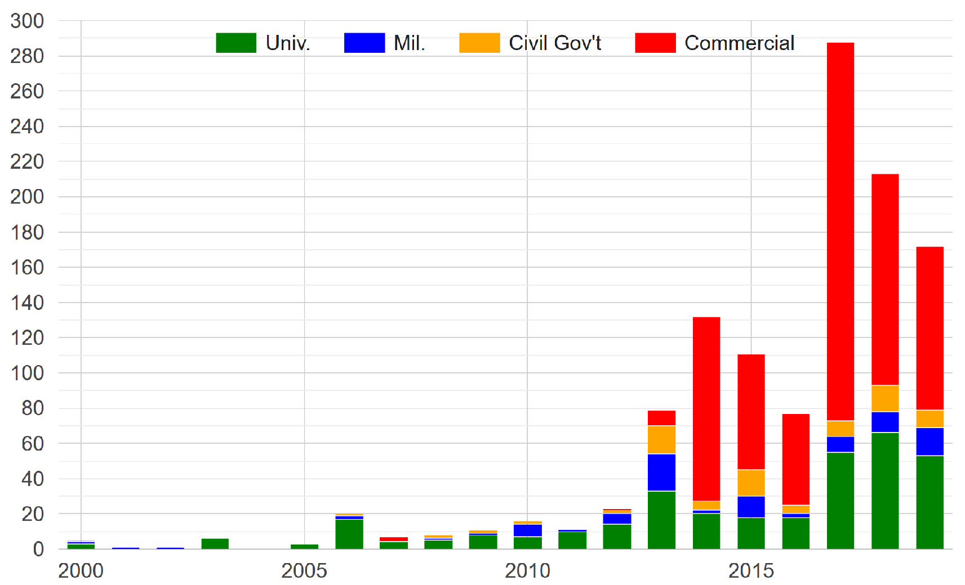
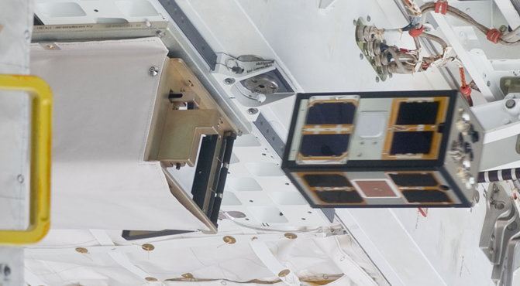
CubeSats and the Small-Satellite Revolution
Containerization of terrestrial shipping
The power of “containerization”
CubeSats revolutionized the small satellite industry through containerization, just as containerization revolutionized terrestrial shipping
  Containerization simplifies the interface and protects the host, enabling inexpensive rideshare
  In 20 years, well over 1000 CubeSats have been launched worldwide
  CubeSats have flown on at least 20 different launch vehicle types
CubeSats are rigidly constrained by the volume of the container
  Limits on power and aperture, even with complex deployables
Images courtesy U.S. DOT
Containerization
Reduced launch risk and simplified interface
Inexpensive rideshare
Frequent and flexible launch
Commercial expansion
CubeSats launched per year
Mass production
PSSCT-2 leaving dispenser on STS-135
Image courtesy NASA
Data from M. Swartwout
How to get the benefits of containerization without the limitations of CubeSats?
Slide Courtesy of The Aerospace Corporation

Slide 16
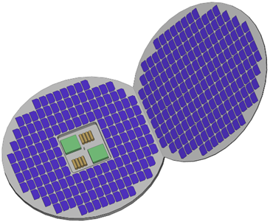
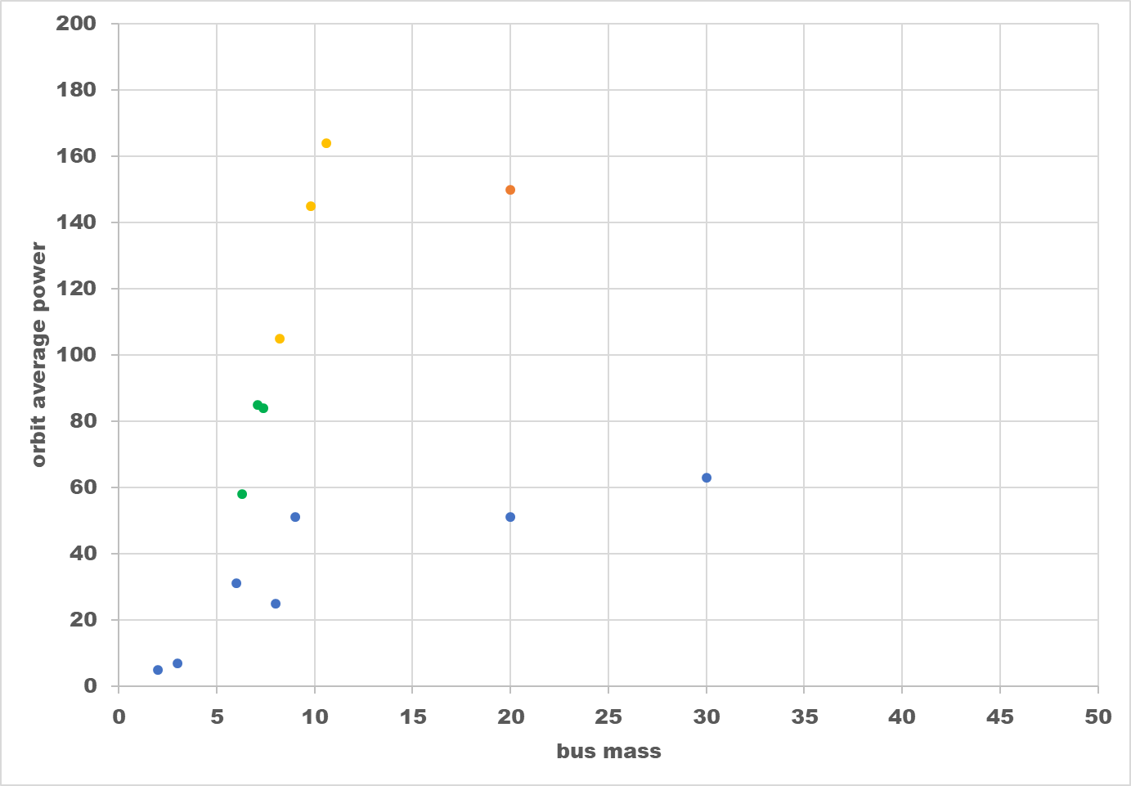
DiskSat Power Budget
DiskSat achieves high power-to-mass ratio without complex deployable solar panels
  1 m diameter has surface area of 0.79 m² and can hold 200 W of high-efficiency solar cells
  Alternatively, can host over 120 W of low-cost, moderate- efficiency cells
Optional deployed panel
  A simple rigid solar panel deployed on a single-hinge doubles surface area for little mass penalty
  At ~30 degrees, the deployed panel ensures steady orbit average power independent of solar beta angle
Thermal management is also simplified because the large surface area allows for sufficient area dedicated to heat dissipation without substantially interfering with power collection
DiskSats with deployable fixed-angle array
12U CubeSat with two 17-fold deployables
DiskSats with no deployables
Traditional satellites with standard deployables
Sun angles
Orbit velocity vector (into page)
Nadir
Typical orbit-average power available from various satellite bus designs assuming comparable LEO orbits
Deployable panel
Disk
Slide Courtesy of The Aerospace Corporation

Slide 17
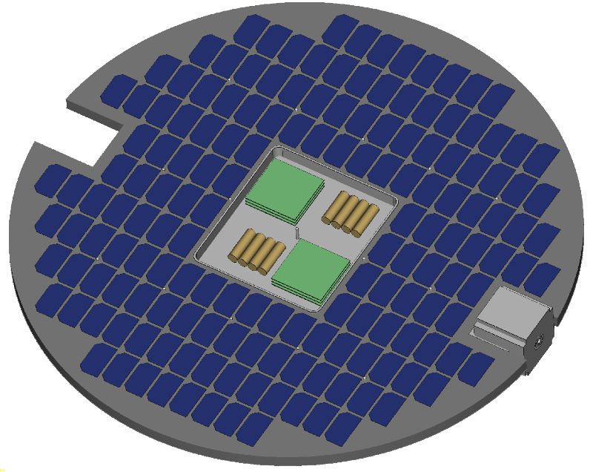
Maneuverability
High power combined with low mass
Power to mass ratio supports electric propulsion with high delta-v capability
Orbit raising
  Initial deployment at lower altitude increases launch payload mass
Orbit maintenance
  Less than 10 m/s/year delta-v maintains 600 km orbit
  VLEO: high delta-v combined with low drag of DiskSat is expected to enable sustained flight below 400 km
Rapid rephasing of constellations
Cis-Lunar space
  <4000 m/s delta-v required for transfer from GEO to lunar orbit
Electric thruster
Low drag for VLEO operations
322 cm² cross section
High drag for rapid deorbit
7700 cm² cross section
DiskSat has unparalleled orbit agility; high power combined with low drag and low mass
Slide Courtesy of The Aerospace Corporation

Slide 18
Slide Courtesy of The Aerospace Corporation

Slide 19
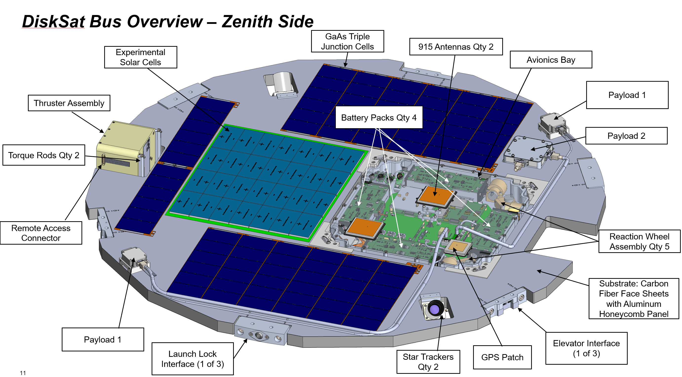
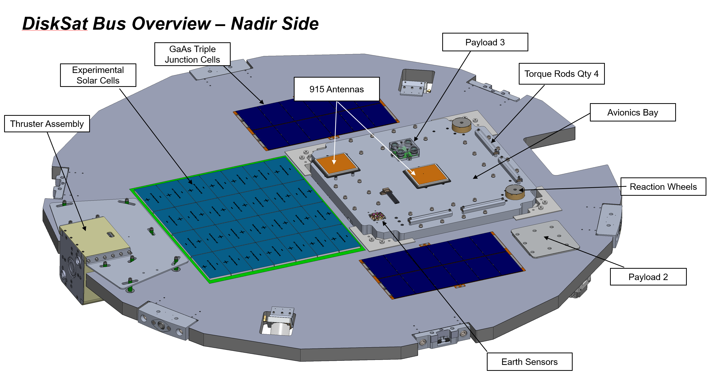
DiskSat Demonstration Mission
First flight of DiskSat
Plan: Fly four “DiskSat” satellites at low altitudes, equipped with electric propulsion
Experiment goals:
  Demonstrate performance/utility of DiskSat form factor
  Demonstrate multi-satellite deployment
  Demonstrate generation and management of up to 200 W peak power
  Demonstrate maneuverability and flight in Very Low Earth Orbit (VLEO)
Aerospace to operate satellites using Aerospace Ground Network
Task | Date
ATP | 4/28/2022
SRR | 07/08/2022
PDR (Bus) | 10/18/2022
PDR (Dispenser) | 11/18/2022
CDR (Bus) | 8/15/2023
CDR (Dispenser) | 8/29/2023
TRR (Bus) | April 2024
TRR (Dispenser) | March 2024
PSR (Bus) | August 2024
PSR (Dispenser) | August 2024
Launch | TBD
Slide Courtesy of The Aerospace Corporation

Slide 20
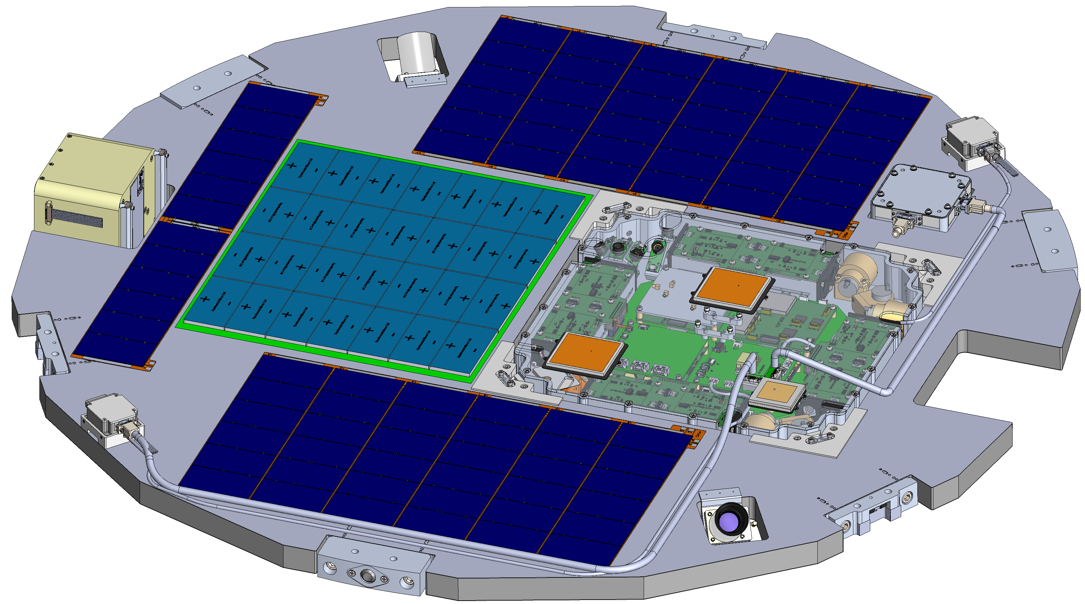
DiskSat Bus Overview – Zenith Side
GaAs Triple Junction Cells
915 Antennas Qty 2
Experimental Solar Cells
Avionics Bay
Payload 1
Thruster Assembly
Battery Packs Qty 4
Payload 2
Torque Rods Qty 2
Remote Access Connector
Reaction Wheel Assembly Qty 5
Substrate: Carbon Fiber Face Sheets with Aluminum Honeycomb Panel
Payload 1
Elevator Interface (1 of 3)
Launch Lock Interface (1 of 3)
Slide Courtesy of
The Aerospace Corporation
Star Trackers Qty 2
GPS Patch
Notes:
beth

Slide 21
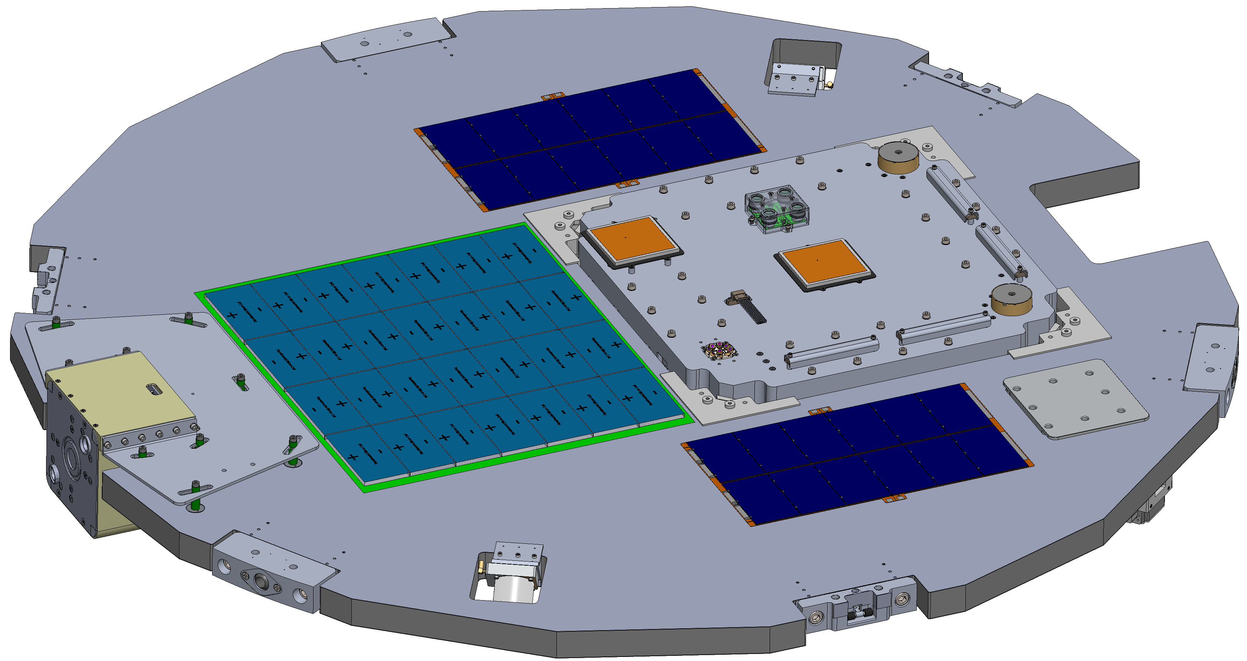
DiskSat Bus Overview – Nadir Side
Payload 3
GaAs Triple Junction Cells
Experimental Solar Cells
Torque Rods Qty 4
915 Antennas
Avionics Bay
Thruster Assembly
Reaction Wheels
Payload 2
Earth Sensors
Slide Courtesy of
The Aerospace Corporation
Notes:
beth

Slide 22
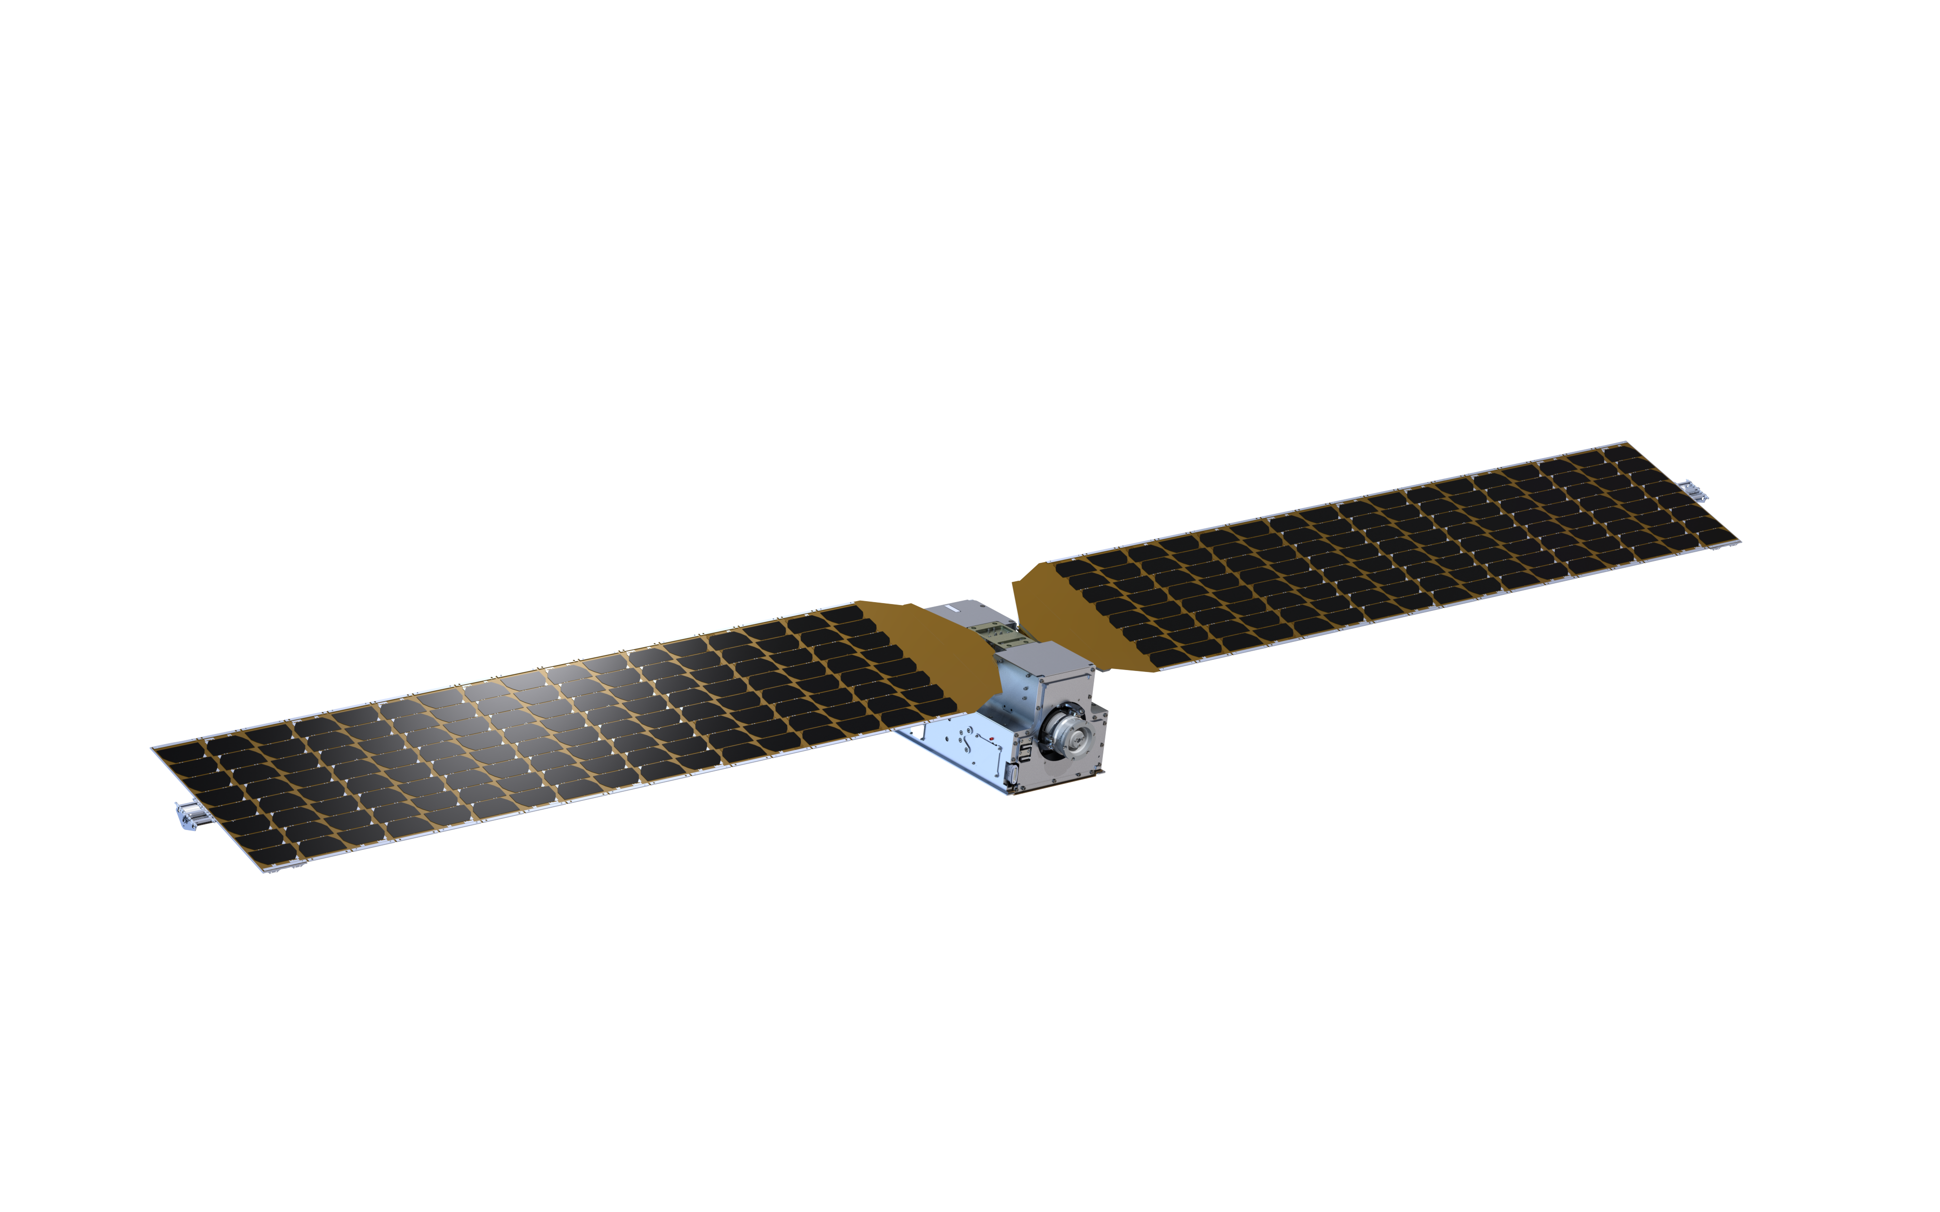
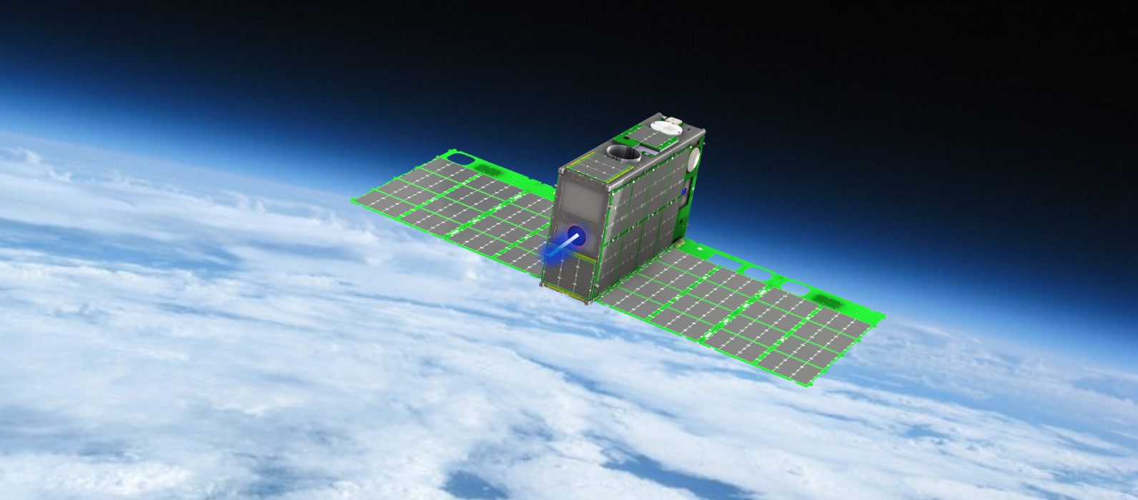
Tipping Point Projects – 2019
The 12U Courier CubeSat contains a compact, high impulse solar electric propulsion module that uses xenon as a propellant. The mission will demonstrate a Halo Hall Effect Thruster which operates between 85-175 W.
Launch Timeframe: Oct. 2024
Image Credits: ExoTerra Resource, LLC.
A 6U Dual Propulsion Experiment (DUPLEX) CubeSat. Both propulsion systems, the Fiber-fed Pulsed Plasma Thruster and Monofilament Vaporization Propulsion, were developed with NASA SBIR funding.
Launch Timeframe: Feb. 1, 2024
Image Credits: CU Aerospace, LLC.

Slide 23
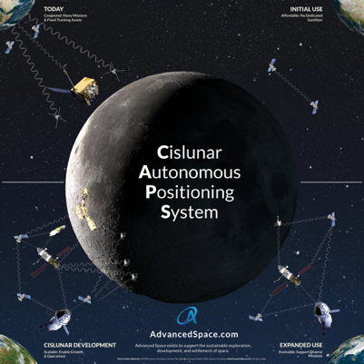
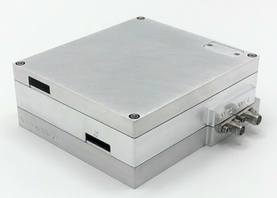
Announcement of Collaboration Opportunity Projects – 2018
Diagram of the concept of operations for the Cislunar Autonomous Position System (CAPS). CAPS is an innovative spacecraft-to-spacecraft navigation solution to be demonstrated on the CAPSTONE mission currently in orbit around the Moon. CAPS is anticipated to allow future spacecraft the ability to determine their location relative to the Moon without relying exclusively on tracking from Earth.
Image Credits: Advanced Space, LLC
A public-private partnership with NASA’s Goddard Space Flight Center
The Vulcan Wireless CubeSat radio, NSR-SDR-S/S. This CubeSat radio is a fully integrated, full-duplex, software-defined radio transponder. The radio transponder is being tested for compatibility with NASA’s Space Network.
Image Credits: Vulcan Wireless, Inc.
A public-private partnership with NASA’s Goddard Space Flight Center

Slide 24
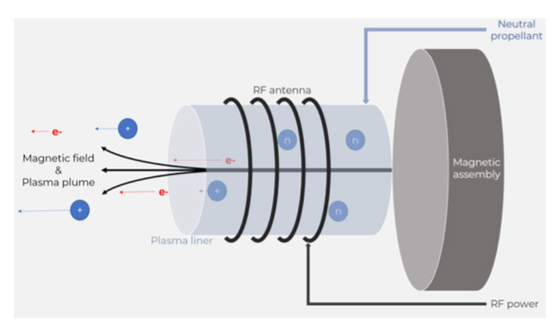
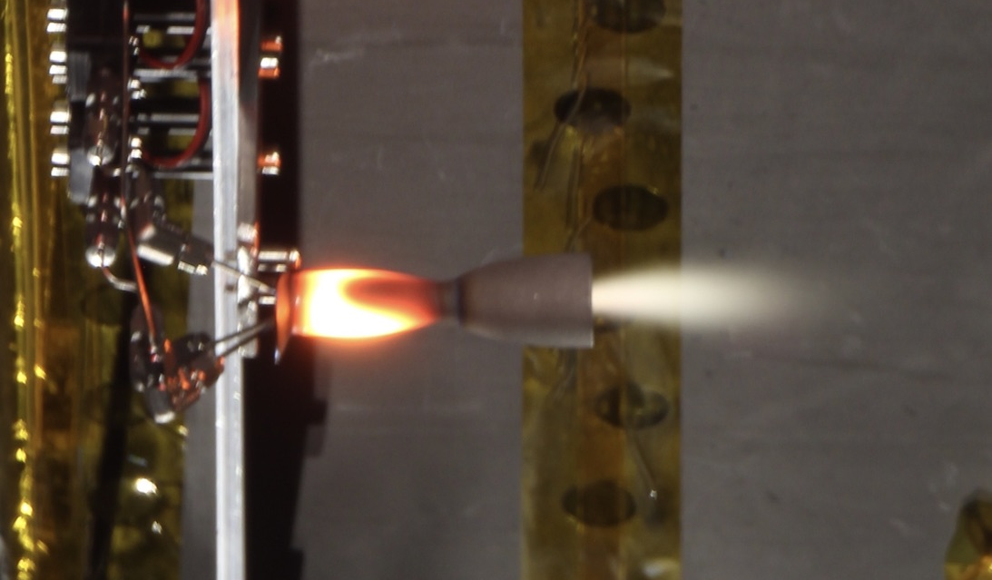
Announcement of Collaboration Opportunity Projects - 2020
The Phase Four RF plasma thruster operates by using RF to heat propellant into ionized plasma that is then ejected away from a spacecraft by a permanent magnet, creating thrust.
Image Credits: Phase Four
A public-private partnership with NASA’s Glenn Research Center
A prototype bipropellant thruster is shown in ambient pressure testing. The key technology being tested is the propellant pump - an enabling technology for launch safety approval (no stored gas) and system performance (lightweight tanks). Testing includes a propulsion system composed of monopropellant and bipropellant systems.
Image Credits: Stellar Exploration, Inc.
A public-private partnership with NASA’s Ames Research Center

Slide 25

University SmallSat Technology Partnership Successes to Date
Investments:
Over $30,000,000 awarded
54 partnerships in 6 cohort years
36 universities in 22 states (+6 supporting collaborators in 6 states)
8 of 10 NASA centers partnered
Results:
24 flight demonstrations performed/planned
1 Intersatellite Network Planning/ Routing tool software open-sourced
36 Universities in 22 States
8 NASA Centers (including JPL FFRDC)
6 Supporting University Collaborators in 6 States
Numerous New Technology Reports/Patents
30+ conference presentations
50+ papers published
100+ students involved
Many technology readiness levels (TRL) raised

Slide 26
2013 University SmallSat Technology Partnership Cohort
106 proposals submitted
13 proposals selected
Technical Topics:
  Communications
  GN&C
  Propulsion
  Power
  Science Instrument Capabilities
  Advanced Manufacturing
Project | Topic | PI | University | NASA Support | Center
High Rate CubeSat X-band/S-band Communication System | Comm | Scott Palo | University of Colorado, Boulder | Sarah Melssen, Gary Crum, ALTUNC, SERHAT, Scott Schaire, Steven Bundick, | GSFC/ MSFC
Space Optical Communications Using Laser Beam Amplification | Comm | Govind Agrawal | University of Rochester | Peter Goorjian | ARC
Development of Novel Integrated Antennas for CubeSats | GN&C | David Jackson | University of Houston | Patrick Fink | JSC
SmallSat Precision Navigation with Low-Cost MEMS IMU Swarms | GN&C | John Christian | West Virginia University | Darryl Mary | JSC
CubeSat Autonomous Rendezvous & Docking Software (CARDS) | Science Instrument Capabilities | Glenn Lightsey | University of Texas, Austin | Christopher D'Souza, Darryl Mary, James Casey | JSC
Radiation Tolerant, FPGA-based SmallSat Computer System |  | Brock LaMeres | Montana State University, Bozeman | Tom Flatley | GSFC/ MSFC
An Integrated Precision Attitude Determination and Control System | GN&C | Norman FitzCoy | University of Florida, Gainsville | Zhiqiang Zhou, Carlos Roithmayr, Natalie Clark | LaRC
Propulsion System and Orbit Maneuver Integration in CubeSats | Propulsion | Jennifer Hudson | Wester Michigan University, Kalamazoo | Damon Landau, Charles Vanelli, Eric Gustafson, Richard Hfofer, Sara Spangelo | JPL
Film-Evaporation MEMS Tunable Array for PicoSat Propulsion and Thermal Control | Propulsion | Alina Alexeenko | Purdue University | Eric Cardiff | GSFC
SmallSat Low Mass, Extreme Low Temperature Energy Storage | Power | Sharlene Katz | California State University, Northridge | Naomi Palmer, William West | JPL
Compressive Sensing for Advanced Imaging and Navigation | GN&C | Richard Kurtwitz | Texas Engineering Experiment Station | Paul Manhart, Glenn Hines, | LaRC
Mini Fourier-Transform Spectrometer for CubeSat-Based Remote Sensing | Science Instrument Capabilities | John Allen | Appalachian State University (supported by University of Maryland - Baltimore County) | Shahid Aslam, Patrick Roman, Qian Gong | GSFC
Printing the Complete CubeSat | Advanced Manufacturing | Craig Kief | University of New Mexico (supported by University of Texas - El Paso, Drake State Technical College) | Kyla Sorensen, Brian Zufelt, Susan De Los Sanots | GRC
Notes:
The first class of Smallsat Technology Partnerships was launched in 2013. 13 proposals were selected. Technologies encompassed: Communications, Guidance, Navigation and Control, Propulsion, Power, Science Instrument Capabilities, Advanced Manufacturing. Several of these successful technologies were subsequently incorporated into further development efforts and missions. <Which ones flew?>

Slide 27
2015 University SmallSat Technology Partnership Cohort
109 proposals submitted
8 grants awarded
Technology Topic Areas:
  Precise attitude control and pointing systems for CubeSats
  Power generation, energy storage, and thermal management systems
  Simple low cost deorbit systems
  Communications and tracking systems and networks
Project | Topic | PI | University | NASA Support
Solid State Inflation Balloon Active Deorbiter | Prop | Adam Huang | University of Arkansas, Fayetteville | David Mayer, Robin Beck, Kimberly Hines | ARC
Miniaturized Phonon Trap Timing Units for PNT of Cubesats | GN&C | Mina Rais-Zadeh, Associate | University Of Michigan, Ann Arbor | Serhat Altunc | GSFC
Design and Validation of High Date Rate Ka-Band Software Defined Radio of Small Satellite | Comm | Tian Xia Xinming Huang | University of Vermont (supported by Worcester Polytechnic Institute) | Wai Fong, Wing Lee | GSFC
Propellantless attitude control of solar sail technology utilizing reflective control devices | GN&C | Jeremy Munday | University of Maryland, College Park | Tiffany Russell | MSFC
Integrated Solar-Panel Antenna Array for CubeSats (ISAAC) | Power | Reyhan Baktur | Utah State University | Serhat Altunc | GSFC
Small Spacecraft Integrated Power System with Active Thermal Control | Power Thermal | Alexander Ghosh | University Of Illinois, Urbana-Champaign | David Mayer | ARC
Mems Reaction Control and Maneuvering for Picosat beyond LEO | GN&C | Alina Alexeenko | Purdue University | Eric Cardiff | GSFC
Active CryoCubeSat | Thermal | Charles Swenson | Utah State University | Douglas Hofmann Jose Rodriguez A J Mastropietro | JPL
Notes:
Show projects, partners, lab demos, flight demos
<See SPAR spreadsheet for closeout results, tech transfer: Which ones flew? Which lab demos?

Slide 28
2016 University SmallSat Technology Partnership Cohort
80 proposals submitted
8 grants awarded
Technology Topic Areas:
  Enhanced Power Generation and Storage
  Cross-linking Communications Systems
  Relative Navigation for Multiple Small Spacecraft
  Instruments and Sensors for Small Spacecraft Science Missions
Project | Topic | Speaker/PI | Univ. | NASA Support | Center
Highly Integrated THz Receiver Systems for Small Satellite Remote Sensing Applications | Instrument | Christopher Groppi | Arizona Sate University | Jose Siles | JPL
Development of New Low-Resource Magnetometers for Small Satellites | Instrument | Mark Moldwin | Univ. of Mich. Ann Arbor | Eftyhia Zesta | GSFC
Precision GNSS-Based Navigation and Timekeeping for Miniaturized Distributed Space Systems | Navigation | Simone D'Amico | Stanford University | Neerav Shah | GSFC
Smoothing Based Relative Navigation & Coded Aperature Imaging | Navigation | Alvar Saenz Otero | Massachusetts Institute of Technology | Carl Liebe, Norbert Sigrist | JPL
Fast, power efficient pulsed modulators and receivers for space-to-space optical communications | Comm | John Conklin | Univ. of Florida, Gainsville | Belgacem Jaroux | ARC
Development of Lightweight Cubesat with Multifuncitonal Structural Battery Systems | Power | Ryan Karkkainen | Univ. of Miami, Coral Gables | Luke Roberson | GRC KSC
Omnidirectional Inter-satellite Optical Communicator | Cross | Ozdal Boyraz | UC Irvine | Jose Velazco | JPL
Demonstration of a Nano-Enabled Space Power System | Enhanced Power Gen/Storage | Ryne Raffaelle | Rochester Institute of Technology | Geoffrey Landis | GRC
Notes:
Show projects, partners, lab demos, flight demos
<See SPAR spreadsheet for closeout results, tech transfer: Which ones flew? Which lab demos?

Slide 29
2018 University SmallSat Technology Partnership Cohort
111 proposals submitted
8 grants awarded
Technology Topic Areas:
  Instrument Technologies for Small Spacecraft (including multipoint measurements from multiple SmallSats)
  Technologies that Enable Large Swarms of Small Spacecraft
  Technologies that Enable Deep Space Small Spacecraft Missions
Project | Topic | PI | University | NASA Support | Center
Autonomous Nanosatellite Swarming using Radio Frequency and Optical Navigation | Swarms | Simone D’Amico | Stanford | Charles “Scott” Richey | ARC
SPRINT: Scheduling Planning Routing Intersatellite Network Tool | Swarms | Kerri Cahoy | MIT | Jeremy Frank | ARC, GSFC
Application of Machine-learning Algorithms for On-board Asteroid Shape Model Determination and Spacecraft Navigation | Deep Space | Dante Lauretta | University of Arizona | William Cutlip | GSFC
Milli-Arcsecond (MAS) Imaging with Smallsat-Enabled Super-resolution | Instruments | Farzad Kamalabadi | University Of Illinois, Urbana-Champaign | Joseph Davila | GSFC
Distributed Attitude Control and Maneuvering for Deep Space SmallSats | Deep Space | Alina Alexeenko | Purdue University | Khary Parker and Andy Heaton | GSFC, MSFC
Active Thermal Architecture for Cryogenic Optical Instruments | Instruments | Charles Swenson | Utah State | Ian McKinley | JPL
High Specific-impulse Electrospray Explorer for Deep-space (HiSPEED) | Instruments | Paulo Lozano | MIT | Swati Mohan | JPL
Move to Talk, Talk to Move: Tightly Integrated Communication and Controls for Coordinated Swarms of Small Spacecraft | Swarms | Qi Han | Colorado School of Mines | Jean-Pierre de la Croix | JPL
Notes:
After consultation with stakeholders, he 2018 STP solicitation, released in <month> 2017, requested proposals for Instruments for SmallSats including instruments that enable multipoint measurements from multiple SmallSats; technologies that enable SmallSats to operate in deep space; and technologies that enable swarms of SmallSats.
B. Volume, range of submittals, Design Ref Missions proposed: 111 proposals were submitted.
Volume, range of submittals, Design Ref Missions proposed: 111 proposals were submitted.

Slide 30
2020 University SmallSat Technology Partnership Cohort
50 proposals submitted
9 grants awarded
Technology Topic Areas:
  Lunar Communications and Navigation Network
  Smallsat Propulsion for Lunar Missions
  Advanced Electrical Power Subsystem and Thermal Management Technology
Project | Topic | PI | University | NASA Support | Center
Flat Panel Phased Array Antennas with Two Simultaneous Steerable Beams utilizing 5G Ka-Band Silicon RFICs for Tx/Rx Communications between 6U Small Satellite and Lunar surface, Gateway and Earth | Lunar Comm/Nav Network | Satish Sharma | San Diego State University | James Nessel | GRC
3-D Printed Hybrid Propulsion Solutions for SmallSat Lunar Landing and Sample Return | Propulsion | Stephen Whitmore | Utah State University | George Story | MSFC
A high-precision continuous-time PNT compact module for the LunaNet small spacecraft | Lunar Comm/ Nav Network | Chee Wei Wong | University of California, Los Angeles | Andrey Matsko | JPL
Variable Specific Impulse Electrospray Thrusters for Smallsat Propulsion | Propulsion | Manuel Gamero-Castano | University of California, Irvine (supported by California Polytechnic State University, San Luis Obispo) | John Ziemer | JPL
An Additively Manufactured Deployable Radiator with Oscillating Heat Pipes (AMDROHP) to Enable High Power Lunar CubeSats | Power/ Thermal Management | Yen Kuo | California State University, Los Angeles | Benjamin Furst | JPL
Deployable Optical Receiver Aperture for Lunar Communications and Navigation | Lunar Comm/Nav Network | Daniel Jacobs | Arizona State University | Lin Yi | JPL
On-Orbit Demonstration of Surface Feature-Based Navigation and Timing | Lunar Comm/ Nav Network | Brandon Jones | University of Texas, Austin | Christopher D'Souza | JSC
A Small Satellite Lunar Communications and Navigation System | Lunar Comm/ Nav Network | Scott Palo | University of Colorado, Boulder | Mazen Shihabi | JPL
Lunar Missions Enabled by Chemical-Electrospray Propulsion | Propulsion | Joshua Rovey | University Of Illinois, Urbana-Champaign | Thomas Liu | GRC, GSFC

Slide 31
2023 University SmallSat Technology Partnership Cohort
62 Preliminary Proposals submitted
17 full proposals submitted
8 grants awarded
Technology Topic Areas:
  Earth- and Global Navigation Satellite System-Independent Position Navigation and Timing for Small Spacecraft​
  Edge Computing and Machine-Learning Architectures, Software, Platforms, and Devices for Small Spacecraft​
  High Specific Power Systems and Thermal Control for Small Spacecraft​
Project | Topic | PI | University | NASA Support | Center
An Autonomous Optical Navigation Instrument for Deep Space Exploration​ | Navigation/ PNT | John Christian | Georgia Institute of Technology | Rebecca Inman | JSC
Deep Space PNT Instrument (DESPINA)​ | Navigation/ PNT | Demoz Gebre-Egziabher​ | University Of Minnesota | Marc Murbach | ARC
Ultrastable microphotonic clocks for a Cislunar small spacecraft​ | Navigation/ PNT | Kerry Vahala | California Institute of Technology​ | Andrey Matsko | JPL
SCALES: Spacecraft Compartmentalized Autonomous Learning and Edge-computing System​ | Edge Computing/ ML | Phyllis Nelson​ | California State Polytechnic University Pomona | Jeffery Levison | JPL
Low-power Array for CubeSat Edge Computing Architecture, Algorithms and Applications​ | Edge Computing/ ML | Charles Swenson​ | Utah State University​ | Joe Casas and Scott Tashakkor | MSFC
SmallSat Steward: Autonomous Online Learning and Planning for Safe Inspection of Cislunar Stations​ | Edge Computing/ ML | Oliver Jia-Richards | University Of Michigan, Ann Arbor​ | Keenan Albee and David Sternberg | JPL
Passive thermally deployed shape-memory alloy heat-pipe radiators for high-intensity small spacecraft​ | Power/ Thermal | Alexander Rattner​ | Pennsylvania State University | William Sixel and Bilal Bomani | GRC
Passively Deployed Radial Radiator for Transfer and Rejection of CubeSat Waste Heat​ | Power/ Thermal | Rydge Mulford​ | University Of Dayton (supported by Brigham Young University) | Franklin Robinson | GSFC
Notes:
The sixth cohort of the initiative – now USTP to eliminate confusion with Space Test Program – underwent an updated process from a single proposal submission phase to a two-step submission process. Phase 1: Proposers were asked to submit a Mandatory Preliminary Proposal, and reviewers down selected to 17 MPPs that were invited to submit a full proposal. Of the 17 Full proposals, 8 were awarded.

Slide 32
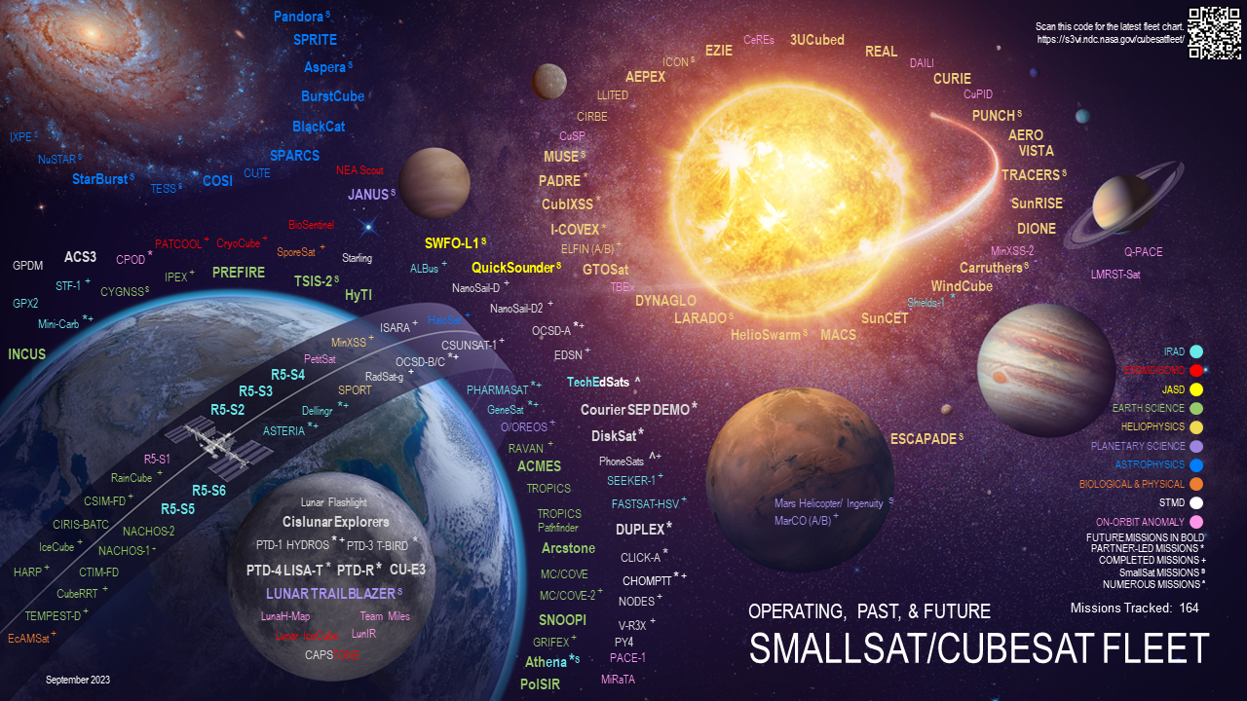

Slide 33






Space Technology Mission Directorate’s Strategic Framework
Go
Rapid, Safe, & Efficient Space Transportation
Land
Expanded Access to Diverse Surface Destinations
Live
Sustainable Living and Working Farther from Earth
Explore
Transformative Missions and Discoveries
Lead
Ensuring American global leadership in Space Technology
Nuclear Systems
Cryogenic Fluid Management
Advanced Propulsion
Entry, Descent, Landing, & Precision Landing
Advanced Power
In-Situ Resource Utilization
Advanced Thermal
Advanced Materials, Structures, & Construction
Advanced Habitation Systems
Advanced Avionics Systems
Advanced Communications & Navigation
Advanced Robotics
Autonomous Systems
Satellite Servicing & Assembly
Advanced Manufacturing
Small Spacecraft
Rendezvous, Proximity Operations & Capture
Sensor & Instrumentation
Advance US space technology innovation and competitiveness in a global context
Encourage technology driven economic growth with an emphasis on the expanding space economy
Inspire and develop a diverse and powerful US aerospace technology community
Learn more about NASA’s critical technology needs at
techport.nasa.gov/framework
Credits: ???

Slide 34
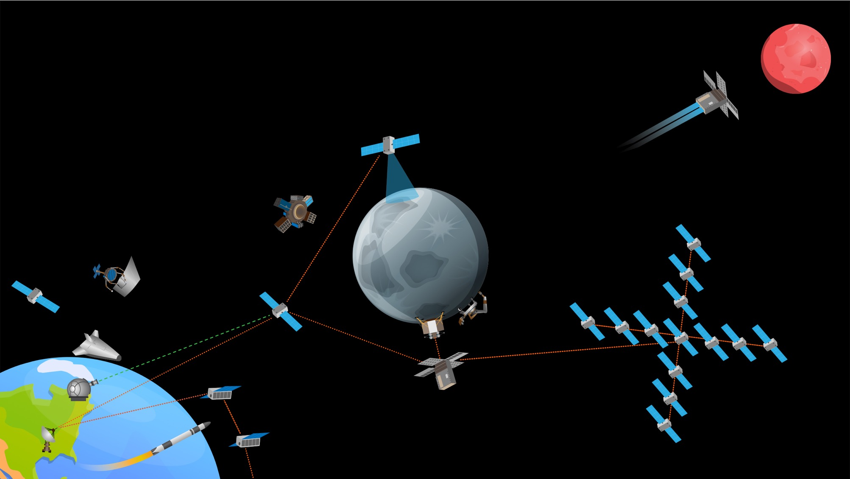
CHANGING THE PACE OF SPACE
Leveraging small spacecraft and responsive launch to rapidly expand space capabilities at dramatically lower costs
Rapid Leap from Lab to Orbit
On-Demand Missions Beyond Earth
Commercial suborbital and orbital test capabilities de-risking technology for future missions. Technology moves from lab to orbit in <9 months.
Responsive deep space access
Targeted measurements of Moon, Mars, Venus, and the asteroid belt in response to events and opportunities. Capabilities are competitive with traditional systems but developed for <$30M in <3 years.
Sustained deep space presence
Commercial lunar activity
In-situ resource extraction
and utilization
Expanded space commerce
On-orbit manufacturing, assembly, and inspection
Unparalleled Sensing Capabilities
Networked spacecraft providing multi-kilometer synthetic apertures and massive sensor webs of 30 to 100 spacecraft. Each node costs <$10M to build and deliver to space.
Unprecedented Deep Space Infrastructure
Modular communications, navigation, and mission support that provides full coverage of Moon and Mars. Each node costs <$20M to build and deliver to space.
NOT ALL ACTIVITIES DEPICTED ARE CURRENTLY FUNDED OR APPROVED. DEPICTS “NOTIONAL FUTURE” TO GUIDE TECHNOLOGY VISION

Slide 35



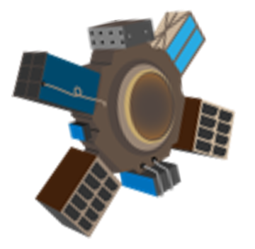


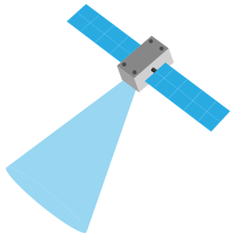




High dV Small Spacecraft Propulsion Systems
Deep Space Orbital Maneuvering Vehicles
Enables small spacecraft missions to the Moon, Lagrange Points, Mars, Venus, and near-Earth objects (NEOs) as well as longer duration and more responsive missions in Earth orbit, including those at lower-altitude or requiring plane changes.
Low-SWaP-C systems capable of imparting 2-5+ km/s dV at the microsatellite scale. Highly manufacturable with repeatable performance and compatible with the deep space environment.
Enables expansion of small risk-tolerant missions further beyond Earth. Enables small missions to reach multiple destinations from a single launch, achieve multiple orbital plane changes or nontraditional orbits, and reach beyond the Moon, Mars, and Venus to asteroids in the main belt or other deep space objects.
OMVs capable of 10+ km/s dV and that can provide position, navigation, and timing (PNT), communications relay, and other services to deployed spacecraft or hosted payloads. Affordable and demonstrated in the deep space environment.

Slide 36





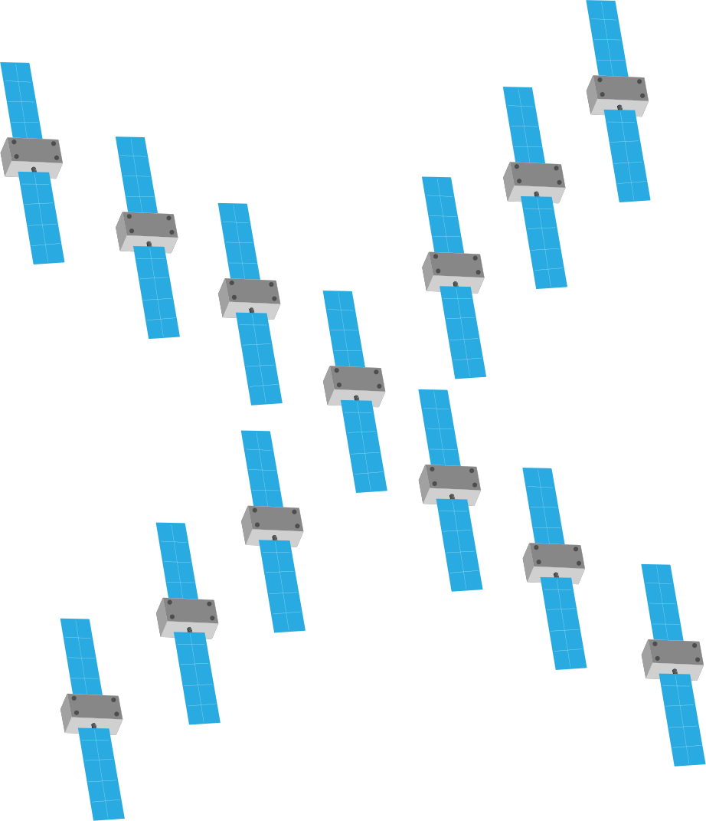



Significant (circa 75%) reduction in ground station aperture time for single small spacecraft missions. Increased in-space autonomy that allows 10’s of small spacecraft to operate as a single unit beyond Earth.
Significant (circa 75%) reduction in ground station aperture time for single small spacecraft missions. Increased in-space autonomy that allows 10’s of small spacecraft to operate as a single unit beyond Earth.
Significant (circa 75%) reduction in ground station aperture time for single small spacecraft missions. Increased in-space autonomy that allows 10’s of small spacecraft to operate as a single unit beyond Earth.
In-Space Autonomy for Small Spacecraft and Distributed Systems
Small Spacecraft Communications and Position, Navigation,
and Timing (PNT)
Services
Interoperable Networking for Small Missions
Enables large distributed missions such as sensor webs for heliophysics and advanced Earth-orbiting missions that can
react without ground stations in the loop. Single-spacecraft
autonomy can enable near-“lights out” operations for missions beyond Earth.
Significant (circa 75%) reduction in ground station aperture time for single small spacecraft missions. Increased in-space autonomy that allows 10’s of small spacecraft to operate as a single unit beyond Earth.
Can help address the strain on current terrestrially based capabilities - particularly tracking - from future cislunar and deep space missions. Offers options for cislunar and lunar surface missions where direct communications with Earth-based systems will not be available.
Small spacecraft that can be deployed to the Moon and deep space destinations to provide global lunar / comprehensive PNT and communications relay infrastructure
Enables ubiquitous communication between in-space assets, airborne systems, in-situ sensors, and ground assets. In cislunar space, will enable a network of surface and orbital nodes, low-SWaP-C relays, and more capable assets that can serve as hubs connecting to Earth-based communication networks.
Increased interoperability between government and commercial space networks. Operational interoperability protocols that help pair the NASA LunaNet concept with the Hybrid Space Architecture and existing capabilities like DTN.

Slide 37
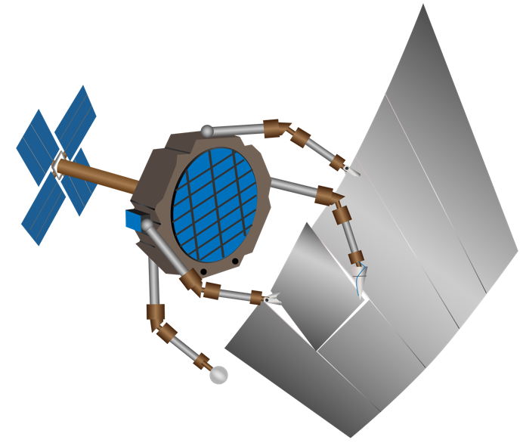

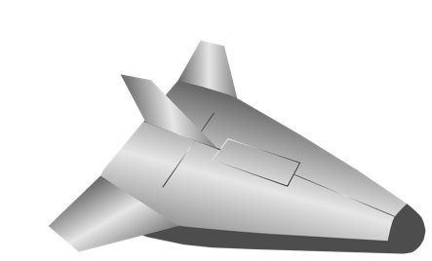

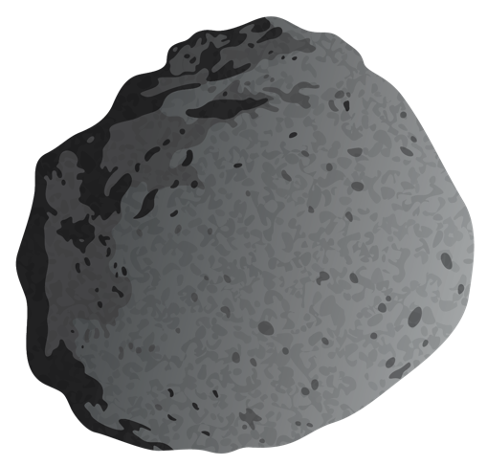
Small Spacecraft Proximity Operations and Abort Systems
Responsive Access to Suborbital and Orbital Space
Needed to reduce risk in use of small satellites in close proximity to high value assets. These systems can also enable small missions to natural targets like NEOs or other missions requiring persistent formation flight.
De-risked low-SWaP-C proximity sensors, software, and reliable proximity abort systems.
Rapid advancement of capabilities requires frequent opportunities to test and evaluate new technology in an operational environment. Embracing “fly-fix-fly” and agile aerospace practices allows technologists to iterate through flights, and failures, to innovate at a pace impossible in a less risk-tolerant environment.
Additional vehicle performance and payload accommodations, including payloads hosted on recoverable orbital launch vehicle stages and greater access to orbital platforms for hosted technology testing.

