Slide 1
PACE OCI crosstalk characterization based on pre-launch testing
Shihyan Lee^{1,2}, Gerhard Meister¹, Samuel Kitchen-McKinley³, Joseph Knuble⁴, Ulrik Gliese⁵, and Robert Bousquet⁶
¹NASA Code 616, Ocean Ecology Lab, Goddard Space Flight Center, Greenbelt, Greenbelt Rd., Maryland, MD 20771, USA
²Science Applications International Corporation, 12010 Sunset Hills Rd., Reston, VA 20190, USA
³Science Systems and Applications Inc., 10210 Greenbelt Road, Lanham, Maryland 20706, USA
⁴NASA Goddard Space Flight Center, Greenbelt, Greenbelt Rd., Maryland, MD 20771, USA
⁵KBR, 7701 Greenbelt Rd., Greenbelt, MD 20770, USA
⁶Genesis Engineering Solutions, Inc., 4501 Boston Way, Lanham, MD 20706, USA
SPIE Sensors + Imaging, Amsterdam, NL September 6, 2023
Notes:
1
1

Slide 2
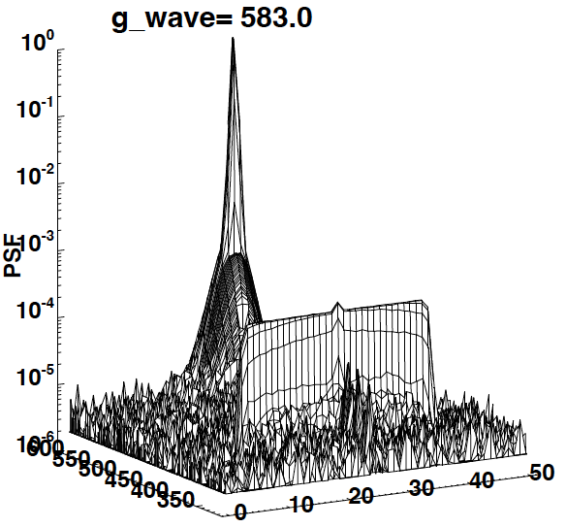
High Contrast Scene Measurements
Straylight
Curtain
1 SP mask
LSF Bench
OCI
Near-field crosstalk
GAToR
GLAMR
ghost@ 382.8nm
31 pixel wide
Source: collimated, mono-chromatic light (GLAMR) @ 583 nm.
Near-field crosstalk into adjacent pixels and wavelengths (bands); exponential decay
Ghost at specific wavelengths and pixels; constant
Wavelength (nm)
pixel
LSF = Line spread function

Slide 3
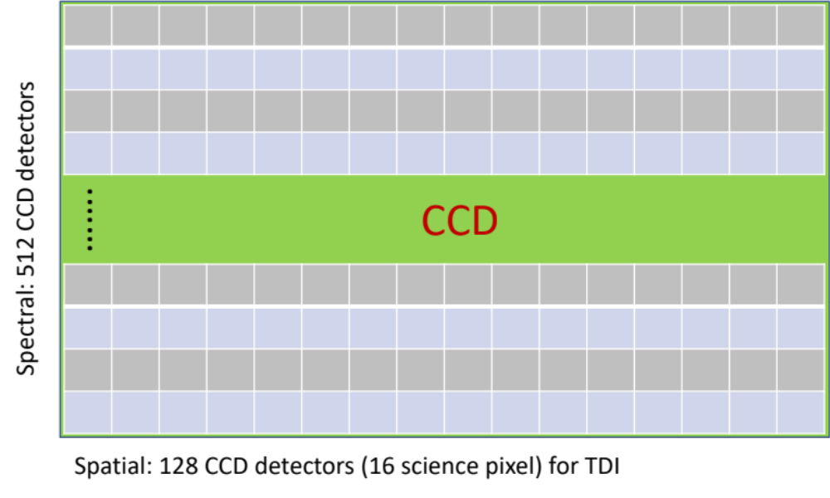
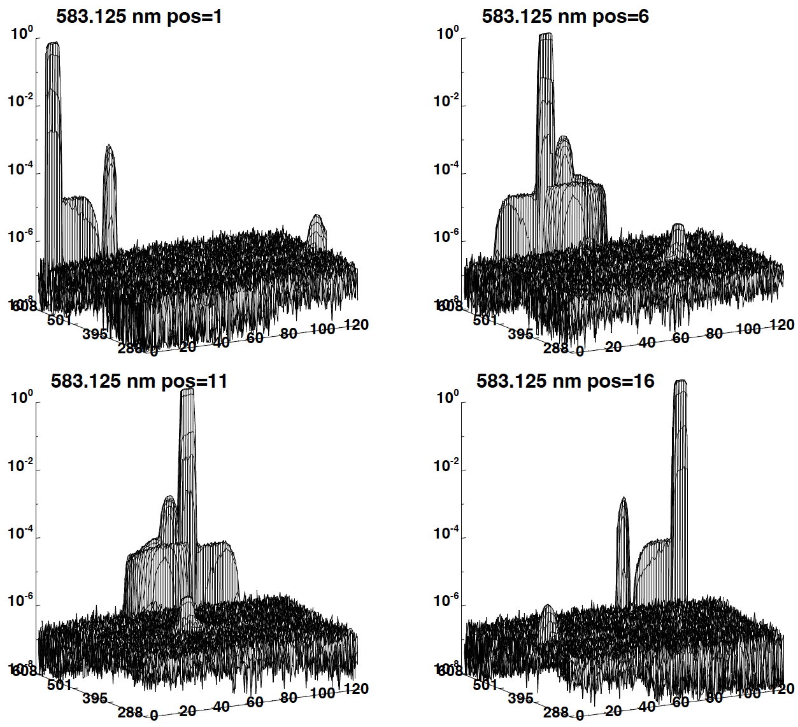
Ghost vs. TDI
(a)
(b)
ghost
@pos=16
ghost
@pos=10
(a)
(b)
(c)
(d)
Wave (nm)
pixel
Ghost and TDI are spatially asynchronous. Source and corresponding ghost pixels are at mirrored positions.
Effects illustrated by OCI optical model
Quantified using test data
(c)
(d)
ghost
@pos=1
ghost
@pos=5

Slide 4
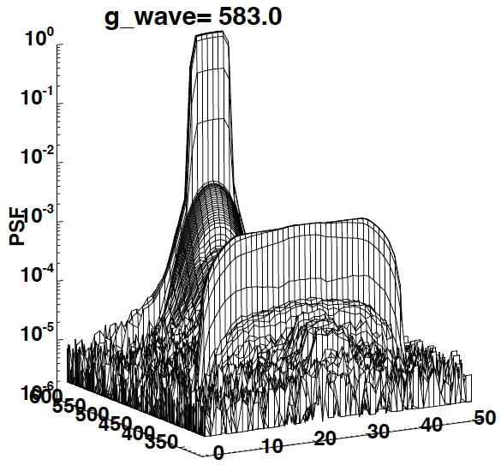
High Contrast Scene Measurements
(a)
(b)
LSF-SP
LSF-7SP
ghost
@382.8nm
ghost
@382.8nm
Wavelength (nm)
Wavelength (nm)
pixel
pixel
LSF 1 science pixel mask (LSF-SP) vs. 7 science pixel mask (LSF-7SP)
Stronger and wider ghost in LSF-7SP data than LSF-SP data
PSF = point spread function, g_wave = GLAMR wavelength

Slide 5
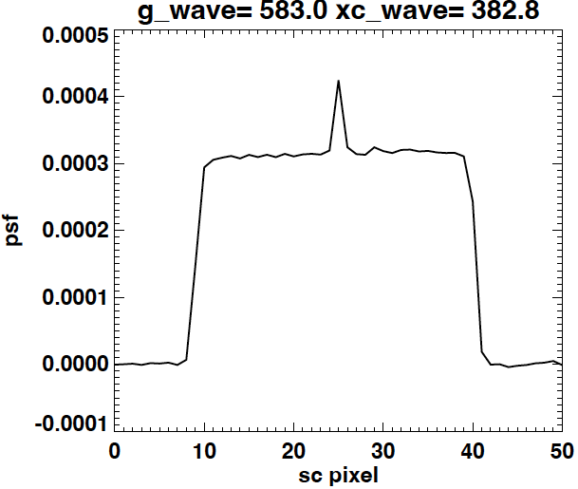
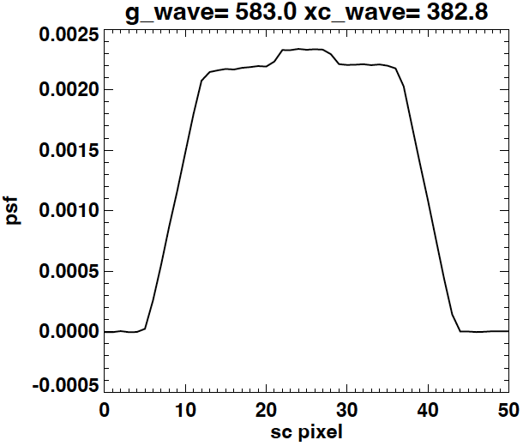
Ghost: LSF-SP vs LSF-7SP
(a)
(b)
OOB
OOB
LSF-7SP
LSF-SP
ghost 0.22%
ghost 0.031%
31 pixel
37 pixel
Ghost Magnitude: LSF-7SP ~ 7x LSF-SP
Ghost Spatial extent: LSF-7SP ~ LSF-SP + 6 pixels
Ghost = convolution of (source and LSF-SP ghost feature)
OOB response (RSR): LSF-7SP ~ LSF-SP
OOB = out-of-band

Slide 6
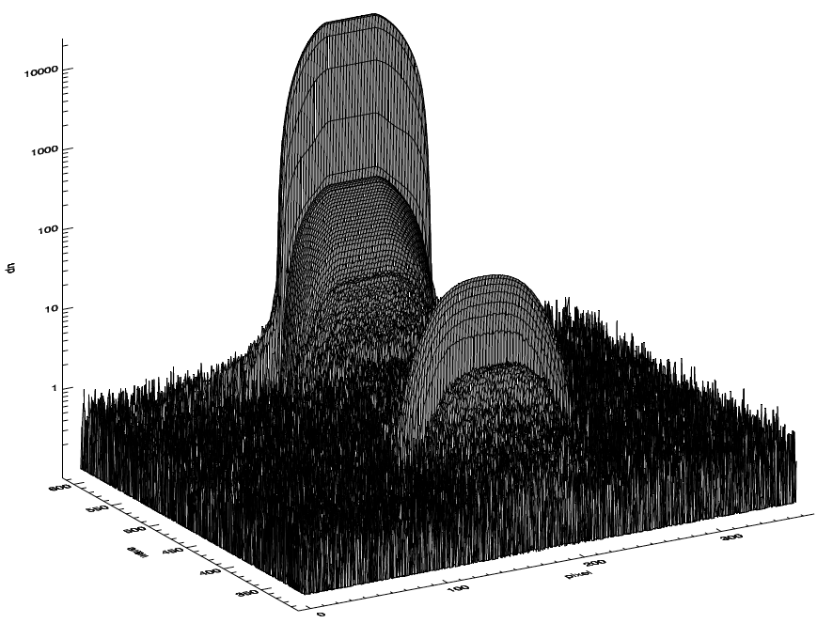
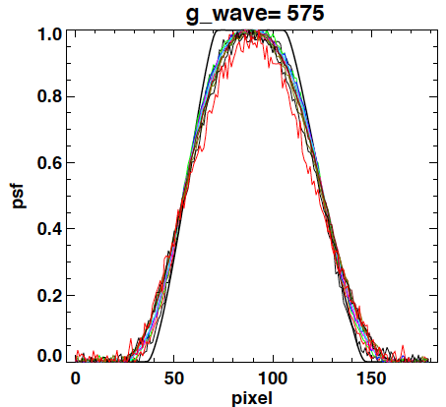
Ghost: monochromatic broad source
CAL1: GLAMR
@575nm
In-band
Ghost
@400nm
dn
Wavelength (nm)
pixel
From LSF-SP: Ghost = convolution of (source and LSF-SP ghost feature)
In-band response: source profile
Ghost response: gaussian like shape
OOB (not shown) response = in-band response

Slide 7
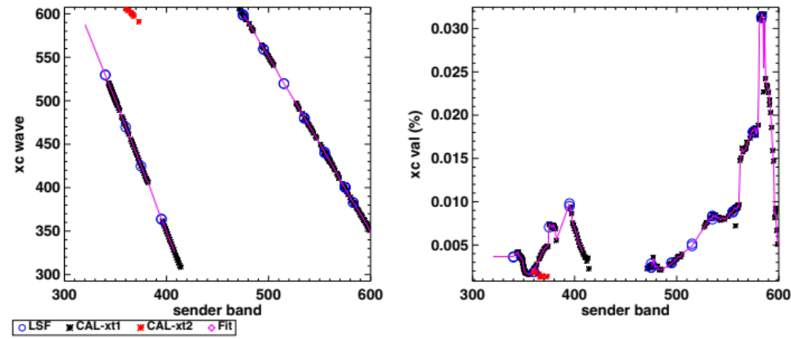
Ghost characterization
(a)
(b)
(nm)
(nm)
LSF: limited wavelengths tested; Most accurate in ghost characterization
GLAMR: data in 1-nm step; LFS data Gap filling
xc wave = ghost wavelength, xc val = ghost magnitude

Slide 8
Crosstalk Map Method
PSF
  Determine ghost wavelength and magnitude in LSF and CAL data
  Interpolate from measured wavelength to all CCD bands
  In LSF-SP data, remove ghost in PSF to create nominal PSF.
  For each band, compute modeled nominal PSF by interpolating 2 adjacent nominal PSFs.
  Add ghost based on the predicted wavelength and magnitude.
PSF to crosstalk
  For each band, compute crosstalk map with sender bands from the same CCD using the modeled PSFs.
  Crosstalk map is computed in 0.625nm resolution from 325nm to 890 nm; aggregated to 5nm bands for science data analysis

Slide 9
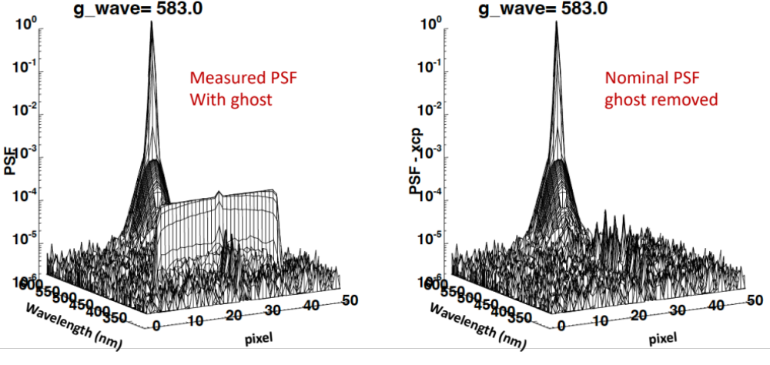
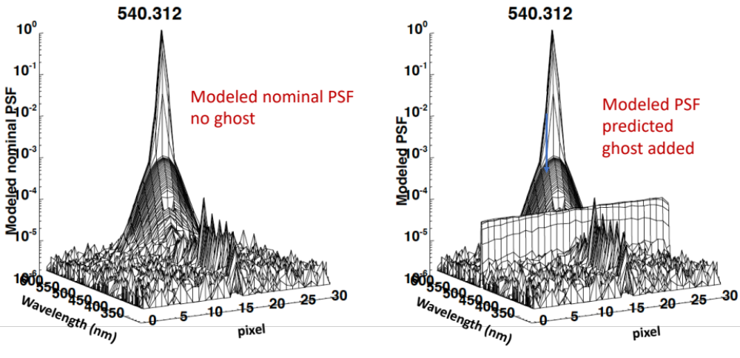
Model PSF
Nominal PSF (Top R): ghost feature removed from measured data.
Modeled nominal PSF (Bot L): interpolated from 535 and 555 nm nominal PSF.
Modeled PSF (Bot R): Add ghost feature in modeled nominal PSF.

Slide 10
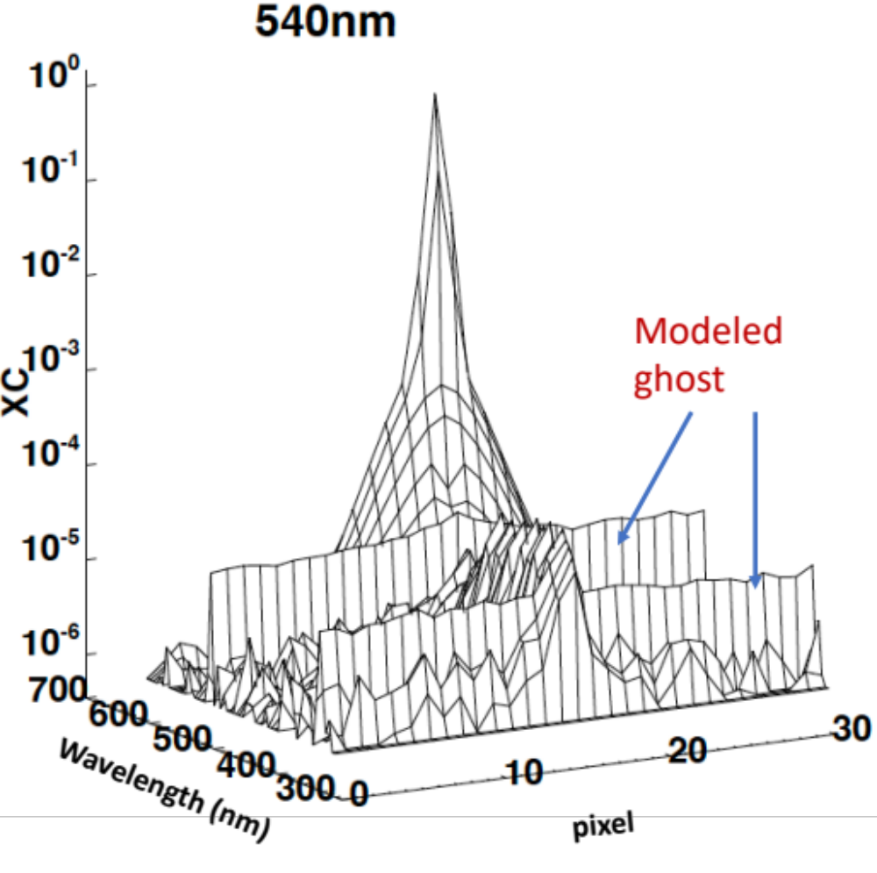
Crosstalk
Compute crosstalk from modeled PSF
2 ghosts in crosstalk vs. 1 ghost in PSF.
2 bands send ghosts into the same wavelength
Nominal PSF

Slide 11
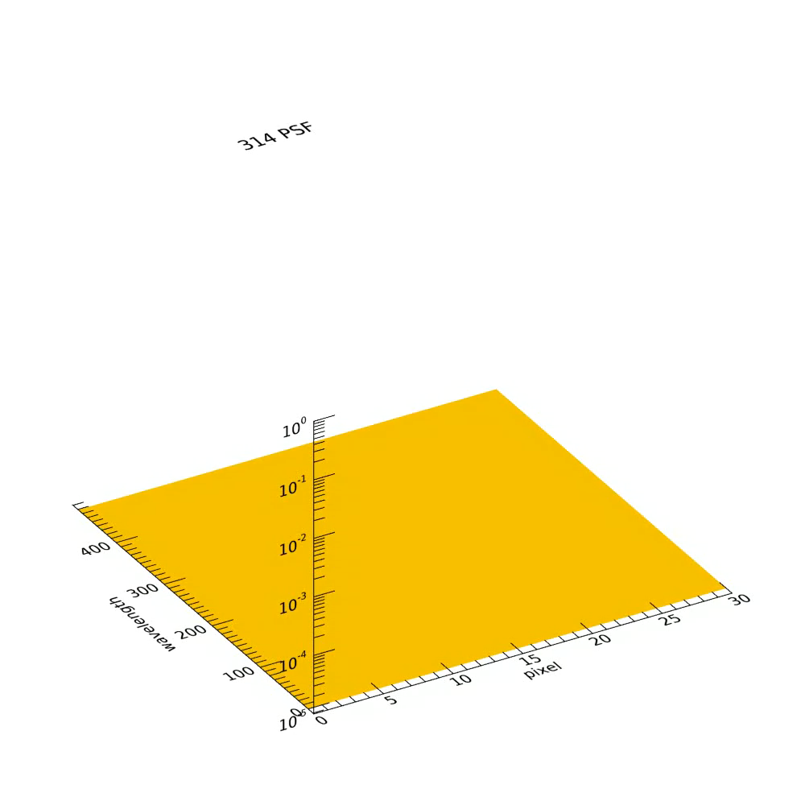
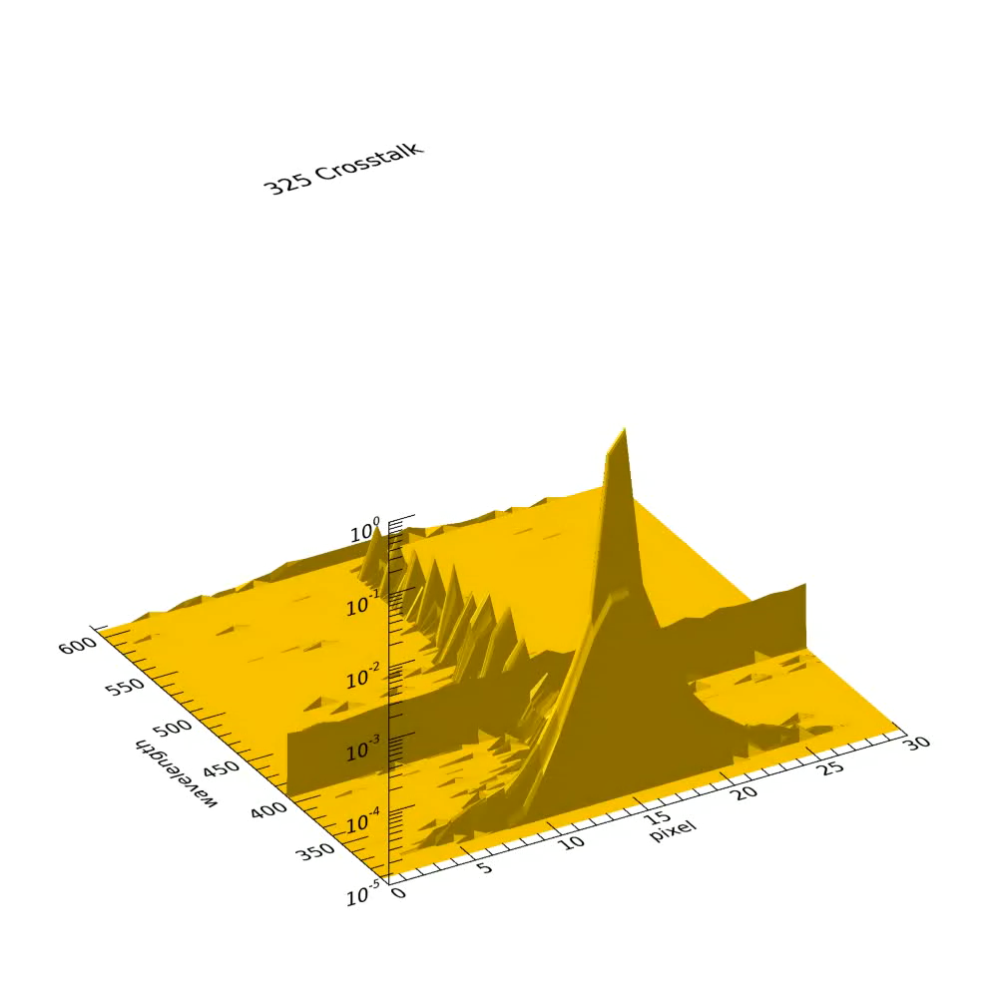
PSF vs. crosstalk map

Slide 12
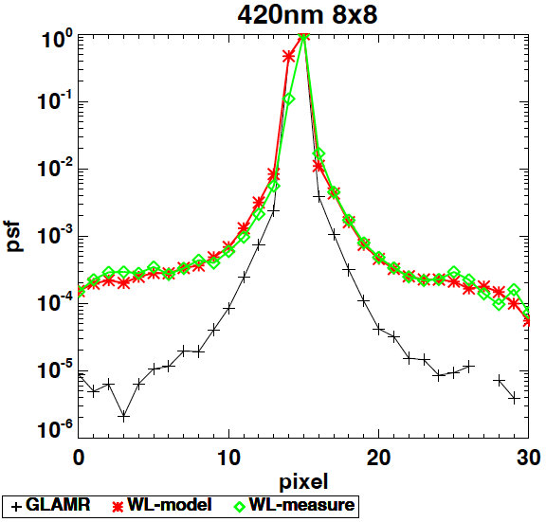
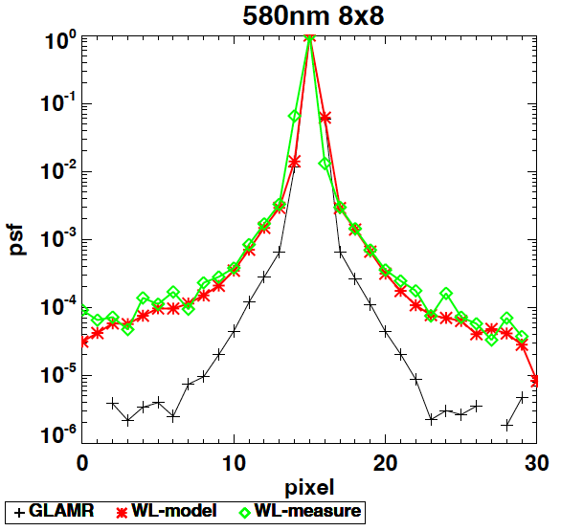
Crosstalk map evaluation
Estimate white light response from modeled PSFs.
WL-model = modeled white light PSF
WL-measure = measured white light PSF
GLAMR = monochromatic light PSF.

Slide 13
Summary
The crosstalk of the OCI blue CCD bands has a ghost feature.
The crosstalk including ghost feature were characterized using high-contrast scene (LSF), and broad source calibration (CAL-GLAMR) data.
The ghost has a spatially continuous impact up to +- 15 pixels from the source; impact can not be mitigated by typical cloud mask
On-going:
New ghost feature discovered in red CCD bands (impact a few bands ~880 nm from sources ~910 nm); characterization underway.
implement crosstalk correction in L1B processing:
  Crosstalk maps -> crosstalk correction LUT;

Slide 14
backup

Slide 15
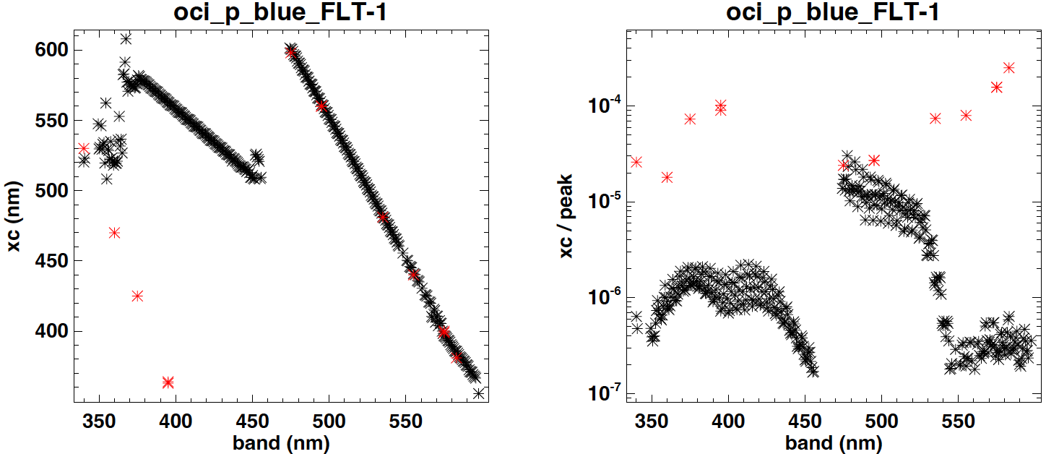
FU1 measured vs. model
ghost wavelength (Left) and magnitude (Right)
Black: model, red: FU1 data

Slide 16
Smaller width@95% max, used to identify ghost
Ghost signal is the convolution of source and TDI pixels

Slide 17
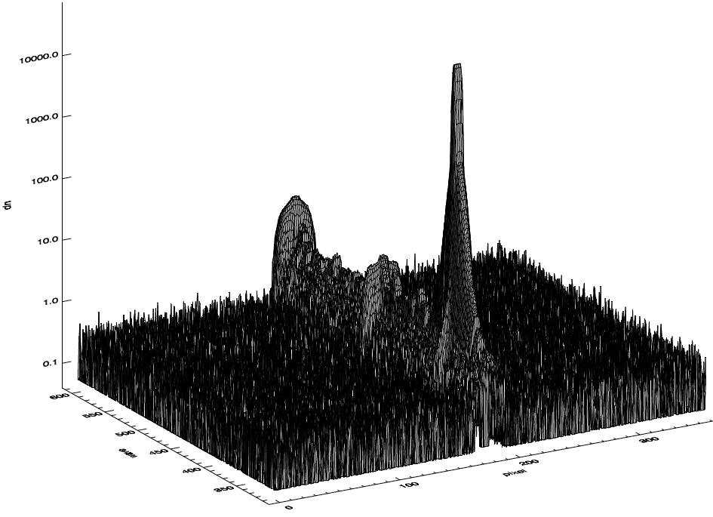
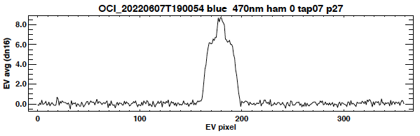
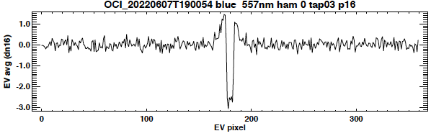
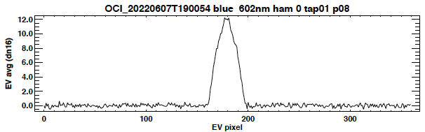
OOB + ghost
OOB
OOB + ghost
LSF-7SP @ 360nm (cds8x1)

Slide 18
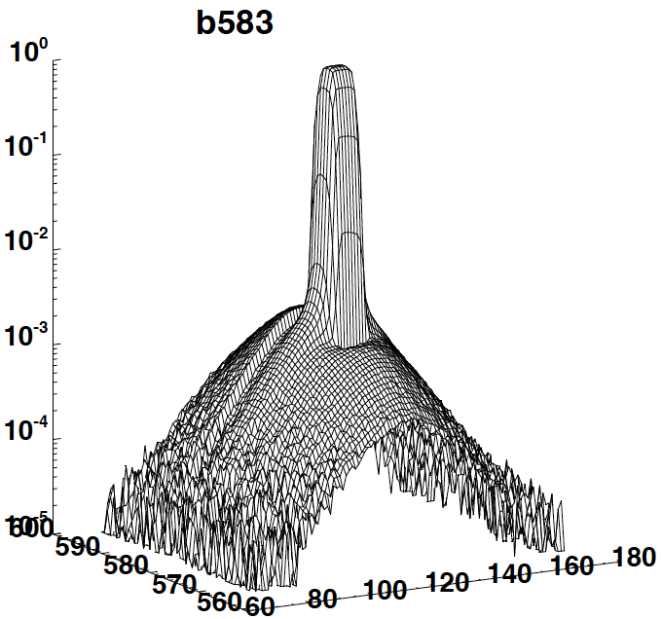
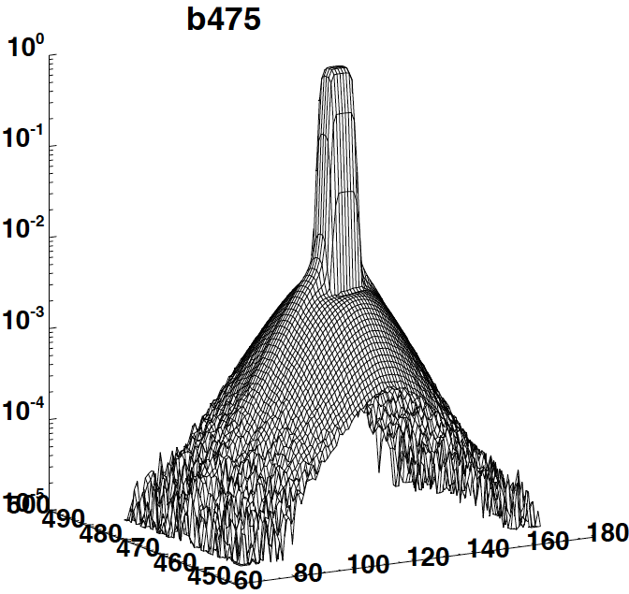
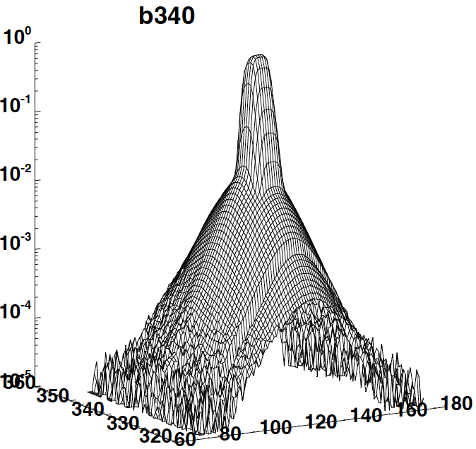
LSF-SP GLAMR
wave
pixel
Higher straylight/crosstalk at lower wavelengths

Slide 19
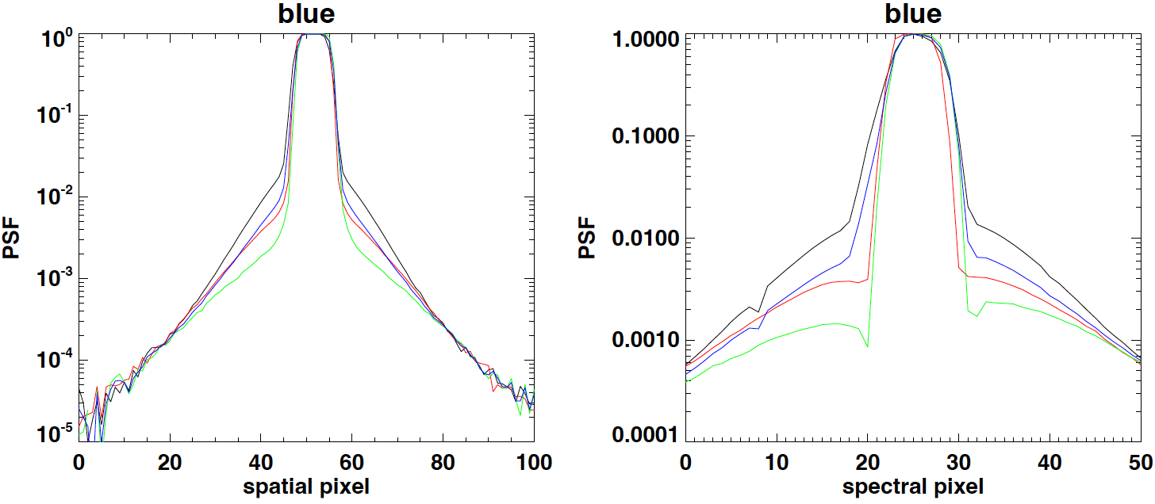
LSF-SP GLAMR
Area of
Interest
Area of
Interest
Higher straylight/crosstalk at lower wavelengths
Interpolate CCD straylight from GLAMR measured wavelengths.
475 nm measured vs. interpolated (linear)

