Slide 1
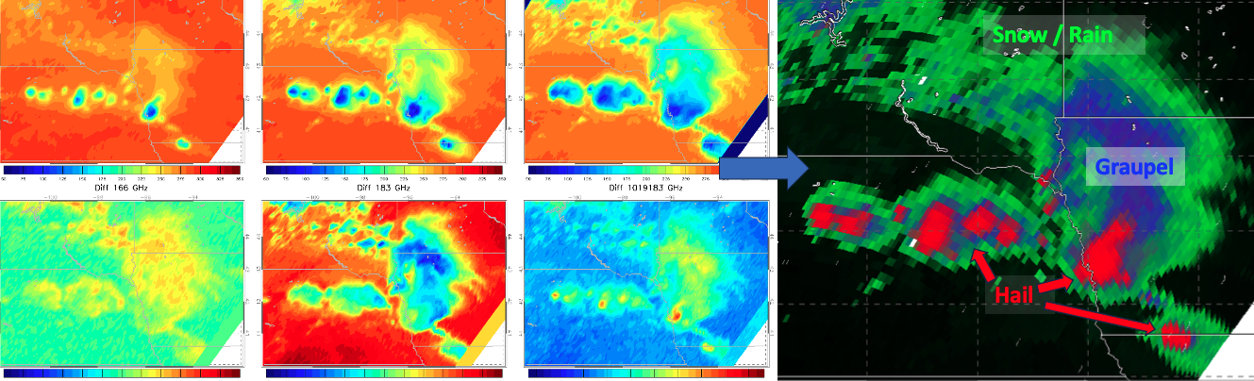
Retrieving Hydrometeor Information from GMI Brightness Temperatures
Daniel J. Cecil, NASA MSFC
Daniel.J.Cecil@nasa.gov
Michael B. Solomon, University of Alabama – Huntsville
mbs0025@uah.edu

Slide 2
Objectives
Use observational datasets to build empirical relationships between brightness temperatures (TB) and hydrometeor types (hail, graupel, snow, rain)
  GMI TB
  GPM Validation Network Hydrometeor Identifications (HID) (from dual-pol radar, matched to GMI field of view)
Use physical understanding to interpret empirical relationships
Construct lookup-tables of the likelihood of a hydrometeor type being present, based on multi-channel TB
Map the hydrometeor types in individual cases
Accumulate climatological maps of hydrometeor types

Slide 3
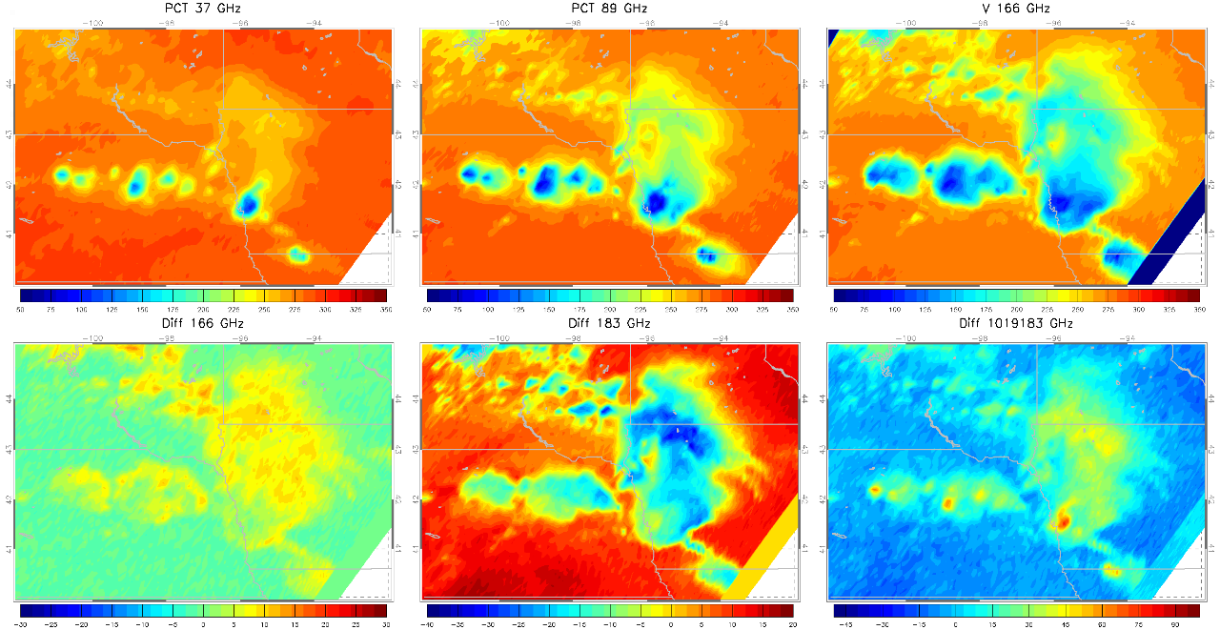
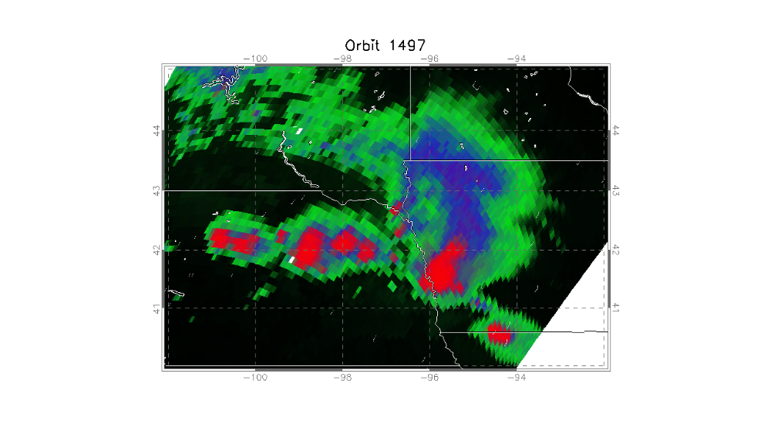
Example case – MCS in Iowa-Nebraska
For each GMI pixel, probability of hydrometeor categories is computed and mapped to a color:
Red = Hail
Blue = Graupel (without hail)
Green = *Snow / *Cloud Ice / *Rain (without hail or graupel)
* Rain vs small ice is computed separately, but combined into one category for plotting here
Snow / Rain
Combinations of brightness temperatures in multiple channels:
Graupel
PCT 37 = 2.2*V37 – 1.2*H37 | PCT 89 = 1.8*V89 – 0.8*H89 | V166 = 166 GHz Vertical TB
Diff166 = V166 – H166 | Diff183 = (V183.3 +/- 7 GHz) – (V183.3 +/- 3 GHz) | Diff10_19_183 = (PCT10 – PCT19) – Diff183
Hail
GPROF Probability Of Precip is used to scaled the brightness, so black = no precip

Slide 4
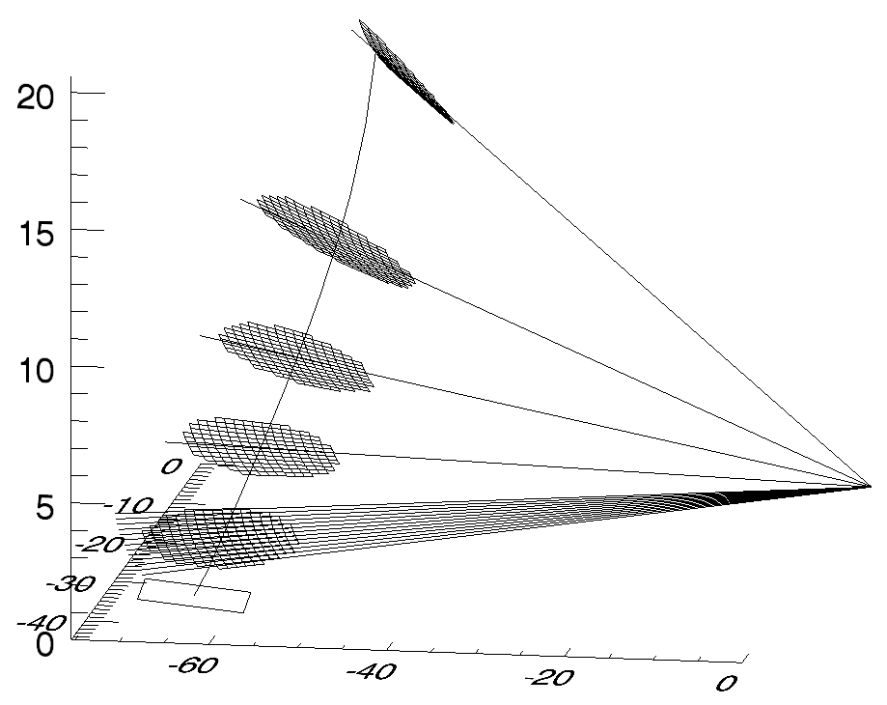
Building the TB-HID Lookup Tables
GPM Validation Network (VN) matches polarimetric radar data to GMI and DPR footprints, accounting for viewing angles. Each GMI footprint has many individual radar gates matched to it, at multiple elevations.
A subset of VN radars were used here from around the USA. We tested subsets by region and season. TB-HID relationships were not sensitive to those distinctions.
Our training and verification is entirely over land (USA)
VN data includes hydrometeor types from CSU algorithm (Dolan et al. 2013).
We use hierarchical categorization from Leppert and Cecil (2015):
If any matched radar gate has HID = Hail or Big Drops, assign the GMI TB to Hail category. If not, then…
If any matched radar gate has HID = Graupel, assign the GMI TB to Graupel category. If not, then…
If any matched radar gate has HID = Aggregates, Dry Snow, Vertically Oriented Ice, or Ice Crystals, assign the GMI TB to Snow category. If not, then…
If any matched radar gate has HID = Rain or Drizzle, assign the GMI TB to Rain category.
In practice, a “Hail” profile only needs one gate of hail somewhere in the column, and probably also has graupel, snow, and rain in the same footprint.
A profile labeled “Rain” in our approach cannot include any gates of hail, graupel, or snow.

Slide 5
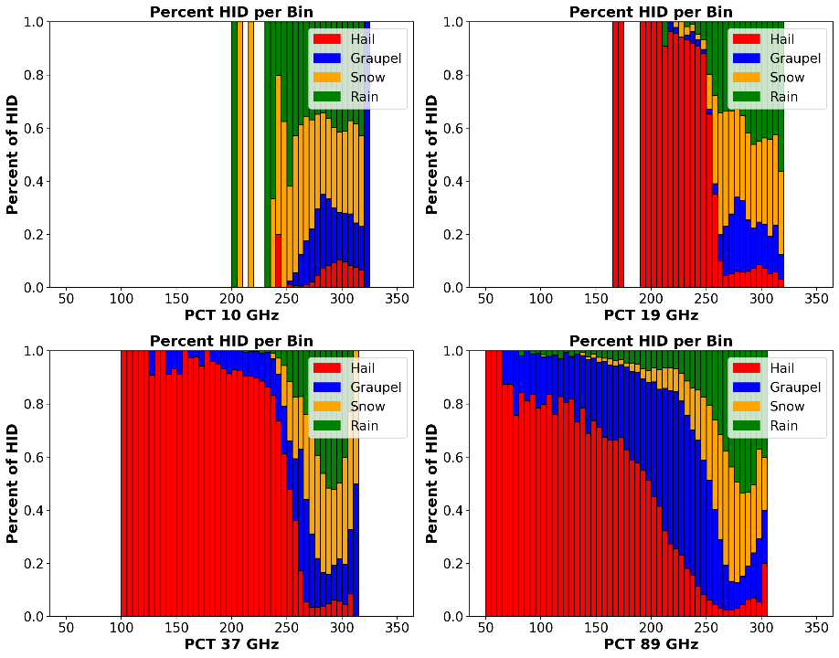
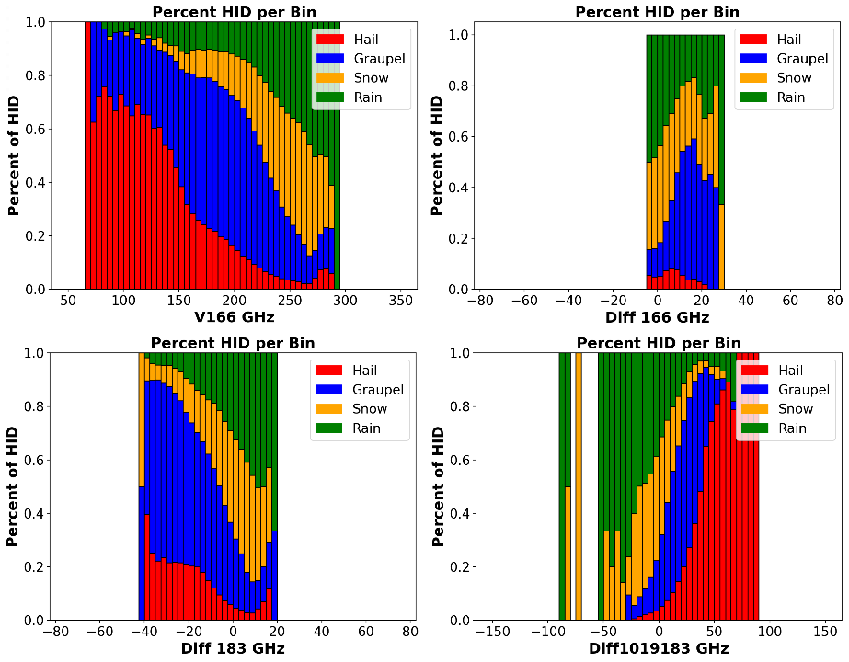
Building the TB-HID Lookup Tables – 1D Histograms
As a function of TB (or TB difference), what fraction of profiles is assigned to each HID category?
19 and 37 GHz have a strong response to hail, without a distinct signature for graupel.
166 and 183 GHz have more of a graupel response, due to their shorter wavelengths.
Not much distinction between snow vs rain-only profiles (at least over land)

Slide 6
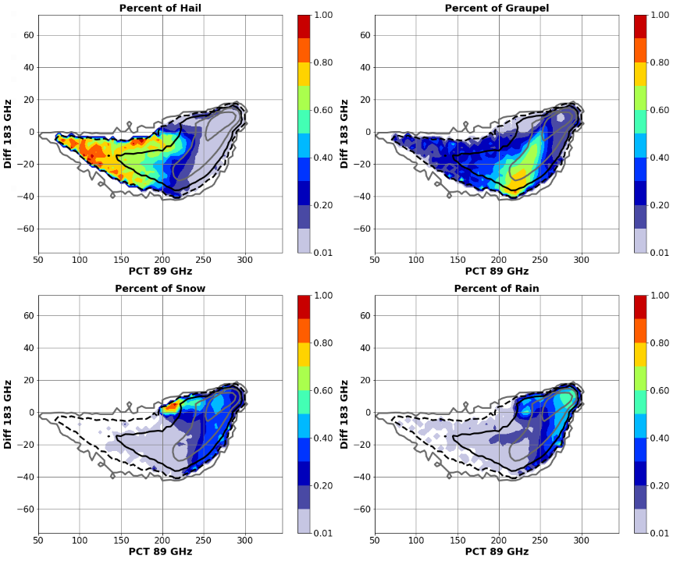
Building the TB-HID Lookup Tables – 2D Histograms
A 2D parameter space brings together multi-channel information
PCT89 vs Diff183
Hail has negative Diff183 (more scattering in the wide band than in the narrow band), and PCT89 below 200 K due to scattering effects.
But the deeper the core, the smaller the Diff183 because both 183 GHz channels get scattered
Hail
Graupel
We use 6 multi-channel combinations;
89 GHz PCT vs Diff183 (183.3+/-7 – 183.3+/-3) shown here.
Line contours are 2D PDF of precip pixels.
Graupel has similar signatures, except less 89 GHz scattering (PCT ~200-250 K).
Graupel by itself gives a more negative Diff183 than hail, because hail is usually accompanied by very deep graupel layers that scatter both the 183 GHz channels.
Snow
Rain
With some overlap, these 2D parameter spaces tend to show separate regions for each HID type.
Snow gives positive Diff183 (emission from liquid rain + cloud gives warmer wideband TB than the upper-level emission in the narrow band), with some 89 GHz scattering.
Rain usually gives positive Diff183 (emission from liquid rain + cloud gives warmer wideband TB than the upper-level emission in the narrow band), with the least 89 GHz scattering.

Slide 7
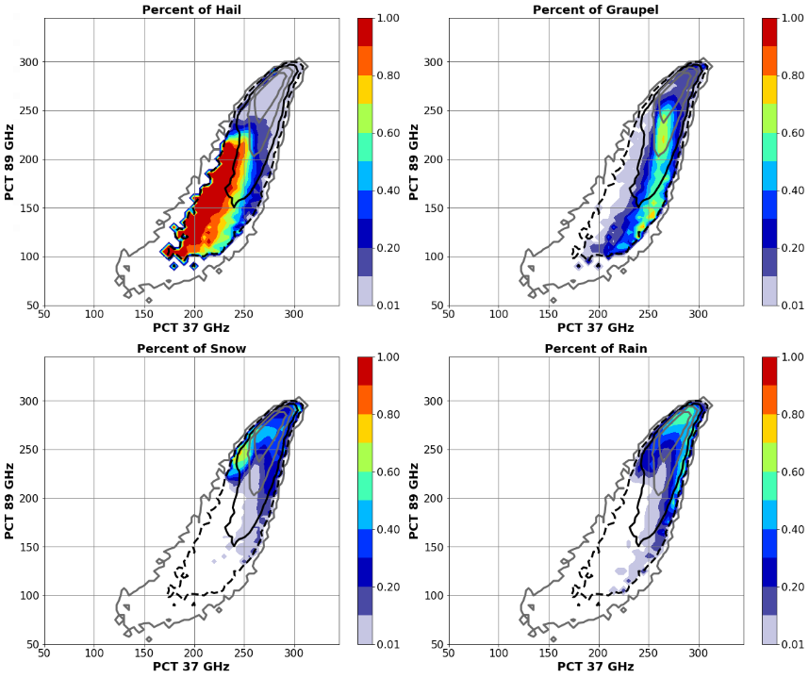
Building the TB-HID Lookup Tables – 2D Histograms
A 2D parameter space brings together multi-channel information
PCT37 vs PCT89
Hail cores generally give the strongest scattering in low frequency channels, so it covers the lower-left portion of these plots
Exception: A very low 89 GHz without especially low 37 GHz can indicate a deep layer of graupel without hail.
Hail
Graupel
We use 6 multi-channel combinations;
37 GHz PCT vs 89 GHz PCT shown here.
Line contours are 2D PDF of precip pixels.
Graupel tends toward less scattering, slightly higher PCT than hail in both channels, but especially higher 37 GHz (PCT ~260 K).
Exception: A very low 89 GHz without especially low 37 GHz can indicate a deep layer of graupel without hail.
Snow
Rain
With some overlap, these 2D parameter spaces tend to show separate regions for each HID type.
Snow gives higher PCT (less scattering) than either hail or graupel in these channels; often ~260-270 K in both channels.
Rain (without ice aloft) gives the highest PCT in both channels, using > ~270 K in both..

Slide 8
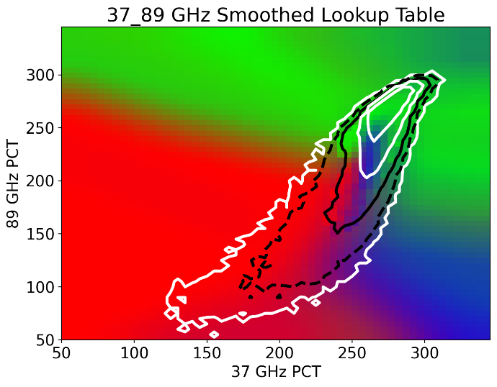
Extrapolate to Fill Out the 2D Lookup Tables
We extrapolate the probabilities to fill out the full 2D parameter space, so TBs that were not encountered in the training data will have a solution.
In these RGB plots, snow and rain are combined into one category (green), but their individual probabilities are retained in the lookup tables.
PCT37 vs PCT89
Hail
Graupel
Rain or Snow
Hail
Snow
Rain
Graupel

Slide 9
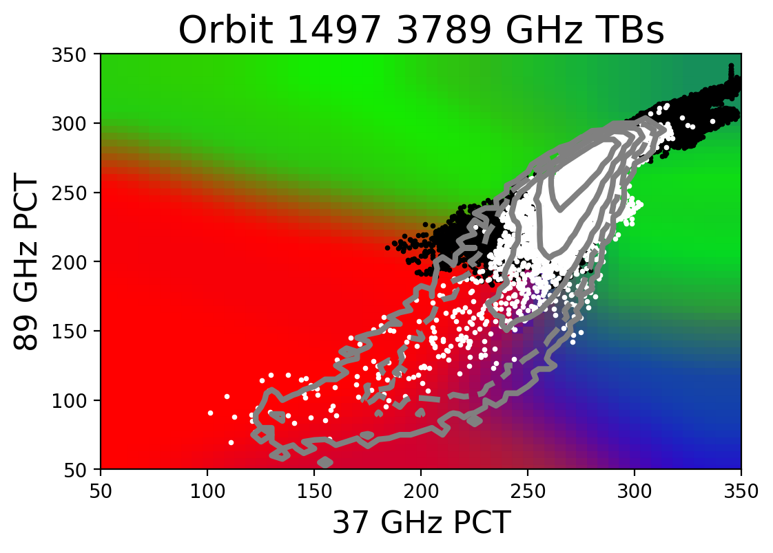
Checking TBs That Are Not Represented in Training Sample
One full orbit that had very strong convection:
White dots: GPROF Probability of Precip > 10%
Black dots: GPROF Probability of Precip < 10%
Rain or Snow
Hail
Graupel

Slide 10
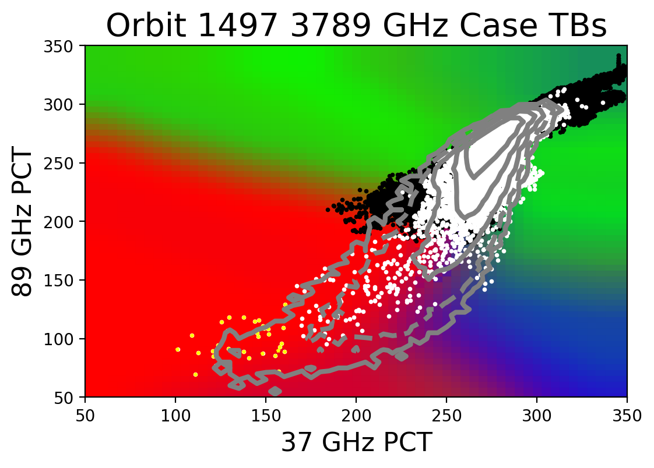
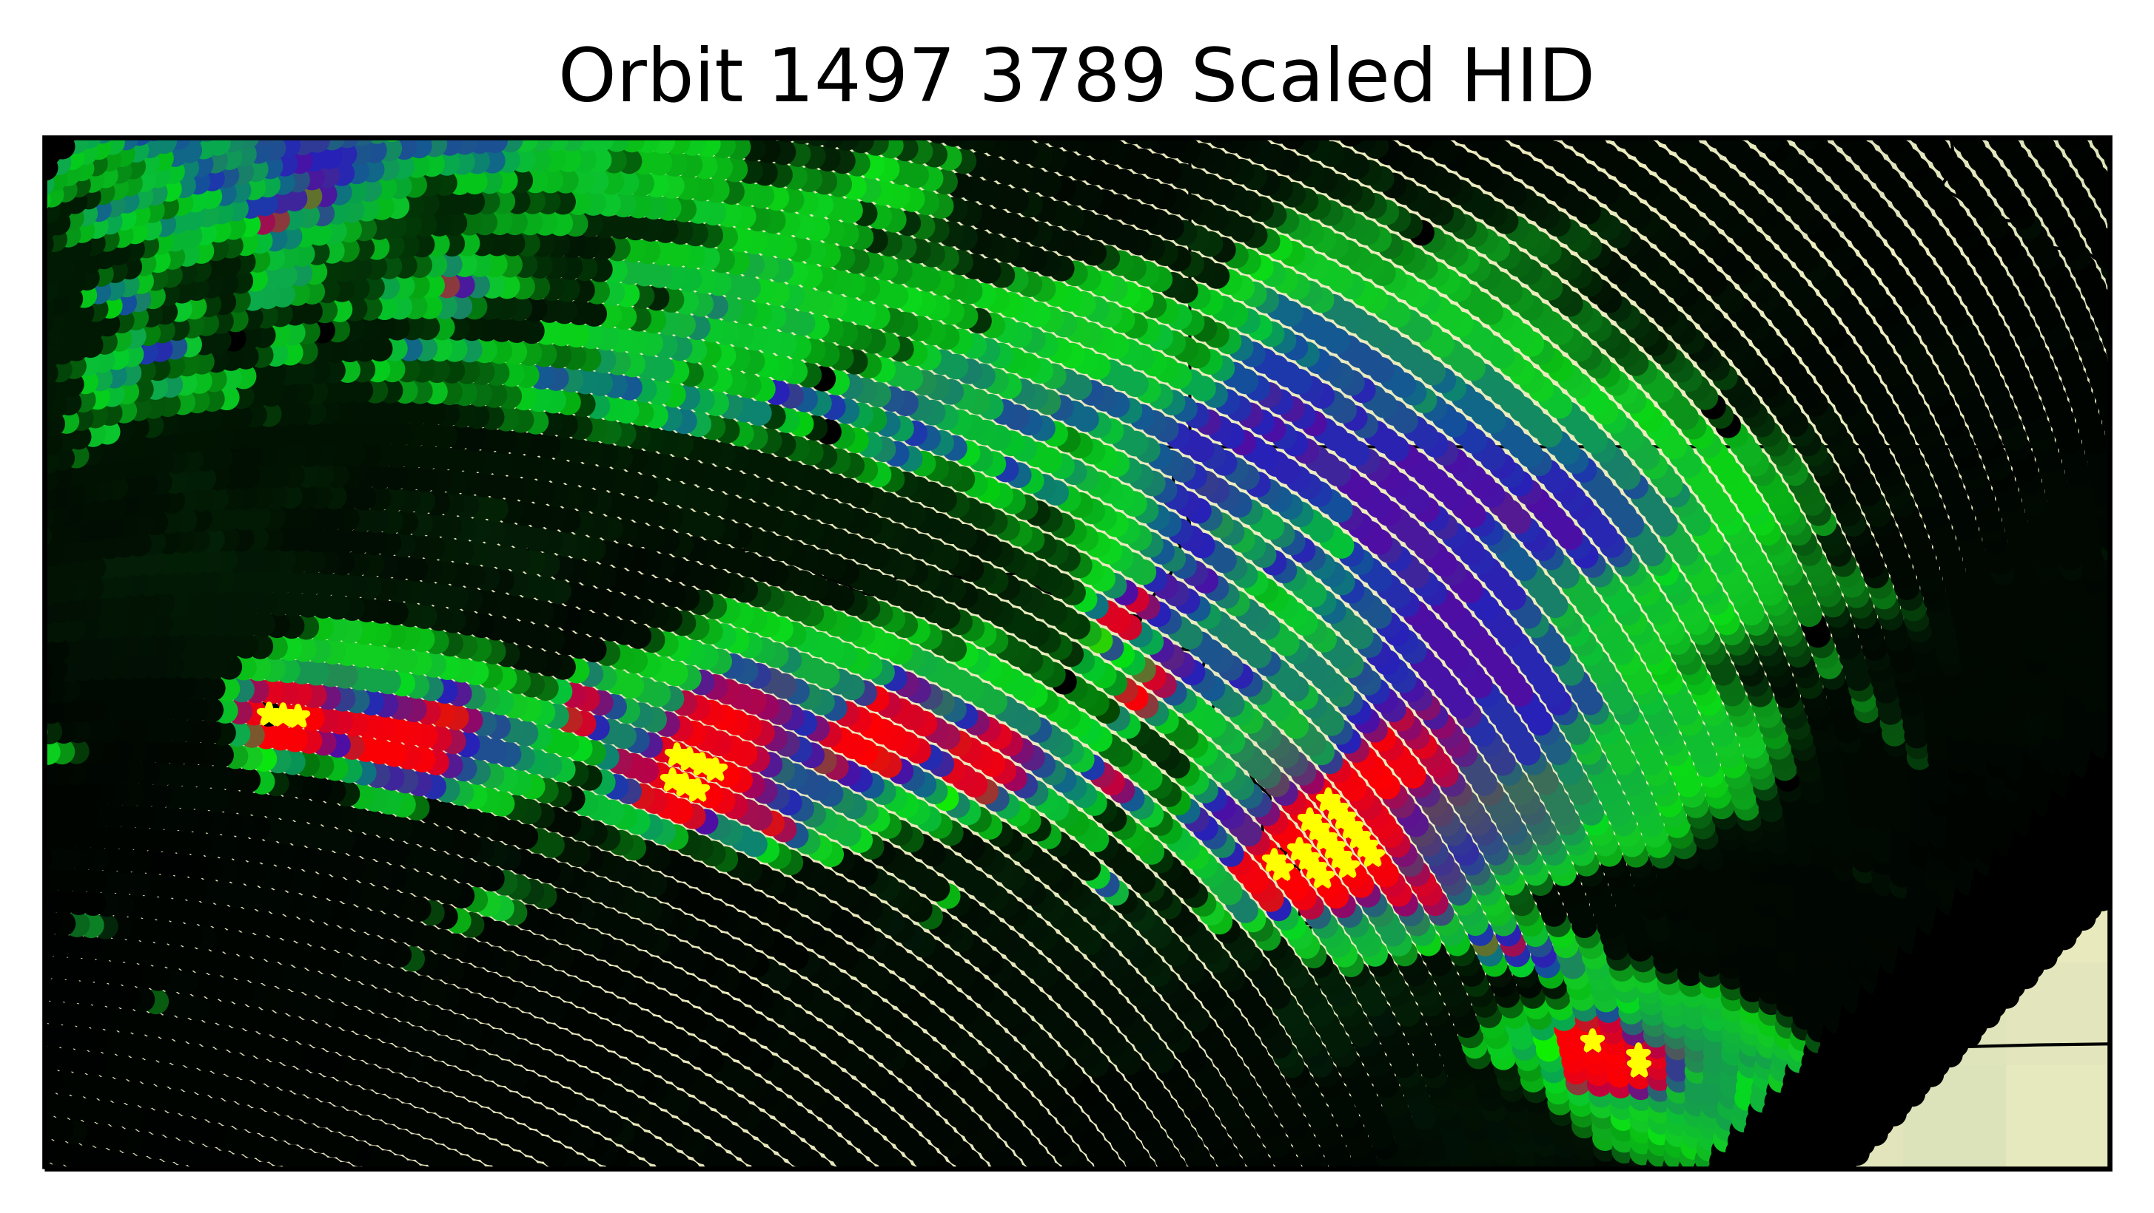
Checking TBs That Are Not Represented in Training Sample
Very low TB pixels (circled yellow on left) are identified as hail by the extrapolation.
This makes physical sense - very strong ice scattering in both frequencies.
Their locations in the convective storm cores (at right) also make physical sense.
Rain or Snow
Hail
Graupel

Slide 11

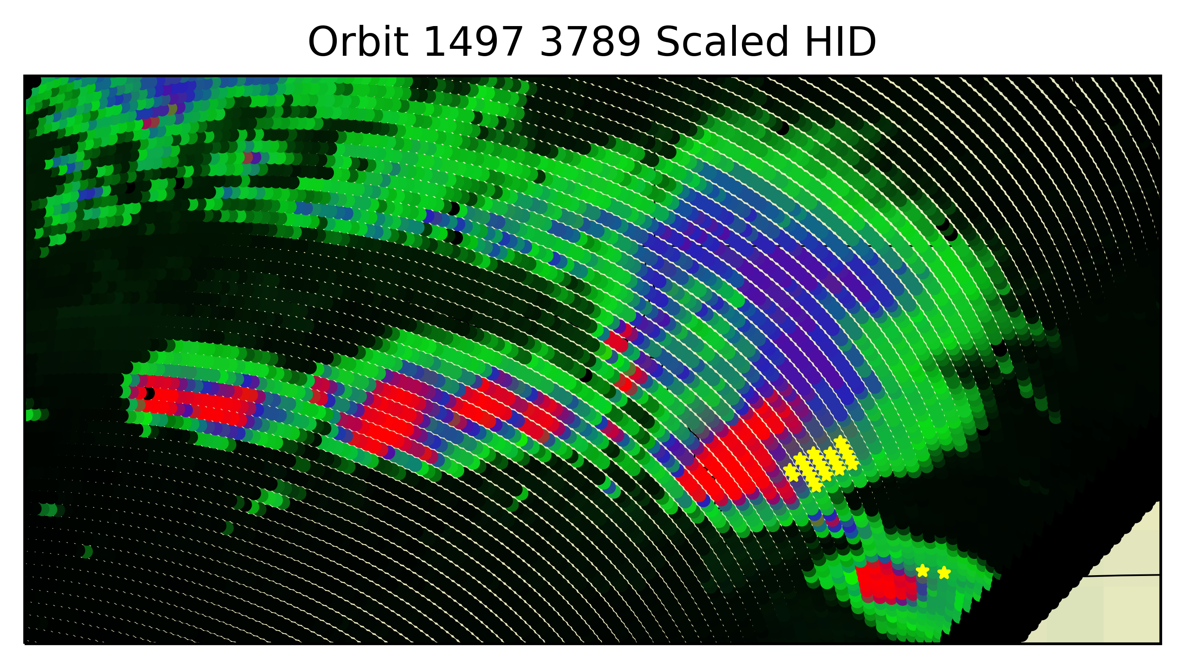
Checking TBs That Are Not Represented in Training Sample
GMI pixels with low 89 GHz but high 37 GHz are identified as mixed chances of graupel, snow, or rain.
Could be interpreted as small graupel or thick anvil scattering the 89 GHz channel, without scattering the longer wavelength 37 GHz channel.
Their locations appear consistent with a forward anvil adjacent to strong convective cores.
Rain or Snow
Hail
Graupel

Slide 12
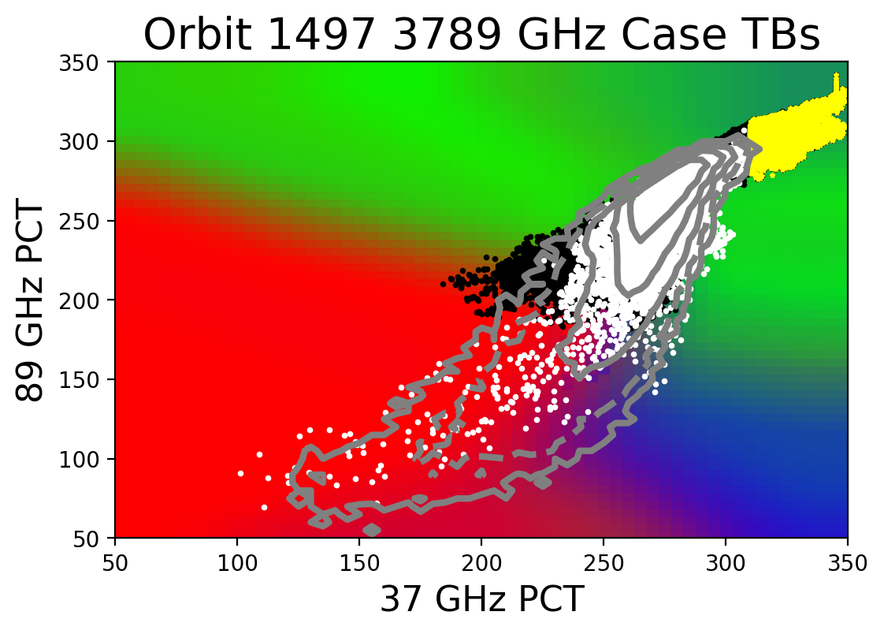
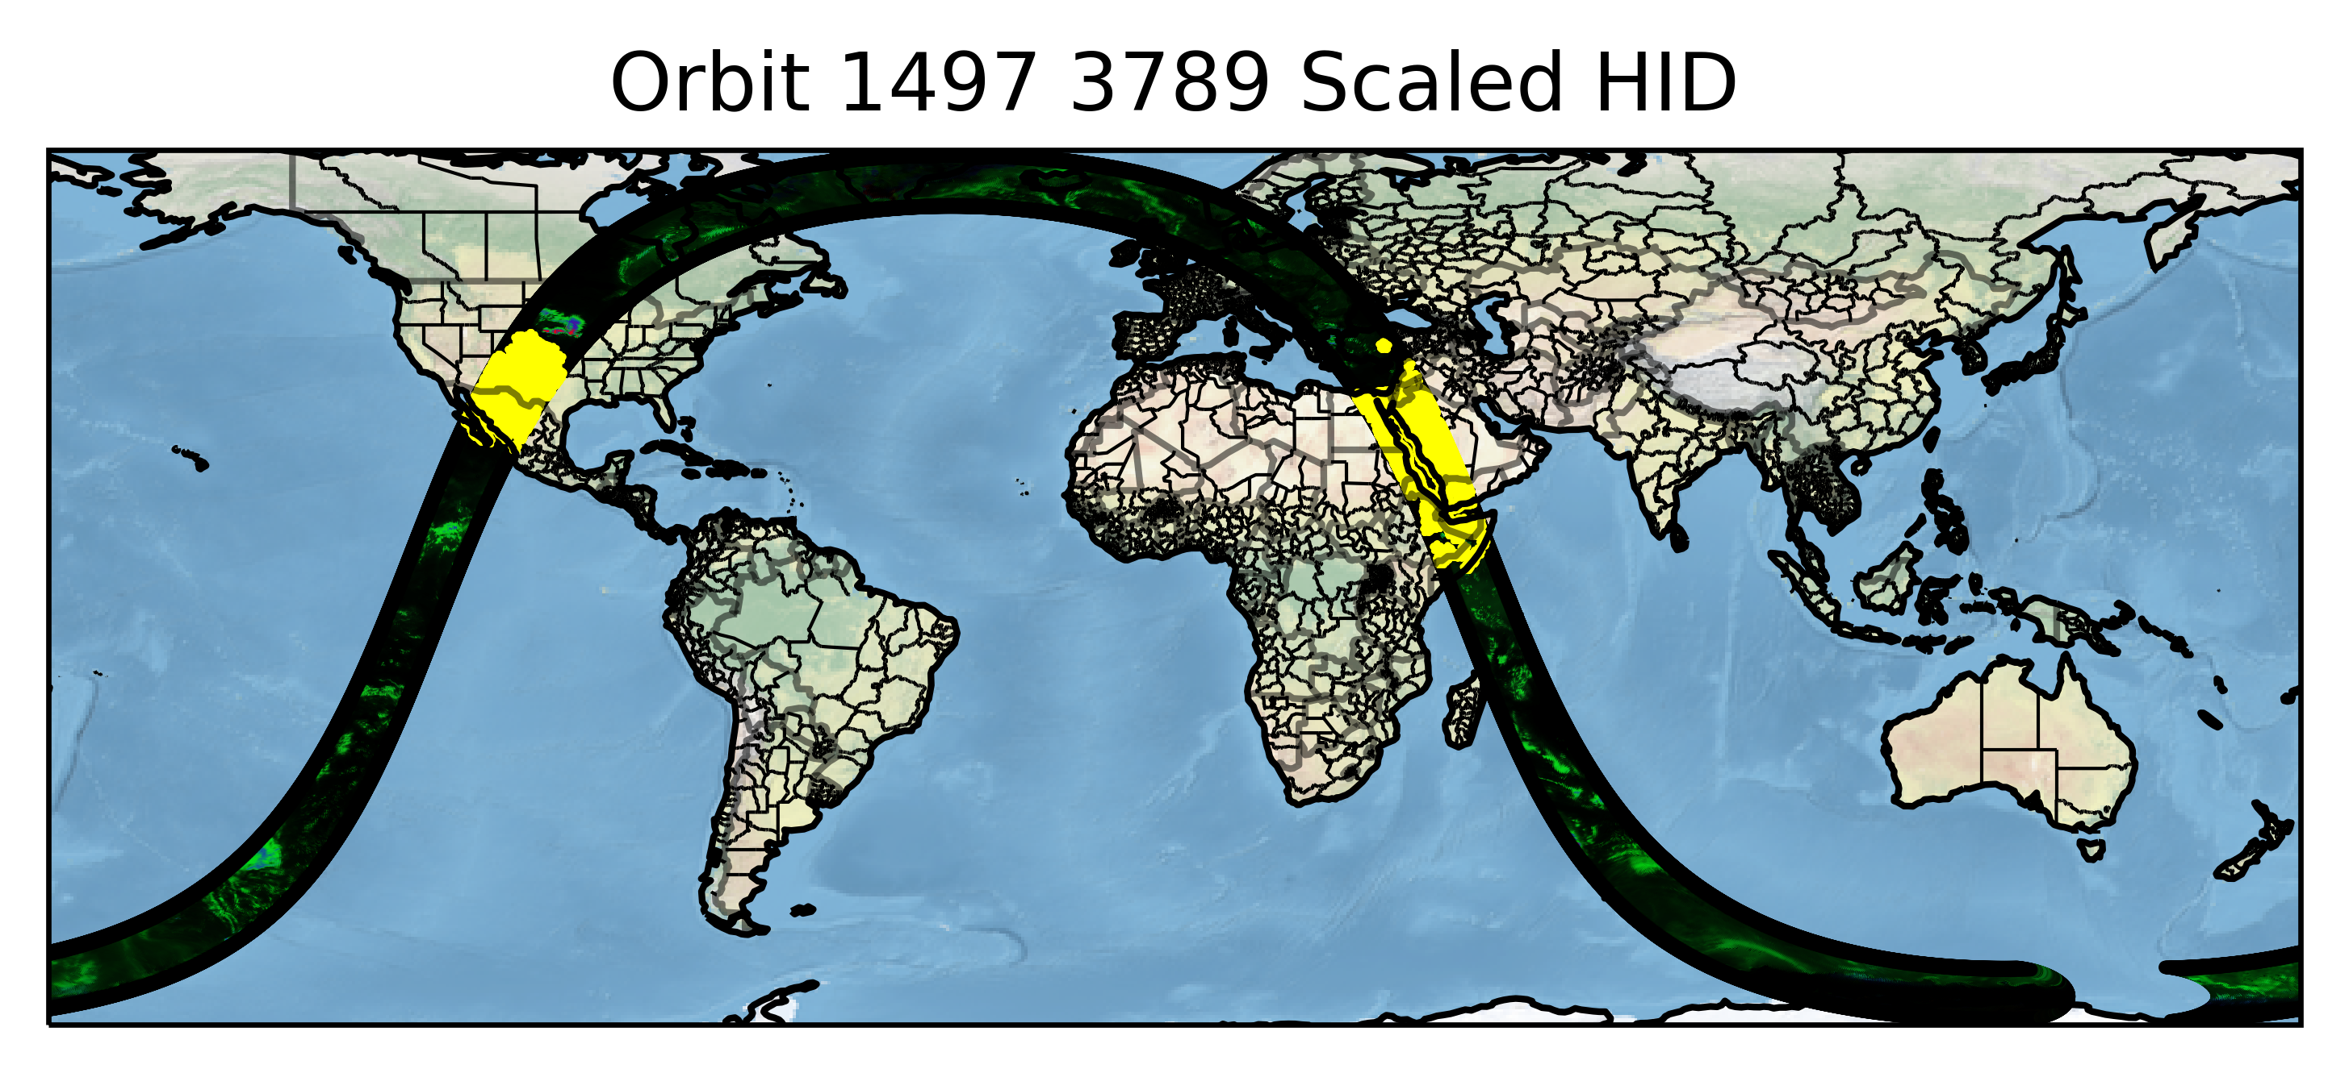
Checking TBs That Are Not Represented in Training Sample
Very high TBs associated with warm land surfaces get a assigned a mix of probabilities of rain or snow, or a small chance of graupel.
We assign hydrometeor probabilities to every possible TB combination, then rely on GPROF to screen out the non-precipitating pixels. (Thanks, GPROF! 😀 )
Rain or Snow
Hail
Graupel

Slide 13
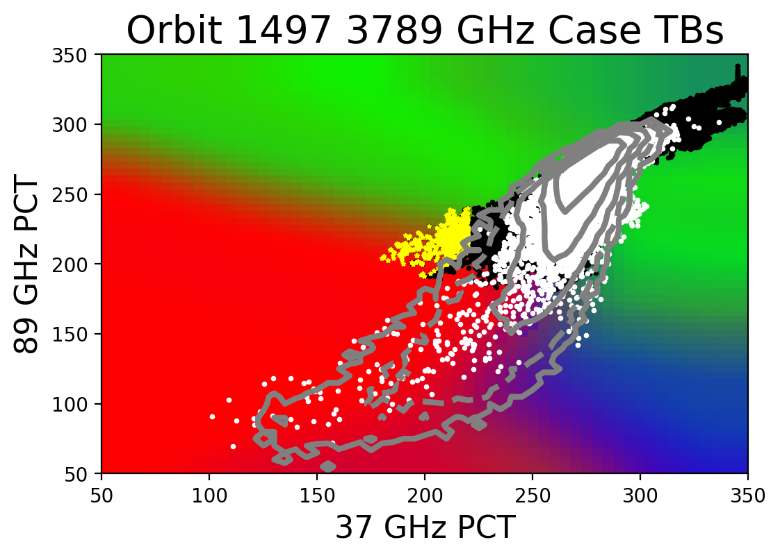
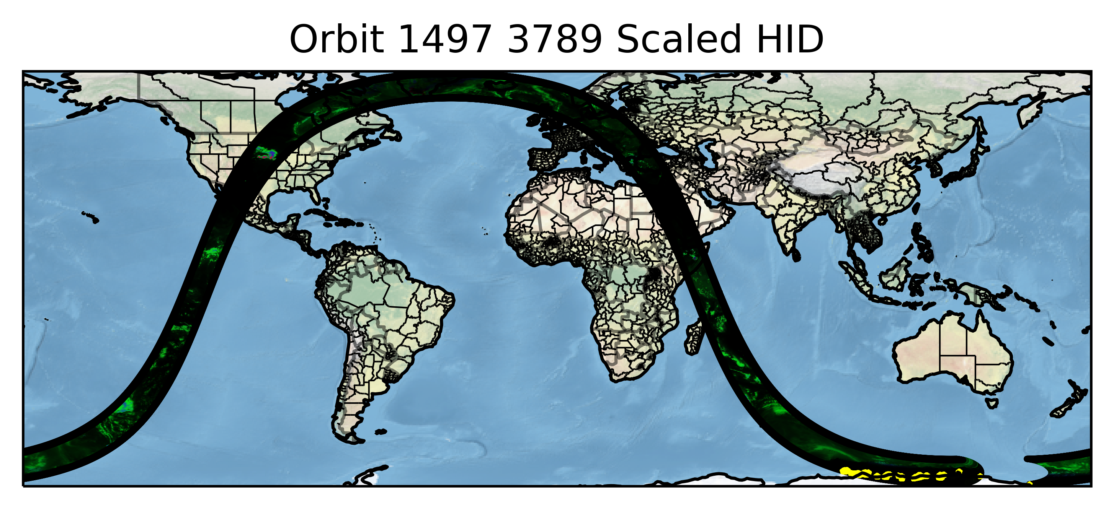
Checking TBs That Are Not Represented in Training Sample
Low 37 GHz PCT without appropriately lower 89 GHz PCT is consistent with a snow or ice-covered surface. It generally gets assigned as hail, or sometimes a mix between hail and snow probabilities, before getting screened out.
We use GPROF Probability of Precip and 2-m Temperature (5° C) as filters. (Thanks again, GPROF! 😀 )
Rain or Snow
Hail
Graupel

Slide 14

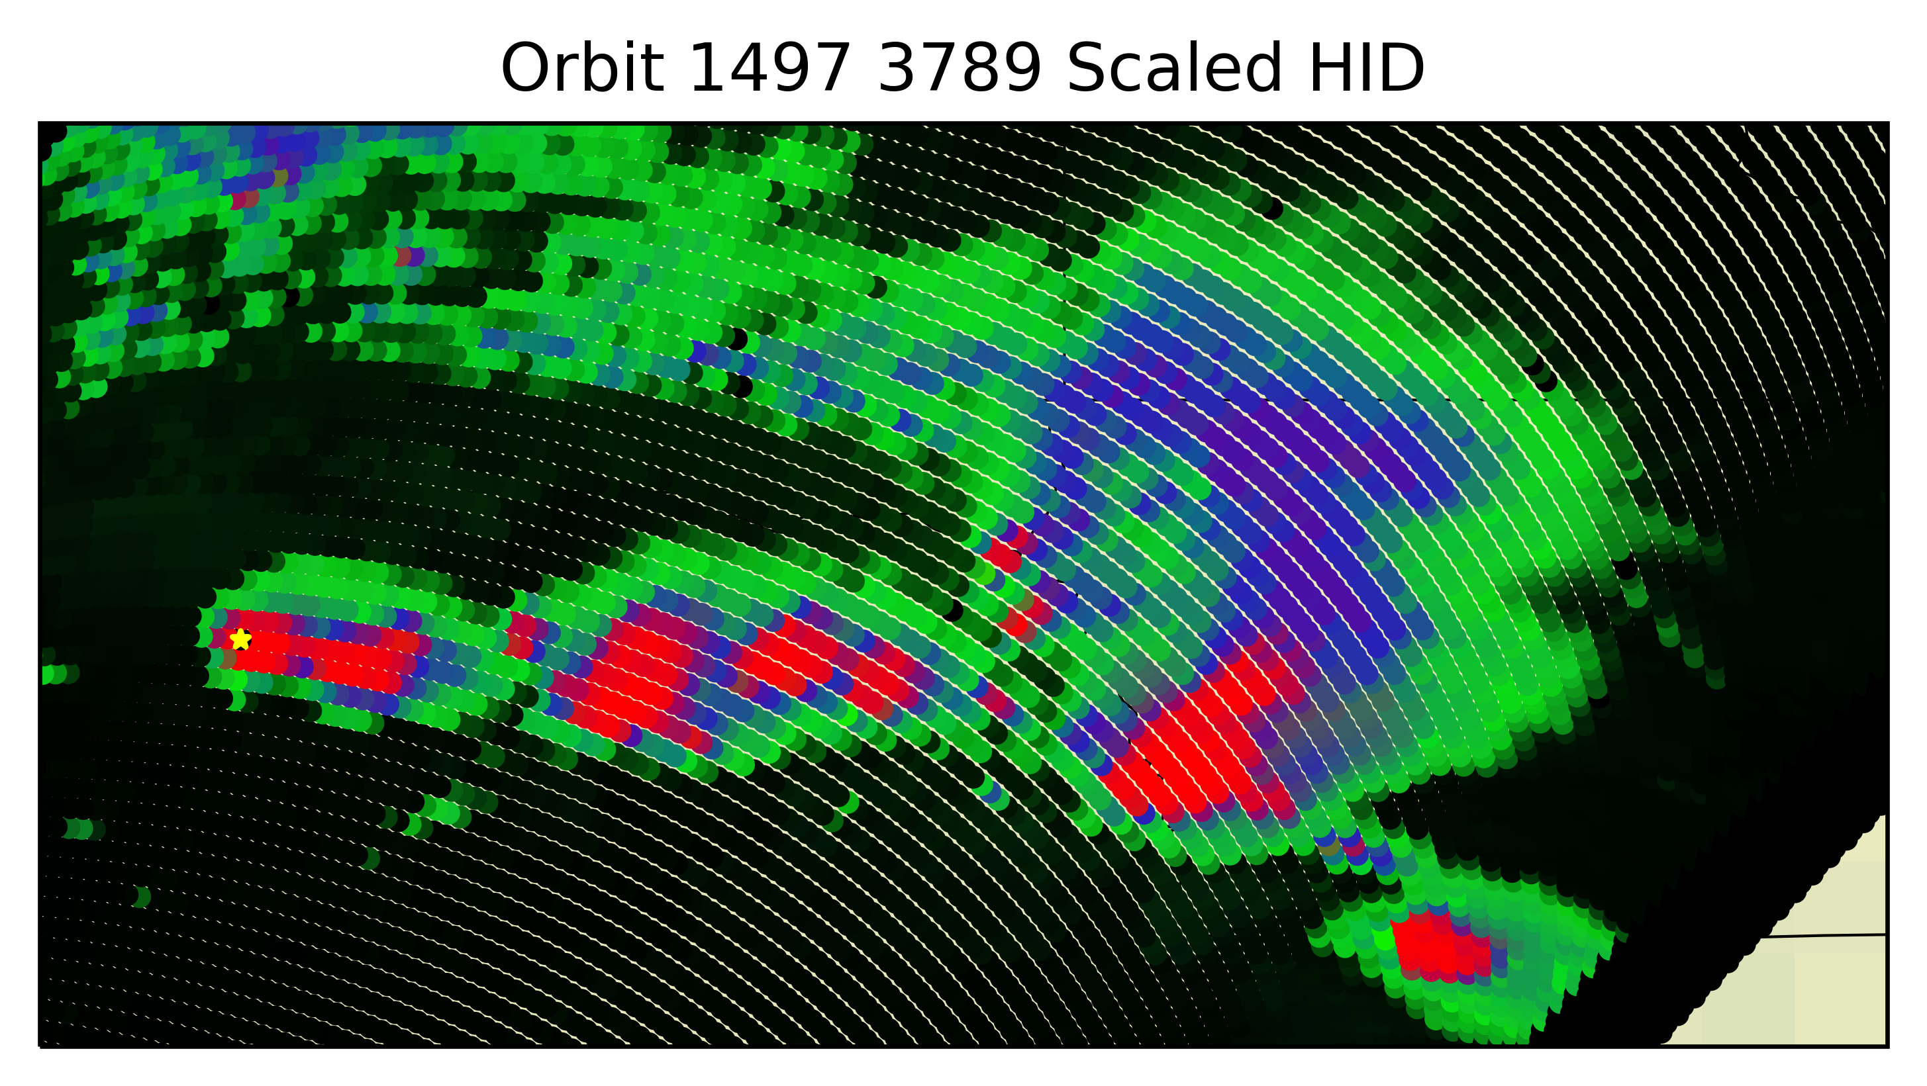
Checking TBs That Are Not Represented in Training Sample
Sometimes a very low TB GMI pixel gets a strange GPROF Probability of Precip (often 36%), sometimes with flags set because the GPROF* did not find an adequate solution.
We re-assign Probability of Precip to 100% if PCT37 < 175 K and PCT89 < 125 K to deal with those cases.
Rain or Snow
Hail
Graupel
* We have not updated from Version 5 yet, that is in the works.
No Version 7 data were harmed in the creation of this powerpoint.

Slide 15
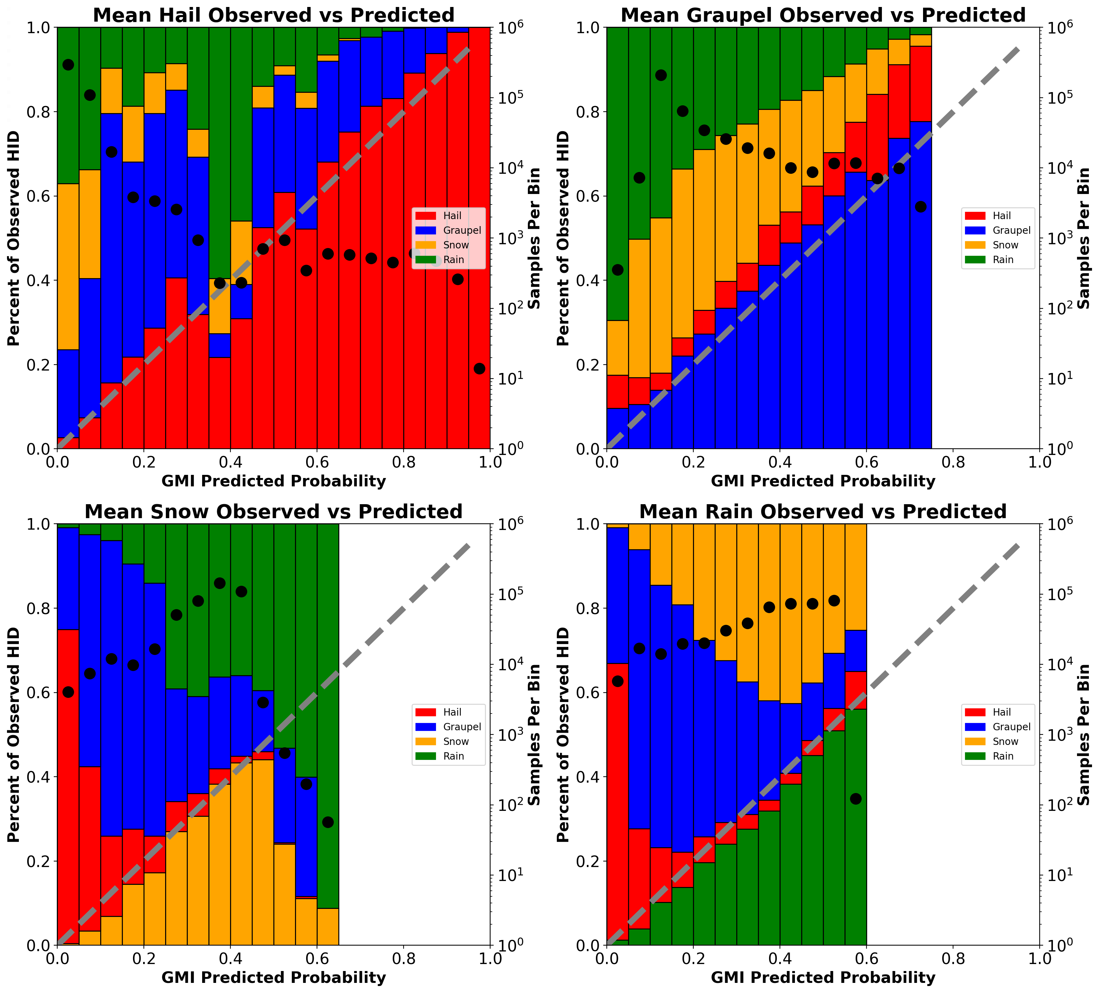
Verification
Verification with an independent year of GPM VN data shows excellent performance for the GMI-derived HID probabilities.
Hail is slightly underestimated.
Graupel is slightly underestimated.
Snow is slightly overestimated.
Rain is slightly overestimated.
We have 6 different versions of this from 6 channel combinations…
Currently we take the mean of those 6 solutions for any given GMI pixel, to get its mean probability of hail, probability of graupel, probability of snow, probability of rain.

Slide 16
Future Considerations
Publish manuscript
Update to V7 product inputs
Expand training and testing databases
Incorporate information from surrounding pixels (storm morphology)
Given our 6 sets of lookup tables from 6 channel combinations:
Weight the channel combinations unevenly, instead of taking a simple mean
Use island/coast sites from VN to make a warm rain / cold rain distinction over water surfaces
Incorporate with another product, or distribute separately?
Adapt to TMI, AMSR, etc?
Require some threshold fraction of the radar gates matched to a GMI profile to have the specified HID type – currently, we just require at least 1 radar gate. This should reduce the number of profiles we identify as “hail”, and shrink the size of “hail cores” in maps of individual cases.

Slide 17
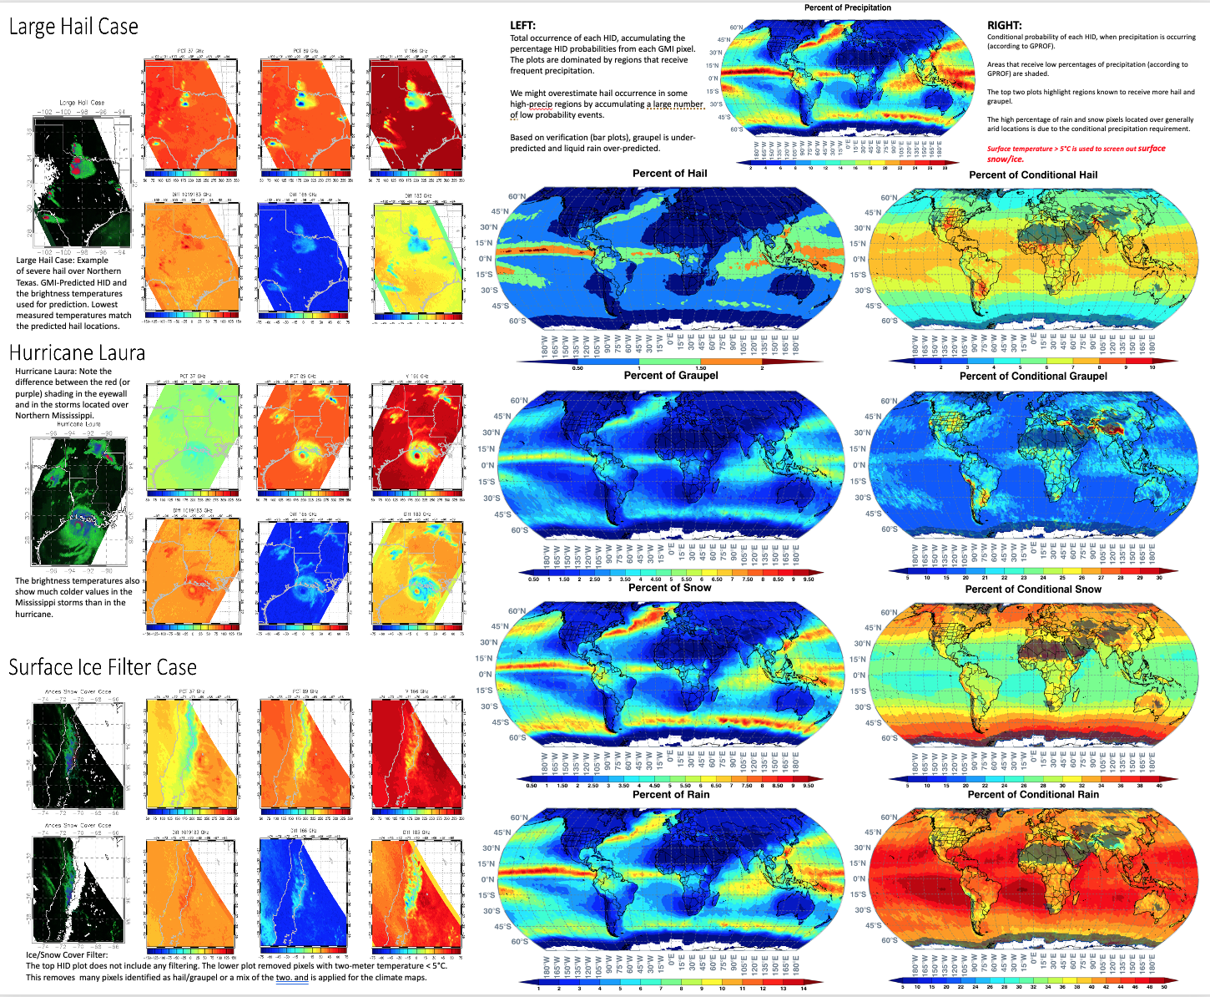
That’s All, Folks
Well, except for climatology maps and more details in Poster 128.

Slide 18
Snow / Rain
Graupel
Hail

