Slide 1

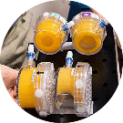
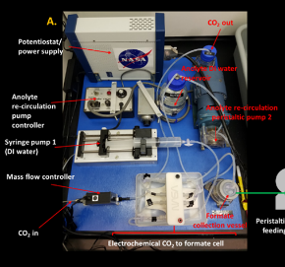
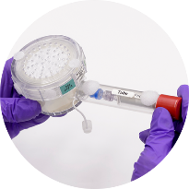
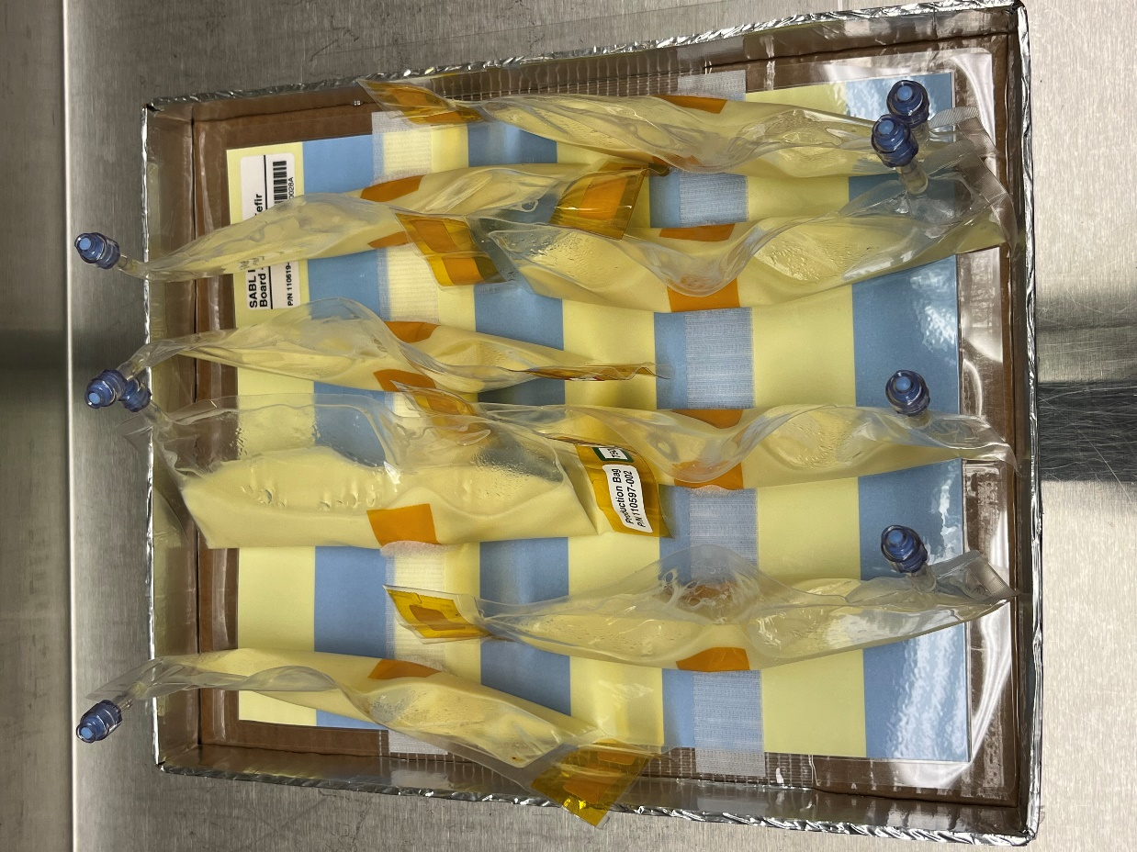
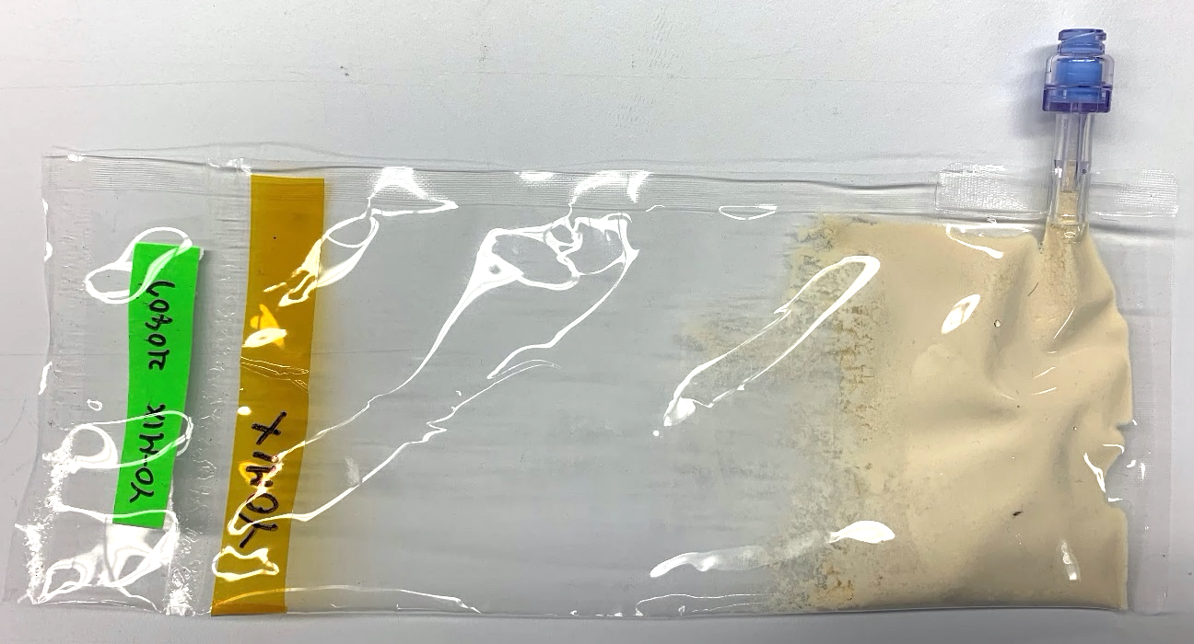
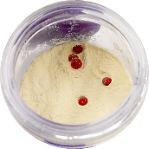
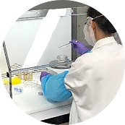
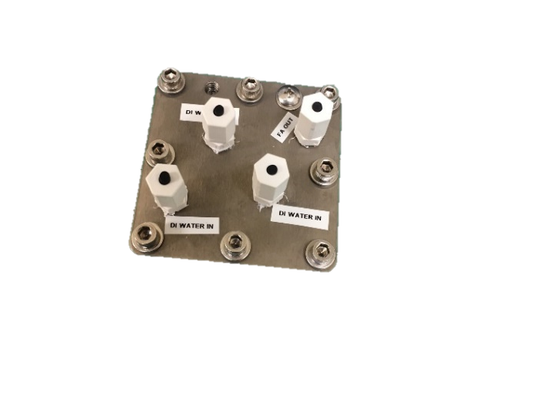
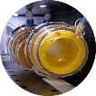
Space Technology Mission Directorate
Game Changing Development Program
Frances Donovan | Hami Ray | FY23 Synthetic Biology Project Annual Review Presentation | 09.20.23
Name/Email POC: Frances.M.Donovan@NASA.gov
Notes:
Note: same images used in FY23 mid-year review presentation (3/6/2023)

Slide 2

BioNutrients Element
Technology Goals & Project Objectives
Technology Development Needs Addressed by Project
MCO | Demonstrate in-mission microbial food production (yeast, yogurt/kefir) to provide fresh nutrients, probiotics, and with genetic engineering, delivery of therapeutics. | Advanced habitation systems. TX06, Gap id # 800, 784, 1013
MCO | Demonstrate food production from a fully dehydrated, low mass/volume/complexity system with up to 5 years ambient shelf life. | Advanced habitation systems. TX06, 2021-3616-​TX11, Gap id # 1171
Technology Goals
Goal #1 | Develop a platform technology for safe, on-demand microbial production of nutrients during missions.
Goal #2 | Demonstrate hardware and microbes in space and use results to guide this technology development effort.
Goal #3 | Develop in-space implementation requirements and methods for initial deployment.
Project Objectives
Objective #1 | Conduct 5-year test to verify concept and create space-adapted hosts for future tests.
Objective #2 | Develop space-ready low mass/volume storage and growth system
Objective #3 | Develop and verify a food safety plan for implementation.
Notes:
2021-2944-​TX06Safe, Acceptable, and Nutritious Food System
2021-2945-​TX06 Food Resources Requirements and Efficiency
2021-3616-​TX11 Low-Hydration Food for Exploration Missions

Slide 3

CO₂-Based Manufacturing Goals & Objectives
Mark Settles
Technology Development Needs Addressed by Project
MCO | The platform produces the enzyme Carbonic Anhydrase for use in Liquid Amines CO2 removal systems. | Advanced habitation systems. TX06 1059, 353
MCO | The platform can use CO2 derived carbon feedstocks for biomanufacturing of many products including plastics, binders, enzymes, nutrients. | Exploration Destination systems. TX07 gap # 589, 586
CO₂-Based Manufacturing Goals
Goal #1 | Develop microbiological techniques using ISRU to widely broaden In Space Manufacturing capabilities.
Goal #2 | Provide technology tests and trade studies demonstrating the technology’s potential impact on lunar and Mars surface missions.
CO₂-Based Manufacturing Objectives
Objective #1 | Perform an initial integration of the developed CO2 conversion, bioreactor, engineered organism and purification systems to both demonstrate the validity of the concept, and to identify needs/challenges for prototype development.
Objective #2 | Develop “space-ready” engineered microorganism(s) capable of making a targeted mission product (carbonic anhydrase), and test with an improved production and product harvesting system.
Objective #3 | Develop use case scenarios for this overall approach, identify needed future areas of research and development, and provide recommendations for forward work.
Notes:
2021-2896-​TX06 Highly reliable, closed-loop-forward carbon dioxide removal systems
2021-3579-​TX07 ISRU from waste materials - plastics
Summary of the CO2-Based Manufacturing task objectives:
1) CO2-Based Manufacturing: Perform an initial integration of the developed CO2 conversion, bioreactor, engineered organism and purification systems to both demonstrate the validity of the concept, and to identify needs/challenges for prototype development.
2) CO2-Based Manufacturing: Develop “space-ready” engineered microorganism(s) capable of making a targeted mission product (carbonic anhydrase), and test with an improved production and product harvesting system that is compatible with spacecraft environments during lunar and Mars missions.
3) CO2-Based Manufacturing: Develop use case scenarios for this overall approach, identify needed future areas of research and development, and provide recommendations for forward work.

Slide 4









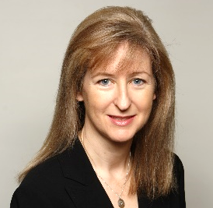








Team Members / Project Org Slide
Program Management
Synthetic Biology Team
GCD
Jim Broyan STMD PT
Kevin Kempton PEM
MCO/Exploration Cap
JJ Edelmann
Kevin Sims
Payload Manager
Alyssa Villanueva
Engineer
Sadie Downing
Support Scientist
Harry Jones, PhD
Systems Engineer
Matthew Paddock
Bioengineer
Hami Ray, PhD
Technical Writer, Support Scientist
ARC
Project Management
NASA Ames Research Center
Lisa Anderson
Ops, Scheduler
Natalie Ball
Scientist
A. Mark Settles, PhD
Omics Lead
Q/A: Paul Milazzo/Leonard Lee
Frances Donovan, Ph.D. Project Manager, Principal Investigator
Sean Sharif
Mechanical Engineer
Hiromi Kagawa, PhD
Scientist
JSC
Daniel Varnum-Lowry
Safety Engineer
Marilyn Murakami Resource Manager
Oscar Roque
Engineer
Sandra Vu
Support Scientist
KSC
Satro Narayan
Support Scientist, Logistics

Slide 5
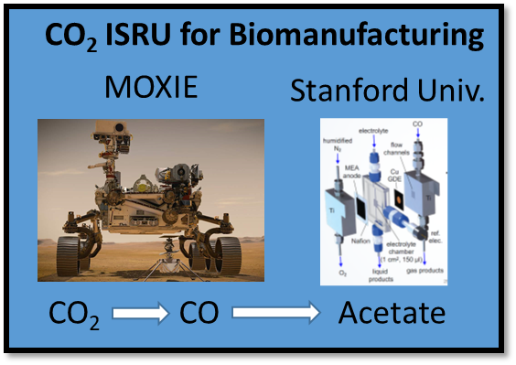
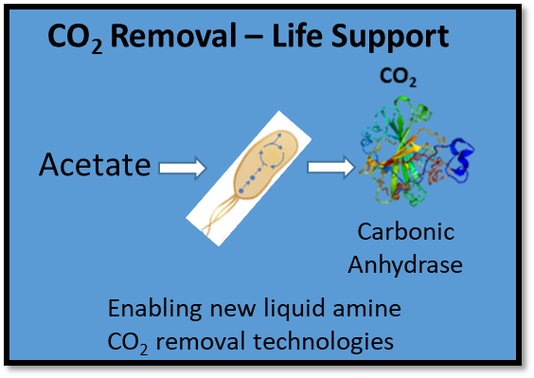


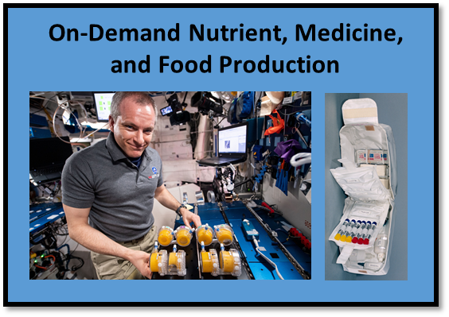
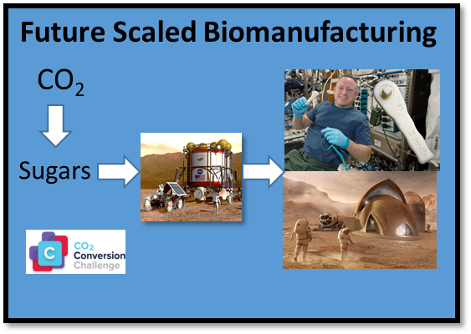


Collaborations & Partnerships
NASA C
MCO
NASA Centennial CO₂ Conversion Challenge
ARCn Challenge
Academic
Stanford University cooperative agreement Kanan Lab
SBIR/STTR
Nature’s Fynd
Mango Materials
NSTRI
CUBES I, II
UC Berkeley
UC Davis
Stanford U
Utah State U
U of Florida
Commercial Vendors​
ATUM​
Claremont BioSolutions​
ThermoFisher​
Cytiva
Instant Systems
Stakeholders:
OGA
DARPA/DOD/Space Force
Biofoundries Program
BioMade
Leveraging technologies, data, and expertise developed for earth based biomanufacturing
Notes:
For OGA: not in actual partnership yet but we benefit from advances made by DARPA/DOD/Space Force
Biofoundries Program
In-Space Biomanufacturing
BRICS
Living Structural Materials
and the new BIOMADE consortium
Cooperative agreement with Dr. Matthew Kanan at Stanford University – Developing electrochemical CO₂ conversion technology to produce microbial substrates – obtaining record efficiencies.
Space Technology Research Institute CUBES – Center for the Utilization of Biological Engineering for Space – Developing ISRU-based biomanufacturing systems for Mars surface missions.
NASA CO₂ Conversion Challenge – Contestants challenged to convert CO₂ to preferred sugars using novel non-biological technologies to generate organic substrates to “feed” microbial biomanufacturing. Phase 1 and 2 now complete.
Commercial Vendors – Using external services to conduct preliminary work and equipment testing during laboratory shut-down. Includes ATUM (secretion chassis engineering), Claremont BioSolutions (cell lysis); ThermoFisher (centrifuge); Cytiva (biomass concentration).

Slide 6
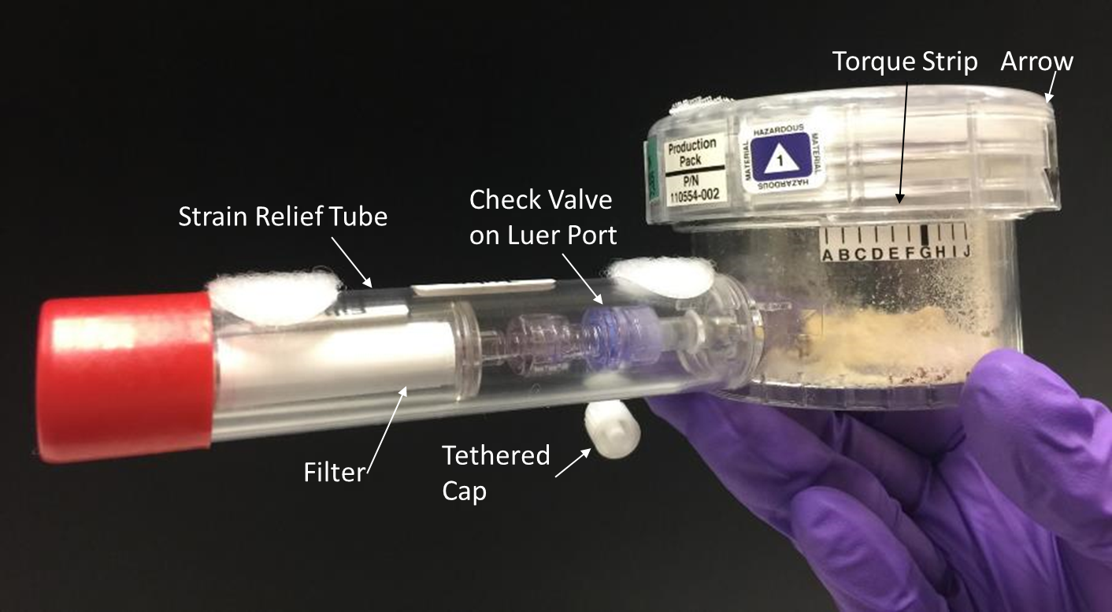
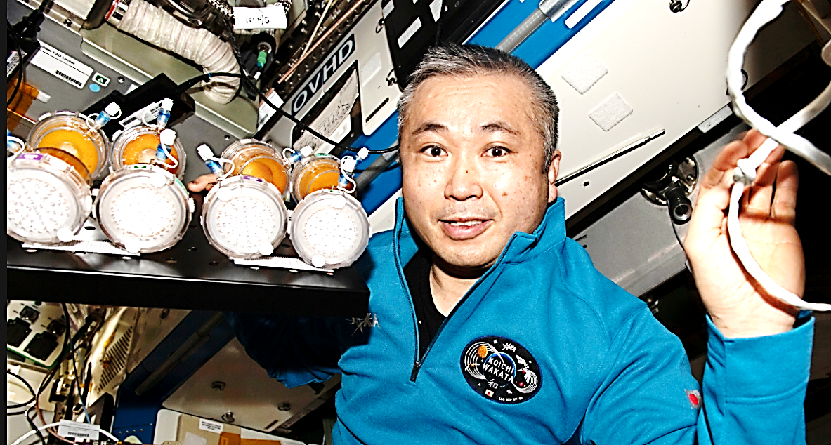
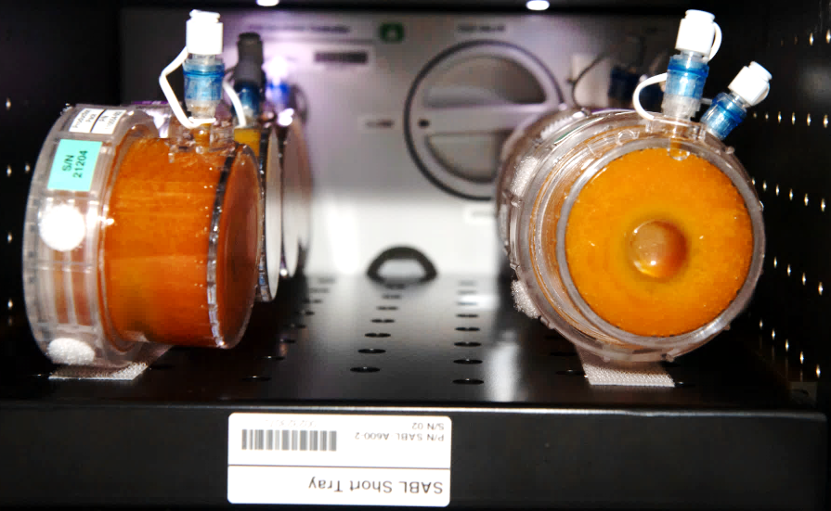
Accomplishments: BioNutrients
BN-1/Gen-0 System
BN-1: 3.7 years of viable production packs.
Gen-0 bioreactor system above. BN-1 run five production packs in SABL incubator on the ISS, January 2023 on right.
Crew member Wakata Koichi removing the BN-1 yeast cultures after growth in the SABL. Image of BN-1 Run 5 production packs at end of incubation.
  No leaking or other failure of the BN-1 gen-0 bioreactor detected (40 ISS packs).
  ISS production and stasis packs returned on Crew 5, March 2023 for analysis.
  Models predict β-carotene cells in the production packs have a 4.2 to 5.8-year shelf-life and demonstrate stable production.
  Zeaxanthin-producing culture data indicate that it should extend to 5 years and readily target metric (50% of initial biomass).

Slide 7
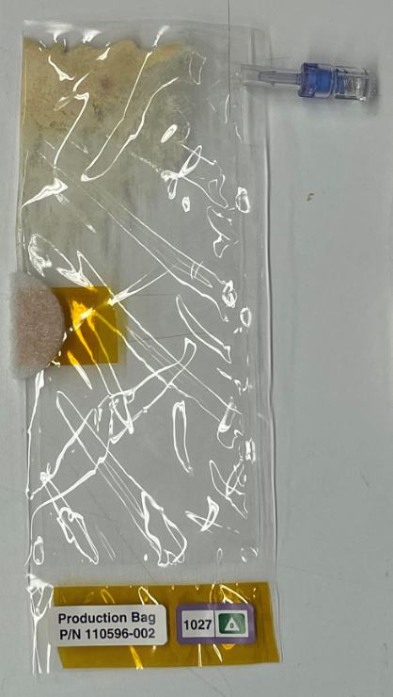
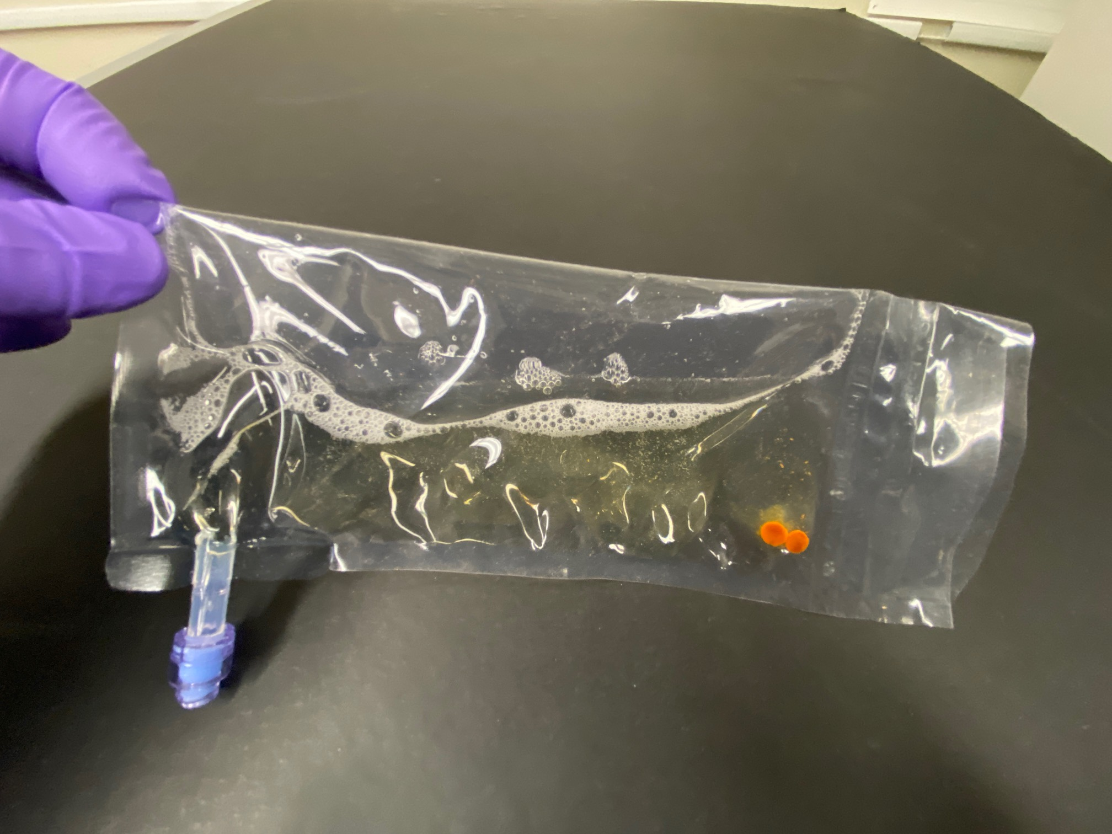
Accomplishments: BioNutrients
BN-2/Gen-1 System
BN-2: yogurt, kefir, and yeast producing follistatin, beta carotene, and zeaxanthin made on the ISS in a lightweight, flat packable system.
  Membrane is a gas permeable material with a 91% reduction in mass compared to the Gen-0 system.
Non-vented Luer Thread Cover
Needle-free Swabbable Barb Valve
Fluorinated Ethylene Propylene (FEP) Tubing
Fluorinated Ethylene Propylene (FEP) Bag
Labels (Cryo-Babies)

Slide 8
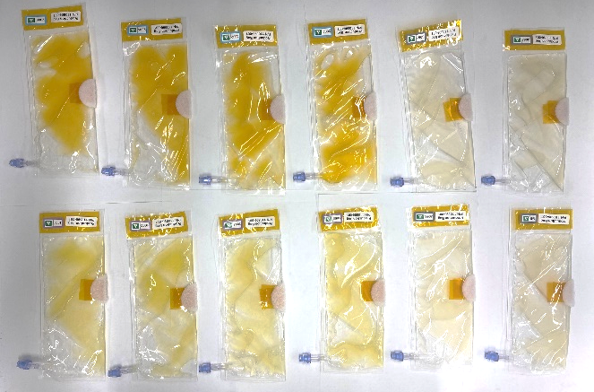
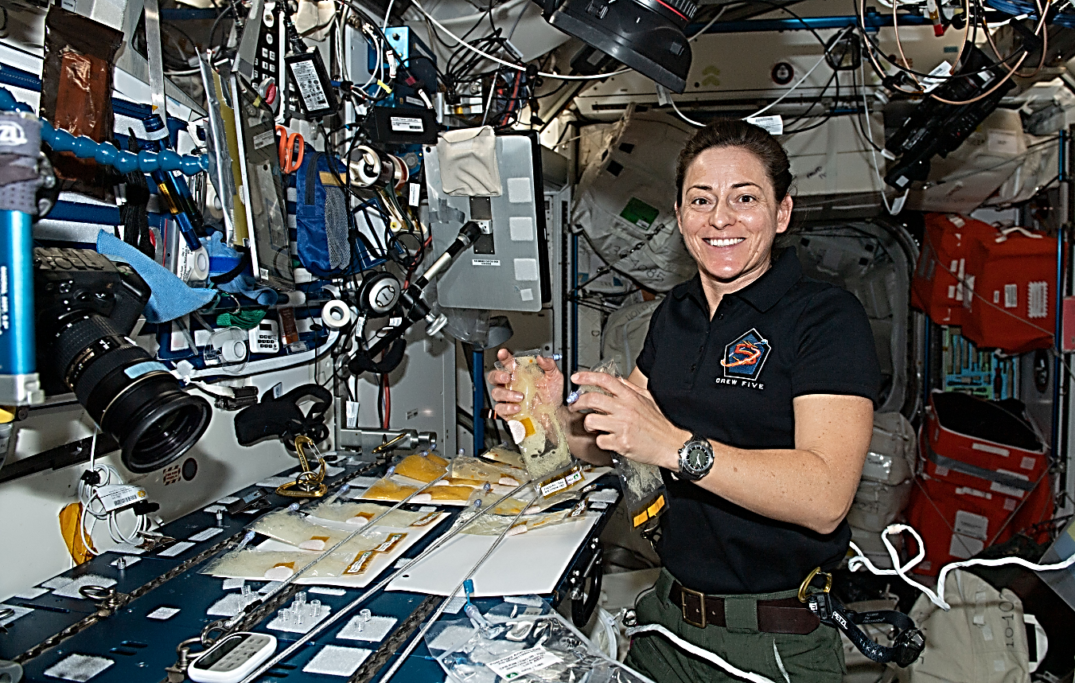
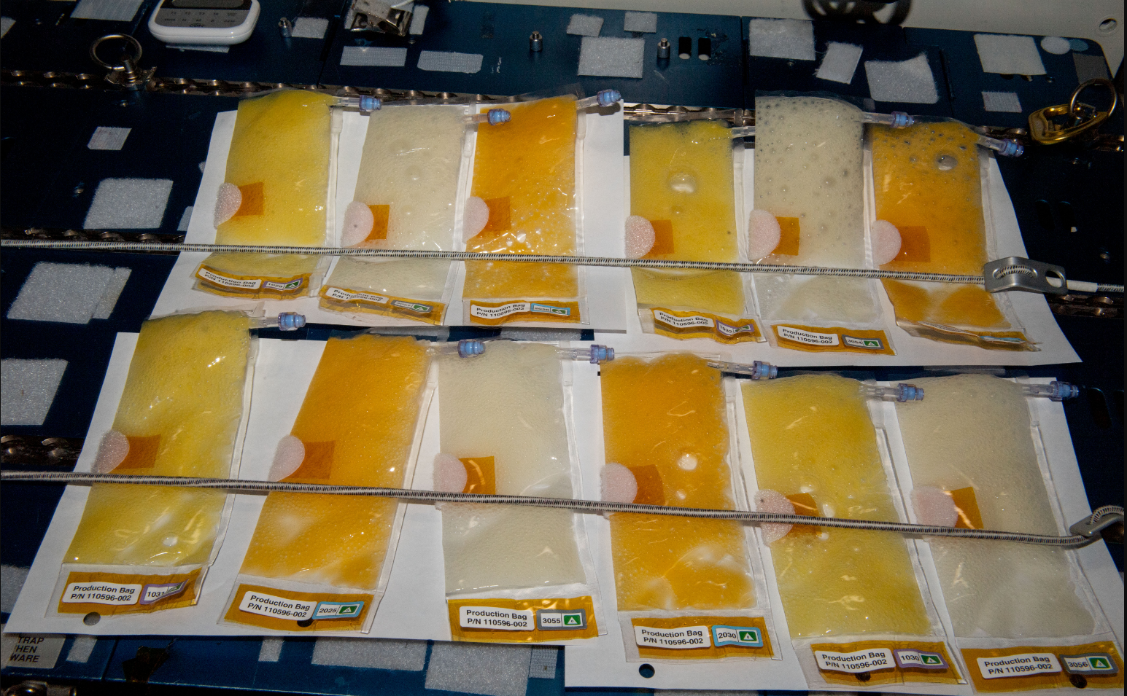
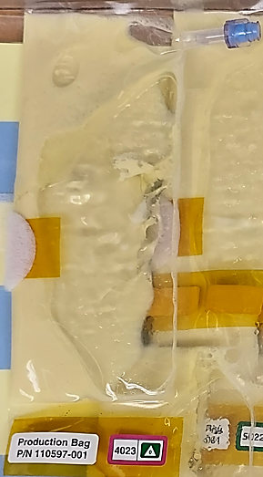
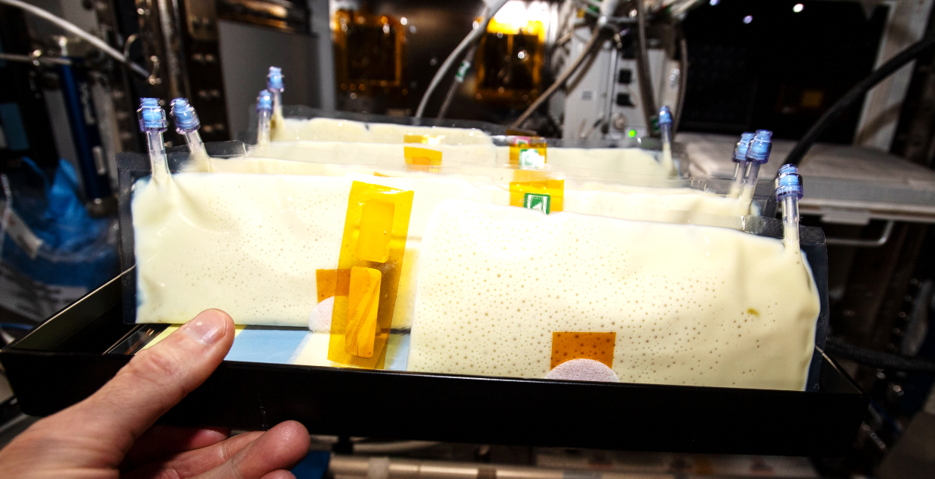
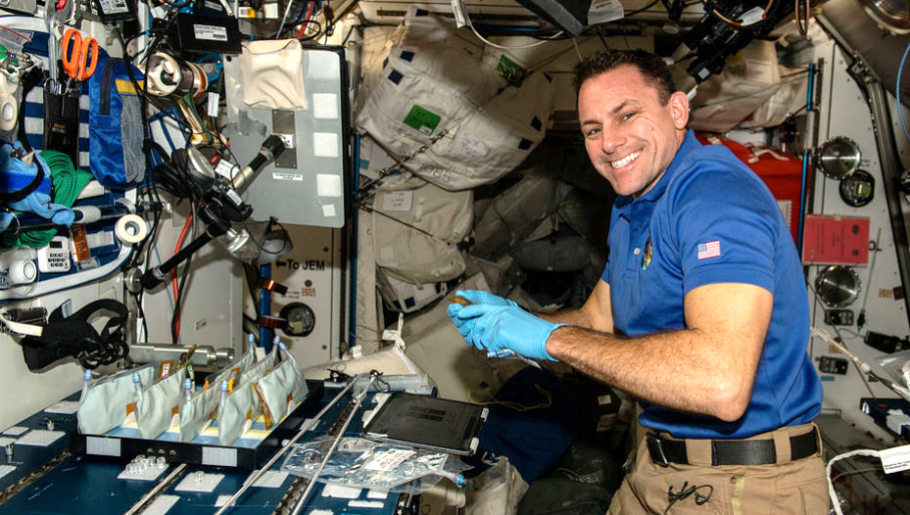
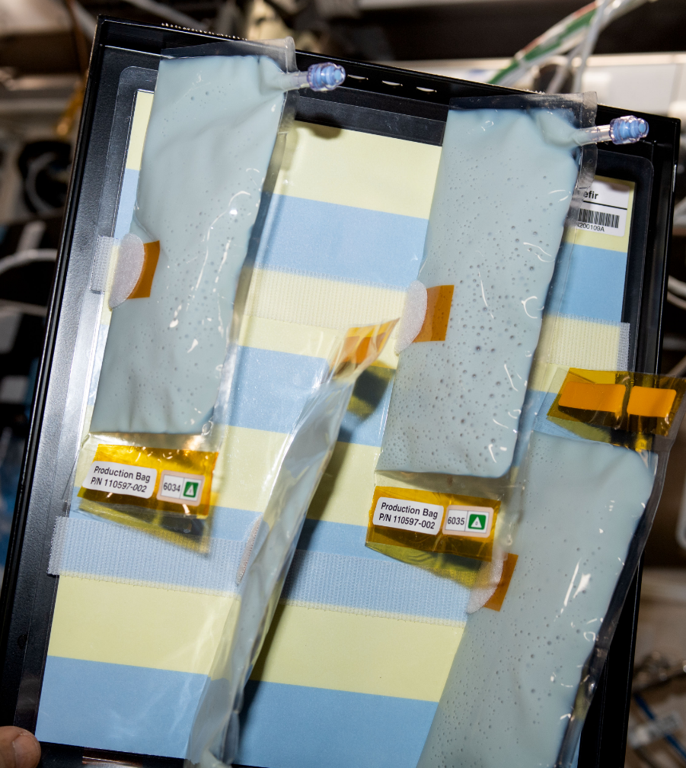
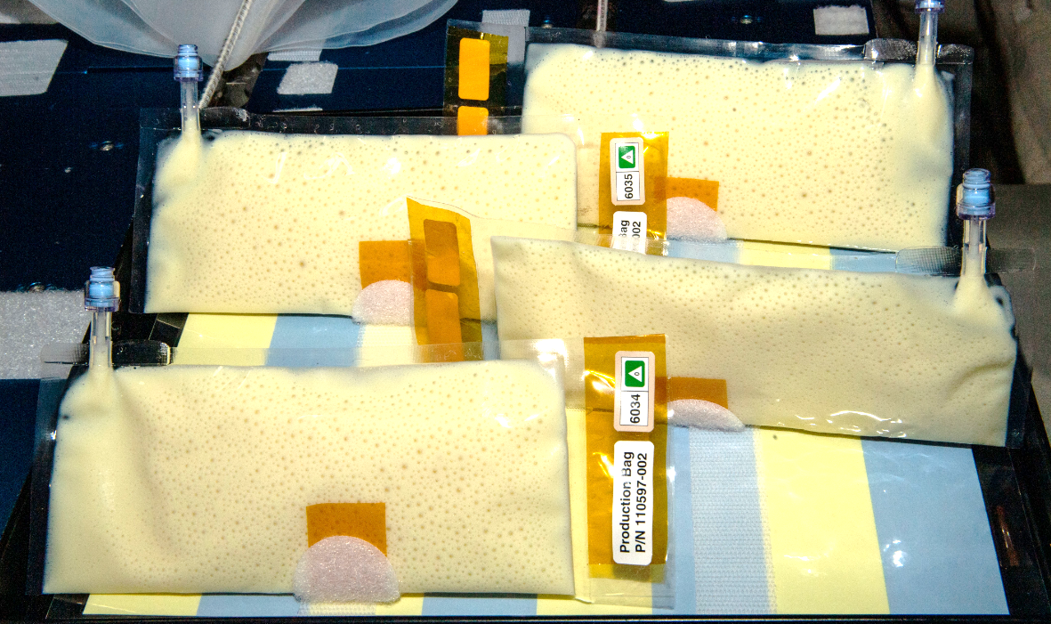
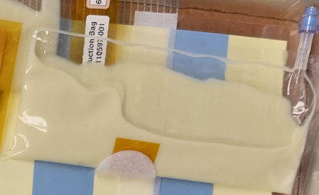
Accomplishments: BioNutrients
BN-2/Gen-1 System
ISS
Ground Control
BN-2 yeast ISS production packs (S. boulardii producing beta-carotene, S. cerevisiae producing zeaxanthin, and K. lactis producing follistatin).
BN-2 yeast ground controls (S. boulardii producing beta-carotene, S. cerevisiae producing zeaxanthin, and K. lactis producing follistatin).
BN-2 ground controls yogurt top, kefir bottom.
Run 1 of yogurt and kefir on ISS. Left: kefir (blue color at initial hydration turns yellow as culture grows and pH lowers), Upper right: yogurt.
Nicole Mann and Josh Casada hydrating and shaking the yeast and yogurt packs respectively. Featured in Space Station Science Highlights: Week of January 2, 2023 | NASA ISS Research on Twitter: "BioNutrients-2 tests an on-demand system to produce key nutrients from yogurt, kefir, and a yeast-based beverage. The study could help maintain the crew's health while reducing launch mass and volume requirements. https://t.co/fuxW39uTWd https://t.co/bzFZVYMIxS" / Twitter

Slide 9
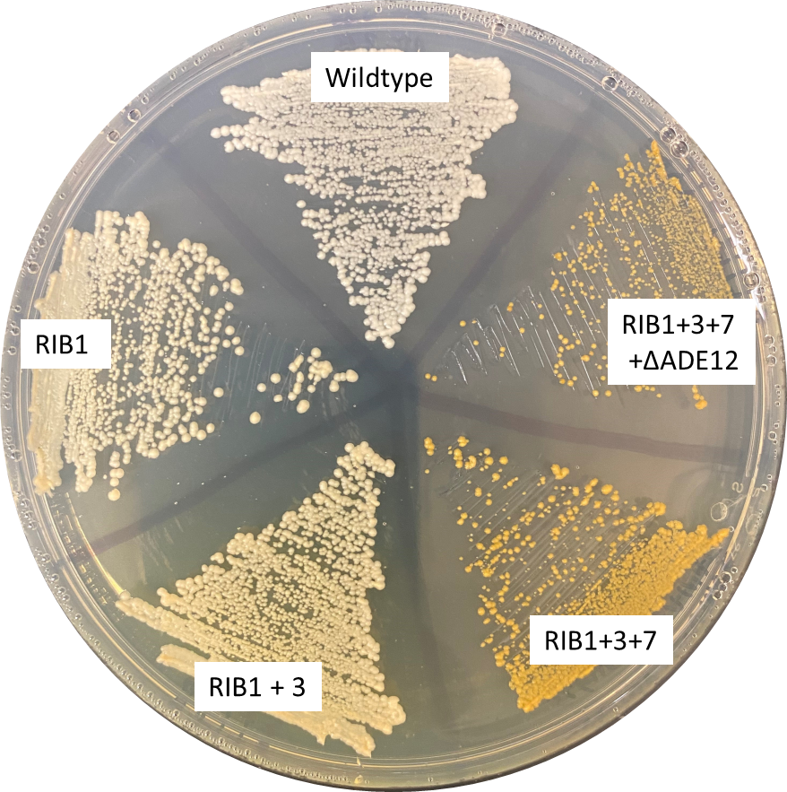
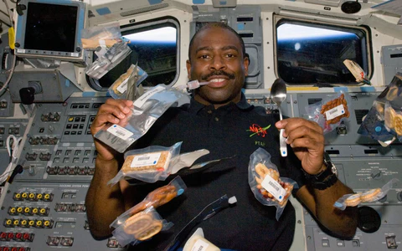
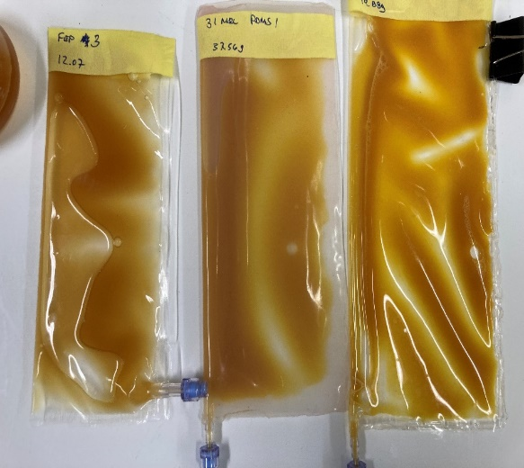
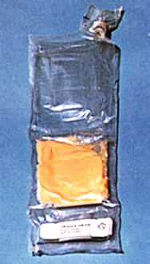
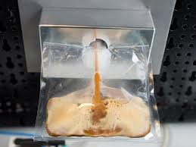
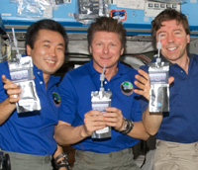
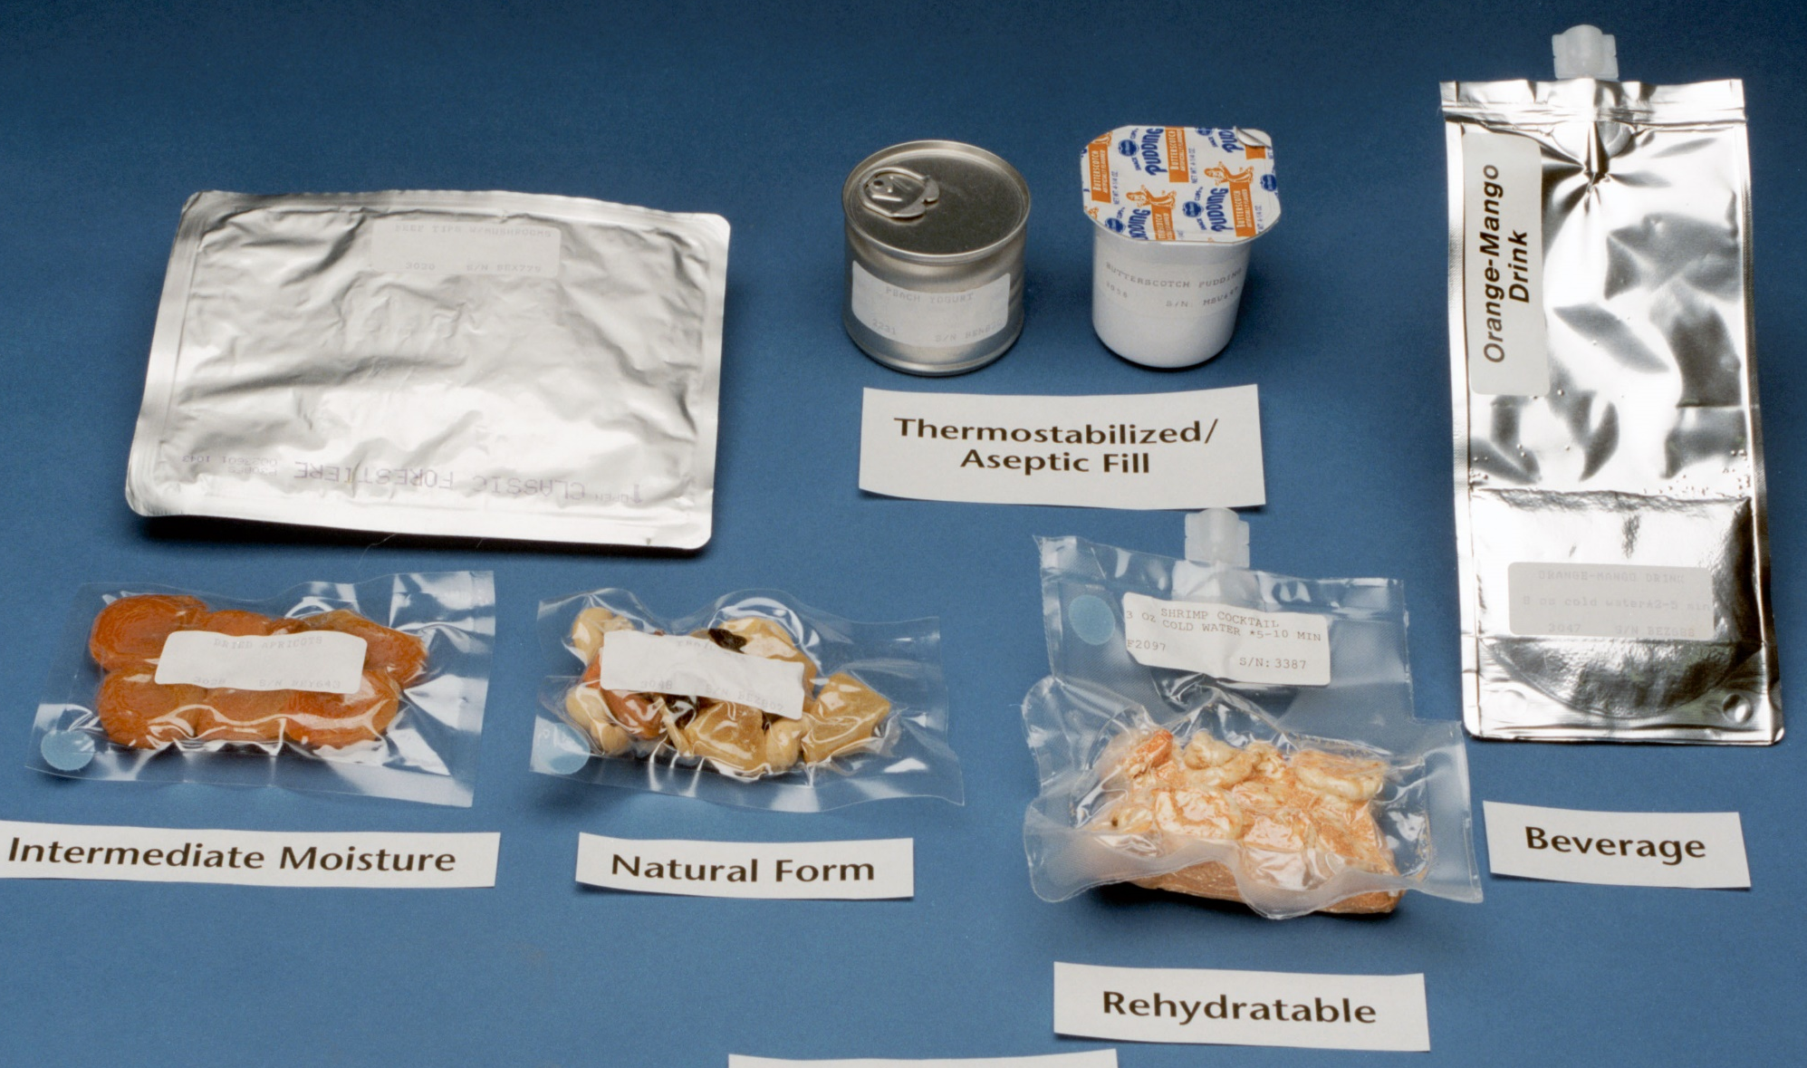
Accomplishments: BioNutrients
BN-3/Gen-2 System
BN-3: on track to produce four vitamins in one organism.
  Gen 2 design will include crew access port capability, accommodate E-Nose testing, and be designed for food warmer style pasteurization.
  Flat packable system made of FEP and/or PDMS.
Received guidance on process to apply for crew testing.
  Began discussions with FDA to obtain approval for human consumption.
  Working with commercial vendor for independent contamination testing.
Future Implementation Concept
Astronaut Leland Melvin 2019
Shuttle era food packaging
Notes:
Pasteurization in Galley Rack Food Warmer (GRFW) – initial discussion and examination of test data makes this a potential option.
Shuttle era food space_food_types_s93-32499.jpeg (4078×4086) (nasa.gov)
Spoilage/pathogen detection
E-nose Began investigations using ARC-based E-Nose technology for rapid in situ detection of volatiles associated with microbial contamination. Potential platform system for wider use.
Image credit: https://astronautfoods.com/blogs/news/space-food-101

Slide 10
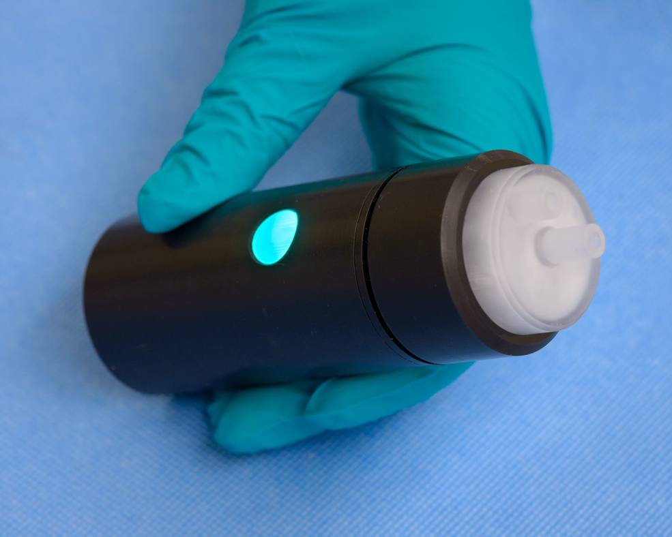
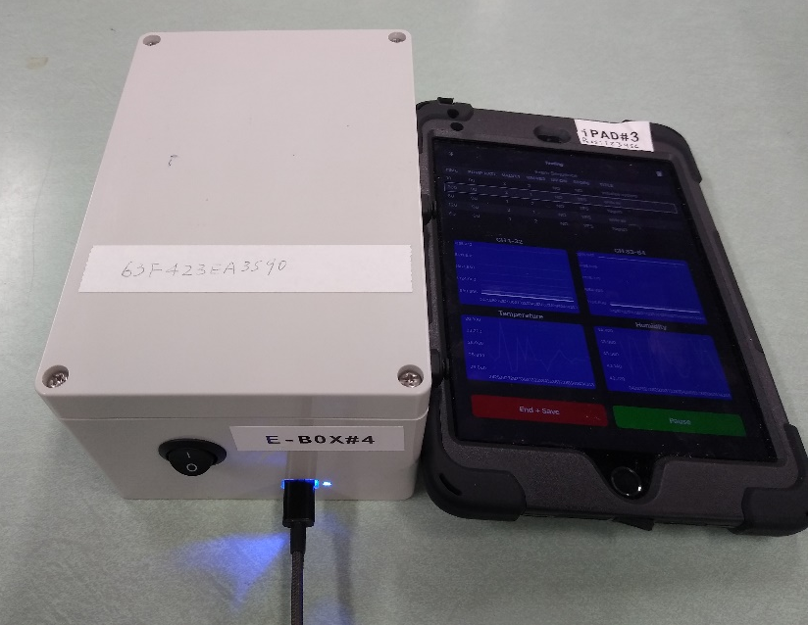
Accomplishments: BioNutrients System Safety Progress
Design: Yogurt/Kefir organisms lower pH of cultures prohibiting growth of other organisms. Yeast fast growth can outcompete other organisms.
Control: HACCP – hazard analysis critical control point plan developed for yeast samples on BN-2 was successful in keeping the yeast samples free from identifiable contamination. A HACCP plan for all samples will be developed for BN-3.
Process: Pasteurization is a means of lowering or eliminating live organisms after production before crew consumption.
  Pasteurization in Galley Rack Food Warmer (GRFW) – initial discussion and examination of test data makes this a potential option.
Detection: Spoilage and pathogen detection via E-Nose volatile sensing.
E-Nose is a sensor technology that allows for detection of volatile organic compounds by “smelling” a gas sample.
BioNutrients has been collaborating with the E-Nose team to determine the feasibility of using the E-Nose for food safety purposes
E-Nose is battery-powered and interfaces with an iPad app.
Similar E-Nose technology flew on a JPL-sponsored flight in 2009 – two sensors in the sensor head are the same as ARC E-Nose. Current sensor head contains 64 nano-technology based sensors.
https://www.nasa.gov/feature/ames/e-nose
Above: Old design, not including pump
Below: New, integrated design including pump

Slide 11
BioNutrients-1, -2, and -3
Lifecycle Maturity/Milestone Schedule
Project Milestone
GCD (Key) Milestone
Controlled Milestone
TRL/SRL/MRL Progression
Final Report on Flight Results
9
FY18 | FY19 | FY20 | FY21 | FY22 | FY23 | FY24
BN-1 Gen-0 bioreactor TRL
BN-1 organisms (IPP and stasis pack)
BN-2 Gen-1 bioreactor TRL and organisms
BN-3 Gen-2 bioreactor TRL
BN-3 organisms
8
Flight report/final results
Flight Results
T8 SP
Run 4 IPP
Run 5 IPP
7
Run 3 IPP
Run 6 IPP
Run 1 IPP
Run 2 IPP
Set 2
6
Set 1
TRL
BN-3 Gen 2 ground Test
BN-1 Gen-0 Design review; EVT
BN-3 Gen 2 CDR
5
BN-2 ground test
BN-2 Gen1 Design review
BN-3 Gen 2 PDR
4
3
BN-3 kick off
BN-1 Launch to ISS
BN-2 Launch to ISS
Notes:
Chart purpose: show TRL/SRL/MRL advancement over the project lifecycle schedule. Show TRL advancements as whole integer increases. Show how Key and Controlled milestones align with TRL advancement.
TRL/SRL/MRL may not advance at each milestone. Often several milestones are required to produce a step increase in TRL/SRL/MRL.
There can be one, or more, of these charts per project as needed.
For projects with fewer technical elements, the TRL/SRL/MRL data can be combined on one chart.
For more complex projects, the TRL/SRL/MRL progression can separated into multiple charts by project technical area.
Show TRL, SRL, and MRL data for each technical element on the same chart.
Delete TRL/SRL/MRL axis-labels that do not apply – e.g., remove SRL/MRL for projects/technical areas where SRL and MRL do not apply.

Slide 12
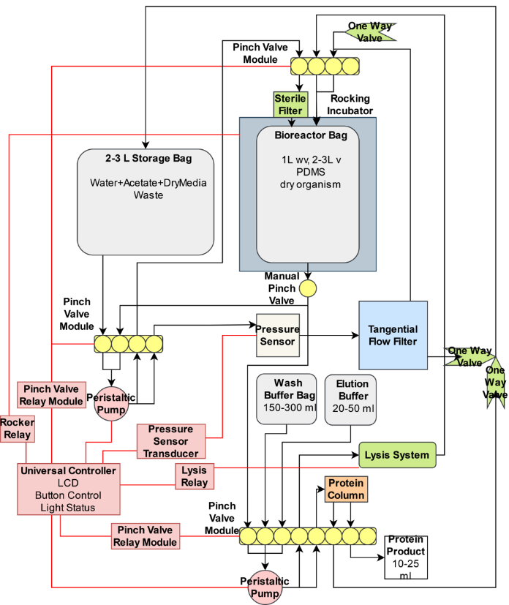
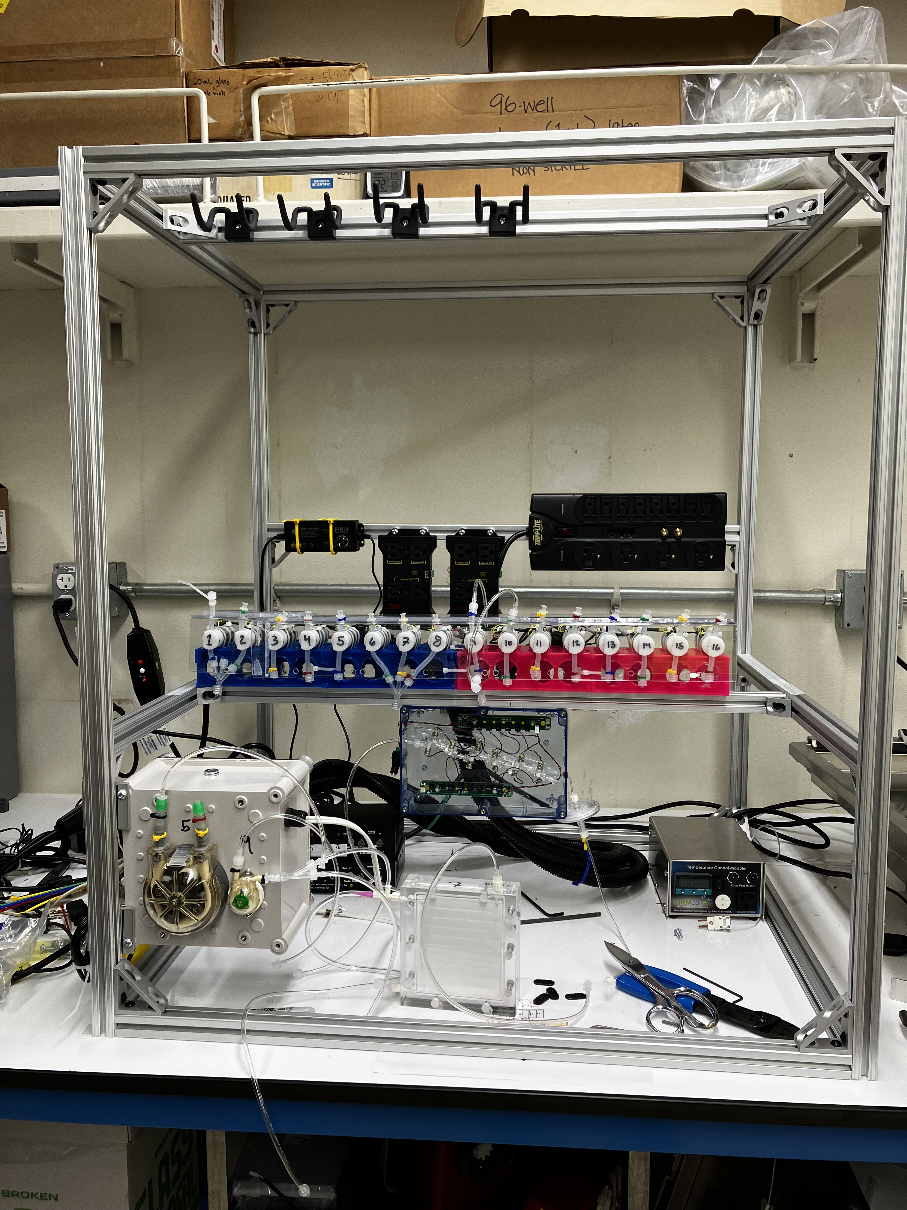
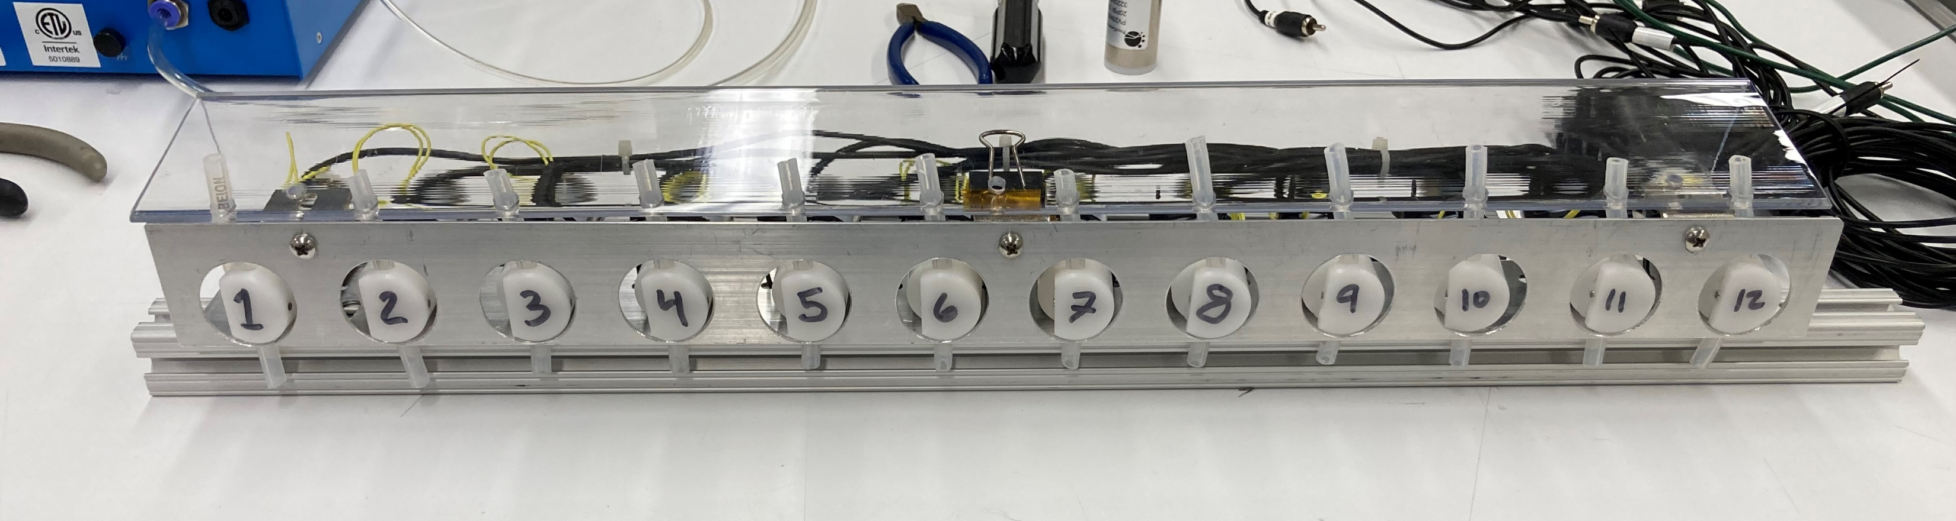
Accomplishments: CO₂ Based Manufacturing
  Design Review held February 16, 2023
  Requirements baselined
  Test and Verification Matrix baselined
  Bioreactor Bag design is finalized and build procedure verified; Bags are in production
    Maximum design pressure and leak testing complete
    biocompatibility testing complete
  Platform Test Plan Draft complete
  Platform build 90% complete – waiting on final configuration of filters
  Two simple carbon feedstock media formulations developed
  End to End test is planned for October
  Paper accepted in Nature Journal npj Microgravity -“Theoretical design of a space bioprocessing system to produce recombinant proteins.” M. Soundararajan, et al.
Platform Design Architecture for CO₂-Based Manufacturing Bioprocessing System
CO₂-Based Manufacturing platform 90% complete

Slide 13
Accomplishments: CO₂ Based Manufacturing
  ESM improvements likely: Bags, Dewatering/clearing filter and cell lyser – proving to be reusable.
  Simple lysis potential: New discoveries by CUBES team members reveal potential for Osmotic lysis – greatly simplifying release of intracellular products.
  Genetic engineering of functional plastics research continues at CUBES II and other research teams.

Slide 14
CO₂-Based Manufacturing
Lifecycle Maturity/Milestone Schedule
Project Milestone
GCD (Key) Milestone
Controlled Milestone
TRL/SRL/MRL Progression
9
FY18 | FY19 | FY20 | FY21 | FY22 | FY23 | FY24
8
7
6
CO₂ Prototype Gen 2 Test
TRL
5
CO₂ Prototype Gen 1 Test
Bioreactor Design Review
CO2-based manufacturing close out report
4
CO₂ Prototype Assembly
Bioreactor materials test
3
Platform fab complete
Production strain ground test
CO₂ Prototype concept
Notes:
Chart purpose: show TRL/SRL/MRL advancement over the project lifecycle schedule. Show TRL advancements as whole integer increases. Show how Key and Controlled milestones align with TRL advancement.
TRL/SRL/MRL may not advance at each milestone. Often several milestones are required to produce a step increase in TRL/SRL/MRL.
There can be one, or more, of these charts per project as needed.
For projects with fewer technical elements, the TRL/SRL/MRL data can be combined on one chart.
For more complex projects, the TRL/SRL/MRL progression can separated into multiple charts by project technical area.
Show TRL, SRL, and MRL data for each technical element on the same chart.
Delete TRL/SRL/MRL axis-labels that do not apply – e.g., remove SRL/MRL for projects/technical areas where SRL and MRL do not apply.

Slide 15
Project Assessment Summary
Project Name | Performance |  |  |  | Comments
 | C | S | T | P
Mid Year |  |  |  |  | Technical – Cost – Schedule – Programmatic -
Annual |  |  |  |  | Technical – Cost – Schedule –Procurement delays impacted CO2 based manufacturing, and Covid delays on BioNutrients led to delays in developing BN-3. Decision memo approval of schedule extension in place, pending approval of updated PP and Control Board. Programmatic -

Slide 16
Plans Forward and Transition / Infusion Plan
Mission Transition/Infusion
ESMD Mars Campaign Office (Exploration Capabilities Tech Maturation Program) is our target NASA customer.
  MCO partially funded FY 23 BioNutrients flight experiments , provided guidance on advancing BioNutrients TRL/HRL
BioNutrients work is aligned with HRP goals addressing food, nutrition, and pharmaceutical shelf-life limitations in future long-duration missions.
  Currently on Food Systems Roadmap – providing status with lead G. Douglas
  Ensuring safe consumption in flight, and human ground testing of products are required for infusion.
BioNutrients and CO₂-Based Manufacturing technologies support future long duration missions where product shelf-life issues pose significant risk, as well as providing scaled commodity products via ISRU
  Mars surface missions and other low/no resupply flight/surface missions are key infusion targets.
  Investigating use-case scenarios and infusion with ISRU and In-Space Manufacturing programs.
Partnerships & Commercial Transition
We are reviewing the SynBio created organisms and bioreactors with NASA Ames Technology Transfer office to determine potential for commercial infusion.
We are pursuing commercial partnership with NASA CO₂ Conversion Centennial Challenge winner for use of CO₂-derived microbial feedstocks.
Working with commercial entities to leverage specific expertise areas; Includes ATUM, Claremont BioSolutions, ThermoFisher , Cytiva, Instant Systems.
Completed cooperative agreement with Kanan Lab at Stanford University for high-efficiency electrochemical acetate production capability to enable CO₂ conversion to viable microbial substrates.
NASA SMD: Results from genomic analysis of 5-year shelf-life study of microbes on the ISS will be shared with the Space Biology GeneLab data depository to contribute to knowledge of microbial responses to ambient storage on the ISS. BN-1 yeast to be used in SMD LEIA (Lunar Explorer Instrument for Space Biology Applications) award.

Slide 17
Education/Public Outreach
EPO Involvement
EPO Calendar Outlook (High Priorities):
BioNutrients flight experiment updates are provided at https://www.nasa.gov/ames/bionutrients
The Space Station Research Explorer provided updates on BN-1, -2
  https://www.nasa.gov/mission_pages/station/research/experiments/explorer/Investigation.html?#id=8521
The first BN-2 on-orbit run was featured in the Space Station highlights for the week of January 2, 2023.
  https://www.nasa.gov/mission_pages/station/research/news/space-station-science-highlights-02jan23
BN-2 run featured on Twitter ISS Research on X: "Bantha milk on @Space_Station? #StarWarsDay Actually, BioNutrients-2 is testing an on-demand production system for key nutrients from yogurt during long-duration missions. The blue color is a pH indicator that allows researchers to quickly visualize the progress of these samples. https://t.co/YSw7LPXEAS" / X (twitter.com)
The fifth BN-1 on-orbit run was also highlighted in the NASA Twitter feed https://twitter.com/ISS_Research/status/1625894289120301057
"Theoretical design of a space bioprocessing system to produce recombinant proteins" accepted for publication in npj Microgravity.
Served as panelist at the Ascend conference October 2022 on Biomanufacturing in space.
HRP IWS Workshop in Houston, TX February 9, 2023 “Strategies For Decreasing Microbial Cell Count Following Microbial Food Production In Space”.
Multiple presentations/lab tours – STMD Triannual Conference, MCO quarterly review and mid year review, and Sierra Space.
6 Month Look-Ahead
Conference or Event | Date
CO₂-based Manufacturing Platform test | November 2023
BioNutrients-3/Gen-2 Preliminary Design Review | NET November 2023
Top 3 Newsworthy Events:
Follistatin – protein therapeutic produced on ISS
CO₂-based Manufacturing Platform test results
Publication of minimal media formulations for bio-manufacturing from CO₂ derived feedstocks.
Notes:
Summary of the EPO activities (papers, conferences, outreach events) participated in over the last 6 months and the forward outlook for 6 months

Slide 18
Summary
BioNutrients-1 passes 3.7 years of 5-year ISS shelf-life study, no leaks/anomalies, met requirements for viability, biomass, no contamination. HPLC analysis of nutrient value is pending.
BioNutrients-2 complete with 2 successful ISS runs, making 6 products, with no leaks, no anomalies, and visible growth, no contamination. HPLC analysis pending.
BioNutrients-3 progressing towards multi-nutrient pack development and food safety through HACCP and pasteurization. Pathogen detection via collaboration with Ames E-Nose team underway.
  We are pursuing FDA approval and have a path towards Crew tasting our BioNutrients products (pending BN-3 outcome).
CO₂-based Manufacturing platform is >90% built and is providing data on filter capacities, shelf stable purification processes, bioreactor materials with high oxygen/CO2 exchange rates, and re-usability of COTS items.
ESM analysis manuscript has been accepted for publication.
KPP for % ISRU media components by mass has increased to 46% (target is 50%) acetate/E. coli recipe, and 78% for ethanol/K. phaffii.
Tech Maturity and TRL at end state
  BioNutrients element expects to have demonstrated the 5-year shelf life of biomanufacturing organisms and media, optimized bioreactors, demonstrated production of multiple nutrients, multiple food types, and a therapeutic in a ready to consume format. Approvals for actual consumption to be pursued post BN-3 results. If successful, TRL 7, HRL 7
  CO₂-Based Manufacturing will demonstrate a small-scale CO₂-based biomanufacturing platform with acetate-based media and ethanol-based media, organism engineered to survive on this media and producing a relevant product, product purified to relevant purity, with assessment of recycling and ESM comparison of options. TRL 5

